Slide 1

Sviluppo di rivelatori a pixel per gli upgrades del tracciatore di ATLAS
Anna Macchiolo
Max-Planck-Institut für Physik
Seminario di Gruppo I, INFN Firenze, 30 Ottobre 2013

Slide 2
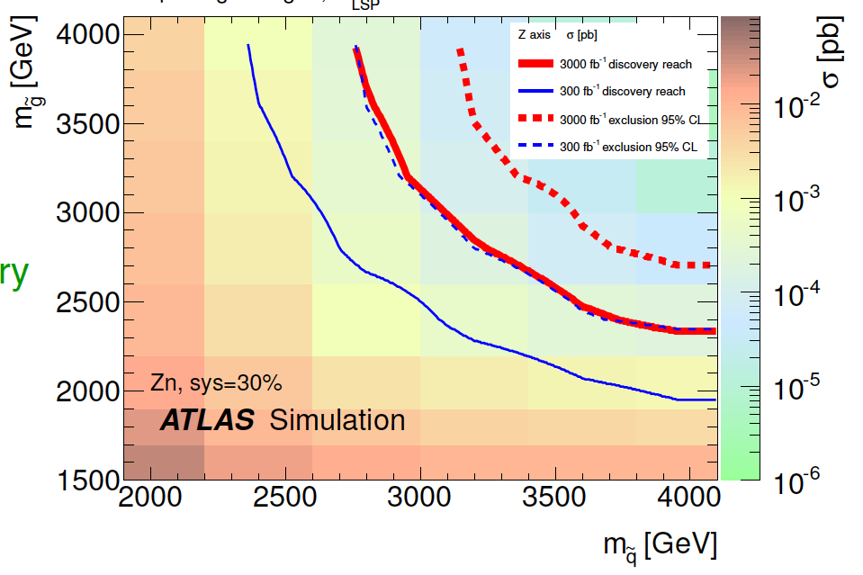
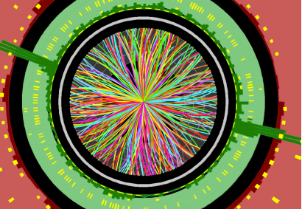
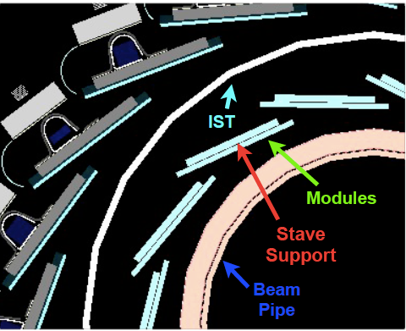
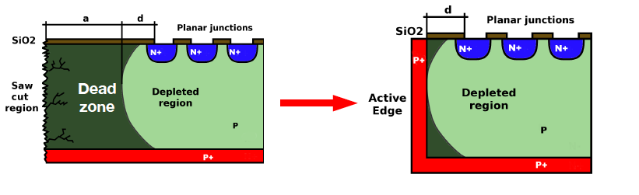
Content
The path for the ATLAS tracker upgrade
Phase II: what are the physics motivations
The performance of present ATLAS pixel detectors
IBL: new technologies for the first upgrade
Requirements of the ATLAS Pixel system in Phase II
Planar Pixel Sensor developments for Phase II
Vertical Integration Technologies and new 3D module concepts

Slide 3

The tracking system of the ATLAS detector
Muon Detector
Tile Calorimeter
Liquid Argon calorimeter
Silicon Pixels
Silicon Strips (SCT)
Transition Radiation Tracker (TRT) up to 36 points/track
2T Solenoid Magnet
Toroid Magnet
Solenoid Magnet
SCT
Pixel Detector
TRT

Slide 4
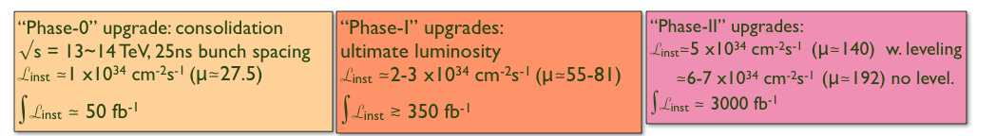
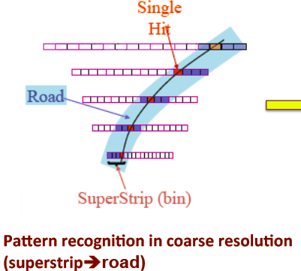
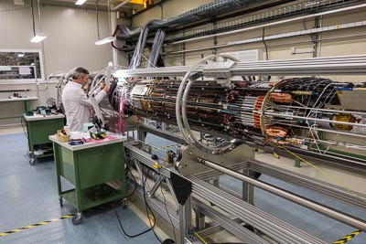
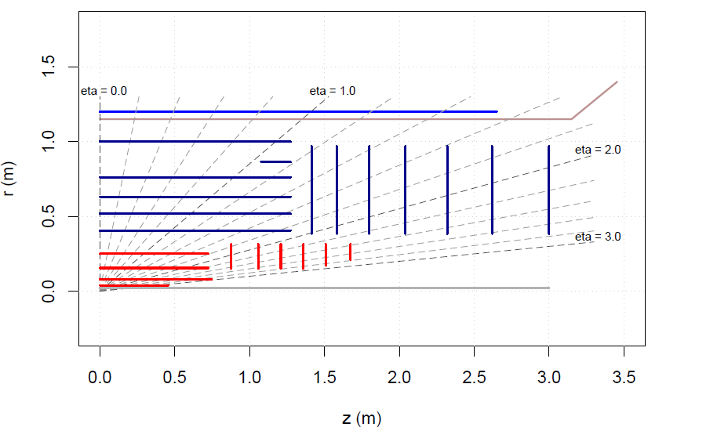
ATLAS Tracker Upgrade Plan
New insertable b-layer (IBL)
New Al beam pipe
New pixel services
Fast TracKing (FTK) for level2 trigger
All new tracker (baseline:
long strips /short strips / pixels)

Slide 5
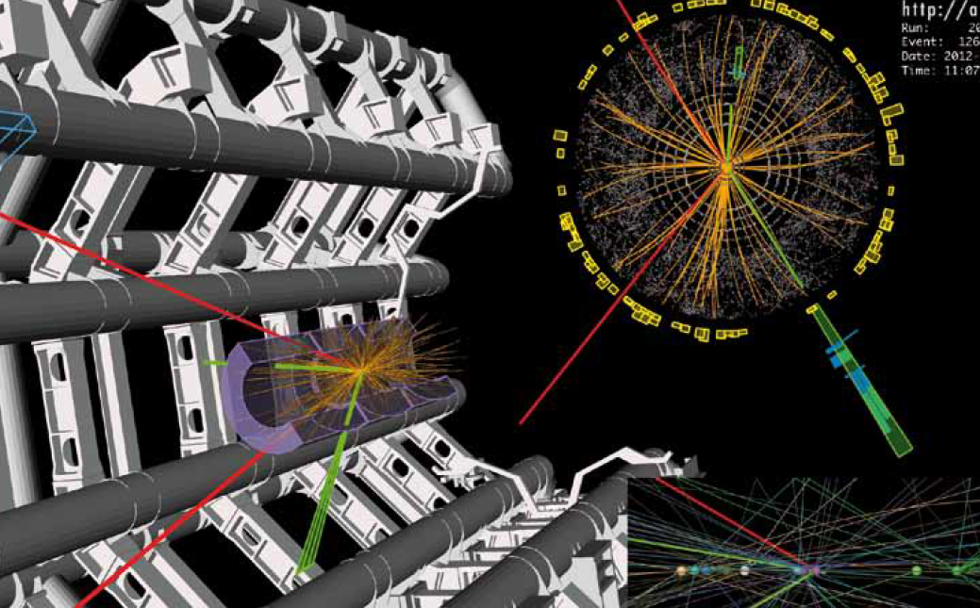
Why Phase II after the discovery of the Higgs boson?

Slide 6
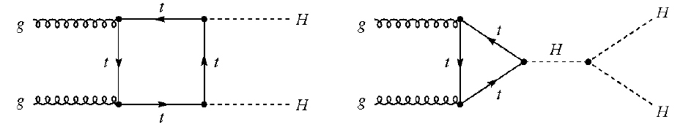
HL-LHC Physics Programm (I)
With LHC 13/14 TeV data until 2022 (~300 fb⁻¹)
  Measure the Standard Model scalar boson properties
    Mass, J^{CP}
    Individual couplings with 5-15% precision
  Search for new physics at higher mass scale (new energy region)
    SUSY, Exotics
With HL-LHC 14 TeV data until 2032 (~3000 fb⁻¹)
  High precision SM scalar boson measurements
    Couplings <5%, study rare decays, self-coupling
P. Wells, Lepton Photon 2013
Higgs triple self coupling

Slide 7
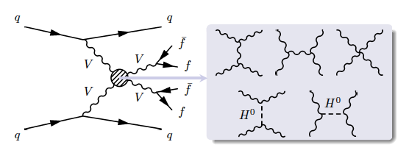
HL-LHC Physics Programm (II)
Study VV scattering
  Verification that Higgs boson cancel divergences in VBF
P. Wells, Lepton Photon 2013
Direct searches of BSM particles
  HL-LHC increases the discovery reach by ~400-500 GeV
ATLAS simplified model with zero mass LSP

Slide 8
The present ATLAS Pixel system

Slide 9
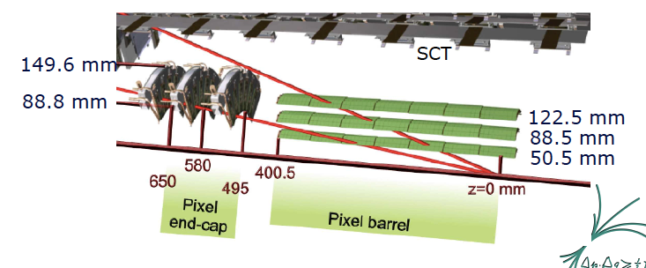
The present ATLAS Pixel system
Sensors and modules:
• 250 μm thick n-on-n type silicon, with typical pixel granularity of 50 μm x400 μm.
• 16 FE-I3 chips per module bump-bonded to a single sensor
1456 modules in the barrel region and 288 modules in the three end-cap discs per side
FE-I3 chip

Slide 10
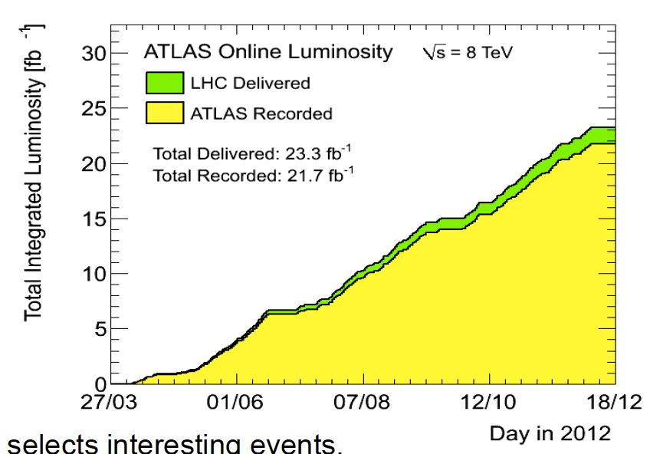
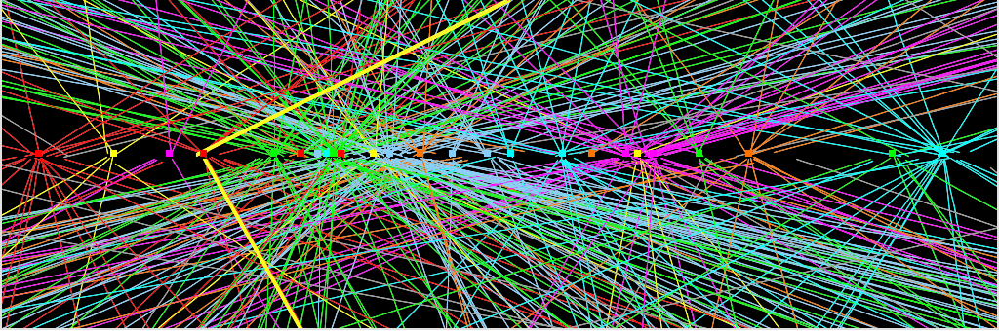
Tracker Performance today
E. Stanecka, Vertex 2013
ATLAS
99.9 % Pixel data taking efficiency in 2012
Hit-to-track association efficiency ~99%
95% of modules are active during data taking in 2012
Inoperable fraction gets addressed in LS1 repair (is now ~ 1%)
Up to ~70 interaction /BX
Up to 4000 tracks per event every 25 ns
ATLAS was designed for 23 evt /BX but continues to do an excellent job with 35

Slide 11
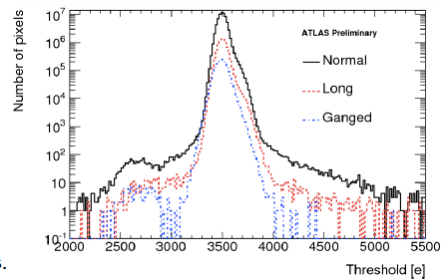
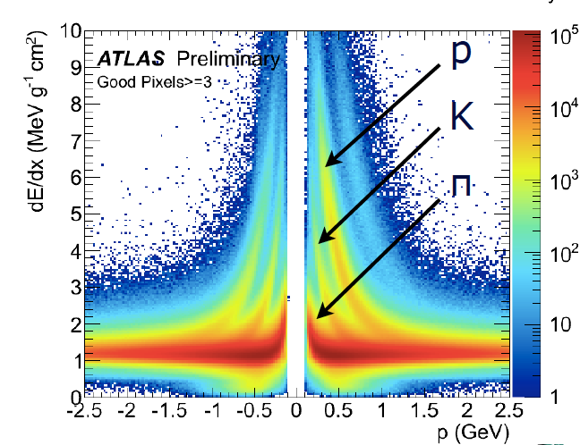
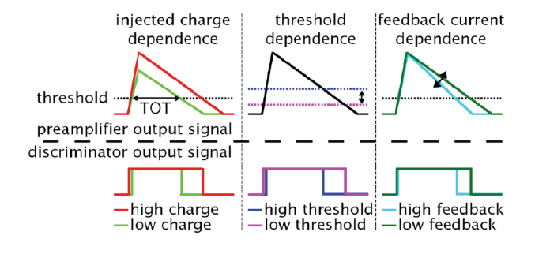
Pixel Detector Performance today
T. Ince, Siena 2013
ATLAS
d
p
κ
π
11
Threshold tuned to 3500 e, with 40 e dispersion
Time Over Threshold: time in which signal is above threshold in units of BC, 25 ns
Tuning target is 30 BC for a charge of 20,000 e (most probable value for m.i.p.)
Advantages:
  improved position resolution (shared hits)
  energy loss proportional to deposited charge ➞ particle identification

Slide 12
The Insertable B-layer

Slide 13
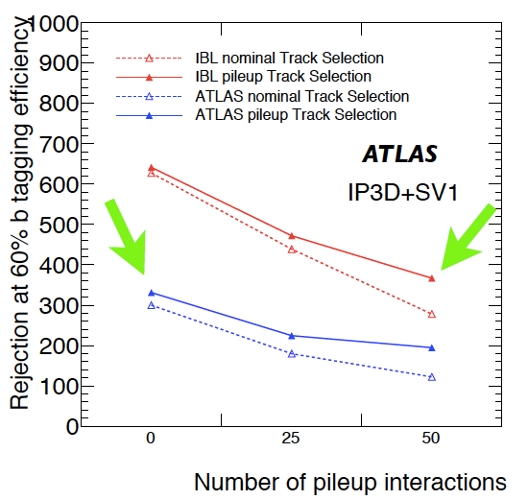
Phase 0 Upgrade: the Insertable B-Layer
Designed to let ATLAS cope with L=3x10³⁴ cm⁻² s⁻¹
New 4th pixel silicon barrel layer with r = 3.3 cm, 12 MegaPixel
  Needs small radius (r = 2.35 cm) beam pipe
  14 staves with Φ = 14° tilt angle & no z overlap
Redundancy to control the fake rate
Improve b-tagging
Good performance with IBL and pile-up → as good or better as for the current ATLAS without pile-up

Slide 14
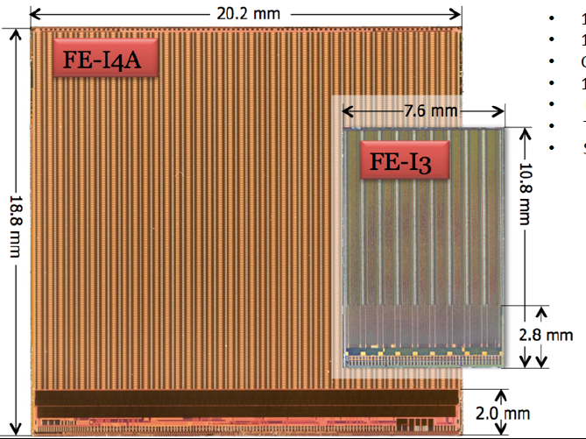
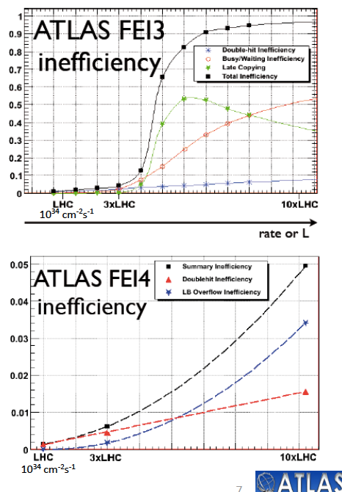
The ATLAS Insertable B-layer
New FE-I4 chip, 2x2 cm², pitch 50x250 μm²
130 nm CMOS
150 μm thickness
Charge by 4 bits ToT
160 Mb/s readout
Power 200 mW/cm²
Total dose tested up to 750 MRad

Slide 15
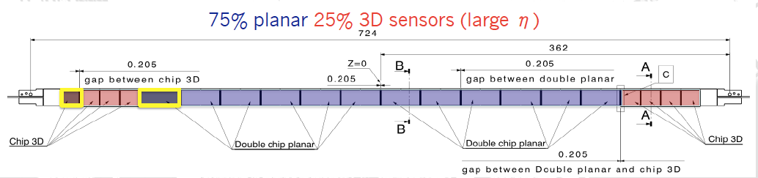
Pixel Sensors for the IBL
Planar n-in-n oxygenated Si sensor
3D double sided silicon sensors
Pixel electrodes on surface of bulk
Proven ATLAS Pixel Detector technology and vendor: CIS
Very high yield (90% accepted for IBL production)
From old pixel system to IBL:
  Pixel size 50x400 μm² → 50x250 μm²
  Thickness 250 μm → 200 μm
  Inactive edge 1 mm→ 200 μm
Vertical 2E electrodes
Reduced operational voltage after irradiation
230 μm thickness
Two 3D sensor vendors (CNM and FBK)
Acceptable yield (60% for IBL)

Slide 16

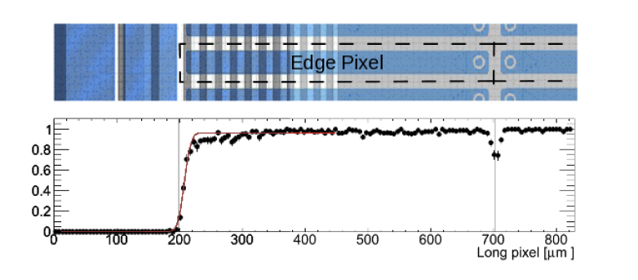
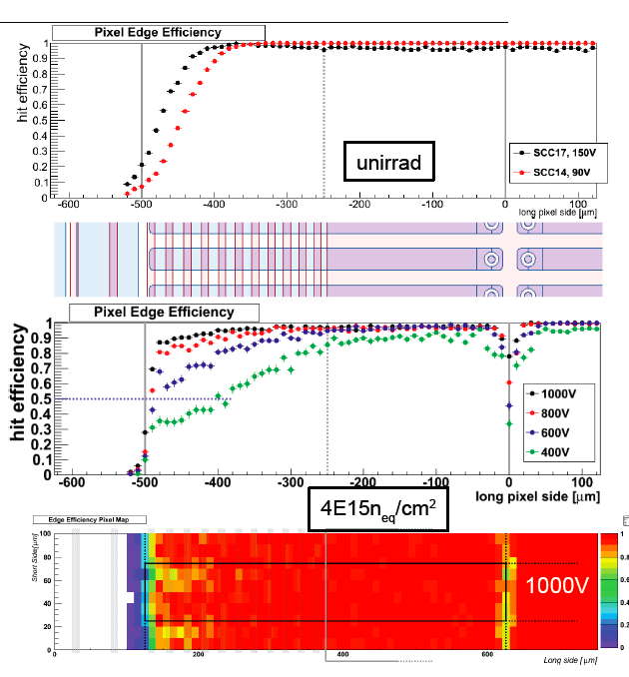
N-in-n pixels for IBL – Slim edge
CIS production of IBL sensors
GR Back-side
Pixel on front-side
other 100 μm to the edge
Study of edge efficiency in beam tests for for FE-I4 n-in-n modules (IBL type)
Before and after irradiation a clear dependence on the bias voltage is visible
reduction of the inactive edge to ~200 μm demonstrated
T. Wittig, Pixel 2012

Slide 17
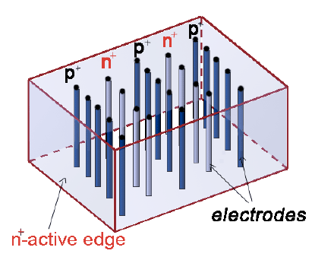
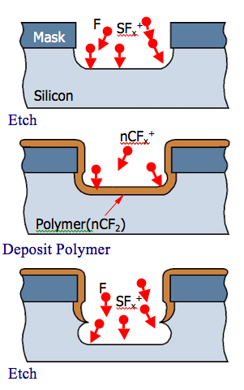
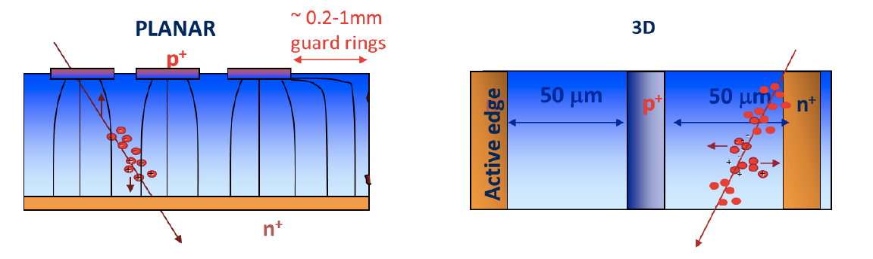
3D pixel sensors
First proposed by S. Parker et. al. in NIMA 395 (1997), 328
Columns etched with Deep Reactive Ion Etching

Slide 18
3D pixel sensors
First proposed by S. Parker et. al. in NIMA 395 (1997), 328
ADVANTAGES
Electrode distance and substrate thickness decoupled
High speed
Good charge collection efficiency → good radiation hardness
DISADVANTAGES
Non uniform response due to electrodes
Complicated technology
Higher capacitance with respect to planar

Slide 19
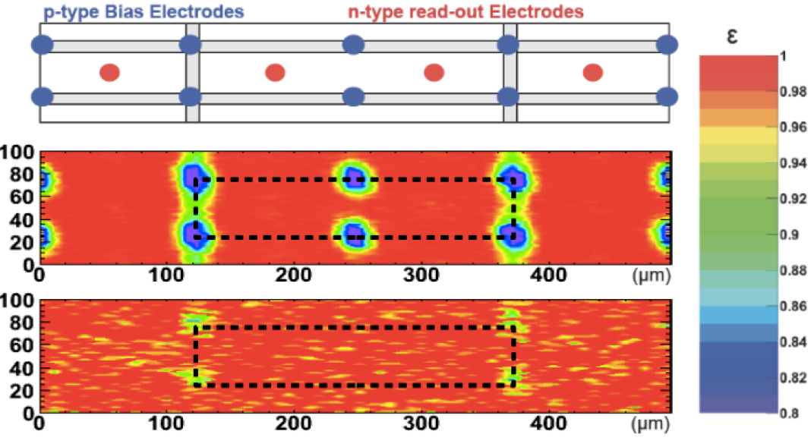
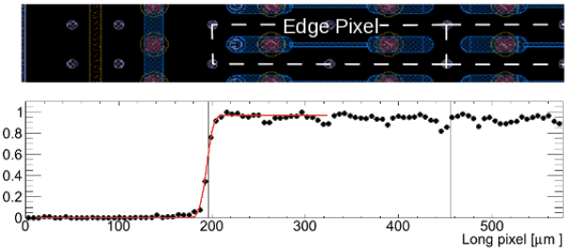
3D pixel sensors for IBL
CNM sensors, V_{bias}=160 V, Φ=5x10¹⁵ n_{eq} cm⁻²
Slim-edge: Dead region along the beam axis < 225 μm
C. Gemme, Vertex 2013

Slide 20
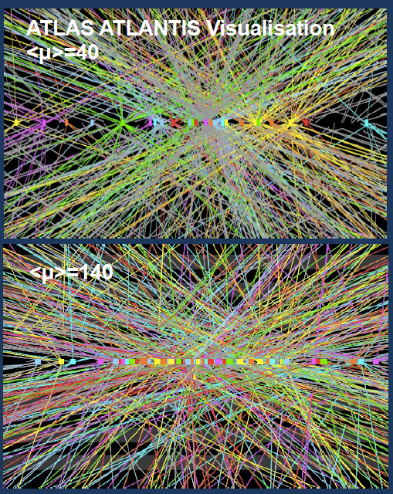
The ATLAS Pixel System in the Phase II Upgrade
Proton-proton collision energy √s=14 TeV
● Instantaneous luminosity of L=5x10³⁴ cm^{‑2}s^{‑1}
● Average number of 'pile-up' collisions per
event <μ> = 130-140
● Integrated luminosity 3000 fb⁻¹ over the entire run
I. Gregor, DESY

Slide 21
Development of planar pixel sensors
for Phase II

Slide 22
Phase II Pixel System Layout and requirements
The layout proposed in the LoI provides 14 points/track to |n| < 2.7
Pixel: 4 layers + 6 disks
2 Outer Barrel Layers / Disks
2 Inner Barrel Layers
Probably planar n-in-p
Sensor thickness 150 μm
Pixel size 50x250 μm²
2x2 (Quad) and 2x3 (Hex) chip modules
Sensors: different materials and technologies possible
Radiation hardness up to 2x10¹⁶ n_{eq}/cm²
Thickness: 150 μm or lower
Pixel size 25x150 μm² → FE-chip in 65 nm CMOS technology
H. Hayward, Hiroshima 2013

Slide 23
Comparison between n-in-n and n-in-p technologies
M. Benoit et al., IEEE Trans. On Nuclear Science, VOL. 56, NO. 6, DECEMBER 2009
n-in-n technology
double sided
slim edges down to 200 μm possible
n-in-p technology
Depletes from the segmented side
Single sided process
30-40% cheaper than n-in-n
More foundries and available capacity world-wide
Easier handling-testing due to lack of patterned back-side implant
230 μm
Standard Guard-Ring

Slide 24
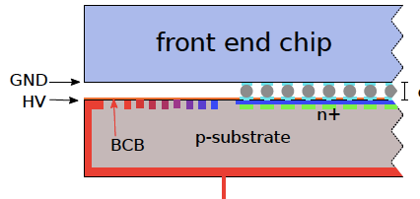
Sensor-chip isolation techniques for n-in-p pixels
Danger of sparks between the chip and the sensor edges at HV
  distance of the order of the bump height ~ 30 μm
3 μm of Benzocyclobutene (BCB) on the sensor surface, litography needed → No sparks observed up to 1000V
Parylene-C deposited all over the module (5-10 μm per side) → tested up to 650V, no sparks.
  Some hints of radiation damage from preliminary studies on test-structures. Parylene-N seems more resistant
Silicon adhesive on the wire bonding side → no sparks observed up to 1000V
HV

Slide 25
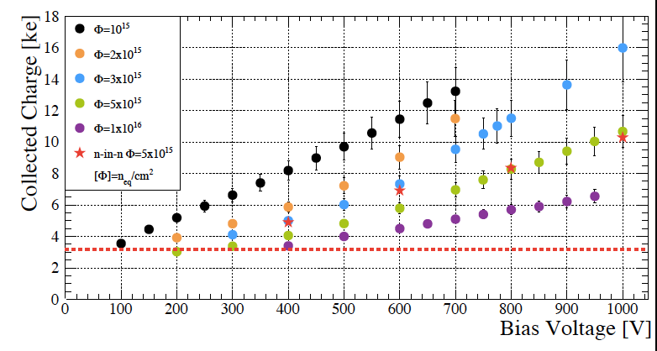
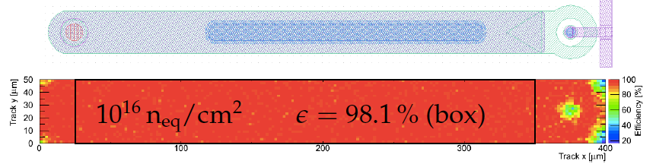
n-in-p performance – FE-I3 modules
MPP/HLL design produced by CiS on 285 μm FZ. n-irradiated up to 10¹⁶ n_{eq}/cm²
Charge exceeds threshold by a factor of 2
Testbeam with Eudet telescope
Hit efficiency of 97.2% at highest fluence, 600V and threshold of 2 ke (98.1% in central region)
Main losses in punch through and corners for perpendicular tracks

Slide 26
n-in-n performance – FE-I3 modules
FE-I3 samples n-in-n
250 μm thickness
PbSn bump-bonded
Φ=1.4x10¹⁶ n_{eq}/cm², p irr.
1000 V
T. Wittig, Pixel 2012
26

Slide 27
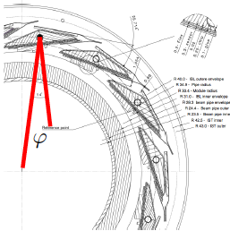
FE-I4 modules 150 μm thick
designed and produced by MPP/HLL
6” wafers with FE-I4 sensors interconnected with bump-bonding at IZM
irradiated up to 4x10¹⁵ n_{eq}/ cm² in KIT and Los Alamos

Slide 28
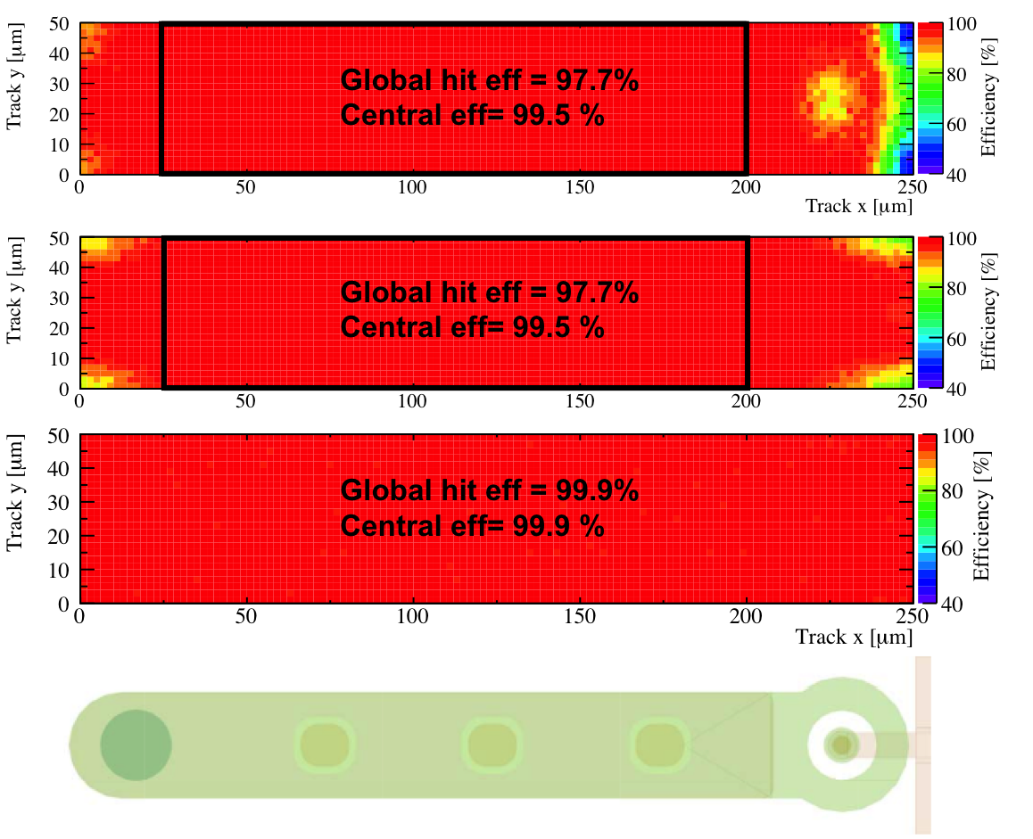
Hit efficiency at different η incidence
FE-I4 150 μm thick, irradiated to 4x10¹⁵ n_{eq}/cm² in Los Alamos
bias voltage: 500 V, Threshold:1600 e-
96.6 % hit efficiency for the full module at perpendicular incidence (500V)
99.1 %
28

Slide 29
Hit efficiency at different η incidence
FE-I4 150 μm thick, irradiated to 4x10¹⁵ n_{eq}/cm² in Los Alamos
bias voltage: 500 V, Threshold:1600 e-
98.4 % hit efficiency for the full module at θ=30º (η=0.55) incidence (500V)
99.0 %

Slide 30
Hit efficiency at different η incidence
FE-I4 150 μm thick, irradiated to 4x10¹⁵ n_{eq}/cm² in Los Alamos
bias voltage: 500 V, Threshold:1600 e-
99.5 % hit efficiency for the full module at θ=45º (η=0.88) incidence (500V)
99.5 %

Slide 31
Hit efficiency at different η incidence
FE-I4 150 μm thick, irradiated to 4x10¹⁵ n_{eq}/cm² in Los Alamos
bias voltage: 500 V, Threshold:1600 e-
99.8 % hit efficiency for the full module at θ=85º (η=3.1) incidence (500V)
99.8 %

Slide 32
Sensor thickness and occupancy at high eta
Mean cluster width along the beam direction as a function of the pseudo-rapidity
Assumed FE-I4 chip pitch along z: 250 μm
Reduced cluster size along the beam direction for thin sensors at high eta!

Slide 33
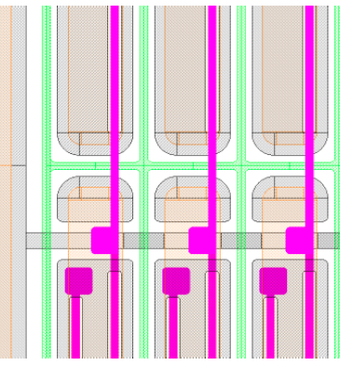
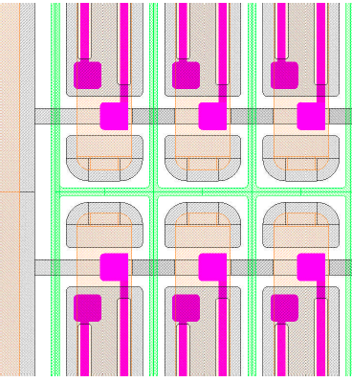
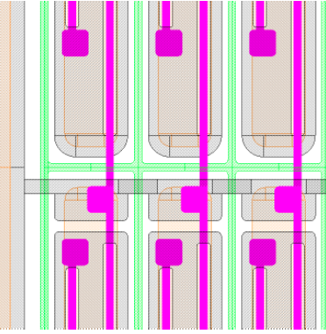
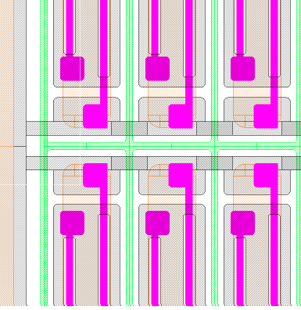
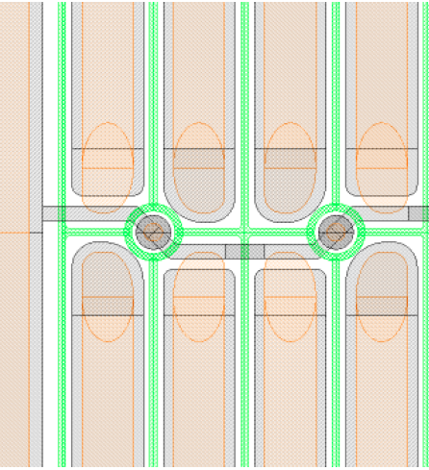
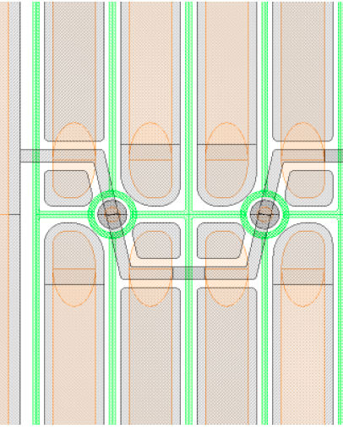
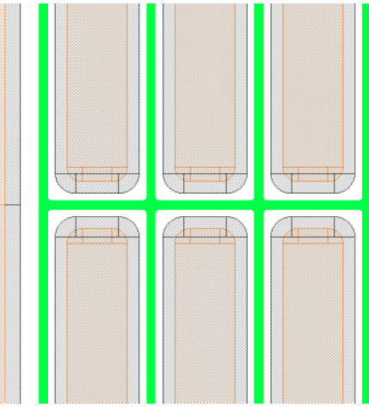
Active area design optimization
New KEK-HPK productions of FE-I4 sensors
Study of different pixel biasing schemes : Punch-through and poly-silicon
p-stop
Type (1, 9)
Type (2, 10)
Type (3, 11)
Type (4, 12)
Poly-Silicon
Type 17
Type 18
Type 19
No Bias
Punch through
Yoshinobu UNNO, KEK

Slide 34
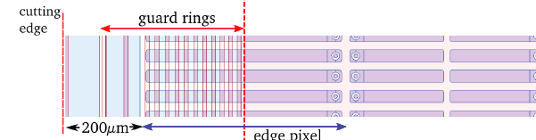
Slim edges planar pixel sensors - Overview
Active edges for n-in-p pixels: Deep Reactive Ion Etching + Side implantation
Design optimization of the n-in-n sensors: GR on backside opposite to pixels on the front
IBL design

Slide 35
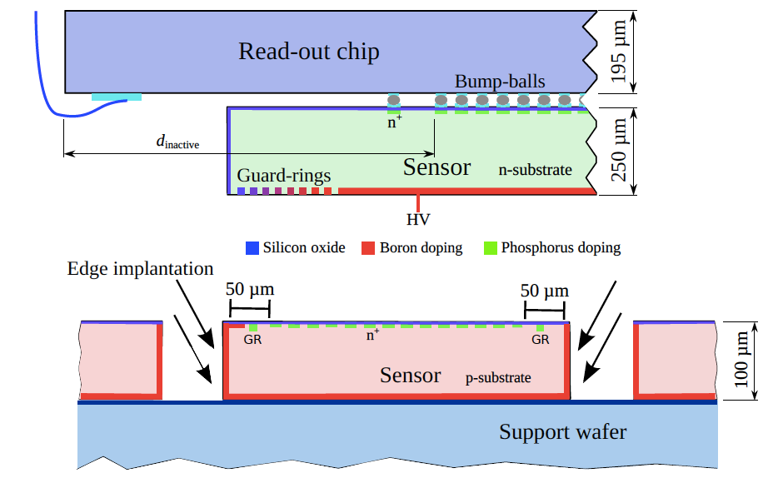

Active edge planar pixels
n-in-p pixels on FZ and MCZ material
100 μm and 200 μm thickness →together with the active edges makes these sensors very attractive candidates for the inner layers in Phase II
p-spray isolation method transferred from HLL to VTT
Flip-chipping performed at VTT after removal of support wafer

Slide 36
Active edge: geometry and IV characterization
125 μm edge implemented In FE-I3 and FE-I4 sensors: Bias Ring + floating Guard Ring
50 μm implemented only in FE-I3 sensors: Floating Guard Ring
Very low leakage current level, < 100 nA for FE-I3 and FE-I4 sensors
Breakdown voltage at 100-110V, much higher than depletion voltage ~ 15V

Slide 37
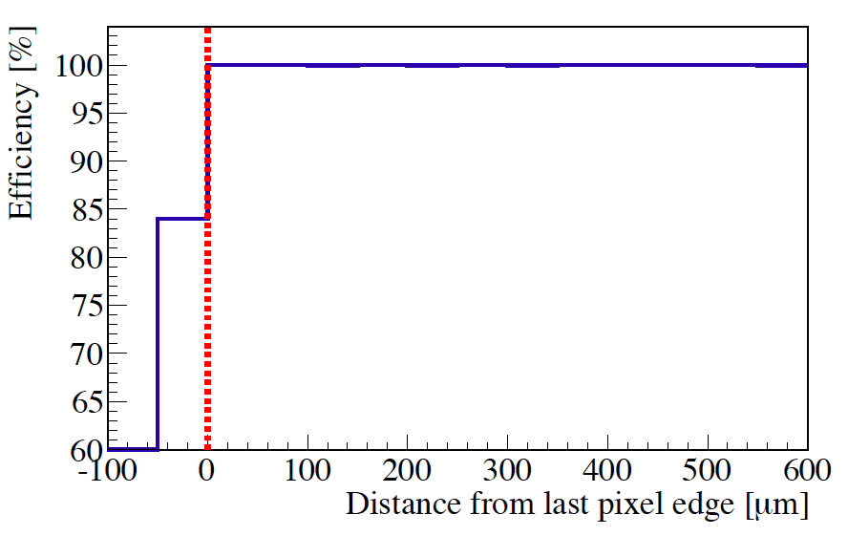
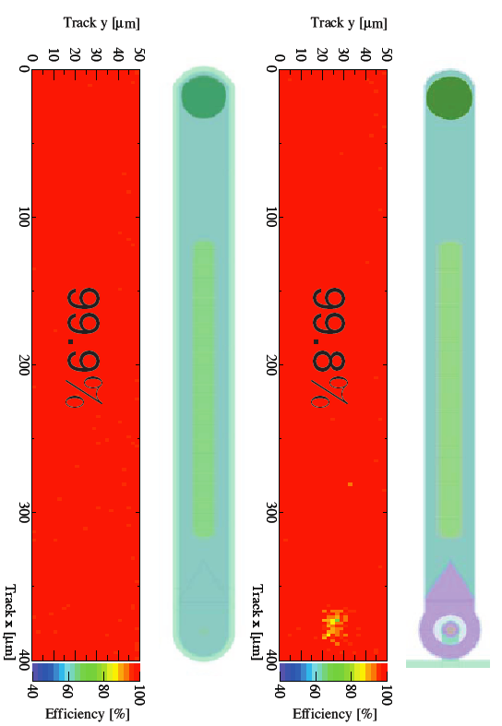
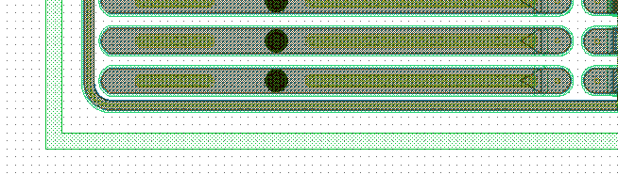
Hit efficiency in the edge region
Edge Tracking Efficiency in Beam Tests at SPS
Global Efficiency in beam test
99-100% hit efficiency on the area of the pixel implant of the edge column
% efficiency in the last 50 μm of the sensor edge, beyond last pixel implant
FE-I3, 50 μm edge,
Vbias=20V
FE-I3, 125 μm edge,
Vbias=20V

Slide 38
Active edge: CCE after irradiation
Φ= (0 -1) e15
FE-I3 100 μm thick sensor with 125 μm slim edge, threshold 1500 e- → 87% CCE at 300 V for both all and edge pixels after irradiation at KIT (1x10¹⁵ n_{eq}/cm²)
p-type MCZ FE-I4, 100 μm thick sensor, with 125 μm slim edge, threshold 1100 e- → compatible charge collection properties between edge and internal pixels
Φ= (0 - 5) e15
Φ=2 e15

Slide 39
Active edge: CCE after irradiation
Φ= (0 -1) e15
Φ= (0 - 5) e15
FE-I3 100 μm thick sensor with 125 μm slim edge, threshold 1500 e- → 87% CCE at 300 V for both all and edge pixels after irradiation at KIT (1x10¹⁵ n_{eq}/cm²) and in Ljubljana (5x10¹⁵ n_{eq}/cm²)
p-type MCZ FE-I4, 100 μm thick sensor, with 125 μm slim edge, threshold 1100 e- → compatible charge collection properties between edge and internal pixels
Φ= (0 - 5) e15
Φ=2 e15
39

Slide 40
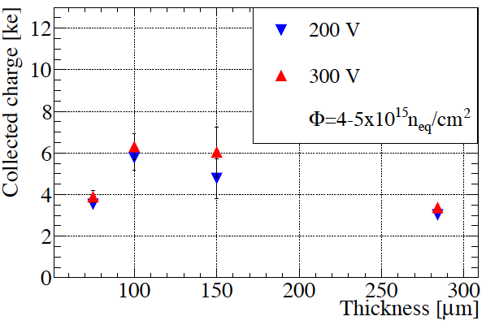
Charge collection for pixels of different thickness
Φ= 2 e15
Φ= 4-5 e15

Slide 41
Charge collection for pixels of different thickness
The 100-150 μm thick sensors show higher charge collection up to a fluence of 4-5x10¹⁵ n_{eq} / cm²
At higher fluences the effect of charge trapping tends to equalize the charge collection efficiency for all thicknesses
Φ= 2 e15
Φ= 4-5 e15
Φ= 10 e15

Slide 42
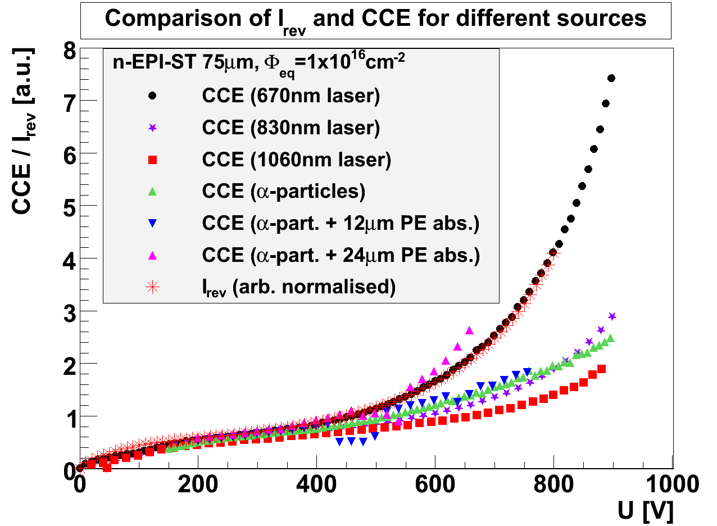
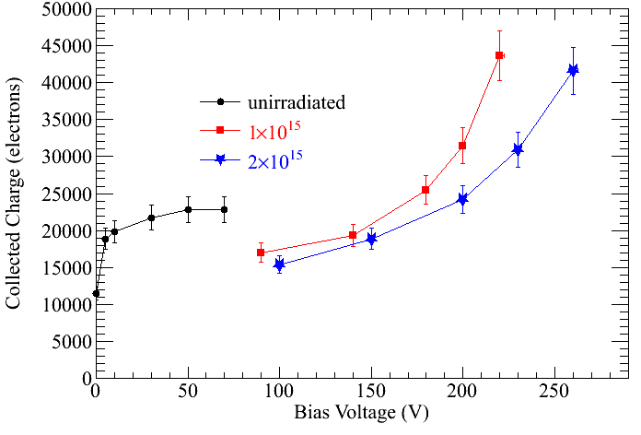
Charge multiplication
Charge Multiplication observed and characterized after high levels of irradiation
with different techniques and in several different types of devices
140 μm thick device
300 μm thick device
Diodes (Φ_{eq}=10¹⁶ cm⁻²)
Leakage Current & Charge Collection
Strip sensors (Φ_{eq}=5×10¹⁵ cm^{-2,} 26 MeV p)
Charge Collection (Beta source, Alibava)
Ref: Diode: J.Lange et al, 16th RD50 Workshop, Barcelona
Strip: G. Casse et al., NIMA 624, 2010, Pages 401-404
3D: M.Koehler et al., 16thRD50 Workshop, Barcelona
3D sensors (Φ_{eq}=1-2×10¹⁵ cm⁻²)
Charge Collection (test beam)

Slide 43
Vertical Integration Technologies
and 3D sensors for Phase II

Slide 44
Vertical Integration Technologies
3D electronics: “the vertical integration of thinned and bonded silicon integrated circuits with vertical interconnects between the IC layers”
New demanding specifications for experiments at new machines:
Improve resolution → shrink pixel size and pitch, down to 20 μm or even less
Preserve or even increase pixel-level electronic functions: handling of high data rates (hit rates > 10 MHz/mm²), analog-to digital conversion while reducing the pixel size
Decrease amount of material  thin sensor and electronics chips, “zero mass” cooling
100-200 μm total module thickness

Slide 45
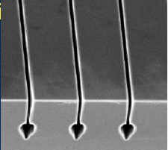

Evolution of Micro-Electronic Technologies
Through Silicon Vias
No roadmap, room for new ideas: monolithic sensors, 3D integration
Micro-channel cooling
Evolutionary roadmap:
nanoscale CMOS
Monolithic sensors
Valerio Re, Vertex 2013

Slide 46


Through Silicon Vias: Via First or Via Last
Via first, Via middle: Vias are part of wafer processing at the CMOS foundry, and are inserted before or right after the fabrication of transistors
➔ High density TSVs (few μm pitch) through thinned wafers, allow multiple connections at the cell (pixel) level between transistor layers
Valerio Re, Vertex 2013
Via last: Vias are fabricated on fully processed CMOS wafers, at a facility outside the CMOS foundry
➔ Low density TSVs (tens of μm pitch) through unthinned wafers or partially thinned wafers, allow connectivity at the pad level in the chip periphery

Slide 47




Through Silicon Vias
FE-I3 chip: TSV (3x10 μm²) etching the chip front-side
TSV on front-side
Processing sequence:
Via- and trench etching in Bosch-process, TSV cross-sect. of 3x10 μm²
insulation with TEOS (low T)
filling of vias with Tungsten
attachment to handle-wafer on the top side and thinning to desired thickness of chip ~ 60 μm
redistribution layer on the backside
SLID-interconnection to sensor wafer.
TSV on back-side
Failure of tungsten filling
TSV on back-side

Slide 48

Through Silicon Vias
FE-I3 chip: TSV (3x10 μm²) etching the chip front-side
TSV on front-side
Processing sequence:
Via- and trench etching in Bosch-process, TSV cross-sect. of 3x10 μm²
insulation with TEOS (low T)
filling of vias with Tungsten
attachment to handle-wafer on the top side and thinning to desired thickness of chip ~ 60 μm
redistribution layer on the backside
SLID-interconnection to sensor wafer.
TSV on back-side
No tungsten adhesion within the TSV
Failure of tungsten filling
TSV on back-side

Slide 49
Through Silicon Vias
FE-I3 chip: TSV (3x10 μm²) etching the chip front-side
TSV on front-side
FE-I4 chip: TSV (~10x30 μm²) etching the chip back-side
TSV on back-side
TSV on back-side
TSV

Slide 50


SLID Interconnection
Alternative to bump bonding (less process steps “lower cost” (EMFT)).
Small pitch possible (~ 20 μm, depending on pick & place precision).
Stacking possible (next bonding process does not affect previous bond).
Wafer to wafer and chip to wafer possible.
Successful interconnection run with FE-I3 chips and sensors with 75 μm active thickness
Stable SLID interconnection after irradiation and thermal cycling
Good Charge Collection efficiency after irradiation up to 10¹⁶ n_{eq}/cm²

Slide 51


3D pixel sensors for Phase II
Cinzia Da Via’, Hiroshima 2013
3D Pixels for Phase II: first indications of good radiation resistance up to a fluence of 2x10¹⁶ n_{eq}/cm²
R&D for Phase II:
  Thinner sensors
  Active edges
Development of active edges with the use of a handle wafer
Etched trench + electrode
Charge Collection by X-ray beam

Slide 52


Micro-channel cooling
3D Pixels for Phase II: embedded micro-channels with CO₂ cooling
Chip footprint
35 micro-channels
50 μm x 50 μm separated by 200 μm walls
Cinzia Da Via’
Hiroshima 2013
Holes for fluidic inlet and outlet

Slide 53

Micro-channel cooling
3D Pixels for Phase II: embedded micro-channels with CO₂ cooling
Target for new 65 nm chip: 400 mW/cm²
Power dissipation for 3D sensor at 2x10¹⁶ n_{eq}/cm² → 450-500 mW/cm²
Total power: 850-900 mW/cm²
Cinzia Da Via’ Hiroshima 2013

Slide 54




3D diamond sensors
RD42 Collaboration
Holes drilled with 800 nm femto-second laser
93% efficiency for column etching
Diamond sensor 500 μm thick
Cr-Au electrodes connecting a row of electrodes into a strip
Read-put by the VA2 chip
Columns are conductive ~1 Ω cm
S. Schnetzer, Vertex 2013

Slide 55

Summary and Outlooks
ATLAS pixel detector is essential for the experiment and will be upgraded in the future:
• A 4th pixel layer (IBL) is well under construction and will be installed in spring 2014 during LS1 of LHC.
• Upgrade to luminosities of 5x10³⁴cm⁻²s⁻¹ and ~250 pile up events pushes the challenges for pixel detectors in new directions.
Looking to the phase 2 plans of the ATLAS pixel detector is difficult now, but
For inner pixel layers:
• hybrid pixels either with FE electronics in 65nm or 3D integrated electronics; sensors could be planar, 3D or diamond
For outer pixel layers:
Standard hybrid pixel detectors most likely planars, with
advanced concepts to save material (TSV, SLID, thin sensors, …)
A lot more R&D is needed!

Slide 56
Additional material

Slide 57




3D pixel sensors for IBL
FBK
CNM
230μm thick 3D sensors
Produced without handle wafer
FBK: temporary metal for testing
CNM: Guard Ring without connection to single pixels
Wafers are selected for UBM if at least 3 tiles out of 8 are good (Vbk >25 V)
CNM yield significantly higher than FBK but FBK measurement on full device, CNM on Guard Ring only.
C. Gemme, Vertex 2013

Slide 58


Active edge: IV after irradiation
100 and 200 μm thickness, active edge
Active edge modules irradiated up to a fluence of 5x10¹⁵ n_{eq}/ cm² have a breakdown voltage above the saturation voltage of the charge collection
Lower breakdown voltages with respect to thin pixel devices with standard GR structure irradiated at the same fluence
150 μm thickness, GR with 450 μm inactive edge
75 μm thickness, standard guard ring

Slide 59
Active edge: charge collection with a ⁹⁰Sr a source
FE-I3
50 μm edge
V_{bias}=15 V
FE-I4
125 μm edge
V_{bias}=15 V
Edge pixels show the same charge collection properties as the central ones

Slide 60

DESY test-beam – Active edge sensors
VTT 100 μm MCz
threshold: 1600 e, Φ=2x10¹⁵n_{eq}/cm²
97.3% global efficiency at 350 V
VTT 200 μm Float Zone (FZ)
threshold: 1100 e, Φ=2x10¹⁵n_{eq}/cm²
98.9% global efficiency at 350 V
V_{bias}=400V
global hit efficiency
97.5 ±0.3%
VTT 100 μm FE-I3 Float Zone
125 μm slim edge, threshold: 1500 e
Φ=5x10¹⁵n_{eq}/cm²

Slide 61



Smaller pitches for internal layers
25 μm x 500 μm pitch
Test for Rφ pitch of 25 μm, as foreseen for inner layers of phase II upgrade in ATLAS
Longer pixels in the z direction (500 μm) to restore compatibility with the FE-I4 chips
MICRON – Liverpool University
Values of the residual are approximately what is expected for pitch / √12
H. Hayward, Liverpool
Hiroshima Symposium 2013

Slide 62
High eta cluster analysis
FE-I4 150 μm thick, irradiated to 4x10¹⁵ n_{eq}/cm² in Los Alamos
85^{O} track incidence ( η=3.1)
bias voltage: 500 V
threshold: 1.6 ke (MPV 9.5 ke)
~ 7.8
Mean cluster width expected along the tilted direction for different incidence angles
Cluster distribution along the tilted direction.
Distribution mean = 6.7

Slide 63


Power dissipation -3D
At 2x10¹⁶ and T=-10C → power disspation =400 mW/cm2

Slide 64

Power dissipation - Planar
At 2x1016 current=1 mA
Vbias=1500 V
T=-15C on the sensor
Power dissipation 1.5 W

Slide 65

EMFT SLID Process
FE-I3
Cu₃Sn
Cu₆Sn₅
27 μm
Sensor
Alternative to bump bonding (less process steps “lower cost” (EMFT)).
Small pitch possible (~ 20 μm, depending on pick & place precision).
Stacking possible (next bonding process does not affect previous bond).
Wafer to wafer and chip to wafer possible.

Slide 66

Chip-sensor interconnection technologies
Solder bump-bonding with different companies:
  IZM Berlin, HPK : SnAg bumps
  VTT (ADVACAM), SnPb bumps
  IZM, HPK: chip thickness down to 150 μm with the use of a glass substrate
  VTT: chip thickness down to 200 μm
Alternative interconnection technologies – Micro-Cu Pillars
Cu post / SnAg solder
50 μm pitch
25 μm diameter
8-12 μm thickness
FE-I4B with micro-pillars
Glasgow-LETI-ADVACAM collaboration
C. Butter, Hiroshima Symposium 2013

Slide 67





Smaller pitches for internal layers
CIS - MPP
KEK – HPK
Confidential for ATLAS (and CMS)
One bias dot every four pixels
END1
MICRON - Liverpool
END2
25 μm x 500 μm pitch
Test for Rφ pitch of 25 μm, as foreseen for inner layers of phase II upgrade in ATLAS
Longer pixels in the z direction (500 μm) to restore compatibility with the FE-I4 chips
Type20
PT No offset
Type 21

Slide 68




n-in-p performance – FE-I4 modules
KEK-HPK n-in-p FE-I4 sensors, 150 μm thickness
Bump-bonded at HPK
Irradiated at Φ=1e16 n_{eq}/cm², Vbias=1200 V
Poly-Si, p-stop
Overall hit efficiency = 96.3%
PT, p-spray
Overall hit efficiency = 97.1%
Poly-Si, p-spray
Overall hit efficiency = 97.6%
Kazuki MOTOHASHI
Hiroshima Symposium 2013
> 99.7 % already at 600V in the electrode region of each sample

Slide 69
Charge collection efficiency after irradiation
Φ= (0 -1) e15
Φ= (0 - 5) e15
FE-I3 100 μm thick sensor with 125 μm slim edge, threshold 1500 e- → irradiated in Ljubljana at 5x10¹⁵ n_{eq}/cm²
Landau distribution obtained at the DESY test-beam with 4 GeV electrons

Slide 70

Test-beam results – 100 μm thick sensors
Test-beam results from DESY test-beam 6 GeV electrons, EUDET telescope → due to multiple scattering the analysis of the edge efficiency is not possible
Tuning Threshold=1600 e, 6 ToT@6ke, beam at perpendicular incidence
VTT FZ, 100 μm thick, not irradiated → total efficiency 99.7% at 40 V
VTT MCZ, 100 μm thick, Φ=2e15 → total efficiency 97.3% at 350 V
98.8 %

Slide 71

Edge efficiency after irradiation
125 μm slim edge FE-I3 module with Bias Ring
not irradiated
threshold: 1500 e
PPS test-beam with 120 GeV pions
68 ±1% hit efficiency between the last pixel implant and the Bias Ring
Φ=5x10¹⁵ n_{eq}/cm²
400 V
threshold: 1500 e
DESY test-beam with 4 GeV e⁻
56±4% hit efficiency between the last pixel implant and the Bias Ring

Slide 72


SCP: Scribe Cleave Passivate
Diamond stylus
Laser
XeF₂ Etch
DRIE Etch
Saw cut (with cleanup step)
Tweezers (manual)
Loomis Industries, LSD-100
Dynatex, GTS-150
N-type P-type (Q_{f} > 0) (Q_{f} < 0)
Native SiO₂ + UV light or high T
PECVD SiO₂
PECVD Si₃N₄
ALD “nanostack” of SiO₂ and Al₂O₃
ALD of Al₂O₃
All Treatment is post-processing & low-temp (Etch-scribing can be done during fabrication)
Basic requirement: <100> wafers (for rectangular side cleaving) with reasonably good alignment between sensor and lattice.
V. Fadeyev
Santa Cruz Institute for Particle Physics
Hiroshima Symposium 201

Slide 73


SCP: Scribe Cleave Passivate
Diamond stylus
Laser
XeF₂ Etch
DRIE Etch
Saw cut (with cleanup step)
Tweezers (manual)
Loomis Industries, LSD-100
Dynatex, GTS-150
N-type P-type (Qf > 0) (Qf < 0)
Native SiO₂ + UV light or high T
PECVD SiO₂
PECVD Si₃N₄
ALD “nanostack” of SiO₂ and Al₂O₃
ALD of Al₂O₃

Slide 74
Reduction of the inactive region on the chip side
Project within AIDA WP3, in collaboration with Fraunhofer EMFT, to develop Inter Chip Vias to show the feasibility to transport signals and services on the backside using the existing FE-I4 chip
Inter-Chip-Vias to be etched on each wire bonding pad, cross section ~ 10x30 μm²
Chip and sensor connected using SLID technology

Slide 75
Inter Chip Vias in the FE-I4 chip
SEM analysis of the FE-I4 wire bonding pad
Most of the eight FE-I4 metal layers are present in the wire bonding pads → not possible to etch ICV from the front-side
Design and test of the ICV layout on test-wafers in on-going: target cross-section 10x30 μm² with a global chip thickness of 100-150 μm

Slide 76





Multi-chip modules
CIS n-in-n
CIS n-in-p
6” wafers from different producers – CIS is also starting the transition from 4” to 6” line
Quad and HEX modules
MICRON n-in-p
HPK n-in-p
FE-I3 1-chip pixels
FE-I4 2-chip pixels
FE-I4 1-chip pixels
FE-I3 4-chip pixels

Slide 77



Multi-chip modules read-out systems
SEABAS (KEK))
USBPix (Bonn) + STControl (Gö)
3 different DAQ systems available in ATLAS for simultaneous steering and reading of 4-chip modules
RCE (SLAC)

Slide 78

L1Track Trigger
Adding tracking information at Level-1 (L1)
  Move part of High Level Trigger (HLT) reconstruction into L1
  Goal: keep thresholds on p_{T} of triggering leptons and L1 trigger rates low
Triggering sequence
  L0 trigger (Calo/Muon)
  reduces rate within ~6 μs
  to ≳ 500 kHz and defines
  RoIs
  L1 track trigger extracts
  tracking info inside RoIs
  from detector FEs
Challenge
  Finish processing within the latency constraints

