Slide 1
Management:
(1) Next GA and trainings
(2) Collaboration with Infieri (ITN-People) https://indico.cern.ch/conferenceDisplay.py?confId=278931
PIN: 2013
(3) LPNHE recruitment

Slide 2
OUTREACH - FTK workshops - Trainings SCHEDULE
YEAR 1
YEAR 2
Where we do it
The second year?
CERN Training!
ALL DONE IN PISA first year
Here you can find a description of the
2nd Workshop on Modern Circuits and Systems Technologies
It will be associated with the AUTH IAPP training
Listen Calliope talk tomorrow!
Immediately before or after we will have the
FTK Workshop at Alexandroupoulis → greek travel!
http://electronics.physics.auth.gr/tomeas/en/jewel/jewel.html

Slide 3
SLP1 task – good occasion with Thales prepare new “Neurons” for Horizon 2020
3 years for a PHD payed by Marie Curie,
50% to be spent at Paris at the company.
Multi-packaging for our SIP.
Let’s describe better what is Infieri and which are the SLP1 plans

Slide 4
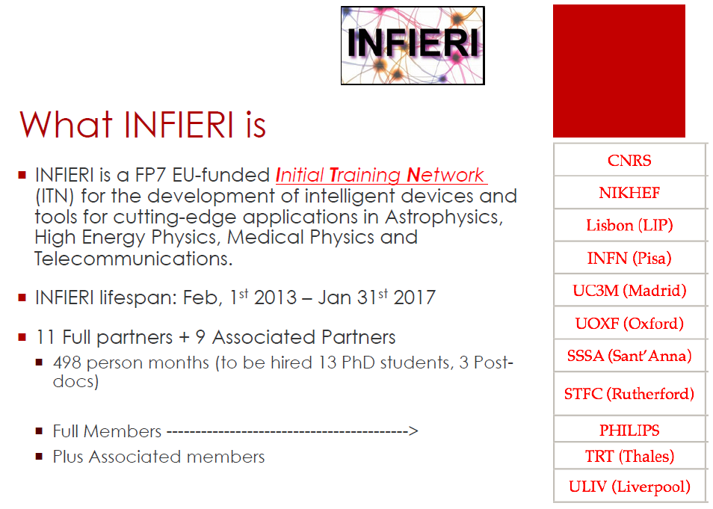
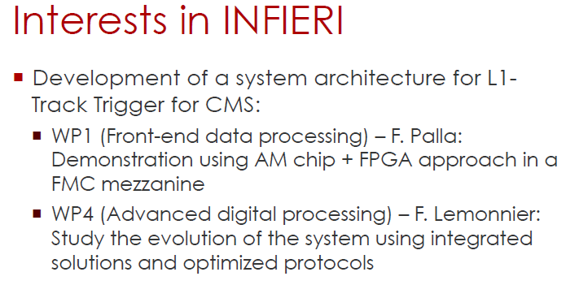

Slide 5
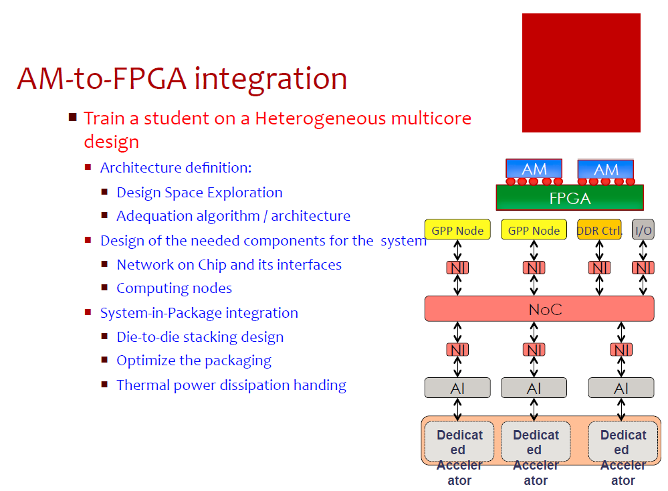

Slide 6
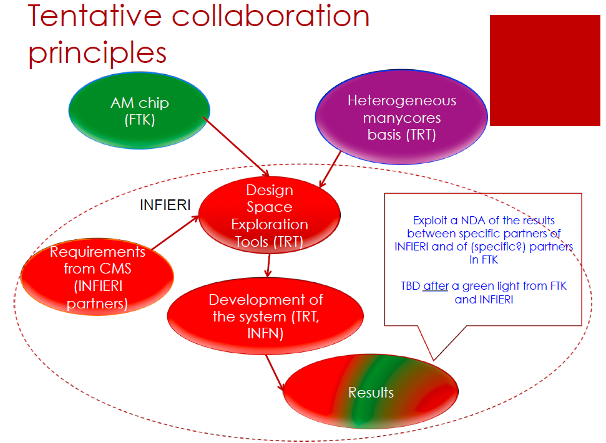

Slide 7
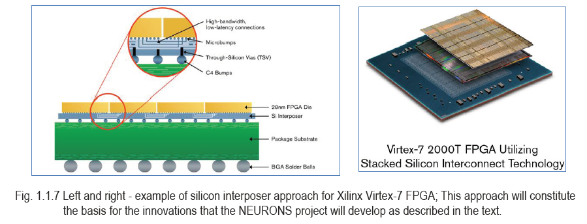
New Ideas for the future - FTK could become smaller and smaller
Multi-packaging FPGA & Amchip – mini FTK
Pattern matching
& track fitting (TF)
sqweezed in a
SIP (BGA 23x23)
TF highly parallelized
We have a very interesting quotation for FPGA bare dies to be packaged with AMchips
IMEC support for feasibility studies
FTK SIP (System In Package) becomes a real possibility – large impact on AM bank sizes

Slide 8
FTK miniaturization for long latency applications
Few future LAMBs could cover the whole detector if used for long latency applications (simulation-offline)
Goal: build a Lamb that can fit in a PC or can be accessed by a PC.
What about this size ?
FP7 IAPP - STREP PROGRAM
Coordinated by University of Pisa and INFN-Pisa
FTK

Slide 9
AGREEMENT FTK-THALES (proposed by Palla)
Define that the firmware is FTK-IAPP background, cannot be available to Infieri
Define the signatures of papers and results
Define the use of the results…..

Slide 10
LPNHE recruitment
Do you agree with the GA decision? Who has to answer:
Dell’Orso UNIPI, Project Coordinator,
Kostas Kordas, AUTH, WP 7
Dimitrios Sampsonidis, AUTH, WP 8
Paola Garosi, CAEN, WP 2
Francesco Crescioli, CNRS, WP 6
Andreas Sakellariou, PRIELE, WP 1
Marco Piendibene UNIPI, WP 5 Coordinator, Member
Chiara Roda UNIPI, WP 4
Betty Magnin CERN, WP 3

Slide 11
CONCLUSIONS
Interesting work developments
Interesting opportunities
Our recruitment – secondment plan is going ahead as expected

