Slide 1
¹⁰B Cathode for thermal neutron
Thermal Neutrons interact with ¹⁰B, and alfas are emitted entering in the gas volume generating a detectable signal.
Gas gap (Ar CO₂)
Low Efficiency
Big active area
Beam Monitor and transmission
Alfas
¹⁰B
Al Support
Thermal neutrons
Side-On detector
High Efficiency
Small active area
Thermal neutrons
Alfas
cathode
Actually 4% efficiency ... working to obtain 70%. Good candidate as ³He replacement detector

Slide 2
Polyethilene for fast neutron
Fast Neutrons interact with H, and protons are emitted entering in the gas volume generating a detectable signal.
Gas gap (Ar CO₂)
Low Efficiency
Big active area
Beam Monitor and transmission
Protons
Al
Idrogenate Support
Thermal neutrons
Side-On detector
High Efficiency
Small active area
Thermal neutrons
Protons
cathode
Actually 0.1% efficiency ... working to obtain few %.

Slide 3
Why Micro Pattern Gas Detector
MPGDs offer the following advantages
Very high rate capability (MHz/mm²) suitable for high flux neutron beams like at ESS
Submillimetric space resolution (space resolution adapted to experimet requirements)
Time resolution from 5 ns
Possibility to be realized in large areas and in different shapes
Radiation hardness and very low neutron-induced discharge probability
Insensitivity to gamma rays (with appropriate gain)

Slide 4
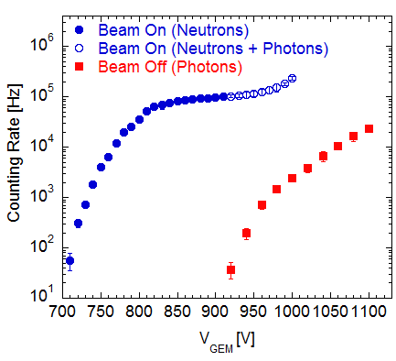
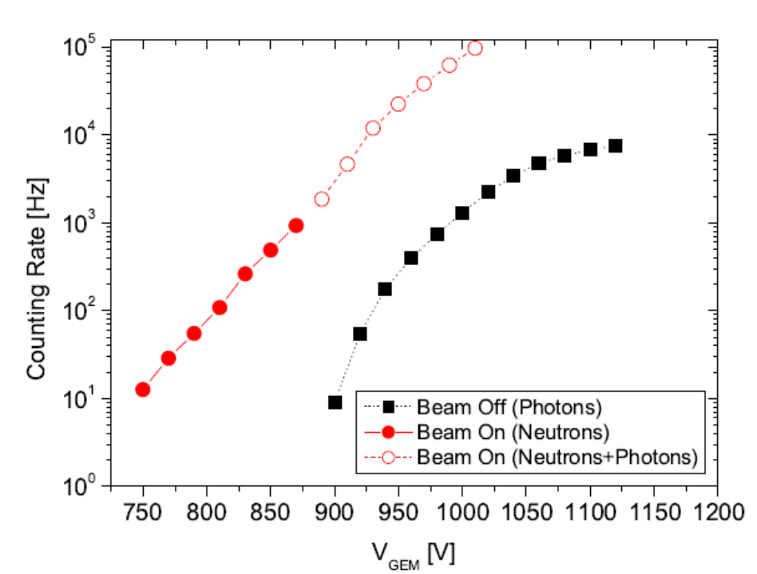
Working point
The alfas produce an higher ionization respect to protons
that allow a wider plateau before the gamma background

Slide 5
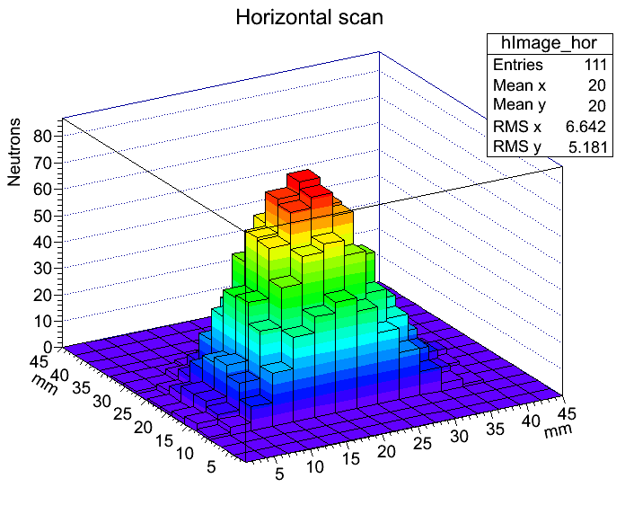
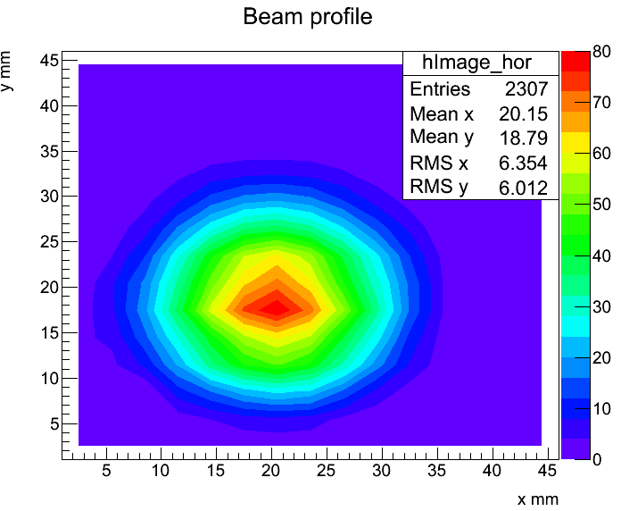
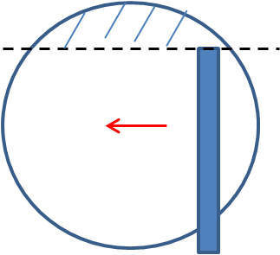
Test @ n-tof: measurements
Neutron beam has been reconstructed making an horizzontal scan on the beam.
Horizontal scan
ToF measurements: thermal energy spectrum
Single event
100 events
Slices acquisition: Time spectrum (1ms/bin), 150ms total gate.

Slide 6
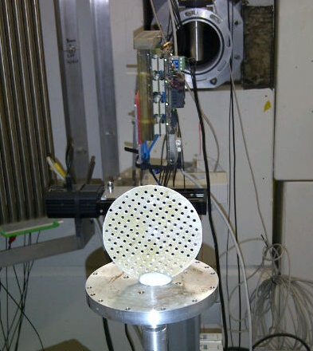
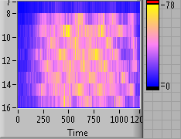
Imaging of Thermal Neutron beam through a cadmium grid (ISIS)
Image realized with a scan
through the beam
Online plot
Real time image with
30 sec scan with pad dimension of 6 mm pad
Beam

Slide 7
Only limited by alfa/proton path
Image dimension 90x90 mm²
^{Pressurized chamber ?} ^{CF4 ?}
^{Sealed detector ?}

Slide 8
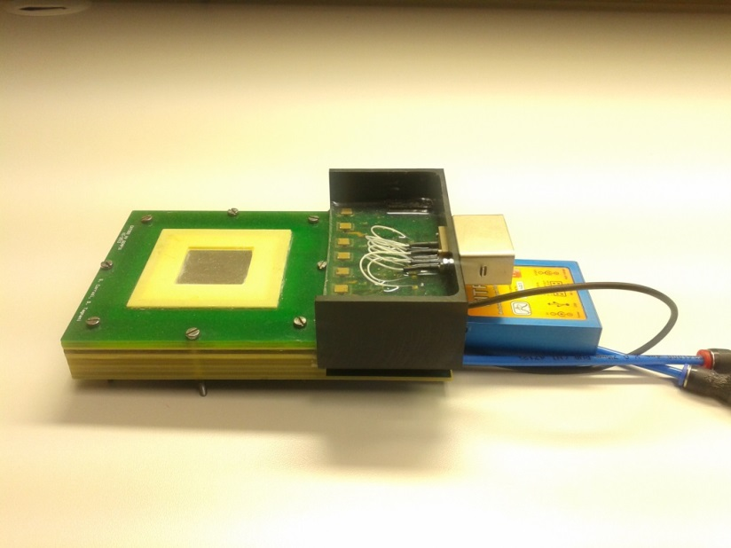
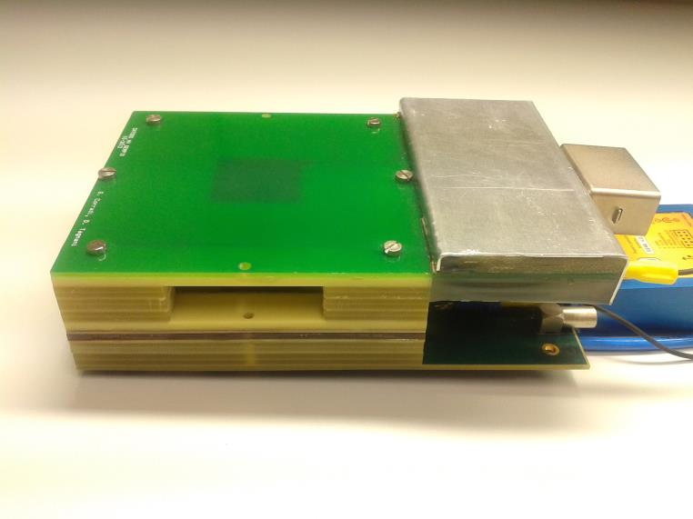
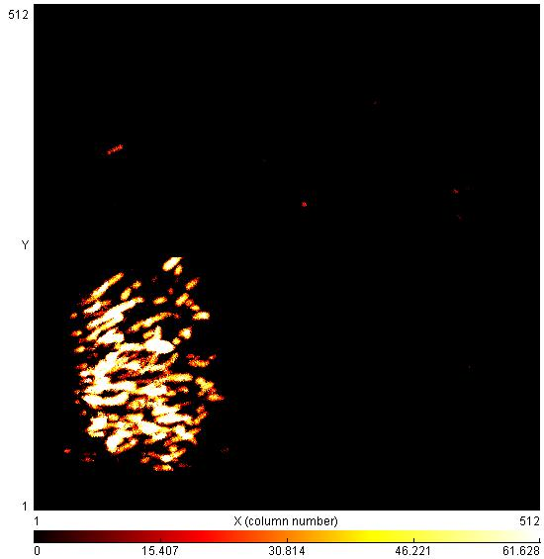
Two prototype of GEMPIX for ¹⁰B studies
Head-on detector
Side-on detector
HV Connector
Medipix
DAQ box
Compton e lectron
from gamma
Cluster detail
3x3 cm2
active area
Pixels of
50x50 µm²
alfas

Slide 9
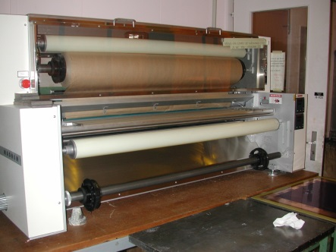
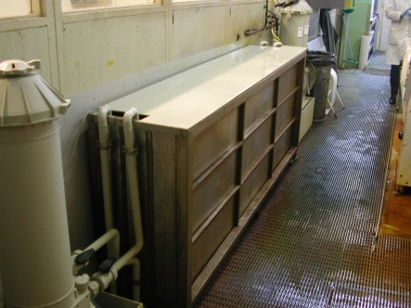
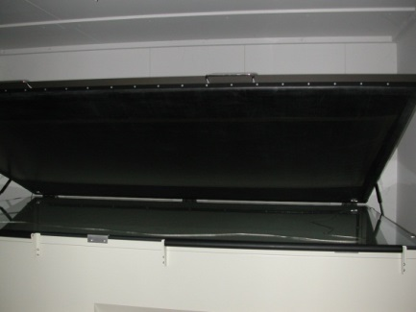
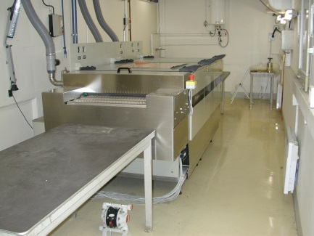
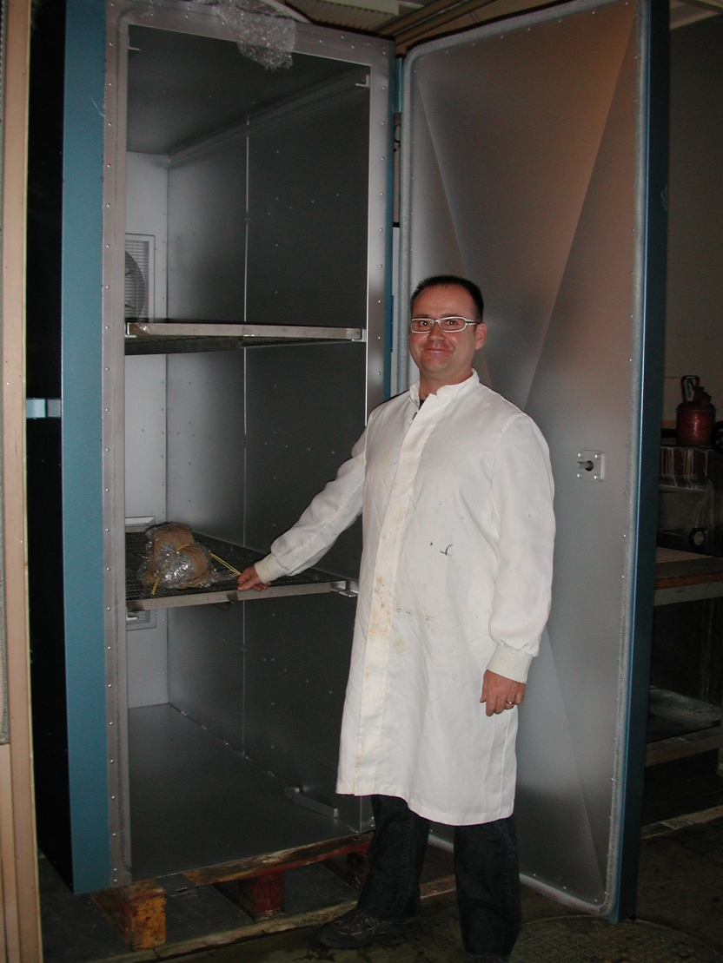
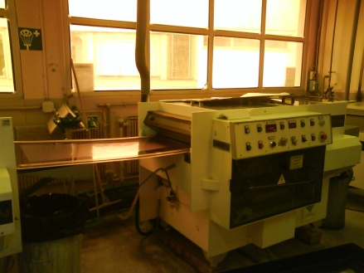
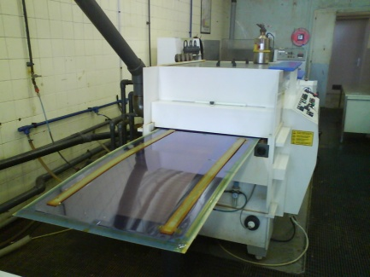
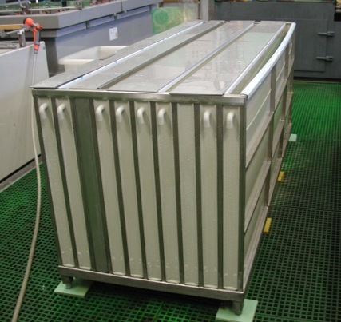
MPGD possibilities at CERN
Large laminator
1.4m
Large Solvent strip
2m x 0.8m
Large exposure
2.2m x 1.4m
PI etching
0.6m
Large oven
1.4mx 2.3m
Large electro-etch
2m x 0.8m
Large developer
Large stripper
Large etcher
I
In 107
In 107→ 1m
Now →0.6m
In 107
Thanks to 9 new equipment and a team of 20 engineer & technicians we have the capability to provide:
-GEM up to 2m x 0.5m
-Micromegas detectors up to 2m x 1m
-THGEMs up to 600mm x 600mm
Equipment are essentially dedicated to prototype production.
Possibilities for medium to high volume productions (but needs formal agreement).

Slide 10
Neutrons converters possibilities
Thermal neutrons
B4C vacuum deposition : some experience on GEM at CERN
BN vacuum deposition : some experience on metals
B10 to be studied
Large sizes up to 600mm width possible in theory.
Fast neutrons
PET GEMs with aluminium electrodes (need laser)
PET THGEMs with aluminium electrodes feasible
Polycarbonate THGEMs have already been produced

Slide 11
Main issue for future developments
Boron / converter depositions
Mecchanical resistence, radiation hard
type of suports and shapes ... large surface !
Fluxed or Sealed and/or pressurized detectors
Radiation Hard Front End Electronics
Channels high density for a better resolution
Pixelated detector to match High Rate capability
2D imaging and fast DAQ
Several neutron surces for detector characterization

