Slide 1
Boron film deposition by electron beam technique
Giuseppe Celentano, Fabio Fabbri, Angelo Vannozzi
Superconductivity Laboratory – ENEA, Frascati Research Centre
Frascati, December 3rd 2013
Outline
Intro: why B films
B film by e-beam deposition technique;
GEM detector;
Conclusions

Slide 2
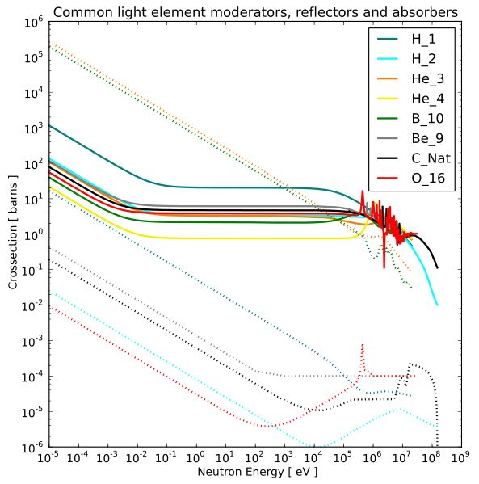
Introduction: why Boron detector
Thermal Neutron detection through absorption reaction by emission of high energy ionized particles
Absorber: dotted line
B-10
He-3
Current technology based on Helium-3 gas detectors is affected by He shortage issue
Alternative (high cross section) elements
Boron-10: stable isotopes composition ¹¹B 80.1% and ¹⁰B 19.9%
Applications: nuclear and medical (neutron capture therapy)
Source: Wikipedia
Notes:
The final goal of this activity is the development of MgO-based buffer layer architecture obtained by combining physical and chemical deposition techniques. The architecture will be composed by MgO deposited by e-beam or sputtering at relatively low T and an oxide layer deposited by MOD for YBCO epitaxy

Slide 3
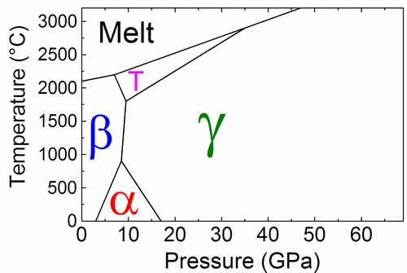
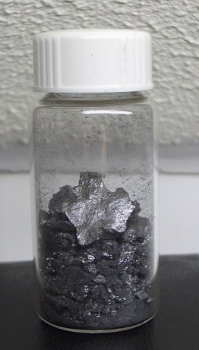
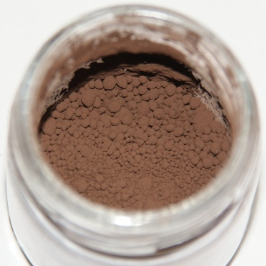
Introduction: Boron
Boron can be prepared in several crystalline and amorphous forms.
Crystalline
Amorphous
Elemental boron does not exist in nature but in minerals, borates…
Rather rare (0.001% earth’s crust), Extremely hard (9.5 on the Mohs scale similar to Si and W carbide), metalloid (10⁶ Ω m)
stable in air at room temperature, but at higher temperatures it burns to form B₂O₃
Melting point: 2076 °C
Low density: 2.4 g/cm³
Hardness (Mohs scale): 9.5
Most stable at RT: rhombohedral-β
Notes:
The final goal of this activity is the development of MgO-based buffer layer architecture obtained by combining physical and chemical deposition techniques. The architecture will be composed by MgO deposited by e-beam or sputtering at relatively low T and an oxide layer deposited by MOD for YBCO epitaxy

Slide 4
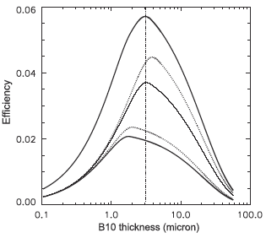
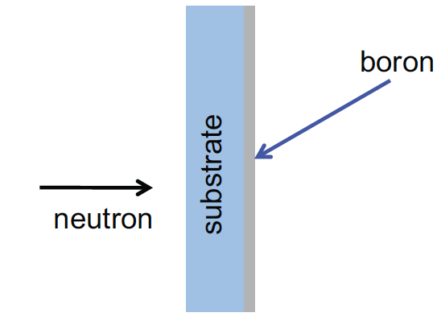
Introduction: detector with B films
For Boron neutron detector film technology can be used:
Gas (like He-3) corrosive compounds such as BF₃ not desirable;
Maximum efficiency is expected for about 1 μm;
Boron-Carbon was mainly proposed and studied as neutron detector^{(*)}
P. Chaudhari, et al., Thin Solid Films 519 (2011) 4561
1: 1.47 MeV α;
2: 1.78 MeV α;
3: 0.84 MeV ⁷Li;
4: 1.02 MeV ⁷Li
CVD, HWCVD, MOCVD techniques
Variety of precursors and substrates
Deposition temperature: 200 °C – 600 °C
1
2
3
Requirements: thickness > 1 μm, adhesion, no contaminations (maximize ¹⁰B content)
4
^{(*)}
H. Pedersen, et al., 2012, Chemical Vapor Deposition, (18), 221
I. Rehana, et al., J. Mater. Sci. Technol., Vol.23 No.4, 2007
P. Chaudhari, et al., Thin Solid Films 519 (2011) 4561
Z. Wang, et al., Nuclear Instruments and Methods in Physics Research A (2011) 322
Notes:
The final goal of this activity is the development of MgO-based buffer layer architecture obtained by combining physical and chemical deposition techniques. The architecture will be composed by MgO deposited by e-beam or sputtering at relatively low T and an oxide layer deposited by MOD for YBCO epitaxy

Slide 5
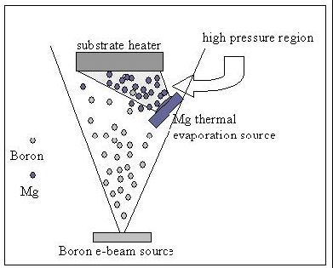
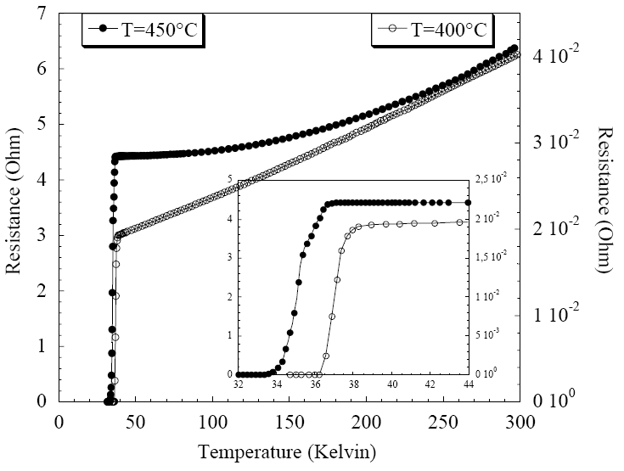
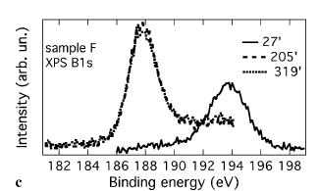
Boron film deposition at ENEA
Boron film can be deposited at RT by e-beam technique
Previous work on superconducting MgB₂ deposition
Superconducting MgB₂ was obtained by multilayer Mg/B or simultaneous deposition of Mg and B
Mg: thermal evaporation
A. Mancini, et al., IEEE Trans. Appl. Supercond. 13 (2003), 3305
G. Grassano, et al., J. Phys. Conf. Ser. 181 (2004), 1367
A. Santoni, et al., Appl. Phys. A (2006),
B: e-beam evaporation
Notes:
The final goal of this activity is the development of MgO-based buffer layer architecture obtained by combining physical and chemical deposition techniques. The architecture will be composed by MgO deposited by e-beam or sputtering at relatively low T and an oxide layer deposited by MOD for YBCO epitaxy

Slide 6
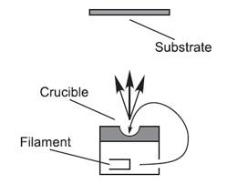
Boron film deposition: optimization
Evaporation system: Thermionics 3 kW (4 kV, 750 mA), 3 crucibles (2.5 cc)
Source: natural Boron pieces, Alfa Aesar (99.5%)
Substrate: Corning glass 21 × 26 mm, r-cut Al₂O₃ 10 × 10 mm
Substrate Temperature: RT
d_{T-S} = 12.5 cm
β-Boron
200 nm-Boron/Al₂O₃
d_{T-S}
Maximum growth rate: 0.35 nm/s
Maximum film thickness: 630 nm limited by crucible volume
Thickness uniformity: > 90% on 50 × 50 mm² area
Film adhesion: good
Notes:
The final goal of this activity is the development of MgO-based buffer layer architecture obtained by combining physical and chemical deposition techniques. The architecture will be composed by MgO deposited by e-beam or sputtering at relatively low T and an oxide layer deposited by MOD for YBCO epitaxy

Slide 7
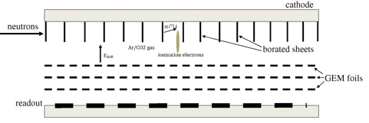
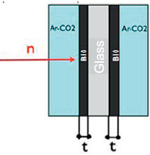
Boron for GEM neutron detector
Concept: multiple boron-coated lamellae placed in sequence along the neutron path
A. Pietropaolo, et al., Nuclear Instr. and Methods A 729 (2013) 117
B coating on both sides: 300 nm × 2 deposited in the same run by using a rotating sample-holder
Notes:
The final goal of this activity is the development of MgO-based buffer layer architecture obtained by combining physical and chemical deposition techniques. The architecture will be composed by MgO deposited by e-beam or sputtering at relatively low T and an oxide layer deposited by MOD for YBCO epitaxy

Slide 8
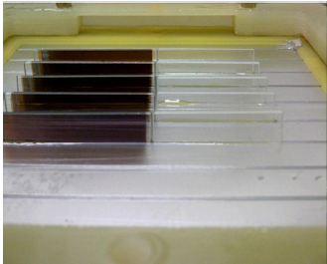
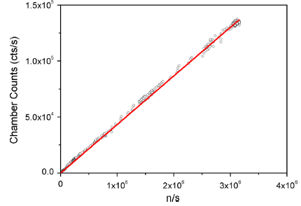
Boron for GEM neutron detector
A. Pietropaolo, et al., Nuclear Instr. and Methods A 729 (2013) 117
300 nm × 2 ¹⁰B coated glass sheet
Tested @ TRIGA reactor ENEA-Casaccia: measured detector efficiency 4.8 (7.6 % estimated)
Notes:
The final goal of this activity is the development of MgO-based buffer layer architecture obtained by combining physical and chemical deposition techniques. The architecture will be composed by MgO deposited by e-beam or sputtering at relatively low T and an oxide layer deposited by MOD for YBCO epitaxy

Slide 9
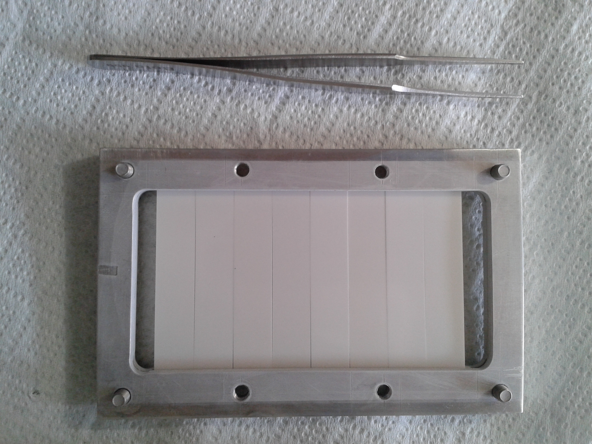
Towards 1 μm thick B films
Evaporation system: Thermionics 10 kW (10 kV, 1 A), 4 crucibles (25 cc)
d_{T-S} = 30 cm
Maximum growth rate: 0.75 nm/s
Thickness uniformity: > 90% on 90 × 50 mm² area
9 lamellae can be simultaneously deposited on both sides
Alumina lamella
10 × 50 × 0.5 mm
Notes:
The final goal of this activity is the development of MgO-based buffer layer architecture obtained by combining physical and chemical deposition techniques. The architecture will be composed by MgO deposited by e-beam or sputtering at relatively low T and an oxide layer deposited by MOD for YBCO epitaxy

Slide 10
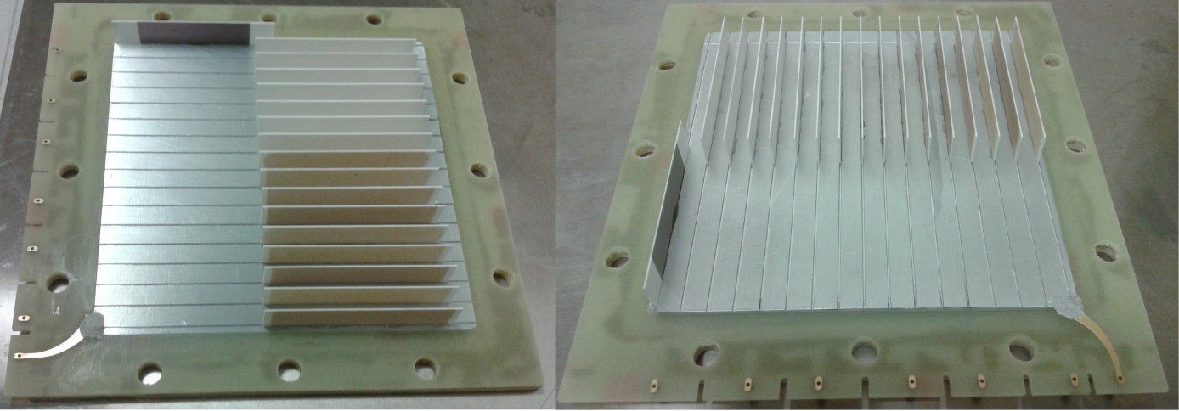
Improved GEM neutron detector
- 16 sheet 1 μm × 2 ¹⁰B coated alumina lamellae (10 x 50 mm)
- 1 sheet 300 nm on one side (deposited in the 3 kW system)
Test @ High Flux Isotope Reactor Oak Ridge NL (US)
Efficiency:
31 % on 16 sheets region;
2.8 % on single
G. Claps, et al., submitted
Notes:
The final goal of this activity is the development of MgO-based buffer layer architecture obtained by combining physical and chemical deposition techniques. The architecture will be composed by MgO deposited by e-beam or sputtering at relatively low T and an oxide layer deposited by MOD for YBCO epitaxy

Slide 11
Improved GEM neutron detector
- 16 sheet 1 μm × 2 ¹⁰B coated alumina lamellae (10 x 50 mm)
- 1 sheet 300 nm on one side (deposited in the 3 kW system)
1st run: B film is white on both sides
2nd run: films become darker
Test @ High Flux Isotope Reactor Oak Ridge NL (US)
Efficiency:
31 % on 16 sheets region;
2.8 % on single
3rd run: dark brown
G. Claps, et al., submitted
Lamellae deposited in 3 runs: 7 + 9 + 1 (single side)
Lamellae from different runs have different appearance: from white (run 1) to dark brown (run 3)
Notes:
The final goal of this activity is the development of MgO-based buffer layer architecture obtained by combining physical and chemical deposition techniques. The architecture will be composed by MgO deposited by e-beam or sputtering at relatively low T and an oxide layer deposited by MOD for YBCO epitaxy

Slide 12
¹⁰B film characterization
B₂O₃ is detected in white films while this component is not detectable in dark brown film
1 μm B/alumina - white
300 nm B/Alumina-dark brown
B₂O₃
Alumina
From XPS analysis (A. Santoni, next presentation):
white : 55 % Boron, 30 % Oxygen
dark brown: 80 % Boron
Notes:
The final goal of this activity is the development of MgO-based buffer layer architecture obtained by combining physical and chemical deposition techniques. The architecture will be composed by MgO deposited by e-beam or sputtering at relatively low T and an oxide layer deposited by MOD for YBCO epitaxy

Slide 13
¹⁰B film characterization
B₂O₃ is detected in white films while this component is not detectable in dark brown film
1 μm B/alumina - white
300 nm B/Alumina-dark brown
B₂O₃
Alumina
From XPS analysis (A. Santoni, next presentation):
white : 55 % Boron, 30 % Oxygen
dark brown: 80 % Boron
different sets of ¹⁰B target were used for the depositions
Notes:
The final goal of this activity is the development of MgO-based buffer layer architecture obtained by combining physical and chemical deposition techniques. The architecture will be composed by MgO deposited by e-beam or sputtering at relatively low T and an oxide layer deposited by MOD for YBCO epitaxy

Slide 14
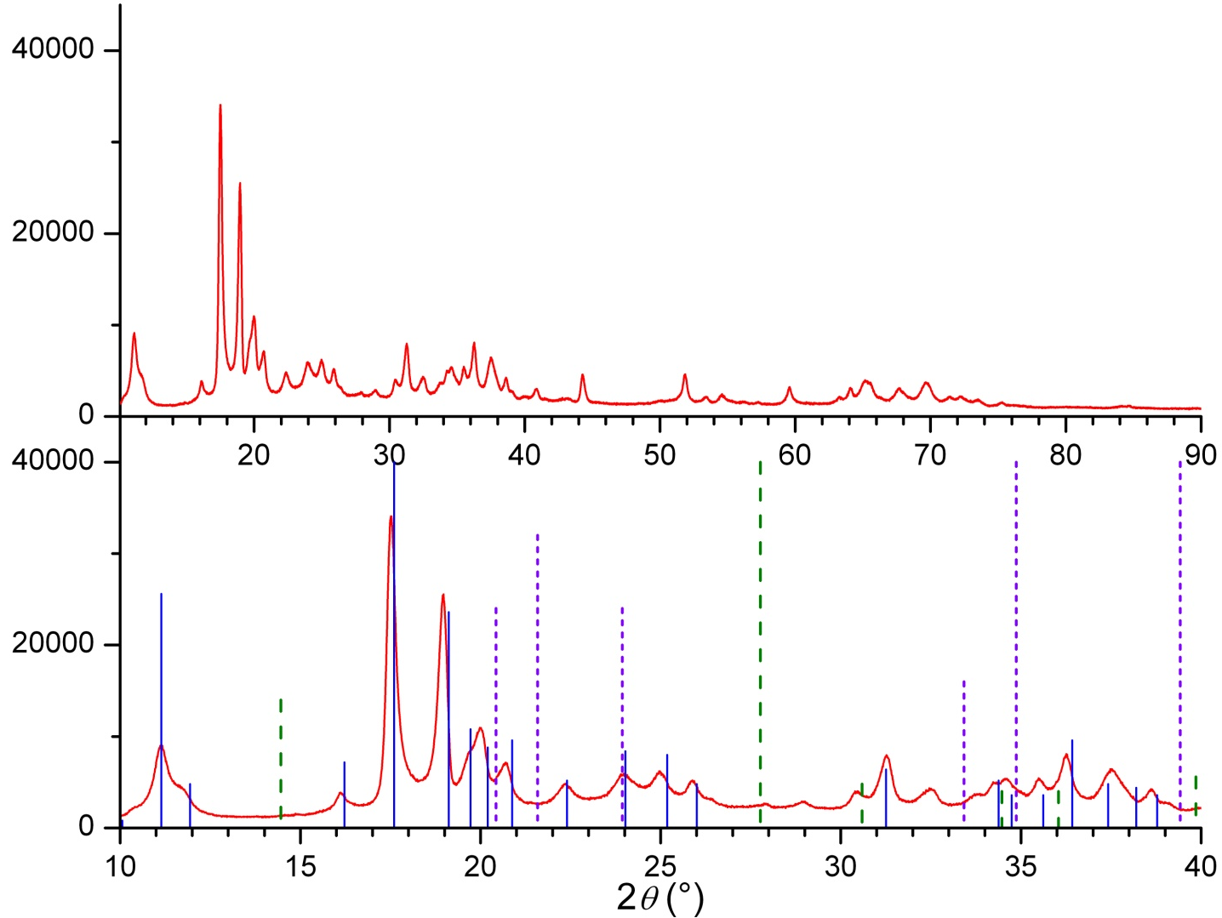
Target analysis
Material: ¹⁰B enriched Boron powder, EaglePitcher Technologies
Target Size: diameter 1/2“ and 1”
Procedure: powder pressed under 250 - 1000 MPa and sinterized at 1200 °C
From XRD analysis:
Powder is β-Boron
no oxide detected
Notes:
The final goal of this activity is the development of MgO-based buffer layer architecture obtained by combining physical and chemical deposition techniques. The architecture will be composed by MgO deposited by e-beam or sputtering at relatively low T and an oxide layer deposited by MOD for YBCO epitaxy

Slide 15
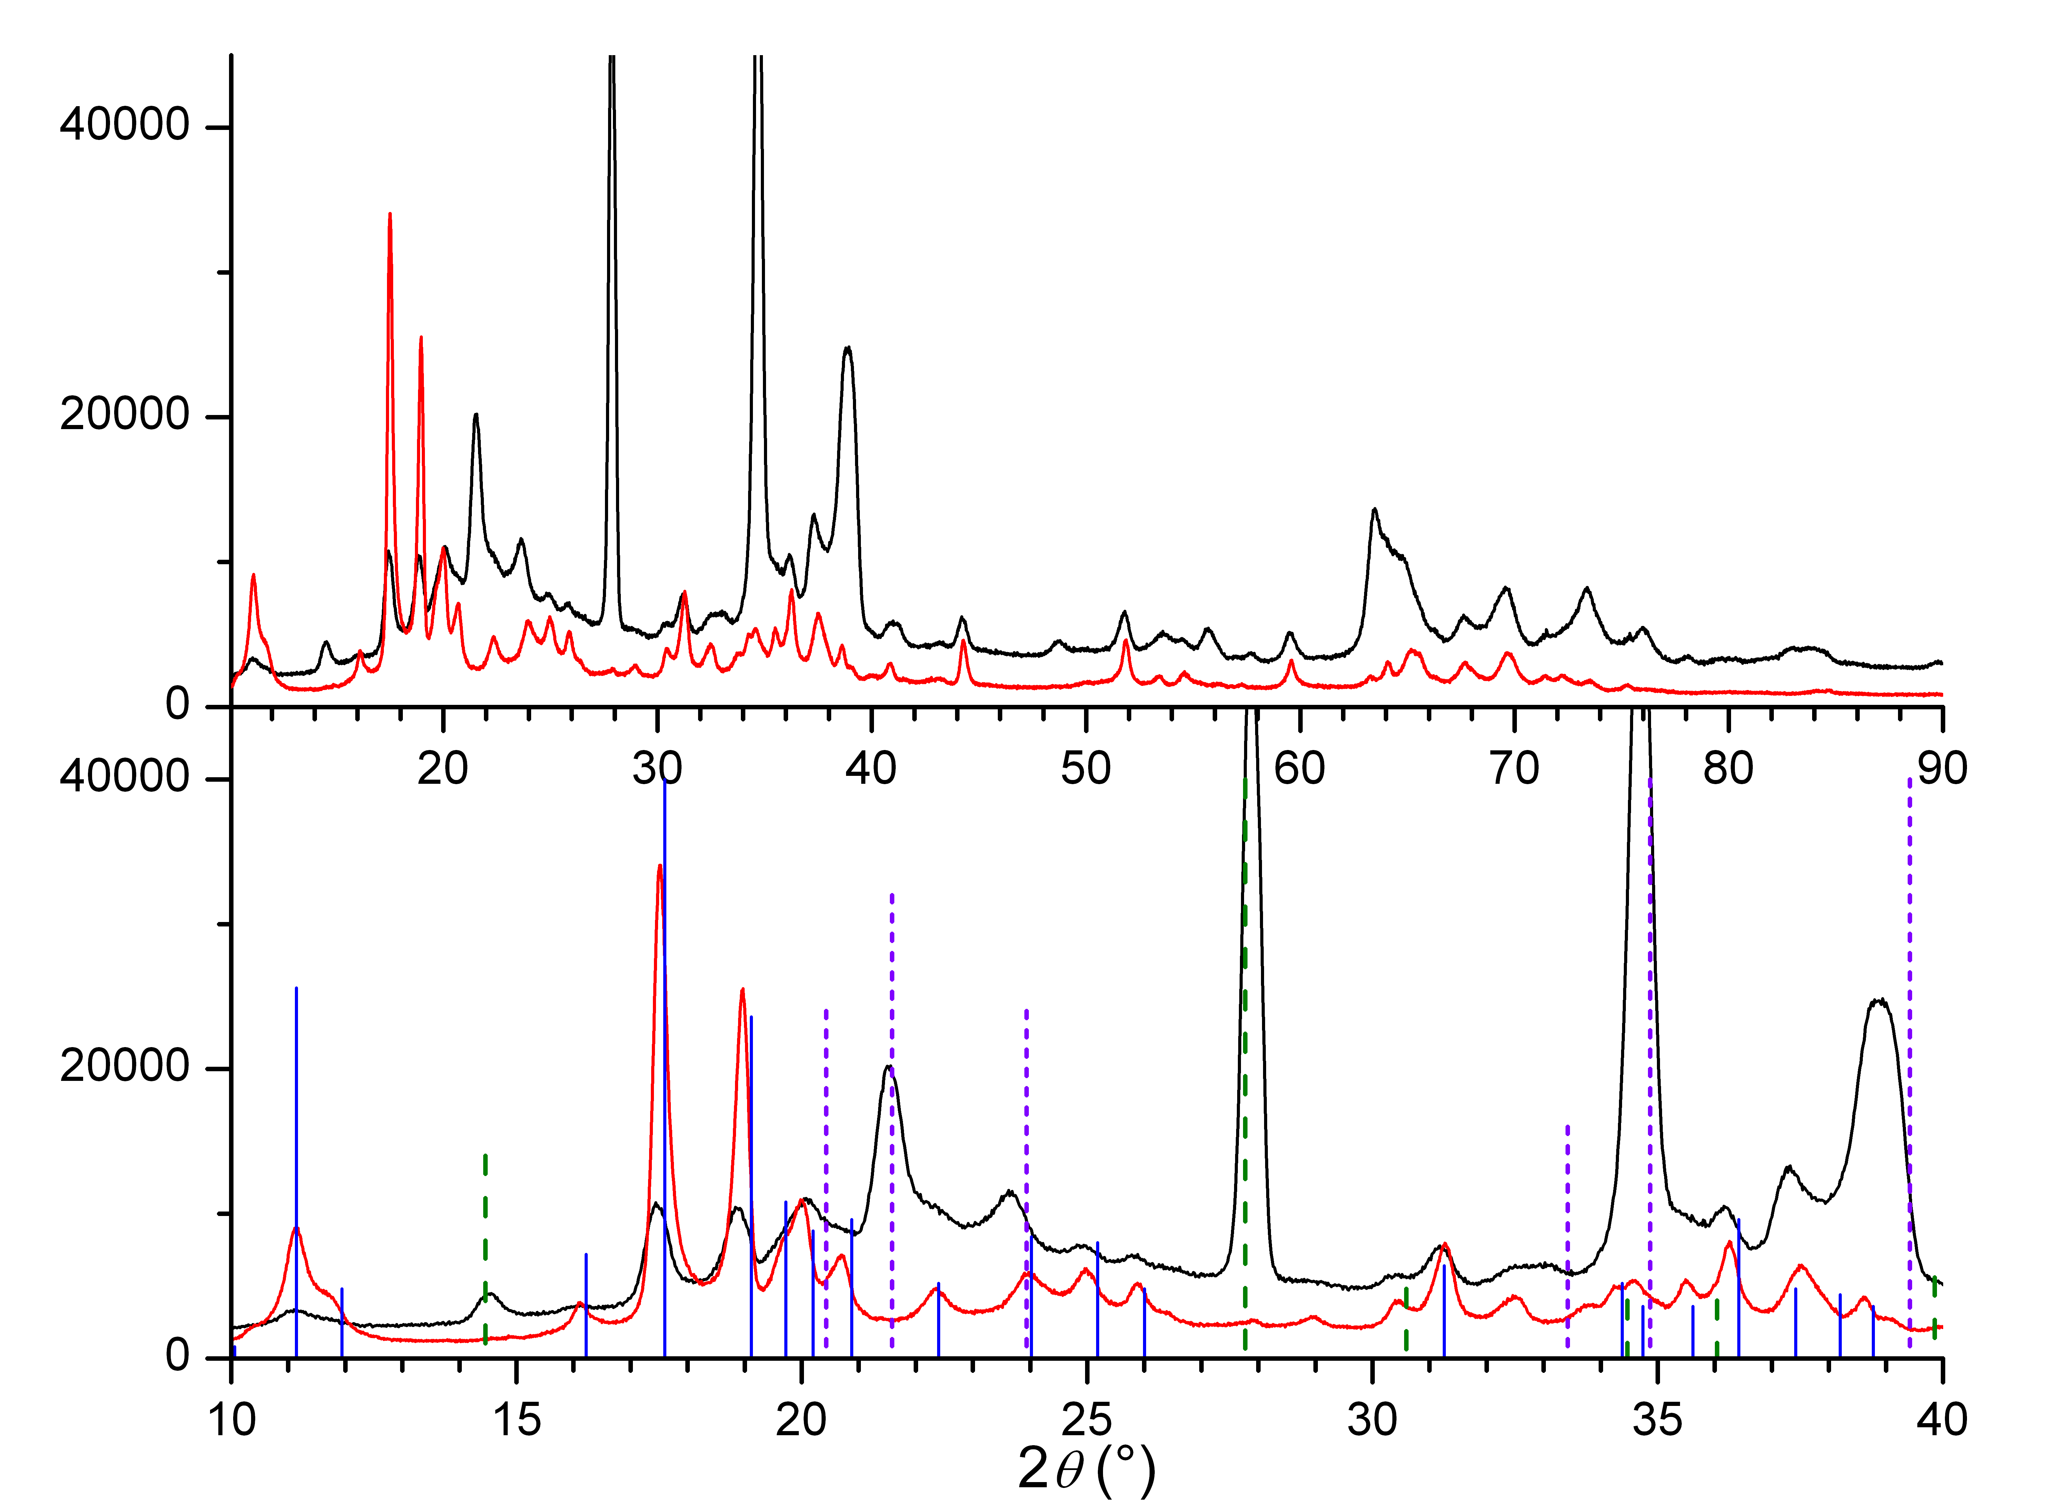
Target analysis
Material: ¹⁰B enriched Boron powder, EaglePitcher Technologies
Target Size: diameter 1/2“ and 1”
Procedure: powder pressed under 250 - 1000 MPa and sinterized at 1200 °C
From XRD analysis:
set of targets used for 1 μm B/Alumina shows B₂O₃
From XRD analysis:
Powder is β-Boron
no oxide detected
Notes:
The final goal of this activity is the development of MgO-based buffer layer architecture obtained by combining physical and chemical deposition techniques. The architecture will be composed by MgO deposited by e-beam or sputtering at relatively low T and an oxide layer deposited by MOD for YBCO epitaxy

Slide 16
Conclusions & Perspectives
B film suitable for GEM neutron detector have been deposited on technical substrates (glass, Alumina) by e-beam technique;
due to target contamination Boron content in the film was remarkably lower than expected;
as soon as target preparation will be optimized, neutron detection efficiency higher than 30 % (current detector) can be reasonably achieved (70 %?)

Slide 17
Conclusions & Perspectives
B film suitable for GEM neutron detector have been deposited on technical substrates (glass, Alumina) by e-beam technique;
due to target contamination Boron content in the film was remarkably lower than expected;
as soon as target preparation will be optimized, neutron detection efficiency higher than 30 % (current detector) can be reasonably achieved (70 %?)
Thank you for your attention
Special thanks to A. Pietropaolo and F. Murtas:
the whole activity is inspired by them

