Slide 1
The italian neutron sources suite and a close look to the BTF at LNF
Paolo Valente – INFN Roma & LNF
Helium Replacement in Italy - HeRe in Italy
ENEA Frascati, December 2nd–3rd, 2013

Slide 2
Outlook
The Italian neutron facilities:
  [Research] reactors and radio-sources
  Accelerator driven
A closer look to BTF at LNF
Future perspectives: IRIDE_{n}

Slide 3
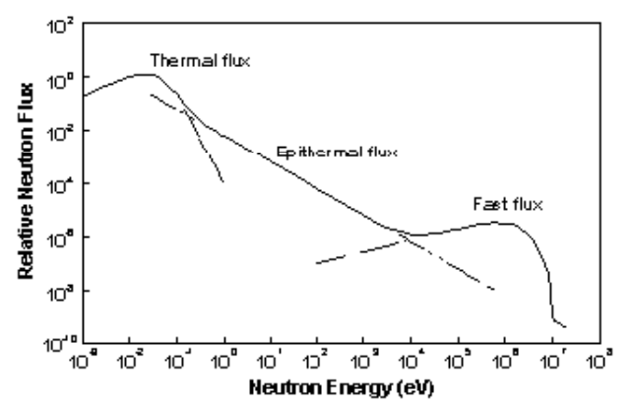
Reactors

Slide 4
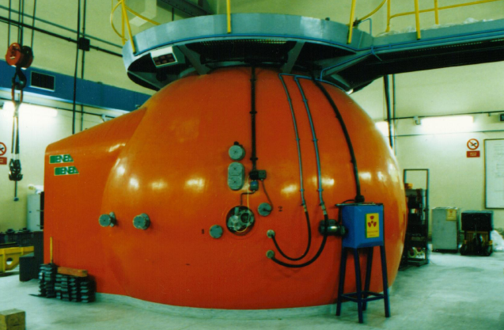
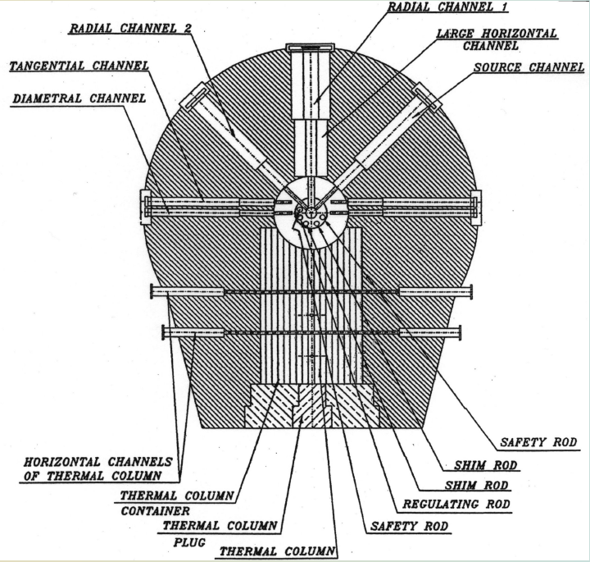
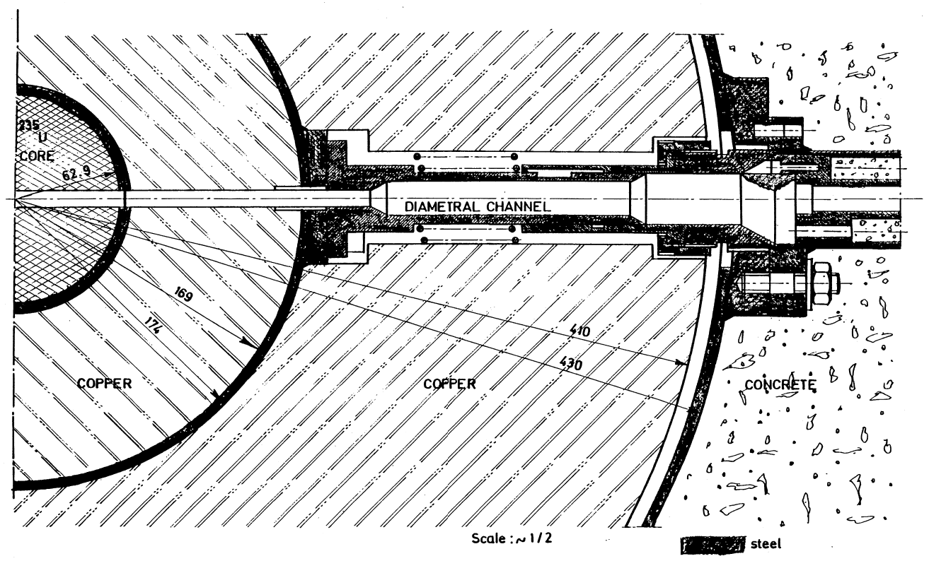
ENEA TAPIRO research reactor
Fast source reactor
Based on the concept of AFSR (Argonne Fast Source Reactor – Idaho Falls)
Designed by ENEA staff
Start-up in 1971
Fuel:
  98.5% U – 1.5% Mo
  18.5 g/cm3 density
  93.5% U²³⁵ enrichment
  22107.42 g/U²³⁵ operative mass
Cladding: 0.5 mm stainless steel
Reflector:
  Material: Copper
  Cylindrical Inner Reflector: 348 mm diameter
  Outer reflector: 800 mm diameter
  Overall height: 700 mm
  Weight: 2600 kg

Slide 5
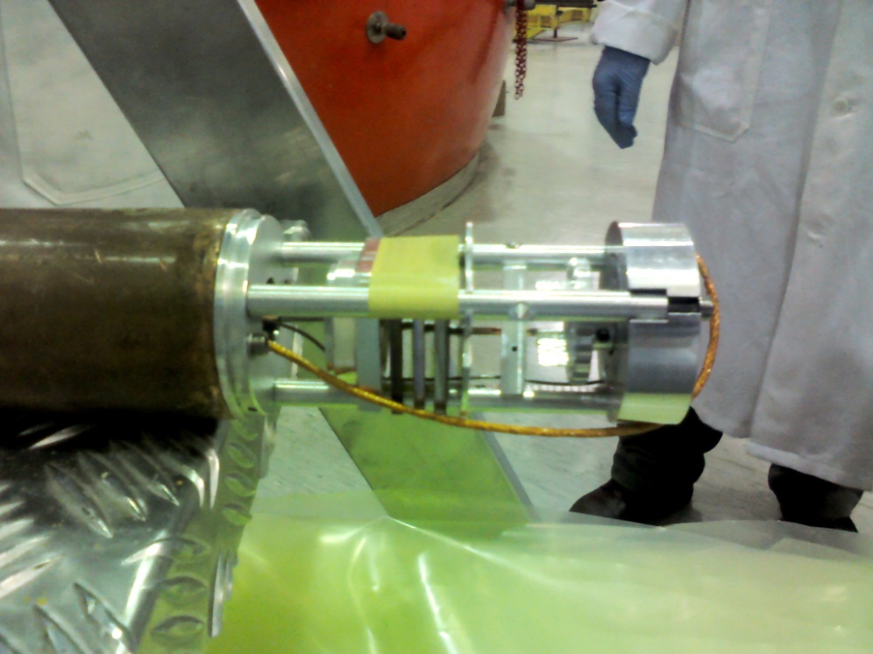
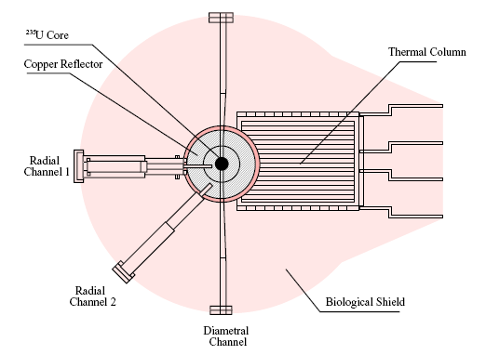
TAPIRO irradiation
Φ ≈ 2∙10¹⁰ n/cm²∙s @ 5 kW
Samples ready for irradiation
in the central radial channel
Φ ≈ 5∙10¹¹ n/cm²∙s @ 5 kW
Φ ≈ 3∙10¹² n/cm²∙s @ 5 kW

Slide 6
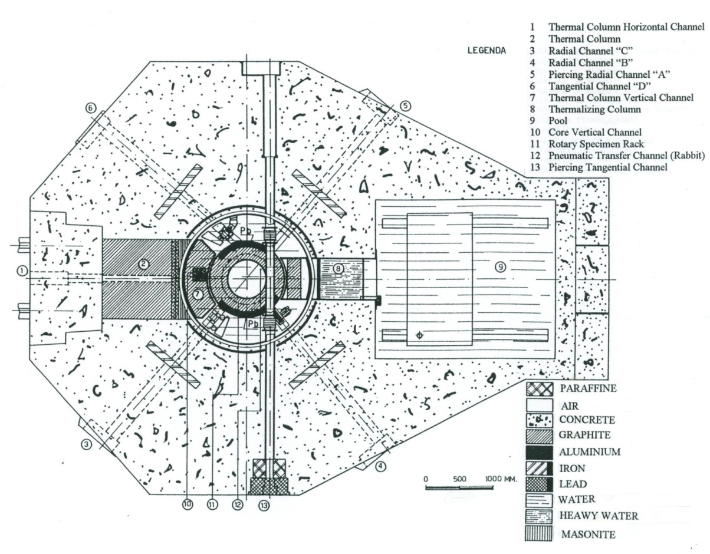
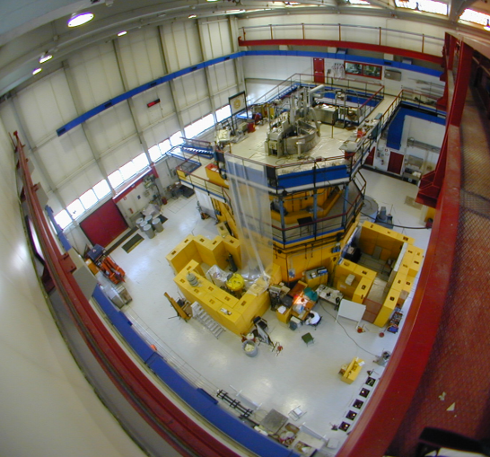
TRIGA RC-1 Mark II, power 1 MW, thermal reactor
Info: Marco Ciotti
marco.ciotti@enea.it
Position | Flux (n/cm²/s)
Rotary Specimen Rack (40 positions) | 2.00·10¹²
Pneumatic Transfer System | 1.25·10¹³
Central Thimble | 2.68·10¹³
Thermal column collimator | ~1.00·10⁶
Tangential channel collimator | ~1.00·10⁸
Reflector: graphite
Control rods: 3 B₄C fuel follower + 1 B₄C regulation rod

Slide 7
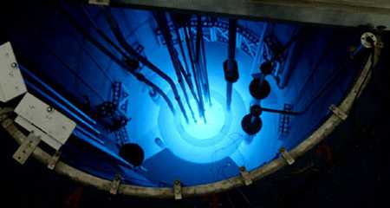
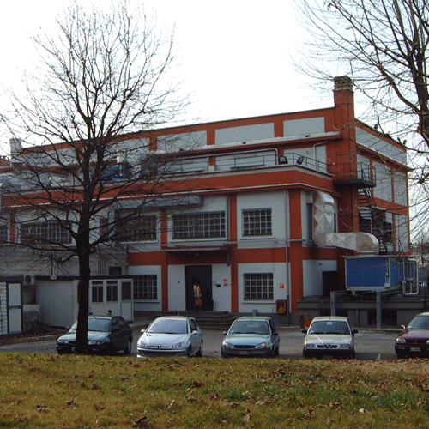
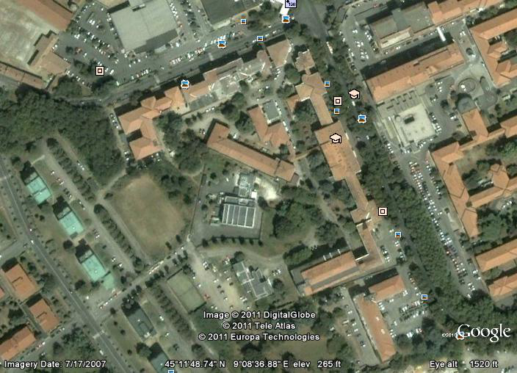

Laboratory of Applied Nuclear Energy (LENA)
University of Pavia, Italy

Slide 8
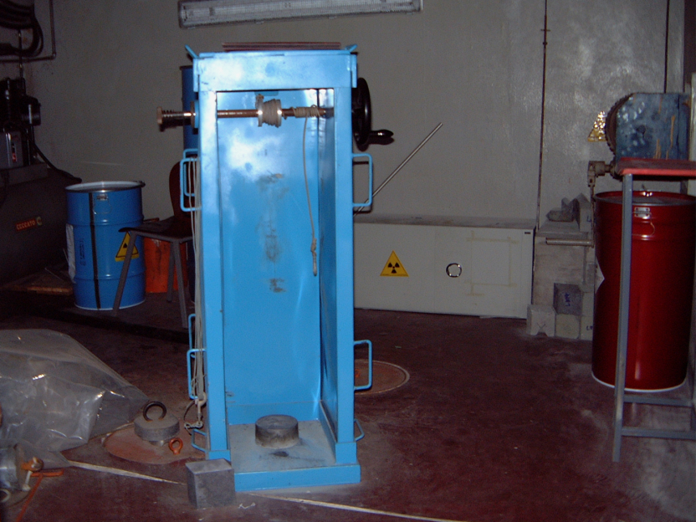
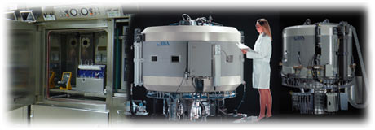
LENA Research Center
Interdepartmental Research Centre of the University of Pavia
(http://www.unipv-lena.it/ )
250 kW TRIGA Mk II Research Reactor
X ray industrial generator
  250kV, 12mA dose 15,6 Gy/min
  350kV, 6mA dose 17,5 Gy/min
Gamma source of Co-60 (0.86KGy/h)
Radiochemistry Laboratory
Cyclotron IBA 18/9
  18 MeV protons (I_{max} = 80 µA)
  9 MeV deuterons (I_{max} = 40 µA)

Slide 9
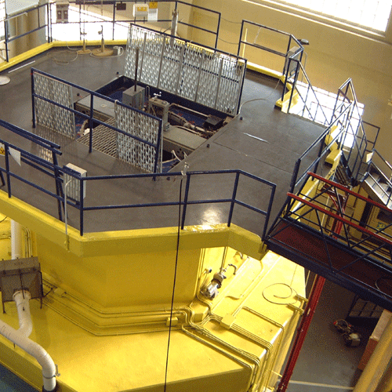
TRIGA Mark II Nuclear Research Reactor
TRIGA (Training, Research, Isotopes production, General Atomics)
250-kW light-water Thermal Reactor with an annular graphite reflector cooled by natural convection
offers many positions of irradiation (facilities) with "in-core" neutrons flux from 10¹² to 10¹³ n cm⁻² s⁻¹
6 “out-core” irradiation facilities with typical neutron flux from 10⁶ to 10¹⁰ n cm⁻² s⁻¹
Fuel: 20% enriched Uranium
Moderator/Cooling: light water
Reflector: grafite
3 control rod
Irradiation: 400 hours/year

Slide 10
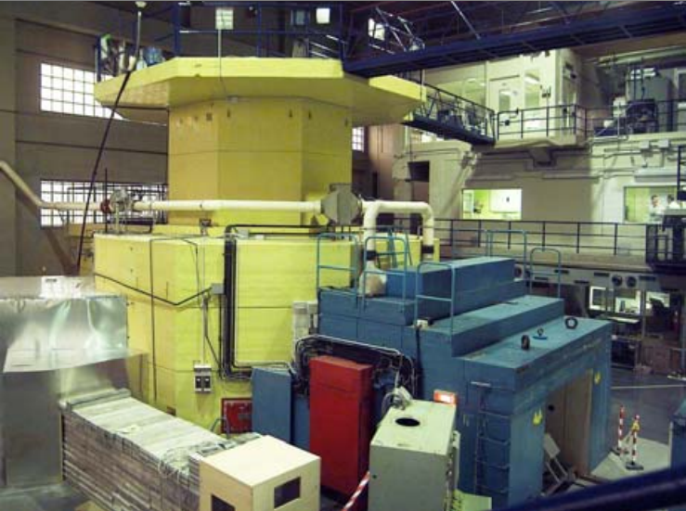
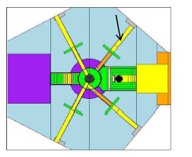
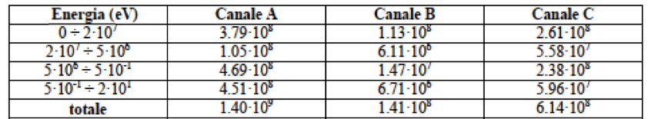
Thermal Column
10⁹ – 10¹⁰ n/s
A
B
C

Slide 11
Radioactive sources

Slide 12
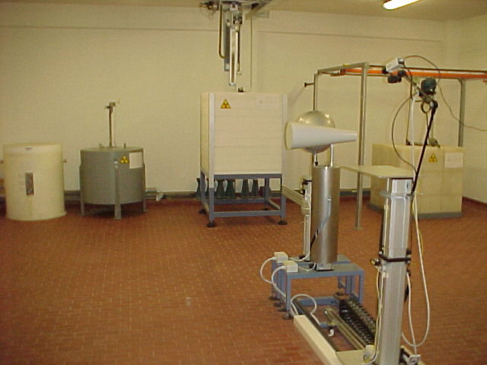
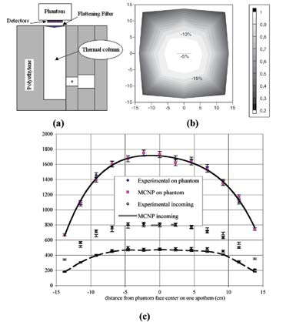
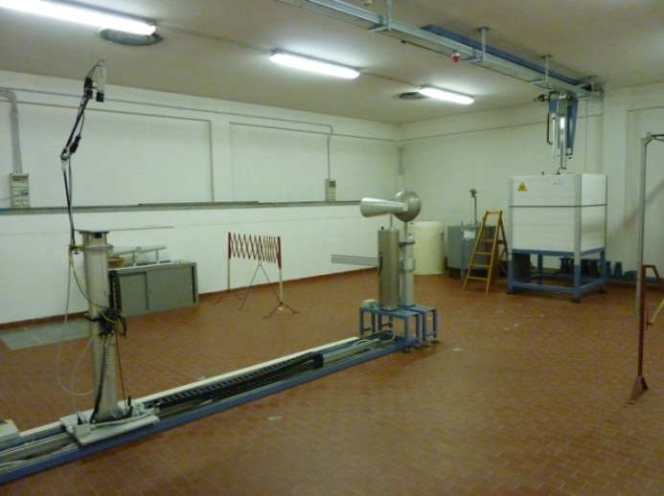
IRP: Radiation Protection Institute
IRP-DOS: Neutron irradiation hall
Shadow cone for the scattered contribution to be determined during instrumentation calibration.
“thermal neutron” facility.
A polyethylene moderating cube, 1 m side, with 3 inserted AmBe sources. Characterized and optimized through Monte Carlo calculations, it provides, at the measuring point (the upper face of the cube), a total neutron flux of about 3.10⁴ cm⁻² s⁻¹ : 60% neutrons of energy < 0.4 eV; 13% in the range 0.4 eV 100 keV; 27% for energies > 100 keV.
“fast neutron” facility
The bank can host 5 sources. Now it contains a ²⁵²Cf source providing a total neutron flux of about 10⁵ cm⁻² s⁻¹ corresponding to a maximum H*(10) dose equivalent rate of 360 μSv/h.

Slide 13
Accelerator driven

Slide 14
The 14 MeV Frascati Neutron Generator - ENEA
The Frascati Neutron Generator (FNG) started operations in Nov. 1992 making available 14 MeV neutrons at a medium intensity (10¹¹n/s) to EU Fusion Community.
It was designed and built by ENEA Frascati for conducting neutronics experiments and to validate nuclear data in the field of thermonuclear controlled fusion.
FNG is a linear accelerator which accelerates a deuterium beam (300 kV and up to 1 mA) onto a tritiated target to produce 14 MeV neutrons via the D+T fusion reaction
The maximum neutron yield is 1.0*10¹¹ n/s. Neutron yield is measured by the associated Alfa particle method with 3 % accuracy. The neutron emission is almost isotropic due to the low acceleration potential (300 KeV maximum) but is characterized by the typical beam-target energy-angle distribution.
During its life FNG has been extensively used for performing a large number of neutronics benchmark and mock-up experiments which covered almost all the most important neutronics aspects related to ITER & Fusion Neutronics.
The FNG facility is also used for qualification, calibration, and radiation damage resistance tests of nuclear detectors and components, and for studies on new neutron (and gamma) detectors.

Slide 15
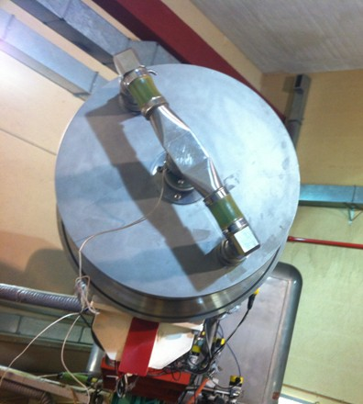
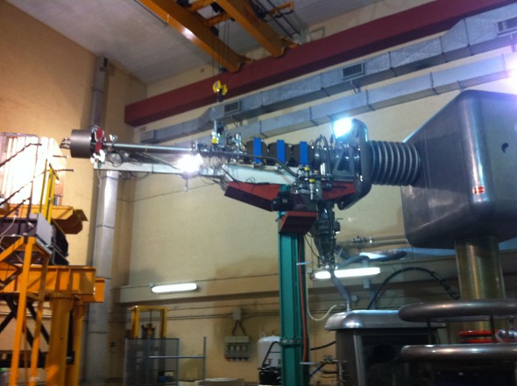
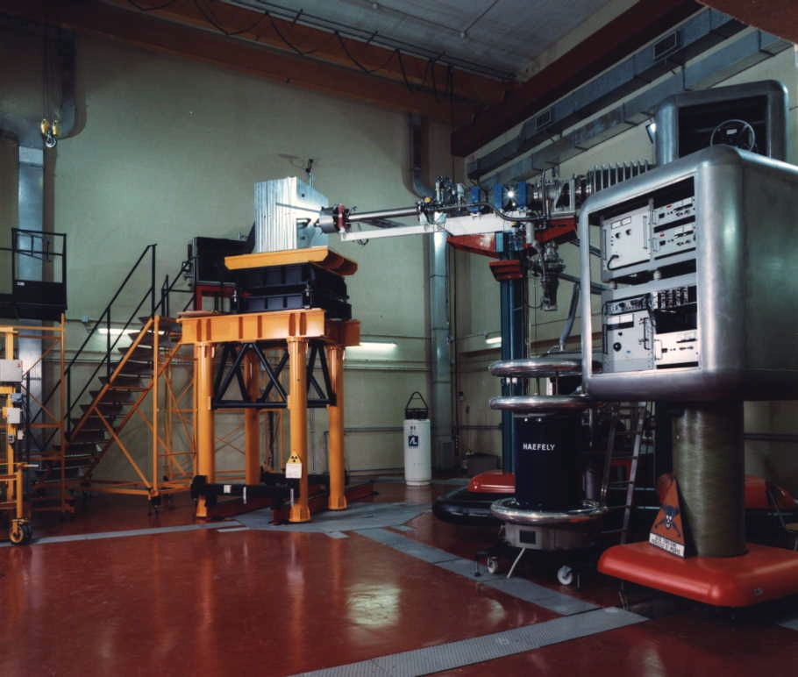

Slide 16
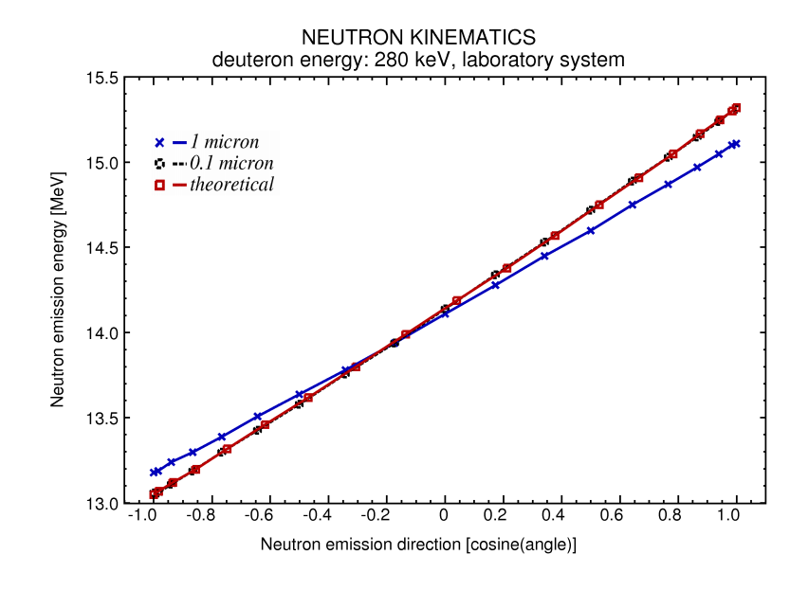
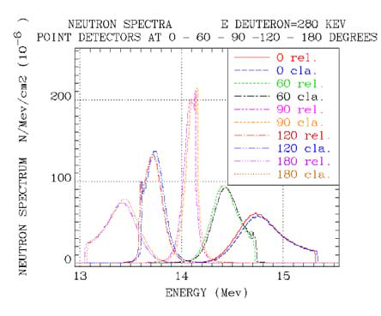
DT & DD Target Simulation
Neutron Energy vs emission angle (DT target)
DD neutron flux around FNG target
DT Spectrum
classic-relativistic
comparison
DT neutron flux around FNG target

Slide 17
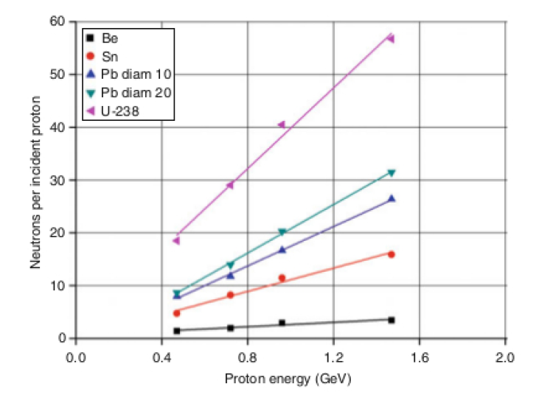
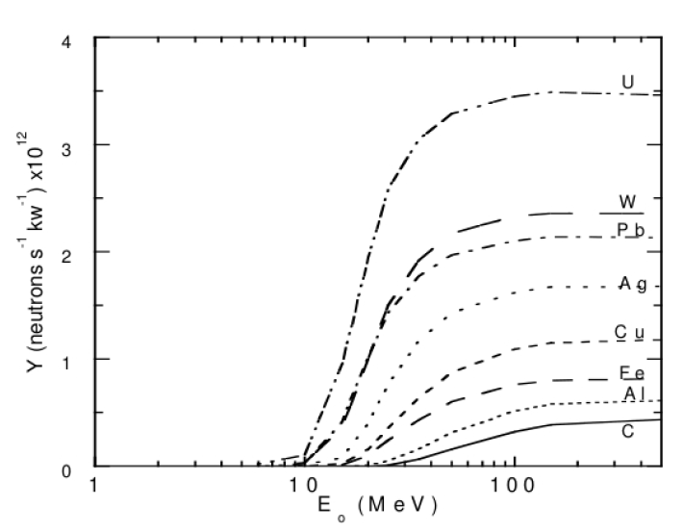
Spallation vs. photo-nuclear production
Spallation
Photo-nuclear

Slide 18
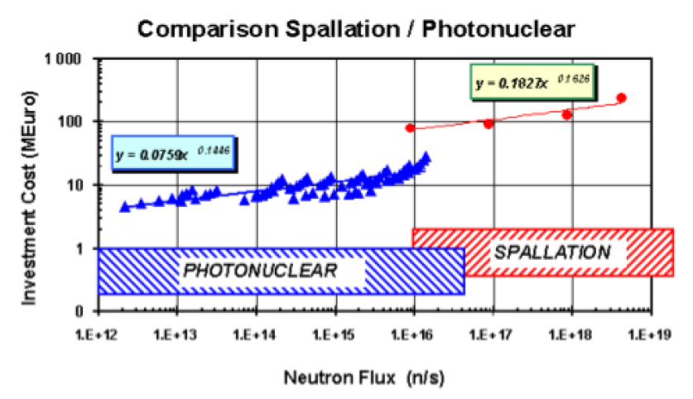
Neutron photo-nuclear production
Why photo-nuclear production from electron beam?
- Competitive costs up to 10¹⁶ n/s (at the target)

Slide 19
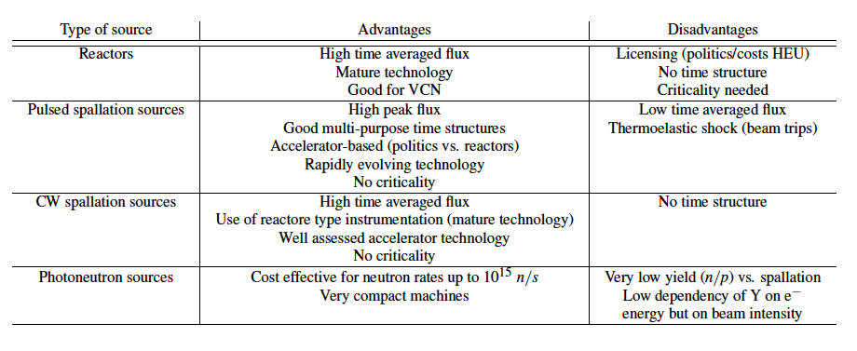
Accelerator driven pro and cons

Slide 20
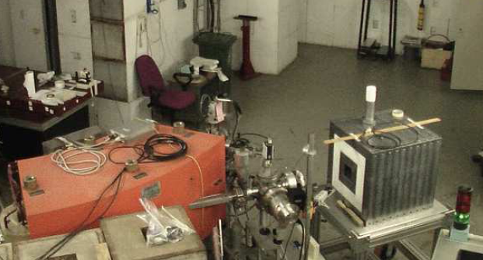
BTF at LNF
From 10⁷-10⁹ positrons or electrons/pulse at 510 MeV from the DAFNE linac…
      …To a finely tuned “single-particle” beam:
  50-500 MeV electrons or positrons (irrespective from linac primaries)
  Poisson statistics at low intensity
  Few % intensity fluctuations at intermediate intensity (thousands of particles)
  <1% momentum spread
  Few mm beam spot
  Up to 50 Hz [minus 1 bunch/s, used for energy measurement]

Slide 21
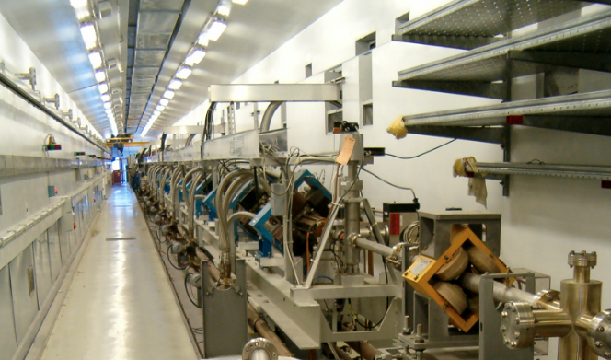
DAFNE Linac
 | Design | Operational
Electron beam final energy | 800 MeV | 510 MeV
Positron beam final energy | 550 MeV | 510 MeV
RF frequency | 2856 MHz
Positron conversion energy | 250 MeV | 220 MeV
Beam pulse rep. rate | 1 to 50 Hz | 1 to 50 Hz
Beam macropulse length | 10 nsec | 1 to 10 nsec
Gun current | 8 A | 8 A
Beam spot on positron converter | 1 mm | 1 mm
norm. Emittance (mm. mrad) | 1 (electron) 10 (positron) | < 1.5
rms Energy spread | 0.5% (electron) 1.0% (positron) | 0.5% (electron) 1.0% (positron)
electron current on positron converter | 5 A | 5.2 A
Max output electron current | >150 mA | 350 mA
Max output positron current | 36 mA | 100 mA max
Trasport efficiency from capture section to linac end | 90% | 90%
Accelerating structure | SLAC-type, CG, 2π/3
RF source | 4 x 45 MWp sledded klystrons TH2128C

Slide 22
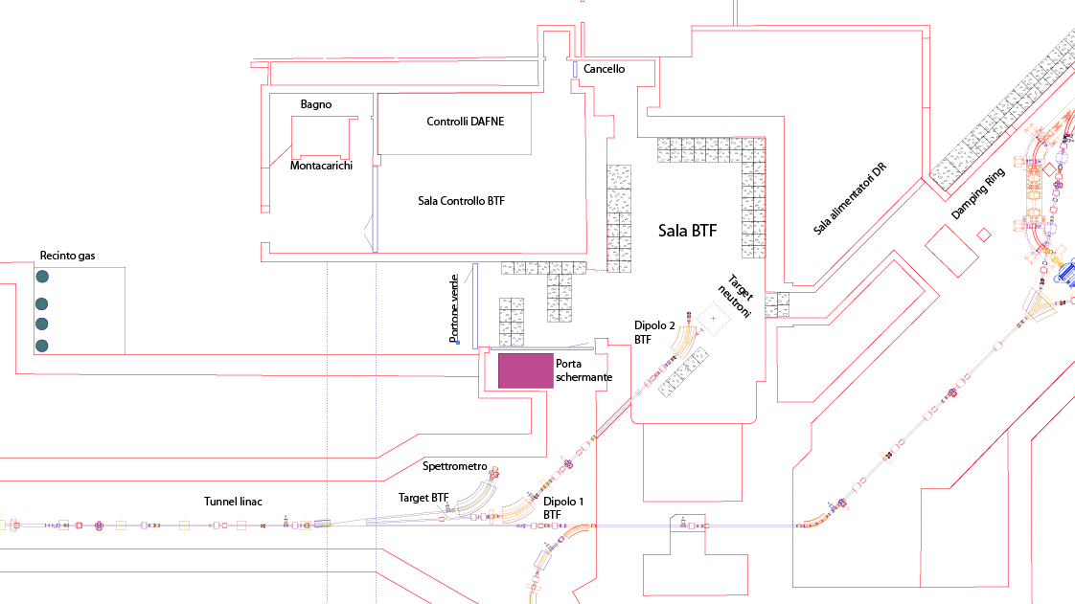
BTF complex

Slide 23
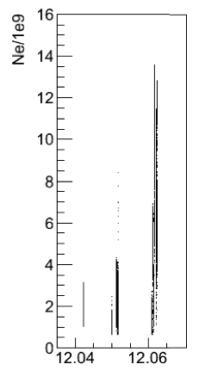
BTF electron beam
P = N f E
N = number of particles [Up to 10¹⁰ e⁻/bunch]
f = repetition rate [Up to 49 bunch/s]
E = beam energy [Nominal: 510 MeV]
Maximum rate = N f = 49 Hz × 10¹⁰ e⁻/s = 4.9×10¹¹ e⁻/s
P_{max} = 0.04 kW

Slide 24

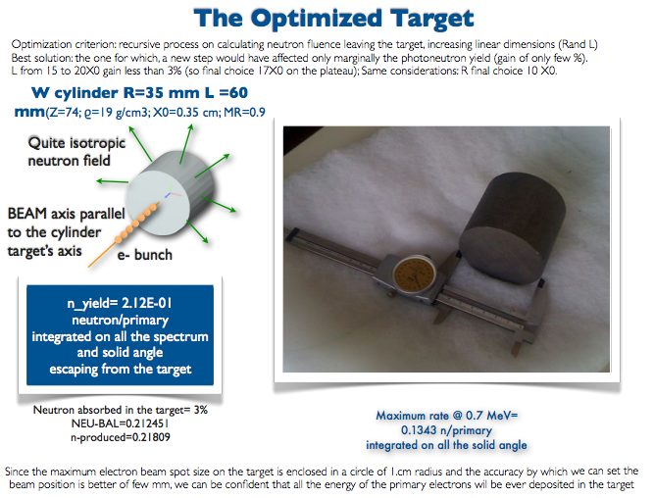

Slide 25
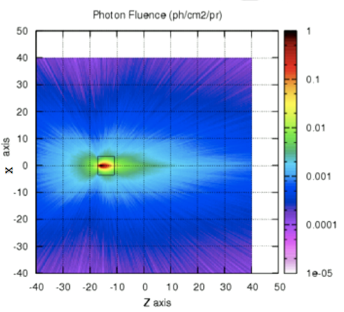
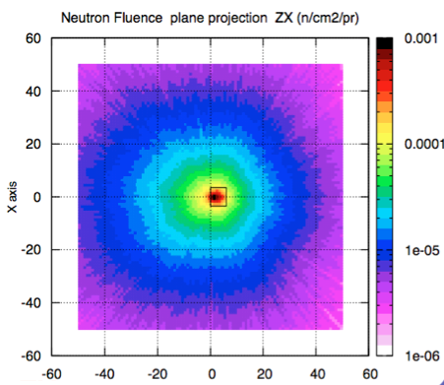

Photon and neutron fluence

Slide 26
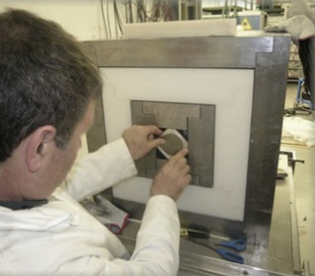
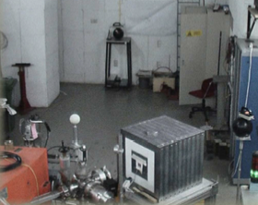
BTF target and shielding

Slide 27
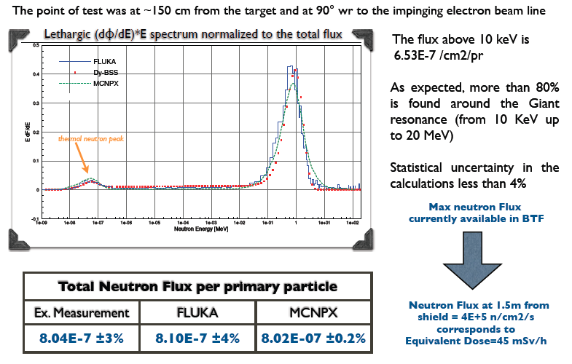
BTF neutron spectrum

Slide 28
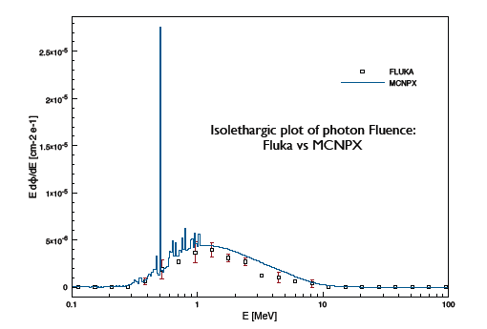
BTF photon background
1.5 m distance
10⁻⁵ photons/cm²/primary

Slide 29
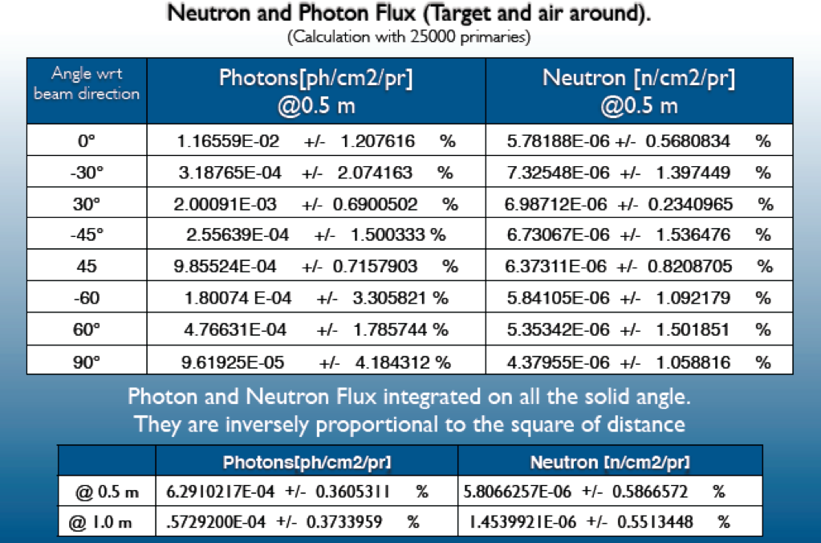

Slide 30
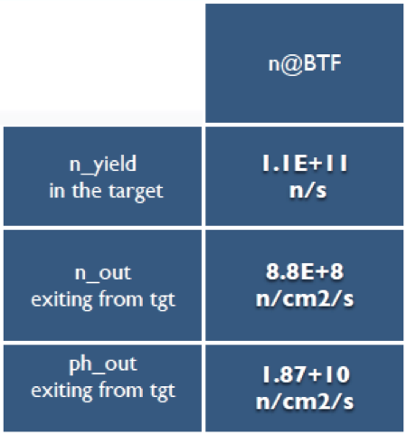
Neutron source summary
At 1.5 m distance:
Total neutron flux: 8×10⁻⁷ n/cm²/pr ±3%
Flux = 4.5×10⁵ n/cm²/s
Equivalente dose = 45 mSv/h
d (m) | ×10⁻⁷ n/cm²/pr
0.5 | 58
1 | 15
1.5 | 8
Total photon flux = 5×10⁻⁵ γ/cm²/pr
d (m) | ×10⁻⁵ n/cm²/pr
0.5 | 63
1 | 5.7
1.5 | 1

Slide 31
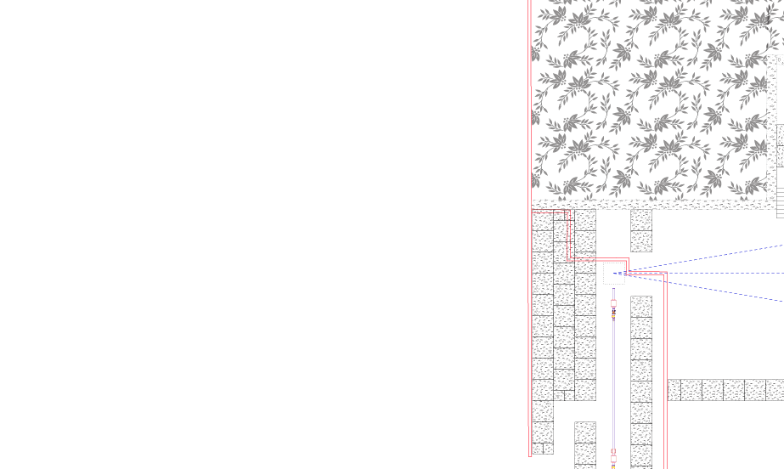
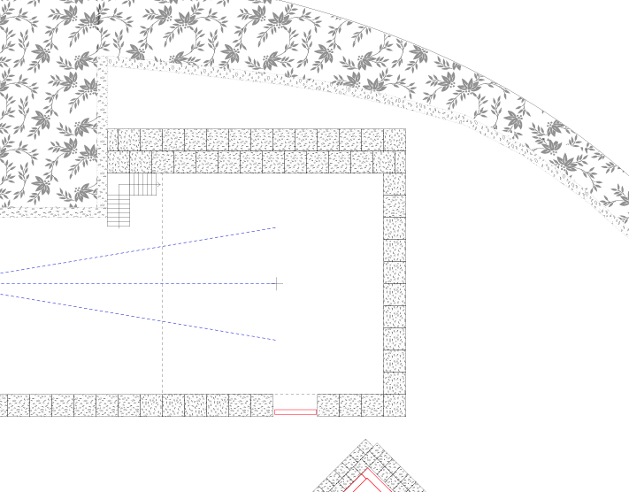
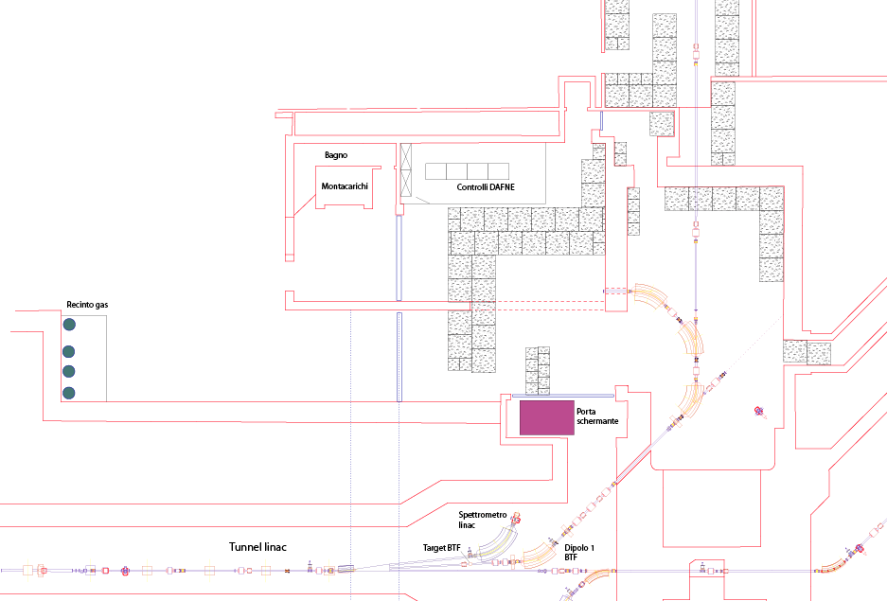
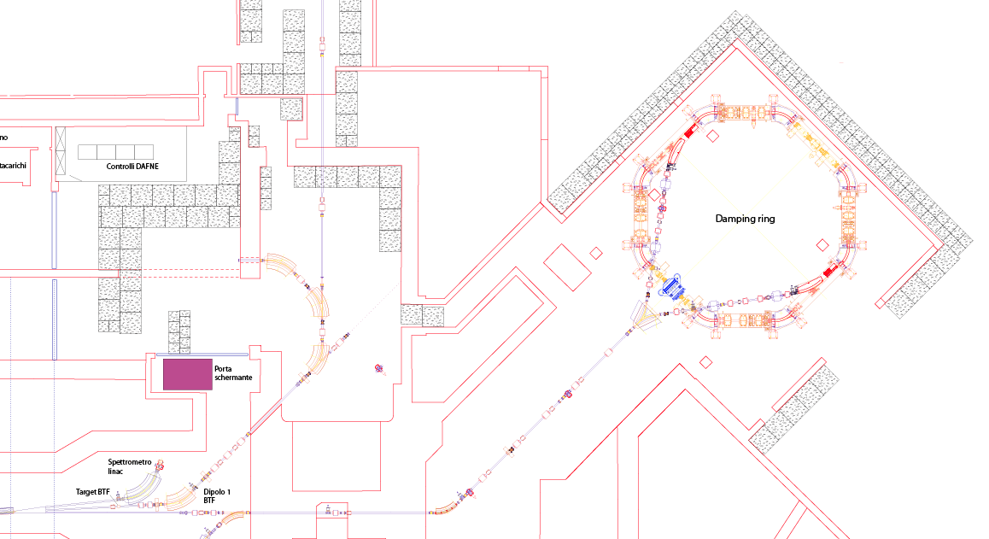
New BTF lines?
  Keep using 0° line for ‘standard’ testing
  Use 45° line to drive beam to a new “target area”
    This allows to have a target station dedicated to neutron production and
    A space for neutron experiments
  Add 90° to build a “low energy” line
    This allows to use the Linac groundwork and tunnel as additional shielding

Slide 32


Slide 33
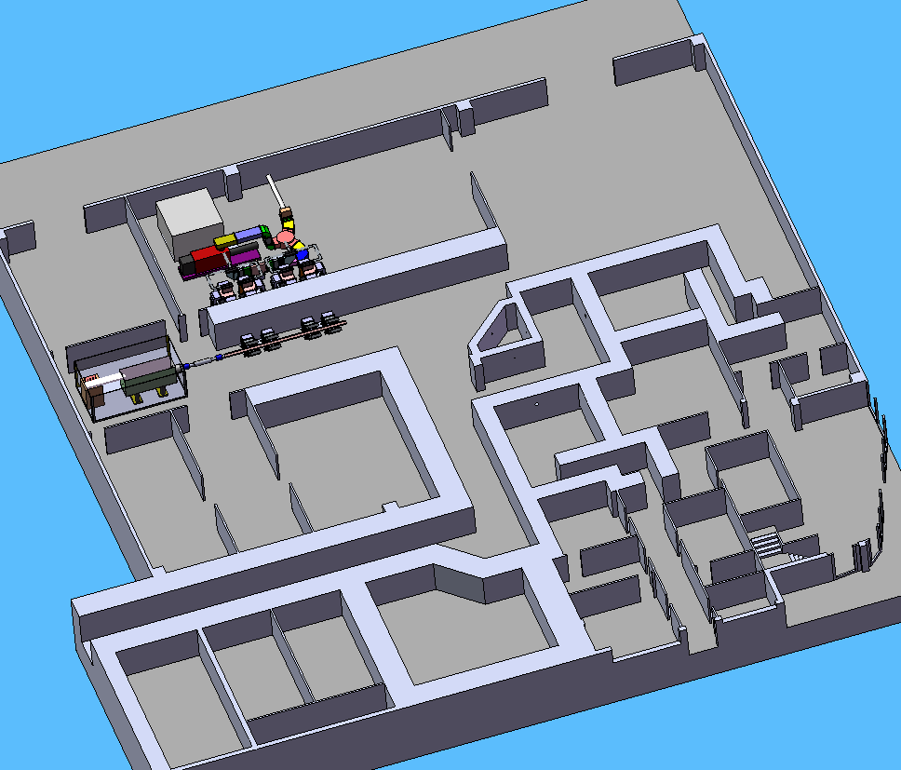
INFN - Laboratori Nazionali di Legnaro (LNL)
Current layout of neutron source facilities
RF wave guides
Neutron facility 2 (Optional) epithermal neutrons for BNCT
Klystron
TRIPS proton source
TRASCO-RFQ accelerator
Neutron facility 1
thermal neutrons for BNCT
Beam line to LENOS facility
Radiation damage facility
SPES (SELECTIVE PRODUCTION OF EXOTIC NUCLEAR SPECIES) PROJECT
FACILITY GENERAL LAYOUT

Slide 34
Future facilities

Slide 35
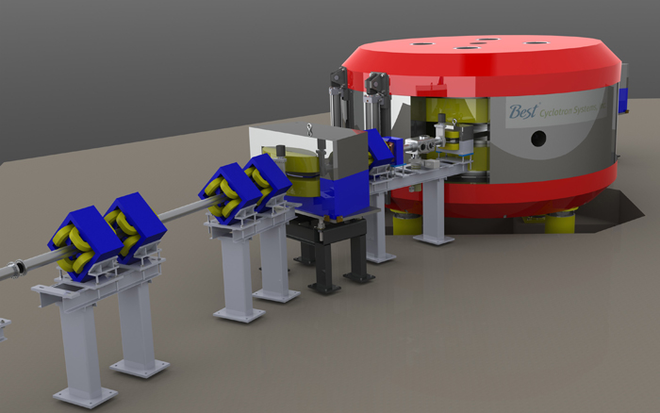

The SPES p Cyclotron at LNL
At the INFN National Labs of Legnaro (LNL), a variable energy (35-70 MeV) high current proton cyclotron (I_{max} = 750 µA) will soon come into operation (2015).
It will open up the prospect of high flux neutron facilities in Italy that could perform various research activities.

Slide 36
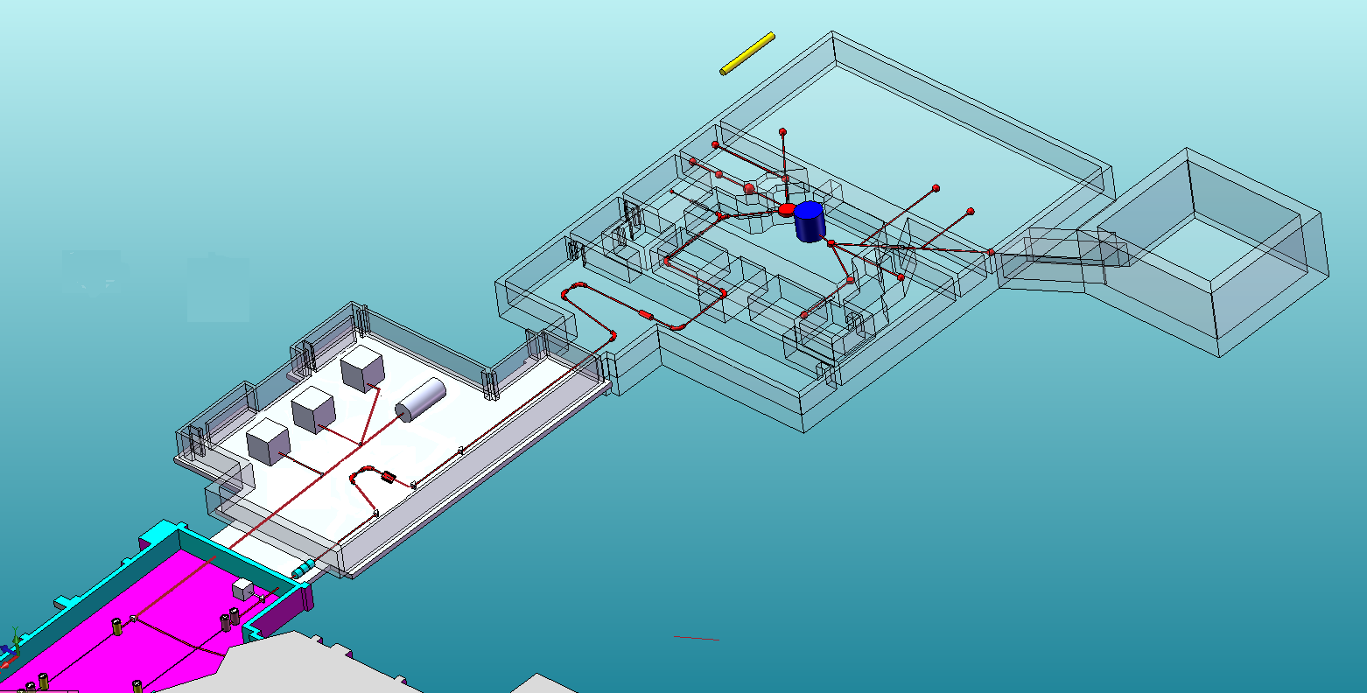

Proton and neutron irradiation areas ( δ-phase)
CYCLOTRON
10m
Radioisotopes for medical applications (γ-phase)
ISOL FACILITY
β-phase
Experimental hall
Expansion for ADS to study GEN4 reactor (δ-phase)
Two ISOL targets
High Resolution Mass Separator
DM/M= 1/40000 (physics design)
ECR-Charge Breeder & Medium Resolution Mass Separator DM/M=1/1000
Reaccelerated RIBs
To ALPI Linac
Radioactive Ion Beams are reaccelerated by the superconductive linac ALPI. A normal conductive RFQ placed before ALPI will match the input acceptance beam parameters.

Slide 37

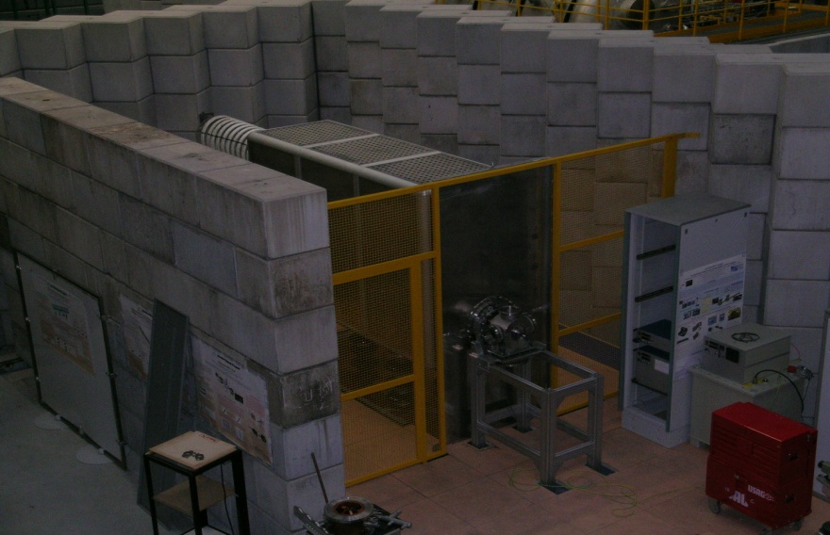






Slide 38

IRIDE
Proposal for a new large infrastructure for fundamental and applied physics research.
Conceived as an innovative and evolutionary tool also for multi-disciplinary investigations in a wide field of scientific, technological and industrial applications
A high intensity “particle beams factory”
Based on a combination of
  a high duty cycle radio-frequency superconducting electron linac (SC RF LINAC)
  high energy lasers.
It will be able to produce a high flux of electrons, photons (from infrared to gamma band), neutrons, protons and possibly positrons, that will be available for a wide national and international scientific community interested to take profit of the most worldwide advanced particle and radiation sources.

Slide 39

IRIDE_{n}: neutrons at IRIDE

Slide 40


1 GeV electrons

Slide 41

Be(p/d,n)
(γ,n)
spallation
IRIDE(expected)
Continuous mode
IRIDE (expected)
Short pulse mode
Short pulse
Long pulse
continuous

Slide 42
Conclusions
Italy has discontinued nuclear power generation since 25 years, still, there are a number of small neutron sources
  Research reactors exist and are routinely used
  Accelerator driven:
    Be/Li/Tritium bombardment with protons/deuterons
    Photo-nuclear production (electron beam)
A growing interest and new impulse to the development of new facilities or upgrade of existing ones
  Complementary to the main European (mainly spallation) sources
  Useful for neutron detectors R&D and industry

