Slide 1

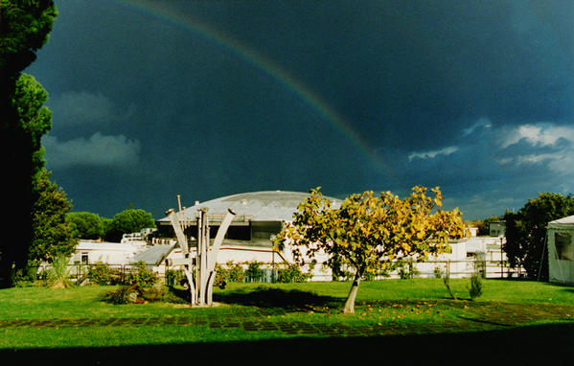



Calorimetry challenges in view of LHC upgrades
Francesca Cavallari
(INFN Roma)
LNF Mini-workshop series: Detectors for the LHC Upgrade, 28/11/2013

Slide 2
Content
HL-LHC landscape
Atlas and CMS Calorimeters
Upgrades of the calorimeter components
Electronics upgrade
LHCb calorimeters and upgrade
Both Alice and LHCb are planning major upgrades in middle of LHC phase1, and their physics program is not directly impacted by the luminosity upgrade of the HL-LHC.
Limited scope of upgrades and/or consolidation foreseen for phase2.
Apologies if I use too many examples from my experiment !

Slide 3

LHC and HL-LHC
Phase1
Phase2
LS1
LS2
LS3
HL-LHC:
L=5 ·10³⁴ cm⁻²s⁻¹
250 fb⁻¹ per year
by 2033 → 3000 fb⁻¹
~140 events per bunch-crossing
Event vertex spread in z over ~ 5 cm
L=1 ·10³⁴ cm⁻²s⁻¹
3 years
50fb⁻¹ per year
L=2 ·10³⁴ cm⁻²s⁻¹
3 years
≥50fb⁻¹ per year
by the end
of Phase1
300-500 fb⁻¹

Slide 4
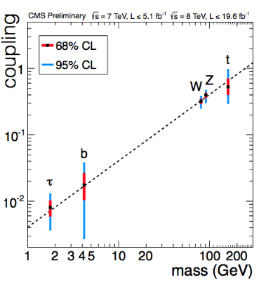
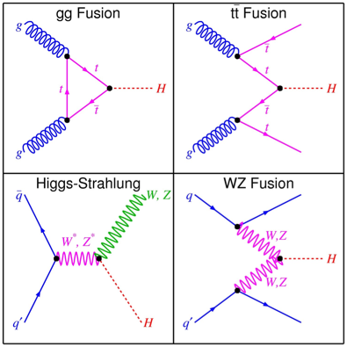
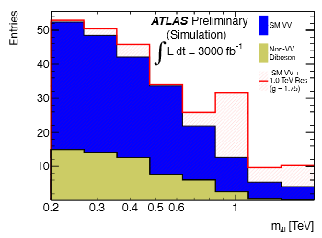
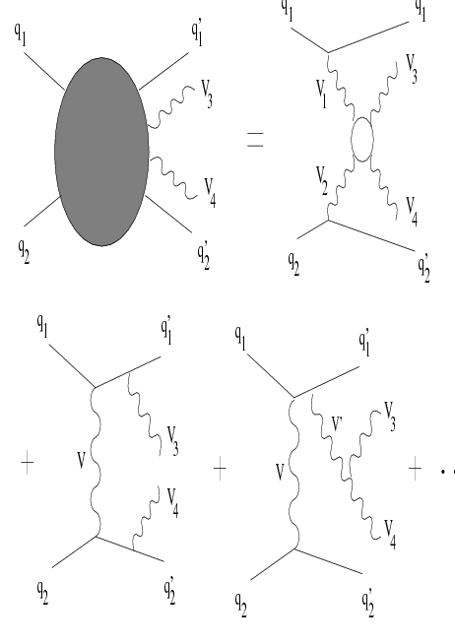
HL-LHC physics for the Atlas and CMS calorimeters
  HL-LHC physics goals
    Precision measurements of the Higgs BR (%) H→ ZZ (4l), H→ WW , H→ γγ, H→ττ
    Rare H decays: H→Zγ, H→cc (J/ψ γ) [http://arxiv.org/abs/1306.5770]
    Distinguish the various production modes of the H (VBF/non-VBF, ttH)
    Double H production: HH (promising: H→bb, H→γγ)
    New «rare» physics not seen in Phase1, or study new physics seen in Phase1 ☺
    Vector Boson Scattering (new physics may be seen in resonances in the VV mass spectrum)

Slide 5
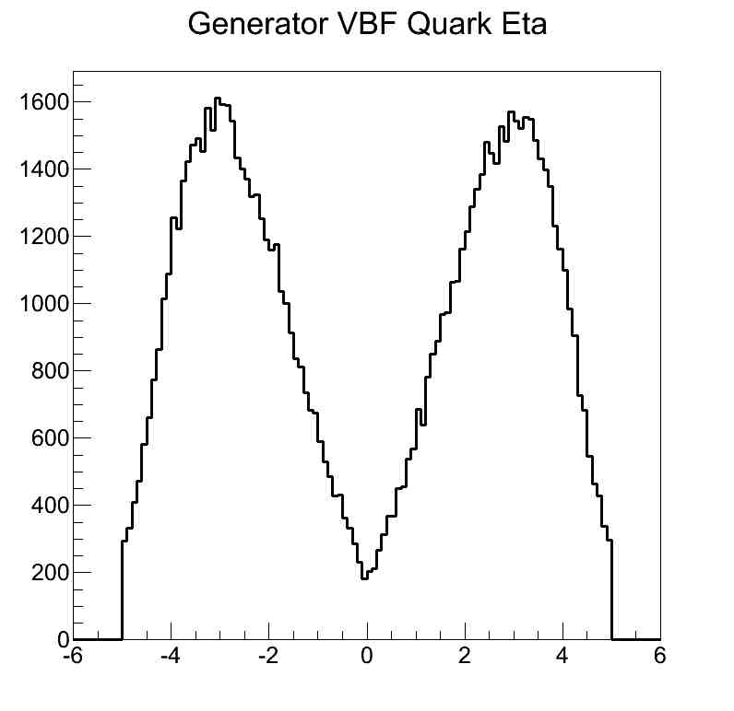
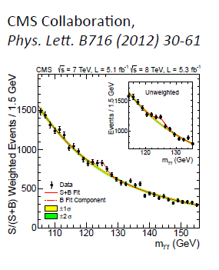
Physics for the calorimeters
Forward physics is fundamental at HL-LHC
  VBS is accompanied by forward jets
  VBF Higgs production is accompanied by 2 forward jets
  → Forward jet tagging with respect to fake jets (from pile-up)
Large acceptance for electrons, photons, jets
  Optimal resolution in a region for the H→γγ mass reconstruction
  Good resolution for electrons and photons in the rest
  Low Higgs mass → mantain sensitivity to low P_{T} objects and low trigger thresholds
Detector requirements
  Jet tagging in the forward region
  Reconstruction/identification of objects e/γ/jet in high pile-up
  Radiation hardness
η
2-photon mass resolution of ~1% needed

Slide 6
Technologies used in the LHC Calorimeters
Lead tungstate homogeneous calorimeter
  (CMS ECAL, ALICE Phos)
Liquid Argon sampling calorimeter
  (Atlas EM Barrel+Endcaps, HADR Endcaps+Forward)
Scintillator tiles / WLS fibers
  (Atlas HCAL Barrel, CMS HCAL, LHCb HCAL)
  Shashlik (LHCb ECAL, Alice EMCAL and DCAL)
Quartz fiber+steel sampling calorimeter
  (CMS HCAL Forward)

Slide 7
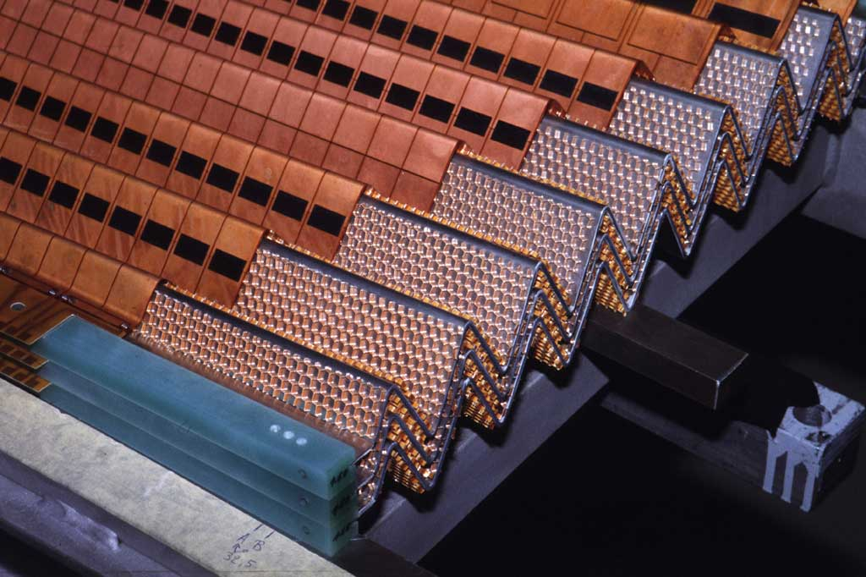
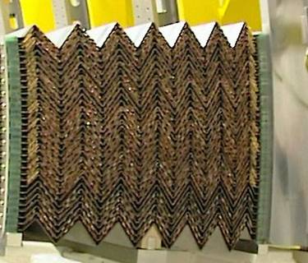
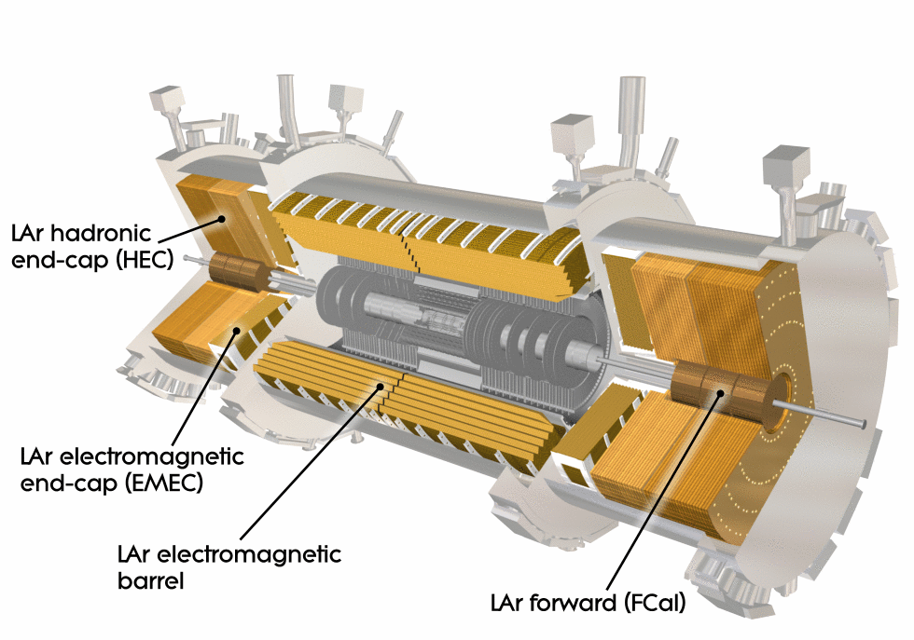
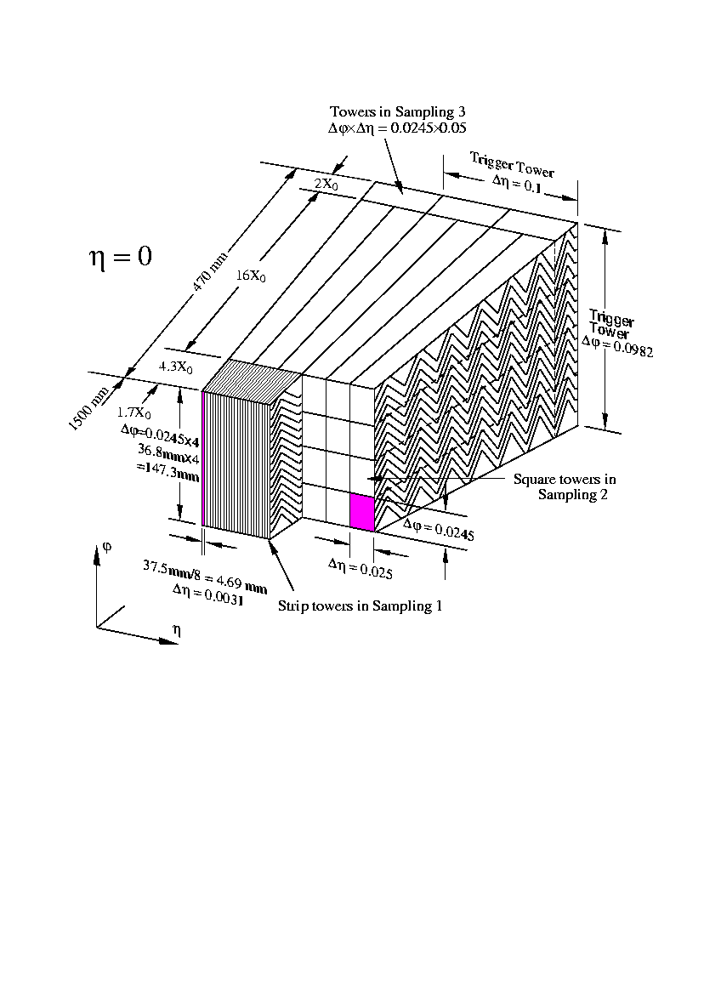
The ATLAS Lar calorimeters
inner diam. 2.8 m
outer diam. 4 m
T~87K
DESIGN ENERGY RESOLUTION
X₀ ~2 cm
Granularity central layer
ΔηxΔφ=0.025x0.025
47 cm
Notes:
Sampling lead-LAr calorimeter
The signal is given by the electrons collection (high signal)
Linear and uniform response
Stability with time
Radiation hard
LAr EM Calorimeter 170 k 98.5%
Tile calorimeter 9800 97.3%
Hadronic endcap LAr calorimeter 5600 99.9%
Forward LAr calorimeter 3500 100%

Slide 8
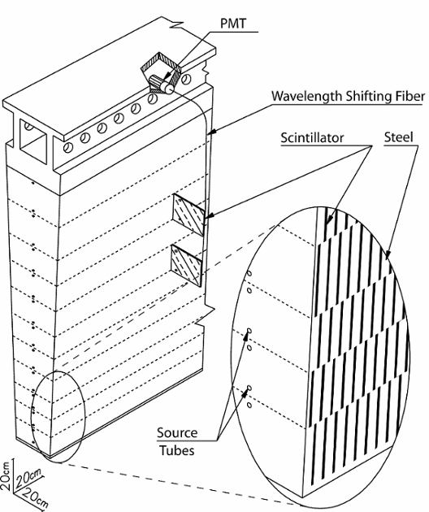
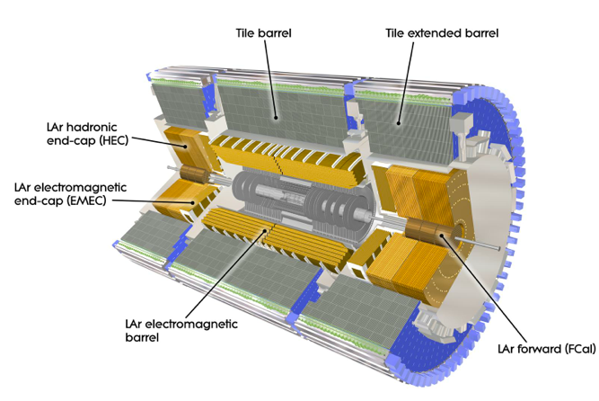
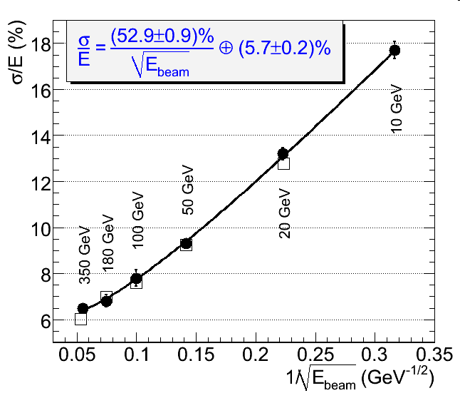
The ATLAS Hadronic calorimeters aaaa
inner diam. 4 m
outer diam. 8 m
T~87K
Barrel HCAL (TileCal):
Steel/Plastic scintillator. Tiles perpendicular to beam axis. Wavelength shifting fibers carry light to PMT. It covers |η|<1.7
Test-beam
Endcap HCAL (HEC)
Cu-LAr 4 wheels, 10 λ, |η|<3.2
Forward HCAL (Fcal)
Tubes and rods in Cu or W
It covers 3.1<|η|<4.9
Notes:
Sampling lead-LAr calorimeter
The signal is given by the electrons collection (high signal)
Linear and uniform response
Stability with time
Radiation hard
LAr EM Calorimeter 170 k 98.5%
Tile calorimeter 9800 97.3%
Hadronic endcap LAr calorimeter 5600 99.9%
Forward LAr calorimeter 3500 100%

Slide 9
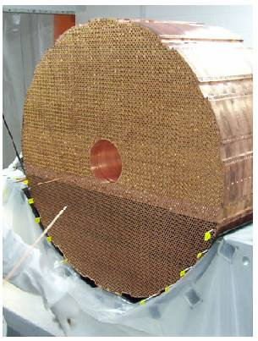
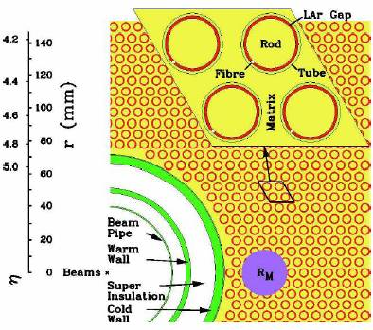
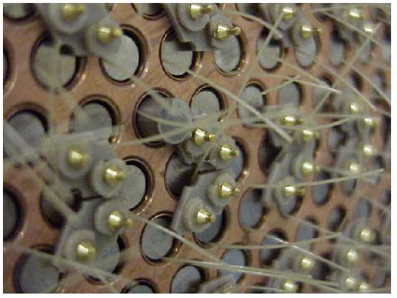
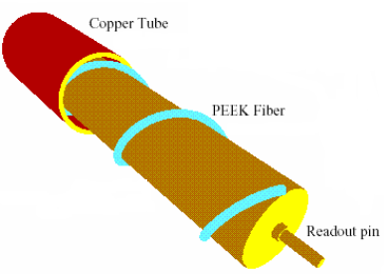
The Atlas Forward Calorimeter
3 modules in each end-cap:
  FCal 1: electromagnetic, LAr-Cu, 28X0
  FCal2/3: hadronic, LAr-W, 2x3.7λ
3.2<|η|<4.9
Resistant to high radiation
narrow LAr gaps
No limitations for LHC Phase1
FCal1
Copper rod in FCal1
Or
Tungsten rod in FCal2/3

Slide 10
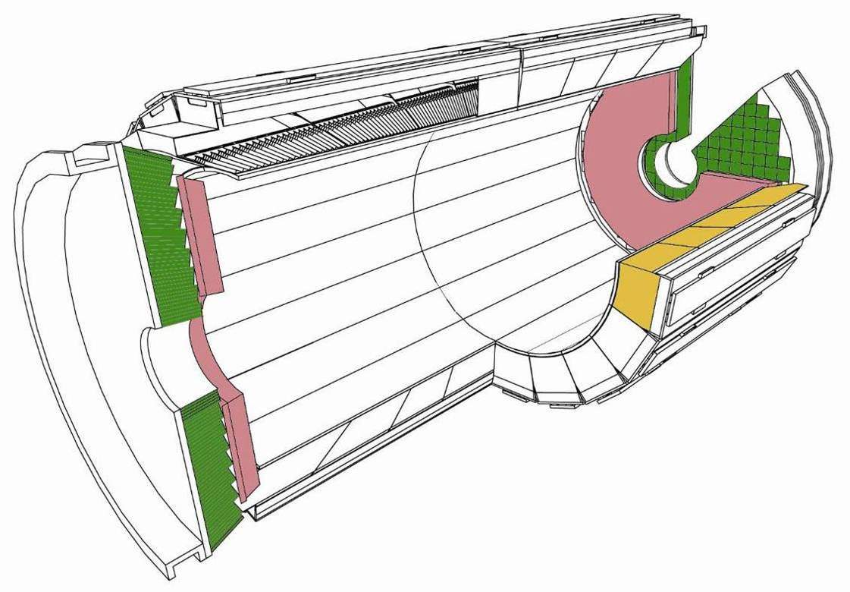
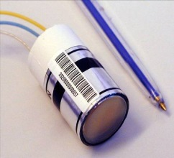
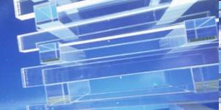
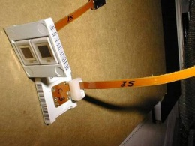
CMS ECAL
inner diam. 2.6 m
outer diam. 3.6 m
VPT
Endcaps: 1.48 < |η| < 3.0
crystals (3x3x22cm³)
Pb/Si preshower
1.65 < | η | < 3.0
PbWO₄
75468 crystals
X₀ 0.89 cm
LY~100 photons/MeV
APD
Barrel: |η| < 1.48
crystals (2x2x23cm³)
DESIGN ENERGY RESOLUTION (BARREL)
Granularity Barrel
ΔηxΔφ=0.0174x0.0174
Notes:
EB 98.7%
EE 99.3%
ES 99.84%

Slide 11
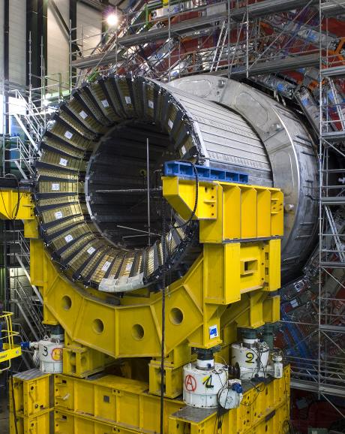
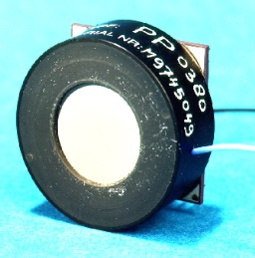
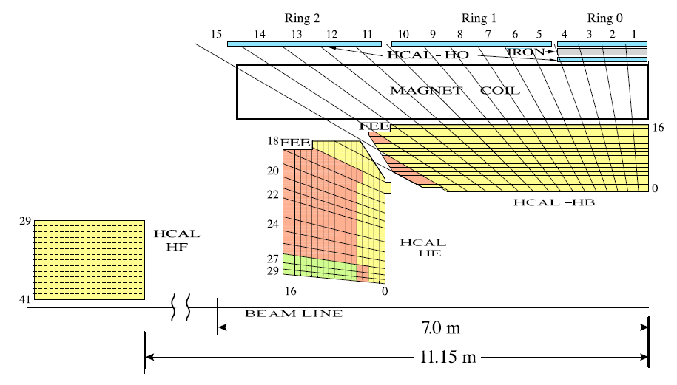
The CMS HCAL
HCAL Barrel
HPD
inner diam. 3.6 m
outer diam. 6 m
HO |η|<1.4
HE 1.3<|η|<3
HB |η|<1.2
HF 3<|η|<5.2
Hadronic Barrel and Endcap calorimeters are sampling brass/scintillator tiles calorimeters.
An additional scintillator layer is located outside the solenoid cryostat: HO
A forward calorimeter made of steel and quartz fiber covers up to |η|<5.2

Slide 12
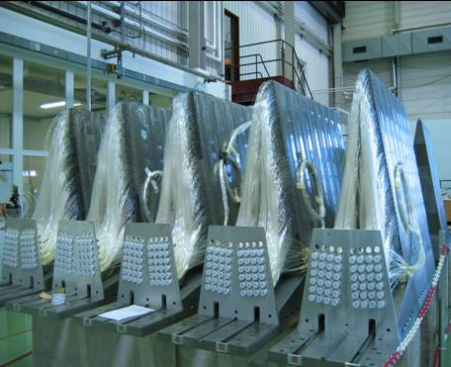
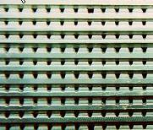
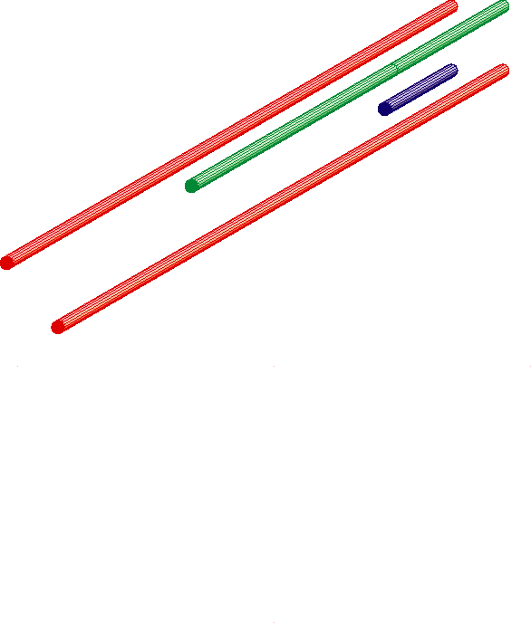
The CMS Forward Calorimeter
5mm
HAD (143 cm)
EM (165 cm)
  Iron/Quartz fiber (Cerenkov light)
  Covers 3<|η|<5
  Total of 1728 towers, 2 x 432 towers for EM and HAD
  segmentation (0.175 x 0.175)
  High dose expected (>1 Grad accumulated in 10 years)
10

Slide 13
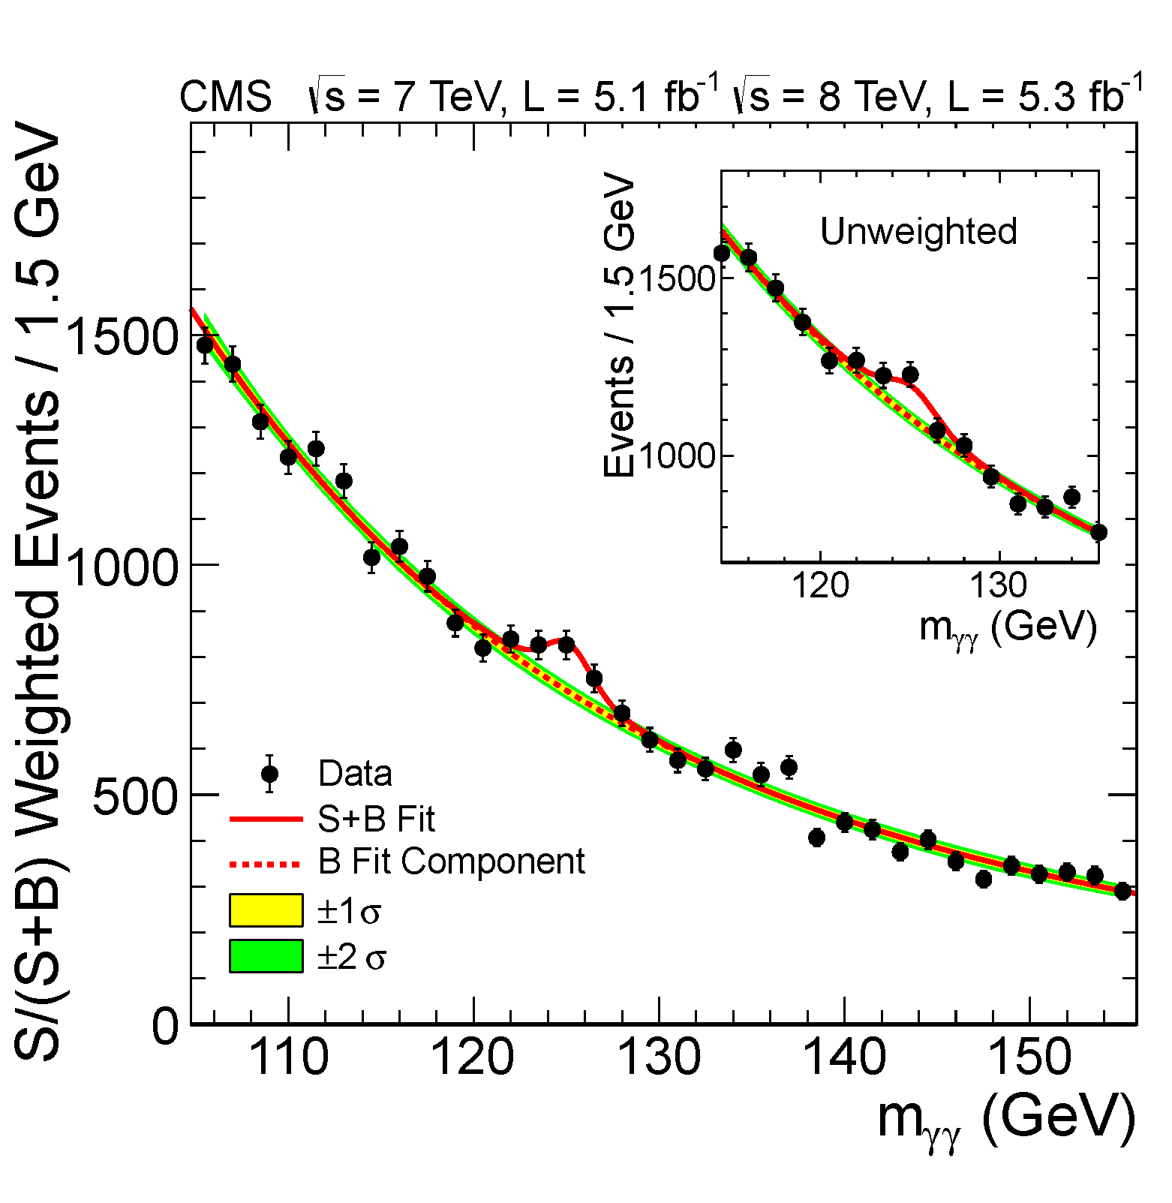
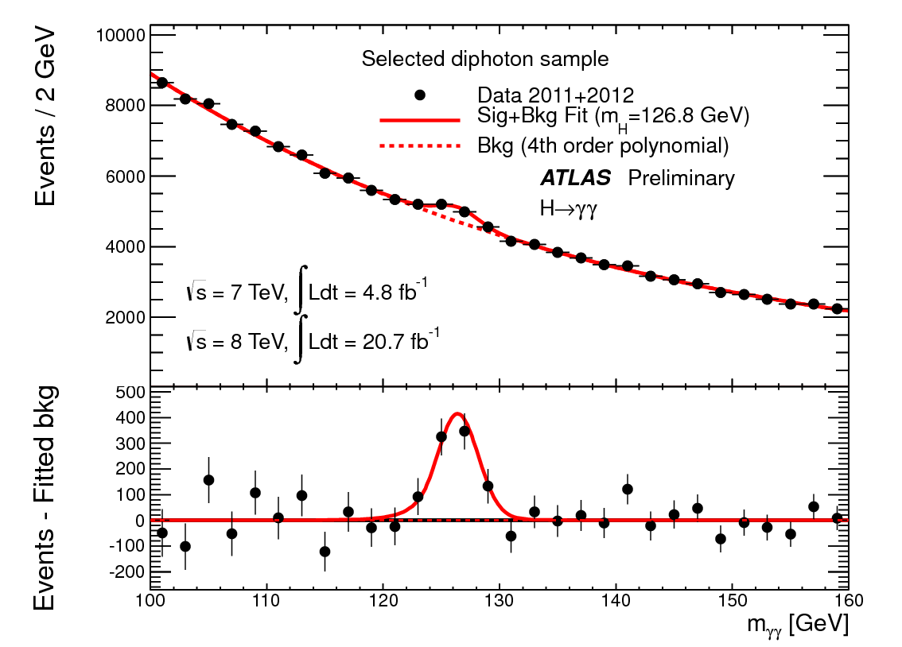
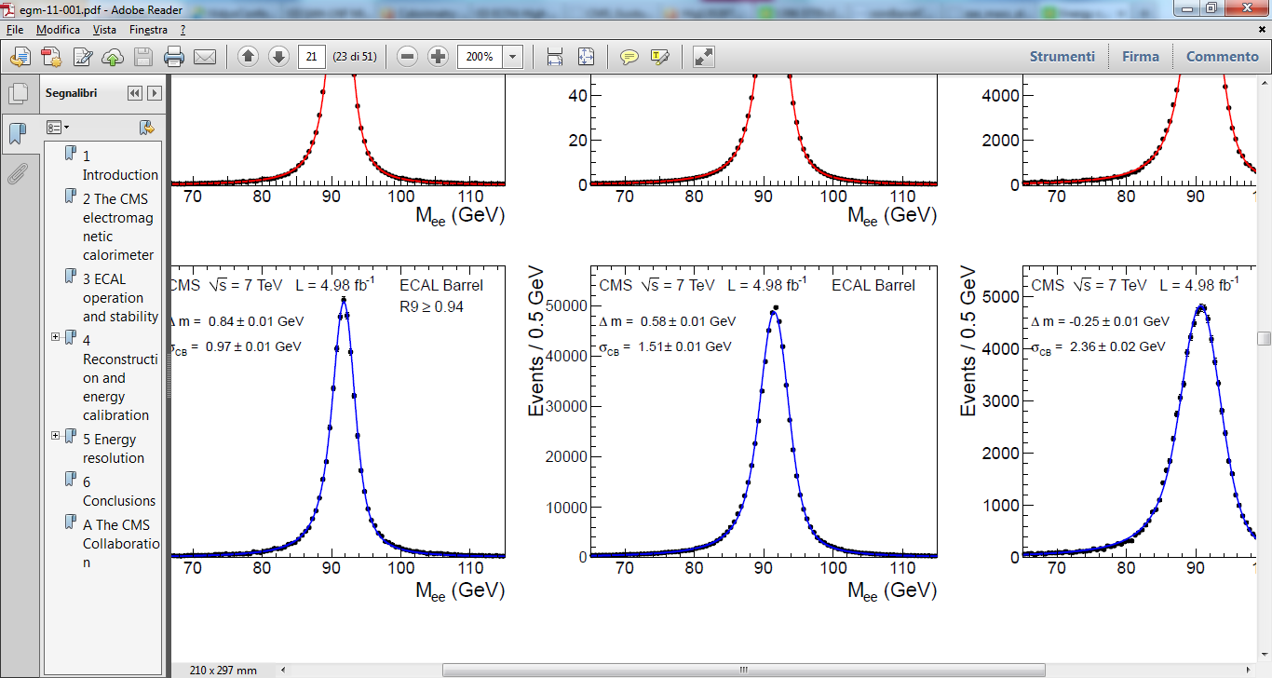
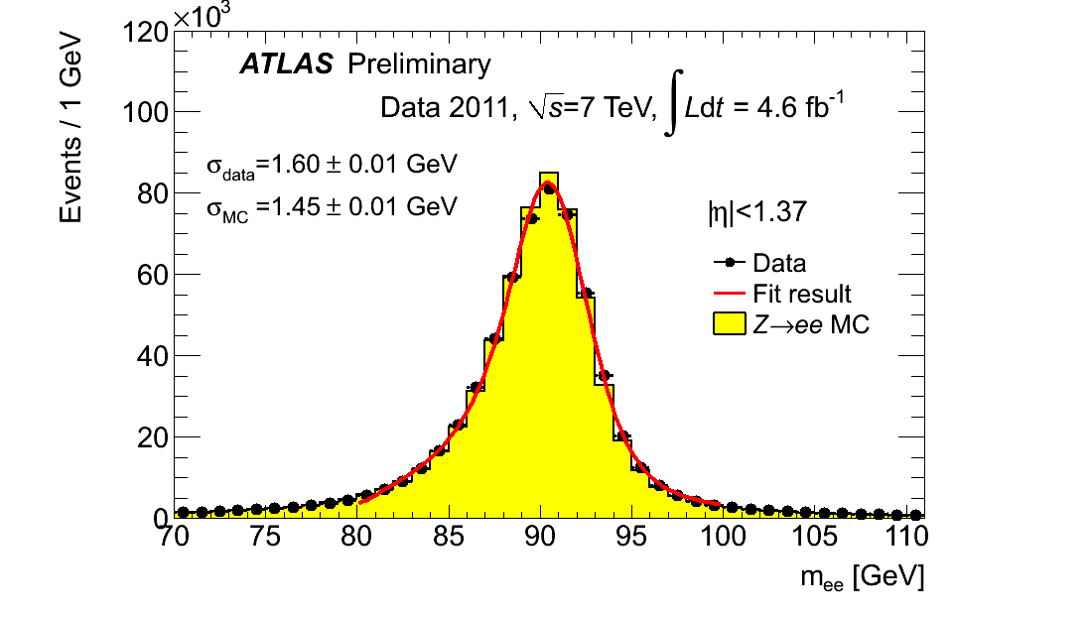
Performance for photons
Mass resolution for the Z→ee decay in Barrel

Slide 14
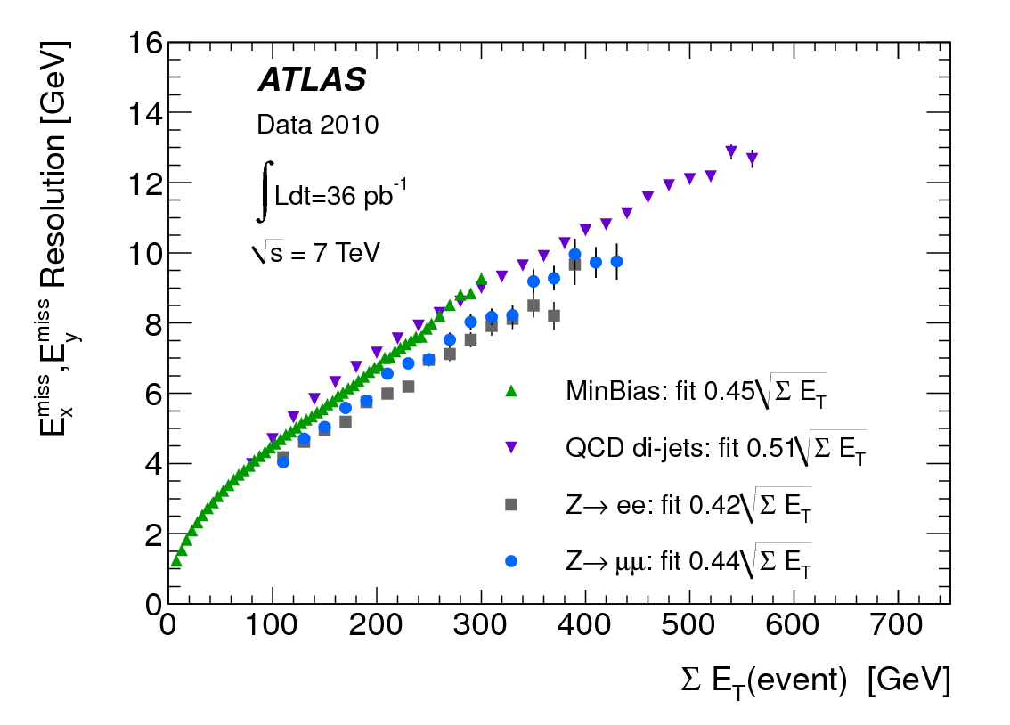
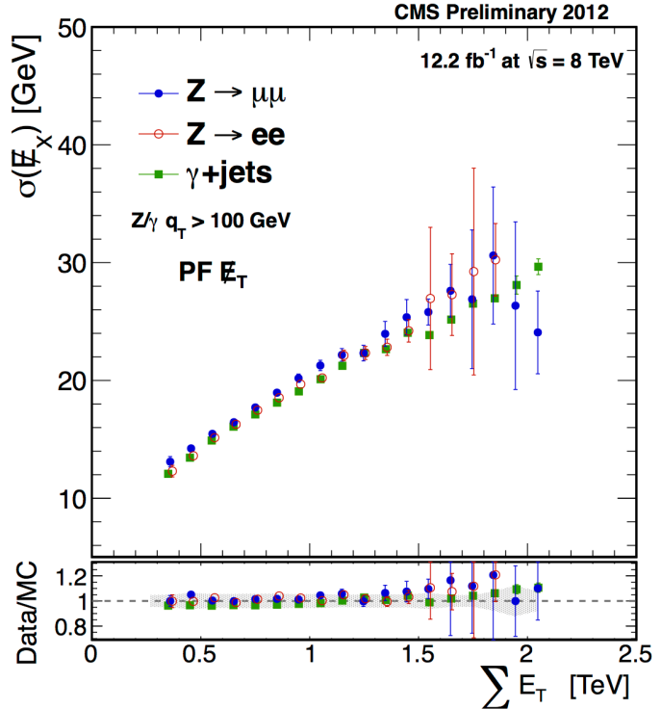
Performance for E_{T}
Jets/E_{T} resolution with calorimeters limited by energy containment (10 λ_{I}) and by non compensation of e/h.
Energy flow/particle flow algorithms make use of the track-calo match for charged particles and particle id to improve the missing energy reconstruction.
σ(E_{x})=0.6√ΣE_{T}

Slide 15
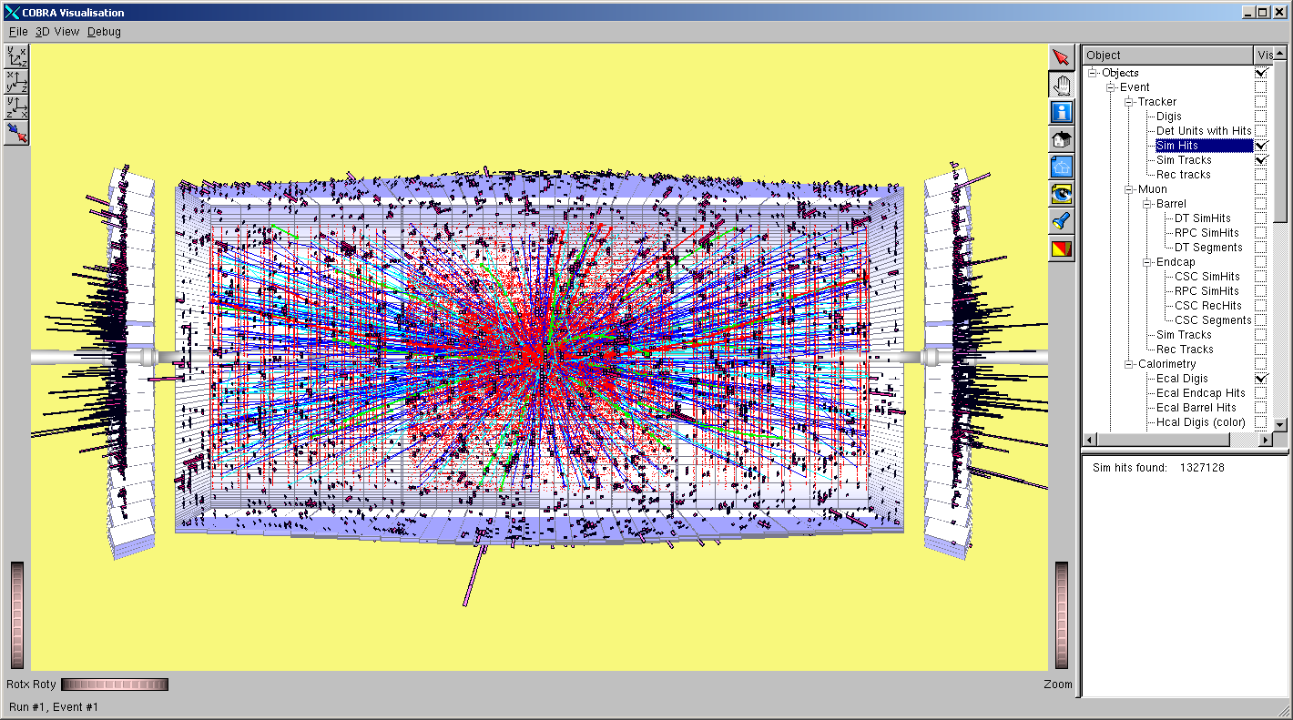
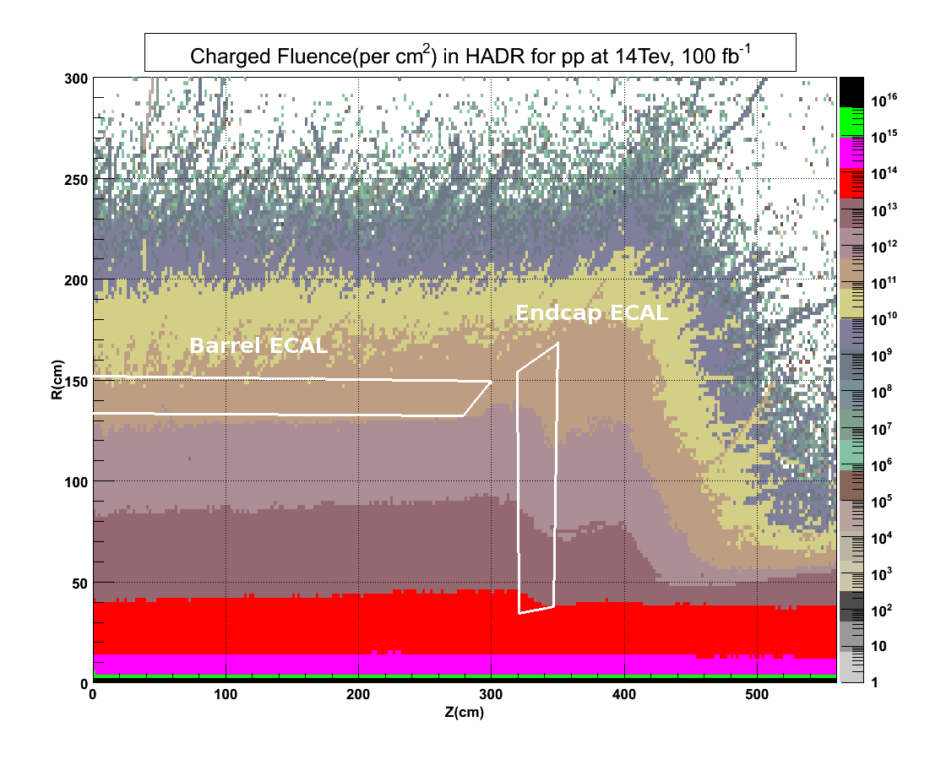
Detector challenges at the HL-LHC
Number of events per bunch crossing (pile-up) ~ 140
Radiation levels will be 6 times higher than for the nominal LHC design, and there is a strong η dependence in the endcaps
Rate effects? Radiation hardness? Longevity? Granularity?

Slide 16
Atlas Calorimeter longevity
Longevity of Atlas LAr
  Intrinsically radiation tolerant
  Challenge for operation is the high instantaneous luminosity leading to high flux of particles crossing the LAr gaps (particularly in the forward region 3<|η|<5, flux of particles up to 5x10⁵ kHz/cm² )
Longevity of Atlas TileCal
  Maximum integrated dose will be 0.2-0.3 Mrad
  Expected signal loss of ~30% for 3000/fb OK

Slide 17
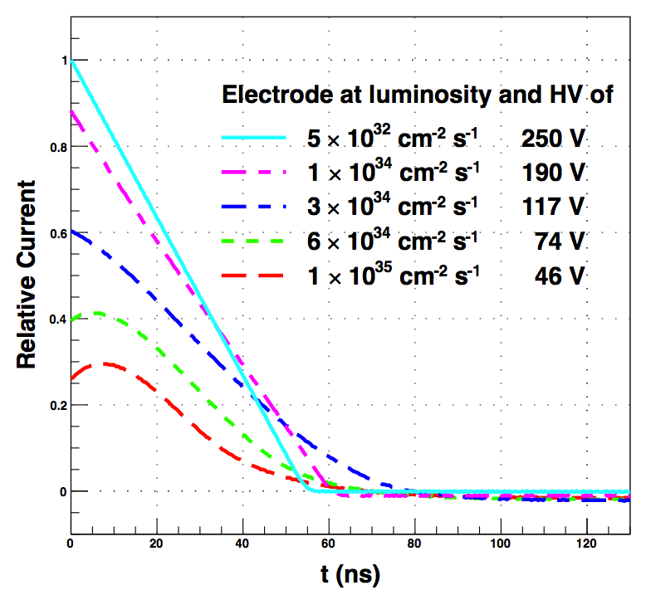
Atlas FCal Calorimeter longevity
Longevity of Atlas FCal
  Space charge effect: buildup of Ar⁺ ions could lead to field distortion→ signal distortion
  large currents through the protection resistor (1MΩ) could lead to HV drop and to a stronger signal degradation
  Energy deposition producing excessive heat could lead to bubble formation in Lar (same cryostat as the endcap).
Atlas simulation , FCal1 at η=4.7

Slide 18
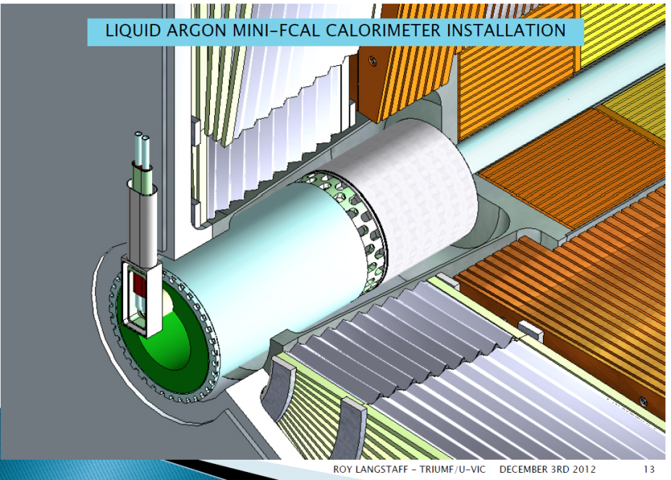
Atlas FCal mitigation options
Studies ongoing to quantify the effect, several options under consideration:
1) If rate effect is small in FCal → do not replace FCal
2) Replace FCal with new one sFCal
  Smaller gaps (100μm), smaller resistor (100KΩ), cooling loops
  This requires opening of the LAr endcap cryostat, to be pursued only if cryostat has to be opened for other reasons
3) Install additional calorimeter in front , miniFCal, to decrease flux of particles.
  Various technologies under consideration (LAr, Xe, diamond sensors)

Slide 19
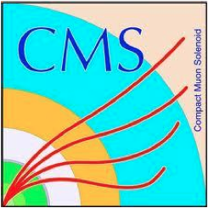
CMS: Radiation dose map
ECAL Barrel
below 10⁴Gy (1 Mrad)
HCAL Barrel
below 10³Gy (0.1 Mrad)
HCAL Barrel
HCAL Endcap
ECAL Barrel crystals
EE xtals
ECAL Endcap
At η=2.6: 3*10⁵Gy (30 Mrad), 2*10 ¹⁴ h/cm ²
HCAL Endcap
up to 10⁵Gy (10 Mrad)

Slide 20
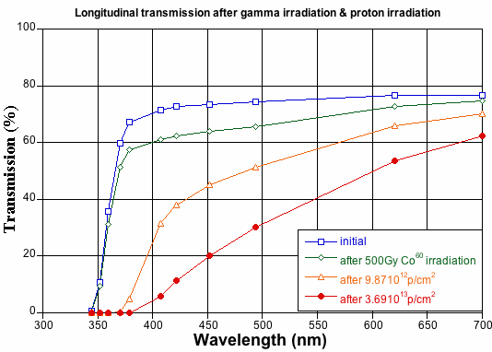
CMS ECAL crystal longevity
PbWO₄ crystals are subject to 2 types of radiation damage:
Gamma irradiation damage is spontaneously recovered at room temperature.
150/fb at η=2.6
600/fb at η=2.6
Hadron damage creates clusters of defects which cause light transmission loss. The damage is permanent and cumulative at room temperature.
- - - PbWO₄ emission spectrum
ECAL Endcap
At L=3000/fb η=2.6: 3*10⁵Gy (30 Mrad), 2*10 ¹⁴ h/cm ²

Slide 21
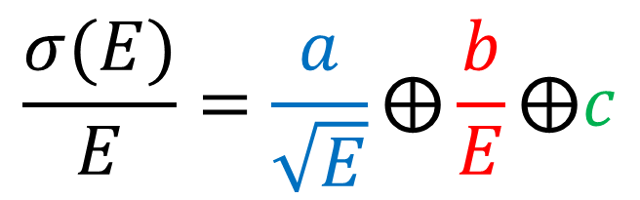
CMS ECAL Endcaps response evolution
→extensive test-beam studies with proton-irradiated crystals
Reduction of light output causes:
Worsening of stochastic term
Amplification of the noise
light collection non-uniformity (impact on the constant term)
Simulation
50 GeV e-
Fraction of ECAL response
$$\frac{σ(E)}{E}=\frac{a}{\sqrt{E}}⨁\frac{b}{E}⨁c$$
Progressive deterioration of energy resolution and trigger efficiency, with strong η dependence
Performance for e/y is acceptable up to 500 fb-1
CMS ECAL endcaps should be replaced after 500fb⁻¹ (during LS3)

Slide 22

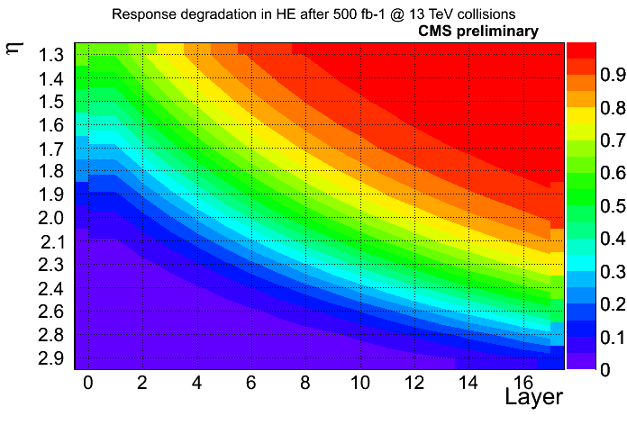
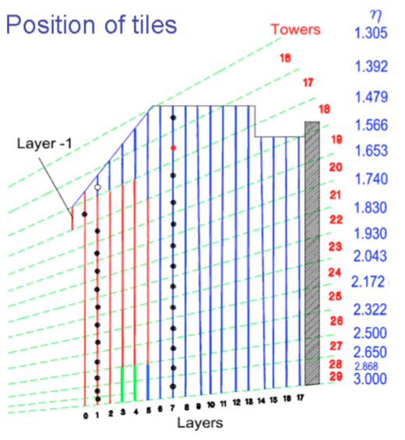
CMS HCAL Endcap Longevity
500 fb⁻¹ of collisions at 14 TeV
undamaged
damaged
< 5% of original signal
CMS will upgrade Front End Electronics of HE (and HB) in LS2:
Photon Detection Efficiency (PDE) of SiPMs will be x3 higher than in present photodetectors.
Depth segmentation will allow for re-weighing of radiation damage degradation.
This upgrade will ensure performance of HE up to LS3.
CMS HCAL Endcap calorimeter will be replaced during LS3.

Slide 23
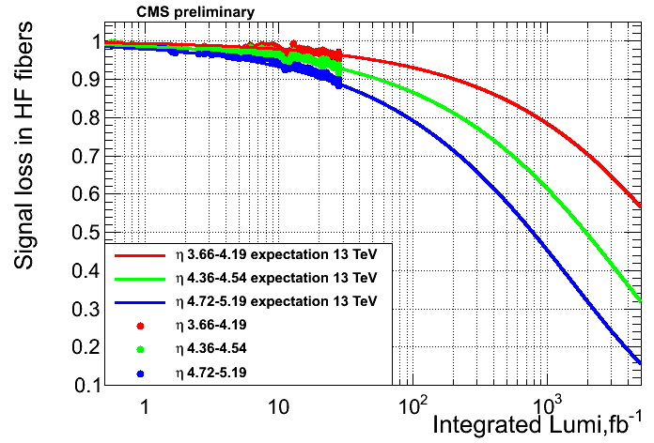
CMS HCAL Forward Longevity
HF front face/inner ring:
0.5*10⁷ Gy ( 500 Mrad)
Extrapolation to 3000 fb⁻¹,
NIM A 585 (2008)
11 metres from collision vertex
Signal loss in HF due to radiation induced reduction of transparency of quartz fibers.
Expected loss of signal for up to 3000 fb⁻¹:
In the highest η region, signal reduction by factor x3-x4 is expected and can be compensated by re-calibration.
HF will survive 3000 fb⁻¹, at least up to η < 4.5.
No upgrade of HCAL Forward is planned for LS3.

Slide 24
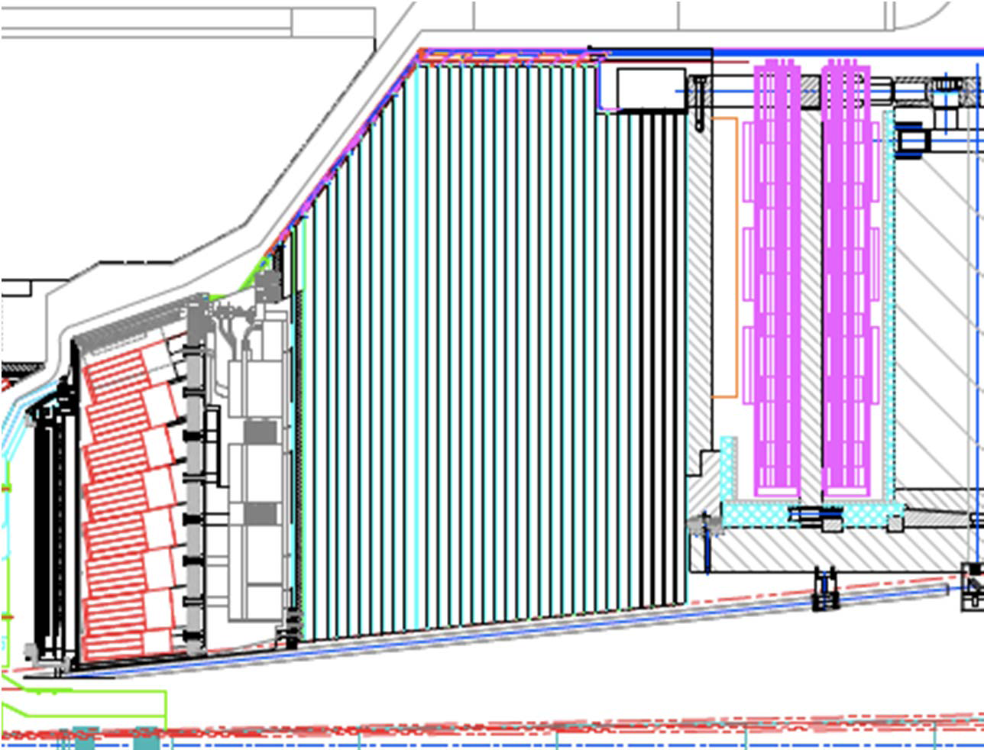
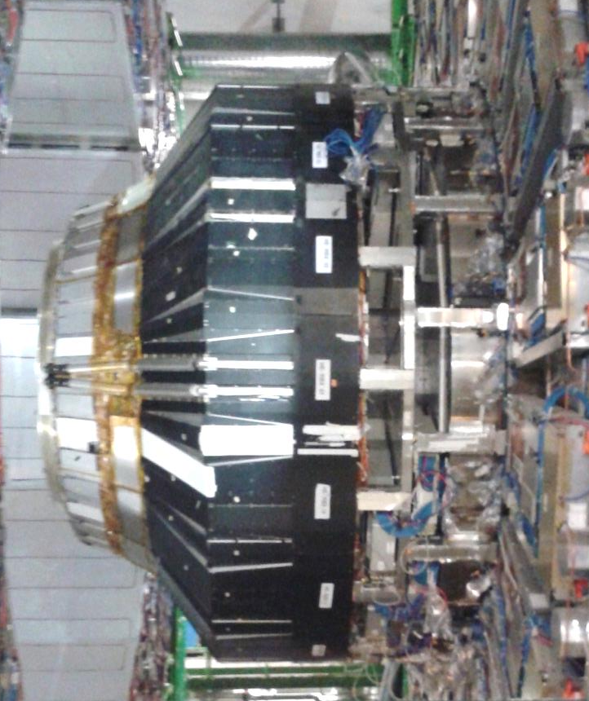
CMS: options for the endcap calorimeters
2 possibilities:
  1
  HE absorber remains, only active material is replaced
  And a new ECAL endcap is made
  2
  HE is completely replaced
  Possibility to consider a combined ECAL+HCAL
3 solutions under consideration
(1 standalone,
2 combined ones)
ES
HE
EE
Possibility to extend the calorimeters up to η=4

Slide 25
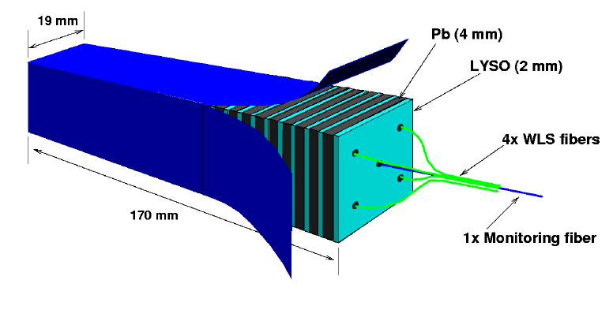
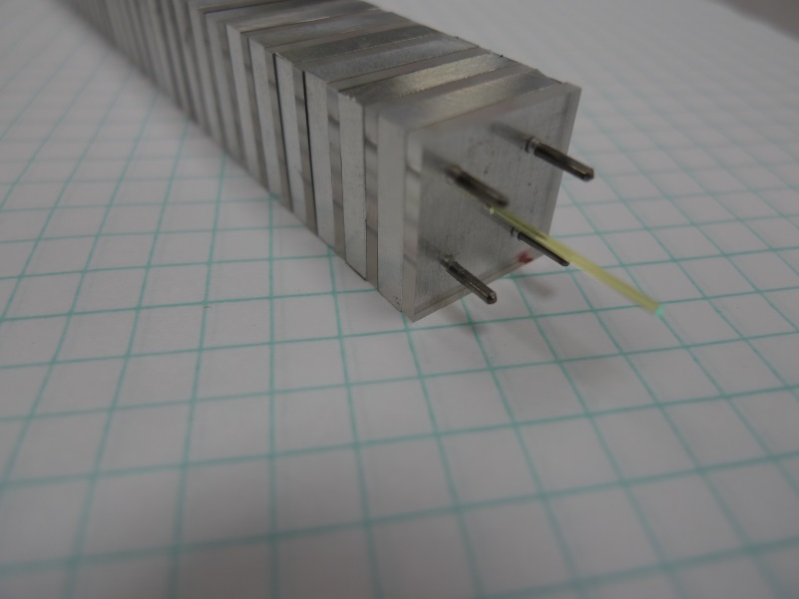
Scenario 1: standalone EE - shashlik
Shashlik calorimeter
  Inorganic rad. hard. scintillators e.g. LYSO o CeF₃
  Pb or W (at large η) as absorbers (R_{M}=1,7 o 1,2 cm)
  WLS fibers passing through the scintillators
Short light path → rad-hardness
Possible photo-detectors
  GaInP photo-sensors, 1 sensor per fiber (4 fibers per channel), R&D ongoing
Challenges: rad-hard fibers, photo-detectors, mechanical assembly (tolerances)
Pb or W
inorganic scintillator
Mechanics prototype

Slide 26
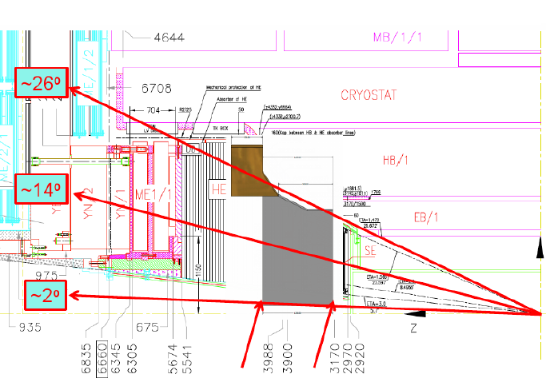
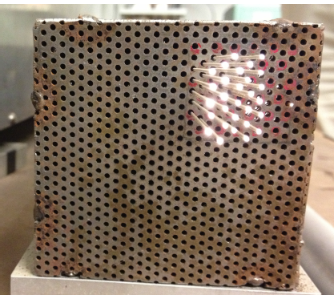
Scenario 2: Dual readout calorimeter
Dual Readout: simultaneous measurement of the Cerenkov and scintillation light to correct the intrinsic fluctuations of the hadronic and e.m. (γ,π⁰,η) components of the hadronic showers (RD52)
Proposed option with W or brass + fibres
No longitudinal segmentation
Distance btw fibers ~ 1.2 mm
1 photo-sensor per fiber
~ 1M channels
Challenges:
rad-hard fibers, photo-detectors, mechanics, monitoring

Slide 27
Scenario 2: imaging calorimeter
Imaging calorimeters: measure the charged particles with tracker, measure the neutrals in the calorimeter (Calice)
Crucial point: separate the showers
The high rate in the forward region draws technology choice
Options: W/Pb+Si or gaseous detector (em) and steel+GEM (had)
Number of channels 4M (em)+0.6M(had)
Electronics (P. Aspel: 128 ADC in 1 chip), trigger formed on detector and processed off detector, readout on L1 accept
Challenges: number of channels, compact and inexpensive electronics, trigger, cooling, performance at high pile-up, linearity

Slide 28
Electronics

Slide 29
Electronics of the calorimeters at the HL-LHC
Calorimeter
Front-End
Back-End DAQ + Trigger
LHC Calorimeter electronics was designed 10 years ago, to last 10 years in the LHC under the assumption of L=500/fb for the radiation hardness.
It was not possible due to technology limitation and cost to read-out all channels at 40 MHz. So the L1 trigger sums are done on the Front-End of the detectors. (The trigger has access to a coarser granularity)
Data are fully readout on L1 accept.
For HL-LHC the trigger requirement is to keep the trigger thresholds low in events 10 times more complicated.
  Add tracker information (longer processing time→ longer data buffer)
  shift the processing at HLT on full event info (larger L1 accept rate)
General trend for calorimeters
  send all data off detector for trigger and read-out at 40 MHz
  Process the data with more powerful hardware or software
  install front-end components which are more radiation tolerant – if necessary

Slide 30

ATLAS Upgrade of Calorimeter Electronics
Reasons for replacement of ATLAS calorimeter electronics in LS3 :
  Ageing and radiation tolerance of front-end electronics → system longevity
  Limited on-detector buffer prevent application of more advanced trigger algorithms
  On-detector digitization of all signals at 40 MHz → input to Level-0/Level-1 triggers
    Level-0 with accept rate of 500 kHz and latency of 6 μs
    Level-1 with accept rate of 200 kHz and latency of ~20 μs
Tile Calorimeter front-end:
9852 channels,
total ionizing dose requirement 1kGy
LAr Calorimeter front-end:
182468 channels,
total ionizing dose requirement
0.15-2.8 kGy
Hadronic LAr Endcap Calorimeter:
pre-amplifier and summing boards
inside endcap cryostat (optional replacement)
+ new back-end
electronics
LAr: Full readout of all 182468 channels with 40 MHz front-end ADCs and optical transmission to back-end .
TileCal: Full readout at 40 MHz. More redundant FE board.

Slide 31


CMS Calorimeter Electronics Upgrade
Electromagnetic
Calorimeter (ECAL)
~76k scintiallating PbWO₄ crystals
  HCAL plan:
  Thin window, multi-anode PMTs will be installed on Hadron Forward Calorimeter in LS1
  Silicon Photomultipliers (SiPM) will replace Hybrid Photon Detectors (HPD) in LS2 in HCAL Barrel and Endcap
  Finer longitudinal segmentation of HCAL (x3/x5 in barrel/endcap):
  Full readout at 40MHz
Forward
Calorimeter
Steel + quartz fibers
~2k channels
Hadron
Calorimeter (HCAL)
Brass + plastic scintillator
~7k channels
  ECAL plan for LS3 (Phase II):
    upgrade the ECAL Barrel electronics (cannot cope with trigger requirement) → full readout at 40MHz
    Adapt shaping time to higher APD dark current

Slide 32
PILE-UP Mitigation

Slide 33

Pile-up mitigation
Atlas and CMS experiments were designed for a pile-up of 20-25
Lot of work done to improve pile-up rejection in 2012 for jet and missing energy reconstruction:
  Particle flow track-object matching (PF) and particle id.
  Selection of Particle Flow Objects belonging to the primary vertex (No-PU PF)
  Jet reconstruction and sophisticated jet selection based on the jet shape and vertex
  (MVA PF)
Missing energy resolution in Z→ee events
[CMS-PAS-JME-12-002]
PU fake-jet
real jet
efficiency for PU vertex reco ~ 70%
These techniques must be pushed further for higher PU. Granularity of calorimeters, vertex pointing capability (segmentation and TOF) may help.

Slide 34





Pile-up Mitigation
Pile-up is most critical in the forward region, so upgrades should aim at optimizing the forward detector for high pile-up conditions.
Two areas of study :
  Increased granularity and segmentation may help to separate out pile-up activity from primary event physics objects
  High precision (pico second) timing may help in pile-up mitigation. The subdetector providing the precision timing may best be associated to precise and finely segmented detector ⇒ ECAL.
    Object reconstruction/PU cleaning
    Object-to-vertex attribution
    H→γγ vertex
  Studies on precision timing are ongoing for pile-up mitigation through time-of-flight. Desired resolution is 20-30 ps.

Slide 35



The material budget in front of the em calorimeters
Amount of material in front of the calorimeters
ATLAS
new tracker
phase2
Beam pipe, pixels, Silicon Tracker,
TRT, LAr cryostats and solenoid
Beam pipe, pixels, full silicon tracker

Slide 36



The material budget in front: photon conversions
2009 COLLISIONS
ATLAS
TRT
2009 COLLISIONS
SCT
CMS preliminary
PIXELS
Photon conversion in first Silicon Tracker Layer

Slide 37




The material budget in front: electron Bremsstrahlung
EFFECT on electrons IN CMS
super-cluster
2.5 GeV electron plus
Bremsstrahlung photons
basic cluster
e
γ
50% electrons give a non negligible brem
special e track reconstruction
special clustering algorithm
In case of high pile-up clusters should be made smaller, so algorithm tuning is necessary!
Fraction of radiated energy = (P_{in}-P_{out})/P_{in}

Slide 38


LHCb Calorimeters
Single arm spectrometer (covers angle from beam from 10-300 mradians)
Detectors assembled in two halves
preshower: Pb/Scin. with WLS, 2.5 X₀
ECAL: Pb/Scin. with WLS fibers in shashlik config.+PMT, 25 X_{0,}6000 cells
HCAL:Fe(16mm)/Scint.tiles 5.6 λ_{I}
High radiation level at small angle
Calorimeters purpose:
L0 trigger on high p_{T} e±, π⁰, γ, hadron
precise energy measurement of e± and γ
particle identification: e±/γ/hadron; μ id.
LHCb upgrade will happen already in LS2
  prepare for 5-10 fb⁻¹ / year
ECAL TEST-BEAM

Slide 39



LHCb: longevity of the ECAL
Simulation of Radiation Doses in ECAL:
~6 Mrad is expected for 50 fb⁻¹ in Shower Max region, ECAL cells closest to the beam pipe
Measurement of Signal Degradation:
~ x2 reduction in the light output is seen for inner most cells after ~1 Mrad (red vs black )
ECAL module
PMT
Beam direction
initial
1 Mrad
Reduction by x5 in light output is acceptable from resolution point of view.
→ Preshower and Scintillator pads will be removed
→The performance of ECAL central modules is expected to remain satisfactory till LS3.
-> LHCb plans replacement of ECAL central modules (288 channels out of ~ 6000) during LS3.

Slide 40


LHCb: Longevity of HCAL
Simulation of Radiation Doses in HCAL:
~1 Mrad for 50 fb⁻¹ is expected for the up-stream front, central cells of HCAL
Observed Signal Loss for HCAL central cells: ~15%/ 3.4 fb⁻¹ (2011+2012)
(~50krad)
  HCAL should survive longer than ECAL, but the performance will not be in specification up to 50fb-1.
  Consider it will not be critical to lose the most internal cells after several tens of fb-1
LHCb HCAL modules will not be replaced for Phase2

Slide 41

Upgrade of LHCb Calorimeter Readout
Expected total ionizing dose at front-end:
1 Gy/fb → 50-100 Gy
front-end
electronics
Front-end upgrade motivation:
  PMT gain reduction by factor 5 to increase lifetime
  → front-end with higher gain necessary, but requirement to keep same level of noise (~1 ADC count for 12-bit ADC)
Back-end upgrade:
  all-data-out readout system at 40 MHz
  input to software-based High Level Trigger switched PC-farm
No further upgrade of calorimeter electronics foreseen after LS2
ECAL
Pb/Scint
HCAL
Fe/Scint

Slide 42




LHCb: new electronics
The new electronics design is based on the following requirements:
  ECAL ET range of [0, 10]GeV
  A resolution of 2.5MeV (ET) per ADC count
  12 bits ADC
  Noise small compared to pile-up (~1 ADC)
  Spill-over residue < 1 %
  Non-linearity < 1 %
Radiation tolerant commercial ADCs are being evaluated, e.g. Analog Devices AD9238
  Radiation tolerant FPGAs, e.g. reprogrammable Actel A3PE1500
CERN GBTx/Versatile Links at 5 Gbps link speed
1) ICECAL ASIC: SiGe BiCMOS 0.35μm AMS
Noise levels reached: ~1.4 ADC (ASIC) and ~2.3 ADC (COTS)
2) COTS
architecture:

Slide 43
Conclusions
It was a wonderful adventure to build these extraordinary detectors.
The HL-LHC poses severe requirements to calorimeters in terms of performance and rad-hardness.
CMS endcaps calorimeters must be replaced at the end of the LHC phase1 (after 500 fb⁻¹). New calorimeter options are being studied, key points are rad-hardness, granularity and segmentation.
Interesting R&D on photo-detectors, fibers, timing devices are going to be launched
CMS, Atlas and LHCb are moving to 40MHz full data readout to back-end for electronics ageing and trigger requirements.
The full data readout to back-end will allow better flexibility, essential in this complex environment.

Slide 44


ECAL Endcaps energy resolution evolution
η=2.2 500 fb⁻¹
η=2.2 3000 fb⁻¹
Progressive deterioration of the energy resolution and trigger efficiency, with strong η dependence
Performance for e/y is acceptable up to 500 fb-1
ECAL endcaps will have to be replaced after 500fb⁻¹ (during LS3)

Slide 45

R&D on new scintillators
R&D on new crystal materials and new growing techniques are ongoing.
Key points are:
  radiation hardness, especially for hadron damage
  Light emission spectrum matching to WLS fibers or rad-hard photo-detectors

Slide 46


ECAL electronics
CMS L1 trigger will require an upgrade for the HL-LHC.
One of the critical points to be added to the system is some track and momentum information already at the L1 trigger level.
L1 track information will also be beneficial for the e/γ triggers ( e / «π⁰ in jets» separation, track-cluster matching, better isolation, primary vertex match for multiple triggers: e+jets)
HL-LHC
√s=14 TeV at
L=5·10³⁴ cm⁻² s⁻¹
L1 accept 100 kHz
L1 up to 1 MHz
ECAL front-end electronics cannot meet with the HL-LHC L1 trigger requirement and will need to be replaced.
0.5-1 kHz
10 kHz
46

Slide 47



ECAL Barrel
Photo-detectors:
APD
PWO
APD dark current grows linearly with neutron fluence. As a consequence there is an increase in noise in EB.
The dark current can be mitigated cooling the EB.
A reduction of 2-2.5 in current cooling EB to 8 C.
At lower temperature PWO decay time is slower, and e.m. damage spontaneous annealing is less effective.
An optimization of the temperature may be needed.

Slide 48




Fighting the pile-up
Pile-up has a non negligible impact on the energy/position measurement
  Change the reconstruction: define smaller clusters
  Analysis shows that 2x2 is better
    Reduction of the tail due to pile-up
    But less energy measured
      No significant effect on the resolution
Resolution
Pile-up
Missing
Energy
fraction

Slide 49



Preserve the particle identification performances
Particle identification
  SPD/PS removal → new algorithms
    Absolute degradation by 10-15 % on photons (constant contamination)
    Pile-up does not seem to have a strong impact for photon
    Significant impact on low E electrons from SPD/PS removal and upgrade conditions
      No tuning of the algorithms
  Electrons with p>10GeV are not significantly affected
    Electrons for physics analysis are mostly in this second category.
Neutral cluster reconstruction
Photon identification
Electron mis-id

Slide 50


ALICE calorimeter system
ALICE goal after LS2:
Collect up to 10 nb⁻¹ of Pb-Pb collisions,
with Inst. Lumi up to 6 *10 ²⁷ cm⁻²/s

Slide 51
ALICE calorimeter system
Upgrades during LS1:
EMCal:
Pb/Scin (Shashlik), 0.12 <|η| < 0.7
Increase of φ coverage by adding Dijet Calorimeter (Dcal)
number of towers from 12.3k to 17.7k
Photon Spectrometer (PHOS):
PbWO₄ crystals, |η| < 0.12
Increase of φ coverage by installation of 4th module
Number of towers from 10.8k to 14.3k
Longevity of calorimeters:
Calorimeters located in ALICE central barrel (|η|<0.7, r~4.5m):
expected doses ~1Gy ( ~ 0.1 krad)
No issues related to integrated radiation dose are expected
for ALICE calorimeters

Slide 52
ALICE FoCal
ALICE considers installation of additional calorimeter in the forward pseudorapidity region after LS2.
Two positions are being considered for FoCal:
Preferred option:
  At z = 7-8m
  3.3 < η < 5.3
Alternative option:
  2.5 < η < 4.5
Main features of FoCal:
21-24 layers with tungsten absorber (3.5 mm, ~ 1X₀/sampling) and Si-sensors, dia ~ 1.2m
Sensors: 2-3 very high-granularity (~mm²) layers + ~20 lower-granularity (~1 cm²) layers
Small Molière radius ( ~1cm) to separate γ’s from π⁰ decays
Active R&D ongoing
beam tests of prototype module performed, results very promising (http://arxiv.org/abs/1308.2585)

