Slide 1


ASY-EOS 2015
International Workshop on
Nuclear Symmetry Energy and Reaction Mechanisms
FARCOS:
a new telescope array for correlations and spectroscopy
A. Trifiró¹, L. Acosta² , R. Andolina⁷, L. Auditore¹, C. Boiano³, G. Cardella⁴, A. Castoldi^{3,5}, M. D’Andrea⁴, E. De Filippo⁴, S. De Luca¹, D. Dell’Aquila⁹, L. Francalanza⁹, E. Geraci^{4,7}, B. Gnoffo⁴, C. Guazzoni^{3,5}, G. Lanzalone^{6,8}, I. Lombardo⁹, N. Martorana^{6,7}, T. Minniti¹, S. Norella¹, A. Pagano⁴, E.V. Pagano^{6,7}, M. Papa⁴, S. Pirrone⁴, G. Politi^{4,7}, F. Porto^{6,7}, L. Quattrocchi¹, F. Rizzo^{6,7}, E. Rosato⁹, P. Russotto⁴, G. Saccà⁴, M. Trimarchi¹, G. Verde^{4,10}, M. Vigilante⁹.
¹ Dipartimento di Fisica e Scienze della Terra, Università di Messina & INFN Gruppo Collegato di Messina, Messina, Italy
² Instituto de Física, Universidad Nacional Autónoma de México, México D.F. 01000, Mexico
³ INFN Sezione di Milano, Milano, Italy
⁴ INFN Sezione di Catania, Catania, Italy
⁵ Politecnico di Milano, Dipartimento di Elettronica, Informazione e Bioingegneria, Milano, Italy
⁶ INFN Laboratori Nazionali del Sud, Catania, Italy
⁷ Dipartimento di Fisica e Astronomia, Università di Catania, Catania, Italy
⁸ Università Kore Enna, Enna, Italy
⁹ INFN-Sezione di Napoli & Dipartimento di Fisica, Università di Napoli Federico II, Napoli, Italy
¹⁰ Institute de Physique Nucléaire d’Orsay, Orsay, France

Slide 2
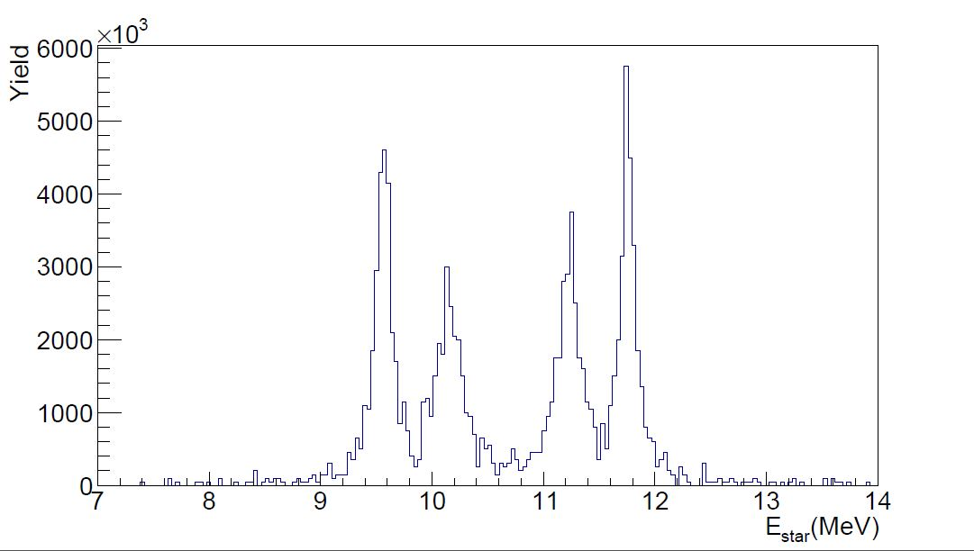
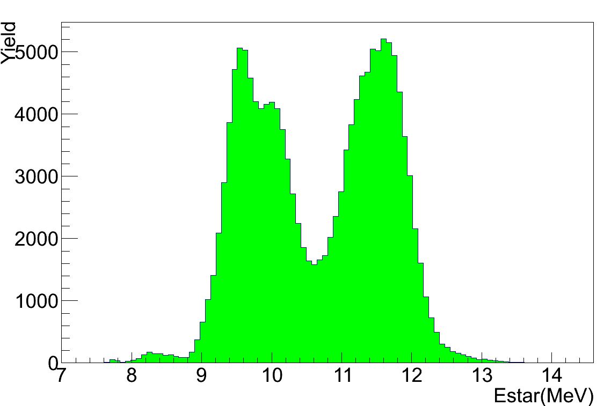
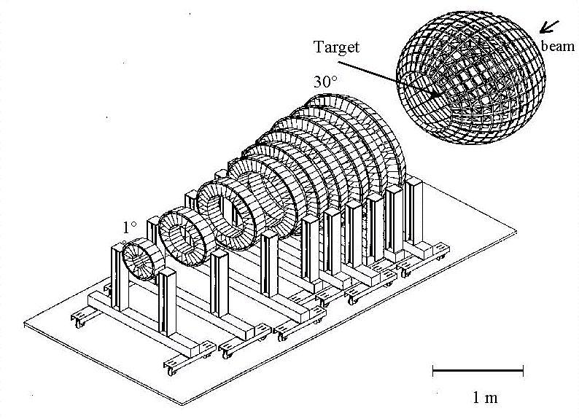
¹⁰Be:
possible molecular state
α
V_{cm}
α
α
n
α
n
Emitting Source Frame
M. Freer et al., Phys. Rev. Lett. 96, 042501 (2006)
Lab Frame
¹⁰Be
theoretical
(?)
11.230 MeV
(4+)
11.760 MeV
(2+)
9.56 MeV
(4+)
10.150 MeV
⁶He
V_{cm}
⁶He

Slide 3

Features planned for FARCOS array
High energy and angular resolution (θ,φ)
Wide dynamic range of identification
  -MeV to GeV
Pulse-shape capabilities
-Low identification thresholds
High Modularity
Flexibility
-Electronics integrated, reconfigurable
-Copuling with 4π array, magnetic spectrometers,
neutron detectors, etc..
Portability
-Campaign in several facilities around the world

Slide 4
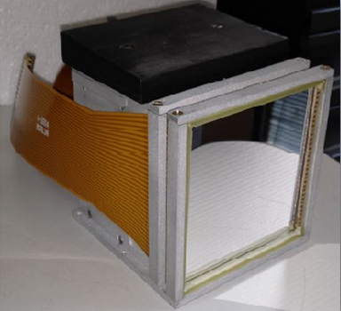
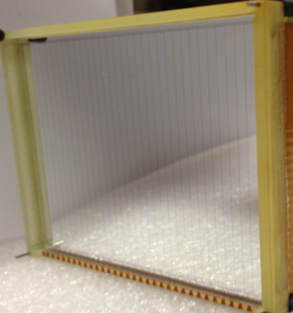
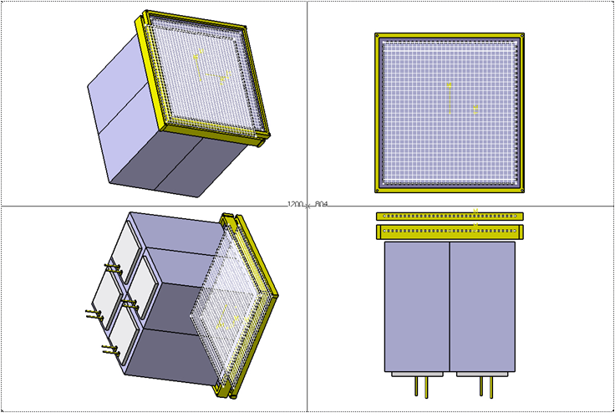
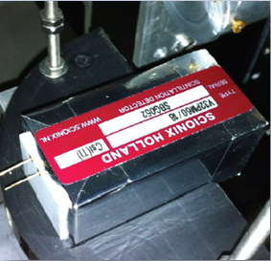
FARCOS (Fentomscopy ARray for Correlation and Spettroscopy)
1°stage:
1 square (0.3x62x62 mm³) DSSSD 32+32 strips
2° stage:
1 square (1.5x62x62 mm³) DSSSD 32+32 strips
3° stage:
4 60x32x32mm³
CsI(Tl) crystals
photodiodes

Slide 5
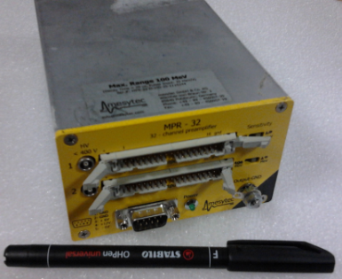
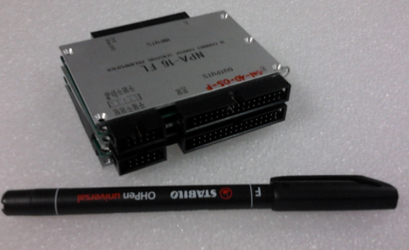
Test of Silicon Detectors
Pre-Amplification Stage
Mesytec MPR-32
Net-Instruments
NPA prototype
Amplification and Acquisition Systems
Analogue acquisition based on 16 channels NIM-CAEN Amplifiers
and VME CAEN 64 channels QDC
Digital acquisition of PAC signals with aliasing filter and AAA
Amplifier [1] and SIS3301 ADC boards [2] for digitizing of 64 channels.
Digital acquisition of PAC signals with GET [3] electronics;
[1] Boiano et al., A 16-Channel Programmable Antialiasing Amplifier, 2010 IEEE
[2] SiS33001SiS330/ 651801/00 MHz VME FADCs - User Manual, Struck Innovative System GmbH, Germany, 2004
[3] S. Anvar et al. and AT-TPC collaboration, 2011 IEEE

Slide 6
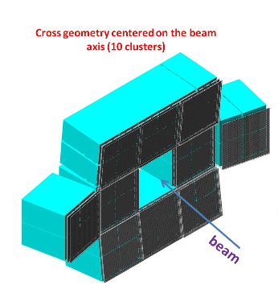
New front-end electronics planned for FARCOS array
General Electronics for TPCs
AGET
DETECTOR ARRAY
132 channels for each telescope
PA
Shaper
SCA
Pulser
ASAD
AGET
ASAD
ASAD
AGET
ASAD
ASAD
AGET
ASAD
AGET
ASAD
AGET
ASAD
AGET
AGET
ASAD
AGET
AGET
ASAD
ASAD
ASAD
AGET
AGET
AGET
AGET
AGET
AGET
AGET
AGET
AGET
AGET
AGET
AGET
AGET
AGET
AGET
AGET
AGET
AGET
AGET
AGET
AGET
AGET
AGET
AGET
AGET
AGET
AGET
AGET
AGET
AGET
AGET
AGET
AGET
AGET
AGET
AGET
AGET
AGET
AGET
µTCA Backplane
µTCA Crate
10 Gb Switch
µTCA MCH
MUTANT A
COBO
COBO
COBO
MUTANT B
RAM
Gb Eth
Gb Eth
Gb Eth
RAM
Multiplicities
FPGA
CPU
1 Gb Ethernet
per COBO
FPGA
CPU
FPGA
CPU
FPGA
CPU
FPGA
CPU
µTCA Backplane
RAM
RAM
RAM
Gb Eth
Trigger / TS
DAQ Network Switch
DAQ Workstations
10 Gb Ethernet

Slide 7
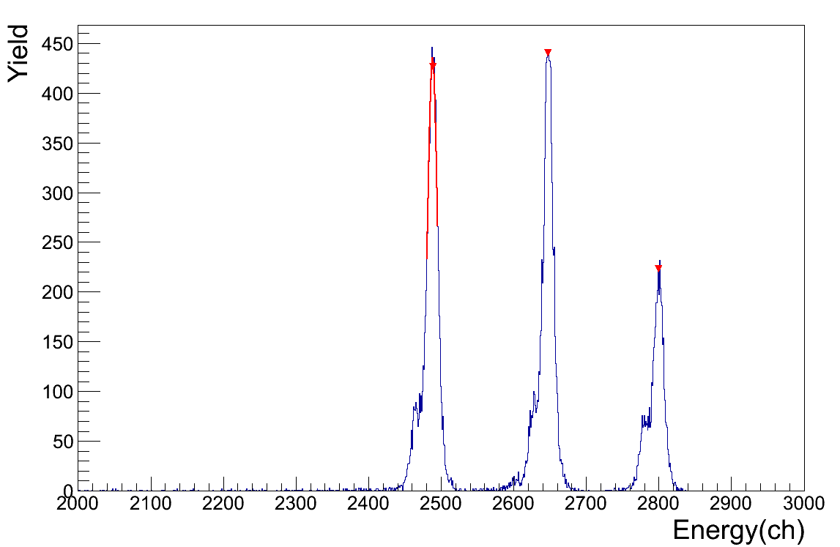
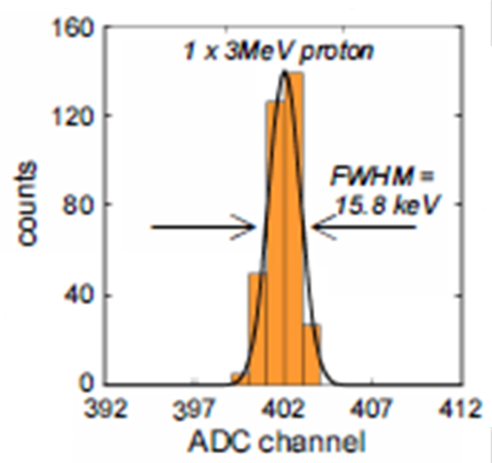
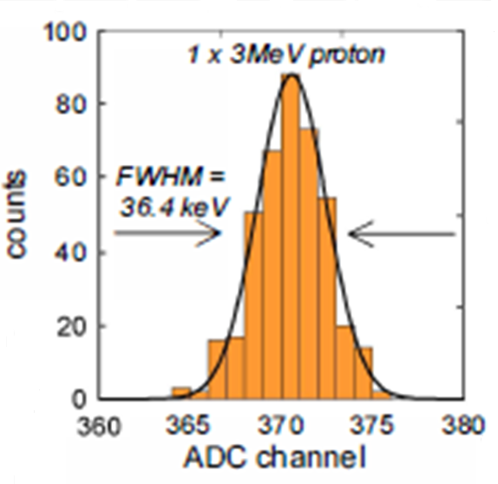
Test of Silicon Detectors
Mixed
alpha
source
3MeV protons
300µm
Junction side
3MeV protons
FWHM = 0.5%
300µm
ohmic side
FWHM = 1.2%

Slide 8
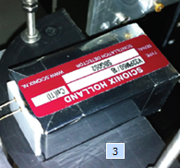
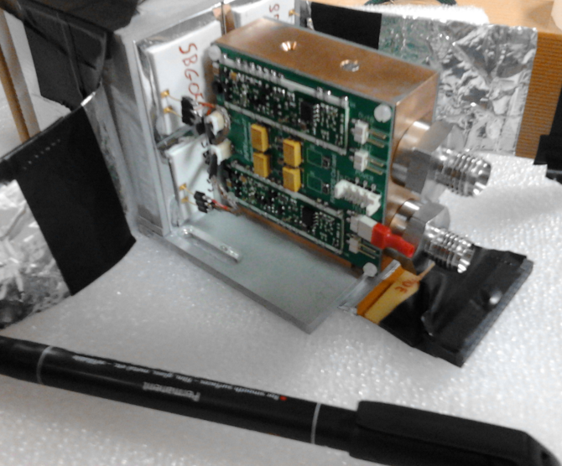
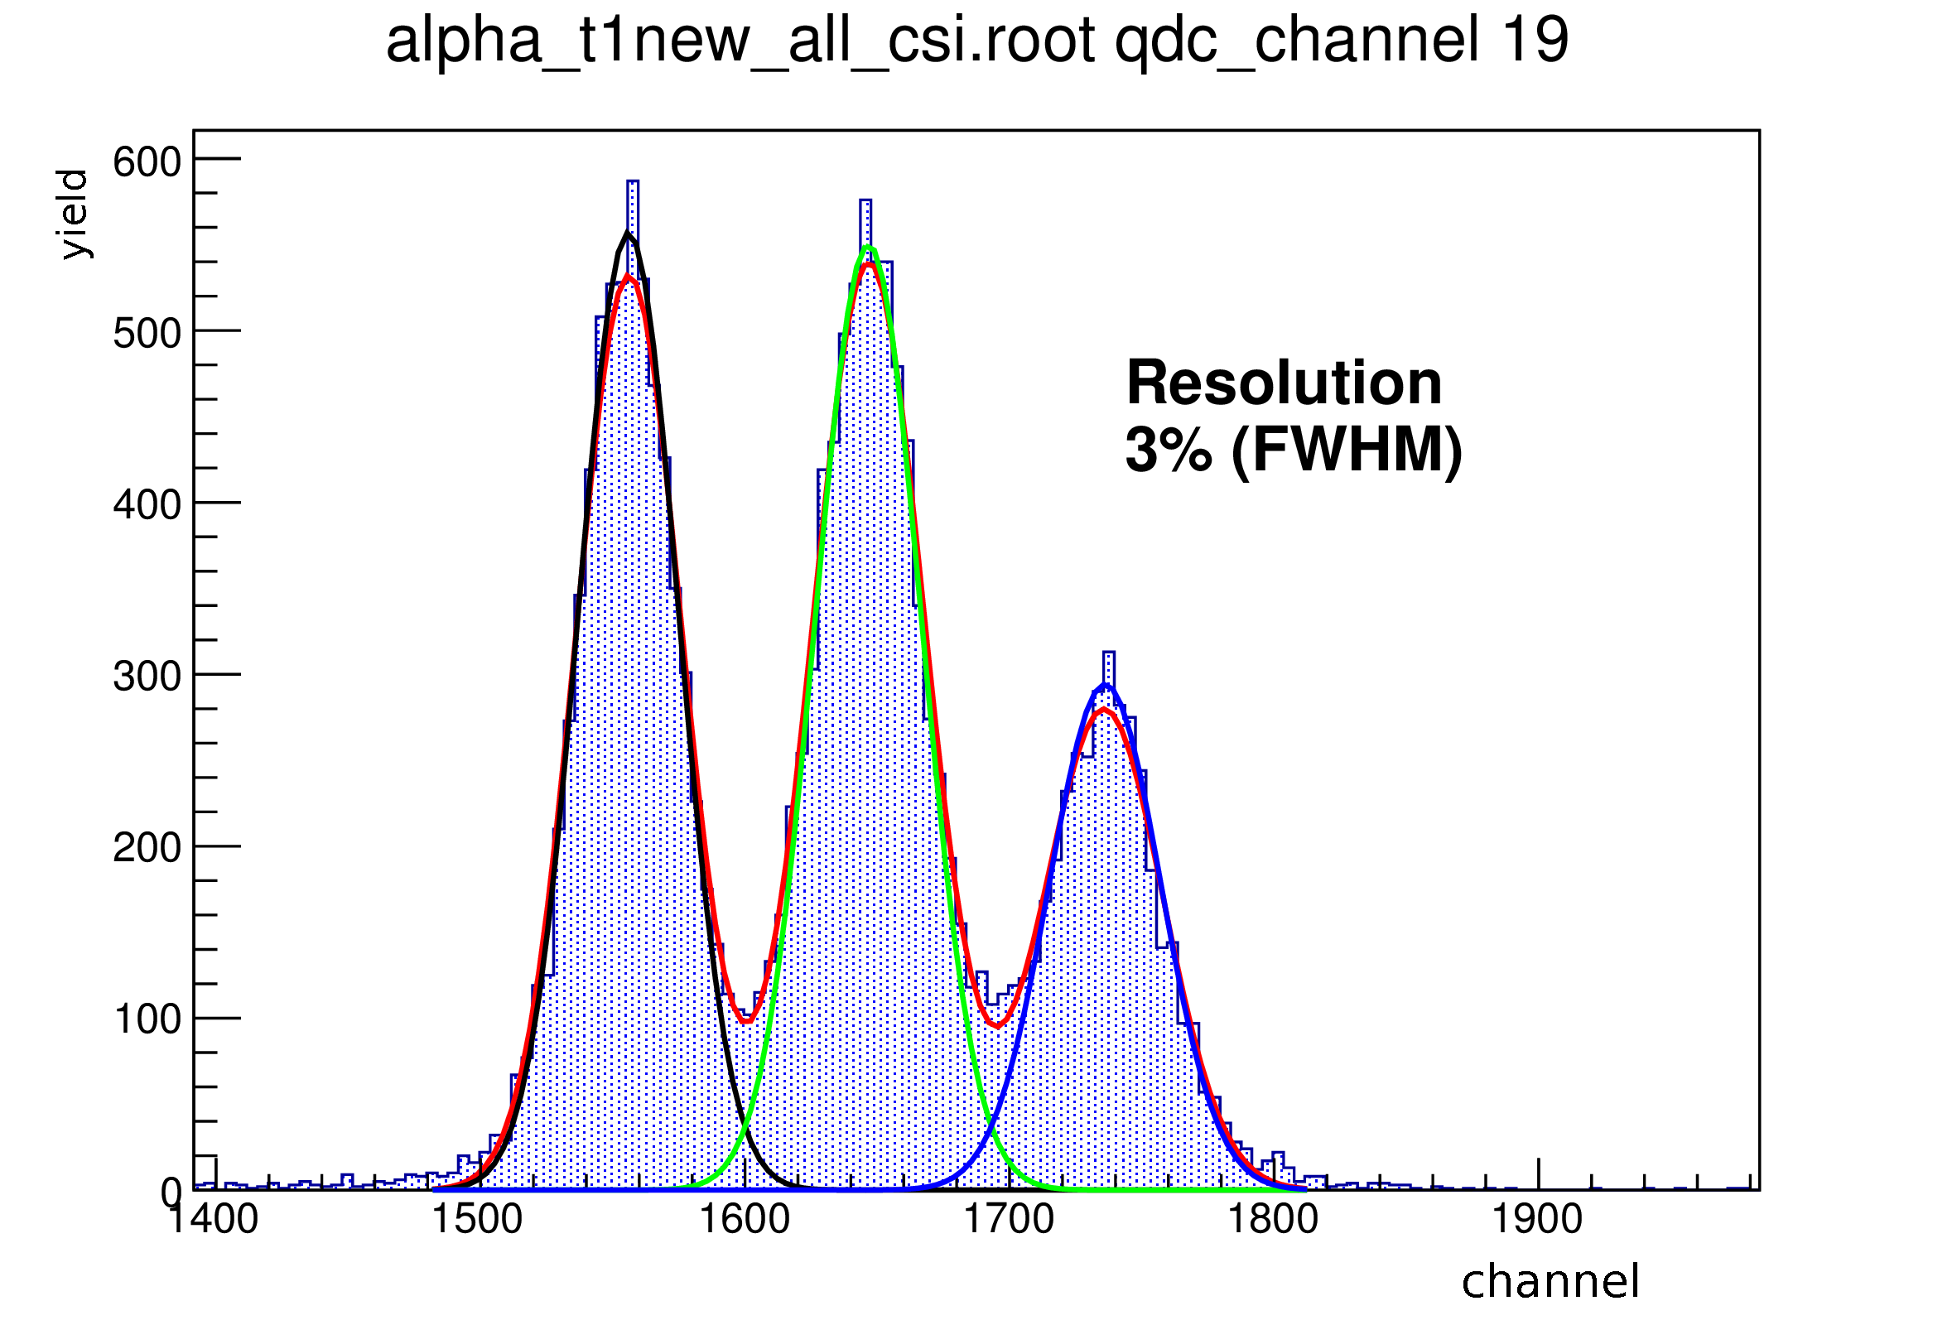
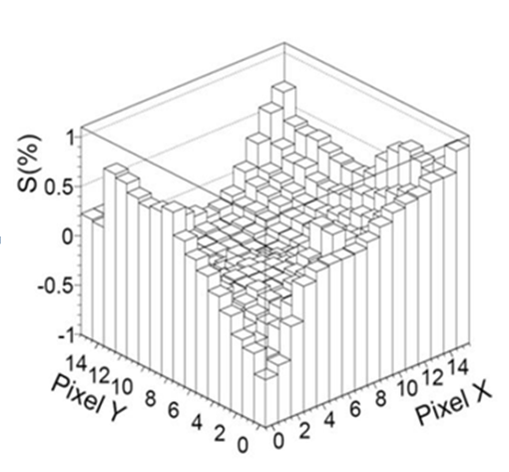
Test of CsI(Tl) Detectors
Charge Sensitive
Preamplifiers
based on
CHIMERA ones
α+Pb @ 62AMeV
Mixed α source
Energy (channel)

Slide 9
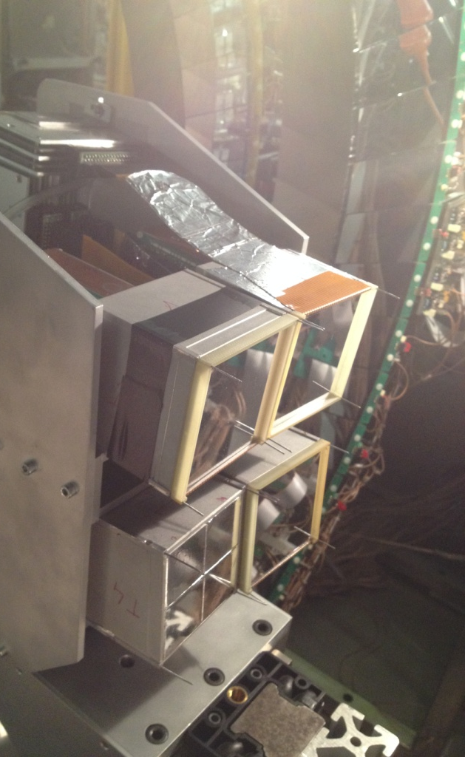
The FARCOS prototype (4 modules) was coupled to the
4π detector CHIMERA at LNS during the InKiIsSy experiment
(see E. De Filippo Talk):
¹²⁴Xe+⁶⁴Zn @ 35 AMeV reaction was studied in order to disentangle
Isospin against Size effects in Projectile Like Fragments dynamical fission
16°<θ_{lab}<44°

Slide 10
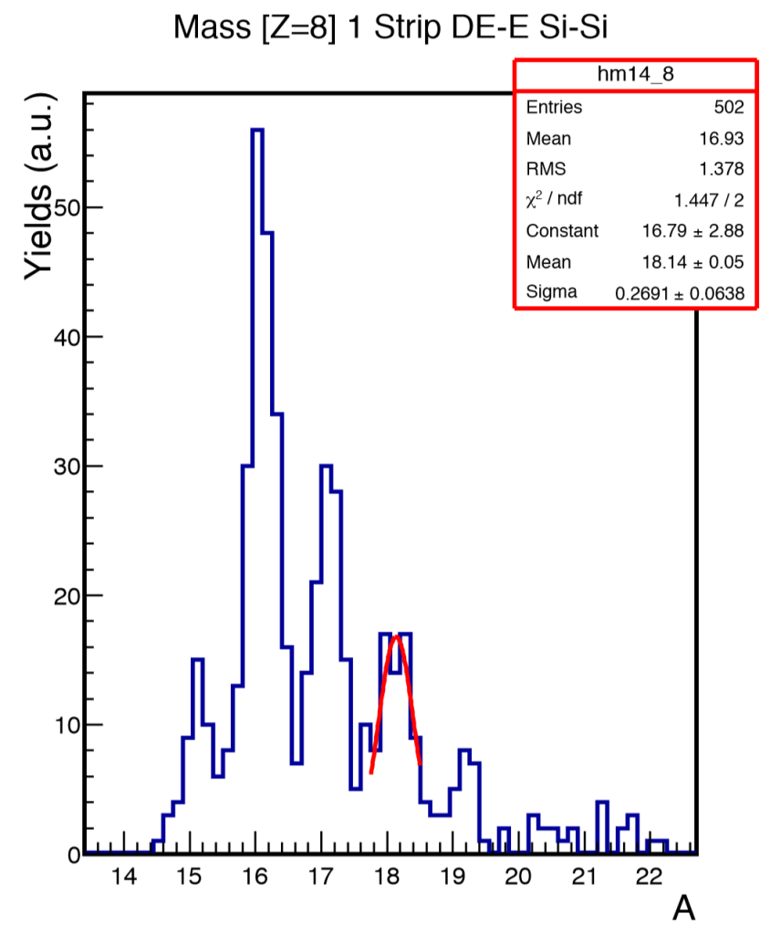

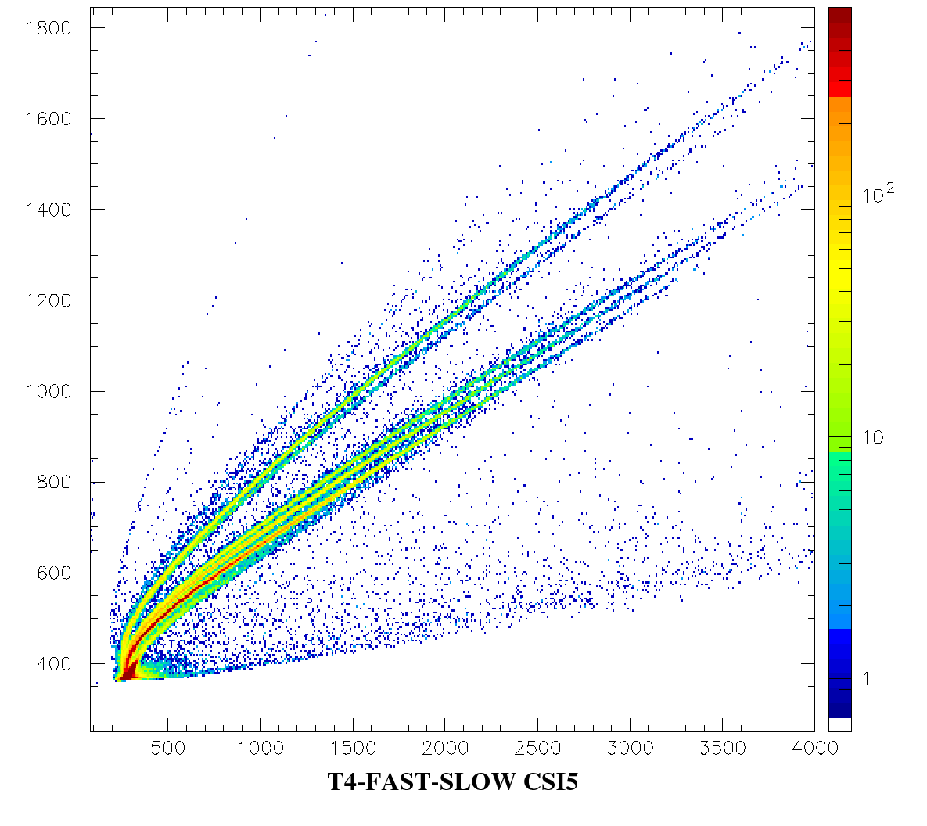
Z=8
^{α}
E_{Si(1500µm)} (ch)
t
³He
d
p
E_{CsI}(ch)

Slide 11
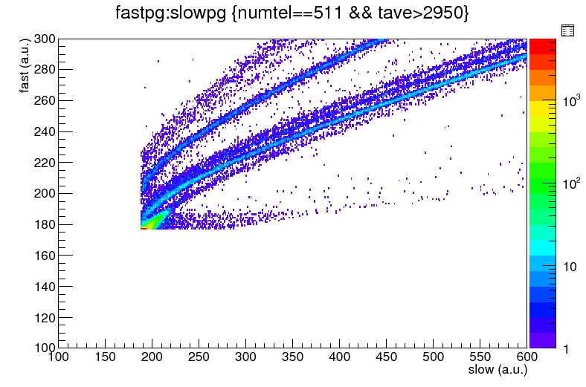
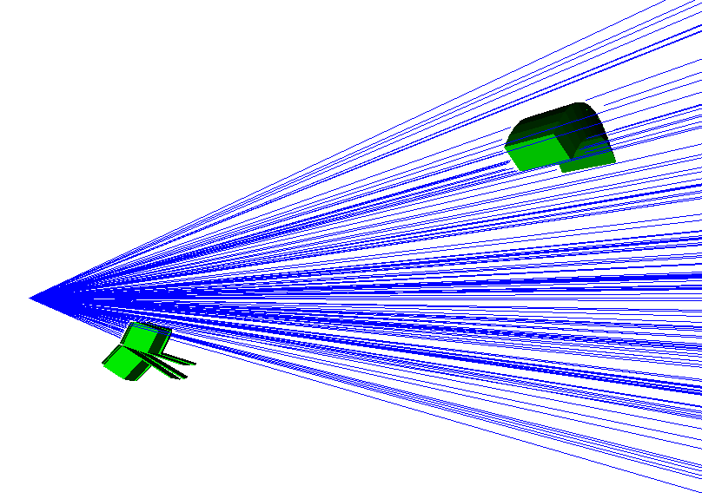
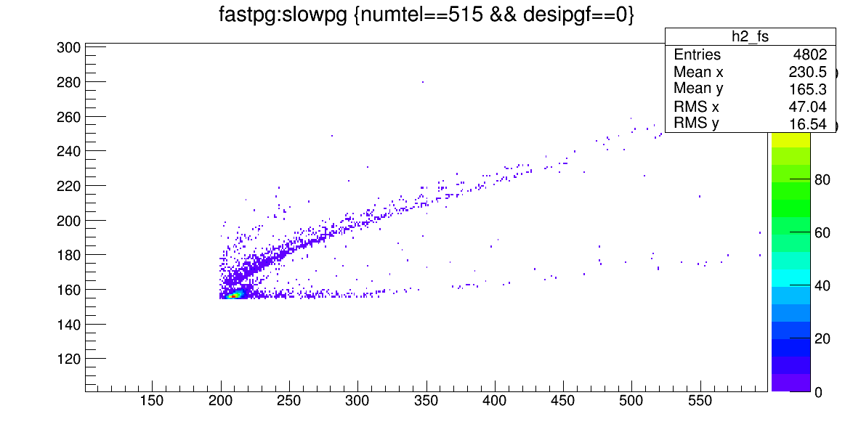
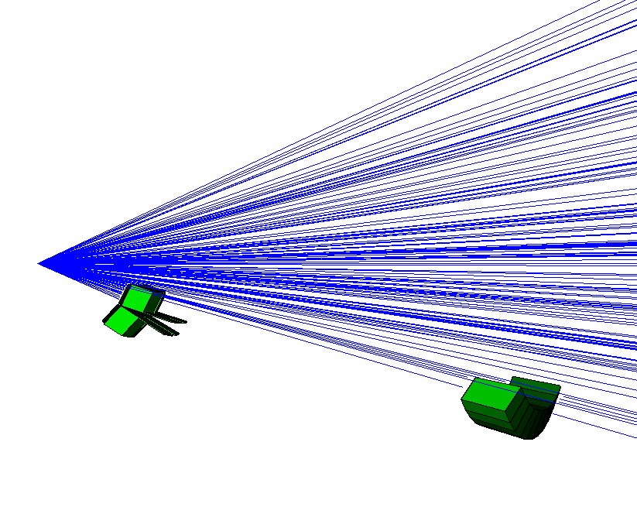
Information on Neutrons
Ring8 - UP
CsI(Tl)
Ring8 - BOTTOM
CsI(Tl)

Slide 12
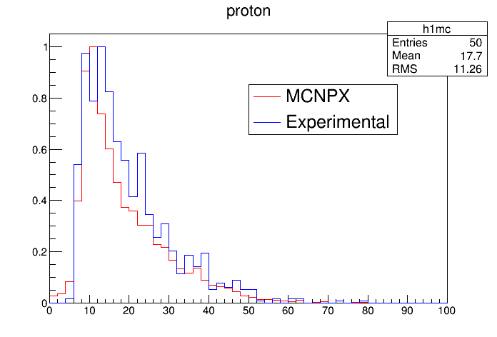
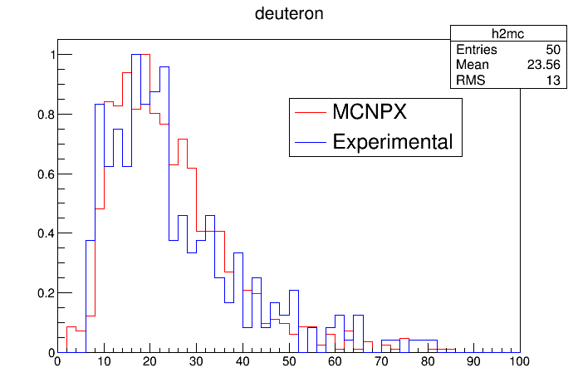
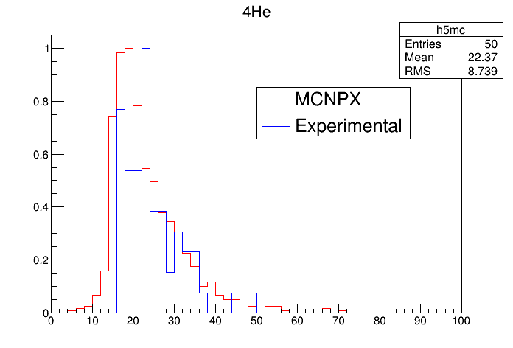
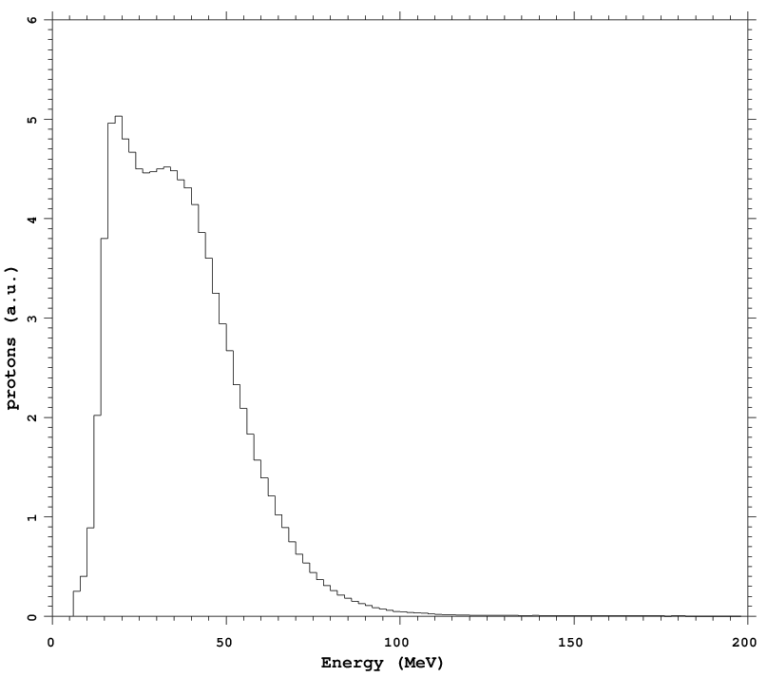
Information on Neutrons
(n,dx) reaction
in CsI(Tl)
(n,px) reaction
in CsI(Tl)
Estimated efficiency ≈ 3%
Yeld of Neutrons (a.u.)
(n,αx) reaction
in CsI(Tl)

Slide 13
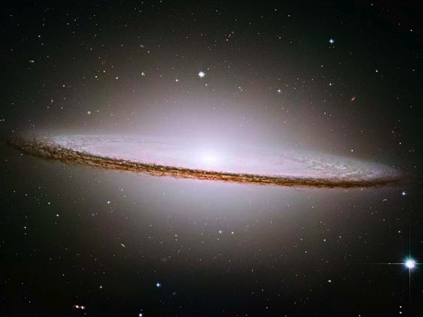
Features of FARCOS array
High energy and angular resolution (θ,φ)
Wide dynamic range of identification
  -MeV to GeV
Pulse-shape capabilities
-Low identification thresholds
High Modularity
Flexibility
-Electronics integrated, reconfigurable
-Copuling with 4π array, magnetic spectrometers,
neutron detectors, etc..
Portability
-Campaign in several facilities around the world

Slide 14
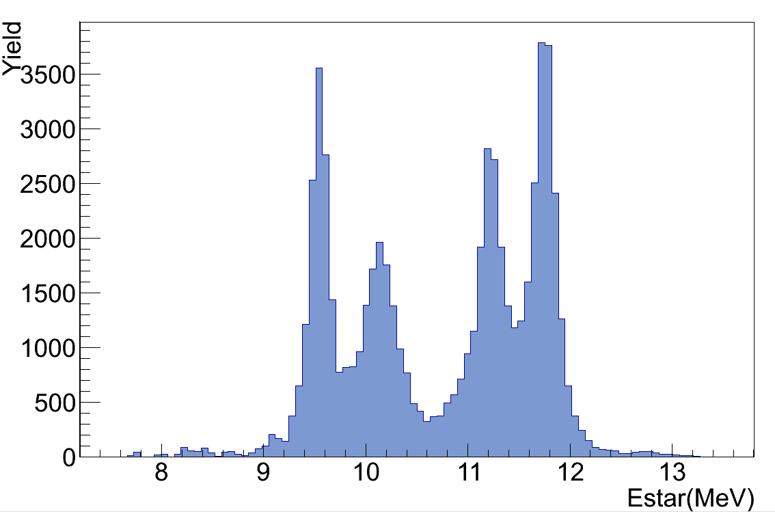
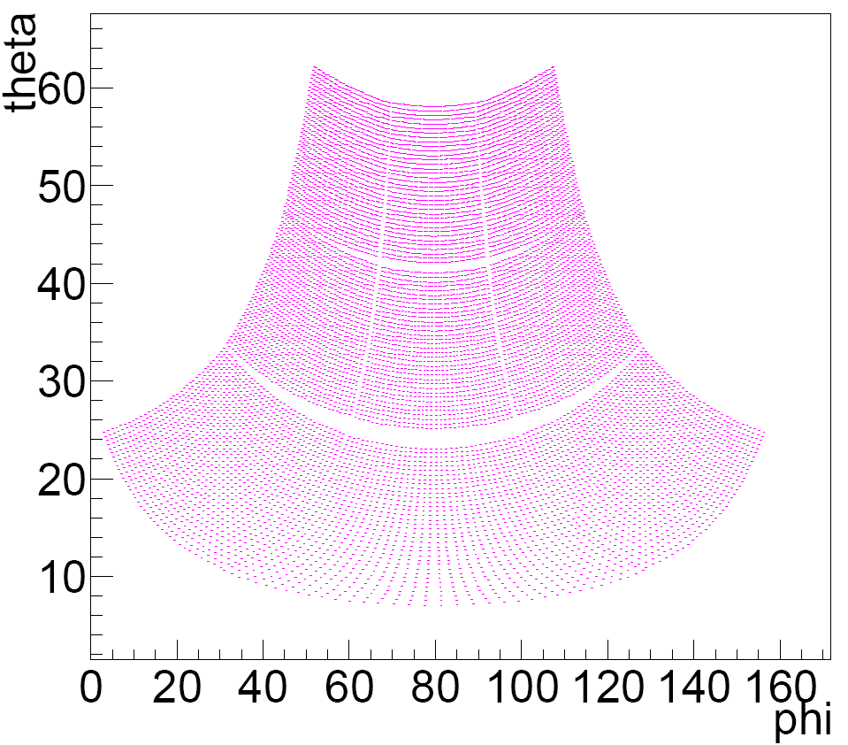
¹⁰Be:
possible molecular state
α
V_{cm}
α
α
n
α
n
Emitting Source Frame
M. Freer et al., Phys. Rev. Lett. 96, 042501 (2006)
Lab Frame
¹⁰Be
theoretical
(?)
11.230 MeV
(4+)
11.760 MeV
(2+)
9.56 MeV
(4+)
10.150 MeV
⁶He
V_{cm}
⁶He
● center of each pixel
Δθ=0.5º
d=250mm

Slide 15
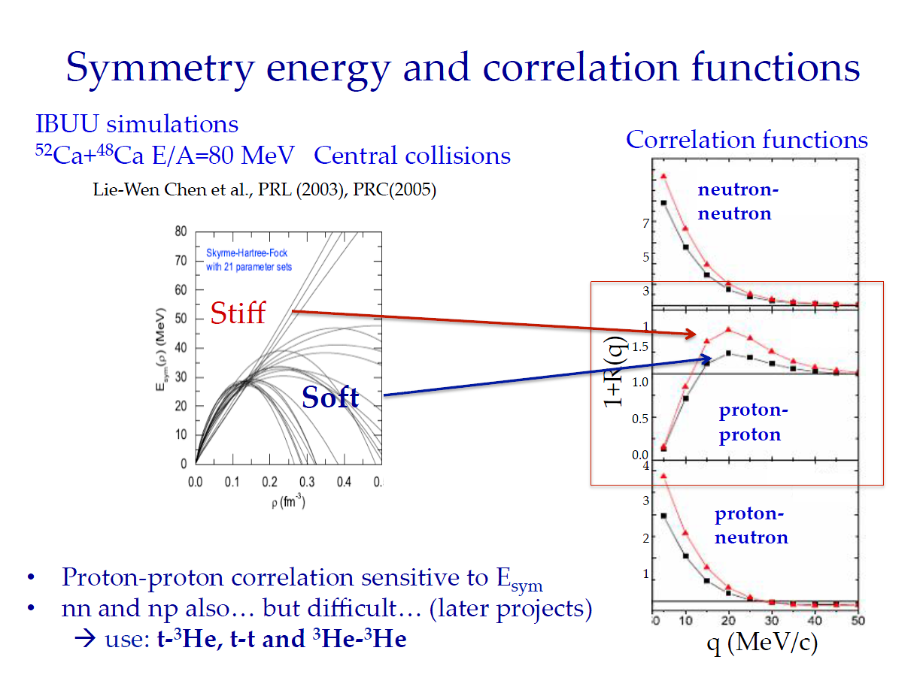
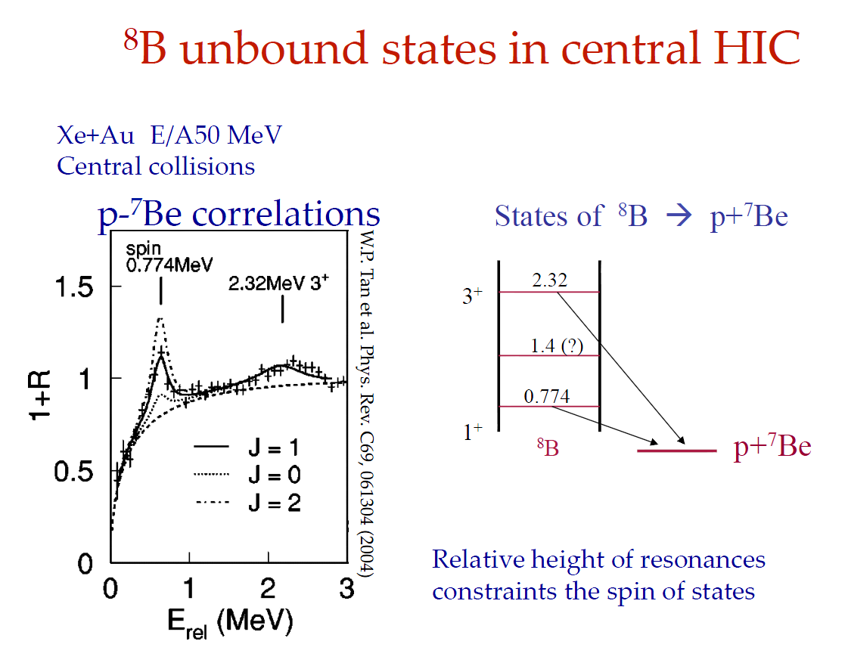
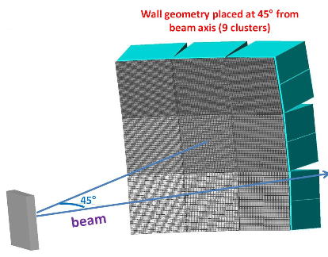
Physics Cases
Particle-Particle Correlation Function → E_{sym}
Cluster states (α-conjugate, boson condensates,…)
Invariant mass spectroscopy
Femtoscopy: space time probes of emitting source
Study of isospin effects on reaction mechanisms
and on IMF production
…
Possible Coupling of Farcos to other apparata:
Chimera
Indra
Must2
Fazia
Magnex
… … …
G. Verde
G. Verde

Slide 16


A. Trifiró¹, L. Acosta² , R. Andolina⁷, L. Auditore¹, C. Boiano³, G. Cardella⁴, A. Castoldi^{3,5}, M. D’Andrea⁴, E. De Filippo⁴, S. De Luca¹, D. Dell’Aquila⁹, L. Francalanza⁹, E. Geraci^{4,7}, B. Gnoffo⁴, C. Guazzoni^{3,5}, G. Lanzalone^{6,8}, I. Lombardo⁹, N. Martorana^{6,7}, T. Minniti¹, S. Norella¹, A. Pagano⁴, E.V. Pagano^{6,7}, M. Papa⁴, S. Pirrone⁴, G. Politi^{4,7}, F. Porto^{6,7}, L. Quattrocchi¹, F. Rizzo^{6,7}, E. Rosato⁹, P. Russotto⁴, G. Saccà⁴, M. Trimarchi¹, G. Verde^{4,10}, M. Vigilante⁹.
¹ Dipartimento di Fisica e Scienze della Terra, Università di Messina & INFN Gruppo Collegato di Messina, Messina, Italy
² Instituto de Física, Universidad Nacional Autónoma de México, México D.F. 01000, Mexico
³ INFN Sezione di Milano, Milano, Italy
⁴ INFN Sezione di Catania, Catania, Italy
⁵ Politecnico di Milano, Dipartimento di Elettronica, Informazione e Bioingegneria, Milano, Italy
⁶ INFN Laboratori Nazionali del Sud, Catania, Italy
⁷ Dipartimento di Fisica e Astronomia, Università di Catania, Catania, Italy
⁸ Università Kore Enna, Enna, Italy
⁹ INFN-Sezione di Napoli & Dipartimento di Fisica, Università di Napoli Federico II, Napoli, Italy
¹⁰ Institute de Physique Nucléaire d’Orsay, Orsay, France

