Slide 1
Summary of Deliverables
&
Reached Milestones
History and explanation of steps
Milestones this year
Deliverables: who is going to write what
Outreach : what’s done & to be Done

Slide 2
List of Work Packages & WP leaders
Prototype Construction & Production Validation (PRIELE, M1-M42)
Infrastructure & Integration (CAEN, M1-M48)
Commissioning (CERN, M12-M48)
Architecture Simulation (UniPisa, M1-M48)
Image Processing (UniPisa, M25-M48)
Silicon Detectors (CNRS,M1-M48)
Outreach (AUTH, M1-M48)
Workshops & Trainings (AUTH, M1-M48)

Slide 3
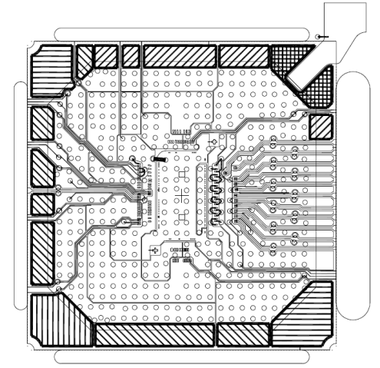
History: past, present, near future
Demonstrator: AMBFTK, LAMBFTK and
AMCHIP04 (14 mm²); produced and tested
It works but the AMchip package is unsuitable for large chips (>1 cm²) →new package, new IP core, new serialized I/O
→ New AMBSLP
→ New LAMBSLP in two versions:
  Mini_LAMBSLP for Miniasic Amchip to test the IP core
  LAMBSLP for final BGA package for AMchip05 and 06.
PQ208 (old)
BGA
23x23
(new)

Slide 4
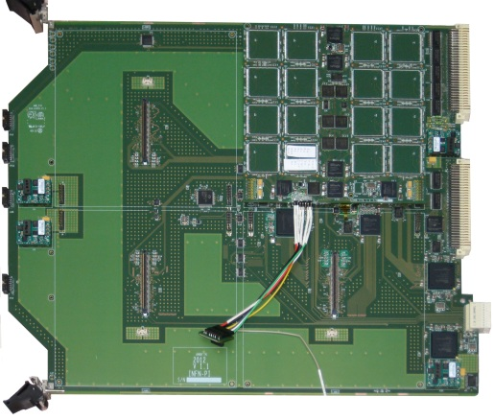
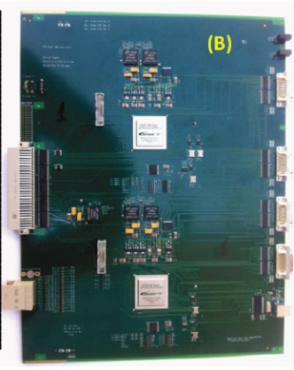
Status of Deadlines - Milestones in 2013
Milestones do not need separate documents – they will be mentioned in the periodic report
Milestone Name WP Delivery Comments
ID Leader date
M.4.1 Demo general simulation ok UniPisa M6 (July) Demonstrator: simulated architecture ok
basic AMBFTK simulation ok
M.1.1 Slp2 prototype ok at Priele PRIELE M12 (Jan) SLP2 prototype validated at PRIELE
Ongoing work – boards available (Saverio-Pierluigi)
M.1.2 Prototypes: Atlas review PRIELE M12 Atlas evaluation of FTK prototypes
M.2.1 Demonstrator ok at Caen CAEN M12 Demonstrator must run flawlessly at Caen
Integration with AUX card (Marco – Takashi)
SSB:
Final Fit-HW
(a)
Proto
AUX
AMBoard
DF

Slide 5
OUTREACH MILESTONES
M.7.1 – M.7.3 Open Days results verification AUTH M8, M20,M32
M.7.4 – M.7.6 Workshop days results verification AUTH M6, M18,M30 JULY
M.7.7 – M.7.9 Summer schools results AUTH M7, M19,M31
Summer School: VHDL language and ISE Xilinx CAD July 1 – 4 2013
http://agenda.infn.it/conferenceDisplay.py?confId=6549
Workshop DAY: July 12 2013?
IAPP Open day: inside the Department “congressino” FTK communicates to students
April 17 2013 http://www.df.unipi.it/eventi/congressino-2013

Slide 6
DELIVERABLE SUMMARY
Reports after secondments are inputs to Deliverables Deliverables are documents written by the WP leader
N. Title Nature /Dissemination Date
D.2.1 (CAEN) VS infrastructure at CAEN for FTK demonstrator (Kostas-Daniel) R/RE M6
D.4.1 (UNIPI) FTK Demonstrator detailed simulation (Marco-Simone-Daniel) R/RE M9
D.4.2 (UNIPI) Test Vectors for the FTK demonstrator (Marco-Simone-Daniel) R/RE M10
D.2.2 FTK demonstrator fully integrated with old power supply (Saverio) Pub/PU M12
D.1.1 SLP2 prototype constructed at PRIELE (Daniel) Pub/PU M12
D.6.1 (LPNHE) Test bench at CAEN (Calderini) R/RE M12
D.7.1 IAPP project open days (Paola) R/PU M7, M19, M31, M43
D.7.2 Workshop days (Paola) R/PU M5, M17, M29, M41
D.7.3 Summer school weeks (Paola) R/PU M6, M18, M30, M42
D.7.4 &
D.8.3 World wide web site for dissemination - status (Kostas) R/PU M6, M18, M30, M48
D.8.1. FTK Workshops (Paola) R/RE M1, M13, M30, M46
D.8.2. Trainings (Paola, CAEN) (AUTH is next) R/RE M1, M5, M9, M19,
M29, M47
Move next training (M9) to march: ASSOCIATE TO THE NEXT WORKSHOP AT PRISMA

Slide 7
OUTREACH SCHEDULE
http://electronics.physics.auth.gr/tomeas/en/jewel/jewel.html
Here you can find a description of the
2nd Workshop on Modern Circuits and Systems Technologies
It will be associated with the AUTH IAPP training
Immediately before or after we will have the
FTK Workshop at Alexandroupoulis → travel to Greece!

Slide 8
Aree di lavoro presente-futuro
WP1: Prisma → produzione, tests schede (Marco+?)
WP2: CAEN integrazione → clustering (Calliope), AMSLP2, SLP1 (Christos), infrastrutture
WP3: commissioning → a partire dall’anno prossimo
WP4: simulazione, studi triggers → arriva Guido

Slide 9
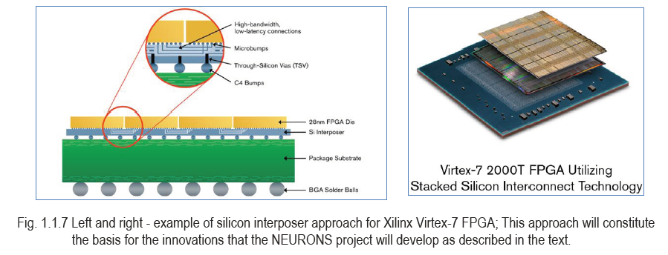
New Ideas for the future - FTK could become smaller and smaller
Multi-packaging FPGA & Amchip – mini FTK
Pattern matching
& track fitting (TF)
sqweezed in a
SIP (BGA 23x23)
TF highly parallelized
We have a very interesting quotation for FPGA bare dies to be packaged with AMchips
IMEC support for feasibility studies
FTK SIP (System In Package) becomes a real possibility – large impact on AM bank sizes

Slide 10
FTK miniaturization for long latency applications
Few future LAMBs could cover the whole detector if used for long latency applications (simulation-offline)
Goal: build a Lamb that can fit in a PC or can be accessed by a PC.
What about this size ?
FP7 IAPP - STREP PROGRAM
Coordinated by University of Pisa and INFN-Pisa
FTK

Slide 11
SLP1 – occasione con Thales
3 anni di Ph.D. pagati Marie Curie, da spendere al 50% a Parigi presso la ditta.
Multi-packaging del nostro SIP.

Slide 12
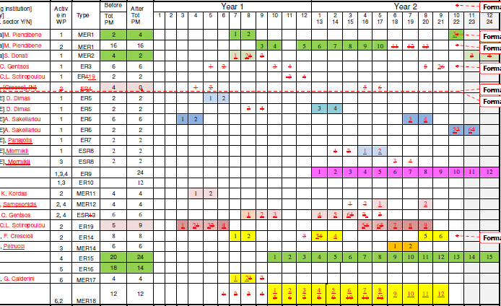
Nuova distribuzione di comandi/assunzioni
???
Guido V.
Rob. B.

Slide 13
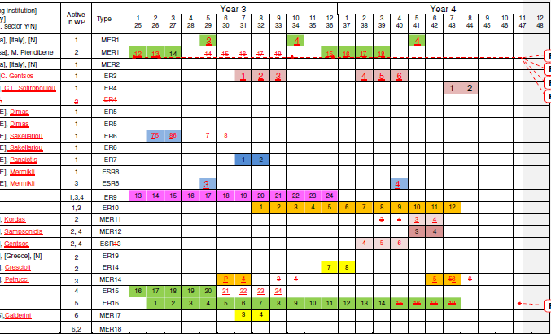
ANNO III e IV

Slide 14
CONCLUSIONS
TIME IS RUNNING FAST
trying to keep the pace ‘:-P
A LOT OF REPORTS TO PREPARE
OUTREACH AND TRAININGS ONGOING
@ high rate trigger :-D
WE HAVE AT HANDS THE EXPECTED RESULTS!

