Slide 1


Quantum algebraic curve
For N=4 SYM
Nikolay Gromov
Based on works with V.Kazakov, S.Leurent, D.Volin 1305.1939
F. Levkovich-Maslyuk, G. Sizov 1305.1944
November 6, 2013 Bologna, Italy

Slide 2

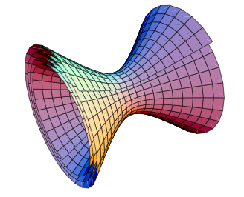
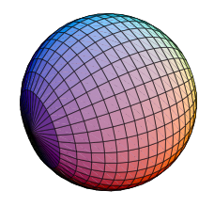
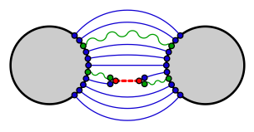
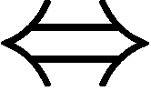
(type IIB super) string theory in AdS5xS⁵
x
Maldacena
is dual to a 4 dimensional conformal field theory (N=4 SYM)
Local operators String states

Slide 3
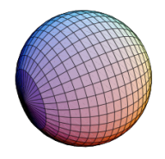
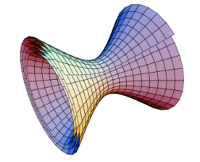
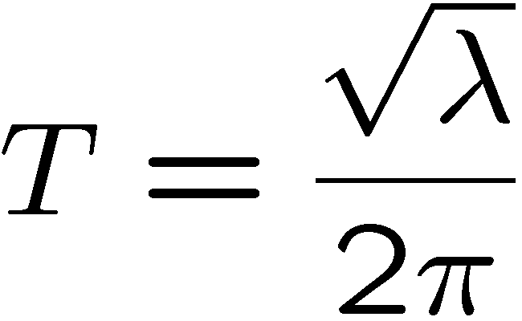
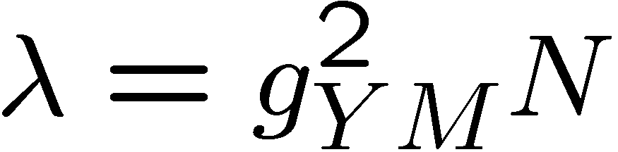
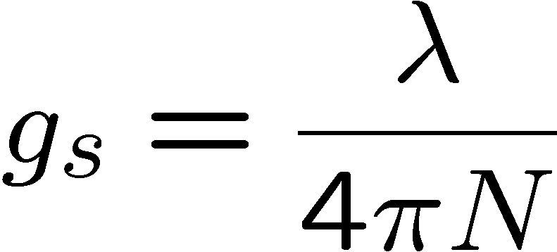
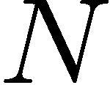
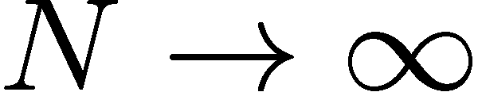
x
String tension
`t Hooft coupling
String coupling
Number of colors
We will mainly focus on
limit
i.e. planar limit in YM, and free strings

Slide 4
Lipatov
Faddeev,Korchemsky
Minahan,Zarembo,
Beisert,Kristijanssen,Staudacher
Bena,Roiban,Polchinski
Kazakov,Marshakov, Minahan,
Zarembo, Frolov, Tseytlin
Beisert,Kazakov,Sakai,Zarembo
NG,Vieira
Arutyunov,Frolov,Staudacher
Staudacher, Beisert
Janik
Hernandez,Lopez
Roiban, Tseytlin
Beisert,Eden,Staudacher
Ambjorn,Janik,Kristijanssen
Arutyunov,Frolov
Bajnok,Janik
NG , Kazakov, Vieira
Bombardelli,Fioravanti, Tateo
NG , Kazakov,Vieira
Arutyunov, Frolov
Aharony, Bergman, Jafferson, Maldacena
Minahan,Zarembo,
NG , Vieira
Babichenko,Stefanski,Zarembo
Origins of YM integrability: Lipatov’s BFKL Hamiltonian
Perturbative integrability in N=4 SYM
Classical integrability of string ϭ-model on AdS₅×S⁵
Finite gap solution and quasilcassics
S-matrix, asymptotic Bethe ansatz (ABA). Cusp dimension
Finite size corrections and mirror model
Y-system for all operators at all couplings, Konishi dimension
numerics
TBA for AdS/CFT, confirming and clarifying the Y-system
New integrable AdS/CFT’s: AdS4/CFT3, AdS3/CFT2,.....
Notes:
4

Slide 5

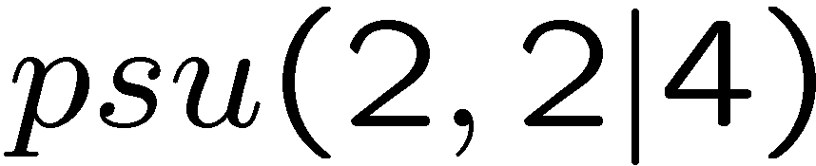
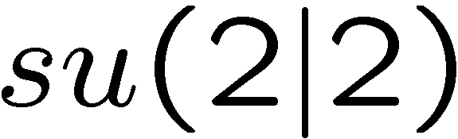
SU(N) Super Yang-Mills :
`t Hooft coupling
Anomalous dimensions of YM = spectrum of 2D integrable field theories
Symmetry:
In string theory:
Fixing light-cone gauge:
No Lorenz symmetry
No worldsheet conformal symmetry
No psu(2,2|4) symmetry
S-matrix is well defined
S-matrix factorizes – “only” 256 components

Slide 6
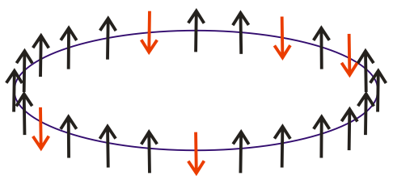
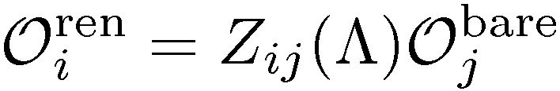
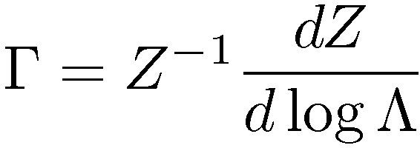
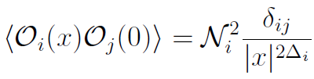
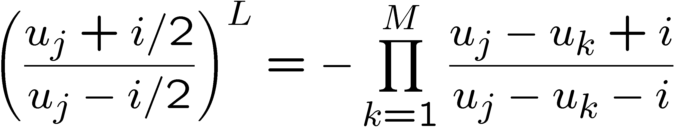
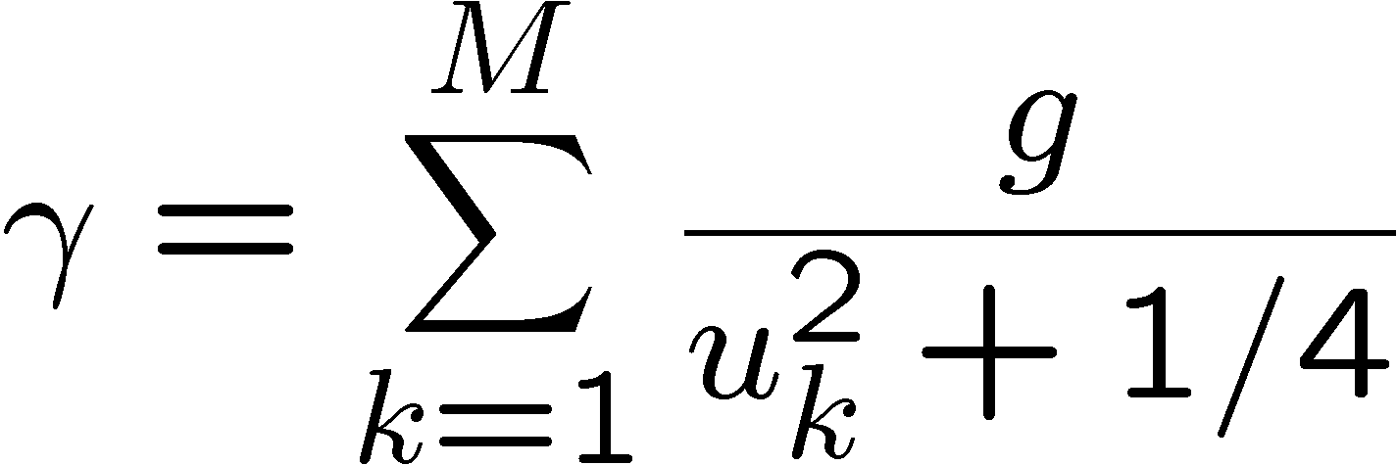
- Mixing matrix –
integrable Hamiltonian
At one loop:
[Minahan, Zarembo 2002&2008]

Slide 7
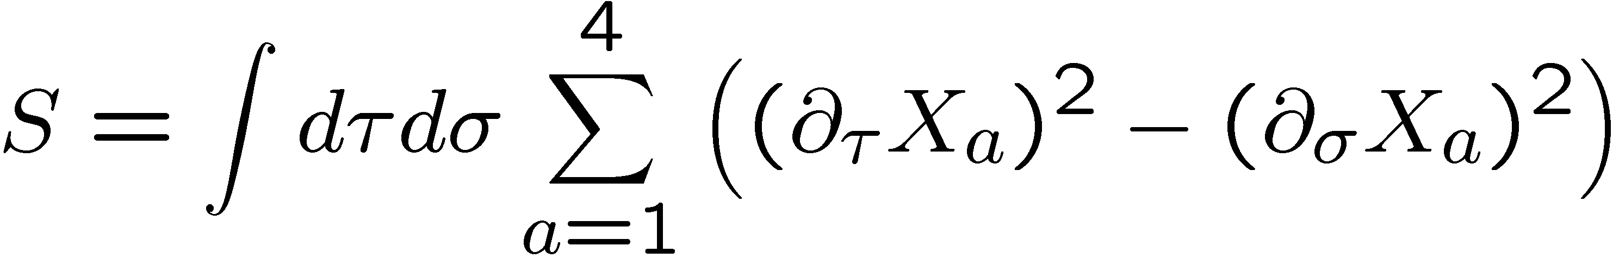
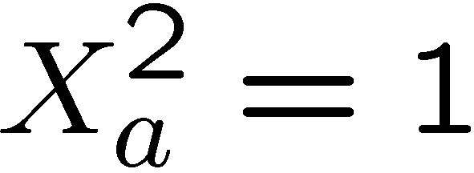
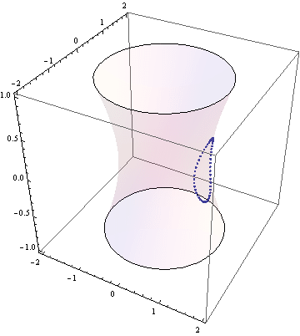
The scalar fields are constrained
Motion of the string:

Slide 8
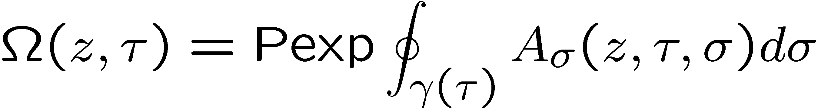
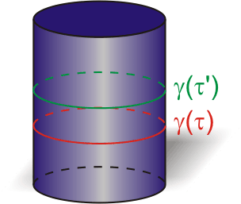
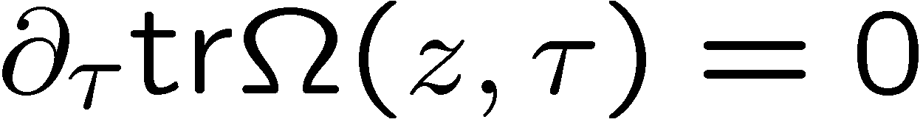
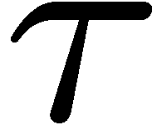
on equations of motion
Bena, Polchinski, Roiban;
Kazakov, Marshakov, Minahan, Zarembo;
Eigenvalues = integrals of motion

Slide 9
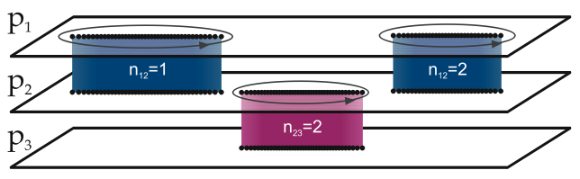

According to Beisert, Kazakov, Sakai and Zarembo, we can map a classical string motion to an 8-sheet Riemann surface
Bohr-Sommerfeld quantization condition:

Slide 10




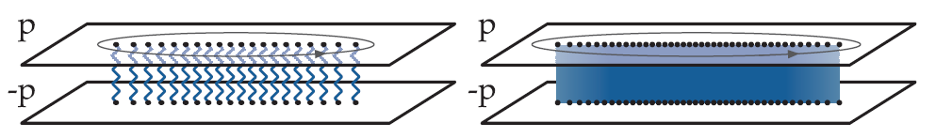

For the simplest 1D system we can define quasi-momentum:
for oscillator we have:
Schrodinger equation becomes
In the quasi-classical limit goes to zero:
Quantum
Classical

Slide 11
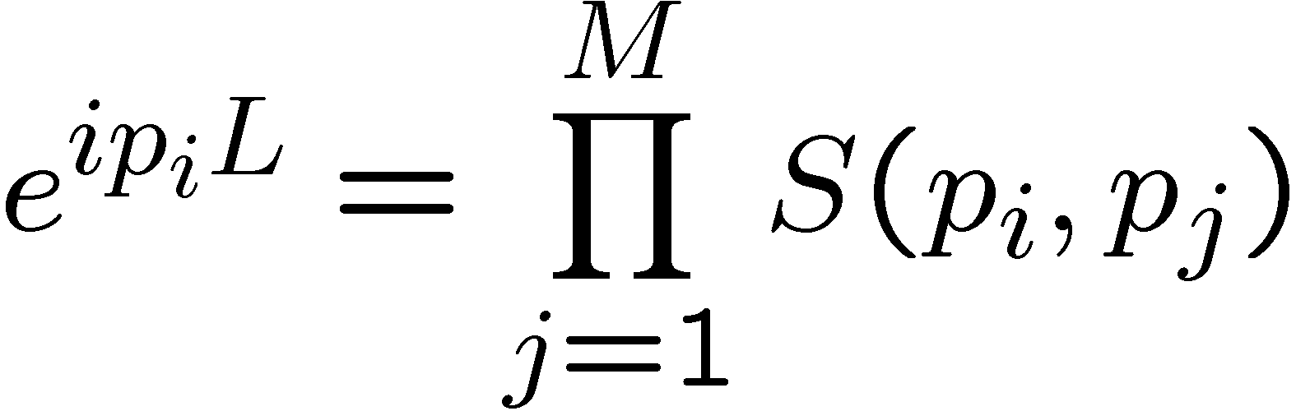

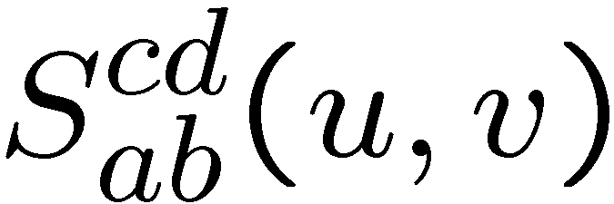




For spectral density we need finite volume
From periodicity of the wave function
SU(2|2) invariant tensor with 4 fundamental indexes
S
Notes:
Due to the properties we described above the number of particles is a conserved quantity, when the particles are far from each other. Accordingly the spectrum of the theory in the large box can be labeled by the number of particles.
Inside each sector the problem is almost finite dimentional – like nonrel. quantum mechanics with delta function iteraction.
One particle state – wave function should be periodical => e
Two prticle state – x<<y x>>y – two wave functions + Psi(x,y)=Psi(x+L,y)

Slide 12
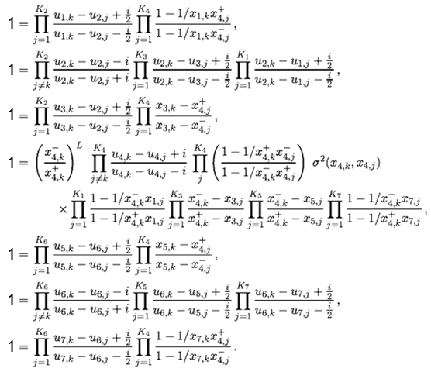


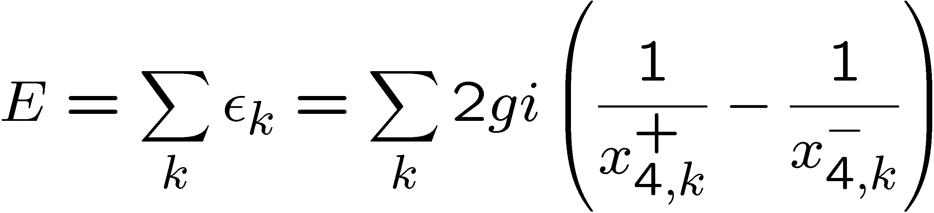
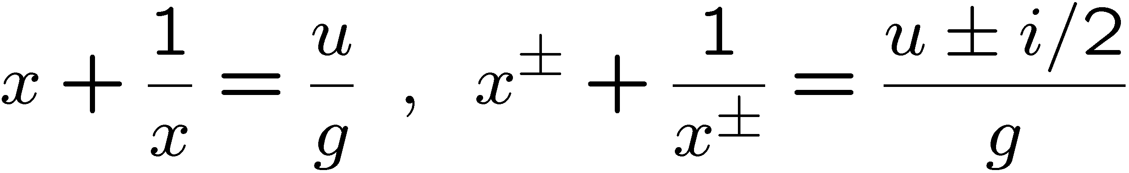
Beisert, Staudacher;
Beisert, Hernandez, Lopez;
Beisert,Eden,Staudacher

Slide 13
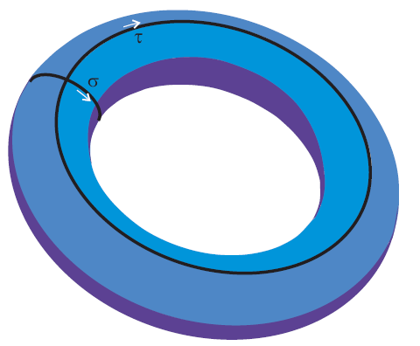
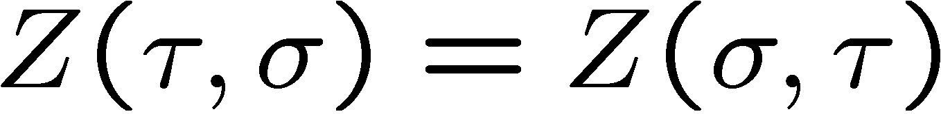
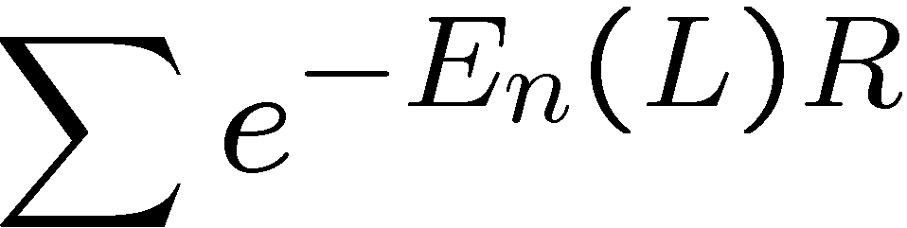
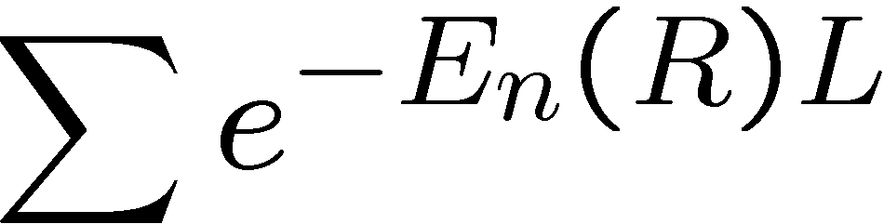
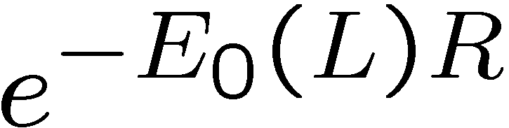
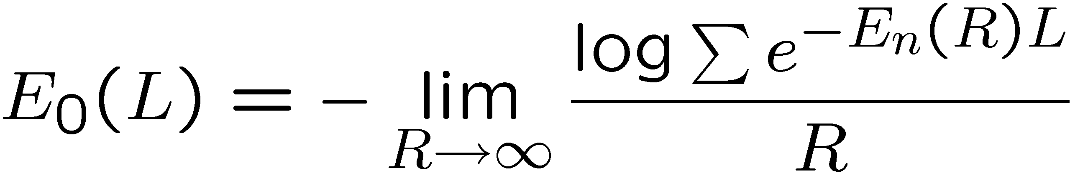
…,Matsubara, Zamolodchikov,…
I.e. from the asymptotical spectrum (infinite R) we can compute the Ground state energy for ANY finite volume!

Slide 14


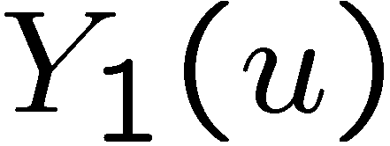
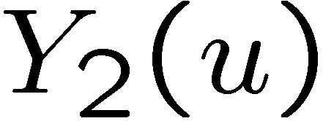
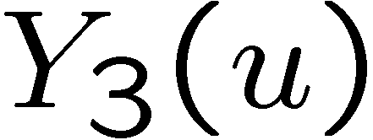
+
+
+ …

Slide 15
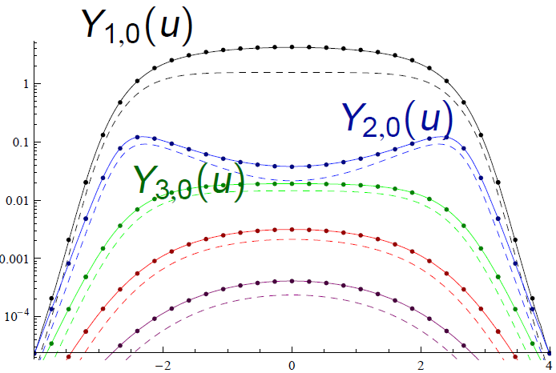
Maxwell-like distributions

Slide 16
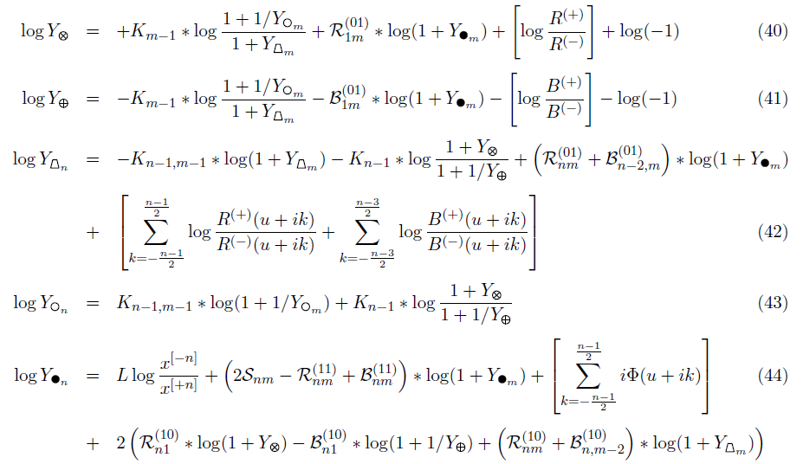
Bombardelli, Fioravanti, Tateo
N.G., Kazakov, Vieira
Arutynov, Frolov

Slide 17
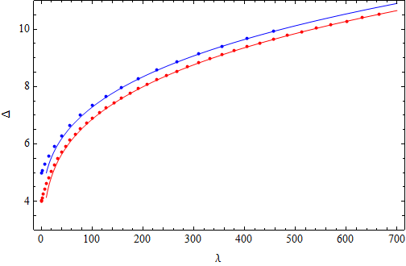
N.G., Kazakov, Vieira ‘09
Numerics
Gromov, Serban, Shenderovich, Volin`11;
Roiban, Tseytlin`11;
Vallilo, Mazzucato`11
N.G., Valatka`11
String theory
Gubser, Klebanov, Polyakov `98
Agrees with weak coupling gauge theory up to 5 loop!
Fieamberti, Fantambrogio, Sieg, Zanon `08
Eden, Heslop, Korchemsky, Smirnov, Sokatchev `12
Bajnok, Janik, Lukowski `08
Bajnok, Hegedus, Janik, Lukowski `09
Arutyunov, Frolov, Suzuki `10

Slide 18
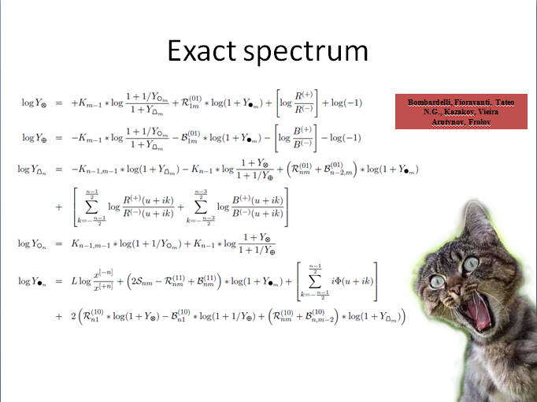
Is it the final answer to the spectral problem???

Slide 19
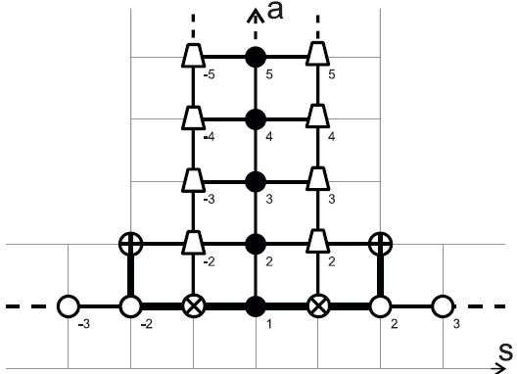
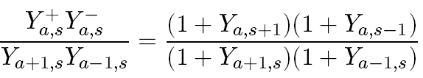
N.G., Kazakov, Vieira
+ discontinuity relations
Cavaglià, Fioravanti, Tateo

Slide 20
Quantum spectral curve

Slide 21










The system reduced to 4+5 functions:
Analytical continuation to the next sheet:
Quadratic branch cuts:

Slide 22
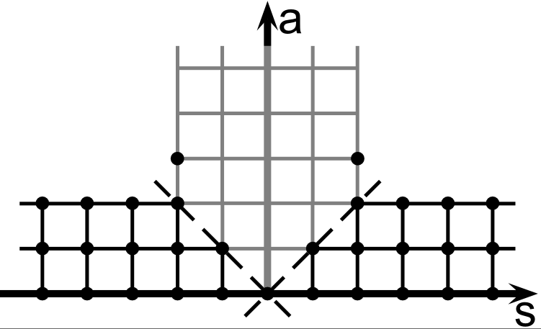





Relation to TBA
Any T-function can be found
Any Y-function can be found
Y-functions automatically satisfy TBA equations!
In particular:
Useful: [Cavaglia, Fioravanti, Tateo]
encodes anomalous dimension

Slide 23
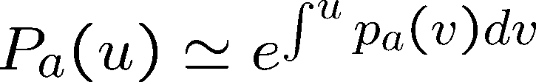

Simple relation to the quasi-momenta:
exactly like:
Quantum
Classical

Slide 24
Example: Wilson line with cusp

Slide 25




Slide 26



For L=0 the result is known from localization: [Corea,Maldacena,Sever 2012]
Which is in fact log derivative of expectation value of a circular WL
[Ericson, Semenoff, Zarembo 2000; Drukker, Gross 2000]

Slide 27




Near BPS limit – can solve analytically:
1.
2.
3.
Main simplification are small
All are trivial

Slide 28




Hilbert transform of the r.h.s.
Is a polynomial of degree L
The R-charges of the state are encoded in the asymptotics
Angle and the energy are in the coefficients of the expansion
For L=0, is a constant and

Slide 29


Slide 30

[NG, Levkovich-Maslyuk, Sizov 2013]

Slide 31

Quantum
Classical

Slide 32




Slide 33

[NG,Sever 2012;
Valatka, Sizov 2013]

Slide 34
Dressing factor

Slide 35


Next order
Small P’s imply small discontinuity of mu:
Small P’s imply small discontinuity of mu:
Result:
[NG. Sizov, Valatka, Levkovich-Maslyuk in prog.]
Dressing phase!

Slide 36


Dressing phase, asymptotic limit
Our result contains an essential part of the dressing phase:
These integrals already appeared in our result.
In general we derive the ABA of Beisert-Eden-Staudacher in full generality from
System in asymptotic limit when
is an analog of Baxter equation from which ABA follows as an analyticity
Condition.
[NG., Kazakov, Leurent, Volin to appear]

Slide 37
Conclusions
Analytical results can be generated away from BPS
By making certain analytical continuation - BFKL
More observables can be studied
Full string theory as a matrix integral (multi-matrix integral)? Skylanin variables?
Correlation functions? Relation to Bubble ansatz

