Slide 1
Thomson Source commissioning progress
C. Vaccarezza
on behalf of the SPARC_LAB team

Slide 2
Outline:
From last SPARC_LAB Program Advisory Board Meeting
SL_Thomson activity report & commissioning results on:
  150 - 75 - 50 MeV e-beam.
May-October operation report
Next commissioning plan

Slide 3
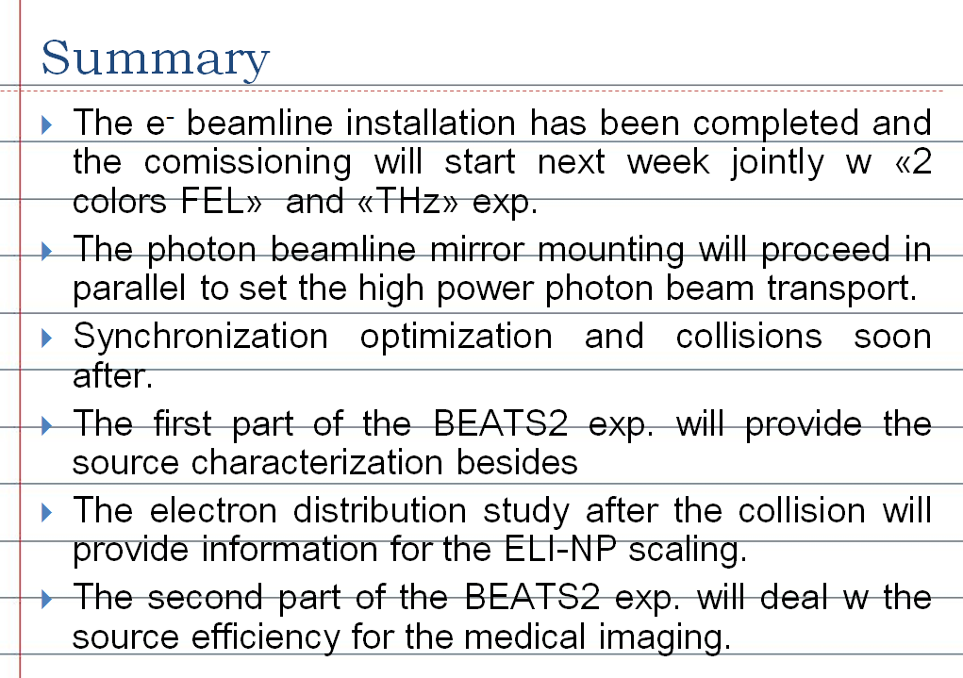
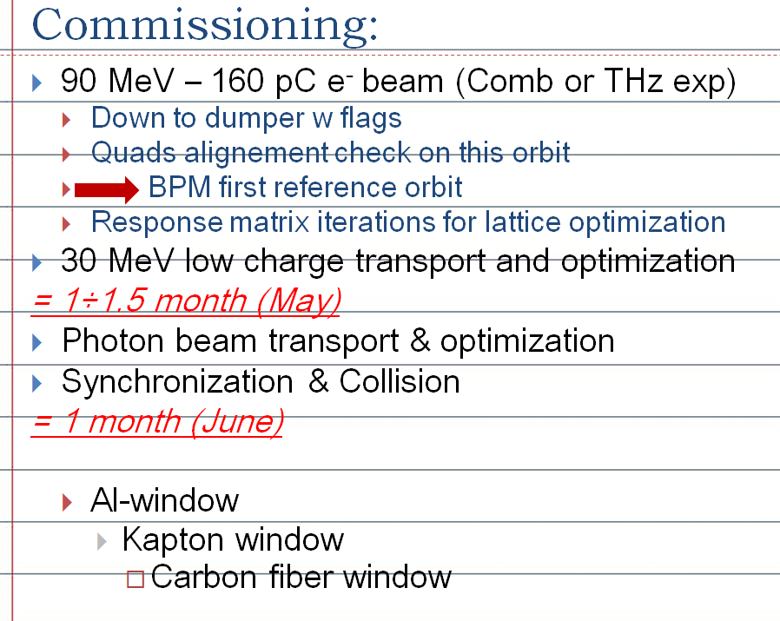
from the previous SL-AdvisoryMBoard

Slide 4

SL_Thomson activity report 1/2
End of May (e-beamline installation yet completed)
  May 29: system debug
  May 30: 157 MeV e- beam up to IP valve
June:
  June 11-14: too much severe energy jitter.
August:
  Aug 1st: 157 MeV beam on Thomson beamline
  short pulse (~300 fs from laser)
September:
  Sep 2-10 : All system check
  Sep 11-13:
    155 MeV beam e- transport check

Slide 5
SL_Thomson activity report 2/2
  Sep 18: Energy scaling to 75 MeV - beam on dumper
October:
  Oct 10-11: Energy scaling to 50 MeV - beam on dumper
  Oct 21: 1st Optimization on 50 MeV e-beam
  Oct 22: C-speed exp.

Slide 6
May-October 2013 operation report 1/2
End of May
  Laser clean room conditioning fixed (maintenance procedure revised)
June:
  First plan: 1d/w Thomson comm. – 4d/w 2col-Fel
  June 11-14: too much severe energy jitter.
  June 21 Kly1 Ampl oscillation (randomly distributed after hrs/days)
  Planning update: from June 25 devoted to 2colFel completion:
  LLRF crosstalk Kly1-Kly2 addressed
July: 2col-Fel completion:
  Severe charge and energy instability through all the period

Slide 7
May-October 2013 operation report 2/2
Sep 2-10 : All system check
Sep 11-13:
  System startup
Sep 19 - Oct 9:
  too much severe Kly2 fwd power jitter (randomly distributed after hrs/days)
  Kly2 instability addressed w :
    Monitoring of Modulator HV signal (from Dafne during night)
    Modulator on resistive load
    HV cable replacement
Oct 14-25:
  Photon beamline finalization & transport (G. Gatti)

Slide 8
Next commissioning plan
Oct 21-25 :
  50 MeV e-beam transport check and RM acquisition
  Measuring Propagation Speed of Coulomb Fields at SPARC_LAB: C-speed
  50 MeV e-beam final focusing w :
    Spot size quadrupole bump calibration at IP
    Position & angle bump calibration at IP
  X-ray Detector background acquisition (local remote)
Oct 28-31:
  Photon beamline finalization & transport (G. Gatti)
Nov 5-17 (-25) TeraHz exp. Completion
Nov 22 (28)- Dec
  Long pulse from laser (10-13 ps) Q=250-300 pC
  e-beam FF on IP
  Collision startup

Slide 9
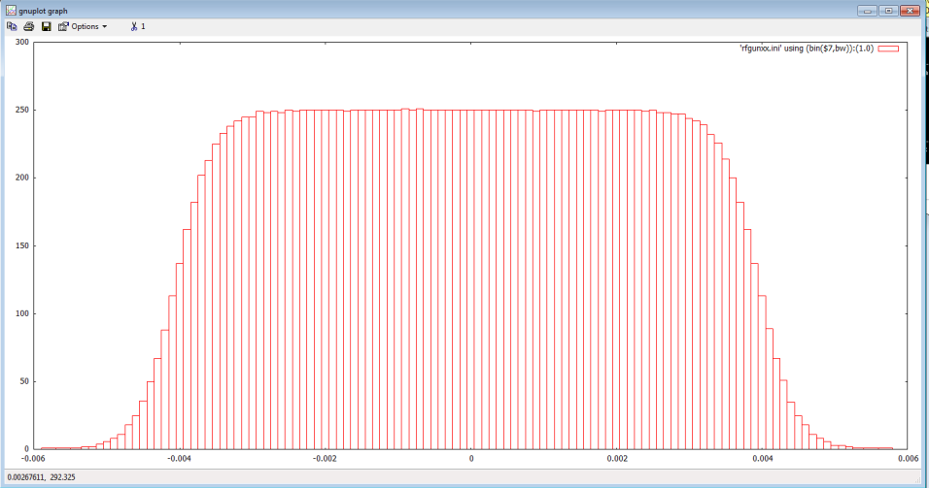
From simulations: (A. Bacci)
Thomson two different WPs: 80MeV, 200pC, case 1) and case 2)
SOL1 ON, 0.07T, corrisponde a circa 100A
Espread=94KeV (0.07%)
flat-top=8ps
rise_time=1ps, sig_x =0.300mm (uniform)
Fase gun=-5.6 dall’energia massima
Fase S1=-27.7
Fase S2=+27.7
Fase S3=+182.2
SOL1 & SOL2 ON, 0.03T & 0.015T
Espread=58KeV (0.11%)
flat-top=11ps
rise_time=1ps, sig_x =0.22mm (uniform)
Fase gun=-2.5 dall’energia massima
Fase S1=-46.3
Fase S2=+46.3
Fase S3=-0.6

Slide 10
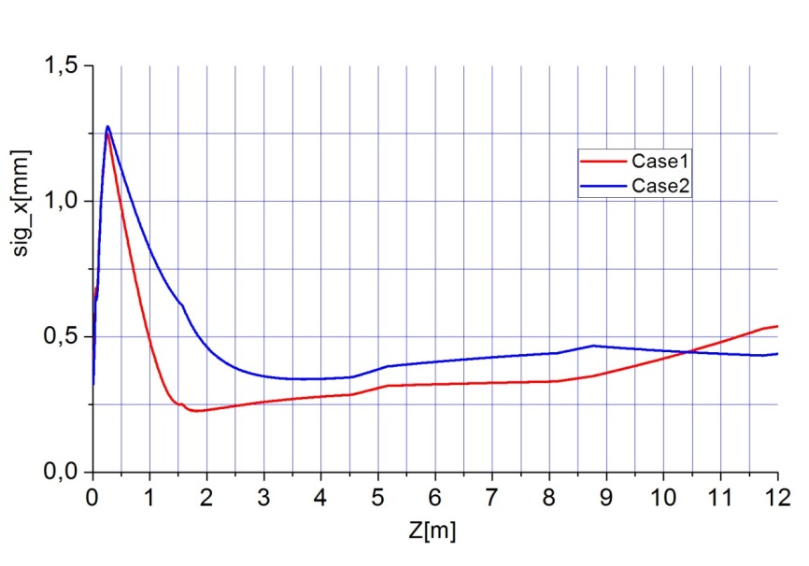
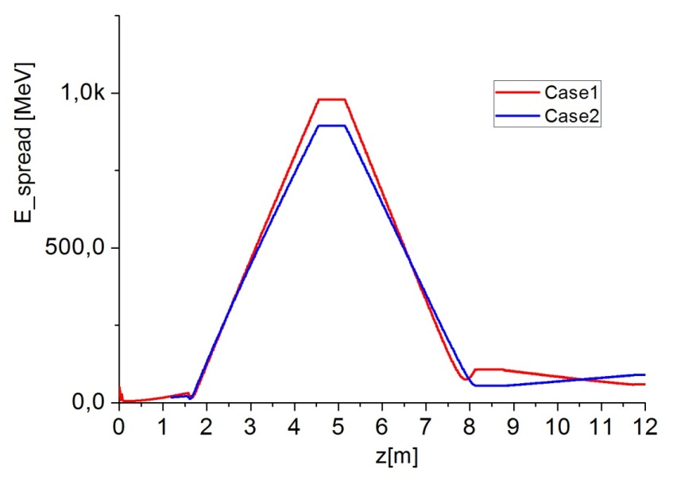
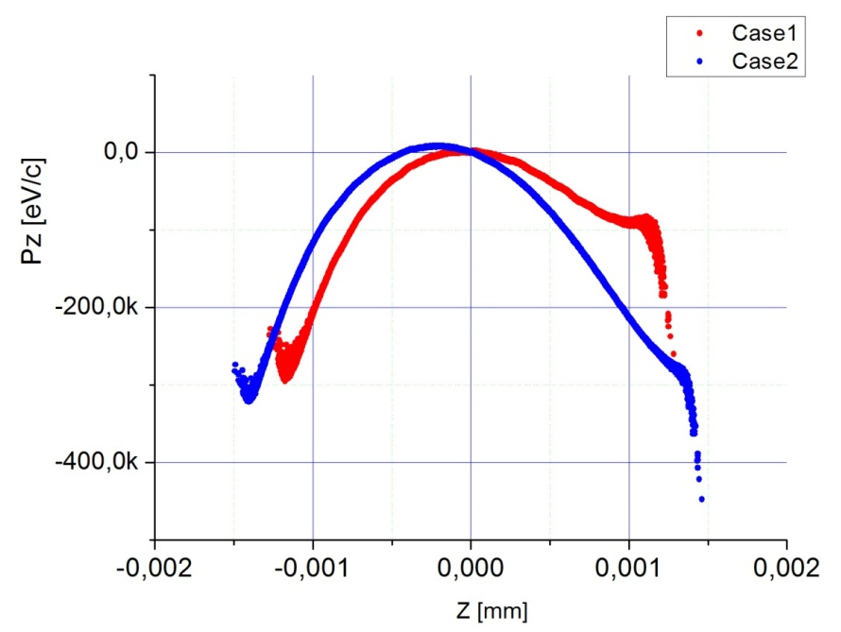
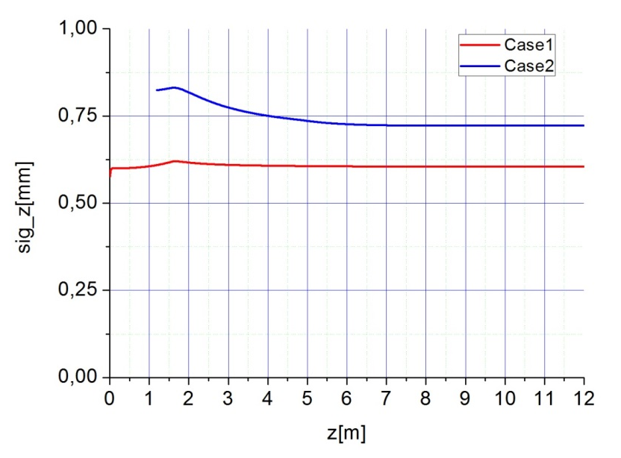
Phase space:

Slide 11
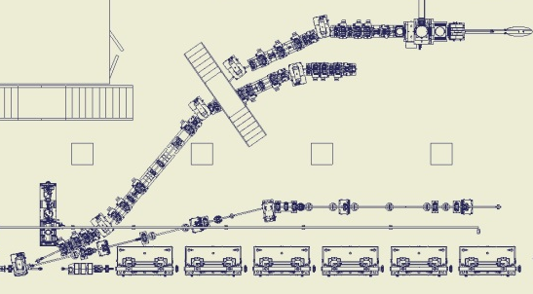
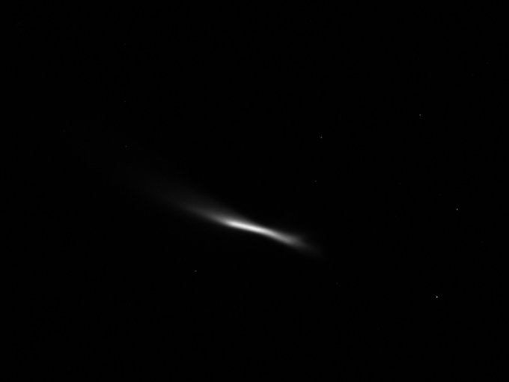
THMFLG02 May 30, 2013
back

Slide 12
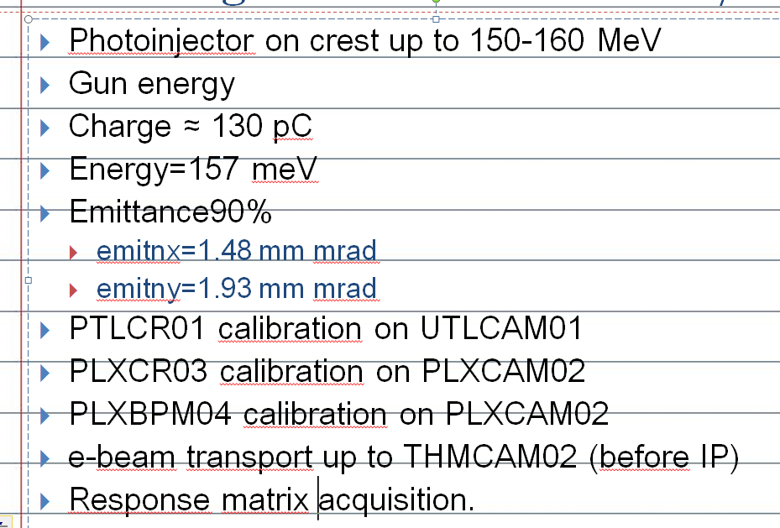
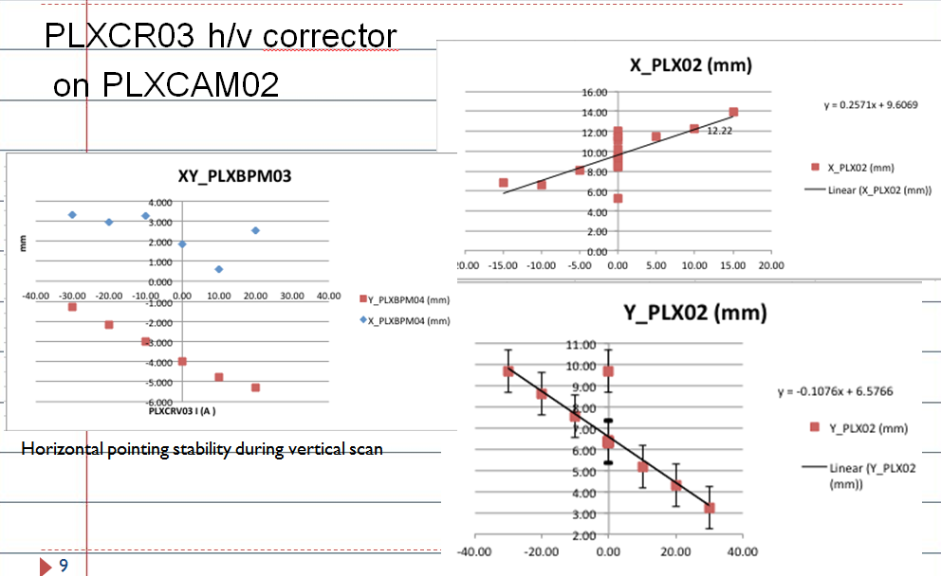
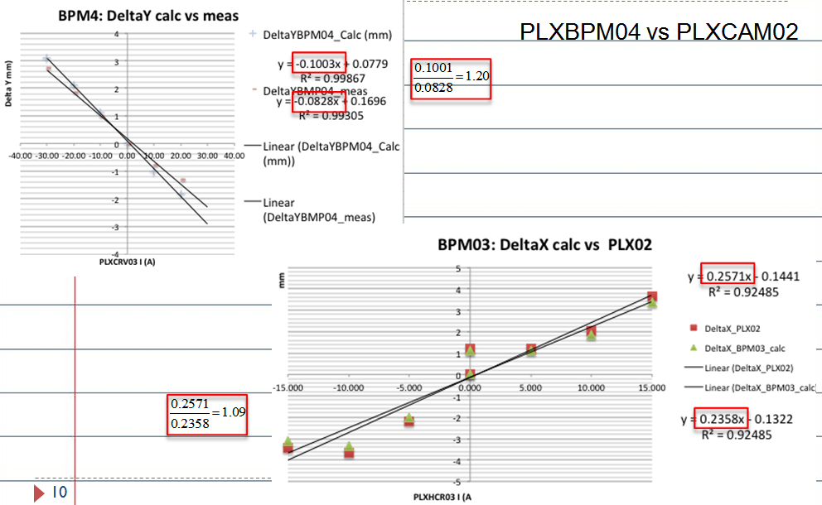
Aug 1st, 2013
back

Slide 13
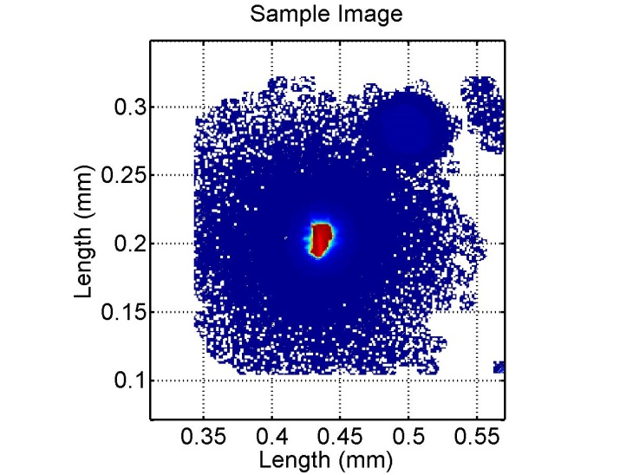
Sep.13th :System ON
back
  Energy from gun =5.50(MeV)
  Charge ≈ 300pC
  Energy=157 meV
  Emittance meas:
    Emittance90%
    emitnx=2.70711 mm mrad
    emitny=5.00067 mm mrad
  Grounding problem on BCM1:
  solved
  Shift end : THMCAM02 fault.
Al window (200 µm)
Spot on Thomson IP
(THFLG03)
E=157 MeV
X Sigma (mm) 0.50 (2.E-2)
Y Sigma (mm) 0.28 (1.E-2)

Slide 14
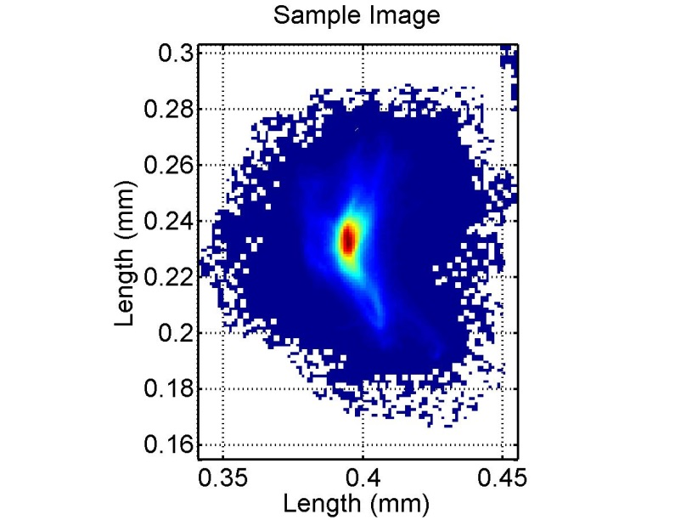
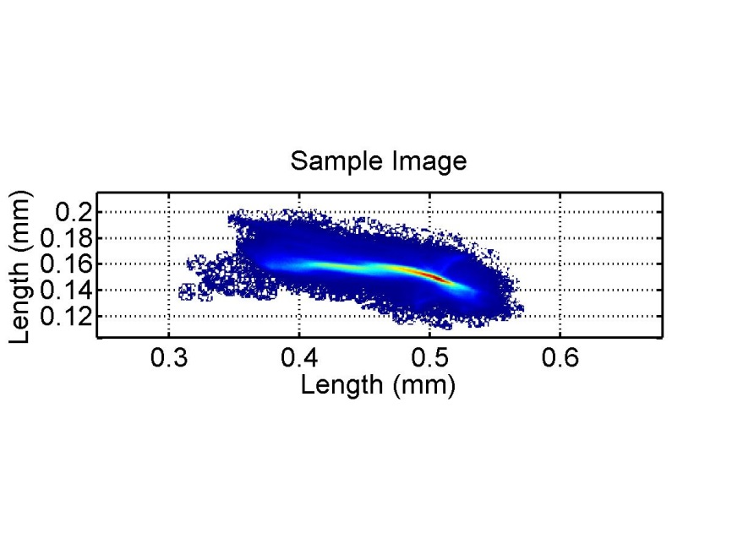
Sep. 18th : energy scaling to 75 MeV
back
Spot on Thomson IP (THMFLG03)
E=75 MeV, Q=240 pC
X Sigma (mm) 0.55 (2.E-2)
Y Sigma (mm) 0.36 (1.E-2)
Spot on THMFLG04 (downstream dumper)
E=75 MeV
X Sigma (mm) 1.60 (2.E-2)
Y Sigma (mm) 0.34 (1.E-2)

Slide 15
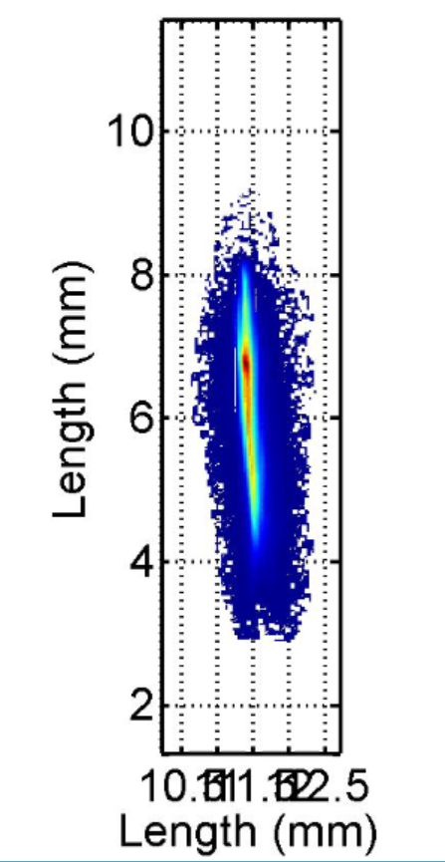
Oct. 10-11: energy scaling to 50 MeV
-back
Q=240 pC
Emittance 90%:
emitnx= 1.5 mm mrad
emitny = 2.8 mm mrad (wo optimization)
X Sigma (mm) 2.68E-1 (5.89E-3)
Y Sigma (mm) 1.08E+0 (5.45E-2)
Spot on Thomson IP
E=50 MeV
NB dispersion not corrected!

Slide 16
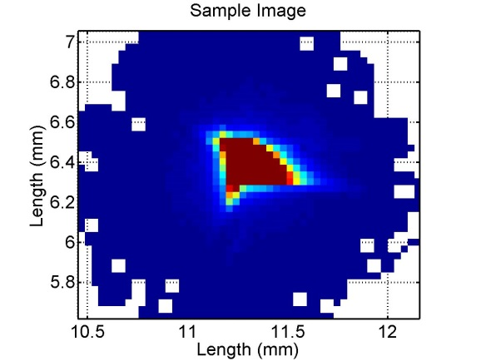
Oct. 21: 50 MeV 1st optimization run
-back
Q=230 pC
Emittance 90%:
emitnx= 1.2 mm mrad
emitny = 2.3 mm mrad (no solenoid on S1-S2)
sigmaz= 2ps
sigmaδ < 0.1%
Spot on Thomson IP
E=50 MeV
X Sigma (mm) 1.83E-1 (6.96E-3)
Y Sigma (mm) 1.66E-1 (6.91E-3)
X centroid (mm) 1.13E+1 (1.11E-2)
Y centroid (mm) 6.32E+0 (5.04E-2)

