Slide 1


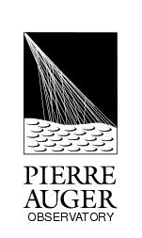
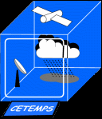


Raman LIDARs for Pierre Auger Observatory: field experiences and results.
Vincenzo Rizi
CETEMPS,
Dipartimento di Scienze Fisiche e Chimiche,
Università Degli Studi dell’Aquila,
L’Aquila, Italy
vincenzo.rizi@aquila.infn.it
AtmoHEAD 2014 - Padova Italy, 19-21 May, 2014

Slide 2
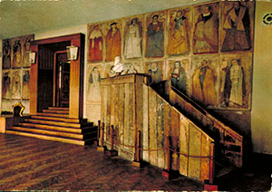
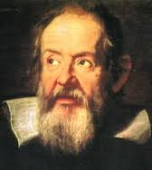
SORRY!

Slide 3
OUTLINE
The different Raman LIDARS at Pierre Auger Observatory
Performances and constrains
Aerosol observations
Some results and comments

Slide 4
Primary issue.
Is the Raman LIDAR useful to the High Energy Astroparticle Detectors?
YES
Why?

Slide 5
atmosphere as a calorimeter
fluorescence detector concept
UHECR (Ultra High Energy Cosmic Rays)
energy deposit in the atmosphere
fluorescence (UV range)
fluorescence detector
Fluorescence yield
Detector calibration
E: shower energy
T: atmospheric optical transmission

Slide 6
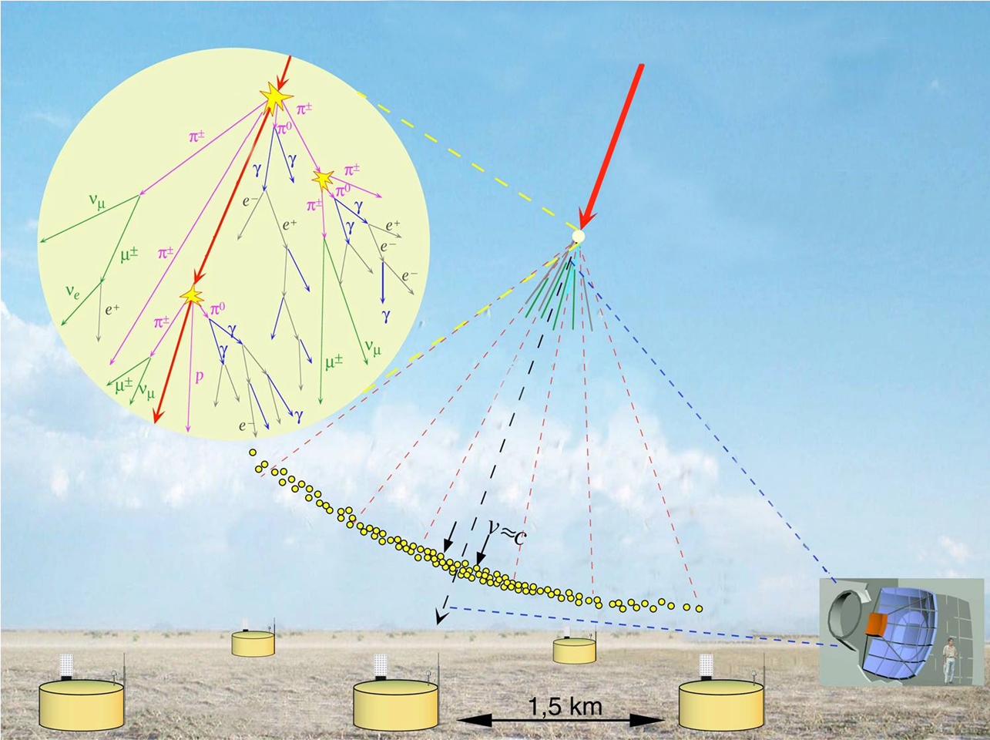
http://apcauger.in2p3.fr/Public/Presentation/

Slide 7
Total atmospheric (optical) transmission
It can be easily estimated with sufficient precision ...
High variability …
direct measurements
s range along the line of sight
The absorption can be neglected …

Slide 8
LIDAR ARCHITECTURE
TRANSMITTER
RADIATION SOURCE
RECEIVER
LIGHT COLLECTION AND DETECTION
SYSTEM CONTROL AND DATA ACQUISITION

Slide 9
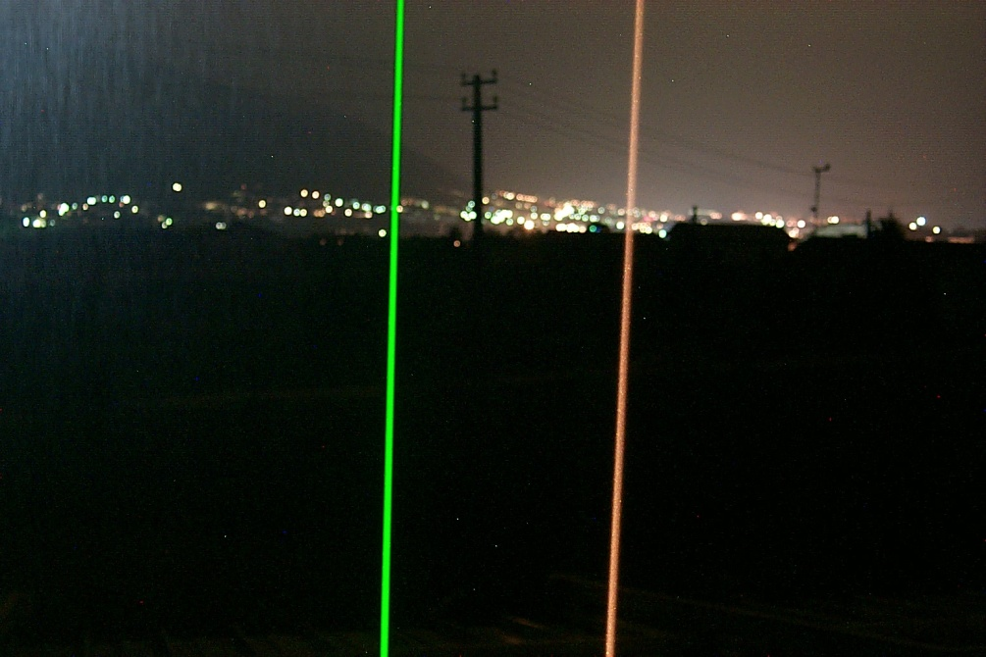
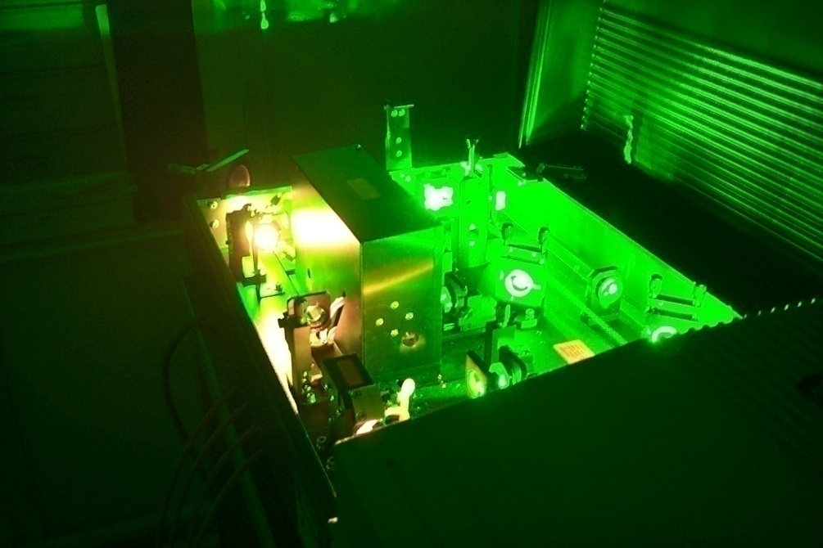
TRANSMITTER
It provides laser pulses that meet certain requirements depending on application needs (e.g., wavelength, pulse duration time, pulse energy, repetition rate, divergence angle, etc).
Transmitter consists of lasers, collimating optics, diagnostic equipment.

Slide 10
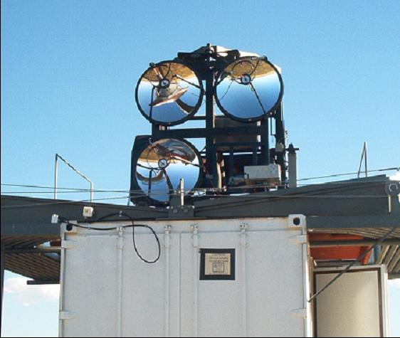
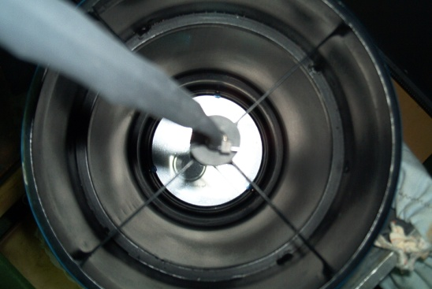
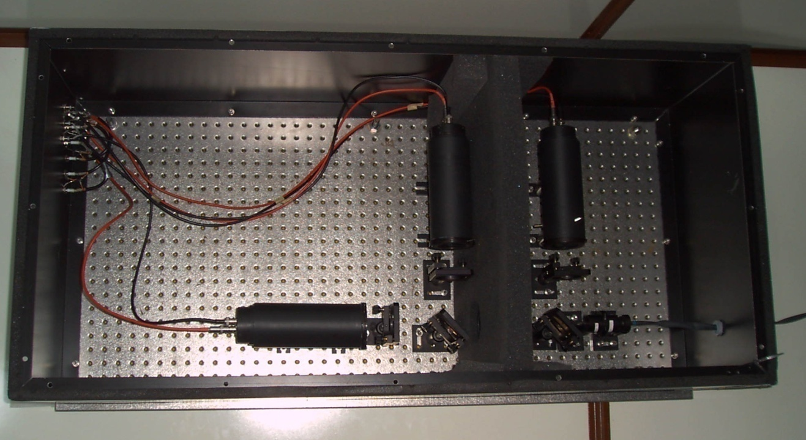
RECEIVER
It collects and detects returned photons
It consists of telescopes, filters, collimating optics, photon detectors, discriminators, etc.
The receiver can spectrally distinguish the returned photons.

Slide 11
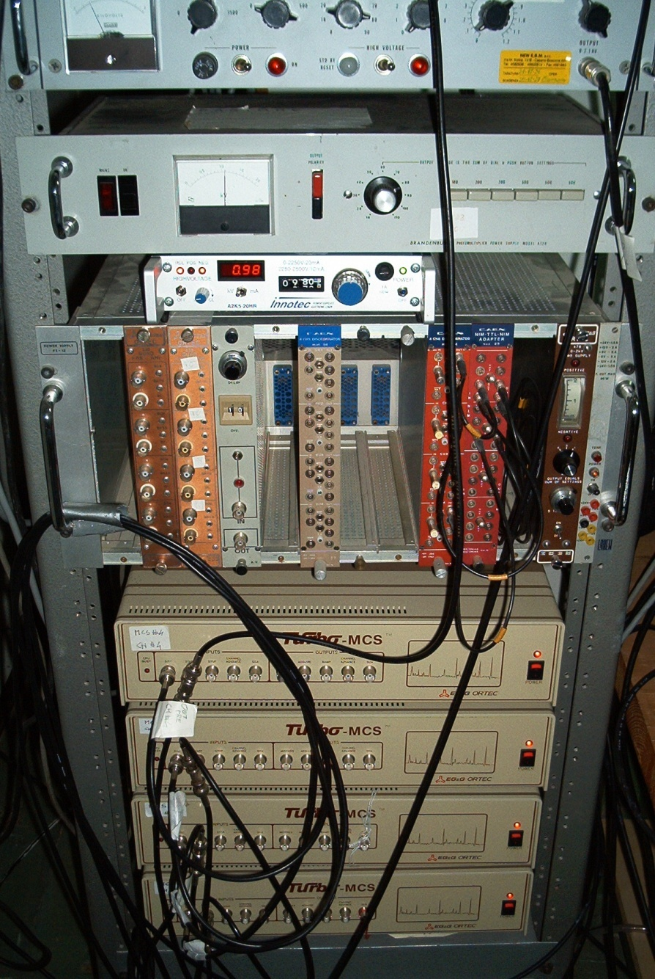
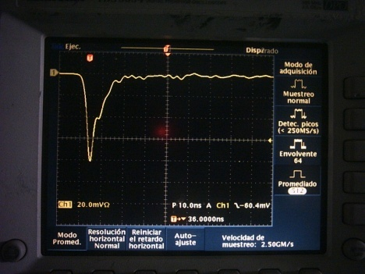
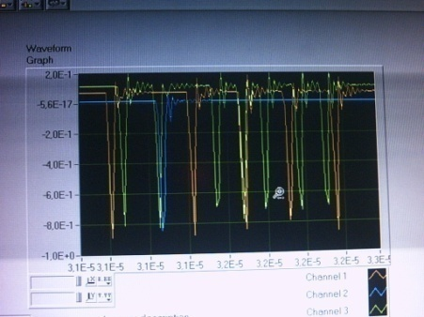
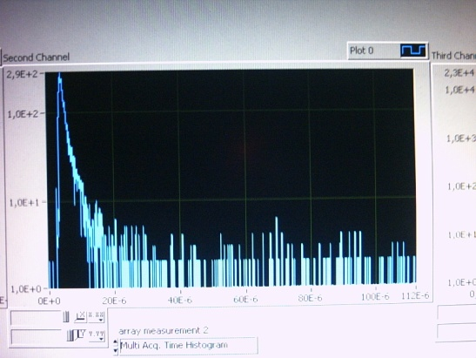
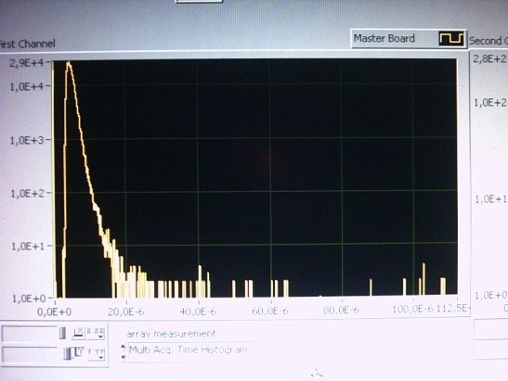
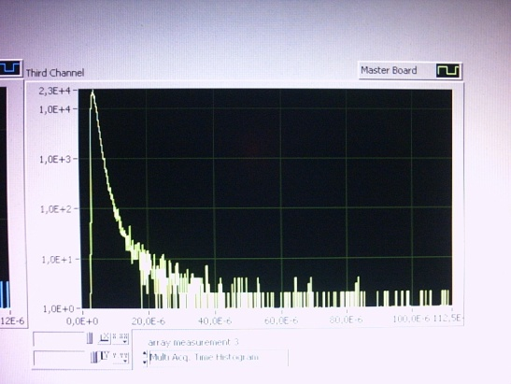
SYSTEM CONTROL AND DATA ACQUISITION
It records returned data and corresponding time of flight, and provides the coordination to transmitter and receiver.
It consists of multi-channel scaler which has very precise clock so can record time precisely, discriminator, computer and software.

Slide 12
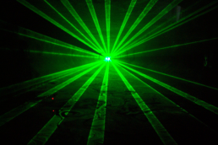
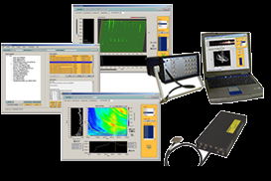
Interaction between
radiation and object
signal
propagation
radiation
propagation
radiation
source
detector
Data acquisition and analysis

Slide 13
Interaction between
radiation and object
signal
propagation
radiation
propagation
radiation
source
detector
Data acquisition and analysis

Slide 14
Emitted laser photon number
Laser photon transmission through medium
Probability of a transmitted photon to be scattered
Scattered photon transmission through medium
Probability of a scattered photon to be collected
Lidar system efficiency and geometry factor

Slide 15
In general, the interaction between the light photons and the particles is a scattering process.
The expected photon counts are proportional to the product of the
(1) transmitted laser photon number,
(2) probability that a transmitted photon is scattered,
(3) probability that a scattered photon is collected,
(4) light transmission through medium, and
(5) overall system efficiency.
Background photon counts and detector noise also contribute to the expected photon counts.

Slide 16
A PARTIAL REPRESENTATION
(a physics-ological drama)

Slide 17
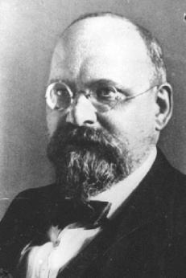
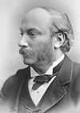
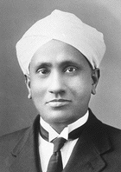
LIDAR PHYSICAL PROCESS
Interaction between light and objects
Scattering (elastic & inelastic): Mie, Rayleigh, Raman
…
Light propagation in atmosphere or medium: transmission/extinction
Extinction = Scattering + Absorption

Slide 18
scattering
back-scattering
aerosol
back-scattering
LIDAR
extinction
aerosol extinction

Slide 19


Back-scattering cross sections
Physical process | Back-scattering cross section
Mie (aerosol) scattering | 10⁻⁸ ÷ 10⁻¹⁰ cm² sr⁻¹
Rayleigh scattering | 10⁻²⁷ cm² sr⁻¹
Raman scattering | 10⁻³⁰ cm² sr⁻¹
receiver
laser

Slide 20
Example ...λ_{o}=355nm
Δλ~21nm
Δλ~32nm
Δλ~53nm

Slide 21
LIDAR … aerosol devoted

Slide 22
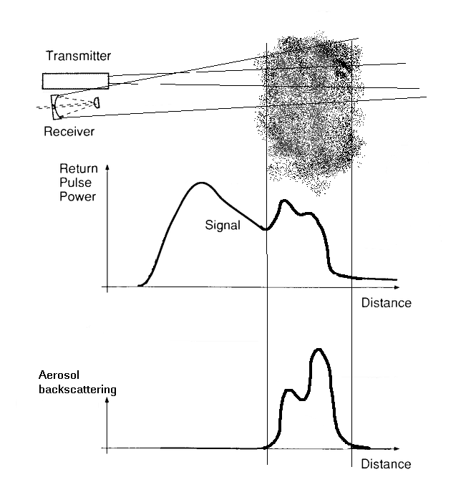

Aerosol lidar
i.e., tropospheric aerosols
backscattering increase

Slide 23
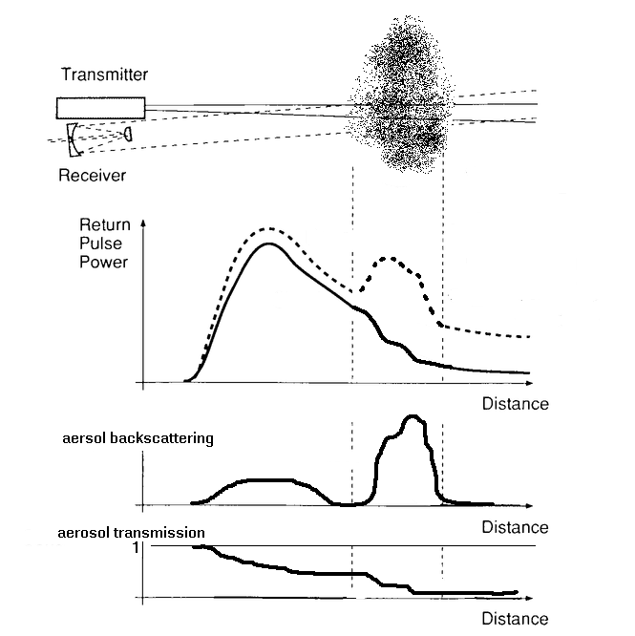
Raman aerosol lidar
i.e., tropospheric aerosol
Rayleigh/Mie signal
λ_{o}
more backscattering
N₂ Raman/anelastic signal
λ_{o}+Δλ_{N2}
more attenuation
no backscattering

Slide 24
Main characteristics
capability of detecting low light levels
suppression of cross-talking between the different
channels (i.e, suppression of the strong elastically
backscattered light in Raman channels)

Slide 25
Real Raman signal in presence of a cloud
Nitrogen Raman
1/2 hour
measurements
nighttime
Sept. 2001
cloud transmission
Air/aerosol Rayleigh
cloud backscattering

Slide 27
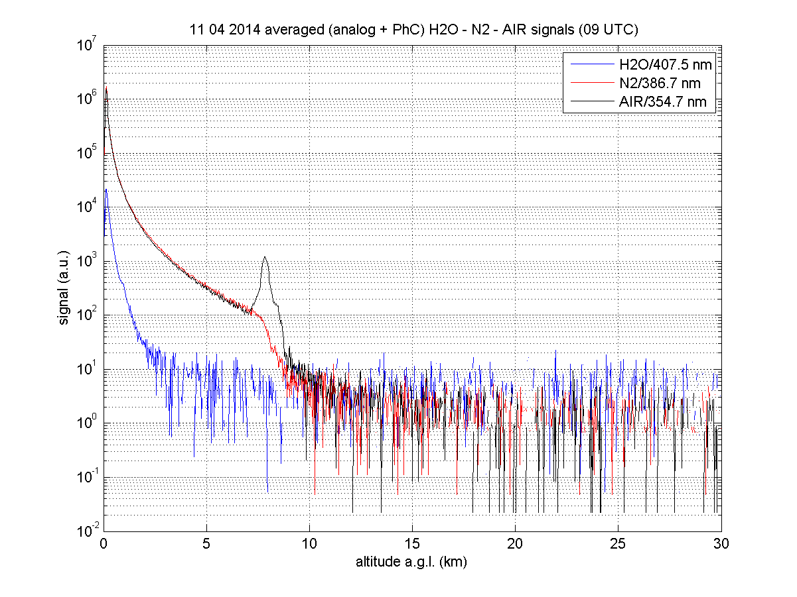
Raman LIDAR signals

Slide 28
WHY … a Raman LIDAR system? 1/2
ADVANTAGES of Raman LIDAR technique:
A major drawback of backscatter LIDARs is that it is not possible to independently invert the optical parameters of interest, namely, the aerosol extinction (i.e., attenuation) and the aerosol backscatter (equivalently to the mean reflectivity in the observation volume) without introducing correlating hypotheses between these two parameters.
This limitation is, however, superseded by Raman LIDARs, i.e., systems combining the elastic channel and one inelastic (nitrogen or oxygen) Raman channel.

Slide 29
WHY … a Raman LIDAR system? 2/2
DISADVANTAGES of Raman LIDAR technique at AUGER:
Limited measurement time period.
It needs long acquisitions (∼ 30 min)

Slide 30
The standard atmospheric Raman lidar are usually deployed where the aerosols are abundant!
Within AUGER observatories, we are facing the sensitivity limits of the Raman lidar sampling.
This is improving the understanding of the technique.

Slide 31
The different Raman LIDARS at Pierre Auger Observatory

Slide 32
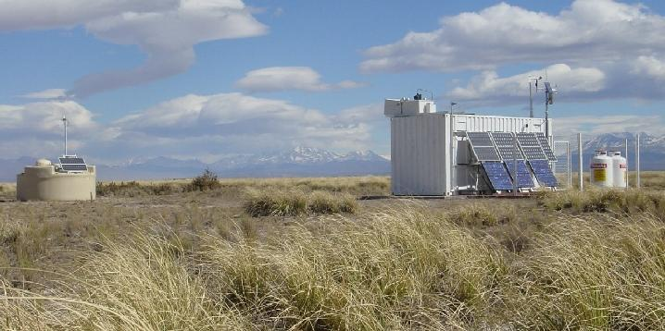
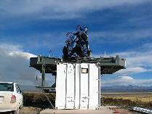
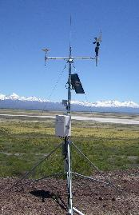
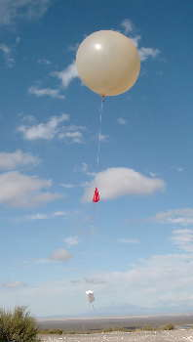
AUGER Atmospheric monitoring
Understanding fluorescence data requires monitoring atmospheric conditions
Laser facilities
FRAM, HAM
APF
Star monitor
LIDAR
at each eye
Weather stations
& Radiosondes

Slide 33
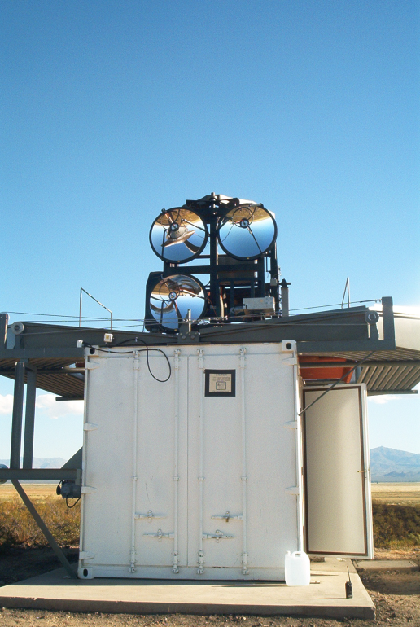
Aug. 2006 to Jun. 2007
RAMAN LIDAR (located at Los Leones: 35.32S, 69.30W, 1416m a.s.l.),
remotely operated, with the primary goal of measuring (at the best) the
vertical profile of the aerosol optical depth.
In spite of some problems, one year of observations allows to characterize the aerosols climatology over the site.
# 1
V.R.

Slide 34
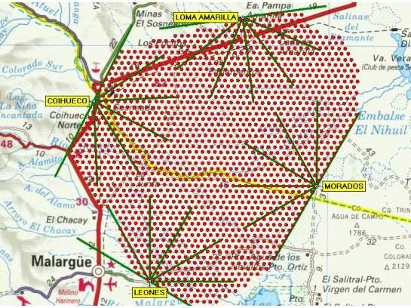
WHERE … was the RAMAN LIDAR located?
expected a high degree of horizontal homogeneity in the atmospheric properties

Slide 35
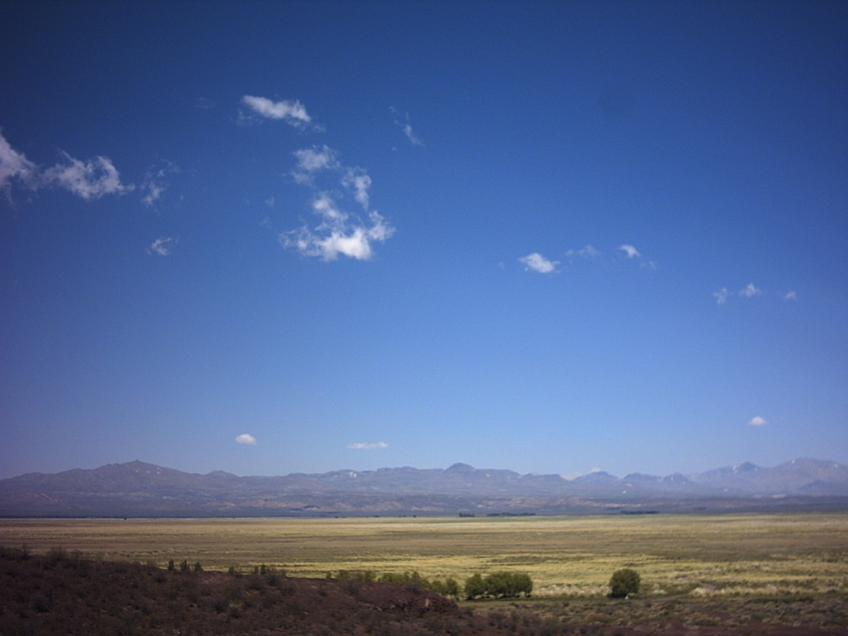
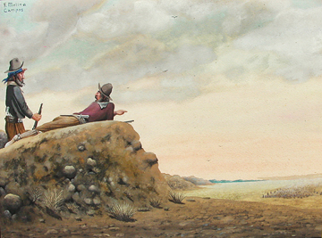
F. Molina Campos
V.R.

Slide 36
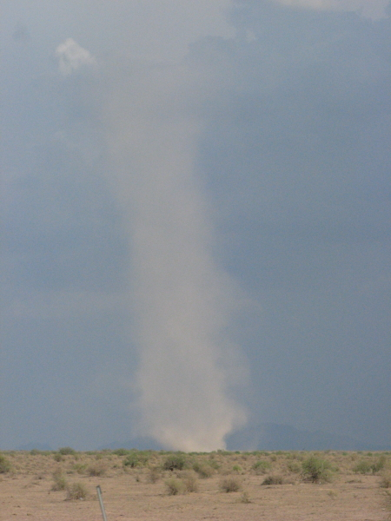
AUGER RAMAN
LIDAR
in the dry or semi-arid pampa
V.R.

Slide 37
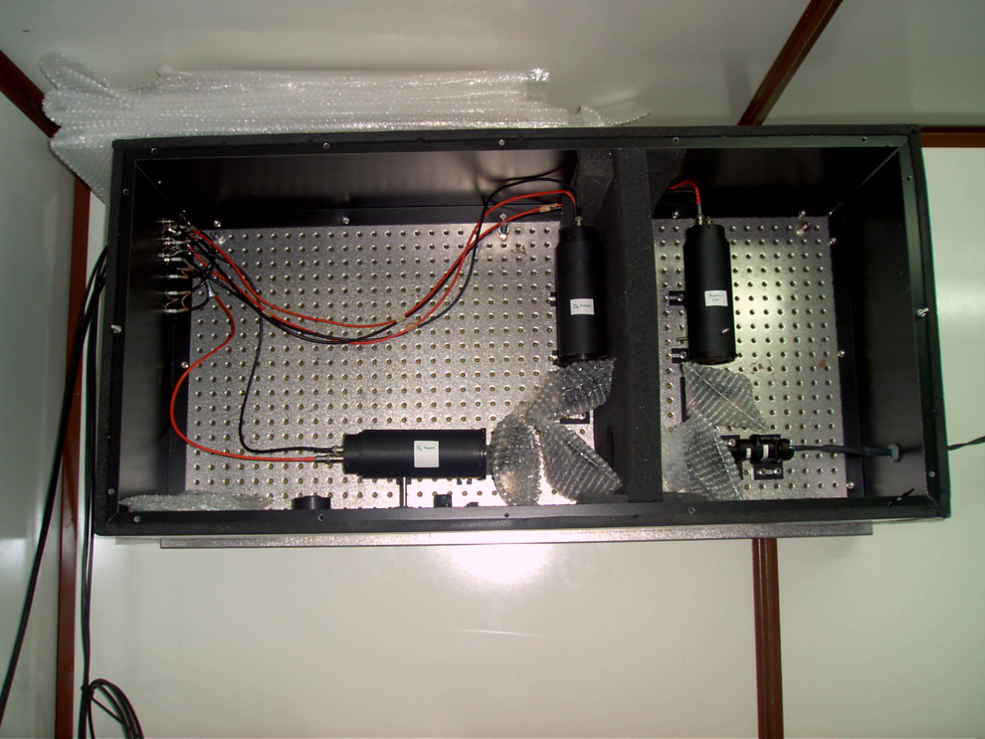
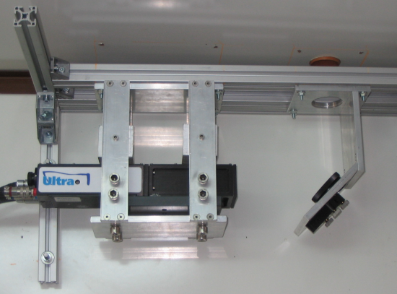
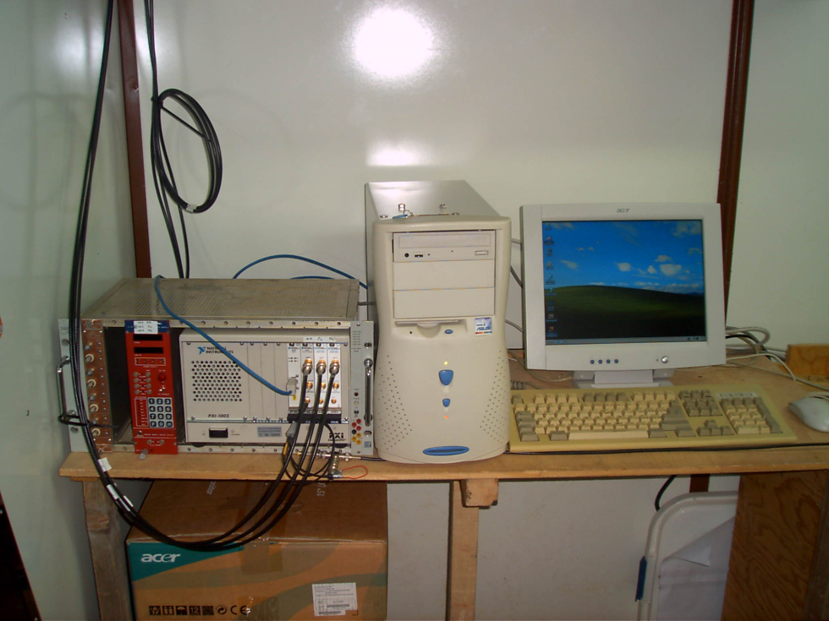
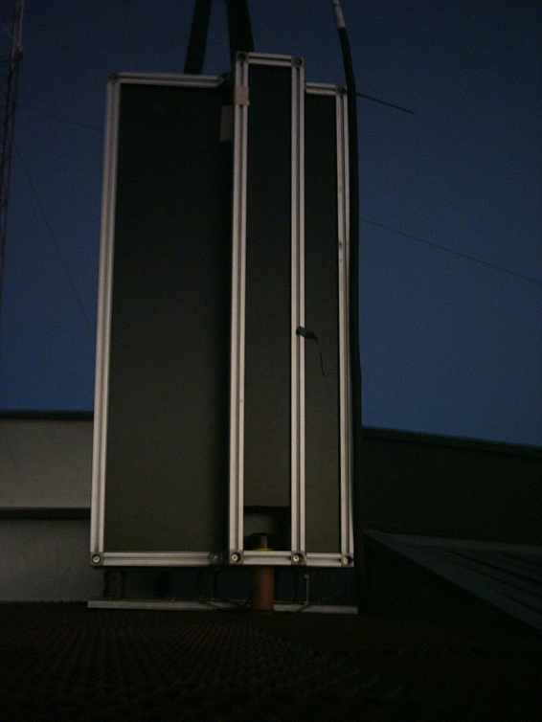
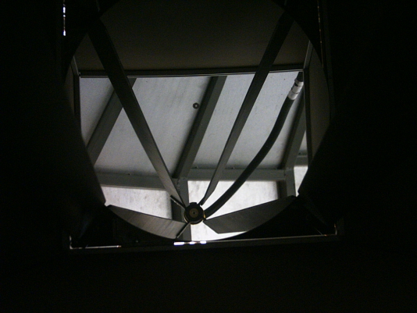
The RAMAN CORNER
RAMAN
receiver
Optical fiber
from telescope
Elastic
O₂
Laser
N₂
V.R.
V.R.
DAQ
telescope
V.R.
small cost!
V.R.
V.R.

Slide 38
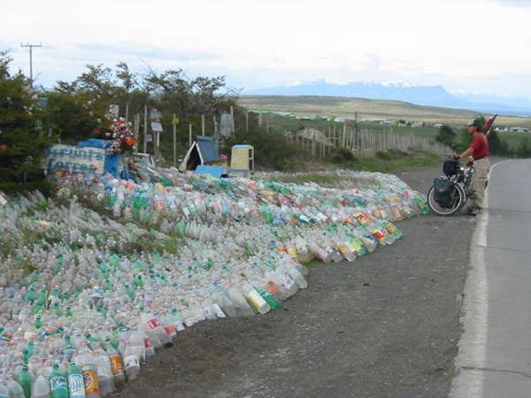
WHEN … the RAMAN LIDAR measurements?
The measurements cover a period from 15/08/2006 to 24/06/2007
(179 homogeneous measurements of aerosol extinction and backscatter coefficients).
Thanks to
La difunta correa

Slide 39
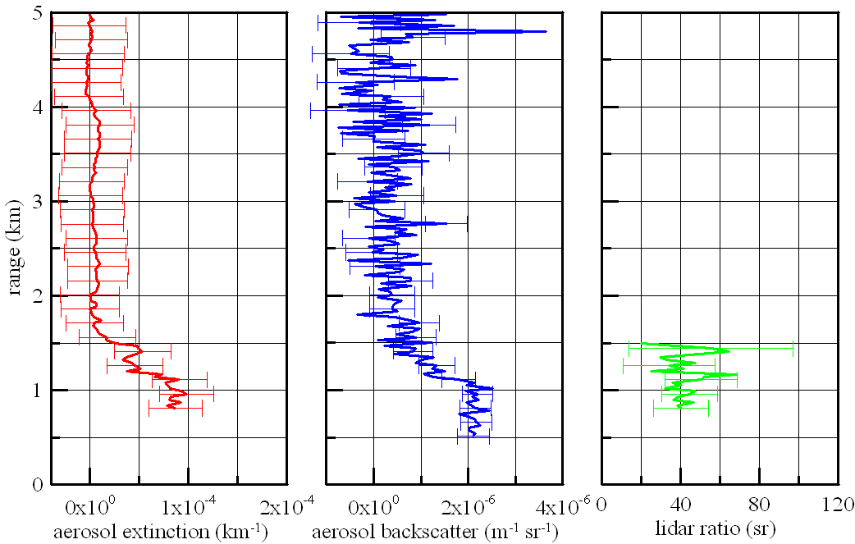
WHAT … is the RAMAN LIDAR measuring?
An example of RAMAN LIDAR data
The aerosol extinction, backscatter and lidar ratio profiles measured on May 18, 2007 (about 48000 laser shots) in the period 19:26-20:06LT. The error bars indicate the propagated statistical indetermination
Entrainment zone
Planetary Boundary Layer

Slide 40
winter aerosol backscatter coefficient profile

Slide 41
summer aerosol backscatter coefficient profile
longer extension in vertical of the aerosols

Slide 43
PBL monthly mean values

Slide 44
The PBL thickness (s_{PBL}) shows low values in fall/winter and enlarges in spring/summer.
The extension of the entrainment region (h) is reduced during late spring/summer (… the free troposphere is more stable than in autumn/winter, and the vertical mixing is damped)

Slide 45
VAOD and INTβ monthly mean values (at about 5km)
summer
autumn
winter
spring

Slide 46
The Raman (monthly mean) VAODs and INTβ:
Low values during late fall and early winter
High values in summer
Relative high content of aerosols in late winter and early spring (diffuse regional meteorological pattern? Increased occurence of dust storms? …)

Slide 47
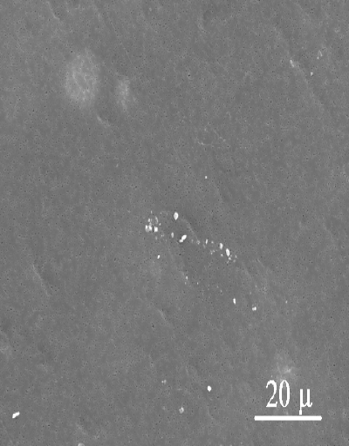
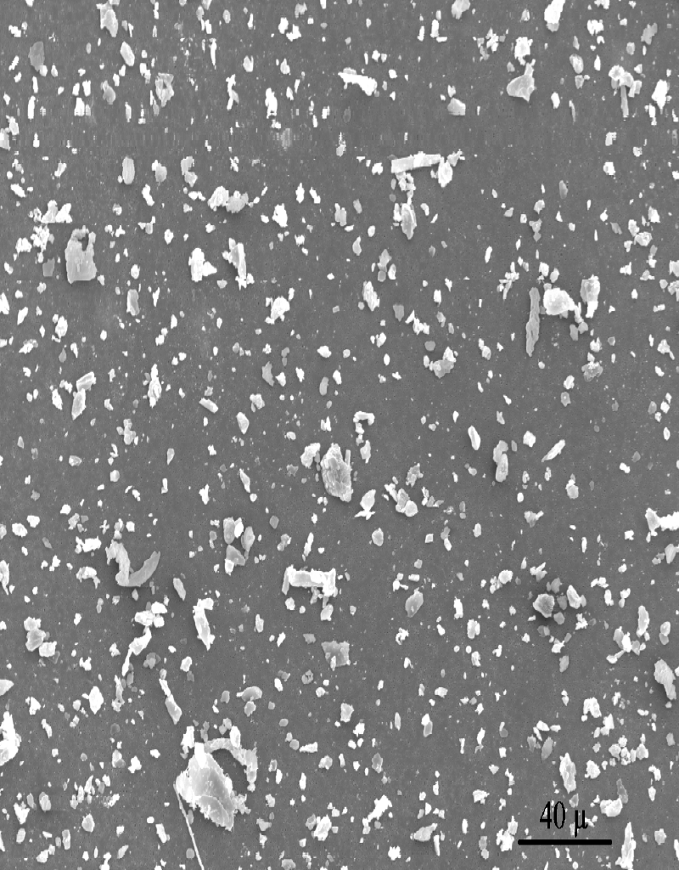
WHO … are these aerosols?
Instituto de Física Rosario (IFIR)
Universidad Nacional de Rosario
SEM images of two samples of coarse aerosols between 2.5-10μm size.
Left: sample collected on 1 June 2008, concentration 4.6μg/m³.
Right: sample collected on 14 August 2008, concentration 13.6μg/m³

Slide 48
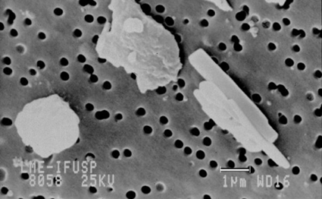
The black circles showed in each figure correspond to filter pores, while the aerosol particles are showed in white or gray tones. The scale on the bottom of image shows a 1 micrometer reference for the particle size. The mineral dust particles are irregular and relatively large, they are made mainly of SiO₂, and other oxides of metal elements like Al, Ca, Mg and Fe.

Slide 49
# 2
Sept. 2010 to July 2011
RAMAN LIDAR (located at 37.9228N, 102.6109W and 1198m a.s.l. in Prowers County, Colorado, about 15 km south of Lamar, Colorado, USA).
remotely operated, with the primary goal of measuring (at the best) the
vertical profile of the aerosol optical depth to be compared with simultaneous side scattering technique.

Slide 50
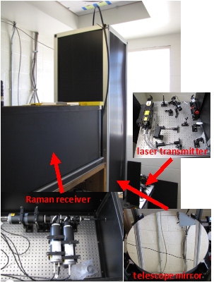
The Raman LIDAR system: the side pictures show the 3 channel LIDAR receiver, the telescope, and the laser transmitter (UV mirrors, and beam expander).

Slide 51
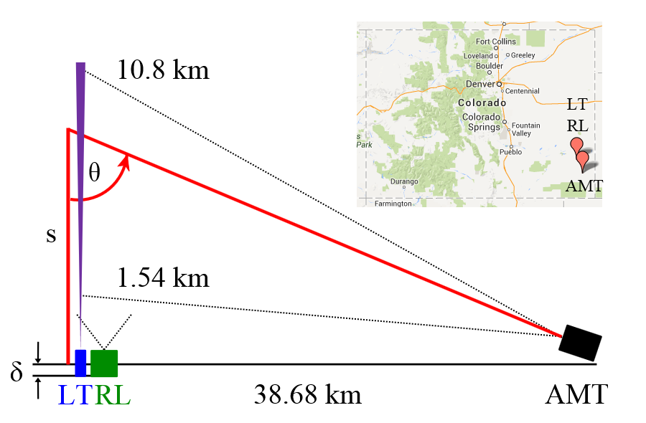

Slide 52
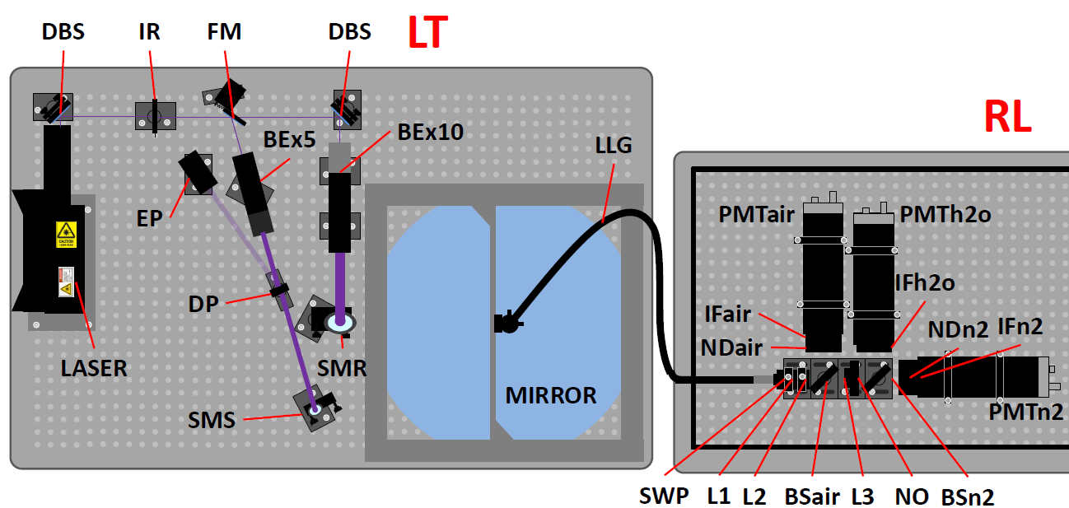

Slide 53
Left: The VAODs data versus time as measured with the AMT (black dots) and the Raman LIDAR (blue squares) at 6 km a.g.l. Right: VAODs measured with the AMT versus Raman LIDAR for hours observed with both instruments. The diagonal is shown in black, a fit to the black dots in red.

Slide 54
# 3
May 2013 to …
RAMAN LIDAR (located at 35°16'50.65"S, 69°20'12.26"O and 1379m a.s.l. in Central Raman LIDAR Facility (previous Central Laser Facility) at AUGER observatory
remotely operated, with the primary goal of measuring (at the best) the
vertical profile of the aerosol optical depth to be the benchmark of the measurements carried with FD telescopes and the central laser.

Slide 55
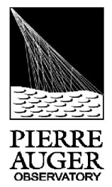
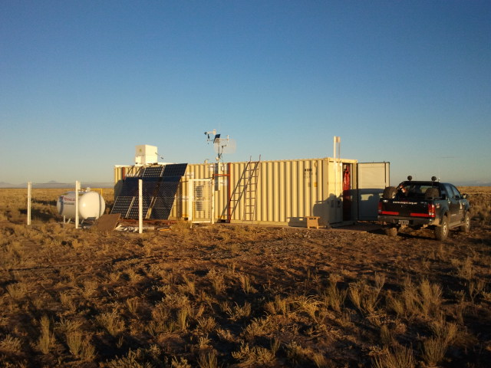


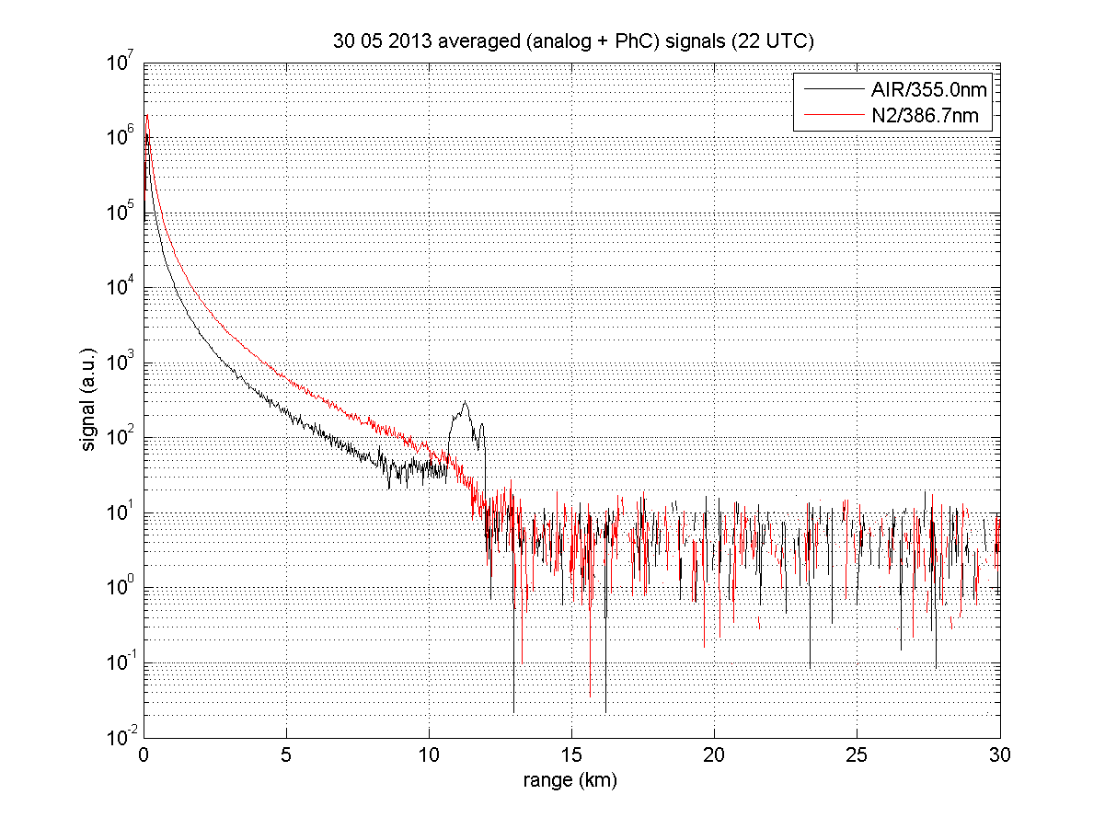
The Raman LIDAR at C(R)LF

Slide 56
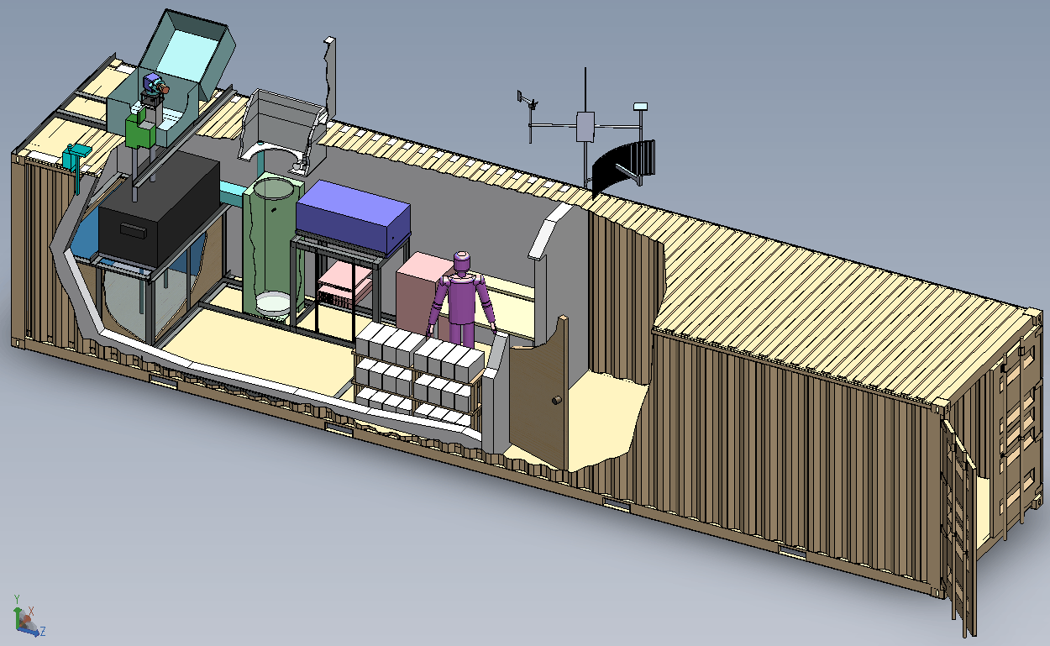
Raman LIDAR
Weather
Station
Microwave
Link
Insulation
Laser,
Beam Switching,
Robotic Calibration
Storage and
future expansion
Thermal
Reservoir
(2000 L Water)
Batteries
Nev DeWitt Pierrat, Blake Knoll (CSM)

Slide 57
STATUS and PERFORMANCES of the Raman LIDAR:
opto-mechanics highly stable;
sampling from boundary layer to free troposphere;
one vertical profile of AOD and aerosol backscatter in 12’ or 24’.
UPGRADE of the Raman LIDAR:
capability to measure the H2O mixing ratio profile;
better detection of the (weak) Raman backscatterings;
(this LIDAR and analysis methods benchmarked against EARLINET)

Slide 58
PERFORMANCES of the Raman LIDAR
Raman LIDAR operation in CLF
Raman data taken before and after FD shifts, 24 min (evening) 12 min (morning), since end of July.
After each Raman run:
- data are copied to LNGS/INFN/Italy and CSM/USA
- a program computes preliminary VAOD values and generates preliminary VAOD plots, all is available after few seconds;
- off-line, more refined analysis after few days on http://atmoforum.aquila.infn.it/osservatorio/

Slide 59
PERFORMANCES of the Raman LIDAR
aerosol day to day variability
Clean and dirty nights along a FD shift.

Slide 60

Clean

Slide 61

Dirty

Slide 62



EVOLUTION of the Raman LIDAR

Slide 63
Raman LIDAR
equipments raw costs
Solid state Nd:YAG laser 40000$
High power mirrors 900$
Beam expander 1500$
Silica window 6000$
Telescope parabolic mirror 3000$
Optical fiber 1500$
Interference filters, beam splitters 18000$
Photomultipliers 3900$
High voltage power supply 4500$
Data Acquisition system 8600$
Optical parts (lenses, etc.) 2200$
Opto-mechanical parts (optical tables, holders, etc.) 6200$
TOTAL 96300$

Slide 64
THANK YOU!

Slide 65


