Slide 1
WELCOME AND INFO
Michele Doro

Slide 2
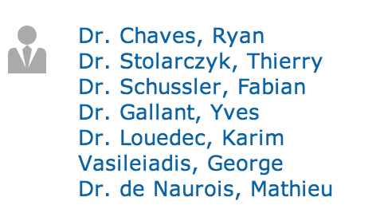
ATMOHEAD(S)
MAIN SESSIONS: A) HIGHLIGHTS, B) OVERVIEW OF EXPERIMENTS, C) INSTRUMENTS AND METHODS, D) COMPANIES

Slide 3
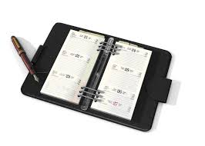
AGENDA
MONDAY
Highlights
TUESDAY
Overview on experiments
Highlights II
Visit to Palazzo Bo (35 person max) at 14.30
Social Dinner at 20.30
WEDNESDAY
Companies contributions
Instruments and methods
Goodbye coffe break at 16.30
Poster session
Mon at 14.00
Wed at 14.00
Please submit talks in indco or prepare a stick drive

Slide 4
Proceedings
There will be proceedings with full review system with the Nuclear Instruments and Methods A journal
Timetable is not defined yet, but we foresee to have first submission in June/July and publication by the end of the year
Number of pages depends whether contribution is highlight, overview, instruments and methods or poster
Details to come

Slide 5
Coffee breaks
Just exit the bulding and go 50m on your left
Bar Antille
Be prepared to order the coffee you prefer!

Slide 6
VISIT TO PALAZZO BO
Meet at 14.30 just outside the Aula Nievo (Cortile Antico) with an English guide
If you have not filled the formulary, please tell me

Slide 7
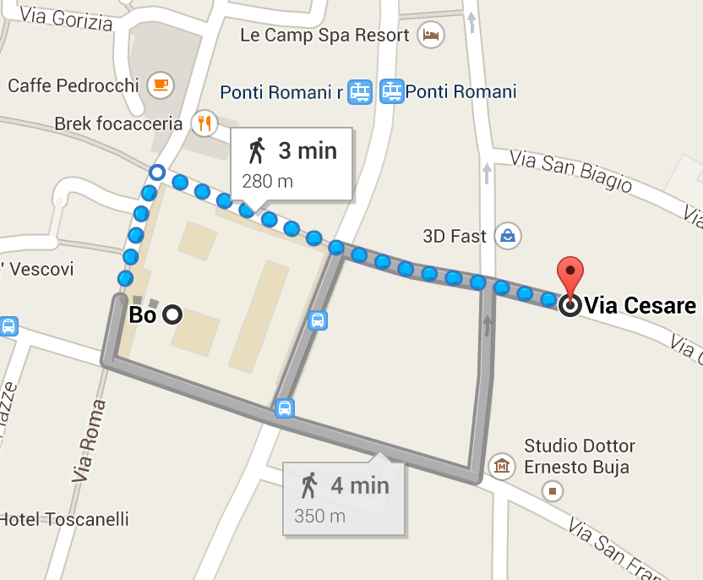
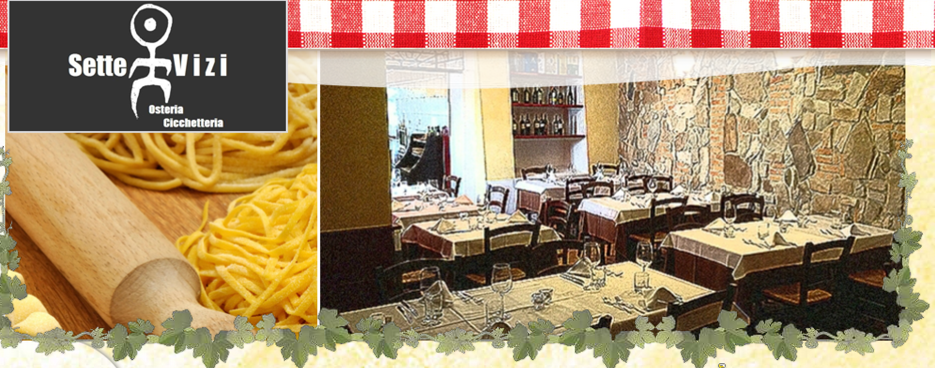
Social dinner
La trattoria 7 Vizi, via Cesare Battisti 44
Local kitchen
If you have not filled the formulary, please tell me

Slide 8
INTERNET
There is a free wireless in the room called “Padova WIFI”
I am tethering from a laptop
Name “Atmohead”
I am truly sorry if there are problems, the room will be renovated this year and the University could not reinforce the network system
Probably you will have to follow the talks! Please be patient!

Slide 9
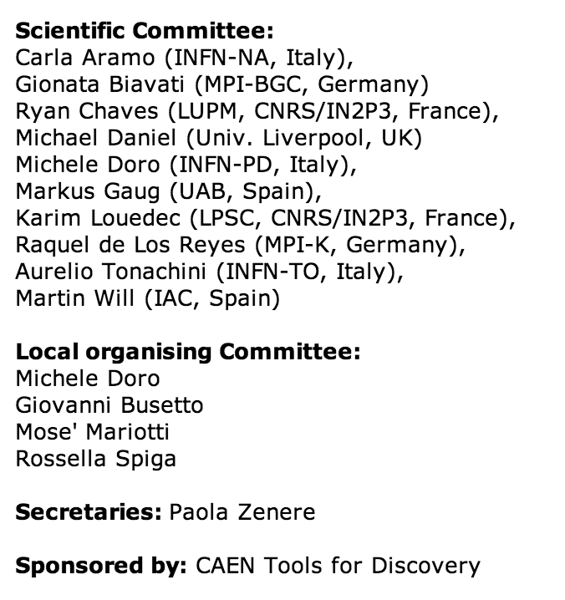
Have a good meeting and stay!
And don’t forget to try the local aperitif: spritz!

