Slide 1
Search for Electric Dipole Moments with Polarized Beams in Storage Rings
Paolo Lenisa
Università di Ferrara and INFN - Italy
LNS. November 20 ^{th} 2013

Slide 2
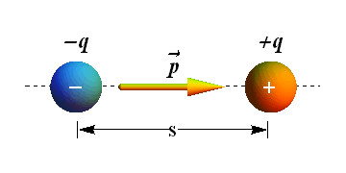
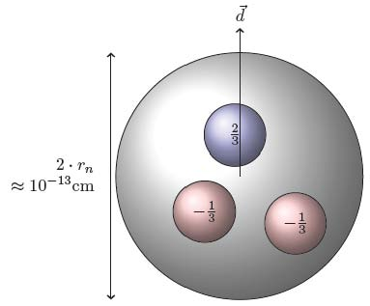
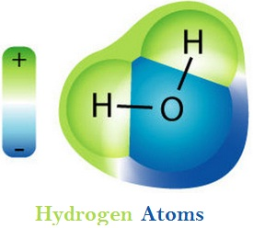
Electric Dipoles
Definition
$$\vec{p}=q∙\vec{s}$$
Charge separation creates an electric dipole
Orders of magnitude
 | Atomic physics | Hadron physics
Charges | e | e
|r₁-r₂| | 10⁻⁸ cm | 10⁻¹³ cm
EDM (naive) exp. | 10⁻⁸ e cm | 10⁻¹³ e cm
observed | H₂O molecule 2∙10⁻⁹ e cm | Neutron < 3∙10⁻²⁶ e cm
H₂O molecule:
permanent EDM
EDM 3∙10⁻²⁶ e cm → charge separation < 5∙10⁻²⁶ cm between u and d quarks

Slide 3
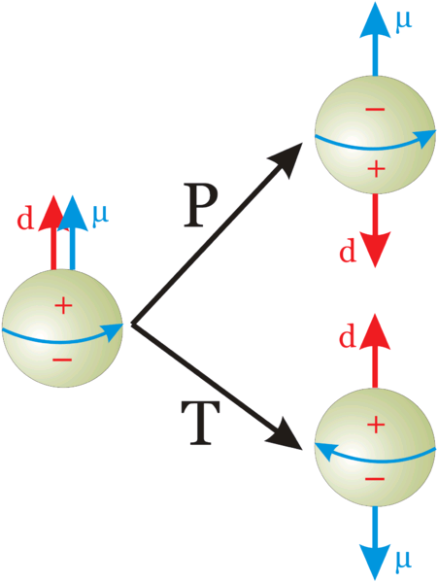
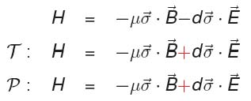
EDM of fundamental particles
Molecules have large EDM because of degenerated ground states with different parity
Elementary particles (including hadrons) have a definite partiy and cannot have EDM
Unless P and T reversal are violated
$\vec{μ}$: magnetic dipole moment
$\vec{d}$: electric dipole moment
(both aligned with spin)
Permanent EDMs violate P and T
Assuming CPT to hold, CP violated also

Slide 4
CP violation
.Universe dominated by matter (and not anti-matter).
${(n}_{B}−n_{\overline{B}})/n_{γ}$ = 6x10⁻¹⁰
Equal emounts of matter and antimatter at the Big Bang.
CP violation in SM: 10⁻¹⁸ expected
1967: 3 Sacharov conditions for baryogenesis
Baryon number violation
C and CP violation
Thermal non-equilibrium
New sources of CP violation beyond SM needed
Could manifest in EDM of elementary particles
Carina Nebula (Largest-seen star-birth regions in the galaxy)

Slide 5
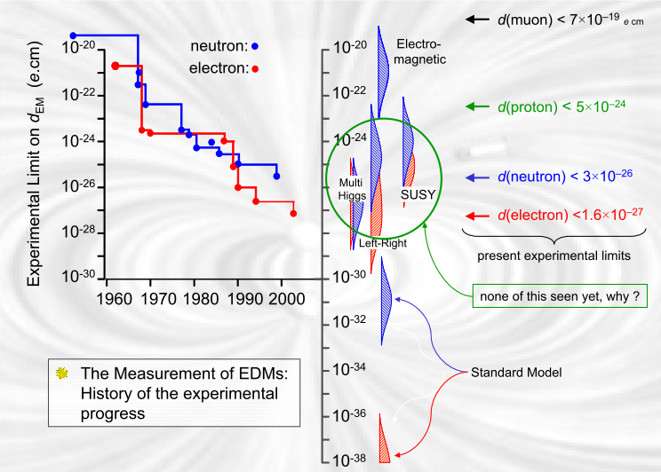
Theoretical predictions
planned
experiments
No Standard Model Background!
J.M. Pendlebury: „nEDM has killed more theories than any other single expt.“

Slide 6
EDM searches: state of the art
EDM searches: only upper limits yet
E-fields accelerate charged part. → search limited to neutral systems
„Traditional“ approach: precession frequency measurement in B and E fields
B
E
B
E
µ d
hf₊ = 2µB + 2dE
hf₋ = 2µB - 2dE

Slide 7
EDM searches: state of the art
EDM searches: only upper limits yet
E-fields accelerate charged part. → search limited to neutral systems
„Traditional“ approach: precession frequency measurement in B and E fields
B
E
B
E
µ d
hf₊ = 2µB + 2dE
hf₋ = 2µB - 2dE
Particle/Atom | Current EDM Limit | Future Goal |  𝒅_{𝒏} equivalent
Electron | < 1.6 $$ 10⁻²⁷
Neutron | $$\text{3} ×\text{ 10}\text{−2}\text{6}$$ | ∼10⁻²⁸ | 10⁻²⁸
¹⁹⁹Hg | $$\text{3.1} ×\text{ 10}\text{−2}\text{9}$$ | ∼10⁻²⁹ | 10⁻²⁶
¹²⁹Xe | $$\text{6} ×\text{ 10}\text{−2}\text{7}$$ | ∼10⁻³⁰- 10⁻³³ | ∼10⁻²⁶- 10⁻²⁹
Proton | $$\text{7.9} ×\text{ 10}\text{−2}\text{5}$$ | ∼10⁻²⁹ | 10⁻²⁹
Deuteron | ? | ∼10⁻²⁹ | ∼$\text{3} $10⁻²⁹- $\text{5} $10⁻³¹
(Till now) two kinds of experiments to measure EDMs:
Neutrons
Neutral atoms (paramagnetic/diamagnetic)
No direct measurement of electron or proton EDM yet

Slide 8
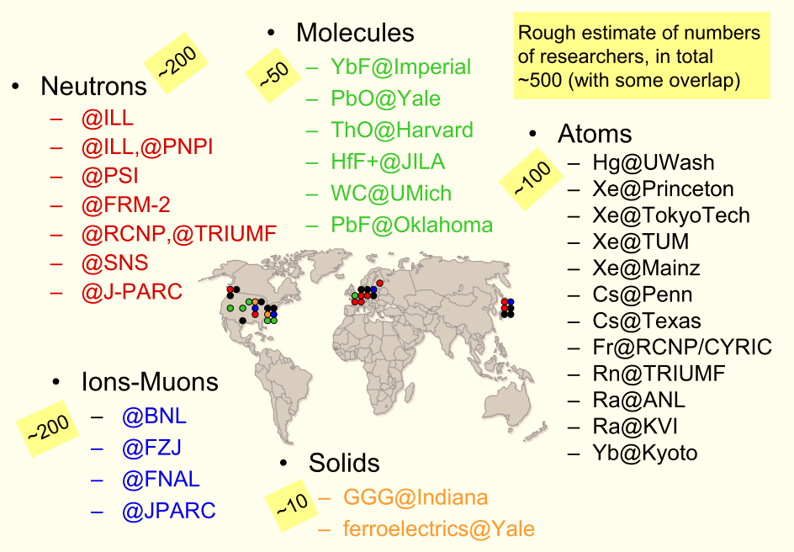
Ongoing/planned Searches
new

Slide 9
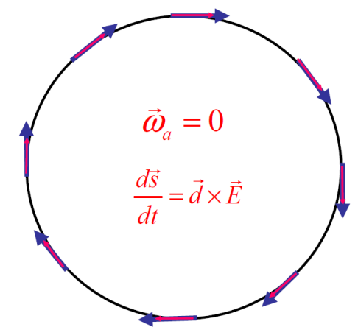
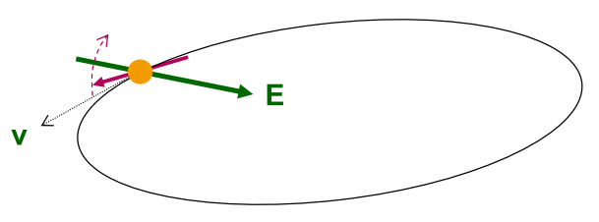
EDM of charged particles: use of storage rings
PROCEDURE
Place particles in a storage ring
Align spin along momentum ( →freeze horizontal spin precession)
Search for time development of vertical polarization
$$\frac{d\vec{s}}{dt}=\vec{d}×\vec{E}$$

Slide 10
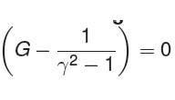
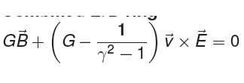
Frozen spin method
Spin motion is governed by Thomas-BMT equation:
d: electric dipole moment μ: magnetic dipole moment
Two options to get rid of terms ∝ G (magic condition):
1. Pure E ring (works only for G>0, e.g proton):
2. Combined E.B ring (works also for G<0, e.g deuteron)

Slide 11
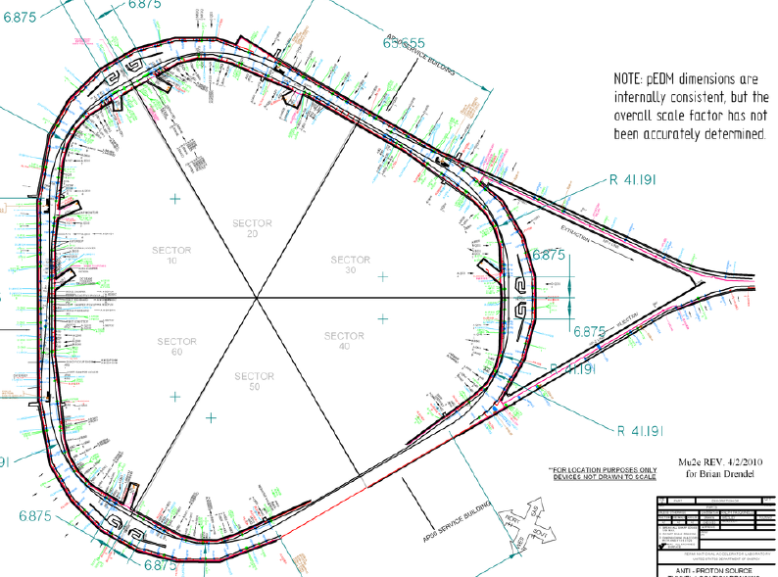
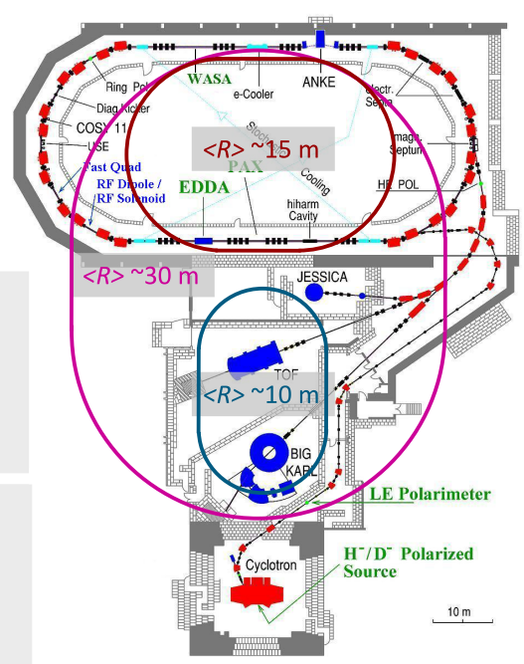
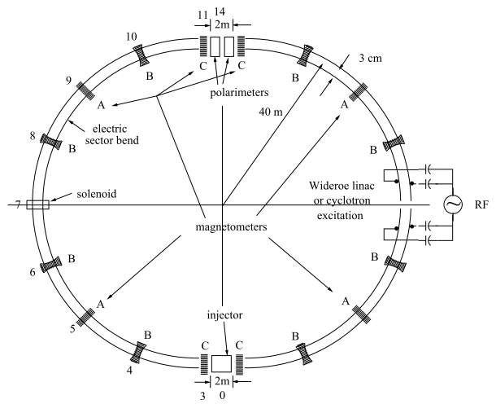
Storage ring projects
pEDM in all electric ring at BNL
Jülich, focus on deuterons, or a combined machine
or at FNAL
(from R. Talman)
CW and CCW propagating beams
(from A. Lehrach)
Two projects: US (BNL or FNAL) and Europe (FZJ)

Slide 12
Magic Storage rings
A magic storage ring for protons (electrostatic), deuterons, …
B
Particle | p(GeV/c) | E(MV/m) | B(T) | R(m)
Proton | 0.701 | 16.789 | 0.000 | ∼ 25
Deuteron | 1.000 | -3.983 | 0.160
³He | 1.285 | 17.158 | -0.051
Possible to measure $p$, $d$, $3He$ using ONE machine with $r \sim 30$m
Notes:
12
12

Slide 13
Statistical sensitivity
$$σ≈\frac{h}{\sqrt{NfTτ_{P}}PEA}$$
E | Electric field | 10 MV/m
P | Beam polarization | 0.8
A | Analyzing power | 0.6
N | Particles/cycle | 4×10⁷
F | Detection efficiency | 0.005
τ_{P} | Spin-coherence time | 1000 s
T | Running time per year | 10⁷ s
Sensitivity: σ = 10⁻²⁹ e-cm/year (→10⁻²⁷ e-cm/week)
Expected signal: 3x10⁻⁹ rad/s for d= 10⁻²⁹ e-cm

Slide 14
Technological challenges
SYSTEMATIC ERROR PLAN
PROTON BEAM POSITION MONITORS (<10 nm)

Slide 15
Systematics
One major source:
Radial B_{r} field mimics EDM effect
Example: d = 10⁻²⁹ e cm with E = 10 MV/m
If μB_{r}≈dE_{r} this corresponds to a magnetic field:
(Earth magnetic field = 5 ∙ 10 ⁻⁵ T)

Slide 16
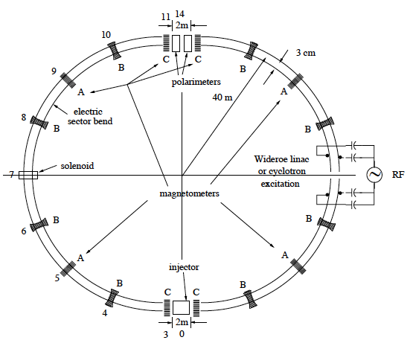
BNL Proposal: counterpropagating beams
2 beams simultaneously rotating in an all electric ring (cw, ccw)
CW & CCW beams cancels systematic effects
 | CW |  | CCW
Polarization $(Pz)$ | $$+$$ | $$−$$ | $$+$$ | $$−$$
EDM $(\vec{d}×\vec{E})$ | $$−$$ | $$+$$ | $$+$$ | $$−$$
Sokolov-Ternov | $$−$$ | $$−$$ | $$+$$ | $$+$$
Gravitation | $$−$$ | $$+$$ | $$−$$ | $$+$$
BPM with relative resolution < 10 nm required
use of SQUID magnetomers (fT/√Hz) ? → Study started at FZJ
Notes:
16
16

Slide 17
Technological challenges
SYSTEMATIC ERROR PLAN
PROTON BEAM POSITION MONITORS (<10 nm)
ELECTRIC FIELD, as large as practical (no sparks).

Slide 18
Electric field for magic rings
R$adial E$field only
$$E=17 MV/m$$
$$r=24.665 m$$
Challenge to produce large electric fields

Slide 19
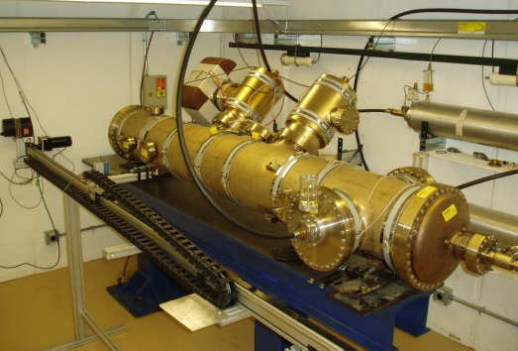
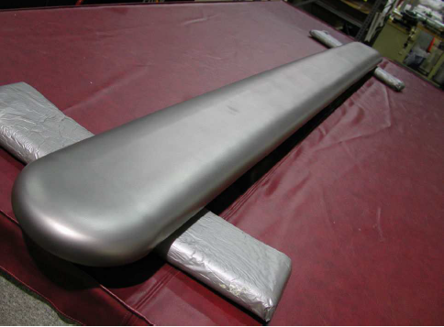
Tevatron electrostatic separators
- avoids unwanted $\overline{p}p$ interactions
- electrodes made from Titanium
L~2.5 m
Routine operation at $1$spark/Year at $6$MV/m (180 kV at 3 cm)
Winter 2013-14: Transfer of separator unit plus equipment from FNAL to Jülich
Development of new electrode materials and surfaces treatment

Slide 20
Technological challenges
SYSTEMATIC ERROR PLAN
PROTON BEAM POSITION MONITORS (<10 nm)
ELECTRIC FIELD, as large as practical (no sparks).
POLARIMETER
The sensitivity to polarization must by large (0.5).
The efficiency of using the beam must be high (> 1%).
Systematic errors must be managed (< 10^{‒6}).
N.P.M. Brantjes et al. NIMA 664, 49 (2012)

Slide 21
Technological challenges
SYSTEMATIC ERROR PLAN
PROTON BEAM POSITION MONITORS (<10 nm)
ELECTRIC FIELD, as large as practical (no sparks).
POLARIMETER
The sensitivity to polarization must by large (0.5).
The efficiency of using the beam must be high (> 1%).
Systematic errors must be managed (< 10^{‒6}).
N.P.M. Brantjes et al. NIMA 664, 49 (2012)
POLARIZED BEAM
Polarization must last a long time (> 1000 s).
Polarization must remain parallel to velocity.

Slide 22
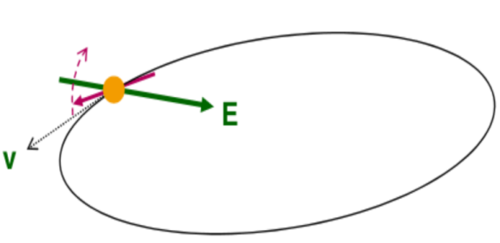
EDM buildup time
Minimal detectable precession
$θ≈{10}^{−6}$ rad
Assuming
$$d≈{10}^{−29}e∙cm$$
$$E=17MV/m$$
$$θ_{EDM}= \frac{2dE}{ℏ}\sim 5\left({10}^{−9}{rad}/s\right)t$$
$$θ_{EDM}\sim \frac{{10}^{−15}rad}{turn}$$
$$1 turn \sim {10}^{−6} s$$
10⁹ turns needed to detect EDM signal
Spin aligned with velocity for t>1000 s (→ Spin Coherence Time next slides)
Feasibility studies @ COSY

Slide 23
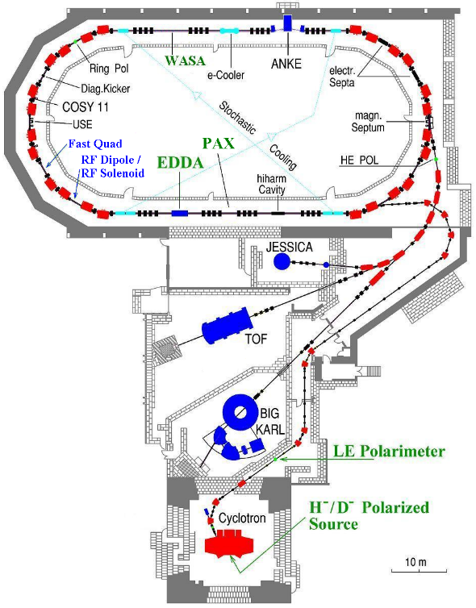
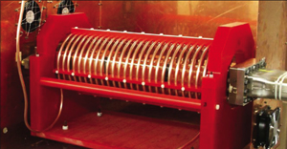
COoler SYnchrotron (FZ-Jülich, GERMANY)
Momentum: <3.7 GeV/c
Circumference: 183 m
Polarized proton and deuteron
Beam polarimeter (EDDA detector )
Instrumentation available for manipulation of
- beam size (electron/stochastic cooling, white noise)
- polarization (RF solenoid)

Slide 24
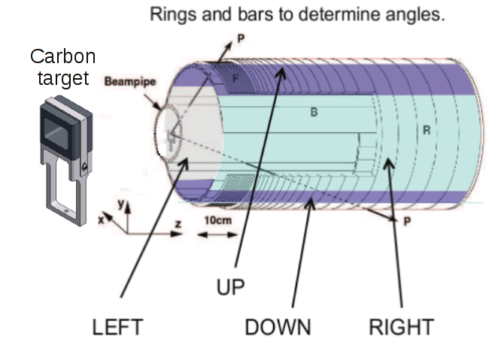
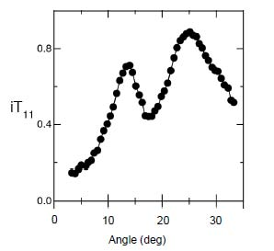
EDDA beam polarimeter
ASYMMETRIES
$$ε_{V}=\frac{L−R}{L+R}∝p_{V}A_{y}$$
beam
A_{y}
VERTICAL polarization
Analyzing power
$$ε_{H}=\frac{U−D}{U+D}∝p_{H}A_{x}$$
HORIZONTAL polarization
Analyzing power
Beam moves toward thick target continuous extraction
Elastic scattering (large cross section for d-C)

Slide 25
Spin invariant axis
one particle with magnetic moment makes one turn
“spin invariant axis”
θ_{s} = 2πν_{s} precession angle per turn
ν_{s}=γG “spin tune”
ring
A
Stable polarization if S||n_{co}

Slide 26
Spin coherence time
Ensemble of particles circulating in the ring
- Spin coherence along ${\hat{n}}_{co} is not an issue$
Vertical polarization not affected
At injection all
spin vectors aligned (coherent)
After some time, spin vectors get out of phase and fully populate the cone

Slide 27
Spin coherence time
Ensemble of particles circulating in the ring
- Spin coherence along ${\hat{n}}_{co} is not an issue$
Vertical polarization not affected
At injection all
spin vectors aligned (coherent)
After some time, spin vectors get out of phase and fully populate the cone
- For $\vec{S}⊥ {\hat{n}}_{co}$ (machines with frozen spin) the situation is different
Longitudinal polarization vanishes!
At injection all spin vectors aligned
Later, spin vectors are out of phase in the horizontal plane
In EDM machine observation time is limited by SCT.

Slide 28
Decoherence: where does it arise?
LONGITUDINAL PHASE SPACE
Problem: beam momentum spread ( )
E.g. Δp/p=1∙10⁻⁴ →Δν_{s}/ν_{s}=2.1x10⁻⁵ →τ_{pol}=63 ms
Solution: use of bunched beam (<Δp/p> = 0)
RF-E
Δp/p ≠ 0 → Δν_{s}/ν_{s} ≠ 0
P. Benati et al. Phys. Rev. ST, 049901 (2013)
TRANSVERSE PHASE SPACE
Problem: beam emittance ≠ 0 → betatron oscillations
Y
Δx (Δy) from reference orbit
X
→ Longer path:
$$\frac{∆L}{L_{0}}=\frac{θ_{x}^{2}+θ_{y}^{2}}{4}$$
Z
→ Higher particle speed → Δν_{s}
E.g. θ = 1∙ mrad → τ_{pol}=9.9 s
Possible solution to this problem investigated at COSY

Slide 29
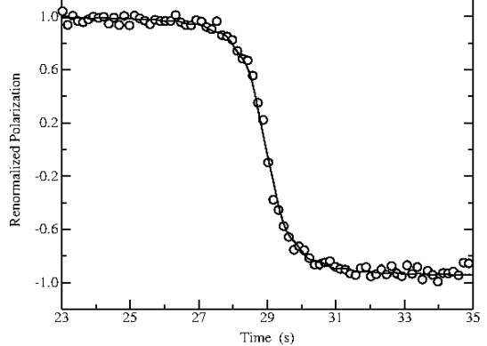
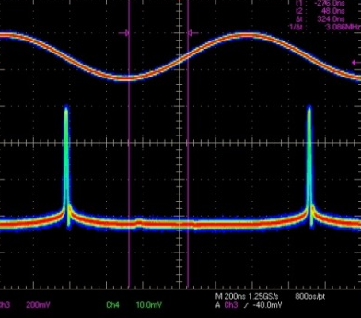
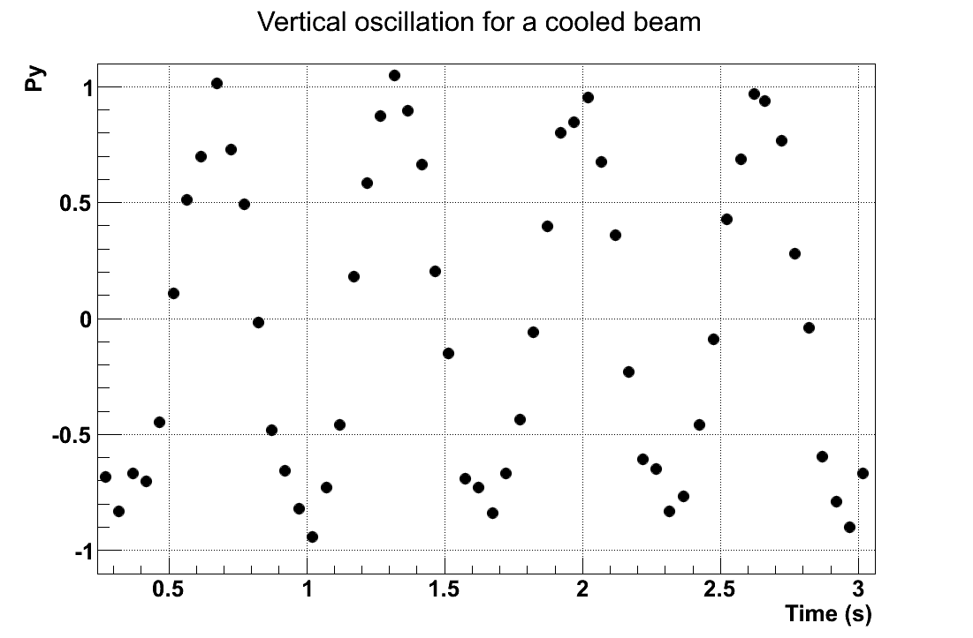
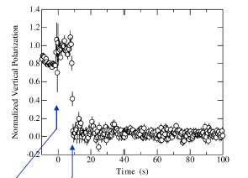
Preparing a longitudinal polarized beam with RF-solenoid
1) Froissart-Stora scan
Identification spin resonance frequency
$$f_{RES}=\left(1−Gγ\right)f_{CYC}≃871434$$
Hz
Vertical polarization
(L-R
asymmetry)
$$Δf=400$$
linear ramping in 40 s
frequency
2) Fixed frequency measurements
On resonance
Vertical polarization
(L-R
asymmetry)
COOLED BEAM
time
3) Solenoid on for half-cycle
Vertical polarization = 0
Polarization is horizontal
(L-R
asymmetry)
time

Slide 30
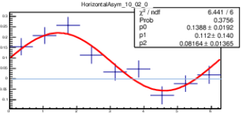
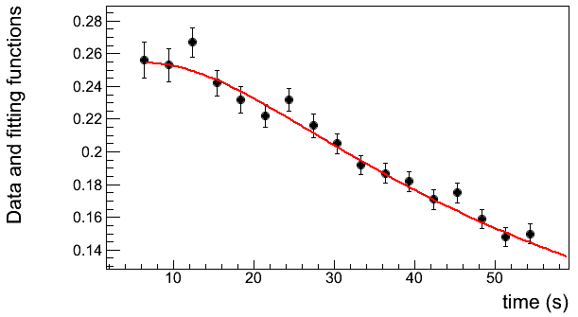
Polarimetry of precessing horizontal polarization
No frozen spin: polarization rotates in the horizonthal plane at 120 kHz
DAQ synchronized with cyclotrhon freqyency -> count turn number N
Compute total spin-precession angle (with spin-tune ν_{s}=Gγ)
Bin by phase around the circle
Compute asymmetry in each bin
x
(U-D asymmetry)
Polarim.
$$ε_{H}$$
Polarim.
z
$$φ$$
Derivation of horizontal spin coherence time
Amplitude vs time
30
Spin coherence time extracted from numerical fit

Slide 31
Performance
One Store 8x10⁷ turns
Time stamp system
COSY orbit =
183 m
Bunching starts
Cooling starts
Full extraction
starts
Spin-tune and machine stability
Phase over time can be tracked with precision ∼ 10⁻⁸
Stability of the ring magnets < 2x10⁻⁷
from Dennis Eversmann

Slide 32
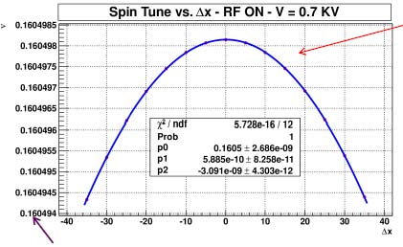
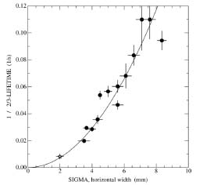
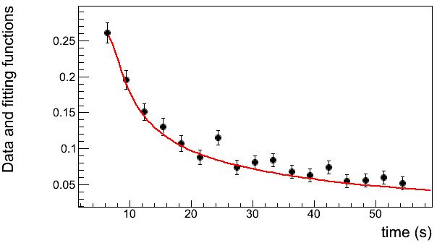
Beam emittance studies
Beam Profile Monitor
Beam preparation
Pol. Bunched deuteron beam at p=0.97 GeV/c
Preparation of beam by electron cooling.
Selective increase of horizontal emittance
Heating through white noise
y
1 fill
x
$$ε_{x}$$
$$ε_{y}$$
Cooling+bunching
Horizonthal heating
Quadratic dependence of spin tune on size of horizonthal betatron oscillation
Investigation of emittance effect on spin-coherence time:
(betatron oscillation → Longer path → different spin tune →spin decoherence)
Narrow profile
Wide profile
$τ_{SCT}=5,0±$0,6 s
$τ_{SCT}=50±2,5$ s
(from A. Pesce)
Simulations (COSY Infinity)
Measurement at COSY
Beam emittance affects spin-coherence time

Slide 33
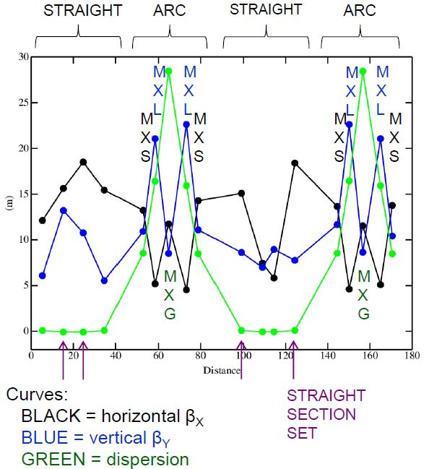
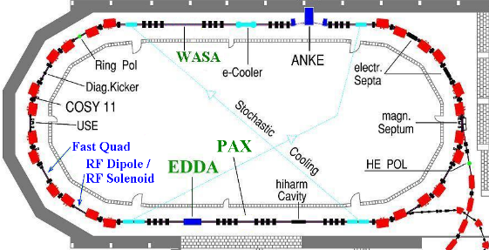
Lengthening the SCT by COSY sextupoles
6-pole field:
$$B=kx^{2}$$
Particle orbit correction
Spin tune spread correction
$$\frac{∆L}{L_{0}}=\frac{θ_{x}^{2}+θ_{y}^{2}}{4}$$
$$∆ν_{s}=GΔγ$$
Use of 6-poles where β_{x} function is maximal
Sextupoles at β_{x} max

Slide 34
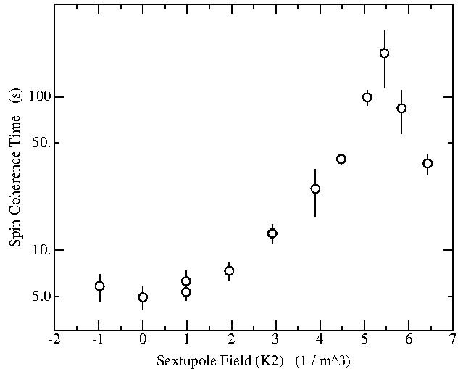
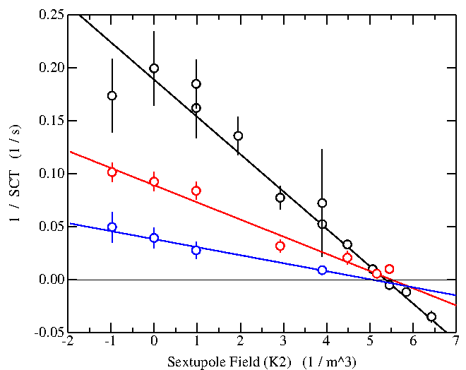
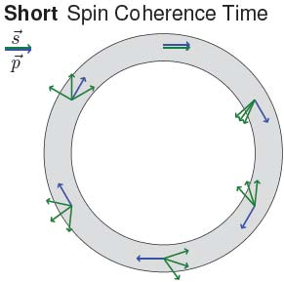
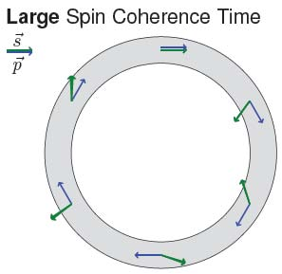
Results
Compensation by means of 6-pole fields:
1/τ_{SCT} = A<θ²_{x}> + a<θ²_{x}> A = original effect
a = sextupole effect
Choose a= -A
SCT $≈200 s$
Results
Wide profile
Wide profile
Medium profile
Medium profile
Different horizontal profile widths
Different slopes
Zero crossing indep. of width
Narrow profile
Narrow profile
Different horizontal profile widths
Different slopes
Zero crossing indep. of width
10⁹ particles synchronously precessing for > 2x10⁸ revolutions!
Previous best 10⁷ @ Novosibirsk
Same zero crossing!
Same zero crossing!
Sextupole fields can be used to increase $τ_{SCT}!$

Slide 35
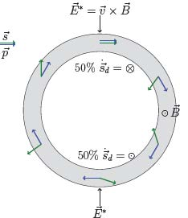
APPENDIX: Precursor experiments RF methods
Pure magnetic ring (existing machines)
Problem: precession caused by magnetic moment:.
- 50 % of time longitudinal polarization || to momentum
- 50 % of time is anti-||
E* in particle rest frame tilts spin (due to EDM) up and down
→ No net EDM effect

Slide 36
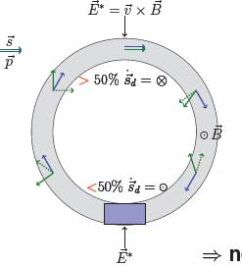
APPENDIX: Precursor experiments RF methods
Pure magnetic ring (existing machines)
Problem: precession caused by magnetic moment:.
- 50 % of time longitudinal polarization || to momentum
- 50 % of time is anti-||
E* in particle rest frame tilts spin (due to EDM) up and down
→ No net EDM effect
Solution; use of resonant „magic“ Wien-filter in ring (E+vxB=0)
E*=0 → particle trajectory not affected
B*≠0 → magnetic moment is influenced
→ net EDM effect can be observed!
Principle: make spin prec. in machine resonant with orbit motion
Two ways:
Use of RF device operating at some harmonics of the spin prec. frequency
Ring operation on an imperfection resonance

Slide 37
Resonance Method with „magic“ RF Wien filter
Avoids coherent betatron oscillations of beam. .
First direct measurement at COSY.
$E^{∗}=0$⇒ $ER =−By$„Magic RF Wien Filter“ no Lorentz force
RF E(B)-field
In plane polarization
P_{y} buildup during spin coherence time
stored d
Polarimeter (dp elastic)
Statistical sensitivity for $dd$ in ${10}^{−23}$ to ${10}^{−24} ecm$ range possible.
Alignment and field stability of ring magnets
Imperfection of RF-E(B) flipper

Slide 38
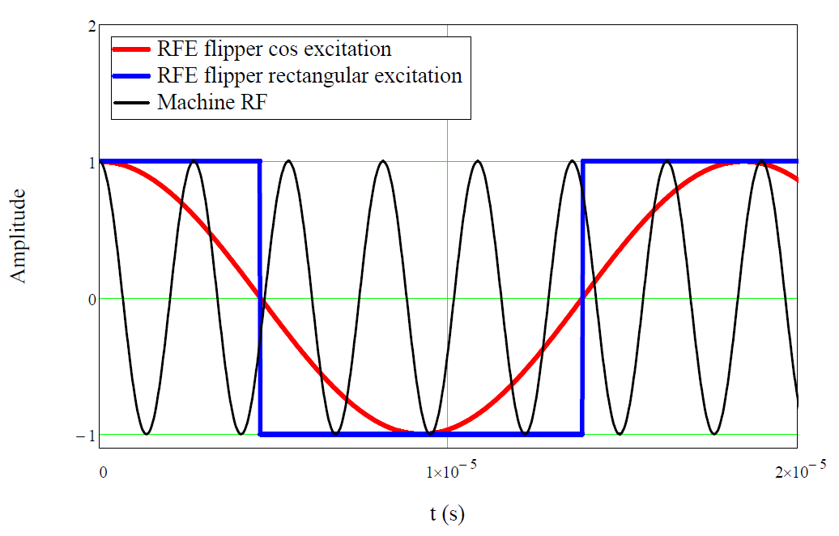
Operation of „magic“ RF Wien filter
Radial E and vertical B fields oscillate, e.g., with $f_{HV}=\left(K+Gγ\right)∙f_{rev}=−54.151×{10}^{3} Hz$(here $K=0$).
beam energy
$$Td=50 MeV$$

Slide 39
Resonance Method for deuterons at COSY
Parameters: beam energy $Td=50 MeV$ $LRF=1 m$
assumed EDM $dd={10}^{−24} ecm$
E-field $30 kV/cm$
$$Px$$
$$Pz$$
$$Py$$
$$ω={2πf}_{rev}Gγ$$
$=−3.402×{10}^{5} Hz$
$$turn number$$
EDM effect accumulates in $P_{y}$

Slide 40
Development: RF E/B-Flipper (RF Wien Filter)
Upgrade test flipper with electrostatic field plates (end of year).
Build lower power version using a stripline system
Build high-power version of stripline system ($E>100$ $kV/m$)
Work by S. Mey, R. Gebel (Jülich)
J. Slim, D. Hölscher (IHF RWTH Aachen)

Slide 41
Conclusions
Non-zero EDM within the actual experimental limits clear probe of new physics
Pol. beam in S. R. might pave the way to direct measurement of EDM of ch. particles.
Challenges willl stimulate development in Storage Ring technology.
At the COSY ring dedicated feasibility tests are underway.
SCT studies on a real machine
Emittance affects SCT of the stored beam.
Sextupole field can be effectively used to increase SCT.
Next step:
Compensation of (<ΔP/P>)² with the same principle
The way to a Storage Ring EDM:
Precursor experiment
(Prototype electron ring?)
Proton/deutern storage ring
P.S. A srEDM experiment is realatively cheap….

Slide 42
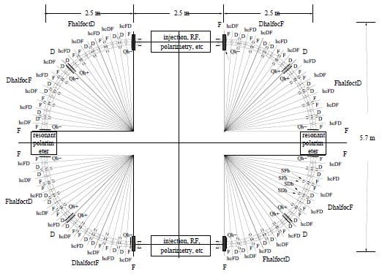
All electric electron-EDM storage ring
Magic energy for electron: 14.5 MeV (γ=29.4)
E = 6 MeV/m → R = 2.5 m
(from R. Talman)
Note:
Electron → μ_{e} = 5.788 x 10⁻⁵ eV/T G_{e}=0.001159 → $\frac{G_{e}μ_{e}}{ℏ}$ =1.020 x10⁸s⁻¹/T
Proton → μ_{p} = 3.152 x 10⁻⁸ eV/T G_{p}=1.792 → $\frac{G_{p}μ_{p}}{ℏ}$ =0.859 x10⁸s⁻¹/T
Almost same precession frequency in magnetic field
Issue: polarimetry?

Slide 43
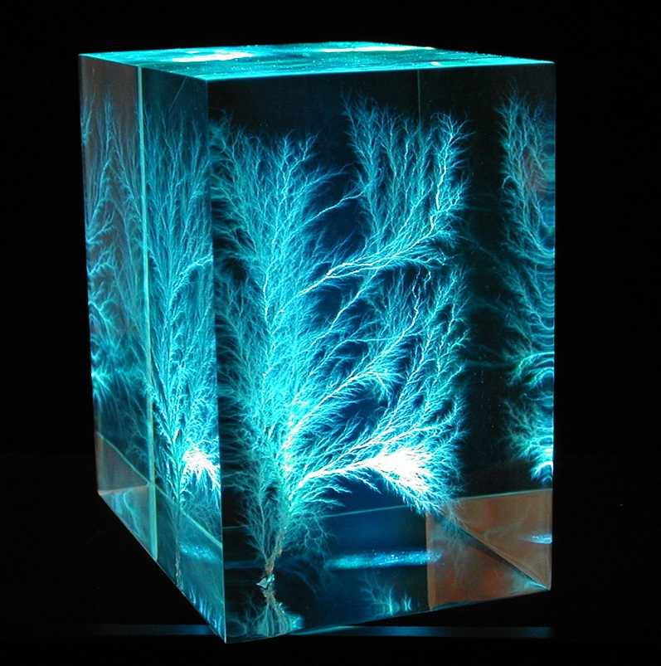
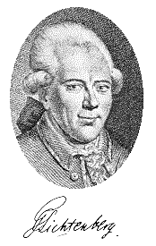
Georg Christoph Lichtenberg (1742-1799)
“Man muß etwas Neues machen, um etwas Neues zu sehen.”
“Devi creare qualcosa di nuovo
se vuoi vedere qualcosa di nuovo”

Slide 44
Spin coherence time collaboration
Z. Bagdasarian¹, P. Benati², S. Bertelli², D. Chiladze^{1,3}, J. Dietrich³, S. Dimov^{3,4}, D. Eversmann⁵, G. Fanourakis⁶, M. Gaisser³, R. Gabel³, B. Gou³, G. Guidoboni², V. Hejny³, A. Kacharava³,
V. Kamerdzhiev³, P. Kulessa⁷, A. Lehrach³, P. Lenisa², Be. Lorentz³, L. Magallanes⁸, R. Maier³, D. Michedlishvili^{1,3}, W. M. Morse⁹, A. Nass³, D. Öllers^{2,3}, A. Pesce², A. Polyanskiy^{3,10}, D. Prasun³, J. Pretz⁵, F. Rathmnann³, Y. K. Semertzidis⁹, V. Schmakova^{3,4}, E. J. Stephenson¹¹, H. Stockhorst³, H. Ströher³, R. Talman¹², Yu. Valdau^{3,13}, Ch. Weideman^{2,3}, P. Wüstner¹⁴.
¹Tbilisi State University, Georgia
²University and/or INFN of Ferrara, Italy
³IKP Forschungszentrum Jülich, Germany
⁴JINR, Dubna, Russia
⁵III. Physikalisches Institut RWTH Aachen, Germany
⁶Institute of Nuclear Physics NCSR Democritos, Athens, Greece
⁷Jagiellonian University, Krakow, Poland
⁸Bonn University, Germany
⁹Brookhaven National Laboratory, New York, USA
¹⁰Institute of Theoretical and Experimental Physics, Moscow, Russia
¹¹Center for Exploration of Energy and Matter, Indiana University, Bloomington, USA
¹²Cornell University, New York, USA
¹³Petersburg Nuclear Physics Institute, Gatchina, Russia
¹⁴ZEL Forschungszentrum Jülich, Germany

