Slide 1
Novita’ FTK da luglio
P. Giannetti per il gruppo FTK
Review Amchip - lieve cambiamento alla schedule
Il problema del cooling ed I tests a punto 1
Test miniasic e ordini di AMchip05
Le schede
Richieste e responsabilita’

Slide 2
Review AMchip
Review Boards
Review cooling @point 1

Slide 3
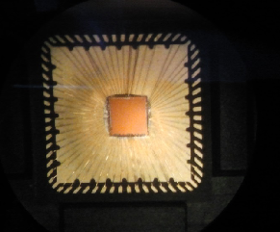
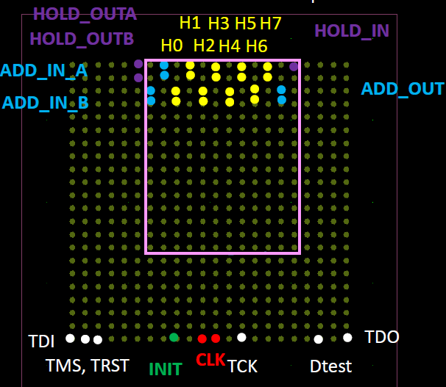
AMCHIP status
MiniAsic - ongoing tests at Milan –
Silicon Creation Serializer/Deserializer OK
Design of AMchip05
(LPNHE-MI-LNF-PI-) advanced – Submission during october/november
Design of AMchip06 expected for spring 2014 – as early as possible to maintain
the commissioning milestone
BGA package common to AMchip05 & 06 defined – Amchip05 order is urgent now

Slide 4
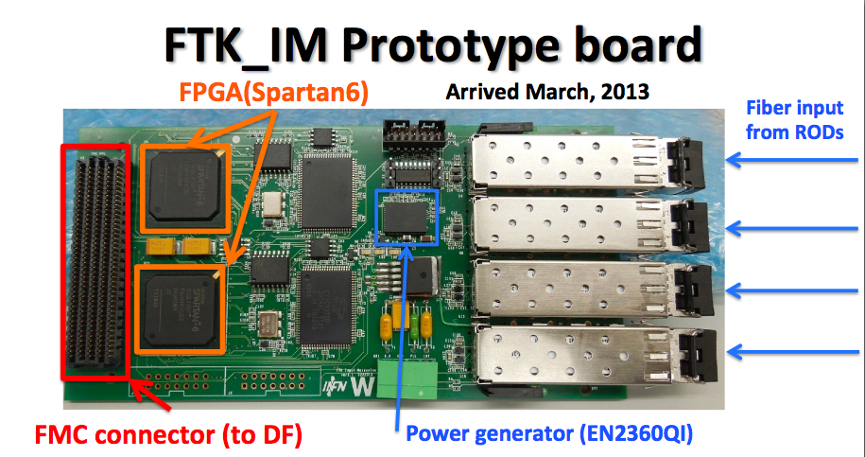
FTK_IM prototype compatible with DF via FMC connector.
Problem with power generator solved (changed component)
Output to DF tested up to 400 MHz (design) for some lines.
New requirement from DF: more lines at 400MHz required → new version needed

Slide 5
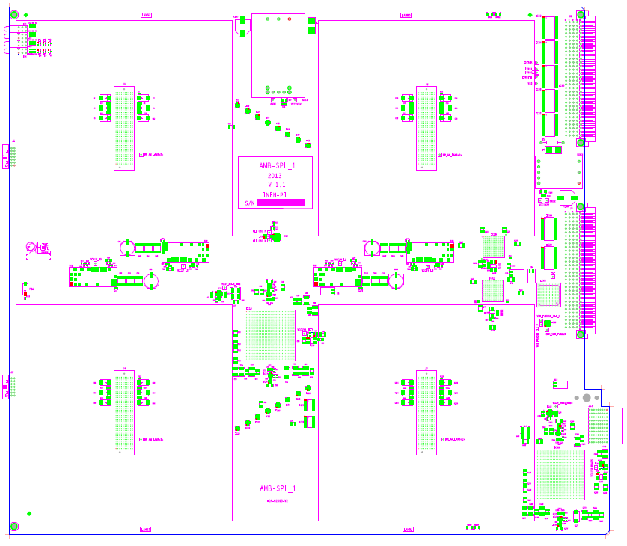
La nuova scheda
AMBSLP –
Il prototipo e’
costruito, a giorni
cominceranno I tests

Slide 6
Richieste
Sblocco SJ 2013
PER IL 2014:
FRASCATI: Produzione mezzanine FTK_IM -> 135 keuro; CPU ATCA (non core) 7 keuro.
PISA: schede e chips per 20 AMBSLPs -> 30 Pisa + 10 keuro SJ di contingenza.
MILANO: tests AMchips alla Microtest 50 keuro + 50 SJ alla definizione finale del costo.
PAVIA: consumo per test di raffreddamento e sviluppo del controllo del power supply: 5 keuro
TOT = 135 + 7 + 30 + 50 + 5 = 227 keuro + 60 keuro SJ

Slide 7
RESPONSABILITA’ ITALIANE IN FTK
FTK team organization
Deputy Project Manager - P. Giannetti (Pisa)
Task LeadersHardware
FTK_IM - M. Beretta (Frascati)
AMBoard - M. Piendibene (Pisa)
LAMB – P. Giannetti (Pisa)
AMBoard and LAMB firmware - D. Magalotti (Perugia)
AM chip - A. Stabile (Milan),
System Integration
Tests & board integration in the Vertical Slice - M. Piendibene (PI)
DAQ integration: Vertical Slice/Demonstrator - A. Annovi (Frascati)
Rack integration including power supplies, cooling, & safety - A. Lanza (Pavia)
Interface to level-2 - A. Negri (Pavia), A. Annovi (Frascati)
FTK simulation - G. Volpi (LNF)

