Slide 1

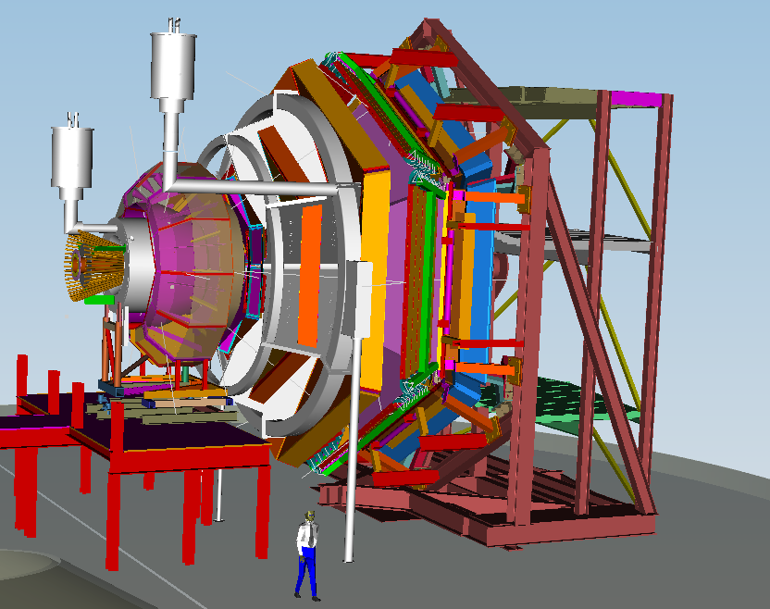
CLAS12
status of the project
Patrizia Rossi Jefferson Lab/LNF-INFN
2nd Workshop on PSHP 11-13 November 2013 – LNF

Slide 2


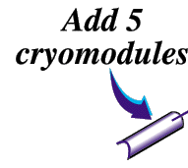




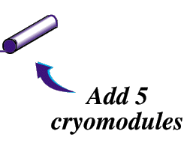
add Hall D
(and beam line)
12 GeV CEBAF
6 GeV CEBAF
Upgrade magnets and power supplies
Energy: 0.8 - 5.7 GeV
Current: 0.1nA - 200 μA
Polarization: 75-85%
CHL-2
  Complition of the 6 GeV program & Accelerator Shut Down
  May 18, 2012
Beam Current: 90 µA
Max Pass energy: 2.2 GeV
Max Enery Hall A,B,C: 10.9 GeV
Max Energy Hall D: 12 GeV
Enhance equipment in existing halls
Maintain capability to deliver lower pass beam energies : 2.2, 4.4, 6.6,….

Slide 3
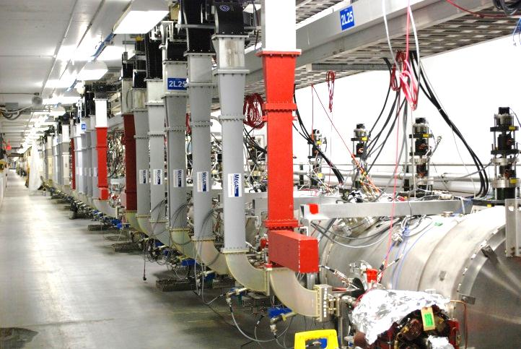
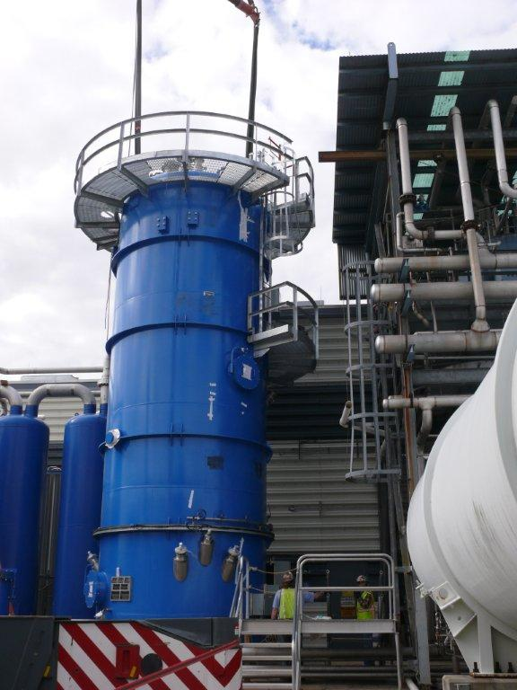
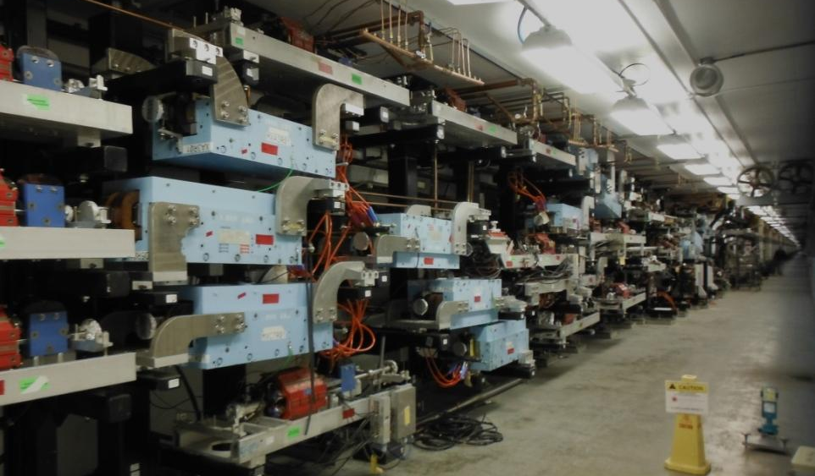
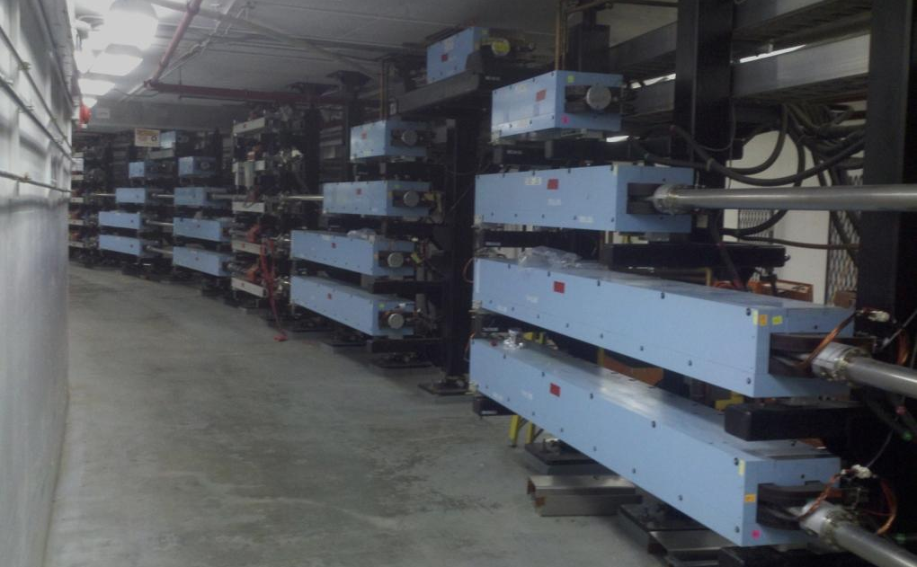
Accelerator Status
Cryomodules: all ten C100s built, installed, and commissioned
RF Power: zones #1 - #10 complete, all commissioning complete
Cryogenics: CHL2 met the commissioning performance goals
12 GeV Cryomodules & RF Zones
East Recombiner
East Arc
Start of Beam Commissioning December 2013
CHL Upper Coldbox

Slide 4
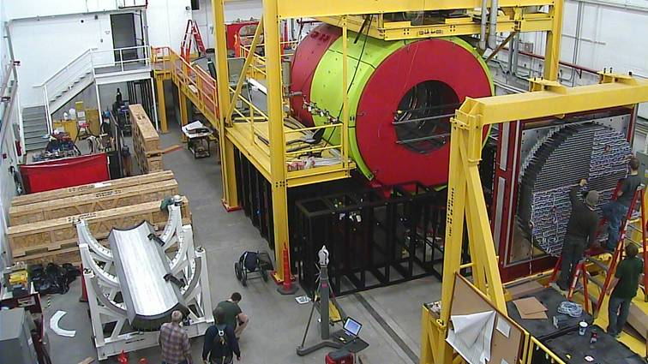
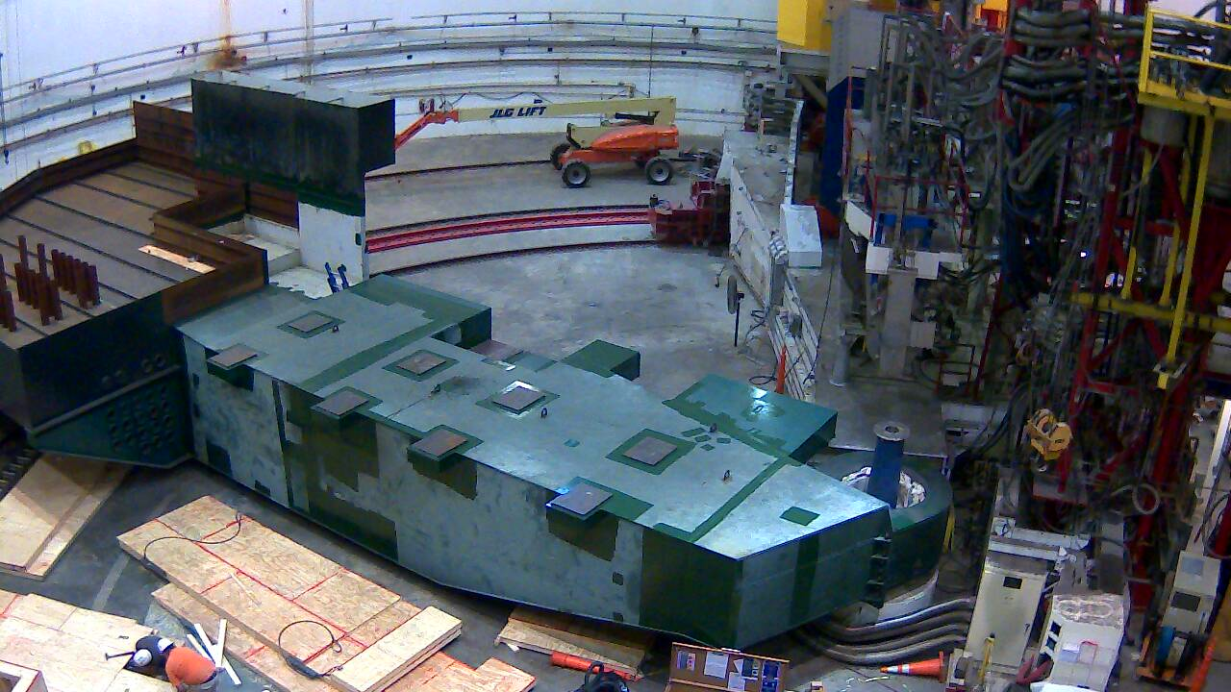
Status of the Project
Project 82% Complete, 96% Obligated
Civil (92%) ; Accelerator (95%) ; Physics Equip (~69%)
TPC = $338M ; CD-4B 9/2017
Hall D Interior
    Hall A commissioning start
    March 2014
    Hall D commissioning start
    October 2014
    Halls B & C commissioning start January/February 2016
    Project Completion September 2017
Hall C Interior

Slide 5

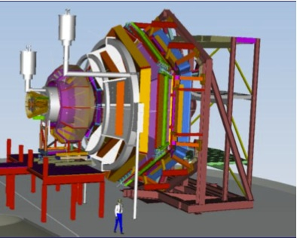
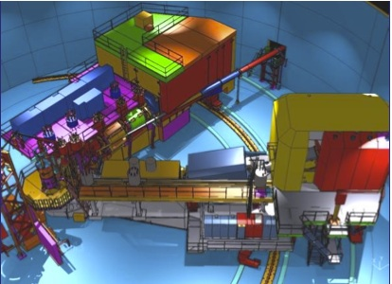
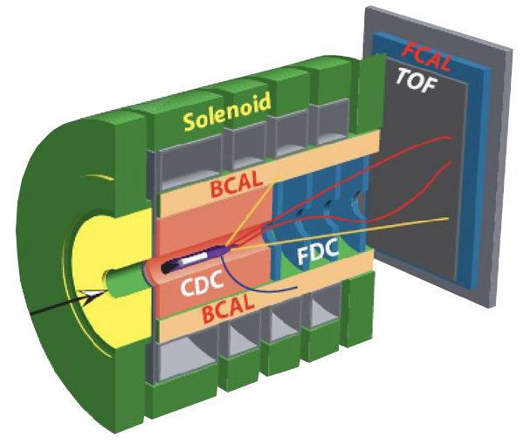
Physics Program at 12 GeV
Hall A – form factors, GPDs & TMDs , SRC
Low-energy tests of the SM and Fund. Symmetry Exp.
Hall A
Hall B
High luminosity, high resolution & dedicated equipments
Hall B - 3-D nucleon structure via GPDs & TMDs
Search new form of hadron. matter via Meson Spectr.
4π detector
Hall C – precision determination of valence quark properties in nucleons and nuclei
Hall C
Hermetic detector
Photon tagger
high momentum spectrometers & dedicated equipments
Hall D
Hall D - exploring origin of confinement by studying exotic mesons using real photons

Slide 6
12 GeV Approved Experiments
Topic | Hall A | Hall B | Hall C | Hall D | Other | Total
The Hadron spectra as probes of QCD (GluEx and heavy baryon and meson spectroscopy) |  | 1 (+1) |  | 2 |  | 3
The transverse structure of the hadrons (Elastic and transition Form Factors) | 4 | 3 | 2 | 1 |  | 10
The longitudinal structure of the hadrons (Unpolarized and polarized parton distribution functions) | 2 | 4 | 6 |  |  | 12
The 3D structure of the hadrons (Generalized Parton Distributions and Transverse Momentum Distributions) | 5 | 8 | 4 |  |  | 17
Hadrons and cold nuclear matter (Medium modification of the nucleons, quark hadronization, N-N correlations, hypernuclear spectroscopy, few-body experiments) | 4 | 2 | 6 |  | 1 | 13
Low-energy tests of the Standard Model and Fundamental Symmetries | 2 |  |  | 1 | 1 | 4
Total | 17 | 18 (+1) | 18 | 4 | 2 | 59
The approved program equals well beyond 7 years

Slide 7
Hall B all experiments (A + CA)
Topic | Approved | Conditionally Approved | (Approved + Cond. Appr.)
Hadron Spectroscopy | 119 (+120) |  | 119 (+120)
Form Factors | 85 |  | 85
Forward parton distributions (PDFs) | 230 |  | 230
3D Structure of the Nucleon GPDs + TMDs | 872 | 330 | 1202
Hadrons in Nuclei | 120 |  | 120
Fund. symmetries & Physics beyond SM |  | 180 | 180
All | 1,426 (1,546) | 510 | 1,936 (2,056) days
Per year we may run 85 full PAC days. To run all these experiments with full beam time as individual experiments would require 23 years.
CLAS12 experiments will run as “run groups” => 8 years of beam time required
1) HPS experiment requires beam energies up to 6.6 GeV and equipment that is not part of the 12 GeV upgrade project.
2) PCR experiment needs 1.1 and 2.2 GeV beam energy and does not require CLAS12.
=> Both experiments could run before the completion of CLAS12.

Slide 8

The CLAS12 Detector
Baseline equipments
Forward Detector (FD)
  - TORUS magnet (6 coils)
  HT Cherenkov Counter
  Drift chamber system
  LT Cherenkov Counter
  Forward ToF System
  Pre-shower calorimeter
  E.M. calorimeter
Central Detector (CD)
  SOLENOID magnet
  Barrel Silicon Tracker
  Central Time-of-Flight
Beamline
  Polarized target (transv.)
  Moller polarimeter
  Photon Tagger
Optimized for exclusive and semi-inclusive reactions
Capable to operate at luminosity up to 10³⁵ cm⁻²sec⁻¹
To be used with polarized target
Particle ID up to high momentum for e⁻/π⁻, π/K/p, γ/πº separation
Good momentum & angle resolution for use of missing mass techniques
Coverage of large ranges in ϑ and φ angles
Upgrade of the CLAS Detector
Upgrades to the baseline &
under construction
RICH detector (FD)
  Forward Tagger (FD)
  Neutron detector (CD)
  Micromegas (CD)
  Polarized target (long.)
FOCUS of this WORKSHOP

Slide 9
CLAS12 - Institutions
  Armenia:
  - Yerevan Physics Institute, Yerevan, Armenia
United States of America:
- Argonne National Laboratory, Argonne, MI
- California State University, Dominguez Hills, CA
- Catholic University of America, Washington, DC
- College of William and Mary, Williamsburg, VA
- Christopher Newport University, Newport News, VA
- Fairfield University, Fairfield, CT
Florida International University, Miami, FL
Hampton University, Hampton, VA
- Idaho State University, Pocatella, ID
- James Madison University, Harrisionburg, VA
Norfolk State University, Norfolk, VA
North Carolina A&T, State University, Greensboro, NC
- Ohio University, Athens, OH
- Old Dominion University, Norfolk, VA
- Renselaer Polytechnic Institute, Troy, NY
- Temple University, Philadelphia, PA
- Jefferson Lab, Newport News, VA
- University of Connecticut, Storrs, CT
- University of New Hampshire, Durham, NH
- University, of Richmond, Richmond, VA
- University of South Carolina, Columbia, SC
University of Virginia, Charlottesville, VA
France:
- Grenoble University, IN2P3, Grenoble
- Orsay University, IN2P3, Paris
- CEA Saclay, IRFU, Paris
Italy:
- INFN - Frascati, Rome
- INFN - Genoa, Genoa
- INFN - University Bari, Bari
- INFN - University Catania, Catania
- INFN - University Ferrara, Ferrara
- INFN - ISS Rome 1, Rome
- INFN - University of Rome Tor Vergata, Rome
Republic of Korea:
- Kyungpook National University, Daegu, Korea
Russian Federation:
- MSU, Skobeltsin Institute for Nuclear Physics, Moscow
- MSU, Institute for High Energy Physics, SiLab, Moscow
- Institute for Theoretical and Experimental Physics, Moscow
United Kingdom:
- Edinburgh University, Edinburgh, Scotland
- Glasgow University, Glasgow, Scotland
    Strong International Collaboration

Slide 10
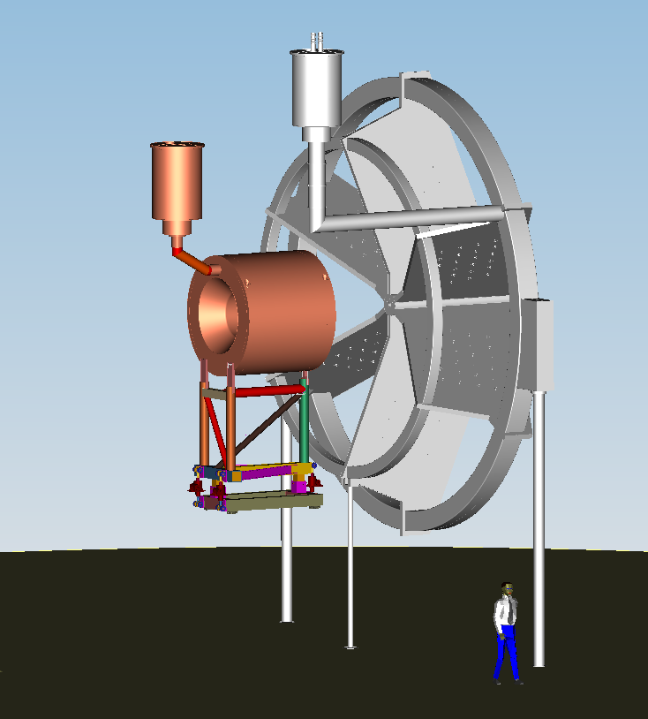
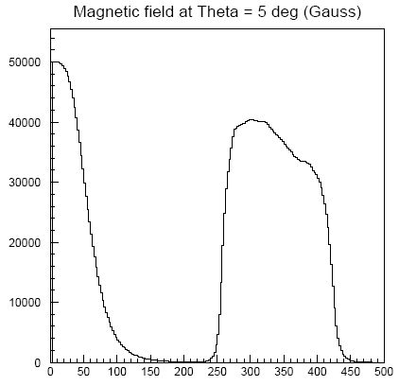
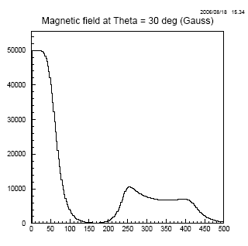
CLAS12 - MAGNETS
Solenoid
Self-shielded super-conducting magnet around the beam line to produce a field primary in the beam direction
Θ = 5º
Torus
B(Gauss)
Provides:
magnetic field for particle tracking of CD
Moeller electron shield
Uniform field (ΔB/B < 10⁻⁴ in 2.5x4 cm cylinder) for polarized target operation
Solenoid
Torus
Θ = 30º
Solenoid
B(Gauss)
Magnet will be designed, fabricated and assembled in the cryostat by Everson Tesla Inc. (ETI)
JLab will design the cryogenic system, the instrumentation, power and control system
JLab will install and commission the magnet in Hall B
Torus
Based on six superconducting coils around to produce a field primary in the φ direction.
Design driven by :
- Large acceptance for forward going particles
- Good momentum resolution
- Large bore for passage of scattered primary beam
Significant Dates
Jan 2014: Begin prototype coil
Dec. 2014: Shipment to JLab
Project Status
Preparation for FDR under way
Provides magnetic field for particle tracking of forward detector

Slide 11
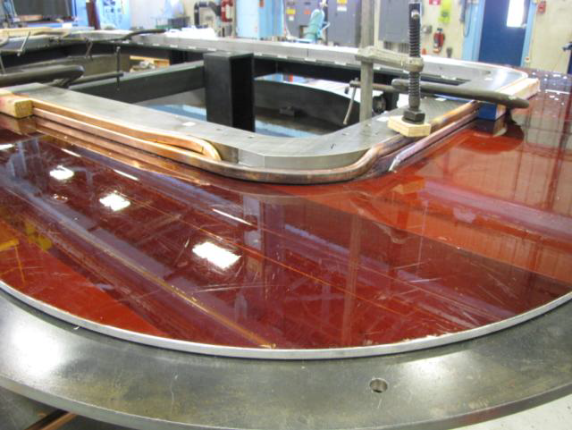
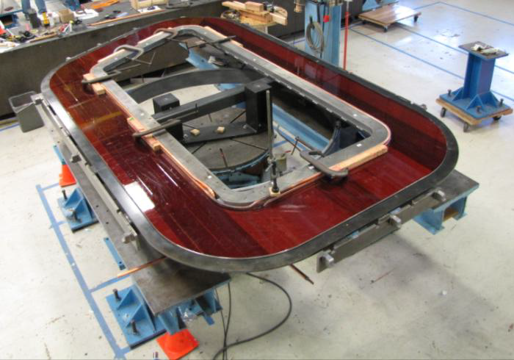
TORUS Construction Status
JLab leads the design effort & procures the conductor
FNAL will manufacture 8 coils (CCMs)
JLab will assemble each coil into cryostats on site
All 8 coils will be tested at 80K ; 2 spare coils will be cooled and powered at 4K
The six coils will be assembled and tested as a magnet in Hall
Project Status
Design coils complete, most parts in procurement process
Cryostat factory team established
Construction process for final assembly of the magnet in Hall B determined
Significant Dates
January 2, 2014: First coil fabrication start
October 17, 2014: 6 Coils ready for installation
August 31, 2015: Torus commissioned and field mapped in the Hall
CLAS12 Torus prototype coil winding table at FNAL

Slide 12
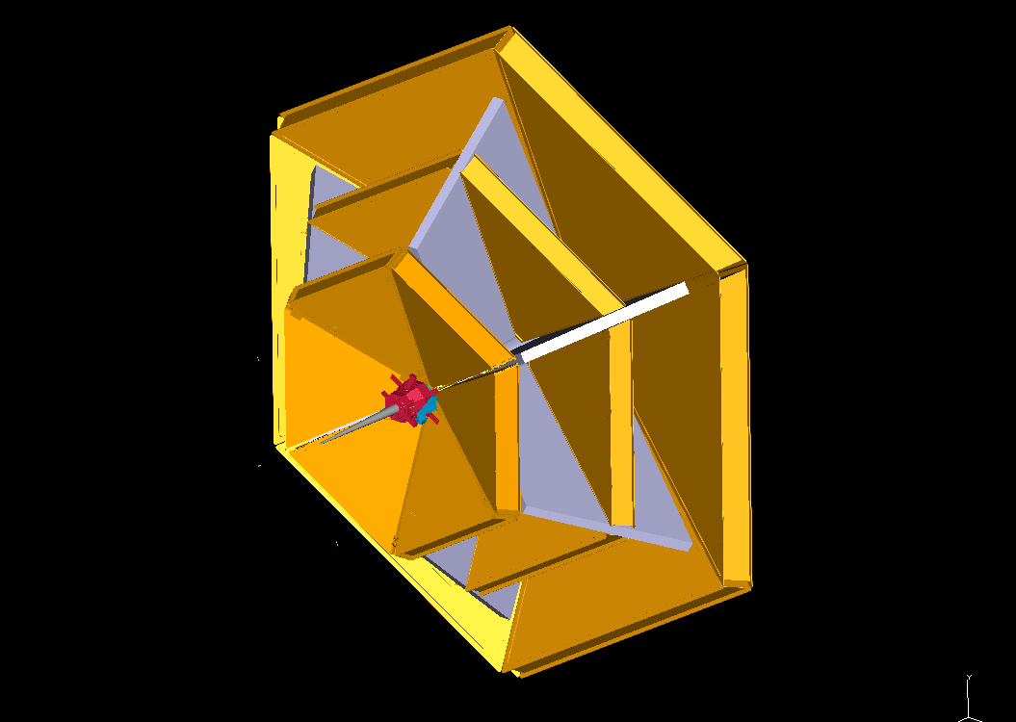
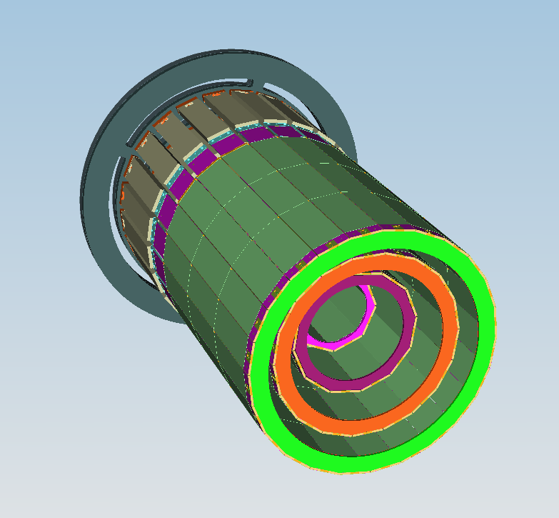
CLAS12 – Tracking System
It will measure the momentum (DC+SVT) and determine the vertex of charged particles (SVT)
Drift Chambers(DC/FD)
Angular coverage: 5° ≤ ϑ ≤ 40° (50% φ coverage at 5°)
  3 regions (at ~2, 3, 4m from the target); 6 sectors/region
  2 super-layers/sector - 6 layers/super-layer
  112 wires/layer (24192)
  Gas : 90/10 Argon/CO₂
Small cells (exagonal) & fast drift velocity to meet L =10³⁵ cm⁻²s⁻¹
Spatial resolution of each cell ~250 – 350 μm to meet Δp/p < 1%
Drift chambers System
RII
RIII
RI
Silicon Vertex Tracker (SVT/CD)
Angular coverage: 35° ≤ ϑ ≤ 125° (for 30 mm target); φ ∼ 2π
  4 regions (10,14,18, 24 modules); Silicon area ~ 1.5 m², channels: ~34,000
Δp/p ~ 5% for 1 GeV particles at ϑ=90°
Stable operation in B=5 Tesla and L=10³⁵ cm⁻²s⁻¹ (over several years)
Torus coils
Essential parts of the GPD program: tracking of low momentum particles with few percent momentum and ~1° angle resolution at large angles.
Allows reconstruction of detached vertices, e.g K_{s} →π⁺π⁻, Λ→π⁻p, Ξ→Λπ for efficient experimental program in strangeness physics.
Beam direction

Slide 13
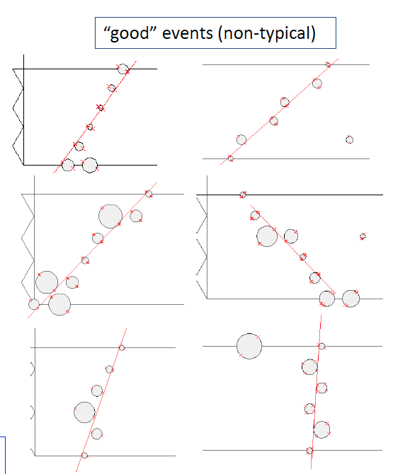
Drift Chambers - Status
Collaboration efforts:
R1 = JLab, Idaho;
R2 = JLab, ODU;
R3 = JLab
Project Status
17 Chambers Built
Commissioning Underway
Remaining Challenges:
Software correction for distortions (sector-dependent change in wire tension)
Calibrations
Significant Dates
Spring 2014: Complition of construction last R3 Chamber
DC R2 - Cosmic Ray Tests @ ODU
Efficiency measured just over 98% at 2550V

Slide 14
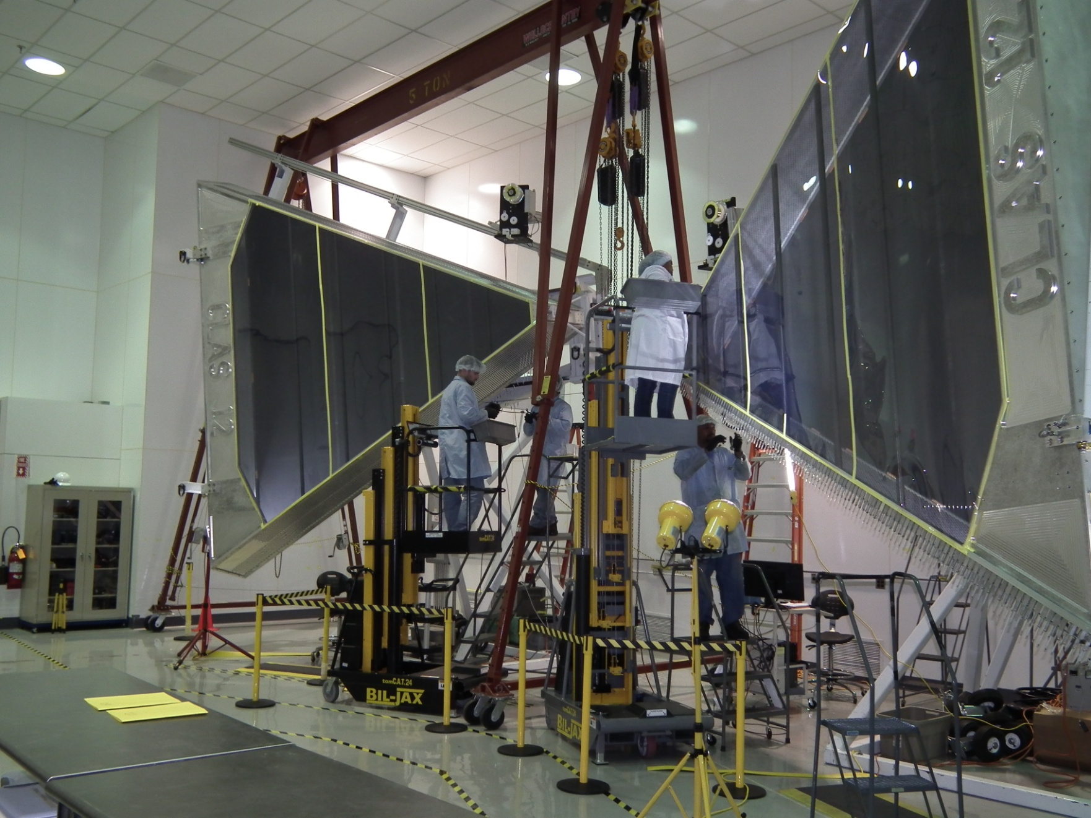
Drift Chambers
REGION 3 DC @ JLab

Slide 15
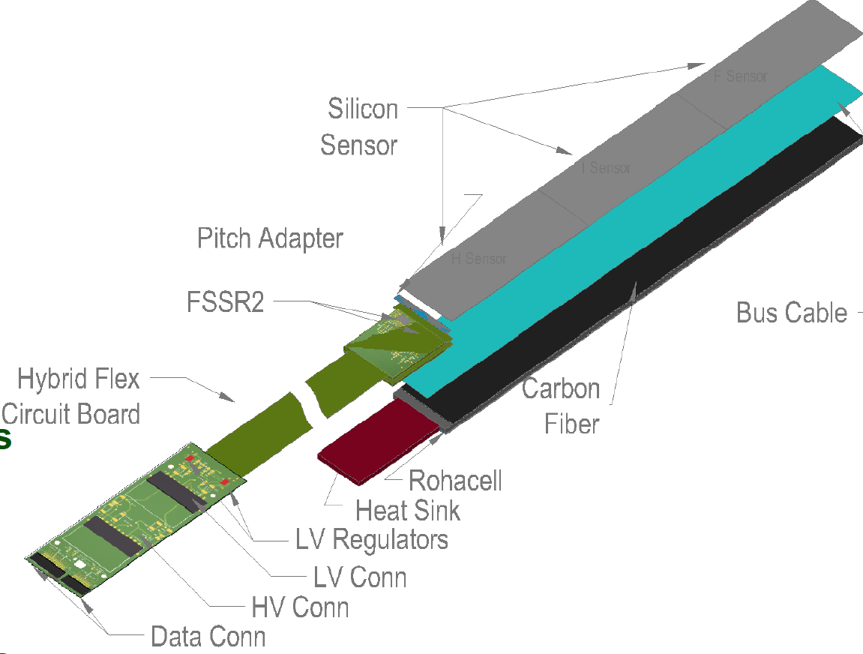
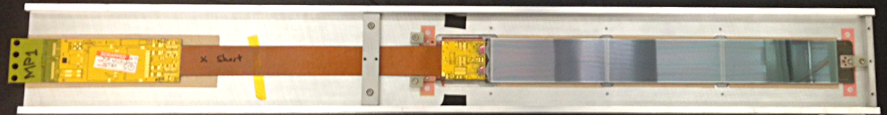
SVT Status
Modules will be fabricated at Fermilab under the direction of JLab
QA/QC and final assembly of the detector will be done at Jlab
SVT Module
Project Status
Two production modules completed
Detailed study of noise (correlated noise) performed
Beam tests conducted at Protvino ( Russia), JLab and Fermilab
Cosmic rays based signals and signal to noise measured
Module noise performance is among the leading microstrip silicon trackers
Detector/module | Strip length, cm | ASIC | ENC, e
CMS TOB OB1 | 18 | APV25 | 1100
ATLAS Barrel | 13 | ABCD3A | 1500
CDF Run2b L0 | 24 | SVX4 | 1600
SVT (for reference) | 13 | FSSR2 | 770
SVT (for reference) | 18 | FSSR2 | 960
SVT (for reference) | 24 | FSSR2 | 1200
SVT (full length) | 33 | FSSR2 | 1600
Significant Dates
Jul. 2013 – Sep. 2014: Module production at FNAL
Oct. 2013 – Oct.2014: QA and module assembly at JLab
Nov 2015: Installation of the SVT
NIMA55845 (2013): Performance of the CLAS12 Silicon Vertex Tracker modules

Slide 16
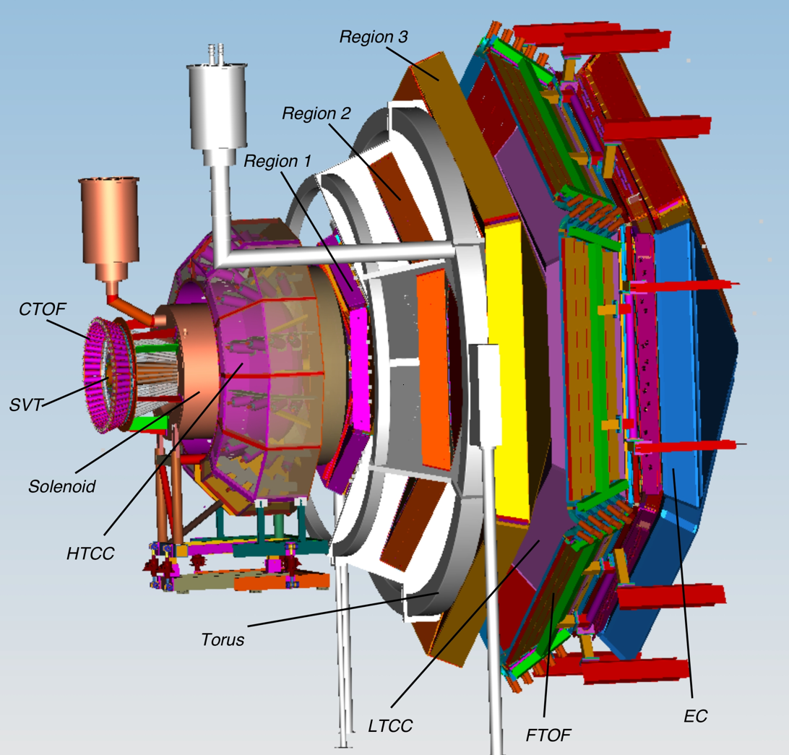
Baseline PID @ CLAS12
HTCC (electron ID):
High Threshold Cherenkov Counter
New detector
LTCC (pion ID):
Low Threshold Cherenkov Counter
Derived from CLAS
 | P_{π} (GeV/c) | P_{K}(GeV/c) | P_{p} (GeV/c)
HTCC CO₂ n=1.00041 | 4,9 | 17,2 | 32,8
LTCC C₄F₁₀ n=1.00153 | 2,7 | 8,9 | 16,9
HTCC
LTCC: π in‐efficiency for min. 2 p.e. :
~ % level around 5 GeV/c
~ per mil level above 7 GeV/c
LTCC
FTOF
FTOF (π/k ID < 3 GeV/c ):
Forward Time‐of‐Flight system
Partially derived from CLAS

Slide 17
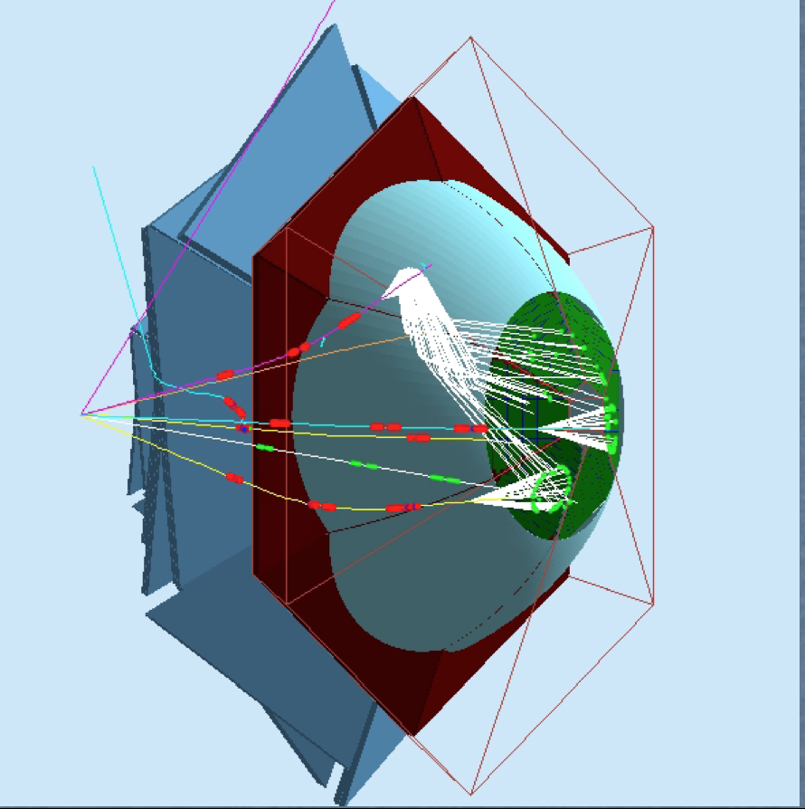
CLAS12 – RICH
GeV/c | 1 | 2 | 3 | 4 | 5 | 6 | 7 | 8 | 9 | 10
π/K
π/p
K/p
e/π
The RICH project is a collaboration between:
Argonne National Lab (USA)
Duquesne University (USA)
Kyungpook National University (Republic of Korea)
INFN, sezione di Bari (Italy)
INFN, sezione di Ferrara (Italy)
INFN, sezione di Genova (Italy)
INFN, sezione di Roma 1 & ISS (Italy)
INFN, Laboratori Nazionali di Frascati(Italy)
J. Gutenberg Universitat Mainz (Germany)
Thomas Jefferson National Accelerator Facility (USA)
Universidad Tecnica Federico Santa Maria (UTFSM – Chile
University of Connecticut (USA)
University of Glasgow (UK)
TOF
LTCC
HTCC
TOF
HTCC
LTCC
TOF
TOF
LTCC
HTCC
EC
RICH
The RICH Project is led by INFN
Review of the Project by JLab Physics Division and DOE held on Sept. 5-6, 2013
Project approved and ~60% of the total cost funded by US.
M. Mirazita’s talk

Slide 18
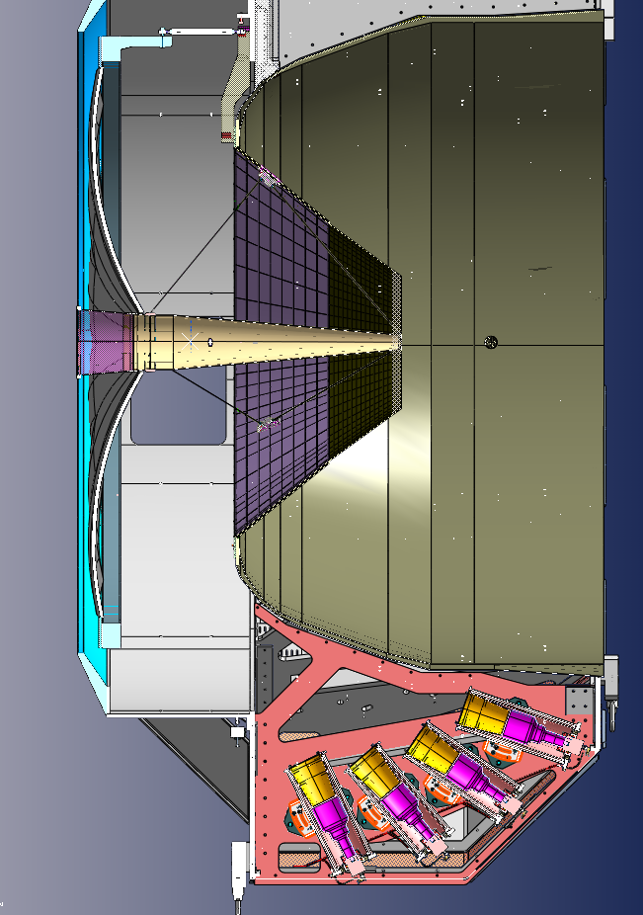
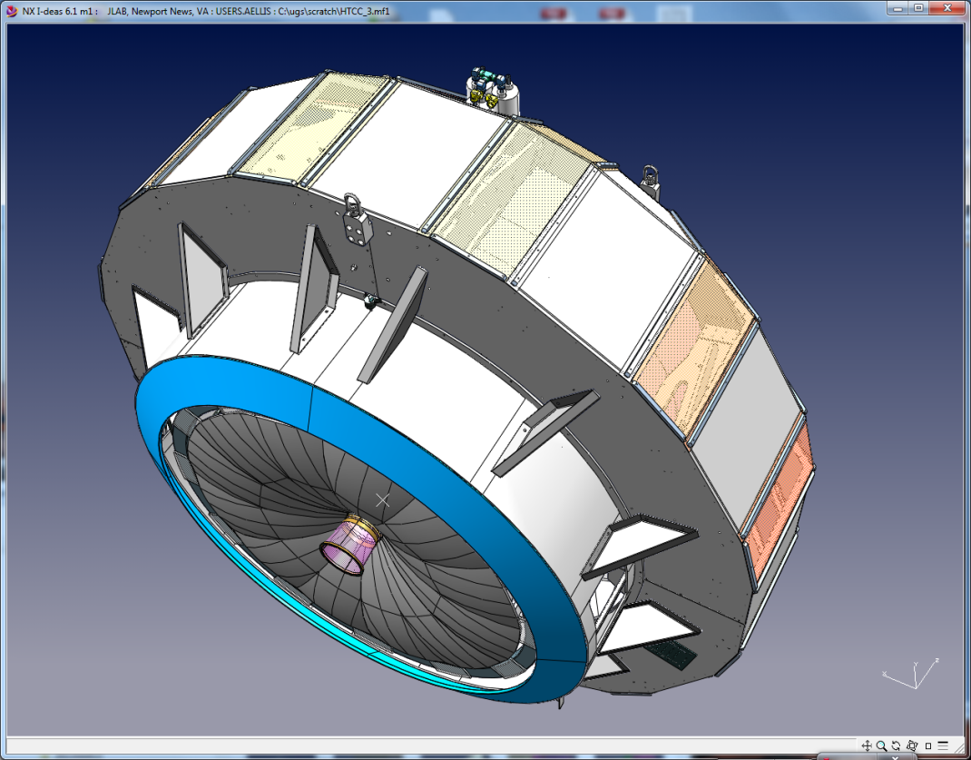
High Threshold CC (HTCC)
Clean separation of electrons and charged pions for momentum < 5 GeV/c for use in fast trigger
Parameters:
    Working Gas: CO₂@1atm, 25ºC
Threshold: 4.9 GeV/c (charged π)/15 MeV/c (e)
Main components:
Mirrors
Containment Vessel
Photomultipliers: 5″ ET- 9823QKB (quartz)
Entry Dish
Moller Cup
Beam
Overall Dimensions: Ø 4.5 m, L = 1.8 m along beam direction
Entry Cone

Slide 19
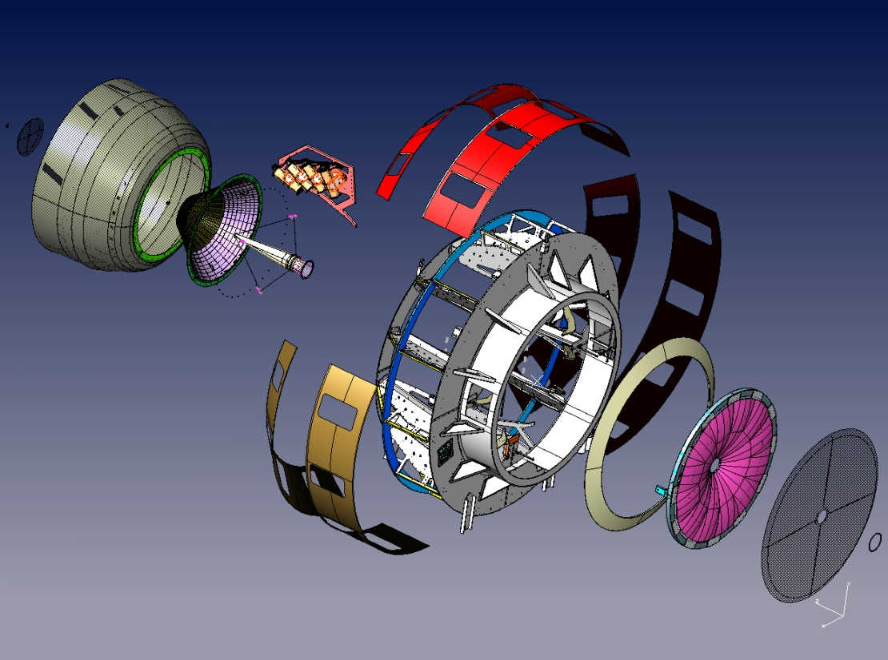
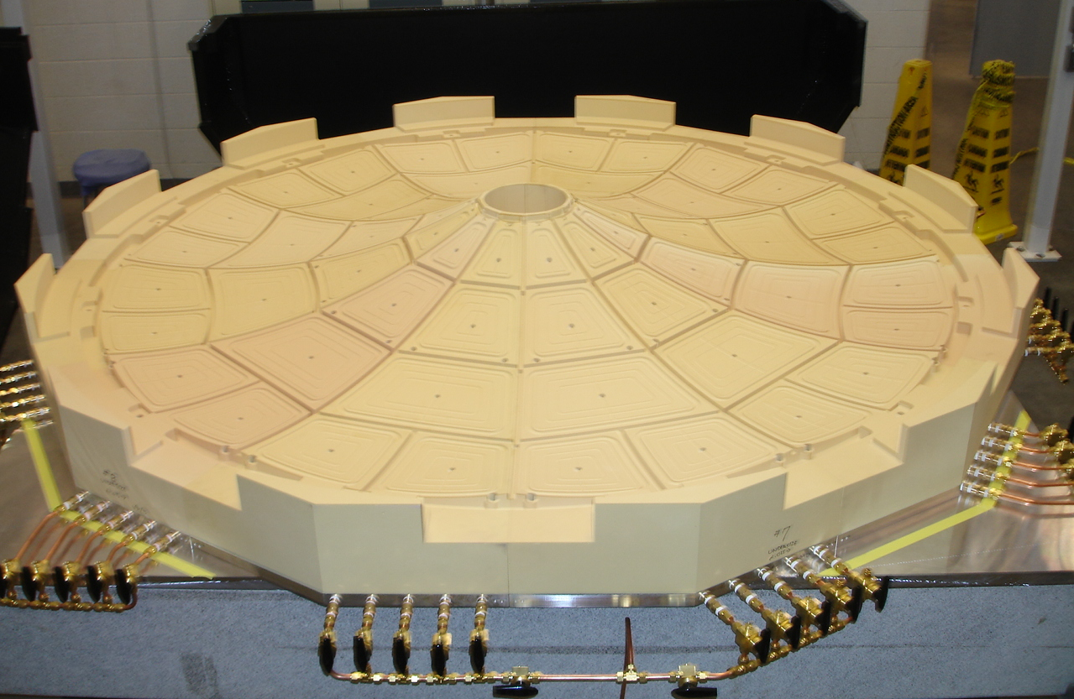
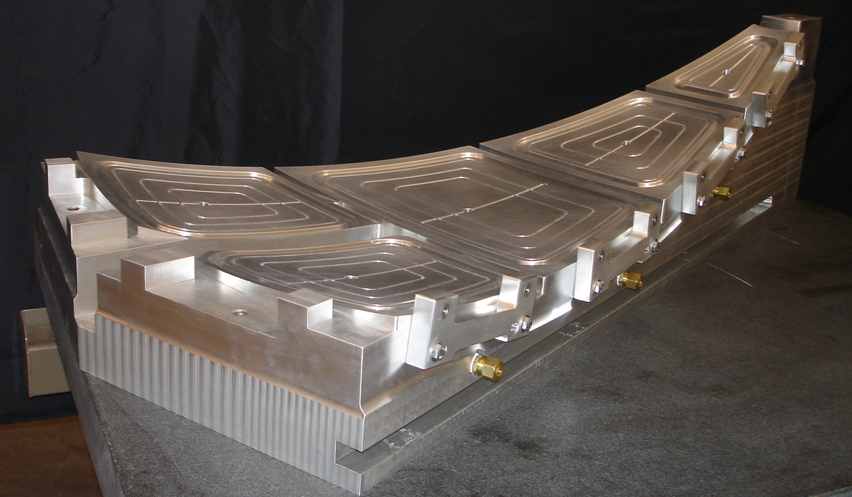
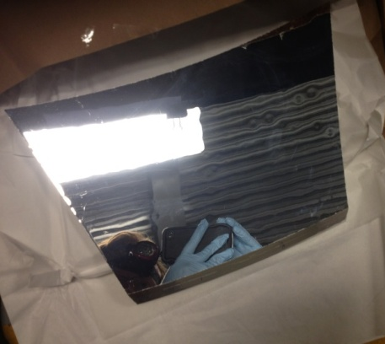
HTCC - Construction
Entry Dish
Containment
Vessel
Containment
Vessel
Moeller Cup
Moeller Cup
Mirrors
Manufacturing of the mirror facets at JLab
Mirrors
Project Status
Coating of mirrors in progress.
Tooling for mirror assembly completed
Light Concentrators delivered, tested and accepted.
Test of the 5-inch quartz PMT tubes completed
Manufacturing,of the containment vessel on going
Exit Window
Exit Window
Significant Dates
May 2014 : QC of the assembled ellipsoidal mirrors
Aug 2014 : QC of the containment vessel construct.
Nov 2014 : Optical tests of mirrors in situ
Apr 2015 : Detector ready for installation
Coating of the mirrors done by outside vendors

Slide 20
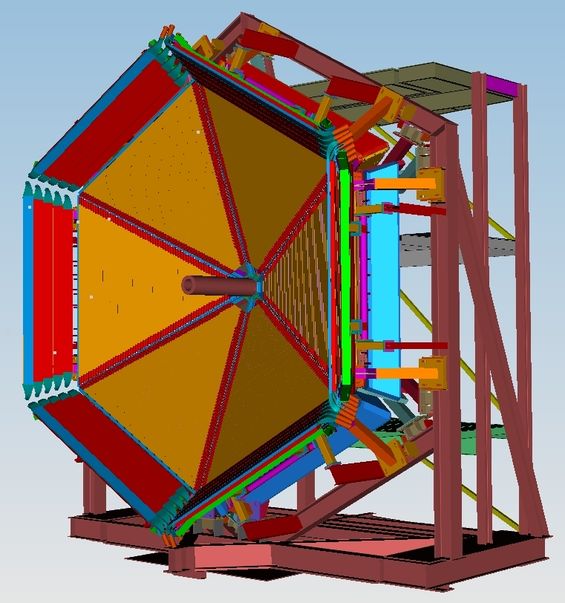
Forward Time-of-Flight (FTOF)
USC, JLab
For each CLAS12 sector
Two scintillators panels for ϑ = 5°-35°
Panel 1a: 5 x 15 x (32‐375) cm - from CLAS
(23 counters)
Panel 1b: 6 x 6 x (17‐408) cm - new
(62 counters)
Combined expected resolution: 50‐90 ps
1 scintillator panel for ϑ = 35°-45°
Panel 2: 5 x 22 x (371‐426) cm - from CLAS
(5 counters)
Expected resolution: 140‐165 ps
π/K separation ➔4σ separation up to 2.8 GeV
K/p separation ➔4σ separation up to 4.8 GeV
π/p separation ➔4σ separation up to 5.4 GeV
Project Status
All Panels tested with cosmic rays : all design specs met or exceeded
Detector arrays ready for installation in Hall B

Slide 21
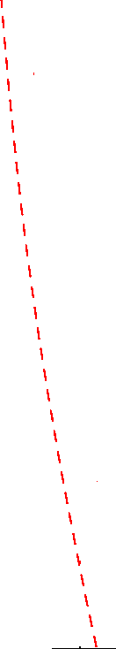
FTOF – Panel 1b (USC)
FTOF New Panel Time Resolution Measurements
combined plane spec.
62 counters in 6 sectors
L = 17 → 408 cm, 6 cm x 6 cm
double-sided readout Hamamatsu R9779 PMTs

Slide 22
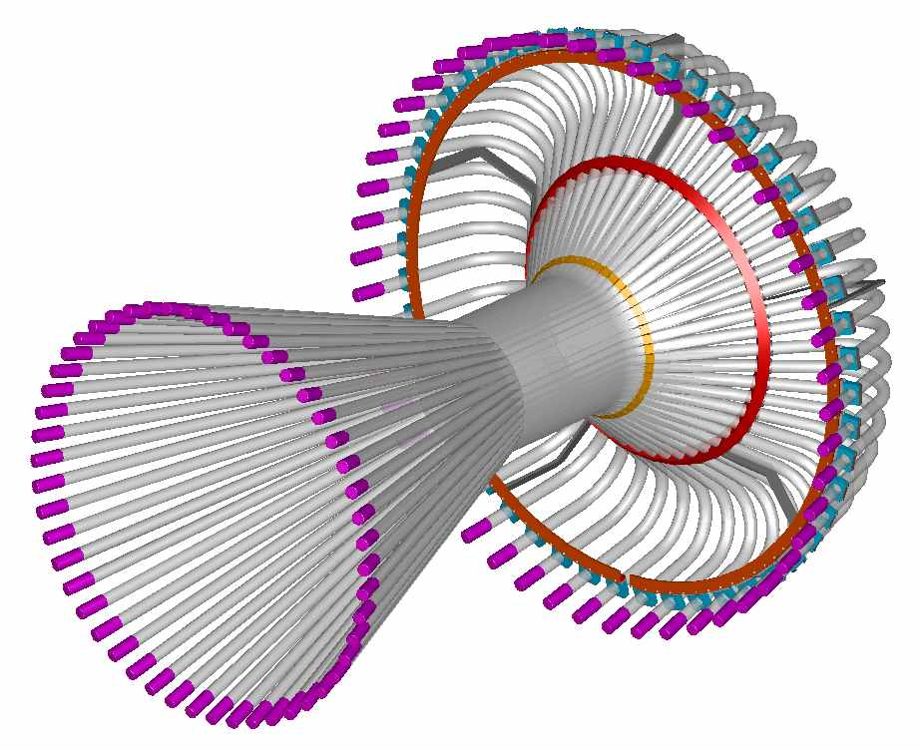
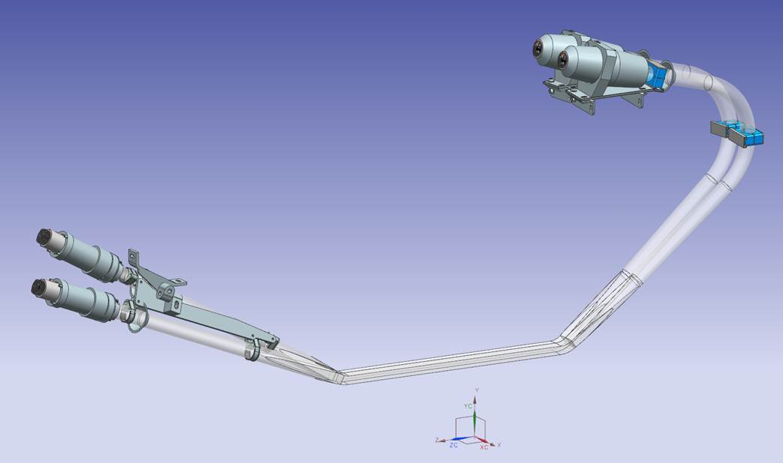
Central Detector - CTOF (JLab, KNU)
downstream
48 plastic scintillators with double-sided PMT readout via 1 m-upstream and 1.6 m downstream focusing light guides
Angular coverage ϑ = 35°-125° ; φ = 0°-180°
The barrel placed inside a 5T solenoid
Expected resolution: 60 ps
π/K separation ➔3.3σ separation up to 0.64 GeV
K/p separation ➔3.3σ separation up to 1.0 GeV
π/p separation ➔3.3σ separation up to 1.25 GeV
upstream
CTOF Light guide
Project Status
Light guides: Completed
Scintillators: Fabrication and QA complete
PMTs: Fabrication and QA procedures complete
CTOF counter assembly: has started

Slide 23
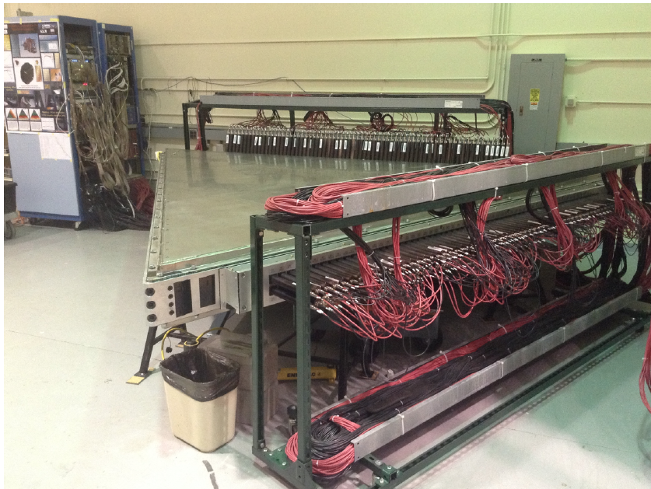
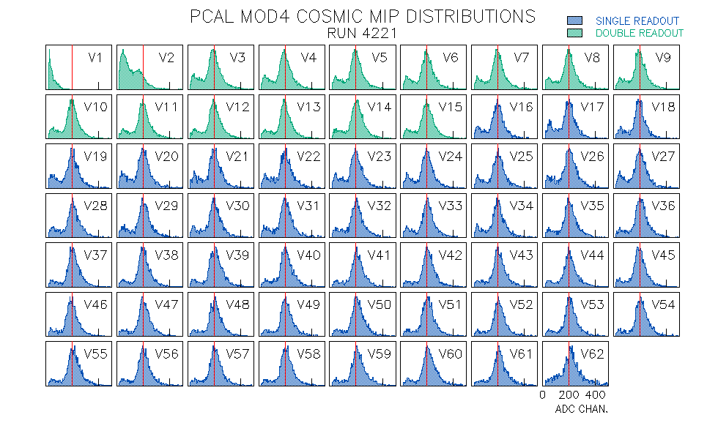
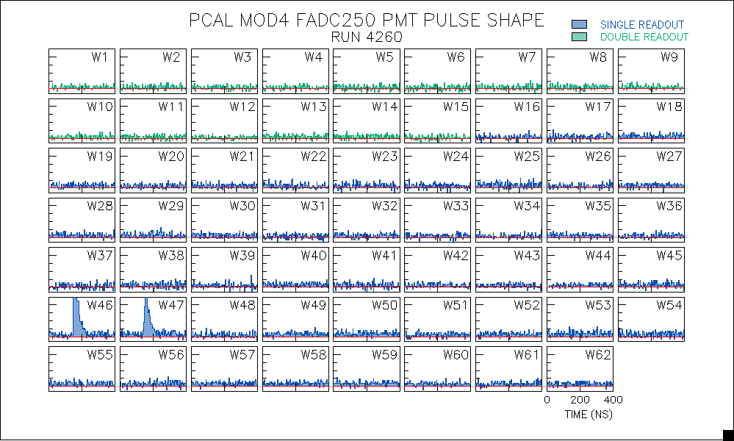
Calibration with Cosmics
Preshower Calorimeter (PCAL)
Used primarily for identification of electrons, photons, π⁰->γγ, and neutrons
Cosmic Ray Test Setup
Calorimeter type: Sampling, lead-scintillator
Scintillator strips: 1x4.5 cm² extruded (FNAL); Readout via WLS fibers
Angular coverage ϑ = 5°-35°
Energy resolution: 10%/√E (with EC)
Position resolution: 0.5 cm
Time resolution: 500 ps
Project Status
All six PCAL modules are fully assembled and ready to be installed.

Slide 24
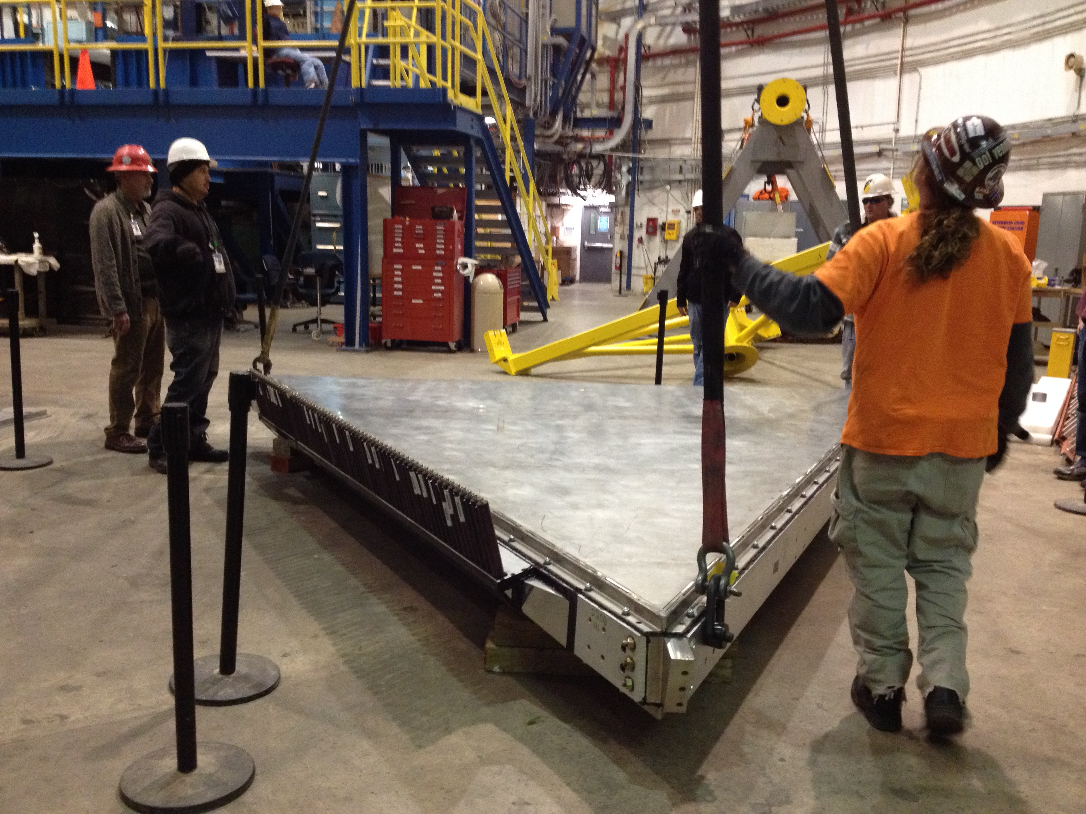
First PCAL Module in Hall B
Installation Nov. 12, 2013

Slide 25
Beyond the baselane: Forward Tagger
PbWO₄ e.m. calorimeter to identify e-, measure the e.m. shower energy and provide a fast trigger signal
Tracker to measure the scattering angles with the required accuracy
Scintillator hodoscope to provide e/γ separation
Angular coverage ϑ = 2.5°- 4.5°
Energy resolution: σ_{E}/E ≤ 2%/√E(GeV) ⊕ 1%
Angular resolution : σ_{ϑ}/ϑ ≤ 1.5 %, σ_{ϕ} ≤ 2º
Time resolution: ≤ 300 ps
Project Status
  FT-Cal procurements started
  FT-Trck design is being finalized.
  FT prototype tested at JLab & BTF at LNF
  FT mechanical design in final phase and first parts have been machined.
  Benchmark bed in Genova for full FT functionality tests is in preparation and planned for fall 2015
Essential parts of the Meson Spectroscopy program
Project leads by the Ge-INFN group
R. De Vita’s talk

Slide 26
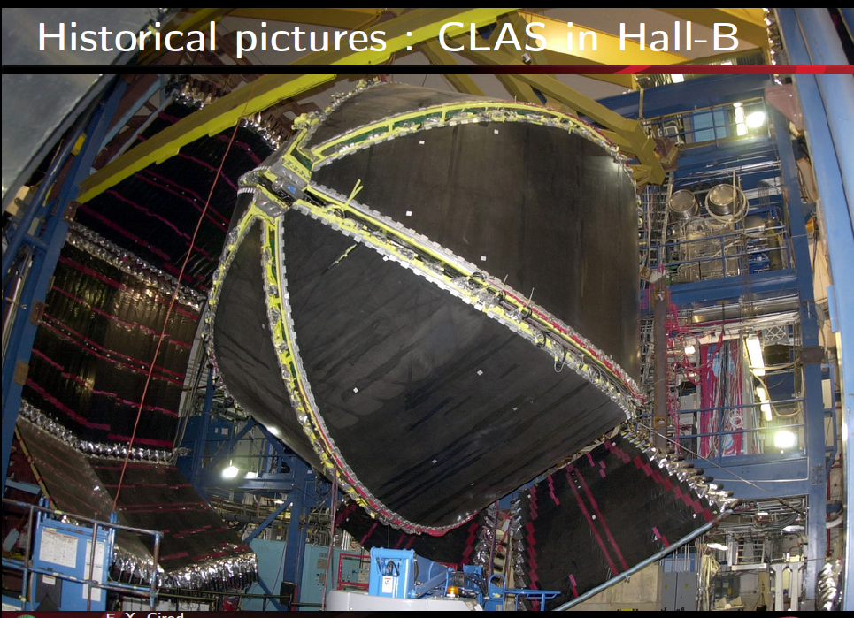
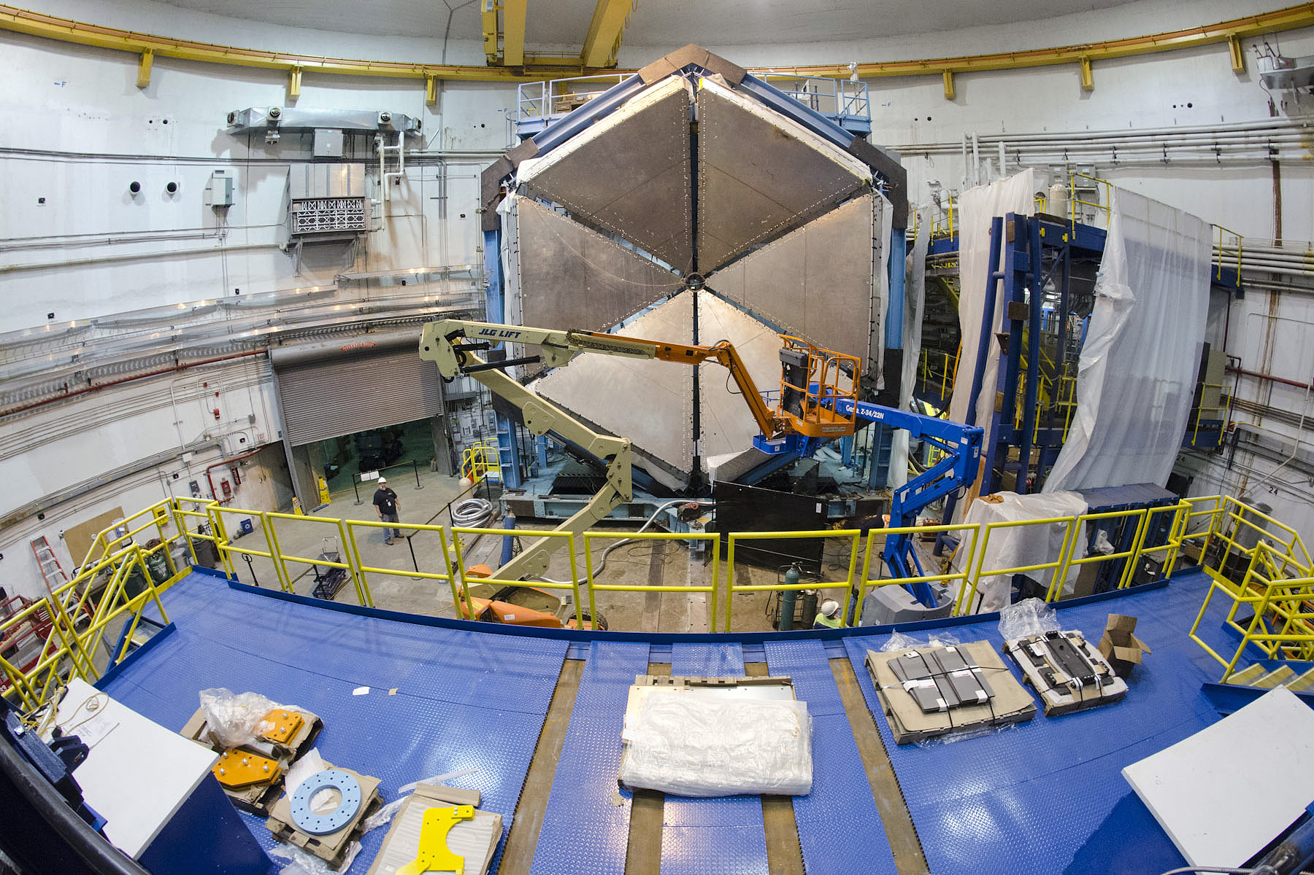
Current Hall B Status

Slide 27
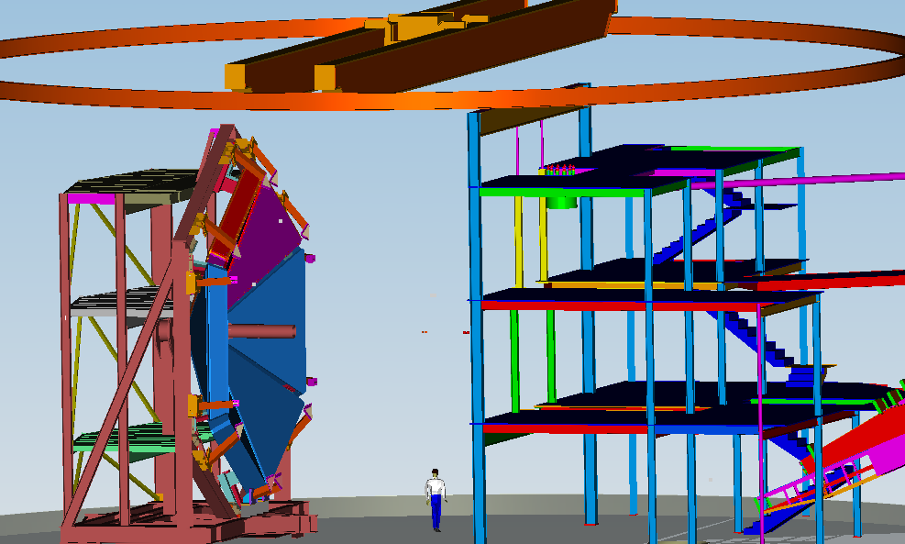
CLAS12 Installation
EC already in place

Slide 28
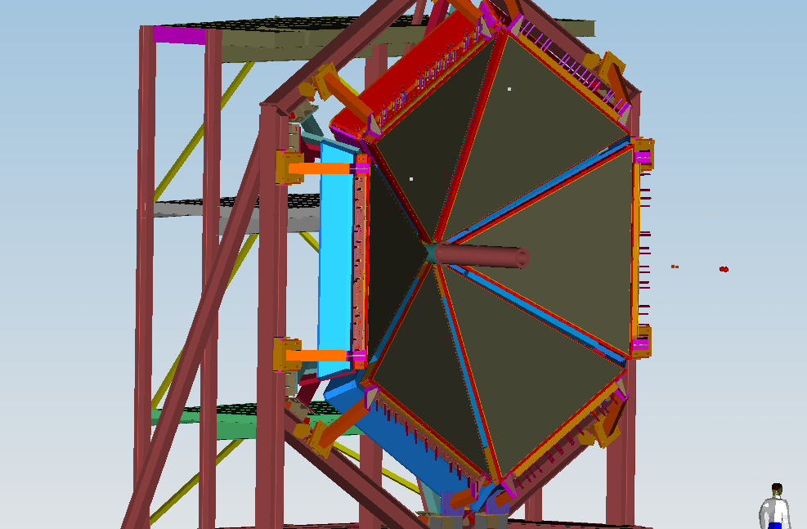
EC and PCAL on the Forward Carriage
Pcal Installation: end of Nov 2013

Slide 29
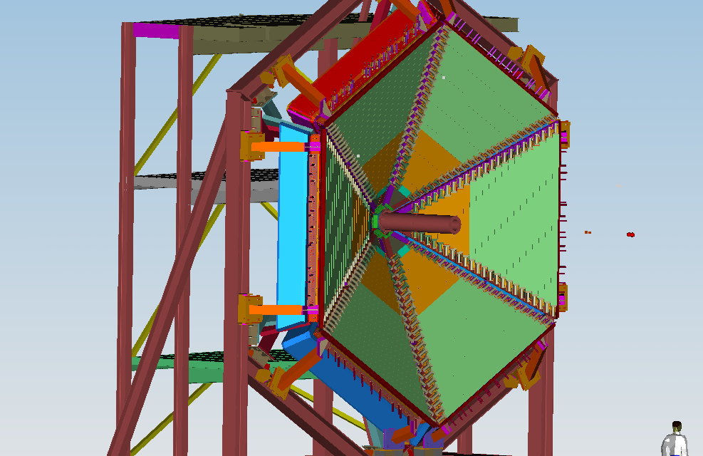
Forward TOF placed over PCAL
TOF Panel 1a:
January 2014

Slide 30
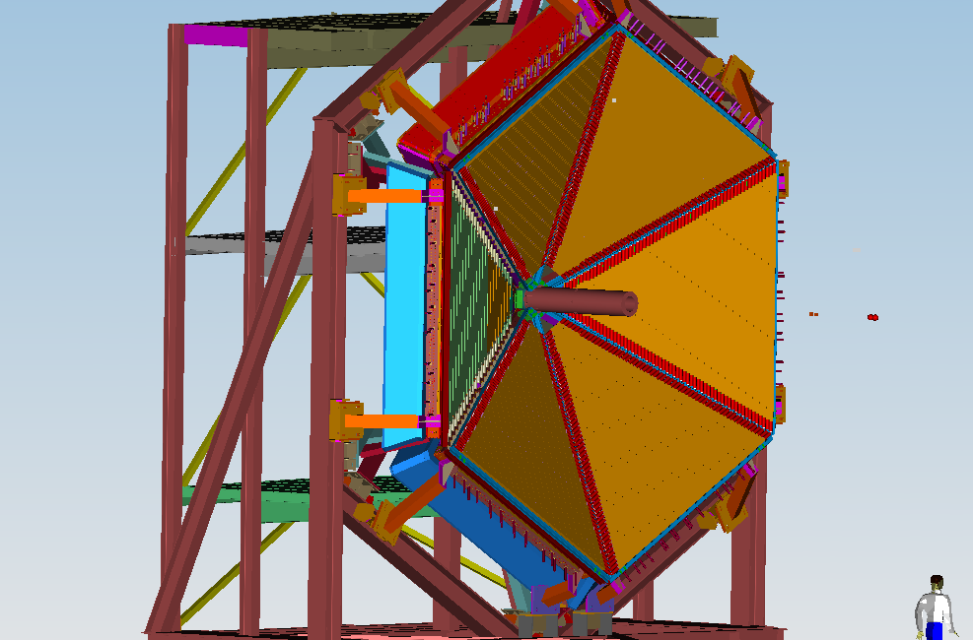
High resolution FTOF 1b added
TOF Panel 1b:
February 2014

Slide 31
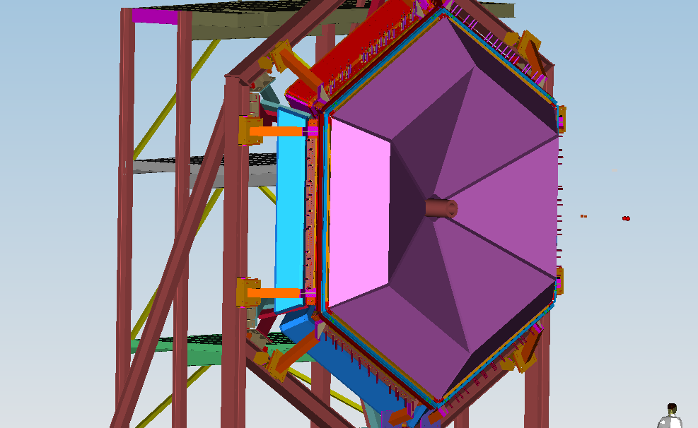
Low Threshold CC (LTCC) installed
LTCC: February 2015

Slide 32
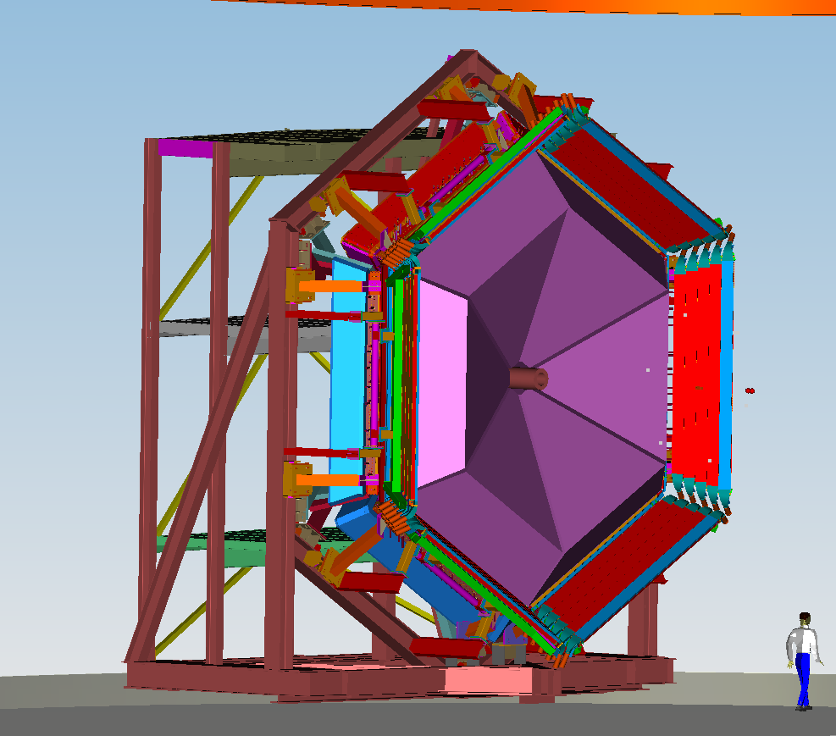
Forward TOF Panel 2 added
Panel 2 to be reused from CLAS: February 2015

Slide 33
Installation of 1 RICH sector
1 RICH sector

Slide 34
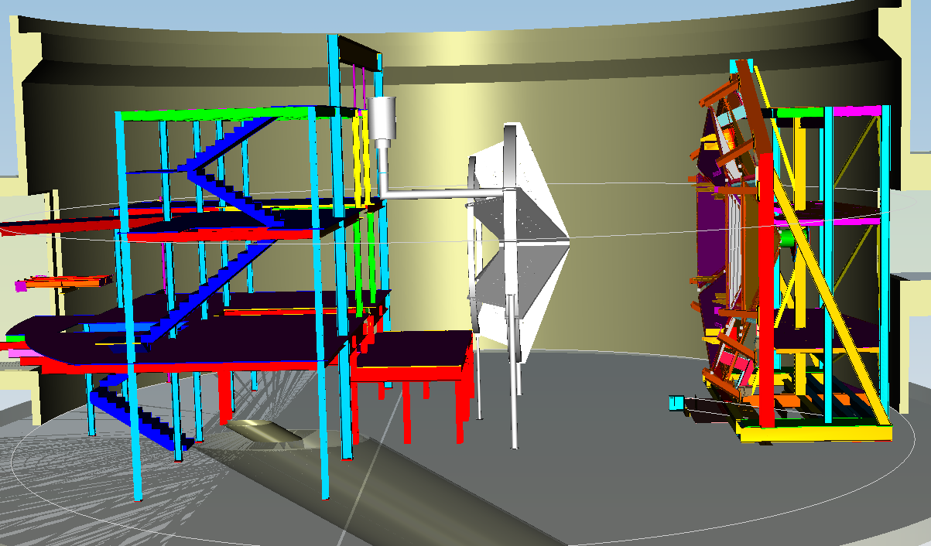
Torus positioned
TORUS:
June 2014 – October 2015

Slide 35
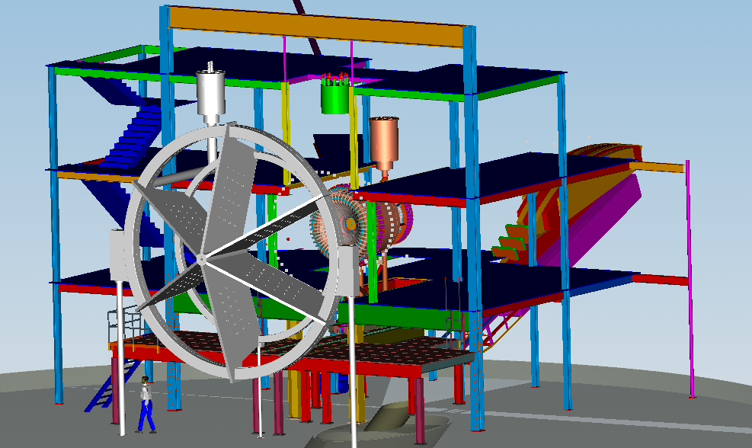
Central Detector
Solenoid: January 2015 – August 2015
CTOF + CND: October 2015
SVT: November 2015 – December 2015

Slide 36
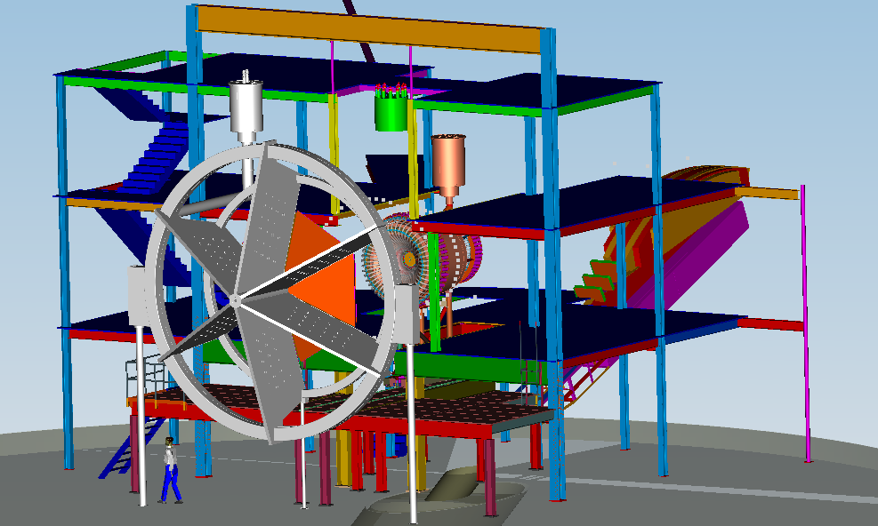
DC installation
DC: October – November 2015

Slide 37

DC installation
DC: October – November 2015

Slide 38

DC installation
DC: October – November
2015

Slide 39

Forward Tagger
Forward Tagger

Slide 40

Install High Threshold CC (HTCC)
HTCC: November 2015

Slide 41

Add beam line devices to complete CLAS12
Completion CLAS12: December 2015
Beamline

Slide 42


Slide 43
Summary
The 12 GeV upgrade of CEBAF is 82% complete
We expect to start commissioning the 12 GeV accelerator beginning of December
CLAS12 in Hall B is progressing very well : several detectors are completed or near completion
Infrastructure in Hall B is progressing very well, space frame installation completed, detector installation ready to start
Additional users-led detector constructions are on track , among which a RICH detector to improve the kaon identification of CLAS12
A RICH physics program is coming!

Slide 44

Offline Software
COMPONENTS | DESCRIPTION
GEMC | Full-Geant4 based detector simulation
CED | Event-level visualization
CLaRA | SOA-based Physics Data Processing application development framework
DPE | Physics Data Processing Environment in Java, C++, and Python
Service Containers | Multi-threaded support
Application Orchestrators | Cloud/ batch-farm support
Online Level-3 Data Processing | ClaRA-based application deployment and operation on the online farm
Reconstruction Services
Tracking | Charged-particle track reconstruction
FTOF/CTOF | Time of flight reconstruction for PID
EC/PCAL | Neutral particle identification
LTCC/HTCC | K/pi separation
Forward Tagger | Quasi-real photon tagger
PID | Particle identification
Calibration and Monitoring Services | Detector calibration, monitoring of data processing, histograming
Auxiliary Services | Geometry service, magnetic field service
Calibration and Conditions Database | Calibration and conditions database for on/offline constants
Data Analysis
DST | Data summary tapes, data format for analysis
Data Mining | Distributed data access
The CLAS12 offline software system will analyze the large amounts of experimental data acquired by the CLAS12 detector.
The system is a Service Oriented software Architecture which consists of the framework, event reconstruction, visualization, calibration, monitoring services, as well as detector and event simulation.
Goal: Be ready on Day 1 of beam for full data collection/calibration/processing/analysis
ClaRA Framework: Complete
Event simulation: GEMC – nearly complete
Event reconstruction: In development, plan for full reconstruction in late 2014

Slide 45
Offline Software
COMPONENTS | DESCRIPTION
GEMC | Full-Geant4 based detector simulation
CED | Event-level visualization
CLaRA | SOA-based Physics Data Processing application development framework
DPE | Physics Data Processing Environment in Java, C++, and Python
Service Containers | Multi-threaded support
Application Orchestrators | Cloud/ batch-farm support
Online Level-3 Data Processing | ClaRA-based application deployment and operation on the online farm
Reconstruction Services
Tracking | Charged-particle track reconstruction
FTOF/CTOF | Time of flight reconstruction for PID
EC/PCAL | Neutral particle identification
LTCC/HTCC | K/pi separation
Forward Tagger | Quasi-real photon tagger
PID | Particle identification
Calibration and Monitoring Services | Detector calibration, monitoring of data processing, histograming
Auxiliary Services | Geometry service, magnetic field service
Calibration and Conditions Database | Calibration and conditions database for on/offline constants
Data Analysis
DST | Data summary tapes, data format for analysis
Data Mining | Distributed data access
The CLAS12 offline software system will analyze the large amounts of experimental data acquired by the CLAS12 detector.
The system is a Service Oriented software Architecture which consists of the framework, event reconstruction, visualization, calibration, monitoring services, as well as detector and event simulation.
Goal: Be ready on Day 1 of beam for full data collection/calibration/processing/analysis
ClaRA Framework: Complete
Event simulation: GEMC – nearly complete
Event reconstruction: In development, plan for full reconstruction in late 2014

Slide 46

DAQ & Trigger
PARAMETER | DESIGN VALUE
Module Format/Bus | VITA 41 - VME64x and VXS (High Speed Serial Extensions)
Number of Readout Crates | 50
Number of L1 Crates | 30
Serial Interface Technology | 2.5Gbps and 5Gbps
Serial Interface Transmission | Backplane and Multi-Fiber Optic
VME64x Data Bus Transfer | 200MB/sec
Trigger Distribution Method | High Speed Serial over Fiber Optic
Full L1 System Latency | < 3.7us
Trigger Rate | 200KHz
Trigger Resolution | 4ns
Trigger Types | 32
Front End Acquisition Clock | 250MHz
Synchronicity (All crates) | 4ns
Bit Error Rate | TBD
System goal and physics requirements
200kHz average L1 Trigger Rate, Dead-timeless, Pipelined, 2ns bunch crossing (CW Beam)
Sector based L1 trigger supporting streaming subsystem hit patterns and energy summing with low threshold suppression
Scalable trigger distribution scheme (Up to 128 front-end L1 crates)
Low cost front-end & trigger electronics solution
Different programmable features for each Detector that participates in the L1 trigger
  Full crates installed in the Hall
  Production Flash ADC front end modules delivered and tested
  21 slot VXS powered card enclosures delivered and tested
  Custom VXS switch slot timing distribution board delivered and tested
  Custom Trigger Interface boards delivered and tested
  Custom CLAS12 Trigger Processor design requirements complete.
  Custom SubSystem Processor delivered and acceptance testing in progress
  Fiber Optic interface cable specified

Slide 47
Forward Time-of-Flight (FTOF)
USC, JLab
PARAMETER | DESIGN VALUE
Panel-1a:
Angular Coverage | θ: 5º → 35º, φ: 50% at 5º → 85% at 35º
Counter Dimensions | L = 32.3 cm → 376.1 cm, w x h = 15 cm x 5 cm
Scintillator Material | BC-408
PMTs | EMI 9954A, Philips XP2262
Design Resolution | 90 ps → 160 ps
Panel-1b:
Angular Coverage | θ: 5º → 35º, φ: 50% at 5º → 85% at 35º
Counter Dimensions | L = 17.3 cm → 407.9 cm, w x h = 6 cm x 6 cm
Scintillator Material | BC-404 (#1 → #31), BC-408 (#32 → #62)
PMTs | Hamamatsu R9779
Design Resolution | 60 ps → 110 ps
Panel-2:
Angular Coverage | θ: 35º → 45º, φ: 85% at 35º → 90% at 45º
Counter Dimensions | L = 371.3 cm → 426.2 cm, w x h = 15 cm x 5 cm
Scintillator Material | BC-408
PMTs | EMI 4312KB
Design Resolution | 110 ps → 150 ps
PID:
π/K Separation | 4σ separation up to 2.8 GeV
K/p Separation | 4σ separation up to 4.8 GeV
π/p Separation | 4σ separation up to 5.4 GeV
Purpose: Provide timing information for charged particle identification and separate pions, kaons and protons. Will also be used in fast trigger decision.
Status: Panel 1a: Refurbishment and QA with cosmic rays completed at JLab. Panel 1b: All counters assembled and QA cosmic ray tested at USC and being shipped to JLab

Slide 48

CLAS12 Design Parameters
Forward Detector
Forward Central
Detector Detector
Angular range
Tracks 5⁰ – 40⁰ 35⁰ – 125⁰
Photons 3⁰ – 40⁰ n.a.
Resolution
δp/p (%) < 1 @ 5 GeV/c < 5 @ 1.5 GeV/c
δθ (mr) < 1 < 10 - 20
Δφ (mr) < 3 < 5
Photon detection
Energy (MeV) >150 n.a.
δθ (mr) <4 @ 1 GeV n.a.
Neutron detection
efficiency < 0.7 (EC+PCAL) n.a.
Particle ID
e/π Full range n.a.
π/p Full range < 1.25 GeV/c
π/K Full range < 0.65 GeV/c
K/p < 4 GeV/c < 1.0 GeV/c
π⁰→γγ Full range n.a.
η→γγ Full range n.a.
Central Detector

Slide 49

CLAS12 Detector Grouping
HTCC
Supported on Cart on Space Frame Subway
Forward Detectors:
LTCC, FTOF, PCAL, EC, all supported by Forward Carriage
Tracking Assembly: Drift Chambers Supported by the TORUS
also Moeller Electron Shield and Inner Calorimeter
Central Detectors:
CTOF, SVT
Supported from the SOLENOID
Beamline:
Raster Magnets, Beam Position, Targets Systems,
Moeller System, etc.
Solenoid
Torus

Slide 50




CLAS12 TORUS Highlights
Prototype Winding at FNAL
Winding Tooling at FNAL
Conductor on Spool at FNAL
Solder Pot at AES

Slide 51

High Threshold CC (HTCC)
Purpose: Clean separation of electrons and charged pions for momentum < 4 GeV/c for use in fast trigger.
PARAMETER | DESIGN VALUE
Working Gas | CO₂@1atm, 25ºC
Angular Coverage | ϑ= 5º – 35º; f= 0º – 360º
Threshold | 15 MeV/c (electrons)
Threshold | 4.9 GeV/c (charged pions)
Rejection of pions at 2 GeV/c | >10³ (99.9% electron detection efficiency)
Rejection of pions at 4 GeV/c | >0.5x10³ (99.9% el. detection efficiency)
Overall Dimensions | Ø 4.5 m, L = 1.8 m along beam direction
Mirror Type | Combined Ellipsoidal, dimensions Ø 2.5m
Mirror Substrate Structure | Acryl (0.01”) + PMI Foam (0.6”) + Acryl (0.1”)
Mirror Thickness | (130 – 135) mg/cm ²
Number of Channels | (12x4) = 48
Photomultiplier Tubes | Electron Tubes 9823QKB (5”, quartz window)
Number of Reflections | 1 (80%) + 2 (20%)
Magnetic Field | < 35 Gauss (along PMT axis)
Magnetic Shield | Multilayer with compensation coil

Slide 52
Central Detector - CTOF (JLab, KNU)
downstream
PARAMETER | DESIGN VALUE
CTOF barrel
Angular Coverage | θ: (35º , 125º) φ: (0,180º)
Counter Dimensions | #48 BC-408 Trapezoidal cross section ~3 x3 x 92 cm³
PMTs | #96 R2083 ( PC 46 mm , H2431-MOD assembly)
Light Guides Upstream | #48 OD=2” ,1m-long ,focusing design, straight
Light Guides Downstream | #48 OD=2”,1.6 m-long ,focusing design, bent 135º
Magnetic shields | #96 triple cylinder Steel-2008/Hiperm49/CONETIC
Magnetic shields | #96 compensating coils around innermost cylinder
Design Resolution | 60 ps
PID:
π/K Separation | 3.3σ separation up to .64 GeV
K/p Separation | 3.3σ separation up to 1.0 GeV
π/p Separation | 3.3σ separation up to 1.25 GeV
upstream
The CLAS12 CTOF system will be part of the Central Detector used for identification of charged particles via their time-of-flight. It includes 48 plastic scintillators with double-sided photomultiplier (PMT) readout via 1 m-upstream and 1.6 m downstream focusing light guides.
The array of 48 counters forms a hermetic barrel around the target. The barrel is aligned with the beam axis inside the 5T solenoid. The PMTs are placed in the region of 1000 Gauss fringe field of the solenoid and enclosed into the triple dynamical magnetic shield that provides 0.2 G internal PMT field.
Project status:
Magnetic shields: Construction and QA complete
Light guides: Completed, some rework underway
Scintillators: Fabrication and QA procedures complete
PMTs: Fabrication and QA procedures complete
CTOF counter assembly: To begin his summer

Slide 53

FToF Panel-1a
JLab
Panel-1a FTOF arrays:
- 23 counters in 6 sectors
L = 32 → 376 cm, 5 cm x 15 cm
double-sided readout
Electron Tubes 9954A PMTs
- Positioned on Fwd Carriage upstream of PCAL
- All counters refurbished, cabled and cosmic rate
tested
Panel-2 FTOF arrays:
- 5 counters in 6 sectors
L = 371 → 426 cm, 5 cm x 22 cm
double-sided readout
Electron Tubes 4312KB PMTs
- Mounted around perimeter of Fwd Carriage
- Counter refurbishment completed and all cosmic ray tested with average δT ≈150- 175psec
Panel-1a counters

Slide 54

Low Threshold CC (LTCC)
PARAMETER | DESIGN VALUE
Mirrors
Support Structure | 3 kevlar layers sandwiched with vinyl foam
Elliptical | Length = 6’’ to 55’’, Width = 8’’ to 11’’
Hyperbolic | Length = 12’’ to 30’’, Width = 8’’ to 9.25’’
Mirror Coating | Al/MgF2
Reflectivity | 90% from 250 to 650 nm
Gas
Refraction Index | 1.00134
Transparency | 100% above 220nm
Density | 9.94 Kg/m³
Window Material | tedlar/mylar/tedlar composite
PMTs
180 | Photonis XP 4500B
18 | Electron Tubes 9823QKB
18 | Photonis XP 4508
Magnetic Shields
Material | Eagle AAA: 80% Ni, 4.20% Mo, and 15% Fe
Field Attenuation Factor | 85 Axial, 390 Transverse
PID:
π/K Separation | 3.5 to 9 GeV/c
The LTCC system is part of the forward CLAS12 detector and will be used for pions/kaons discrimination. The LTCC consists of 6 sectors of lightweight mirrors, light collecting cones, 5’’ PMTs and magnetic shields. The sectors are filled with C₄F₁₀ gas, providing pion/kaon discrimination from 3.5 to 9 GeV/c. Each sector contains:
  108 lightweight mirrors
  36 Winston Cones
  36 5’’ PMT
  36 Magnetic Shields
The LTCC is required to have excellent efficiency over the forward angular acceptance available to CLAS12.
Mirrors, WC:
  Evaluating 2 vendors for recoating
  5 out of 6 sectors mirrors removed
LTCC Box:
  5 out of 6 sectors stripped
  Remodeling in progress

Slide 55




PCAL Calibration with Cosmics
Module 4 readout with JLab Flash ADCs

Slide 56

Subway level added

Slide 57




Accelerator Schedule
CD-4A
CD-4B
Accelerator
Hall A
REBASELINE
Hall D
Hall B & Hall C
Start of Beam Commissioning January 2014

Slide 58
12 GeV Approved Experiments
Topic | Hall A | Hall B | Hall C | Hall D | Other | TOTAL
The Hadron spectra as probes of QCD (GluEx and heavy baryon and meson spectroscopy) |  | 119 |  | 320 |  | 439
The transverse structure of the hadrons (Elastic and transition Form Factors) | 144 | 85 | 102 | 25 |  | 356
The longitudinal structure of the hadrons (Unpolarized and polarized parton distribution functions) | 65 | 230 | 165 |  |  | 460
The 3D structure of the hadrons (Generalized Parton Distributions and Transverse Momentum Distributions) | 409 | 872 | 161 |  |  | 1442
Hadrons and cold nuclear matter (Medium modification of the nucleons, quark hadronization, F N-N correlations, hypernuclear spectroscopy, few-body experiments) | 159 | 120 | 179 |  | 14 | 472
Low-energy tests of the Standard Model and Fundamental Symmetries | 513 |  |  | 79 | 60 | 652
Total | 1290 | 1426 | 607 | 424 | 74 | 3821

Slide 59
Baseline PID @ CLAS12
HTCC (electron ID):
High Threshold Cherenkov Counter
New detector
FTOF (π/k ID < 3 GeV/c ):
Forward Time‐of‐Flight system
Partially derived from CLAS
LTCC (pion ID):
Low Threshold Cherenkov Counter
Derived from CLAS
HTCC
π in‐efficiency for minimum 2 p.e. :
100 % below 2.7 GeV/c (Cherenkov th.)
~ % level around 5 GeV/c
~ per mil level above 7 GeV/c
LTCC
FTOF

Slide 60

First PCAL Module in Hall B

