Slide 1



The PANDA Barrel DIRC
Matthias Hoek
on behalf of the PANDA Cherenkov Group
PSHP 2013, Frascati, 11.-13. November 2013

Slide 2
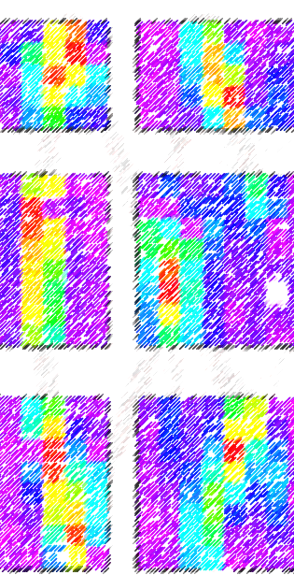
Overview
FAIR & PANDA Experiment
Barrel DIRC Design
Pattern Reconstruction
Technical Challenges
Prototyping
Conclusions

Slide 3
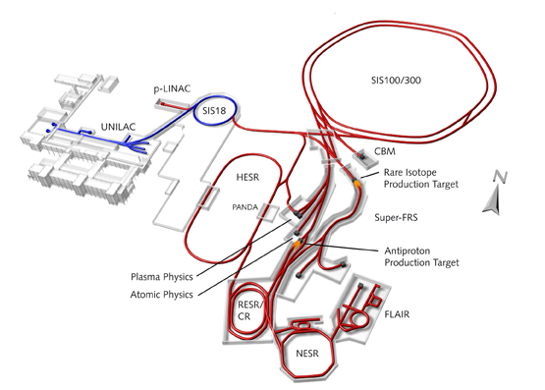
Facility for Antiproton and Ion Research (FAIR)
Primary beams
  Heavy Ion Beams
  30 GeV protons (2·10¹³s⁻¹)
GSI
PANDA
HESR
5·10¹⁰ antiprotons
• 1.5 to 15 GeV/c
High luminosity mode Δp/p ≈ 10⁻⁴ with stochastic cooling L = 10³² cm⁻²s⁻¹
High precision mode (<8.9GeV/c) Δp/p ≈ 10⁻⁵ with electron cooling L = 10³¹ cm⁻²s⁻¹
Secondary beams
  Broad range of radioactive beams up to 1.5 – 2 GeV/u
  Antiprotons 3 – 30 GeV

Slide 4
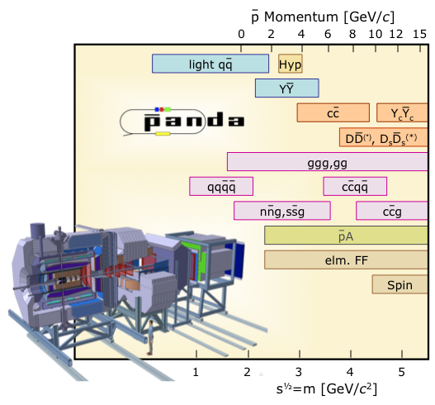
Physics Goals of PANDA
Non-perturbative QCD
Hypernuclei
Precision Hadron Spectroscopy
Excellent PID required
Exotic States
(Glueballs, Hybrids)
In-Medium Modifications
Nucleon Structure
Notes:
Some physics book results
General PANDA physics goals (Map?)
Final states for some key channels

Slide 5
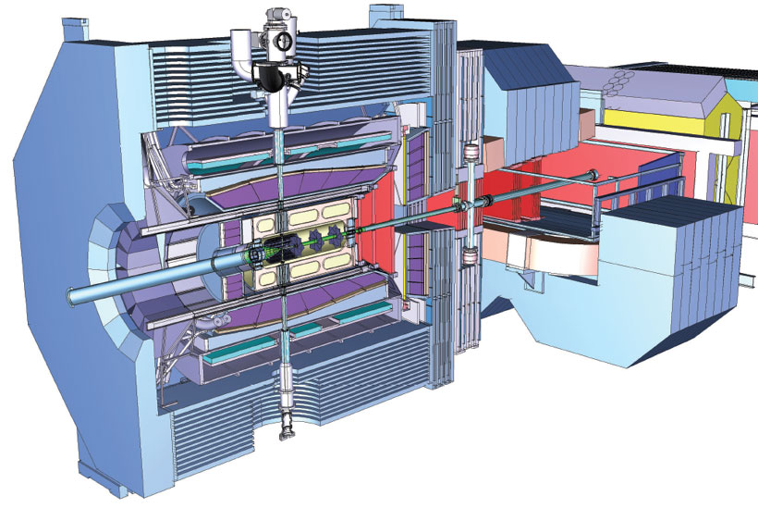
PANDA DIRC Detectors
Barrel DIRC
(22˚- 140˚)
EMC
GEM
Endcap Disk DIRC
(5˚- 22˚)
Beam
Notes:
Picture of TS + geometrical acceptance

Slide 6
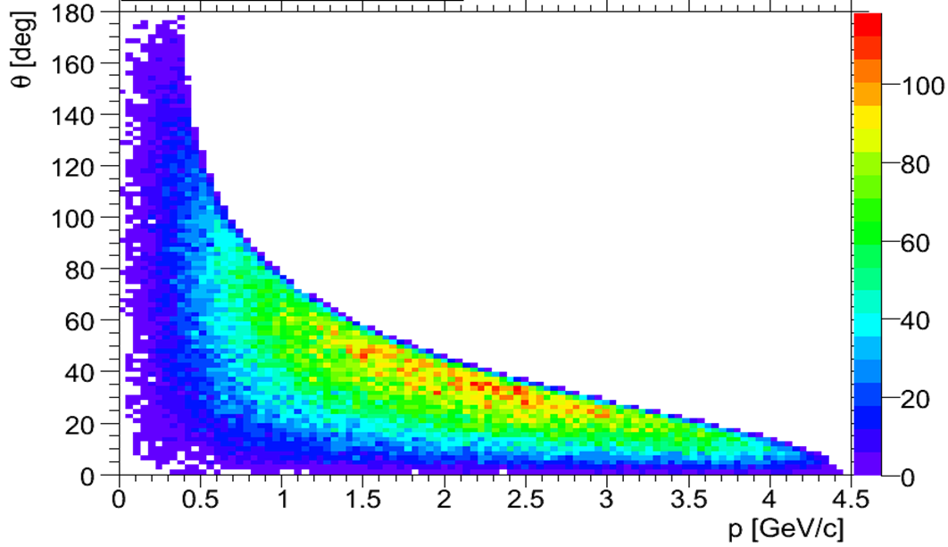
PANDA DIRC Detectors
Barrel DIRC
(22˚-140˚)
Endcap Disk DIRC
(5˚ -22˚)
Kaon distribution of the radiative decay J/ψ → K⁺K⁻ γ
Beam
Barrel DIRC
PID Goal: 3σ π/K separation up to 3.5GeV/c
Endcap Disk DIRC
Novel design
PID Goal: 3σ π/K separation up to 4GeV/c
π/K Cherenkov angle difference at 3.5 GeV/c in fused silica ~8.5mrad
Notes:
Picture of TS + geometrical acceptance
This radiative decay is a benchmark channel for glue balls;

Slide 7
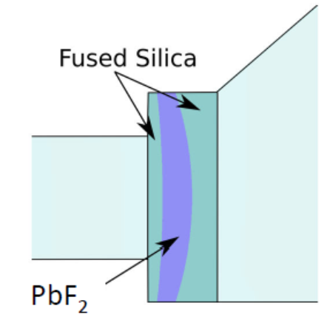
Barrel DIRC Base Design
Photon detection
& Electronics
15000 channels
MCP-PMTs
Fast TDC + ADC FEE
Expansion Volume
Mineral oil
250cm
Simulated hit pattern
100cm
30cm
Radiator bars (80pcs)
17mm×32mm×2400mm
Syn. fused silica
Performance Goals
θ_{c} single photon resolution 8-10mrad
20 detected photons per track (β=1)
Timing resolution ~100ps
Focussing optics
High-refractive index lens
N-LaK 33
Notes:
General design + numbers
15k readout channels
Timing
Rates

Slide 8
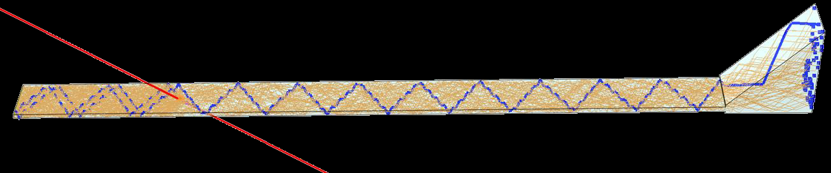
Barrel DIRC Design Options
Narrow bars
& segmented expansion volume
Plate & Prisms
1 plate per sector (16cm)
Similar to Belle II iTOP
Less surfaces
Needs timing information
X-Y hit pattern
Y (cm)
One fused silica prism per sector (5 bars)
Higher photon yield
More ambiguities in reconstruction
X (cm)
Fused silica prism
Notes:
Bars or plates

Slide 9
Barrel DIRC Pattern Reconstruction (Bar)
Use BaBar-like reconstruction approach
Generate Look-up table
The ambiguity background is spread around the true peak
Photon arrival time information is used to reduce the ambiguity background
Does not work for plate configuration
Reconstructed
Cherenkov angle
for 50 tracks
(with time cut)
See H. Kumawat’s talk @ DIRC2013

Slide 10
Barrel DIRC Pattern Reconstruction (Plate)
Approach inspired by BELLE II
Use photon hit time per pixel & generate PDFs (needs simulation)
2 GeV/c muon, 35˚
X-Y
X-T
T-Y
3.5 GeV/c, 22˚
π⁺
K⁺
1 GeV/c Pion
π/K separation at 3.5 GeV/c possible even w/o focussing
1 GeV/c Kaon
See H. Kumawat’s talk @ DIRC2013

Slide 11
Barrel DIRC Technical Challenges
Radiator
Production of large fused silica bars or plates
Strict mechanical tolerances on shape with optical finish and long sharp edges
Few potential vendors worldwide
Photon Detection
Single photon detection
Spatial resolution ~ few mm
Operation in 1T field
Fast rise time
High-rate capability 0.2 MHz/cm²
Fast Frontend
Electronics
High-precision timing
Fast high-bandwidth pre-amplifiers
Radiation hardness
Trigger-less DAQ
Large data volume
Notes:
Radiator
FEE
Photon Detector

Slide 12
Barrel DIRC Radiator
~30 bar and plate prototypes from different vendors
  Different fabrication process and bulk materials
Characterise bar surfaces and shape with lasers
  Bulk transmission
  Internal reflection coefficient
Sensitive to surface roughness and subsurface damage
  RMS roughness (indirect) with 1-2Å precision
See G. Kalicy’s talk @ DIRC2013
Notes:
Surface properties
Bar geometry

Slide 13
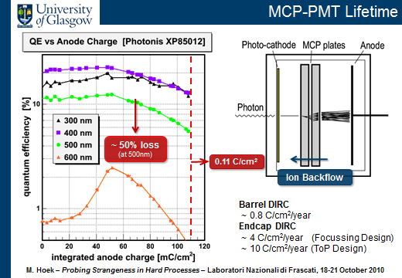
Barrel DIRC Photon Detection – 3 years ago

Slide 14
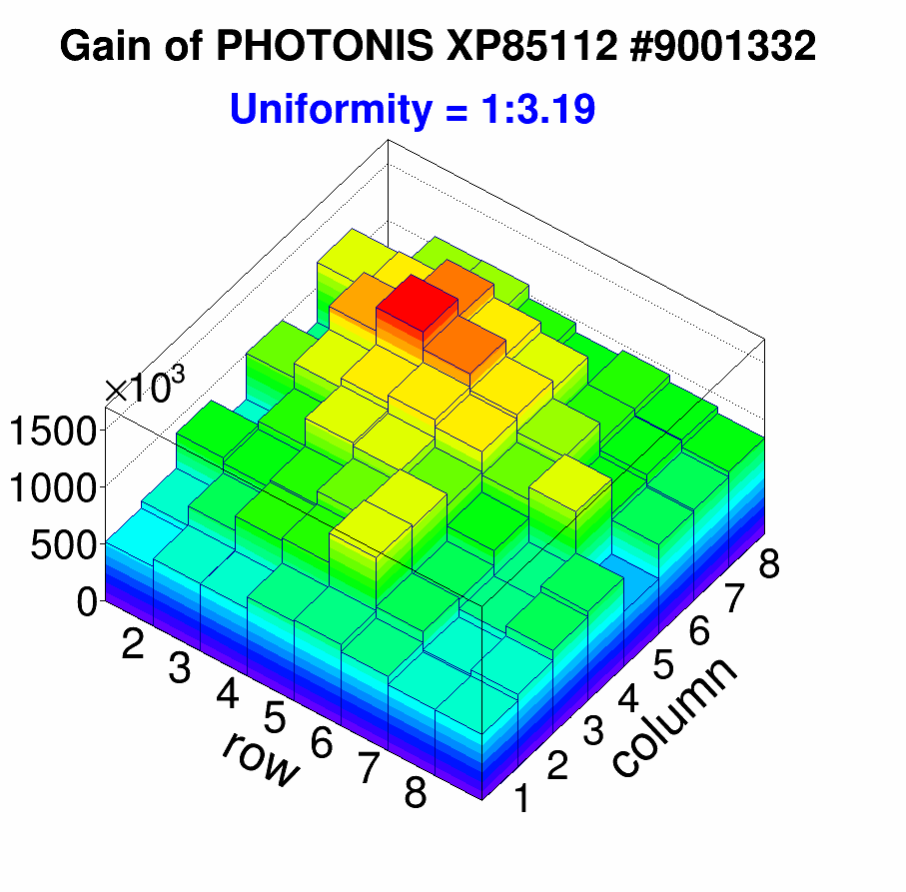
Barrel DIRC Photon Detection
MCP-PMT is preferred sensor technology
ALD technique improves lifetime
  6C/cm² reached
Meets most PANDA requirements
See A. Lehmann’s talk @ DIRC2013
Notes:
MCP-PMTs life time development

Slide 15
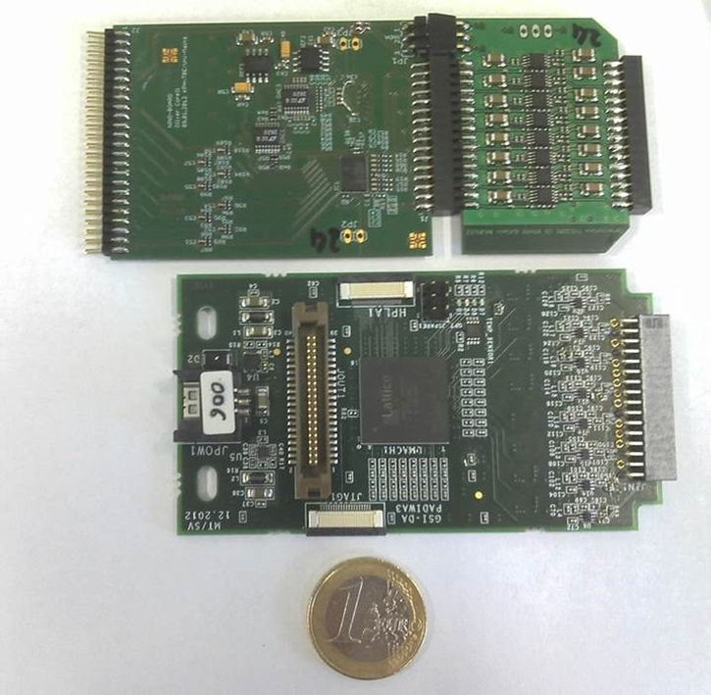
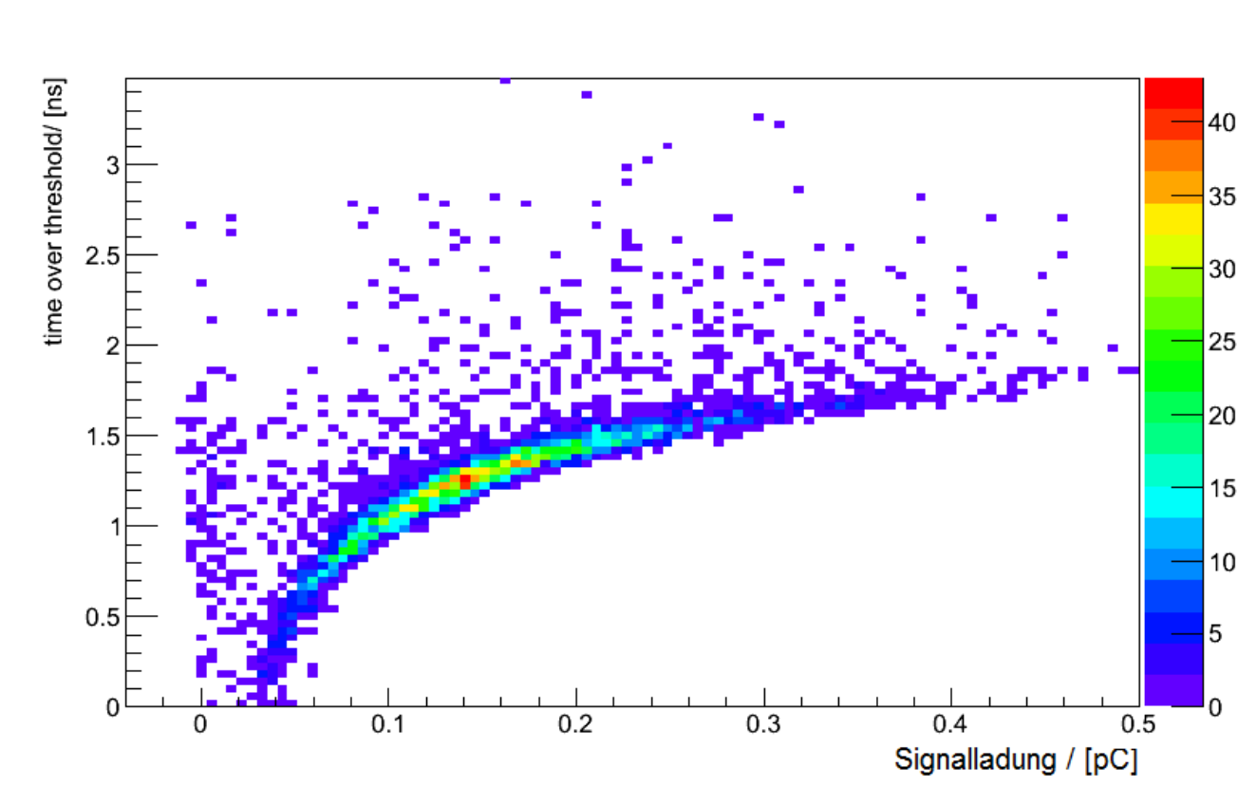
Barrel DIRC Frontend Electronics
DAQ system based on TRBv3 board (developed at GSI)
  High-resolution TDC (<10ps) based on FPGAs
  LVDS input signals
Precise timing
  amplitude information (ToT)
Discriminator
Card (16ch)
Pre-amplifier
Card (16ch)
LVDS output+ slow control
MCP-PMT
connector
NINO
NINO ASIC
(8 ch)
Current feedback amplifier (THS3201)
Power supply
(+5V)
PADIWA
LVDS output
MCP-PMT
connector
Charge (pC)
FPGA programming interface
Pre-amplifier
(MMIC)
Compare different technologies
  ASIC: NINO chip (ALICE TOF)
  FPGA: PADIWA (GSI)
FPGA
(Lattice MachXO2)
Notes:
FEE development
TRB system + NINO Frontend card

Slide 16
Barrel DIRC Protypes
Prototypes in test experiments
2009 – GSI
  Proton beam, E~2GeV
  Oil tank
2011 – CERN T9
  Mixed hadron beam, p<15GeV/c
  Oil tank
2012 – CERN T9
  Fused silica prism
  3x3 Planacon MCP-PMT matrix
  896 readout channels
  Fused silica plate
See G. Kalicy’s talk @ DIRC2013
CERN T9 (2012)
Notes:
Test beam results from CERN 2012
Pattern with prism attached
Look at Greg’s talk!

Slide 17
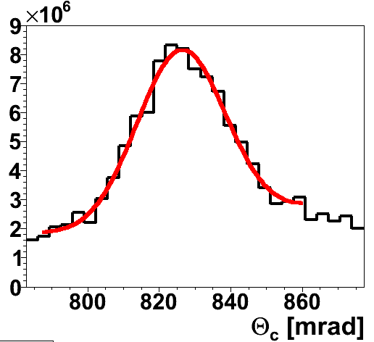
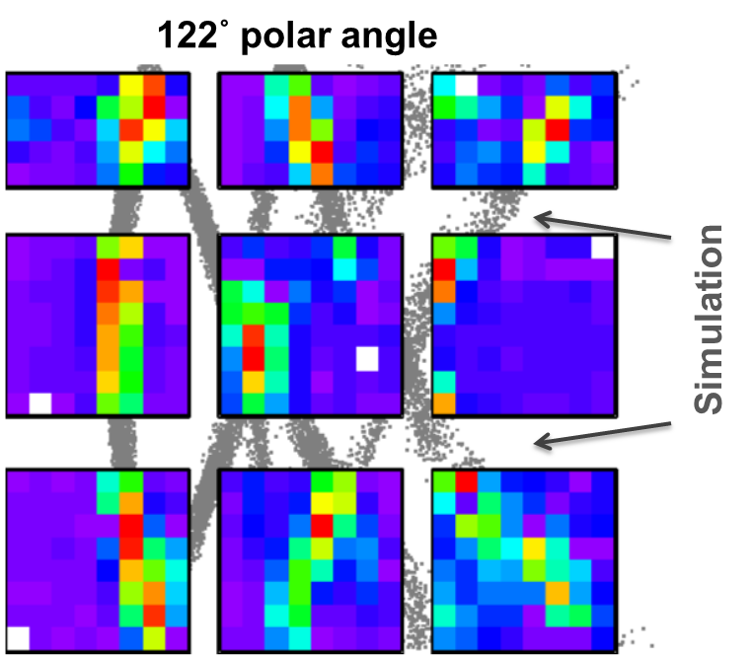
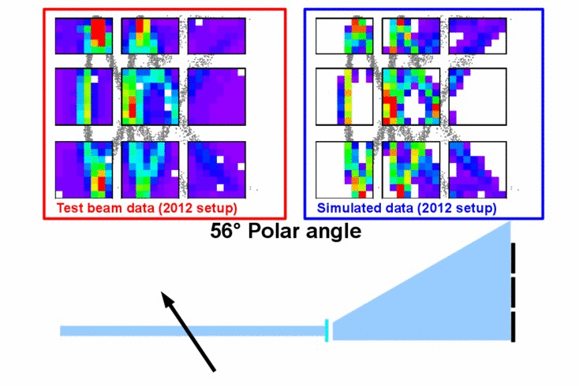
Barrel DIRC Prototypes
Θ_{c}=825mrad
σ_{Θc}≈ 11mrad
2012 Analysis in progress
  3D tracking to be added
  Improve timing/position calibration
  Plate reconstruction in preparation
Preliminary results indicate sufficient performance
Expected: Θ_{c}=824mrad, σ_{Θc}≈9mrad
10 GeV/c, 60˚
Number of detected photons
See G. Kalicy’s talk @ DIRC2013
Notes:
Test beam results from CERN 2012
Pattern with prism attached
Look at Greg’s talk!

Slide 18
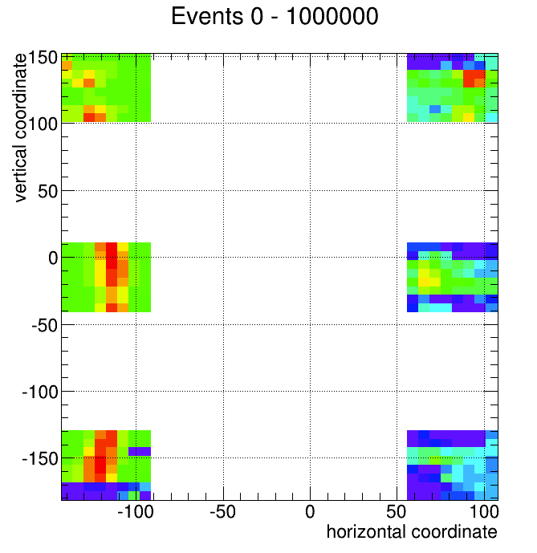
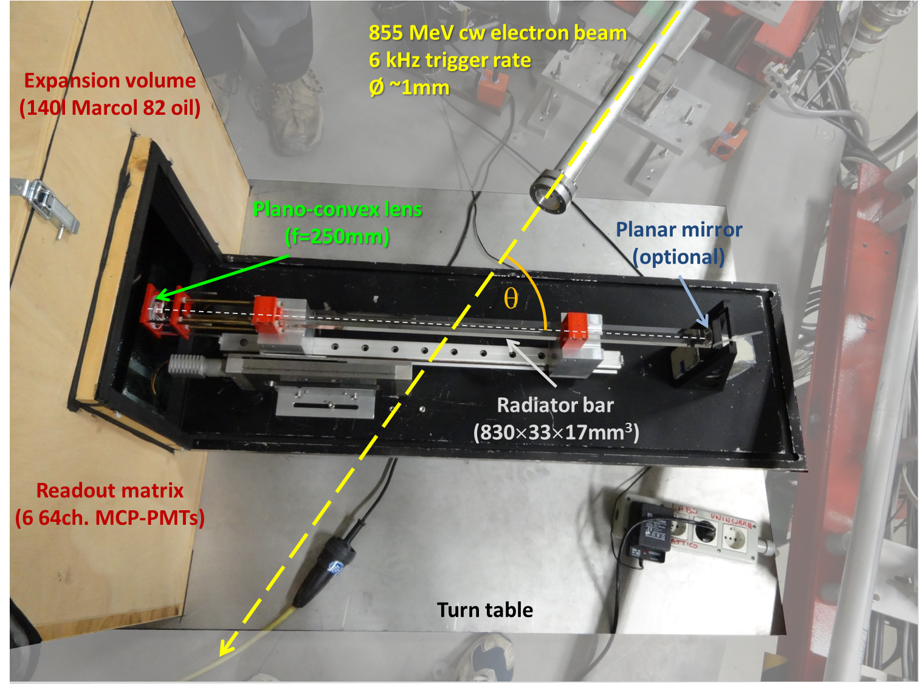
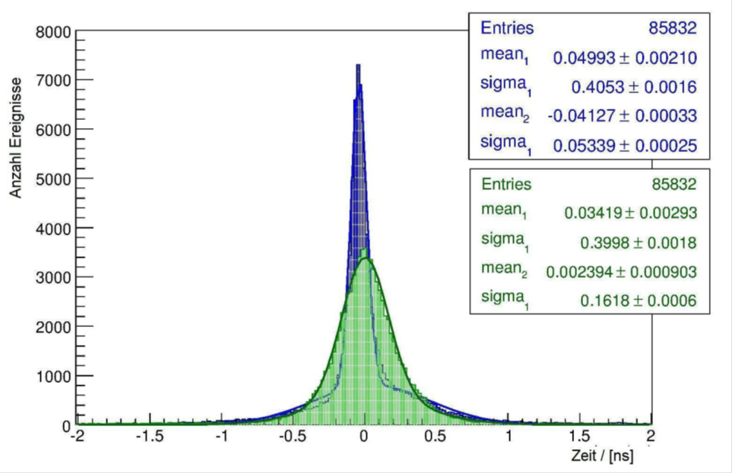
Barrel DIRC Prototypes
2013 – MAMI B, 855 MeV electron beam
Test frontend electronics
  Timing resolution
  Time walk correction
  Thresholds
PADIWA
NINO
33˚
Walk correction
frequency
w/o correction
Time (ns)
Notes:
MAMI 2013 results
Picture of our prototype
Image
Timing results

Slide 19
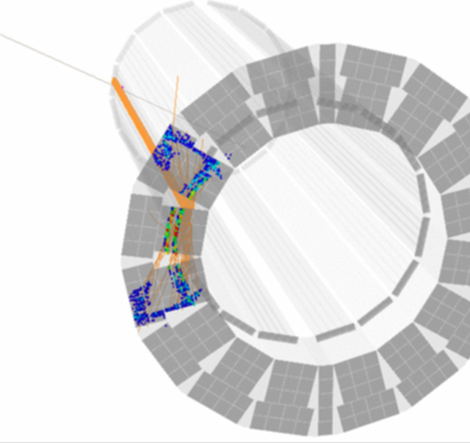
Conclusions
Barrel DIRC is a key component of the PANDA PID system
Challenging R&D program
  Radiator production
  Compact expansion volume
  Lens system
  Photon detection in strong magnetic field
  Fast frontend electronics
Sophisticated prototypes to verify performance
  Decision on radiator geometry in 2014
TDR ready end of 2014
Installation planned for 2017
PANDA Cherenkov Group
JINR Dubna | FAU Erlangen-Nürnberg | JLU Gießen | U. Glasgow |
GSI Darmstadt | HIM Mainz | JGU Mainz | SMI OeAW Vienna

