Slide 1

IAPP-FTK Status Report
1.5 MEuros
Years
6 Institutions
FTK
b
e
b
μ
τ
b
b
μ
b
τ
h
e
τ

Slide 2
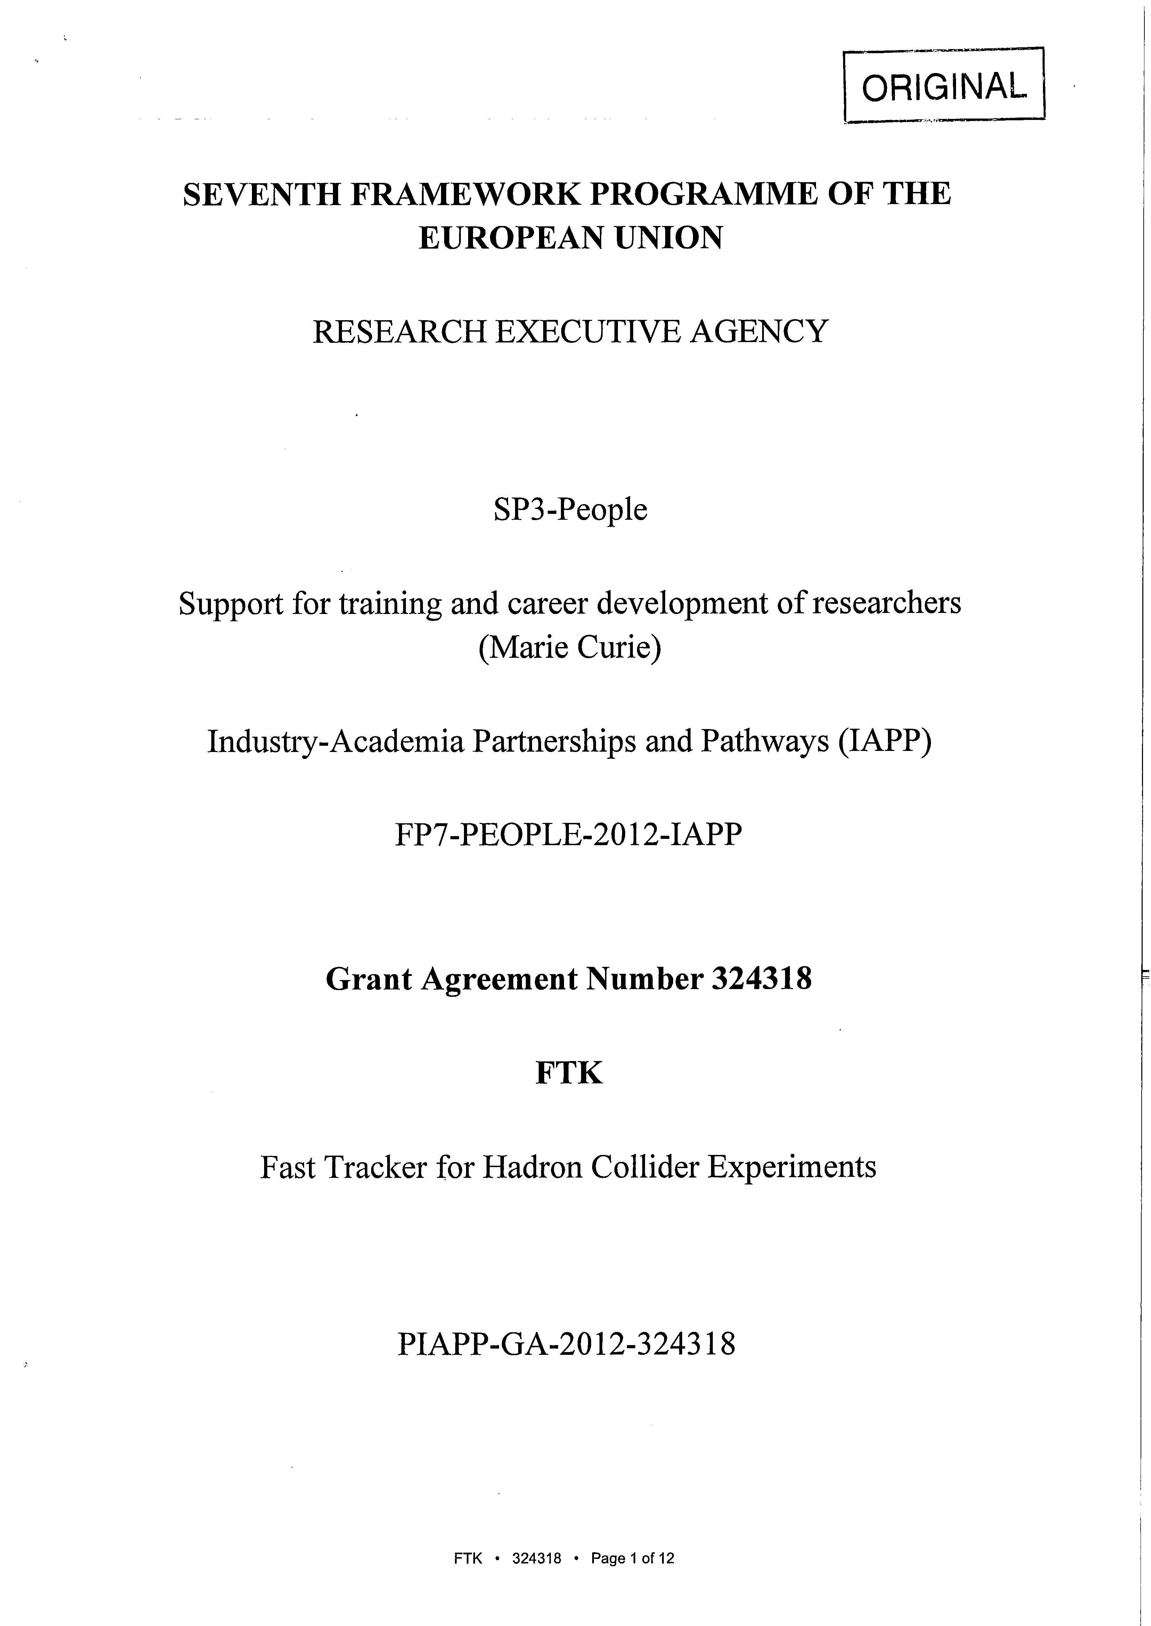

Slide 3
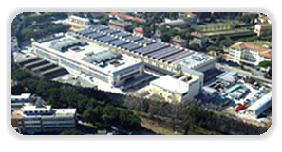
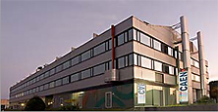
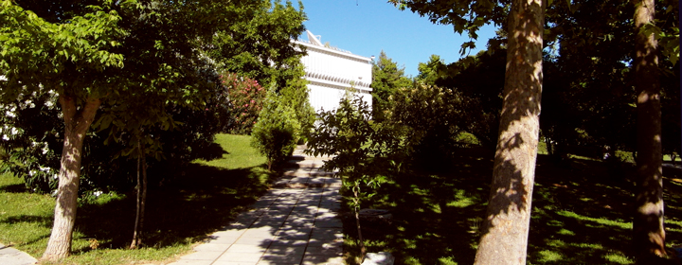
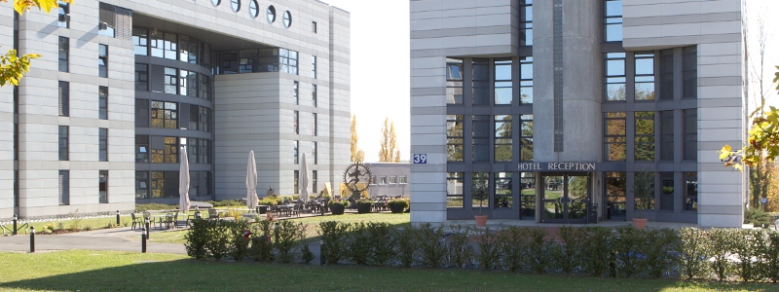
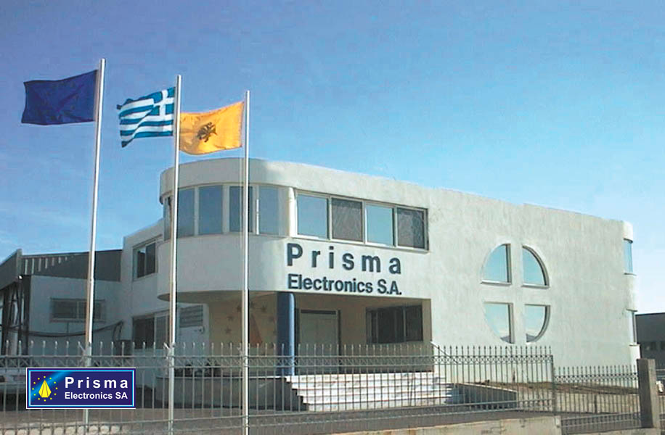
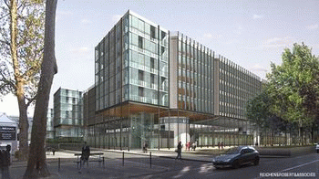
Participants
UNIPI
CAEN
AUTH
CERN
PRIELE
CNRS

Slide 4
List of Work Packages & WP leaders
Prototype Construction & Production Validation (PRIELE, M1-M42)
Infrastructure & Integration (CAEN, M1-M48)
Commissioning (CERN, M12-M48)
Architecture Simulation (UniPisa, M1-M48)
Image Processing (UniPisa, M25-M48)
Silicon Detectors (CNRS,M1-M48)
Outreach (AUTH, M1-M48)
Workshops & Trainings (AUTH, M1-M48)

Slide 5
Participation to Work Packages

Slide 6
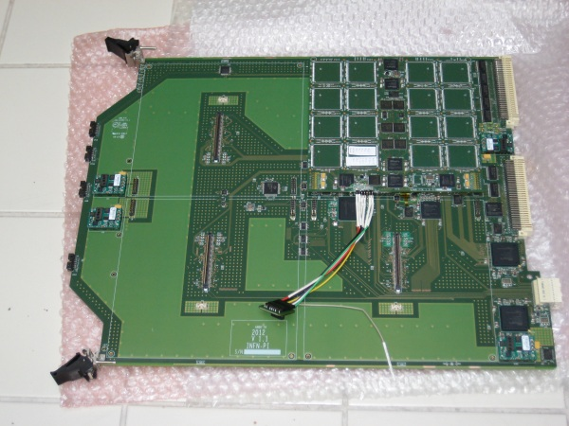
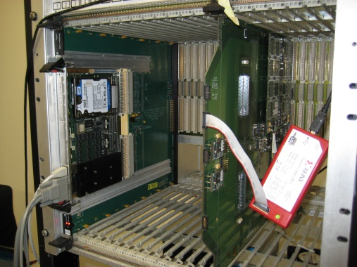
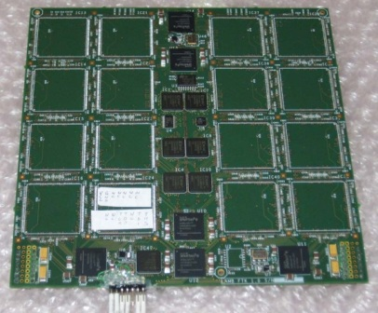
WP1: Prototype Construction & Production Validation
(Priele)
Objectives
Construction and standalone validation of an FTK processor based on
Serial Link technology for Level 1 and Level 2 trigger applications
Transfer of Knowledge to PRIELE for board assembly and validation
and among all research institutions about Associative Memory technology
on of SLP2 at PRIELE before integration at CAEN
128 AMchip04s
Task 3: prototype test
Task 1: design
Task 2: prototype design & assembly

Slide 7
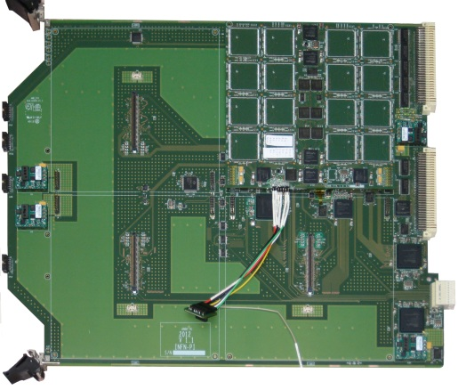
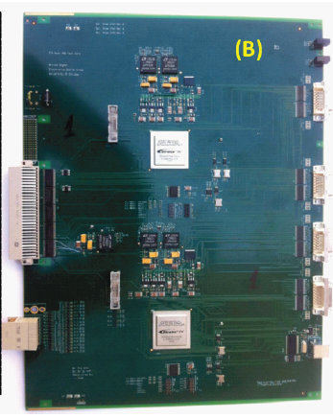
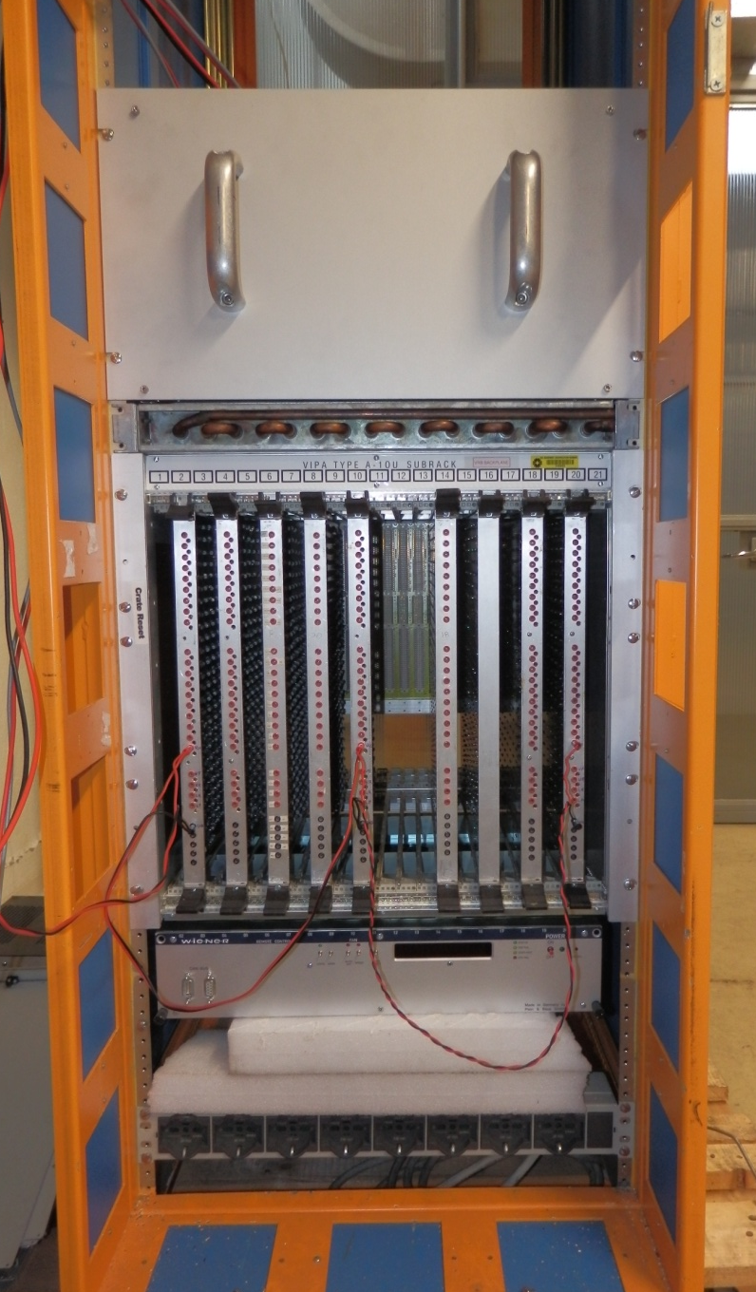
WP2: Infrastrucure & Integration (CAEN)
Objectives
Infrastructure construction and validation (racks, crates, power supplies, cooling)
Validation/integration of prototypes from Europe, Japan and USA
Software development for system test/control/monitoring
Transfer of Knowledge among CAEN and research institutions
Description of work
T.2.3. Software development for tests of the VS
T.2.4. Tests and validation of the baseline FTK system for the demonstrator
After:
T.2.2. Prototyping of a CAEN power supply
for the final crate (5kW)
T.2.5. Tests and validation of the SLP2-based system
T.2.6. Tests and validation of the SLP1-based system
T.2.7. Tests of cooling and mechanics of a rack with complete final crates
SSB:
Final Fit-HW
DF
ITALY
USA
USA

Slide 8
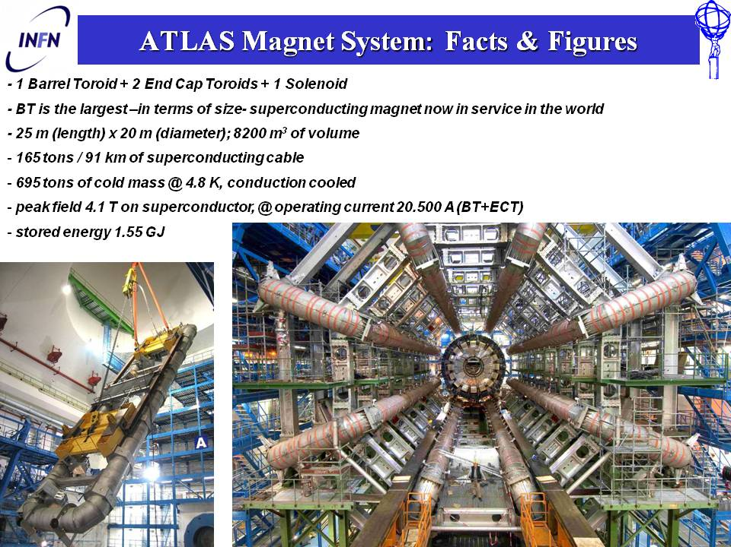
WP3:Commissioning (CERN)
Objectives
Infrastructure installation and validation at point 1 (racks/crates/power supplies)
Board installation/validation and running control/functional monitoring
Transfer of Knowledge among CAEN and research institutions for board
Commissioning/maintenance
Description of work
T.3.1. Installation of Infrastructures, validation tests & ToK
T.3.2. Installation of boards (SLP2 or FTK baseline) for the demonstrator
T.3.3. Tests and validation of the FTK demonstrator
T.3.4. T.3.5 as T.3.2, T.3.3. for the first production
T.3.6. T.3.7. as T.3.2, T.3.3. for the second production

Slide 9
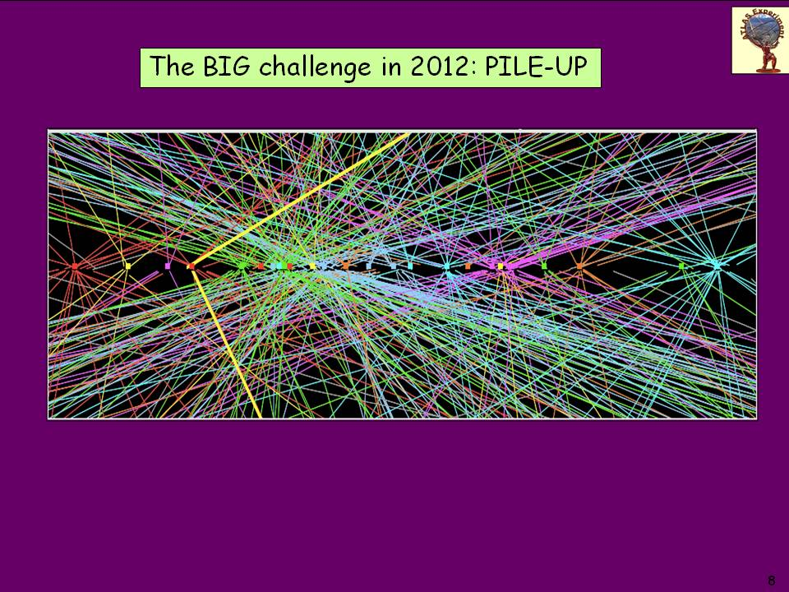
WP4: Simulation (University of Pisa)
Objectives
Production of test vectors to validate hardware configurations
Definition of Level 1/Level 2 architectures to optimize physics reach

Slide 10
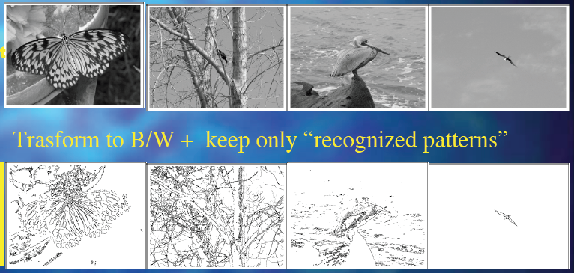
WP5: Image Processing (University of Pisa)
Objectives
Test Associative Memory capability to extract relevant features from
natural/medical images
Evaluate impact on medical imaging/diagnosis and robotic automation

Slide 11
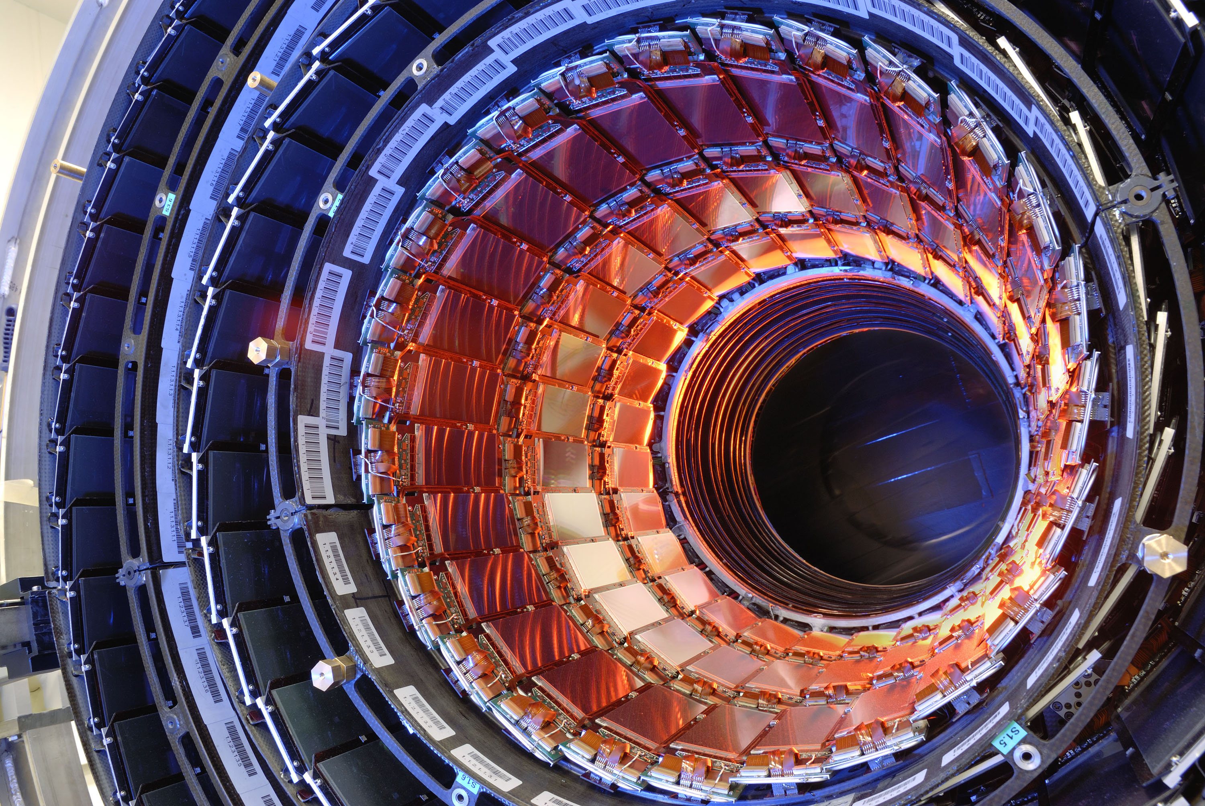
WP6:Silicon Detectors (CNRS)
Objectives
Optimizationof CAEN power supply for LHC pixel detectors (phase-II)
Description of work
T.6.1. Setup of a test bench for PS performance evaluation at CAEN
T.6.2 Measurements on PSes equipped with undamaged readout chips (FEI4 devices)
T.6.3. Optimization of PSes with irradiated devices
T.6.4. Tests with optimized Pses

Slide 12
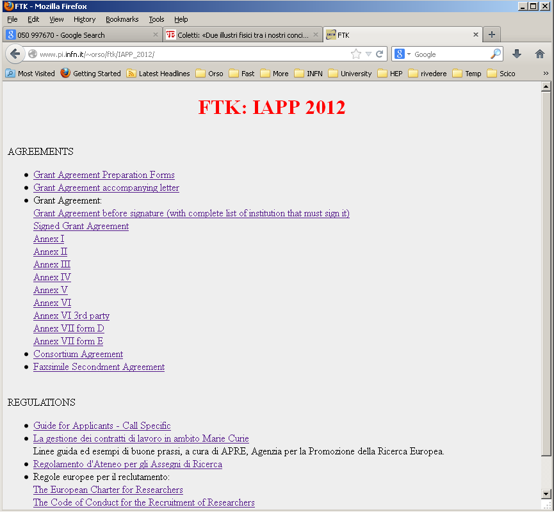
Documents: 90 MB
Most relevant: 9 MB

Slide 13
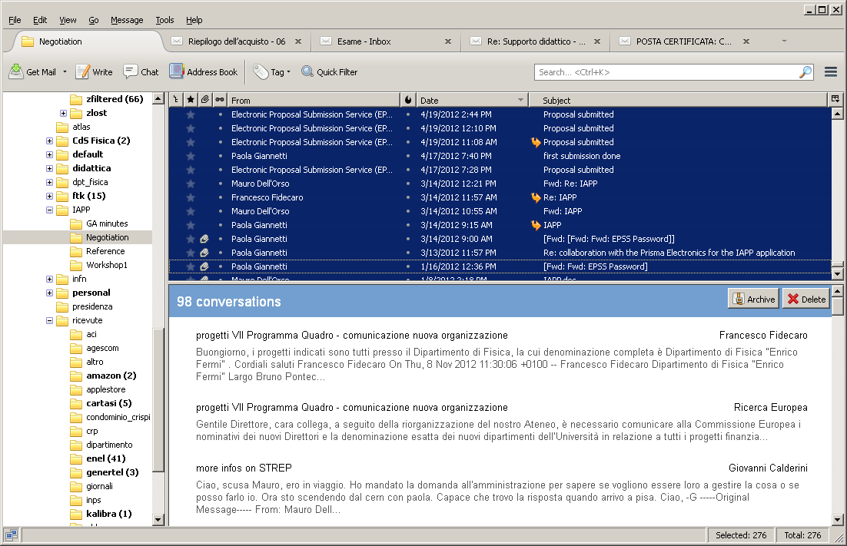

Slide 14
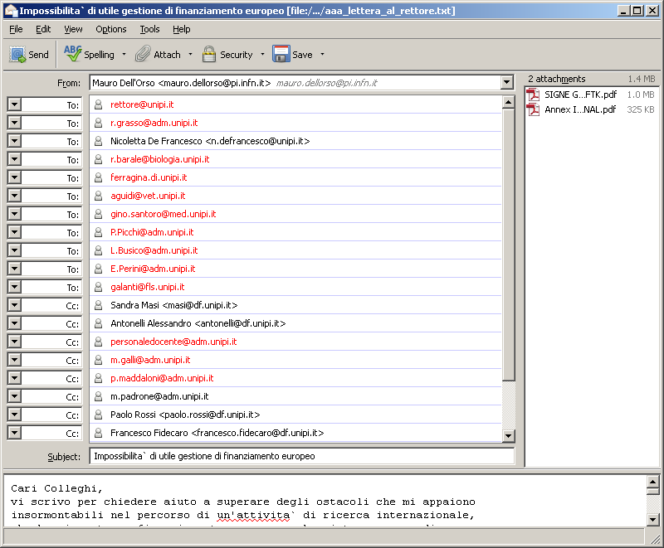

Slide 15
Deliverables & reached Milestones
Milestones this year
Deliverables: who is going to write what
Done & to be done of the Outreach plan

Slide 16

Deadlines under the corner:
Milestones in 2013
Milestone no. name WP Delivery Comments
Leader date
M.4.1. Demo general simulation ok UniPisa M6 Demonstrator simulated architecture ok
basical AMBFTK simulation OK, see tests described by Kostas Kordas
M.1.1. Slp2 prototype ok at Priele PRIELE M12 SLP2 prototype validated at PRIELE
Ongoing work (see Marco’s and Saverio’s talks)
M.1.2. Prototypes Atlas Review PRIELE M12 Atlas evaluation of FTK prototypes
M.2.1. Demonstrator ok at Caen CAEN M12 Demonstrator runs flawlessly at Caen
Integration with AUX card
SSB:
Final Fit-HW
(a)
Proto
AUX
AMBoard
DF

Slide 17
OUTREACH MILESTONES
M.7.1.-M.7.3. Open Days results verification AUTH M8, M20,M32
M.7.4. –M.7.6. WorkS. days results verification AUTH M6, M18,M30 JULY
M.7.7. –M.7.9. Summer schools results AUTH M7, M19,M31
Summer School: VHDL language and ISE Xilinx CAD July 1 – 4 2013
http://agenda.infn.it/conferenceDisplay.py?confId=6549
Workshop DAY: July 5 2013?
IAPP Open day: inside the “Department congressino” FTK communicates to students
April 17 2013 http://www.df.unipi.it/eventi/congressino-2013

Slide 18
OUTREACH SCHEDULE

Slide 19
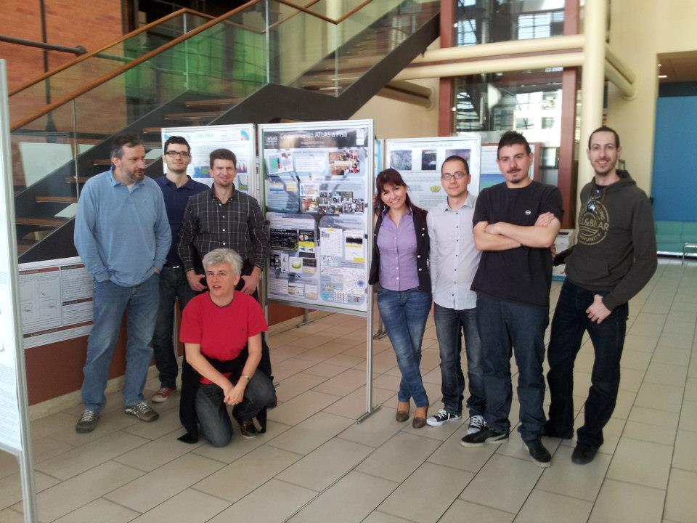
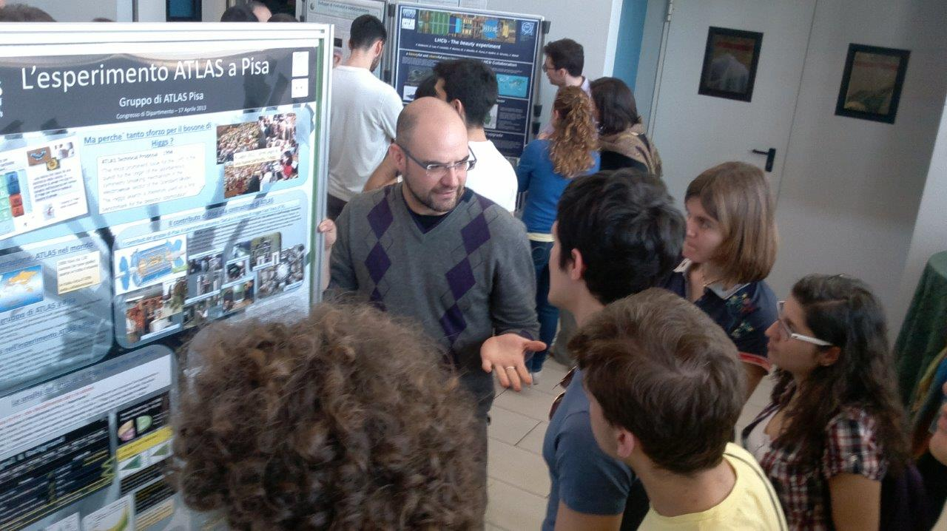
FIRST OUTREACH ACTIVITY: April IAPP day
The FTK group at the IAPP Poster during the “UNIPI congressino”
Simone
from UNIPI
Marco
from
UNIPI
Calliope
from
AUTH
Andreas
from PRIELE
Open LAB – posters on FPGA-based Supercomputer – ATLAS
Federico from UNIPI
& the students

Slide 20
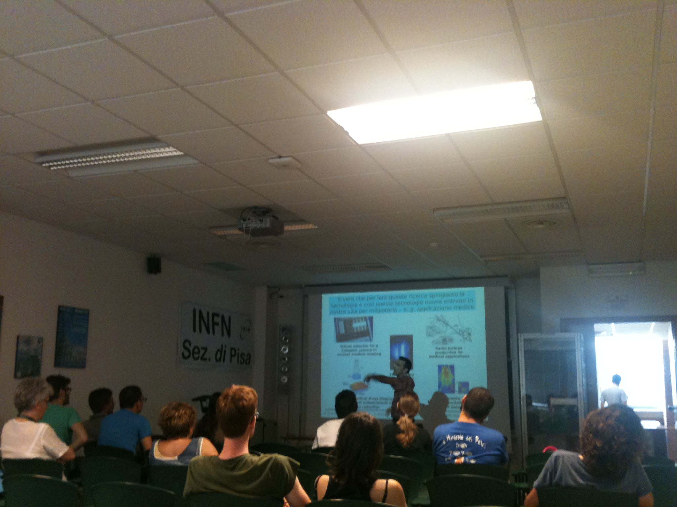
Workshop Day
July 12 2013
LHC e l’ago nel pagliaio
Seminars to students for:
  Trigger in HEP
  FPGA applications outside HEP

Slide 21
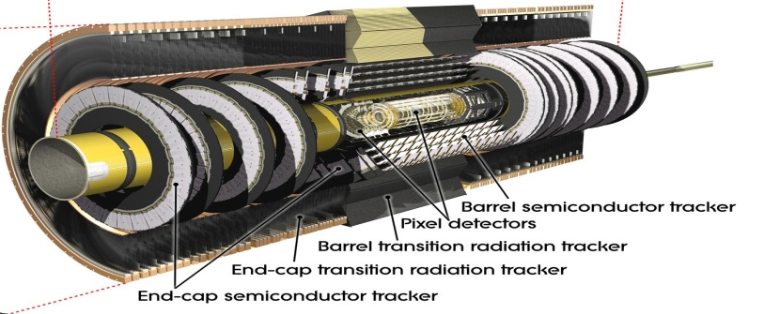
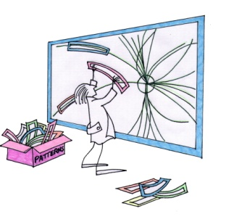
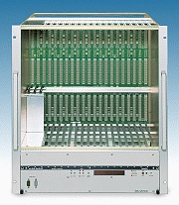
LHC e l’ago nel pagliaio
Il problema del trigger
L’ Esperimento
e l’Higgs
H → Z⁰Z⁰ → 4μ
40 TB/s
p
p
DETECTOR
ASICs
2 “Divine Commedie”
ogni 25 nsec
FTK
25 us
FPGAs
Dov’e` il bosone di Higgs ?
10 μs per rispondere
FTK
b
b
e
b
τ
b
b
b
τ
μ
h
Potente come un
centro di calcolo
ma occupa lo spazio
di un computer
1/10⁹ interazioni
e
τ
Su Nastro

Slide 22
Per tutti gli studenti:
FAST TRACKER AI COLLIDERS ADRONICI
Venerdi 12 luglio edificio C aula 131 ore 9:00-12:00
Gli esperimenti. La nuova particella: Higgs SM ? Kostas Kordas
(Aristotle University of Thessaloniki)
Il problema del Trigger Kostas Kordas
(Aristotle University of Thessaloniki)
Memoria Associativa (AM) per vedere l’Higgs in 10 μs
Mauro Dell’Orso (Universita` di Pisa)
Logica programmabile (FPGAs) per calcolo intensivo: un esempio per ricostruzione di immagini Calliope-Louisa Sotiropoulou
(Aristotle University of Thessaloniki)
Tutto questo spiegato con parole semplici e comprensibili
Super-calcolo

Slide 23
SUMMER SCHOOL
Lessons and exercises immediately after
To complete a project (see figure)
and simulate it
Lab section the last day
Teacher:
Calliope-Louisa seconded from AUTH to Pisa
Teacher assistants:
Marco Piendibene to be seconded to Priele
Daniel Magalotti (INFN-PG)
: interested to recruitment
Between Students:
Kostas Kordas seconded from AUTH to Pisa
Dimitrios Dimas seconded from Priele to Pisa
Guido Volpi (CERN): interested to recruitment
Other students: Jafar Shojaii (Uni. Milan), Cinzia Decesare (Uni. Milan), + altro Milan, Takashi Kubota (Uni. Melbourne), Mariano Falcitelli (CNR Pisa), Emanuele Raffaele (studente ingegneria, S. Anna Pisa), + altra ragazza Uni Pisa (chi e’?)
See the school web site for details:
http://agenda.infn.it/conferenceDisplay.py?confId=6549

Slide 24
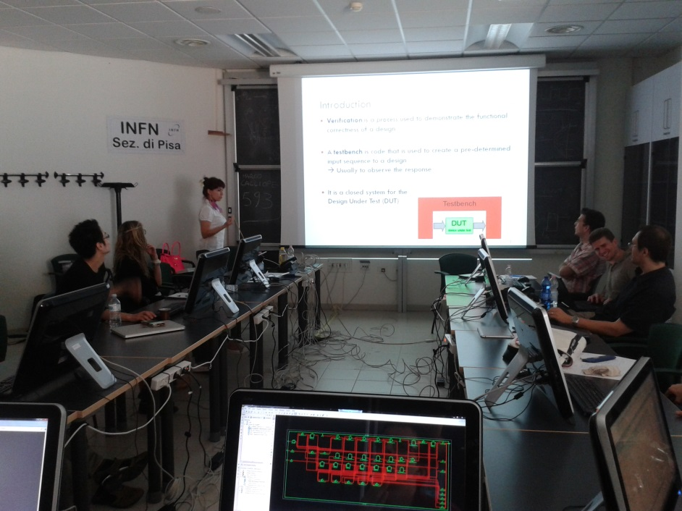
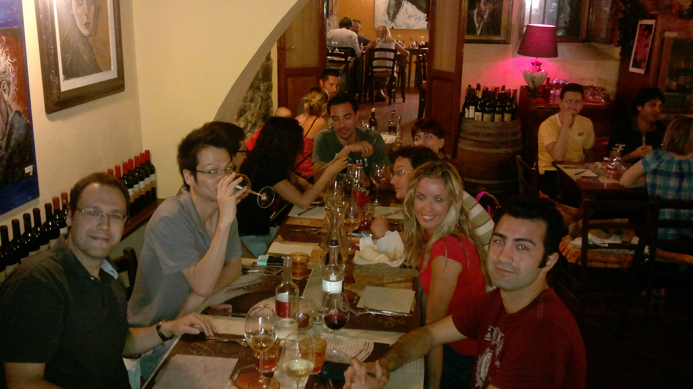
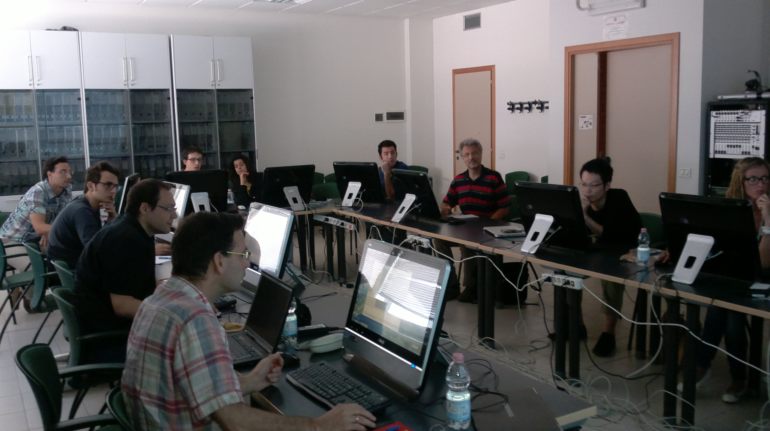
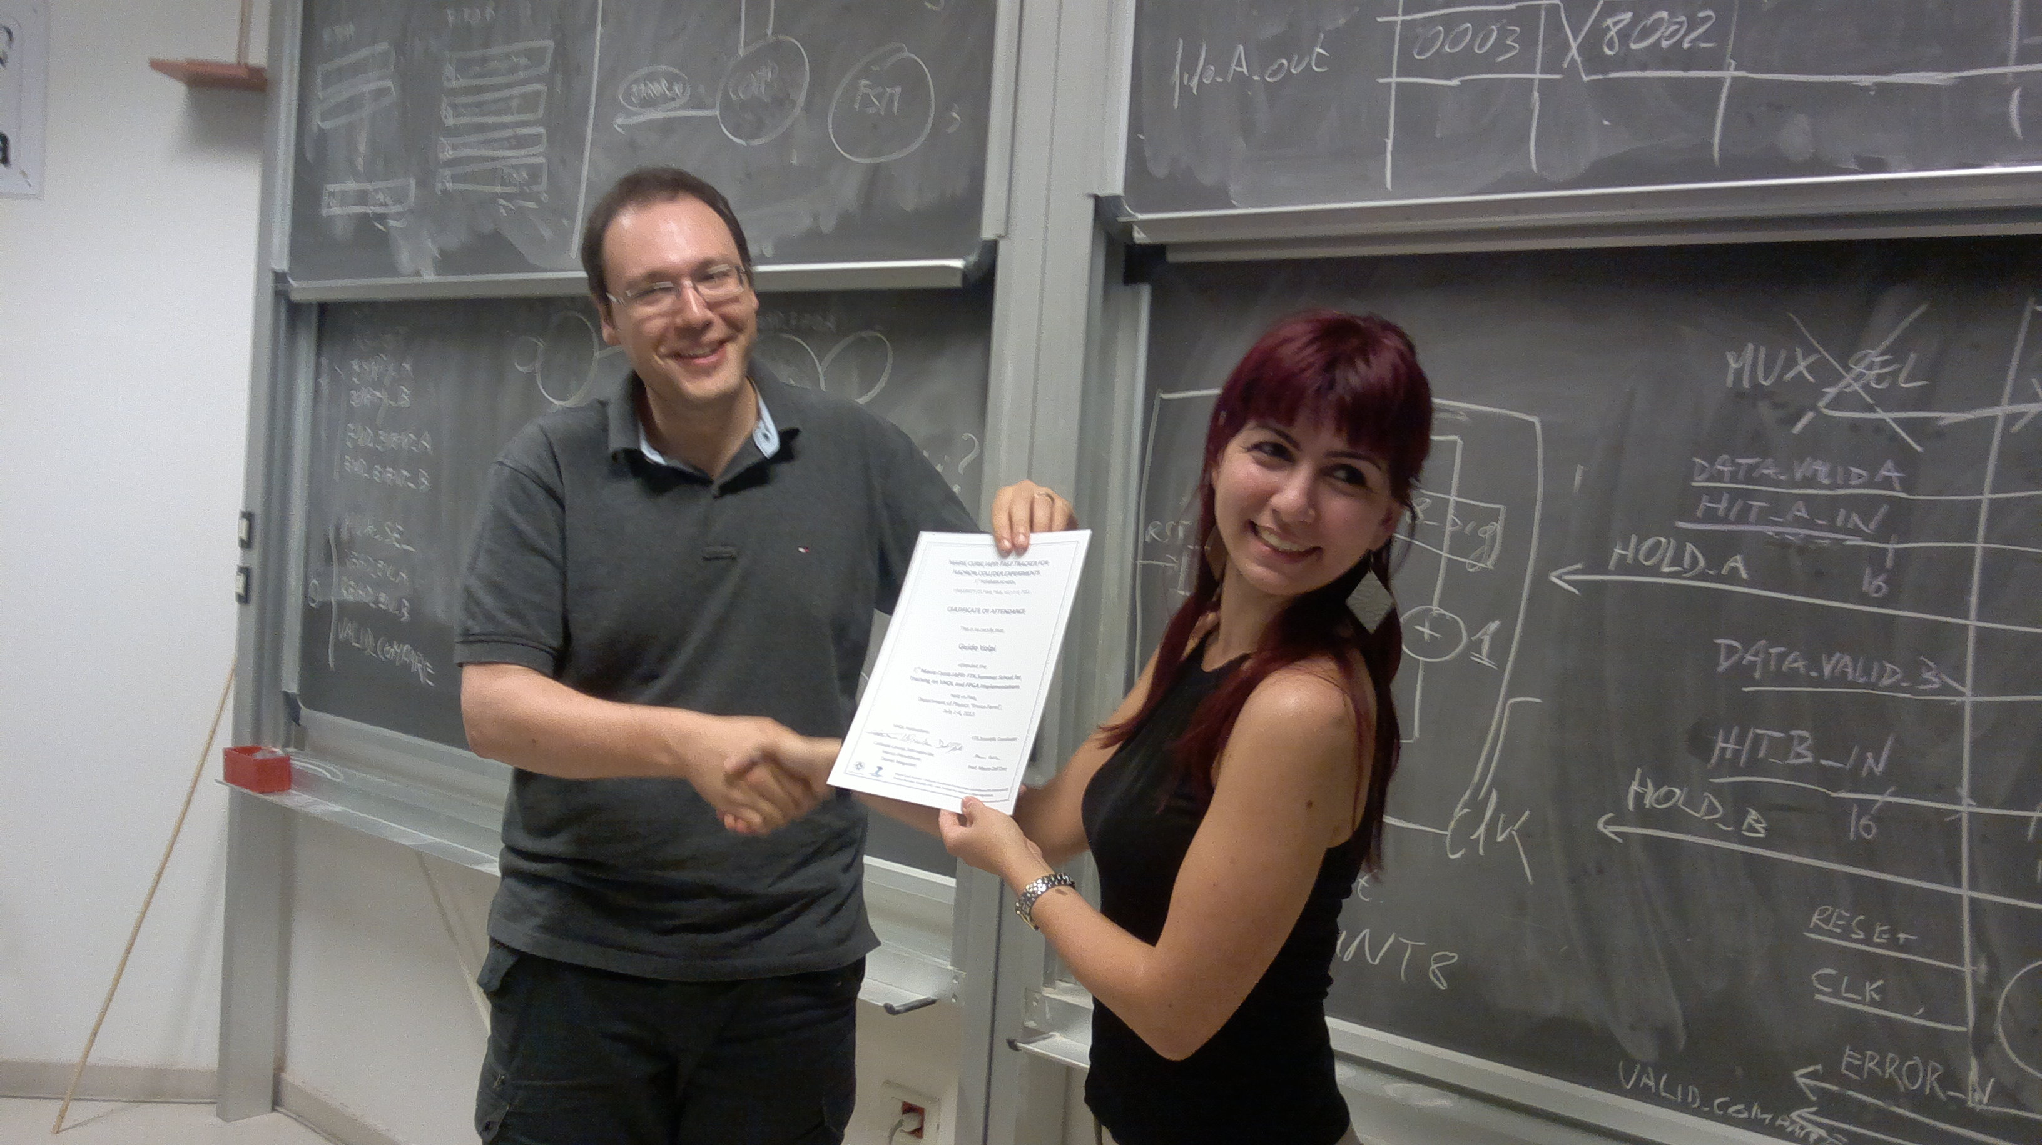
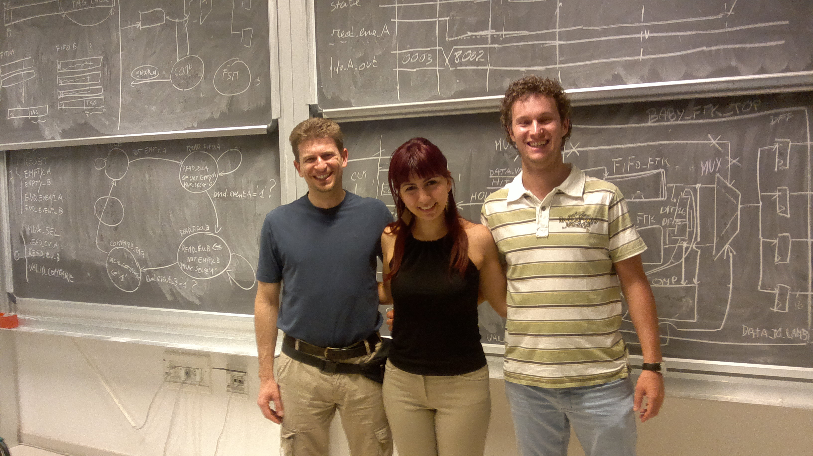
The School: Great success
For lunch all together
At the end: a document for each one
The teaching team

Slide 25
DELIVERABLE SUMMARY
ASK PO about Deliverables classified ad Report.
Del. no. Deliverable Title Nature Dissemination level Delivery date
D.2.1. VS infrastructure at CAEN for FTK demonstrator integration R RE M6
D.4.1. FTK Demonstrator detailed simulation R RE M9
D.4.2. Test Vectors for the FTK demonstrator R RE M10
D.2.2. FTK demonstrator fully integrated with old power supply Pub PU M12
D.1.1. SLP2 prototype constructed at PRIELE Pub PU M12
D.6.1 Test bench R RE M12
D.7.1. IAPP project open days R PU M7, M19, M31, M43
D.7.2. Workshop days R PU M5, M17,M29, M41
D.7.3. Summer school weeks R PU M6, M18,M30, M42
D.7.4 D.8.3 World wide web site for dissemination R PU M6, M18, M30, M48
what to report?
D.8.1. FTK Workshops R RE M1, M13, M30, M46
D.8.2. Trainings (next is CAEN) R RE M1, M5, M9,M19, M29, M47
Let’s do it in July!

Slide 26
CONCLUSIONS
TIME IS RUNNING FAST
A LOT OF REPORTS TO PREPARE (HOPEFULLY)
OUTREACH AND TRAININGS ONGOING
@ high rate
HOWEVER WE HAVE IN HANDS THE EXPECTED RESULTS!

