Slide 1
OUTLINE
Attivita’ periodo 15 settembre 2012 – 15 giugno 2013
Test beam, novembre 2012
Produzione THGEM
Uniformita’
Confronto THGEM grandi e piccole
Verso il test del rivelatore ibrido
Anodo resistivo
Strato di micromesh
Costruzione del Leopard
Coordinemanto del progetto
Documentazione

Slide 2
Attivita’ periodo 15 settembre 2012 – 15 giugno 2013
Test beam, novembre 2012

Slide 3
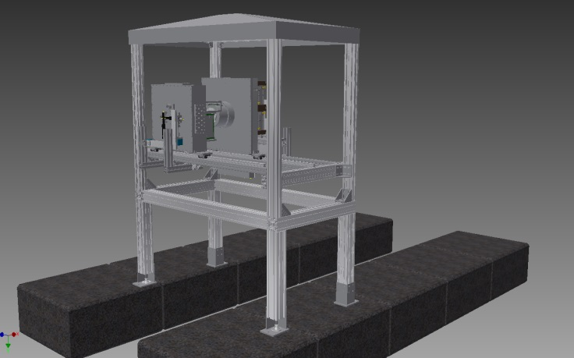
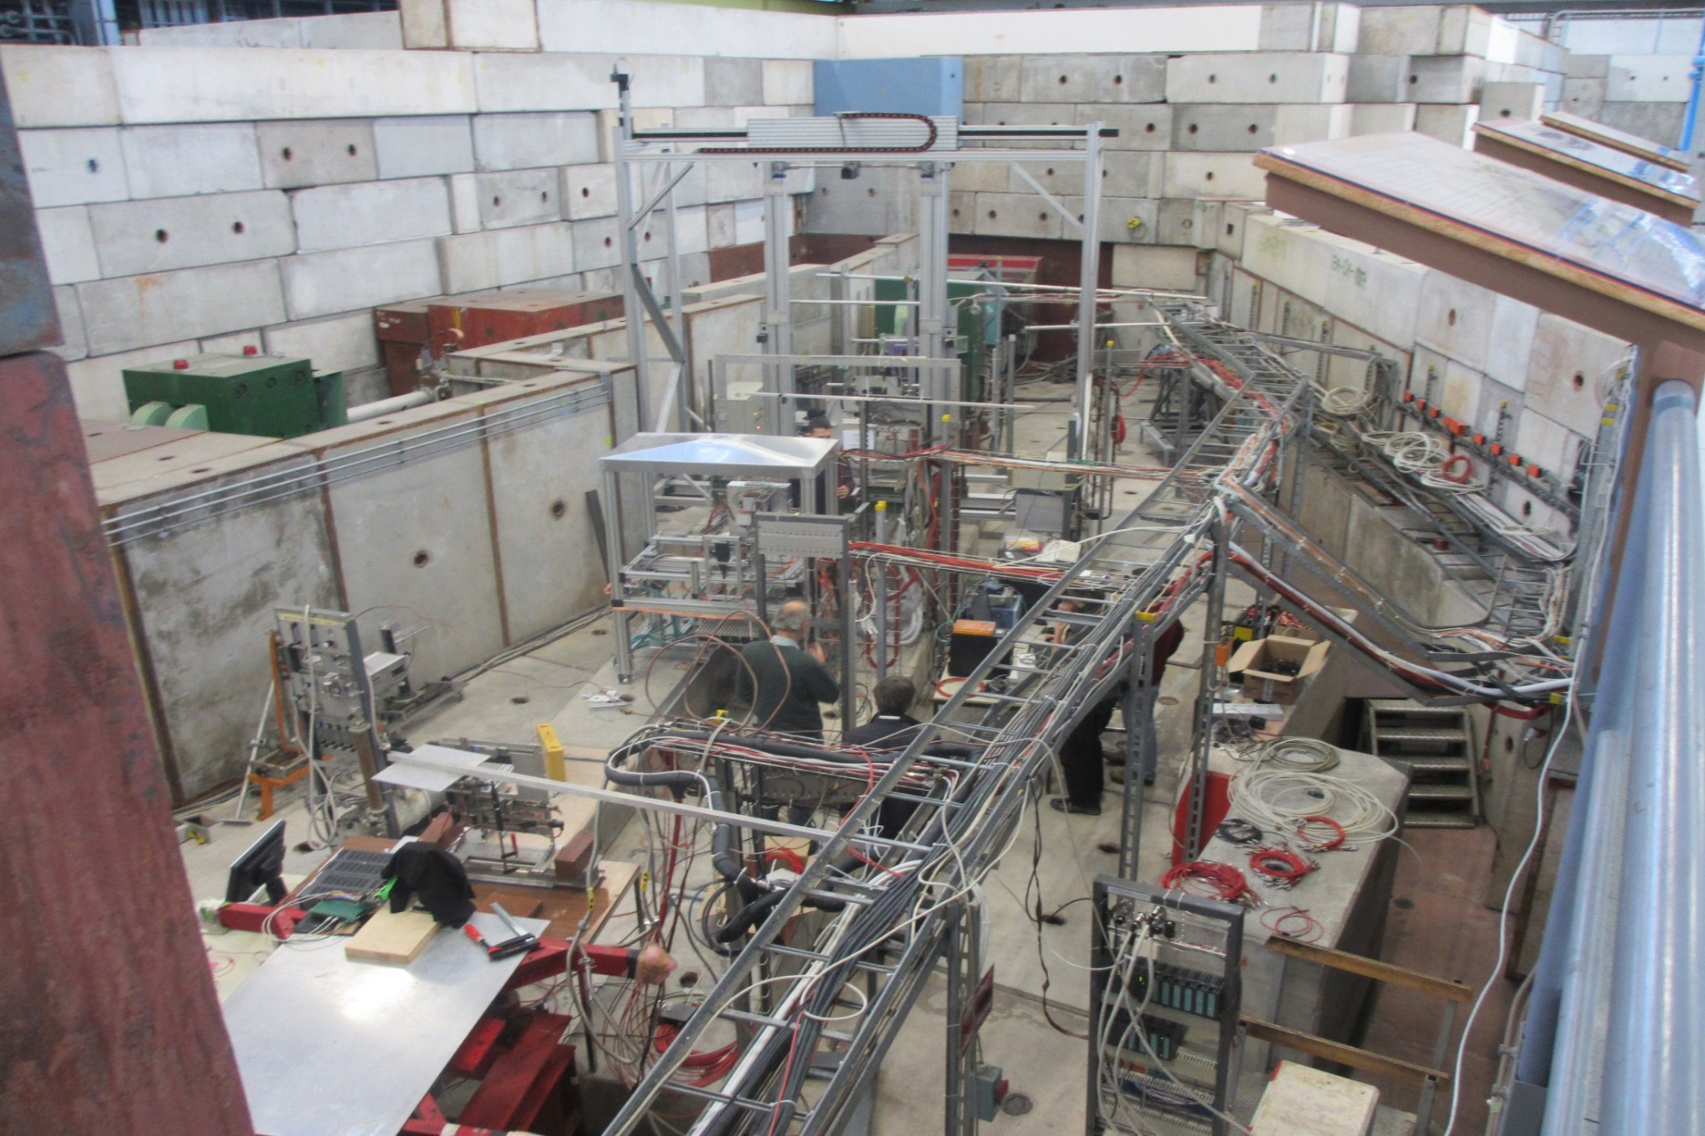
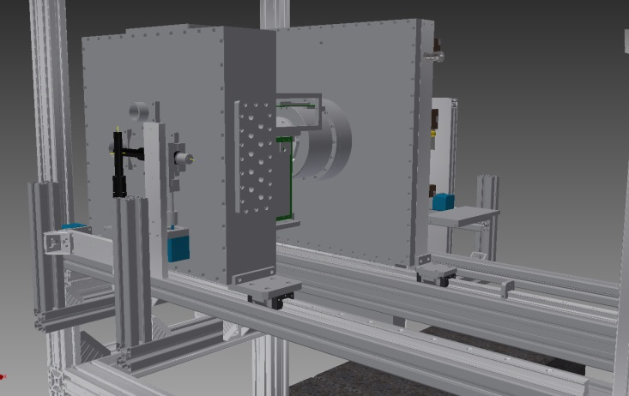
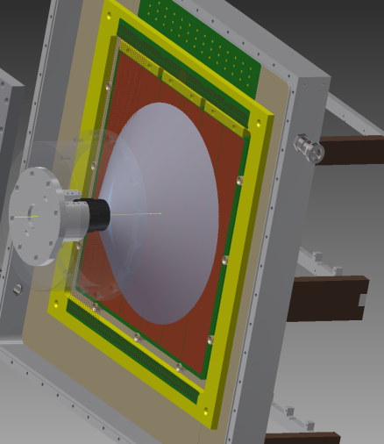
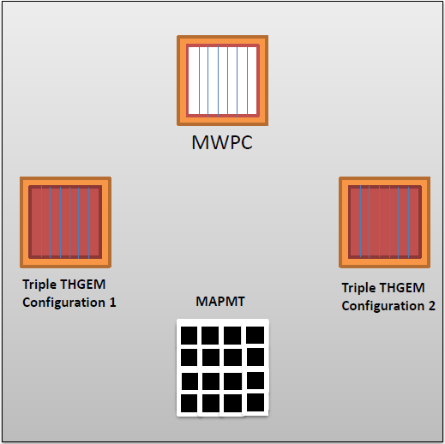
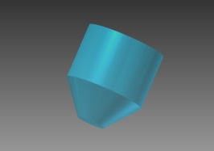
TEST BEAM
CERN PS, T10

Slide 4
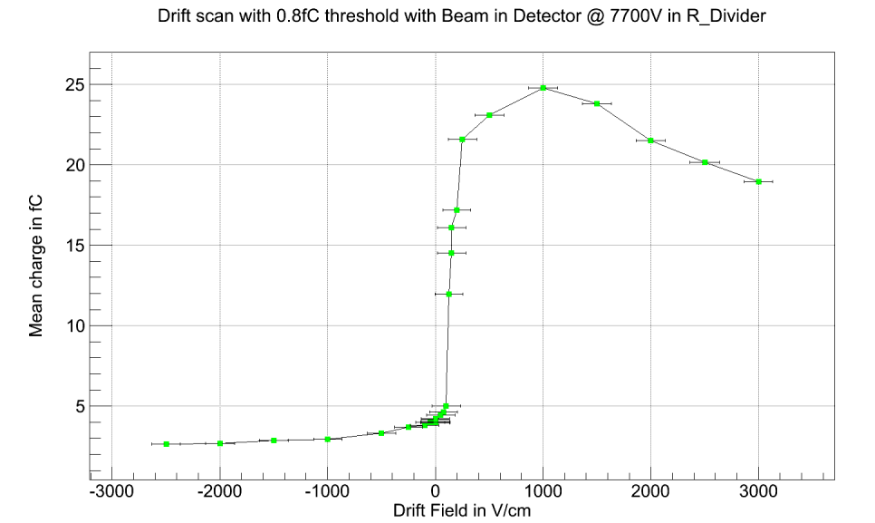
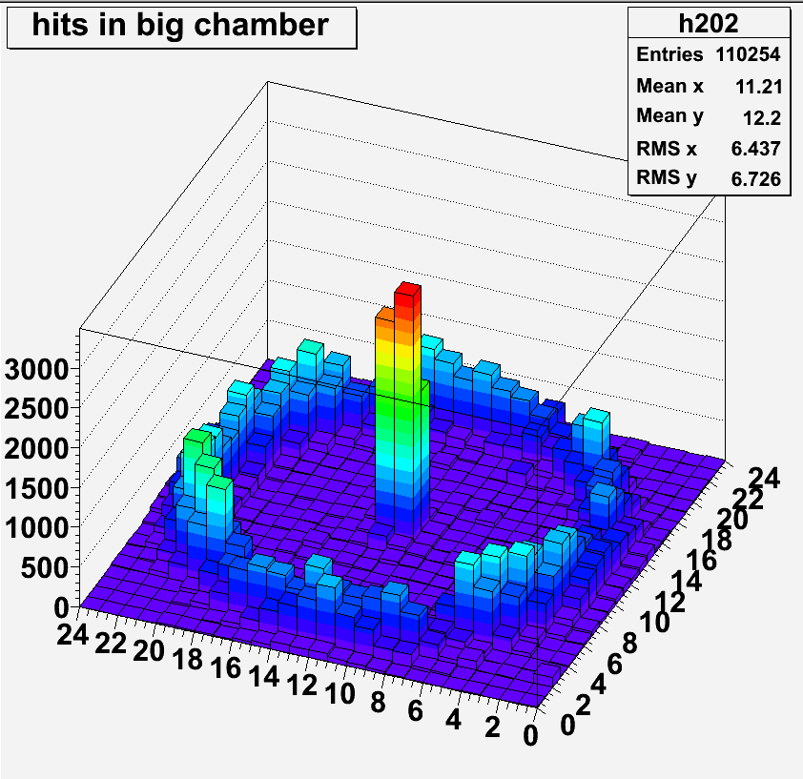
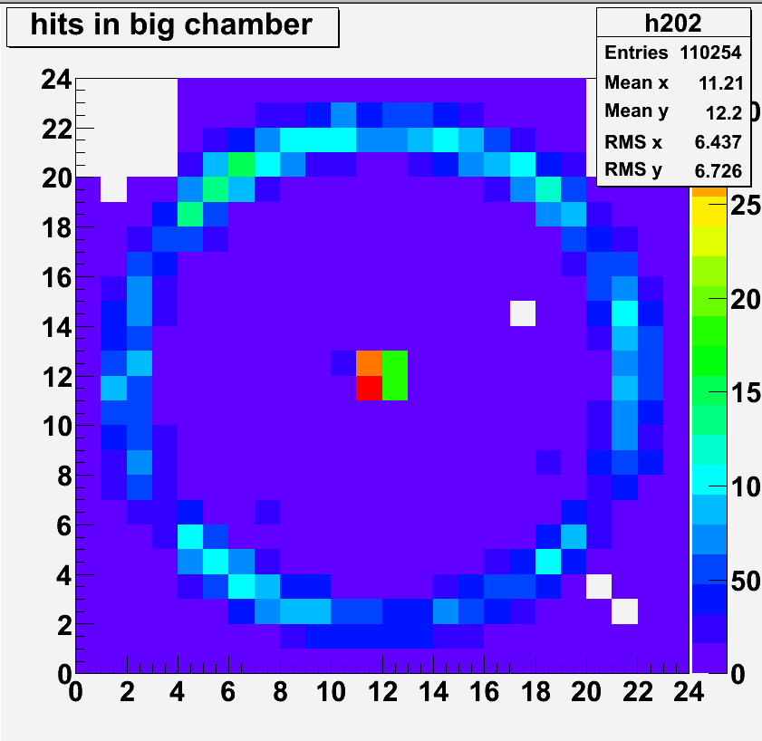
TEST BEAM
RESULTS, only a flavour
Effect of the reverse
bias on MIP detection
Response of the large-size prototype

Slide 5
OUTLINE
Attivita’ periodo 15 settembre 2012 – 15 giugno 2013
Produzione THGEM
Uniformita’
Confronto THGEM grandi e piccole

Slide 6
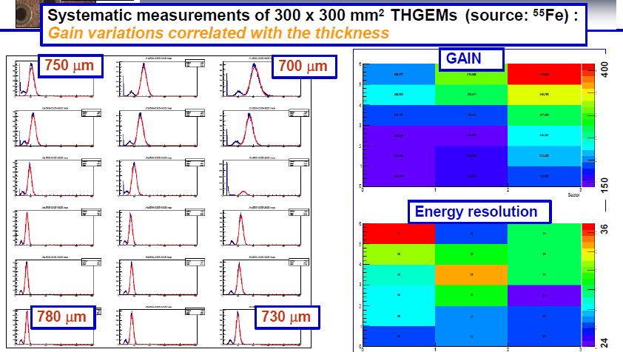
THGEM PRODUCTION – thickness uniformity
September 2012, status
GAIN
Max/Min
= 2.9

Slide 7
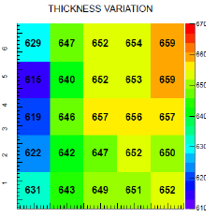
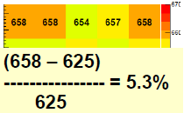
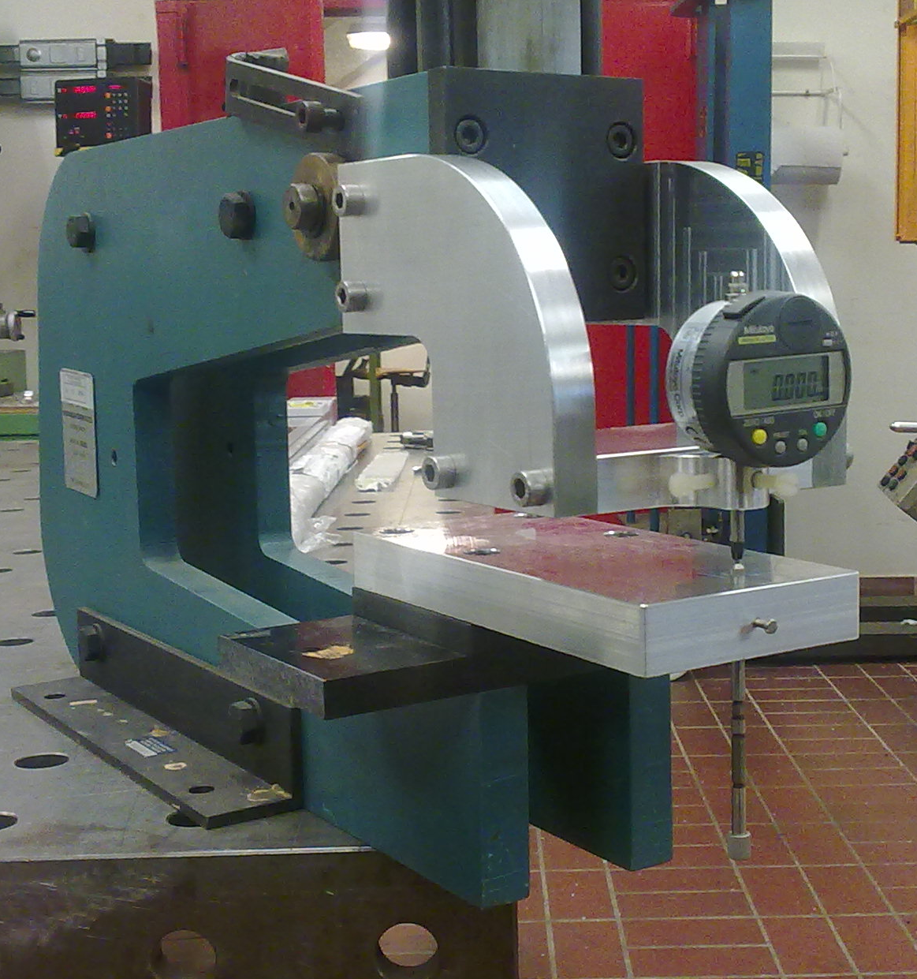
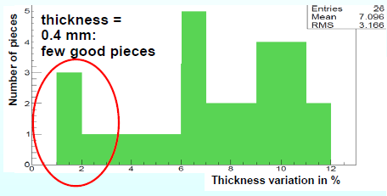
THGEM PRODUCTION – thickness uniformity
Selection of the fiberglass plates (with Cu)
(μm)
January 2013, status
50 cm
50 cm

Slide 8
THGEM PRODUCTION – thickness uniformity
Different material:
Permaglas, machinable (~ Stesalite)
BUT: ELTOS could not glue the Cu layers with standard pre-preg
Glued at CERN, now back to Eltos
May 2013, status
Thickness: 0.8 mm
Thickness: 1 mm
5.3 %
5.3 %
3.8 %
2.5 %
5.2 %
2.1 %
2.5 %
2.6 %

Slide 9
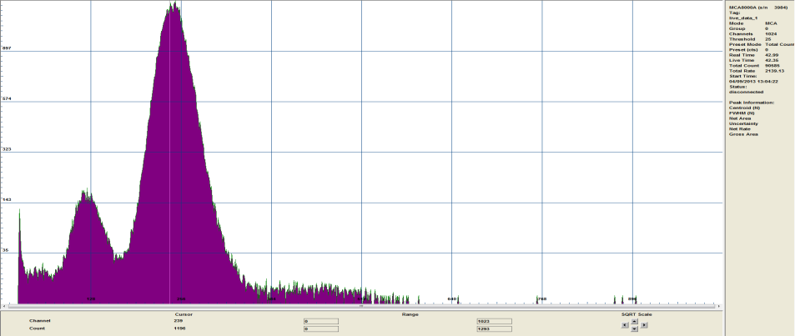
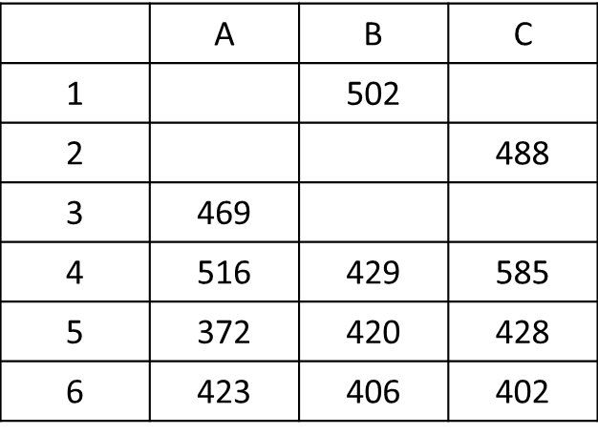
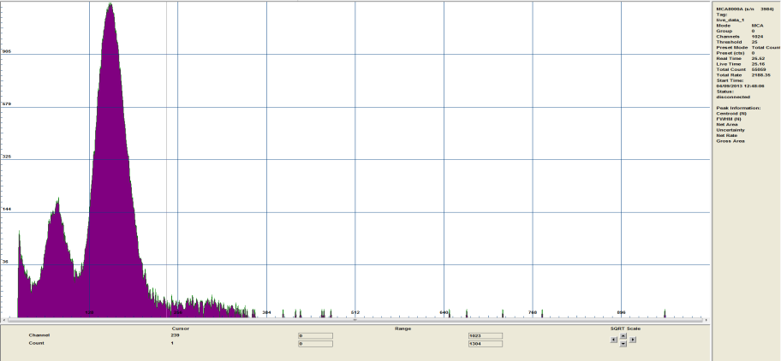
THGEM PRODUCTION – thickness uniformity
April 2013, status
THGEMs from selected boards:
GAIN
Max/Min
= 1.6

Slide 10
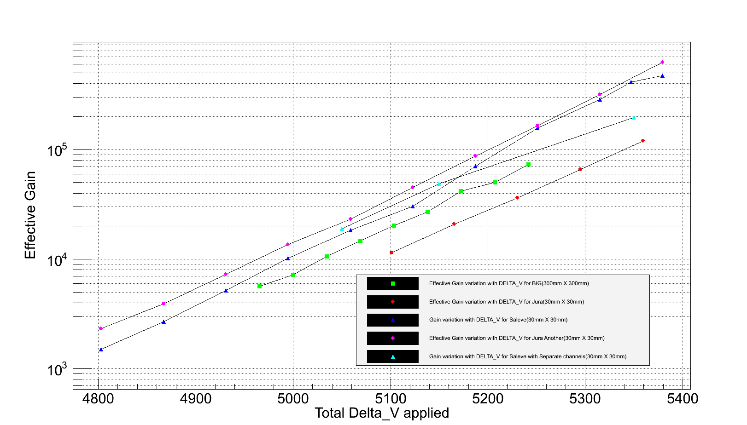
THGEM GAIN: LARGE vs SMALL
The 300 x 300 mm² chamber exhibits the same
response of the small ones (300 x 300 mm²),
but it cannot reach the same maximum gain
January 2013, status
Max GAIN
small / large = 10
(best small assumed)
300 x 300

Slide 11
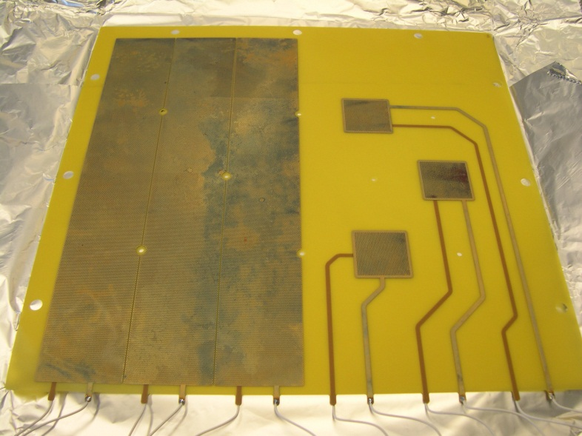
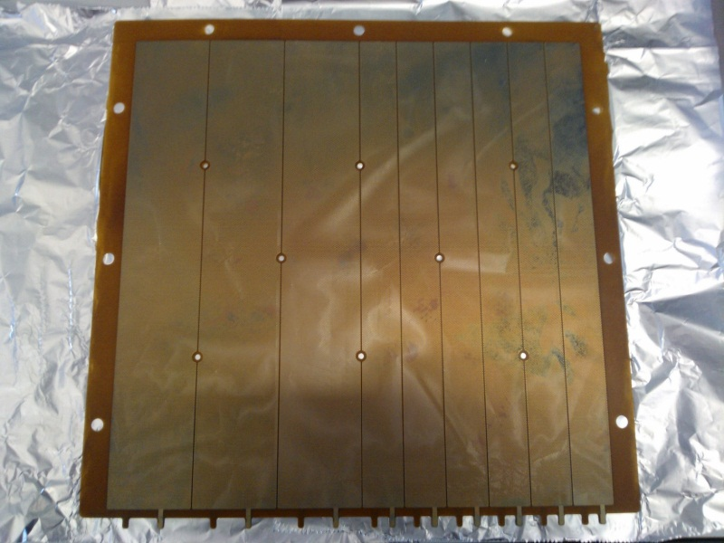
THGEM GAIN: LARGE vs SMALL
Design and production of non-standard THGEMs
dedicated to these studies
April 2013, status
Large and small in the same PCB
The role of the segmentation

Slide 12
THGEM GAIN: LARGE vs SMALL
Understand the role of the Paschen curve
The breakdown V_{bd} depends on
P
d (electrode distance)
the specific gas
d = 0.4 mm → V_{bd} = 2270 V
Δd = 20 μm → ΔV_{bd}= 100 V
ΔP = 20 mbar → ΔV_{bd}= 35 V
April 2013, status
CERN, COMPASS TB meeting, 8/5/2013
Silvia DALLA TORRE

Slide 13
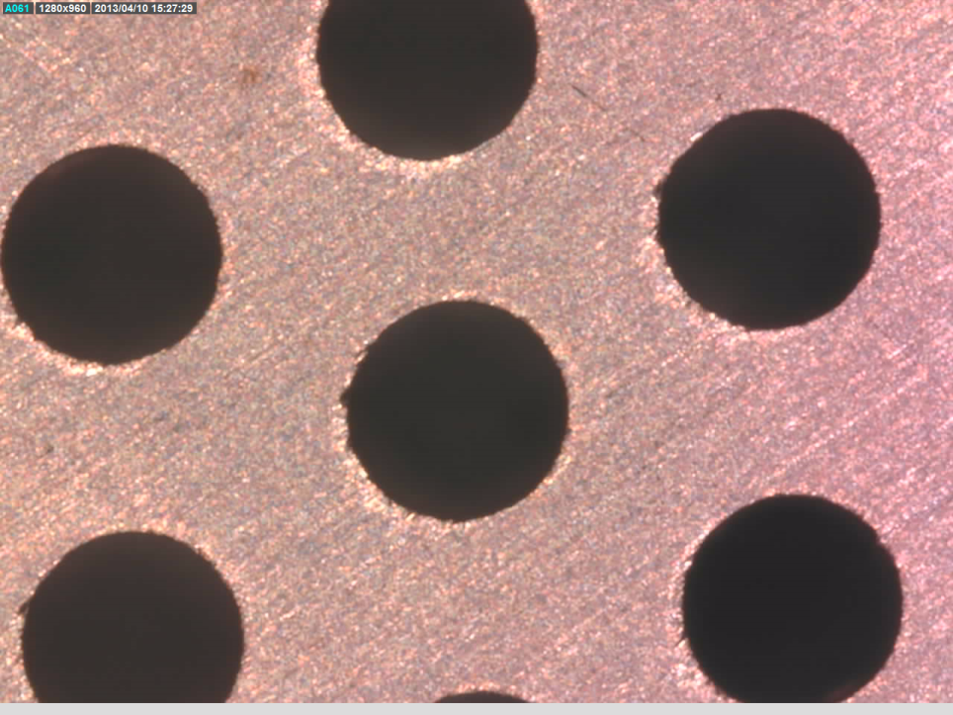
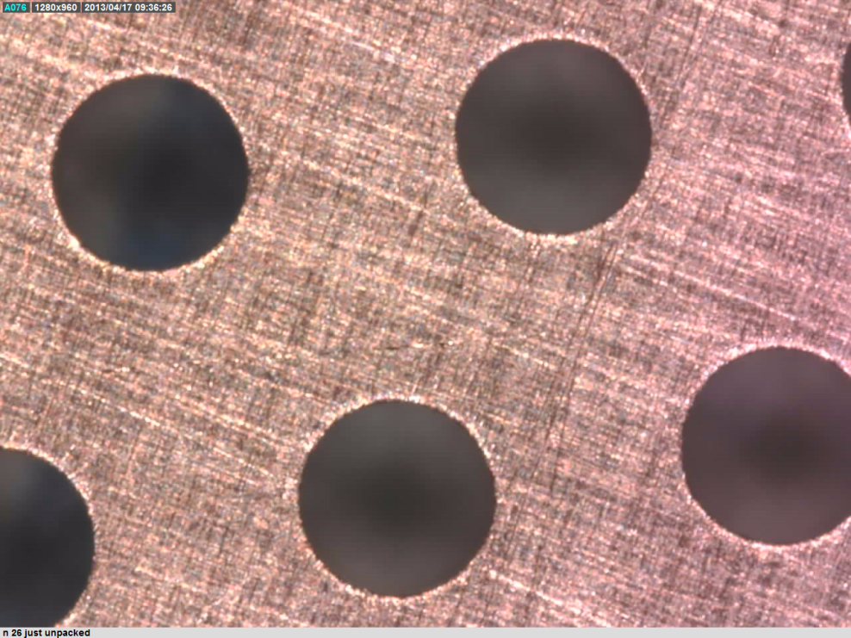
THGEM GAIN: LARGE vs SMALL
THGEM production, after drilling
ELTOS (industrial poroducer) : microetching, brushing
CERN workshop, brushing
Irregularities are gone, but still the Max V_{bd} is far from Paschen’s curve … related to surface irregularities ?
These defects (due to brushing?) are (almost) non present in the small THGEMs

Slide 14
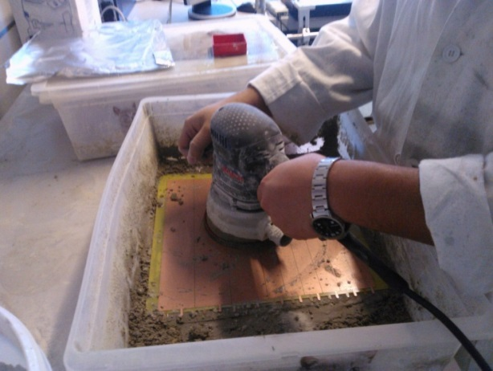
THGEM GAIN: LARGE vs SMALL
THGEM production, after drilling
NEW: in Trieste
1. polishing (Hinrichs Pumice Powder)
2. cleaning with high pressure water to remove all pumice residuals
3. ultrasonic bath (~1 h) @ 50-60 ºC in Sonica PCB solution (pH11)
4. washing with demineralized water plus oven at 180 ºC
for 24 h
All w/o adequate equipments and tools !
April 2013, status

Slide 15
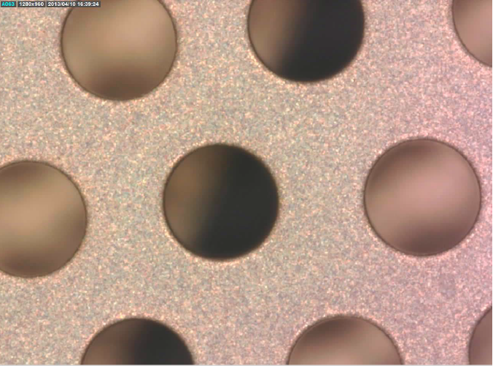
THGEM GAIN: LARGE vs SMALL
summarising
April 2013, status
initial
final

Slide 16
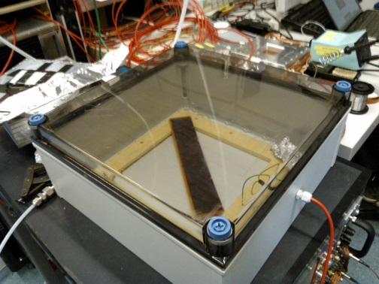
THGEM GAIN: LARGE vs SMALL
Does the new procedure pay ?
this and the following tests in AIR
April 2013, status
300 X 300 Single Sector #1 (before treatment) | 300 X 300 Single Sector #1 (After treatment)
1390 V | 2180 V
Paschen limit =
2190.76V
63 % | 99 %
% of the Paschen limit

Slide 17
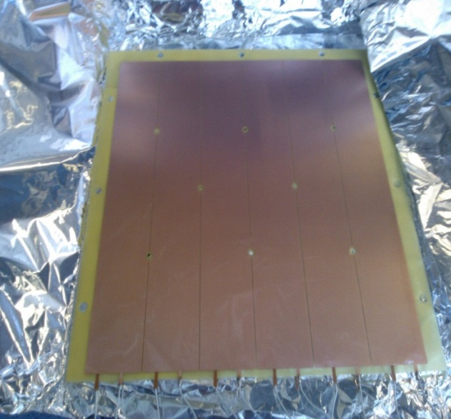
THGEM GAIN: LARGE vs SMALL
Does the new procedure pay ?
April 2013, status
out of the box | 1410 | 1220 | 1610 | 1430 | 1410 | 1450
After first treatment | 2140 | 1980 | 1940 | 2120 | 2110 | 2100
After second treatment 24/4 | 2200 | 2190 | 2140 | 2120 | 2220 | 2180

Slide 18
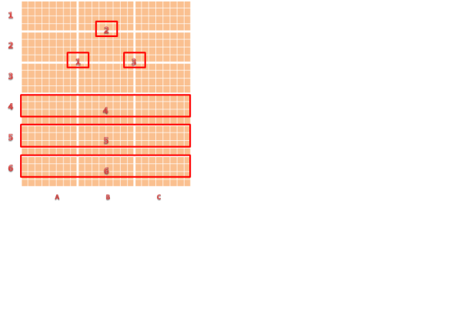
THGEM GAIN: LARGE vs SMALL
Does the new procedure pay ?
April 2013, status
TABLE I:
Maximum ∆V scan with & without source
Now in
Ar/CO2 : 70-30%
 | A | B | C
1 |  | 1690 (1540)
2 |  | 1810 (1610)
3 |  | 1660 (1570)
4 | 1470 (1410) | 1470 (1410) | 1470 (1410)
5 | 1510 (1490) | 1510 (1500) | 1510 (1500)
6 | 1590 (1580) | 1590 (1550) | 1590 (1500)
TABLE II:
Gain measurement @ highest
∆V of the sectors
 | A | B | C
1
2 |  | 1137
3
4
5 | 312 | 335 | 350
6 | 581 | 474
Without source
(With Source)
Gains in the same range !

Slide 19
OUTLINE
Attivita’ periodo 15 settembre 2012 – 15 giugno 2013
Verso il test del rivelatore ibrido
Anodo resistivo
Strato di micromesh

Slide 20
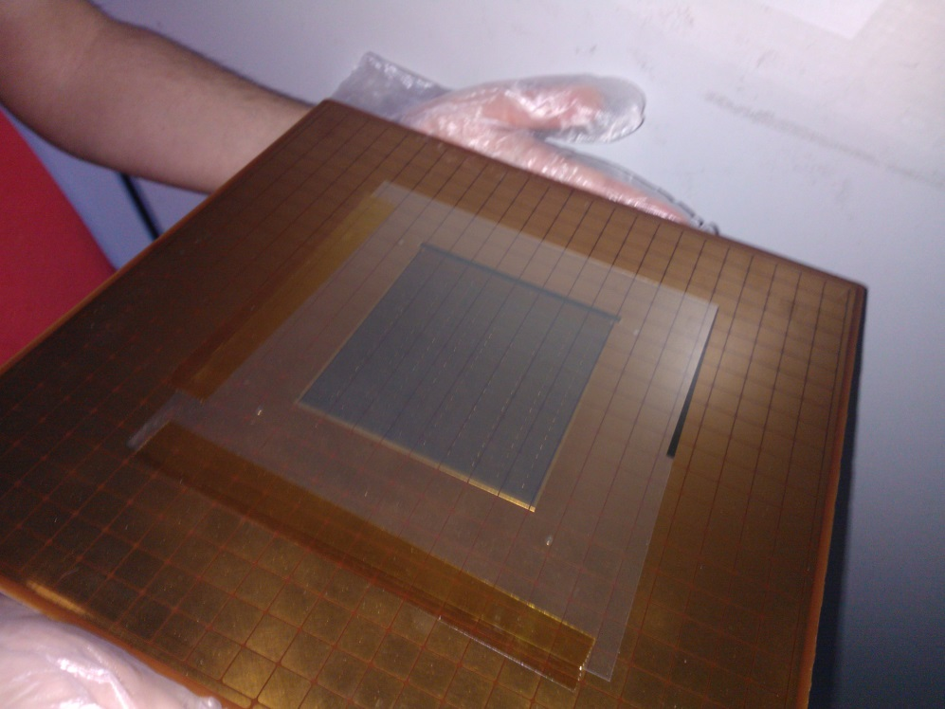
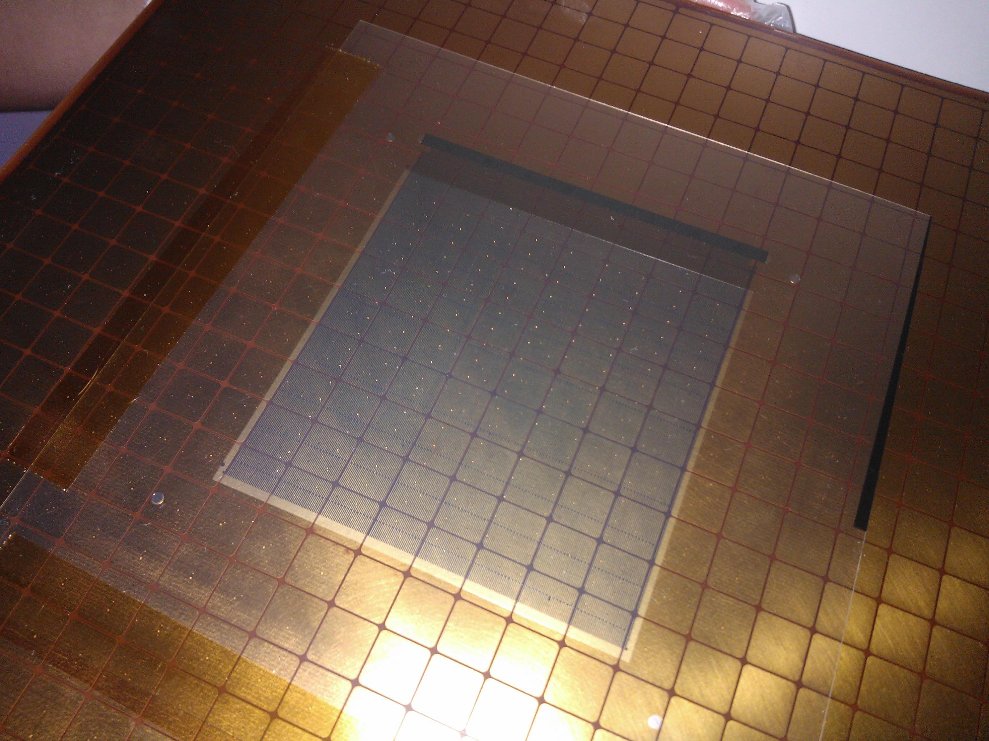
THE HYBRID DETECTOR – MICROMESH
A first resistive anode produced
Obtained modifying an existing anode
Using lithographic masks already available
Useful surface: 100 x 100 mm²
April 2013, status

Slide 21
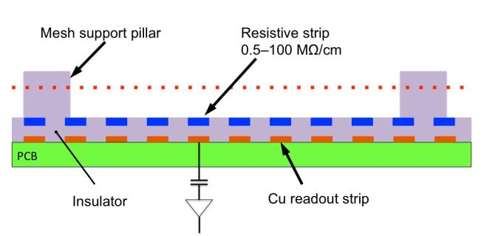
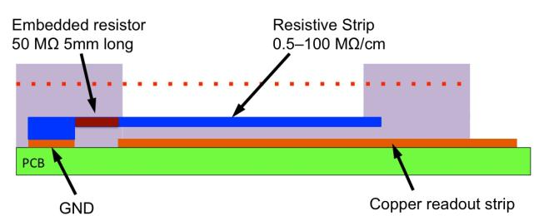
THE HYBRID DETECTOR – MICROMESH
A first resistive anode produced
April 2013, status

Slide 22
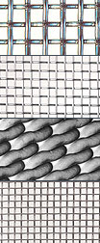
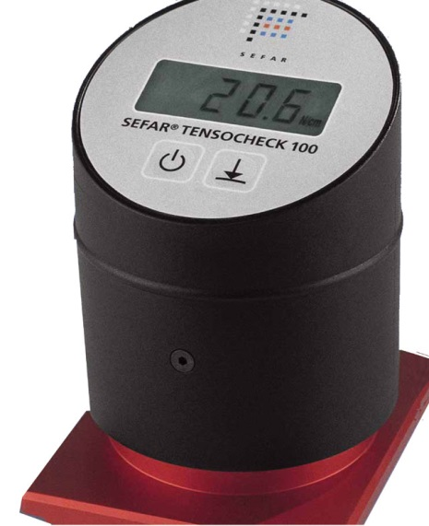
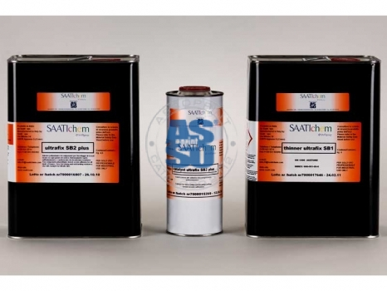
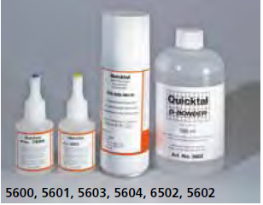
THE HYBRID DETECTOR – RESISTIVE ANODE
April 2013, status
Micromesh “production”
A learing session at Seritech services SA (Montrex)
Micromesh:
G Bopp & Co AG
18μm φ , hole: 45 μm
SEFAR
Tensocheck 100-R
GLUES
Thick: SAATIchem Ultrafix SB2
Thin: SEFAR NYTAL Cyanacrylat Kleber

Slide 23
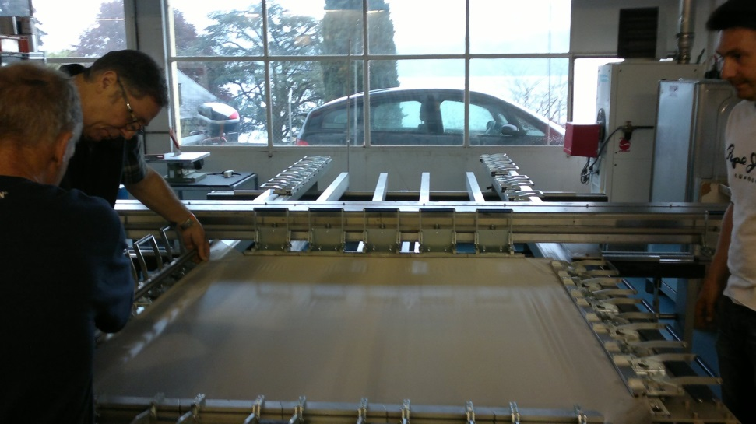
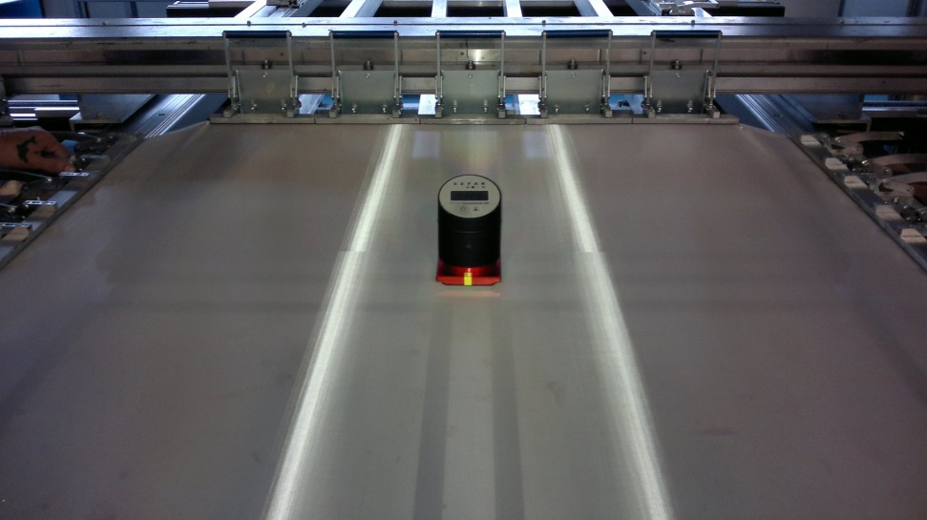
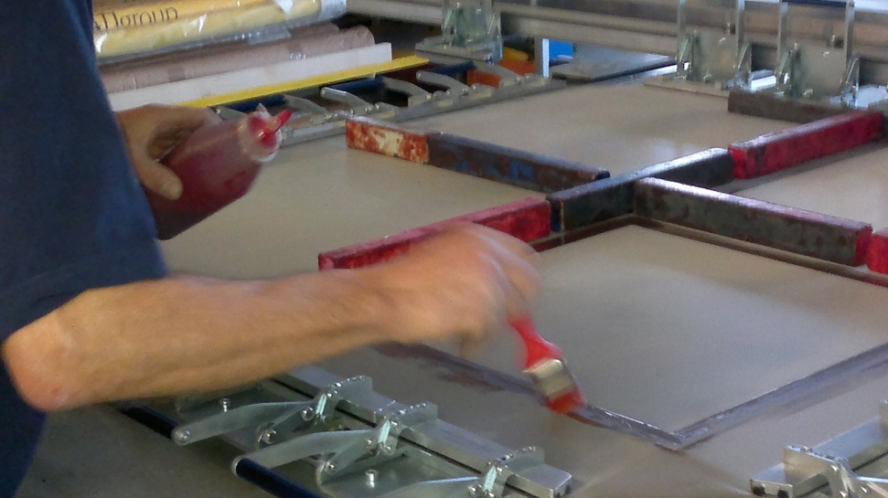
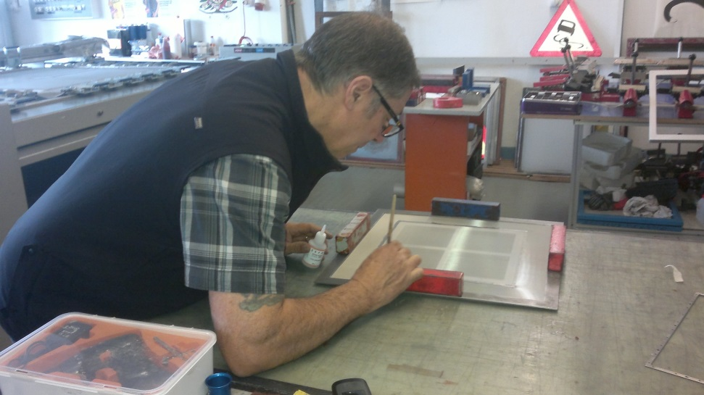
THE HYBRID DETECTOR – RESISTIVE ANODE
Micromesh “production”
A learing session at Seritech services SA (Montrex)
April 2013, status
Tensioning the mesh
(15N/cm ± 1N/cm)
Glueing onto the TRANSPORT frame
Glueing onto the FINAL frame (with reinforcement)
CERN, COMPASS TB meeting, 8/5/2013
Silvia DALLA TORRE

Slide 24
OUTLINE
Attivita’ periodo 15 settembre 2012 – 15 giugno 2013
Costruzione del Leopard

Slide 25

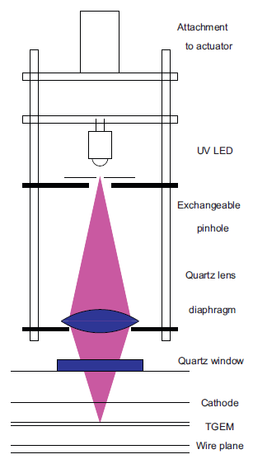
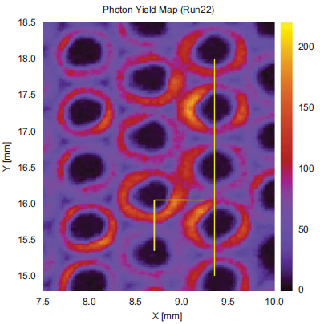
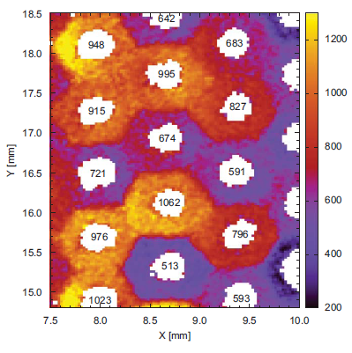
LEOPARD CONSTRUCTION
A few images to remind about the LEOPARD
Efficiency
map
Gain map
G.Hamar and D. Varga, NIMA 694(2012)16

Slide 26
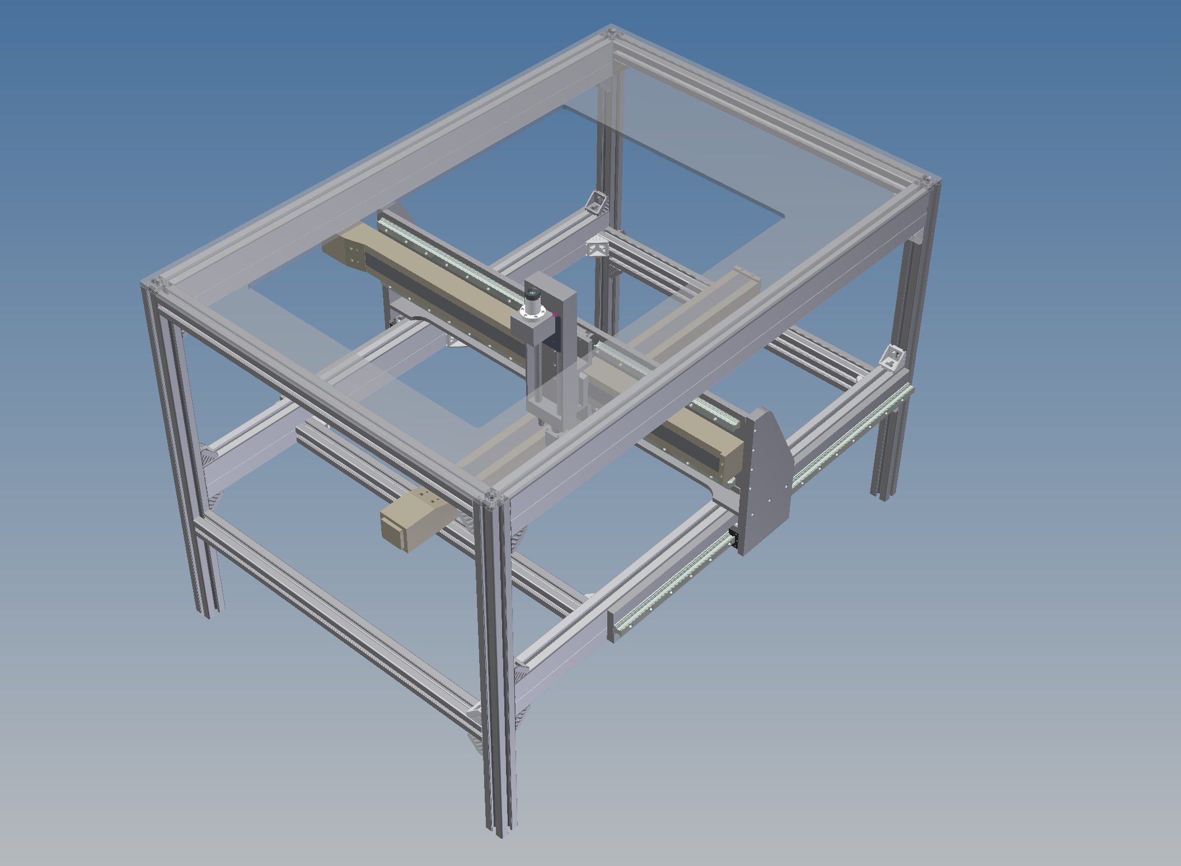
LEOPARD CONSTRUCTION
The CAD design
January 2013, status

Slide 27
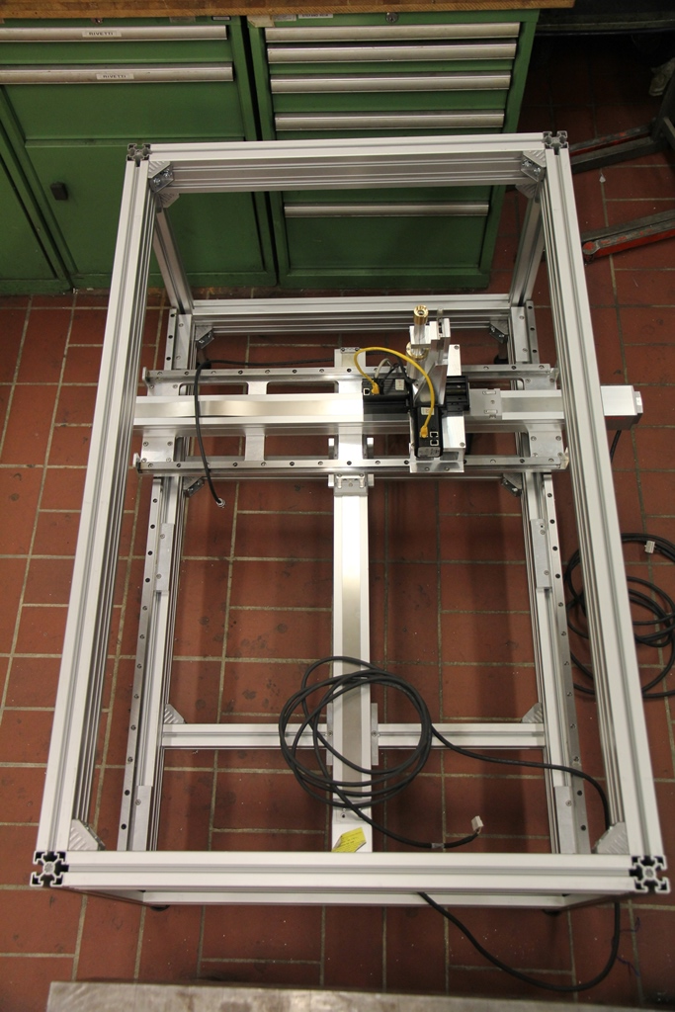
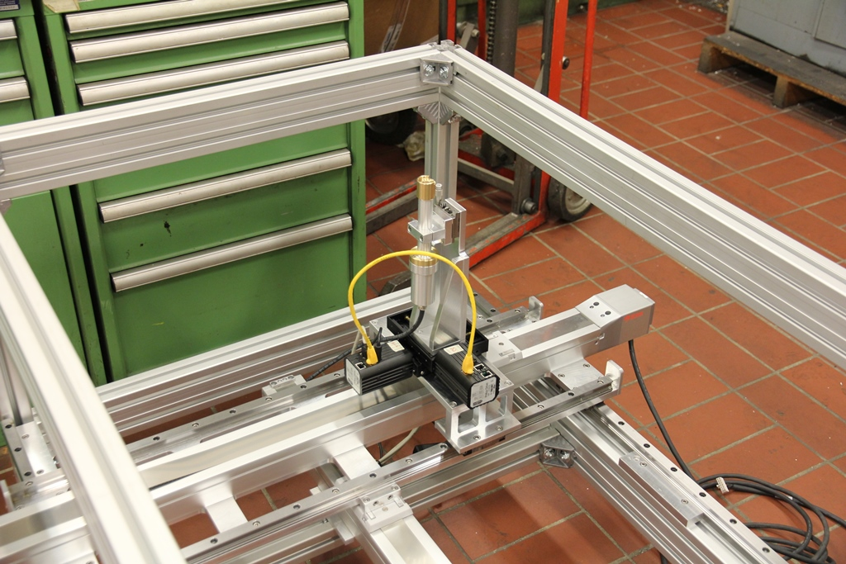
LEOPARD CONSTRUCTION
April 2013, status
Leopard mechanics and stepping motors computer control ready
large x & y movement
fine x & y movement

Slide 28
OUTLINE
Attivita’ periodo 15 settembre 2012 – 15 giugno 2013
Coordinemanto del progetto

Slide 29
1st PROJECT MEETING
Trieste, 21/1/2013
Attendance (25 in total):
Aveiro: C.Santos, C.Azevedo, J.Veloso
Freiburg: M.Büchle, H.Fischer, F.Herrmann, S.Schopferer
Liberc: K.Novakova, L.Steiger, M.Sulc
Matrivani: S. Dasgupta
Prague: M.Finger,M.Finger, J.Novy
Trieste: M.Alekseev, F.Bradamante, R.Birsa, A.Bressan,
P.Ciliberti, S.Dalla Torre, S.Levorato, A.Martin,
G.Menon, G.Sbrizzai, F.Tessarotto

Slide 30
Trieste, 21/1/2013 - AGENDA
Introduction (Silvia) Session: Test beam session Set-up and preparation (Carlos)
FE performance (Maxim)
Data analysis (Stefano)
Session: More information THGEM read-out (Max) THGEM read-out FE (Maxim) Cherenkov photons from quartz radiators (Miroslav) The hybrid detector (Stefano) The "leopard" (Fulvio)
CsI QE vs time in the present detectors (slides by Federica shown by Silvia)
Session: planning
Next 6 month planning in Trieste (Fulvio) General Discussion

Slide 31
OUTLINE
Attivita’ periodo 15 settembre 2012 – 15 giugno 2013
Documentazione

Slide 32
THGEM: DOCUMENTAZIONE ATTIVITA’
CONFERENZE:
13th Vienna Conference on instrumentation Pisa Meeting on Advanced Detectors (VCI 2013), 11-15/2/2013, Vienna, Austria
THGEM-based Photon Detectors for the upgrade of COMPASS RICH-1
F. Tessarotto
5th IEEE International Workshop on Advances in Sensors and Interfaces (IWASI 2013), 13-14/6/2013, Bari, Italy
A Hybrid photon sensitive detector based on MPGD (relazione su invito)
S. Levorato
3rd International Conference on Micro-Pattern Gaseous Detectors (MPGD 2013), 1-4/7/2013, Zaragoza, Spain
MPGDs developments: Historical Roadmap and Recent Progresses in Consolidating
MPGDs (relazione su invito)
S. Dalla Torre
Status and progress of the novel photon detectors based on THGEM and hybrid
MPGD architectures
F. Tessarotto
ARTICOLI :
M. Alexeev et al., NIMA 695 (2012) 159.
M. Alexeev et al., JINST 8 (2013) P01021.
The development of Thick GEM-based photon detectors for COMPASS RICH-1 (submitted to NIMA)

