Slide 1






Relazione Coordinatore CSN3@LNF
Consiglio Laboratorio Aperto 2 Luglio 2013
Alessandra Fantoni
CERN Fisica: QGP FTE: ric.+tecnol. 9.9 + 0.6UE
Jlab Fisica: adronica FTE: ric.+tecnol. 7.5 + 2UE
Bonn/Mainz Fisica: adronica FTE: ric.+tecnol. 1.3
GSI Fisica: adr./nucl. FTE: ric.+tecnol. 2.2
LNF Fisica: nucleare FTE: ric.+tecnol. 10.5 + 0.4UE
LNGS Fisica: nucleare FTE: ric.+tecnol. 5.8
VIP
FTE Totali: Ric.+Tecnol. 40.2 / Tecnici 4.8
3 sigle (su 6) con Responsabilità Nazionali INFN: PANDA, SIDDHARTA, VIP
Numerose importanti responsabilità nazionali / internazionali

Slide 2
Nuclear Physics Exp. @ LNF in 2013
Funding 2013, SJ 2013 at the level of 1 kE
Exp | Res | Tec | FTE | ME |  | CON |  | APP |  | INV |  | Other
ALICE | 8.9 | 0.5 | 9.4 | 69 |  | 17 |  |  |  | 9
JLAB12 | 11 | 1 | 12 | 57 |  | 15 |  | 67 |  | 3 |  | 3 | TRA
KAONNIS | 9.3 | 1.9 | 11.2 | 24 | 3 | 28 | 5 |  |  | 34 |  | 2 | MAN
MAMBO | 1.5 | 0 | 1.5 | 12 |  | 3
PANDA | 1.3 | 1.3 | 2.6 | 20 |  | 9 | 3
VIP DTZ | 4.1 36.1 | 1.1 5.8 | 5.2 41.9 | 19 24 |  | 13 20 |  |  |  | 8 26 |  | 1 11 | MAN MAN/SEM/TRA

Slide 3
LNF activities
12 researchers for 10.7 FTE
Average participation of 90%
Responsabilities:
2 Period Run Coordinators
1 System Run Coordinator (EMCAL)
1 HLT coordinator for EMCAL
1 calorimeter expert on call
1 calorimeters construction coordinator
1 deputy spokesperson in calo MB
1 member of the calo MB
1 Heavy Flavour Physics conv @ CERN
1 “Collider Xtalks group” conv @ CERN
1 spokesperson Jet Physics HP3
N. Bianchi 0.8
L. Cunqueiro 1
P. Di Nezza 1
A. Fantoni 1
P. Gianotti 0.4
S. Liuti 1
A. Moregula 1
V. Muccifora 0.7+0.3
A.R. Reolon 1
F. Ronchetti 0.5+0.5
S. Sakai 1
E. Spiriti 0.5
A.Orlandi (tech) 0.5
A. Viticchié (tech) 0.5
Data taking
& detectors
Management
Physics
Publications in 2012-2013:
1 paper first author, published JHEP
1 paper first author, in advanced status
2 papers co-first author, in advanced status
1 paper first author, in a very early status
1 non ALICE, co-first author, pubbl. JHEP
F. Ronchetti:
Co-head of Consolidation Task Force (Technical Coord.) in 2013-14
Run Coordinator in 2015 data taking

Slide 4
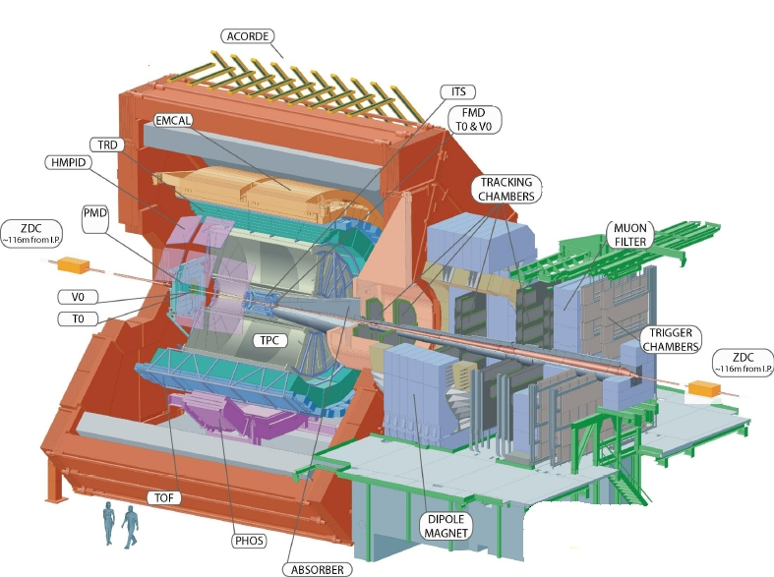
The activity of the LNF group

Slide 5
The activity of the LNF group
Construction of the
e.m. calorimeter

Slide 6
The activity of the LNF group
Construction of the
e.m. calorimeter
Online monitoring
Offline codes
High Level Trigger

Slide 7
The activity of the LNF group
DCal: first ALICE
upgrade (calorimetry)
DCal

Slide 8
The activity of the LNF group
Jet physics
Jet Quenching
+ phenomenology

Slide 9
The activity of the LNF group
Jets with
associated Λ
TMDs in pp
Transverse
Λ polarization
GPDs in pp
Λ

Slide 10
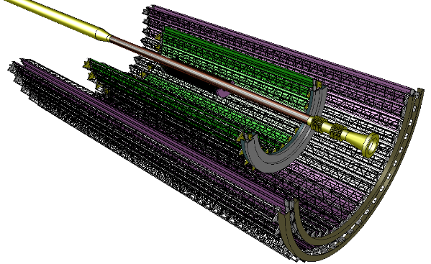
The activity of the LNF group
ALICE UPGRADE
ITS Outer Barrel (OB): 4 layers pixels
Radial position (mm): 200, 220, 410, 430
Length in z (mm): 843, 1475
Nr. of modules: 48, 52, 96, 102 → 298
Nr. of chips/module: 28, 28, 52, 52
Nr. of chips/layer: 2688, 2912, 9600, 10200 → 25400
Pixel size: ~ 20 μm x 20 μm or bigger
Material thickness: ~ 0.3% X₀
Throughput: < 6 Mbit / sec·cm²
Preparation for the new Inner Tracking System construction
LNF as national production center for all the ALICE INFN groups

Slide 11
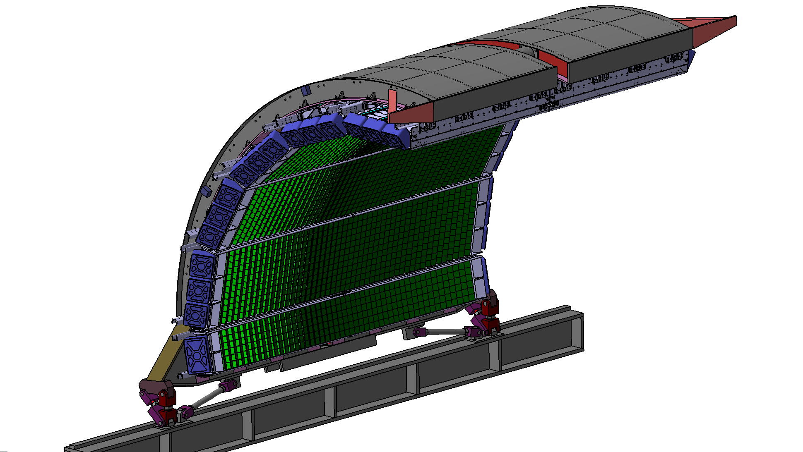
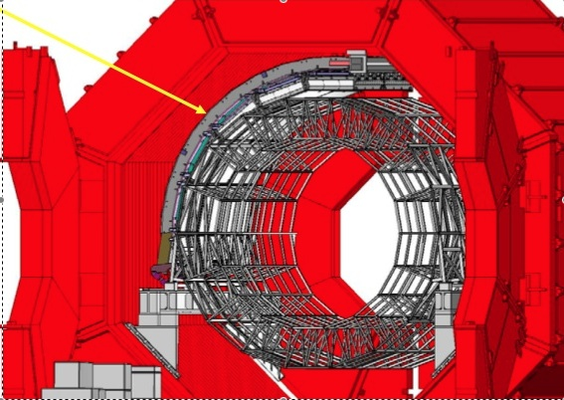
EMCal
France, Italy and USA Collaboration
  7 US Super-Modules (SM)
  3 EU SMs (Italy and France)
  Construction started in 2008
  4/10 SM installed in 2009
  Complete installation in 2011
  2 short (1/3) SM in LS1 in 2013
Lead-Scintillator Sampling Calorimeter
Δη = 1.4, Δφ =100º, 20.1 X₀
Shashlik Geometry, APD Photosensor
12k Towers

Slide 12
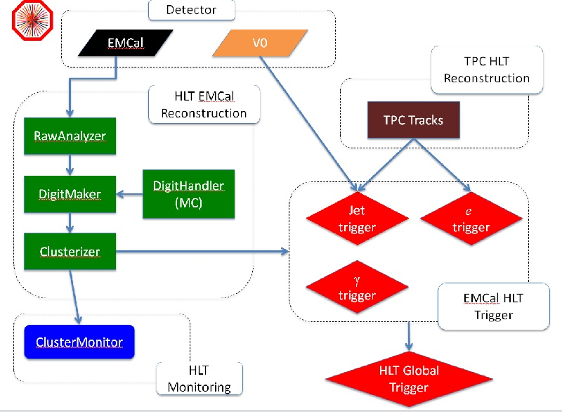
HLT for EMCal
Main HLT strategy for EMCAL:
Reconstruction for calibration, monitoring and triggering
Event rejection using
high-E_{T} (cluster) trigger OR jet trigger AND e⁻ trigger
arXiv:1209.3647v1

Slide 13
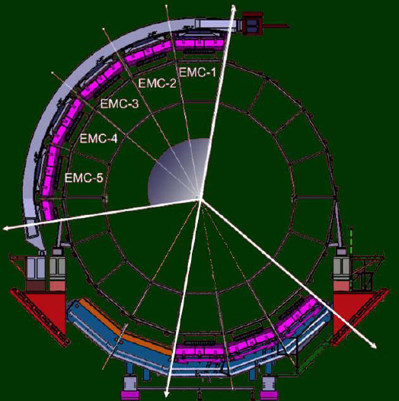
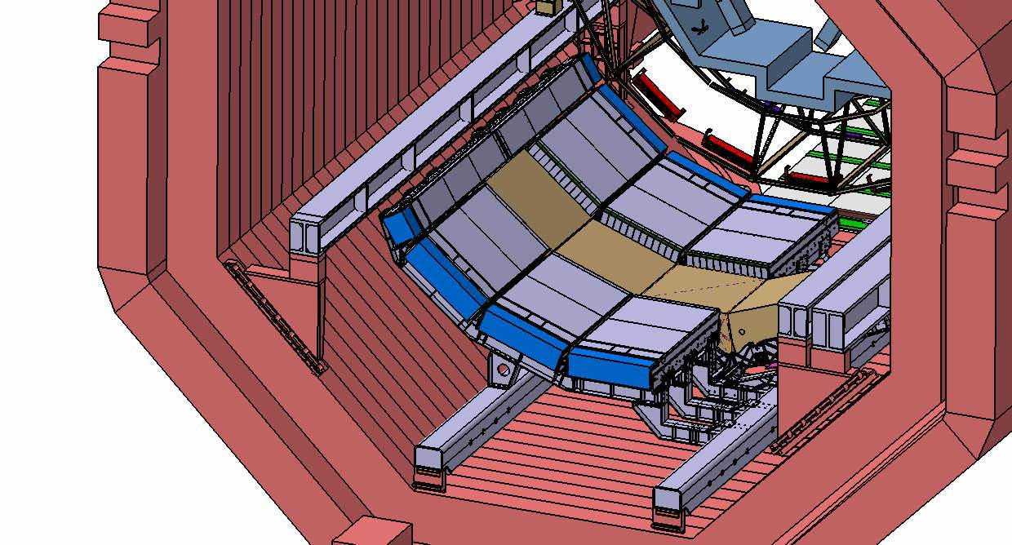
From EMCal to DCal
DCal, the first upgrade approved by the Alice collaboration.
Installation in LS1 fall 2013: extension of EMCal for jet-jet and γ-jet physics
DCal – 6 +2 (1/3) super modules
PHOS
DCAL modules:
same technology than EMCal
LNF contribution with tools, expertise and manpower
EMCAL+DCAL => more than 250k fibers sputtered

Slide 14
LNF main contributor to jet physics@LHC
1. ALICE Jet Results:
ALICE first publication on Heavy Ion Jets JHEP 1203 (2012) 053 [LNF primary author]
Charged jet spectrum upcoming publication [LNF co-primary author]
Full jet spectrum upcoming publication [LNF co-primary author]
Hadron-jet and recoil jet spectrum upcoming publication [LNF primary author]
2. Phenomenological studies of jet quenching
and first interpretation of LHC data
Collaboration with Santiago de Compostela & LNF theory departments:
”Medium evolved fragmentation functions” [Armesto,Cunqueiro,Salgado,Xiang] JHEP 0802 (2008)
“QPYTHIA:a medium-modified implementation of fin.state rad. [Armesto,Cunqueiro,Salgado] EPJ C61 (2009)
“Angular-ordered parton showers with in-medium modified splittings”
[Armesto,Corcella,Cunqueiro,Salgado] JHEP0911 (2009) 122
“Analysis of the influence of background subtraction and quenching on jet observables” [Apolinario,Armesto,Cunqueiro] JHEP1302 (2013) 022
More details on LNF general seminar http://agenda.infn.it/getFile.py/access?resId=0&materialId=slides&confId=6014
3. Transverse Λ polarization in unpolarized pp scattering
Λ reconstruction globally and in jets => First polarization measurement on TeV scale
First link of GPDs and TMDs with LHC

Slide 15
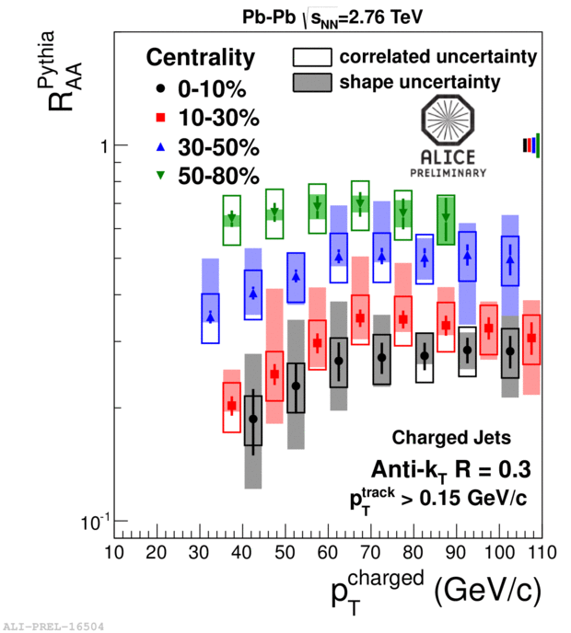
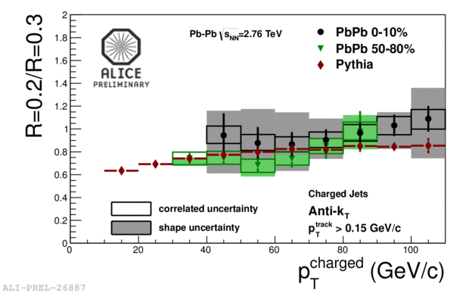
Inclusive charged jet spectra and R_{AA}
R_{AA} for R=0.3 is not very different to R_{AA} for single hadrons!
Energy distribution within a cone of R=0.3 is not very different
(within large systematic errors) from PYTHIA's

Slide 16
Richieste 2014
12 Ricercatori e Tecnologi, 10.7 FTE
- Richieste economiche complessive 175kEuro:
Richieste ai servizi LNF:
SPCM: 2 mesi/uomo
SEA: 1 mese/uomo
2 FTE tecnici
MI+ME | TRA | C.APP | INV/CON | Totale
115 | 5 | 0 | 55 | 175

Slide 17
Richieste ITS upgrade (2015-2016)
Camera pulita per l’assemblaggio degli stave
  50mq, classe ≤ 100 000
  Macchina di misura a controllo numerico
    Campo di lavoro 2m x 1m
    Campo di misura ≥ 1m x 0.5 m
  Impianti di vuoto, aria compressa, acqua, ecc.
Area per test e stoccaggio dei moduli in ricezione e degli stave
  ~100mq, ambiente pulito con atmosfera controllata
  Microscopio per ispezioni ottiche
  Sistema cooling → supporto servizi
  Test system
Laboratorio per piccoli lavori di elettronica e meccanica
Personale tecnico:
  Allestimento Laboratorio: da definire
  Produzione stave:
    Stima complessiva: 5 unità/giorno, 3 Turni settimanali, turno 5 giorni/settimana
    Contributo LNF: 5 tecnici (2 montaggi di precisione, 2 competenze elettroniche per i test e 1 di supporto) → 30% FTE/unità

Slide 18
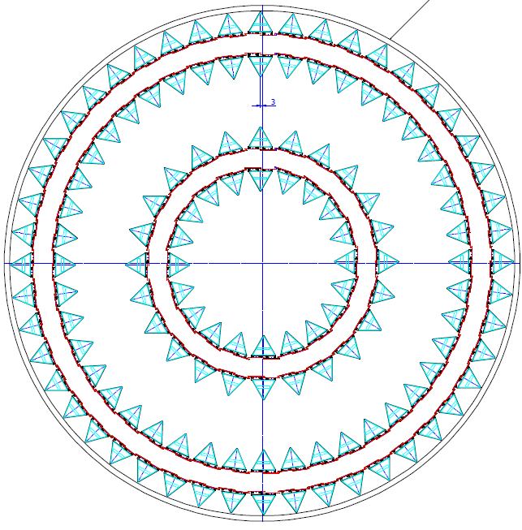
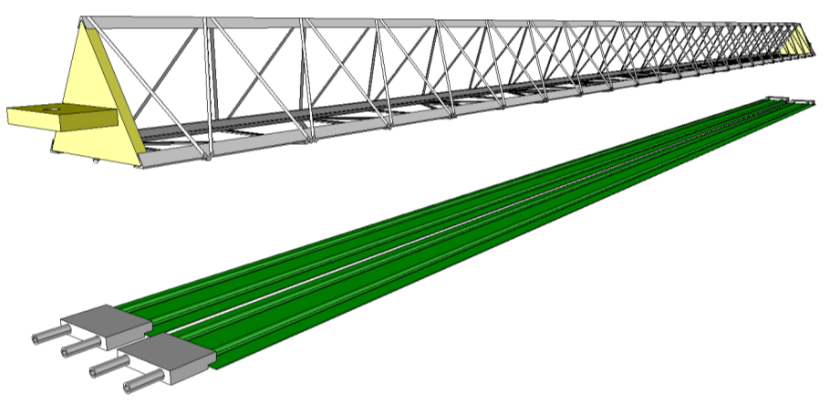
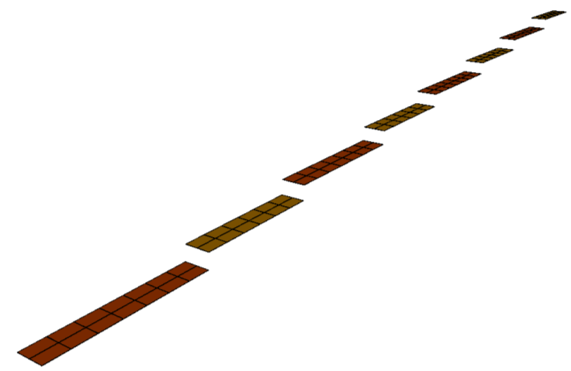
Outer Barrel
Middle Layers
Two inner layers of the Outer Barrel, i.e. layers 3 and layer 4
Outer Layers
Two outermost layers, i.e. layer 5 and layer 6
Baseline for the Outer Barrel Stave in the TDR
Stave
Spaceframe
Cold Plate
Cold Plate
Half-Stave
Each half-stave will consists of a number of modules glued on a common cold plate
Each module consists of a hybrid integrated circuit, i.e. a number of pixel chips (e.g. 2 x 7) bonded on a flexible printed circuit, which might be glued on a carbon ply
Module

Slide 19
INFN-ITSupgrade Project Organization
Module development and production (Ba, Ct, To, Ts + NIKHEF)
  Flex Printed Circuit (FPC) → To (+NIKHEF)
  Flip-chip mounting → Ba, Ts
  Assembly Procedure → Ba
  Jigs and tooling production → Ba, Ts
  Pre-assembly testing of components (pixel chip, FPC, etc.) → Ct, Ts et al.
  Production → Ba (+ NIKHEF)
  Test and characterization → Ba, Ts
Stave Development and production (Al, Ca, LNF, Rm, To, all + NIKHEF)
  Assembly Procedure → To
  Jigs and tooling production → LNF, To, Ca
  Setting up of the production centre at LNF → LNF
  Production at LNF → all (+ NIKHEF)
  Test and characterization → all
Integration and alignment of the staves in half-layers (Pd)
  Integration and alignment procedure
  Jigs and tooling production
  End-wheels and support mechanics

Slide 20
LNF activities
M. Aghasian 0 + 1UE
A. Courtoy 1
E. De Sanctis -
D. Hasch 1
V. Lucherini 0.5
M. Mirazita 1
R. Montgomery 1
S. Pereira 0 + 1UE
J. Phillips 1
S. Pisano 1
P. Rossi 1
11 Physicists for 9.5 FTE
Average participation of 86%
2 FTE technicians
Technicians:
A. Orlandi 0.5
A. Viticchié 0.5
L. Trevisan 1
Research activity & Responsibilities
1. Physics Analysis => Study of parton distribution functions in exclusive and semi-inclusive reactions with 6 GeV electron data:
  Deeply Virtual Compton Scattering S. Pisano
  Two-hadron semi-inclusive production S. Pisano & S. Pereira (data analysis)
          A. Courtoy (theory)
  Λ polarization in semi-inclusive production J. Phillips (PhD thesis)
  New methodes of data analysis M. Aghasyan
2. Hardware for upgrade => Preparation for 12 GeV running:
  RICH detector for the CLAS12 spectrometer in Hall-B
  M. Mirazita, V. Lucherini, D. Hasch, S. Pereira, M. Aghasyan, J. Phillips, R.Montgomery
  A. Orlandi, A. Viticchié, D. Orecchini, S. Tomassini

Slide 21
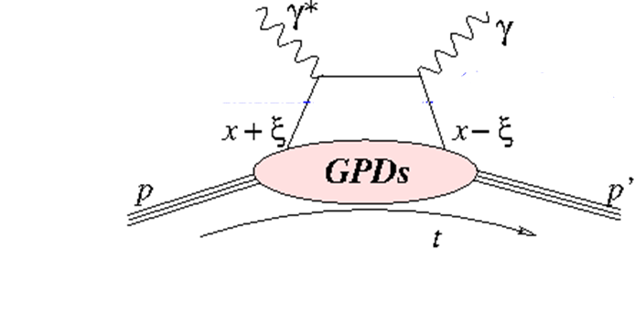
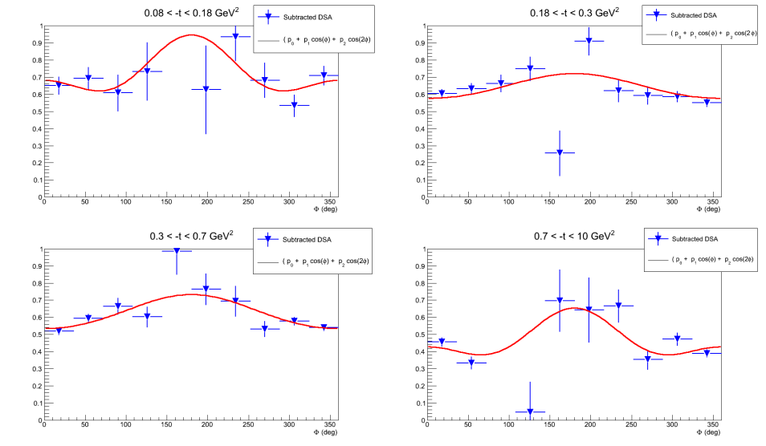
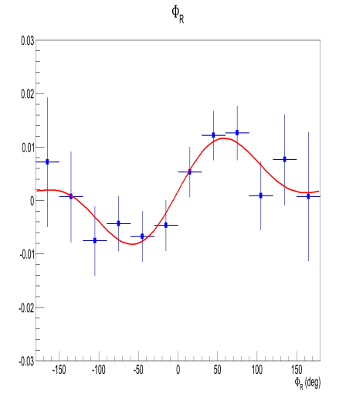
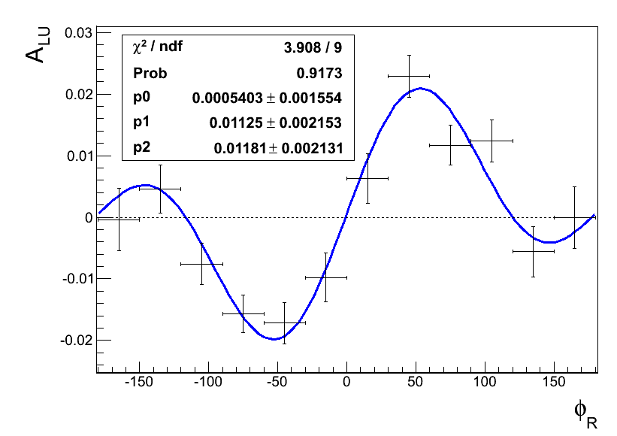
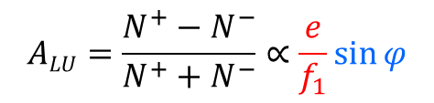
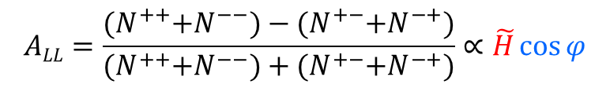
1. Physics analysis
DVCS
e p→e’ p γ
Di-Hadron SIDIS
e p→e’ π π X
e’
e
e’
p
e
Generalized Parton Distribution (GPD) functions
parton longitudinal momentum at a transverse position
Transverse Momentum Dependent (TMD) parton distribution functions
parton longitudinal and transverse momentum
polarized beam and polarized target
DOUBLE SPIN ASYMMETRY
simpler extraction of TMDs than in one hadron processes
PDF
$$ALL=\frac{{(N}^{++}+N^{−−})−{(N}^{+−}+N^{−+})}{{(N}^{++}+N^{−−})+{(N}^{+−}+N^{−+})}∝\tilde{H}\cos{φ}$$
$$ALU=\frac{N^{+}−N^{−}}{N^{+}+N^{−}}∝\frac{e}{f_{1}}\sin{φ}$$
BEAM SPIN
ASYMMETRY
preliminary
preliminary
under Collaboration revue
H₂
NH₃

Slide 22
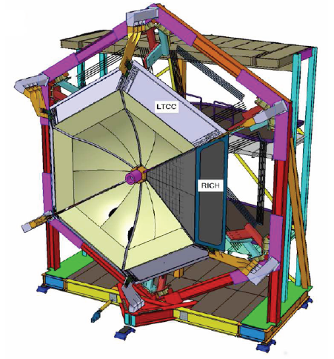
2. The RICH project for CLAS12
Improvement of PID needed to extend TMD measurements to kaons
2010
  concept of design and technology
2011
  start test of components
  first testbeam with small prototype
2012
  tetsbeam with electrons (BTF)
  two testbeams with hadrons (CERN)
2013
  start of engeneering phase
  completion of testbeam data analysis
  BTF testbeam for the electronics (july)
  final design of the detector
  preliminary JLab review (june)
  DOE review (september)
2014
  start of construction
First sector ready in 2016
replace one LTCC sector with a RICH
Institutions:
  INFN (LNF, Fe, Bari/Lecce, Genova, ISS/Roma1)
  JLab (USA)
  Argonne National Laboratory (USA)
  Christopher Newport University (USA)
  University of Glasgow (UK)
  Universidad Tecnica Federico Santa Maria (Chile)
  Institut fur Kernphysik of Mainz (Germany)

Slide 23
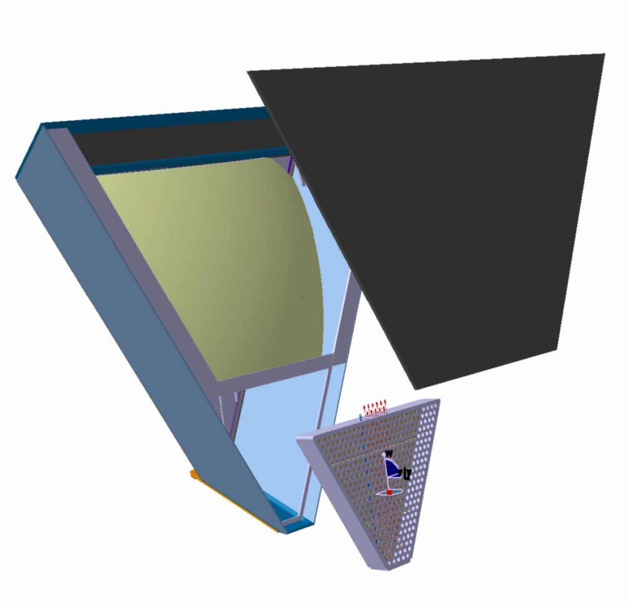
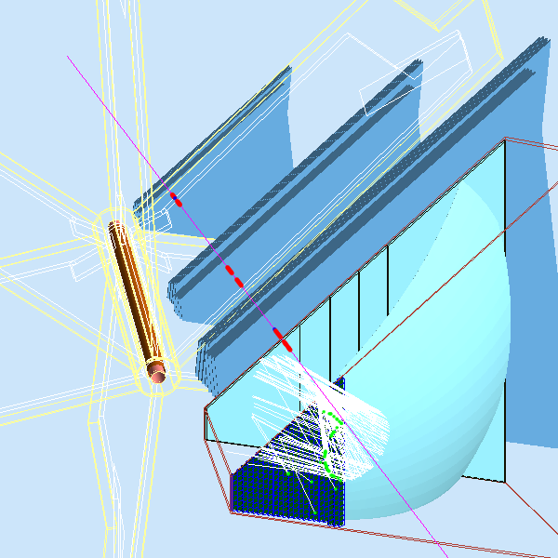
2a. The RICH design
target
particle’s trajectory
DC3
θ
DC1
DC2
spherical
mirror
mirror+radiator
beam
pipe
mirror
MAPMT housing box
PMTs
Design of the internal structure of the RICH under LNF responsibility
S. Tomassini, D. Orecchini
Collaboration with JLab and other INFN groups for the design of the Front End readout
G. Corradi
RICH components
aerogel radiator
MAPMTs for photon detection
spherical and planar mirrors to reduce the area of MAPMTs
integrated electronic readout

Slide 24
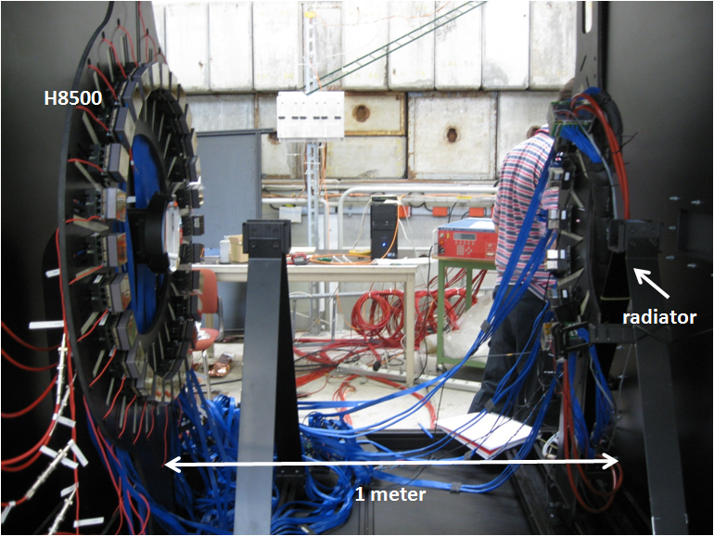
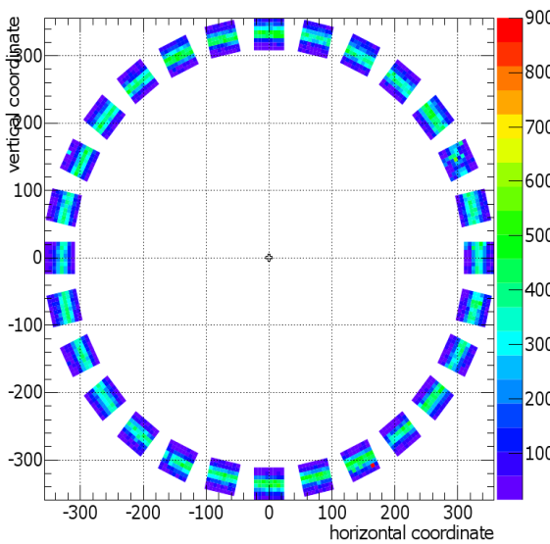
2b. Results from CERN test beam
H8500
Radiator
beam
π/K
pions
kaons(x60)
Cherenkov opening angle (mrad)
p=6 GeV/cc
p=7 GeV/c
p=8 GeV/c

Slide 25
Richieste e fondi esterni
Richieste finanziarie
apparati+consumo+inventario 150k
missioni 85k
Richieste ai servizi
elettronica 1 mese/u
progettazione apparati 3 mesi/u
PRIN 2012
Una nuova fase nell’esplorazione del nucleone: moto orbitale, distribuzioni di spin e impulso trasversi dei partoni in QCD
TS (A. Martin Responsabile Scientifico), LNF (M. Mirazita Responsabile di Unita’), Ca, Fe, Pv, RM2, To
Premiali
CLAS-MED: estensione del RICH a 6 settori
sviluppo di nuovi fotorivelatori a basso costo e grande area
elettronica integrata veloce
Responsabile del progetto: M. Contalbrigo (Fe)
INFN & Università Fe, Ba, RM1

Slide 26
LNF activities
3 researchers for 1.3 FTE
Average participation of 43%
Total INFN ~14 FTE
Nucleon excited states via meson photoproduction at MAMIc (Mainz) and ELSA (Bonn)
Transition form factor
  International collaboration: Bonn PI, Bonn HISKP, Gießen, ISS, LNF, Messina, Pavia, Roma2, Torino, Glasgow, Basel, PNPI Gatchina, INR Mosca, IHENP Kharkov
1. P. Levi Sandri 0.8
2. D. Pietreanu 0.4
3. A. Saputi 0.1
Responsibilities:
Co-spokesperson BGO-OD
Analysis and MC coordinator
Activities:
Main interest in BGO-OD
BGO (+ Roma2)
Barrel (+ ISS)
MRPC (+ Roma2)

Slide 27
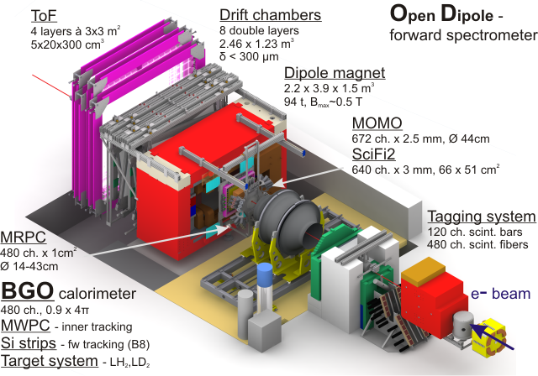
Open Dipole + BGO calorimeter @ Bonn

Slide 28
ELSA (Bonn) beamline S - Status
Responsabilità INFN:
Commissioning calorimetro, barrell e bersaglio. Ora fase di ottimizzazione (LNF/Roma1/Roma2/Messina). Schermatura per campo magnetico necessaria agli angoli in avanti. Simulazioni effettuate, individuata soluzione (LNF).
Test beam @ BTF: ottima linearità e ottima risoluzione in energia. Calibrazione con sorgente trasportabile ad alta energia (Roma2/Messina).
Camere cilindriche (Pavia) saranno installate inizio 2014 (ritardo dovuto all’elettronica di Front End di responsabilità INR).
MRPC in costruzione, trovata soluzione separatori. Supporto meccanico installato. Installazione rivelatore prevista fine 2013, inizio 2014.
MonteCarlo in continuo sviluppo, generatore di eventi (LNF/Messina/Roma2)
Coordinamento del gruppo di simulazione/analisi (LNF).
Co-spokesperson dell’esperimento BGO-OD (LNF).

Slide 29
ELSA (Bonn) beamline S - Status
Responsabilità altri istituti:
Tagger (Bonn PI): installati 30/120 scintillatori. Installazione finale entro autunno
Goniometro (Bonn PI): installato, ottenuti primi Stonehenge plots (polarizzazione lineare)
Moller (Bonn PI): in fase di studio (polarizzazione circolare)
Magnete: raggiunto il campo Massimo (0.43T)
Rivelatori per tracciamento: installati e commissionati
TOF: installato 40%
Monitor: ok
Altri rivelatori attesi per fase 2 (2016): Cerenkov (Basel), silici per vertice e polarizzazione di rinculo (HISKP), odoscopio a piastrelle (Glasgow)

Slide 30
Programma 2013-2014
Completare installazione e commissioning rivelatori in costruzione:
  MRPC (Roma2/LNF)
  MWPC (Pavia)
  TOF (Bonn-PI)
Commissioning fascio e BGO
  (2 settimane Settembre-Ottobre 2013)
Prima presa dati in configurazione ridotta con bersaglio H
  (4 settimane Novembre-Dicembre 2013)
Run in configurazione completa (con MRPC+tagging) nel 2014
  (12-20 settimane)

Slide 31
Richieste 2014
3 Ricercatori e Tecnologi, 1.3 FTE
- Richieste economiche complessive 33kEuro (8sj):
Richieste ai servizi LNF:
1 mese/uomo per costruzione e installazione MRPC
MI | ME | TRA | INV | C.APP | CON | Totale
2 | 20 (8sj) | 0 | 5 | 0 | 6 | 33 (8sj)

Slide 32
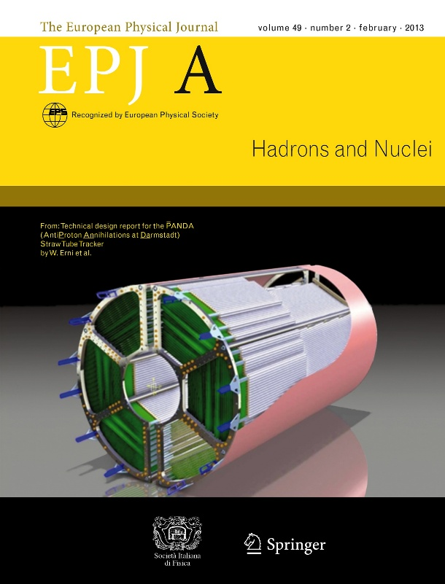
LNF activities
6 researchers for 2.2 FTE
Average participation of 37%
N. Bianchi 0.2
M. Bragadireanu 0.2
3. P. Gianotti 0.6
4. V. Lucherini 0.5
5. E. Pace 0.5
6. D. Pietreanu 0.2
L. Passamonti (tech) 0.3
D. Pierluigi (tech) 0.3
A. Russo (tech) 0.3
Responsibilities:
INFN National Responsible
Physics Coordinator
Tracking System Coordinator
Activities:
PANDA Central Tracking System
Complete Straw Tubes characterizations
Gas mixture/overpressure/gain; HV working point; electronics
Design of STT mechanical frame
Prototype realization of CTM
Services housing
electronics and gas distribution location, cabling
STT TDR in EPJA (2013) 49, 25
DOI: 10.1140/epja/i2013-13025-8

Slide 33
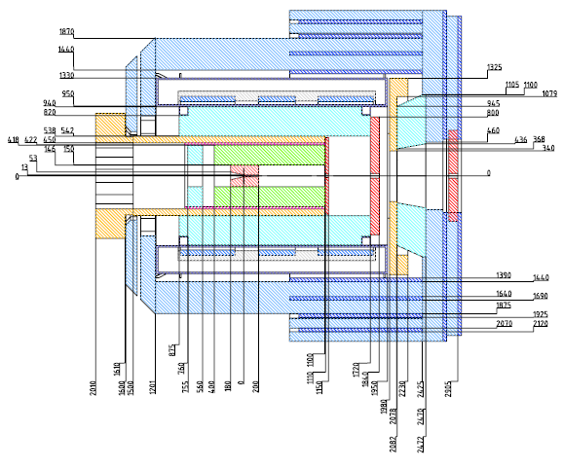
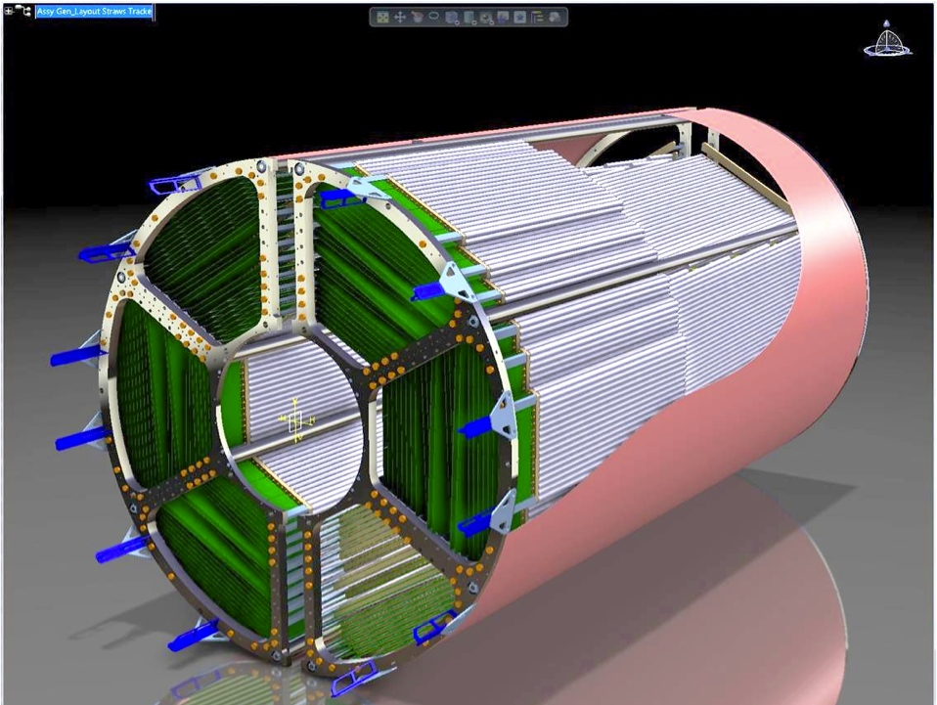
Straw Tube Tracker (STT) layout
PANDA central tracking detector has to fill a cylindrical volume with an internal radius of 150 mm, external one of 420 mm, and a length of 1500 mm.
4636 Straw tubes in 2 semi-barrels
23-27 planar layers in 6 hexagonal sectors
  15-19 axial layers in beam direction
  4 stereo double-layers with ±2.89° skew angle
Time readout (isochrone radius)
Amplitude readout (energy loss)
σ_{rΦ} ~ 150 (100) µm , σ_{z}~ 3.0 (2.0) mm
σ_{E} /E < 8% for π/K identification
σ_{p} /p ~ 1 - 2% at B=2 Tesla
X/X₀ ~ 1.2% (²/₃ tube‘s wall + ¹/₃ gas)
3d-view,
incl. frame

Slide 34
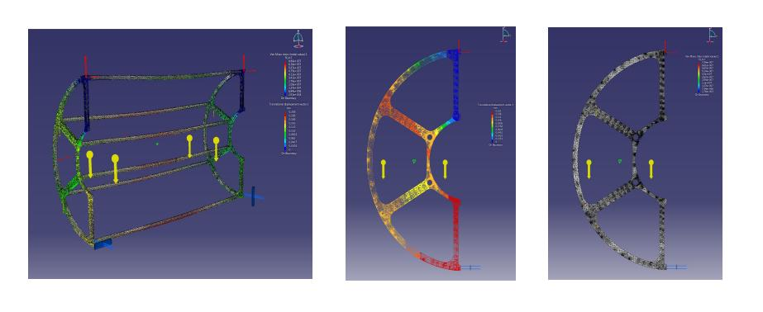
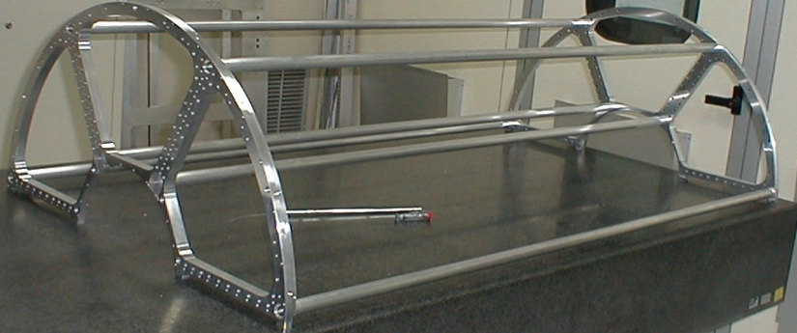
STT Mechanical Frame
LNF is responsible for the design of the mechanics:
2 Separate semi-barrels with end flanges, connected by spacer bars
Flanges have precise holes to fix straw modules
FEM analysis: 0.03mm max. deflection
Inner & outer protection skins (~0.1% X/X₀ Kevlar)
Mechanical frame weight: 2× 9 kg
11.6 kg Straw tubes (4636× 2.5 g) with
  strong wire stretching (230 kg equiv.)
  strong tube stretching (3.6 t equiv.)
Semi-barrel components for 2 End flanges | FEM analys 60 N
6 Connecting bars (4 needed) | 30 N
2300 Straw tubes Straw grounding, boards | 60 N 20 N
Electronics, gas supply | 110 N
Total weight Material | 280 N Aluminum
Density Youngs modulus Radiation length (X₀) Thermal expansion | 2.7 g/cm³ 70 GPa 9 cm 24 ppm/°C

Slide 35
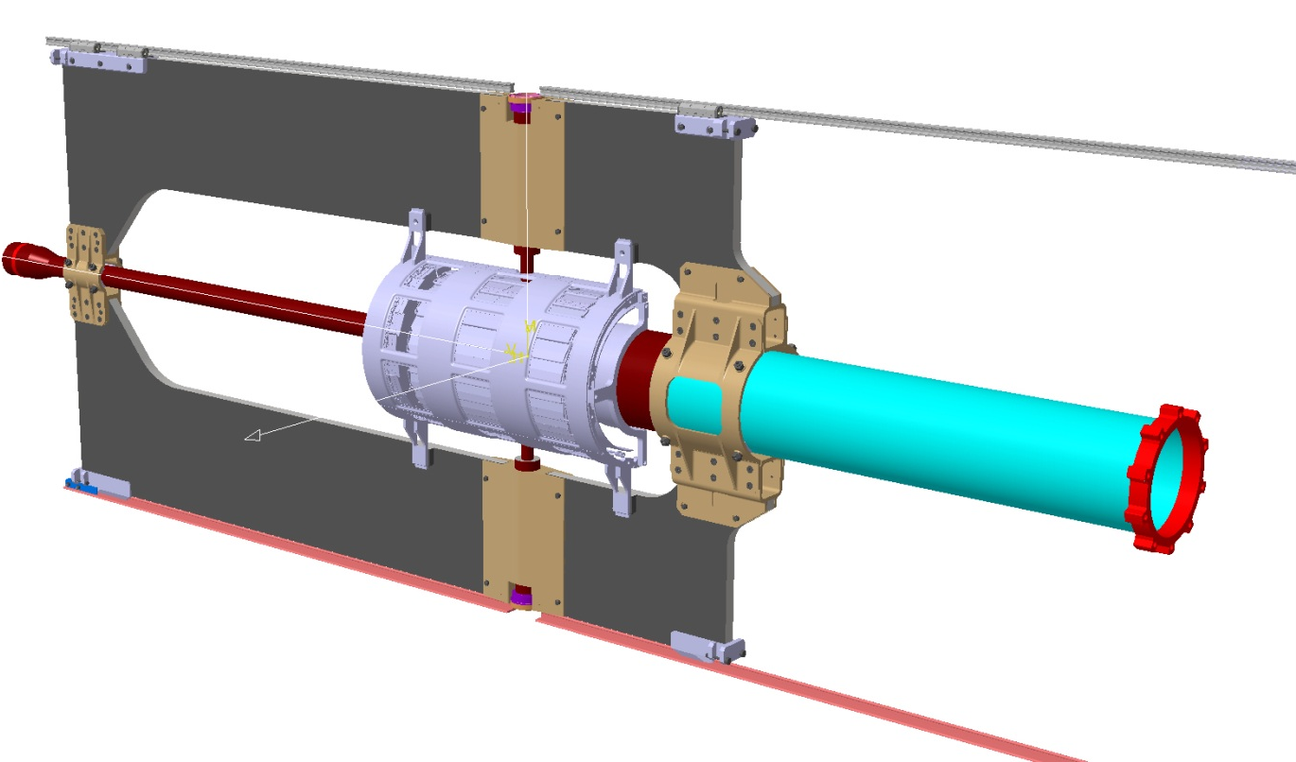
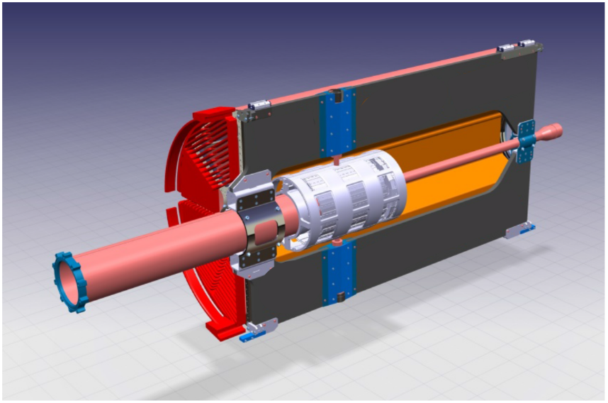
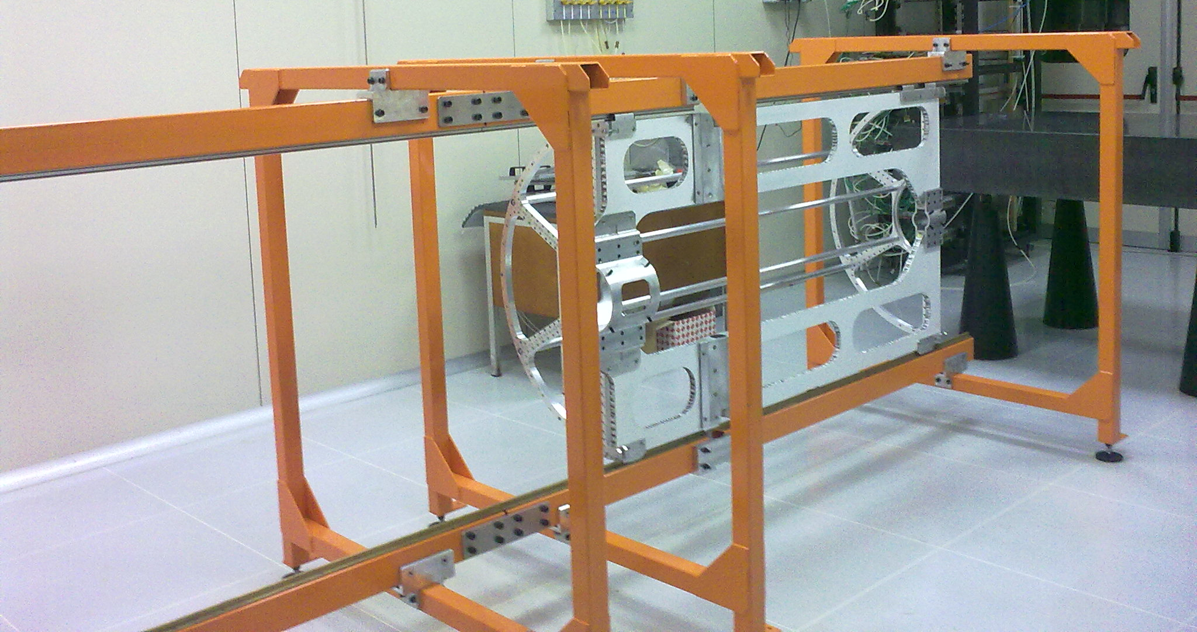
Central Tracker Mechanics
-The general design and the main dimensions are fixed;
- Preliminary mechanical solutions to support the target-beam cross pipe have been developed;
-The preliminary structural calculations have been made with positive results;
- A full scale prototype has been realized in collaboration with Torino Group.

Slide 36
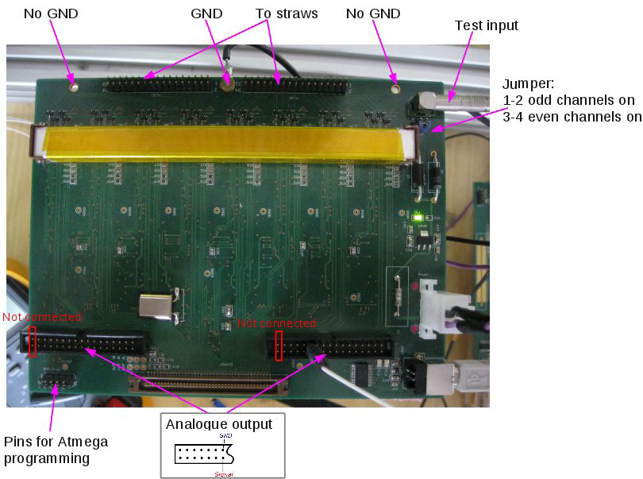
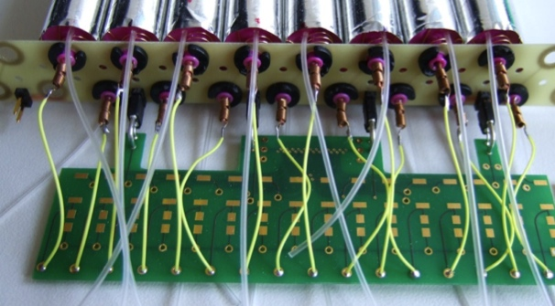
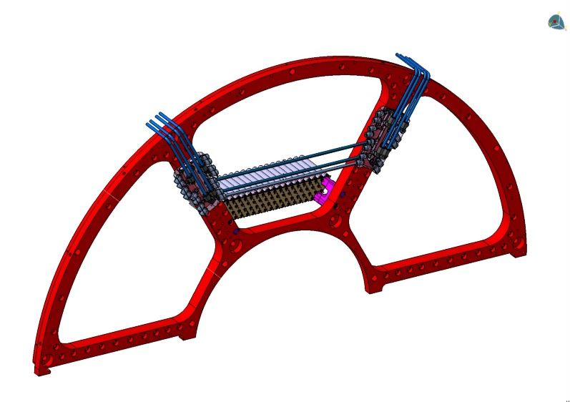
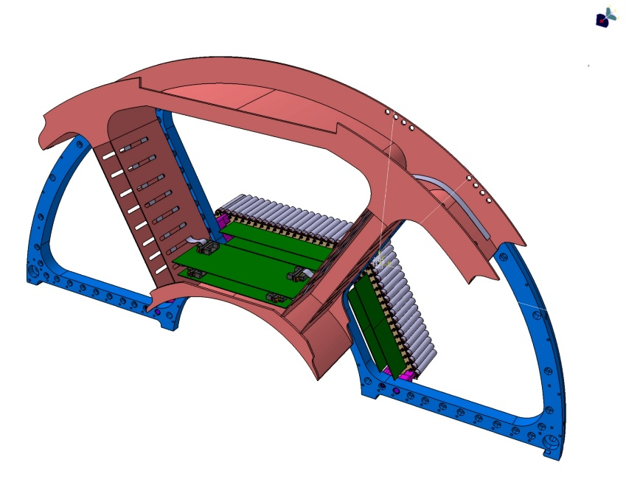
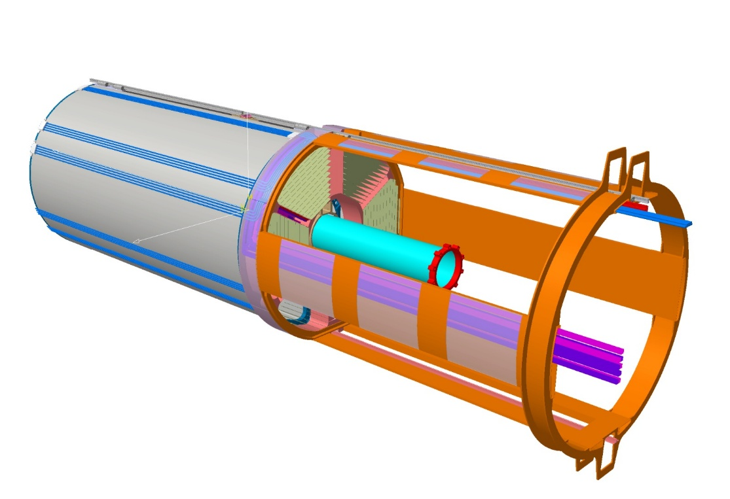
Present activity
presently working on services housing:
electronics and gas distribution location, cable routing
gas distributors
- HV Distribution.
- Read Out Electronics.
- Straw Modules.
- Cables Support Structure.
-The gas pipes are routed outside the STT outer encumbrance to the forward side where we have distribution.
- Support End-Plate.
-This mechanical structure rout out cables, gas pipes and all the STT services

Slide 37
PANDA - STT Timelines
 | Task / Years |  |  |  | 2011 |  | 2012 |  | 2013 |  | 2014 |  | 2015
 |  |  |  |  | I | II | I | II | I | II | I | II | I | II
1 | TDR Central Tracker
2 | Decision STT - TPC
3 | Funding application
4 | Allocation of workshop time slots
5 | Final design
 | 5.1 | Mechanical design
 |  |  | Straw design & layout
 |  |  |  | Straw tube materials
 |  |  |  | Straw layer design (axial, stereo)
 |  |  | Mechanical frame structure
 |  |  |  | Support & alignment structures
 |  |  |  | Electronics support cage
 |  |  | Final decision of mechanical design
 | 5.2 | Electronics readout
 |  |  |  | Frontend electronics, cables, ..
 |  |  |  | Digitizers & readout
 |  |  |  | Test measurements (beam, cosmics)
 |  |  |  | Final decision of electronics readout
 | 5.3 | Gas system
 | 5.4 | Slow control system
 | 5.5 | Integration in the PANDA central spectrometer
 | 5.6 | Final design freeze
6 | Tenders and orders
7 | Construction
 | 7.1 | Straw mass production & assurance tests
 | 7.2 | Straw layers production & assurance tests
 | 7.3 | Mechanical frame construction
 | 7.4 | Assembly of straw layers in mechanical frame
 | 7.5 | Electronic readout & supply, assurance tests
 | 7.6 | Gas system & supply lines
 | 7.7 | Slow control system
 | 7.8 | Mounting STT electronics
8 | STT commissioning with cosmic tests (data-taking)
9 | STT preassembly in PANDA

Slide 38
Richieste 2014
6 Ricercatori e Tecnologi, 2.2 FTE
- Richieste economiche complessive 80kEuro:
Richieste ai servizi LNF:
SPAS: 6 mesi/uomo
MI | ME | TRA | INV | C.APP. | CON | Totale
6 | 25 | 2 | 0 | 10 | 37 | 80

Slide 39
LNF activities
21 researchers for 11.2 FTE
Average participation of 53%
Total INFN ~14 FTE
1. M. Bazzi 0.8
2. C. Berucci 0.5
3. A. Bragadireanu 0.8
4. A. Clozza 0.3
5. C. Curceanu 0.5
6. A. D’Uffizi 0.2
7. C. Guaraldo -
8. M. Iliescu 0.5
9. P. Levi Sandri 0.2
10. D. Pietreanu 0.2
11. K. Piscicchia 0.5
12. M. Poli Lener 1
14. E. Sbardella 0.6
15. A. Scordo 0.6
16. H. Shi 0.6
17. D. Sirghi 0.3
18. F. Sirghi 0.6
19. H. Tatsuno 1
20. I. Tucakovic 1
21. O. Vazquez Doce 0.4
F. Lucibello (tech) 0.5
KAONNIS= Low energy kaons interaction studies at Daφne
Integrated initiative (SIDDHARTA + AMADEUS)
Precise measurement of kaonic atoms X-ray transitions
  International collaboration: INFN; SMI-OAW (Austria); IFIN-HH (Romania); Politecnico MI; MPE, TUM, PNSensors (Germany); RIKEN, Tokyo U. (Japan); Victoria U. (Canada); Zagreb U. (Croatia)
ALL Responsabilities in LNF
Publications:
K⁴He first measurement ever in gaseous target
PLB 681 (2009) 310; NIM A628 (2011) 264; PLB 697 (2011); PhD
KH 400pb⁻¹, most precise measurement PLB 704 (2011) 113, NP A881 (2012) 88; Ph D
K³He 10 pb⁻¹, first measurement in the world PLB 697 (2011) 199; Ph D
KD: 100 pb⁻¹, exploratory first measurement ever NP A907 (2013) 69; Ph D
Widths and yields of K³He and K⁴He PLB 714 (2012) 40
ongoing: KH yields; kaonic kapton yields…
SIDDHARTA: important training for young researchers

Slide 40
KAONNIS (Integrated Initiative):
Low-energy QCD in strangeness sector – unprecedented results!
SIDDHARTA data analyses and SIDDHARTA-2 experiment: kaonic atoms studies
AMADEUS : kaon-nuclei interaction studies at low energies
other collaborations related to strangeness physics (JPARC)
support from European projects: HP3 (ongoing),
ECT* Workshop 21-25 October 2013:
“Strangeness in the Universe? Theoretical and experimental progress and challenges”

Slide 41
1) Kaonic deuterium measurement - 1st measurement and R&D for other measurements
2) Kaonic helium transitions to the 1s level – 2nd measurement, R&D
3) Other light kaonic atoms (KO, KC,…)
4) Heavier kaonic atoms measurement (Si, Pb…)
5) Kaon radiative capture – Λ(1405) study
6) Investigate the possibility of the measurement of other types of hadronic exotic atoms (sigmonic hydrogen ?)
7) Kaon mass precision measurement at the level of <10 keV
SIDDHARTA2 strategy – phases

Slide 42
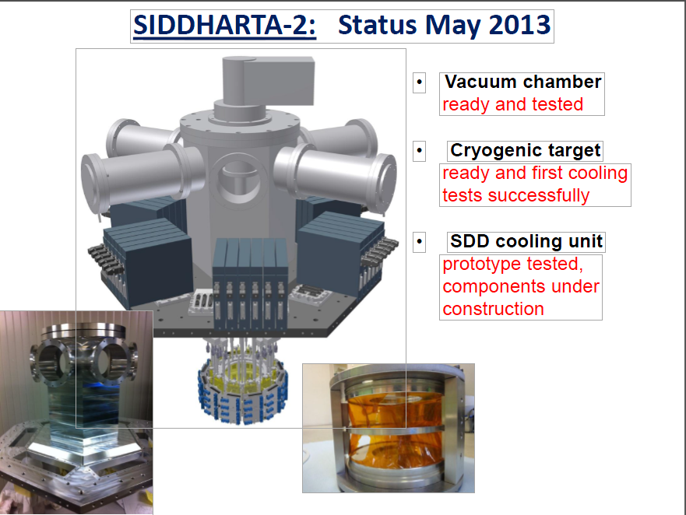

Slide 43
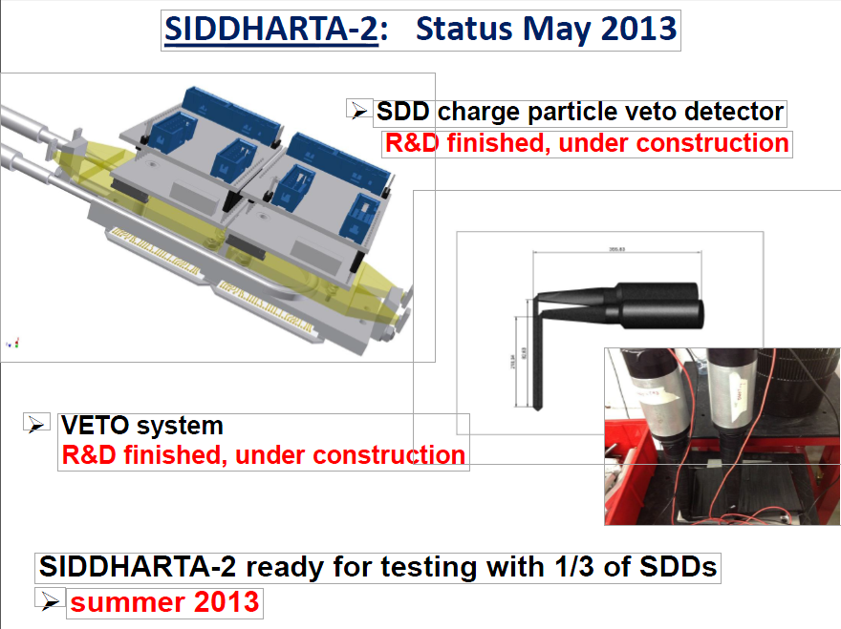
      Use of new SDD detectors (FBK)

Slide 44
Kd measurement:
SIDDHARTA-2 setup is going to be ready in 2014 (compatible with financing)
We are confident that with an integrated luminosity of 600 pb⁻¹, SIDDHARTA-2 will be able to perform a first X-ray measurement of the strong interaction parameters - the energy displacement and the width of the kaonic deuterium ground state, a fundamental measurement in low-energy strangeness QCD.
Prepare for other measurements – SIDDHARTA-2 has a scientific program which could last about 2 years
44
Notes:
44

Slide 45
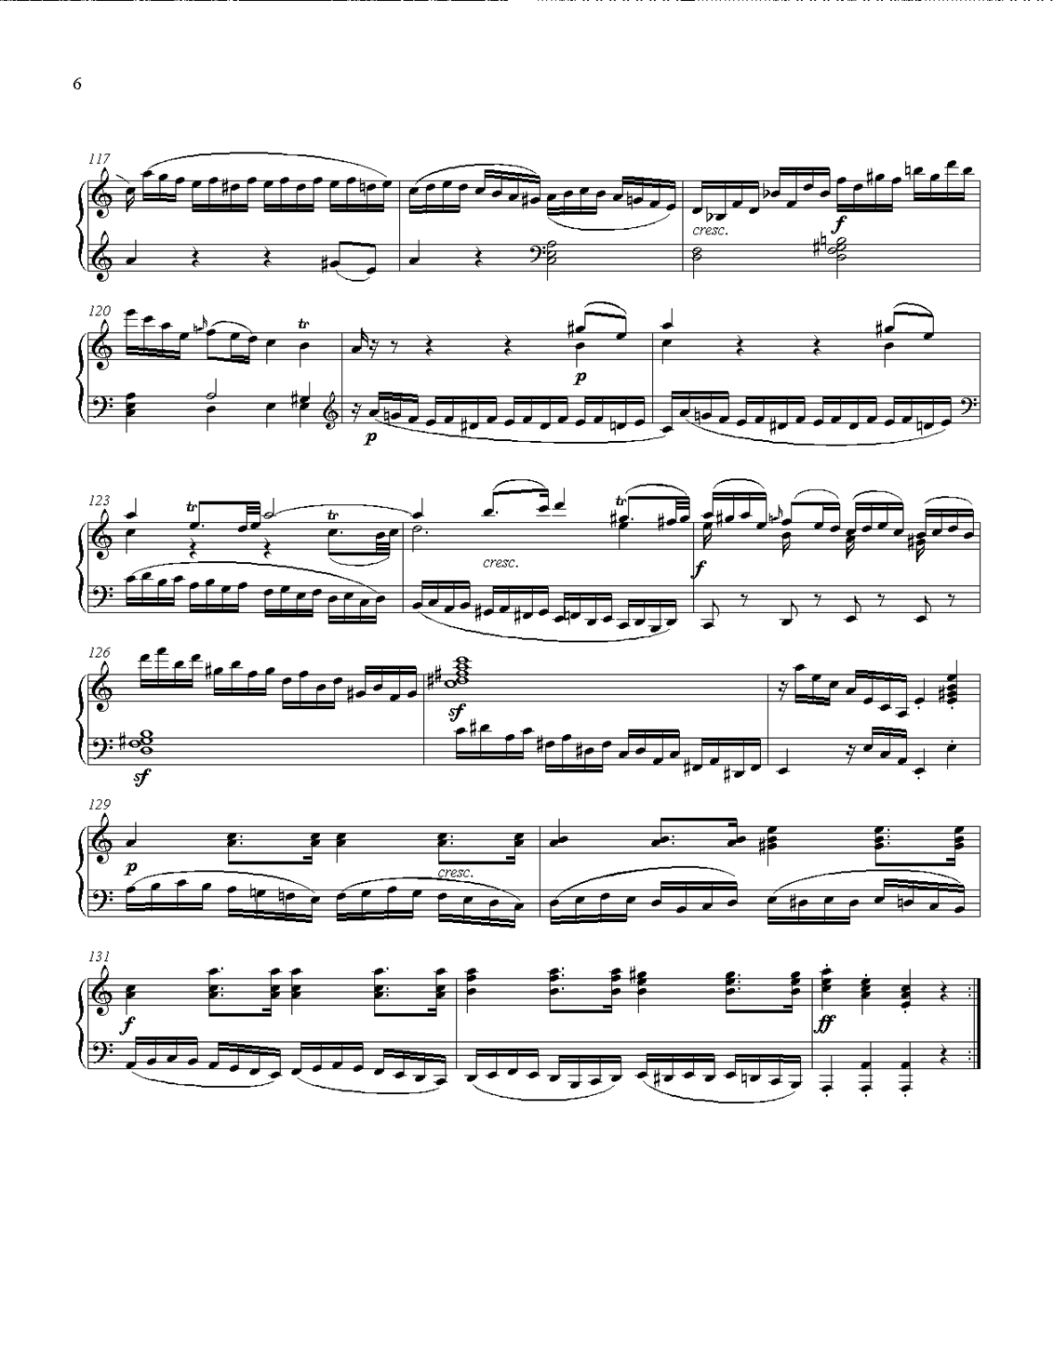
Antikaonic
Matter
At
DAΦNE: an
Experiment
Unraveling
Spectroscopy
AMADEUS
AMADEUS collaboration:
119 scientists from 13 Countries and 34 Institutes
For more details – talks at previous SC by Oton https://agenda.infn.it/getFile.py/access?contribId=15&sessionId=3&resId=0&materialId=slides&confId=6256

Slide 46
Experimental program of
AMADEUS
Unprecedented studies of the low-energy charged kaons
interactions in nuclear matter: solid and gaseous targets (d,
He3, He4) in order to obtain unique quality information
about :
Nature of the (elusive) Λ(1405)
Possible existence of kaonic nuclei clusters (deeply bound kaonic nuclei states)
Interaction of K- with one and two nucleons
Low-energy charged kaons cross sections for K momenta lower than 100 MeV/c (missing today);
Many other processes of interest in the low-energy QCD in strangeness sector -> implications from particle and nuclear physics to astrophysics

Slide 47
AMADEUS status:
- analyses of the 2002-2005 KLOE data -> publications
- Step 0 – Pure Carbon Target inside KLOE data taking in 2012 – under analyses -> publ.
- R&D for more refined setup: trigger and active target
- in 2014: collaboration AMADEUS – KLOE for KLOE-2 data taking and
Studies of future possible scenario and addings (hypernuclear…)

Slide 48
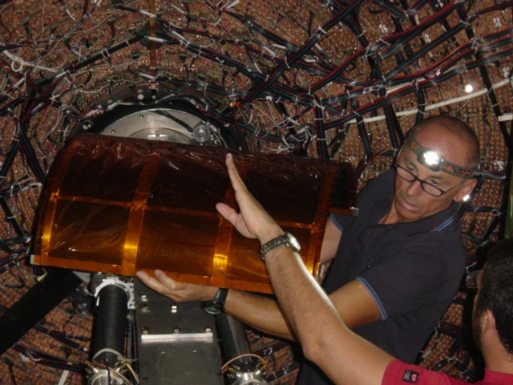
Pure carbon target inserted in KLOE DC end of August 2012 – took data for 100 pb-1

Slide 49
Richieste 2014
15 Ricercatori e Tecnologi, 5.8 FTE
- Richieste economiche complessive 376kEuro:
Richieste ai servizi LNF:
SEA: 6 mesi/uomo
SPAS: 5 mesi/uomo
SPCM: 8 mesi/uomo
VIP
MI | ME | TRA | INV | C.APP. | CON | Totale
14 | 20 | 2 | 80 | 10 | 250 | 376

Slide 50
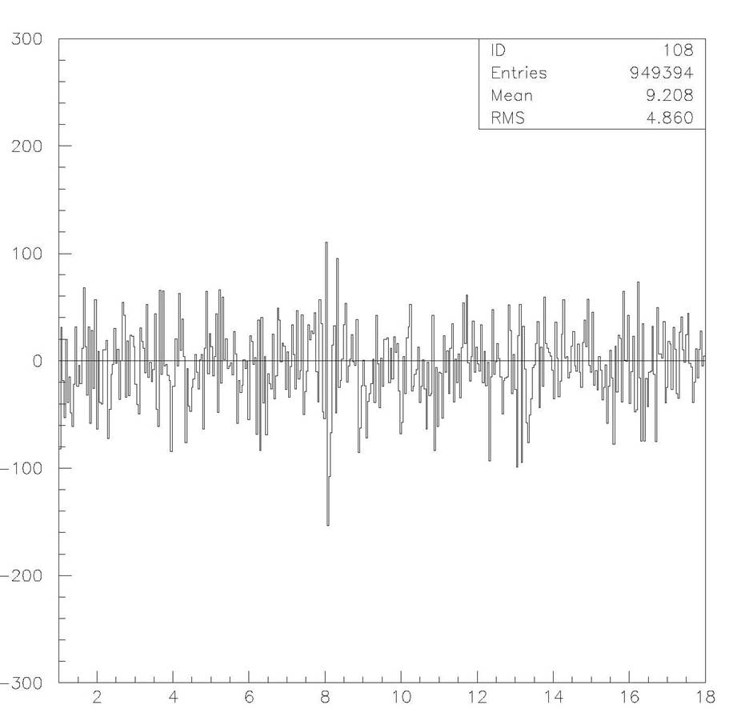
15 researchers for 5.8 FTE
Average participation of 39%
Total INFN 5.8 FTE
LNF activities
VIP
S. Bartalucci 0.4
C. Berucci 0.5
A. Clozza 0.2
C. Curceanu 0.4
A. D’Uffizi 0.4
C. Guaraldo -
D. Pietreanu 0.2
K. Piscicchia 0.5
E. Sbardella 0.4
A. Scordo 0.2
D. Sirghi 0.4
F. Sirghi 0.2
H. Shi 0.4
L. Sperandio 1
O. Vazquez Doce 0.6
VIP=Violation Pauli Exclusion Principle (PEP)
Perform experimental test of PEP for e⁻ with a clean method
Located at LNGS to reduce X-ray background
  International collaboration: LNF, LNGS, Ts INFN; SMI-OAW (Austria); IFIN-HH (Romania); Neuchatel U. (Switzerland)
VIP already established a probability of PEP violation β²/2<4x10⁻²⁹
previous limit <1.7x10⁻²⁶ PLB 328 (1990) 438
VIP upgrade (CCD detectors replaced by SDD)
ALL Responsabilities
Previous limit improved by 3 orders of magnitude
International Journal of Quantum Information 9 (2011) 145

Slide 51
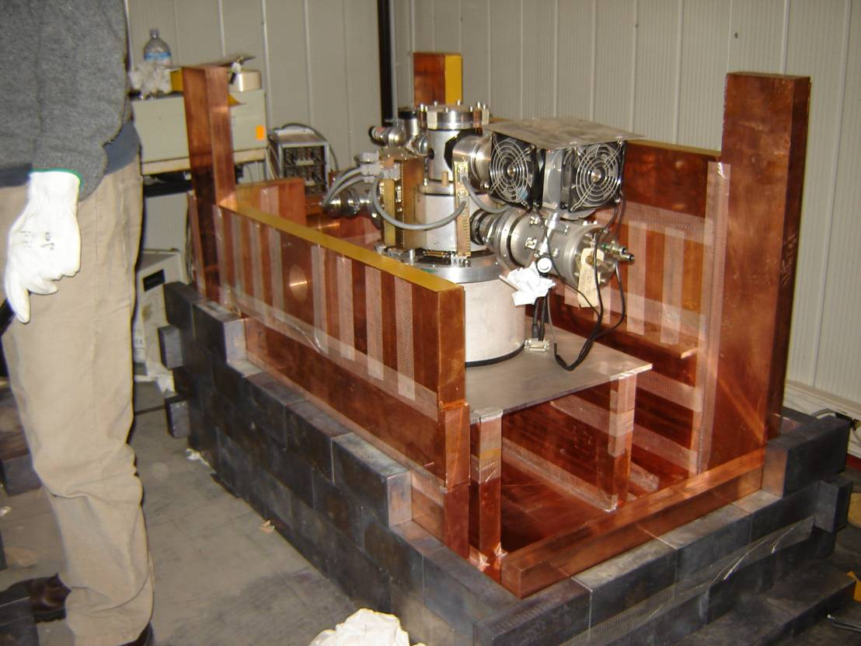
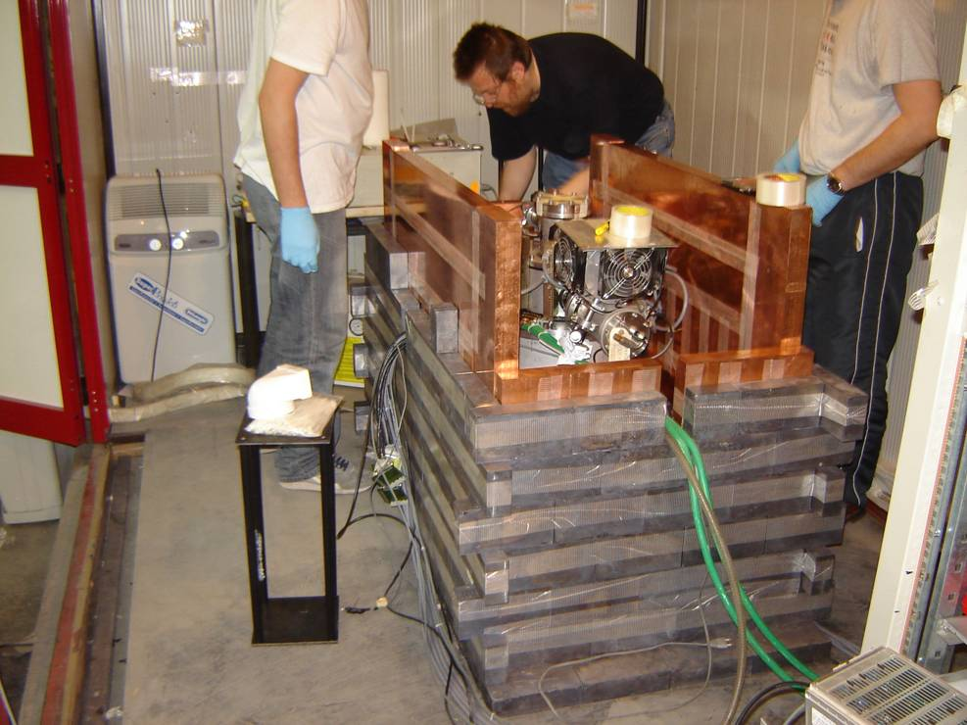
VIP setup at LNGS (2005-2011)
VIP

Slide 52
Drawbacks of VIP:
Reused an already done setup (DEAR experiment) – limitations in many aspects: signal and background
No timing (trigger) capabilities
Limited energy (efficiency) range (30 μm)
.......
VIP-upgrade:
Use new detectors – triggerable SDD
300 μm – more efficient in a broader energy range
Design a new setup – much more compact; higher acceptance (present one 2.8%) and lower background
VIP
Goal to gain a factor 100
VIP upgrade ready to be moved to LNGS

Slide 53
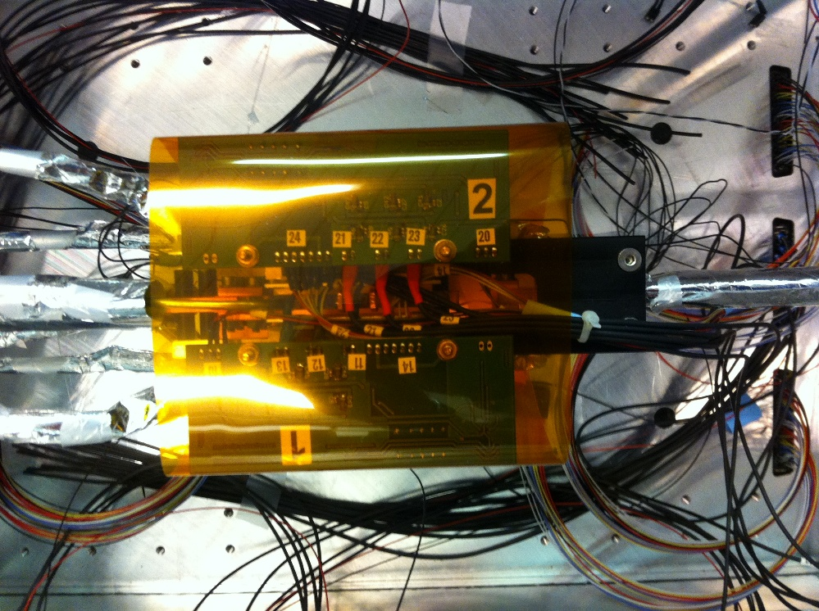
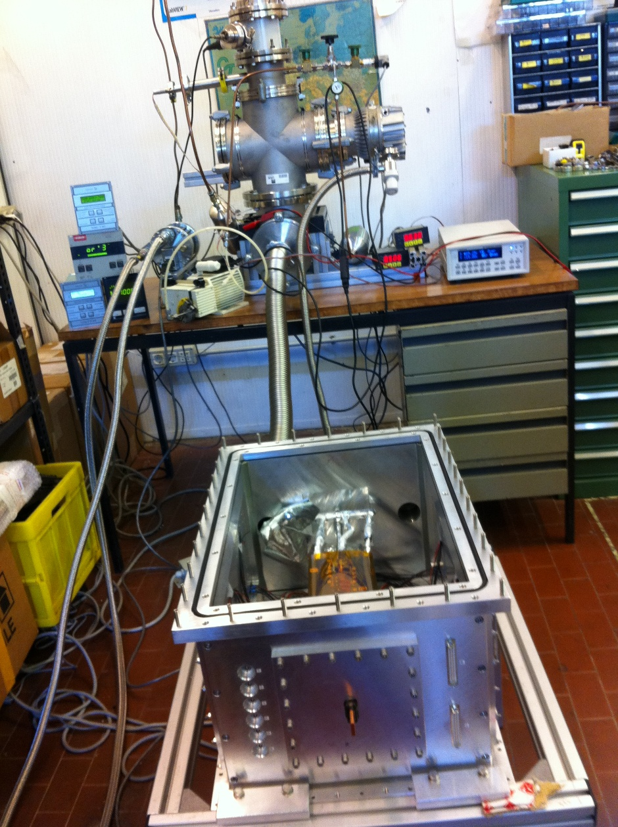
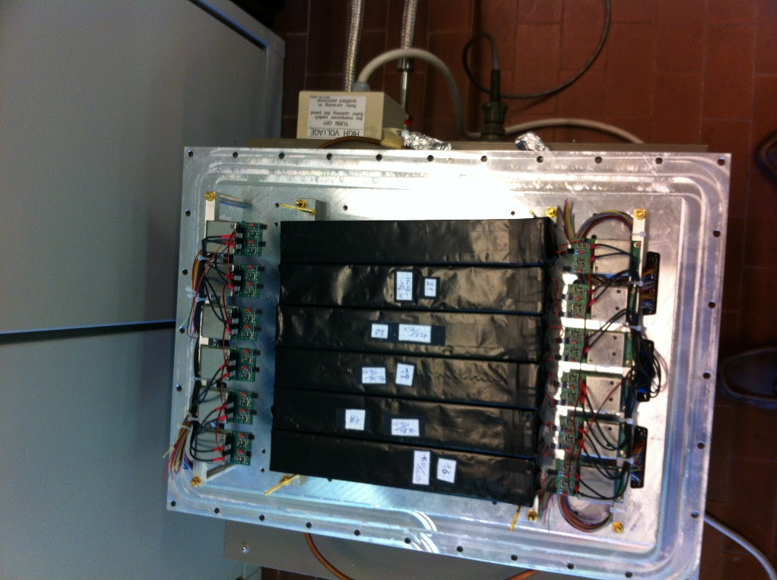
Upgraded VIP setup – tests at LNF
VIP

Slide 54
- Detector ready to be moved to LNGS
- Autumn 2013: start data taking with upgraded setup
- Expectation either to find a small violation or to be able to bound the probability that PEP is violated by electrons pushing it from about 4·10⁻²⁹ to 10⁻³¹
- Expected period of data taking: 3-4 years
Explore other type of physics – quantum mechanics (collapse models predictions)
Upgraded VIP setup
VIP

Slide 55
Richieste 2014
15 Ricercatori e Tecnologi, 5.8 FTE
- Richieste economiche complessive 68kEuro:
Richieste ai servizi LNF:
SEA: 2 mesi/uomo
SPAS: 2 mesi/uomo
SPCM: 4 mesi/uomo
VIP
MI | ME | TRA | INV | C.APP. | CON | Totale
18 | 10 | 3 | 12 | 0 | 25 | 68

Slide 56

Summary
Nuclear physics group involved in 6 international collaborations, inside LNF and outside
Big LNF contributions in all 6 collaborations
Several national and/or international responsibilities
LNF Support for design and construction
Relevant contribution of LNF technicians for construction
4.1 46th SC Recommendations http://www.lnf.infn.it/committee/pdf/FindRec46.pdf
The SC is impressed by the strength of the LNF participation to CSN3 activities: the contribution of the LNF groups to the scientific production of the Nuclear Scientific Community is of primary importance. Each group went much over the threshold of the participation for a good visibility. The only concern is that there is a group waiting for PANDA.

