Slide 1
γ-RESIST
L.A. Gizzi, D. Giulietti, G. Grittani, L.Labate, T. Levato, A. Macchi, J. Oishi, F. Pegoraro P. Tomassini, PISA
P. Londrillo, G. Turchetti, F. Rossi, G. Servizi, P.L. Ottaviani, BOLOGNA
R. Fedele, U. De Angelis, S. De Nicola, G. Fiore. L. Gialanella, A. Mannan, M.R. Masullo, F. Tanjia, NAPOLI
R. Faccini, C. Conti, P. Valente, ROMA1
G. Gatti, M.P. Anania, C. Gatti, A. Ghigo, F Villa, G. Di Pirro… LNF-FRASCATI
S. Tudisco, S. Cherubini, A. Anzalone, F. Musumeci, LNS-CATANIA

Slide 2
Motivation and background
Laser-plasma acceleration (LPA)¹ aiming² at 10 GeV;
A route to a TeV collider is being established³ worldwide;
Meanwhile LPA established up to^{4,5} 1 GeV and beyond^{6;}
Basic electrodynamics issues increasingly important due to high e.m.field;
Entering radiation reaction^{9,10,11} domain in electron-laser experiments;
Emerging laser-driven sources (FEL⁷, γ-rays⁸ …).
¹ T. Tajima and J.M. Dawson, Phys. Rev. Lett. 43, 267 (1979),
² CERN Courier January 2010
³ CERN Courier June 2010
⁴ S.P.S. Mangles et al., C.G.R. Geddes et al., J.Faure et al., Nature, vol. 431, (2004),
⁵ W. Leemans, et al., Nat. Phys. 2, 696 (2006).
⁶ C.E.Clayton et al., Phys, Rev. Letters, 105, 105003 (2011)
⁷ J.G. Gallacher et al. Phys. Plasmas 16, 093102 (2009).
⁸ A. Giulietti et al., Phys. Rev. Lett. 101, 10500 (2008).
⁹ M. Abraham, Theorie der Elektrizitaat (Teubner, Leipzig, 1905).
¹⁰ P.A.M.Dirac, Proc. R. Soc. A, 167, 148 (1938);
¹¹ L.D.Landau and E. M. Lifshitz, The classical Theory of Fields (Elsevier, Oxford, 1975)

Slide 3
γ-Resist objectives
All-optical Inverse Compton/Thomson, ultrafast γ-ray source based upon laser wakefield acceleration:
Thomson scattering requires an electron bunch and an intense laser pulse in a counter-propagating interaction configuration;
We propose a compact, all-optical approach with one laser pulse used to accelerate electrons with self-injection (cfr. SITE@FLAME) a second laser pulse used for Thomson scattering.
Expected photon flux based upon current self-injected electrons:
≈ 800 pC
≈ 1-10%
photons/sec (over all solid angle and spectrum)
Nγ = 10⁸ ph/sec 10% bandwidth => Spectral BW> 10² photons/sec/eV
State of the art for future standard γ-ray sources (≈100 M€): 10⁴ photons/sec/eV

Slide 4
Method
COUNTER-PROPAGATING LASER CONFIGURATION
conceptual setup: self-injection + scattering pulse
AUX laser pulse
Thomson
scattering laser pulse
Main laser pulse
γ-rays
Interaction
point
(gas-jet target)
Plasma
Acceleration laser pulse
Laser intensity and energy requirements set basic conditions$ on laser performance for this configuration to be feasible.
A <30 fs pulse with a minimum of 1 J (ideally 2 J) in the focal point for the accelerating self-injection pulse (100 MeV – 1 GeV).
Energy (intensity) on the scattering pulse sets the regime of interaction (linear, non-linear, radiation dominated …
$H. Schwoerer et al., Phys. Rev. Lett. 96, 014802 (2006)

Slide 5
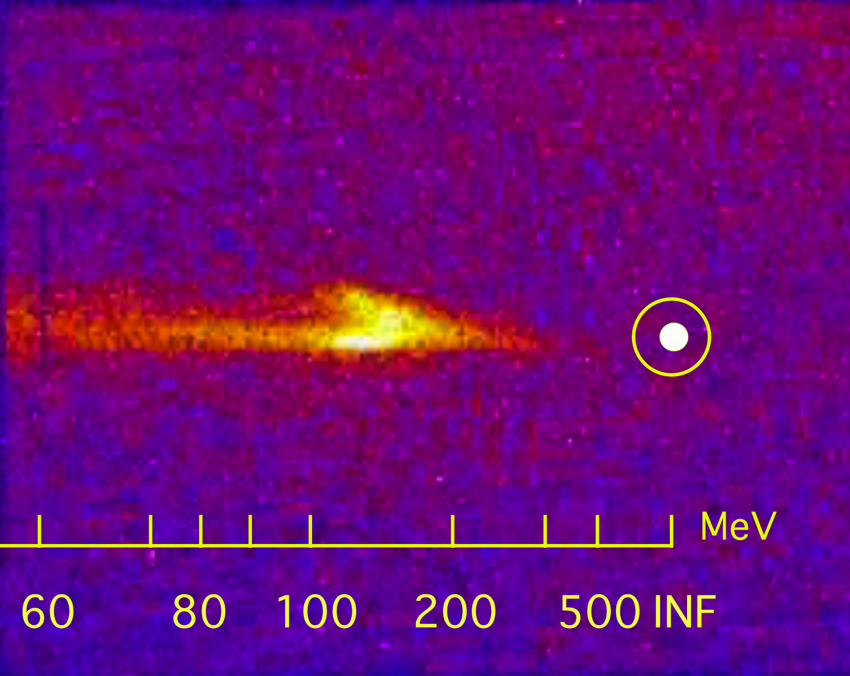
Self-injection at FLAME
Self-injection electron bunch established at FLAME*(2012)
Accelerated electrons hit a scintillating screen
50 mrad
Reliable production of 150 MeV electron bunches with ≈mrad divergence;
Stability, spectral width and energy control (vs density) in progress;
* See publication list below

Slide 6
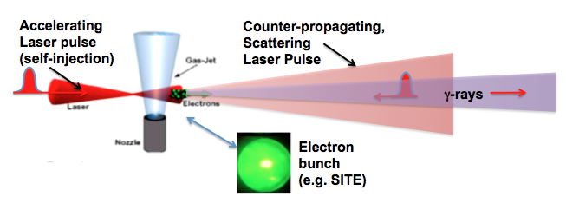
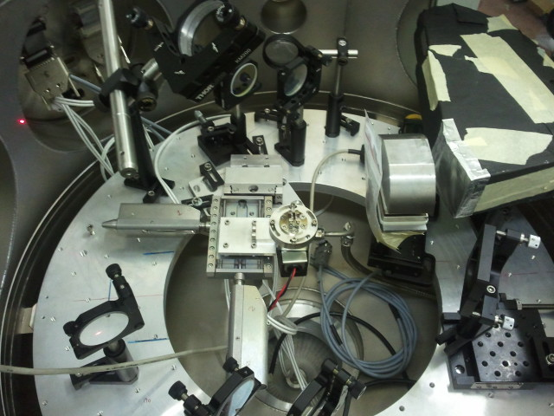
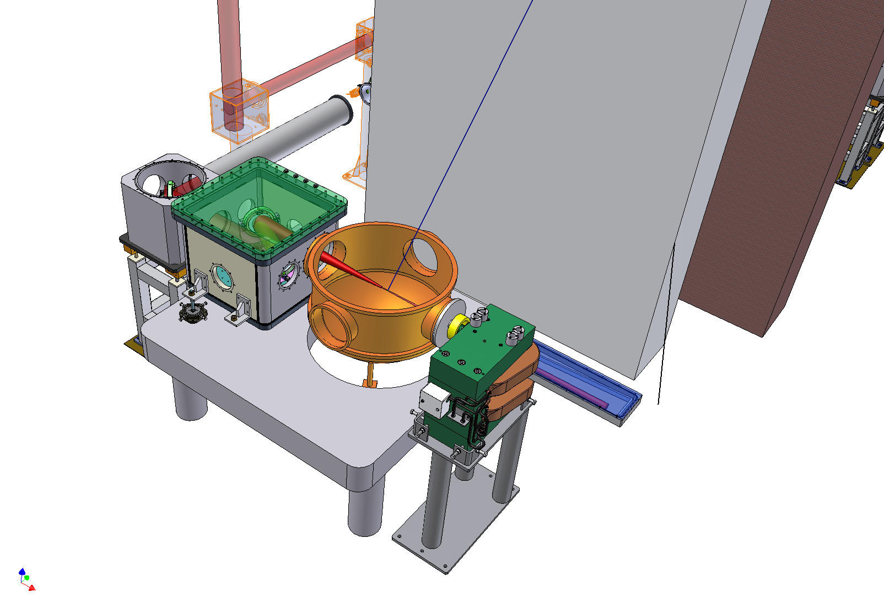
γ-Resist at FLAME
Set-up at flame completed for linear regime (low intensity scattering pulse)
First run with counterpropagation configuration in progress
Interaction point – deflecting p. magnet – TS beam
Set up 15/06/2013

Slide 7
Timescale

Slide 8
Riassunto attività 2012-13
Aprile 2012: CDR
Novembre 2012: Workshop/kick-off meeting
Gennaio-Febbraio 2013 – Partecipazione ad un esperimento presso Laser Astra-Gemini al RAL (Central Laser Facility) (GB)
Marzo – Maggio 2013: acquisizione rivelatori come da richieste 2012:
Rivelatore CZT (array) per imaging e spettroscopia “single-hit”
emCCD per imaging array NaI(Tl)
Array NaI(Tl) per imaging fascio γ
Ottiche e meccanica per delay line di alta precisione (µrad) da utilizzare su linea Thomson.
Giugno 2013: avvio misure a FLAME (in progress)
Attività di modellizzazione PIC self-injection con Bologna
Attività di modellizzazione (montecarlo) Thomson : P. Tomassini

Slide 9
Attività 2014
Per il 2014 l’unità di Pisa sarà prevalentemente impegnata nell’attività sperimentale presso LNF (FLAME)
Si prevede nuovo run sperimentale presso Astra-Gemini (GB) (call Laserlab CLF RAL)
Analisi dati in collaborazione con Bologna e Napoli su dati self-injection e con Catania su dati γ-ray beam.

Slide 10
Richieste
Missioni 13 k€ (missioni a LNF: 10 k€ - missioni estere per exp ral e diffusione risultati: 3 k€)
Consumo 4k€ (realizzazione di schermi e collimatori per i sistemi di rivelazione gamma - non si richiede supporto progettazione o officina)
TOTALE 17 k€

Slide 11
Pubblicazioni 2012-2013
Principali pubblicazioni e conferenze recenti:
L. A. Gizzi, M. P. Anania , M. Ciofinid) , L. Espositoe) , P. Ferraraa) , G. Gatti c) , D. Giuliettia,b,f) ,G. Grittania,b,f) , J. Hostaš ae) , M. Kandog) , M. Krus h) , L. Labatea,b) , A. Lapucci d) , T. Levatoa, h,i) Y. Oishil) , A. Pirrim) , F. Rossin) , G. Toci m) , M. Vannini m), Laser-Plasma Acceleration and RadiationSources for Applications, CLEO-PR & OECC/PS 2013 conference June 30th-July 4th 2013, Kyoto International Conference Center, Kyoto, Japan
G. Grittani1,2,3, M. P. Anania4, G. Gatti4, D. Giulietti1,2,3, M. Kando5, M. Krus6, L. Labate1,2, T. Levato6,7, P. Londrillo9, F. Rossi9 and L. A. Gizzi1,2, High energy electrons from interaction with a structured gas-jet at FLAME, 1st European Advanced Accelerator Concepts Workshop, 2-7 June 2013, Elba, Italy
L. A. Gizzi, M. P. Anania, G. Gatti, D. Giulietti, G. Grittani, M. Kando, M. Krus, L. Labate, T. Levato, Y. Oishi, F. Rossi, Acceleration with Self-Injection for an, a, S. Fioravan All-Optical Radiation Source at LNF, NIM-B, in press (2013)
Presentazione (su invito) di G-Resist alla conferenza Channeling 2012 (Alghero).http://arxiv.org/abs/1212.6652).
D. Jovanovic, R. Fedele, F. Tanjia, S. De Nicola, and L.A. Gizzi, Nonlocal effects in the self-consistent nonlinear 3D propagation of an ultrastrong, femtosecond laser pulse in plasmas, Eur. Phys. J. D66, 328 (2012)
T. Levato, M. Calvetti, F. Anelli, D. Batani, R. Benocci, L. Cacciotti, C.A. Cecchetti, O. Cerafogli, P. Chimenti, A. Clozza, N. Drenska, a, A. Esposito, R. Facciniti, A. Gamucci, C. Gatti, A. Giulietti, D. Giulietti, L. Labate, V. Lollo, S. Martellotti, M. Monteduro, E. Pace, N.C. Pathak, L. Pellegrino, F. Piastra, M. Pistoni, G. Di Pirro, R. Di Raddo, U. Rotundo, R. Ricci, M. Richetta, C. Vaccarezza, P. Valente, a, L.A. Gizzi, First electrons from the new 220 TW Frascati Laser for Acceleration and Multidisciplinary Experiments (FLAME) at Frascati National Laboratories (LNF), NIM A680 (2012).
G. Cristoforetti, M. P. Anania, A. Ya. Faenov, A. Giulietti, D. Giulietti, S. B. Hansen, P. Koester, L. Labate, T. Levato, T. A. Pikuz, L.A. Gizzi, Spatially resolved analysis of Kα x-ray emission from plasmas induced by a femtosecond weakly relativistic laser pulse at various polarizations, Physical Review E 87 023103 (2013)

