Slide 1


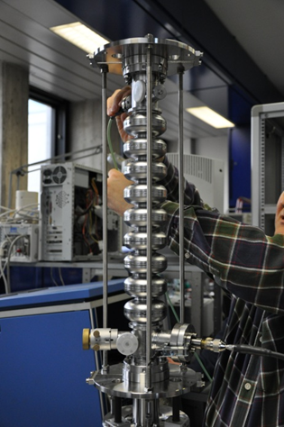
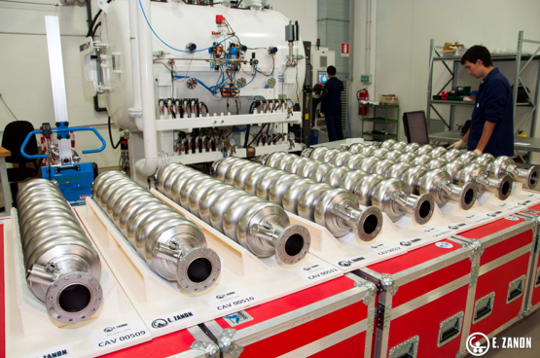
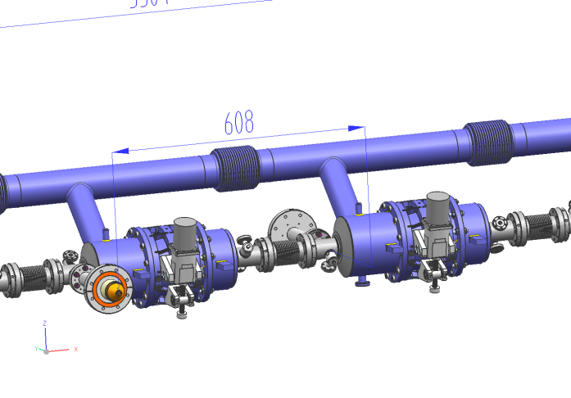
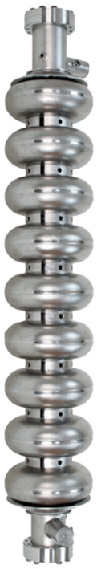
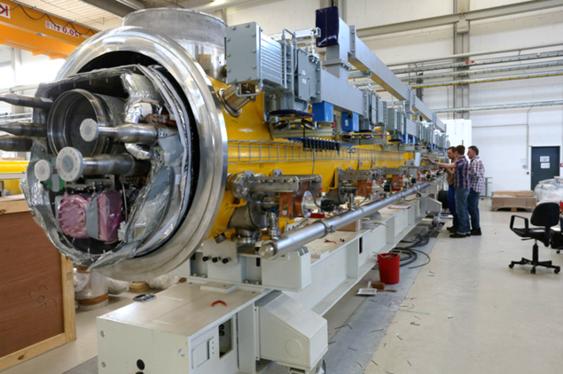
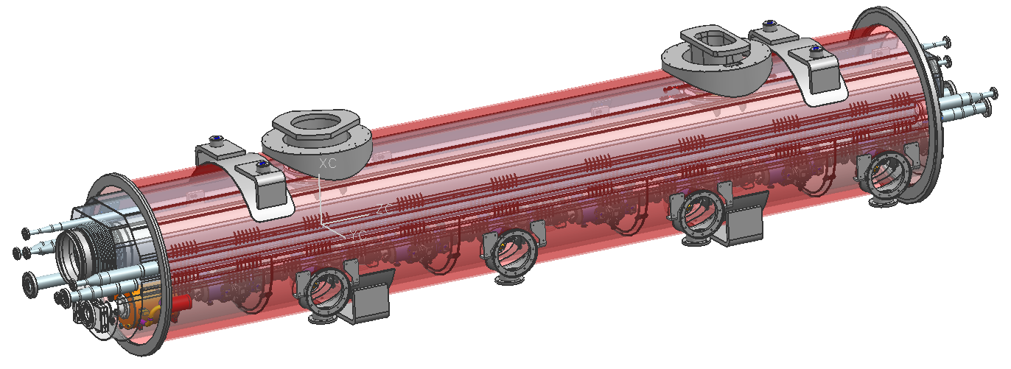
European XFEL aggiornamenti e prossimi sviluppi
Paolo Michelato
Consiglio di Sezione, 27 luglio 2013

Slide 2
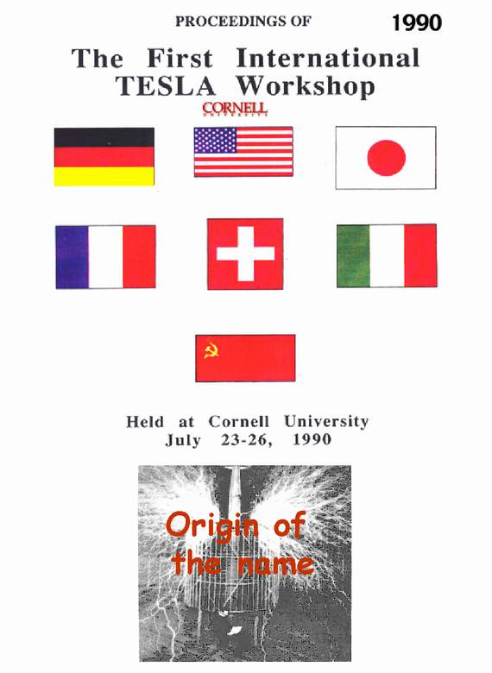
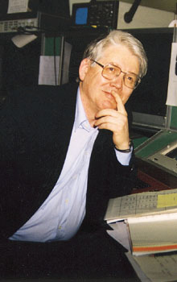
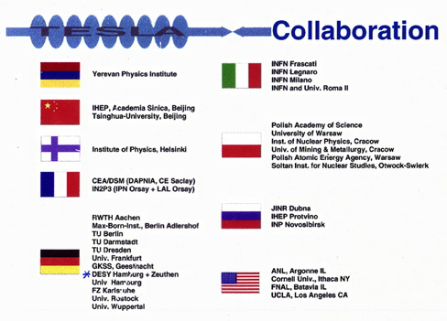
The TESLA Collaboration Mission
Develop SRF for the future TeV Linear Collider
Basic goals
  Increase gradient by a factor of 5 (Physical limit for Nb at ~ 50 MV/m)
  Reduce cost per MV by a factor 20 (New cryomodule concept and Industrialization)
  Make possible pulsed operation (Combine SRF and mechanical engineering)
Major advantages vs NC Technology
  Higher conversion efficiency: more beam power for less plug power consumption
  Lower RF frequency: relaxed tolerances and smaller emittance dilution
as in 1992
Björn Wiik

Slide 3
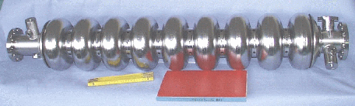
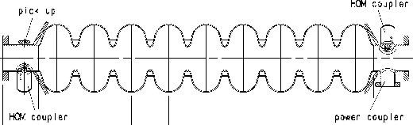
TESLA Technology: SRF Cavities
Major contributions from: CEA-Saclay, CERN, Cornell, DESY and INFN-LASA
(Alphabetic order)
Bulk Nb, 9-cell, 1.3 GHz
TESLA cavity parameters
R/Q | 1036 | Ω
E_{peak}/E_{acc} | 2.0
B_{peak}/E_{acc} | 4.26 | mT/(MV/m)
Δf/Δl | 315 | kHz/mm
K_{Lorentz} | ≈ -1 | Hz/(MV/m)²

Slide 4
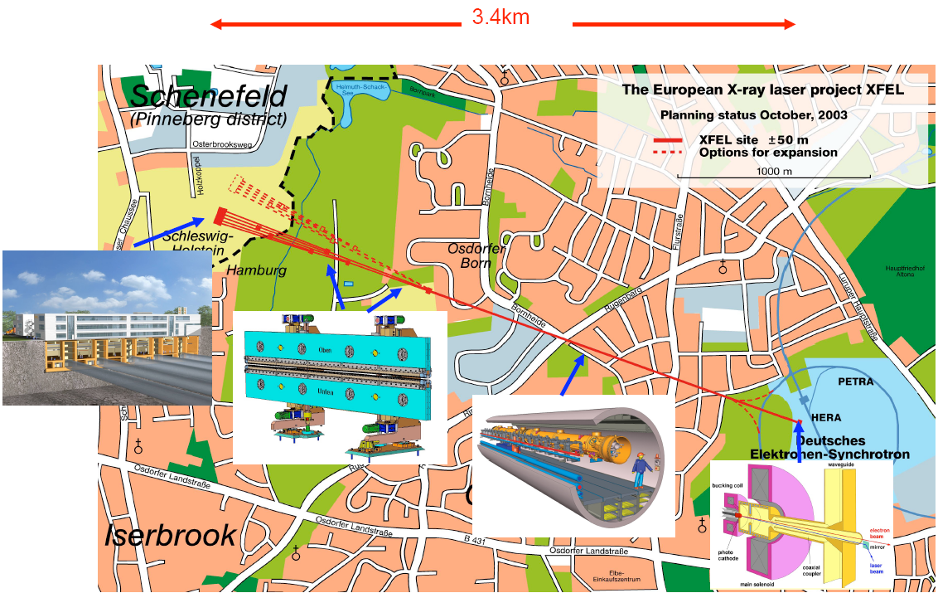
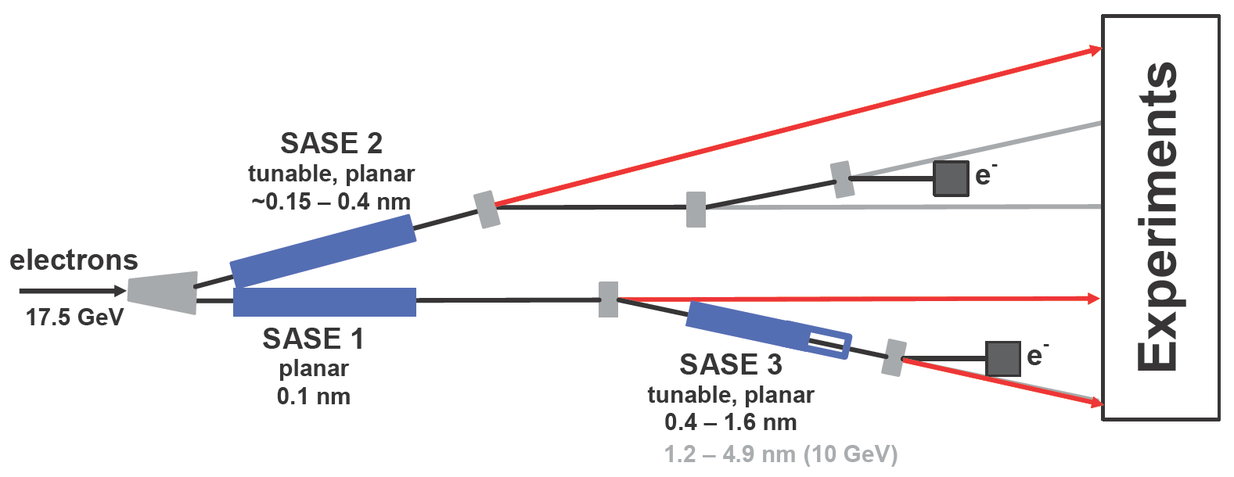
The European XFEL
Some specifications
Photon energy 0.3-24 keV
Pulse duration ~ 10-100 fs
Pulse energy few mJ
Superconducting linac. 17.5 GeV
10 Hz (27 000 b/s)
5 beamlines / 10 instruments
  Start version with 3 beamlines and 6 instruments
Several extensions possible:
  More undulators
  More instruments
  …….
First beam late 2015
SASE2
(= SASE1)
17.5 GeV
SASE1, λ_{u}= 40 mm
0.2 – 0.05 nm
SASE3, λ_{u}= 68 mm
1.7 – 0.4 nm

Slide 5
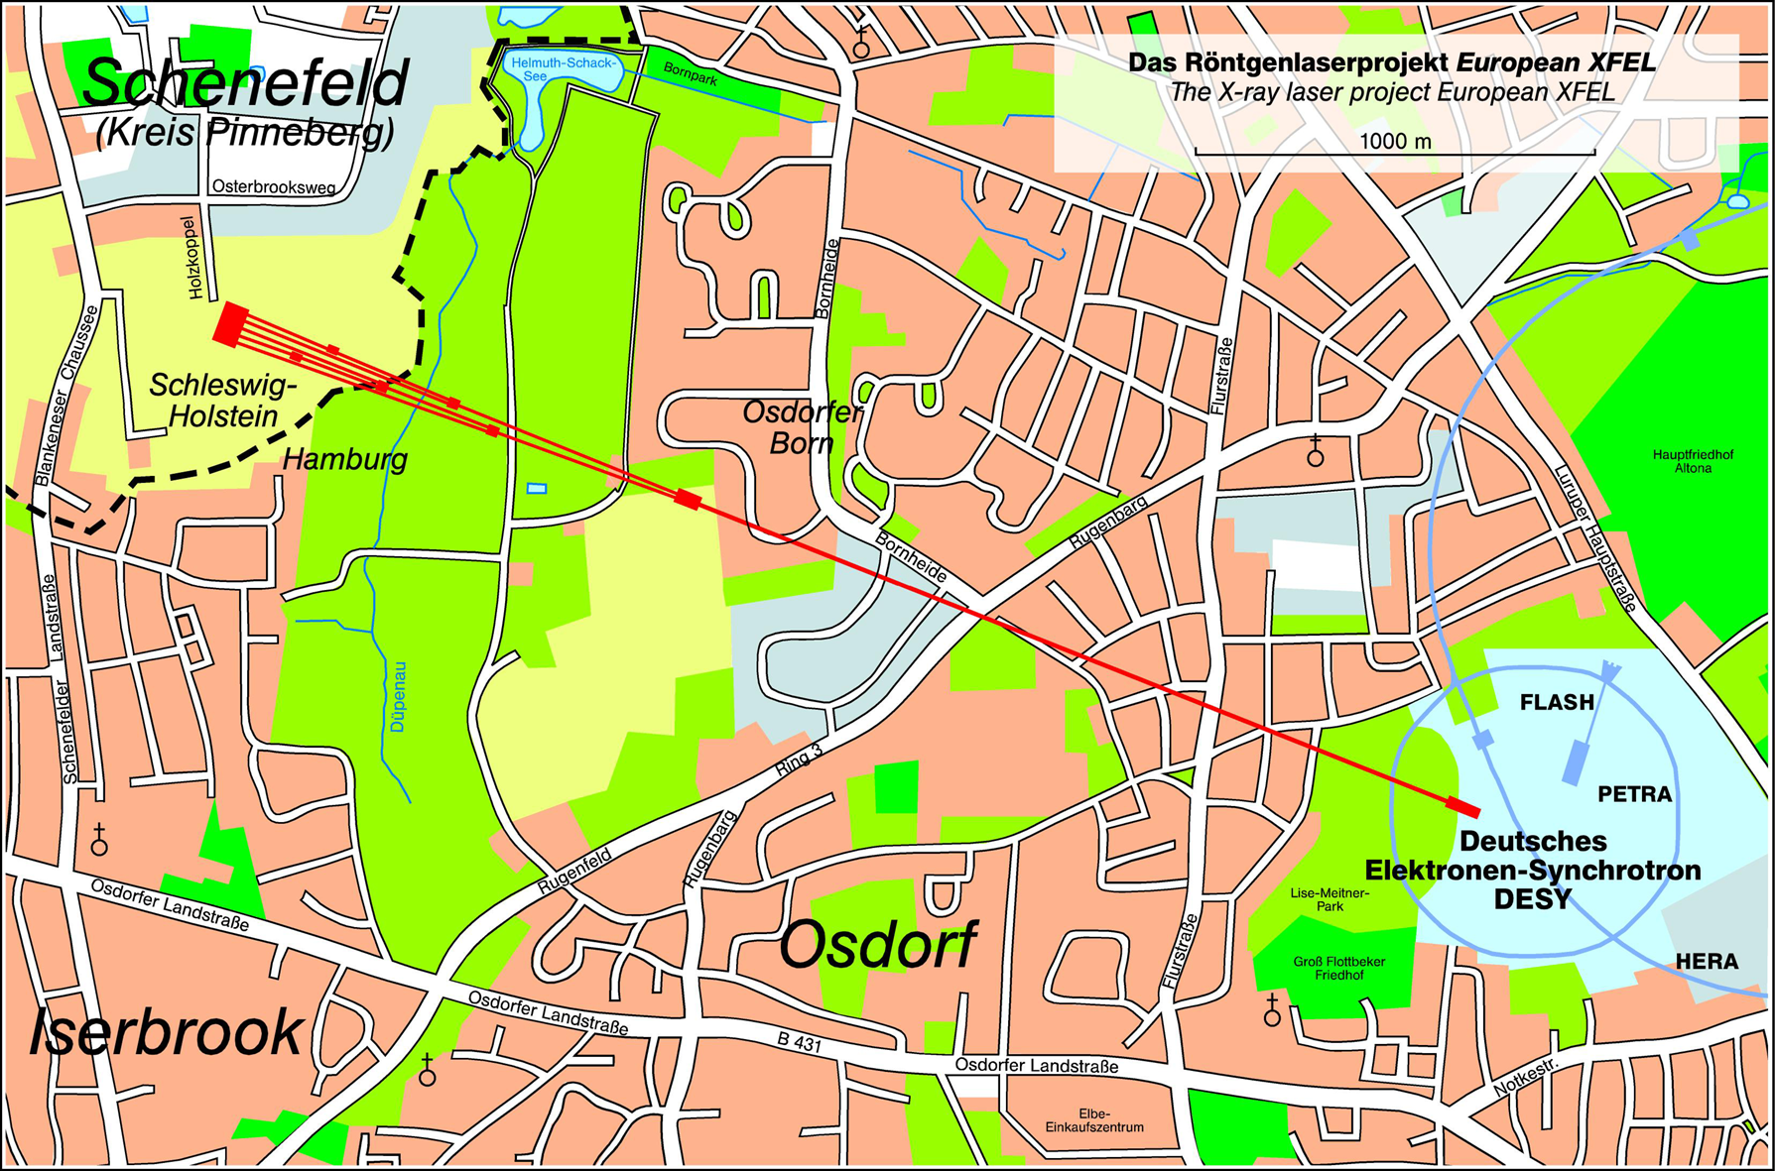
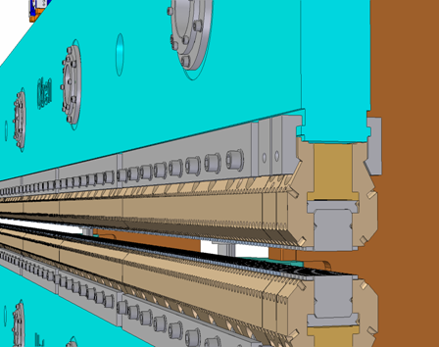
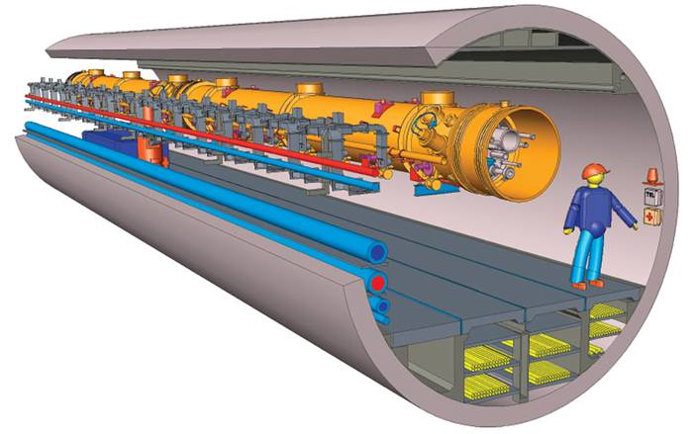
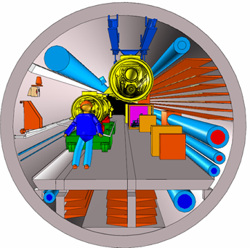
All 5.8 km of tunnels excavated (06 June 2012)!
http://www.xfel.eu/

Slide 6
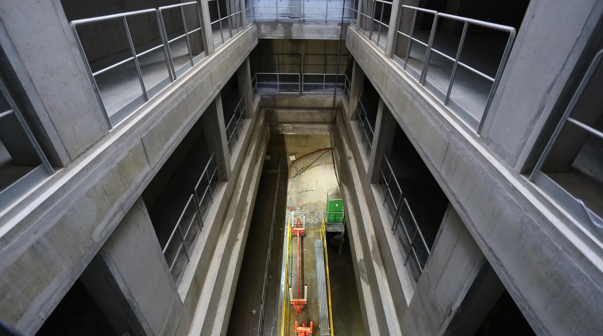
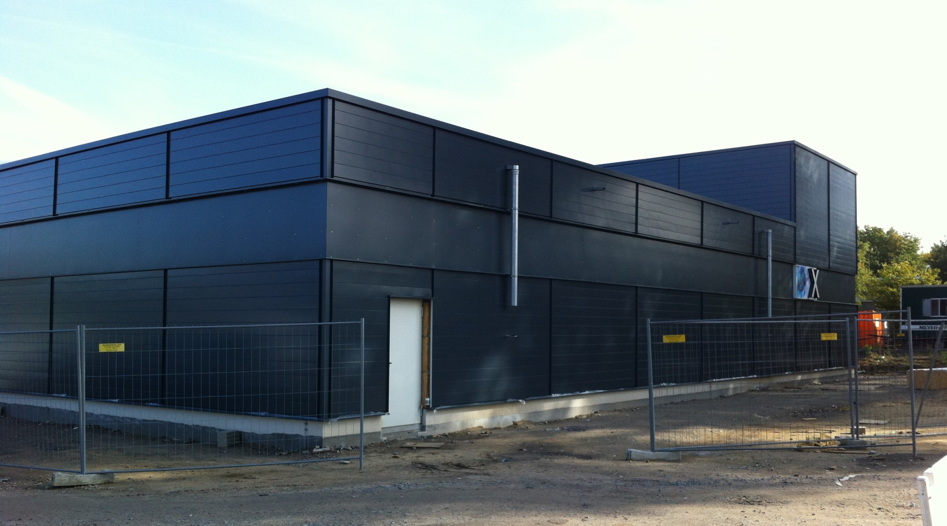
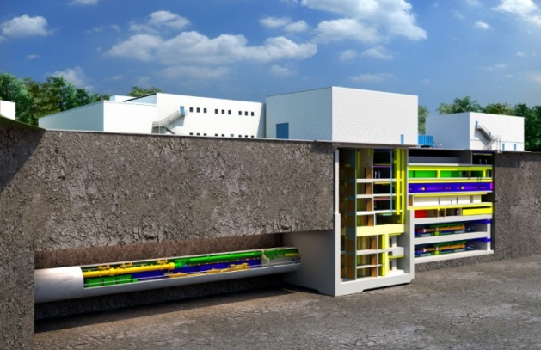
Injector shaft

Slide 7
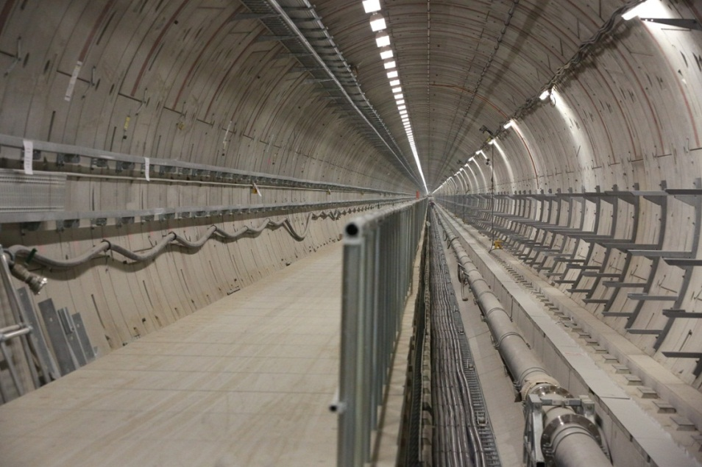
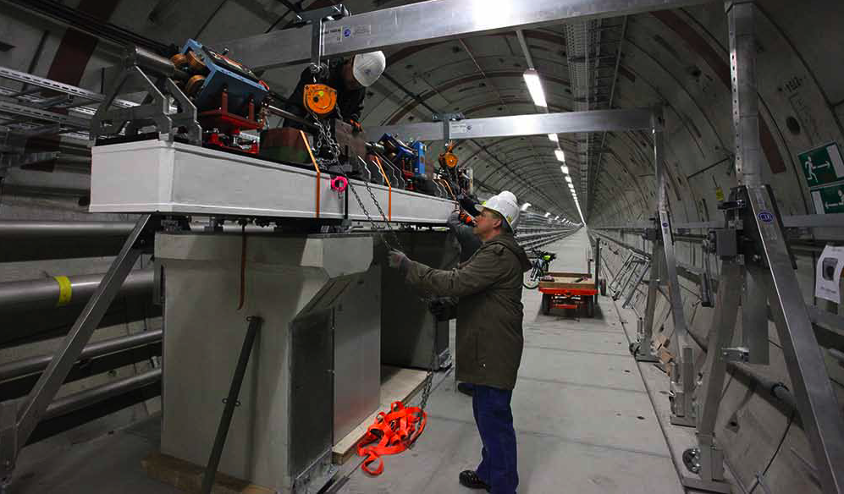
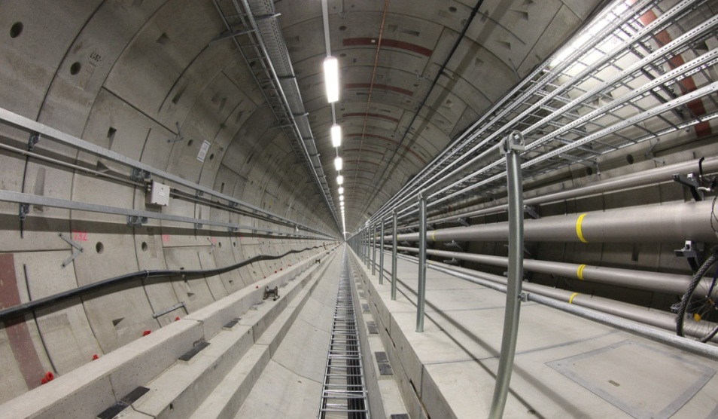
Linac tunnel

Slide 8
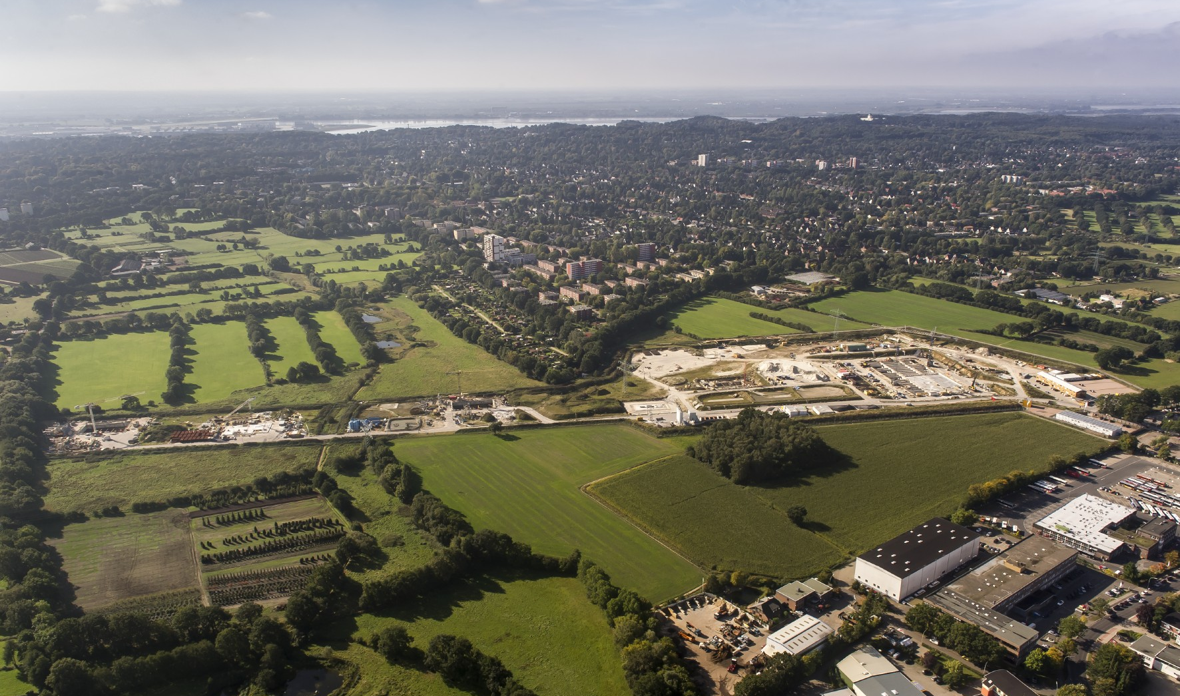
Schenefeld campus: experimental area

Slide 9
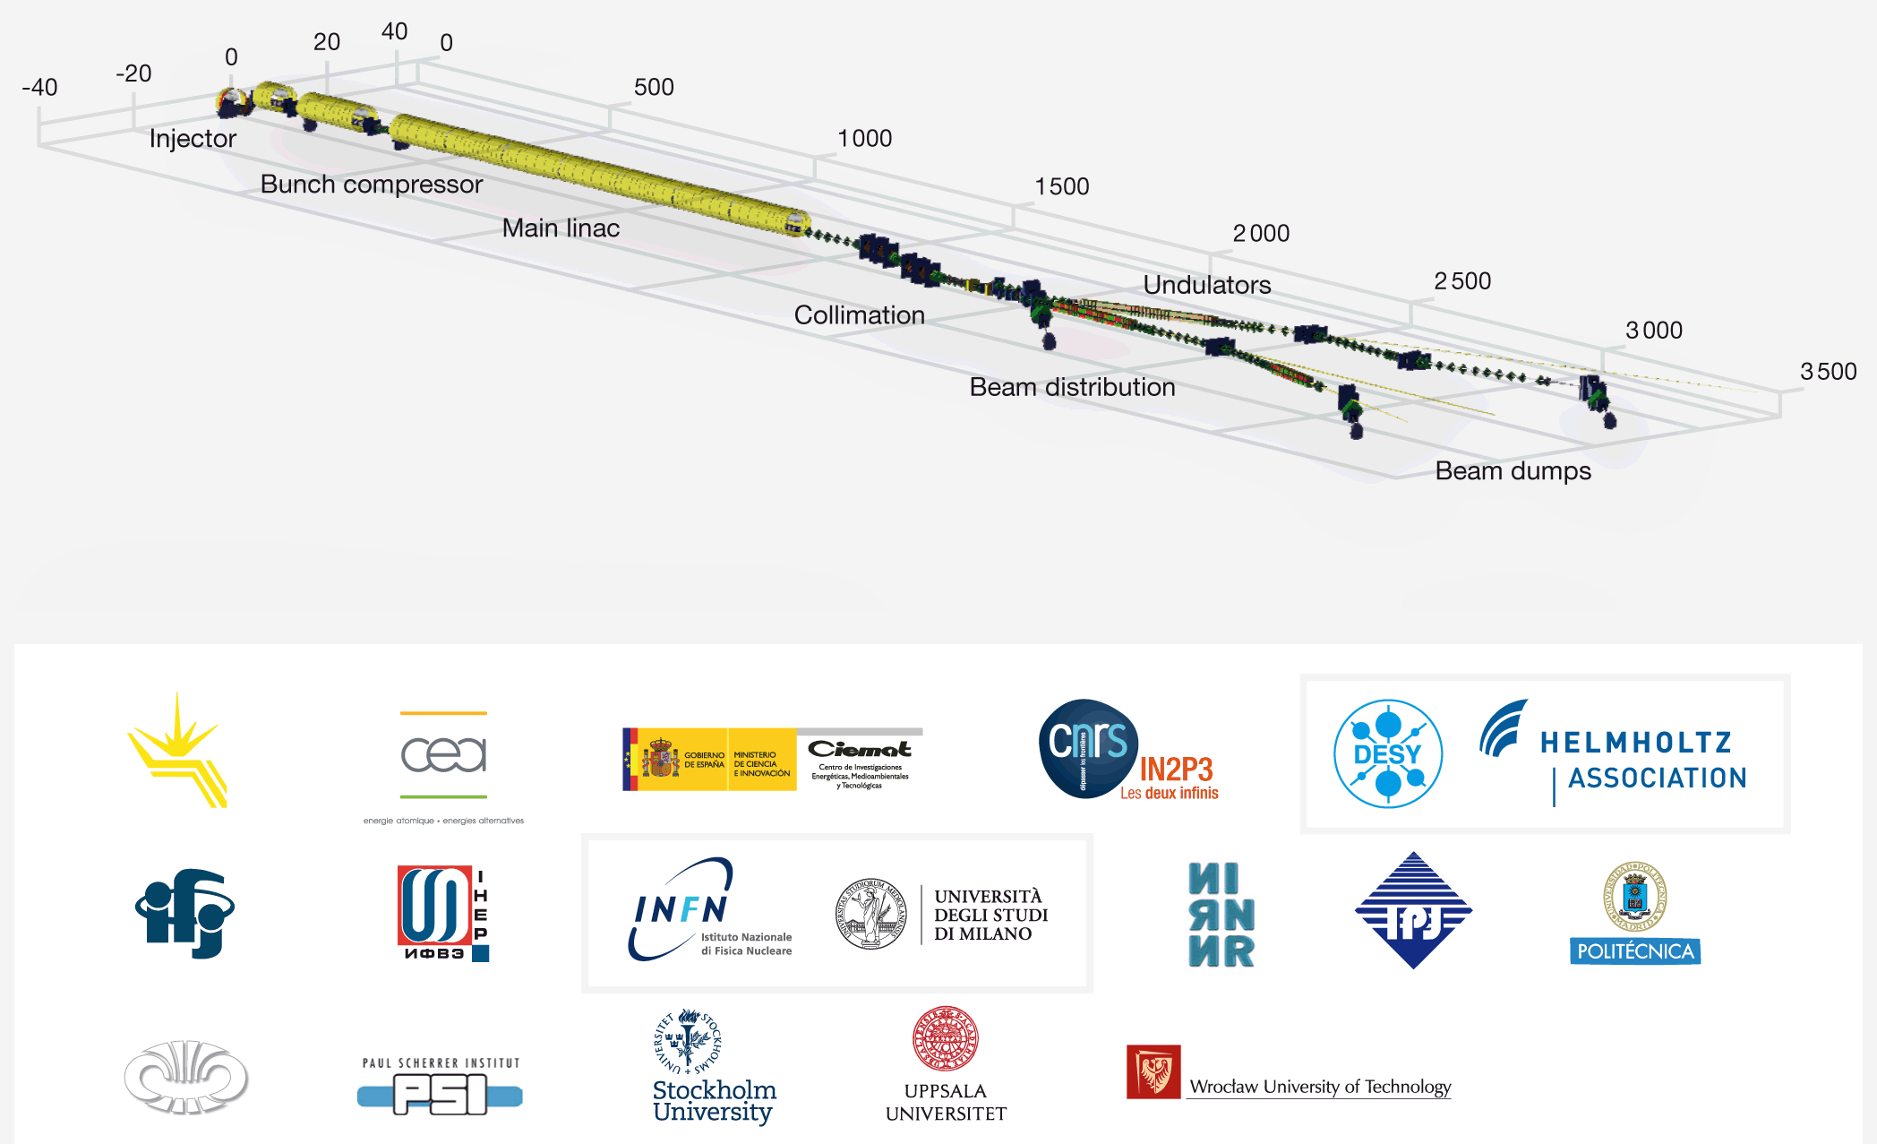
The Accelerator Consortium
FROM Massimo Altarelli, European XFEL Coll. Meeting 2013

Slide 10
Impegno Italiano: 33 M€ (2005) in-kind
Il contributo alla fase di costruzione di XFEL sottoscritto dall’Italia ha le seguenti caratteristiche:
  E’ in-kind, per un valore di 33 M€ (indicizzato 2005) secondo le cifre indicate a “budget book” e approvate insieme alla Convenzione.
  Comprende attività di sviluppo, di trasferimento di know-how e di produzione con l’industria, di collaudo e certificazione.
In sostanza, attraverso la partecipazione responsaabile dell’INFN, l’Italia garantisce la fornitura di metà delle cavità superconduttive, di una parte dei criomoduli e del sistema di terza armonica (cavità e criomodulo).

Slide 11
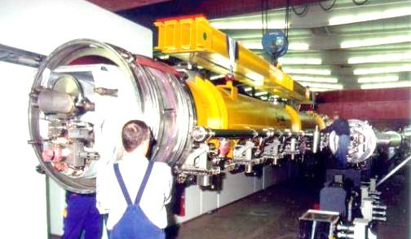
Italian Contribution (based on INFN know how)
ITALY: IN KIND contribution for 33 MIO Euro (2005)
400 Bulk Nb 9-cell 1.3 GHz cavities
45 cryomodules
8 Bulk Nb 3.9 GHz SC Nb cavities with Cryomodule (+spares)
Activity for Tuners for SC linac
4 WP co-leaded INFN - DESY
All components produced by Italian Industry

Slide 12
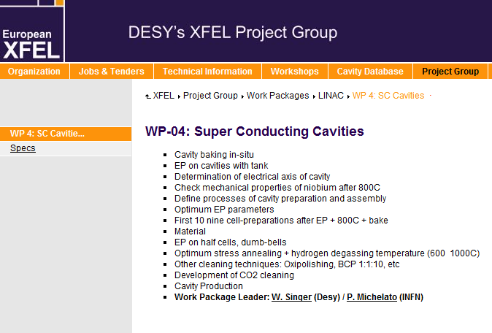
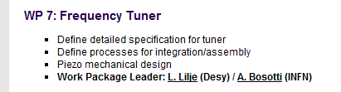
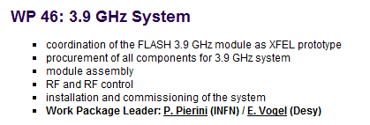
Contributi «Tecnici» di Milano nei WP
Riconosciuti nella struttura di progetto
WP3 Cryomodule (~concluso)
WP4 Cavities
  WPL P.Michelato
WP7 Tuners
  WPL A.Bosotti
WP46
  WPL P. Pierini

Slide 13
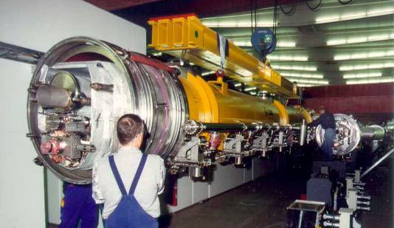
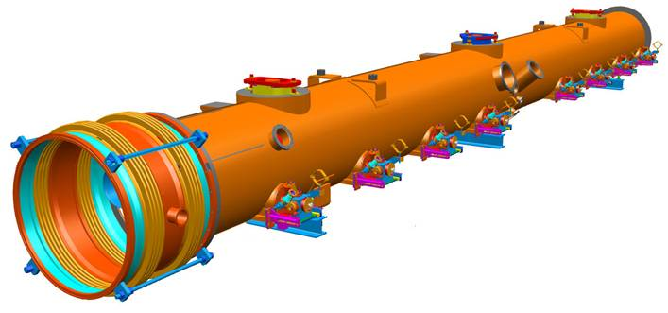
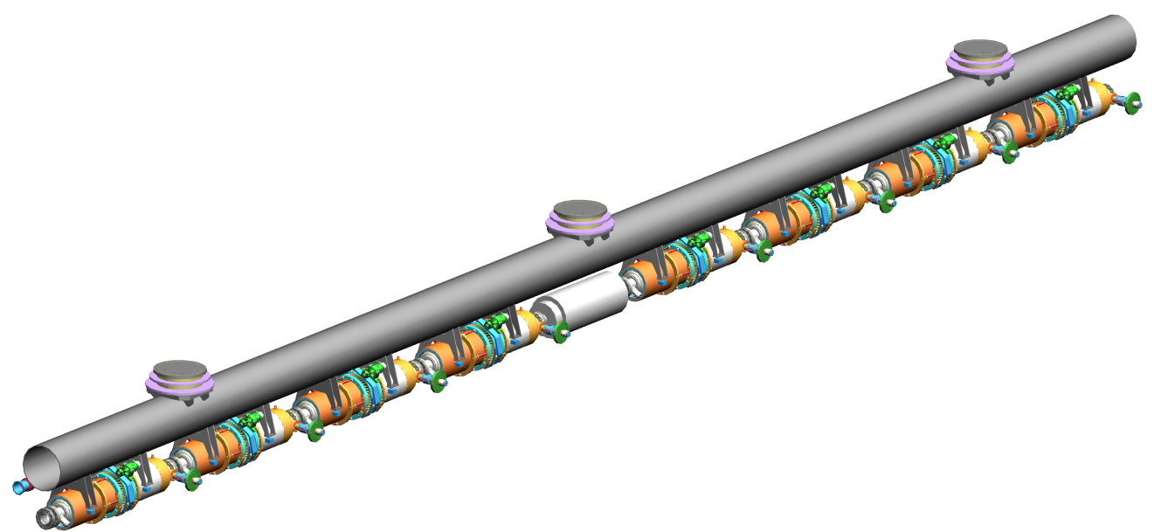
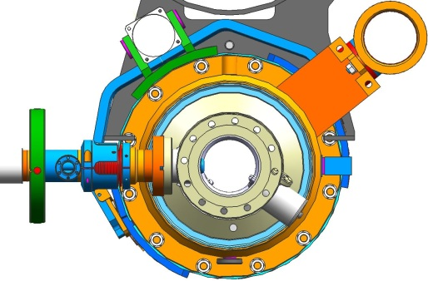
TESLA Technology: the INFN Cryomodule
International collaborative Effort in the three regions for ILC
Design changes are towards nailing down slot length of components
Costing should be straight-forward from TTF and XFEL experience

Slide 14

WP3: Moduli acceleranti

Slide 15
WP3: Moduli acceleranti
L’INFN ha sviluppato tutti i moduli acceleranti per FLASH
  Finanziamenti ex-TESLA/TTF dagli anni 90s
Leadership mondiale riconosciuta nella progettazione di criostati a basso consumo statico per cavità acceleranti ad alto gradiente
  Forniti a FNAL per la facility ILC/Project-X
  Fornitura a KEK per S1-Global
  Technical Area Group Leadership nel GDE per il TDR di ILC e primary author capitoli criomoduli
Per XFEL supervisione della produzione di 45 moduli prodotti dalla Ettore Zanon (a oggi consegnati 20 moduli)

Slide 16
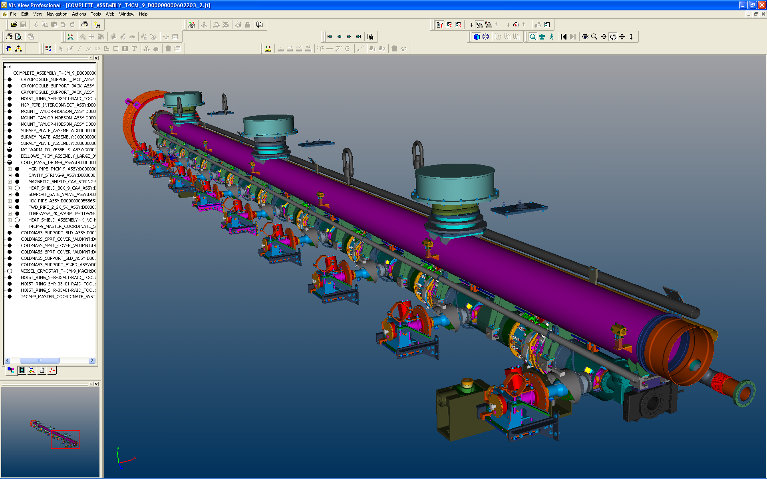
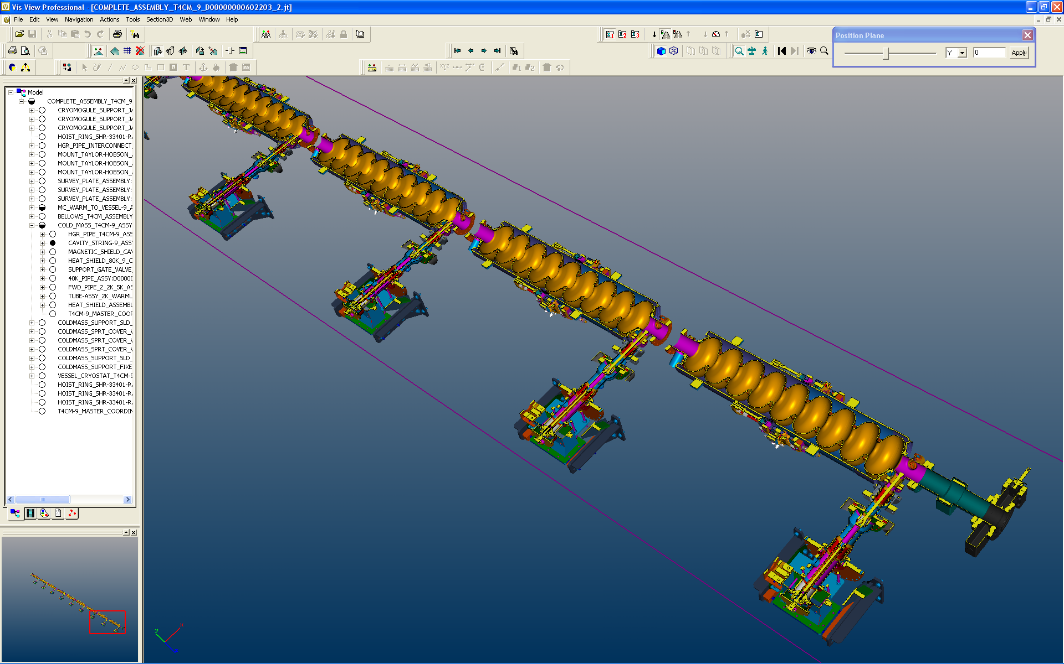
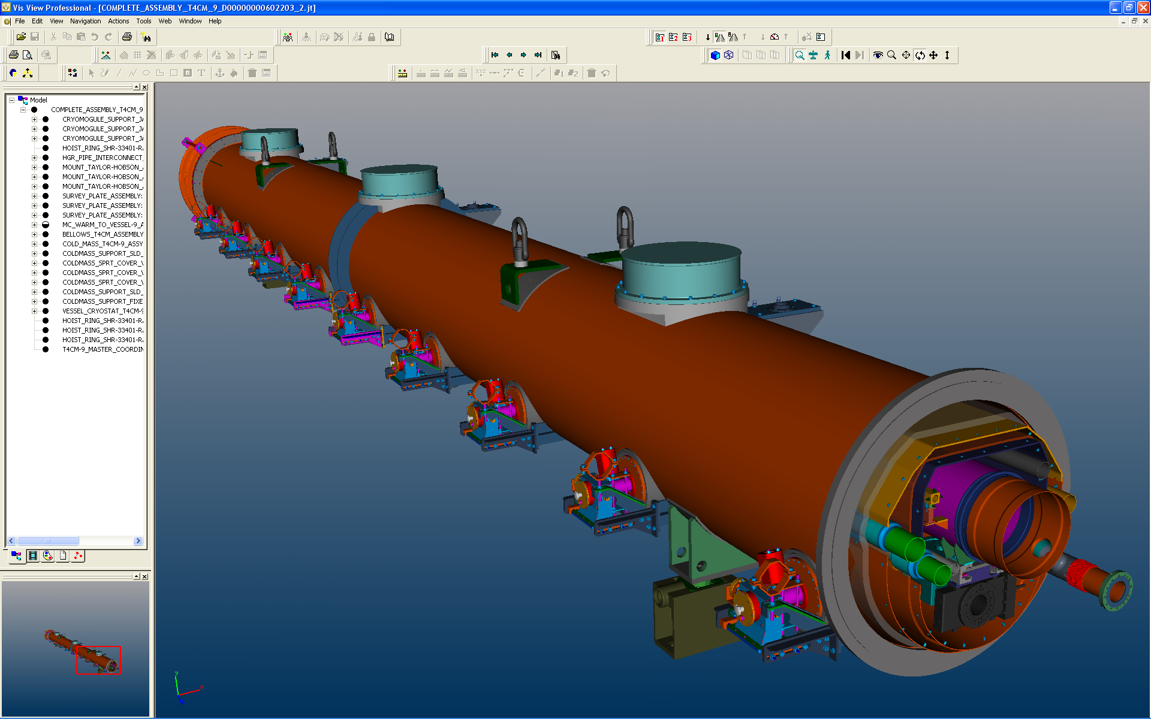
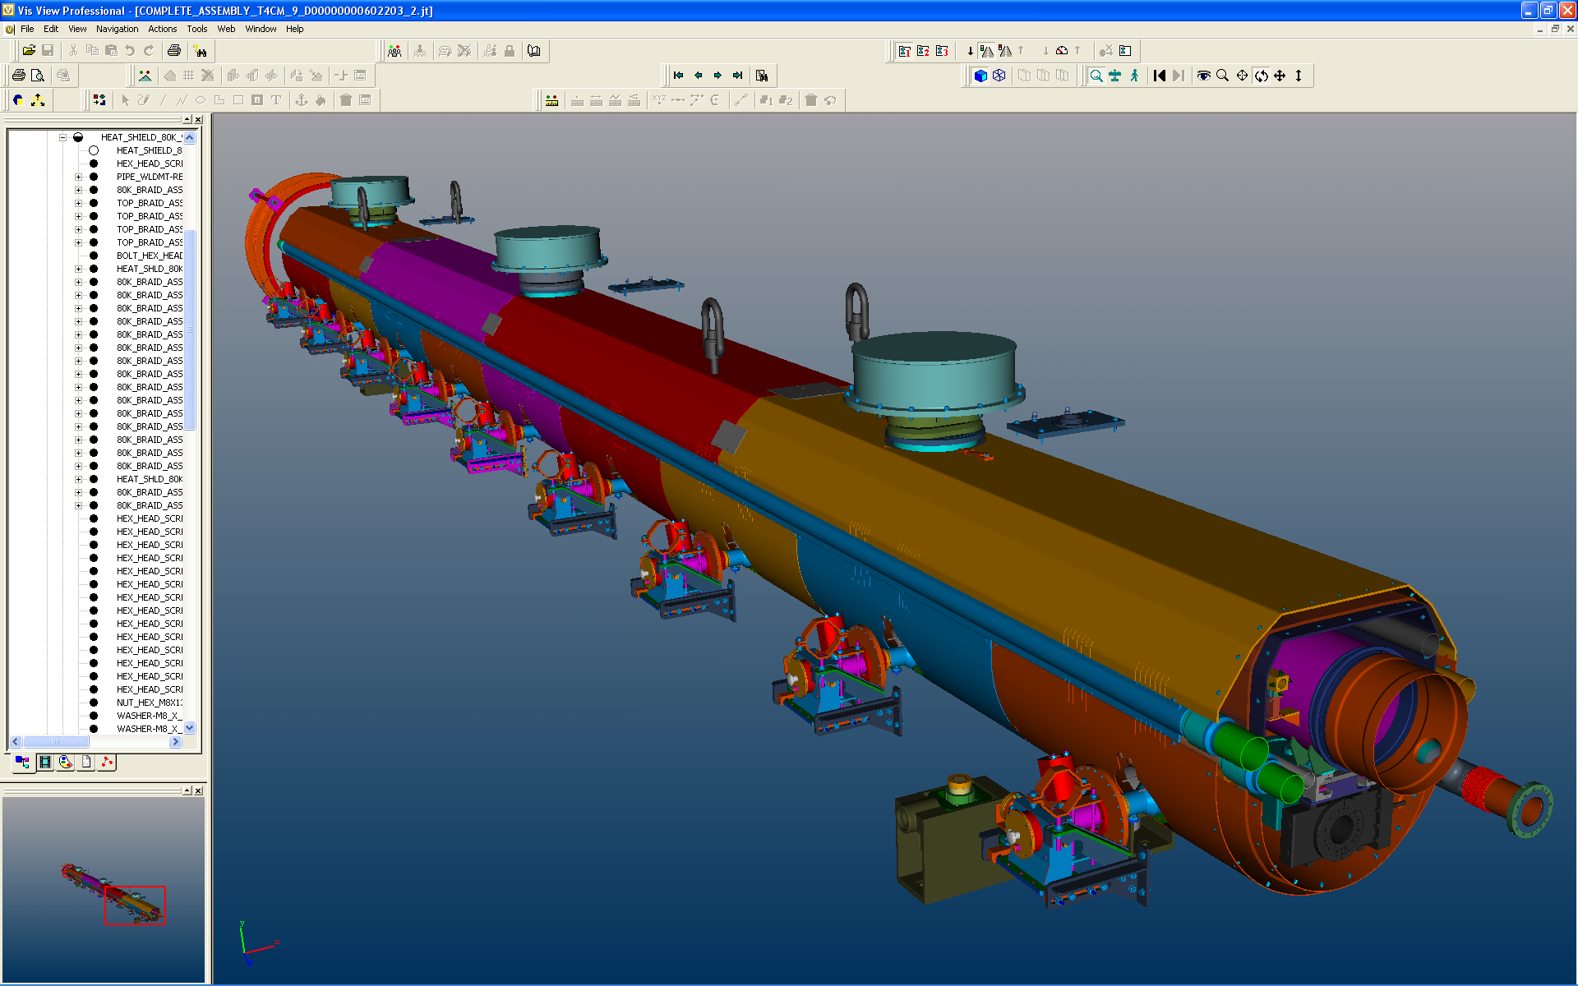
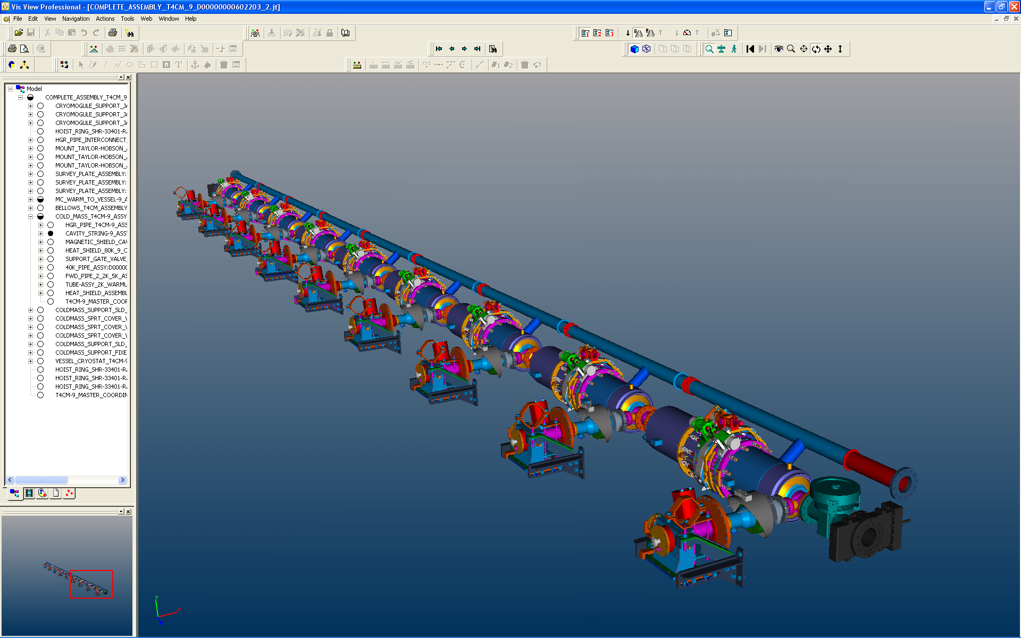
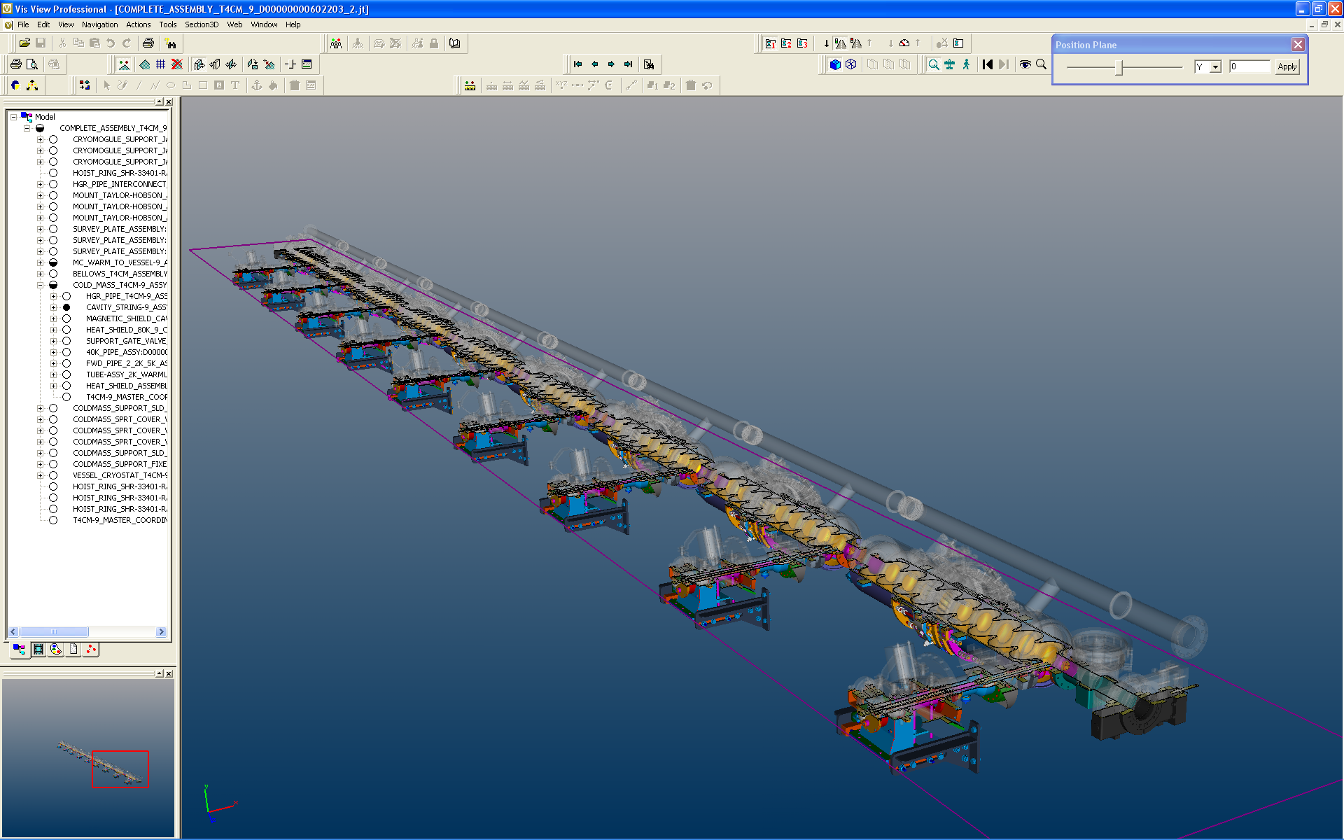
The INFN Cryomodule for XFEL & ILC

Slide 17
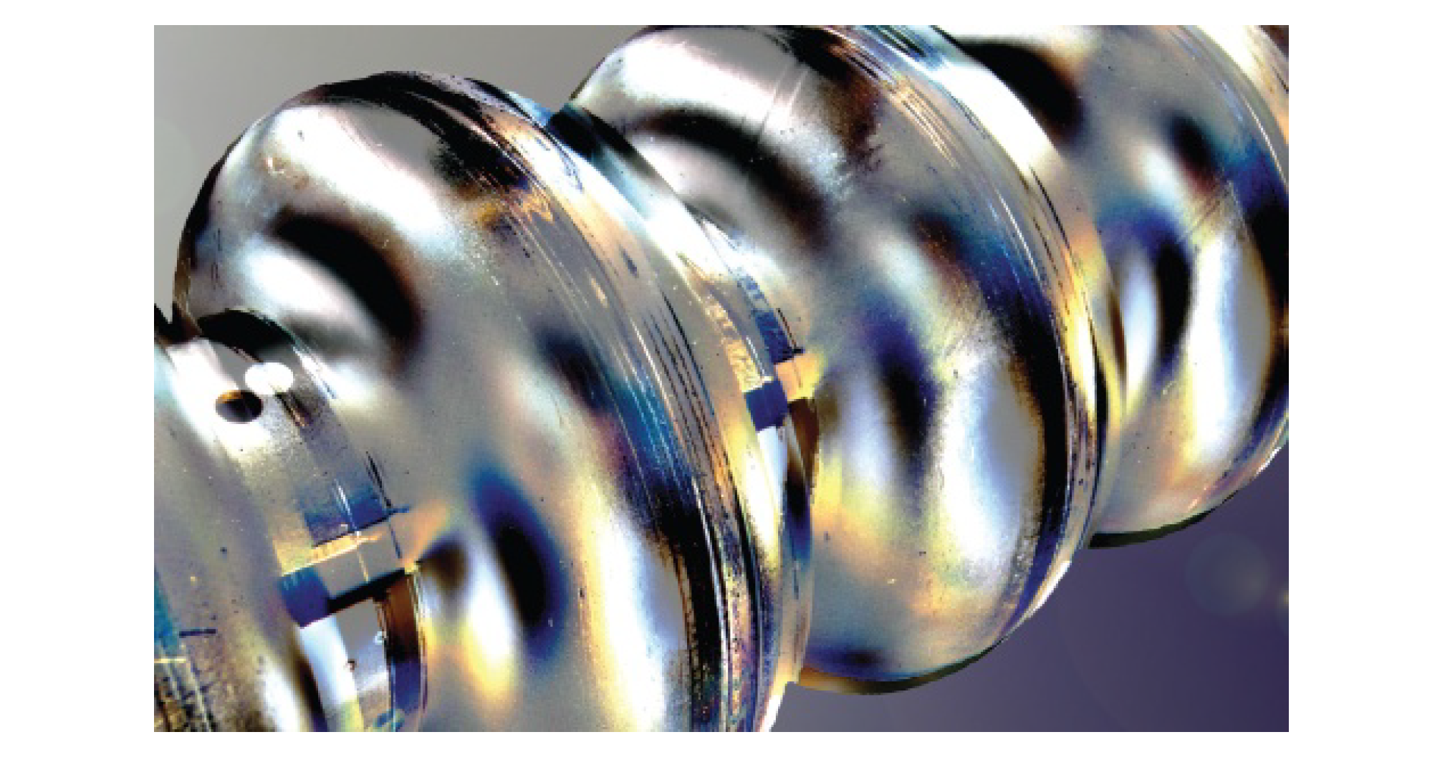
WP4: Cavità SC di accelerazione (1.3 GHz)

Slide 18
Cavità a 1.3 GHz: attività WP4
  800 cavità superconduttive da produrre in 2 aziende (50% ognuna):
  Ettore Zanon (EZ)
  RI Research Instruments (RI)
Produzione organizzata come «built to print»: specifiche dettagliate di costruzione che comprendono anche la descrizione dell’infrastruttura da utilizzare
Attività concluse, in corso e future:
  Trasferimento tecnologico alle aziende EZ e RI
  Crescita e qualifica delle infrastrutture presso entrambe le aziende
  Attività PED
  Supervisione e controllo qualità durante la produzione
  Produzione in serie

Slide 19
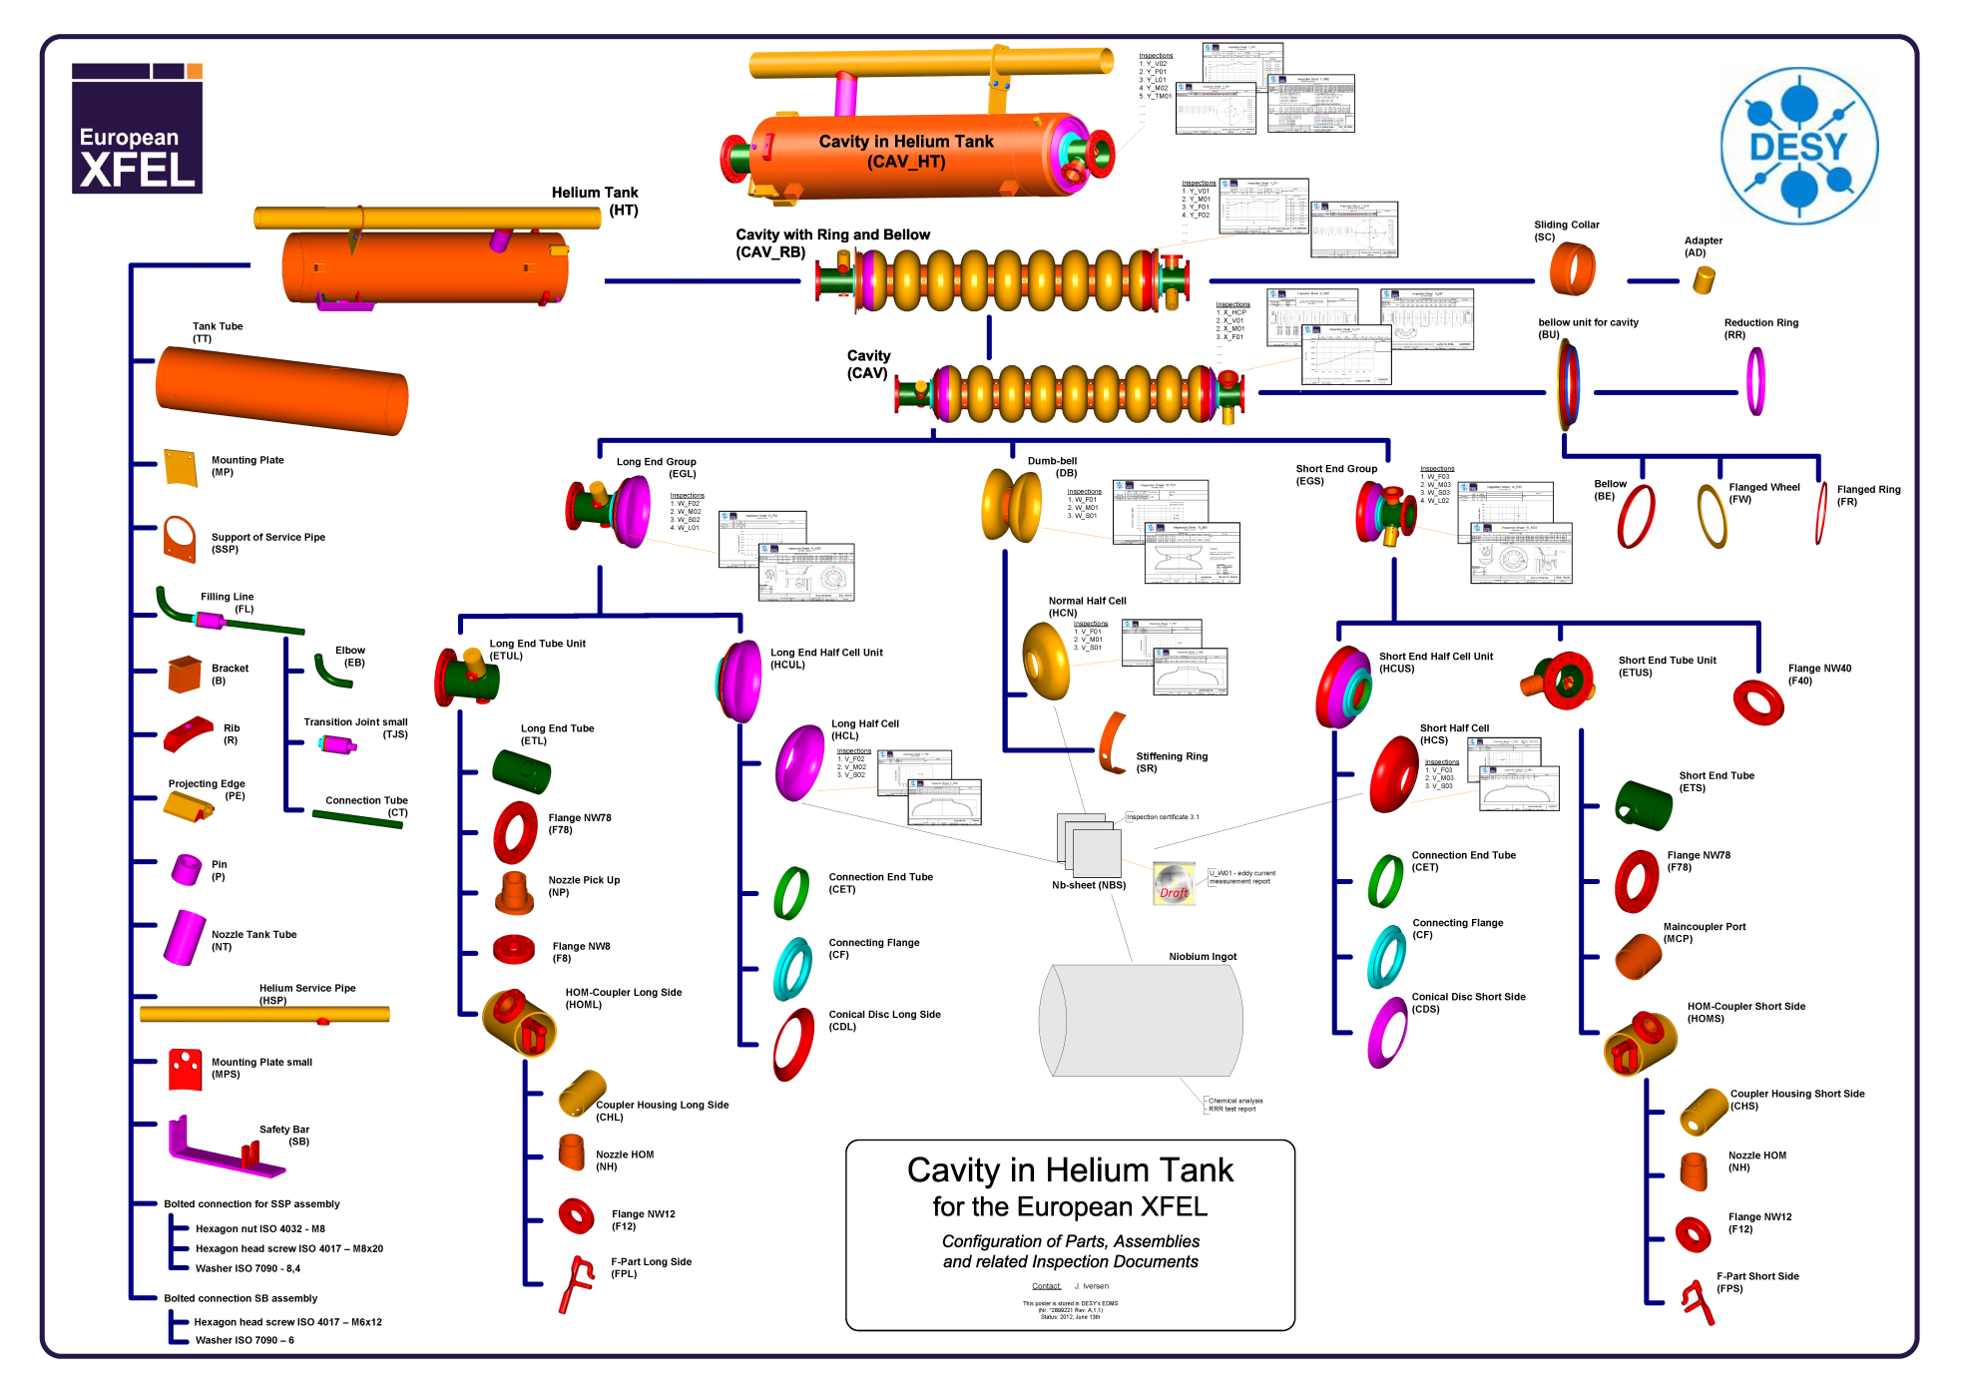
XFEL Cavity structure

Slide 20
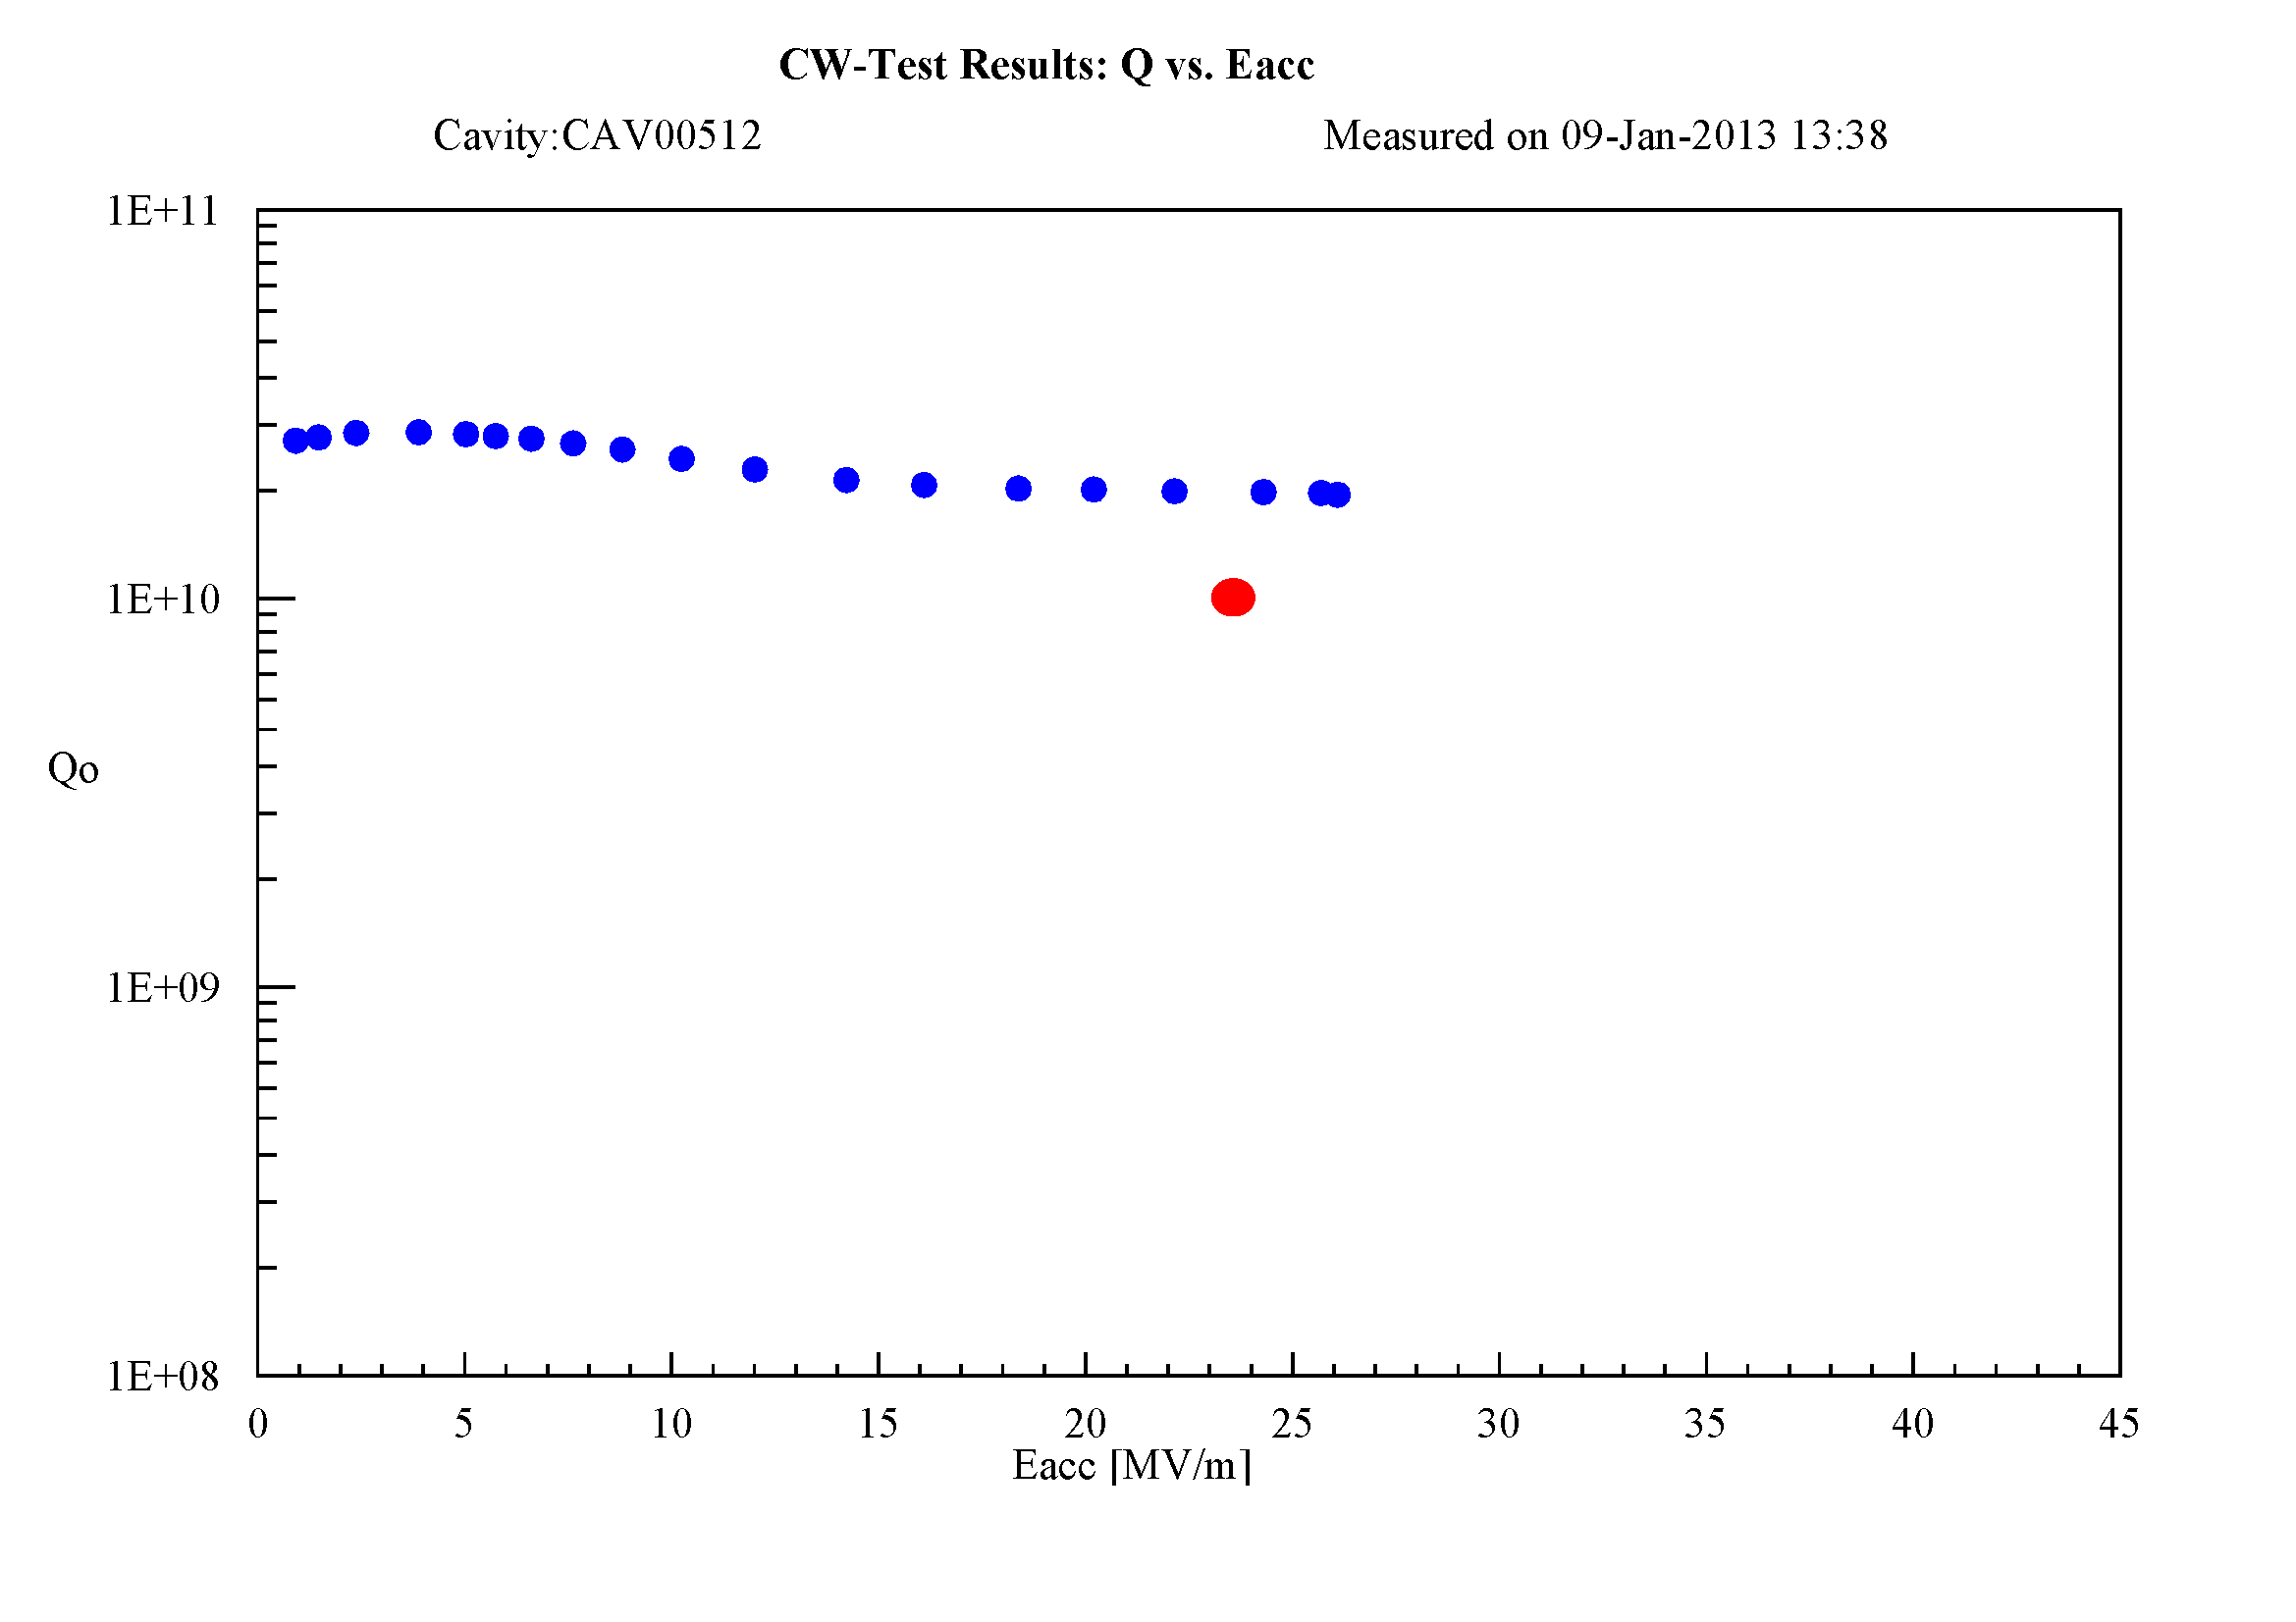
First series cavity prepared at EZ
First PCV ready by Christmas 2012 fully produced, treated and integrated in the Helium Tank at EZ
Goal value

Slide 21
Cavità a 1.3 GHz: attività WP4
Stato produzione: 800 cavità totali da produrre (EZ + RI)
  Produzione «meccanica» di cavità: 130 pezzi prodotti
  Cavità spedite a DESY: 67
  Cavità testate a DESY: 48
  Cavità spedite a Saclay: 25
  Indice di difettosità: ~ 10%
    molti difetti recuperati con ritrattamento (HPR) a DESY
  Rate di produzione odierno: ~ 6 cav/settimana (ramp-up)
  Rate di produzione previsto: 8 cav/settimana
  Fine produzione: primo quarto 2015, in accordo con schedula prevista

Slide 22
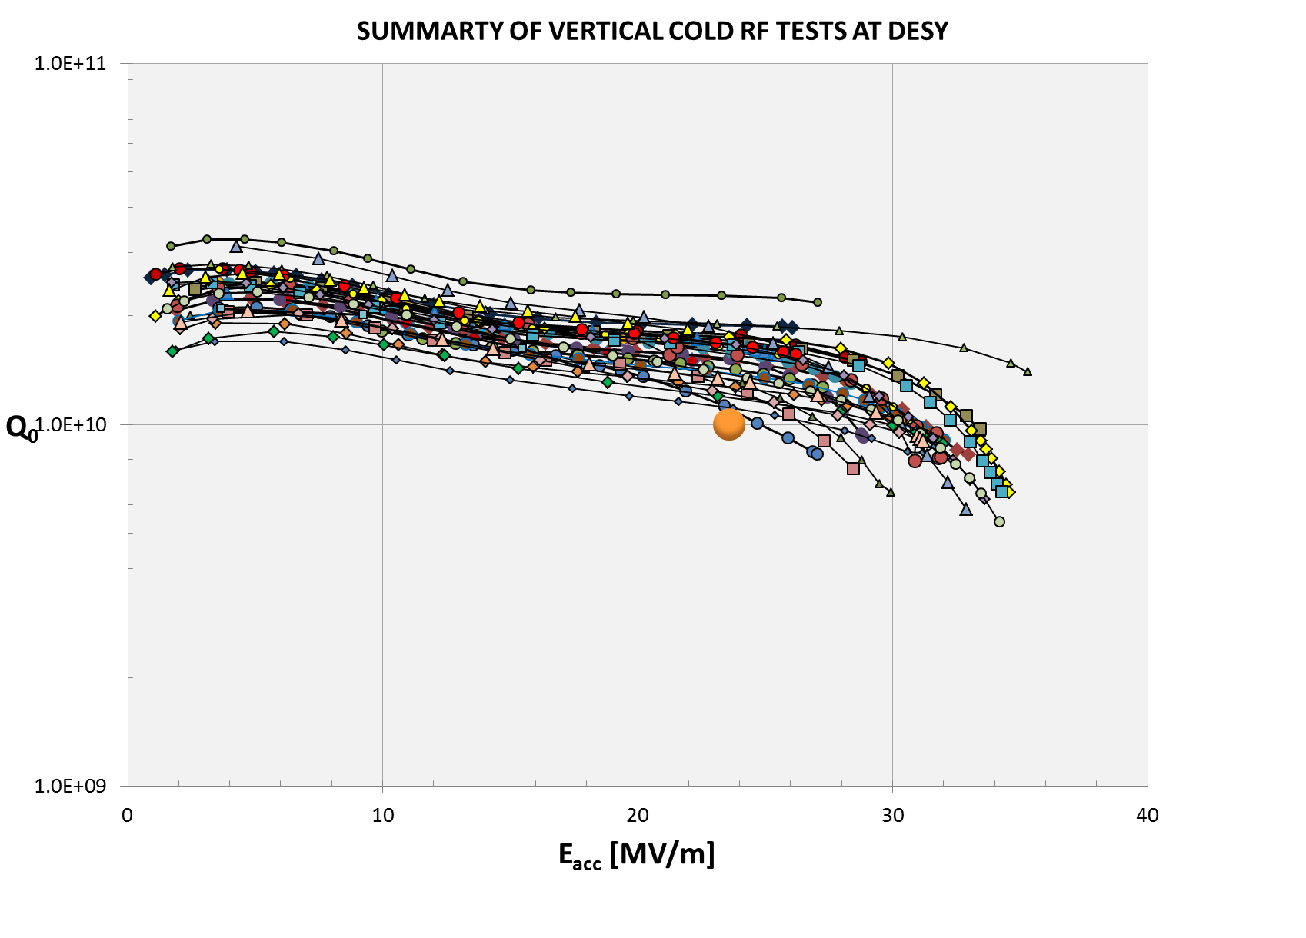
Vertical test of EXFEL 1.3 GHz cavities

Slide 23
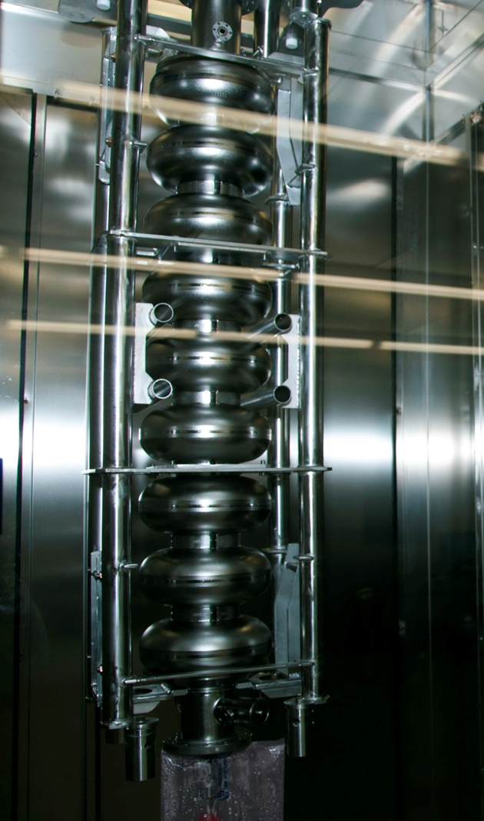
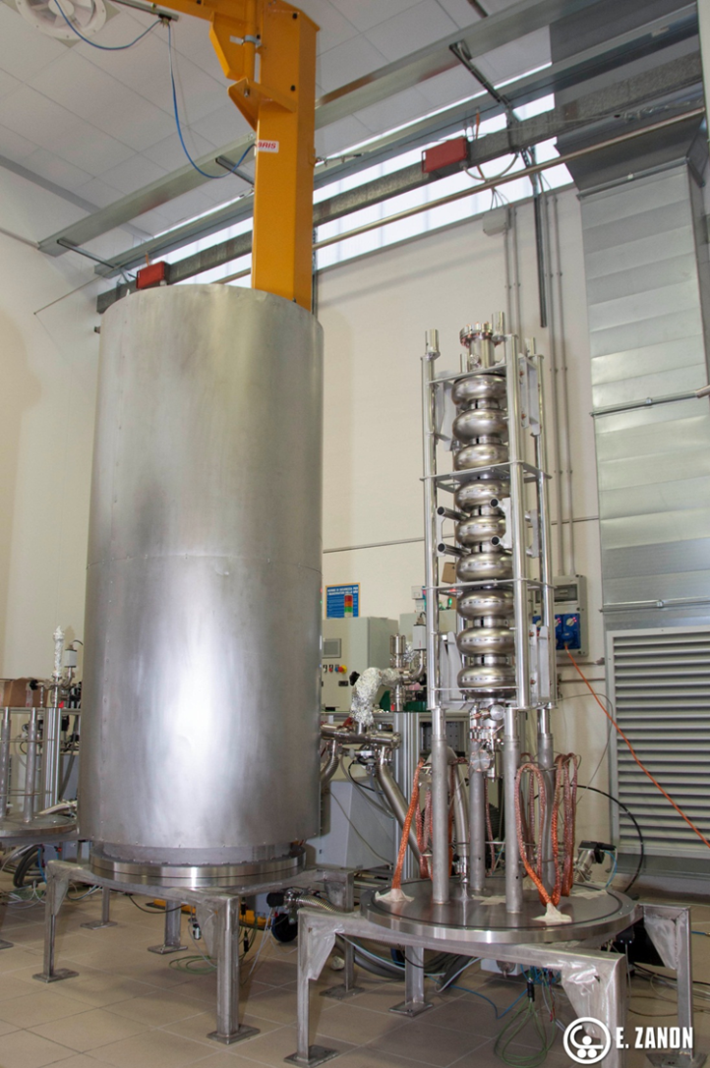
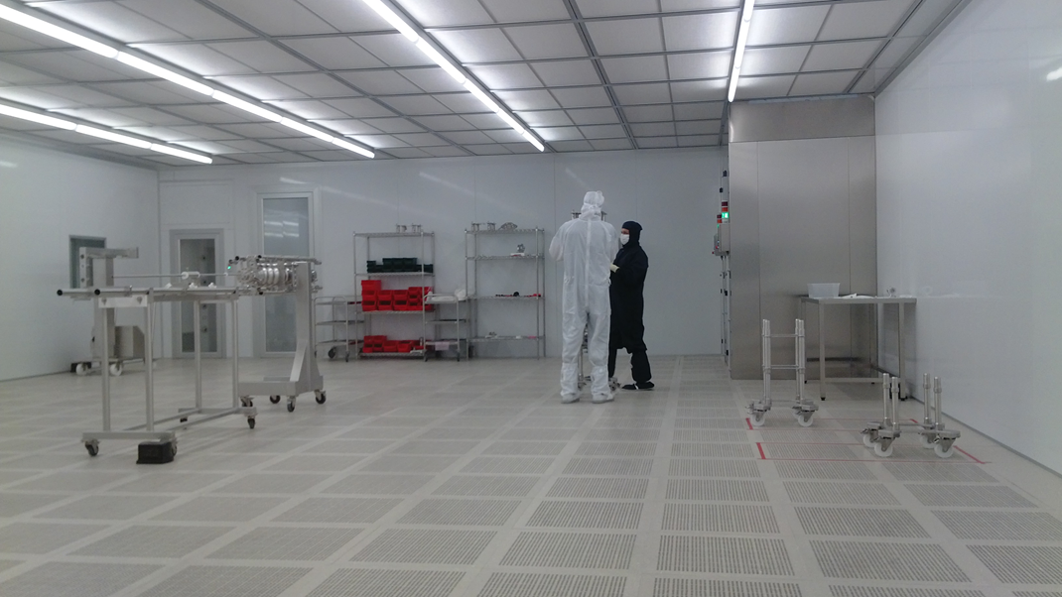
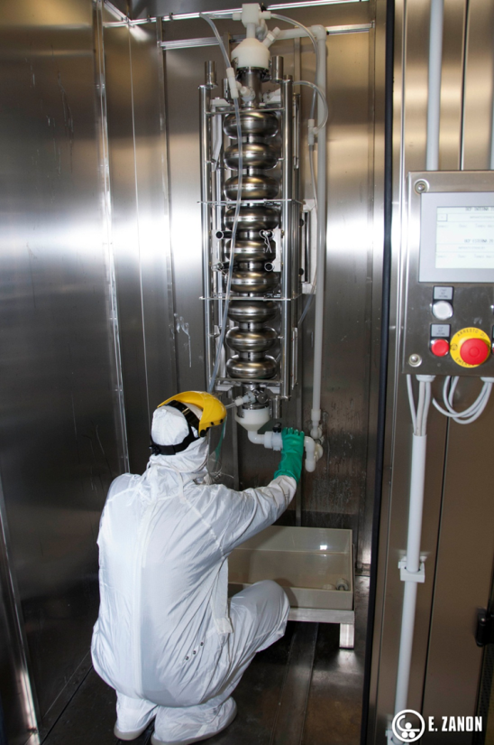
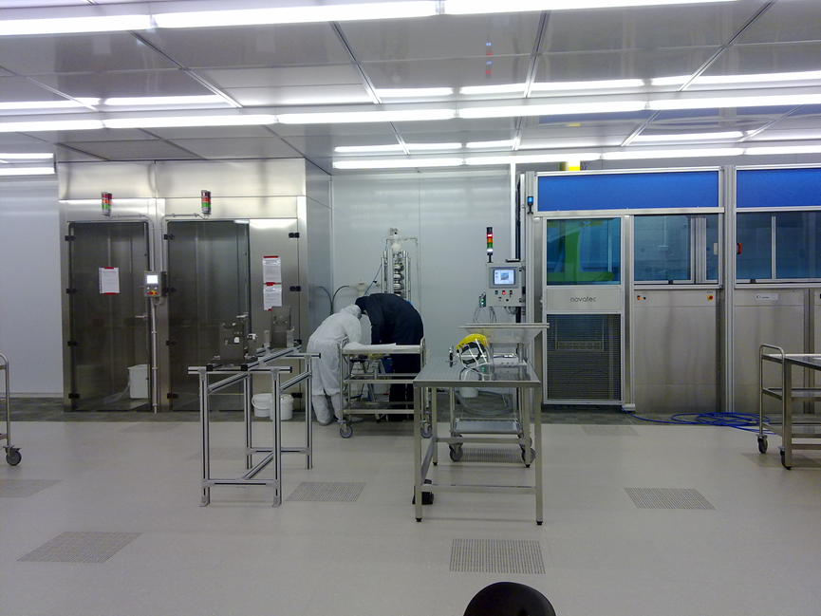
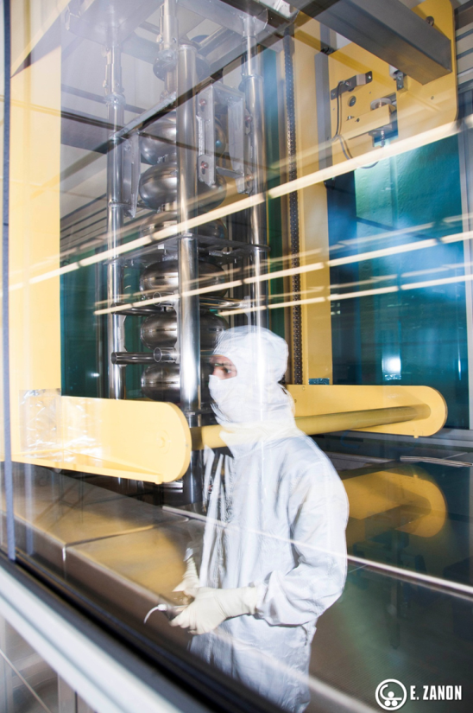
Activity at the EZ infrastructure
(courtesy of EZ)

Slide 24
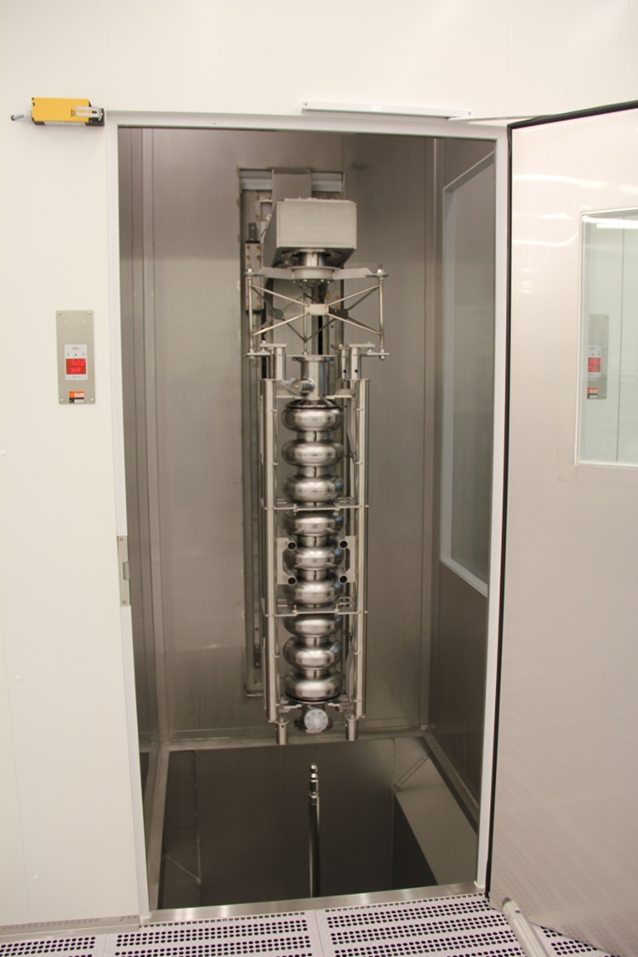




Activity at the RI infrastructure
(courtesy of RI)

Slide 25



Preseries cavities and subcomponents at EZ
(courtesy of EZ)

Slide 26




Preseries cavities and subcomponents at RI (courtesy of RI)

Slide 27
After construction, what happens to cavities?
EZ
DESY
Cold test
CEA Saclay
assembly of cavities in the cryomodule
RI
DESY
Cryomodule
Cold test
Cryomodule installation in the XFEL tunnel

Slide 28

Italian cavities travel to DESY in red boxes

Slide 29

When Cavities arives at DESY they are tested in the Vertical Test Cryostat at AMTF

Slide 30




XFEL 3° Harmonic System (3.9 GHz)

Slide 31

XFEL 3° Harmonic System
3.9 GHz RF system is right after injector module,
before first bunch compressor
Max 40 MV required in a 8 cavity module
  Gradients are well within possible cavity/module performances (15 MV/m)
    cavity active length 0.346 m
  i.e. standard BCP treatment is sufficient for performance

Slide 32
XFEL 3° Harmonic System
To preserve beam quality before compression
  Linearize RF curvature effects
Design, realization, test of the main components is an In-Kind Italian contribution to XFEL
  WP46
beam

Slide 33


Work share within WP46
Split between INFN-DESY (48%-52%) in-kind contributions
Very rough splitting of work:
  INFN
    Design/procure: cavities, tuners, cryomodule
    Vertical testing of all cavities, @ LASA
    Join assembly/test @ DESY (up to commissioning)
  DESY
    Procurement of quad/couplers/power RF and controls
      and “standard” 1.3 GHz components...
    Power RF testing (horizontal/module test) @ DESY
    Most infrastructural work for module assembly/testing and installation (besides VT)

Slide 34
Design and procurement
Cavity Prototypes
  All tested vertically at LASA (with HOM)
  (Still) to be assembled in tanks for horizontal tests
All main system components designed
  Cavity PRR in 2011
    Tender assigned to EZ
  Module PRR in 2013
    CFT ongoing
In procurement phase for all main components
  at INFN and DESY

Slide 35





Prototypes
Test of all 3.9 GHz cavities at INFN
Vertical Test Facility
  18 W @ 2 K / 10 W @ 1.8 K
  less than 1 W static
  VT insert 2x3.9 GHz cavities
  200 W RF
Clean room (9m²), UPW plant and HPR
qualified for operation
CR with HPR
VT

Slide 36






Setting of fabrication/treatment procedures
RF “parts”
Analysis, derivation of sensitivity coefficients
and comparison with FNAL experience
Before etch
Copper mockup
After etch
Full Nb mockup
Inspections
BCP Cabinet

Slide 37

Outcome of VT on prototypes: 3HZ03
Full qualification of 3HZ03, also with HOM antennas
    Q>2 10⁹, Max E_{acc} 19 MV/m

Slide 38
Development of Diagnostics for SC cavities RF cold test
Second sound
Fast thermometry
Photodiodes for X ray mapping
X ray spectroscopy (from outside the cryostat)
Mode analysis
…

Slide 39

XFEL 3.9 Cryomodule design: transverse layout
Design is “Plug compatible” with Type III+/XFEL modules
  Identical transverse X-section for all cryo piping
Module part of the same cryo line
with the injector module
  Adapts at interfaces of
  standard cryo components
Shorter module/string lengths
All cryo piping in the same
relative position with
respect to beam axis

Slide 40

INFN: Main deliverables to WP46
40
Qualification and characterization of component prototypes
  Cavity design and supervision of DESY procurement: DONE
  Qualification of the 3 «naked» prototypes in VT at LASA
    All prototypes tested
    Used for setup of the preparation and testing infrastructure
  Design and completion of the 3 prototype dressed cavities for horizontal testing:
    Tank design/fabrication/tendering: DONE
    Integration to cavities: UNDER WAY
    Tuner design (Evolution of the «slim» ILC type): DONE
    Participation to horizontal tests at DESY: SCHEDULED
Notes:
40
Before you start editing the slides of your talk change to the Master Slide view:
Menu button “View”, Master, Slide Master:
Edit the following 2 items in the 1st slide:
1) 1st row in the violet header:
Delete the existent text and write the title of your talk into this text field
2) The 2 rows in the footer area: Delete the text and write the information
regarding your talk (same as on the Title Slide) into this text field.
If you want to use more partner logos position them left
beside the DESY logo in the footer area
Close Master View

Slide 41

XFEL 3° Harmonic tank and tuner

Slide 42








INFN: Work on prototypes and VT preparation
VT
preparation
Clean Room
at INFN
RF
testing
Weld inspection
Cavity Tests
BCP
at EZ
VTA
at INFN

Slide 43





Longitudinal interfaces preserved as in ML
Shorter module length...
XFEL Module @ 1.3 GHz

Slide 44


String and module assembly
DESY Hall III clean room and assembly area will be used for the 3.9 GHz string and module assembly
  adaptations for cavity, string and cold mass handling are required

Slide 45
Anagrafica XFEL
45
Ricercatori | Tecnologi | Ass Ricerca | Tecnici
Bellomo | Bosotti | Bertucci | Bonezzi
Michelato | Monaco | Maiano | Fusetti
Pagani | Paparella | Jinfang (in arrivo)
Pierini
Sertore
+ 1 Assegno di ricerca
+ altri contratti da definire (ingegnere, perito)
Notes:
45

