Slide 1
PMT charge measurements:
- pedestal subtraction and signal decompression
- results using decompression tables

Slide 2
NEMO-Phase2 PMT signal is sampled by using two 8 bits ADCs (ADC-A, ADC-B), with 100 MHz samplings, and sampling times “staggered” by 5 ns.
In order to increase the ADC input “dynamics” the PMT signal is “compressed” with a quasi-logarithmic law:
  low voltage signals are sampled with high accuracy (up to few s.p.e.)
  high voltage signals are sampled with lower accuracy.
As a consequence:
  the real PMT’s pulse can be obtained only “inverting” the compression law (i.e. converting ADC-channels into Charge)
  the conversion law must be known for each ADC (A and B) and for each “working Temperature”.
This is provided by the “Electronics group” (F. Ameli, C.A. Nicolau, F. Simeone) as results of the FEM detailed calibration as a function of the FEM temperature.

Slide 3
Generation date: Fri May 10 15:11:22 2013
Fem ID: 1
Temperature: 24.400000
Pedestal Channel A = 5.001452
Pedestal Channel B = 5.000852
Number of points in source decompression table = 272
Number of points in resampled decompression table = 256
ADC Value Channel A Channel B
0 0.000128 0.000099
1 0.000093 0.000065
2 0.000082 0.000055
3 0.000047 0.000045
4 0.000035 0.000035
5 0.000000 0.000000
6 -0.000010 -0.000010
7 -0.000024 -0.000023
8 -0.000058 -0.000033
9 -0.000069 -0.000065
10 -0.000102 -0.000075
11 -0.000110 -0.000081
12 -0.000142 -0.000113
13 -0.000149 -0.000142
14 -0.000176 -0.000145
15 -0.000200 -0.000172
16 -0.000198 -0.000195
The first table delivered by C.A. Nicolau
multiply this number (current, [A]) for the sampling time 5*10⁻⁹ s to obtain the charge [pC]
ADC input
Current [A]
channel A
ADC value NO
PED subtraction

Slide 4
Part of the decompression table
for FEM n. 1
F. Ameli, C.A. Nicolau, F. Simeone
Generation date: Tue Jun 11 18:52:09 2013
Fem Serial Number: 1
Temperature: 24.400000
Pedestal Channel A = 5.001452
Pedestal Channel B = 5.000852
Number of points in source decompression table = 272
Number of points in resampled decompression table = 256
ADC Value Channel A Channel B
0 0.000093541838 0.000087413008
1 0.000074838883 0.000069933386
2 0.000056135951 0.000052453762
3 0.000037433020 0.000034974139
4 0.000018730088 0.000017494516
5 0.000000000000 0.000000000000
6 -0.000018605194 -0.000017242664
7 -0.000037374813 -0.000034766861
8 -0.000056159974 -0.000052304636
9 -0.000074710234 -0.000069852048
10 -0.000093762377 -0.000087911869
11 -0.000112332381 -0.000106226423
12 -0.000130913808 -0.000124301698
13 -0.000149738933 -0.000142885047
14 -0.000168560832 -0.000161218197
15 -0.000186887081 -0.000180047099
16 -0.000204706148 -0.000198380298
multiply this number (current, [A]) for the sampling time 5*10⁻⁹ s to obtain the charge [pC]
ADC input
Current [A]
channel A
ADC value NO
PED subtraction

Slide 5
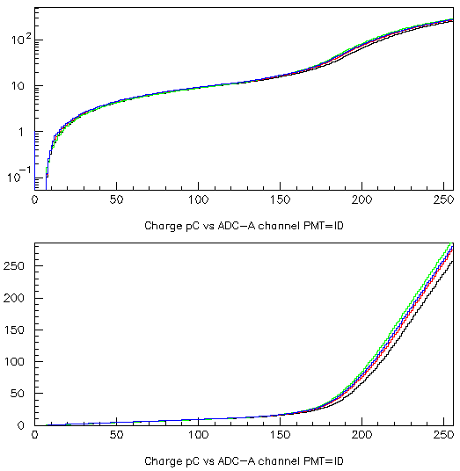
Charge [pC]
… using the first decompression table
ADC channel
Charge [pC]
ADC channel

Slide 6
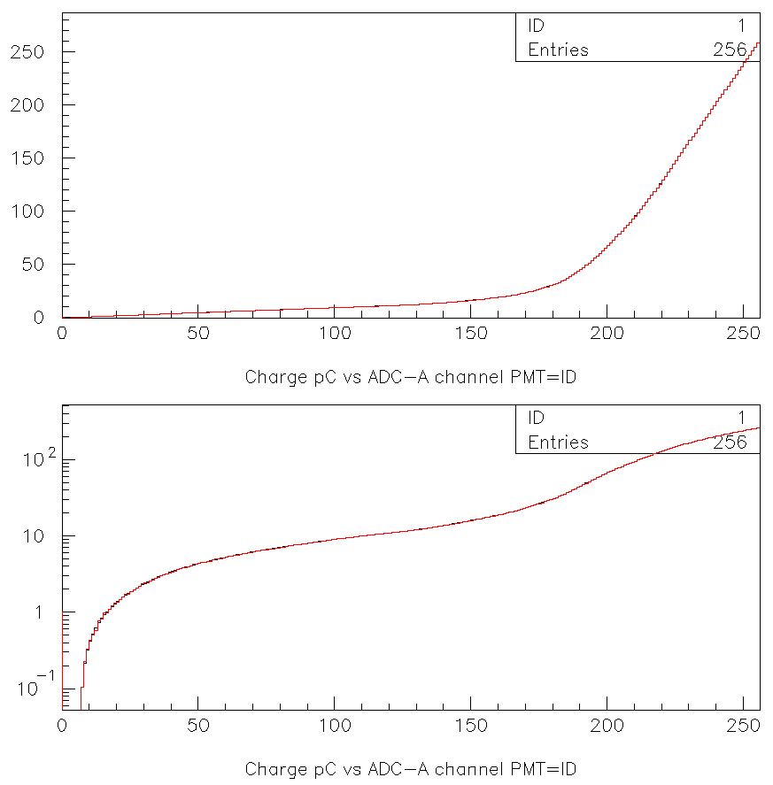
[ pC ]
charge
PMT 1 – ADC_A
Black new conversion table
Red old conversion table
≈16 pC: ≈ 2p.e.
[ ADC channel]
[ pC ]
charge

Slide 7
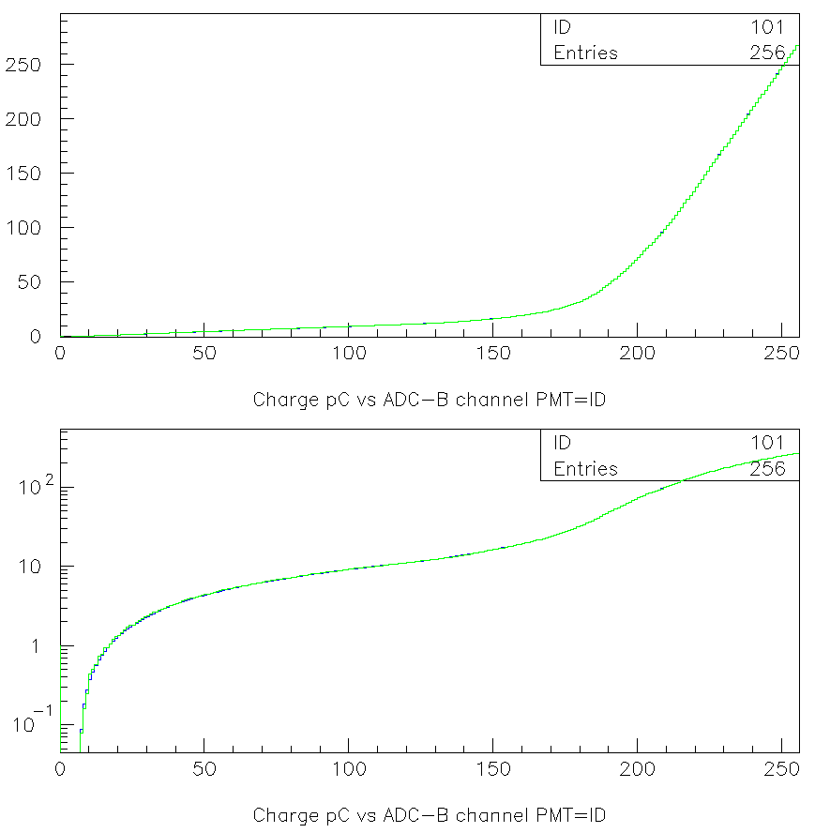
[ pC ]
charge
PMT 1 – ADC_B
Blue new conversion table
Green old conversion table
[ ADC channel]
[ pC ]
charge

Slide 8

[ pC ]
charge
PMT 3 – ADC_B
Blue new conversion table
Green old conversion table
[ ADC channel]
[ pC ]
charge

Slide 9
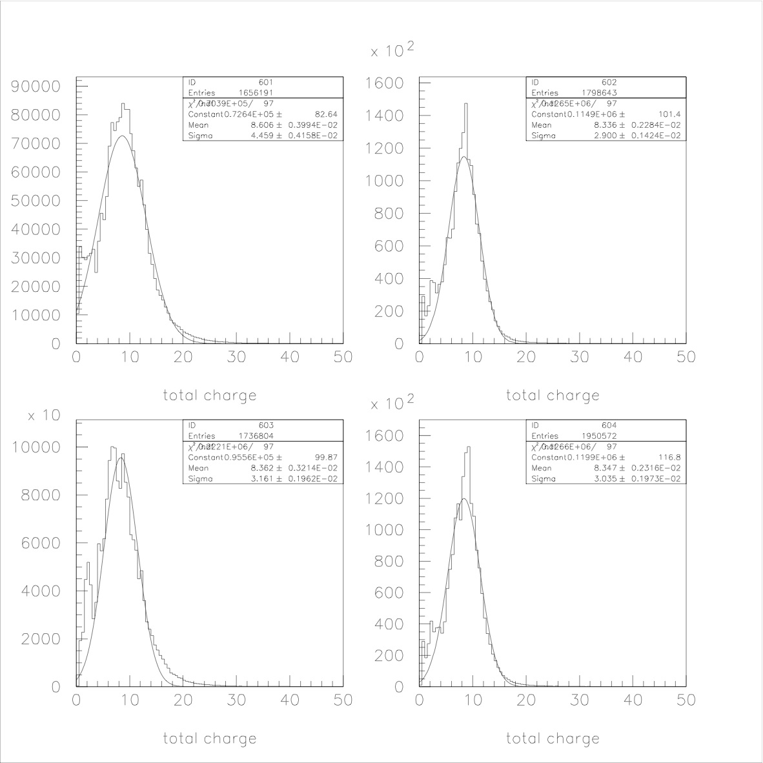
Run 499_file 0 (after adjusting the PMTs HV searching for p.h. uniformity)
Floor 1
[ pC ]
[ pC ]
[ pC ]
[ pC ]
… using the first decompression table

Slide 10
Run 499_file 0 (after adjusting the PMTs HV searching for p.h. uniformity)
Floor 1
[ pC ]
[ pC ]
[ pC ]
[ pC ]
… using the last decompression table

Slide 11
Run 499_file 0 (after adjusting the PMTs HV searching for p.h. uniformity)
Floor 2
[ pC ]
[ pC ]
[ pC ]
[ pC ]
… using the last decompression table

Slide 12
Run 499_file 0 after adjusting the PMTs HV searching for p.h. uniformity
Floor 3
[ pC ]
[ pC ]
[ pC ]
[ pC ]
… using the last decompression table

Slide 13
Run 499_file 0 after adjusting the PMTs HV searching for p.h. uniformity
Floor 4
[ pC ]
[ pC ]
[ pC ]
[ pC ]
… using the last decompression table

Slide 14
Run 499_file 0 after adjusting the PMTs HV searching for p.h. uniformity
Floor 5
[ pC ]
[ pC ]
[ pC ]
[ pC ]
… using the last decompression table

Slide 15
Run 499_file 0 after adjusting the PMTs HV searching for p.h. uniformity
Floor 6
[ pC ]
[ pC ]
[ pC ]
[ pC ]
… using the last decompression table

Slide 16
Run 499_file 0 after adjusting the PMTs HV searching for p.h. uniformity
Floor 7
[ pC ]
[ pC ]
[ pC ]
[ pC ]
… using the last decompression table

Slide 17
Run 499_file 0 after adjusting the PMTs HV searching for p.h. uniformity
Floor 8
[ pC ]
[ pC ]
[ pC ]
[ pC ]
… using the last decompression table

Slide 18
PMT 0
PMT 1
PMT 2
PMT 3
 | <charge> [pC] | rms [pC] | <charge> [pC] | rms [pC] | <charge> [pC] | rms [pC] | <charge> [pC] | rms [pC]
Floor1 | 8.9 8.6 | 3.7 4.5 | 8.1 8.3 | 2.5 2.9 | 8.1 8.4 | 3.5 3.2 | 8.1 8.3 | 2.4 3.0
Floor2 | 10.8 10.7 | 4.2 4.4 | 8.1 7.2 | 3.0 4.0 | - - | - - | 9.4 9.5 | 3.8 3.9
Floor3 | 9.3 8.7 | 3.3 3.5 | 9.3 8.3 | 3.1 3.6 | 8.1 7.7 | 3.1 3.1 | 7.9 7.8 | 3.4 3.9
Floor4 | 7.8 7.4 | 2.7 3.0 | 6.6 5.8 | 2.7 3.1 | 8.1 5.8 | 3.4 3.9 | 8.6 8.1 | 3.4 4.2
Floor5 | 10.6 10.2 | 3.9 4.7 | 8.4 7.6 | 3.1 3.4 | 9.3 8.7 | 3.4 3.8 | 6.2 6.5 | 2.3 2.8
Floor6 | 8.6 8.8 | 3.4 3.6 | 7.4 6.7 | 2.8 3.2 | 8.1 8.6 | 2.6 3.1 | 7.8 7.9 | 3.1 3.3
Floor7 | 8.4 8.2 | 3.3 3.7 | 7.1 7.1 | 2.6 2.9 | - - | - - | 6.6 6.1 | 2.4 3.4
Floor8 | 9.0 8.5 | 3.3 3.4 | 7.8 8.1 | 3.4 3.9 | 7.6 7.4 | 2.4 3.2 | 7.8 6.7 | 2.9 3.3
In red I do report for comparison results obtained with the previous decompression tables

Slide 19
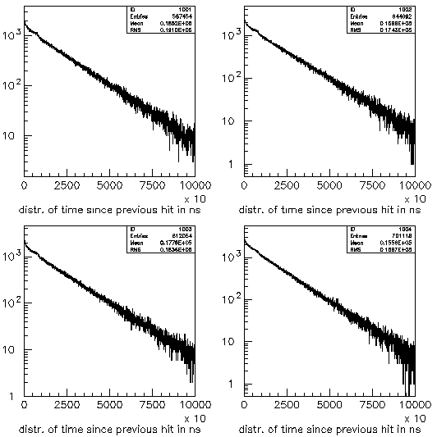
Floor1 – PMT1
Floor1 – PMT2
Floor1 – PMT3
Floor1 – PMT4

Slide 20
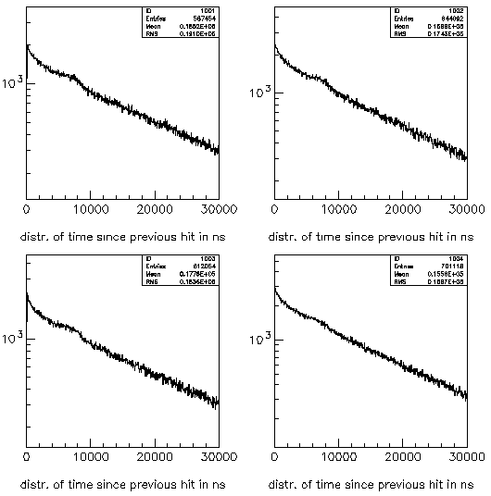
Floor1 – PMT1
Floor1 – PMT2
Floor1 – PMT3
Floor1 – PMT4

Slide 21
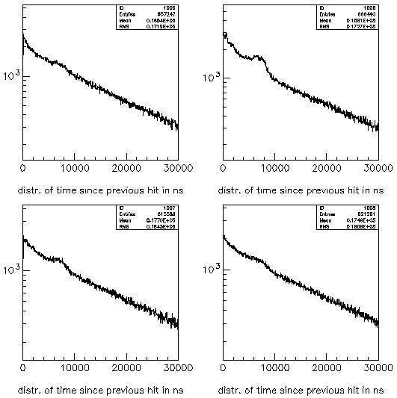
Floor2 – PMT1
Floor2 – PMT2
Floor2 – PMT3
Floor2 – PMT4

Slide 22
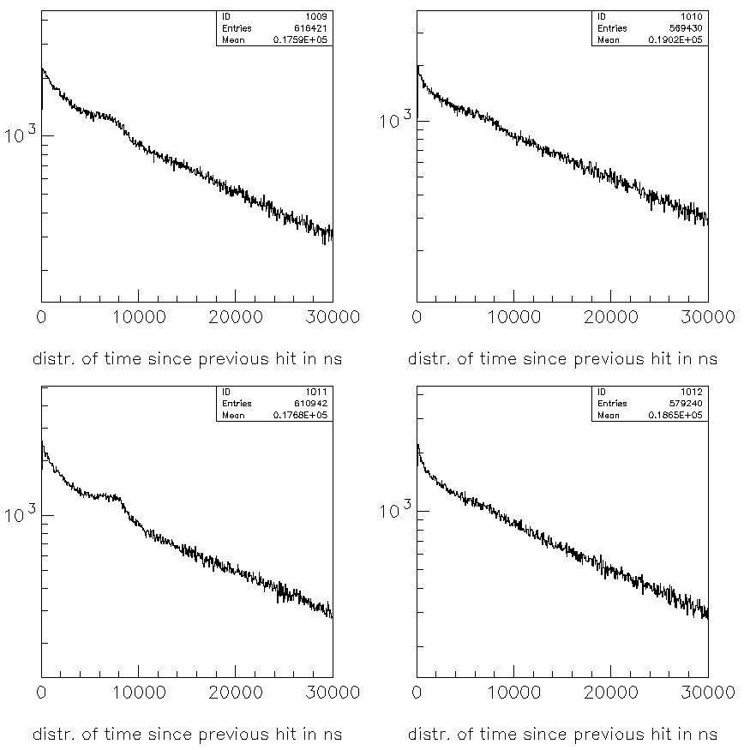
Floor3 – PMT1
Floor3 – PMT2
Floor3 – PMT3
Floor3 – PMT4

Slide 23
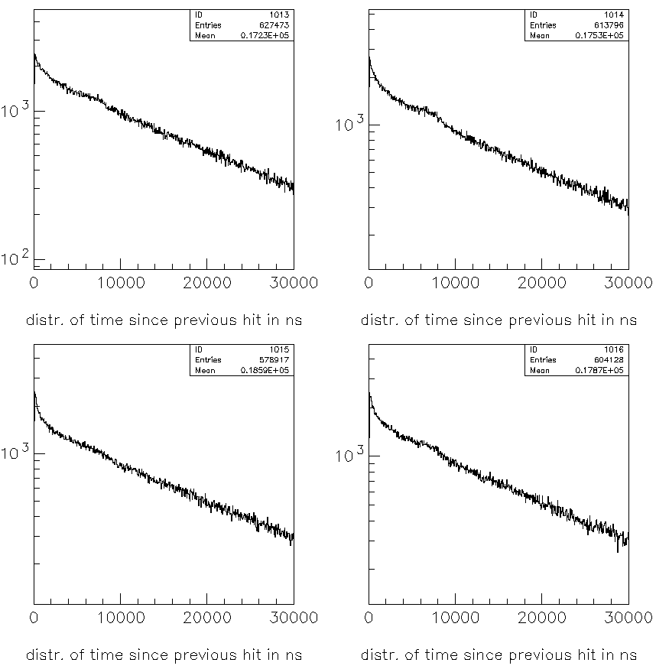
Floor4 – PMT1
Floor4 – PMT2
Floor4 – PMT3
Floor4 – PMT4

Slide 24
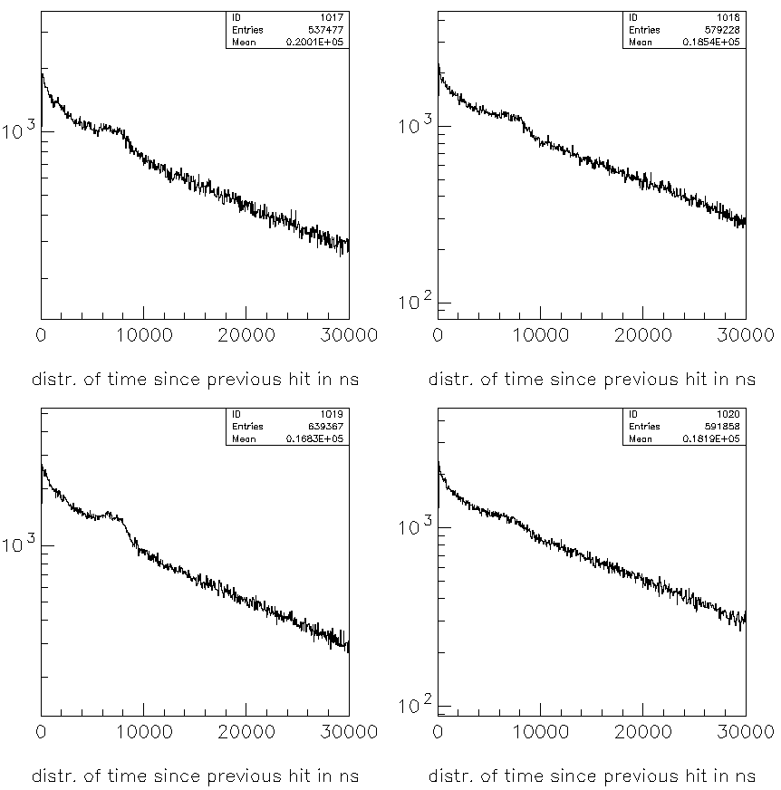
Floor5 – PMT1
Floor5 – PMT2
Floor5 – PMT3
Floor5 – PMT4

Slide 25
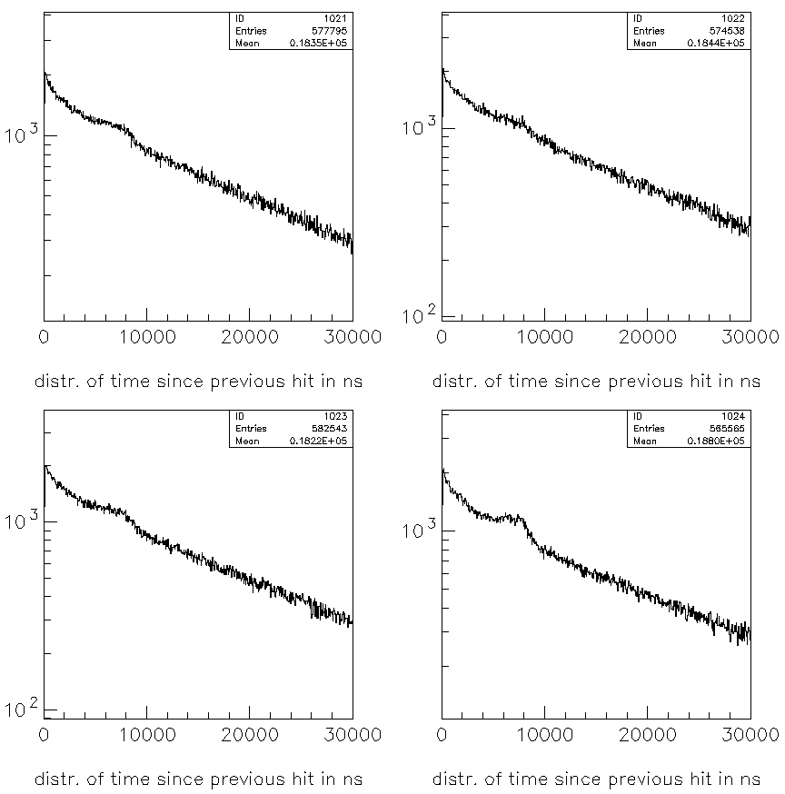
Floor6 – PMT1
Floor6 – PMT2
Floor6 – PMT3
Floor6 – PMT4

Slide 26
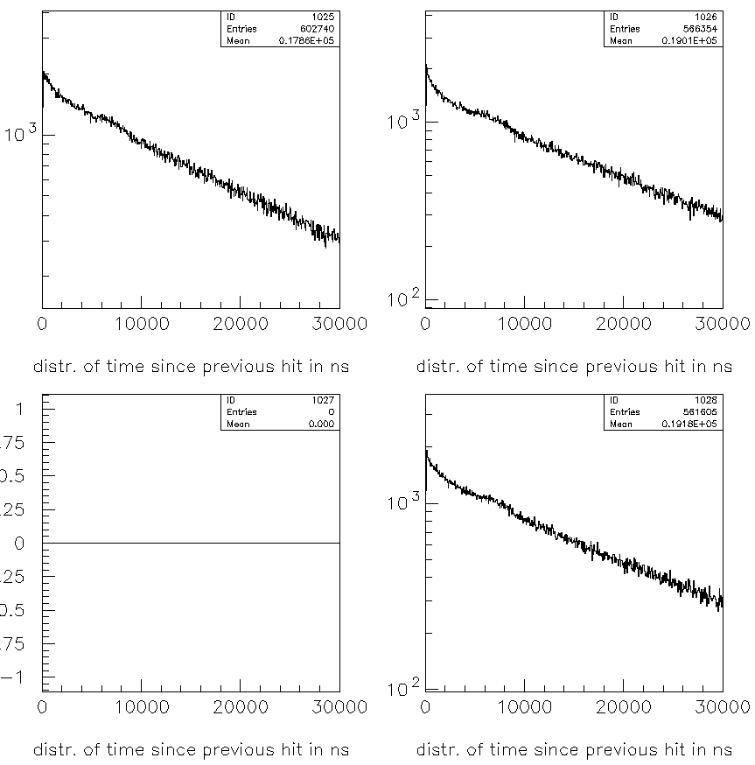
Floor7 – PMT1
Floor7 – PMT2
Floor7 – PMT3
Floor7 – PMT4

Slide 27
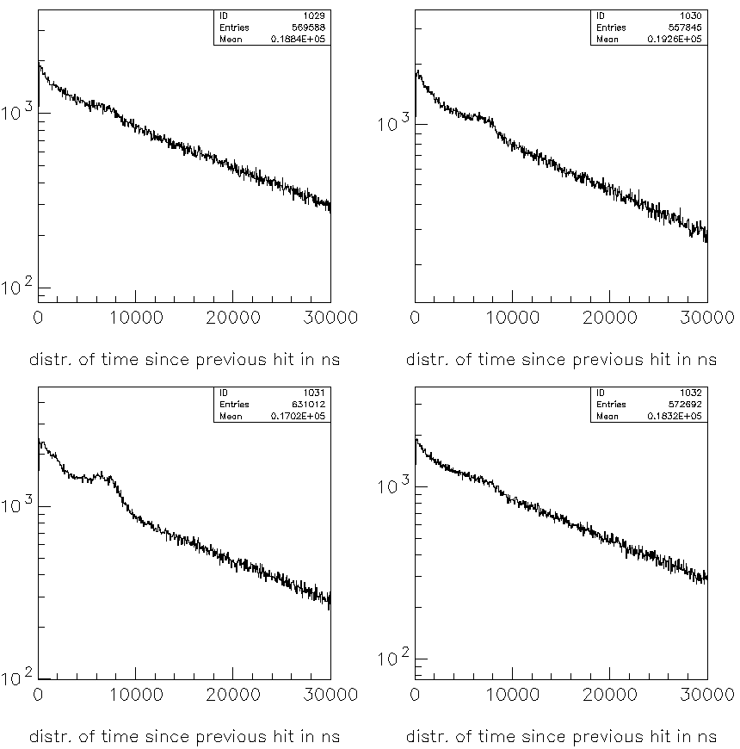
Floor8 – PMT1
Floor8 – PMT2
Floor8 – PMT3
Floor8 – PMT4

Slide 28
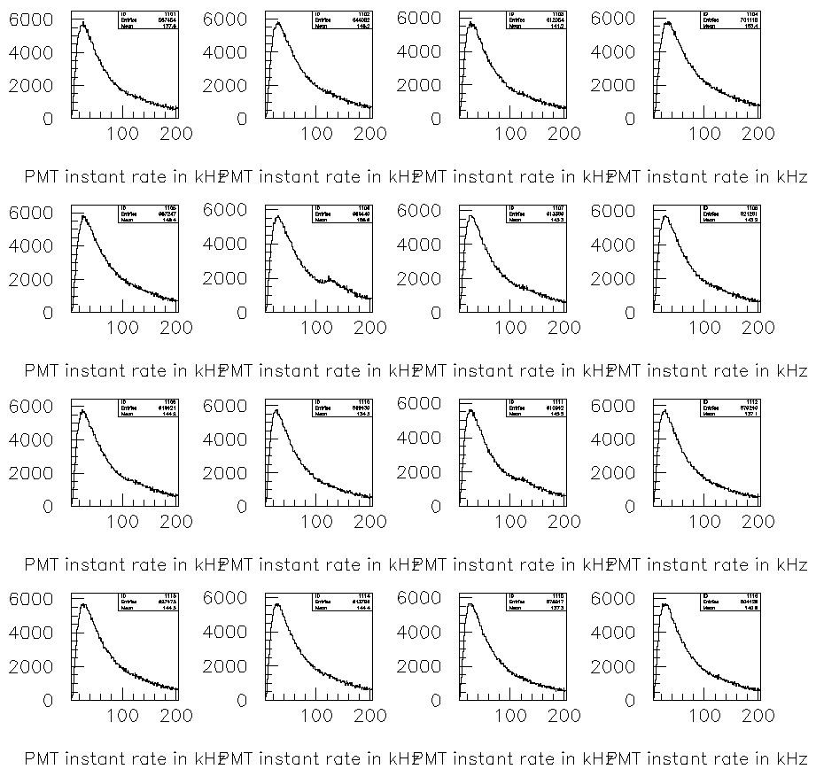

Slide 29
