Slide 1
The Gamma-400 MISSION
Valter Bonvicini
INFN – Trieste, Italy
On behalf of the Gamma-400 Collaboration
12th LNF Mini-workshop series: INFN-Space/3
Laboratori Nazionali di Frascati, 18-19 September 2013

Slide 2
Outline
Introduction
GAMMA-400 mission:
“Baseline” (original Russian) project:
The B1 configuration
Italian proposals:
The B2 configuration
Physics with GAMMA-400
Photons
Electrons
Nuclei
Conclusions

Slide 3
GAMMA-400 Collaboration

Slide 4
The GAMMA-400 project
Mission is approved by ROSCOSMOS (launch currently scheduled by November 2018)
GAMMA-400:
Scientific payload mass: 4100 kg
Power budget: 2000 W
Telemetry downlink capability: 100 GB/day
Lifetime: ∼10 years
Orbit (initial parameters): apogee 300000 km, perigee 500 km, orbital period 7 days, inclination 51.8 °
Gamma-400 will be installed onboard the platform “Navigator” manufactured by Lavochkin and launched by a “Proton-M” rocket

Slide 5
GAMMA-400 orbit

Slide 6
GAMMA-400 “baseline”: the B1 version
Original Russian design focused on:
High energy gamma-rays (10 GeV - 3 TeV)
High energy electrons (e⁻ and e⁺)
Science objectives (from Russian proposal):
“To study the nature and features of weakly interacting massive particles, from which the dark matter consists”
“To study the nature and features of variable gamma-ray activity of astrophysical objects from stars to galactic clusters”
“To study the mechanisms of generation, acceleration, propagation, and interaction of cosmic rays in galactic and intergalactic spaces”

Slide 7
Gamma-400 “baseline”: the B1 version
Gamma-ray energy range | 10 – 3000 GeV
Multilayer converter | Si-W, 10 layers, 100 x 100 cm² , 0.84 X₀
Calorimeter CC1 | CsI-Si, 5 layers, 80 x 80 cm², 3 X₀
Calorimeter CC2 | 1024 BGO bars (25 x25 x 250 mm³), 80 x 80 cm², 22 X₀
Angular resolution (@ 100 GeV) | 0.01 – 0.02°
Energy resolution (@ 100 GeV) | 1 – 2%
Proton rejection | ∼10⁵

Slide 8
GAMMA-400: Italian proposal
Availability for a revision of the design that could enhance the performance and science capability of the project during the last years, a great deal of effort has been deployed by the Italian collaboration in order to significantly improve the scientific characteristics of the GAMMA-400 mission. The guidelines of this work have been:
to define the best configuration for a dual instrument for photons (30 MeV - > 300 GeV) and cosmic rays (electrons > 1 TeV and high-energy cosmic-ray nuclei, p and He spectra close to the “knee” region (10¹⁴ – 10¹⁵ eV): E version.
to agree upon a jointly defined dual instrument that, taking into account the currently available financial resources, optimizes the scientific performance and improves them with respect to the B1 version: this new “baseline” version, called B2, has been agreed upon by both (Russian and Italian) sides during a collaboration meeting held in Moscow in February 2013.

Slide 9
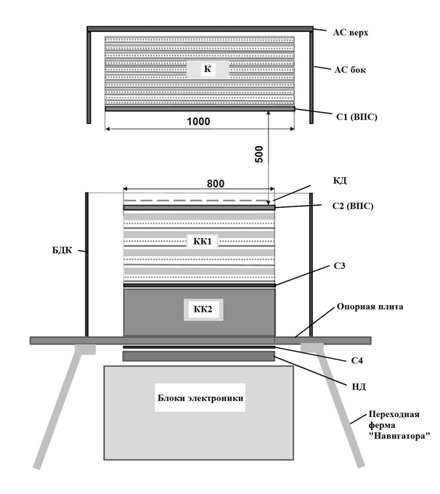
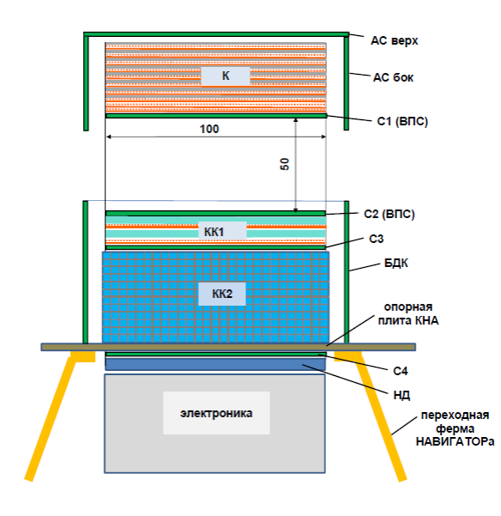
The new B2 version
Original Russian proposal (2011)
Jointly agreed Russian-Italian proposal (2013)

Slide 10
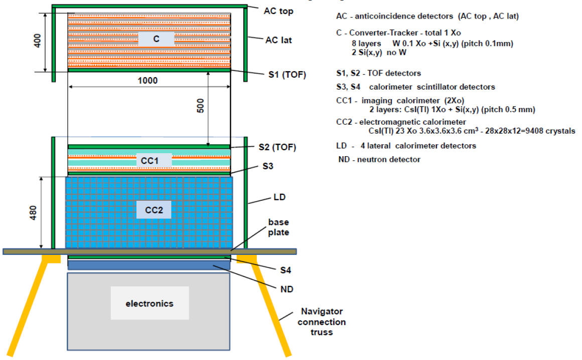
The new B2 version
B2 over B1 improvements:
Introduction of the highly segmented
homogeneous calorimeter with CsI
cubes ⇒ improved energy resolution,
extended GF with lateral particle
impingement, nuclei capability
Increase of the planar dimensions of
the calorimeter (from 80 cm x 80 cm
to 100 cm x 100 cm) ⇒ larger A_{eff}
Si strip detector pitch of the 2 CC1
layers decreased from 0.5 mm to
0.1 mm

Slide 11
Converter/Tracker
Homogeneous Si-W Tracker
4 towers (∼ 50 cm x 50 cm each);
8 W/Si-x/Si-y planes + 2 Si-x/Si-y planes (no W);
Thickness of each plane 0.1 X₀
Each sensor ∼ 9.7 cm x 9.7 cm from 6” wafers;
Sensors arranged in ladders (5 detectors/ladder), 1 ladder ∼ 50 cm;
Read-out pitch 240 µm (capacitive charge division), 384 strips/ladder
Implant pitch:
Either 120 µm (one strip every 2 is read-out)
Or 80 µm (one strip every 3 is read-out)
2000 silicon detectors;
153600 readout channels, 2400 front-end ASICs (64 channels/ASIC)

Slide 12
Converter/Tracker: FE electronics
Front-end ASIC: architecture similar to TAA1 used in AGILE, with sparse read-out (only triggered ASICs are read-out).
Configuration: CSA, shaping amplifier, S/H and MUX. Each channel has a comparator with adjustable (via a DAC) threshold for trigger.
The ASIC should be designed in a “modern” technology: AMS 0.35 µm CMOS is well known (reliability) and offers excellent noise performance!

Slide 13
Converter/Tracker: FE electronics
Preliminary specs for the GAMMA-400 Tracker front-end ASIC:
128 channels
Self-triggerable
Power dissipation < 0.5 mW/channel
S/N > 20 @ C_{det} = 60 pF
Dynamic range ≥ 25 fC
Contacts with IDE AS (Norway) already established, preliminary project done.

Slide 14
Calorimeter
0.1 mm

Slide 15
Calorimeter

Slide 16
Calorimeter
Minimum 2 photodiodes are needed on each CsI crystal to cover the HUGE (1 MIP ÷ 10⁷ MIP) dynamic range, hence:
A front-end electronics with large dynamic range and sensitivity down to 1-MIP signals is needed:
CASIS 1.2 ASIC, developed by the Trieste group

Slide 17
Calorimeter

Slide 18
Calorimeter

Slide 19
Calorimeter

Slide 20
Calorimeter

Slide 21
Calorimeter

Slide 22
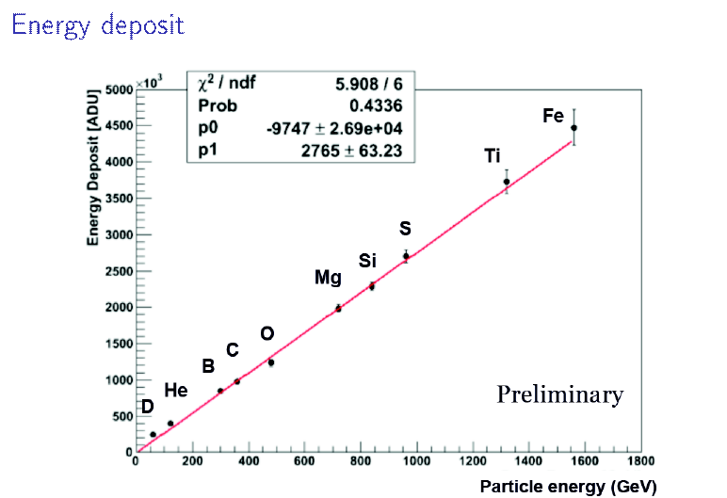
Calorimeter

Slide 23
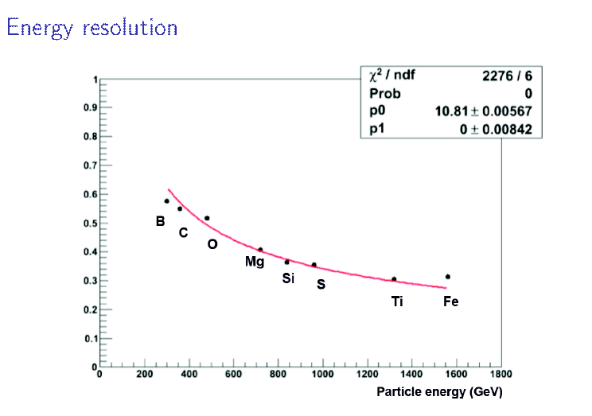
Calorimeter
Preliminary!

Slide 24
Calorimeter

Slide 25
Calorimeter
FE Electronics: next step, CASIS1.2B
The final version of the FE ASIC includes a 12-bit ADC/channel (design submitted on August 30th, 2013 to Europractice)
ASICs are expected by November 2013

Slide 26
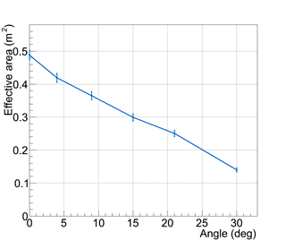
B2 configuration: performance
Preliminary!
Preliminary!
Effective area (m²) of the G-400 instrument with B2 configuration. Left panel: variation of the effective area with energy for normal incidence and flat area distribution (Blue: G-400, Green: Fermi-LAT total, Red: Fermi-LAT front). Right panel: variation of effective area of G-400 at 100 GeV with polar angle for flat area distribution.

Slide 27
B2 configuration: performance
Preliminary!
Variation of angular resolution (68% fraction) of the G-400 instrument with B2 configuration with energy for normal incidence and flat area distribution, and comparison with Fermi-LAT. (Blue: G-400, Green: Fermi-LAT total, Red: Fermi-LAT front)

Slide 28
B2 configuration: performance
Preliminary!
Variation of energy resolution (68% fraction) of the G-400 instrument with B2 configuration with energy for normal incidence and flat area distribution, and comparison with Fermi-LAT. (Blue: G-400, Green: Fermi-LAT total, Red: Fermi-LAT front)

Slide 29
Physics with GAMMA-400

Slide 30
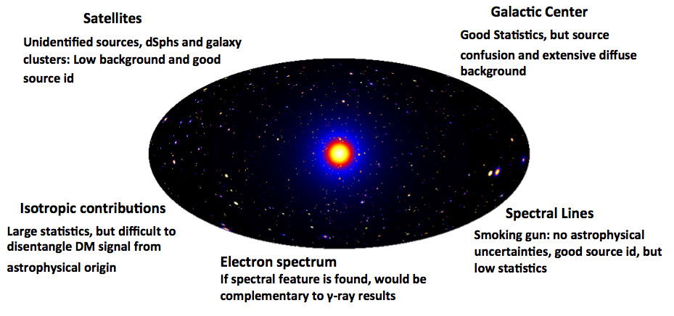
Physics with GAMMA-400
Possible scenarios in indirect dark matter search in γ-rays

Slide 31
Physics with GAMMA-400
+
arXiv:1205.1045
arXiv:1206.1616
Gamma-400 ideal for looking for spectral DM-induced
features, like searching for γ–ray lines! If Weniger is right, the 130 GeV line should be seen with ∼10 σ significance (L. Bergström et al., arXiv:1207.6773v1 [hep-ph])
L. Bergström, , Stockholm 2012

Slide 32
Physics with GAMMA-400

Slide 33
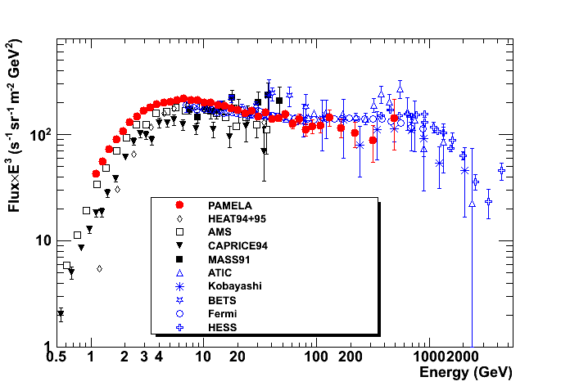
Physics with GAMMA-400
Electron spectrum

Slide 34
Physics with GAMMA-400
Cosmic-ray acceleration and propagation

Slide 35
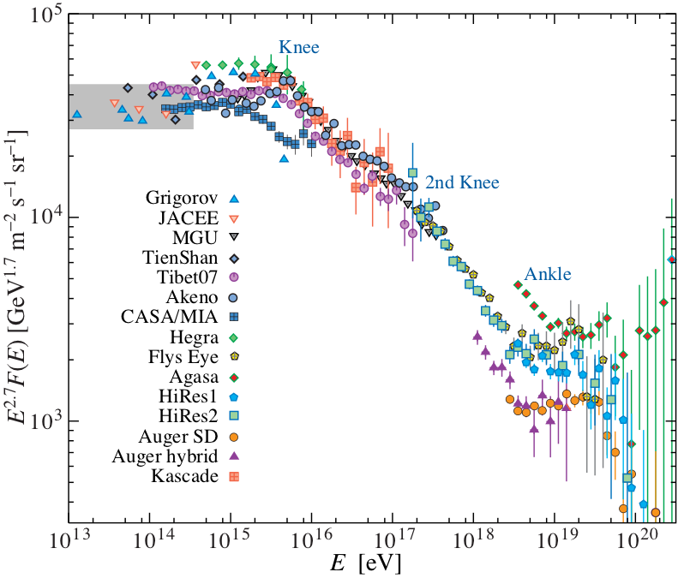
Physics with GAMMA-400
Nuclei
Knee structure
Structures in the GeV - TeV
region recently discovered for
p and He
Current spectral measurements
in the knee region are only
indirect

Slide 36
Conclusions
The Gamma-400 mission represents a unique opportunity to perform simultaneous measurements of photons, electrons and nuclei with unprecedented accuracy.
Pointing strategy without Earth occultation/large FOV
High resolution converter/tracker providing excellent PSF
Excellent energy resolution from the deep, homogenous calorimeter
Gamma-400 can provide in-depth investigations on some of the most challenging physics items, such as DM search, CR origin, production and acceleration to the highest energies…

Slide 37
Back-up slides

Slide 38
Gamma-400: scientific goals
Dark matter studies at GeV energies, resolving the Galactic Center and providing excellent sensitivity for searches in spheroidal galaxies (several times better than Fermi-LAT)
Cosmic-ray acceleration in SNR and galactic diffusion resolved with unprecedented detail in both space and spectra.
Excellent sensitivity to neutral pion emission below 200 MeV.

Slide 39
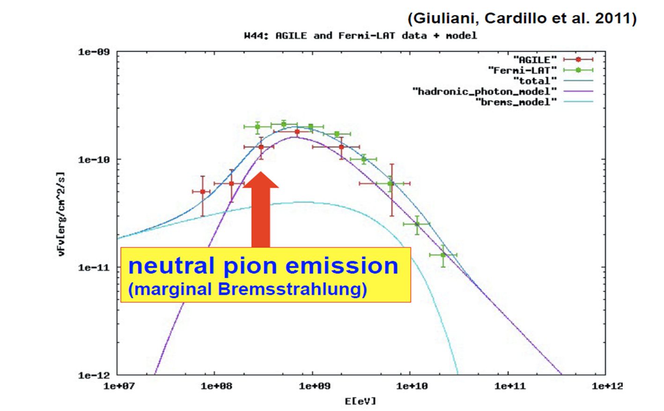
Scientific goals: low-energy γs
Cosmic rays and low-energy γs

Slide 40
Scientific goals: electrons

Slide 41
Scientific goals: nuclei

Slide 42
Converter/Tracker
Homogeneous Si-W Tracker
25 W/Si-x/Si-y planes
Thickness of each plane 0.03X₀
4 towers (∼ 50 cm x 50 cm each)
Single-sided, ∼ 120 µm pitch
microstrip detectors
Each sensor ∼ 9.7 cm x 9.7 cm
Sensors arranged in ladders (5
detectors/ladder)
Capacitive charge division readout
(1 strip every 2)
5000 silicon detectors
384000 readout channels

Slide 43
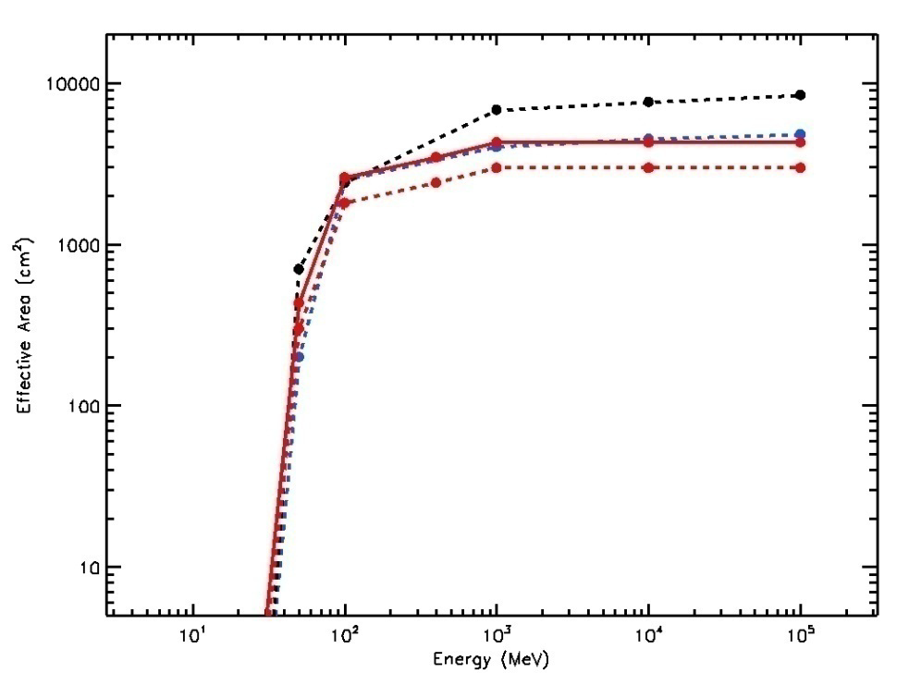
Gamma-400 and Fermi: A_{eff} & PSF
Effective area
PSF
Black line: Fermi front+back
Blue line: Fermi front
Red solid line: G-400 120 x 120 cm²
Red dashed line: G400 100 x 100 cm²
Black line: Fermi front
Blue line: Fermi front + back
Red line: Gamma-400

Slide 44
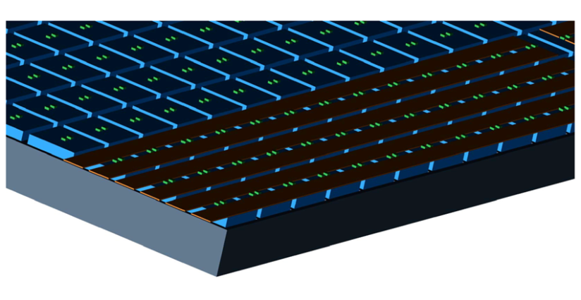
Calorimeter
Homogeneous cubic calorimeter
Symmetric, to maximize GF
Total mass < 1600 kg
Very large dynamic range
Finely segmented in all directions
1 R_{M} x 1 R_{M} x 1 R_{M} CsI(Tl) cubic
crystals
Few mm gaps between crystals
Detail of a calorimeter plane:
Blue: crystals
Grey: Al support
Green: photodetectors
Brown: readout cables

Slide 45
Calorimeter details
 | Cubes | Cubes | Cubes | Cubes
N×N×N | 20×20×20 | 20×20×19 | 21×21×18 | 32×32×32
L (cm) | 3.6* | 3.6* | 3.6* | 2.2
Crystal volume (cm³) | 46.7 | 46.7 | 46.7 | 10.6
Gap (cm) | 0.3 | 0.4 | 0.3 | 0.3
Mass (Kg) | 1683 | 1599 | 1578 | 1574
N.Crystals | 8000 | 7600 | 7497 | 32768
Size (cm³) | 78.0×78.0×78.0 | 80.0×80.0×76.0 | 81.9×81.9×81.9 | 80.0×80.0×80.0
Depth (R.L.) “ (I.L.) | 39×39×39 1.8×1.8×1.8 | 39×39×37 1.8×1.8×1.7 | 41×41×33 1.9×1.9×1.6 | 38×38×38 1.8×1.8×1.8
Planar GF (m²sr) (fiducial**) | 1.72×1.72×1.72 | 1.81×1.72×1.72 | 1.91×1.53×1.53 | 1.89×1.89×1.89
(* one Moliere radius)
(** within a reduced perimeter of size (N-1)*L )

Slide 46
Russian vs. Italian design

Slide 47
Tracker geometry

Slide 48
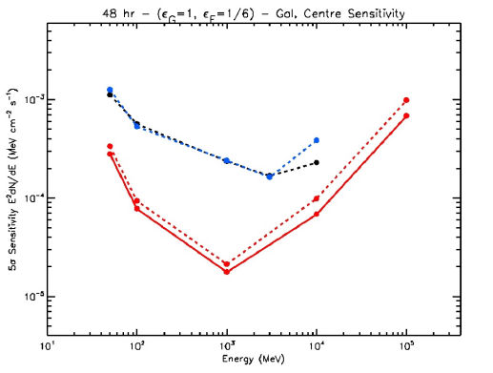
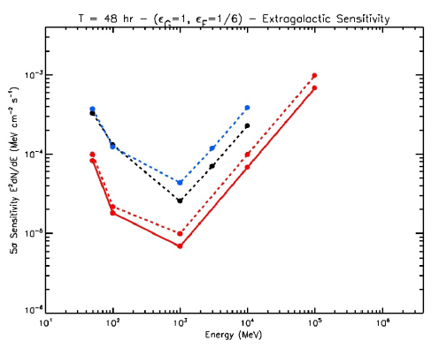
Sensitivity – 48 hrs
Galactic center
Extragalactic
Black line: Fermi front+back
Blue line: Fermi front
Red solid line: G-400 120 x 120 cm²
Red dashed line: G400 100 x 100 cm²

Slide 49
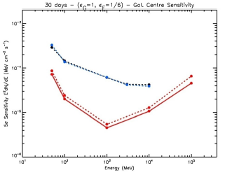
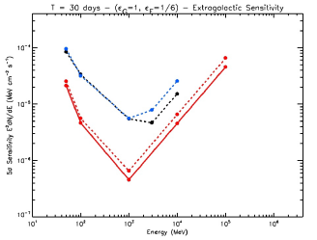
Sensitivity – 1 month
Galactic center
Extragalactic
Black line: Fermi front+back
Blue line: Fermi front
Red solid line: G-400 120 x 120 cm²
Red dashed line: G400 100 x 100 cm²

Slide 50
Calorimeter summary

Slide 51
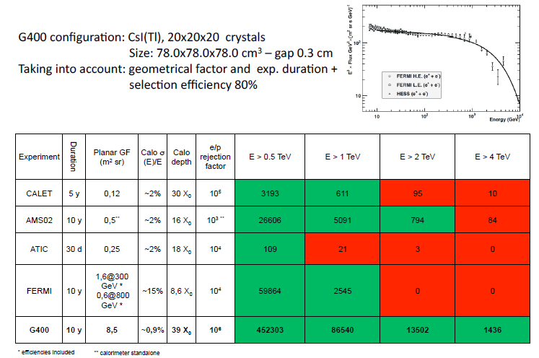
Electrons – counts estimation

Slide 52
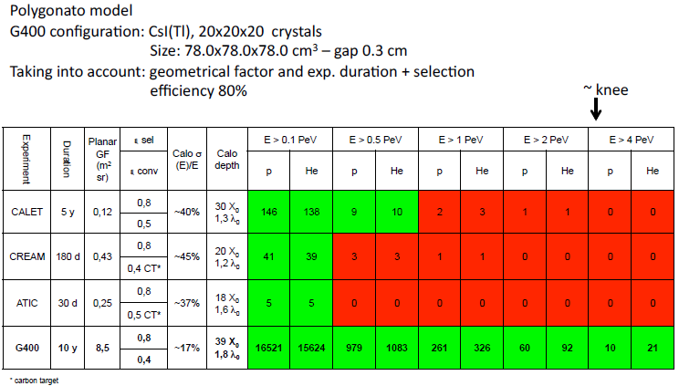
Protons and He – counts estimation

Slide 53
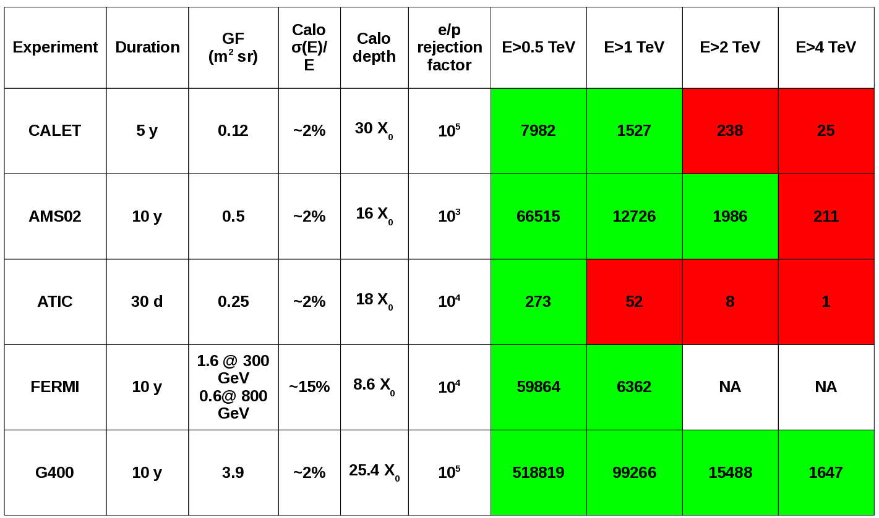
B2: electron count estimation

Slide 54
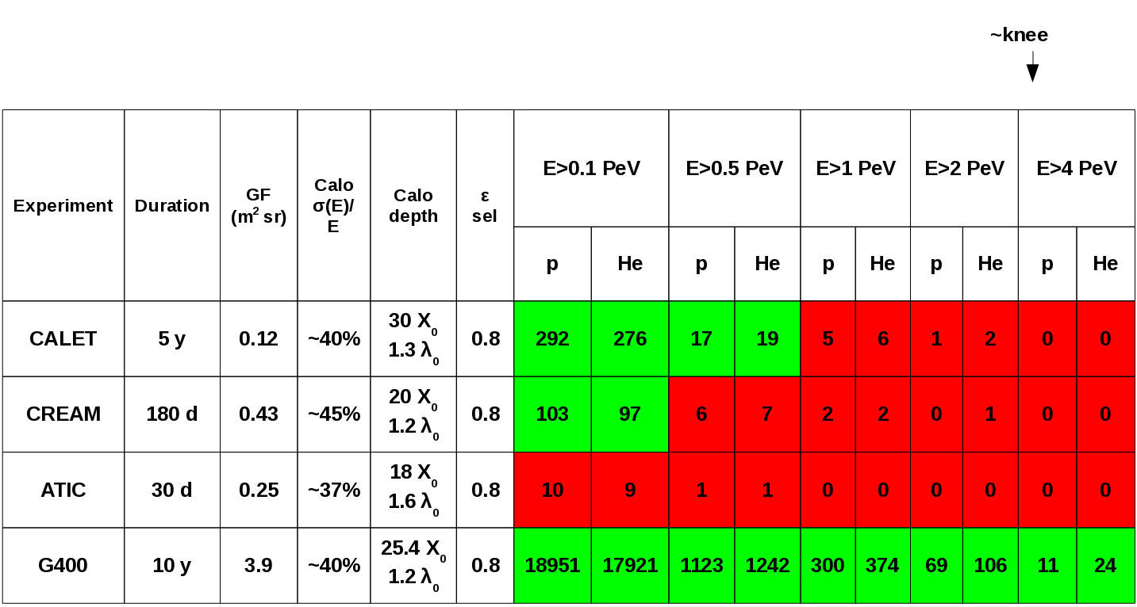
B2: p and He count estimation

Slide 55
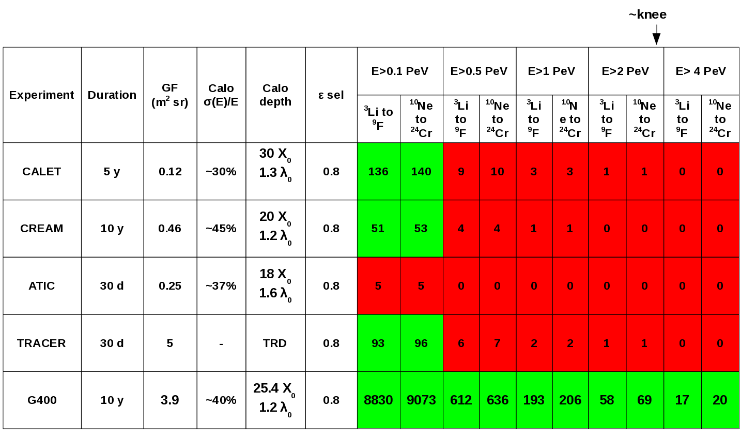
B2: heavy nuclei count estimation

