Slide 1


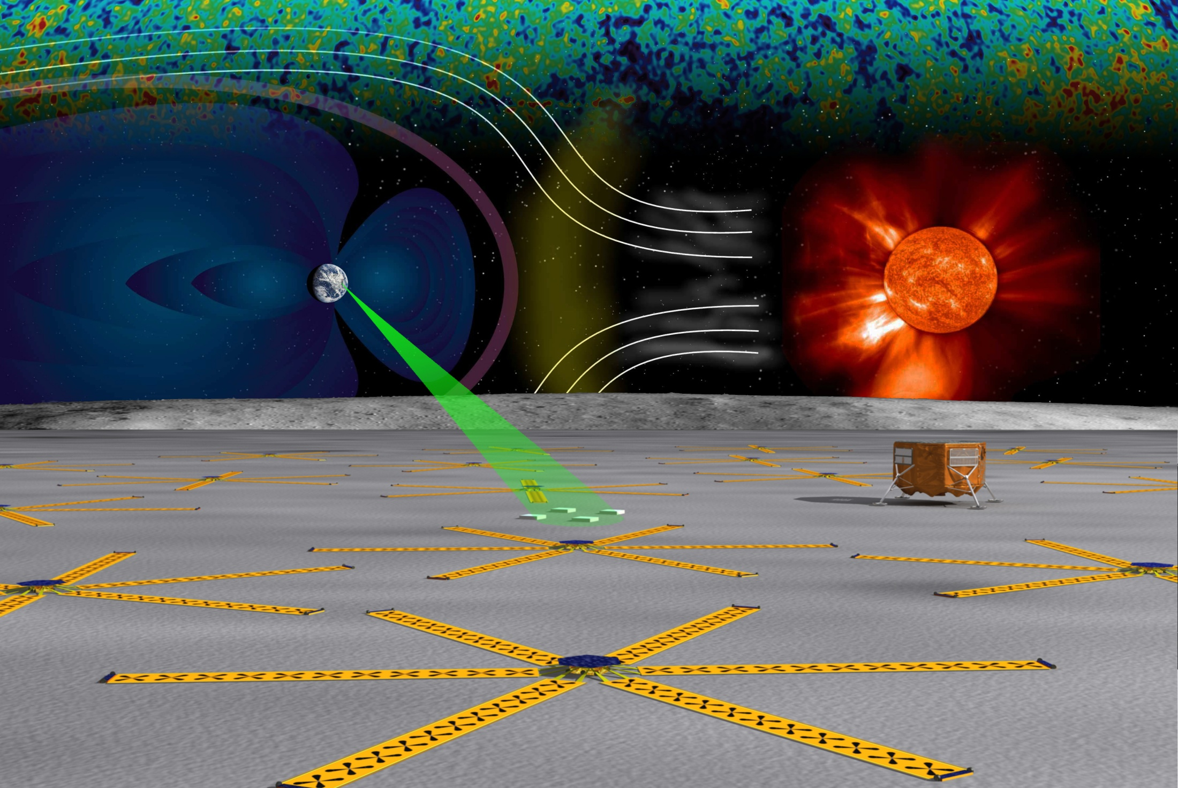


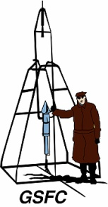








A LUNAR LASER RANGING RETRO-REFLECTOR ARRAY
for the 21st CENTURY
Professor Douglas Currie
University of Maryland, College Park, MD, USA
NASA Lunar Science Institute, Moffett Field, CA
INFN – LNF, Laboratori Nazionali di Frascati, Italy
& The LLRRA-21 Teams with the
Lunar University Network for Astrophysics Research
Jack Burns, Director
Notes:
BBB
I will discuss the history and current status of our “Lunar Laser Ranging Retroreflector Array for the 21st Century”. Ten years ago, we discovered the molten core of the moon, and have since defined the size and shape as well as properties of the core-mantle boundary. This has recently been confirmed by the reanalysis of Apollo siesmometry by Rene Weber. It is also one of the strongest tests of General Relativity, investigating theories that try to explain Dark Energy and Dark Matter.
ccc
I want to discuss our “next generation” approach to understanding Gravity and Relativity
Why? For the past five centuries Gravity has been a central feature in our understanding of the external universe in what is now called astrophysics. Tyco Brahe, Kepler, Newton and Einstein. All these great minds have analyzed gravity, so we should know all about it – right?.
Ccc
I want to review the current status of our work on the next generation of LLR.
[NASA looking at science that could be done on a return to the moon.]
I was a part of the team that put the Apollo ccrs on the moon 40 years ago.
Now looking at the next generation. Last two years supported by lsso
The current effort is supported by NLSI thru the LUNAR program that addresses astrophysics from the moon, that is, LLR, radio solar physics and radio studies of the early universe
have been investigated
Our part in return to the moon
We, LLR, now a part of the NLSI/LUNAR program at U of Colorado

Slide 2
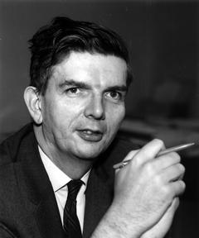
PreHistory of Dicke Group
Professor Robert Dicke of Princeton University
  Early Interest in Tests of General Relativity
    Measured the Gravitational Red Shift
    Investigated the Precession of Mercury
    Scalar-Tensor – Brans-Dicke – Alternative to General Releativty
  Considered Ranging to the Surface with Spotlight
    Insufficient Accuracy – Ranging from the Surface
    Insufficient Signal – Outgoing Beam was too Broad
  In the 1960’s – Two Great Leaps Forward
    Maiman Demonstrated the Laser
    Kennedy said We are Going to put a Man on the Moon
  Measurements of Sufficient Accuracy
    Could Finally be Accomplished!!!
Notes:
bbb

Slide 3
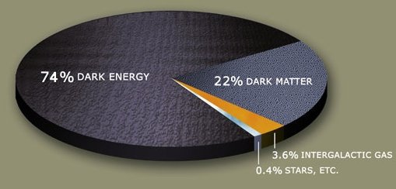
? Quantum Mechanics ?
Notes:
Bbb
Wrong - Today as we look out to the universe, the matter known to Newton and Einstein makes up less than 1% of the universe. Dark matter and dark energy dominate and we have yet to understand them. Even worse, in the last century Quantum Mechanics has accurately explained the phenomena of the small and has been tested with phenomenal accuracy. And yet we know that Einstein’s General Relativity and Quantum Mechanics cannot both be correct. So we must keep pushing on more tests of General Relativity, testing to the limit.

Slide 4
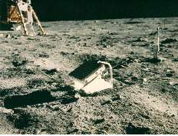
Brief History of Lunar Laser Ranging
Operational Procedure
  Transmit Narrow Laser Pulse from Earth
  Pulse is Reflected from a Fixed Point on the Moon
  Measure the Light Travel Time
  Analyze Time Series of Measurements for Frequencies
Apollo Range Improvements
  Kilometers (Radar) to ~300 mm
Continue for Long Time Series
  Originally 3 Ranges per Day
Notes:
Bbb
Back in Apollo days, a group of us, led by the University of Maryland, developed a special mirror to be carried to the moon and deployed by the astronauts. I built the “Lunar Laser Ranging Observatory” at the McDonald Observatory in Texas to fire short laser pulses to the mirror, which sent the light back to the observatory. By timing the return we were able to determine the distance of ~300 mm. While all the other Apollo experiments died after a few years, these retroreflectors are still operating and we continue to generate new discoveries about gravity and lunar physics.
20111201
bbb

Slide 5
LLR LUNAR SCIENCE
Discovery of the Inner Liquid Core
Dissipation at Liquid-Core/Mantle Interface
Physical Librations in Longitude
Lunar Moment of Inertia
Free Librations – in Crustal Frame
Love Numbers of the Crust
Notes:
Bbb
Likewise, we discovered a molten liquid core of the moon, and many other lunar properties.
ccc
Liquid Core: Fluid Core Moment of Inertia
The fluid core moment of inertia is the latest lunar geophysical parameter to emerge from the LLR analysis. Sensitivity comes because the orientations of both mantle and fluid core follow the slow motion of the ecliptic plane, while the core has diminished response to faster variations. The solution for the ratio of fluid moment to total moment gives Cf/C = (12±4)x10^{–4}. For a uniform liquid iron core without an inner core this value would correspond to a radius of 390±30 km while for the Fe-FeS eutectic the radius would be 415 km. Those two cases would correspond to fluid cores with 2.4% and 2.2% of the mass, respectively.
Tides
There is elastic information from the Apollo seismometers, but that information does not extend to the lower mantle and core. Of the three Love numbers, l2 is least sensitive to the deep zones so we solve for k2 and h2 while fixing l2 at a model value of 0.0105. Solutions give k2 = 0.0199±0.0025 and h2 = 0.042±0.008.
Dissipation from Tides and Core
There are many small perturbations on the orientation of the lunar orbit and equator planes, but there is one big effect. The key to separating the two causes of dissipation was the detection of small physical libration effects of a few milliarcseconds (mas) size. Guided by semi-analytical theories for tide and core dissipation (Williams et al., 2001), we solve for periodic terms in longitude physical librations at 1 yr (annual mean anomaly), 206 d, and 1095 d (1/2 period of argument of perigee) in addition to a tidal time delay and the fluid core Kv. The tidal time delay and the CMB dissipation are both effective at introducing a phase shift in the precessing pole direction. The solution gives dissipation from the CMB and tides. Both are strong contributors to the 0.27” offset of the precessing rotation pole from the dissipation-free pole, equivalent to a 10” shift in the node of the equator on the ecliptic plane.
Core Oblateness
Detection of the oblateness of the fluid-core/solid-mantle boundary (CMB) is independent evidence for the existence of a liquid core. In the first approximation, CMB oblateness influences the tilt of the lunar equator to the ecliptic plane (Dickey et al., 1994). Parameters for CMB flattening, core moment of inertia, and core spin vector, are introduced into torque Tcmb in the numerical integration model used for lunar orientation and partial derivatives. Equator tilt is also influenced by moment-of-inertia differences, gravity harmonics and Love number k2, solution parameters affected by CMB oblateness. Solutions can be made using the core and mantle parameters.
Torque from an oblate CMB shape depends on the product of the fluid core moment of inertia and the CMB flattening, fCf=(Cf–Af). Both are uncertain and there is no information about flattening apart from these LLR solutions. The LLR solution gives f=(Cf–Af)/Cf=(2.0±2.3)x10^{–4}. For a 390 km core radius the flattening value would correspond to a difference between equatorial and polar radii of about 80 m with a comparable uncertainty. The f uncertainty seems to imply no detection, but the oblateness parameter f correlates –0.90 with core moment. The derived oblateness varies inversely with fluid core moment, as expected theoretically, so a smaller fluid core corresponds to a larger oblateness value. The product f Cf/C=(Cf–Af)/C=(3±1)x10⁻⁷ is better determined than f alone. Core flattening appears to be detected and the foregoing product is more secure in a relative sense than the value of f itself. In the solution of this paper the corrections to core moment and CMB flattening were substantial compared to the prefit DE421 values. In the earlier solution leading to DE421 the fluid core moment was fixed (Williams, Boggs and Folkner, 2008). Updated values are anticipated with the next ephemeris.
Free Librations
Dissipation has been recognized by LLR from both tidal flexing and the fluid/solid interaction at the core/mantle boundary. Dissipation introduces a phase shift in each periodic component of the forced physical librations. The differential equations for lunar rotation have normal modes, three for the mantle and one for the fluid core. It might be expected that that the free physical librations associated with these normal modes would be imperceptible since the damping times are short compared to the age of the Moon.
However, substantial motions are found for two of the modes (Calame, 1976ab; Jin and Li, 1996; Newhall and Williams, 1997; Chapront et al., 1999; Rambaux and Williams, 2009ab) and we have to ask what is the source of stimulation? Reported here are results from the recent effort with Rambaux that analyzed the DE421 physical librations. The free physical librations depend on the initial conditions for the Euler angles and spin rates, which are adjusted during the LLR fits. The integrated Euler angles were fit with polynomials plus amplitudes and amplitude rates for trigonometric series. More than 130 periodic terms were recognized in two latitude libration angles, while longitude libration yielded 68. The free libration terms were identified among many forced terms.
The longitude mode is a pendulum-like oscillation of the rotation about the (polar) principal axis associated with moment C. The period for this normal mode is 1056 d =2.89 yr. The lunar wobble mode is analogous to the Earth’s polar motion Chandler wobble, but the period is much longer and the path is elliptical. Observed from a frame rotating with the lunar crust and mantle, the rotation axis traces out an elliptical path with a 74.6 yr period. The amplitudes are 3.3”x8.2” (28 m x 69 m). The computed damping time is about 106 yr. The two remaining free modes are retrograde precession modes when viewed from a nonrotating frame in space. The mantle free precession of the equator (or pole) has an 81 yr period. An amplitude of 0.03” is found for this mode, but there is uncertainty because the LLR fit for the integration initial conditions appears to be sensitive to the lunar interior model. The expected damping time is 2x10⁵ yr. The fluid core free precession of the fluid spin vector has an expected period >170 yr, as previously discussed under Core Oblateness; it would be 197 yr for the DE421 integration. Based on the trigonometric analysis, this mode must have a small amplitude.
Search for a Solid Inner Core
It is reasonable to expect that the Moon would have a solid core interior to the fluid core, but it remains undetected. The phase diagram for Fe-FeS shows that cooling of fluid alloys of iron and sulfur would freeze out part of the iron while concentrating sulfur compounds in the fluid (Brett and Bell, 1969). There is no direct evidence for a solid inner core. An inner core might be detected through its influence on physical librations or gravity, or through seismology. Any detection would establish the last major unit of the Moon’s structure.
Lunar Laser Ranging is sensitive to small effects in the lunar physical librations. Predicting the size of these effects depends on a number of unknown parameters including the inner core moment of inertia and gravity field, and the mantle’s gravity field interior to the CMB. An inner core might be rotating independently or it might lock to the mantle rotation through gravitational interaction. The inner core and mantle interact through their nonspherical gravity fields. This gravitational interaction is probably very much stronger than torques from the fluid core so we assume that the mean rotation rates of mantle and inner core are the same. The inner core also interacts gravitationally with the Earth. Like the mantle, the orientation of the inner core is expected to precess at the same node rate as the mantle, but not necessarily with the equator of the inner core exactly aligned with the mantle’s equator. The tilts between the two equators and the ecliptic plane will be different and this difference will cause a small variation in the external gravity field of the Moon that might be detected by spacecraft (Williams, 2007). A strong gravitational interaction between inner core and mantle tends to align their equator planes and a very weak interaction makes the orientations more independent. The inner core rotation dynamics has a resonance if the precession normal mode frequency of the inner core matches the forcing frequency of –1/18.6 yr. Close to such a resonance the two orientations could be very different. There are other forcing frequencies that can also resonate causing potentially observable effects in the physical librations. The frequency of the precession-like normal mode would determine which physical libration terms would get modified most strongly.
An inner core can also modify the physical librations in longitude. There are a large number of forcing terms for longitude librations. The inner core introduces a new normal mode with a natural frequency and that frequency will determine which longitude libration periodicities are most strongly affected. The period of the normal mode might be from less than one year to decades.
To look for inner core effects, the postfit LLR residuals for each retroreflector array have been analyzed to produce spectra. The Apollo 11 and 14 arrays are near the equator (see Fig. 2), so they will be most sensitive to longitude librations. The Apollo 15 array, well north of the equator with a small longitude, provides the most sensitivity to latitude librations. The Lunokhod 2 array is sensitive to both longitude and latitude librations, but the smallest number of observations (477 is 2.8%) gives this array the noisiest spectra.
All of the spectra are highest for periods longer than a year. The Apollo 11 spectrum is highest on either side of the 1056 d mantle resonance: 9 mm at 850 d and 10 mm at 1350 d. The Apollo 14 spectral amplitudes are highest at 1200 d (9 mm) and 2200 days (11 mm). The latter period is very interesting because it coincides with a 2190 d = 6.0 yr argument of perigee period that is a forcing term. The phase aligns more closely with the cosine of argument of perigee. If from longitude librations, the amplitude at 6.0 yr should also show in the Apollo 11 spectrum with opposite sign from Apollo 14, but we find a 5 mm amplitude with the same sign. So we cannot claim detection of an anomalous libration amplitude at 6.0 yr. The amplitudes for the Apollo 15 spectrum are all <5 mm.
The detection of the Moon’s inner core will be a major accomplishment for any technique. For LLR it is a future possibility.
Orbit Evolution
Dissipation in the Moon and Earth causes slow changes in the lunar orbit. The semimajor axis and eccentricity increase with time and the inclination decreases. Dissipation in the Moon also deposits heat in the Moon. This is a minor effect now, but could have been much more important when the Moon was closer to the Earth. Here we summarize the orbit changes.
Table 1 presents dissipation-induced secular rates for mean motion n, eccentricity e, and
Earth rotation rate ω. LLR results on two lines are compared with model computations on three. The LLR integration model for terrestrial tidal dissipation uses Love numbers and time delays for three frequency bands: zonal (long period), diurnal, and semidiurnal. For DE421 the three Love numbers and the zonal time delay were set to model values. The diurnal and semidiurnal delays were fit to LLR data in creating DE421. For the Moon, the lunar Love number k2, time delay, and CMB dissipation parameter Kv were fit for DE421. The Earth and Moon related rates in the table are computed from the DE421 Earth and Moon parameters. For the LLR fits, the Earth tide parameters are sensed through the orbit changes, but the lunar parameters are mainly determined from the physical librations. The anomalous eccentricity rate is not present in the DE421 integration, but a rate of unknown cause is routinely found to be significant. For comparison, model values of dn/dt, de/dt and dω/dt were computed for the Earth based on the IERS Conventions (McCarthy and Petit, 2003) for the main body and FES2004 results for the ocean tides (Lyard et al., 2006; Ray, 2007). There is some uncertainty in converting the terrestrial Love numbers and time delays to orbit rates, but the same theoretical expressions were used for converting the LLR and Earth model parameters and that should minimize differences. The results are presented in Table 1.
Table 1. Dissipation-induced rates for mean motion, eccentricity, and Earth rotation comparing LLR to an Earth model. units zonal diurnal In the table note that the total Earth dn/dt from LLR and the Earth model differ by <1%. An independent LLR analysis for total dn/dt of –25.858 ”/cent2 (Chapront et al., 2002) gives very good agreement with the DE421 mean longitude acceleration of –25.85 ”/cent2 given here. The DE421 value corresponds to a 38.14 mm/yr rate for semimajor axis.
There is less agreement between eccentricity rate from LLR and the Earth model because the LLR solutions mainly accommodate the tidal acceleration dn/dt that very strongly affects the LLR data. Most of the Earth tide de/dt comes from the N2 tide, while for dn/dt the M2 and O1 contributions are larger. For the lunar tides, the component with the anomalistic period is most important for de/dt. Accounting for the difference in de/dt from the simple LLR integration model and the more complete Earth model, the unexplained eccentricity rate is (0.9±0.3)x10^{–11} /yr, equivalent to an extra 3.5 mm/yr in the perigee rate. The inclination rate is not given in the table since it is computed to be only –1x10^{–6} ”/yr. The predicted Earth spin rate change is given in the last line of the table. In decreasing order, the most important tides for secular rotation acceleration are M2, S2, K1, O1, and N2. The S2 and K1 tides do not cause secular changes in lunar mean motion or eccentricity.
There is no evidence for any anomaly in the tidal acceleration in mean longitude. By contrast, the anomalous lunar eccentricity rate indicates that something is not understood well enough. Though it cannot be said with certainty that the anomaly comes from the Moon, the lunar interior is less well known than the Earth’s interior. Computation of lunar orbit evolution over long times needs a good understanding of the various contributions to the secular rates. Long-time evolution of the orbit is complex because of evolving lunar thermal conditions and changing ocean tides (Bills and Ray, 1999).
Table is missing.

Slide 6
What have the Apollo Arrays Done
Relativity Science
  LLR Currently Provides our Tests of:
    The Strong Equivalence Principle (SEP)
    Nordtvedt parameter η = (3 ± 3.6) · 10⁻⁴
    Time-Rate-of-Change of G
    (1 ± 2.5) · 10⁻¹³ , (4 ± 5) · 10⁻¹⁵
    Inverse Square Law, Deviation of 1/r
      α_{λ=400 000 km =} (3 ± 2) · 10⁻¹¹
    Geodetic Precession
    Gravitomagnetism
Notes:
Bbb
Some of the results are that the change of gravity since the big bang is less than 1%, the demonstration that there is no change of the gravitational constant between here and the moon, and many other tests of General Relativity have resulted from the analysis of the changing distance over the decades.
The arrays we placed on the moon forty years ago are still operating.
Done > achieved
“Solar orbit”
Get references for each bbb

Slide 7
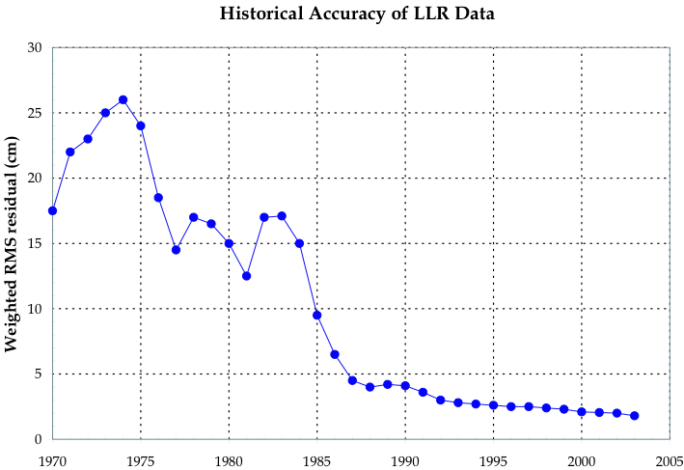
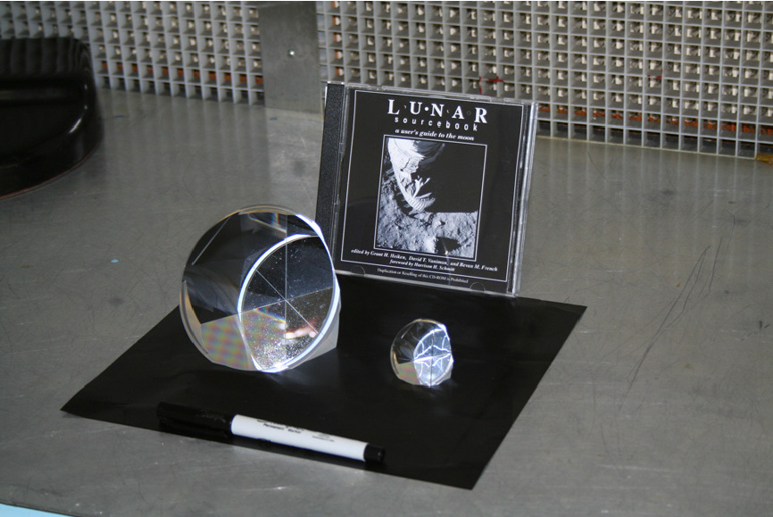
LIBRATION PROBLEMS
Why is there a Problem with the Apollo Arrays
  Lunar Librations in Tilt Both Axis by 8 degrees
  Apollo Arrays are Tilted by the Lunar Librations
  CCRs in Corner are Different Ranges by > 10 cm
CAM
Notes:
Bbb
Over the past four decades, the lunar observatories have improved their ranging accuracy by a factor of about 200, and yet the fit between observations and theory has stabilized and not improved over the past decade. This is because our Apollo arrays were composed of 100 or 300 cube corner reflectors in a panel. Over the months the moon appears to rotate slightly and then we cannot tell if the return photon came from the cube corner reflector in near corner of the panel with a shorter range or the one in the far corner. To address this NASA has supported our development of the next generation of retroreflector. This is a single large solid cube corner reflector. We will ready for flight within the next year. This should improve our ability to address gravity, relativity and the properties of the moon by a factor of 10 to 100, depending upon the method of deployment on the lunar surface.

Slide 8
CHALLENGES for a LARGE SOLID CCR
Fabrication of the CCR
Thermal Distortion of Return Beam
Stability of Emplacement
Notes:
Bbb
However, there are significant challenges that we must address with the large solid retroreflector.
ccc
The challenges for our big (more massive by a factor of eight) BigCCR
Needs lead-in
Fabrication of Large Cube Corner Reflectors to Required Tolerances
Angular Tolerances ~2.5 times More Restrictive than State of the Art
Size is a Challenge w.r.t. Homogeneity of Fused Silica Material
Thermal Control to Reduce Thermal Gradients to Acceptable levels
Thermal gradients produce gradients in the index of refraction
Thermal gradients cause spread of return beam and low returns
Emplacement Goal – A Long Term Stability of 10 microns w.r.t. CoM
Defeat Day/Night motion of the Regolith of ~200 microns
Anchor to Regolith at ~1 m – Negligible Change in Temp.
Support CCR with INVAR Rod and
Temperature Compensation in Housing
bbb

Slide 9
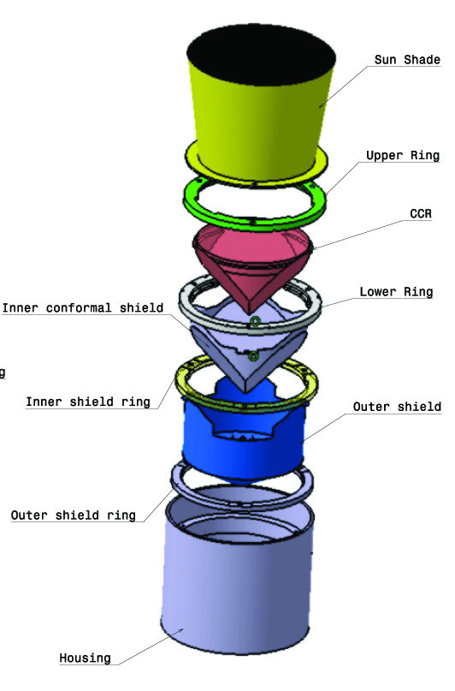
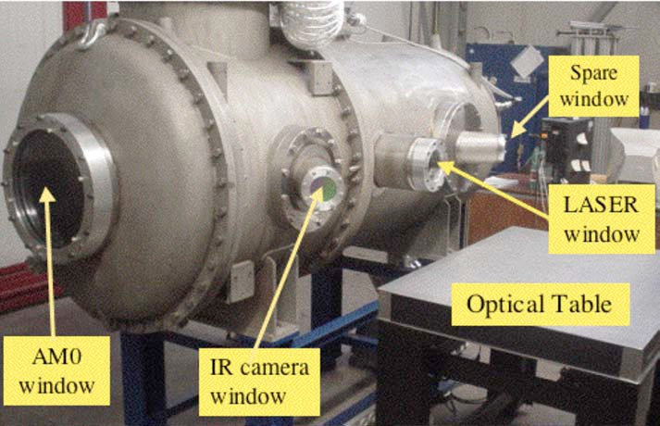
CURRENT STATUS
Preliminary Definition of Overall Package
Completed Preliminary Simulations
Completed Phase I Thermal Vacuum Tests
Notes:
Bbb
We have addressed these challenges with computer simulations and hardware testing in a special vacuum chamber in Frascati Italy
But how do we get to the moon?
We are working with lander group of European Space Agency, but they will not fly until 2017. On the other hand, commercial groups are planning to soft-land on the moon in the next two or three years. We are working with several such groups, and particularly the Moon Express group located in Mountain View California.
ccc
Separate these
Image of SCF
Image of back
Clean Room by 1 January 2011
bbb

Slide 10
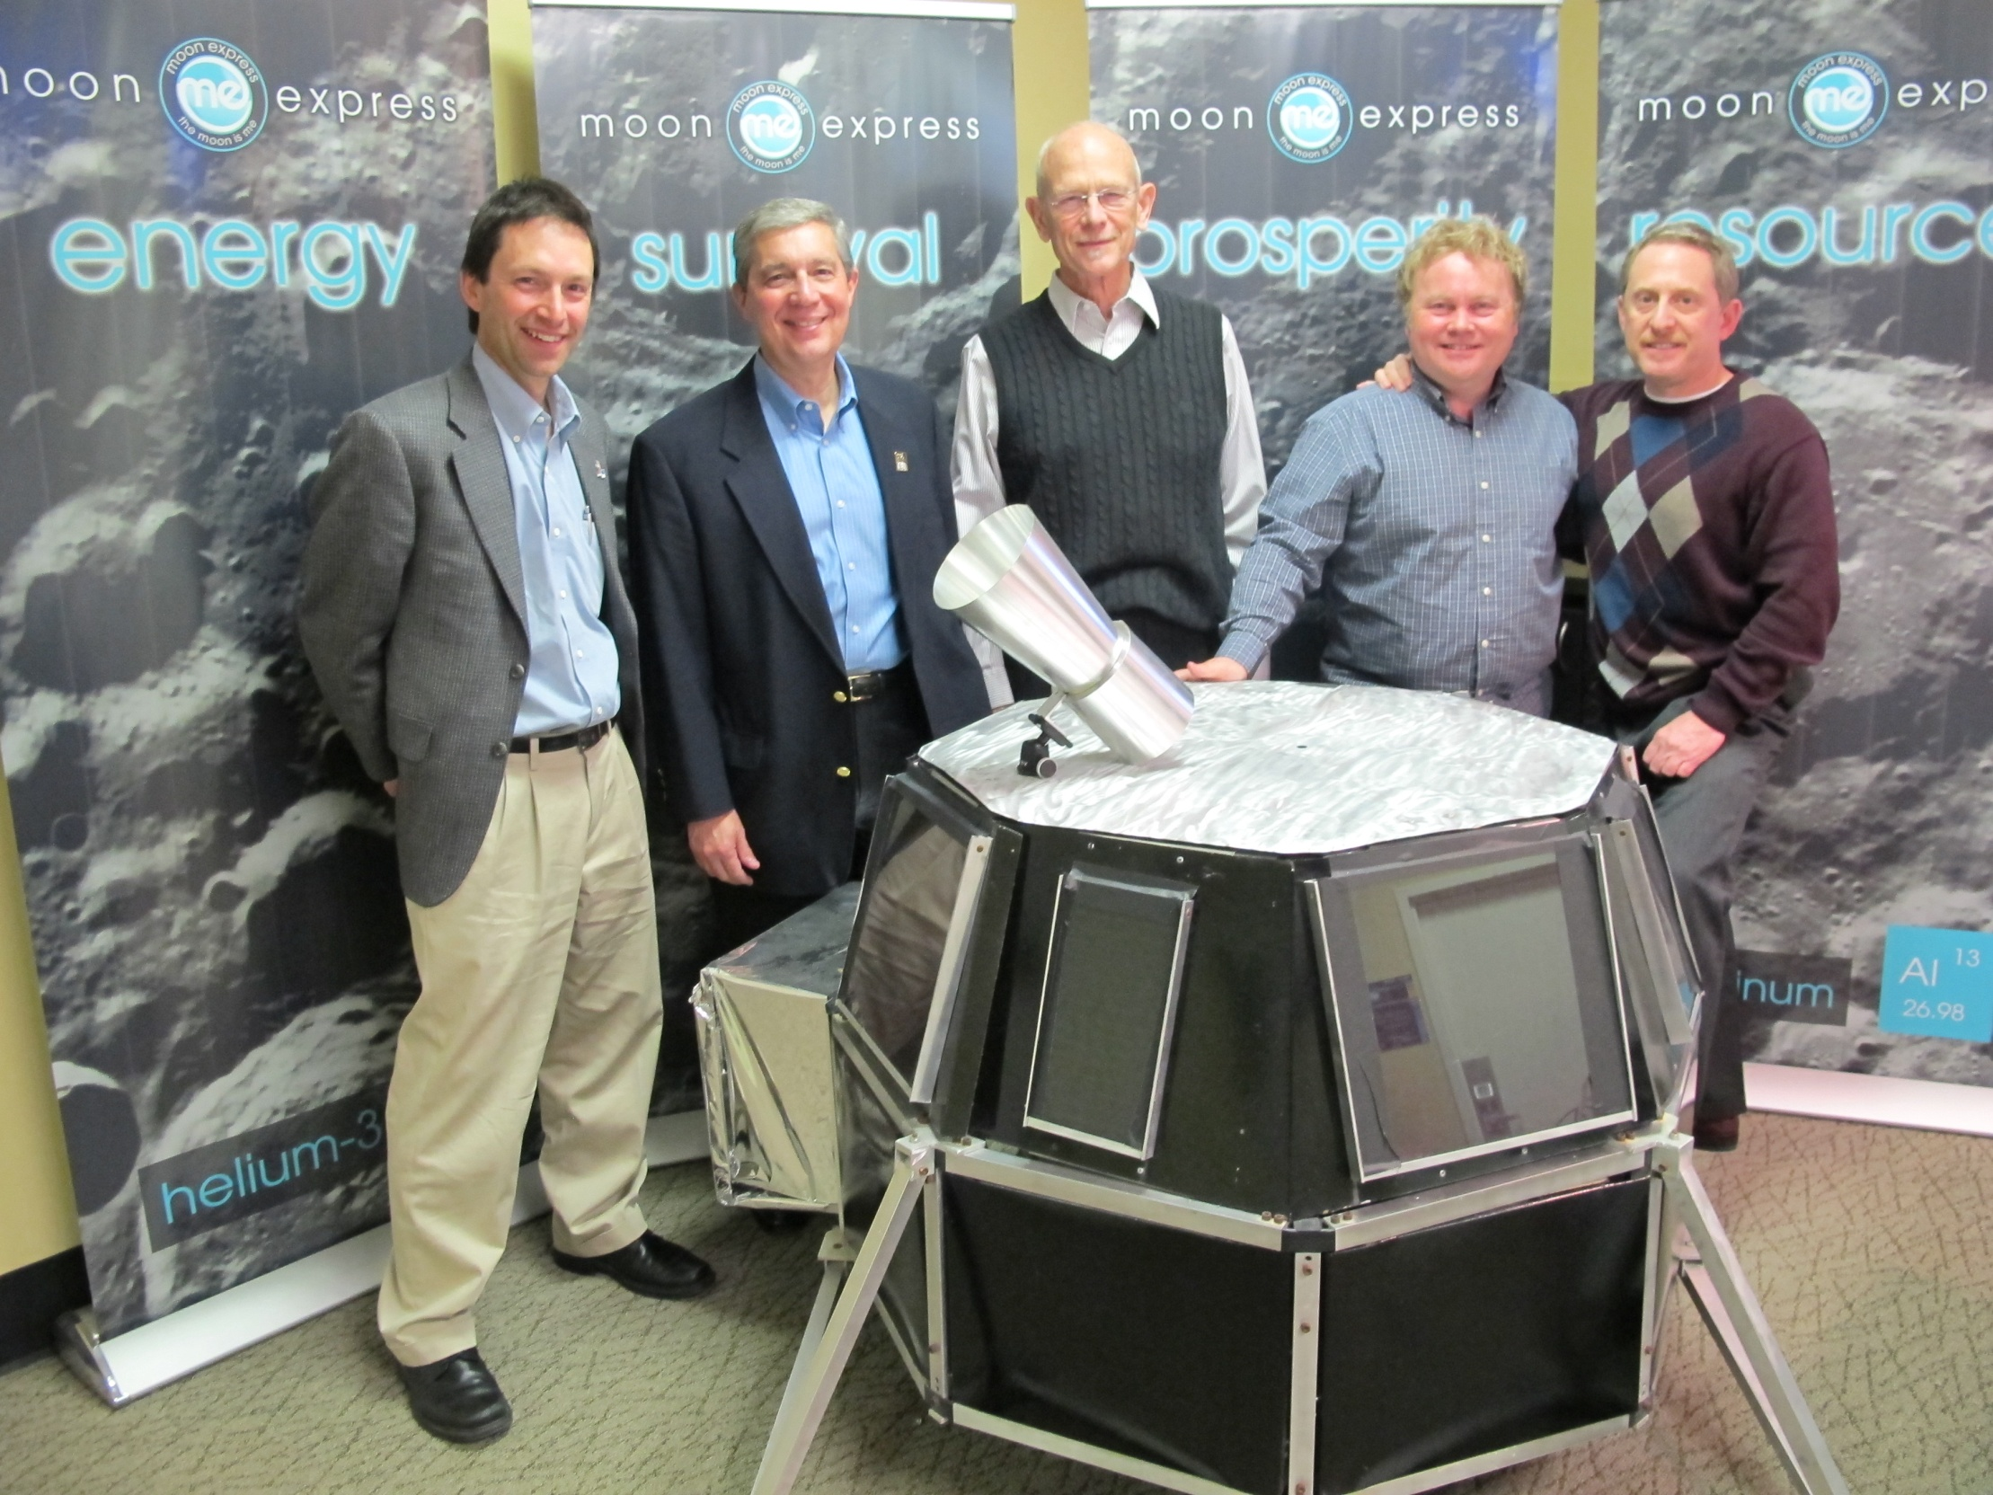
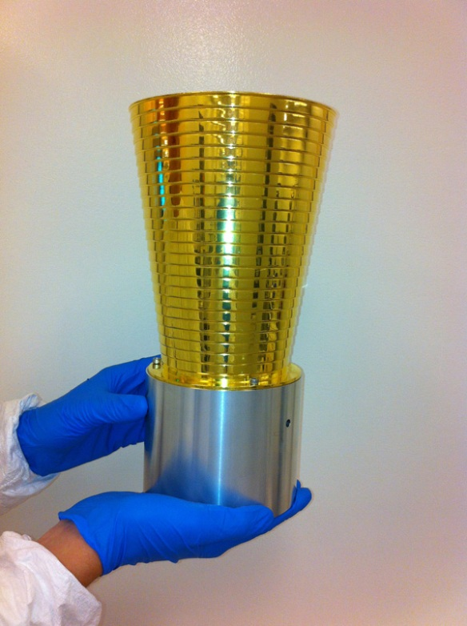
LLRRA-21 & MoonEx1
Notes:
bbb
In this photo, we see with a model of our Lunar Laser Ranging Retroreflector for the 21st Century mounted on the instrument platform of the model of their MoonEx1.
Working with these commercial groups, Moon Express, Astrobotics and SpaceX is a refreshing experience. They have the youth, enthusiasm and excitement that I enjoyed in NASA in the early days.

Slide 11
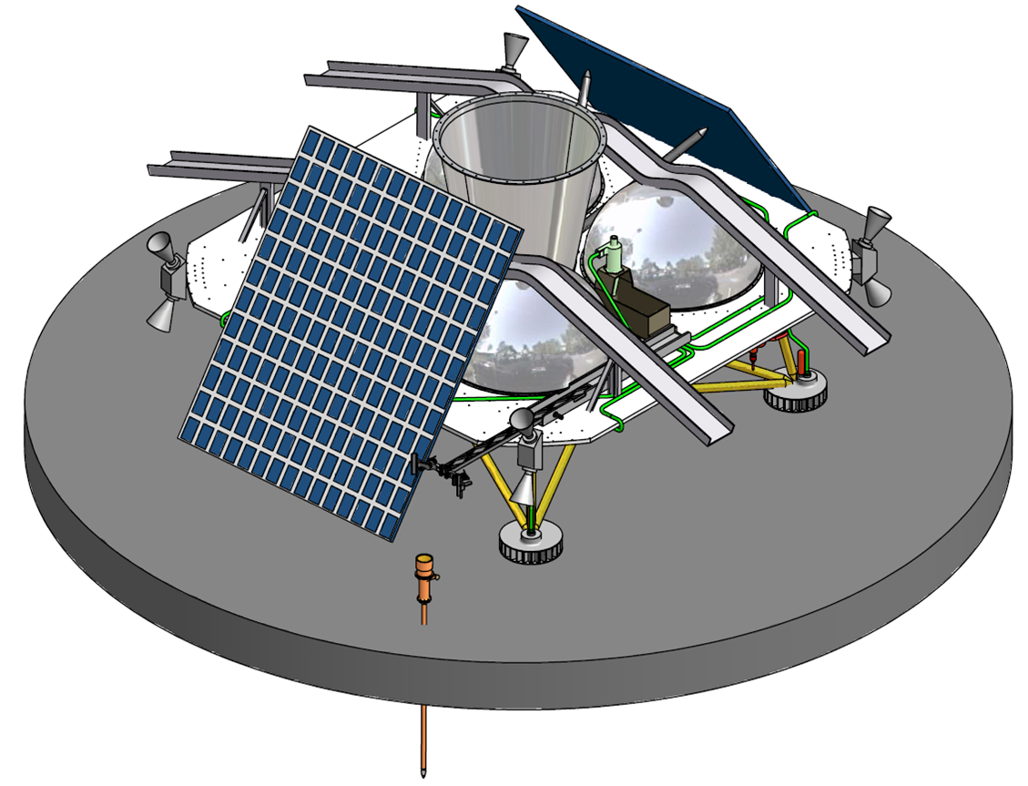
Anchored Deployment
Astrobotics & Honeybee

Slide 12
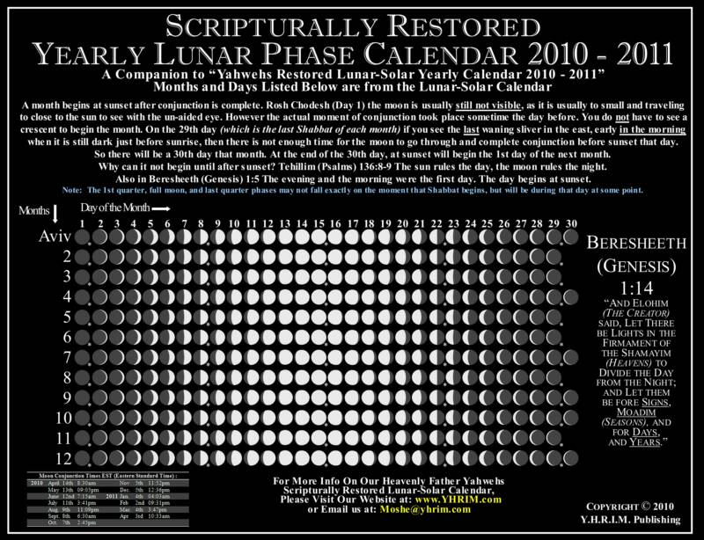
Reflector Degradation
100
what we expect
Reflector Strength (%)
50
what we really get…
1% the full moon curse
10
10%
0
0
90
180
270
360
Lunar Phase
Tom Murphy - UCSD
Notes:
Need to say that the problem *developed* over the first decade

Slide 13
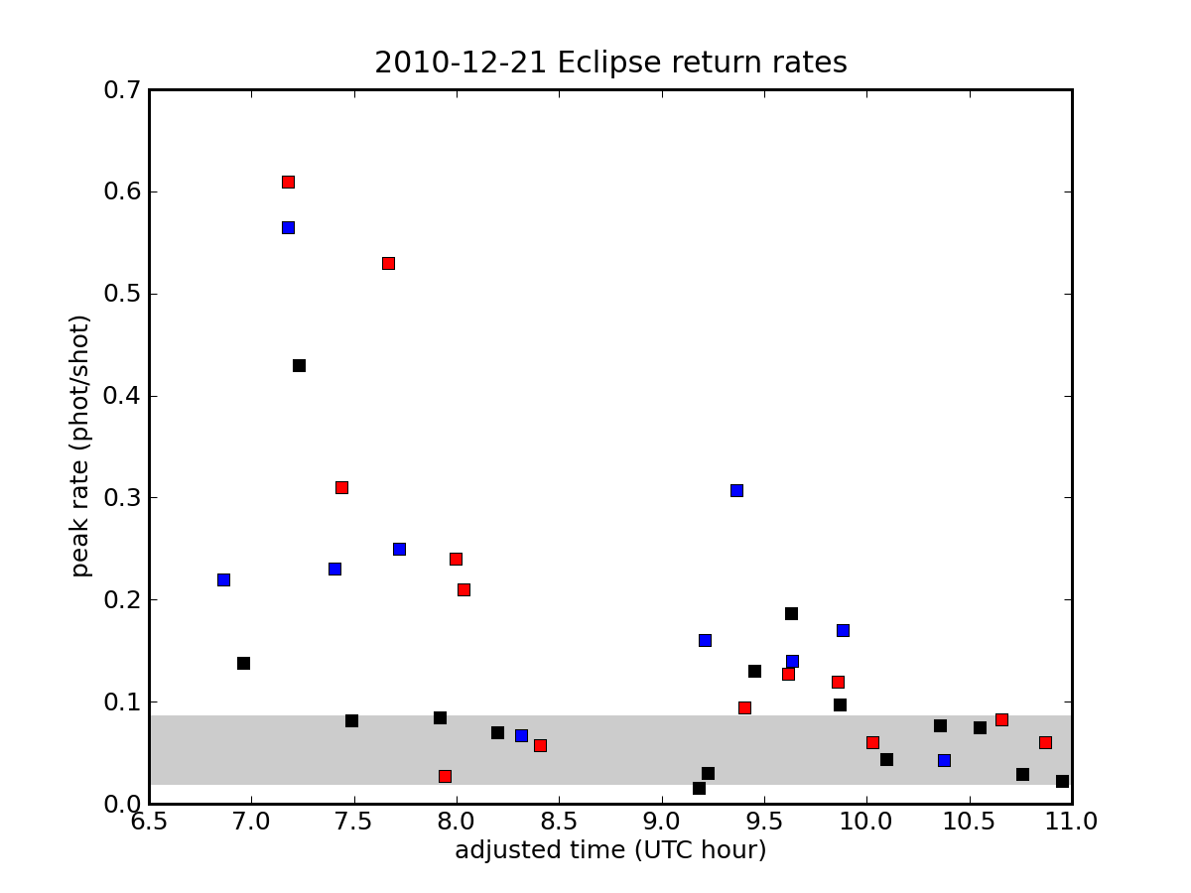
Preliminary Eclipse Results
full shadow
Apollo 11
Apollo 14
(Apollo 15)/3.0
historical peak range @ F.M.
robust recovery initially, then down, and brief resurgence once light returns
Tom Murphy - UCSD

Slide 14
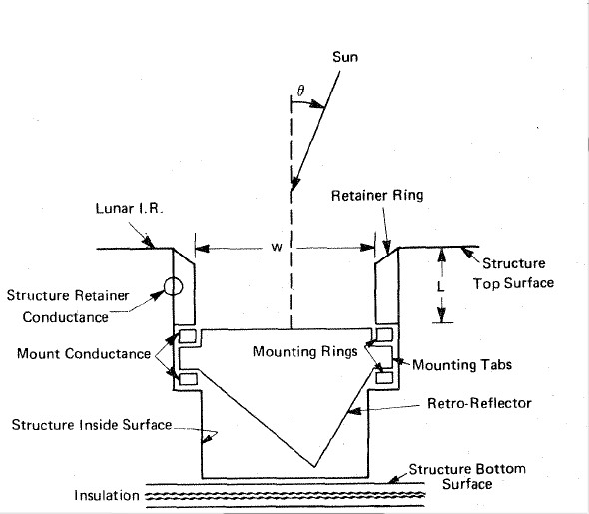
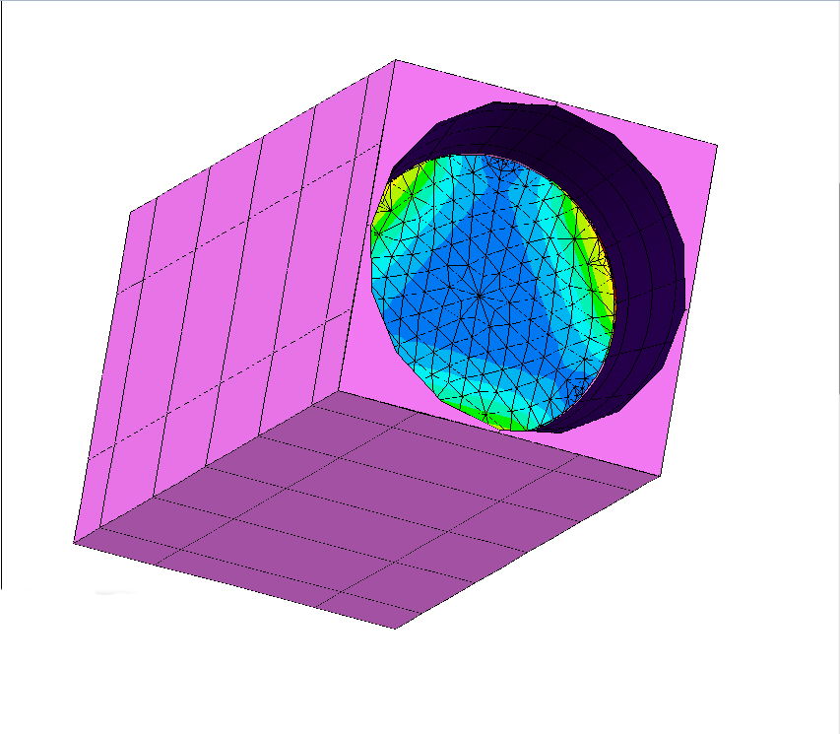
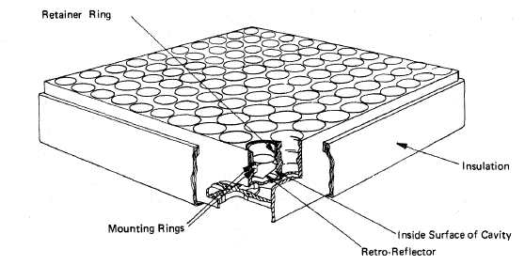
Apollo Simulation

Slide 15
CONCLUSIONS
LLRRA-21 Will Improve Ranging Accuracy
  By a Factor of 10 to 100
  Depending Upon Deployment Method
LLRRA-21 Provides a High Return
  Many More Observations/Month
  Many More Laser Ground Stations
Ready for Flight in Less than a Year – End of 2015
  Package Weighs Less than 1.7 kilogram + Pointing
  No Power or Communication Required
Google Lunar X Prize
Extremely Cost Effective for the Quality of Science
First Science on Lunar Surface in 45 Years
Notes:
Bbb
We will improve ranging accuracy and thus the science by factors of 10 to 100
We will enable more stations with higher accuracy and higher return rate
We will be ready to fly in less than a year
This is a very cost effective program for furthering our understanding of gravity
ccc

Slide 16
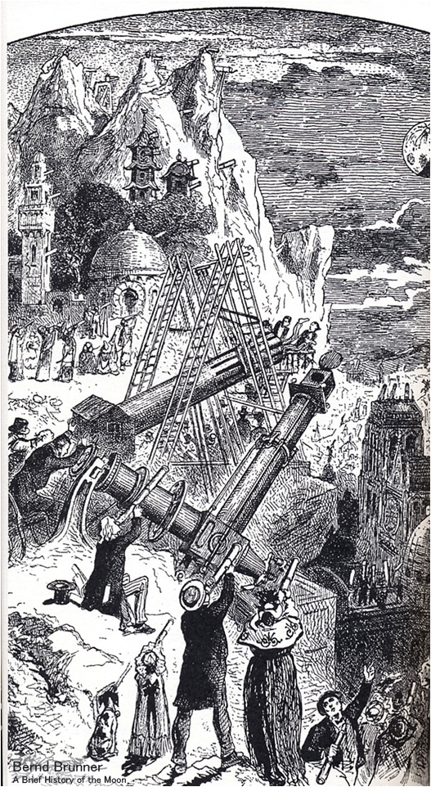
Thank You! any
Questions? or
Comments?
. with
Special Acknowledgements to
NASA Lunar Science Sorties Opportunities
NASA Lunar Science Institute
Italian Space Agency
INFN-LNF, Frascati
LSSO Team
&
LUNAR Team
.
Douglas Currie currie@umd.edu
301 412 2033
Notes:
bbb
I am happy to say, that, after many years of languishing out of the limelight,
interest in the moon is now reviving.
Ccc
ddd

Slide 17
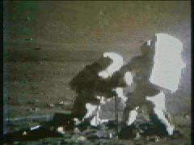
Apollo 17 - Drilling
Jack Schmitt & Gene Cernan

Slide 18
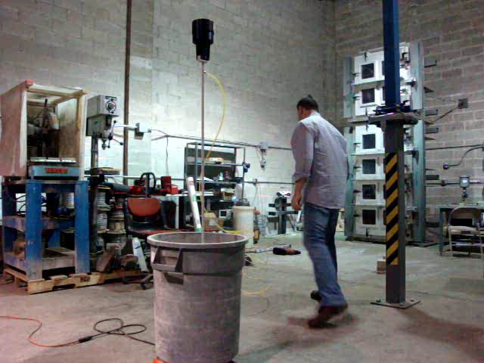
PNEUMATIC PROBOSCIS SYSTEM
Chris Zacny – Honeybee, Inc.

Slide 19
Anchored Deployment
Astrobotics & Honeybee

Slide 20
NASA Lunar Science Institute
US Member Teams
CCLADS
Lunar Dust
and
Atmosphere
POLAR
Exploration
of
Lunar Poles
CLSE
Evolution
via Samples
LUNAR
AstroPhysics
From the Moon
CLOE
Evolution
via
Bombardment
BROWN
Origin of
Terrestrial
Planets
DREAM
Dynamics
of
Exosphere
Type “HeatLoad Charts” > CR > 1 CR > then when done > exitType “HeatLoad Charts” > CR > 1 CR > then when done > exit
COSMOLOGY
LUNAR LASER RANGING
HELIOPHYSICS
UCSD
APOLLO
Station
Lunar Laser Ranging Retroreflector Array for the 21st Century
University of Maryland, College Park
GSFC
Open CCR

Slide 21
Historical Science Results
General Relativity Tests
  Strong Equivalence Principle
    Different Materials Fall toward the Sun at the Same Rate
  Inertial Properties of Gravitational Energy
    Moon is Harder to Push due to Inertia of Gravitational Self-Energy
  Change of gravitational constant
    With Time – 1% in the Life of the Universe
    In Space – No Yukawa Behavior of Gravity Between Earth and Moon
Lunar Physics
  Liquid Core – discovery, size, shape
  “Q” of the Moon – Internal Dissipation
  Crustal Properties

Slide 22
Reflector Degradation
100
what we expect
Reflector Strength (%)
50
what we really get…
1% the full moon curse
10
10%
0
0
90
180
270
360
Lunar Phase
Tom Murphy - UCSD
Notes:
Need to say that the problem *developed* over the first decade

Slide 23
Preliminary Eclipse Results
full shadow
Apollo 11
Apollo 14
(Apollo 15)/3.0
historical peak range @ F.M.
robust recovery initially, then down, and brief resurgence once light returns
Tom Murphy - UCSD

Slide 24
CONCLUSIONS
LLRRA-21 - Ready for Flight
  Moon Express by end of 2015
  Other GLXP Trams
Pioneering Role of Commercial Transport
  Allows Entrance to Space on Science Budgets
  Allows Entrance to Space for Many Countries
GLXP has been the “Spark-Plug” for This
Now Need “Taxi Fare”
  In the US - National Science Foundation
  In Italy - INFN/Italian Space Agency

