Slide 1



Gravity and fundamental physics:
Probing the Equivalence Principle at Classical and Quantum Level
Salvatore Capozzielloª and Gaetano Lambiase^{b}
  ª Università di Napoli “Federico II”
  and INFN, Sez. di Napoli, Italy
^{b} Università di Salerno
and INFN, Sez. di Napoli, Italy

Slide 2
Summary
Foundation: gravity and space-time
Shortcomings in General Relativity
Alternatives, way out and extensions
Metric or connections?
The role of Equivalence Principle
Testing EP at classical and quantum level
STE-QUEST: a possibility
Conclusions

Slide 3
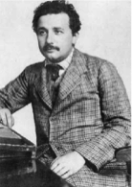
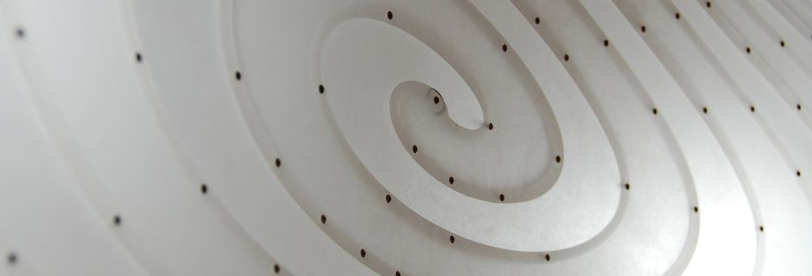
Foundation: gravity and space-time
Einstein worked hard at finding a theory
of gravity based on the following requirements:
principle of equivalence
principle of relativity
Gravity and Inertia are indistinguishable; there exist observers in free fall (inertial motion)
Special Relativity holds pointwise; the structure of the spacetime is pointwise Minkowskian
principle of general covariance
principle of causality
Riemann’s teachings about the link
between matter and curvature
“democracy” in Physics
all physical phenomena propagate respecting the light cones

Slide 4
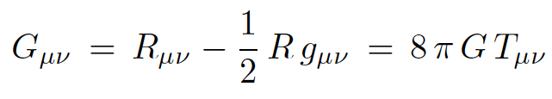
Foundation: gravity and space-time
The distribution of matter influences Gravity through 10 second order equations, nowadays called Einstein equations:
A linear concomitant of the Riemann tensor, nowadays called the Einstein tensor, equals the stress-energy tensor that reflects the properties of matter.
They have a structure that suitably reduces to Newtonian equations in the “weak field limit.”

Slide 5
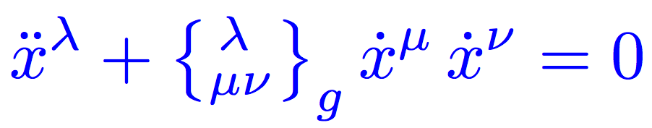

So, is g the gravitational field?
Einstein knows that it is not, since g is a tensor, while the principle of equivalence holds true! Free fall is described by the geodesics of (M, g):
This is the right object to represent the gravitational field: g is just the potential of the gravitational field... but being
constructed since g, the metric remains the fundamental variable: g gives rise to the gravitational field, to causality, to the principle of equivalence, to rods & clocks.

Slide 6




Foundation: gravity and space-time
Working on the theory of “parallelism” in manifolds, Tullio Levi-Civita understands that it is not a metric property of space, but rather a property of “affine” type, having to do with “congruences of privileged lines.”
Generalizing the case of Christoffel symbols ,
Levi-Civita introduces the notion of linear connection as the more general object
such that the equation of geodesics
is generally covariant.
A connection in a 4D space has 64 components. Only 40 if it is symmetric.
Any linear connection defines a (different) covariant derivative.

Slide 7
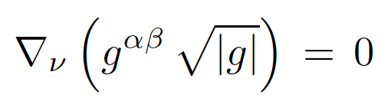
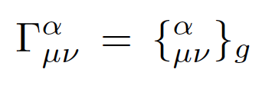
Foundation: gravity and space-time
If Γ is the Levi-Civita connection of g, then the covariant derivative of g vanishes:
If has no torsion (i.e. it is symmetric) this is a characteristic property of Γ_{L-C}(g):
Its 40 components are function of 10 fields.

Slide 8

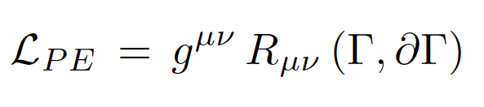
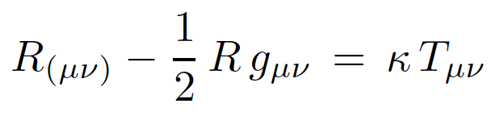
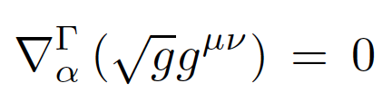
Foundation: gravity and space-time
Einstein was not so happy with the fact that the gravitational field is not the fundamental object, but just a by-product of the metric. Using a method invented few years before by Attilio Palatini, he realizes that one can obtain Einstein equations by working on a theory that depends on two variables, varied independently:
a metric g and a linear connection Γ assumed to be symmetric.
There are 10 + 40 independent variables and the equations are:

Slide 9
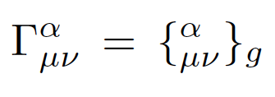
Foundation: gravity and space-time
Field equations for the 40 components of Γ ensure that Γ is the Levi-Civita connection of g (Levi-Civita theorem):
Field equations for the remaining 10 variables transform directly into Einstein equations.
In Palatini formalism, the metric g determines rods & clocks, while the connection Γ the free fall.

Slide 10
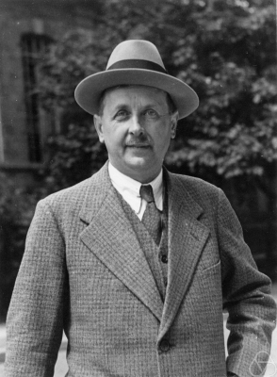
Foundation: gravity and space-time
Hermann Weyl makes a celebrated attempt to unify Gravity with Electromagnetism. He understands that Electromagnetism is a gauge field.
He introduces a scalar factor φ (a “gauge”) that point by point calibrates the interaction.
The metric g (Gravitation) and the scalar factor φ (the “phase”) determine in fact a linear connection in spacetime.
Weyl’s idea fails. The Lagrangian is not appropriate and field equations describe a “massive photon” (it is in fact a
Proca-Yukawa interaction in modern language).
Weyl’s idea generates however a keypoint: connections may have an interesting dynamics. Fields may be gauge fields - i.e. fields with group properties coming from further
principles and “internal symmetries”.

Slide 11
Shortcomings in General Relativity
Is still g the fundamental object of Gravity?
Einstein tries to consider directly the connection as the fundamental object of Gravity, but he never completes the process of “dethronizing” g.

Slide 12
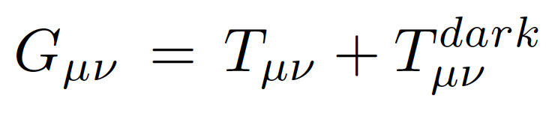
Shortcomings in General Relativity
But after all, what are the problems with GR?
GR is simple, beautiful.. but seems to be not self-consistent at all scales:
cosmological constant Λ
Inflation
Dark Matter + Dark Energy
Quantum Gravity problem
Consistency of EP at classical and quantum level
Today observations say that there is too few matter in the Universe! Thence the need, in order to save GR, for dark energy and dark matter:

Slide 13
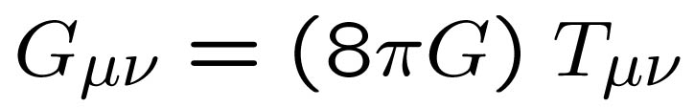
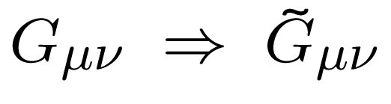
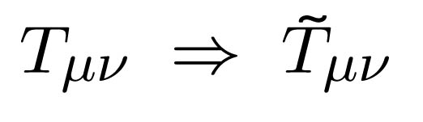
In summary: We must suitably discriminate among different theories of gravity!!!
Extended theories of Gravity
Dark Energy and Λ
WHY?
QFT on curved spacetimes
String/M-theory corrections
Brane-world models
Cosmological constant (Λ)
Time varing Λ
Scalar field theories
Phantom fields
Phenomenological Theories
Exotic matter
Curvature invariants or scalar fields have to be taken into account

Slide 14
Is there any way out to these shortcomings?

Slide 15

Alternatives, way out and extensions
A particular family of NLTG is that of f(R) theories in metric formalism, in which the Hilbert Lagrangian is replaced by any non-linear density depending on R. GR is retrieved in (and only in) the particular case f(R)=R.
In these theories there is a second order part that resembles Einstein tensor (and reduces to it if and only if f (R) = R) and a fourth order “curvature part” (that reduces to zero if and only if f (R) = R):
Higher order Gravity (4th)!
Pushing the 4th order part to the r.h.s. lets interpret it as an “extra gravitational stress” , much in the spirit of Riemann.
These theories can be recast in scalar-tensor form so the paradigm is that higher order terms can be dealt under the standard of scalar fields
(see Weyl appraach!).

Slide 16
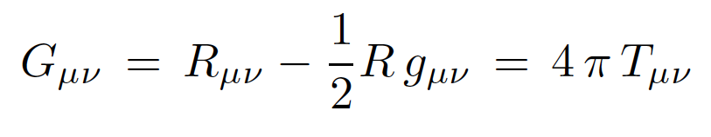
Alternatives, way out and extensions
From f(R) theories GR is retrieved in (and only in) the particular case f(R)=R.
f ’(R) = 1
Second Order
Field Equations
degenerate
theory
f ’’( R ) = 0
Gravitational contribution
Matter contribution

Slide 17
The role of Equivalence Principle
We need to investigate the EP:
discriminating among theories of gravity
its validity at classical and quantum level
investigating geodesic and causal structure

Slide 18
The role of Equivalence Principle
Einstein Equivalence Principle states:
Weak Equivalence Principle is valid;
the outcome of any local non-gravitational test experiment is independent of velocity of free-falling apparatus;
the outcome of any local non-gravitational test experiment is independent of where and when in the Universe it is performed.

Slide 19
The role of Equivalence Principle
One of the predictions of this principle is the gravitational red-shift, experimentally verified by Pound and Rebka in 1960
Gravitational interactions are excluded from WEP
and Einstein EP
In order to classify alternative theories of gravity, the Gravitational WEP and the Strong Equivalence Principle (SEP) has to be introduced

Slide 20
The role of Equivalence Principle
The SEP extends the Einstein EP by including all the laws of physics in its terms:
WEP is valid for self-gravitating bodies as well as for test bodies (Gravitational Weak Equivalence Principle);
the outcome of any local test experiment is independent of the velocity of the free-falling apparatus;
the outcome of any local test experiment is independent of where and when in the Universe it is performed.
The SEP contains the Einstein Equivalence Principle, when gravitational forces are neglected

Slide 21
The role of Equivalence Principle
Two different classes of experiments can be considered:
the first ones testing the foundations of gravitation theory (among them the EP)
the second one testing the metric theories of gravity where space-time is endowed with a metric tensor and where the Einstein EP is valid.
For several fundamental reasons extra fields might be necessary to describe the gravitation, e.g. scalar
fields or higher-order corrections in curvature invariants.

Slide 22
Several theories are characterized by the fact that a scalar field (or more than one scalar field) is coupled or not to gravity and ordinary matter
There are several reasons to introduce a scalar field:
* Scalar fields are unavoidable for theories
aimed to unify gravity with the other fundamental forces: e.g.
Superstring, Supergravity (SUGRA), M-theories.
* Scalar fields appear both in particle physics and cosmology:
- the Higgs boson in the Standard Model
- the dilaton entering the supermultiplet of higher dimensional gravity
- the super-partner of spin ½ in SUGRA.
The introduction of a scalar field gives rise typically to a possible
“violation” of the Einstein Equivalence Principle (EEP).

Slide 23
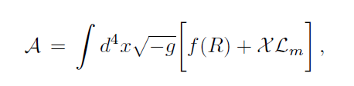



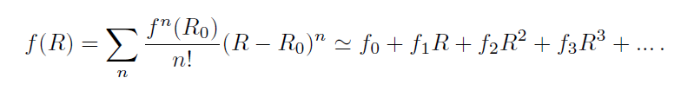
In order to distinguish competing theories, a possibility
is related to the so-called “fifth force” approach.
For example, the case of f(R)-gravity:
The variation with respect to the metric tensor gives
Trace equation

Slide 24
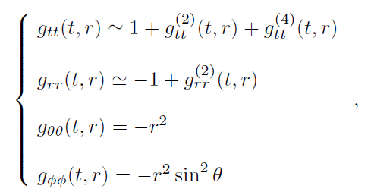
In the Newtonian limit,
let us consider the perturbation of the metric
with respect to the Minkowskin background
The metric entries can be developed as

Slide 25
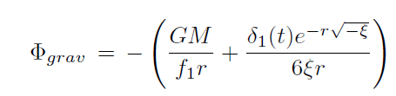


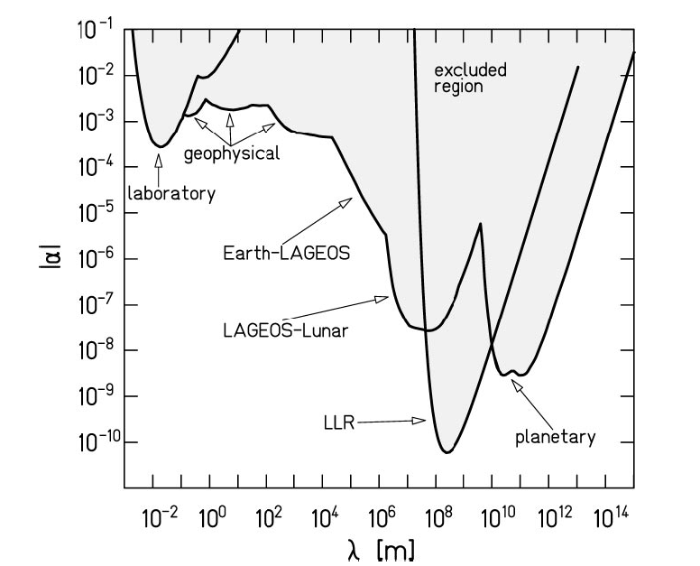
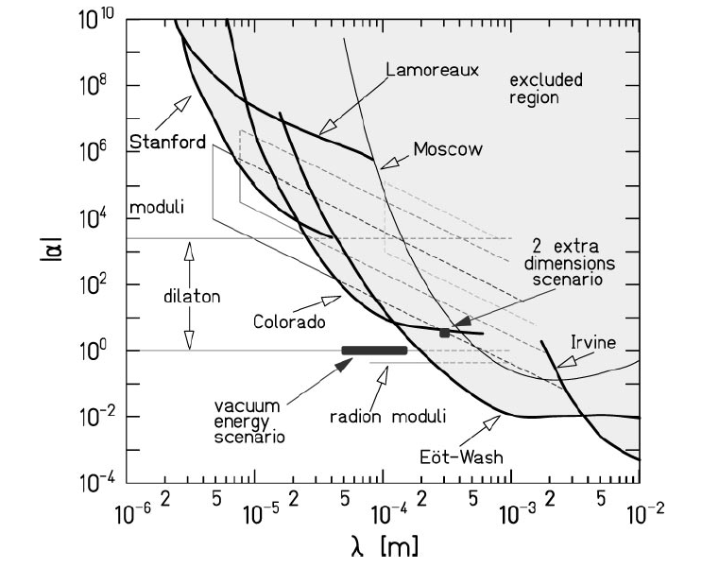
As general solution:
Fifth force
Experimental bounds

Slide 26
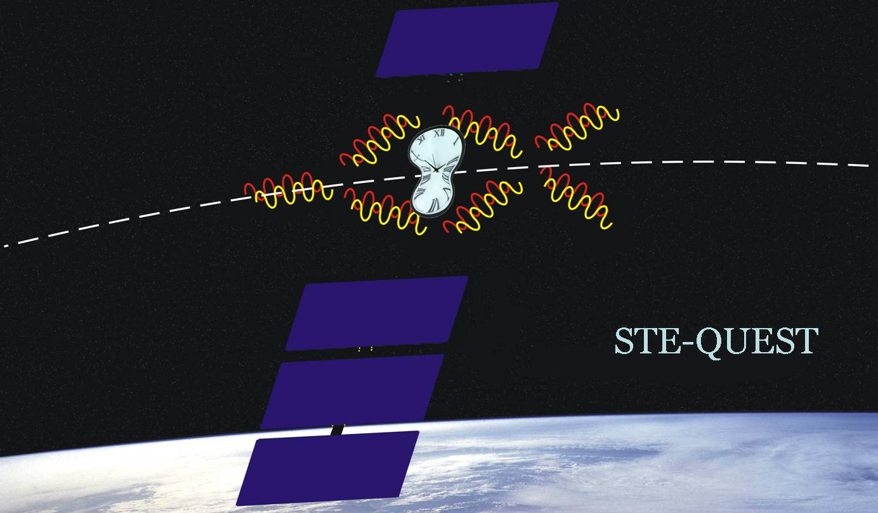
The STE-QUEST Experiment could allow:
to set and refine the bounds on space parameters
to discriminate among competing theories
fifth force
to test EP and SEP at quantum level

Slide 27
Mission Summary
Theme:
Primary Goal: To test Einstein’s Equivalence Principle to high precision and search for new fundamental constituents and interactions in the Universe
Observables: Clock redshift measurements;
Differential acceleration measurements of freely
falling atoms
Spacecraft and Instruments: Single spacecraft carrying:
A microwave clock based on laser cooled rubidium atoms;
A differential atom interferometer operating on the two rubidium
isotopes;
Time and frequency transfer links in the microwave and optical domain
for space-to-ground comparisons of clocks.
Orbit: Highly elliptical orbit around the Earth
Lifetime: 5 years
Type: M-class mission.

Slide 28
Primary Science Objectives
Scientific objective | Target accuracy
Gravitational Redshift Test
Earth gravitational redshift | Measurement of Earth’s gravitational redshift to a fractional frequency uncertainty lower than 2×10⁻⁷, with an ultimate goal of 4×10⁻⁸
Sun gravitational redshift | Measurement of the Sun's gravitational redshift to a fractional frequency uncertainty better than 2×10⁻⁶, with an ultimate goal of 6×10⁻⁷
Weak Equivalence Principle Tests
Universality of propagation of matter waves | To test the universality of the free propagation of matter waves to an uncertainty in the Eötvös parameter better than 1×10⁻¹⁵

Slide 29
Additional Science with STE-QUEST
Scientific objective | Target accuracy
Time and frequency metrology | STE-QUEST will connect atomic clocks on ground in a worldwide network, bringing important contributions to the generation of atomic time scales and to the synchronization of clocks
Relativistic geodesy: | The comparison of clocks on Earth will give access, via the red-shift formula, to differential geopotential measurements on the Earth's surface. A resolution at the level of 1 cm on the differential geoid height can be achieved by STE-QUEST
Cold-atom and matter wave physics in conditions of weightlessness | STE-QUEST will study the evolution of ultra-cold atomic samples in an environment free from perturbations and over long free-propagation times
Optical and microwave ranging | The optical and microwave links will allow the cross-comparison of different ranging techniques and the measurement of differential atmospheric propagation delays (optical vs microwave)

Slide 30
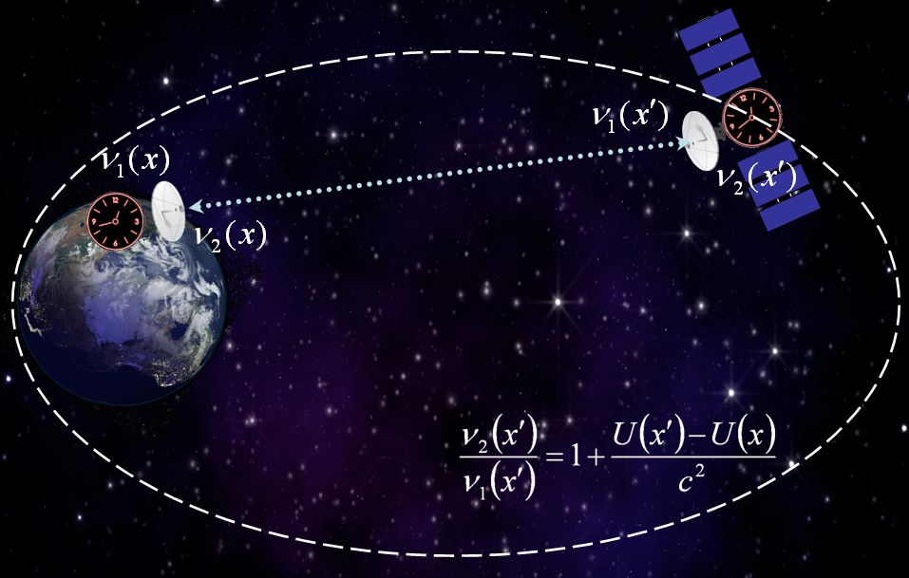
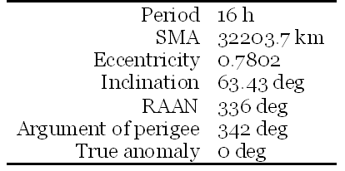
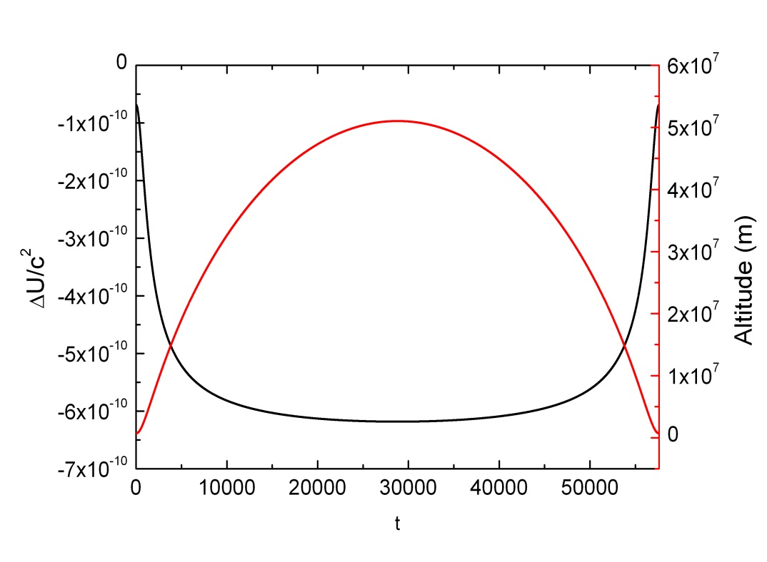
Earth Gravitational Redshift Measurements
Typical orbit parameters
Gravitational redshift measurement:
Absolute comparison of the space clocks to clock on the ground
Modulation of the redshift effect between perigee and apogee

Slide 31
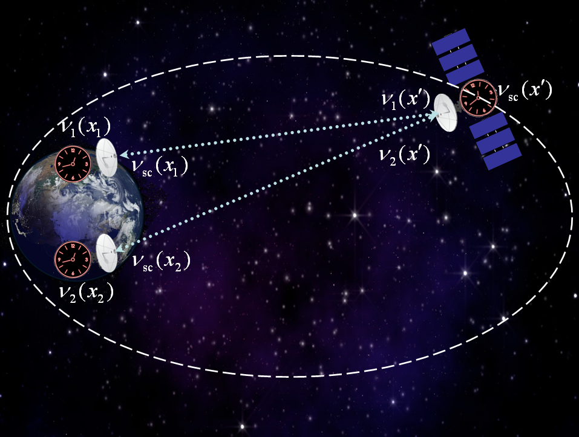
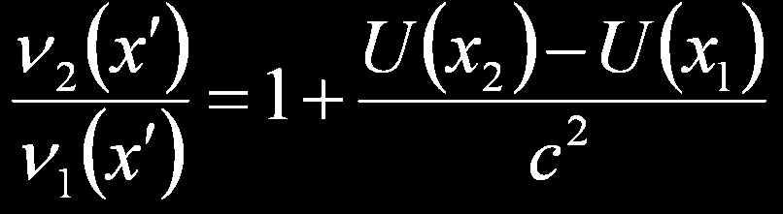
Comparison of Clocks on the Ground

Slide 32
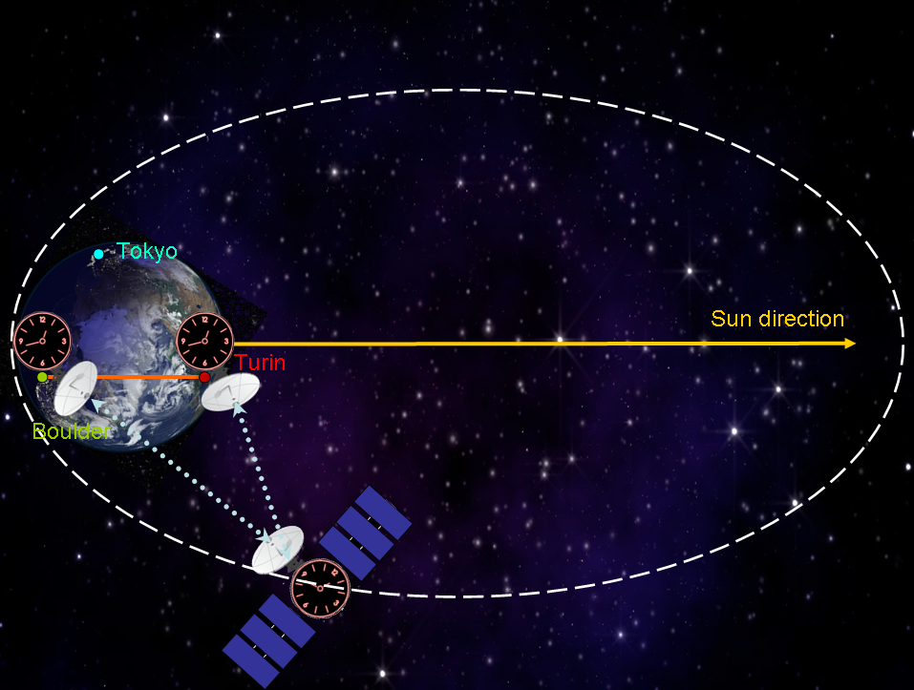
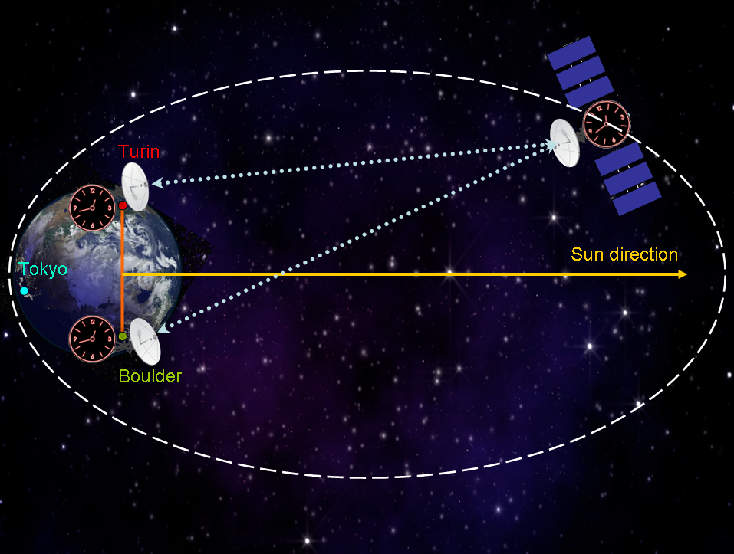
Sun Gravitational Redshift Measurements

Slide 33
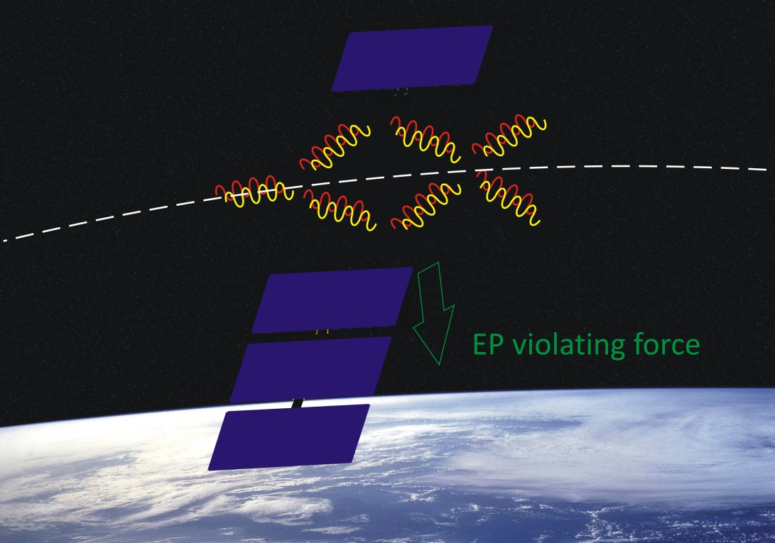
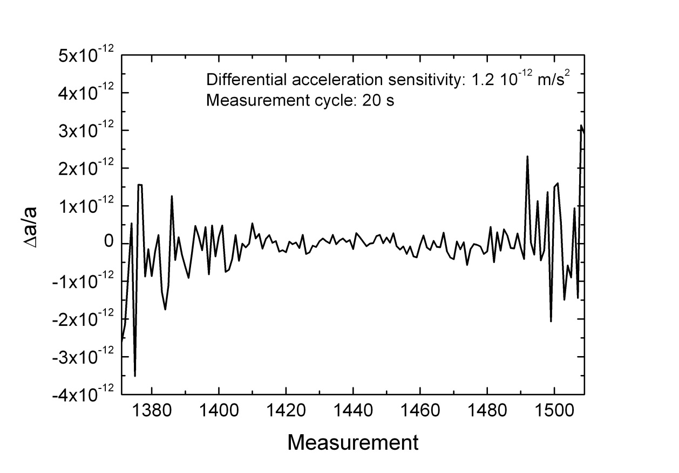
Universality of Free Motion for Matter Waves
WEP measurement:
Spacecraft with fixed orientation around perigee (g > 4.5 m/s2, h < 3000 km)
Differential acceleration measurement (⁸⁵Rb – ⁸⁷Rb) by atom interferometry

Slide 34
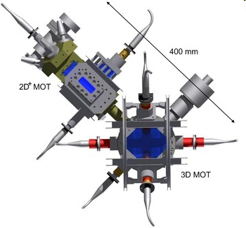
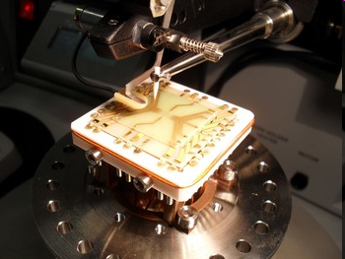
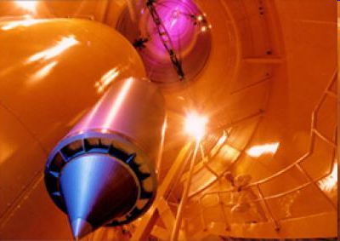
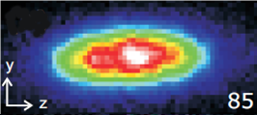
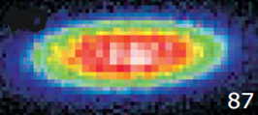
⁸⁵Rb-⁸⁷Rb Differential Atom Interferometer
Testing the Weak Equivalence Principle:
  Differential acceleration measurement on two sample of ultra-cold ⁸⁵Rb and ⁸⁷Rb atoms;
  Long interrogation times (T~1-10 s): 2 to 3 orders of magnitude improvement with respect to ground based instruments;
  10⁷ rejection ratio of common mode acceleration noise (drag and mechanical vibration)
  Absolute sensor with precisely known scale factor;
  Atom interferometry measurements performed in a small size vacuum system: simplified control of external perturbations (magnetic, thermal, etc).
QUANTUS (DLR)

Slide 35
Conclusions
Several shortcoming in standard General Relativity
We have to test the fundamental gravitational
fields. Is it g or Γ ?
Coincidence of geodesic and causal structures strictly
depends on the validity of the Equivalence Principle
(Levi-Civita)
Discrimination of gravitational theories at quantum level
Tools: atomic clocks, free fall, space-craft (STE-QUEST)
WORK IN PROGRESS!!!

