Slide 1
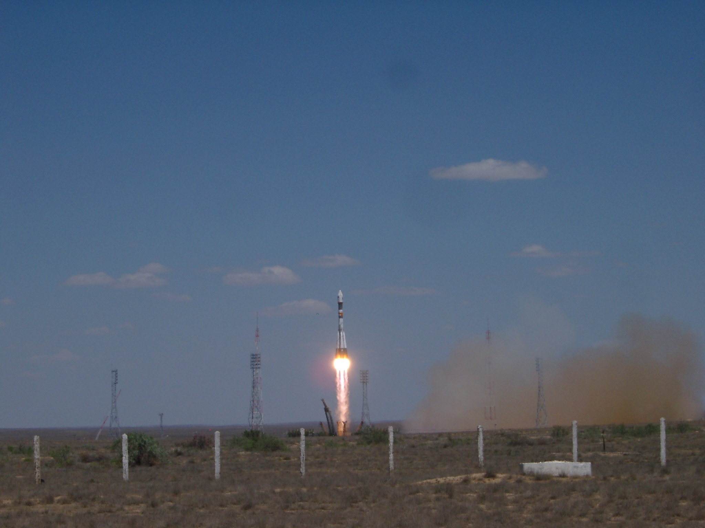
The PAMELA space experiment: results after seven years in orbit
Mirko Boezio
INFN Trieste, Italy
On behalf of the PAMELA collaboration
INFN-Space/3, Frascati
September 18th 2013

Slide 2







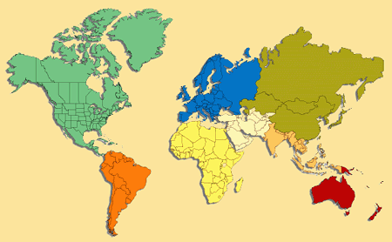





PAMELA Collaboration
Italy:
Bari
Florence
Frascati
Naples
Rome
Trieste
CNR, Florence
Russia:
Moscow
St. Petersburg
Germany:
Sweden:
Siegen
KTH, Stockholm

Slide 3
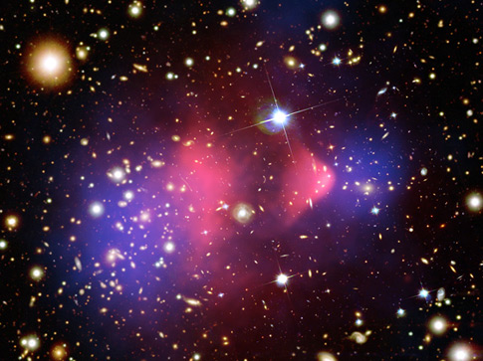
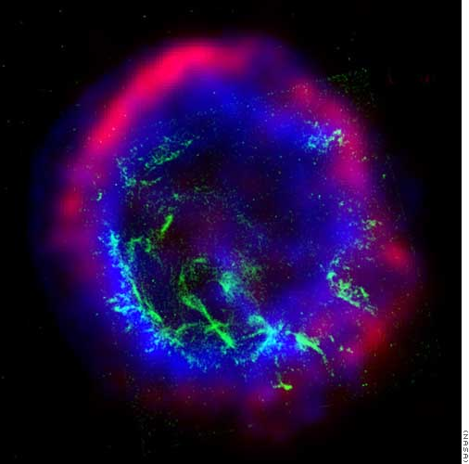
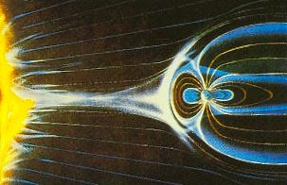
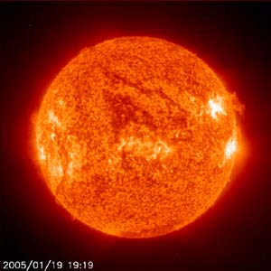
Scientific goals
Search for dark matter annihilation
Search for antihelium (primordial antimatter)
Search for new Matter in the Universe (Strangelets?)
Study of cosmic-ray propagation (light nuclei and isotopes)
Study of electron spectrum (local sources?)
Study solar physics and solar modulation
Study terrestrial magnetosphere

Slide 4
PAMELA Apparatus

Slide 5
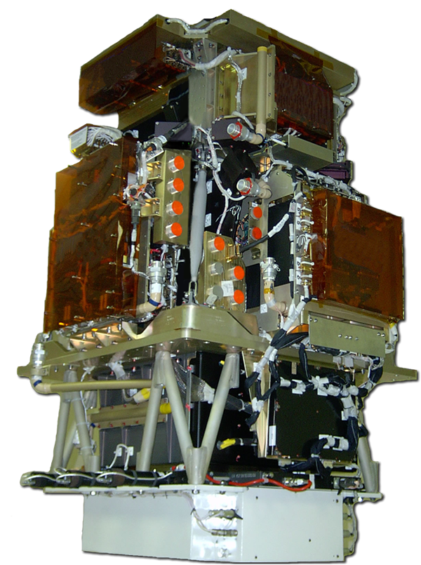
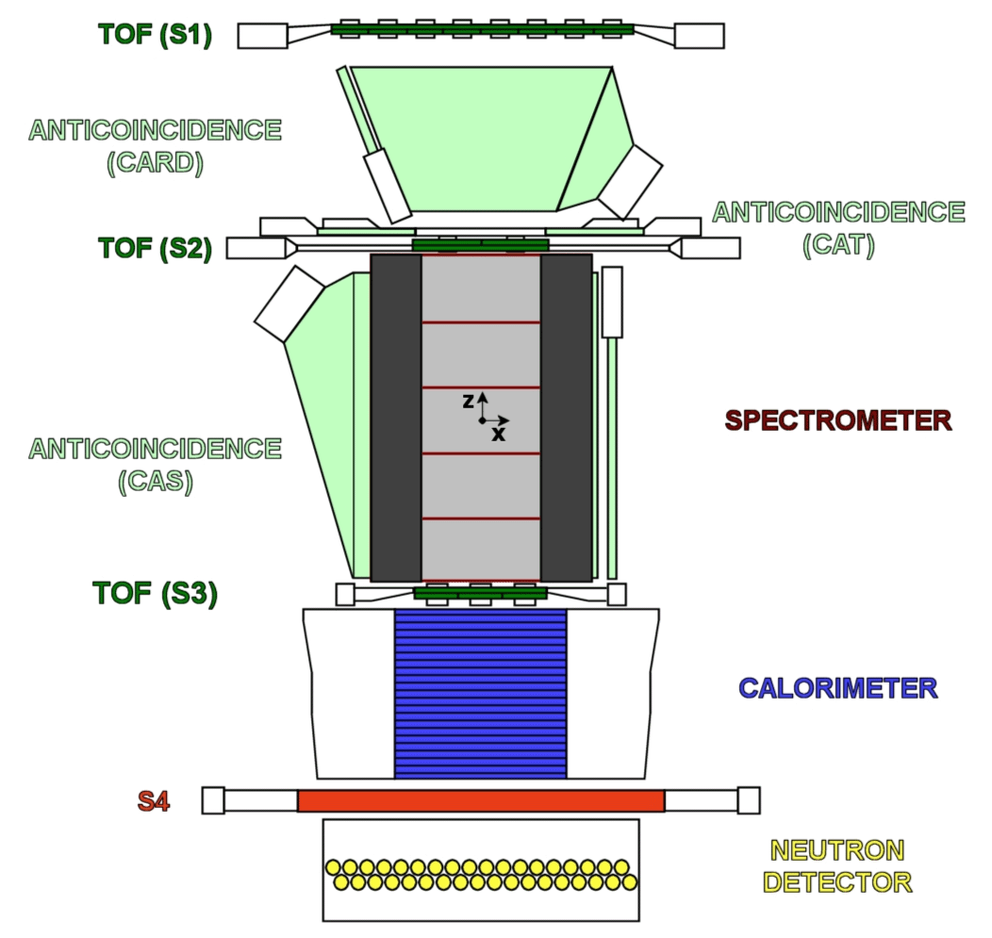
PAMELA Detectors
Main requirements → high-sensitivity antiparticle identification and precise momentum measure
+ -
Time-Of-Flight
plastic scintillators + PMT:
Trigger
Albedo rejection;
Mass identification up to 1 GeV;
- Charge identification from dE/dX.
Electromagnetic calorimeter
W/Si sampling (16.3 X₀, 0.6 λI)
Discrimination e+ / p, anti-p / e⁻
(shower topology)
Direct E measurement for e⁻
Neutron detector
³He tubes + polyethylene moderator:
High-energy e/h discrimination
GF: 21.5 cm² sr Mass: 470 kg
Size: 130x70x70 cm³
Power Budget: 360W
Spectrometer
microstrip silicon tracking system + permanent magnet
It provides:
  - Magnetic rigidity → R = pc/Ze
  Charge sign
  Charge value from dE/dx
Notes:
Overview of the apparatus

Slide 6
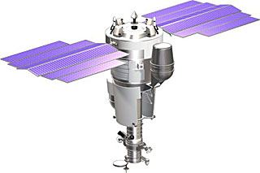
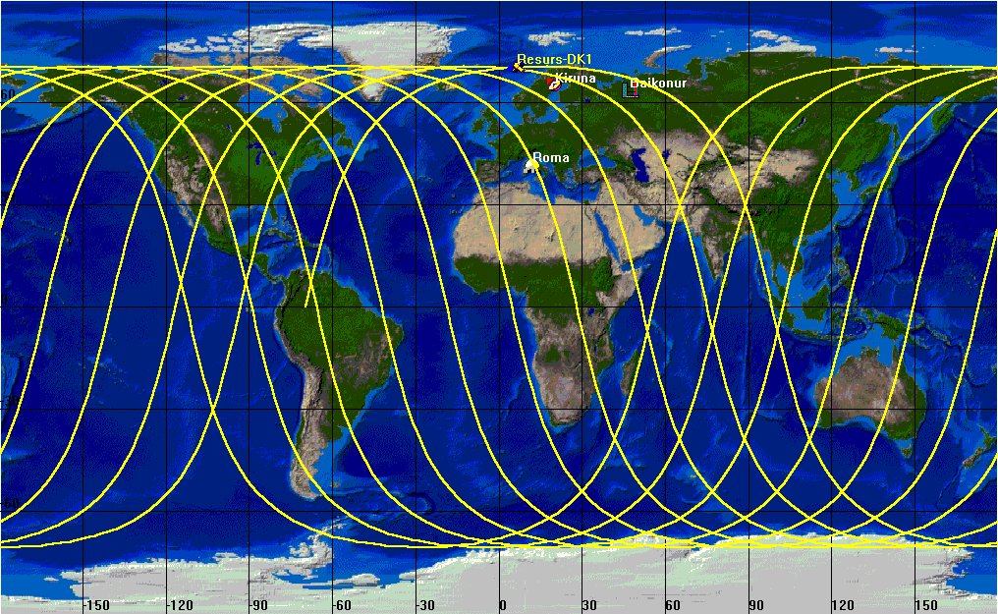
Resurs-DK1 satellite + orbit
Resurs-DK1: multi-spectral imaging of earth’s surface
PAMELA mounted inside a pressurized container
Lifetime >3 years (assisted, first time February 2009), extended till end of satellite operations
Data transmitted to NTsOMZ, Moscow via high-speed radio downlink. ~16 GB per day
Quasi-polar and elliptical orbit (70.0°, 350 km - 600 km) – from 2010 circular orbit (70.0°, 600 km)
Traverses the South Atlantic Anomaly
Crosses the outer (electron) Van Allen belt at south pole
PAMELA
Resurs-DK1
Mass: 6.7 tonnes
Height: 7.4 m
Solar array area: 36 m²
350 km
70º
SAA
610 km
~90 mins

Slide 7
Cosmic Ray Spectra
Cosmic-Ray Acceleration and Propagation in the Galaxy

Slide 8
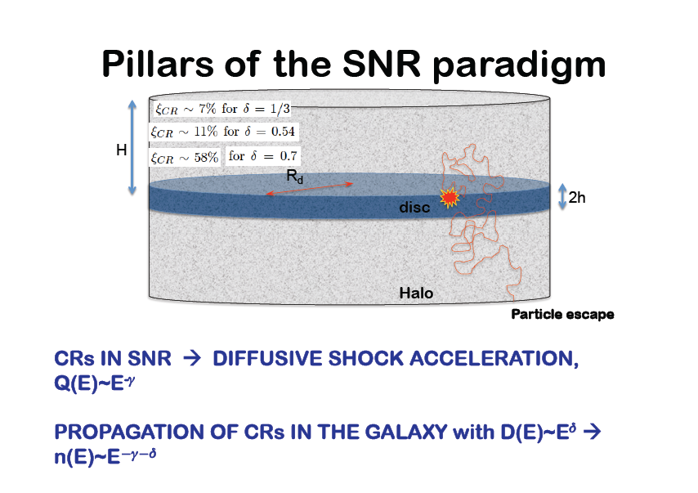
P. Blasi, TeVPA 2011, Stockholm 2011

Slide 9
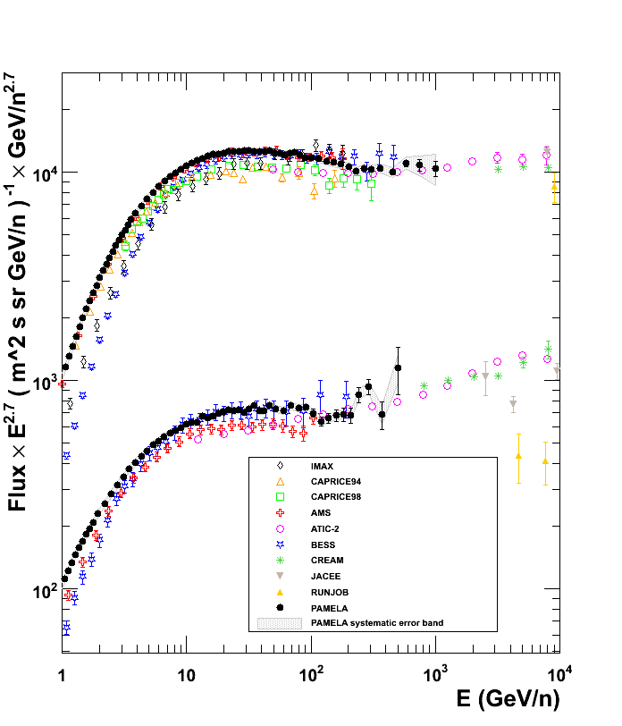
Proton and Helium Nuclei Spectra
O. Adriani et al., Science 332 (2011) 69

Slide 10
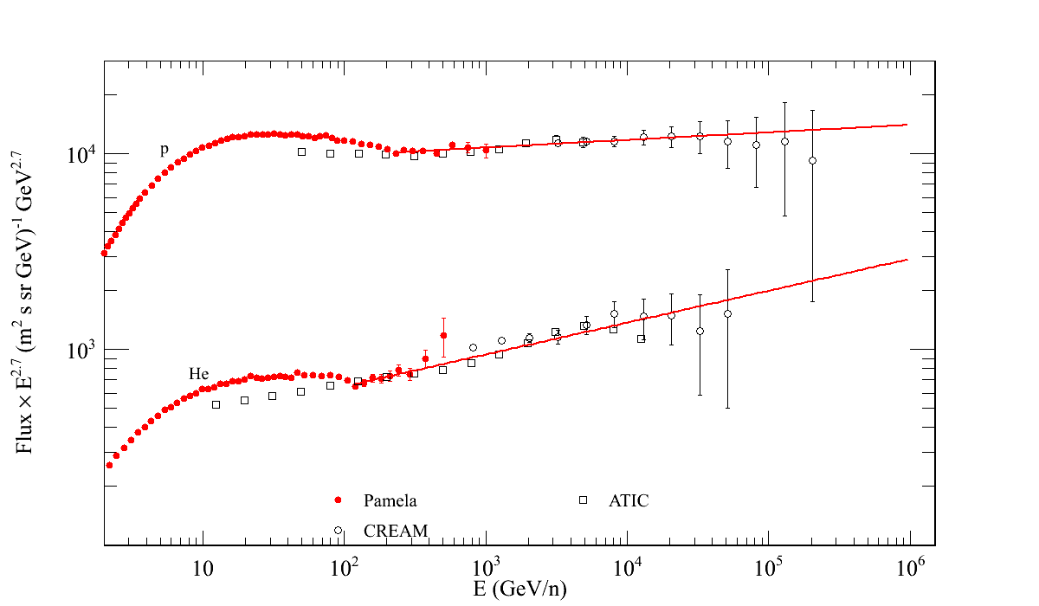
Proton and Helium Nuclei Spectra

Slide 11
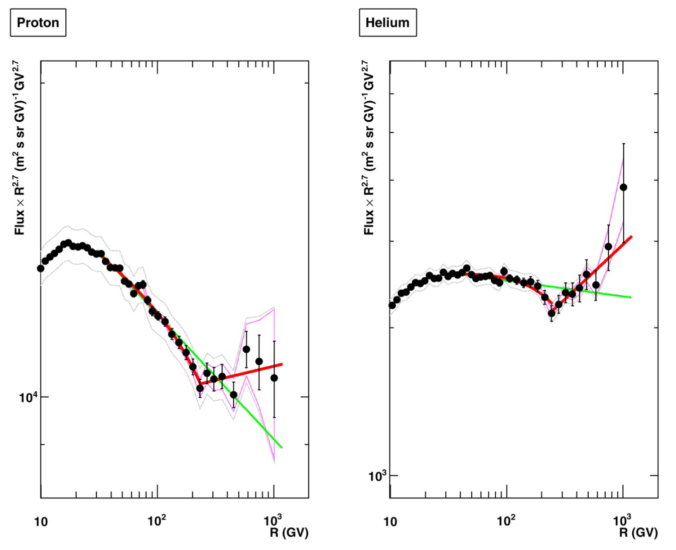
H & He absolute fluxes @ high energy
2.85
Spectral index
2.77
2.67
2.48
Deviations from single power law (SPL):
Spectra gradually soften in the range 30÷230GV
Spectral hardening @ R~235GV Δγ~0.2÷0.3
SPL is rejected at 98% CL
Origin of the structures?
- At the sources: multi-populations, non-linear DSA
- Propagation effects
232 GV
243 GV
Solar modulation
Solar modulation
H
He

Slide 12
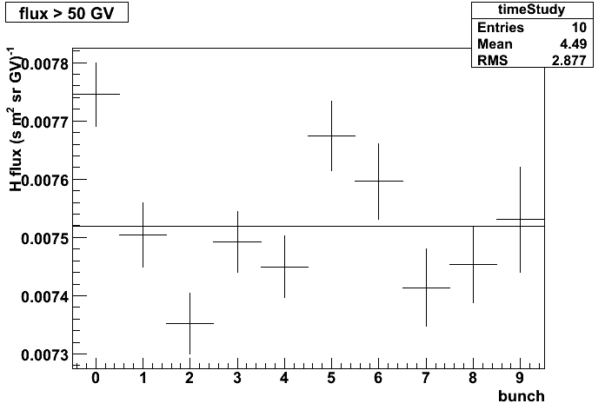
Check of systematics
Integral proton flux (>50GV)
Fluxes evaluated by varying the selection conditions:
Flux vs time
Flux vs polar/equatorial
Flux vs reduced acceptance
Flux vs different tracking conditions (⇒ different response matrix)
…
3%
Time interval (2 months)

Slide 13
PAMELA & AMS

Slide 14
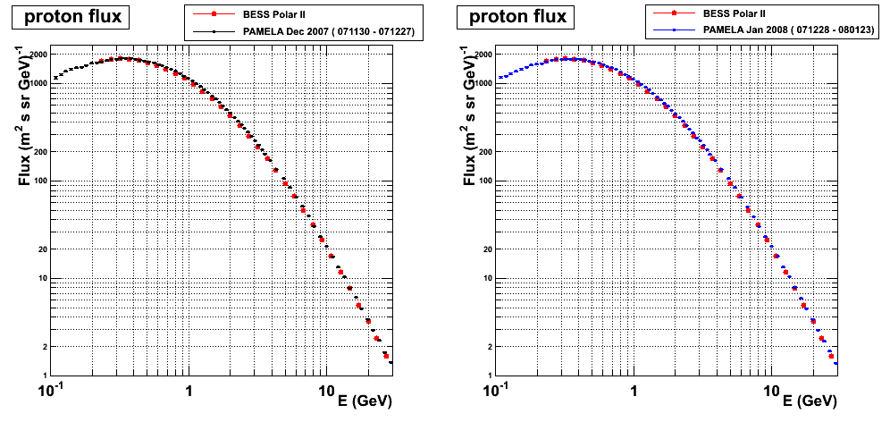
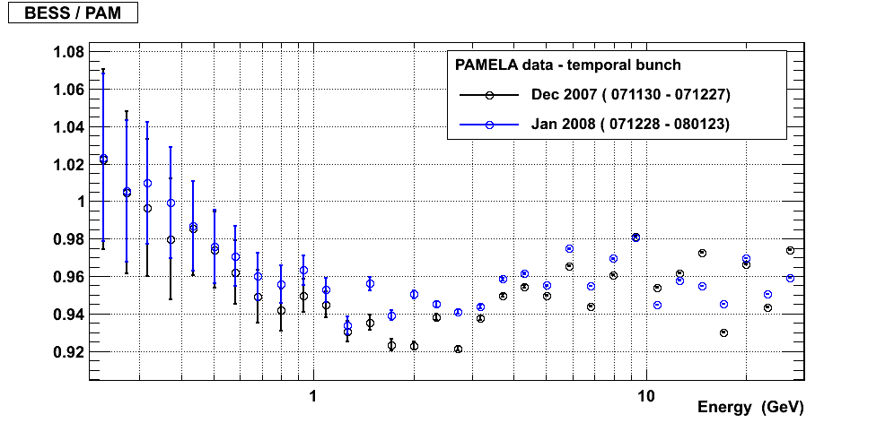
PAMELA & BESS-PolarII proton spectrum

Slide 15
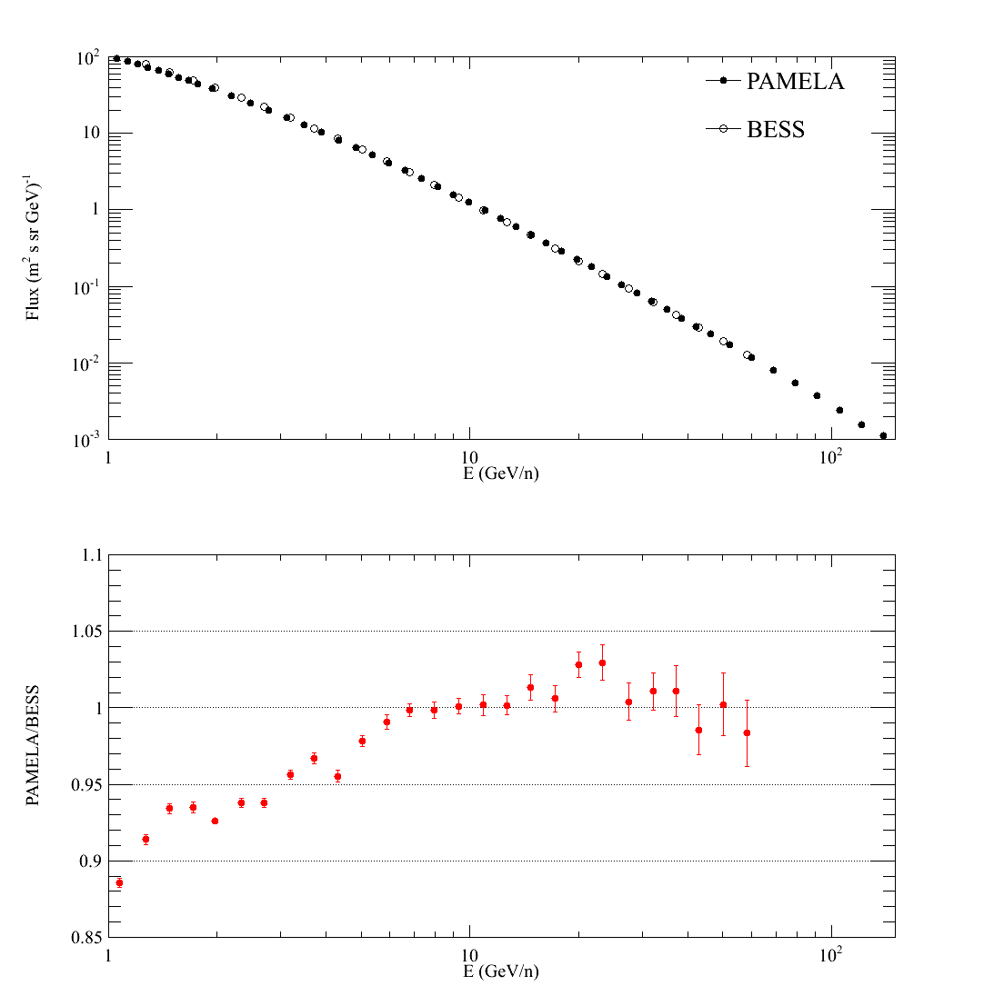
PAMELA & BESS-PolarII helium spectrum

Slide 16
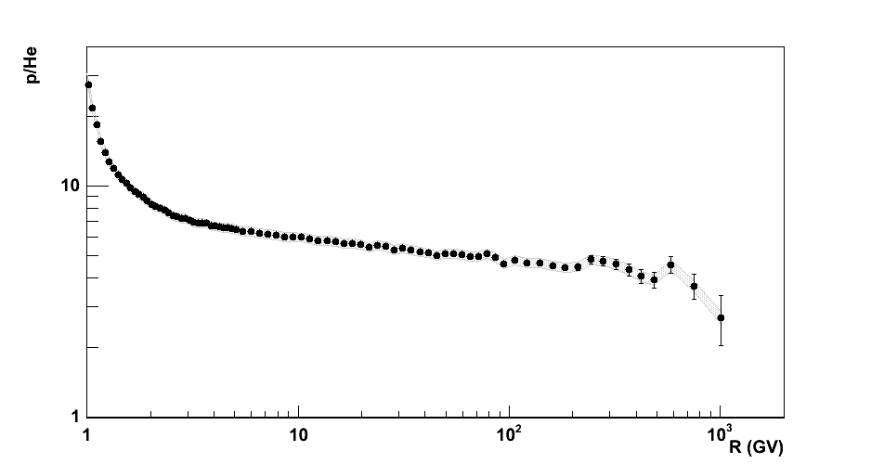
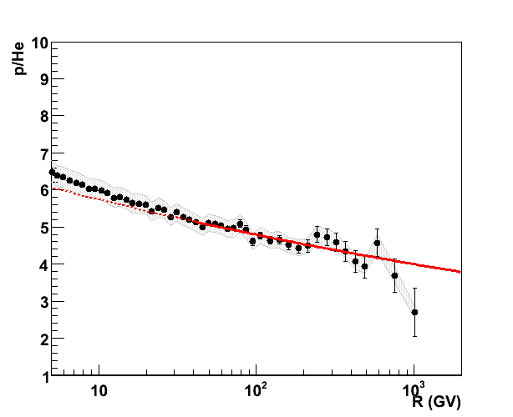
H/He ratio vs R
Instrumental p.o.v.
Systematic uncertainties partly cancel out
Theoretical p.o.v.
Propagation effects small above ~100GV → information about source spectra
Power-law fit (χ²~1.3)
α_{He}-α_{p} = 0.078 ±0.008

Slide 17
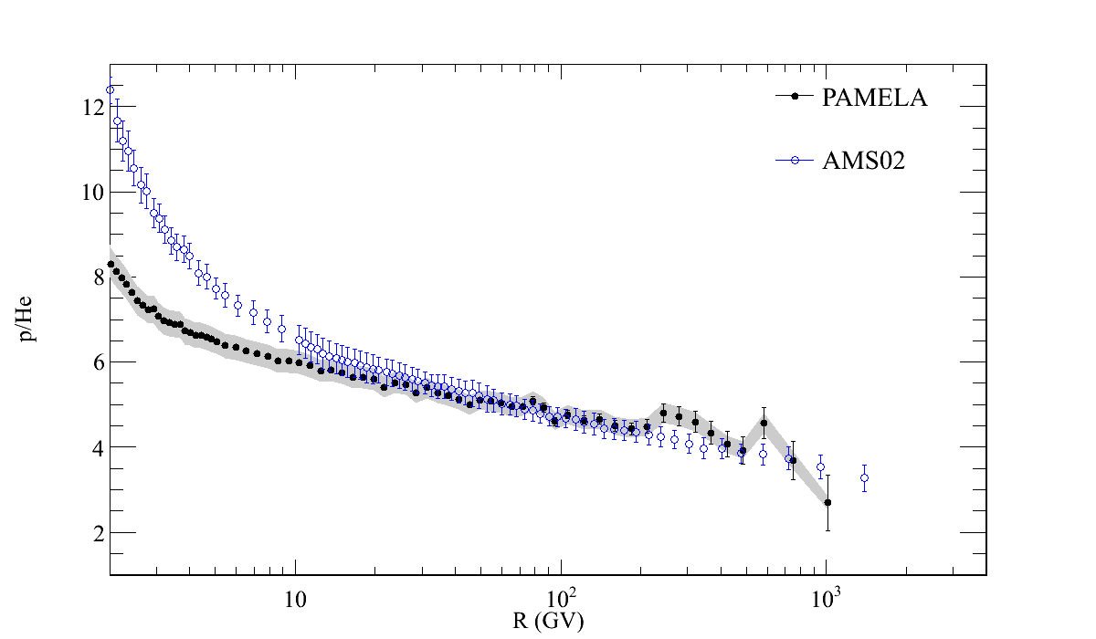
H/He ratio vs R
Instrumental p.o.v.
Systematic uncertainties partly cancel out
Theoretical p.o.v.
Propagation effects small above ~100GV → information about source spectra

Slide 18
Light Nuclei and Isotopes
Tuning of cosmic-ray propagation models with measurements of secondary/primary flux ratio
²H/¹H and ³He/⁴He are complimentary to B/C measurements in constraining propagation models (Coste et al., A&A 539 (2012) A88)

Slide 19
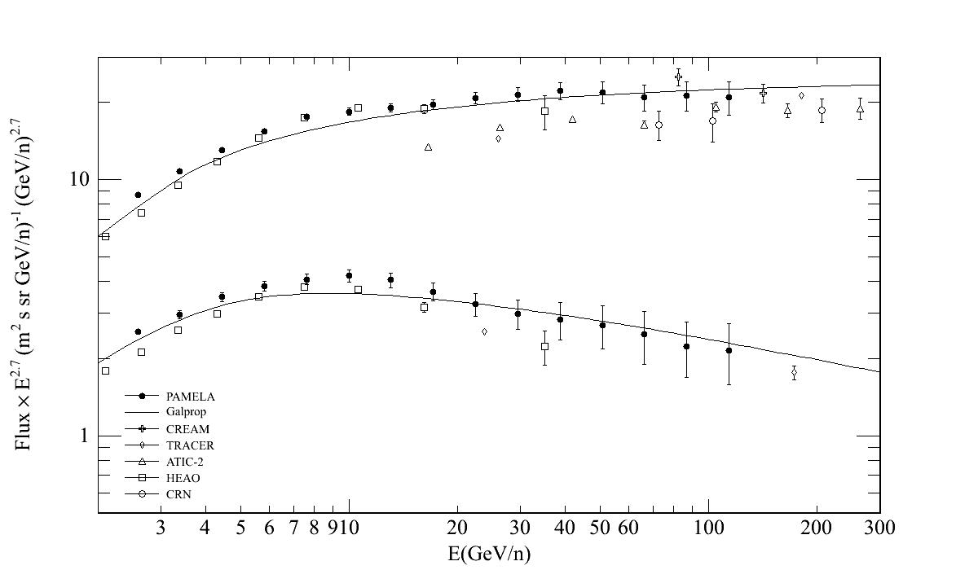
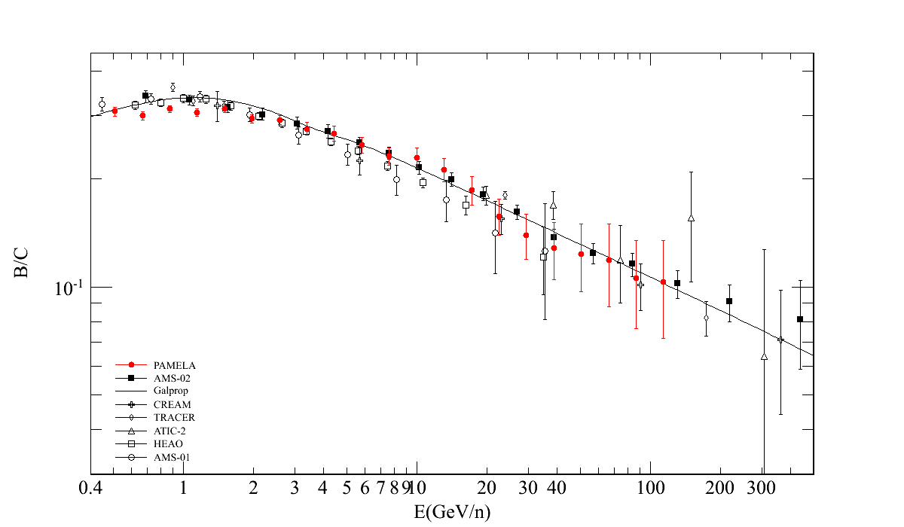
Boron and Carbon
Preliminary
C
GALPROP
B
Preliminary
GALPROP

Slide 20
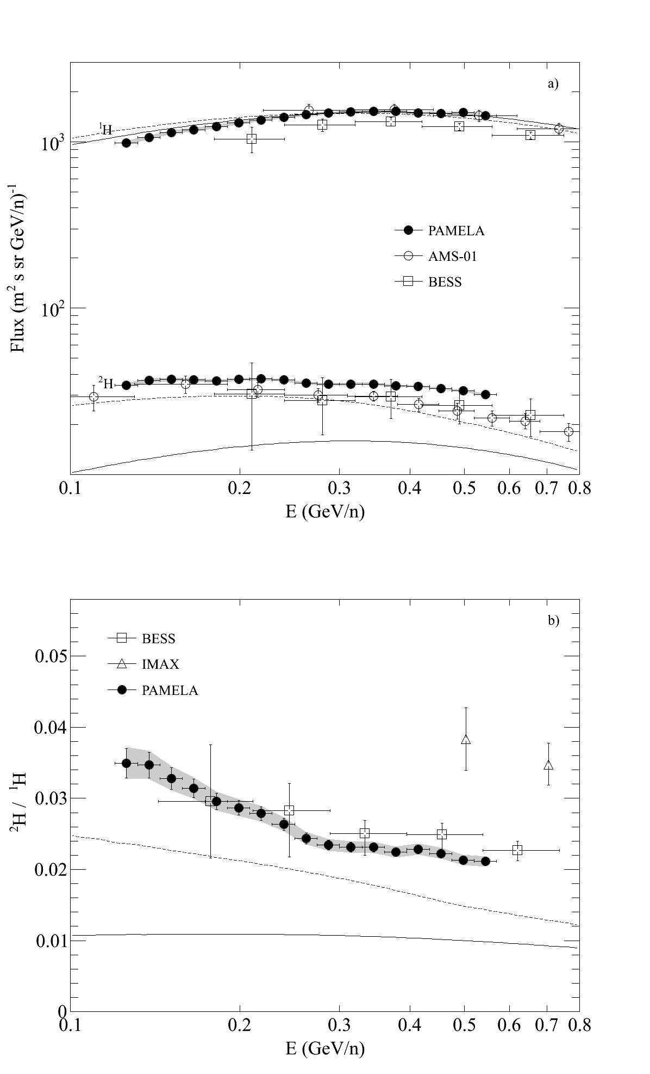
Hydrogen Isotopes
¹H and ²H fluxes
²H/¹H
O. Adriani et al., ApJ 770, (2013) 2

Slide 21
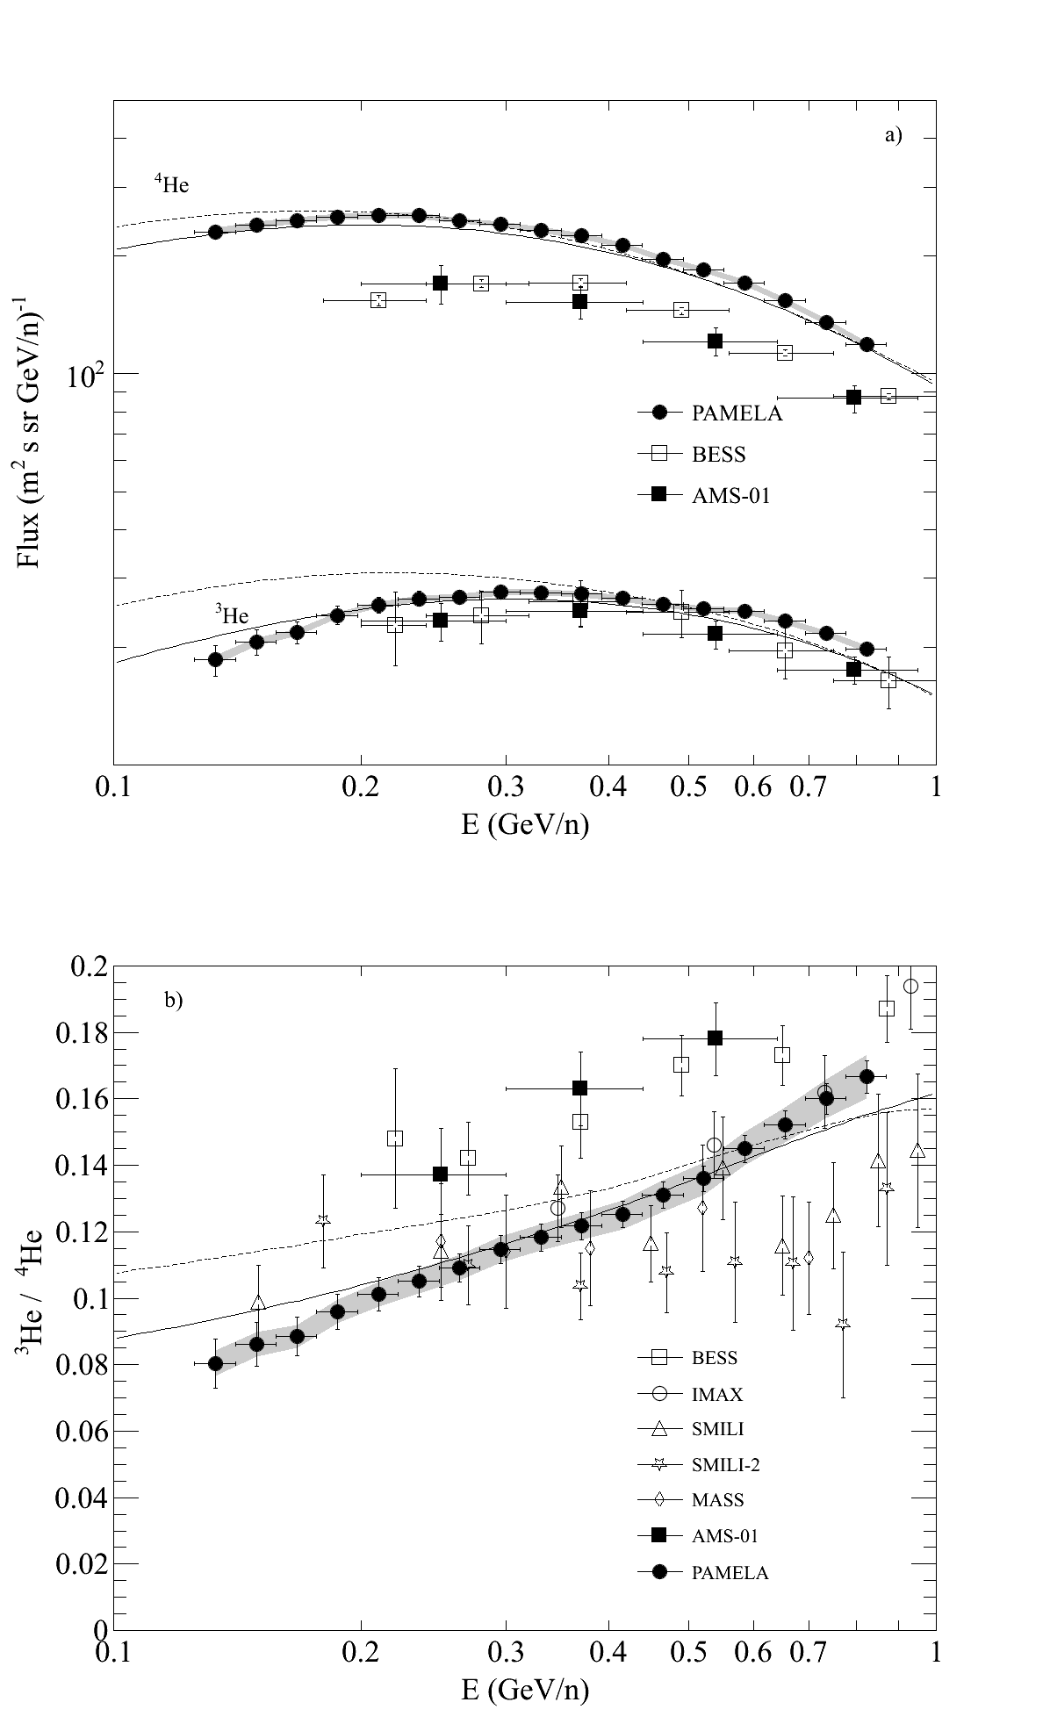
Helium Isotopes
⁴He and ³He fluxes
³He/⁴He
O. Adriani et al., ApJ 770, (2013) 2

Slide 22
Electrons

Slide 23
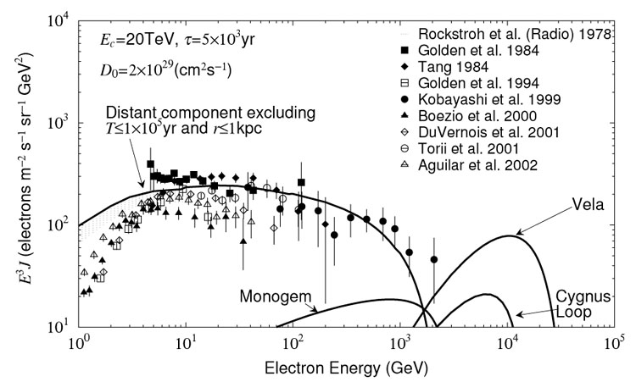
Electrons can tell us about local GCR sources
High energy electrons have a high energy loss rate ∝ E²
  Lifetime of ~10⁵ years for >1 TeV electrons
Transport of GCR through interstellar space is a diffusive process
  Implies that source of high energy electrons are < 1 kpc away
Only a handful of SNR meet the lifetime & distance criteria
Kobayashi et al., ApJ 601 (2004) 340 calculations show structure in electron spectrum at high energy
J. P. Wefel, TevPA 2011, Stockholm (2011)

Slide 24
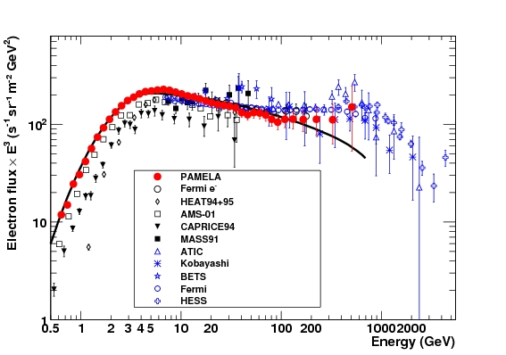
PAMELA Electron (e⁻) Spectrum
GALPROP
e⁻
e⁺ + e⁻

Slide 25
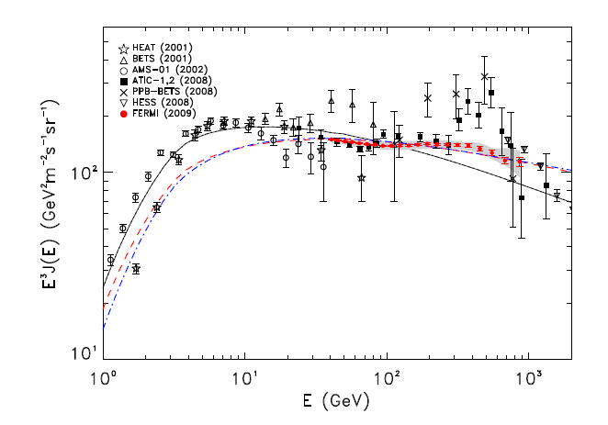
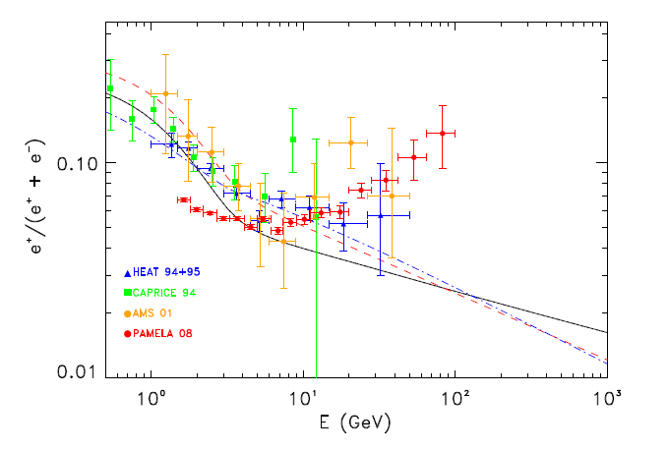
Electron Spectrum and Positron Fraction
Modify the injection indices of GALPROP?
Does not fit at all the positron fraction:
D. Grasso et al., Astropart.Phys. 32 (2009) 140; arXiv:0905.0636

Slide 26
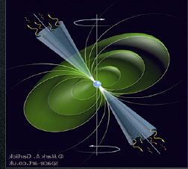
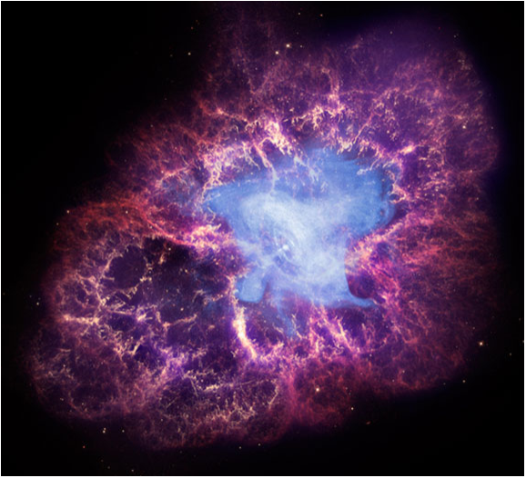
Astrophysical Explanation:
Pulsars
Mechanism: the spinning B of the pulsar strips e⁻ that accelerated in the outer magnetosphere emit γ that produce e±. But pairs are trapped in the cloud. After (4-5)x10⁴ years pulsars leave remanent and pairs are liberated (e.g. P. Blasi & E. Amato, arXiv:1007.4745).
Young (T < 10⁵ years) and nearby (< 1kpc)
If not: too much diffusion, low energy, too low flux.
Not a new idea, e.g.: Harding & Ramaty, ICRC 2 (1987), Boulares, ApJ 342 (1989), Atoyan et al. PRD 52 (1995)‏
CRAB NEBULA

Slide 27
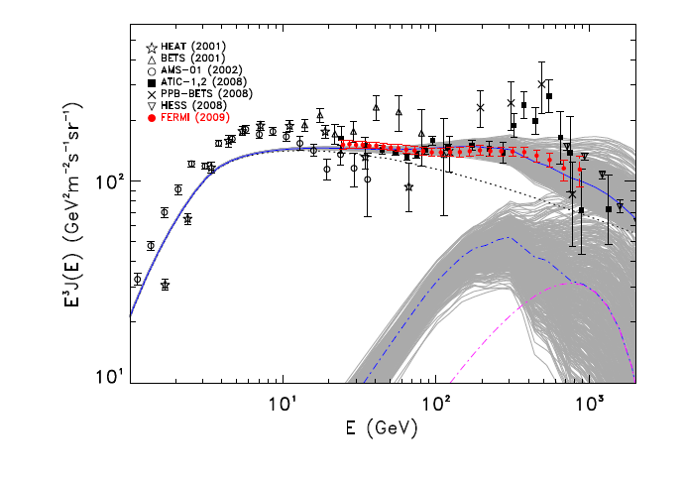
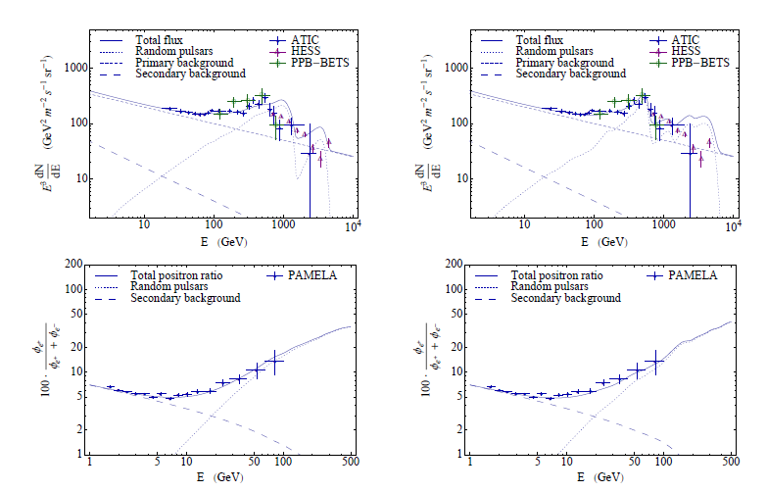
Pulsar Explanation
Some structure in the curve should eventually be seen for pulsars? (D. Grasso et al., Astropart. Phys. 32, 140, 2009).
D. Malyshev, I. Cholis and J. Gelfand, PRD 80 (2009) 063005

Slide 28
Antiparticles with PAMELA

Slide 29
Astrophysics and Cosmology compelling Issues
Origin and propagation of the cosmic radiation
Nature of the Dark Matter that pervades the Universe

Slide 30
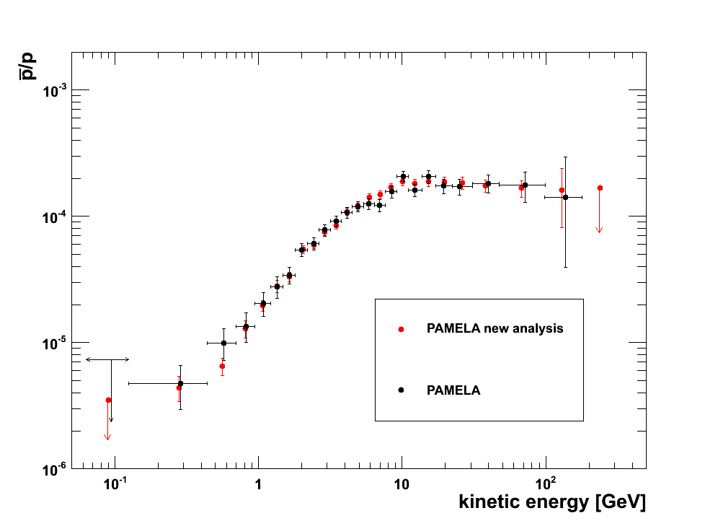
Antiproton to proton flux ratio
Using all data till 2010 and multivariate classification algorithms 20-50% increase in respect to published analysis

Slide 31
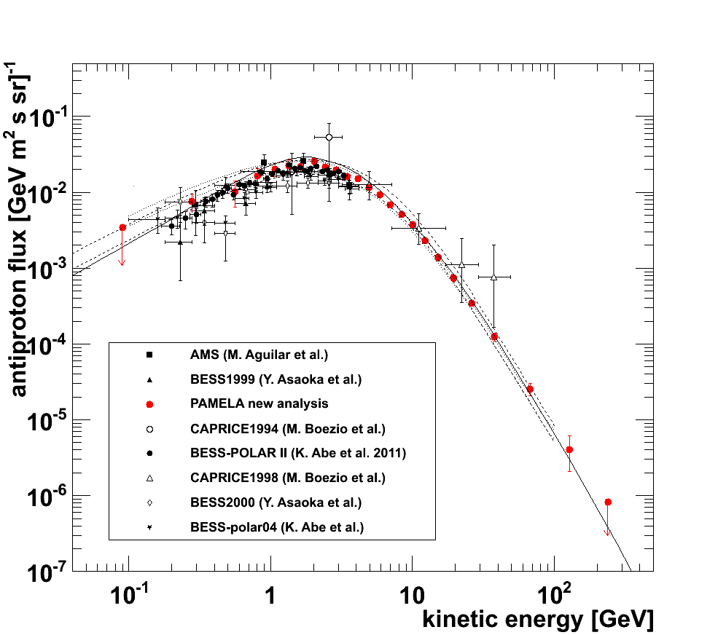
Antiproton energy spectrum
Donato et al., ApJ 563 (2001) 172
Ptuskin et al. ApJ 642 (2006) 902

Slide 32
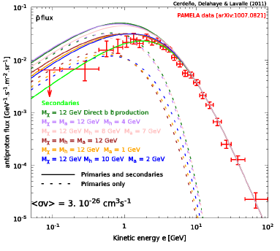
Cosmic-Ray Antiprotons and DM limits
D. G. Cerdeno, T. Delahaye & J. Lavalle, Nucl. Phys. B 854 (2012) 738
Antiproton flux predictions for a 12 GeV WIMP annihilating into different mass combinations of an intermediate two-boson state which further decays into quarks.
See also:
M. Asano, T. Bringmann & C. Weniger, Phys. Lett. B 709 (2012) 128.
M. Garny, A. Ibarra & S. Vogl, JCAP 1204 (2012) 033
R. Kappl & M. W. Winkler, PRD 85 (2012) 123522

Slide 33
Positrons with PAMELA

Slide 34
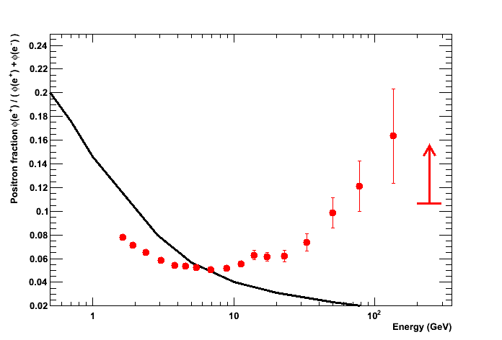
Positron to Electron Fraction
Positron fraction: ...disagreement with pure secondary production model
Using all data till 2010 and multivariate classification algorithms about factor 2-3 increase in respect to published analysis
Secondary production Moskalenko & Strong 98
O. Adriani et al., PRL 111 (2013) 081102; arXiv:1308.0133

Slide 35
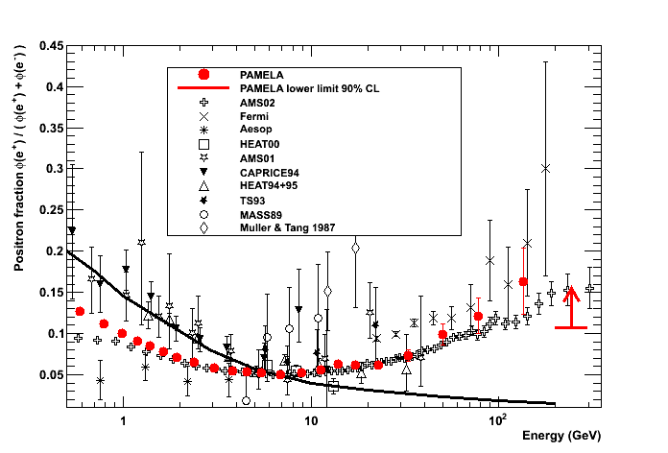
Positron to Electron Fraction
Preliminary
Secondary production Moskalenko & Strong 98

Slide 36
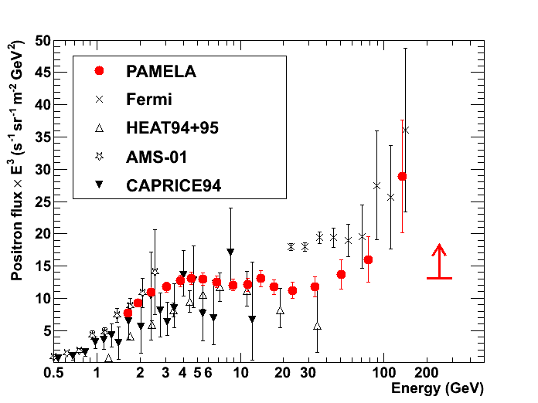
Positron Energy Spectrum
Positron fraction: disagreement with pure secondary production model
O. Adriani et al., PRL 111 (2013) 081102; arXiv:1308.0133

Slide 37
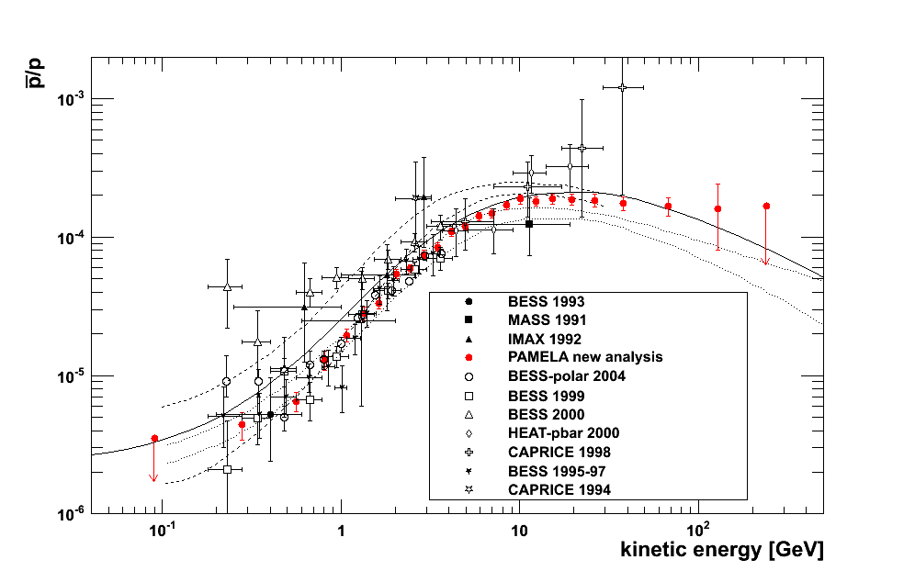
A Challenging Puzzle for CR Physics
CR Positron spectrum significantly harder than expectations from secondary production
Moskalenko & Strong 98
Preliminary
Donato et al. (PRL 102 (2009) 071301)
Simon et al. (ApJ 499 (1998) 250)
Ptuskin et al. (ApJ 642 (2006) 902)
But antiprotons in CRs are in agreement with secondary production

Slide 38
Implications
A rising positron fraction requires:
An additional component of positrons with spectrum flatter than CR
  primary electrons
2. A diffusion coefficient with a weird energy dependence
(BUT this should reflect in the CR spectrum as well)
Subtleties of Propagation
Courtesy by P. Blasi

Slide 39
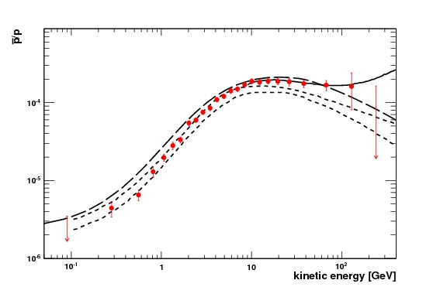
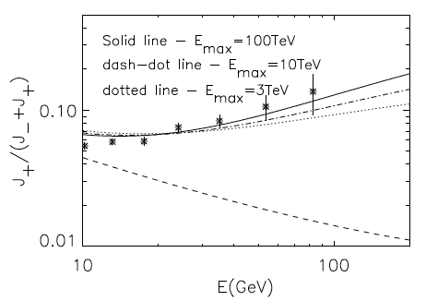
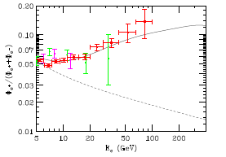
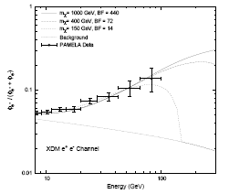
A Challenging Puzzle for CR Physics
P. Blasi & P. Serpico - PRL 103 (2006) 081103
Ptuskin et al. - ApJ 642 (2006) 902
Donato et al. PRL 102 (2009) 071301
P.Blasi, PRL 103 (2009) 051104; arXiv:0903.2794
Positrons (and electrons) produced as secondaries in the sources (e.g. SNR) where CRs are accelerated.
D. Hooper, P. Blasi, and P. Serpico, JCAP 0901:025,2009; arXiv:0810.1527
Contribution from diffuse mature &nearby young pulsars.
But also other secondaries are produced: significant increase expected in the p/p and B/C ratios.
I. Cholis et al., Phys. Rev. D 80 (2009) 123518; arXiv:0811.3641v1
Contribution from DM annihilation.

Slide 40
Cosmic Rays in the Heliosphere

Slide 41
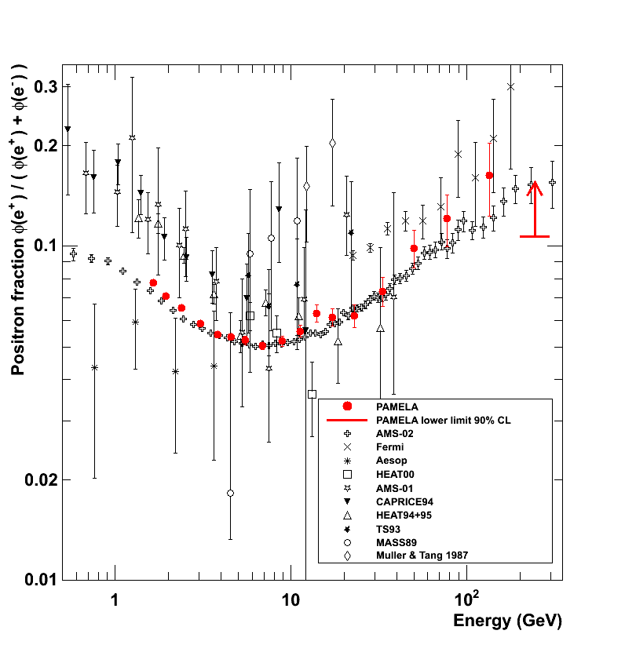
Positron to Electron Fraction
Solar Modulation?
?
Secondary production Moskalenko & Strong 98
Adriani et al, Astropart. Phys. 34 (2010) 1 arXiv:1001.3522 [astro-ph.HE]

Slide 42
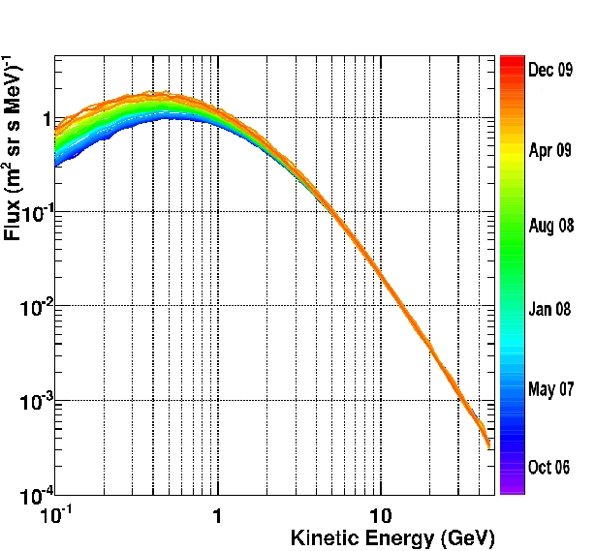
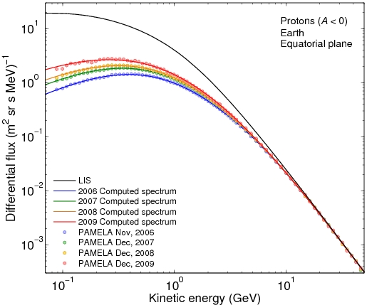
Time Dependance of the Proton Flux
Evolution of the proton energy spectrum from July 2006 to Deember 2009
The PAMELA proton spectra over four months compared with the computed spectra
O. Adriani et al., ApJ 765 (2013) 91;
M. S. Potgieter et al., arXiv:1302.1284

Slide 43
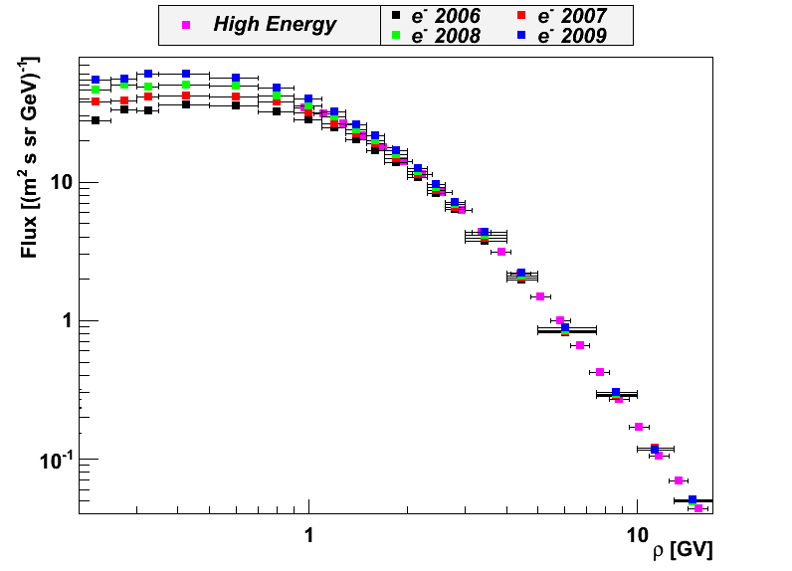
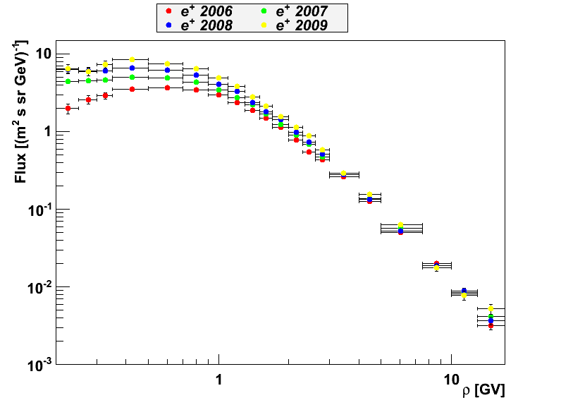
Galactic e⁻ and e⁺ modulation
preliminary
electrons
positrons

Slide 44
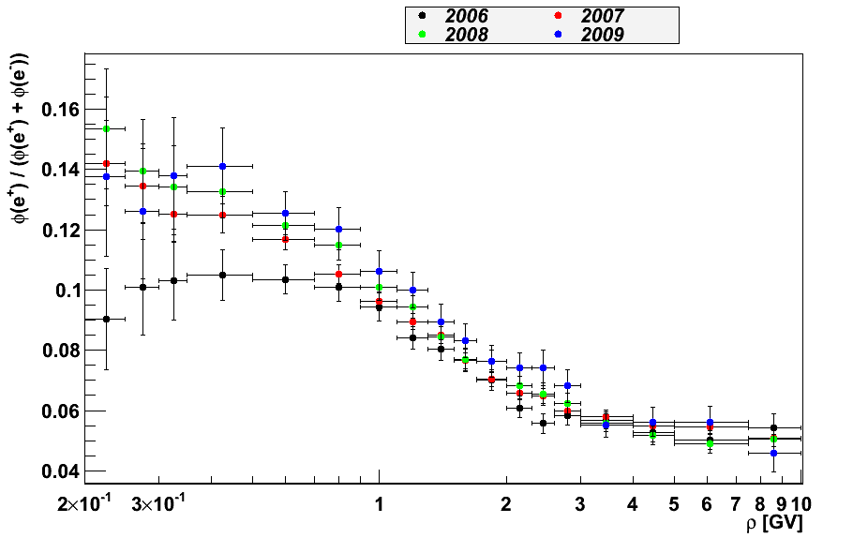
Positron fraction increases going towards solar minimum
time
preliminary
2009
2008
2007
2006
Positron fraction increases from 2006 to 2009.

Slide 45
Solar Events

Slide 48

Summary of PAMELA results

Slide 49

Summary
PAMELA has been in orbit and studying cosmic rays for ~7 years. >10⁹ triggers registered and >30 TB of data down-linked.
Hydrogen and helium nuclei spectra measured up to 1.2 TV. Theses observations challenge the current paradigm of cosmic ray acceleration and propagation
Antiproton-to-proton flux ratio and antiproton energy spectrum (~100 MeV - ~200 GeV) show no significant deviations from secondary production expectations.
High energy (>10 GeV) positron fraction and energy spectrum increases significantly (and unexpectedly!) with energy. Primary source?
Continuous study of solar physics and solar modulation effects.

Slide 50
Thanks!

Slide 51

Spectrometer Systematic Uncertainties
With real data:
The spectrometer may have a charge-sign dependent systematic
A calorimeter systematic has no such dependence
A systematic deflection shift causes an offset between e⁻ and e⁺ distribution
Upper limit set by positron statistics:
Δη_{sys} ~1∙10⁻⁴ GV⁻¹

Slide 52


Secondary positrons (1)
H
R_{d}
2h
disc
Halo
PRIMARY COSMIC RAY SPECTRUM AT EARTH
SPECTRUM OF PRIMARY ELECTRONS AT EARTH
IF ENERGY LOSSES
ARE DOMINANT
UPON DIFFUSION
(TYPICALLY E>10 GeV
Courtesy by P. Blasi

Slide 53
Secondary positrons (2)
INJECTION RATE OF SECONDARY POSITRONS
EQUILIBRIUM SPECTRUM OF SECONDARY POSITRONS (AND ELECTRONS)
AT EARTH
MONOTONICALLY
DECREASING
FUNCTION OF
ENERGY
POSITRON
FRACTION
Courtesy by P. Blasi

Slide 54
Charge-Sign Dependent Solar Modulation
L. Maccione, PRL 110 (2013) 081101.

