Slide 1
SIRAD
An irradiation facility for radiation damage studies
Serena Mattiazzo
Università di Padova
INFN/Space3 LNF September 18-19 2013

Slide 2
Outline
The INFN Legnaro Laboratories (LNL)
The SIRAD ion facility
Proton beams @ LNL (Ion implanter, AN2000, CN)
Total Dose facilities
The Ion Electron Emission Microscope
Scientific activity @ SIRAD
Future plans

Slide 3
The INFN Legnaro Lab

Slide 4
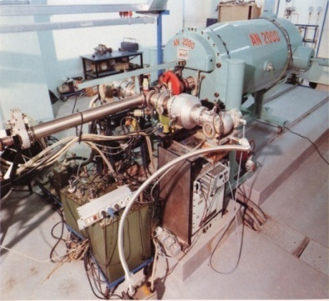
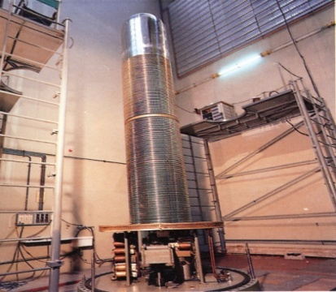
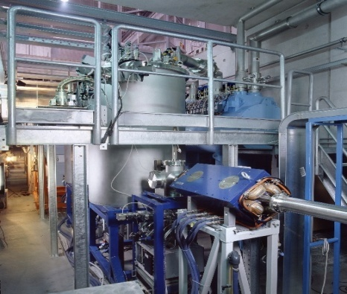
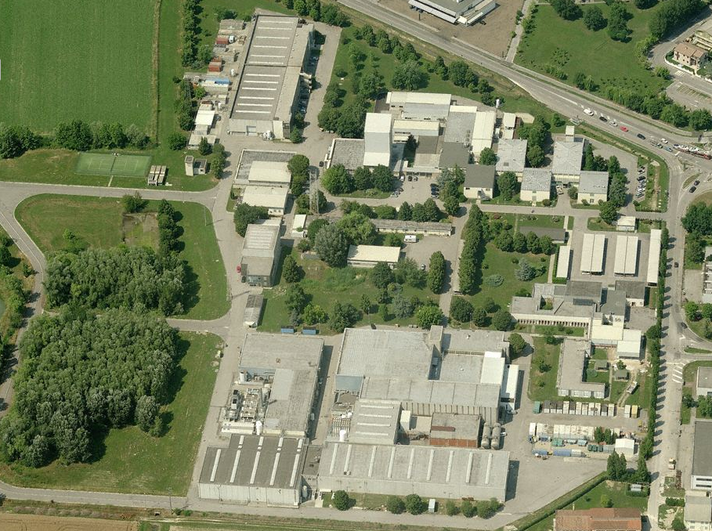
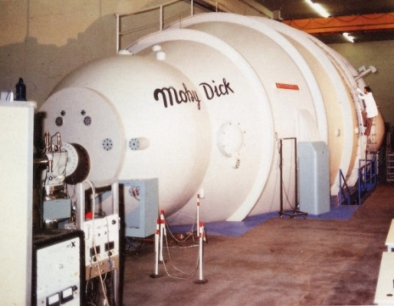
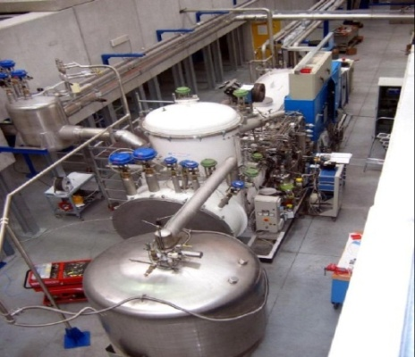
SPES area
AN2000
CN
PIAVE
TANDEM
ACCELERATORS AT LNL
ALPI

Slide 5
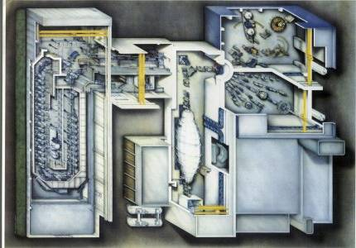
Tandem-ALPI-PIAVE complex
3 Exp. Halls
Here is displayed
the PIAVE-
Tandem-ALPI
complex, the
beams being
injected by the
XTU Tandem
into the three
experimental
Halls, or in to the
superconductive
LINAC
and then
distributed
to three
experimental
halls, two of them are shown.
1 & 2 Exp. Halls
PIAVE
ALPI
XTU Tandem
[Slide courtesy of Dr. D. Carlucci]

Slide 6
The SIRAD beam line
@ Tandem accelerator

Slide 7
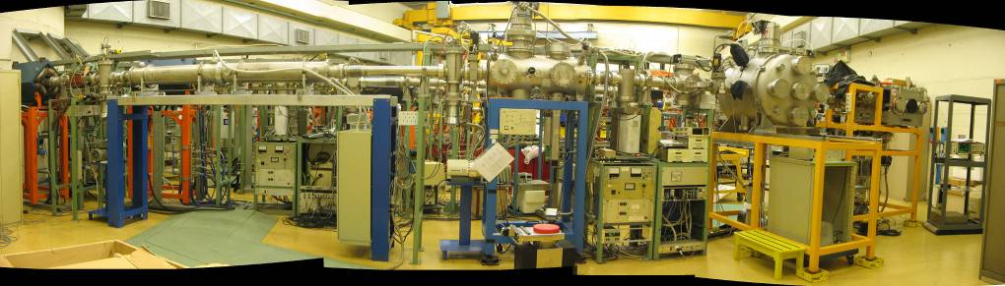
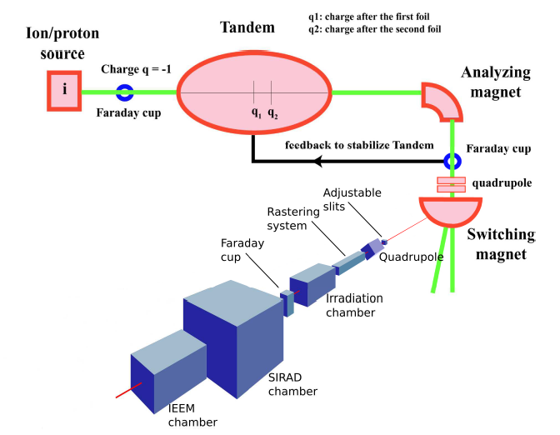
The SIRAD irradiation facility
The SIRAD irradiation facility is located at the Tandem Accelerator of the INFN National Laboratory of Legnaro
Tandem accelerator:
  Van de Graaff type, 15MV (max voltage), two strippers, servicing 3 experimental halls for nuclear and interdisciplinary Physics
SIRAD is located in the
Experimental Hall 1, Beam line +70

Slide 8
Ion beams available at SIRAD
$$E=E_{inj}+V_{0}∙\left[1+q_{1}∙f+q_{2}∙\left(1−f\right)\right]$$
f = 0.25
Typical ions available at SIRAD serviced by the XTU-Tandem accelerator, assuming:
  Tandem voltage at 14 MV,
  the most probable charge state using two strippers.
Note: The range and surface LET are in silicon (SRIM).
The magnetic rigidity is also tabulated. The rigidity limit of SIRAD is ~ 1.6 T-m
Ion Species | Energy [MeV] | q₁ | q₂ | Rigidity [T∙m] | Range in Si [μm] | Surface LET in Si [MeV×cm²/mg]
¹H | 28 | 1 | 1 | 0.77 | 4340 | 0.02
⁷Li | 56 | 3 | 3 | 0.95 | 376 | 0.37
¹¹B | 80 | 4 | 5 | 0.86 | 185 | 1.13
¹²C | 94 | 5 | 6 | 0.81 | 164 | 1.53
¹⁶O | 108 | 6 | 7 | 0.86 | 107 | 2.95
¹⁹F | 122 | 7 | 8 | 0.87 | 95 | 3.90
²⁸Si | 157 | 8 | 11 | 0.87 | 61 | 8.58
³²S | 171 | 9 | 12 | 0.89 | 54 | 11.1
³⁵Cl | 171 | 9 | 12 | 0.93 | 50 | 12.7
⁴⁸Ti | 196 | 10 | 14 | 1.00 | 40 | 20.9
⁵¹V | 196 | 10 | 14 | 1.03 | 38 | 22.6
⁵⁸Ni | 220 | 11 | 16 | 1.02 | 37 | 29.4
⁶³Cu | 220 | 11 | 16 | 1.06 | 34 | 31.9
⁷⁴Ge | 231 | 11 | 17 | 1.11 | 33 | 36.9
⁷⁹Br | 241 | 11 | 18 | 1.10 | 33 | 41.8
¹⁰⁷Ag | 266 | 12 | 20 | 1.21 | 29 | 58.4
¹²⁷I | 276 | 12 | 21 | 1.28 | 30 | 65.4
¹⁹⁷Au | 275 | 13 | 26 | 1.52 | 26 | 79.1
1st multi-source
(¹⁹F, ³⁵Cl, ⁷⁹Br, ¹²⁷I)
2nd multi-source
(¹⁶O, ²⁸Si, ⁵⁸Ni, ¹⁰⁷Ag)

Slide 9
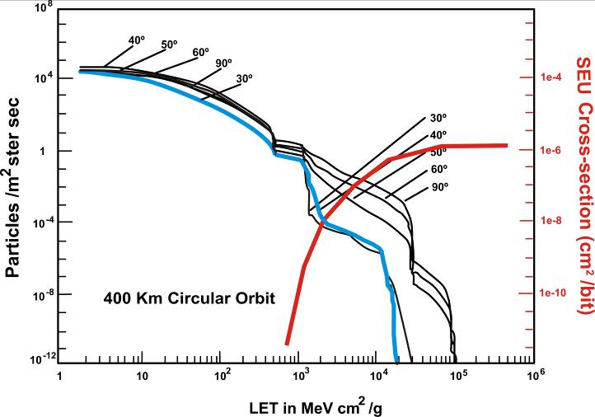
SEE cross section in space
natural cutoff
(LET) of
device
100 MeV cm²/mg

Slide 10
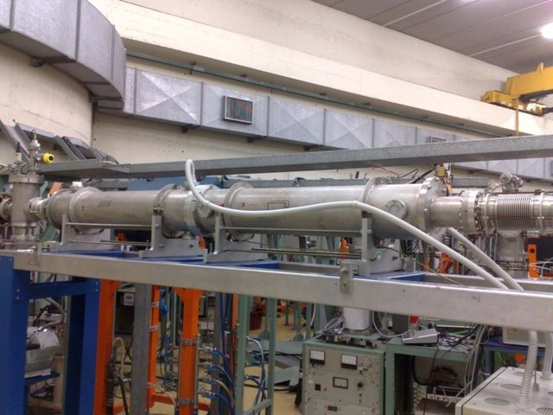
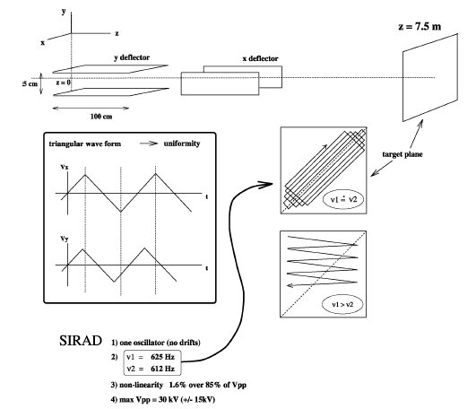
SIRAD technical characteristics
A x,y rastering system to irradiate large targets (bulk damage and TID studies)
± 3.5-15 kV
625, 615 Hz
Linear ramp

Slide 11
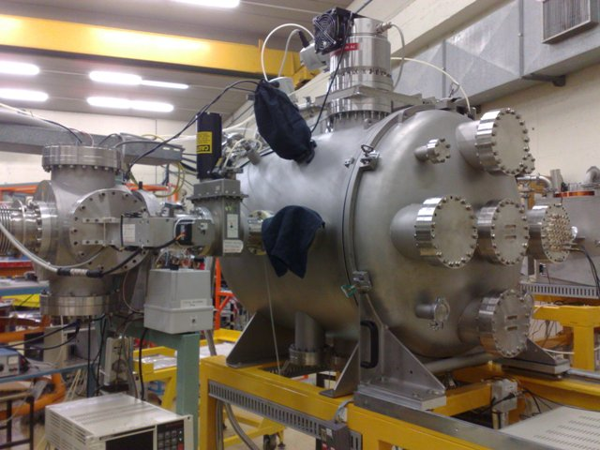
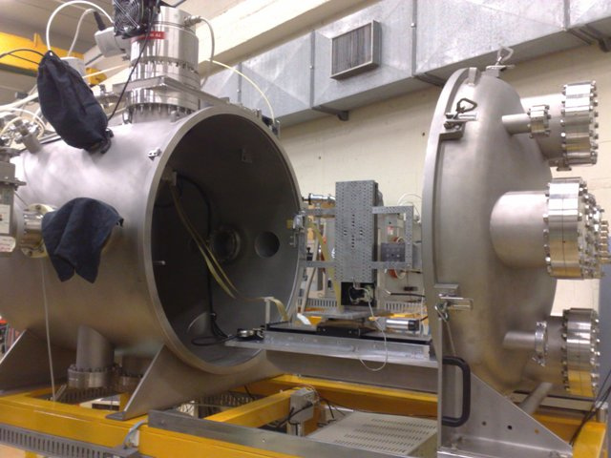
SIRAD technical characteristics
The chamber is open with the sample holder exposed
The new (ESA style) irradiation chamber
(active since 2006)
Diameter : 80 cm
Depth: 80 cm
It is used for global SEE tests, bulk damage and TID studies

Slide 12
Diagnostics
Cumulative effects (DDD, TID)
Single Particle Effects (SEE)
Many particles at a time
One particle at a time
Effect | Particles | On-line diagnostics | Flux [ions/cm²∙s]
Single Event Effect | One ion at a time | PIN diode (counting electronics) | 10-10⁵
Bulk damage effects | Many Protons (lithium ions too) | Faraday Cups | 10⁸-10⁹
Total Dose Effects | Many Ions | Faraday Cups | 10⁸-10⁹

Slide 13
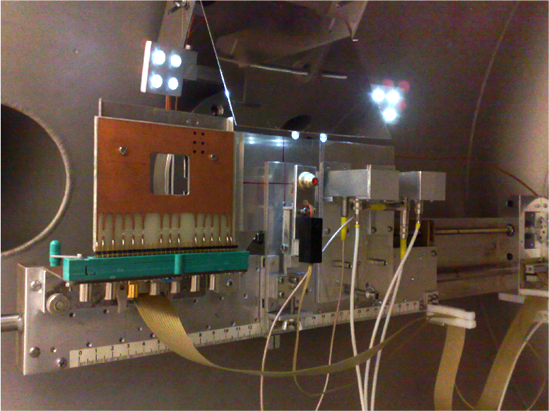
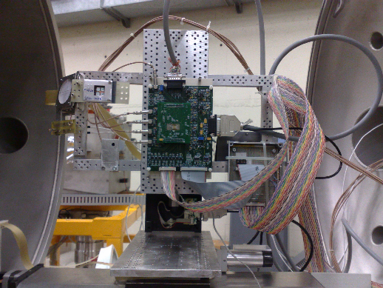
SIRAD technical characteristics
The dosimetry systems inside the irradiation chamber
Mirror of the optical inspection system
Pointing laser
Motorized sample holder
Horizontal transl. 30 cm
Vertical transl. 15 cm
Resolution 10 µm
Rotation axis vertical, +/-80º (1º steps)
Fixed PIN Silicon diodes board
http://www.youtube.com/watch?v=sKPew-nnfog
Faraday cup

Slide 14
Cross section measurement at SIRAD

Slide 15
Not only ion beams
(and not only SIRAD)
Proton beams up to 28 MeV
X-ray machine and ⁶⁰Co γ source

Slide 16
Dose rate at TANDEM
Beam energy can be degraded (to vary the range) with absorbers of proper thicknesses
Energy [MeV] | LET₀ [MeV×cm²/mg] | Range in Si [mm]
10 | 3.48∙10⁻² | 0.71
15 | 2.54∙10⁻² | 1.44
20 | 1.12∙10⁻² | 2.39
25 | 1.70∙10⁻² | 3.55
28 | 1.56∙10⁻² | 4.34

Slide 17
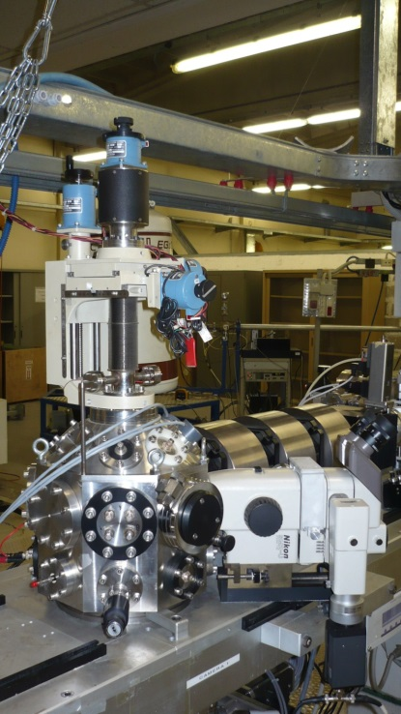
AN2000 and CN accelerators
AN2000
CN
Electrostatic accelerator, Van de Graaff type.
Single stage-Belt charging system.
Maximum terminal working voltage 2.5 MV.
Available accelerated ions: ¹H, ⁴He single charged (³He on request)
Continuous beam.
1 experimental hall; 5 beam lines.
Electrostatic accelerator (Van de Graaff type)
Maximum terminal working voltage: 7MV
Available accelerated ions:
  ^{1,2}H, ³He, ⁴He single and double charged
  D, double charged
Continuous and pulsed beam
1 experimental hall, 7 beamlines
Energy range: 0.25-2.2 MeV (up to 6mm² with unfocused beam but not uniform)
Beam current: few μA max on a spot size of 2-3mm²
For single charged particles (¹H, ²H, ⁴He)
Energy range: 0.85-6 MeV
Beam current:
  <5 μA (depending on the channel, and limited mainly by radioprotection reasons) on a spot size of 2-3mm²
  Low limits not set by the machine; beam intensity can be decreased with the use of unfocused beam, slits, etc (a «single ion microbeam» facility is also available, down to few particles/s with a spot size of ∼ 5 μm)
One of the beamlines is dedicated to a proton microbeam facility
Currents:
  300 pA- 500 pA on a spot of 1 μm of diameter
  5 nA on a spot of 3 μm of diameter
  Possibility to rasterize the microbeam over an area of 5×5mm² on the focal plane
Contact Person:
Dr. Valentino Rigato
LNL INFN
valentino.rigato@lnl.infn.it

Slide 18
Dose rate at AN2000 and CN
Energy [MeV] | LET₀ [MeV×cm²/mg] | Range in Si [μm]
0.5 | 2.55∙10⁻¹ | 6
1 | 1.75∙10⁻¹ | 16
2 | 1.12∙10⁻¹ | 47
3 | 8.48∙10⁻² | 92
4 | 6.90∙10⁻² | 148
5 | 5.86∙10⁻² | 216
6 | 5.12∙10⁻² | 294
Surface LET values and
range in Si
for energy values
0.5 MeV < En < 6 MeV
for a proton beam

Slide 19
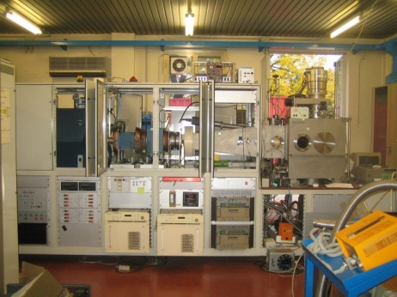
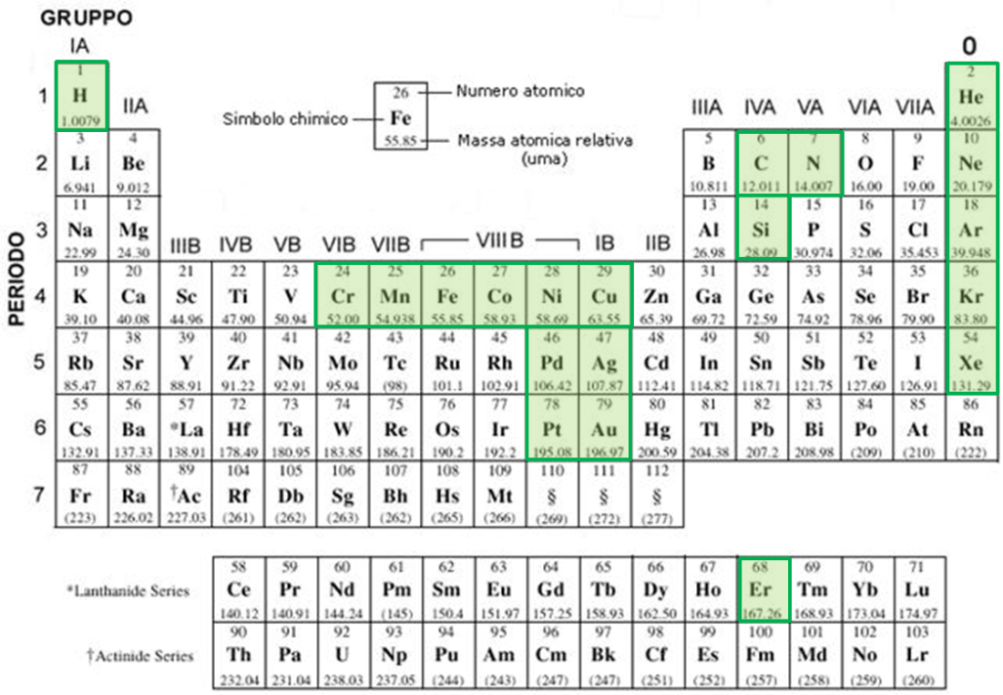
Low energy irradiation
Ion implanter Danfysik 1090
Features:
E_{ion}: 40-200 keV (proton range: 0.4÷1.8μm in Si)
J_{beam} < 2μA/cm²
Area_{raster} < 20 × 20 cm²
Fluence_{ion}: 10¹¹ ÷10¹⁷ cm⁻² (±10%)
Dosimetry: double Faraday
Ion species: see Periodic table
Contact Person:
Prof. Giovanni Mattei
Dip. Di Fisica e Astronomia
Univ Padova
giovanni.mattei@unipd.it

Slide 20
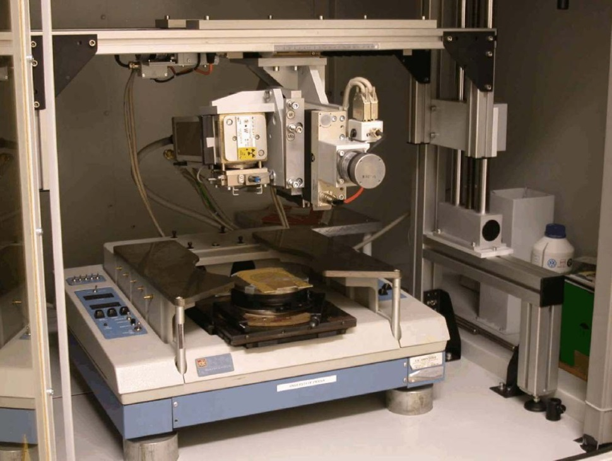
Total dose studies: X-ray machine
• Tube with W (7.4-12.06 keV L-lines) or Mo (17.4-19.6 keV K-lines) anode.
• Maximum tube voltage 60 kV. Maximum tube current 50 mA.
• X,Y and Z (manual) axis for accurate position setting of the tube.
• Radiation hardness qualification of the APV25 chip for the CMS silicon tracker.
Dose rate in x and y
X-ray tube
Z
Y
X
Semi-automatic
probestation

Slide 21
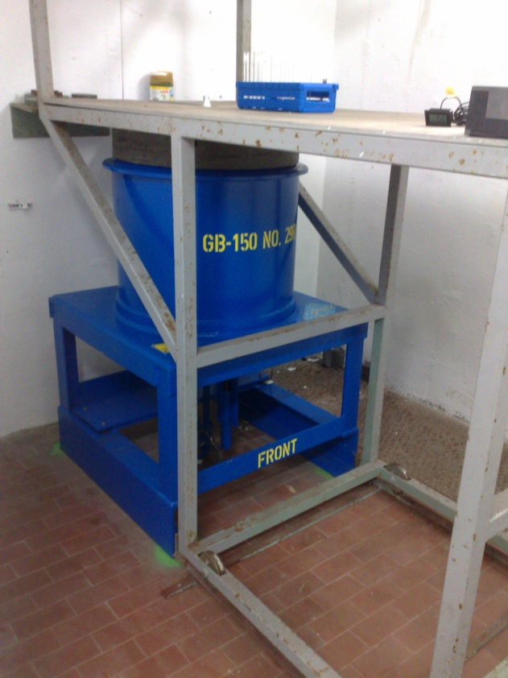
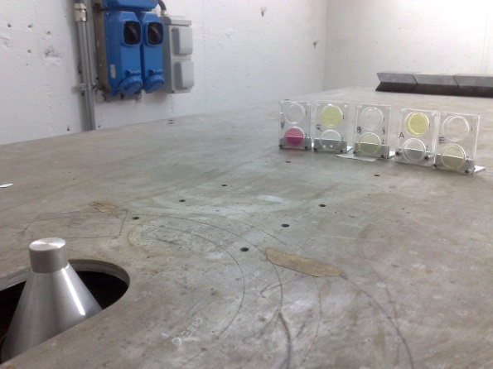
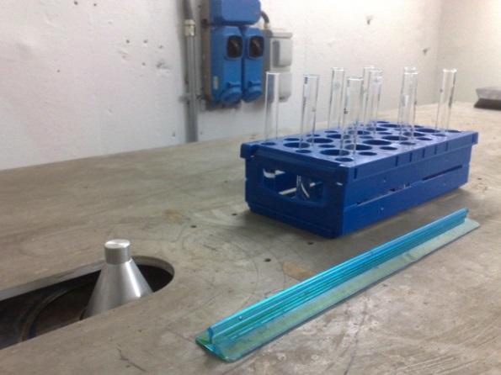
Total dose studies: ⁶⁰Co γ source
Managed by Legnaro LNL Laboratories
Irradiation Facility: Panoramic Gammabeam model 150 produced by Nordion Ltd (Canada)
Photon energies: 1.165 MeV and 1.332 MeV
Point source for D>10 cm (D=10-300cm)
Contact Person:
Dr. Roberto Cherubini
INFN LNL
roberto.cherubini@lnl.infn.it
Tel: +39 049 8068393
Distance from source | 20 cm | 45 cm
Dose rate in Si (Jan 2013) | 1.85 rad/s | 0.37 rad/s
 | 6.67krad/h | 1.32 krad/h
⁶⁰Co source shielding
Source-containing retracted cylinder

Slide 22
The Ion Electron
Emission Microscope

Slide 23
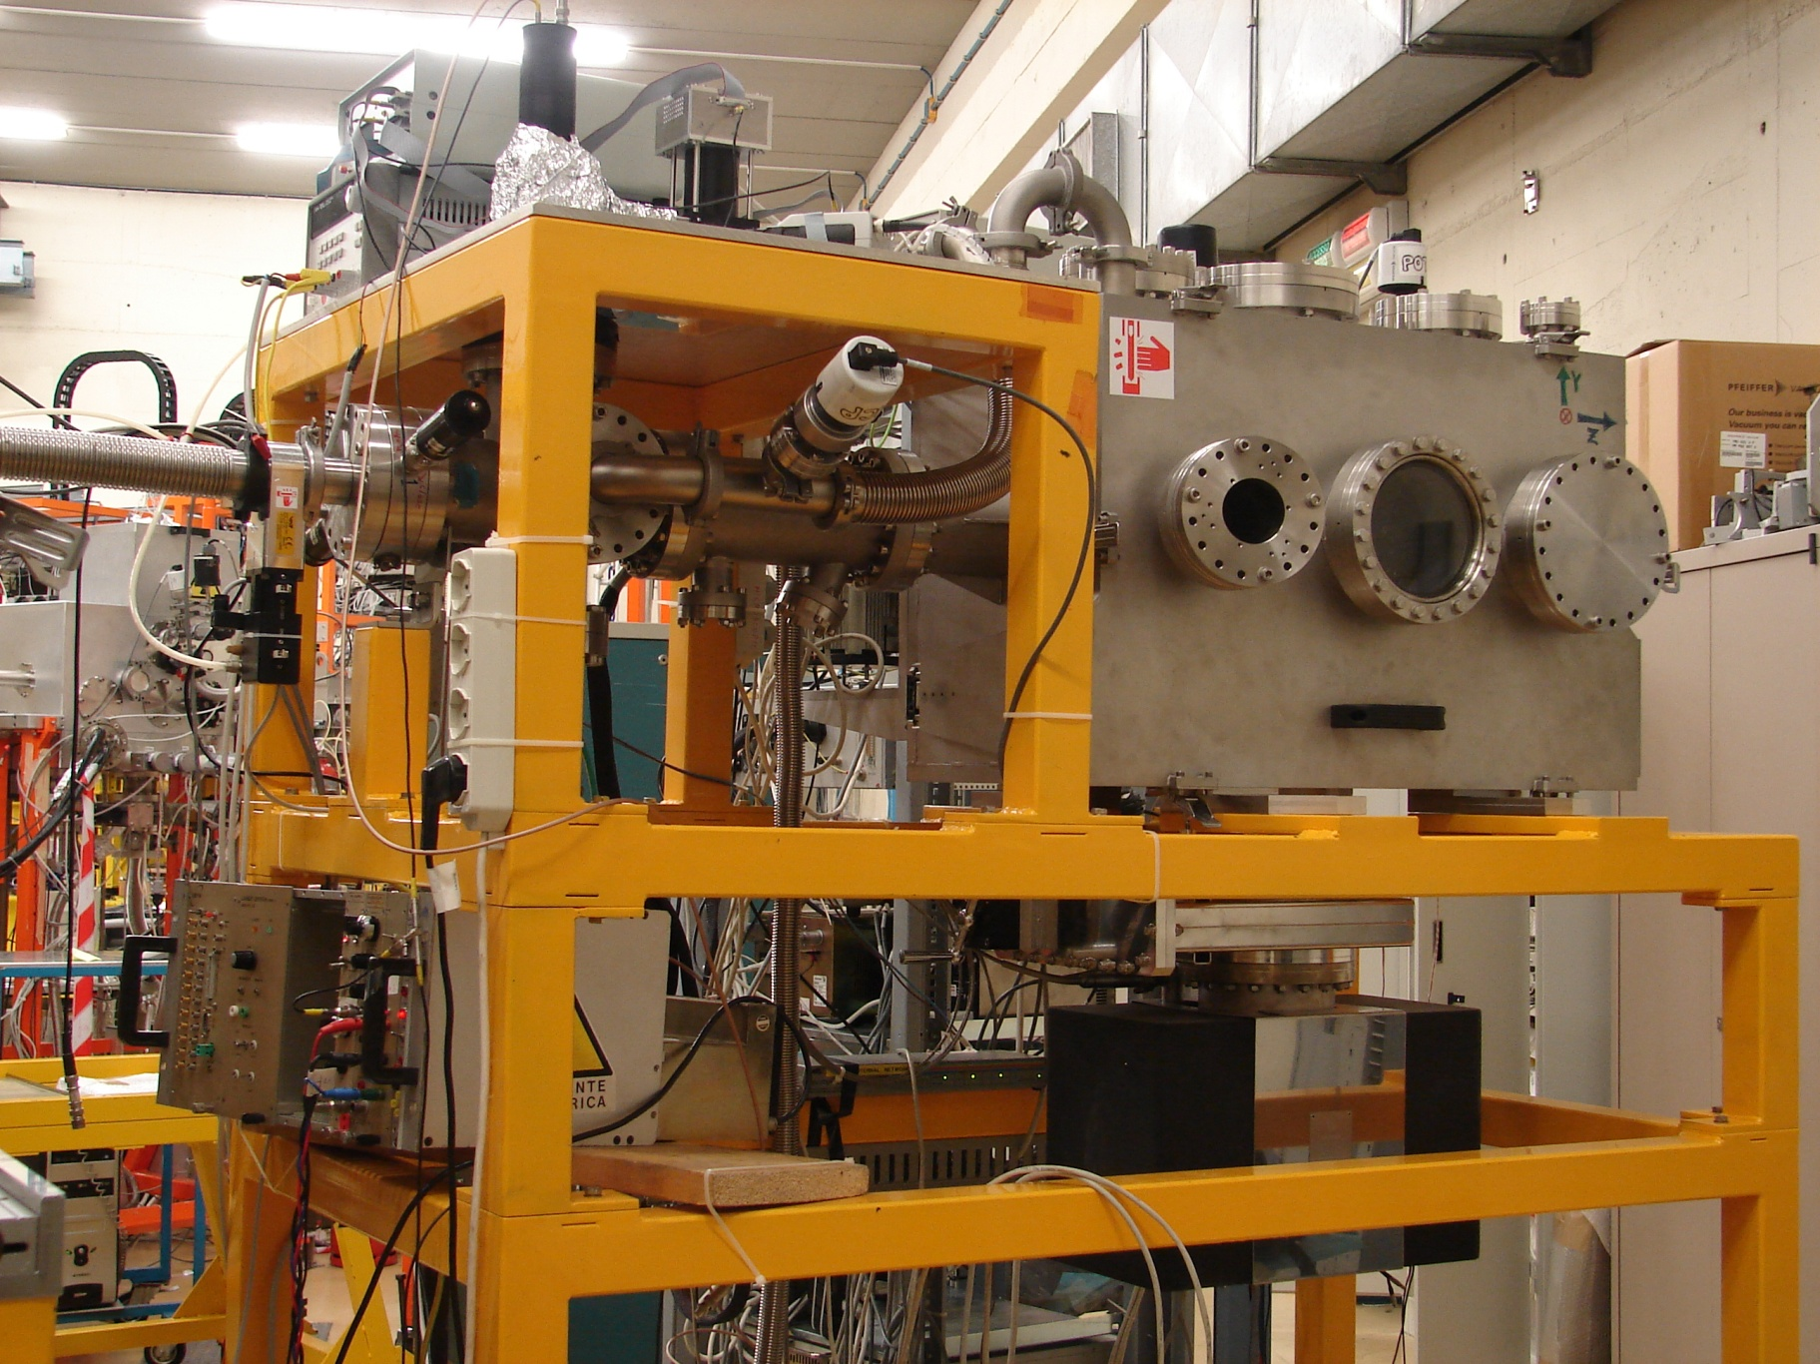
The SIRAD IEEM
IEEM chamber
Position detector
optics
Broad Ion Beam
Device Under Test
Axial IEEM
The IEEM is a novel tool. The only one other one is at SANDIA Labs (B. Doyle – the inventor of the technique)
Single energetic heavy ion impact points can be reconstructed with a resolution of a few microns at a rate of 1kHz over a circular area 180 micron diameter.

Slide 24
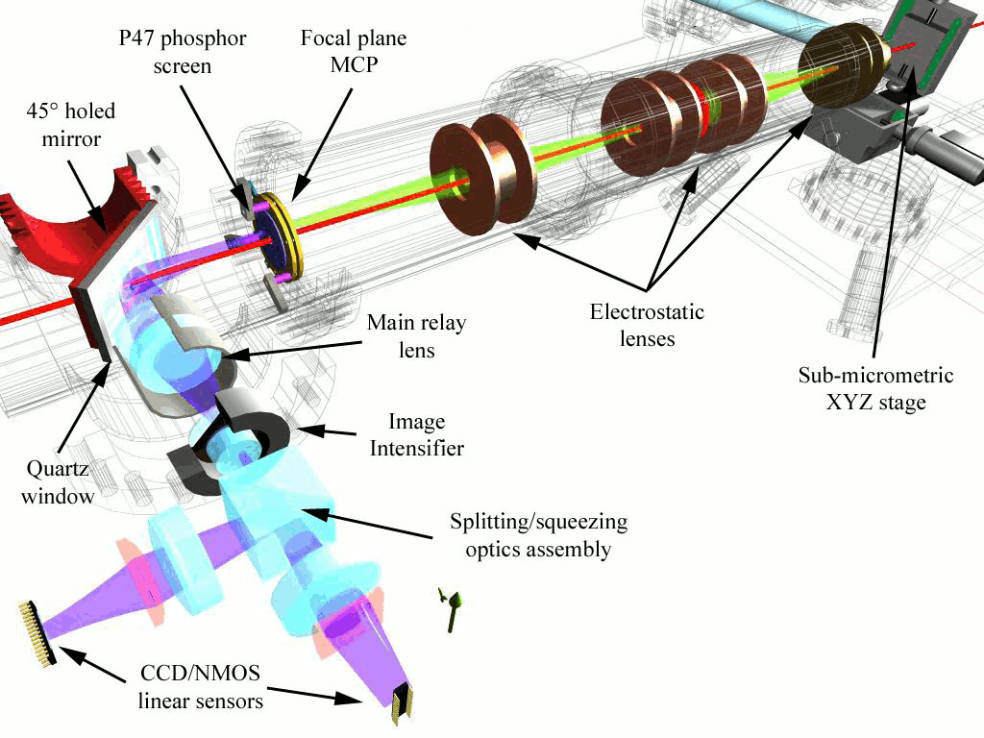
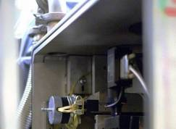
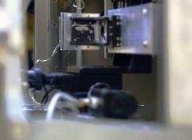
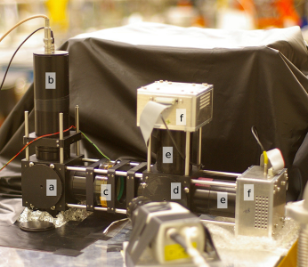
Axial IEEM
UV light for focusing
STRIDE
Phototube for fast signal (delay < 50 ns)
a) Beam splitter
b) PMT
c) Image Intensifier
d) STRIDE beam splitter
e) Squeezing optics
f) NMOS sensors

Slide 25
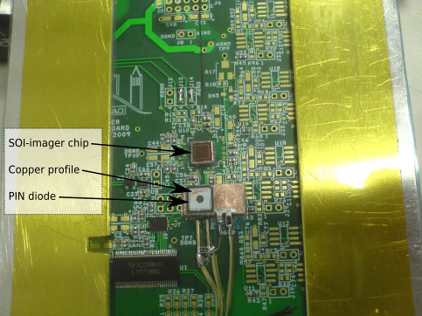
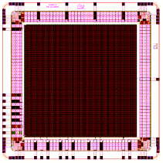
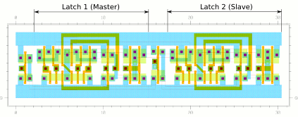
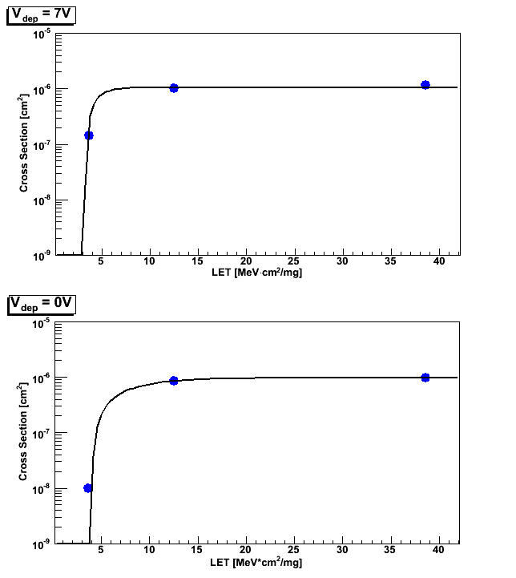
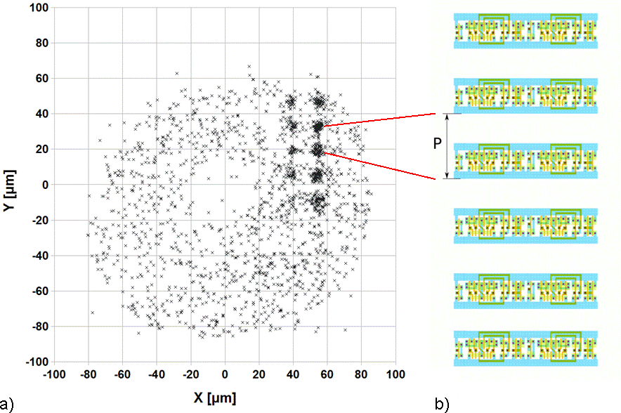
An example: SOImager Shift Register
Shift register cell schematics:
the two Flip Flop D are visible
The SOImager board
SOImager layout
The actual resolution of the IEEM does not allow us to untangle the most sensitive nodes inside the cell (we cannot say which transistor is responsible for an upset), but it is sufficient to distinguish the two Flip-Flops and characterize their relative sensitivity:
The sensitivity of the Master Flip-Flop is 2.6 ± 0.1 times that of than the Slave one.
Shift Register cross section: Weibull fits with V_{bias}=7V (top) and V_{bias}=0V (bottom)
a) Shift Register sensitivity map.
b) Shift register schematics

Slide 26
Beam allocation & activity at SIRAD

Slide 27
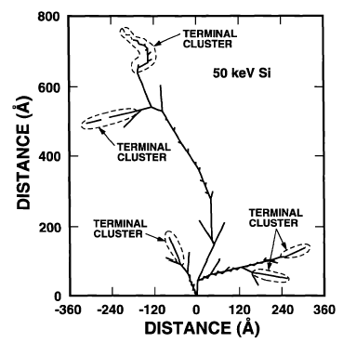
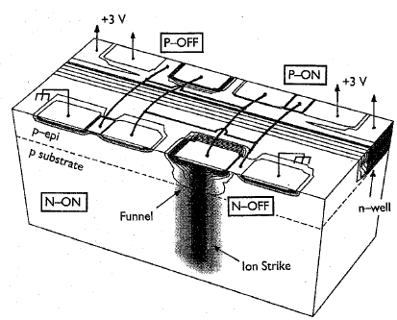
When the SIRAD irradiation facility started…
The facility was initially running in 1998 for bulk damage studies in silicon detectors for High Energy Physics applications in the framework of the RD48 CERN Collaboration by proton irradiation.
The facility was then considered in 2000 for Single Event Effects (SEE) studies by ion irradiation in microelectronics devices for space application in collaboration with
DEI (Univ.Padova) and DIMSAT (Univ. Cassino).
The facility has been equipped with funds from:
Physics Department, Univ. Padova
INFN Section of Padova
INFN National Laboratory of Legnaro.

Slide 28
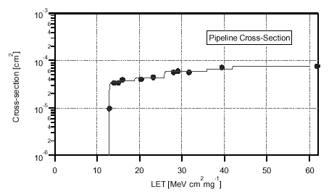
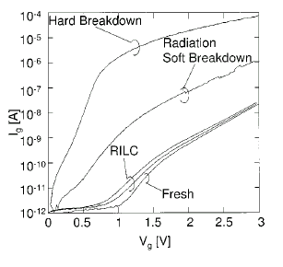
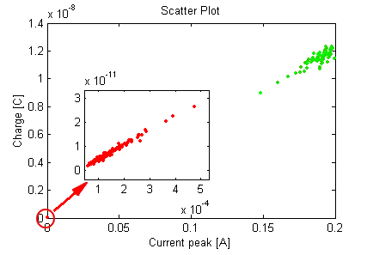
Summary of the first research activities at SIRAD
SEE in ASICs for CMS, FERMI, AGILE, ALICE
SEE in FPGA
Charge loss in Flash E²PROM
SEB, SEGR in power MOSFETs
RILC and RSB (Ultra-thin gate oxide)
Silicon detectors

Slide 29
SIRAD collaboration in Italy and abroad
Dip. di Fisica and INFN Padova
INFN Laboratori Nazionali di Legnaro
Dip. Ingegneria dell’Informazione, Padova
Dip. Informatica e Telecomunicazioni, Trento
INFN Sezione di Trieste
INAF Sezione di Milano
Dip. Elettronica, Pavia
Dip. Ingegneria Industriale, Bergamo
IASF Bologna, INAF Bologna
Dip. Automatica e Informatica, Politecnico di Torino
INFN sezione di Torino
Dip.Ingegneria Elettronica, Università Roma 2
DAEIMI e DSM, Università di Cassino
INFN Sezione di Bari
SELEX Sistemi integrati, Roma
CERN (Ginevra, Svizzera)
Lawrence Berkeley National Laboratory (LBNL, USA)
Santa Cruz Institute for Particle Physica (California, USA)
and many others in the past…
Contact Person:
Prof. Dario Bisello
Dip. Physics and Astronomy, Padova
dario.bisello@pd.infn.it
Tel: +39 049 8277216

Slide 30
Present research activities (1)
Institutions: INFN Padova, Torino, Bari, Trieste
Univ. Padova, Univ. Cassino
INAF-IASF Milano & Bologna
CERN, LBNL
1) SEMICON-MIR: "Semiconductor Relaxation Time for Quantum Vacuum Study”, Spokesperson G. Carugno, INFN Padova
2) SOISEE: "Micromapping the sensitivity to Single Event Upsets of an electronic device in a SOI technology at the LNL IEEM“,
Spokesperson D. Bisello, Collaboration: Univ. & INFN Padova, LBNL (Berkeley)
3) SEUTOPIX: "Single Event Upsets in the ToPix_3 ASIC for the pixel detector readout of the PANDA Experiment“,
Spokesperson D. Calvo, INFN Torino
4) Single Event Effects in Non-volatile Memories
Spokesperson S. Gerardin, DEI, Univ. Padova
5) SEEPMOS: "Single Event Effects on Power MOSFET",
Spokesperson G. Busatto, DAEMI, Univ. Cassino & INFN Pisa
6) VELA: "Characterization of Single Event Transients on VELA, an ASIC for new generation space-based astronomical instruments
Spokesperson M. Uslenghi, INAF-IASF, Milano

Slide 31
Present research activities (2)
7) "Heavy-Ion Effects on Programmable Systems On Chip",
Spokesperson A. Paccagnella, DEI, Univ. Padova & INFN Padova
8) LePIX: "Test of the uniformity in charge collection efficiency of the LePIX pixels with the IEEM at SIRAD
Spokesperson P. Giubilato, Univ. Padova & CERN
9) GBLD-SEU: "Design of a radiation tolerant optical transceiver for HEP at CERN "
Spokesperson G. Mazza, INFN Torino
10) Upgrade of the ALICE Inner Tracking System (ITS):
Evaluation of the radiation hardness for detectors and read-out electronics
Reference person : M. Lunardon
11) Experiment CHIPSODIA: CHIP by Silicon On DIAmond (INFN Group V)
Evaluation and characterization of the monolithic diamond detectors with read-out electronics on silicon by proton beams
Reference person at INFN Bari: A. Ranieri
12) Detectors & ASIC for Astrophysics
INAF-IASF Rome and Bologna
Reference persons at INASF-IASF Rome: E. Del Monte
at INASF-IASF Bologna: M. Marisaldi
13) SiPMRad
Radiation hardness of SiPM
Reference person at INFN Trieste: V. Bonvicini

Slide 32
Increase Ion Range with ALPI

Slide 33
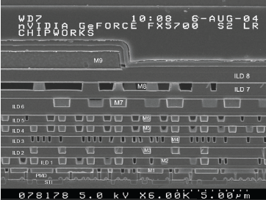
Range and SEE testing facilities
Ions must have sufficient energy to penetrate overlayers
Need to evaluate LET at the correct depth
Have to keep into account any dead superficial layers (plastic lid; metallizations;…). At Tandem need naked devices (de-lidded). And there are experimental problems for some types of devices (see figure)
Section of a chip, Courtesy of Barney Doyle
surface
16 m
Sensitive volume
is down here!
FET

Slide 34
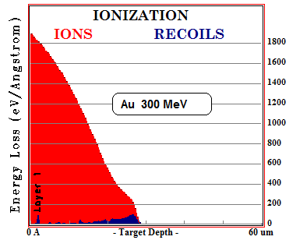
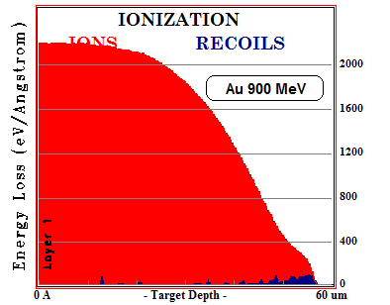
TANDEM energies are limited…
… ALPI energies are better for SEE tests
The heaviest ions should have higher ranges in silicon than those permitted by the Tandem to ensure that the specific ionization be high where its is needed; i.e. in depth where the sensitive nodes of the DUT are located.
The LET in silicon, as a function of the ion depth, of an impinging 300 MeV Au ion falls quickly away from the surface value. (SRIM)
The LET in silicon, as a function of the ion depth, of an impinging 900 MeV Au ion presents a broad plateau before falling.

Slide 35
Ion beams available at SIRAD
Tandem
Tandem+Alpi
Ion Species | q₁ | q₂ | Energy [MeV] | Range in Si [μm] | Surface LET in Si [MeV×cm²/mg]
¹H | 1 | 1 | 28 | 4340 | 0.02
⁷Li | 3 | 3 | 56 | 376 | 0.37
¹¹B | 4 | 5 | 80 | 185 | 1.13
¹²C | 5 | 6 | 94 | 164 | 1.53
¹⁶O | 6 | 7 | 108 | 107 | 2.95
¹⁹F | 7 | 8 | 122 | 95 | 3.90
²⁸Si | 8 | 11 | 157 | 61 | 8.58
³²S | 9 | 12 | 171 | 54 | 11.1
³⁵Cl | 9 | 12 | 171 | 50 | 12.7
⁴⁸Ti | 10 | 14 | 196 | 40 | 20.9
⁵¹V | 10 | 14 | 196 | 38 | 22.6
⁵⁸Ni | 11 | 16 | 220 | 37 | 29.4
⁶³Cu | 11 | 16 | 220 | 34 | 31.9
⁷⁴Ge | 11 | 17 | 231 | 33 | 36.9
⁷⁹Br | 11 | 18 | 241 | 33 | 41.8
¹⁰⁷Ag | 12 | 20 | 266 | 29 | 58.4
¹²⁷I | 12 | 21 | 276 | 30 | 65.4
¹⁹⁷Au | 13 | 26 | 275 | 26 | 79.1
Energy [MeV] | Range in Si [μm] | Surface LET in Si [MeV×cm²/mg]
- | - | -
- | - | -
- | - | -
- | - | -
- | - | -
- | - | -
542 | 373 | 3.9
591 | 311 | 5.2
591 | 268 | 6.2
686 | 188 | 10.9
686 | 171 | 12.2
780 | 147 | 17.3
780 | 135 | 19.1
826 | 121 | 23.8
871 | 112 | 28.1
966 | 83 | 49.4
1011 | 77 | 61.8
1185 | 69 | 92.4

Slide 36
The idea
At present, due to limitation in the switching magnet, we can bend to the SIRAD beam line ions with magnetic rigidity up to 1.6 T∙m
In order to decrease the rigidities of heaviest ALPI ions, we plan to increase their charge state using a single carbon stripping foil placed just before the switching magnet
Tandem
Tandem+Alpi
Piave+Alpi
Accelerator.
Analysis Magnet
post accelerator analyzed beam; i.e. of well defined energy
Post stripper
(carbon foil)
Q₁
Q₂
Q_{n}
Different charge states but of same energy
Switching Magnet
Q_{i-1}
Q_{i}
Q_{i+1}
Different charge states but of same energy
Defocused beam onto SIRAD target

Slide 37
The future:
Proton and Neutron beams with SPES

Slide 38
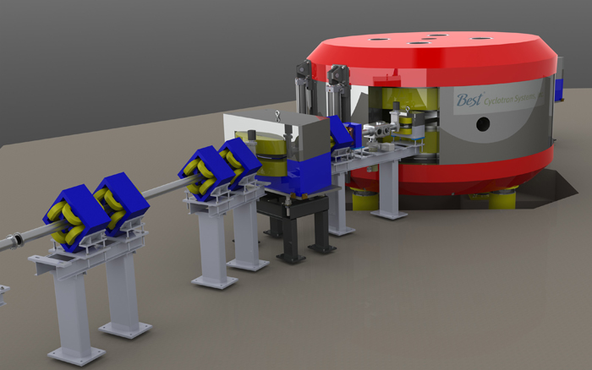
The SPES Cyclotron
At the INFN National Labs of Legnaro (LNL), a variable energy (35-70 MeV) high current proton cyclotron (I_{max} = 750 µA) will soon come into operation (2015): the SPES (Study and Production of Exotic Species) accelerator
It will open up the prospect of high flux neutron facilities in Italy that could perform various research activities.
A neutron irradiation facility has been proposed for studying Singe Event Effects (SEE) in microelectronic components and systems due to neutrons (and protons) :
fast neutrons (E_{n} > 1 MeV)
thermal atmospheric neutrons.
direct protons (35-70 MeV)
Contact Person:
Prof. Jeffery Wyss
Univ of Cassino and INFN Padova
wyss@unicas.it
Tel: +39 345 3163072
Tools at LNL…

Slide 39
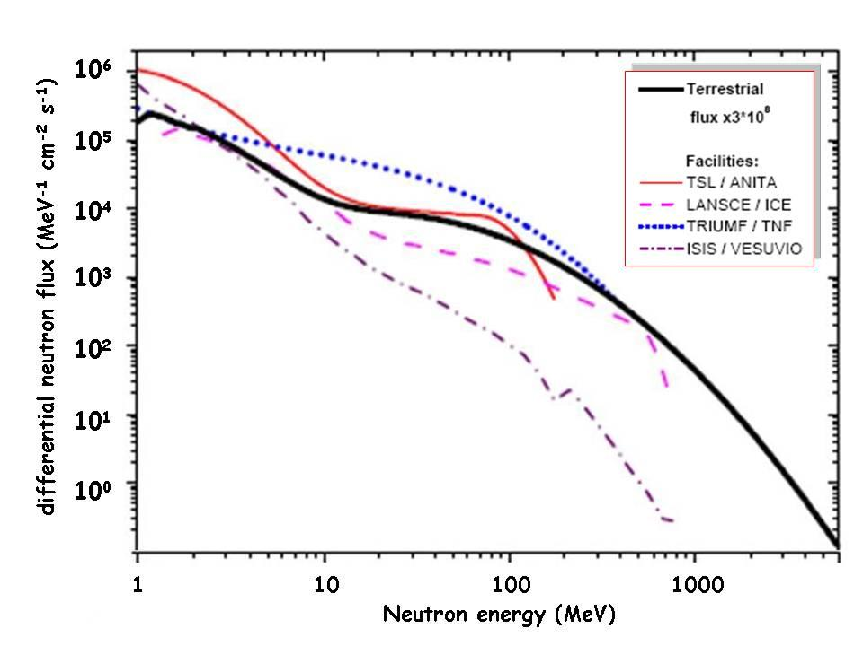
Available beams
Quasi Mono-energetic Neutrons (QMN) from 35-70 MeV protons
  Assortment of thin (3-4mm) Li and Be targets
  Multi-angle collimator for «tail correction»
Continuous energy (white) atmospheric-like neutrons from intense 70 MeV protons. Two targets:
  A «novel» rotating BePb (or BeTa) composite target system (non-stopping) and without moderator
  A «conventionl» thick (stopping) W-based target and moderator system
Direct protons (35-70 MeV)
Neutron beam shaped by composite target

Slide 40
Conclusions
SIRAD is an unique irradiation facility in Italy:
  continuous upgrades have made the facility user friendly for external users to operate it with minimal support
  beam dosimetry validated by measurements with the ESA SEU monitor
  insertion of more energetic Tandem-ALPI ion beams allows for new class of applications
  micromapping of SEE sensitivity with IEE Microscopy allows for detailed studies of electronic devices
  availability of the Panoramic Co⁶⁰ Gammabeam source and X-ray gun for TID tests;
  The SPES project will open soon the possibility of higher energy proton beams and of neutron beams
Accessibility of the SIRAD apparatus can be further increased:
  with dedicated beam time slots;
  by making Tandem and ALPI-PIAVE complexes running independently to increase the beam time availability
  by defining protocols for allowing industrial groups to come and pay for beam and support.
This is an ambitious program for the SIRAD group.
Help from other groups is welcome.

