Slide 1
η-η’: Experimental overview
Camilla Di Donato & Giulia Ricciardi
INFN-Napoli, Universita’ Federico II
η-η’ widths measurement: γ−e Collider @IRIDE

Slide 2
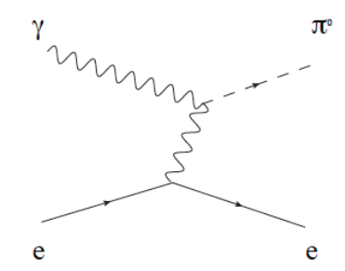
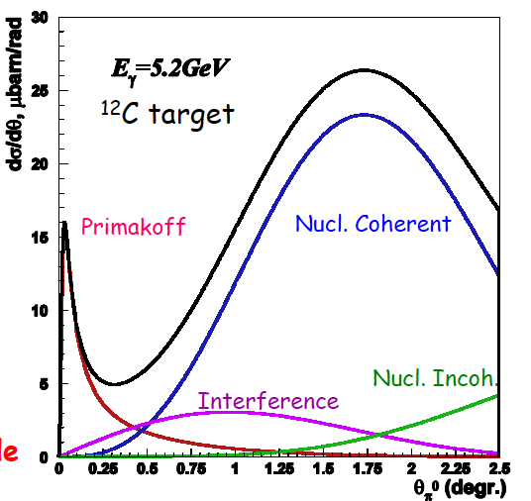
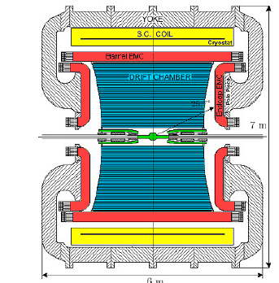
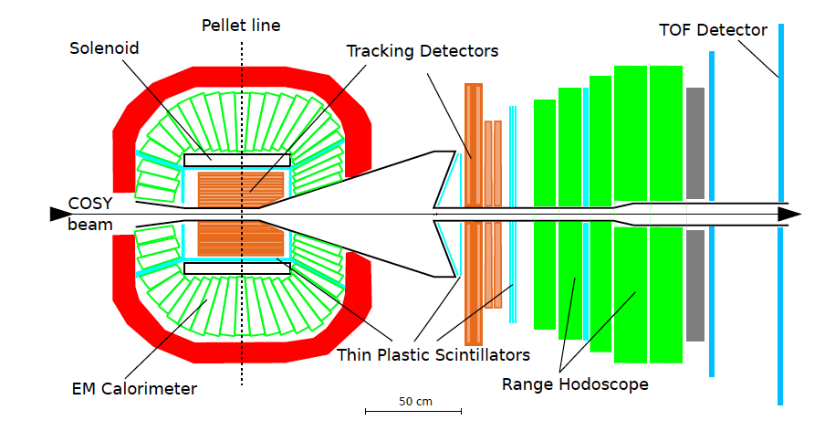
γ-e Linear Collider
Among the large number of activities at IRIDE, we are interested to the fundamental physics investigations with low energy linear colliders
Primakoff effekt: π, η, η’
The photon-electron collision is a much cleaner environment compared to photon-nucleus case
π⁰, η, η’
KLOE/KLOE-2
φ-> η’ γ
φ-> η γ
WASA at COSY
pp->pp η
pd->³He η
L_{I}= 5 fb⁻¹
2∗10⁸ η
1∗10⁶ η’
L_{II}= 20 fb⁻¹
Notes:
coherent photoproduction of pions in the Coulomb field of a nucleus (the Primakoff effect)
2.5 fb-1 on tape @ Ös = Mf
8°—109 f⇒ ~ 108 h ⇒ ~ 5 °—105 h´

Slide 3
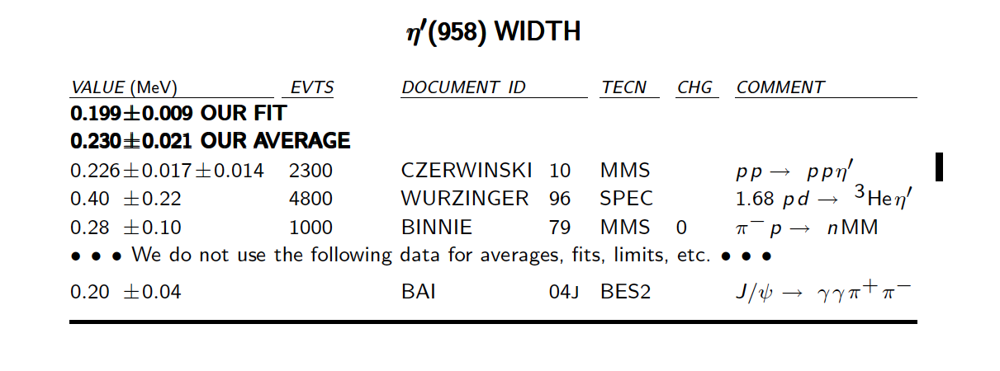
World Average from PDG, PR D86, 010001 (2012)
Note on Decay width Γ(η->γγ) by Roe [Phys. Rev. D 50, ‘94, p.1451]
Direct measurement available: COSY-11 Facility

Slide 4
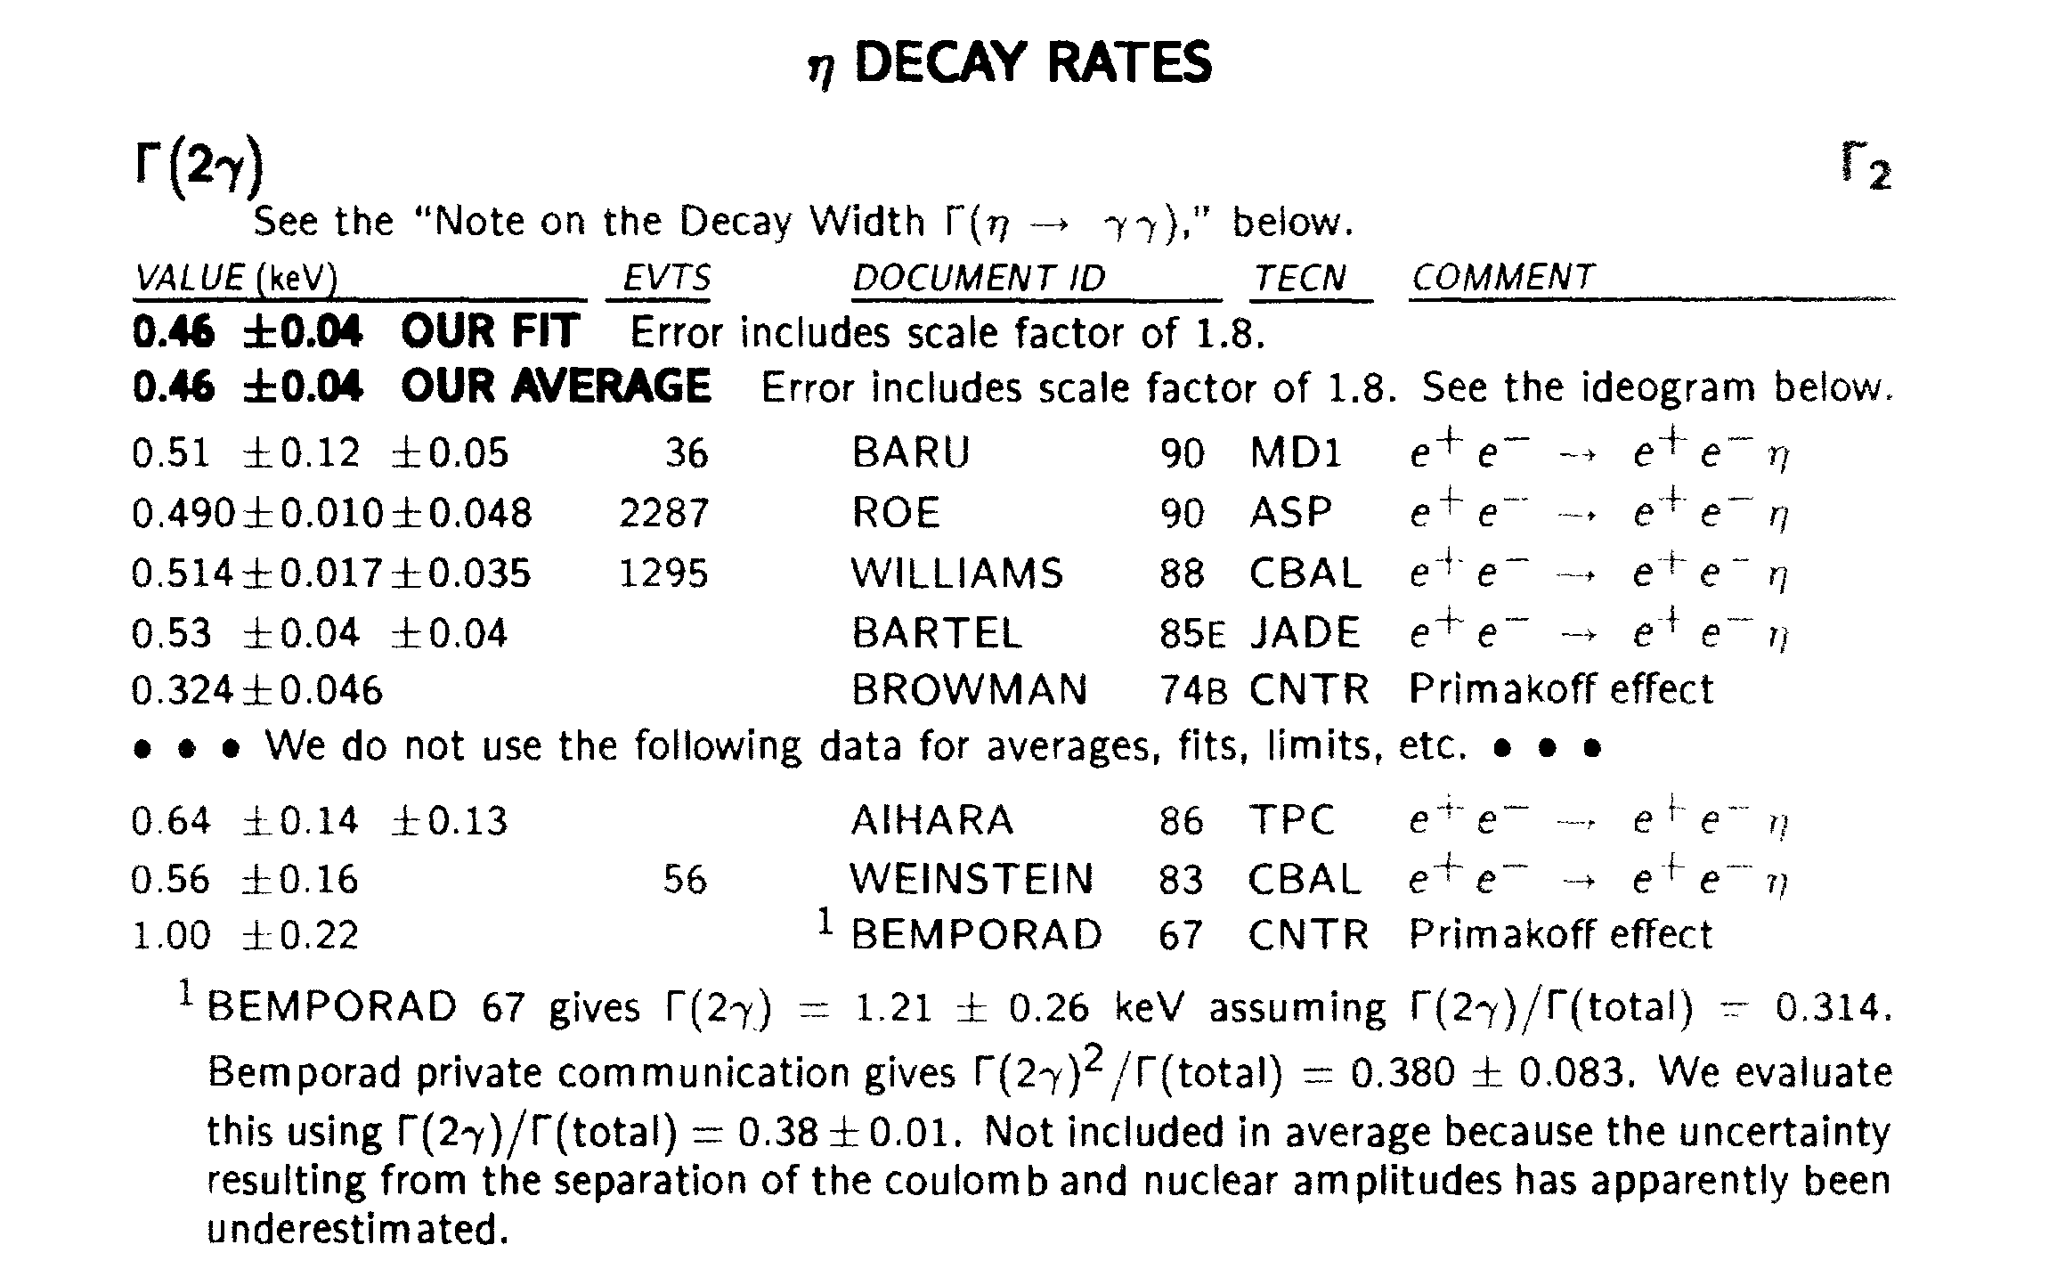
η: 1994 -> 2013
‘94

Slide 5
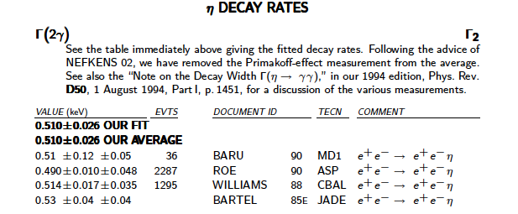
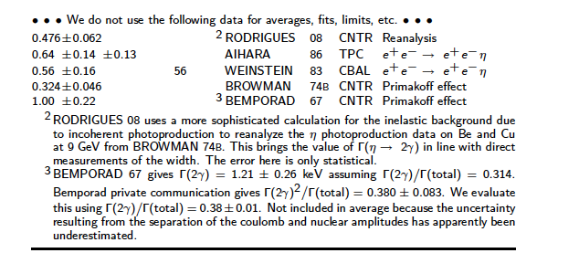
η: 1994 -> 2013
‘94
‘13

Slide 6
η: 1994 -> 2013
‘94
‘13
@ IRIDE: Primakoff effect γ-e
No background due to incoherent
Photoproduction:
Cross-section production should
be evaluated

Slide 7
World Average from PDG, PR D86, 010001 (2012)
Note on Decay width Γ(η->γγ) by Roe [Phys. Rev. D 50, ‘94, p.1451]
Direct measurement available: COSY-11 Facility

Slide 8
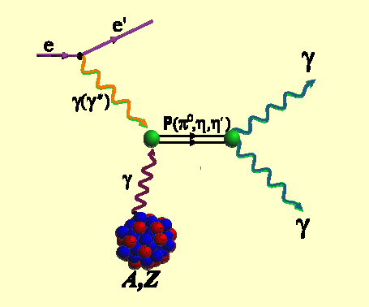
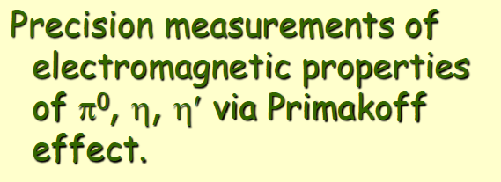
Γ Measurements
COSY11 Facility Γη’ measurement: pp -> ppX
PRL 105 (2010) 122001
Primakoff Program @ JLab. [Primex @ Gluex,
L. Gan, APS April Meeting 2013]

Slide 9
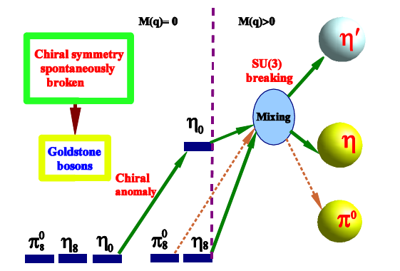
Impact
Accuracy on Γ_{η} and Γ_{η’} limits investigations on many issues:
Quark mass difference
Isospin breaking in QCD, η-η’ mixing
Chiral Anomalies, Γ(π⁰/η/η’->γγ), Γ(η/η’->ππγ)
The system of π⁰, η, η’ mesons as a laboratory to study symmetry structure of QCD al low energies
L. Gan, APS April Meeting 2013

Slide 10
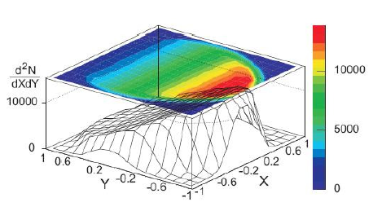
Quark Mass Difference
Determine light quark mass ratio: from
Decay width Γ_{i} disagree between experimental and χPT
Γ_{i(LO)}=40 eV; Γ_{i(NLO)}=160±50 eV; Γ_{i(EXP)}=295±16 eV
KLOE JHEP05 (2008)006:
Dynamics of
Fit to Dalitz plot to measure slope parameters.
Width measurement:

Slide 11
Mixing η−η’ and gluonium
Constraint also from:
Γ(η’->γγ)/Γ(η->γγ)
KLOE analysis [PLB 648 (2007) 267–273; JHEP07(2009)105]
R. Escribano and J. Nadal, JHEP05 (2007) 006.
C. E. Thomas, JHEP10 (2007) 026.
C. Di Donato, G. Ricciardi and I. I. Bigi, PRD 85, 013016 (2012)
PRD85

Slide 12
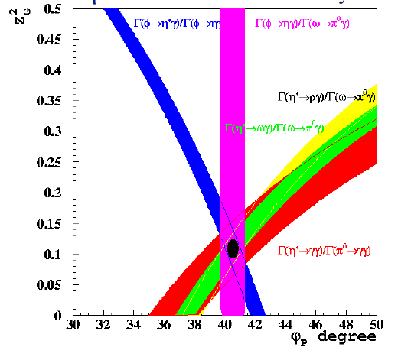
η’ Gluonium VS η-η’ Mixing
KLOE: JHEP07(2009)105
KLOE2: Run at √s≥1.2 GeV
CDD @ Chiral10 Workshop- Valencia 2010

Slide 13
Anomaly
Box Anomaly:   are expected to get contribution from anomaly, Wess Zumino Witten term in ChPT Lagrangian
According to Effective Theory [HLS: Benayoun, Eur. Phys. J. C31 (2003) 525], they could be described by VMD + a direct term
Model independent method based on ChPT and dispersive analysis: do not fix relative strength between tree level contribution and resonance contribution [Stollenwerk, Hanhart, Kupsc, Meiner and Wirzba PLB707 (2012) 184-190]
Theory HLS-Model:
(w = (56.31.7) eV , (wo = (100.92.8) eV
KLOE/KLOE2:
Γ(η→π+π−γ) = (54.7±3.1) eV [PLB 718 (2013) 910–914 ]

Slide 14
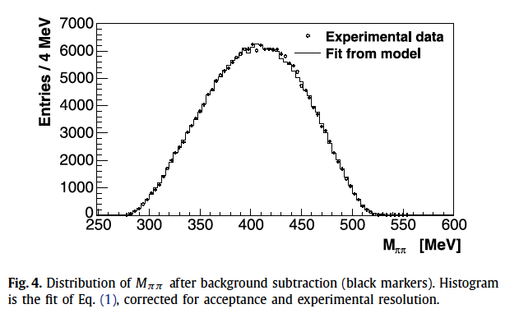
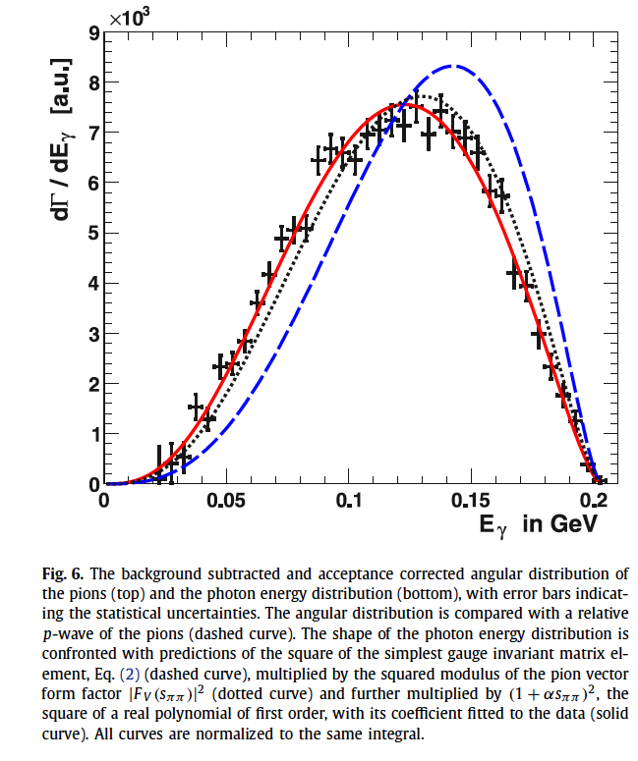
Anomaly
[KLOE/KLOE2PLB 718 (2013) 910–914 ]
[WASA Coll. PLB707 (2012) 243-249]

Slide 15
Remarks & Outlooks
The system of π⁰, η, η’ mesons as a laboratory to study symmetry structure of QCD al low energies
New measurement of Γ_{η} and Γ_{η’} will impact on many issues:
Quark mass difference
Isospin breaking in QCD, η-η’ mixing
Chiral Anomalies

Slide 16
Remarks & Outlooks
IRIDE could also look for f₀ and a₀ mesons
Search of exotic state

