Slide 1
Overview of low energy positron physics and applications
F. Villa

Slide 2
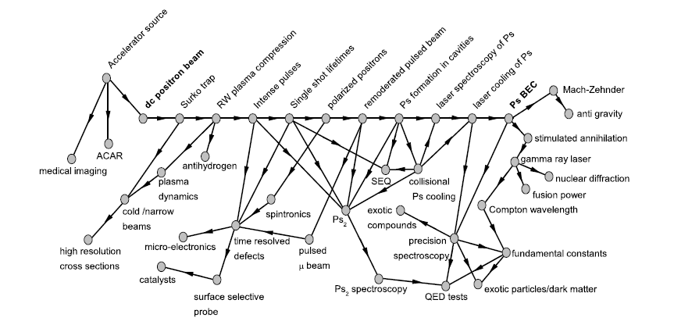
Outline
Low energy positron sources
Physics with low energy positron
  Ps formation
  Ps physics
  Ps BEC & Ps₂
Low energy positrons techniques
  PALS
  PLEPS
  SPM
  GiPS
  CDBS
  PAES
  ACAR
Low energy positron in Italy
All non-commented images are from the talks and the proceedings of the International School of Physics E. Fermi, Course CLXXIV Physics with many positrons

Slide 3
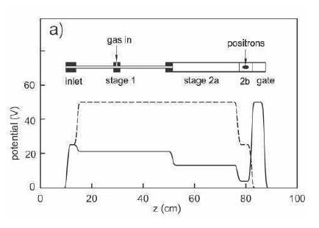
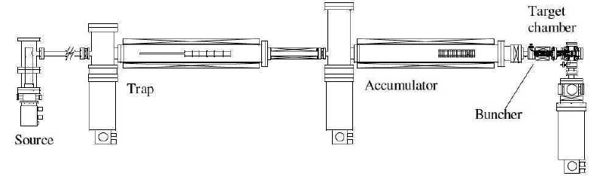
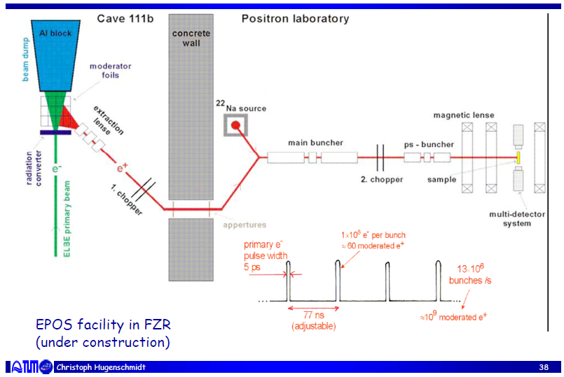
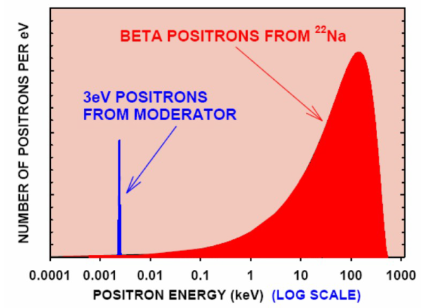
Low energy positron sources
Source: gamma over threshold at 2 m_{e}
Electrons (linac)
Neutrons (nuclear reactors)
decay (²²Na)
Gamma sources (Compton)
Surko trap
Moderation:
W (10⁻⁴ efficiency)
Solid rare gasses (10⁻² efficiency)
Two stage Surko trap with β source
Accumulator: to have highly bunched positron
Surko trap (Penning-Malmberg + rotating wall)
Electron Linac (ELBE, ANL)
Moderation of
positrons

Slide 4

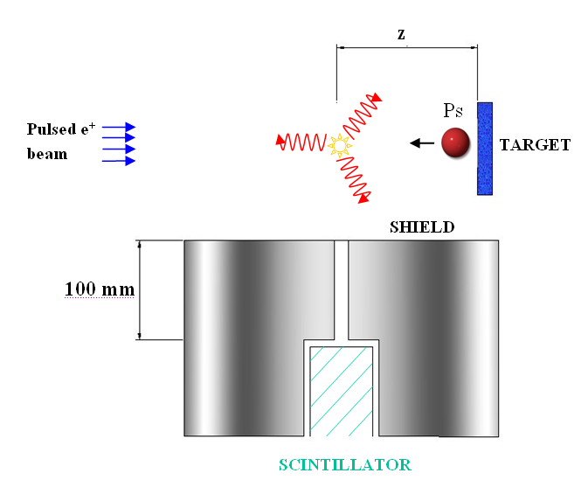
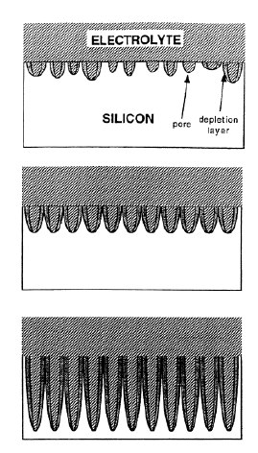
Ps formation
R. Brusa, A. Dupasquier
Vacuum
Porous solid
Positron beam
Valence-conduction gap
(semicond. only)
Work functions
Ps binding energy inside solid
Ps ground state energy
Ps
Ps
Vacuum
Solid
oPs ³S₁ τ=142 ns
pPS ¹S₀ τ=125 ps
Ps
Ps
Ps
Positronium emission
e⁺
e⁺
Time of Flight measurements

Slide 5
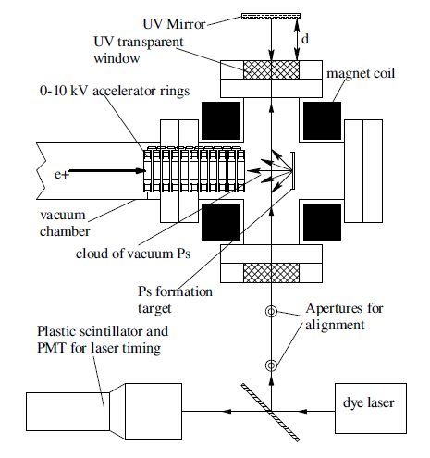
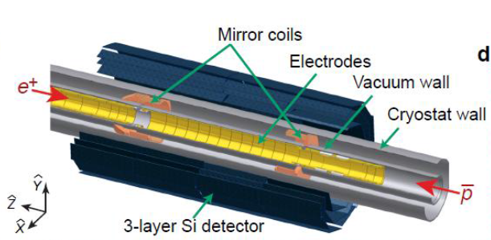
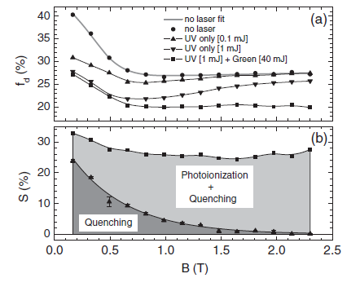
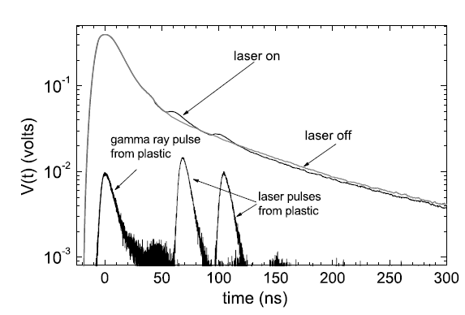
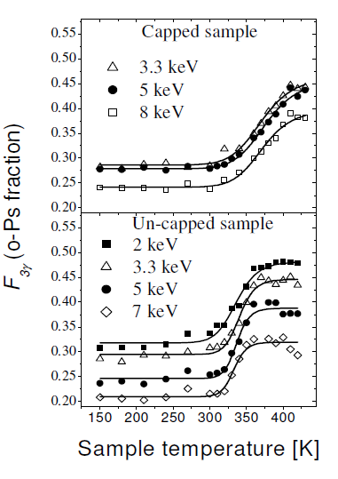
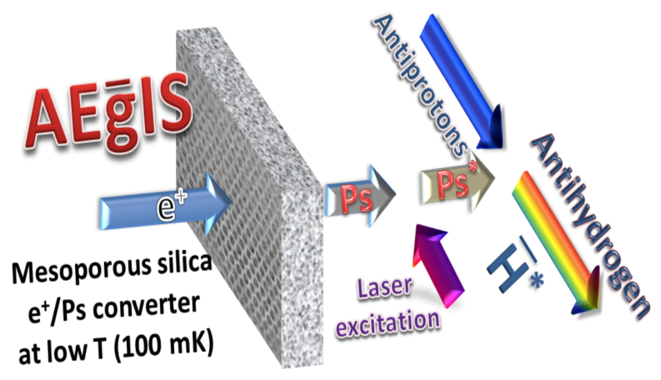
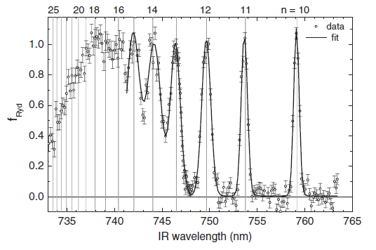
Ps physics & antihydrogen
PRA 81, 012715 (2010)
Nature Physics 7, 558–564 (2011)
Nature 483, 439–443 (2012)
PRL 106, 173401 (2011)
Antihydrogen production:
via collision in magnetic traps
(Alpha, Atrap, Asacusa)
via charge exchange of cold Ps
(Aegis)
Laser spectroscopy
Fine structure
Magnetic quenching
Rydberg Ps
J. Phys. Conf. Ser. 443, 012061 (2013)
PRL 108, 043401 (2012)

Slide 6
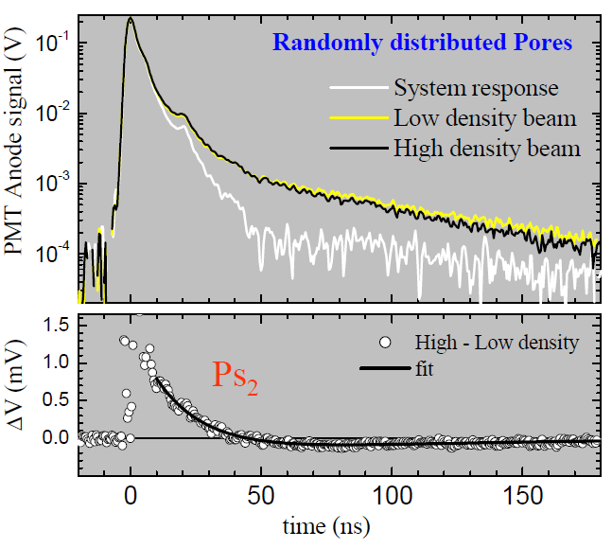
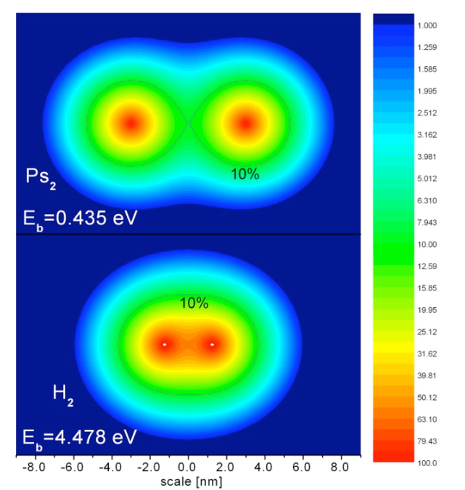
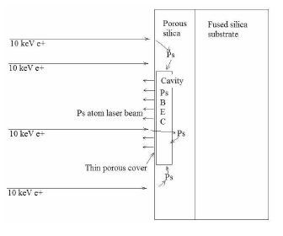
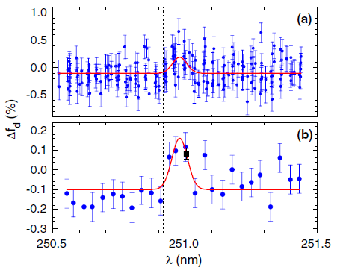
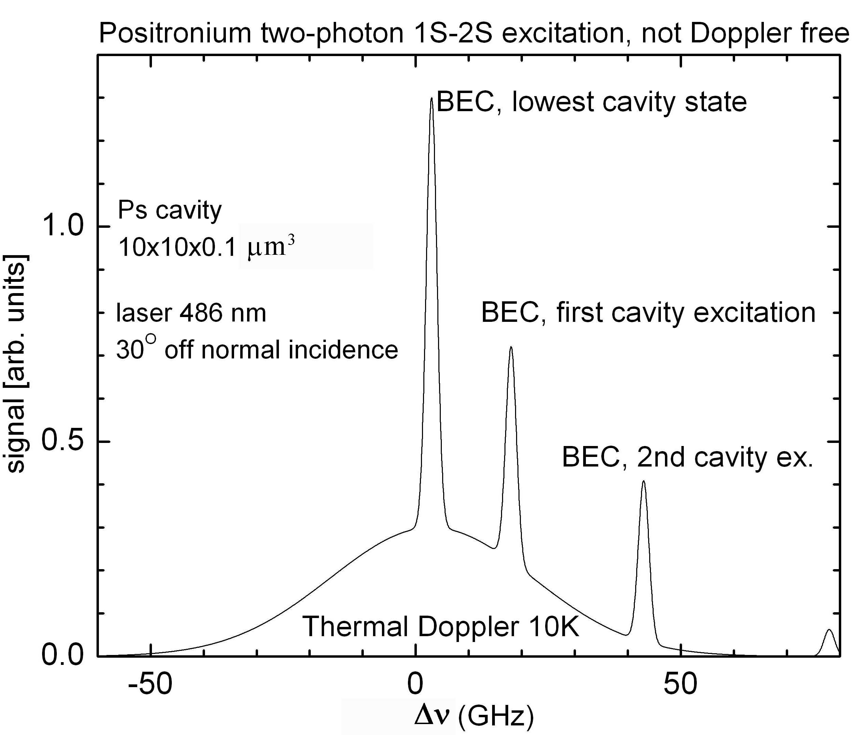
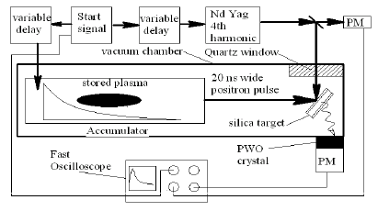
Ps₂ and other interesting items
Ps₂ formation and first attempts of spectroscopy
(compete with spin exchange quenching)
Ps Bose-Einstein Condensate
Expected results:
Ps as a probe for paramagnetic center in porous materials, PRB 75, 085415 (2007)
PRL 108,133402 (2012)
A. P. Mills, D. Cassidy

Slide 7
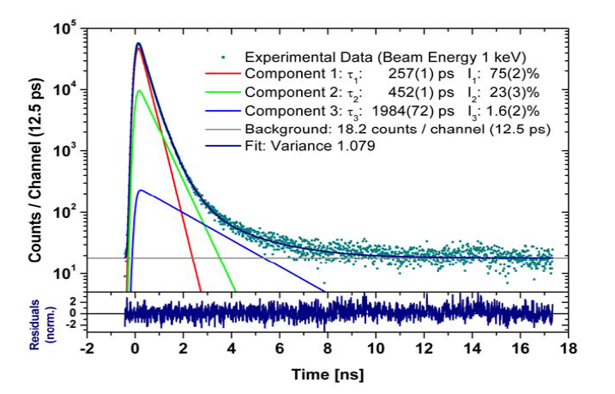
Positron Annihilation Lifetime Spectroscopy
e⁺
γ
κ_{defect}
e⁺
λ_{bulk}
λ_{defect}

Slide 8
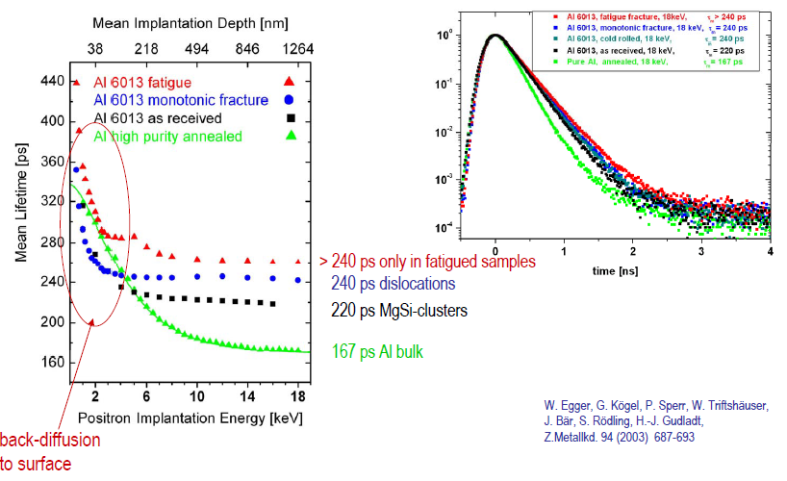
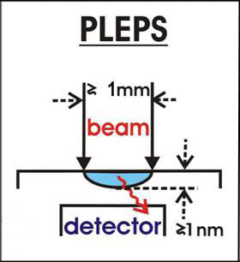
Pulsed Low Energy Positron System

Slide 9
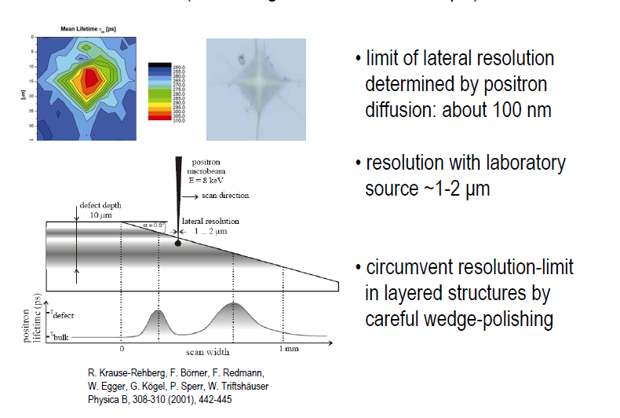
Scanning Positron Microscope

Slide 10
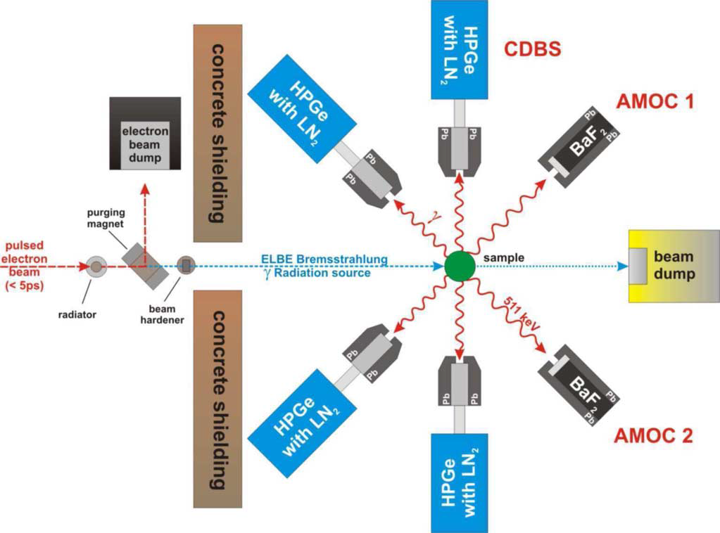
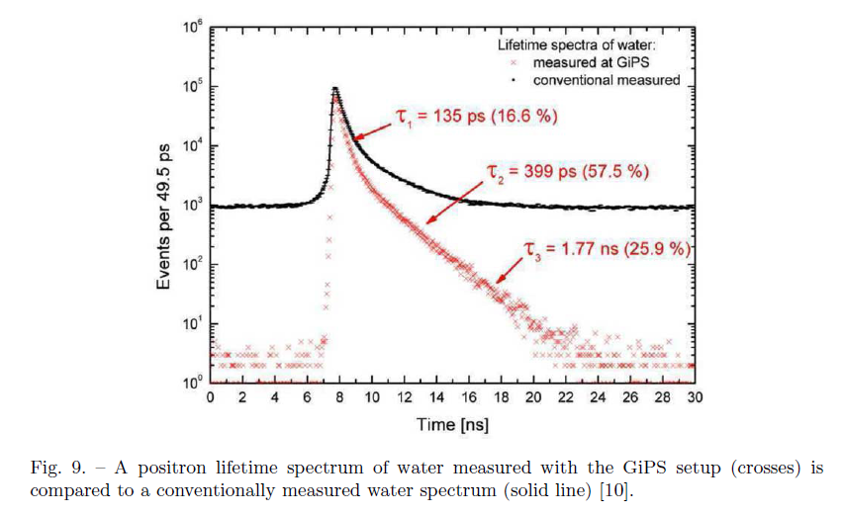
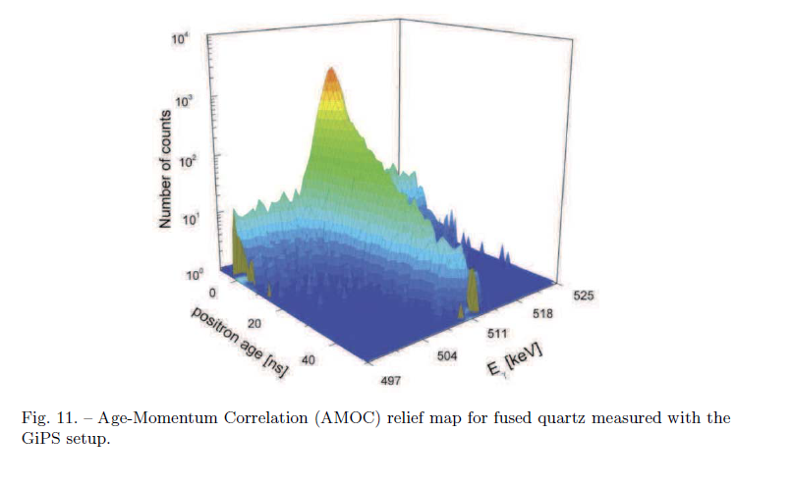
Gamma induced Positron Spectroscopy
Illustration of the GiPS setup at the Forschungszentrum Dresden-Rossendorf

Slide 11
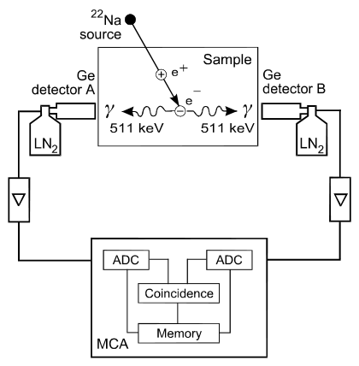
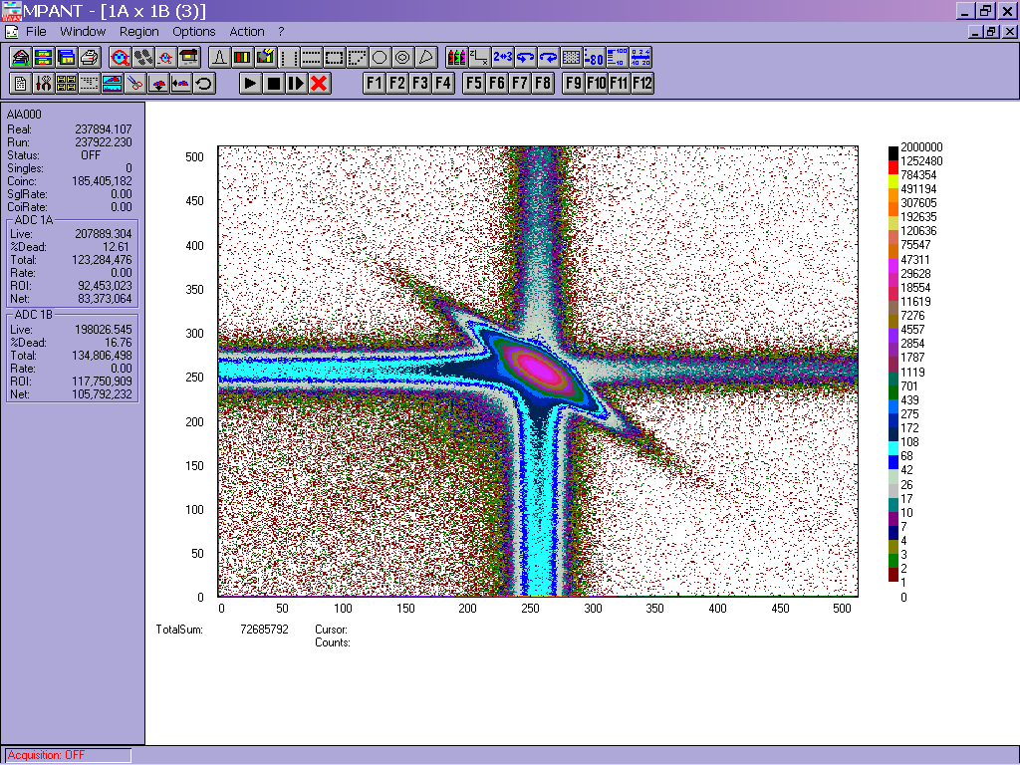
Coincidence Doppler Spectroscopy
Spectra of each detector
Krause-Rehberg, 1998
Total resolution
Coincidences at ΔE
=>Doppler broadening

Slide 12
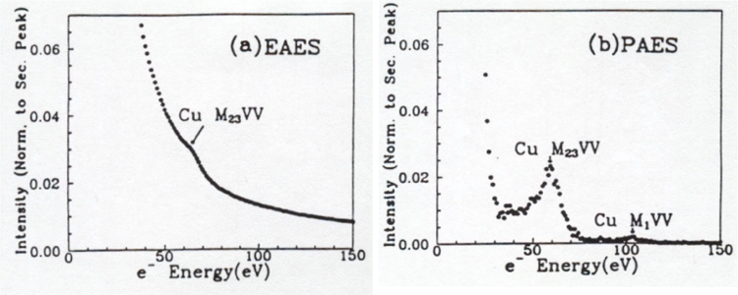
Positron annihilation Auger Electron Spectroscopy
Auger Electron
Vacuum Level
φ
E_{z}
Valence Band
E_{y}
γ
3 keV e⁻ in
E_{x}
30 eV e⁺ in
γ
30eV -1keV Auger e- &
0-3 keV secondary e⁻
30eV -1keV Auger e- & 0-30 eV secondary e⁻
A. Weiss

Slide 13
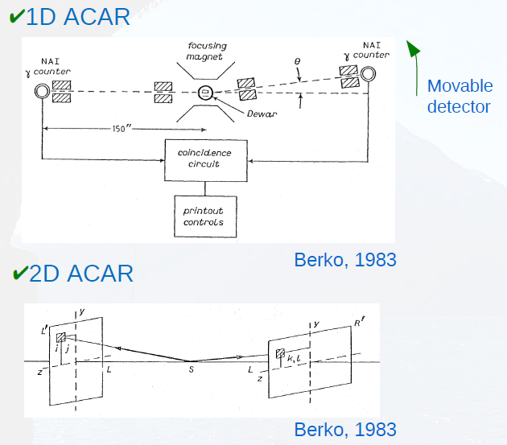
Angular Correlation of Annihilation Radiation

Slide 14
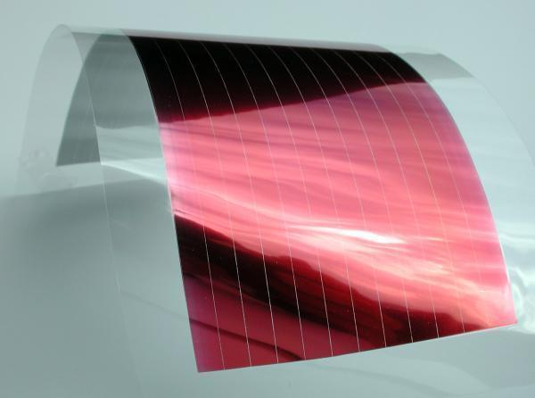

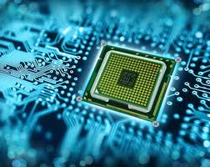
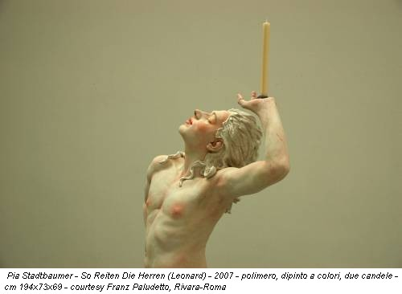
Low energy positron groups in Italy
Politecnico di Milano (Polo Territoriale di Como): R. Ferragut, G. Consolati
Trento: R. S. Brusa, S. Mariazzi
Light alloy
(Al and Mg)
Solar cells
Porous target for Ps production
Polymers
Semiconductors and thin films

Slide 15
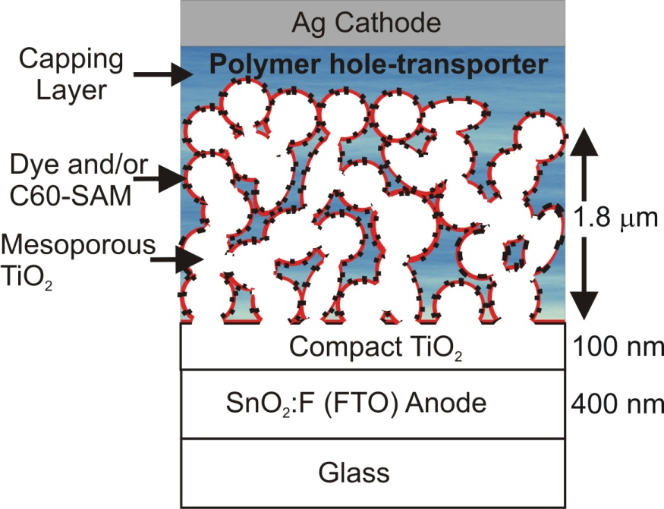
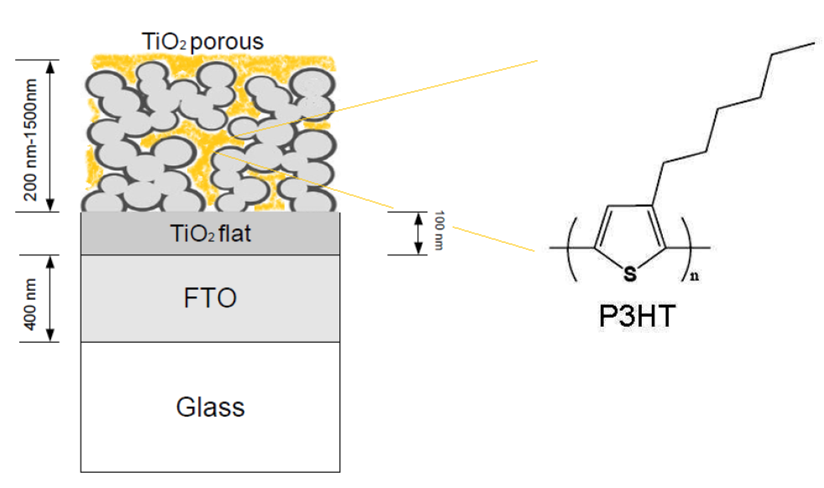
from R. Ferragut
Polymer/Oxide Solar Cells
_
Advantages
flexible and large-area devices
very favourable price/performance ratio
0.8
+
TiO₂ infiltrated with P3HT
_
+
hν
Solar light
poly(3-hexylthiophene)
(Hole-transporter)
TiO2/P3HT
FTO
Glass
Ag Cathode
In collaboration with
Istituto Italiano di
Tecnologia (IIT)
P3HT
capping layer
TiO₂ flat
Energy & Environ. Sci. 5, 9068 (2012) (I.F.: 11.7)

