Slide 1


GRIII - Gamma
Struttura nucleare in condizioni estreme
con spettroscopia γ e particelle cariche
La Domande Fondamentali “away from Stability”
Numeri magici, limiti esistenza nucleare, numeri quantici, r-process…
Esempi di studi (Milano)
1. Accoppiamento particella-Vibrazione
2. Transizione Ordine-Chaos
3. Pygmy Resonances
4. β-decay e processo r
Apparati Sperimentali
1. Array di Ge: AGATA
2. Array di Scintillatori (LaBr3 e BaF2)
3. Ancillari
Collaborazioni e Laboratori

Slide 2
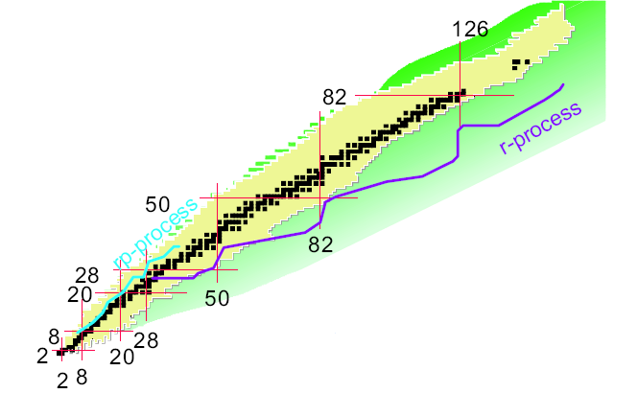
Moving Away from the Stability Valley
EXOTIC NUCLEI
3000 discovered
248 Stable
Limit of Nuclear Existence ?
Robustness of Magic Numbers ?
Validity of Quantum Numbers (K, …) ?
Change in Structure due to n-excess ?
β-decay and r-process path location ?
Z
> 6000 expected
interaction among nucleons
… effective nuclear force
→ SYSTEMATICS is NEEDED
N

Slide 3
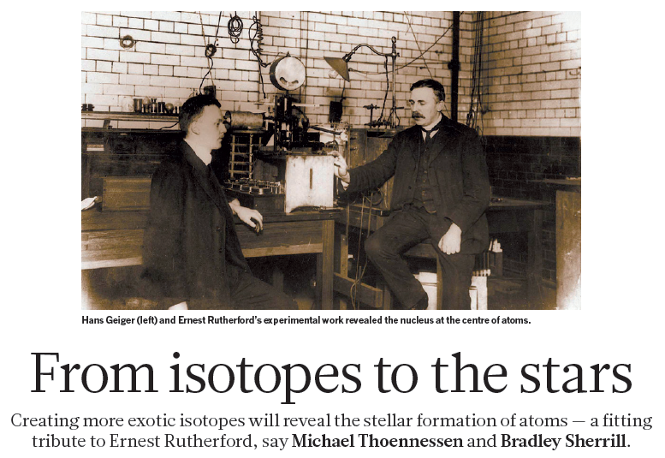
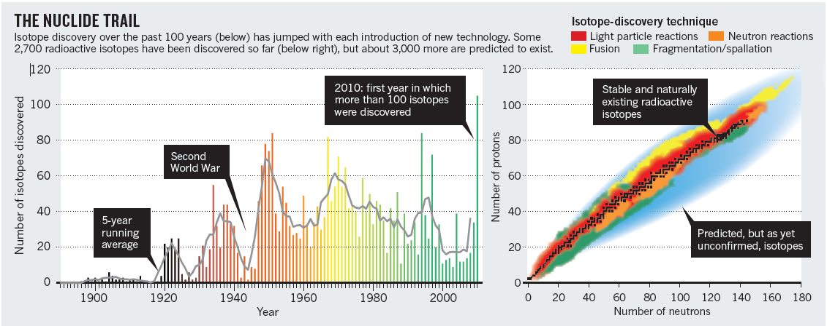
Comment to Nature,
by M. Thoenessen and B. Sherrill
5 M AY 2 0 1 1 | VO L 4 7 3 | N AT U R E | 2 5
In occasion of Rutherford centennial 2011
Radioactive Beams !

Slide 4
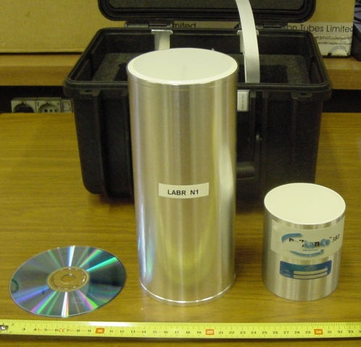
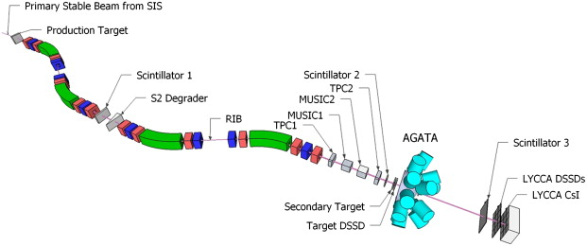
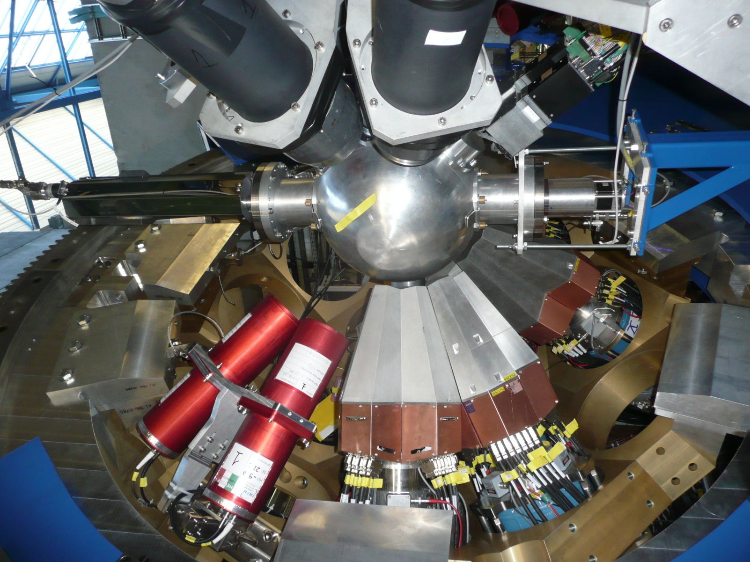
Key technological Aspects:
New Beams
Exotic or Stable with high intensity
Advanced Detection Systems
for γ spectroscopy:
New Generation Ge Array (AGATA) + Ancillaries
+ Spectrometers
LaBr₃ (Milano)
FRS @ GSI
AGATA @ GSI

Slide 5
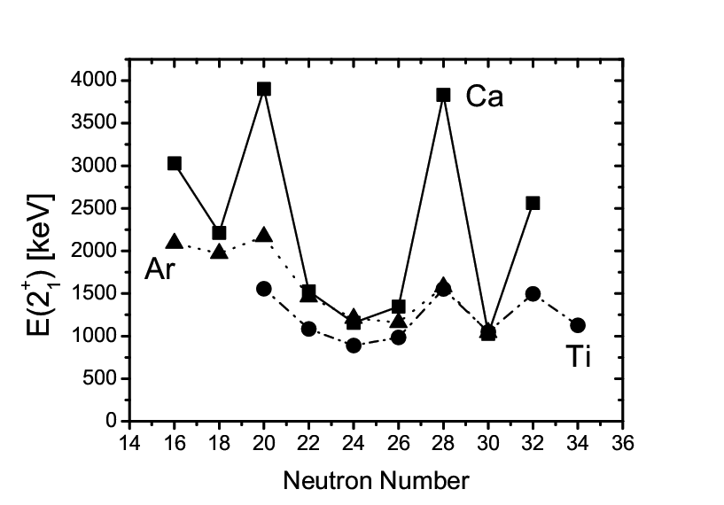
Evolution of Shell Structure
Nucleons generate their own potential
Quantum effects -> shell gaps, magic numbers
Mean field potential: V= HO + L² + LS
(Haxel, Goppert Mayer 1949)
@ Stability Valley
Far from stability:
- New Magic Numbers
- New Shell Closures
Collapse N= 20
& N=28 gaps
82
2d
40
1g
50
1f_{7/2}
40
g_{9/2}
2p_{3/2}
N=3
40
p_{1/2}
1d_{3/2}
2p
f_{5/2}
1f
28
p_{3/2}
16
20
20
f_{7/2}
20
2s_{1/2}
N=2
d_{3/2}
1d_{5/2}
First excited state
2s
s_{1/2}
ν
1d
14
8
d_{5/2}
8
8
… effective
nuclear force
N=1
@ Drip line
H.O
+
L²
+
L.S

Slide 6
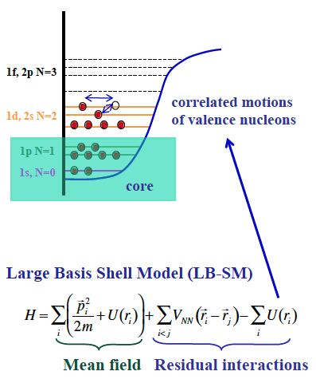
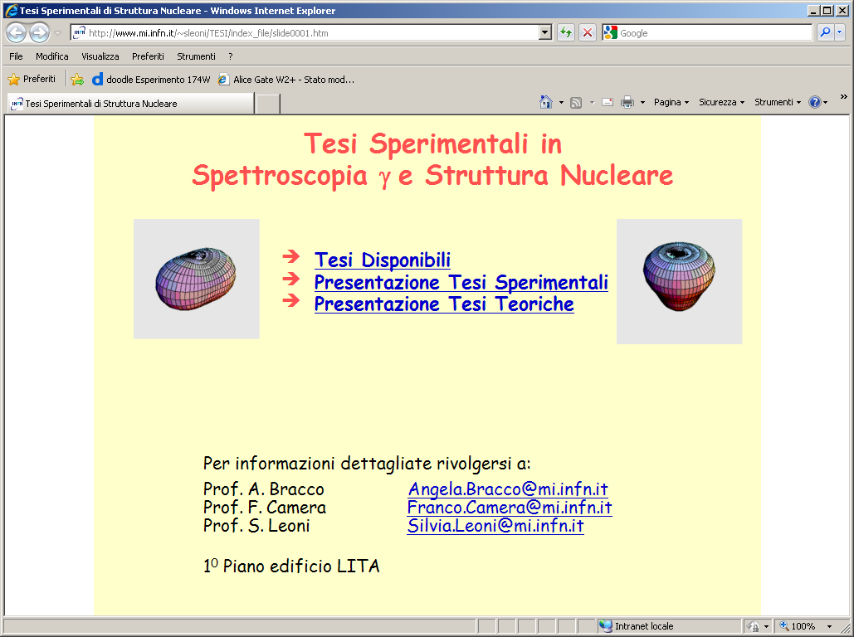
1. MILANO: Robustness of SHELL Closure
Coupling between
Particle and Phonon
Key Ingredient for:
Anharmonicity of vibrational spectra
Damping of Giant Resonances
Quenching of Spectroscopic Factors, …
Large Basis Shell Model (LB-SM)
Correlations among valence nucleons
excited core
(phonon)
Research Program in Milano (with Colò and Bortignon):
Coupling with 1 particle
- effective single particle levels
- coupling strength
Coupling with 2 particles
- core + 2 particles model
- physics of pairing
Coupling between
Particle and Vibrations
is NOT included in SHELL Model

Slide 7
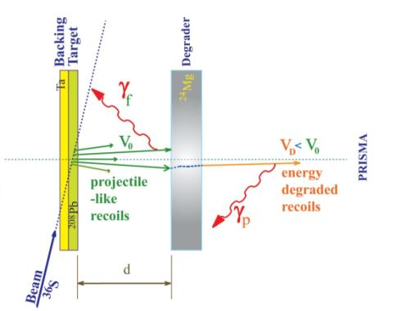
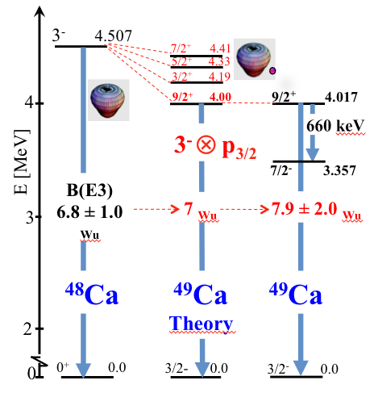
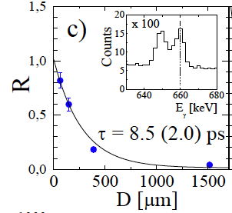
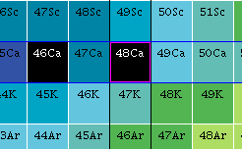
Systematic Study around magic nuclei: Ca, Ni, Sn, …
S. Leoni, A. Bracco, …
lifetime
Angular distributions
Polarizations
Lifetimes
to firmly
establish
I^{π} and B(E/Mλ)
Plunger
τ ≈ 1/B(E,Mλ)
⁴⁸Ca
(Z=20,N=28)
Heavy-Ion multi-nucleon transfer Reaction
⁴⁸Ca+⁶⁴Ni @ 6MeV/A (LEGNARO)
Ge Array (CLARA) + Spectrometer (PRISMA)
Preparatory work for RIB facilities
SPES, SPIRAL2, ISOLDE, …
D. Montanari, S. Leoni et al., PLB697(2011)288
D. Montanari, S. Leoni et al., PRC85, (2012)044301

Slide 8
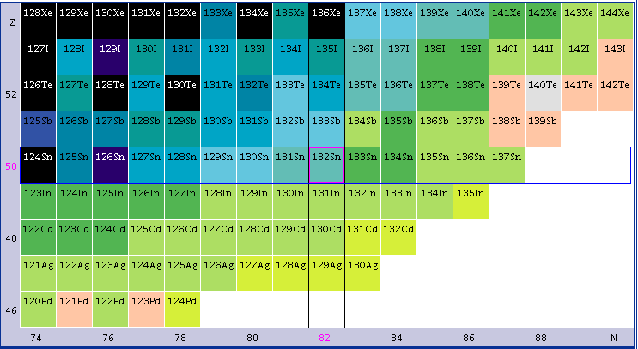
Systematic investigation of Particle-Phonon
coupled states
Under Analysis:
^{65,67}Cu → ^{64,66}Ni + 1p
⁷Li+⁶⁴Ni (Tandem Lab. Bucharest)
ROSPHERE Ge Array+ LaBr₃
^{49,47}Ca → ^{48,46}Ca + 1n
Cold n + ^{46,48}Ca (Reactor ILL, Grenoble)
Exogam/GASP Ge Array + LaBr₃
²¹⁰Bi → ²⁰⁹Bi + 1n
Cold n + ²⁰⁹Bi (Reactor ILL, Grenoble)
Exogam/GASP Ge Array + LaBr₃
1 and 2 nucleons around ¹³²Sn
Cold n + ²³⁵U and ²⁴¹Pu (Reactor ILL, Grenoble)
Exogam/GASP Ge Array + LaBr₃
→ LOI for HIE-ISOLDE, SPIRAL2, SPES, …
Around
Doubly Magic ¹³²Sn
¹³¹In
proton
hole states
G.Colò and P.F.Bortignon

Slide 9
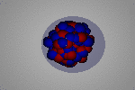
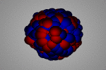
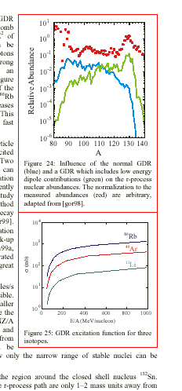
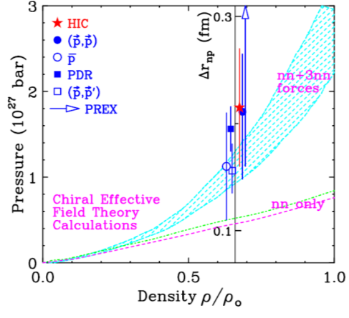
Change of Structure due to n-excess
2. MILANO: Collective dipole modes → pygmy resonances
n excess vs inert core
GDR
IVGDR
PDR
E1 strength shifted
towards low energy
Important Astrophysics Implications
Element Abundance in the Universe
Info on E_{sym}
EOS of nuclear matter
Neutron Pressure:
extrapolation for ²⁰⁸Pb from different
measurements
(including pygmy in ⁶⁸Ni and ¹³² Sn )
→ Neutron stars
Neutron Pressure from SKIN
10¹
10⁰
10⁻¹
10⁻²
10⁻³
10⁻⁴
10⁻⁵
10⁻⁶
exp
Relative Abundance
Theory
+pygmy
80 90 100 110 120 130 140
A
S. Goriely, Phys. Lett. B 436 (1998) 10

Slide 10
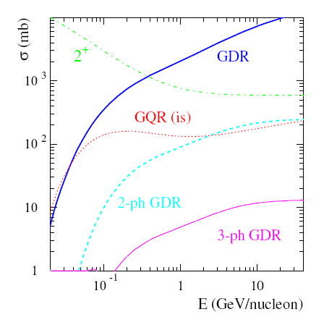
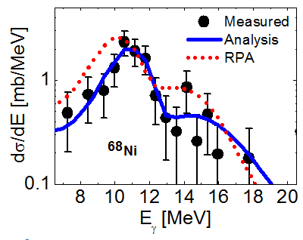
Systematic investigation of Pygmy Resonances
Bracco, O. Wieland, F. Camera, B. Million, …
EXOTIC NUCLEI:
Relativistic Coulomb Excitation
2005:
⁶⁸Ni (600 MeV, 10³ pps) + ¹⁹⁷Au
GSI Laboratory (@Fragment Separator)
RISING Ge Array+ 8 BaF₂
2012:
⁶⁴Fe (400 MeV, 10³ pps) + ²⁰⁸Pb
GSI Laboratory (@Fragment Separator)
AGATA Ge Array+ 8 BaF₂+ 10 LaBr₃
First Part: Autumn 2012
→ Remaining: 2013-2014
^{70,72}Ni (260 MeV, 10⁴-10³ pps) + ²⁰⁸Pb
RIKEN Laboratory (@BigRips)
BaF2 Array DALI2+ 8 LaBr₃
→ To be rediscussed June 2013
T.Aumann et al EPJ 26(2005)441
5-9 % EWSR
⁶⁸Ni
O.Wieland et al. PRL 102, 092502 (2009)
LaBr₃
AGATA at GSI

Slide 11
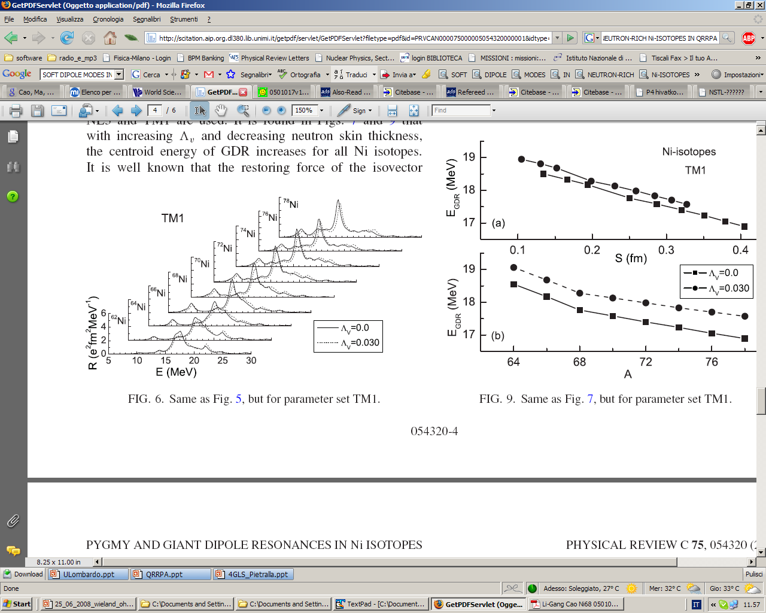

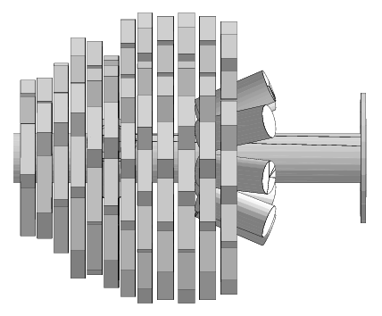
Study the Evolution of the PDR strength in Ni isotopes
PHYSICAL REVIEW C 75, 054320 (2007)
Jun Liang, Li-Gang Cao and Zhong-Yu Ma
SHOGUN
Dali2+LaBr
BU
BaF2
RIKEN
%EWSR
DALI2
NaI
ε=4%
@ 10 MeV
Milano LaBr3
ε=1-2%
@ 10 MeV
Centroid
position
Beam
Cao, Ma, Modern Phys. Lett. A19(2004)2845

Slide 12
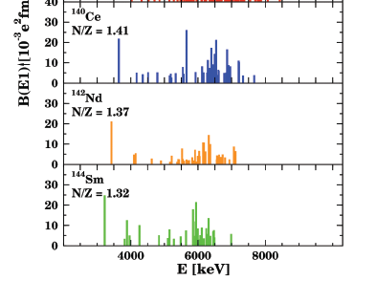
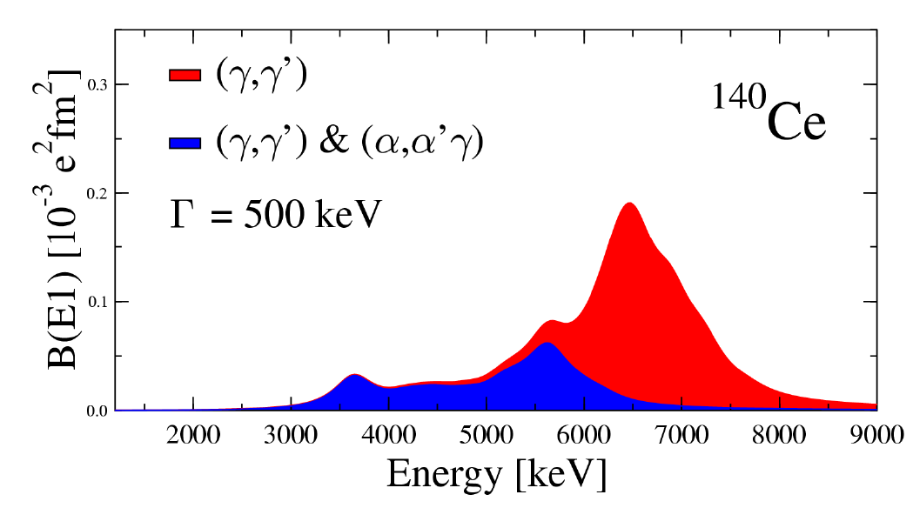
Strong Debate: substructure of pygmy states ?
STABLE NUCLEI:
(γ,γ’) and (α,α’γ) reactions
The pygmy resonance
splits in two parts :
1- one excited both
in (γ, γ’) and in (α,α’γ)
2- the other excited only in (γ, γ’)
Microscopic nature
of excited states
D. Savran et al. PRL97,172502(2006)

Slide 13

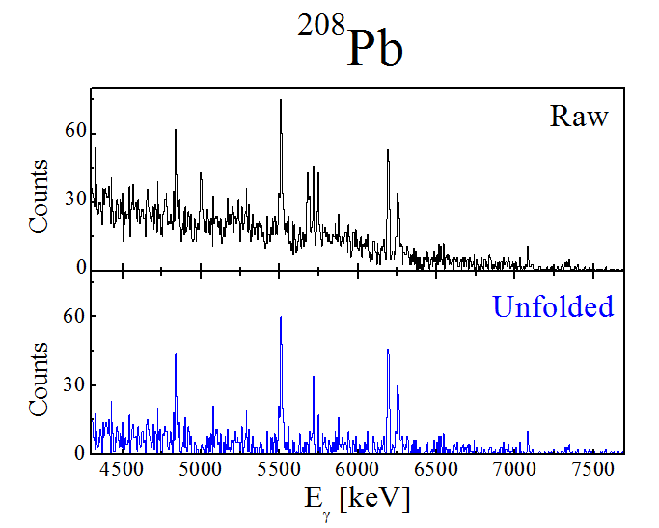
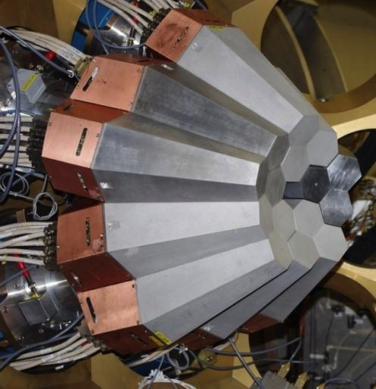
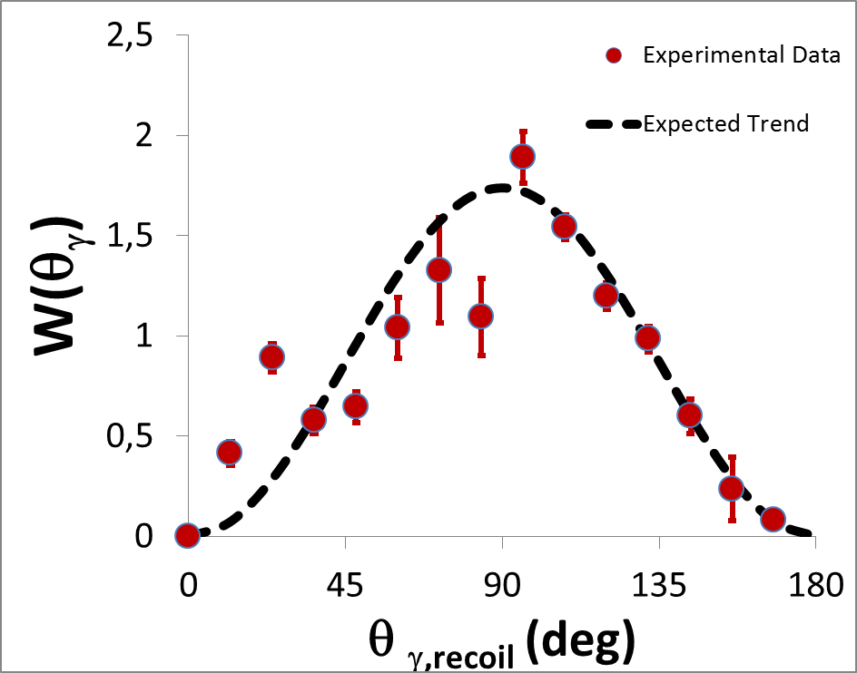
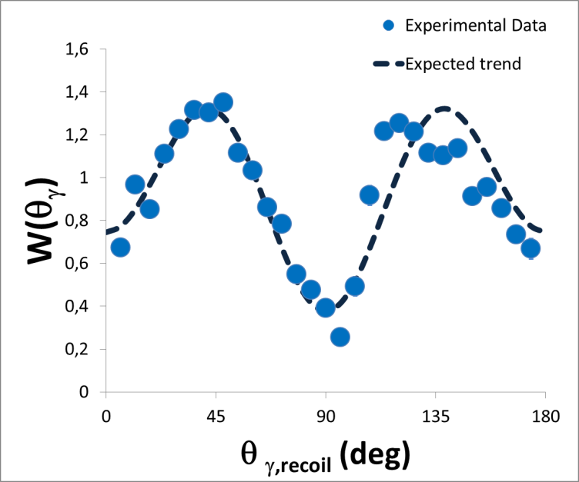
Pygmy Resonance in ²⁰⁸Pb, ¹²⁴Sn and ¹⁴⁰Ce
Bracco, F. Crespi, …
Inelastic Scattering ¹⁷O at 20 MeV/u
AGATA
at LNL
E_{γ} = 5512 keV
E1
Detailed Investigation
Strength
Multipolarity
EM Character
E2
E_{γ} = 4085 keV

Slide 14
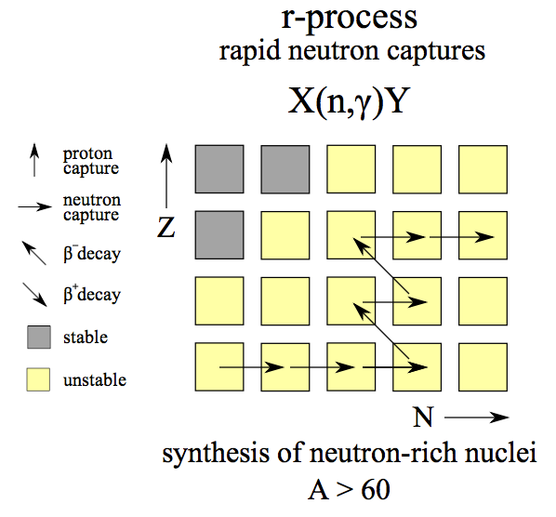
β-decay and r-process location
3. MILANO: n-rich region of Pb and Ni
β-decay half-lives
− neutron emission probabilities
different in DEFORMED and SPHERICAL nuclei
τ_{β SPH} ~ 10 x τ_{βDEF}
P_{nSPH} ~ 0.5 x P_{nDEF}
→ Large uncertainty in r-process location
→ difficoulty to extrapolate to more exotic regions
Importance of Nuclear Structure studies
in the vicinity/towards r-process path:
… first excited states
… Isomeric states
… β decay lifetimes

Slide 15
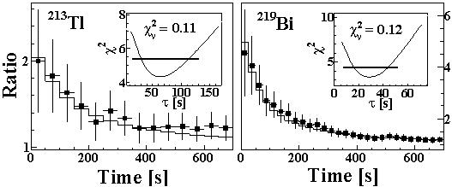
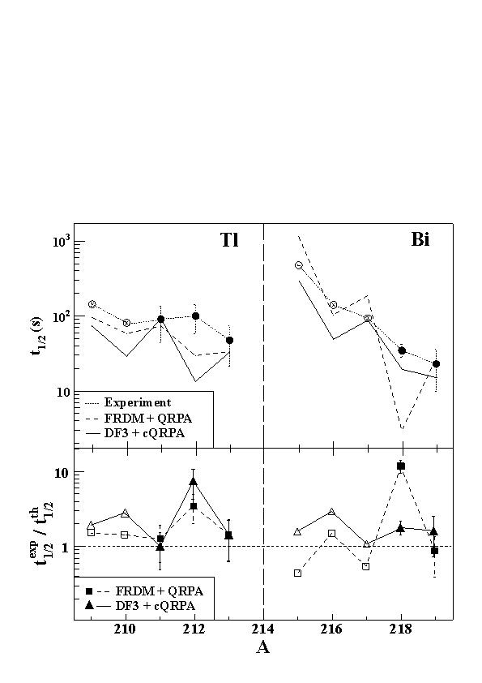
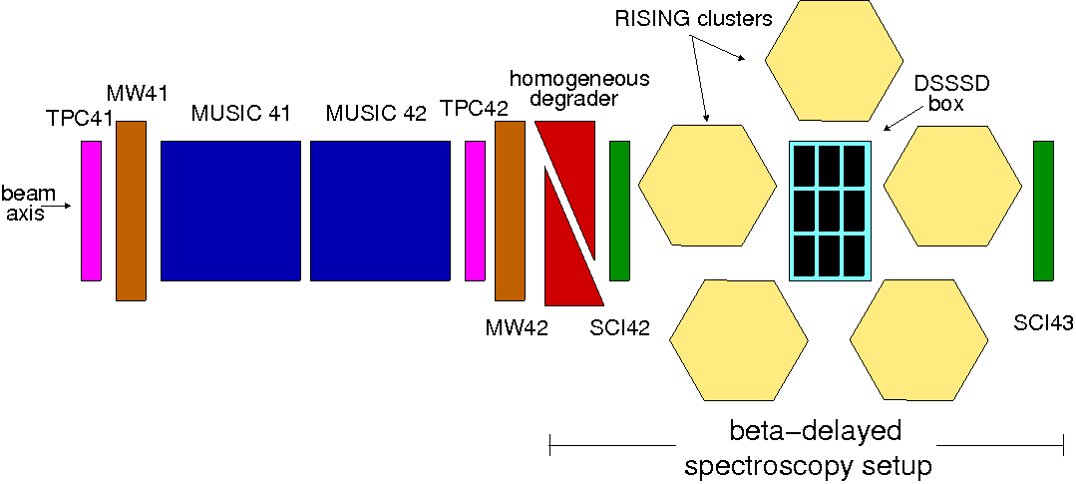
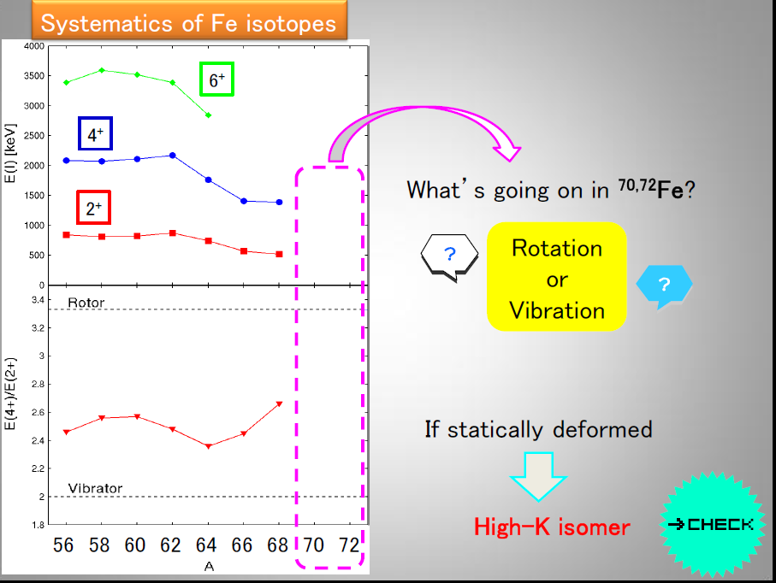
Sistematic investigation of β-decay and β-γ correlations
G. Benzoni, A. I. Morales, …
GSI experiment (n-rich Pb):
²³⁸U (1GeV/u MeV, 3x10⁹ pps) + ⁹Be
@Fragment Separator
RISING Ge Array+ DSSSD active stoppers
Theory underestimates experiments
G. Benzoni et al. PLB715,293(2012)
RIKEN experiment (n-rich Fe)
May 2013:
²³⁸U (345 MeV/u MeV, 3x10⁹ pps) + ⁹Be
@BigRips
EURICA Ge Array+ DSSSD active stoppers
Are ⁷⁰⁻⁷²Fe deformed or γ-soft?
If deformed, are there any high K isomeric states ?

Slide 16
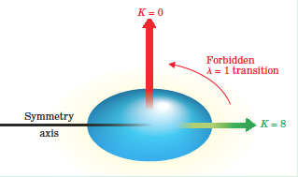

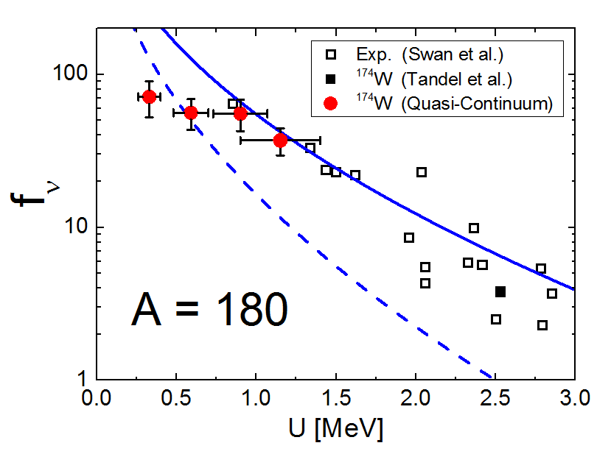

Validity of Quantum Number with T
4. MILANO: weakening of selection rules on K
K
S. Leoni, A. Bracco, G. Benzoni, …
Transitions with ΔK > λ
are strongly hindered
→ ISOMERS
Global properties of γ-decay flow
from warm collective rotation
chaotic
regime
p
(E,I,
π
(E,I,
)
CN
)
CN
K-hindrance from E1 decay of
all discrete excited bands
n
n
g
⁵⁰Ti + ¹²⁸Te
→ ¹⁷⁴W + 4n
γ
E*[MeV]
E*[MeV]
B_{n}
B_{n}
γ -flow
8
8
MF+V_{int}
Yrast Line
Yrast Line
1
1
MF
Weakening due to mixing among states (high level density)
Spin
Spin
T. Døssing et al., Phys. Rep. 268 (1996)1

Slide 17
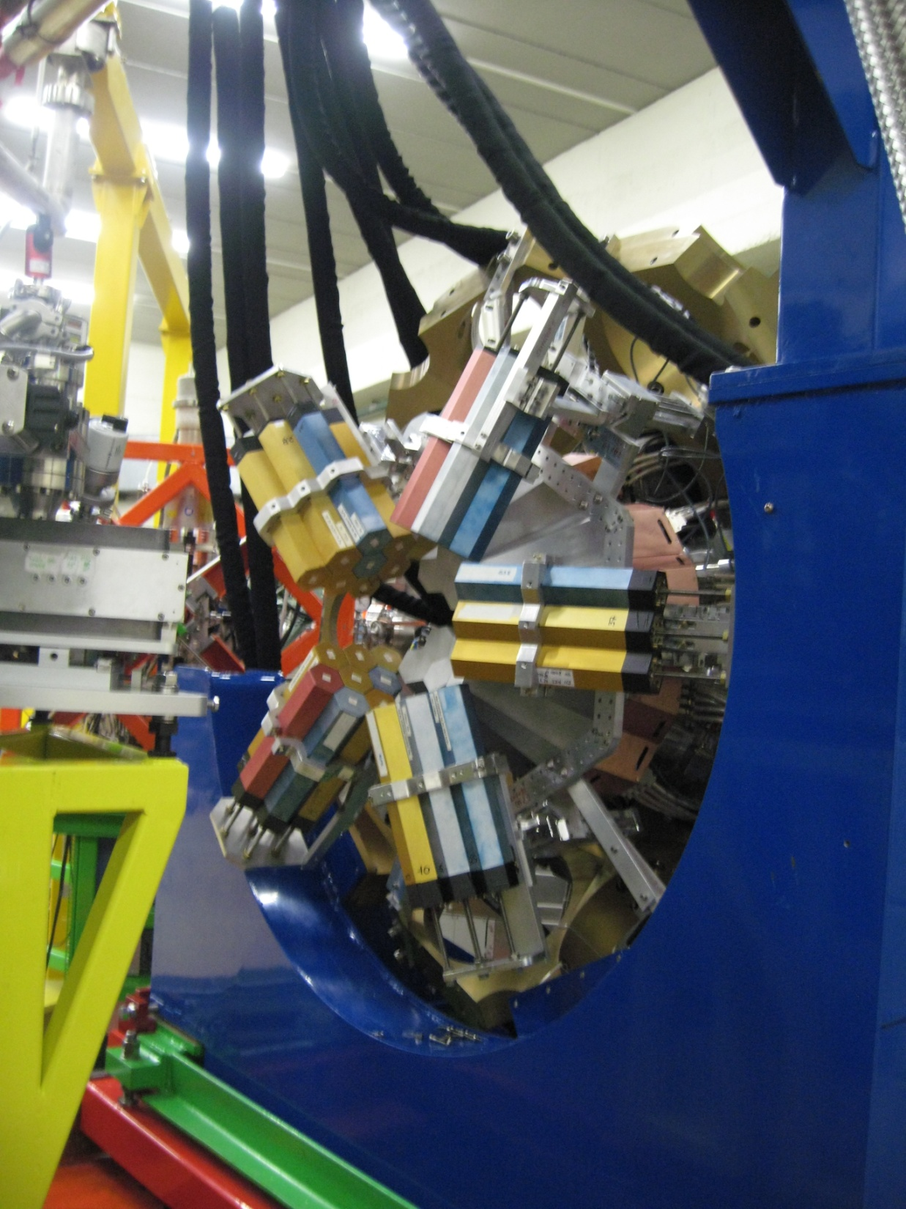
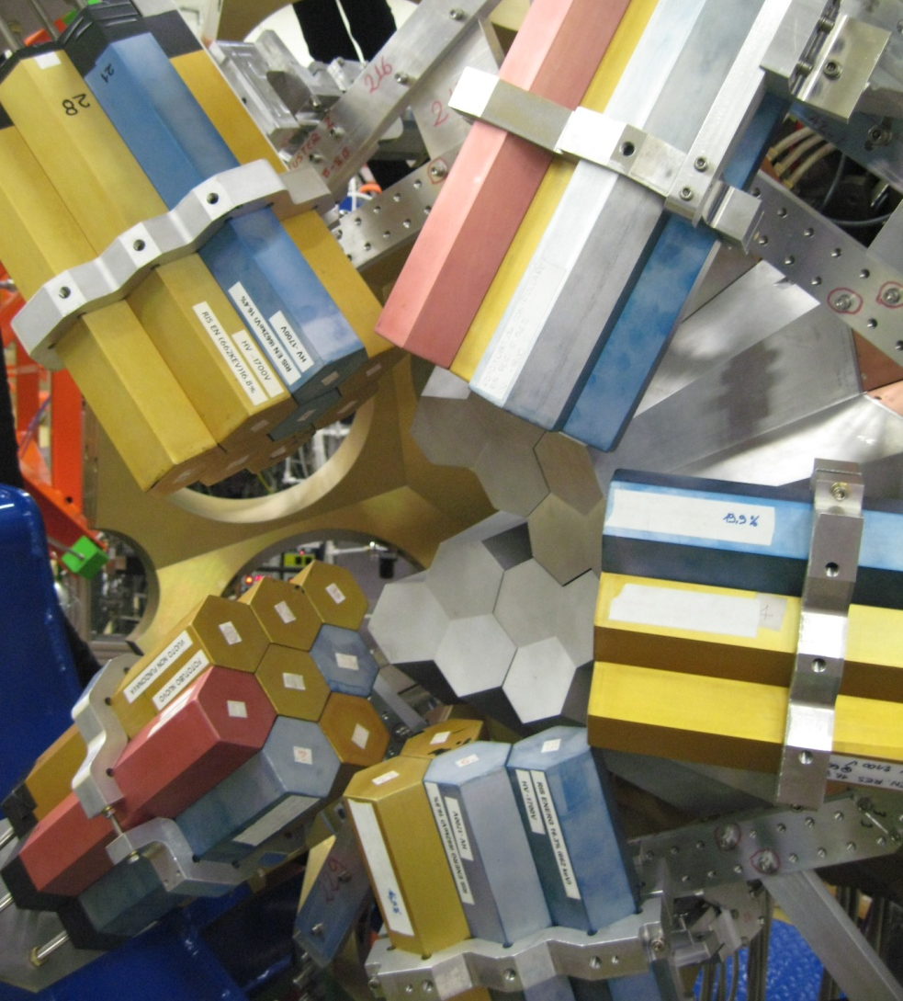
Experimental setup: AGATA + HELENA
Experiment performed in July 2010 at Laboratori Nazionali di Legnaro
AGATA
4 Triple Clusters
2 and 3 folds:
ε_{2γ}=30%, ε_{3γ}=10%
(M_{γ} = 30)
HELENA:
27 detectors: 5 clusters of BaF₂ (3”×3”, exagonal)
Total solid angle: 25% of 4π
Total efficiency: 16% @ 500keV
V. Vandone, S. Leoni, … (Milano University an INFN)
Notes:
The reaction used to populate the 174W nucleus was titanium50 on tellurium128. The main evaporation residua were 174 tungsten and tungsten 173, approximately with the same cross section
Close to the yrast, the nucleus behaves as an ordered system with well-define quantum number and their selection rules, while as the internal energy increase a gradual transition into chaos takes place, and q-n and selection rules lose their meaning.
A useful probe to study the evolution of selection rules is the K-quantum number, namely the projection of the total angular momentum on the symmetry axis. Close to the yrast K is a well-defined quantum number, and low-k and high-k bands flows are well-distinguished. As the internal energy increase statistical k-mixing processes take place that depends on the high density of the states.
The transition into chaos can be studied by the analysis of 2-dimensional γ−γ coincidence spectra, built on specific gamma transition. (AGATA fold distribution is peaked around 3, that is fundamental to build gated g-g matrices).
The experiment performed last July @ LNL. The experimental set-up was composed by the AGATA Demonstrator coupled with an array of 27 BaF scintillators named HELENA.
The goal of our experiment is in particular the statistical analysis of the ridge-valley structure to study the order- to-chaos transition and to evaluate the number of low-K and high-K bands and their correlation. Since we have used backed target, we want also to deduce the lifetime of the excited rotational bands, to test the deformation stability with temperature. As by-product of the experiment we want to study the trend of the GDR width of the W compound nucleus. Finally we can study AGATA response to high-energy gamma rays by testing n-gamma discrimination method developed by the Turkish group of Ankara and the use of PSA techniques to improve time resolution.

Slide 18

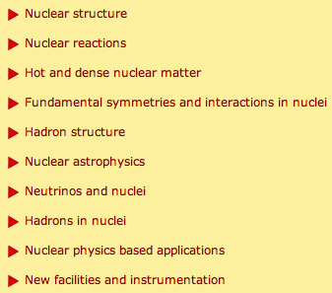
> 750 Participants
Among Plenary Talks
Shell evolution and nuclear forces
Results from FRS and relativistic RIB at GSI
Nuclear structure with gamma-ray tracking arrays (AGATA)
Direct reactions with exotic nuclei
World new facilities for radioactive ion beams
Exploring nuclear structure with deep-inelastic heavy-ion collisions
Imaging devices for medicine and security
…
9 Parallel Sessions
(6 for Nuclear Structure and Nuclear Reactions)
> 40 Invited talks from “Our” Community

Slide 19
Advanced Detection Systems
for γ spectroscopy:
New Generation Ge Tracking Arrays (AGATA/GRETA)
Ancillaries (Scintillators, Si telescopes, …)
Spectrometers/Fragment Separators

Slide 20


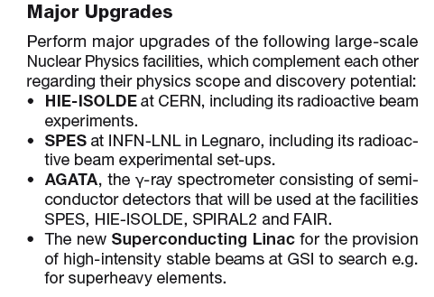
Long Range Plan 2010
Recommendations and priorities

Slide 21

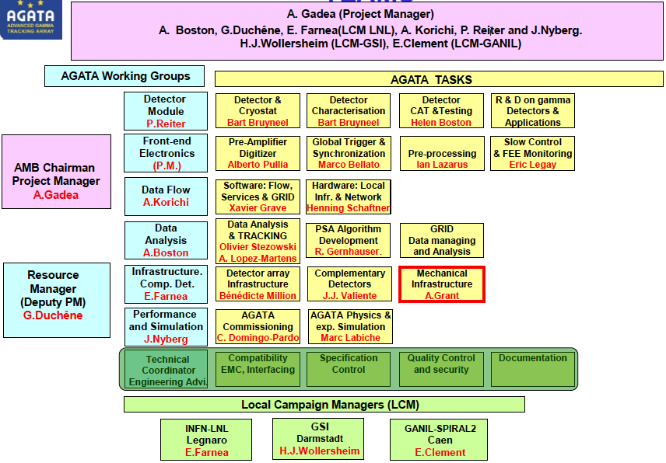
AGATA Steering Committee
AGATA Managing Board

Slide 22
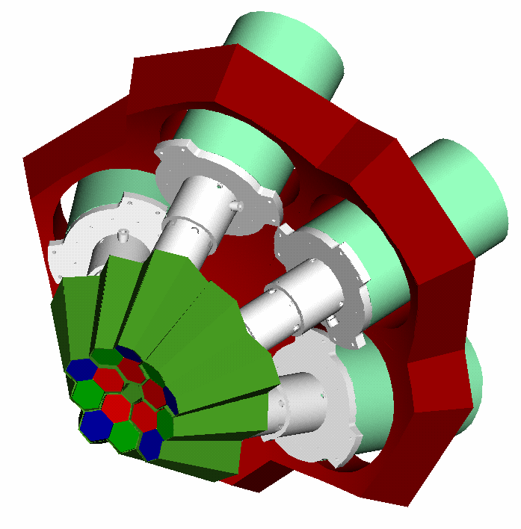
First Step of AGATA:
The AGATA Demonstrator
Objective of the final R&D phase 2003-2011
Full involvement of LEGNARO NATIONAL LABORATORY and GAMMA
1 symmetric triple-cluster
5 asymmetric triple-clusters
36-fold segmented crystals
540 segments
555 digital-channels
Eff. 3 – 8 % @ M_{g} = 1
Eff. 2 – 4 % @ M_{g} = 30
Full ACQ
with on line PSA and γ-ray tracking
Test Sites:
LNL, GANIL, GSI, Köln, …
Ω ∼ 1/3 π − 2/3 π
9 th April 2010: official inauguration at LNL
Notes:
Powerful array in its own right
Still to decide where to site
Still to decide the key test experiments

Slide 23
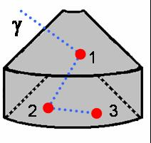
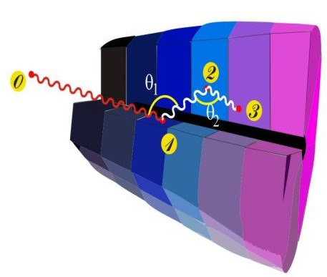
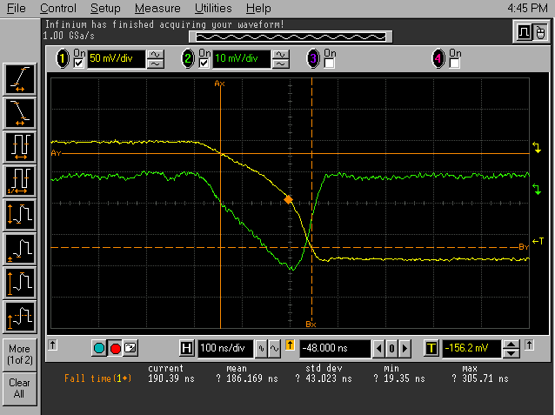
AGATA: a Gamma Tracking Array
Identified
interaction points
4
1
Highly segmented
HPGe detectors
(x,y,z,E,t)_{i}
Reconstruction of tracks
evaluating permutations
of interaction points
·
·
Pulse Shape Analysis
to decompose
recorded waves
3
2
Digital electronics
to record and
process segment signals
Reconstructed
gamma-rays
Notes:
What has to be done to perform tracking
What are the ingredients
Detectors highly segmented, encapsulated, cryostats
Electronics Digital
PSA to extract Energy Time and Position
Algorithm development particularly for position
Area where effort is required Thorsten Kroell. See him.
Tracking algorithms, reconstruction of the events for full array
Obtain full energy
Many technical development in all areas.

Slide 24
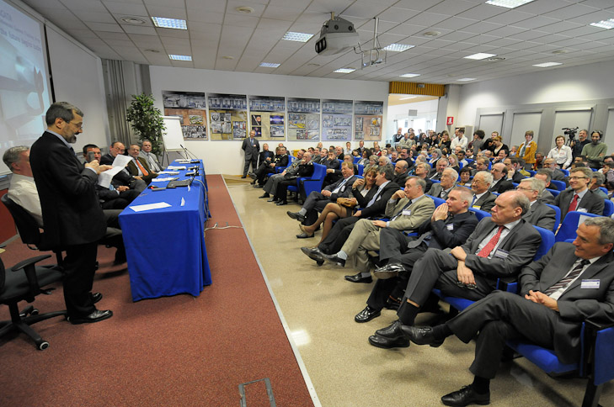
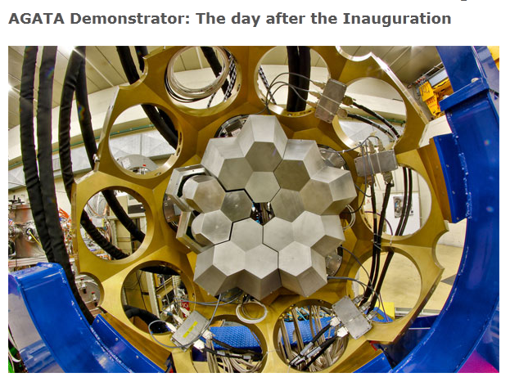
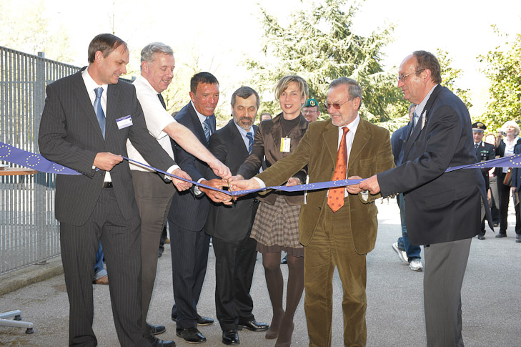
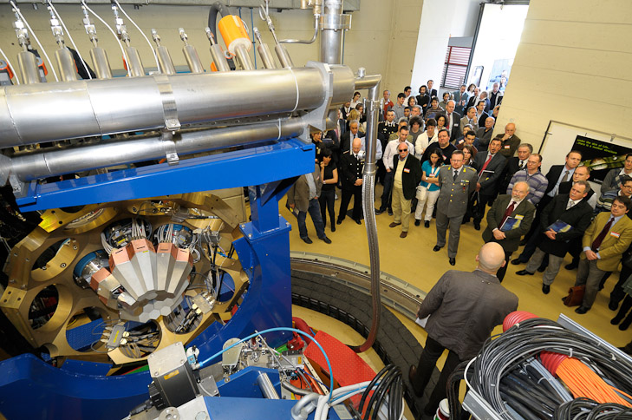
9th April 2010 – Legnaro National Laboratory INFN

Slide 25

FROM INFN BOOKLET

Slide 26
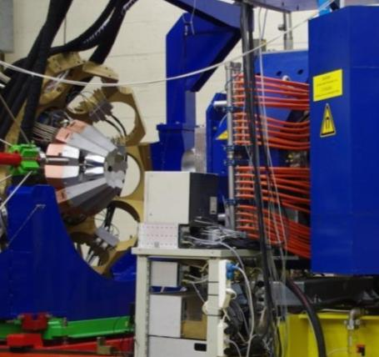
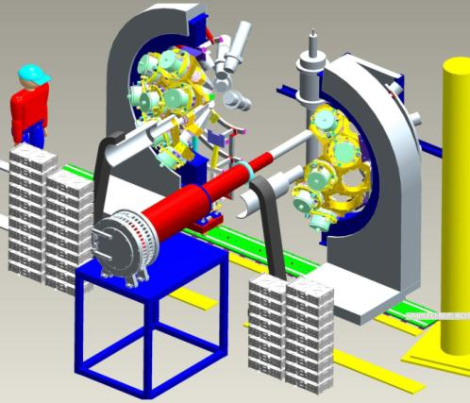

From the Demonstrator to AGATA 1π
Plans for the next few years
LNL: 2010-2011
15 crystals (5TC)
Total Eff. ~6%
GSI: 2012-2013
25 crystals (5DC+5TC)
Total Eff.~10%
GANIL: 2014-2015
45 crystals (15 TC)
Total Eff. ~15%
Demonstrator + PRISMA
“backward”
STABLE BEAMS
AGATA + FRS
“forward”
RELATIVISTIC
EXOTIC BEAMS
AGATA+VAMOS
“backward”
EXOTIC ISOL BEAMS
& STABLE HIGH INTENSITY

Slide 27



Coulex of ⁸⁰Kr beam
GSI: Performance of AGATA at relativistic beam energies
LNL: Performance of AGATA at v/c ≈ 20%
¹⁷O (340 MeV) + ²⁰⁸Pb
v/c ≈ 50%
⁸⁰Kr 2₁⁺ 0₁⁺
616.6 keV
MGT tracking
950 counts
2.2% resolution
Projectile-like (¹⁶O, v/c ~20%)
  > 500 keV @ 5 MeV
OFT tracking
670 counts
1.7%resolution
energy [keV]
One shift = 8h
incident particles ≈ 92·10⁶
part.-AGATA triggers ≈ 1.3·10⁶
Harsh background condition
N. Pietralla,
invited talk at INPC2013

Slide 28


Impegno GAMMA-Milano in AGATA
FINANZIARIO/COMITATI DI GESTIONE APPARATO
OFFICINA (B. Million)
- camera di scattering AGATA@LNL
- telescopic beam line
- flange AGATA@LNL
- Meccanica Ancillari @LNL e GSI
ELETTRONICA e ACQ
- A.Pullia: preamplificatori e digitalizzatori AGATA
- S. Brambilla: sistema AGAVA (AGATA-VME adapter) per sincronizzazione
tra ancillari VME e digital electronics di AGATA
ANCILLARI
- C. Boiano: preamplificatori e amplificatori per telescopi Si tipo pixel (TRACE)
- F. Camera, S. Riboldi, C. Boiano: Elettronica per Scintillatori BaF2 e LaBr3
PSA e TRACKING
- F. Camera, F. Crespi: algoritmo “recursive subtraction” (punto di interazione e n. hits in segmento)
- F. Crespi: metodo sperimentale veloce per caratterizzazione posizionale rivelatori a Ge di AGATA
CASI FISICI
- 5 esperimenti svolti a LNL
- 1 esperimento svolto (in parte) a GSI
- 2 LOI per AGATA@GANIL
spessore cameretta: 2mm
basso assorbimento
vuoto 10⁻⁶
26cm
Shell di 15 flange

Slide 29






Milano triple segment and core preamplifiers for AGATA
Front
view
Back view
Front view
Back
view
Milano pre for GALILEO
Milano digitizers AGATA/GALILEO
Front view
Back
view
A. Pullia
Thanks to A. Pullia

Slide 30


Milano: long tradition of R&D
for Scintillator Detectors
(large Volume)
Started by A. Bracco, F. Camera, …
1980’s: HECTOR+HELENA @NBI
HECTOR:
8 big (14cm x 18cm) BaF₂ crystals
Time resolution <1 ns
Energy resolution = 11%
HELENA
(multiplicity filter
and start signal):
38 small BaF2
Time resolution ≈ 500 ps
Giant Dipole Resonance from
Compound Nucleus Reactions
BaF₂

Slide 31




HECTOR at NBI
14cmx18cm
A. Bracco, F. Camera,
A. Maj, J.J. Gaardhøje, …
HECTOR + EUROBALL
LNL-STASBOURG
1980’s
HECTOR at LNL
BaF₂
HECTOR + AGATA:LNL//GSI
HECTOR + RISING: GSI
HECTOR + GARFIELD:
LNL
2011-2012

Slide 32

2005: LaBr3 from Saint Gobain
More Recently
Available in Large Volume
with performances:
In Milano:
R&D
For top level performances
of Large Volume LaBr3 for
Basic research with
High-energy γ-spectroscopy
Applied research
( medical imaging)
with PoliMi (C. Fiorini)
very fast signal
Rise time 25 ns
Fall time 60-80 ns
→ Total 100 ns
→ count rates up to 1 MHz
Energy Resolution ~ 3 % at 662 keV
Time Resolution ~ 0.5 ns
Linearity good
Density 5.2 g/cm³
Z(I) 57
Large Crystals (3.5” x 8”)
high efficiency
small 1EP (with collimator)
No 2EP
No Sensitivity to neutron damage
Easy Handling
PMT non idealities
Rather High Costs
L.Y. ≈ 63 ph/keV
Decay Time ≈ 16 ns
λ ≈ 380 nm, N ≈ 1.9
NaI
LaBr3
BaF₂

Slide 33

HECTOR+ Array:
10 large (9x20 cm) LaBr3(Ce)
8 large (14x17 cm) BaF2
36 small BaF2
Main Use:
Standalone
Coupled with Ge, …
Campaigns:
AGATA@LNL
AGATA@GSI
OSLO

Slide 34

Characterization of Large Volume
LaBr₃:Ce Detectors
Rise time
Pulse line-shape
Count Rate
Pulse distortion with γ-rays energy
Linearity in energy
Energy resolution and NON homogeneity
High energy gamma rays
Efficiency
→ Tests with Sources and in-beam
Development of dedicated electronics devices: S. Brambilla, S. Riboldi: VME board for sampling (100 MHz, 14bit)
and digital data treatment
C. Boiano, F. Camera: BaFPro Nim Module for PSA
C. Boiano, S. Brambilla, S. Riboldi: Active Voltage Divider
… requested by collaborators: PARIS collaboration, Oslo, …
Milano Digital Electronics
ΔE_{γ}
E_{γ}
p+⁷Li -> ⁸Be
target LiBO₂

Slide 35



Pulse Shape Analysis
with LaBr₃:Ce and LaCl₃:Ce
BaFPro Nim module
16 channels of Shaping amplifier
16 channeld of CFD
16 Channer of peak stretcher for BaF₂ Fast component
g
alpha
alpha
g
Fast vs Slow in a 2”x3” BaF₂ detector
Fast vs Slow in a 3”x3” LaBr₃:Ce
detector
C. Boiano, F. Camera, …

Slide 36




Milano Active Voltage Divider for Large Size LaBr3 ( S. Riboldi, S. Brambilla, C. Boiano)
Adapter PCB
(to fit to different PMT sockets)
The two PCBs coupled together
(top side of VD, showing main electronics:
BJTs, MOSFETs, etc.)
Active voltage divider PCB
(bottom side, showing protecting diodes)
Test with High Count Rate
Digitized signals and offline analysis with integration algorithm
PASSIVE
Hamamatsu
←Significant gain drift
≈ 40 keV
ACTIVE
In house
NO gain drift →
- 5 keV
due to PMT temperature increase

Slide 37
Applied Research with PoliMI (C. Fiorini, A. Giaz, …)
position sensitivity with LaBr3 detector (25 mm x 25 mm)
and SDD matrix (no PMT).
Collimated beam (1mm) of 661 keV
Reconstructed with
Simple algorithm
Source position
2014: rivelatore
di maggiori dimensioni

Slide 38



Present Big Commitment: GALILEO @ LNL
1992-GASP: 20 years of operation
30 march 2012: official shutdown
GALILEO:
GASP and EUROBALL detectors
Fully Digital Electronics
ε_{ph} = 8%
P/T = 50 %
Dedicated WS 10-12 June 2013

Slide 39
Impegno GAMMA-MI in GALILEO
OFFICINA
in corso: camera di scattering (in costruzione)
?? Adattatori Rivelatori GASP a 90°
?? movimentazione meccanica TRIPLETTI Ge (ex-EUROBALL)
Imaging Gamma: Lavorazioni meccaniche (10 gg)
ELETTRONICA e ACQ
in corso (A.Pullia): preamplificatori e digitalizzatori GALILEO (AGATA)
?? S. Brambilla: sistema AGAVA (AGATA-VME adapter) per sincronizzazione
tra ancillari VME e digital electronics di GALILEO
ANCILLARI
?? Supporto integrazione
Si Telescopes EUCLIDES, Scintillatori, Recoil Filter Detector, …

Slide 40



GALILEO Preamplifier
⁶⁰Co spectrum
2.09 keV
The new preamplifier has been tested in Milano and at LNL with a GASP detector in conjunction with an IF1320 input FET.
The obtained resolution is excellent.

Slide 41











AGATA and GALILEO Digitizer
Clock-Distribution
and Control Unit
Padova
GTS
link
Pre-processing Card
Padova
backplane
MDR cables
fibers
Core ADC
Module
Milano
backplane
PCIe expansion box
500 ps
Eye diagram @ 2Gb/s
Workstation
backplane
PS Module, backplane, cooling (under development)
3 Segment ADC Modules
(12 channels each)
Milano
48V
PS module, backplane
Valencia

Slide 42

Spectrum from small front electrode of MARS detector
We have just received an AGATA detector crystal
for full qualification of the Digitizer

Slide 43

Gruppo GAMMA-Milano (a consuntivo 2012)
Milano ≈ 43 % FTE
24 persone (35 %)
Pubblicazioni GAMMA-MI 2012
17 su rivista (di cui 1 PRL, 7 PRC, 2 PLB, …)
20 su atti di conferenze
Nel 2011: 18 articoli, 22 atti di conferenza
Conferenze GAMMA-MI 2012
39 talks (di cui 17 invited)
13 poster a conferenze
Nel 2011: 33 talks
Tesi 2012
15 Triennale/Magistrale
1 PhD
Nel 2011: 17 tesi

Slide 44
Dottorandi:
R. Avigo: Pygmy study in ⁶⁴Fe, AGATA@GSI data
S. Bottoni: n-rich Sr, Zr and Y nuclei with A=100, ISOLDE data
S. Ceruti: Isospin Mixing in ⁸⁰Zr, AGATA@LNL data
L. Pellegri: Pygmy study in stable ¹²⁴Sn and ²⁰⁸Pb, AGATA@LNL data
Assegnisti:
Giaz: Imaging Gamma e Dynamic dipole Resonance, GARFIELD@LNL data
A. I. Morales: β-decay study in n-rich Fe, RIKEN data

Slide 45
A. Bracco:
Chair dell'International Advisory Panel del Progetto HIE-ISOLDE
Membro del comitato Scientifico di RIKEN
Membro del Scientific Committe per i laboratori GSI
Membro dell’AGATA Steering Committee
S. Brambilla:
Conveener del Task2 - Working Group 2 European Gamma and Ancillary Detectors Network (EGAN)
F. Camera:
Membro Rising/Prespec Steering Committee;
Membro Comitato Scientifico della Scuola INFN sui rivelatori innovativi (SNRI).
Coordinatore del Work Package 4 del progetto Nupnet GANAS
S. Leoni:
Membro dello Steering Committee di EXOGAM
Membro PARIS Steering Committee
B. Million:
Team Leader Infrastructure Working Group AGATA
A. Pullia:
Team leader pre-amplifier group AGATA collaboration
O. Wieland:
Member of steering group of SUNFLOWER collaboration @ RIBF / RIKEN
Leaderships
GAMMA-MI
2012

Slide 48



accelerators
+
detectors
Energy
(MeV)
50
LNL: Stable Heavy Ions
AGATA + scintillators + Si
T=2-4 MeV
GSI/RIKEN: exotic beams
EX-EUROBALL + scintillators + Si
T = 0 MeV
Order-to-Chaos
New Isomers, β-decay,
r-process
T<0.5 MeV
HD 3:1
PYGMY
Resonances
SD 2:1
ND 1.3:1
50
SPIN
100
n excess vs inert core
0.2
γ-arrays
ISOSPIN
(N-Z)/A
EUROBALL/AGATA
nuclear structure
at the limits of
spin,temperature, isospin
Exotic beams

Slide 49
Experimental Signature
Multiplet of States: |l-j| ≤ I ≤ l+j
B(Eλ) of phonon
3⁻ 4.507
Energy Split:
Coupling strength
Nuclear Force
7/2⁺
5/2⁺
3/2⁺
4
9/2⁺
3⁻ ⊗ p_{3/2}
E [MeV]
B(E3)
6.8 ^{± 1.0} _{Wu}
7 _{Wu}
3
⁴⁸Ca
(Z=20,N=28)
⁴⁸Ca
⁴⁹Ca
2
0
0⁺ 0.0
3/2- 0.0

Slide 50
Neutron pressure from the skin
…from different measurements … extrapolation for ²⁰⁸Pb
(including pygmy in ⁶⁸Ni and ¹³² Sn )
is related to P_{o}, the pressure from the symmetry energy for pure neutron matter at S_{o}
Betty Tsang
Summary of the NuSYM11 International Symposium on Nuclear Symmetry Energy

Slide 51


Flange Design
(Daresbury Laboratory)
controllo delle specifiche
Daresbury (CMM machine)
48 dimensioni
tolleranza < 0.3 mm
< 0.05°
Metà 2006 – maggio 2008:
lavorazione e montaggio terminati
Shell di 15 flange di AGATA

Slide 52





Camera di scattering per AGATA Demonstrator
su spettrometro PRISMA
spessore cameretta: 2mm
basso assorbimento
vuoto 10⁻⁶
Lavorazione Meccanica
INFN-Milano
26cm
supporto
PARTEC
DANTE
Array
Costi: 8k€ (progettazione) + 2k€ (materiale)
➔ Vecchio progetto CINEL: 8k € + 25 k€
17 mesi di lavoro di tutto il servizio

Slide 53


Telescopic beam line per AGATA Demonstrator
su spettrometro PRISMA
MCP
PRISMA
start detector
PRISMA
beam
gennaio 2007 – maggio 2008:
lavorazione e montaggio terminati

Slide 54


Design Study for
Multiplicity Filter couppled to
AGATA Demonstrator @ LNL
B. Million,
Simulations & Ancillary detectors
35 detectors Helena array:
BaF₂ exagonal scintillators 3”x3”
15 cm from target
Ω = 57% of 4π
Total eff. ε ~ 35%
electronics: AGAVA interface
AGATA detectors @ 23 cm (ε ~ 3%)
➔ @ 14 cm (ε ~ 6%)

Slide 55






Pulse Shape Analyisis e tracking in HPGe (F. Crespi, F. Camera)
Sviluppo di un algoritmo (Recursive Subtraction*) per determinare
posizione e numero di interazioni in un segmento
testato su dati acquisiti in test sotto fascio di rivelatori HPGe segmentati**
⁴⁸Ti + ²H → ⁴⁹T*
PSA
8.2 keV
# interazioni
v/c∼6%
Segment
9.4 keV
No correction
*F.C.L. Crespi et. Al. NIMA 570(2007) 459-466 and **F.C.L. Crespi et. Al. NIMA to be submitted
Nuovo Metodo Sperimentale per estrarre la risposta posizionale di rivelatori HPGe***:
permette di realizzare l’intero scan di un rivelatore in ~ 1 settimana
ordini di grandezza più rapido dei metodi standard basati su misure in coincidenza!
Selected for invited Talk IEEE Dresda October 08
***F.C.L. Crespi et. Al. NIMA 4815 to be published

Slide 56

Sistema ACQ Ancillari di AGATA
S. Brambilla
sviluppo scheda AGAVA (AGATA VME adapter)
per sincronizzazione Ge array & ancillary (HECTOR, DANTE, PRISMA, RFD, …)
- Sviluppo hardware scheda:
Istituto di Cracovia
- Contributo Italiano:
PD, Bellato: GTS Mezzanine
Mi, S. Brambilla:
- implementazione FIRMWARE
- modalità di gestione
- read-out e integrazione AGAVA
con modulistica di Front-End
(TDC – ADC- QDC – SCALER)

Slide 57
Coulex and Fragmentation of ⁸⁰Kr beam
GSI: Demonstration of performance of AGATA at relativistic beam energies (v/c ≈ 50%)
One shift:
duration ≈ 8h
intensity ≈ 35k part. per spill
Difference between the OFT and MGT gamma
tracking algorithms
Trigger:
particle-AGATA-LYCCA
particle-HECTOR-LYCCA
⁸⁰Kr 2₁⁺ 0₁⁺
616.6 keV
MGT tracking
950 counts
2.2% resolution
Gates:
particle-gamma time
LYCCA E-ΔE
LYCCA E-ToF
gamma multiplicity <= 2
OFT tracking
670 counts
1.7% resolution
Statistics:
incident particles ≈ 92·10⁶
part.-AGATA triggers ≈ 1.3·10⁶
energy [keV]
N. Pietralla, invited talk at INPC2013

Slide 58
Projectile-like (¹⁶O, v/c ~20%)
  > 500 keV @ 5 MeV

