Slide 1
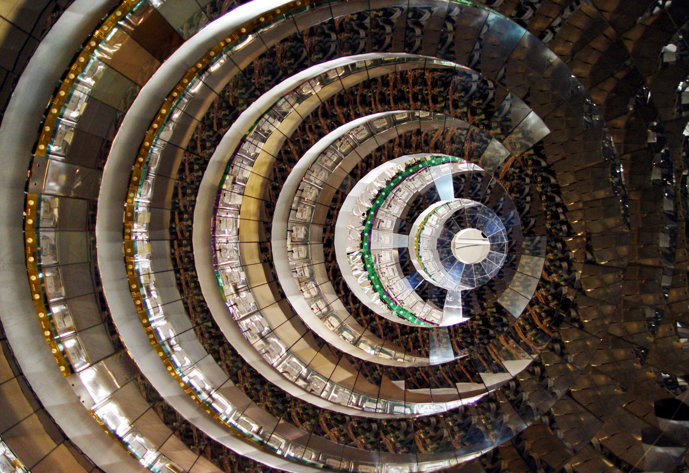
EXOCHIM
Study of the isospin and mass dependence of reaction mechanisms at Fermi energies with particular attention on time scale measurement in multifragmentation.
Study of population and decay of nuclei and resonances at the border of drip lines, searching for exotic decay. This task will be pursued by using radioactive fragmentation beams at LNS at intermediate energies and the EXCYT beams at tandem energy.
Studies on the isospin dependence of the asymmetry term of nuclear equation of state at high density, by measuring differential neutron-proton flows and other variables at GSI using some wheels of CHIMERA coupled to other detectors.

Slide 2


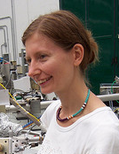
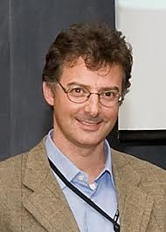

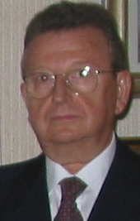
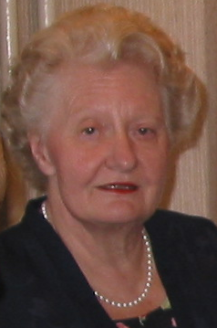
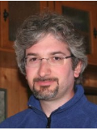
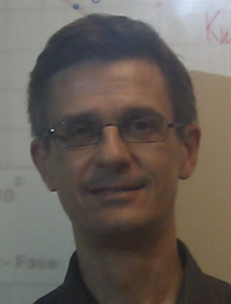

Units and INFN-MI team
Tommaso Parsani
Chiara Guazzoni
Andrea Castoldi
Ciro Boiano
Paolo Guazzoni
Luisa Zetta
Total FTE @ MI: 2.8FTE
    + 1 new PhD student
    + 1 new Research Contract
    + 2 Senior + 3 man/month Electronic Service
    + 1 man/month Mechanical Workshop
Fabio Previdi
Filippo Riccio
Pietro Zambon

Slide 3
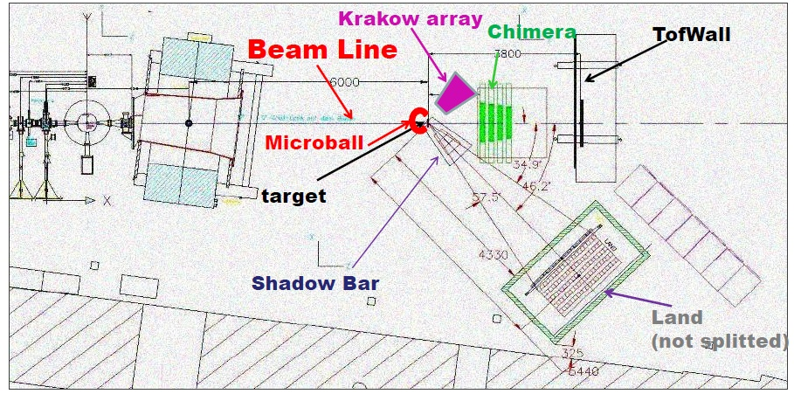
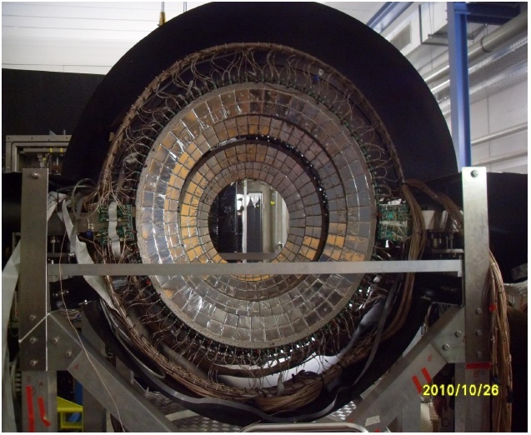
ASY-EOS Experiment at GSI
“Constraining the Symmetry Energy at Supra-Saturation Densities with measurements of Neutron and Proton Elliptic Flows”
Investigated Systems:
¹⁹⁷Au + ¹⁹⁷Au @ 400 AMeV
⁹⁶Ru + ⁹⁶Ru & ⁹⁶Zr + ⁹⁶Zr @ 400 AMeV
Beam-Time:
May, 9 2011 – May 23, 2011
Full data analysis still on-going
  Digital pulse shape acquisition of 18 full telescopes pertaining to Ring #4 & #5
  → Enriching the energy range and isotope list of the available database of waveforms

Slide 4
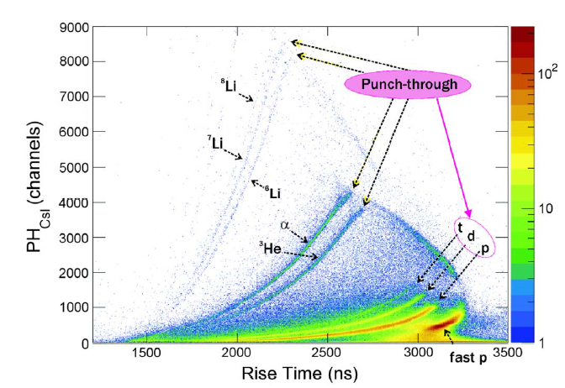
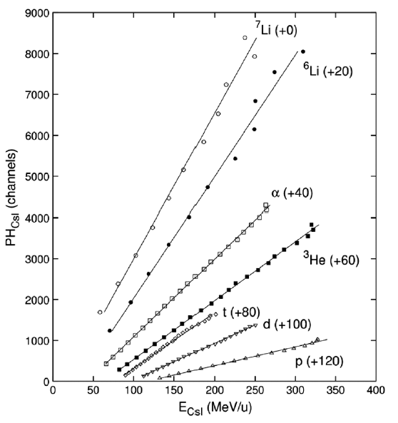
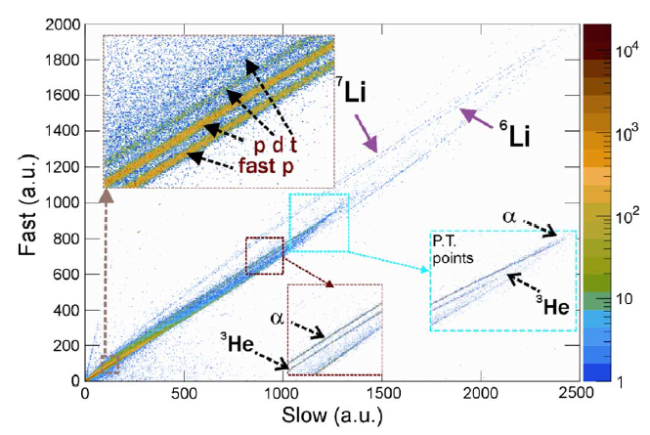
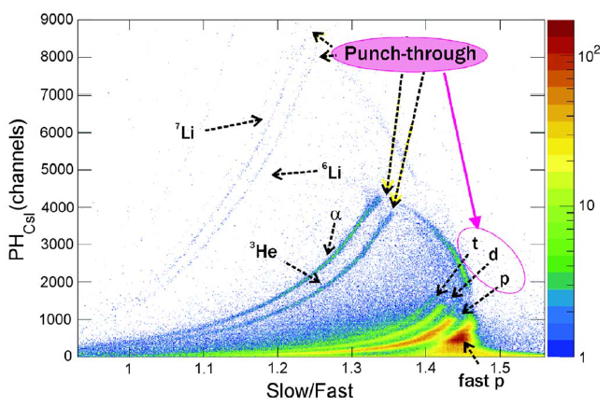


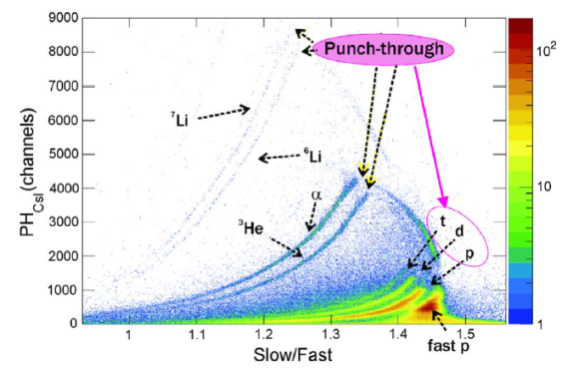
ASY-EOS Experiment at GSI
⁹⁶Zr + ⁹⁶Zr @ 400 AMeV
L. Acosta et al., “Probing the Merits of Different Event Parameters for the Identification of Light Charged Particles in CHIMERA CsI(Tl) Detectors with Digital Pulse Shape Analysis”, IEEE Tran s. Nucl. Sci., Vol. 60, 2013, pp. 284-292.

Slide 5
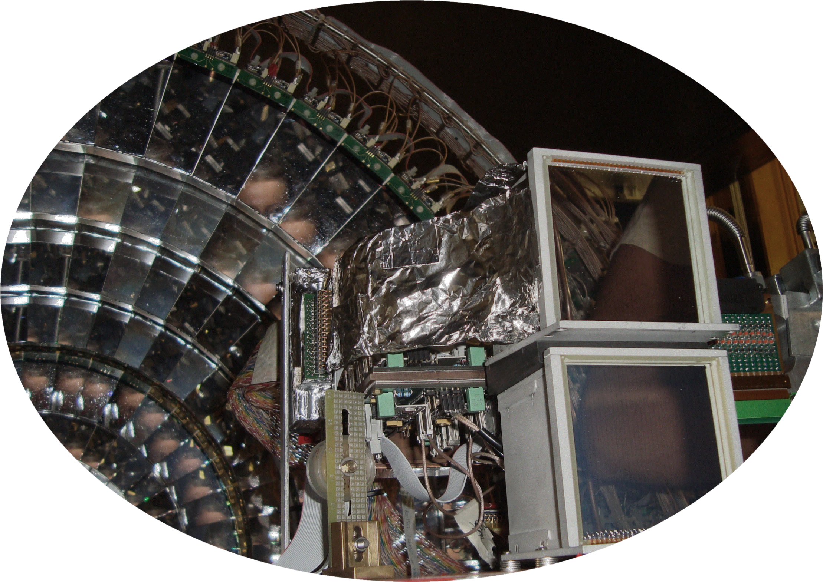








FARCOS
a versatile and modular Femtoscope ARray for COrrelations and Spectroscopy
The FARCOS collaboration
5. Sezione di Catania
1. Lab. Naz. Del Sud
2. Gr. Collegato Messina, 4. Sezione di Milano
11. Sezione di Napoli
8. Univ. degli Studi di Catania
3. Univ. degli Studi di Messina
6. Politecnico di Milano
12. Univ. di Napoli ‘Federico II’
10. Univ. di Enna ‘Kore’
13. Univ. de Huelva
7. IN2P3, CNRS
9. Centro Siciliano di Fisica Nucleare e Struttura della Materia
L. Acosta¹, F. Amorini¹, A. Anzalone¹, L. Auditore^{2,3}, C. Boiano⁴, G. Cardella⁵, A. Castoldi^{6,4}, A. Chbihi⁷, E. De Filippo⁵, L. Francalanza^{1,8}, E. Geraci^{8,5}, S. Gianì^{1,8}, C. Guazzoni^{6,4}, E. La Guidara^{5,9}, G. Lanzalone^{1,10}, I. Lombardo^{11,12}, S. Lo Nigro^{8,5}, D. Loria^{2,3}, C. Maiolino¹, I. Martel¹³, T. Minniti^{2,3}, A. Pagano⁵, E. V. Pagano^{1,8}, M. Papa⁵, T. Parsani^{6,4}, S. Pirrone⁵, G. Politi^{5,8}, F. Porto^{1,8}, F. Riccio^{6,4}, F. Rizzo^{1,8}, P. Russotto^{1,8}, A.M. Sánchez-Benítez¹³, J.A. Duenas¹³, R. Berjillos¹³, S. Santoro^{2,3}, A. Trifirò^{2,3}, M. Trimachi^{2,3} G. Verde⁵, M. Vigilante^{11,12} and P. Zambon^{6,4}

Slide 6
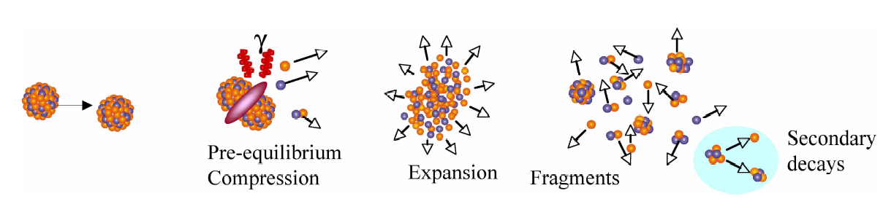
Physics Cases
Heavy ions collisions complex but rich systems to explore the properties of nuclear matter under extreme conditions.
Need for a clear understanding of the dynamics of heavy-ion collisions. Particles are emitted at different stages that are difficult to isolate.
Important to disentangle particle and fragment emitting sources. Where and when are fragments produced?
tracing-back particle and fragment emitting sources to understand dynamics in heavy-ion collisions

Slide 7
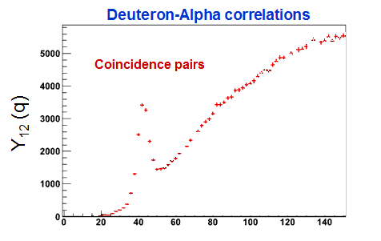
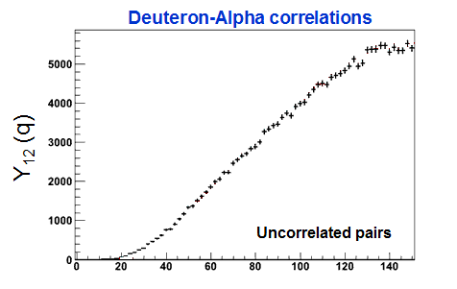
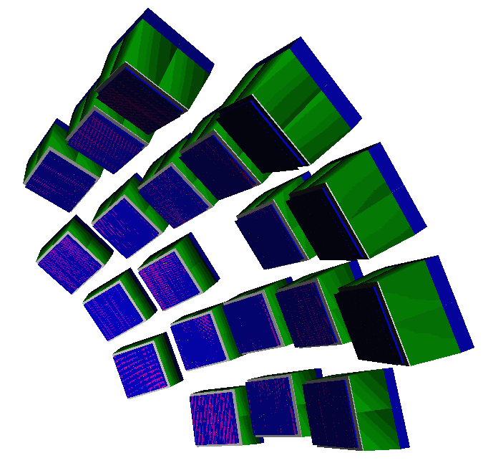
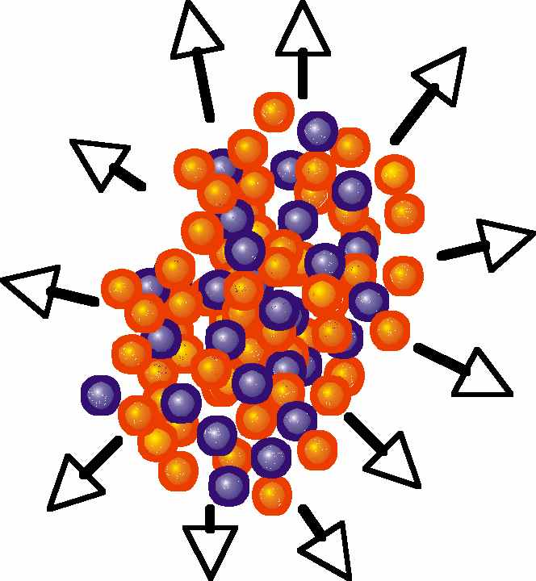
Physics Cases
Measuring particle-particle correlations to probe the space-time features of nuclear reaction mechanism.
Final-state interactions
q (MeV/c)
Coulomb FSI
anti-correlation at small q values
Nuclear FSI
correlation at q=42 and 84 MeV/c

Slide 8
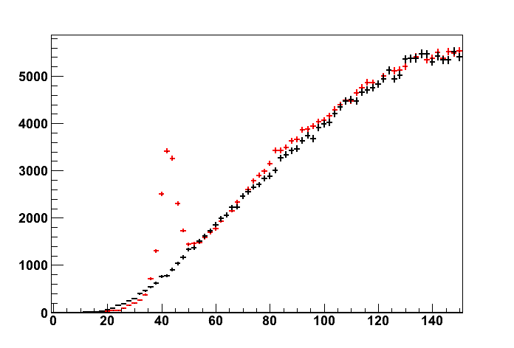
Physics Cases
Measuring particle-particle correlations to probe the space-time features of nuclear reaction mechanism.
FSI
Deuteron-Alpha correlations
Coincidence pairs
deuteron-alpha
Y₁₂ (q)
Uncorrelated pairs
q (MeV/c)
Coulomb FSI
anti-correlation at small q values
Nuclear FSI
correlation at
42 and 84 MeV/c
1+R(q)
Correlation function
q (MeV/c)

Slide 9
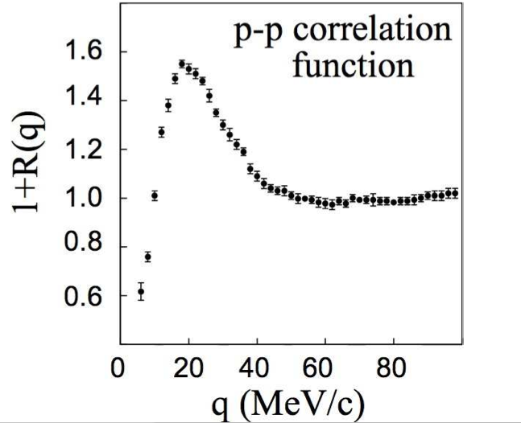
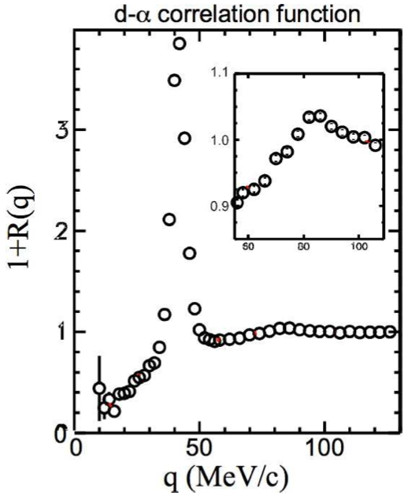
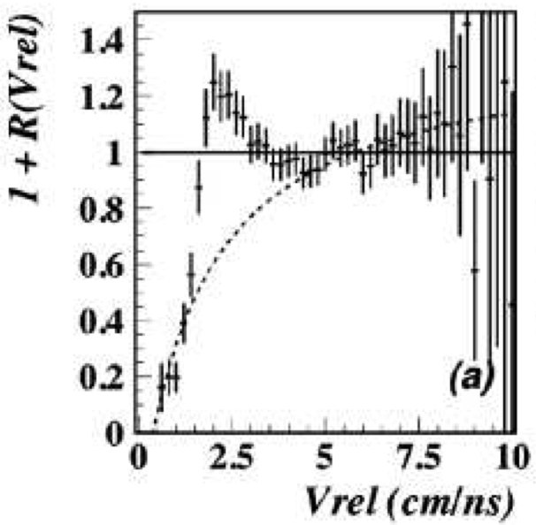
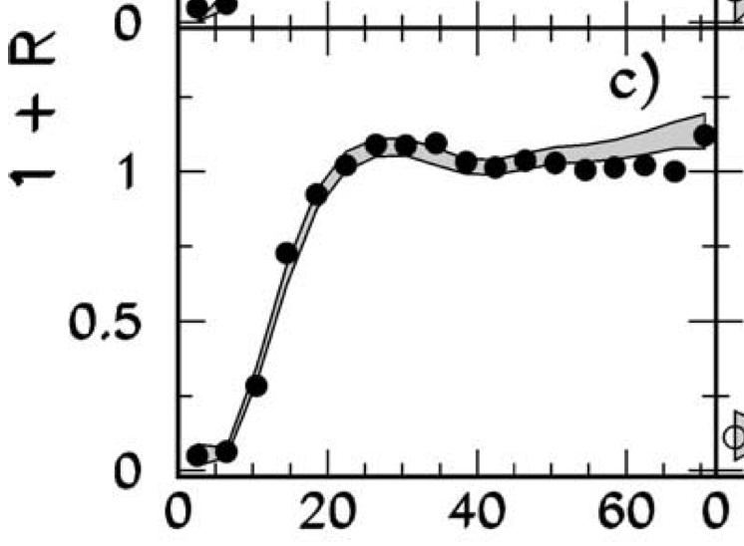
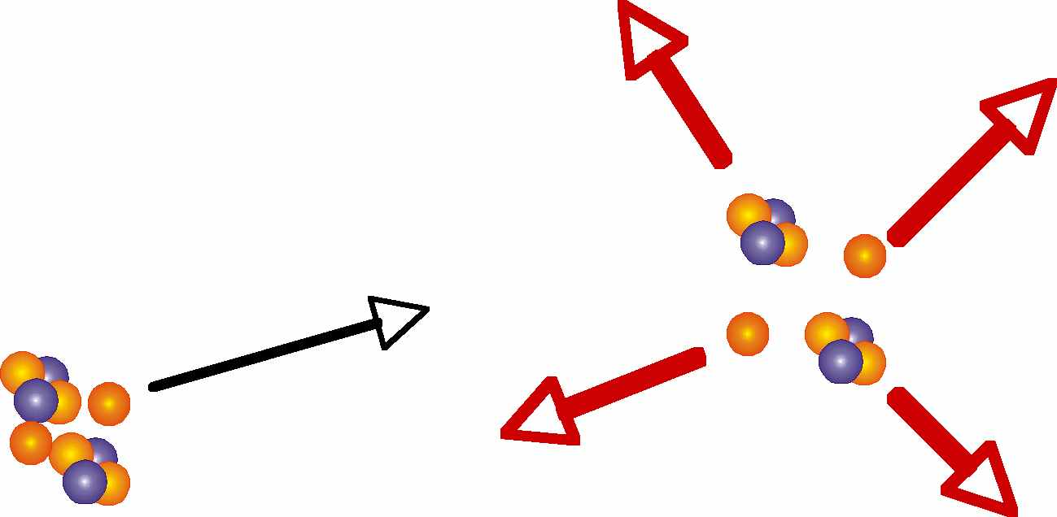
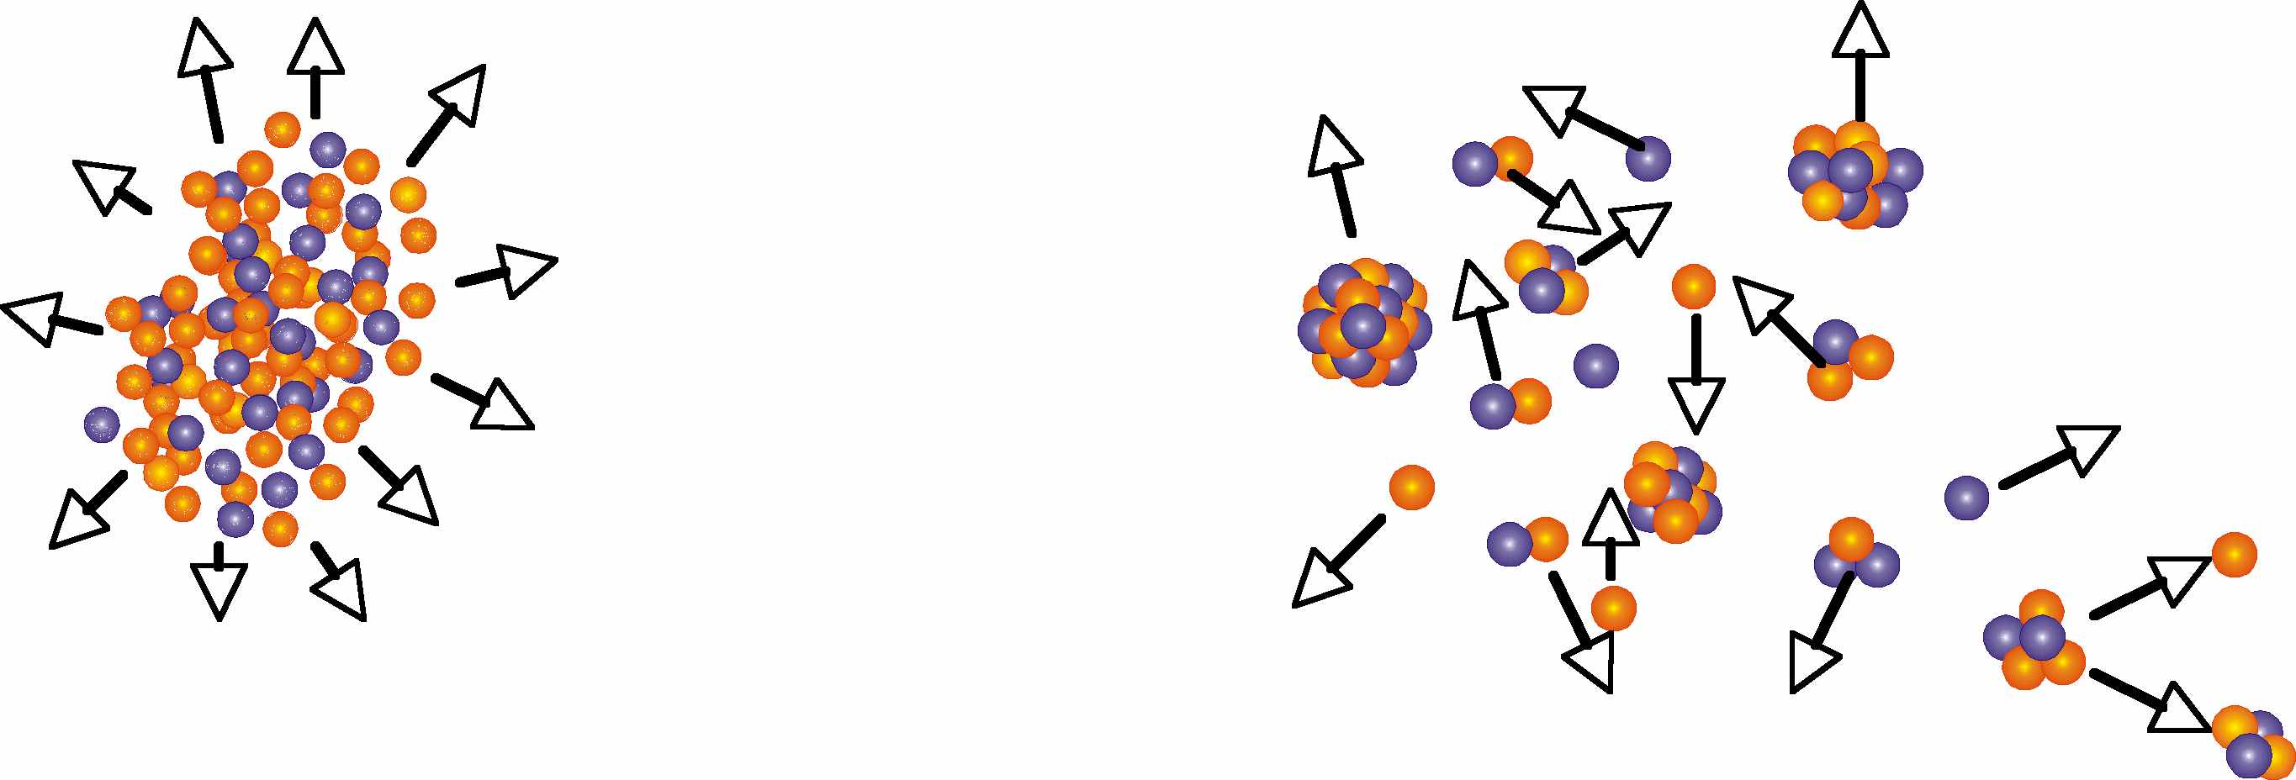
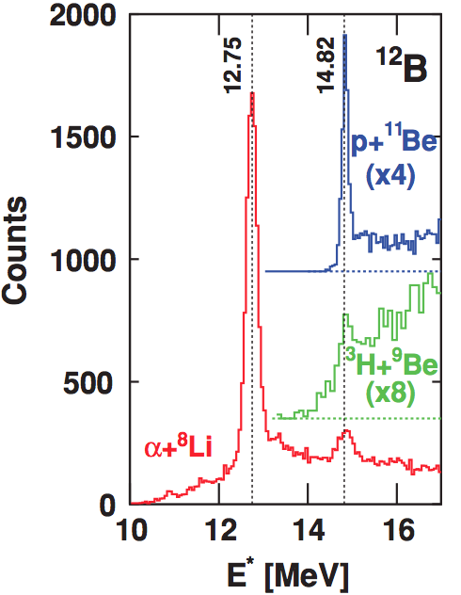
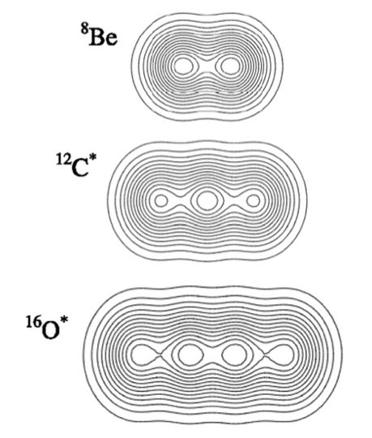
Physics Cases
Extending particle-particle correlation to a wide range of particles:
dynamics and spectroscopy
p-p
d-α
IMF-IMF
LCP-IMF
Decay spectroscopy
α-⁸Li
¹⁰C*
Hoyle states and Bose Condensation
¹²Be (neutron rich) decay

Slide 10
Instrumentation Requirements
High energy- and angular-resolution, to obtain the momentum vector and its correlation (→ correlation measurements and direct reactions in inverse kinematics with RIB)
Wide solid angular coverage, to gain large statistics in two- or more-particle correlation
Low identification thresholds both for LCPs and IMFs (→ low energy measurements with RIB at SPES and SPIRAL2)
Wide dynamic range to detect both LCPs and IMFs in the same event (→ LCP-IMF correlation functions to ascertain temperature and excitation energy of primary fragments and (p,d) and (d,p) direct reactions in inverse kinematics with RIBs)
High stopping power → high-energy LCPs correlations, ‘space-time’ snapshots of particle and complex fragments emitting sources
Simple, versatile, modular and transportable geometry → ease of coupling with other detectors (4π-arrays, spectrometers, neutron detectors) and temporary installation in different facilities.

Slide 11
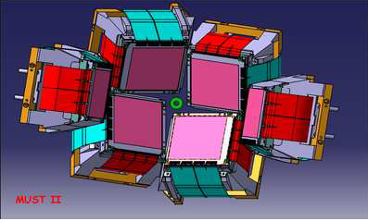
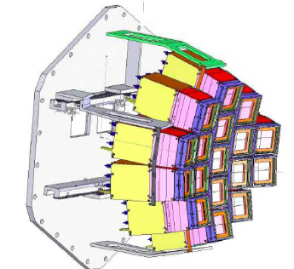
Existing correlators
MUST II - Mur à strip
(@Ganil)
HiRA - High Resolution Array
(@ Michigan State University)
mainly intended for nuclear astrophysics studies (Z=1 and Z=2)
array of 20 telescopes:
  65µm-thick Single-Side Si-strip detector
  1.5mm-thick silicon-strip detector
  four 4cm-thick CsI(Tl) crystals
angular resolution of 0.15° at the nominal distance of 35 cm from the target
70% of the solid angle between scattering angles of 5° and 30°
dedicated to the study of reactions induced by radioactive beams on light particles (up to Z=2)
telescope consists of
  300µm-thick Double-Side Si-strip detector
  two segmented 5mm-thick Si(Li) detector
  3cm-thick CsI(Tl) crystals
large angular coverage (70% up to angles of 45°).

Slide 12
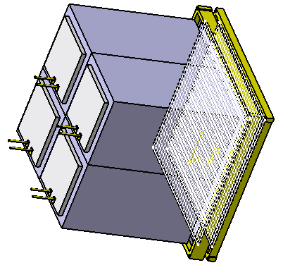
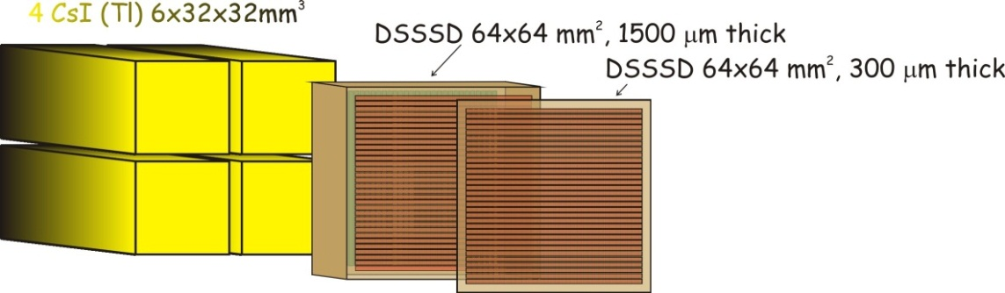
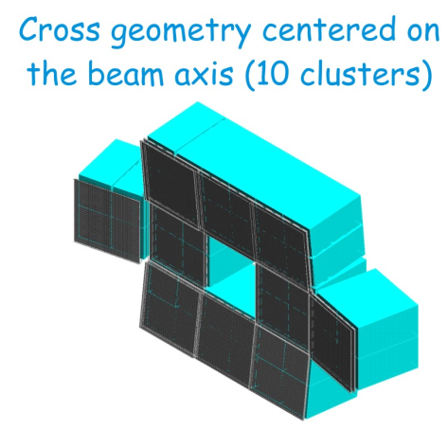
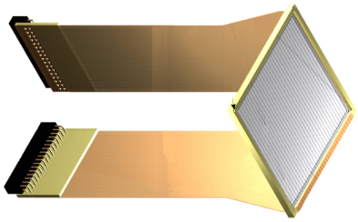
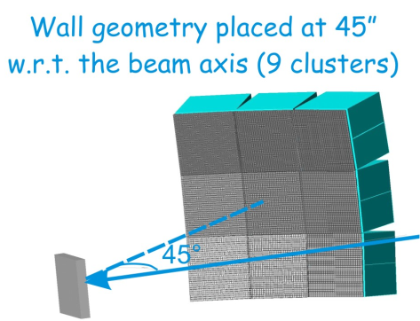
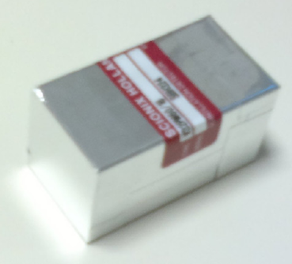
FARCOS components: detectors
Single cluster
Possible geometries
DSSSD, made by MICRON Semiconductor, on a standard design (BB7) with a minimum area PCB frame (4 mm wide)
Front-side gap: 25 μm, back-side gap 40 μm
Kapton cables directly bonded to each side of the welded detector
highly homogeneous CsI(Tl) crystals, made by SCIONIX, with Tl concentration of the order of 1200 to 1500 ppm
each crystal wrapped with 0.12 mm thick white reflector including 50 micron of aluminized Mylar
entrance window composed by 2 μm thick aluminized Mylar with a density of 0.29 g/cm²
output light read out by a Hamamatsu 18x18 mm PIN diode S3204-08, attached to the rear face of each crystal.
geometry of clusters follows the same radius with respect to the center of the target (i.e. each detector tangential
to the imaginary sphere generated by a distance ”target-array” previously fixed)

Slide 13
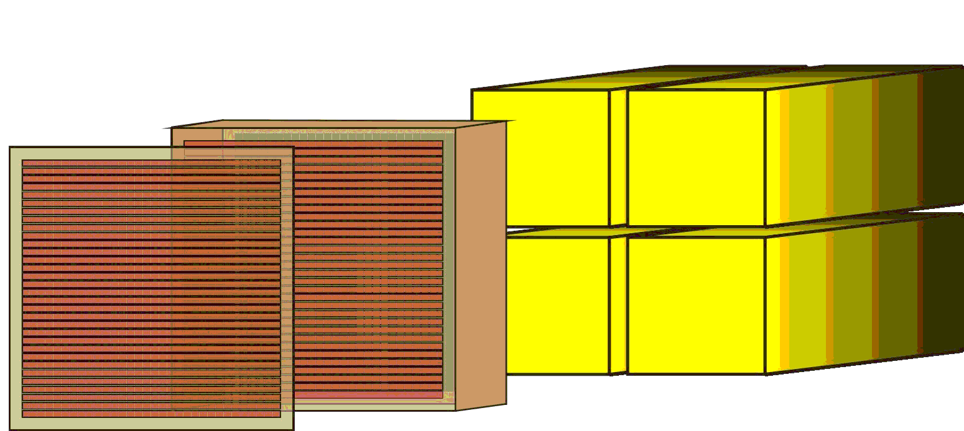
Identification Techniques
Charge
E_{Si}-RT
for ions stopping in Silicon
Charge (isotopic)
ΔE_{Si}-E_{CsI}
for ions stopping in CsI(Tl)
Si
CsI(Tl)
Isotopic (LCP)
Fast-Slow
for ions stopping in CsI(Tl)
Superconducting Cyclotron
Reference Signal
Mass
E_{Si}-ToF
for ions stopping in Silicon

Slide 14
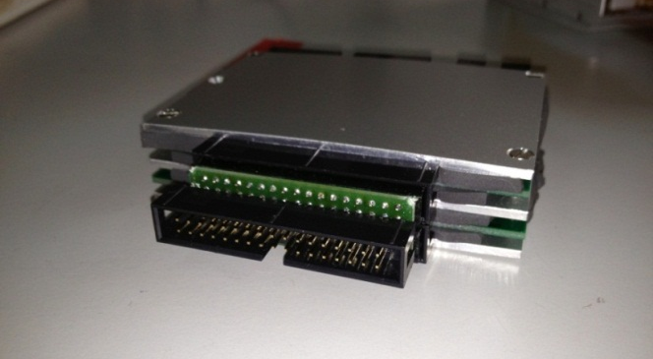
FARCOS components: front-end
Phase 0: Mesytec MPR16 16 channels CPA
Phase I: hybrid large bandwidth charge preamplifers
Low power consumption: ~36 mW per channel
Rise-Time (pulser):
~ 3-7 ns (C_{input}=0-100pF)
Energy resolution : (pulser) ~ 4.3 KeV (C_{input}=0-100pF)
Modules with different sensitivities: 10, 20, 45 mV/MeV…
8 cm
10.5 cm
Final assembly of a 32-channel preamplifier in a compact module
Simplified schematic of one channel CPA
Phase I.1: new design to accomodate 3 different user-selectable sensitivities in a single module
Phase II: VLSI design under way in 0.35 μm AMS CMOS technology both voltage mode and current mode solutions under investigation

Slide 15
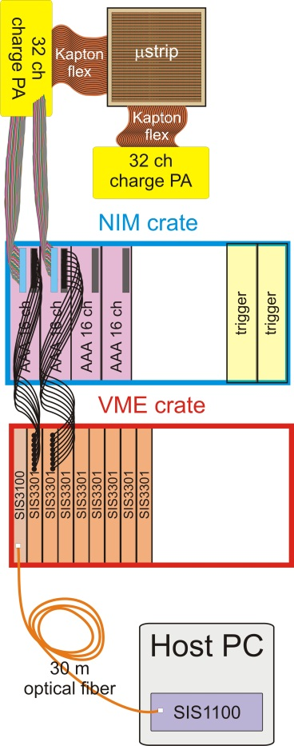
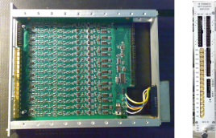
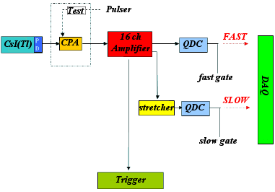
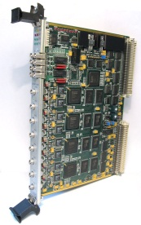
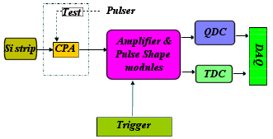
FARCOS components: DAQ
Analog DAQ
borrowed from CHIMERA detector
Digital DAQ
64 channels from DSSSD
+ 4 CsI(Tl)
+ Triggers
4 x 64 channels 300 μm DSSSD
4 x 64 channels 1500 μm DSSSD
4 x 4 CsI(Tl)
528 Total no. channels
Custom Anti Aliasing Amplifiers with selectable gain and BW
DSSSD readout
Fast VME digitizers (12-14-16 bits,
up to 500 MS/s)
Struck GmbH
Host PC,connected via optical link on PCI bus, running custom SW under Linux
CsI(Tl) readout
Digital acquisition runs in parallel to analog DAQ on one selected DSSSD + 4 CsI(Tl) for on-line monitoring, raw waveforms storage, etc.

Slide 16

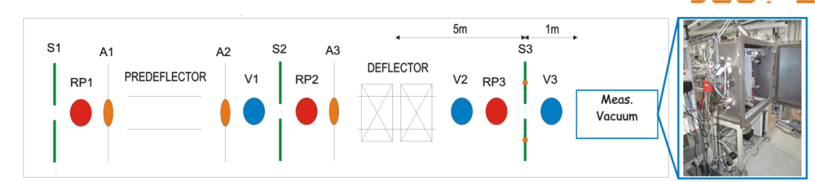
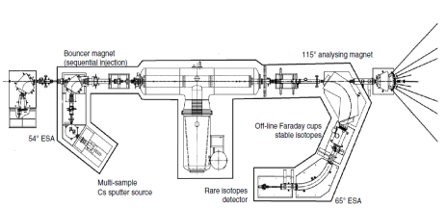
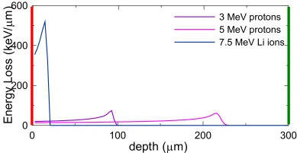
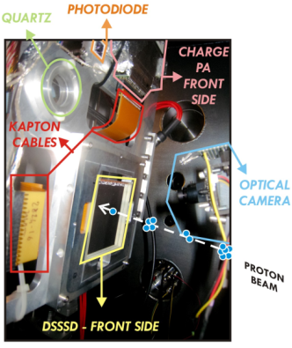
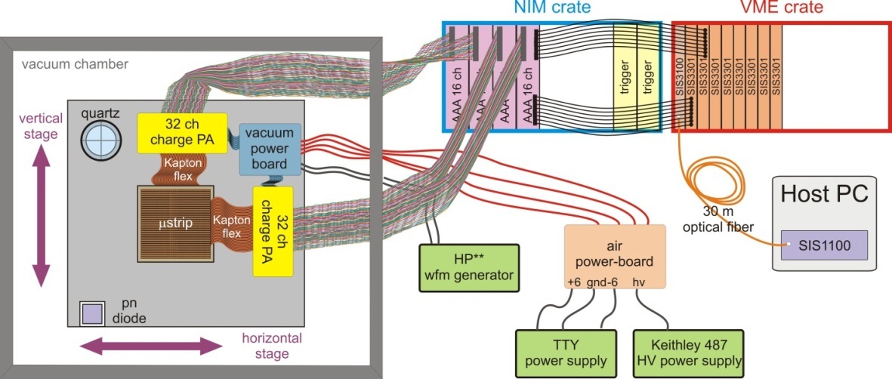
DSSSD qualification – I
ASPIDE
Experimental setup at the DEFEL beamline of LaBeC, INFN, Firenze (Italy)
3MV Tandetron
DEFEL beamline
S1, S2, S3: motorized slits (collimators)
RPs: rotating platforms
A1, A2: A3 tantalum apertures
V1,V2,V3: high vacuum pumping station
Electrostatic chopper deflects the continuous beam of the accelerator transversally across a slit → bunch of ions proceed downstream through an aperture for a short time lapse (of the order of one nanosecond).
Adjustment of the size of the aperture with a motorized slit, and of the intensity of the continuous beam, → pulsed beam with a variable and finely controllable number of particles in each pulse, down to an average value much below 1 proton per trigger
Position of interaction in a defined area of down to better than 100 µm × 100 µm.
Proton energies tunable in the range 1-6 MeV. Repetition rate from a manual single shot up to hundreds of Hz
Other ion types can be accelerated: He2+ up to 8 MeV, Li3+ up to 11MeV, C4+ up to 14 MeV.
Data taking
September 2012

Slide 17
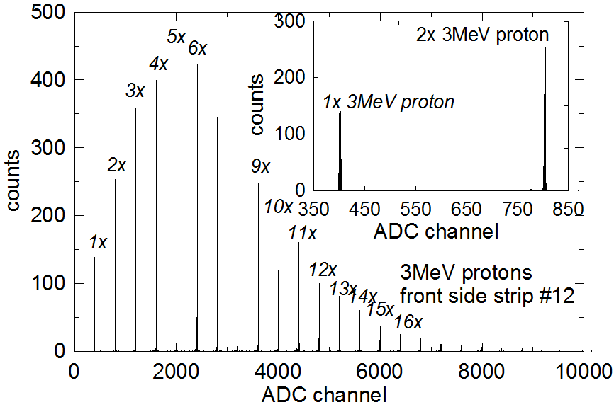


DSSSD qualification - II
Energy calibration, non-linearity and energy resolution
45mV/MeV CPA
accurate energy calibration of each strip and of the corresponding preamplifier in a wide energy range
measure the linearity of the overall system
each bunch gives rise to a single event (detector charge collection time >> bunch duration) of amplitude proportional to the bunch multiplicity
FWHM of single-proton peak for different kernel lengths.
junction side strips
16.5 keV
11.6 keV

Slide 18










DSSSD qualification - IV
2D position response matrix (front injection)
high spatial resolution of the proton beam allows scanning across the strips and record the waveform response
waveform shape vs. interaction position
strip profile and amount of sharing events
junction side
strips
ohmic side
strips
3MeV protons
3MeV protons
F11
B12
C
3
F11
B
B12
2
A
1
F12
B13
F12
B13

Slide 19







DSSSD qualification - IV
2D position response matrix (front injection)
7.5MeV Li ions

Slide 20

3D simulator of electron-hole transport and signal formation in a 2D fully-dep. semiconductor detectors
response of segmented detectors to high-density ionization tracks as in nuclear physics experiments (and FEL facilities).
3D microscopic approach for charge cloud
Runge-Kutta45 Adapt. Step-Size integration of drift equation
Thermal Diffusion – Monte Carlo extraction
Coulomb Interaction - with image charge techniques
Charge Clustering and Adaptive Step-Size
Induced charges and currents at any electrode (Ramo Theorem)
Parallel Computing
…
ELECTRODES
3D CHARGE CLOUD
2D DETECTOR POTENTIAL

Slide 21









7.5 MeV ⁷Li on DSSSD front injection
HOLES
ELECTRONS
ELECTRODE #2
Total generated charge Q₀=2.083×10⁶q
Simulated as 20,000 e^{-_}h⁺ pairs
T_{span} = 8ns ; T_{calc} = 7h on a 24 threads server
ELECTRODE #4

Slide 22


Preliminary on-beam tests - I
Experimental setup
CHIMERA exp. chamber
LNS, Catania – July 2012
62 MeV/u protons
62 MeV/u α particles
20 MeV/u ²⁰Ne

Slide 23




Preliminary on-beam tests – II
Mixed nuclei radioactive source (digital DAQ)
junction side strips
ohmic side strips
²³⁹Pu
²⁴¹Am
²⁴⁴Cm
²³⁹Pu
²⁴¹Am
²⁴⁴Cm
<FWHM> = 17.6 keV
σ = 7.35 keV
<FWHM> = 11.87 keV
(excluding F1)
σ = 1.74 keV

Slide 24






Preliminary on-beam tests - IV
62 MeV/u α particle beam on Pb target – ΔE-E – front strips (digital DAQ)
ΔE_{Si}
junction side strips
elastic scattering peak
³He
⁴He
t
d
p
E_{CsI}

Slide 25



Preliminary on-beam tests - IV
62 MeV/u α particle beam on Pb target – ΔE-E – back strips (digital DAQ)
ohmic side strips
ΔE_{Si}
⁴He
elastic scattering peak
³He
t
d
p
E_{CsI}

Slide 26
Thank you for your attention!

Slide 27
Backup slides

Slide 28


DSSSD qualification - II
Energy calibration and non-linearity
, 45mV/MeV CPA
, 45mV/MeV CPA
each bunch gives rise to a single event (detector charge collection time >> bunch duration) of amplitude proportional to the bunch multiplicity
accurate energy calibration of each strip and of the corresponding preamplifier in a wide energy range
measure the linearity of the overall system

Slide 29


DSSSD qualification - III
Energy resolution
FWHM of single-proton peak for different kernel lengths.
junction side strips
16.5 keV
11.6 keV
ohmic side strips

Slide 30
































Preliminary on-beam tests- II
Mixed nuclei radioactive source (digital DAQ)
junction side strips
F 1
F 2
F3
F4
F5
F6
F7
F8
F9
F10
F11
F12
F13
F14
F15
F16
F17
F18
F19
F20
F21
F22
F23
F24
F25
F26
F27
F28
F29
F30
F31
F32

Slide 31
































Preliminary on-beam tests - III
ohmic side strips
Mixed nuclei radioactive source (digital DAQ)
B1
B2
B3
B4
B5
B6
B7
B8
B9
B10
B11
B12
B13
B14
B15
B16
B17
B18
B19
B20
B21
B22
B23
B24
B25
B26
B27
B28
B29
B30
B31
B32

Slide 32

Anti-Aliasing Amplifier

Slide 33

Digital PSA DAQ control SW

