Slide 1
Λp and Λd correlations from K‐ interactions in the KLOE Drift Chamber Oton Vázquez Doce Excellence Cluster Universe, TUM Advanced studies in the low-energy QCD in the strangeness sector and possible implications in astrophysics. LNF, 19-21 June 2013 Dedicated to the memory of Paul Kienle

Slide 2
Experimental program of AMADEUS
Unprecedented studies of the low-energy charged kaons interactions in nuclear matter: solid and gaseous targets (d, ³He, ⁴He) in order to obtain unique quality information about:
Nature of the controversial Λ(1405)
Possible existence of kaonic nuclear clusters (deeply bound kaonic nuclear states)
Interaction of K⁻ with one and two nucleons.
Low-energy charged kaon cross sections for momenta lower than 100 MeV/c (missing today)
Many other processes of interest in the low-energy QCD in strangeness sector -> implications from particle and nuclear physics to astrophysics (dense baryonic matter in neutron stars)

Slide 3
Analysis of KLOE data by the AMADEUS collaboration Why to perform this analysis?
Pre-stage for AMADEUS experiment in order to know the capabilities of KLOE setup for this kind of studies.
Up to 0.1% of K⁻ can be stopped in the DC gas
+ x10 times more in the Carbon entrance wall of the DC
Possibility to use an active target, a bubble chamber-like analysis. We have realized that it is in fact, a different experiment!
K‐N interactions in KLOE Oton Vázquez Doce (TUM)

Slide 4
Why to perform this analysis?
No-target analysis:
- Poor statistics
- Interaction nuclei difficult
to identify
Active detector:
-Excellence acceptance
-Excellence resolution
-Charged+neutrals
The bad
The good
K‐N interactions in KLOE Oton Vázquez Doce (TUM)

Slide 5
KLOE data analysis by the AMADEUS collaboration
how K+/K- events looks like now in KLOE:
The Drift Chamber of KLOE contains mailny ⁴He (90%, 10% isobutane)
From analysis of KLOE data and Monte Carlo: 0.1 % of K⁻ should
stop in the DC volume
This would lead to hundreds
of events with K- hadronic interactions at rest
“AMADEUS Step-0”
EMC
⁴He
K⁻
e⁻
Φ
e⁺
Drift
Chamber
K⁺
The implementation of the AMADEUS setup will modify the topology of the events
K‐N interactions in KLOE Oton Vázquez Doce (TUM)

Slide 6
Analysis status
Analyses of the 2002-2005 KLOE data: Stopped K⁻ absorption in light nuclei (⁹Be,¹²C, ⁴He)
Dedicated 2012 run with pure Carbon target inside KLOE
Λp from 1NA or 2NA (single or multi-nucleon absorption)
Λd and Λt channels
Λ (1405) -> Σ⁰π⁰
Λ (1405) -> Σ⁺π⁻
ΣN/ΛN internal conversion rates
R&D for more refined setup
Future possible scenario

Slide 7
Analysis status
Analyses of the 2002-2005 KLOE data: Stopped K⁻ absorption in light nuclei (⁹Be,¹²C, ⁴He)
Dedicated 2012 run with pure Carbon target inside KLOE
Λp from 1NA or 2NA (single or multi-nucleon absorption)
Λd and Λt channels
Λ (1405) -> Σ⁰π⁰
Λ (1405) -> Σ⁺π⁻
ΣN/ΛN internal conversion rates
R&D for more refined setup
Future possible scenario
Talks this afternoon
Talk this afternoon

Slide 8
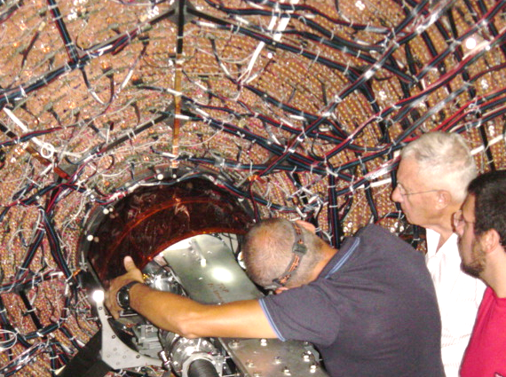
KLOE data on K⁻ nuclear absorption
Use of two different data samples:
- KLOE data from 2004/2005 (2.2 fb⁻¹ total, 1.5fb⁻¹ analyzed)
- Dedicated run in november/december 2012 with a Carbon target of 4/6 mm of thickness (~90 pb⁻¹; analyzed 37 pb⁻¹, x1.5 statistics)

Slide 9
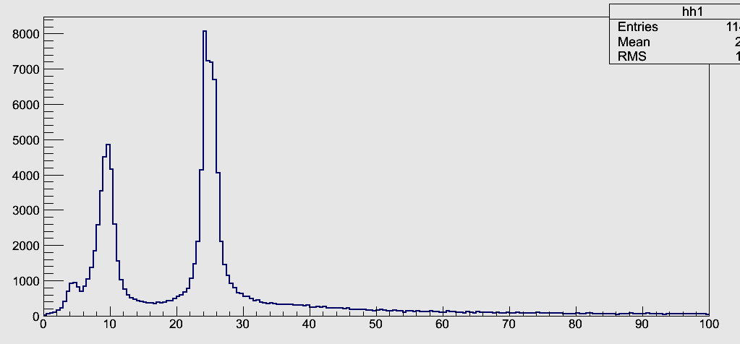
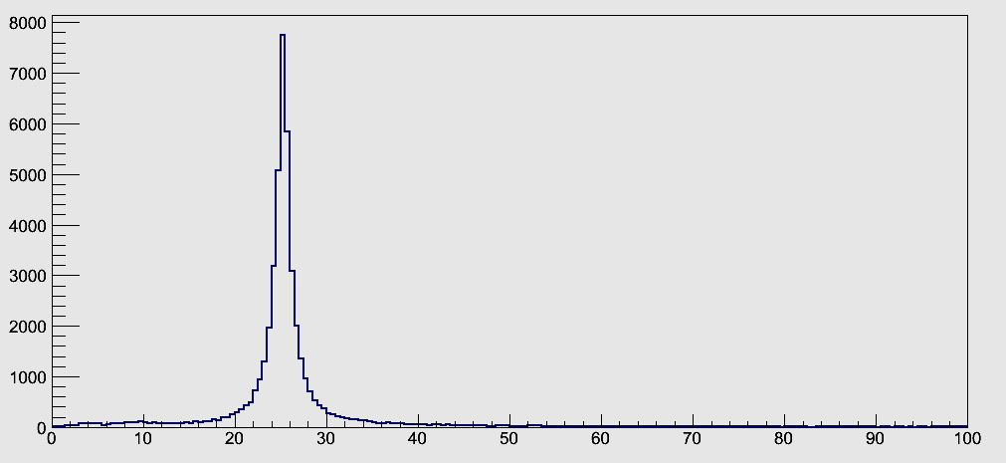
KLOE data on K⁻ nuclear absorption
Use of two different data samples:
- KLOE data from 2004/2005 (2.2 fb⁻¹ total, 1.5fb⁻¹ analyzed)
- Dedicated run in november/december 2012 with a Carbon target of 4/6 mm of thickness (~90 pb⁻¹; analyzed 37 pb⁻¹, x1.5 statistics)
Position of the K⁻ hadronic interaction inside KLOE:
2005 data
C target
2012 with Carbon target
r(cm)

Slide 10
KLOE data on K⁻ nuclear absorption
Use of two different data samples:
- KLOE data from 2004/2005 (2.2 fb⁻¹ total, 1.5fb⁻¹ analyzed)
- Dedicated run in november/december 2012 with a Carbon target of 4/6 mm of thickness (~90 pb⁻¹; analyzed 37 pb⁻¹, x1.5 statistics)
Position of the K⁻ hadronic interaction inside KLOE:
DC-Wall (C)
BP (Be)
2005 data
DC-gas (He)
C target
2012 with Carbon target
r(cm)

Slide 11
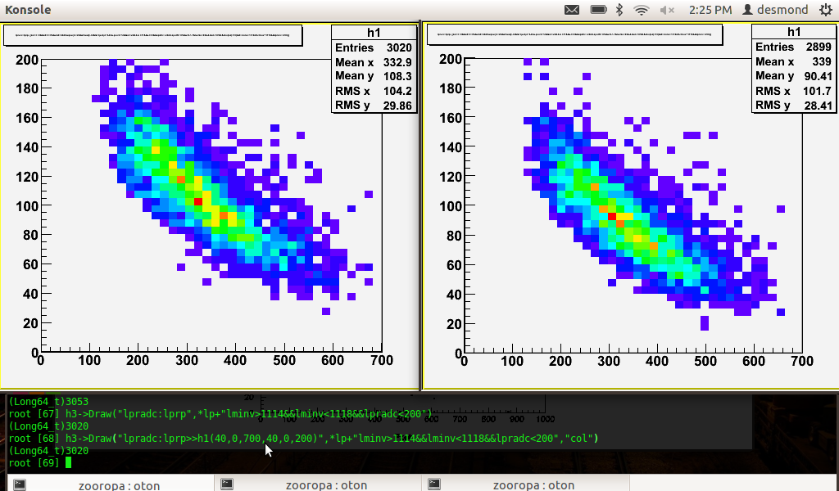
2012 Carbon Target Data
Calibration of the Drift Chamber. PROTON SELECTION
2005 2012
ADC
counts
P (MeV)
- ADC counts (from truncated mean) gives lower values in general.
- PID cuts have been preliminary re-adapted.
- The effect can be caused by the computation of signal from lower
number of wires for the truncated mean.

Slide 12
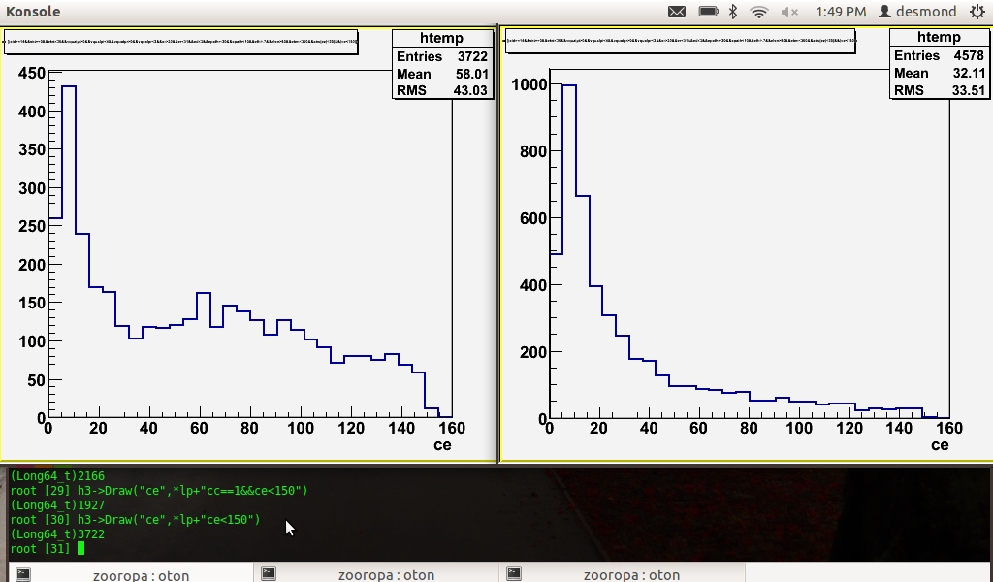
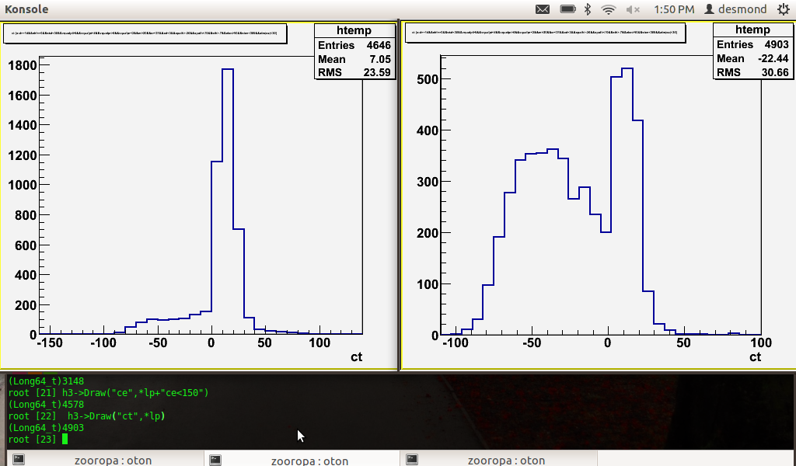
2012 Carbon Target Data
Calibration of the EMC
2005 2012
2005 2012
Clusters energy (MeV)
Clusters time (ns)

Slide 13
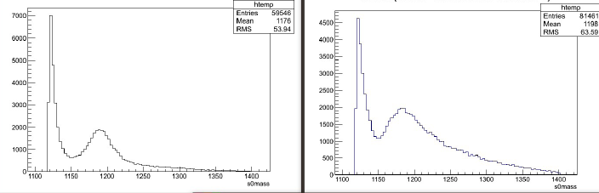
2012 Carbon Target Data
Calibration of the EMC
2005 2012
Σ⁰ contamination in Λp events

Slide 14
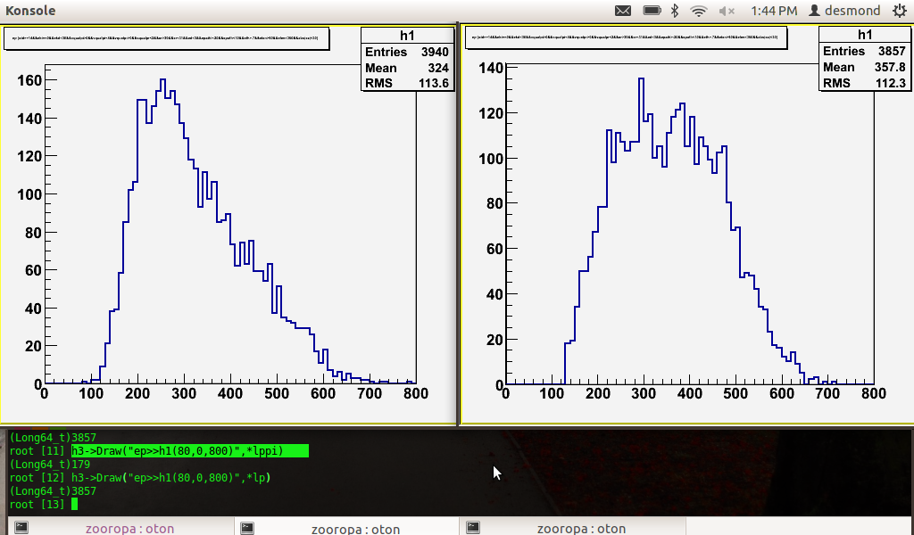
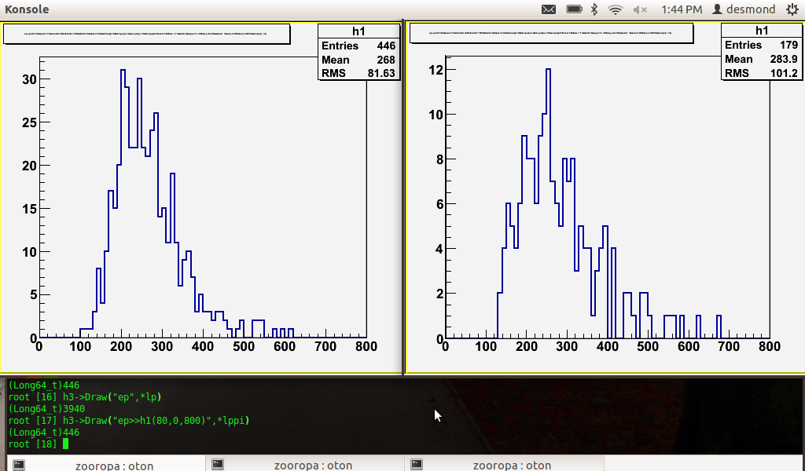
2012 Carbon Target Data
Λp and Λπp events
2005 2012
ALL Lambda+proton events
(exclusive selection)
Proton momentum(MeV)
Lambda+proton+pion events
“Single nucleon
absorption inclusive
selection”
Proton momentum(MeV)

Slide 15
Tools for identifying ΛN events
K‐N interactions in KLOE Oton Vázquez Doce (TUM)

Slide 16
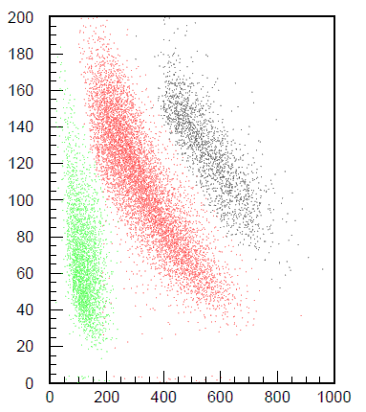
Tools for identifying ΛN events
Trunc ADC
dE/dx in the DC wires
(actually the only study
using this information)
E@EMC
Mass by TOF
Σ⁰ contamination
Λ path&lifetime
Vertex position
d
p
π
P (MeV)
K‐N interactions in KLOE Oton Vázquez Doce (TUM)

Slide 17
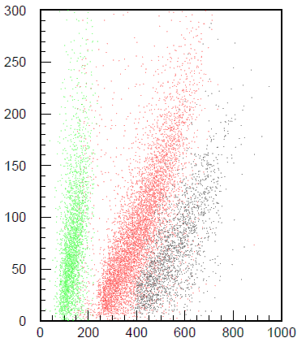
Tools for identifying ΛN events
dE/dx
E@EMC
E(MeV)
p
d
π
P (MeV)
K‐N interactions in KLOE Oton Vázquez Doce (TUM)

Slide 18
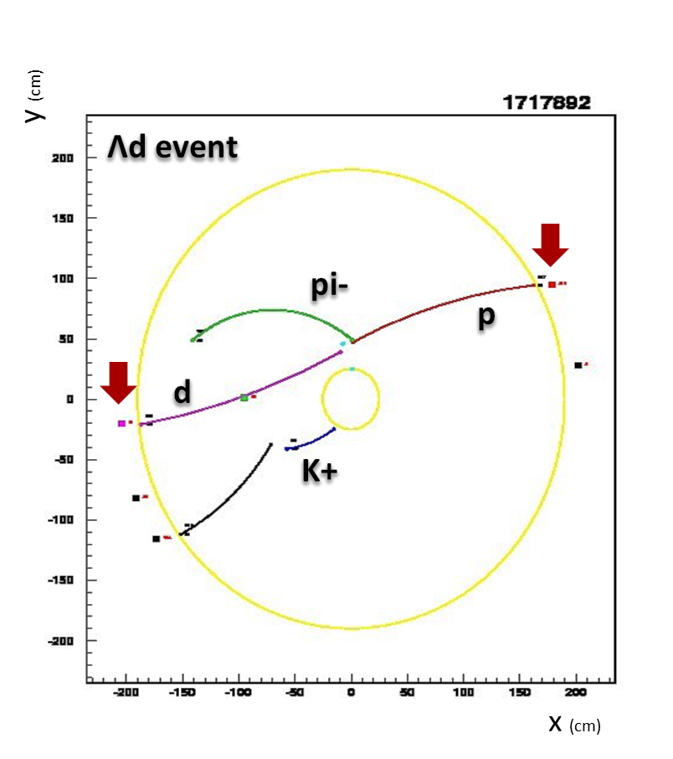
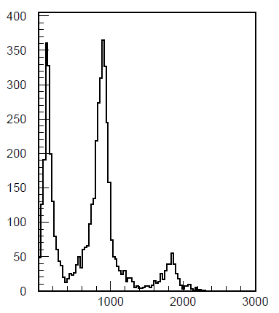
Tools for identifying ΛN events
The use of the EMC clusters associated to tracks allows to calculate particle masses
dE/dx
+ =
E@EMC
Mass by TOF
π
p
d
Mass (MeV)
K‐N interactions in KLOE Oton Vázquez Doce (TUM)

Slide 19
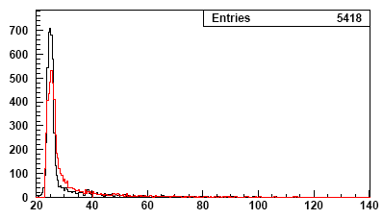
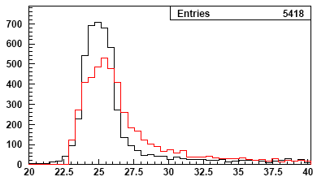
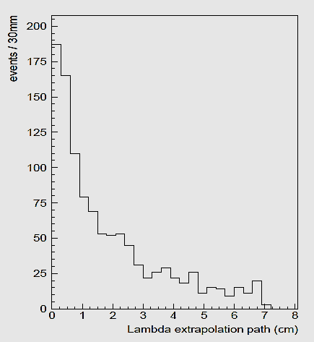
Tools for identifying ΛN events
A good vertex resolution in esential to identify the “interaction” and “lambda” vertices .
Λ -> p+π
Λ+d
2 different vertices reconstruction:
Λ -> p + pion
Λ + d
Use Λ lifetime as quality cut
Vertex radial position (cm)
Not possible for neutral vertices! ☹

Slide 20
Tools for identifying ΛN events
A good vertex resolution in esential to identify the “interaction” and “lambda” vertices .
Not possible for neutral vertices! ☹
Use of the K-?
Tracked K- in 12% of events
Backwards extrapolated K+ used instead
(possible in 95% of events where the K- is missing)
K‐N interactions in KLOE Oton Vázquez Doce (TUM)

Slide 21
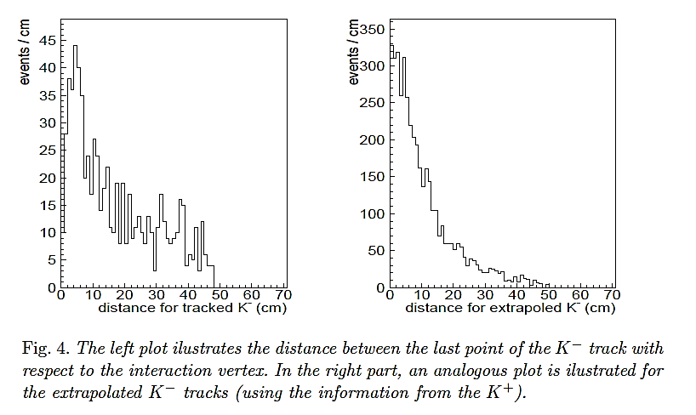
Tools for identifying ΛN events
A good vertex resolution in esential to identify the “interaction” and “lambda” vertices .
Not possible for neutral vertices! ☹
Use of the K-?
Tracked K- in 12% of events
Backwards extrapolated K+ used instead
(possible in 95% of events where the K- is missing)
Only a quality check, not used for vertex

Slide 22
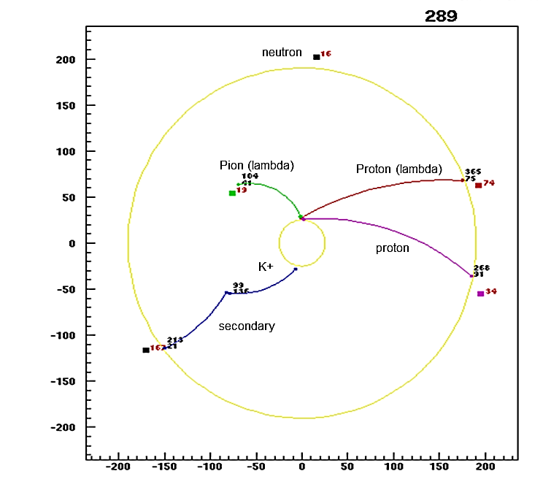
Tools for identifying ΛN events
Use of the calorimeter:
neutrons?
K- + 4He ->
Lambda + p + n + n
Dedicated experimental studies on neutron efficiency of the EMC: KLONE collaboration: 20% of efficiency for
neutrons in the expected
momentum range.
K‐N interactions in KLOE Oton Vázquez Doce (TUM)

Slide 23
Tools for identifying ΛN events
Use of the calorimeter: Photon detection
Black -> energy of photons from π⁰
Blue -> energy of photons from Σ⁰ -> Λγ
K‐N interactions in KLOE Oton Vázquez Doce (TUM)

Slide 24
Tools for identifying ΛN events
Use of the calorimeter: Photon detection
Black -> energy of photons from π⁰
Blue -> energy of photons from Σ⁰ -> Λγ
K‐N interactions in KLOE Oton Vázquez Doce (TUM)

Slide 25
Tools for identifying ΛN events
Use of the calorimeter: Photon detection
Black -> energy of photons from π⁰
Blue -> energy of photons from Σ⁰ -> Λγ
Σ⁰ contamination in Λp events
K‐N interactions in KLOE Oton Vázquez Doce (TUM)

Slide 26
Performance of the KLOE detector:
- Momentum and Invariant masses resolution study with MC
- Acceptance correction
K‐N interactions in KLOE Oton Vázquez Doce (TUM)

Slide 27
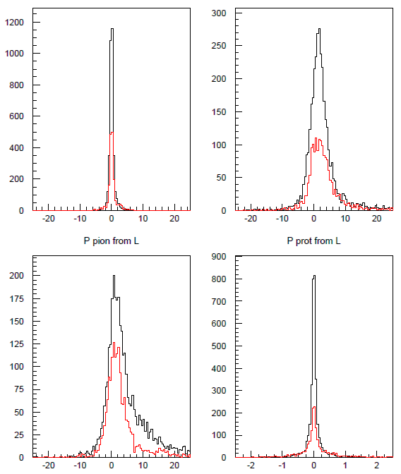
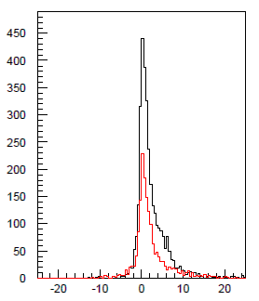
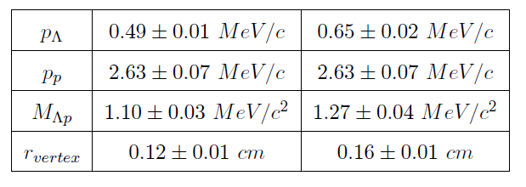
Resolution studied by Λp Monte Carlo
π⁻ from Λ decay (MeV)
p from Λ decay (MeV)
Minv Λp (MeV)
Distributions: MC-Reconstructed
Minv pπ⁻ (MeV)
Tracks connected by KLOE vtx
Tracks NOT connected by KLOE vtx
p (MeV)
Vtx r (cm)

Slide 28
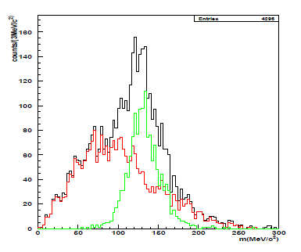
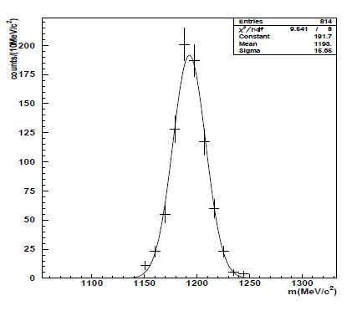
Resolution studied by Λp Monte Carlo
Neutral particles
Green : π⁰-> γγ
Σ⁰ -> Λγ
π⁻ from Λ decay (MeV)
p from Λ decay (MeV)
Minv Λp (MeV)
Distributions: MC-Reconstructed
Minv pπ⁻ (MeV)
Tracks connected by KLOE vtx
Tracks NOT connected by KLOE vtx
p (MeV)
Vtx r (cm)

Slide 29
Acceptance study with phase space K⁻ + ⁴He -> Λ p n n MC simulation
K‐N interactions in KLOE Oton Vázquez Doce (TUM)

Slide 30
Acceptance study with phase space K⁻ + ⁴He -> Λ p n n MC simulation
K‐N interactions in KLOE Oton Vázquez Doce (TUM)

Slide 31
Acceptance study with phase space K⁻ + ⁴He -> Λ p n n MC simulation
Projection of acceptance function depending on (P_{Λ},P_{p},Minv Λp)
on the Invariant mass plane
True phase space MC
Reconstructed MC
Corrected MC with acc. Corr.
Normalization 1:1
(no efficiency evaluation)

Slide 32
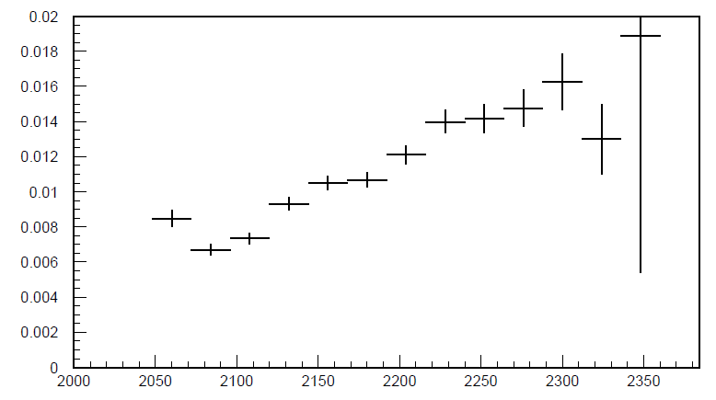
Acceptance study with phase space K⁻ + ⁴He -> Λ p n n MC simulation
Projection of acceptance function depending on (P_{Λ},P_{p},Minv Λp)
on the Invariant mass plane
True phase space MC
Reconstructed MC
Corrected MC with acc. Corr.
Normalization 1:1
(no efficiency evaluation)
Minv Λp (MeV)

Slide 33
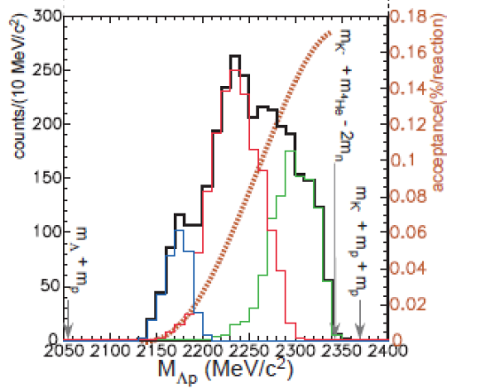
Acceptance study with phase space K⁻ + ⁴He -> Λ p n n MC simulation
Projection of acceptance function depending on (P_{Λ},P_{p},Minv Λp)
on the Invariant mass plane
KEK
As expected, much better acceptance at low momentum range
Minv Λp (MeV)

Slide 34
Λp analysis
1NA: K⁻N→Λπ⁻ (N spectator)
1NA: K⁻N →Σπ⁻→ΛNπ⁻ (N from Σ/Λ conversion)
2NA: K⁻NN→ΛN (pionless)

Slide 35
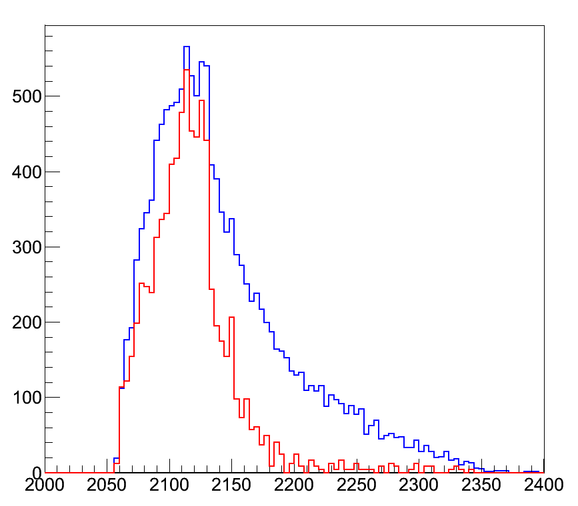
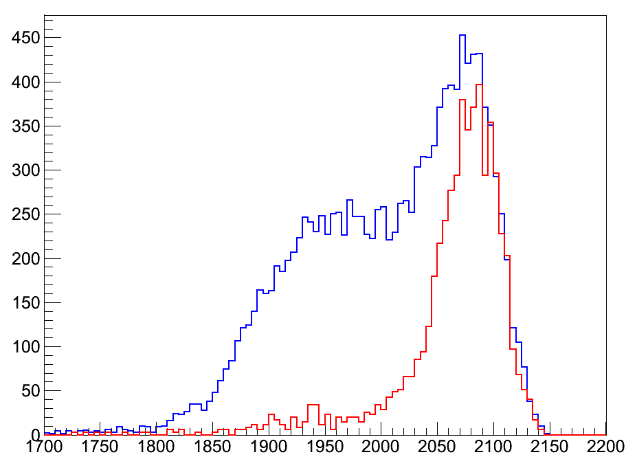
Λp analysis
1NA: K⁻N→Λπ⁻ (N spectator)
1NA: K⁻N →Σπ⁻→ΛNπ⁻ (N from Σ/Λ conversion)
2NA: K⁻NN→ΛN (pionless)
Λp events
In ⁴He
Λp all events
Λπ⁻p events
(arbitrary normalization)
M_{Λp} (MeV)
The Λp missing mass for the
Λπ⁻p events lies exactly
In the 2N+π⁻ mass region
m_{2N}+m_{π}
Λp missing mass (MeV)

Slide 36
Λp analysis
1NA: K⁻N→Λπ⁻ (N spectator)
1NA: K⁻N →Σπ⁻→ΛNπ⁻ (N from Σ/Λ conversion)
2NA: K⁻NN→ΛN (pionless)
A perfect disentanglement
between single and multi-
nucleon absorption can be
achieved thanks to the nice
acceptance:
Λp events
In ⁴He
KLOE
Λp all events
Λπ⁻p events
(arbitrary normalization)
M_{Λp} (MeV)
Acceptance in M_{Λp} (MeV)
(arbitrary normalization)
The Λp missing mass for the
Λπ⁻p events lies exactly
In the 2N+π⁻ mass region
m_{2N}+m_{π}
Λp missing mass (MeV)
KEK-E549
Mod.Phys.Lett.A23, 2520 (2008)

Slide 37
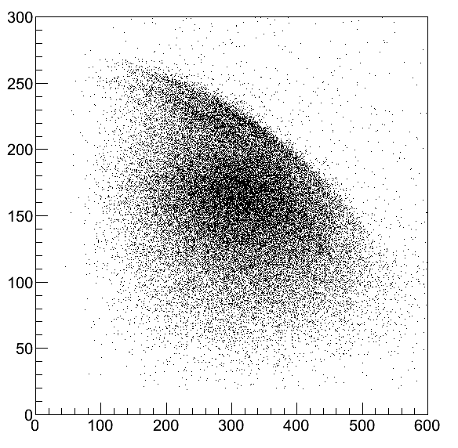
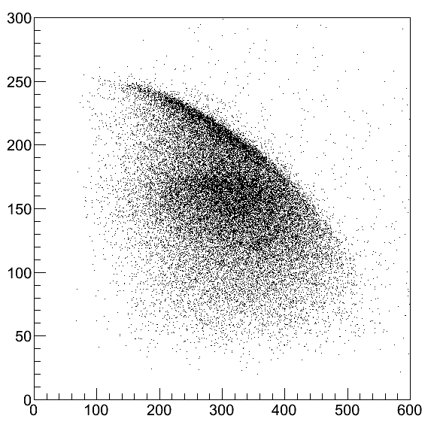
Σ/Λ conversion in the nuclear medium
Λπ⁻ analysis: 1N absorption process K⁻ N → Yπ⁻
Λπ channel: No possible formation of Λ(1405) Well know resonance Σ(1385)
p_{π−} (MeV/c)
Direct formation K⁻ n → Λπ⁻
Clearly visible the 2 bands:
-in flight
-at rest
(only events at rest in Carbon Target)
p_{π−} (MeV/c)
2005. DC-wall carbon
2012 Carbon target
p_{Λ} (MeV/c)
p_{Λ} (MeV/c)
- The data in this channel is of great value to confirm the predicted branching ration modifications in medium for ^{A}Z(K⁻,π⁻)
-Σ/Λ internal conversion rates can be obtained as well in function of the nucleus material
Two-step process involving sigma:
K⁻ n → Σ⁰π⁻
Decay Λγ
Undergo internal conversion
within the residual nucleus
ΣN->ΛN

Slide 38
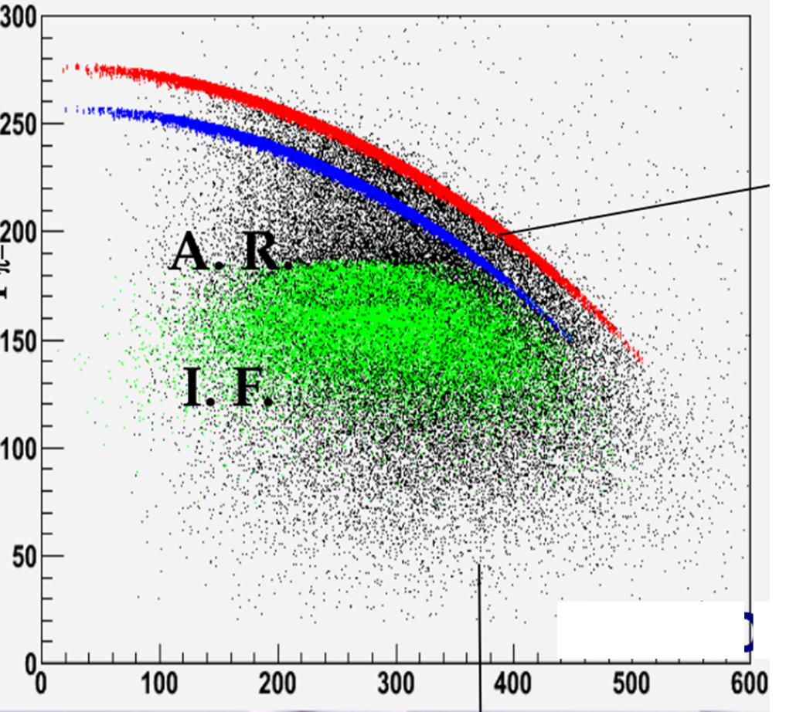
Σ/Λ conversion in the nuclear medium
Λπ⁻ analysis: 1N absorption process K⁻ N → Yπ⁻
Λπ channel: No possible formation of Λ(1405) Well know resonance Σ(1385)
Direct formation K⁻ n → Λπ⁻
p_{π−} (MeV/c)
K⁻ n → Σ⁰π⁻
p_{π−} (MeV/c)
Direct formation K⁻ n → Λπ⁻
Clearly visible the 2 bands:
-in flight
-at rest
(only events at rest in Carbon Target)
p_{π−} (MeV/c)
Σp->Λp
True MC
simulation
2005. DC-wall carbon
2012 Carbon target
p_{Λ} (MeV/c)
p_{Λ} (MeV/c)
- The data in this channel is of great value to confirm the predicted branching ration modifications in medium for ^{A}Z(K⁻,π⁻)
-Σ/Λ internal conversion rates can be obtained as well in function of the nucleus material
Two-step process involving sigma:
K⁻ n → Σ⁰π⁻
p_{Λ} (MeV/c)
Decay Λγ
Undergo internal conversion
within the residual nucleus
ΣN->ΛN

Slide 39
Λp analysis
Λp events
In ⁴He
1NA: K⁻N→Λπ⁻ (N spectator)
1NA: K⁻N →Σπ⁻→ΛNπ⁻ (N from Σ/Λ conversion)
2NA: K⁻NN→ΛN (pionless)
Λp all events
Λπ⁻p events
(arbitrary normalization)
M_{Λp} (MeV)

Slide 40
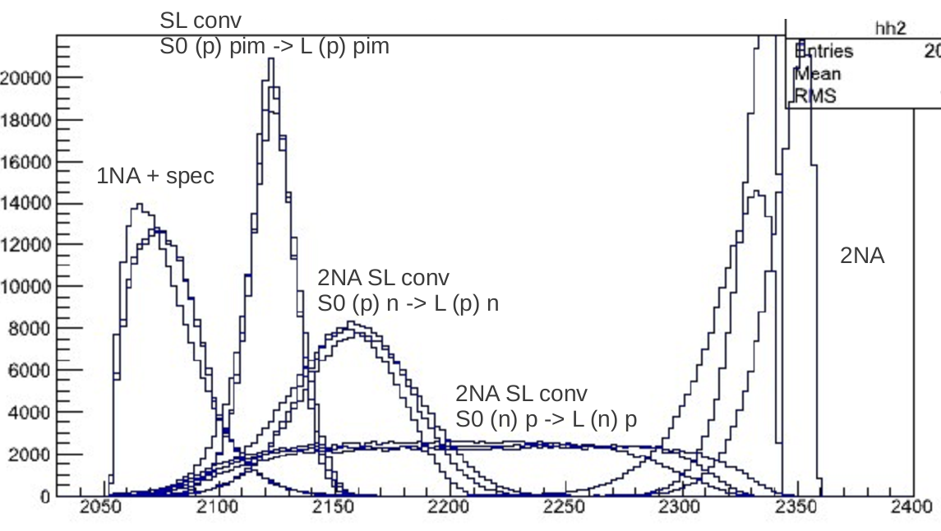
Λp analysis
Λp events
In ⁴He
1NA: K⁻N→Λπ⁻ (N spectator)
1NA: K⁻N →Σπ⁻→ΛNπ⁻ (N from Σ/Λ conversion)
2NA: K⁻NN→ΛN (pionless)
Λp all events
Λπ⁻p events
(arbitrary normalization)
M_{Λp} (MeV)
Internal Conversion Σp→Λp
K⁻n →Σ⁰π⁻→Λ(p)π⁻
2NA absorption
K⁻pp →Λp
True MC simulation
(no accept.)
3 processes simulated:
-interaction in C at rest
-interaction in C in flight
-interaction in He at rest
Spectator proton
K⁻n →Λπ⁻ (p)
2NA absorption
Internal Conversion Σp→Λp
K⁻np →Σ⁰n→Λ(p)n
2NA absorption
Internal Conversion Σp→Λp
K⁻pp →Σ⁰p→Λp(n)
M_{Λp} (MeV)

Slide 41
Λp analysis
Λp events
In ⁴He
1NA: K⁻N→Λπ⁻ (N spectator)
1NA: K⁻N →Σπ⁻→ΛNπ⁻ (N from Σ/Λ conversion)
2NA: K⁻NN→ΛN (pionless)
Λp all events
Λπ⁻p events
(arbitrary normalization)
KEK-E549
Mod.Phys.Lett.A23, 2520 (2008)
M_{Λp} (MeV)
Internal Conversion Σp→Λp
K⁻n →Σ⁰π⁻→Λ(p)π⁻
2NA absorption
K⁻pp →Λp
True MC simulation
(no accept.)
3 processes simulated:
-interaction in C at rest
-interaction in C in flight
-interaction in He at rest
Spectator proton
K⁻n →Λπ⁻ (p)
2NA absorption
Internal Conversion Σp→Λp
K⁻np →Σ⁰n→Λ(p)n
2NA absorption
Internal Conversion Σp→Λp
K⁻pp →Σ⁰p→Λp(n)
M_{Λp} (MeV)

Slide 42
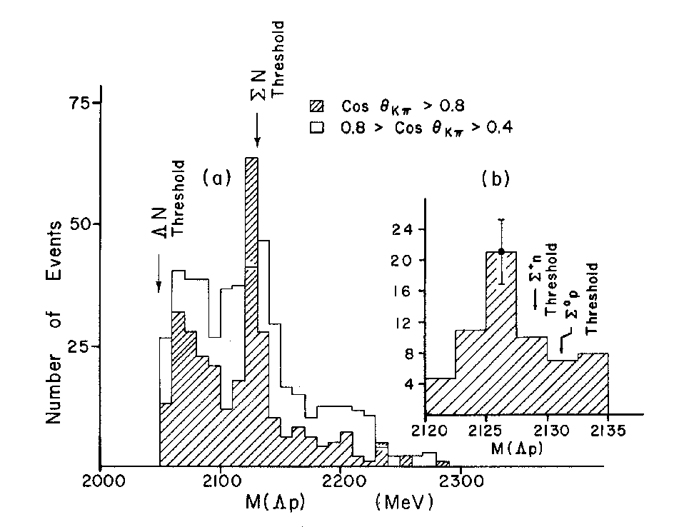
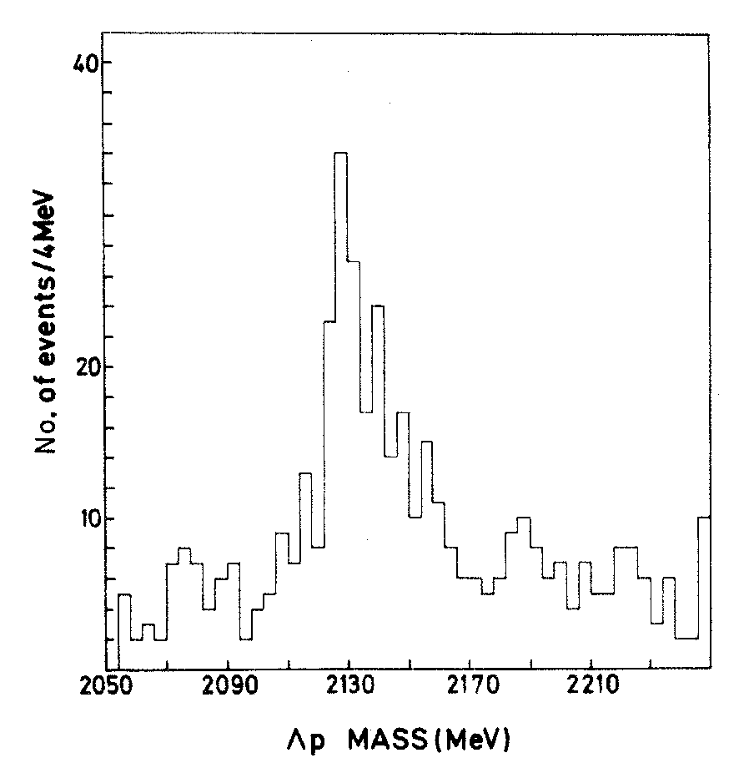
Bubble Chamber K⁻(CF₃Br)→ΛpX
T. Buran et al., Phys. Lett. 20, 318 (1966)
Slide from A. Filippi & S. Piano
The signal is compatible with a
K⁻d absorption with pion
production
K⁻d→(Σ⁺n)π⁻→(Λp)π⁻
D. Eastwood et al., PRD3(1971)2603
K⁻d→Λp π⁻X (1.45 GeV/c and 1.65 GeV/c)
Signal also compatible with a threshold (ΣN) cusp effect (no resonance needed)
D. Cline et al., PRL20(1968)1452
K⁻d→Λp π⁻X (400 MeV/c)

Slide 43
Bubble Chamber K⁻(CF₃Br)→ΛpX
T. Buran et al., Phys. Lett. 20, 318 (1966)
?
Slide from A. Filippi & S. Piano
The signal is compatible with a
K⁻d absorption with pion
production
?non pionic!
K⁻d→(Σ⁺n)π⁻→(Λp)π⁻
D. Eastwood et al., PRD3(1971)2603
K⁻d→Λp π⁻X (1.45 GeV/c and 1.65 GeV/c)
Signal also compatible with a threshold (ΣN) cusp effect (no resonance needed)
D. Cline et al., PRL20(1968)1452
K⁻d→Λp π⁻X (400 MeV/c)

Slide 44
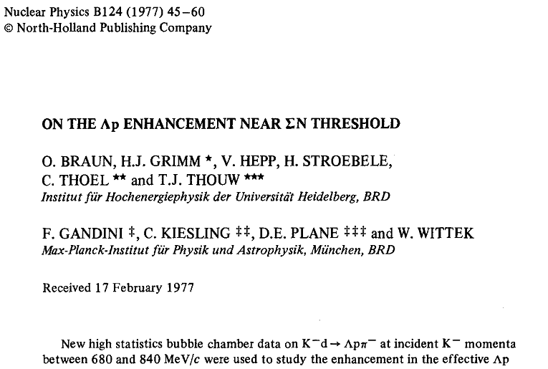
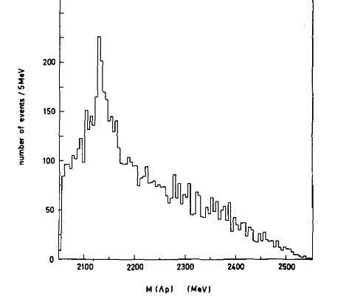

Slide 45
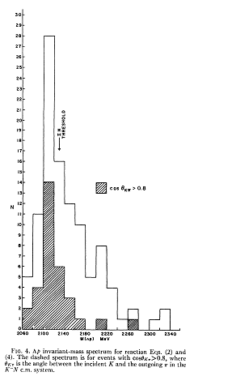

Slide 46
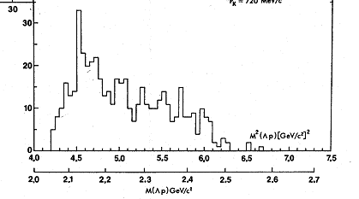

Slide 47
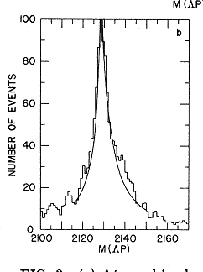

Slide 48
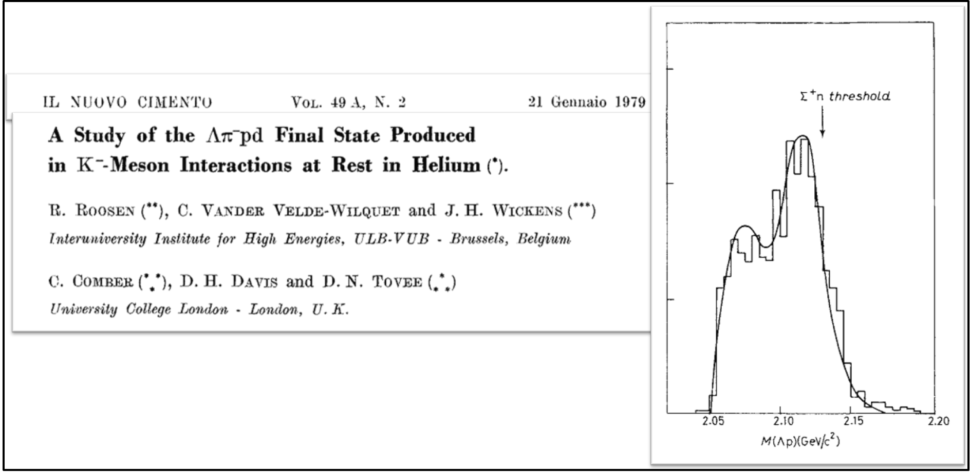

Slide 49
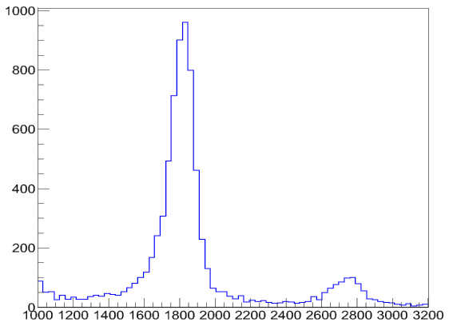
Λd analysis
Search for signal of bound states in the Λd channel. Candidate to be a K⁻ppn cluster. Observed spectra from FINUDA and KEK again showing possible bound states in the in the high invariant mass region.
deuterons
TOF Particle Mass (MeV)

Slide 50
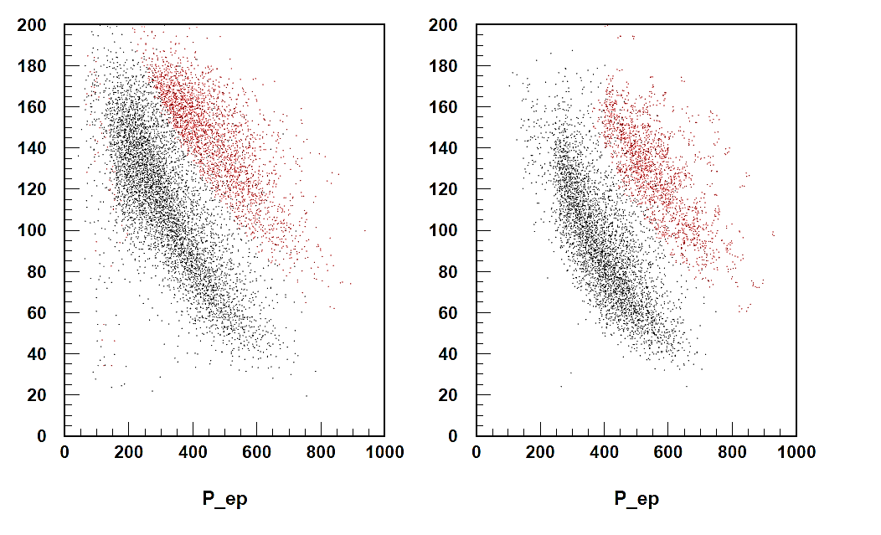
Λd analysis
Search for signal of bound states in the Λd channel. Candidate to be a K⁻ppn cluster. Observed spectra from FINUDA and KEK again showing possible bound states in the in the high invariant mass region.
ADC
No
tof cut
With
tof cut
deuterons
deuterons
deuterons
protons
protons
TOF Particle Mass (MeV)
P(MeV)

Slide 51
Λd analysis
Search for signal of bound states in the Λd channel. Candidate to be a K⁻ppn cluster. Observed spectra from FINUDA and KEK again showing possible bound states in the in the high invariant mass region.
ADC
No
tof cut
With
tof cut
deuterons
deuterons
deuterons
protons
protons
TOF Particle Mass (MeV)
P(MeV)
P_{Λ}(MeV)
P_{d}(MeV)

Slide 52
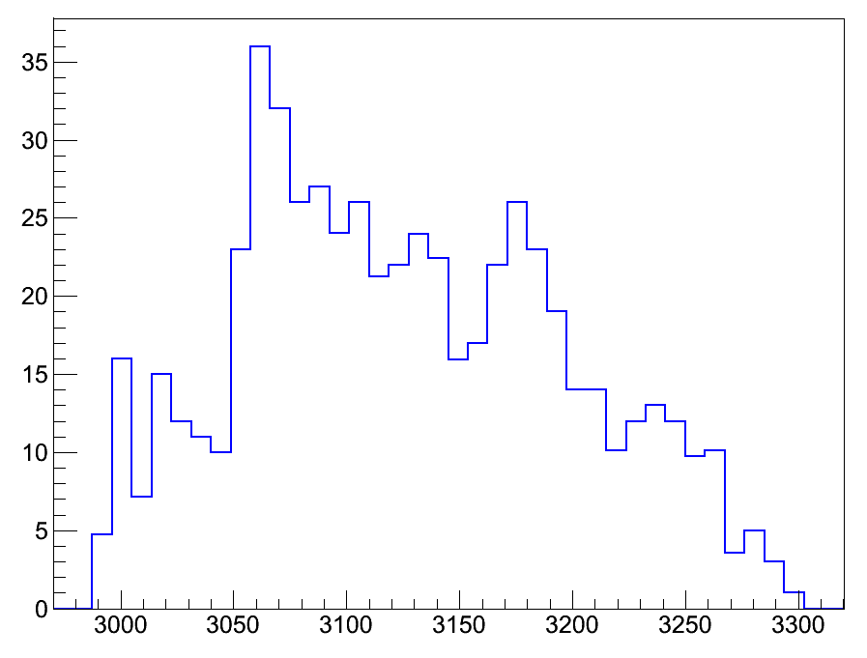
Λd analysis
Search for signal of bound states in the Λd channel. Candidate to be a K⁻ppn cluster. Observed spectra from FINUDA and KEK again showing possible bound states in the in the high invariant mass region.
Preliminary
Λd events
In ⁴He
deuterons
low accept.
region
M_{Λd} (MeV)
TOF Particle Mass (MeV)

Slide 53
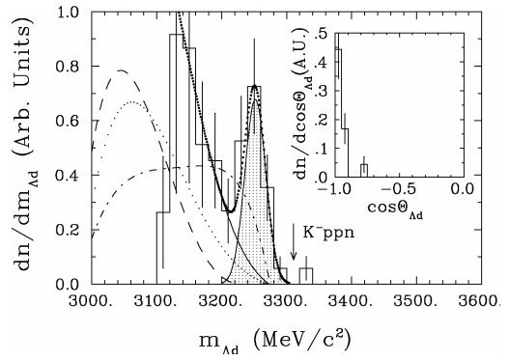
Λd analysis
Search for signal of bound states in the Λd channel. Candidate to be a K⁻ppn cluster. Observed spectra from FINUDA and KEK again showing possible bound states in the in the high invariant mass region.
Preliminary
Λd events
In ⁴He
deuterons
low accept.
region
M_{Λd} (MeV)
TOF Particle Mass (MeV)
FINUDA
Nucl.Phys.A835, 43 (2010)

Slide 54
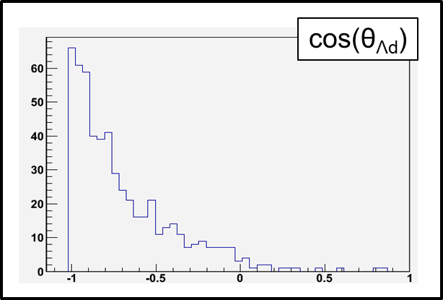
Λd analysis
Search for signal of bound states in the Λd channel. Candidate to be a K⁻ppn cluster. Observed spectra from FINUDA and KEK again showing possible bound states in the in the high invariant mass region.
Preliminary
Λd events
In ⁴He
deuterons
low accept.
region
M_{Λd} (MeV)
TOF Particle Mass (MeV)
FINUDA
Nucl.Phys.A835, 43 (2010)

Slide 55
Λt analyses
Only FINUDA and an old experiment (with only 4 events!) have shown Λt spectra from K⁻ absorption
deuterons
triton
TOF Particle Mass (MeV)

Slide 56
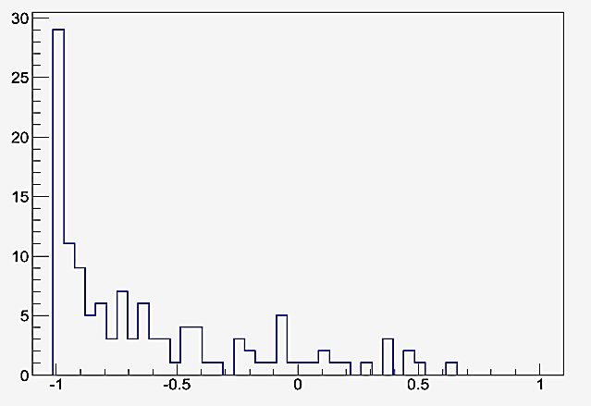
Λt analyses
Only FINUDA and an old experiment (with only 4 events!) have shown Λt spectra from K⁻ absorption
Λt events
In ⁴He
Preliminary
deuterons
triton
Cos(θ_{Λt})
TOF Particle Mass (MeV)

Slide 57
Λt analyses
Only FINUDA and an old experiment (with only 4 events!) have shown Λt spectra from K⁻ absorption
Λt events
In ⁴He
Preliminary
deuterons
triton
Cos(θ_{Λt})
TOF Particle Mass (MeV)
FINUDA Phys.Lett.B 229, 229 (2008)
Filled histogram= data
Open histogram = Phase space
simulation

Slide 58
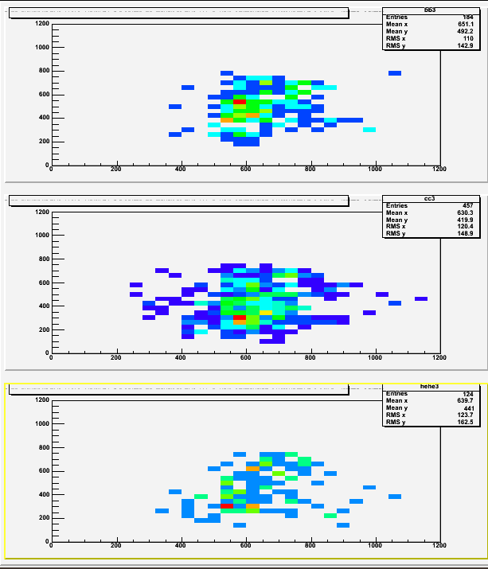
Λt analyses
Lambda
Momentum
(MeV)
Be (beam pipe)
Be (beam pipe)
Only FINUDA and an old experiment (with only 4 events!) have shown Λt spectra from K⁻ absorption
Λt events
In ⁴He
Preliminary
C (DC wall)
deuterons
C (DC wall)
triton
Cos(θ_{Λt})
TOF Particle Mass (MeV)
He (DC gas)
FINUDA Phys.Lett.B 229, 229 (2008)
Filled histogram= data
Open histogram = Phase space
simulation
He (DC gas)
Cos(θ_{Λt})
Triton
Momentum
(MeV)

Slide 59
Λt analyses
Lambda
Momentum
(MeV)
Be (beam pipe)
Be (beam pipe)
Only FINUDA and an old experiment (with only 4 events!) have shown Λt spectra from K⁻ absorption
Λt events
In ⁴He
Preliminary
C (DC wall)
deuterons
C (DC wall)
triton
Cos(θ_{Λt})
TOF Particle Mass (MeV)
He (DC gas)
FINUDA Phys.Lett.B 229, 229 (2008)
Filled histogram= data
Open histogram = Phase space
simulation
He (DC gas)
~FINUDA
SIGNAL
Cos(θ_{Λt})
Triton
Momentum
(MeV)

Slide 60
Conclusions
KLOE has been proved to be an ideal detector for the study of the K⁻N interactions.
Inclusive Λp and exclusive Λpπ⁻ analysis completed and ready to be fitted with background distributions.
Other analysis (Λd , Λt, Σ⁰π⁰, Σ⁺π⁻,hypernuclei, etc) undergoing. See next talks.
Big expectations for data from¹²C solid (half)cylindrical target.
K‐N interactions in KLOE Oton Vázquez Doce (TUM)

Slide 61
Conclusions
KLOE has been proved to be an ideal detector for the study of the K⁻N interactions.
Inclusive Λp and exclusive Λpπ⁻ analysis completed and ready to be fitted with background distributions.
Other analysis (Λd , Λt, Σ⁰π⁰, Σ⁺π⁻,hypernuclei, etc) undergoing. See next talks.
Big expectations for data from¹²C solid (half)cylindrical target.
thanks!
K‐N interactions in KLOE Oton Vázquez Doce (TUM)

Slide 62
SPARE

Slide 63
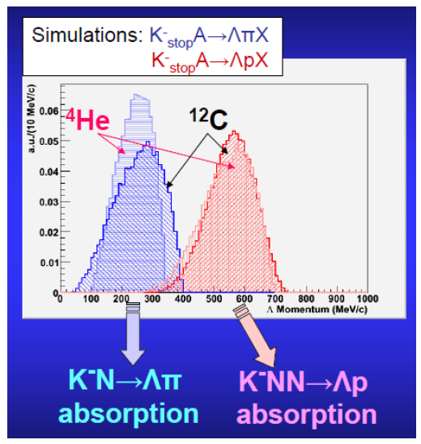
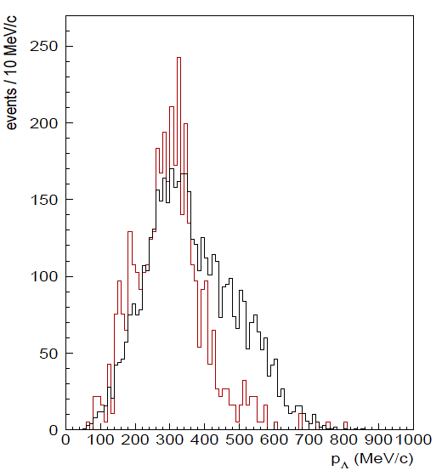
Study of the mesonic absorption modes: Λ momentum spectra
Mesonic channel: Λp + π⁻
Λ momentum in the lower part of the spectra:
(simulation by S. Piano & A. Filippi, FINUDA)
KLOE data exclusive analysis:
π⁻ track found in 1/6 of Λp events
K⁻N -> Λπ
from the residual ⁴He nucleus!
All Λp events
Λp + π⁻ events
(arbitrary normalization)

Slide 64
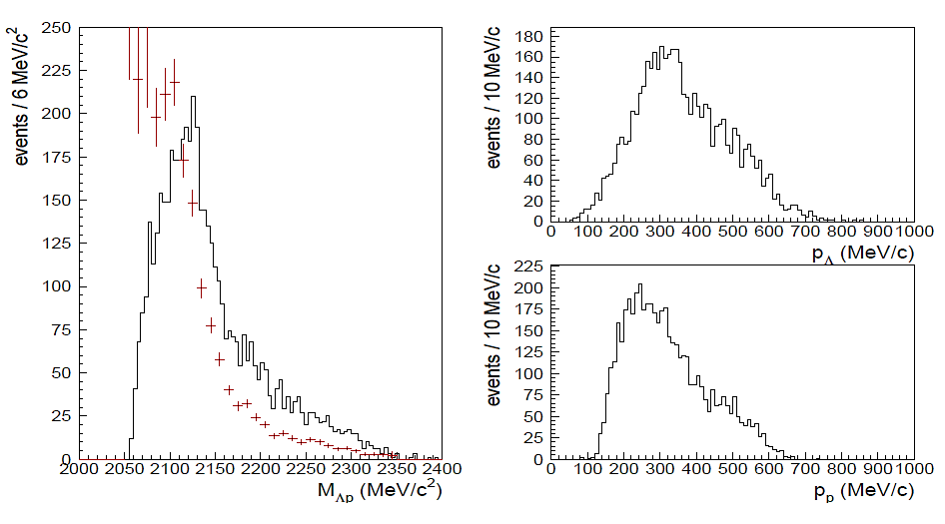
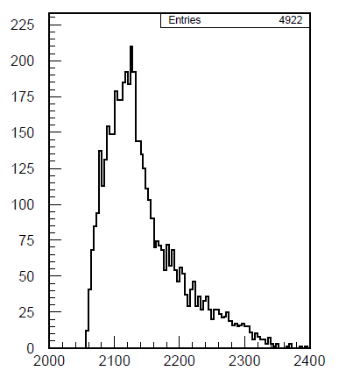
Invariant masses Λp
P_{Λ}(MeV)
P_{p}(MeV)
Minv Λp (MeV)
Acceptance corrected
Inclusive analysis
ALL Λp events
K‐N interactions in KLOE Oton Vázquez Doce (TUM)

Slide 65
Invariant masses Λp
P_{Λ}(MeV)
P_{p}(MeV)
Minv Λp (MeV)
Acceptance corrected
Exlusive analysis
Λp + π⁻ events
High invariant mass and momentum components are lost
CHECK: Missing mass OK!
K‐N interactions in KLOE Oton Vázquez Doce (TUM)

Slide 66
Invariant masses Λp
Missing mass of from Λ + p + π⁻ from K⁻ + ⁴He
Exclusive analysis Inclusive Λp + π⁻
P_{Λ}(MeV)
P_{p}(MeV)
Minv Λp (MeV)
Acceptance corrected
Exlusive analysis
Λp + π⁻ events
High invariant mass component is lost
CHECK: Missing OK!
K‐N interactions in KLOE Oton Vázquez Doce (TUM)

Slide 67
New ¹²C solid semi-cylindrical target
Density 0,95
Length ~ 20+20+20 cm
Angle coverage 165deg
boost
antiboost
Black --- 4mm/4mm
Red ---- 6mm/4mm
Green ---- 6mm/6mm
antiboost
boost
boost
antiboost
Stopped K- vs. azim. angle
Stopped K- vs. Initial momentum

Slide 68
New ¹²C solid semi-cylindrical target
Density 0,95
Length ~ 20+20+20 cm
Angle coverage 165deg
boost
antiboost
Black --- 4mm/4mm
Red ---- 6mm/4mm
Green ---- 6mm/6mm
Stopped K- in different materials:
-TARGET 24.1%
-DC WALL-CF 2.1%
-DC WALL-AL 1.8%
-DC-GAS 0.2%
boost
antiboost
Stopped K- vs. azim. angle

Slide 69
Proton-deuteron contamination
dedx
momentum
Protons
deuterons

Slide 70
P lambda
Minv L-p
Lambda-p
Kek 2NA
Red mcTRUE
Black recosntructed MC
P proton

Slide 71
How this 2na lambda-p
from kek compares
with KLOE spectra
P lambda
P proton
Lambda-p
Red MC “alla KEK”
Black KLOE
P LP
Minv L-p

Slide 72
How this 2na lambda-p from kek compares
with KLOE spectra
Lambda-p
Red MC “alla KEK”
Black KLOE
EXCLUSIVE NON
Extra-extra-track seen
Lambda+p ONLY!

Slide 73
No extra-extra track
All lambda p
Lambda-p
Red MC “alla KEK”
Black KLOE

Slide 74
Minv L-d
Lambda-d
Kek 3NA
P lambda
Red mcTRUE
Black recosntructed MC
P deuteron

