Slide 1


Cutting Edge Technology:
To find something new
you have to do something new
Johann Zmeskal
Stefan Meyer Institute for Subatomic Physics
Advances studies in the low-energy QCD
in the strangeness sector and
possible implications in astrophysics
-
dedicated to the memory of Paul Kienle
June 19-21, 2013
Laboratori Nazionali di Frascati

Slide 2
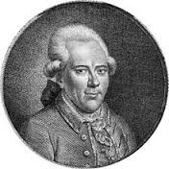
„Man muss etwas Neues machen,
um etwas Neues zu sehen“.
Georg Christoph Lichtenberg (1742 -1799)
One of the first scientists to introduce experiments with
apparatus in their lectures. Lichtenberg was one of the
most popular and respected figure in the European intellectual
circles of his time. He maintained good relations with most of the
great figures of that era, including Goethe and Kant. In 1784 Alessandro Volta visited Göttingen. The mathematician Karl Friedrich Gauss sat in on his lectures.
As a physicist, he is remembered for his investigations in electricity, for discovering branching discharge patterns on dielectrics now called Lichtenberg figures.
In 1777, he built a large electrophorus in order to generate static electricity through induction. One of the largest ever made, it was 6 feet (2 m) in diameter and could produce 15 inch (38 cm) sparks. With it, he discovered the basic principle of modern Xerography copy machine technology.
By discharging a high voltage point near an insulator, he was able to record strange tree-like patterns in fixed dust. These Lichtenberg figures are considered today to be examples of fractals.

Slide 3

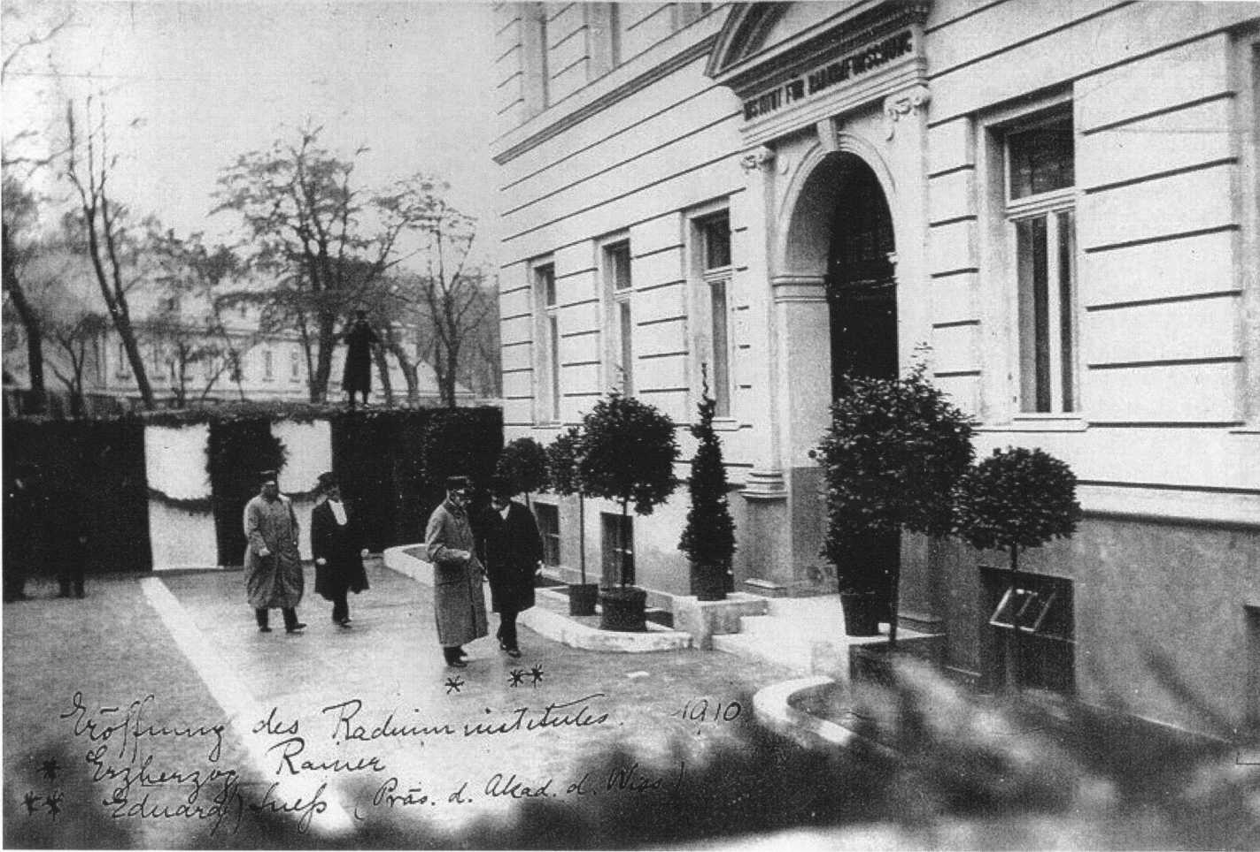
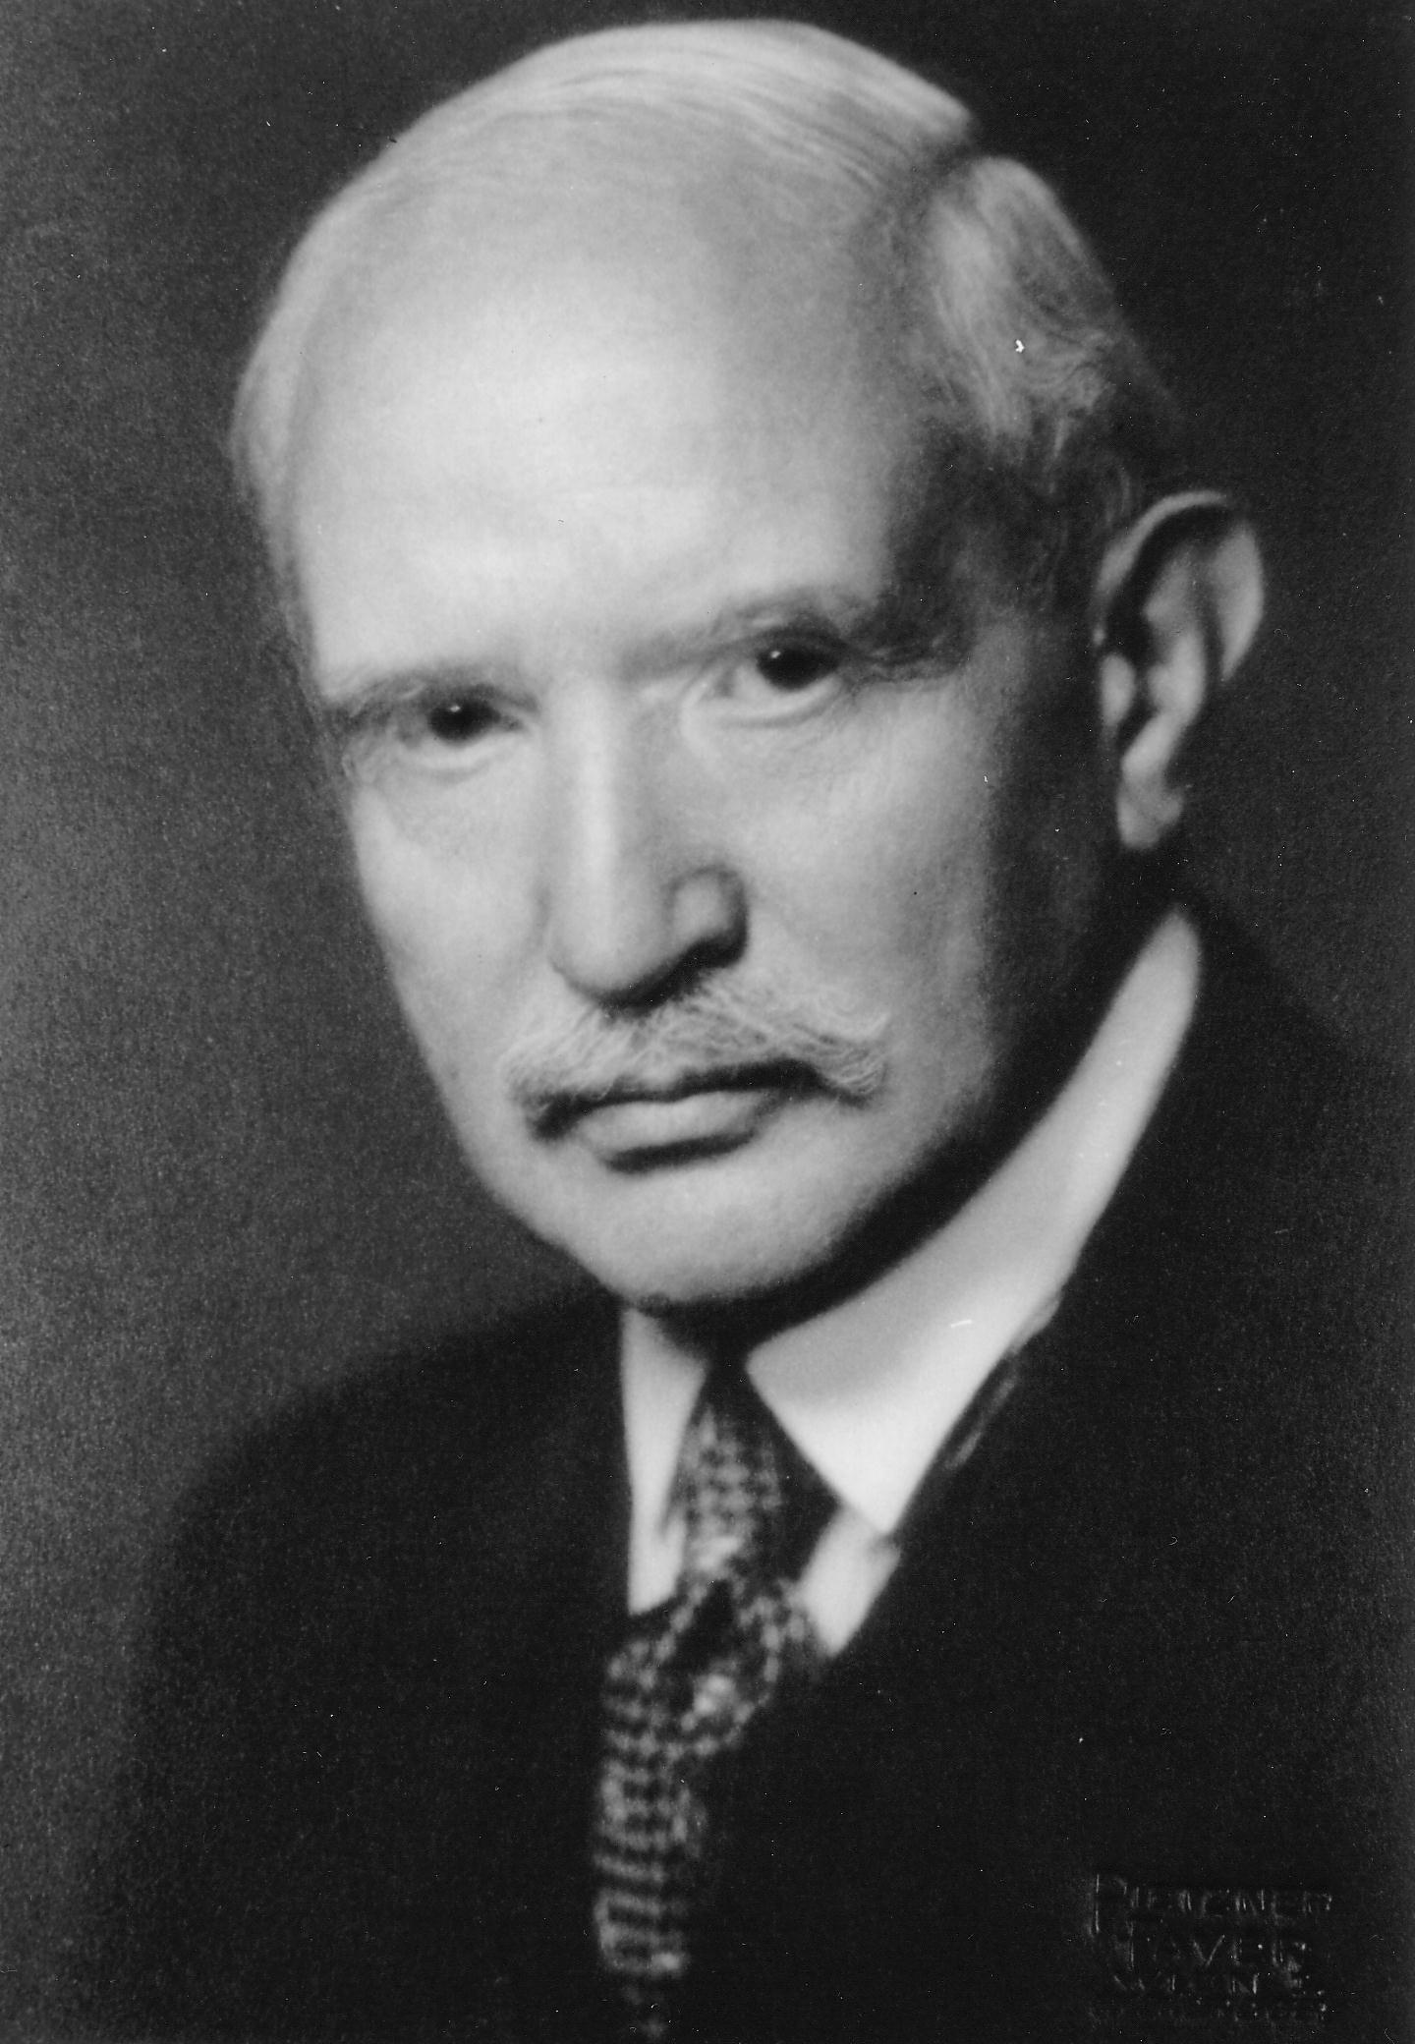
  Programm
  Präsident Herbert Mang
  „Stefan Meyer Institut für subatomare Physik – Neues in alter Tradition“
  Hélène Langevin-Joliot
  „Grußwort“
  Pierre Radvanyi
  „Stefan Meyer und die Pioniere der Radiumforschung“
  Karl Lintner
  „Vom Institut für Radiumforschung zum Institut für Mittelenergiephysik“
  Jean-Pierre Blaser
  „Zusammenarbeit der Österreichischen Akademie der Wissenschaften mit dem Schweizer Institut für Nuklearforschung“
  Sergio Bertolucci
  „Kaon Physics at Laboratori Nazionale di Frascati (LNF)“
  Carlo Guaraldo
  „The DEAR-SIDDHARTA-Project at Laboratori Nazionale di Frascati (LNF)“
  Sydney Gales
  “The FAIR-Project at GSI Darmstadt
  – A European Perspective”
  Volker Metag
  “Perspectives of Hadron Physics at FAIR”
  Paul Kienle
  “One has to do something new in order to find something new”
  (Georg Christoph Lichtenberg)
EINLADUNG
zur Festveranstaltung
Stefan Meyer Institut
für subatomare Physik
Freitag, den 29. Okt. 2004, 15 Uhr
Theatersaal der ÖAW
1010 Wien, Sonnenfelsgasse 19
Stefan Meyer (1872-1949)

Slide 4
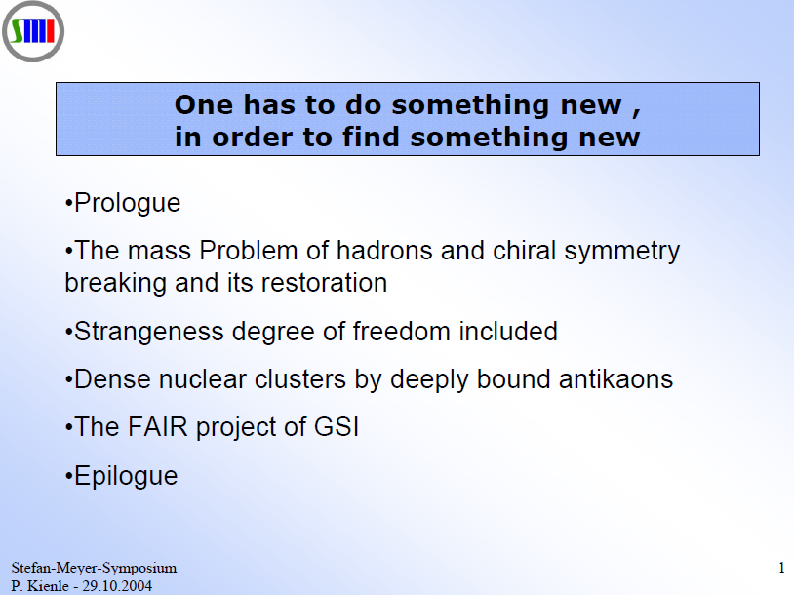

Slide 5

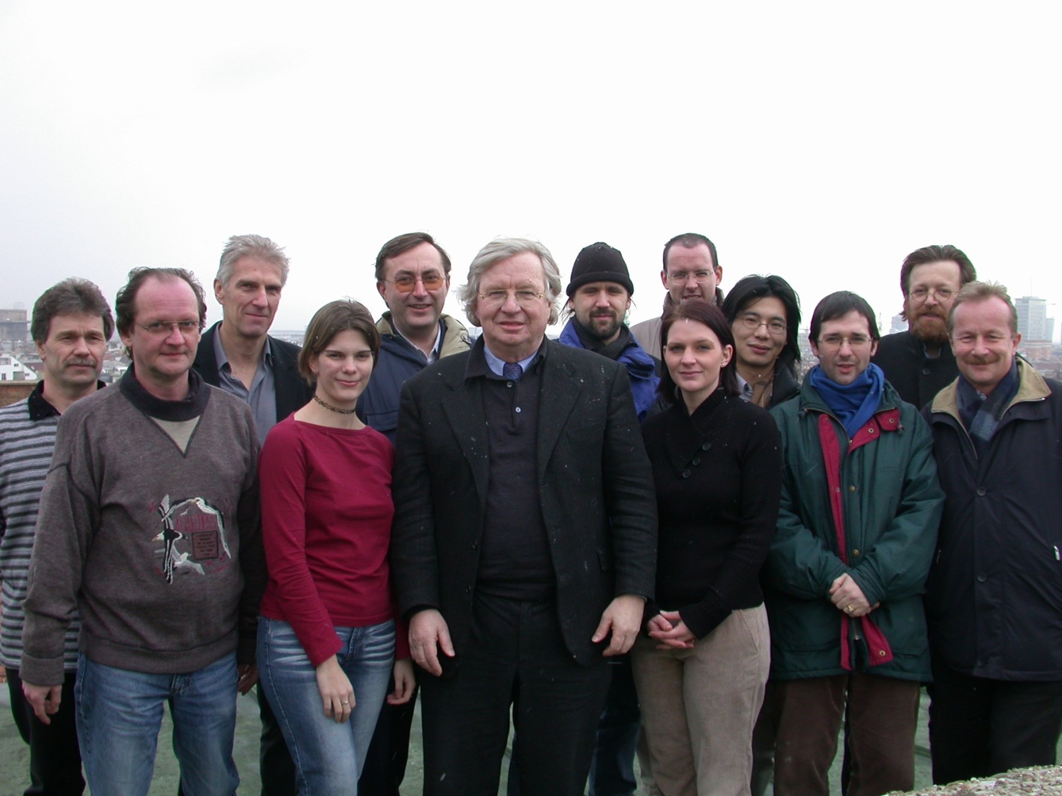

On the roof of SMI - 2004

Slide 6
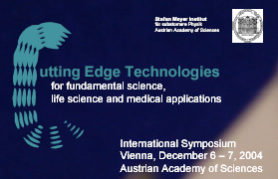

Slide 7
Stefan Meyer Institut
für subatomare Physik
Österreichische Akademie der Wissenschaften
CUTTING EDGE TECHNOLOGIES
for Fundamental Science, Life Science and Medical Applications
Monday Dec. 6, 2004
Titel | Name | Institute
X-ray free electron laser for probing the nano- world on the proper length and time scale | Jochen R. SCHNEIDER | DESY Germany
Particle acceleration with lasers | Dieter HABS | LMU-München Germany
MedAustron | Erich GRIESMAYER | FOTEC Austria
Carbon ion radiotheraby | Dieter SCHARDT | GSI Darmstadt Germany
Dark matter searches with cryogenic detectors | Klaus PRETZL | Univ. Bern Switzerland
Cryogenic calorimeters | Franz von FEILITZSCH | TU-München Germany
Silicon drift detectors for industrial and medical applications | Andreas PAHLKE | KETEK GmbH Germany
Semiconductor drift and pixel detectors for X-ray imaging and spectroscopy | Gerhard LUTZ | MPI-Halbleiterlabor Germany

Slide 8
Stefan Meyer Institut
für subatomare Physik
Österreichische Akademie der Wissenschaften
CUTTING EDGE TECHNOLOGIES
for Fundamental Science, Life Science and Medical Applications
Tuesday Dec. 7, 2004
Titel | Name | Institute
Antiproton Ion Collider | Paul KIENLE | SMI Vienna Austria
Rare-isotope beams – next generation | Hans EMLING | GSI Darmstadt Germany
Physical aspects of protein dynamics | Fritz G. PARAK | TU-München Germany
Polarized He-3 for medical applications | Werner HEIL | Univ. Mainz Germany
Threading ions like pearls on strings - crystalline ion beams | Ulrich SCHRAMM | LMU-München Germany
SNAKE: a superconducting nanoscope for applied nuclear physics experiments | Günther DOLLINGER | TU-München Germany
Gamma tracking detectors | Reiner KRÜCKEN | TU-München Germany
Room temperature detectors for medical applications (CZT) | George BEER | UVic, BC Canada

Slide 9
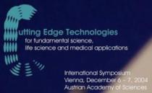
Cutting Edge Technology
  Polarized He-3 for medical applications
  X-ray Free Electron Lasers
  Silicon drift detectors for industrial and
  medical applications
  Semiconductor drift and pixel detectors
  for X-ray imaging and spectroscopy
  Carbon ion radiotheraby
  MedAustron
Notes:
Nochmals auf Programm beziehen, Auswahl

Slide 10
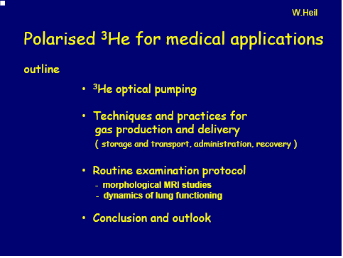
University Mainz, Ecole Normale Superieure Paris

Slide 11
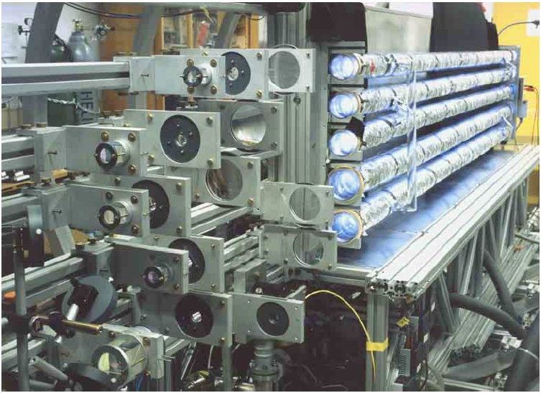
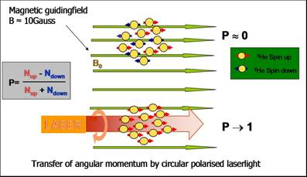
80 bar.liters / day
polarisation > 60%
near-infrared
15 W fibre-laser

Slide 12
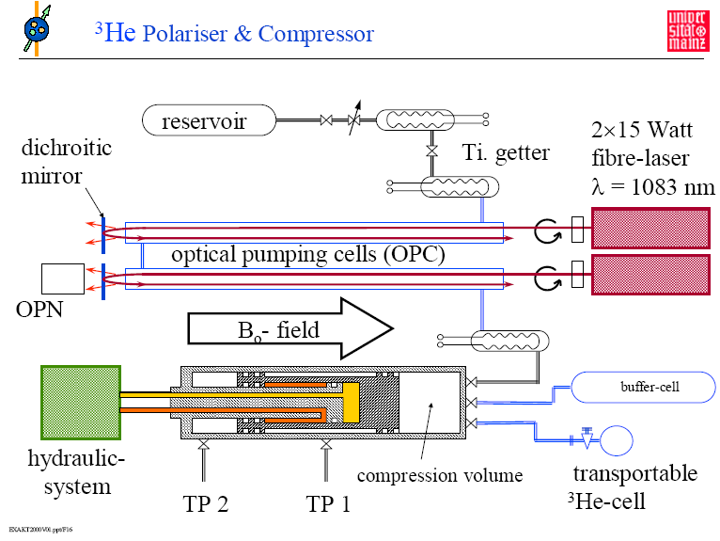

Slide 13
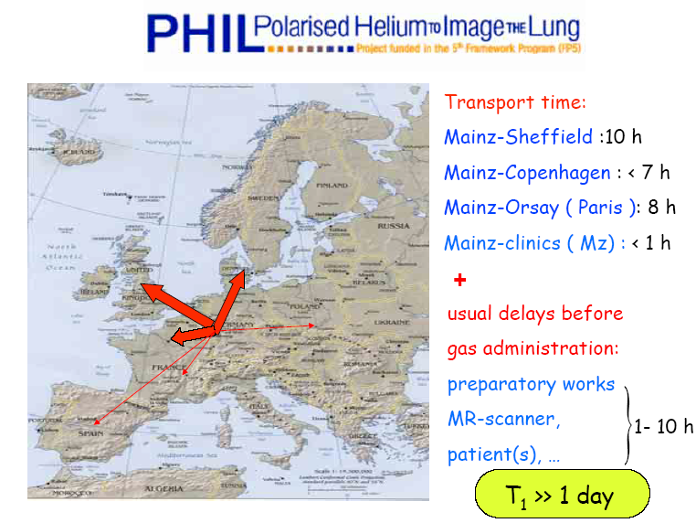

Slide 14
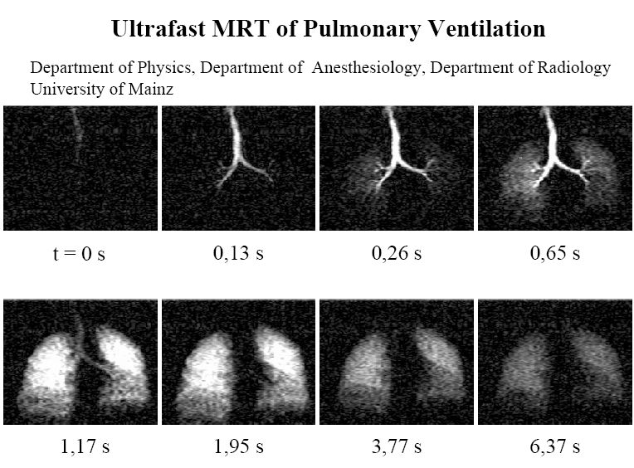
→ 100 times faster
Notes:
Methods: A volunteer inhaled hyperpolarised ³He to fill the lungs, which were imaged with a conventional MRI detector assembly. The nuclear spin polarisation of helium, and other noble gases, can be greatly enhanced by laser optical pumping and is about 10⁵ times larger than the polarisation of water protons. This enormous gain in polarisation easily overcomes the loss in signal due to the lower density of the gas.

Slide 15
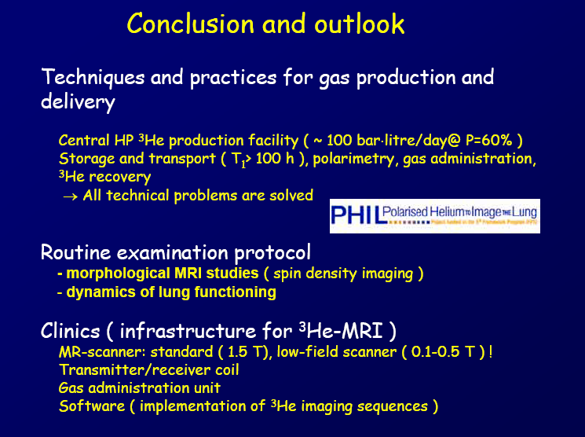

Slide 16
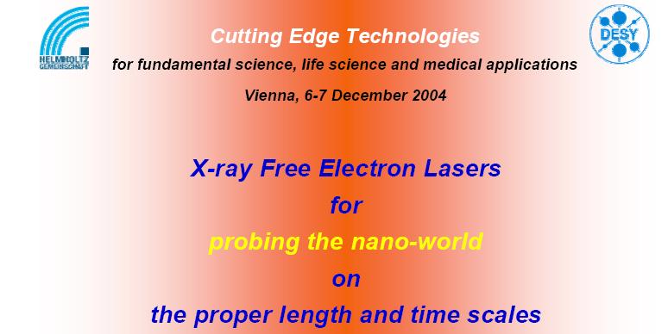
green light for XFEL from the German Government
EU-funding for EUROFEL
9 countries have signed a MoU to build XFEL

Slide 17
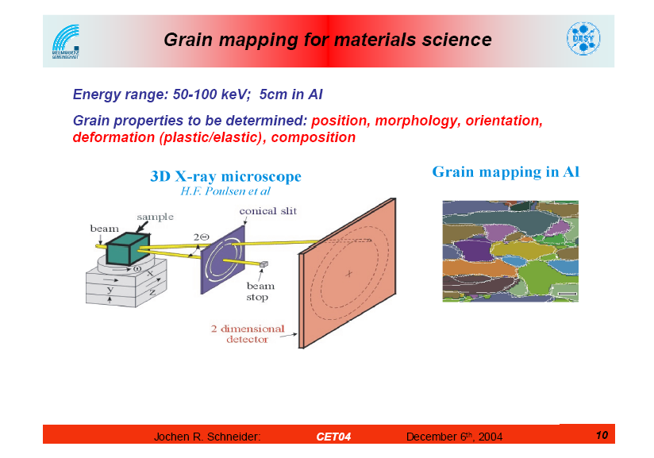

Slide 18
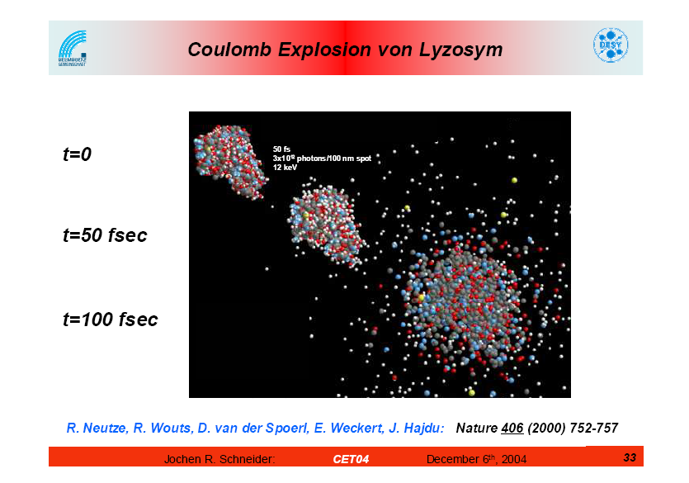

Slide 19
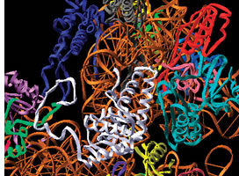
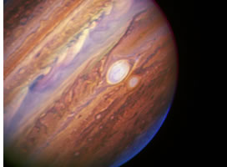
XFEL home page: http://www.xfel.eu/overview
Construction time 2009 – 2015
Operation 2016
Using the X-ray flashes of the European XFEL, scientists can decipher the 3D structure of biomolecules, cell constituents and whole viruses. This will provide the basis for future medicines
The focused X-ray flashes of the European XFEL can create states of matter under extremely high pressures and temperatures. This will help to develop new astrophysical models for planets or push ahead with fusion research for future energy generation here on Earth.

Slide 20
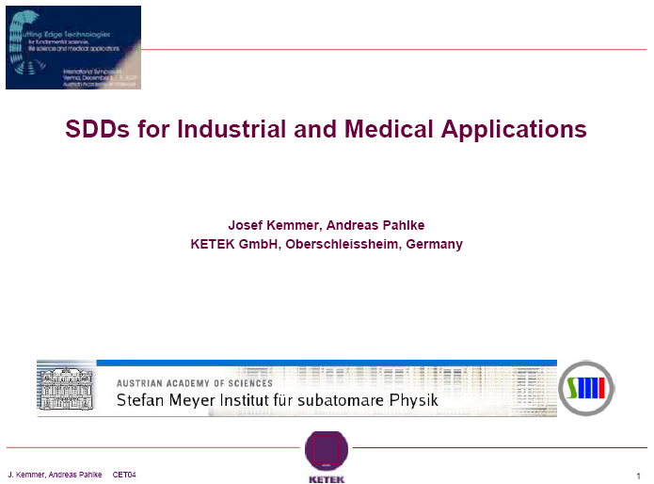

Slide 21
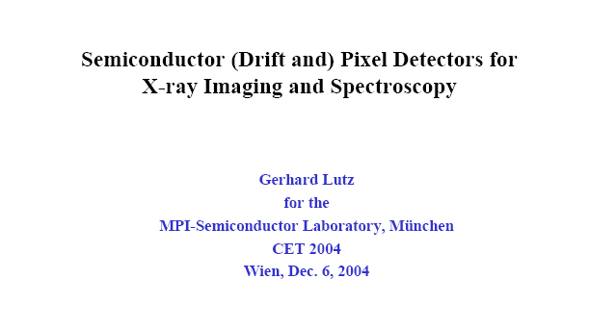
KETEK GmbH
PNSensor

Slide 22
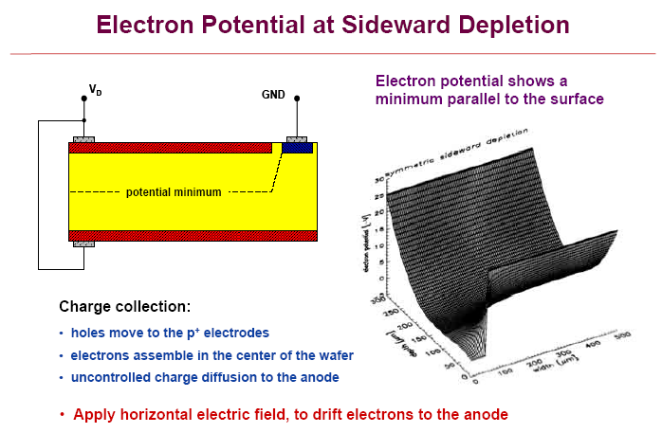

Slide 23
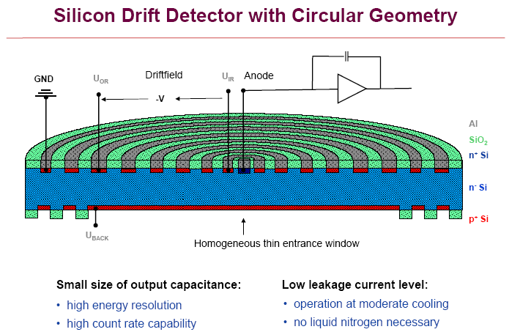

Slide 24
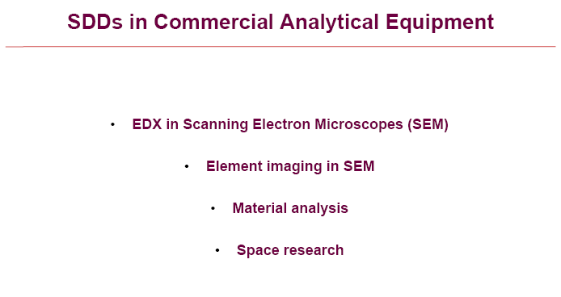


Slide 25
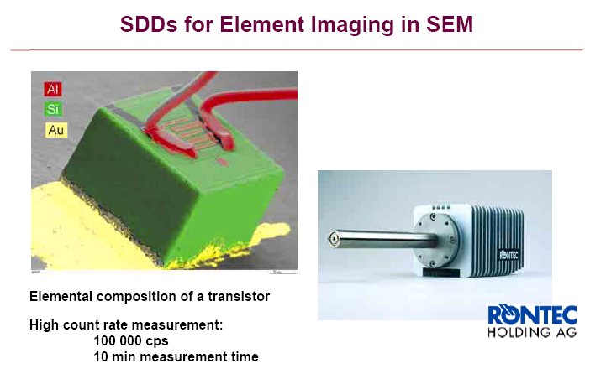

Slide 26


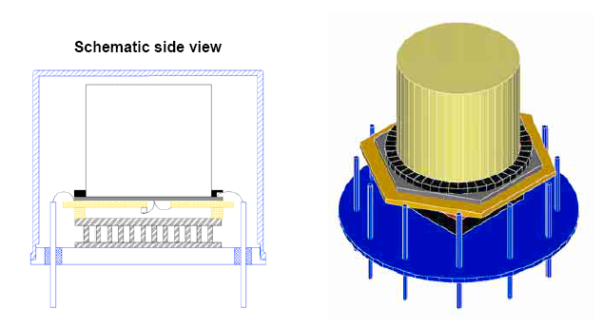

SDD coupled to a CsI-Scintillator: Co-57 (122 keV) → FWHM = 11.7 keV

Slide 27
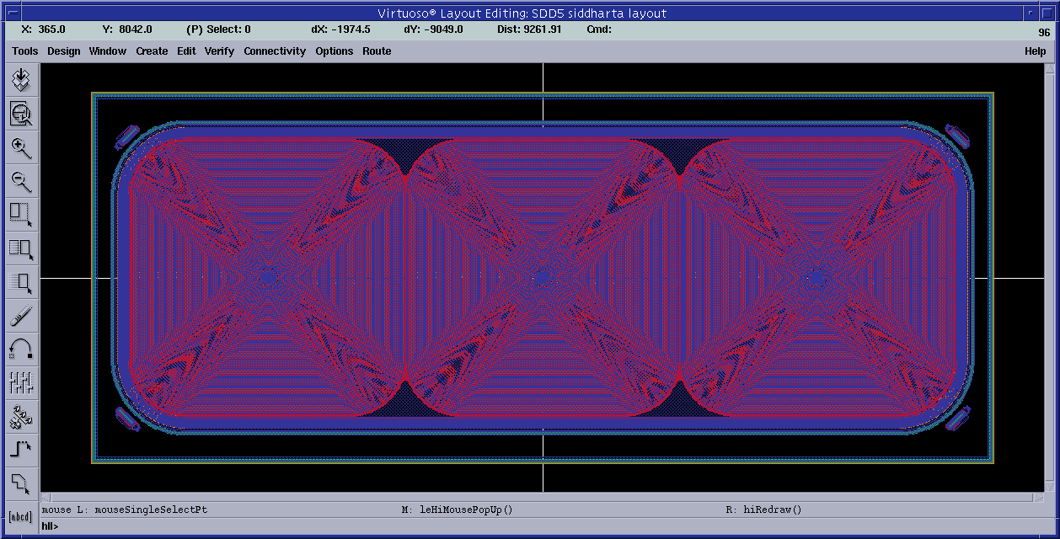


Special chip design and production for SIDDHARTA
LNF, Frascati – Politecnico, Milano – MPI, Munich – SMI, Vienna
→ EU – program: I3-Hadron Physics

Slide 28
Lightweight cryogenic target cell
working T 22 K
working P 1.5 bar
Alu-grid
Side wall:
Kapton 50 µm
Kaon entrance
Window:
Kapton 75 µm

Slide 29
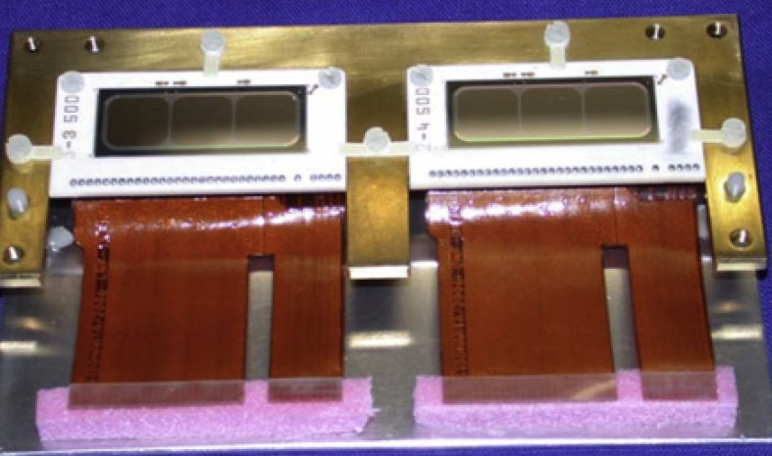
Development of large area SDDs
SDD window frame
(pure Al 99.999%)
flexible Kapton
boards
pre-amplifier
board
HV+LV distribution
board
FP-6 EU programme:
HadronPhysics

Slide 30
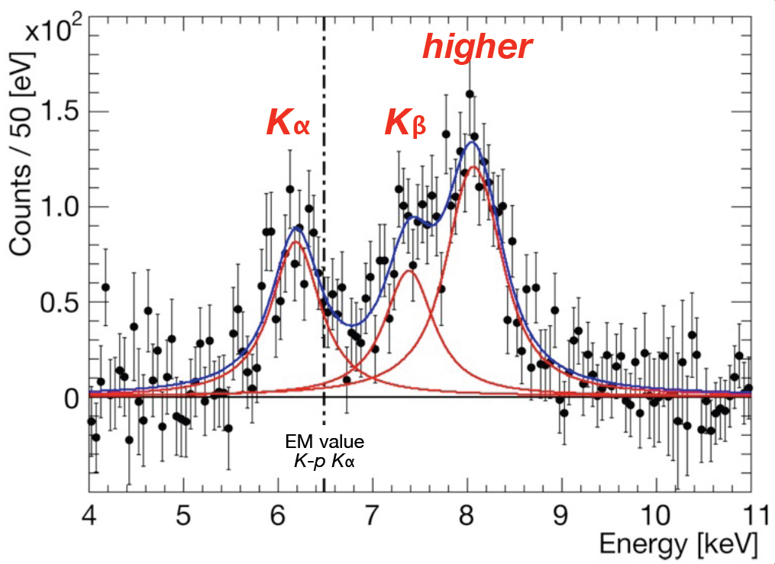
K⁻p spectrum after BG subtraction

Slide 31
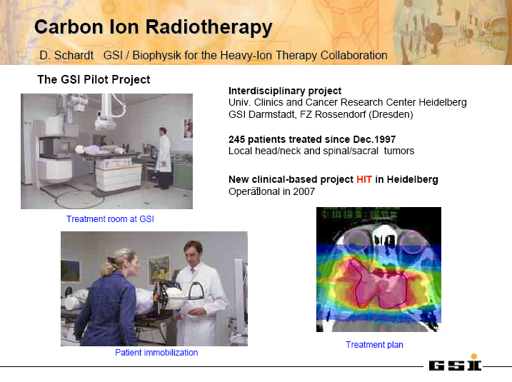

Slide 32
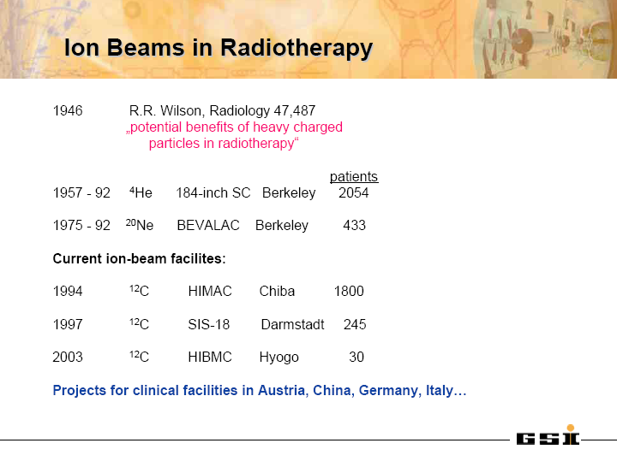

Slide 33
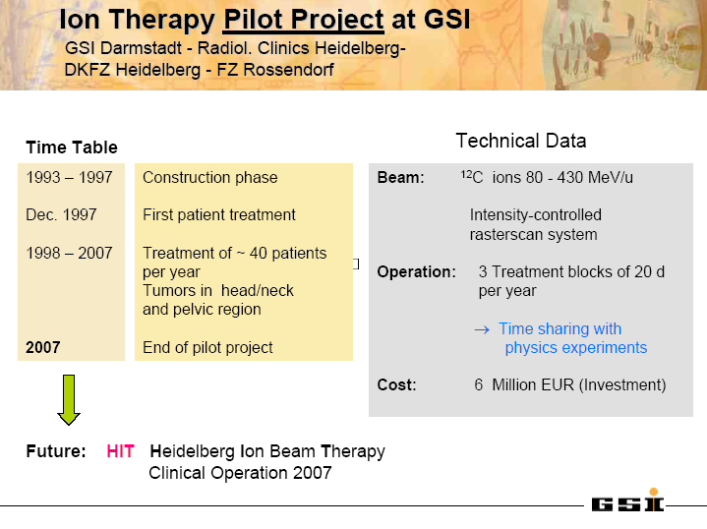

Slide 34
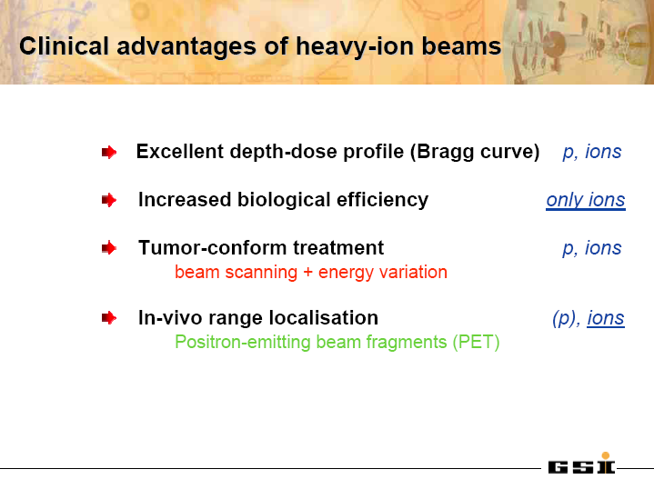

Slide 35
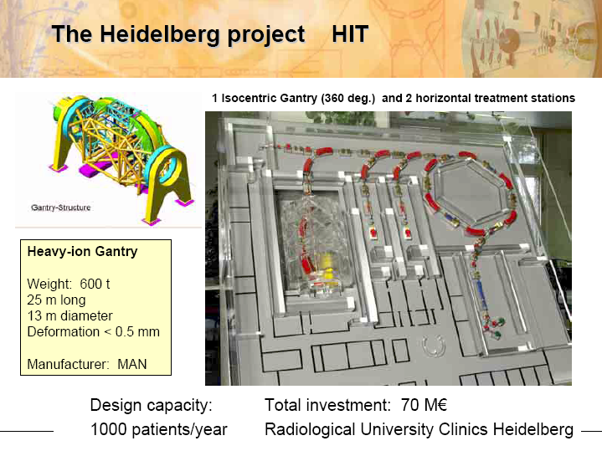

Slide 36
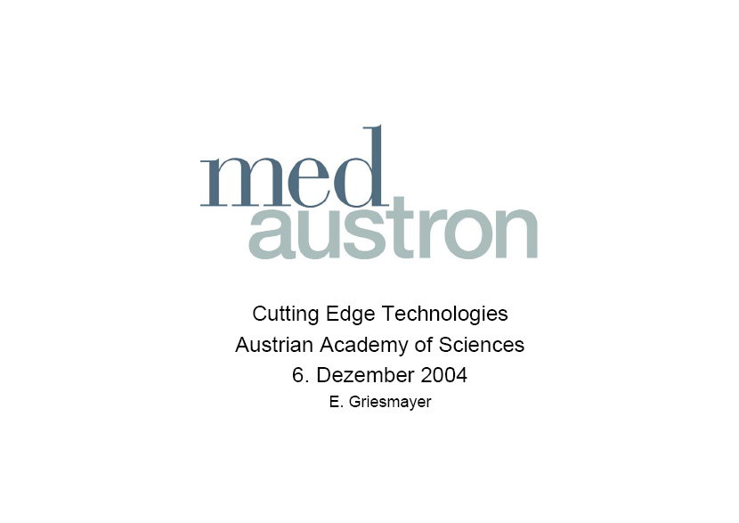

Slide 37

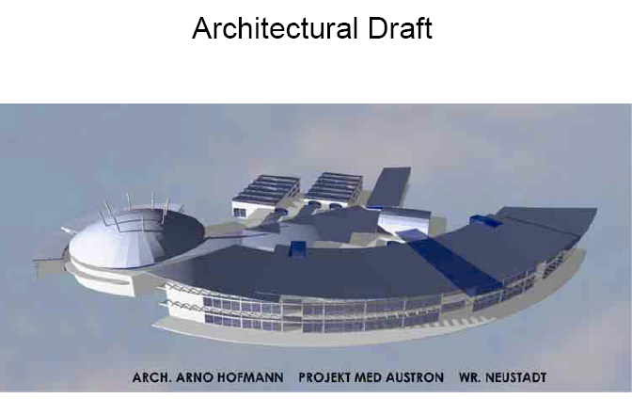

Slide 38
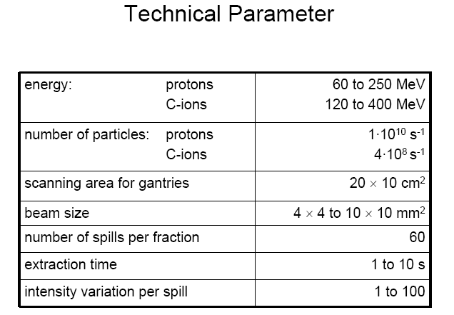

Slide 39
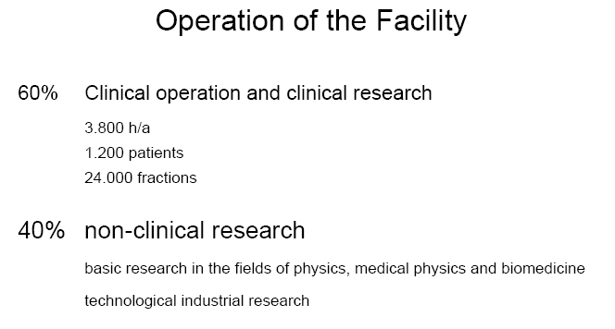

Slide 40
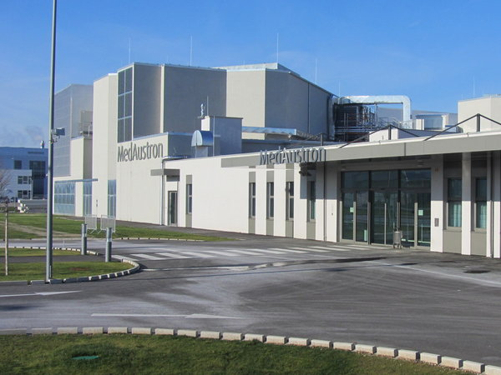
Building finished 2012

Slide 41
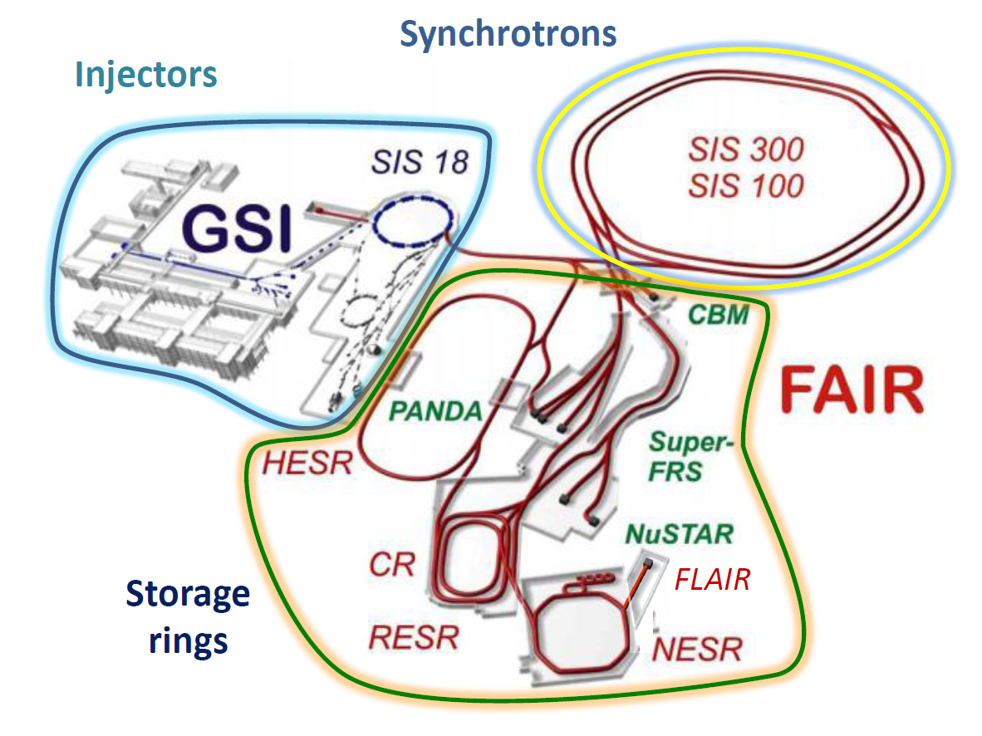
Facility for Antiproton and Ion Research

Slide 42
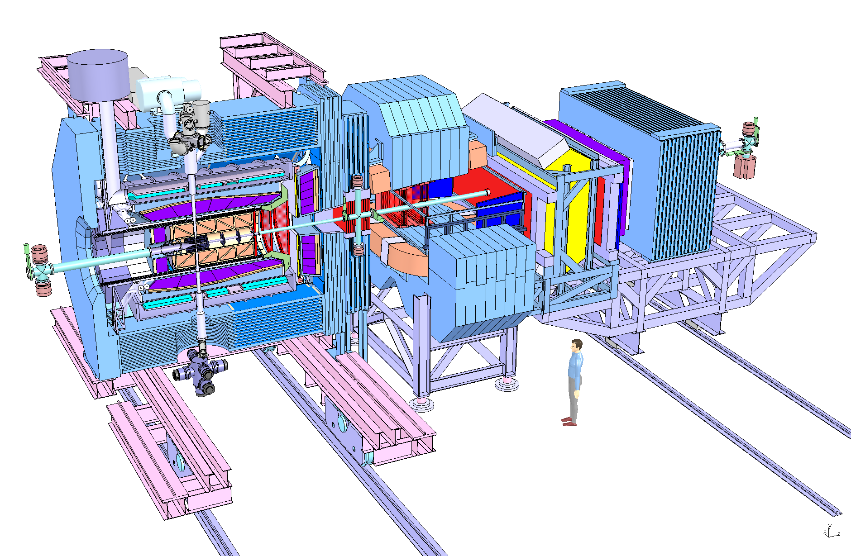
The PANDA Spectrometer
TARGET SPECTROMETER
FORWARD SPECTROMETER
Target
Dipole
Drift Chambers
Solenoid
Muon ID
Muon
Range System
DIRC
Electromag. Calorimeters
RICH
Central Tracker
Vertex
L. Schmitt, GSI

Slide 43
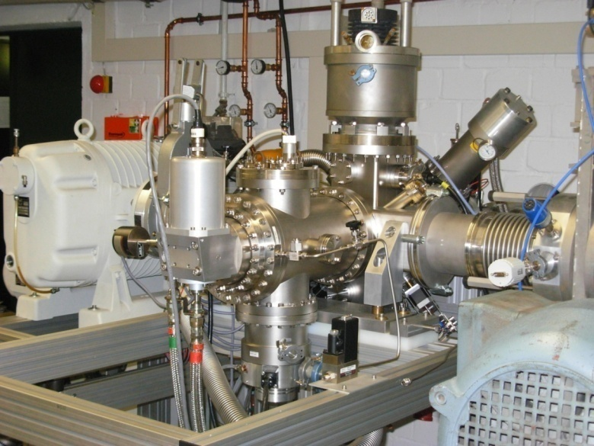
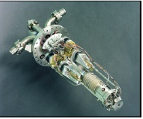
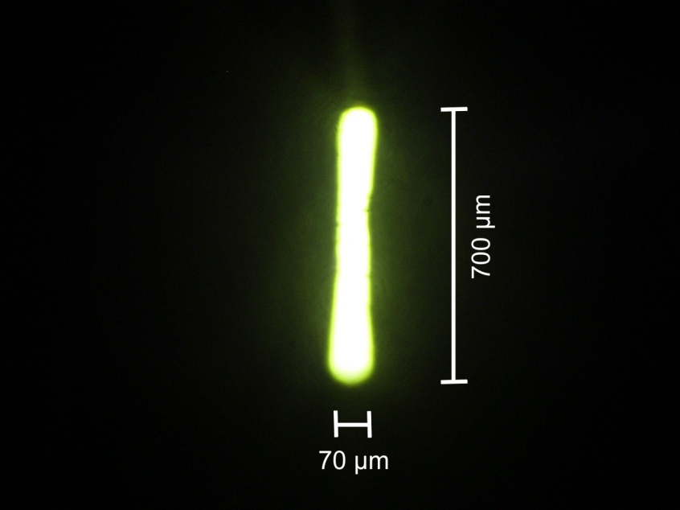
PANDA – Cluster-jet target system
  Cluster-jet target
Well adjustable density
Constant luminosity
Cluster size:
100 ... 1000 atoms
  Full-size prototype
    Achieved density:
    max. 8 × 10¹⁴ atoms / cm²
    Stable operation
    Further density increase: New nozzle design

Slide 44
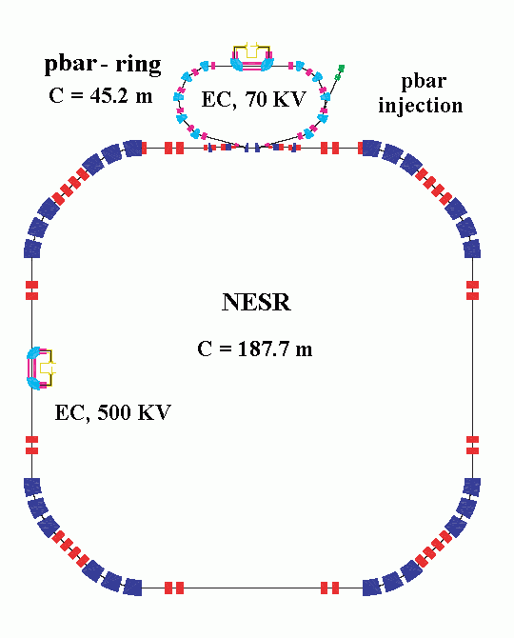
Antiproton-Ion-Collider
A Tool for the measurement of both
neutron and proton rms radii
P. Kienle, SMI Wien and TU-München
AIC Conceptual
Design

Slide 45
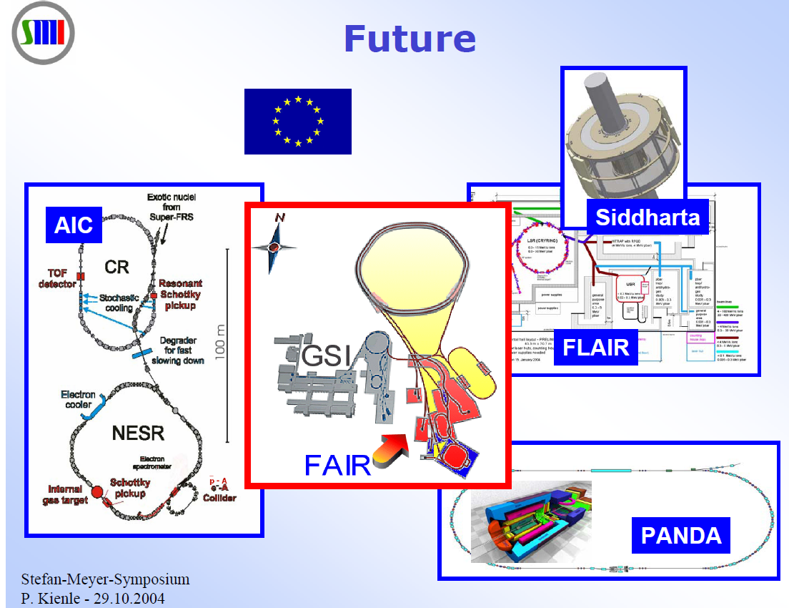

Slide 46
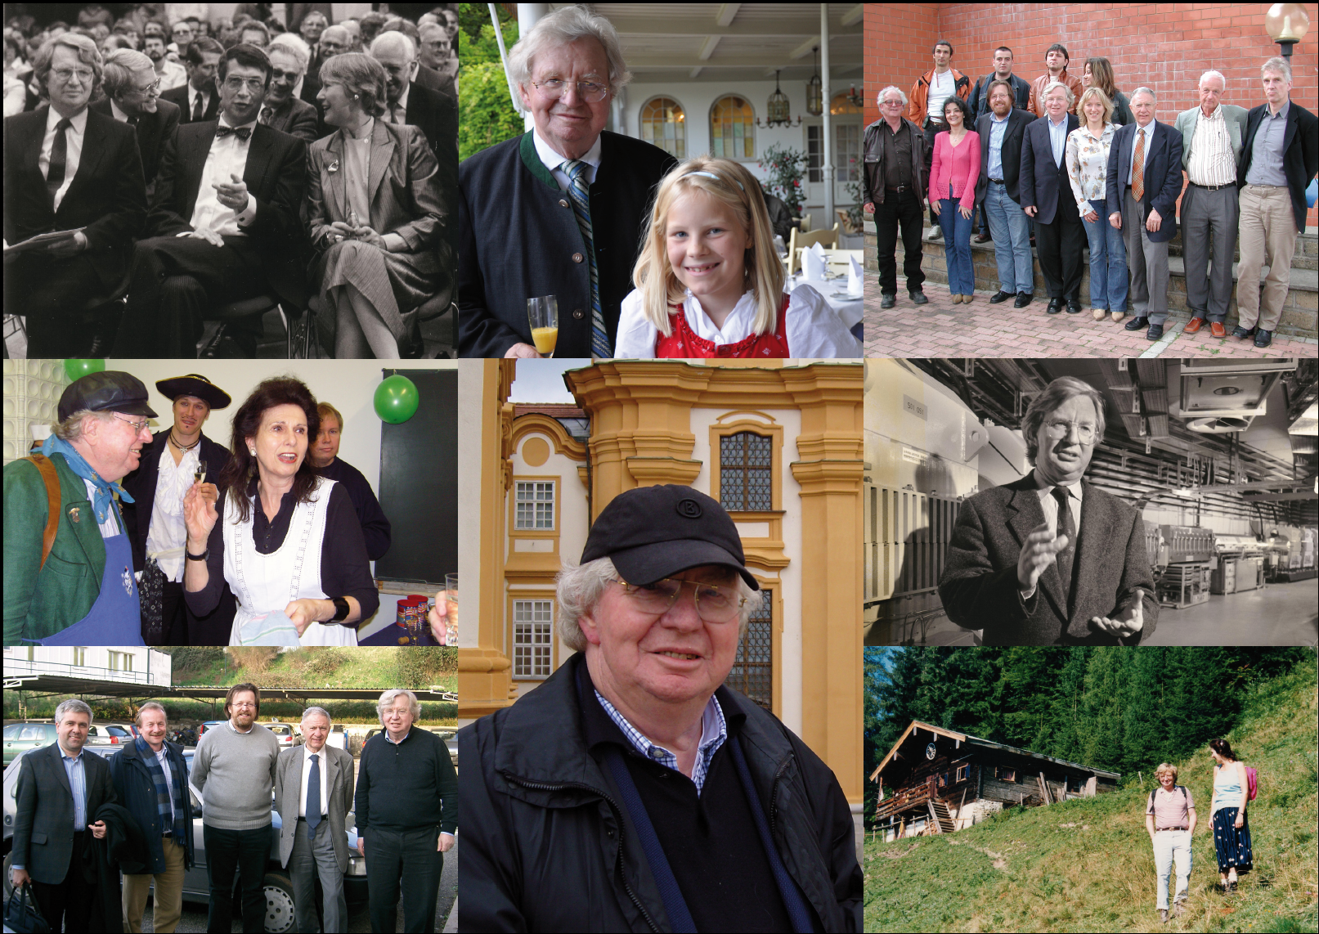
Thank you!
Notes:
Minister for Research: Heinz Riesenhuber
Direktor GSI: 1984 - 1992

