Slide 1
Status report
Carla Distefano
LNS, 29 Maggio 2013

Slide 2
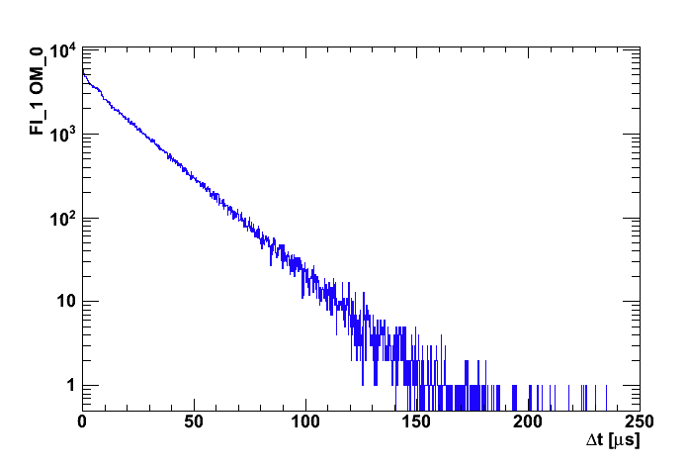
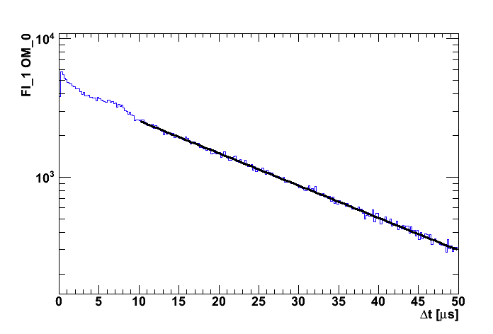
PMT Rates: 1st method
PMT rates from PT files:
Random Trigger (RT) events used: every second, 1 ms of “raw data” is registered.
Evaluation from the time interval distribution of subsequent hits on OMs → exponential fit.
If Poissonian distribution dN/dt = A e^{-Δt/τ}, where 1/τ = Mean Rate frequency (baseline).
Run 412 File 0, file duration ~2h43m.
9770 RT events taken, equivalent live-time 9.8 seconds.
dN/dt = A e-^{Δt/τ}
1/τ = -53.7±0.2 kHz
Floor 1 OM 0
AfterPulses
type-II
T. Chiarusi , S. Biagi

Slide 3
Mean Rates: Summary Table
Run 412 File 0, file duration ~2h43m.
T. Chiarusi , S. Biagi

Slide 4
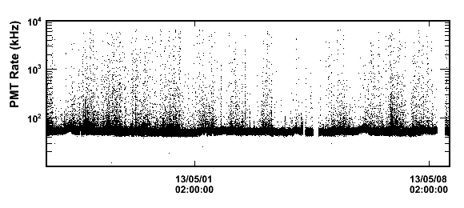
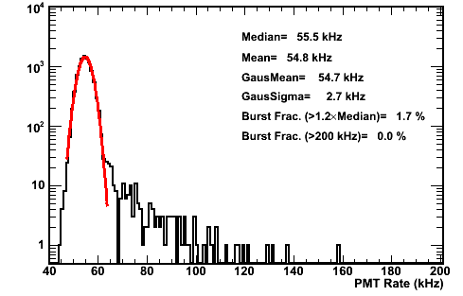
PMT Rates: 2nd method
PMT rates from the Slow Control:
From the FEM: data are sampled once per second and the rate is measured in a time window Δt=10ms.
The DM writes the rates in the DB with a threshold of 2kHz missing data are reconstructed during the analysis
Use the code TestSite to evaluate baseline (peak of the Gaussian) and burst fraction
For a comparison:
Used data reordered between the StartFile and the StopFile of PT file: Run 412 File 0
Start: 27/04/2013 01:34:28
Stop: 27/04/2013 04:17:19
File duration ~2h43m.
M.G. Pellegriti

Slide 5
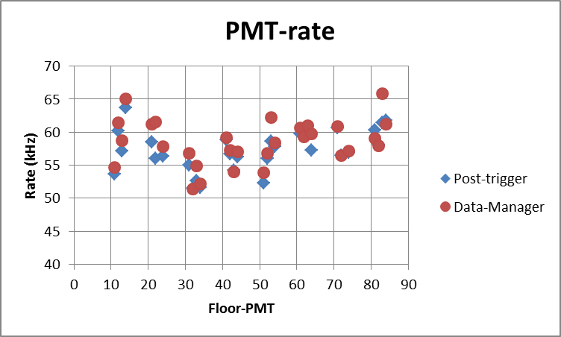
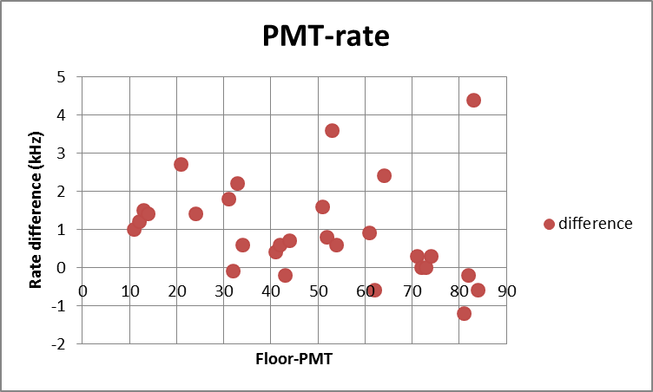
DM-PT
M.G. Pellegriti

Slide 6
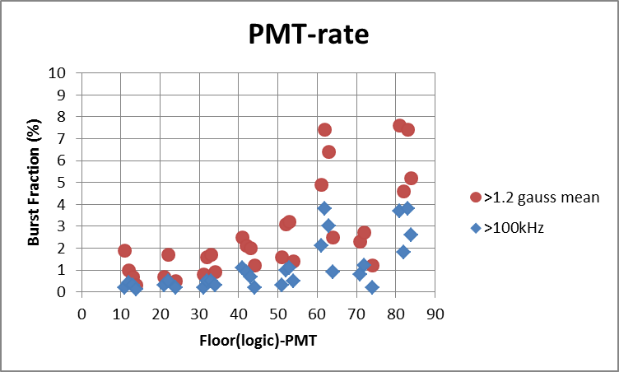
Burst fraction: Correlation with Floors
M.G. Pellegriti

Slide 7
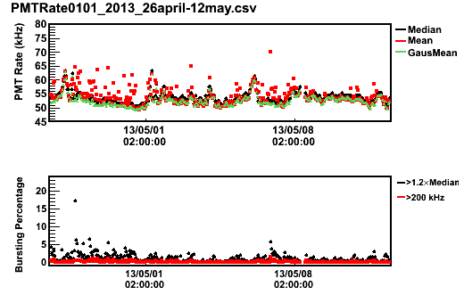
Time variations
Fixing the time window (1h, 0.5h…)
same analysis for each data point (median value, gaussian mean value, mean value, bursting fraction)
1h time window
Median and Gaussian mean have very similar behaviour
Mean values keep information of the burst
Now:
1.2xGausMean
>100 kHz
M.G. Pellegriti

Slide 8
Effects of the time window on the baseline stability
M.G. Pellegriti

Slide 9
Baseline rates per hour
M.G. Pellegriti

Slide 10
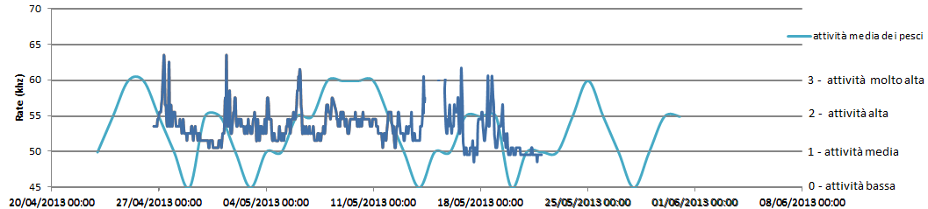
PMT1-Floor1, step=1h
M.G. Pellegriti

Slide 11
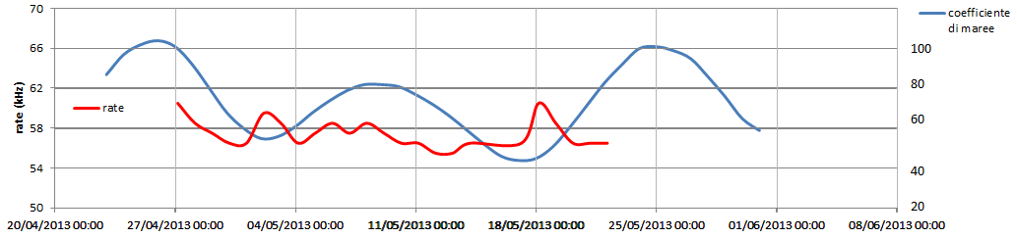
PMT1-Floor4, step=24h
M.G. Pellegriti

Slide 12
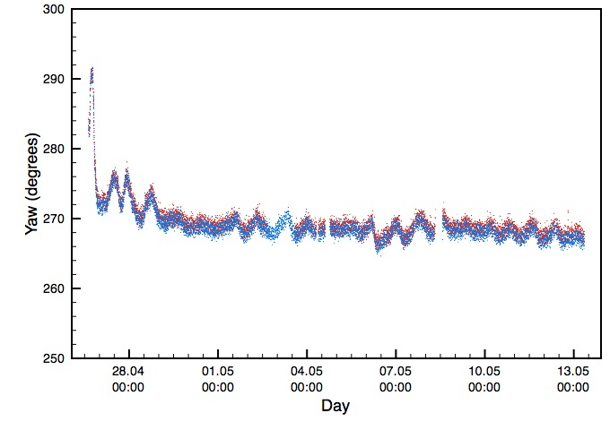
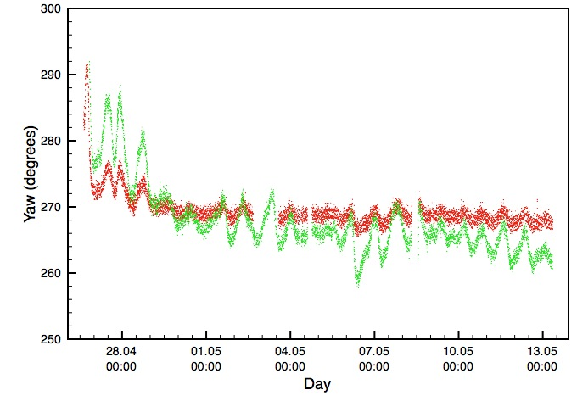
Compass
All compasses are working
The DM writes the data in the DB with a threshold of 1° (probably too high)
Dati raw del compass come estratti dal database
Non c’è calibrazione
Possibili solo confronti relativi tra i vari piani
Periodo ≈ 19 h ≈ 12 h / sin(LAT)
Piano 1
Piano 7
Piano 1
Piano 5
Tutti i piani sono sovrapponibili…
… tranne il quinto
P. Piattelli

Slide 13
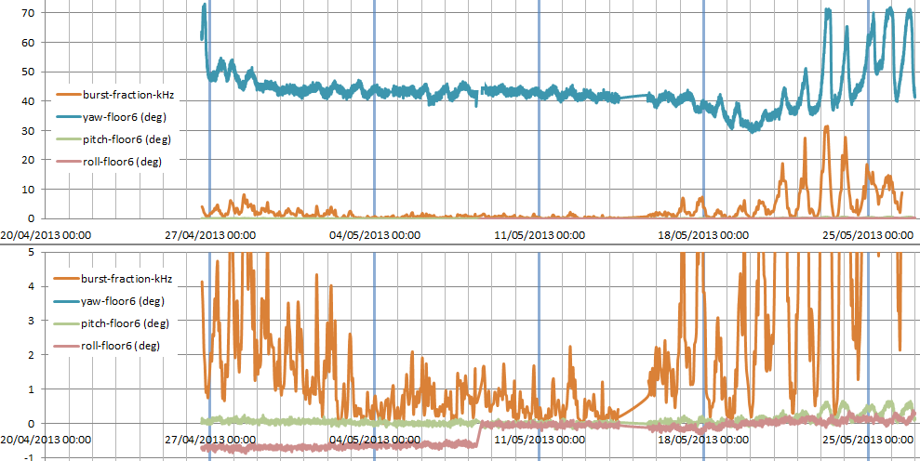
Long term analysis: Rate & Compass
Waiting for data from CTDs and DCS!!!!
M.G. Pellegriti

Slide 14
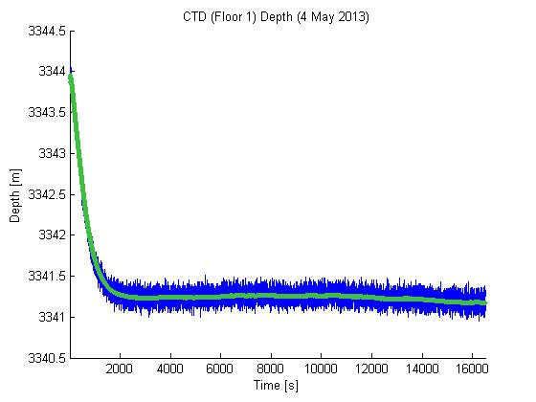
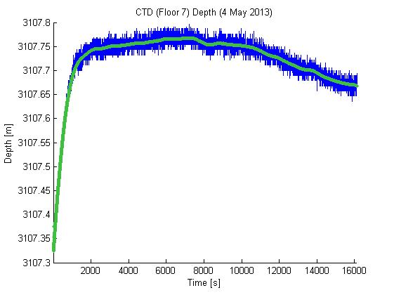
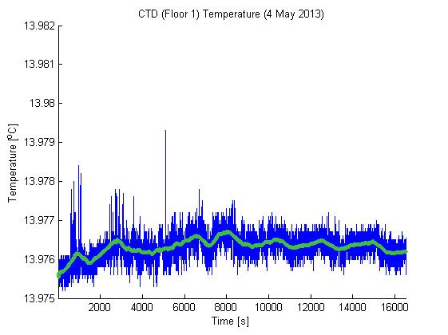
CTD
“I CTD mostrano un evidente transitorio iniziale, di ampiezza contenuta, che termina in circa 30 minuti; i dati, sia di profondità che di temperatura, sono ragionevoli e stabili.” (from eLog #474)
Si sta lavorando al DM per la gestione e il salvataggio dei dati sul DB (presentazione di A. Rovelli)
CTD - Floor 1
Dati
Media mobile (600s)
F. Simeone, F. Ameli, R. Masullo
plot for CTD – Floor 7 in eLog #474

Slide 15
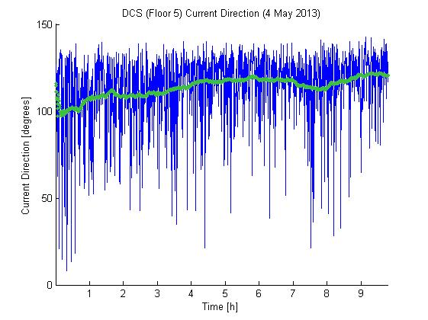
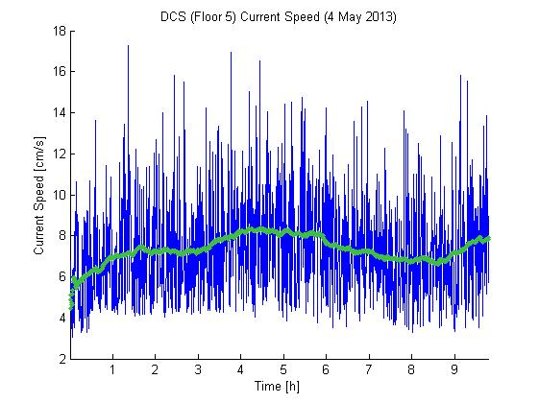
DCS
“Il DCS mostra un'intensità della corrente fortemente variabile, con la media mobile compresa tra 6 e 8 cm/s, sensibilmente superiore alle attese.
Potrebbe essere necessario variare i parametri di acquisizione dello strumento per aumentare la qualità e la stabilità della misura.”
(from eLog #474)
Dati
Media mobile (1 hr)
DCS - Floor 5
F. Simeone, F. Ameli, R. Masullo

Slide 16
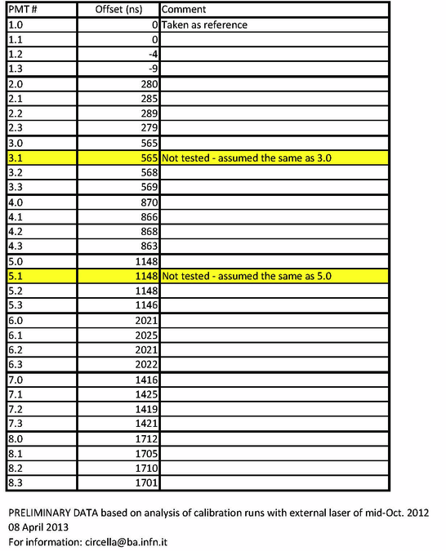
Check of the time calibration
Distribution of time differences between hits on adjacent OMs:
Looking for K40 coincidences to check the time calibration
eLog #222

Slide 17
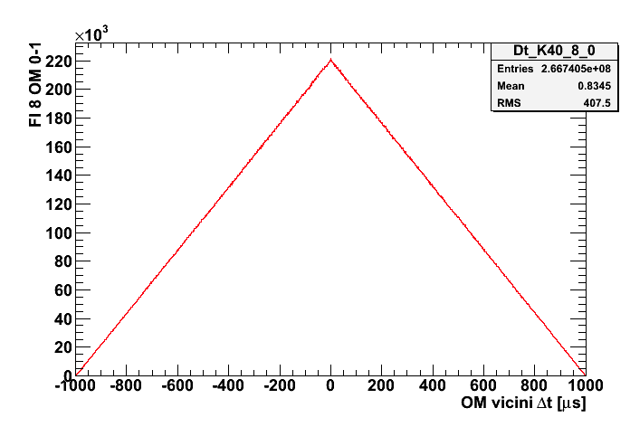
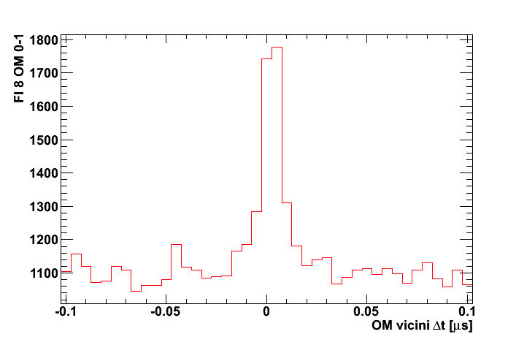
Run 489 (files 0-4), run 491 (files 0-3), run 499 (files 0-1), file duration ~28h.
(Random Trigger events: equivalent live-time ~100 seconds).
If hit times on close OMs are uncorrelated, a triangular distribution is
expected for time differences
Floor 8 OM 0-OM 1
Zooming in, a peak at around zero is seen: evidence of K40 coincidences
It should be peaked at zero, cross check for time calibrations!
T. Chiarusi , S. Biagi

Slide 18
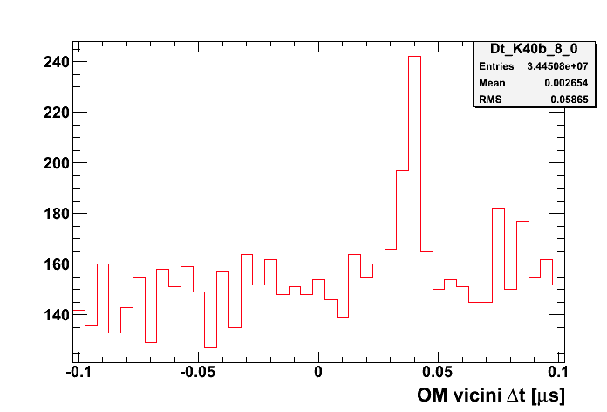
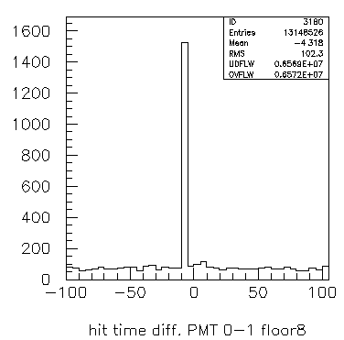
K40 coincidences:
two different analysis with different results (analysis meeting, 16 May 2013)
S. Biagi and T. Chiarusi:
A posteriori time calibrations wrongly applied in the past: bug solved!
Analysis repeated without time offsets.
Time resolution is 5 ns and the majority of time corrections (close OMs) is ⩽5ns → compatible with peaks at zero.
EFCM 8
OM 0-OM 1
T. Chiarusi , S. Biagi
A. Capone
See the slides in the wiki page

Slide 19
T. Chiarusi , S. Biagi

Slide 20
T. Chiarusi , S. Biagi

Slide 21
T. Chiarusi , S. Biagi

Slide 22
T. Chiarusi , S. Biagi

Slide 23
Hit “decompression”
PMT signal is sampled by using two 8 bits ADCs (ADC-A, ADC-B), with 100 MHz samplings, and sampling times “staggered” by 5 ns.
In order to increase the ADC input “dynamics” the PMT signal is “compressed” with a quasi-logarithmic law:
  low voltage signals are sampled with high accuracy (up to few s.p.e.)
  high voltage signals are sampled with lower accuracy.
As a consequence:
  the real PMT’s pulse can be obtained only “inverting” the compression law (i.e. converting ADC-channels into Charge)
  the conversion law must be known for each ADC (A and B) and for each “working Temperature”.
The “Electronics group” (F. Ameli, C.A. Nicolau, F. Simeone) is working to provide the “decompression” tables: one table for each FEM as a function of PedA, PedB and Temp.
After the hit “decompression”, we will get the wave form and then the charge and the time with a better resolution (by interpolation).

Slide 24
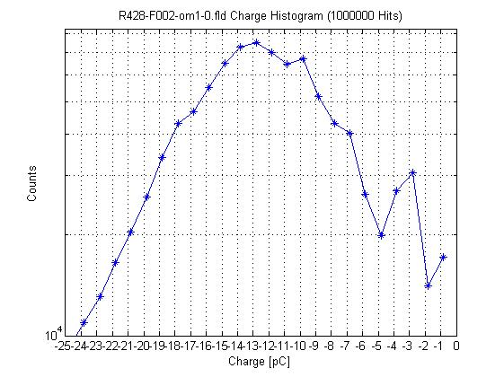
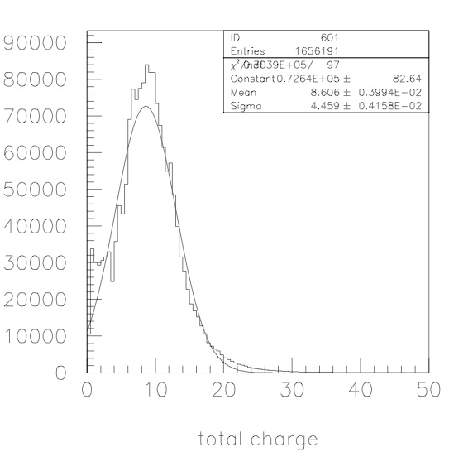
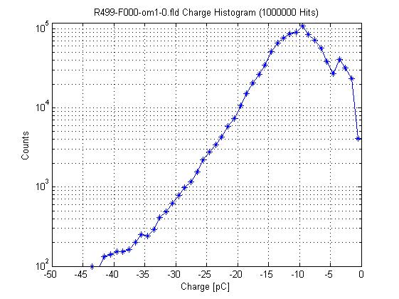
Setting of the PMTs HV
8 Maggio 2012: Sono state modificate le tensioni applicate ai PMT.
Target: uniformare i gain di tutti i PMT con un picco di s.p.e. a 8pC (necessaria la decompressione!!!!).
Vicini al target ma necessario un ulteriore intervento -> verrà fatto nei prossimi due giorni (S. Aiello, F. Ameli, C. Nicolau @CP)
before
after
F. Ameli (see also eLog #431 e #453)
A. Capone (see the wikipage)

Slide 25
Acoustic positioning system
Positioning Matlab code:
Input
- Beacons positions
- TOAs
Depth Floor 1, Depth Floor 7 (incosistency with FUGRO data ?)
Distances between hydrophones in the same floor
Sound velocity
The code finds iteratively a root (zero) of a system of nonlinear equations.
Initial guess:
[Towerbase Easting, Towerbase Northing, Expected depth]
S. Viola

Slide 26
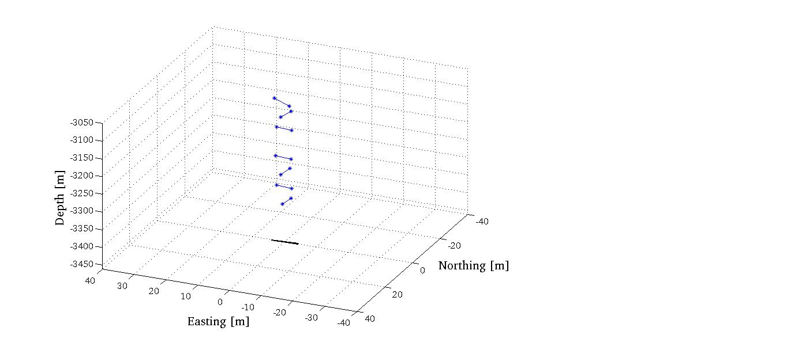
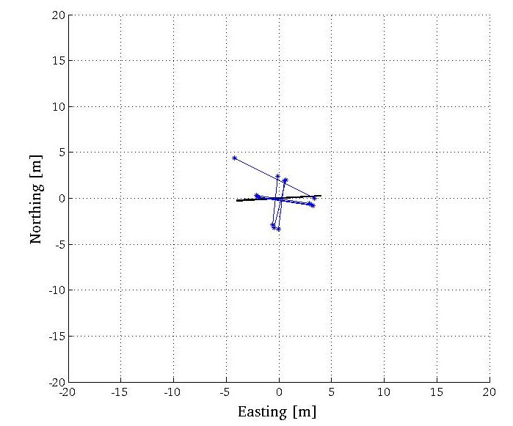
Acoustic positioning system
07/05/2013
00:00 UTC
In progress: writing the algorithm to find the PMT positions → detector geometry files
S. Viola

