Slide 1
DarkSide-50 status report
Consiglio di sezione Milano 21 May 2013
Gioacchino Ranucci

Slide 2
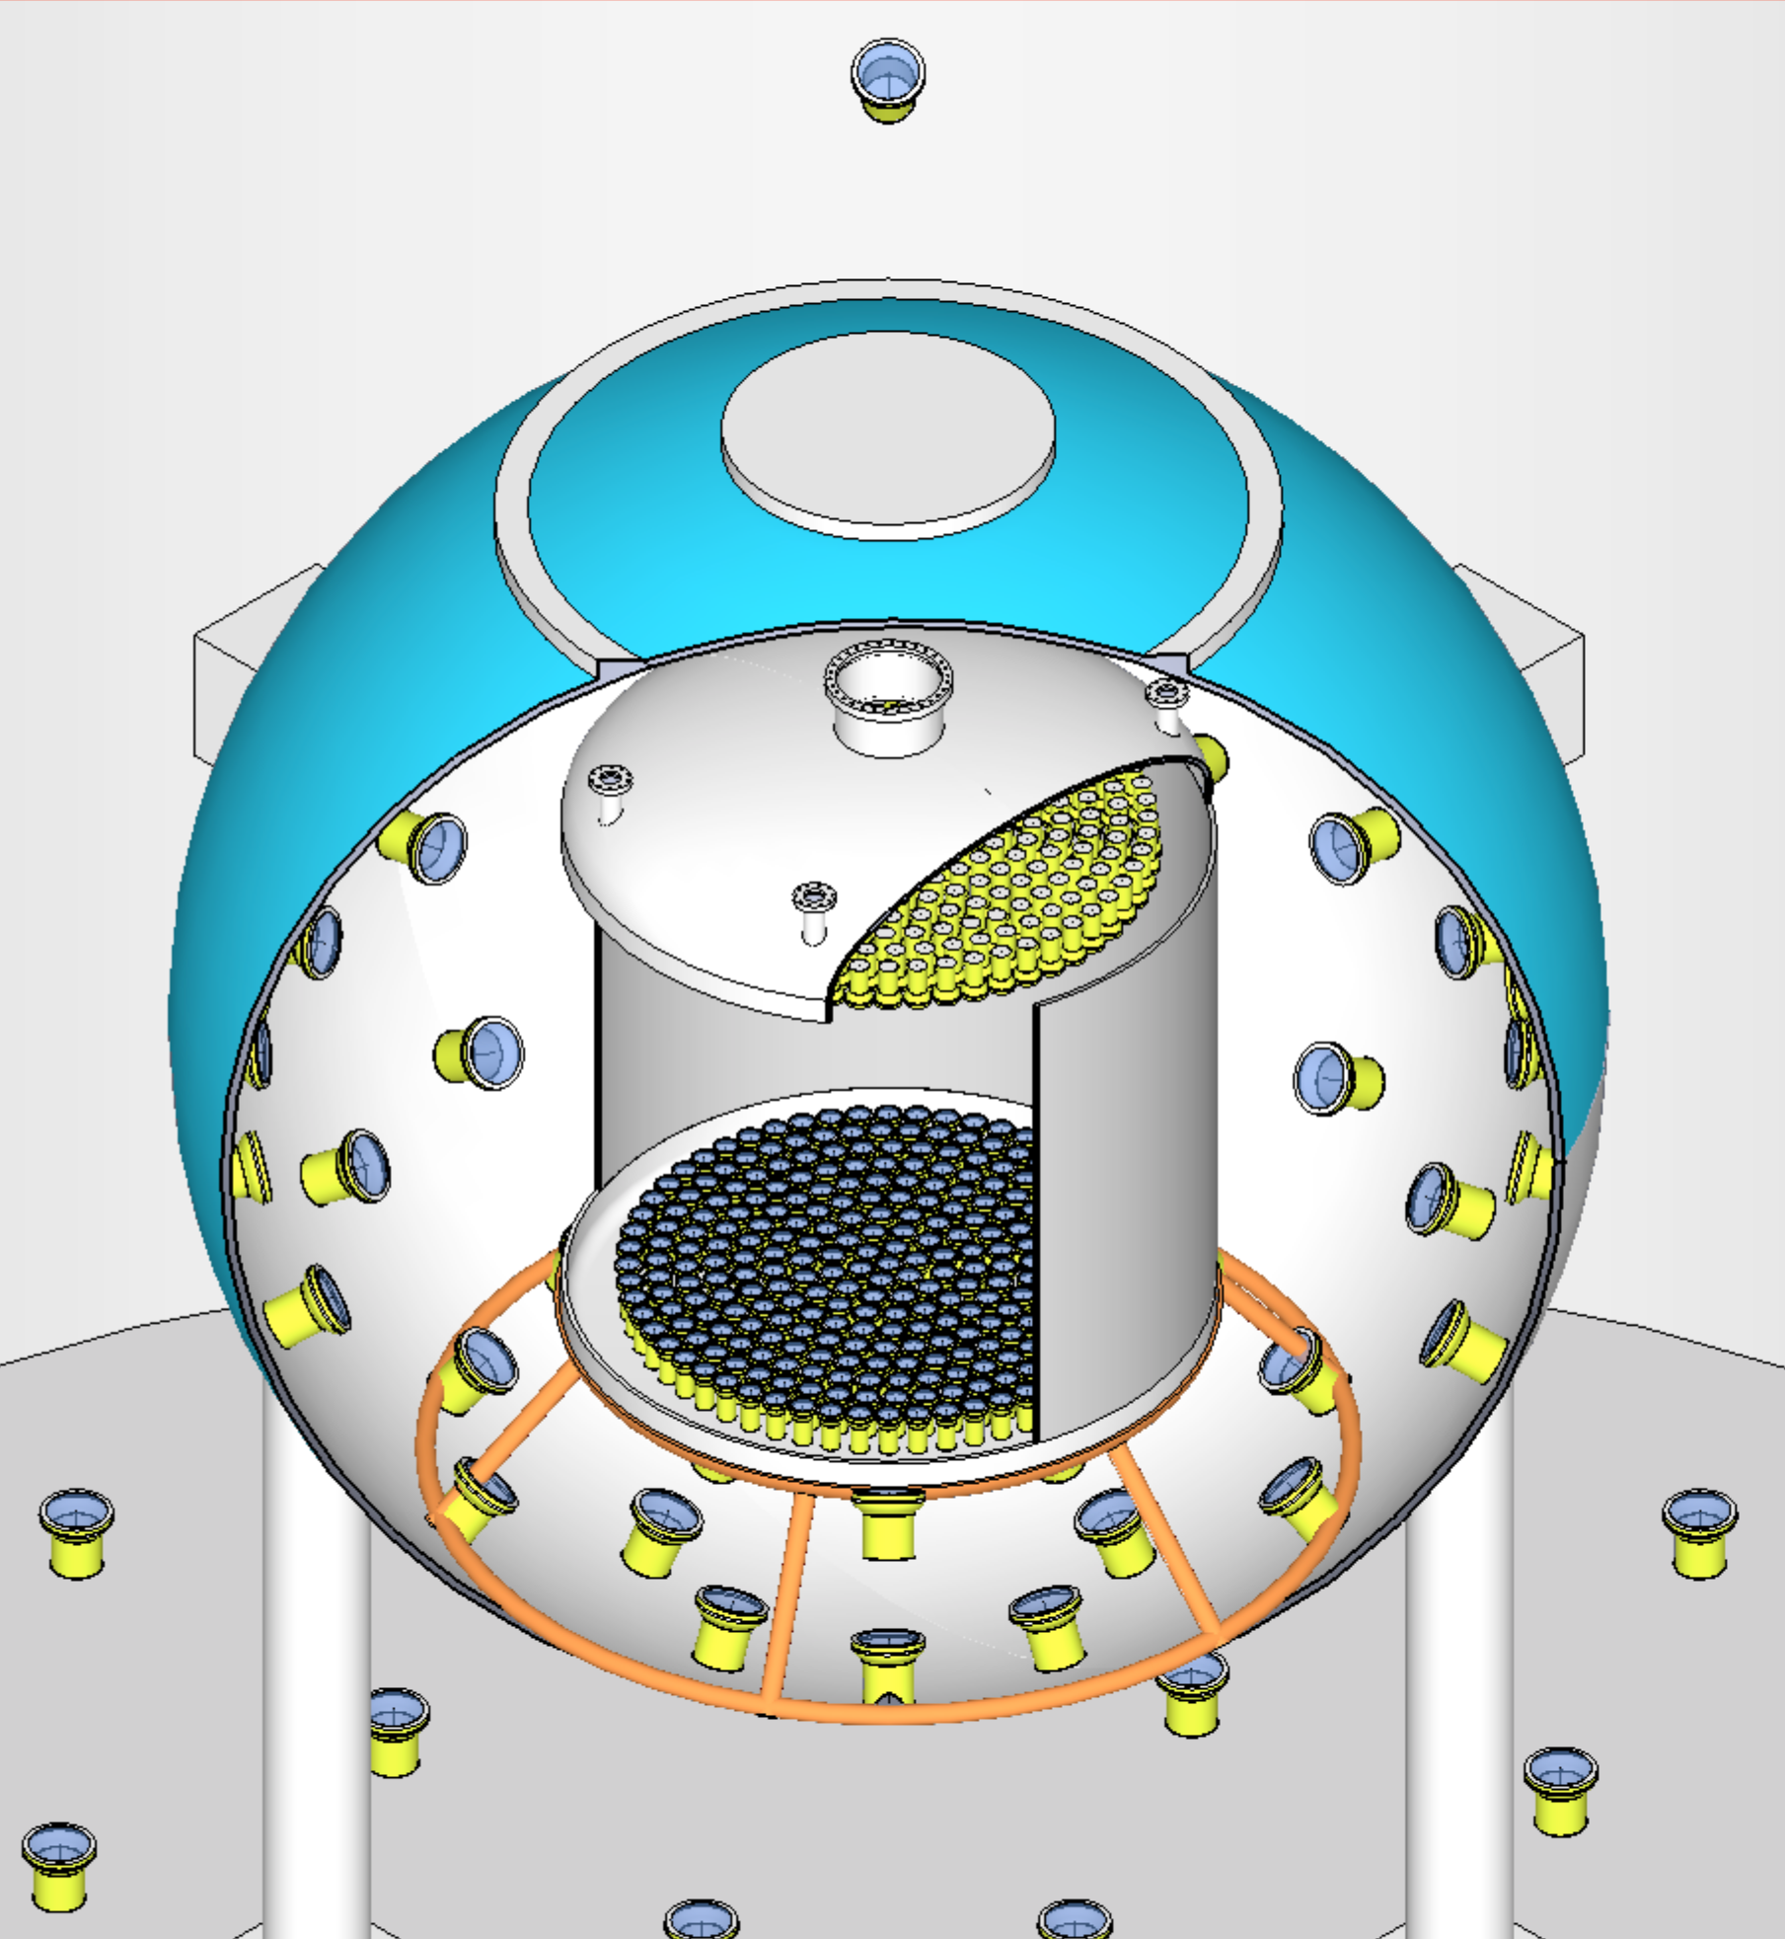
DarkSide Collaboration
Augustana College, USA
APC Paris, France
Black Hills State University, USA
Fermilab, USA
IHEP, China
INFN Laboratori Nazionali del Gran Sasso, Italy
INFN and Università degli Studi Genova, Italy
INFN and Università degli Studi Milano, Italy
INFN and Università degli Studi Napoli, Italy
INFN and Università degli Studi Perugia, Italy
INFN and Università degli Studi Roma 3, Italy
IPHC Strasbourg, France
Jagiellonian University, Poland
Joint Institute for Nuclear Research, Russia
Princeton University, USA
RRC Kurchatov Institute, Russia
SLAC, USA
St. Petersburg Nuclear Physics Institute, Russia
Moscow University, Russia
Institute for Theoretical and Experimental Physics, Russia
Institute of Nuclear Research, Ukraine
Temple University, USA
University College London, UK
University of Arkansas, USA
University of California at Los Angeles, USA
University of Chicago, USA
University of Hawaii, USA
University of Houston, USA
University of Massachusetts at Amherst, USA
Virginia Tech, USA
University of Virginia, USA
Notes:
The DarkSide collaboration comprises 10 institutions, 9 US universities and 1 US National Lab, Fermilab.

Slide 3
General framework
After the end of the full approval process, the preparation and installation activities of the detector progressed at “full steam”
While each group maintained its specific responsibilites for the realization of the various subsystems, the group acted as a unique entity for the management of the underground works, under a centralized top-down organization scheme (already illustrated to the Commettee and borrowed from the Borexino experience)
Over the past months the preparation of the various subsystems went ahead significantly (PMT’s, Electronics, parts of the TPC, cryostat, argon procurement)
Meanwhile important installation and integration jobs have been completed underground: Clean rooms, cryogenic system installation, TMB delivery, cleaning and preparation of the SSS for subsequent installations, neutron veto PMT’s installatoion
The integration of the TPC is in progress since a couple of weeks-just completed
I report here the status of each subsystem preparation and of the overall system integration underground

Slide 4
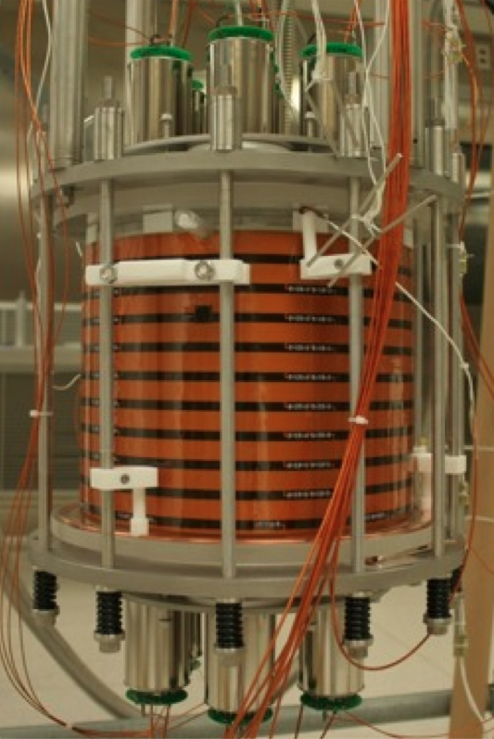
DarkSide 10
7x 3” PMTs
TPB + ITO coated quartz window
Acrylic cylinder with TPB-coated reflector
Flexible PCB field cage
TPB + ITO coated quartz window
7x 3” PMTs
Completed its technological tasks - run stopped
Notes:
15 nm ITO coatings (2% absorption at normal incidence / layer)
Grid ? (optical transparency ~ 89%)
200 ug/cm^2 TPB coating
Photocathode coverage?
Total LAr ?

Slide 5
DarkSide-10 Activities and Results
Not physics capable (a fraction of a neutron per day due to cryostat, feedthroughs, and shield)
Compare performance of different reflectors for light collection
Obtained record light yield of 8.9 pe/keVee
Perform long-term test of HHV system
Stainless steel-cryofitted HDPE HHV feedthrough reached required 36 kV and operated stably for over 8 months

Slide 6
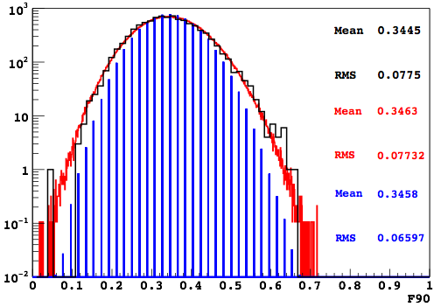
PSD studies and modeling
Data
Full Model
Photoelectron
Statistics
Good agreement between DS-10 data and the developed model describing F90 distribution for electron recoils, down to energies equivalent to 20-25 keVrec (~40 p.e.);
Model predicts significant differences in electron leakage compared to simple Binomial Model;
Confirmed the expected sensitivity of 10⁻⁴⁵ cm² in 0.1 ton*year for a 100 GeV WIMP;

Slide 7
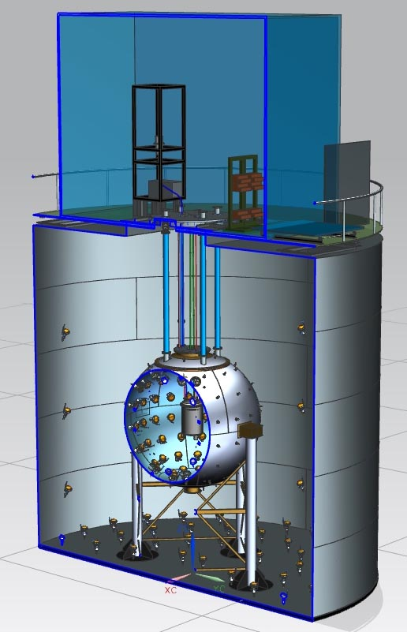
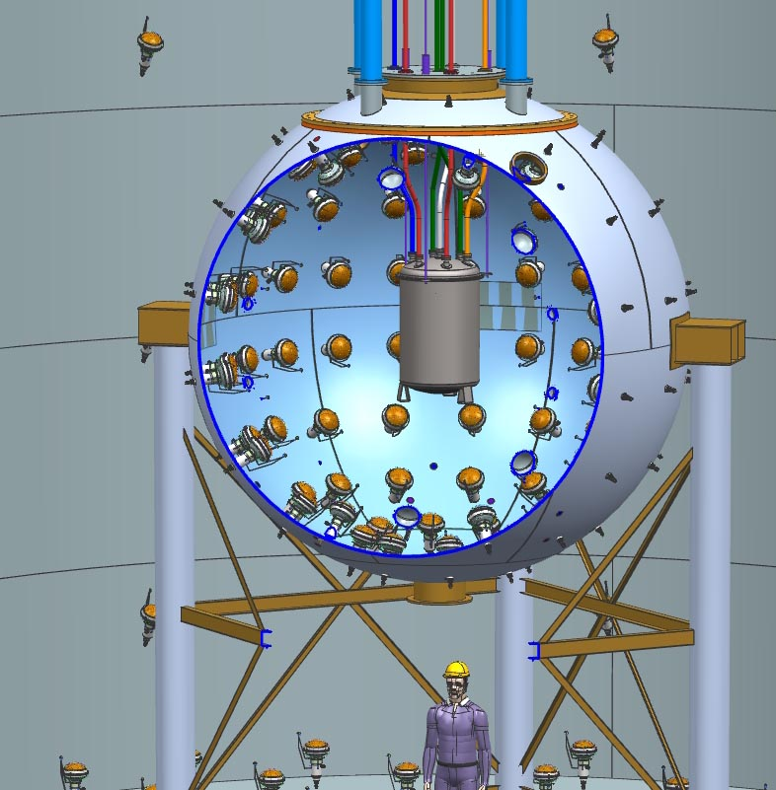
3D full view of the detector

Slide 8
Hardware breakdown
Infrastructures: Clean rooms, Radon suppression system
Vetoes (muon and neutron)
Supporting and Containment Stainless Steel Sphere
Diffusive panels (Tyvek and Lumirror)
PMTs, support parts, cables, fibers for monitoring of the devices
Electronics & DAQ
Liquid scintillator (TMB+PC+PPO)
New purification system
Insertion systems for source calibration (valid also for TPC)

Slide 9
Hardware breakdown (cont’d)
Inner detector
Cryostat
TPC
Teflon support structure for the PMTs
Reflector
field cage rings
Silica windows
Feedthroughs
evaporator
Cryogenic PMTs
Read-out electronics & DAQ
Cryogenic system

Slide 10
Other items
Depleted Argon extraction
Depleted Argon distillation
MC & Analysis

Slide 11
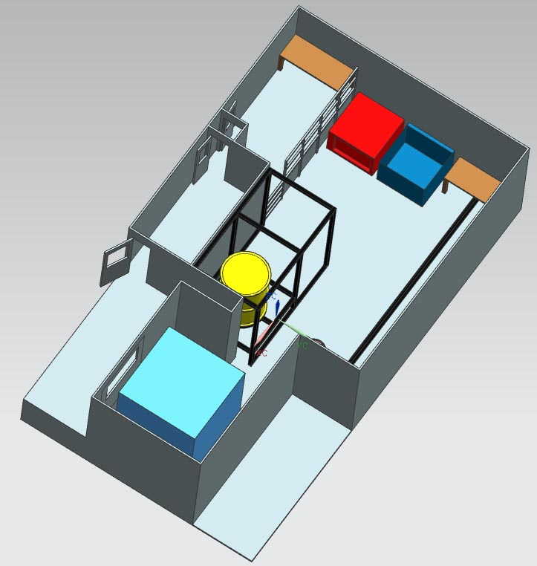
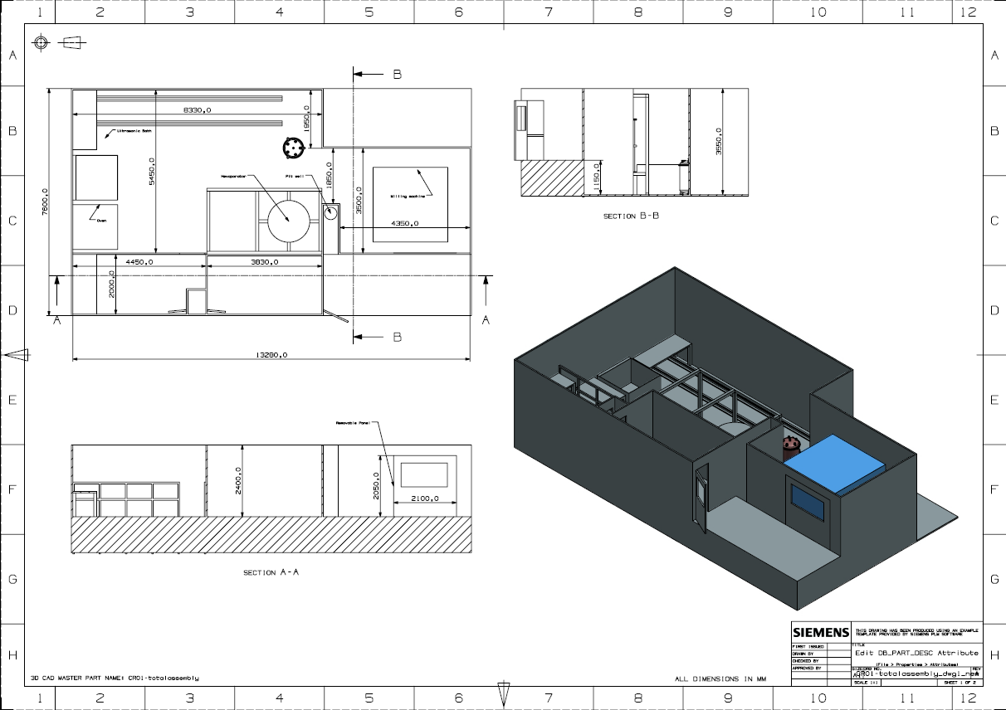
Conc. design of Radon free CR1

Slide 12
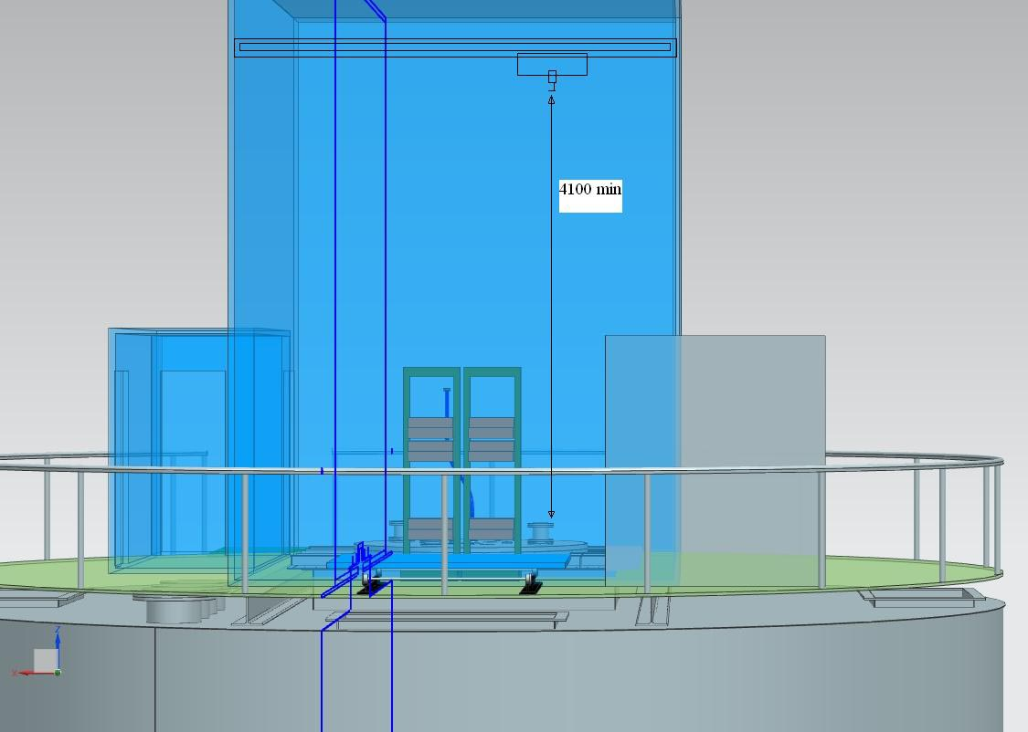
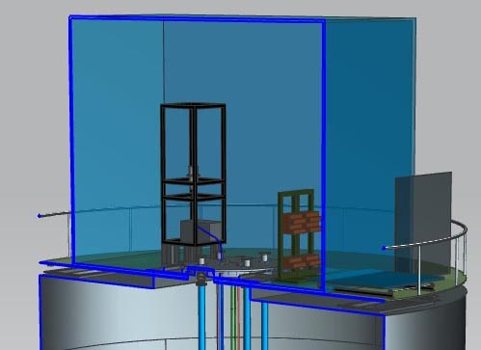
Conc. design of Radon free Hanoi CR
Class of both clean rooms : 10-100

Slide 13
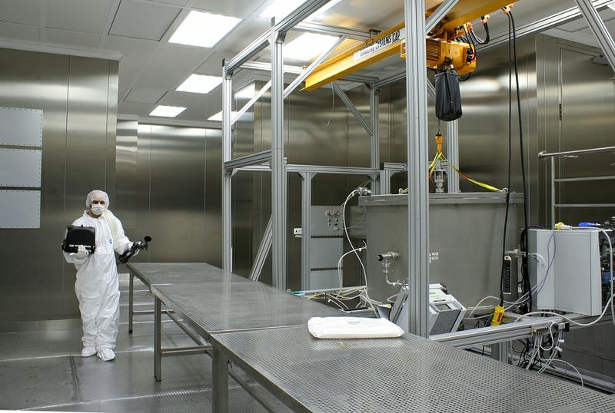
Interior of CR1 completed

Slide 14
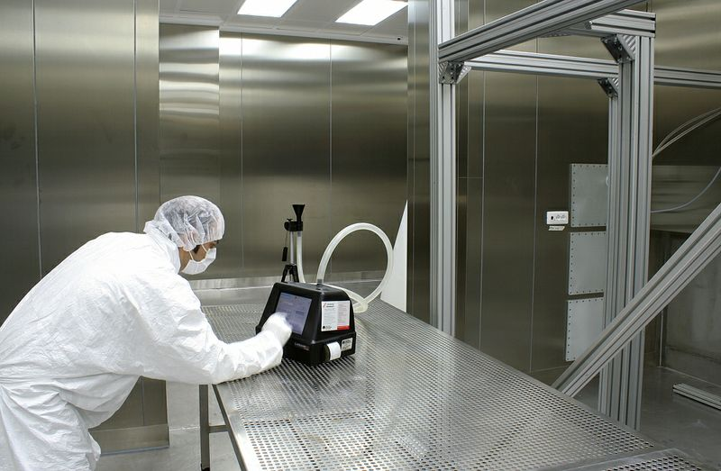
Interior of CR1 completed

Slide 15
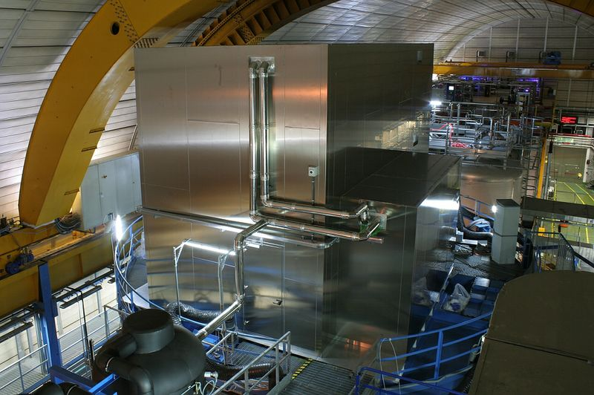
CR on top completed

Slide 16
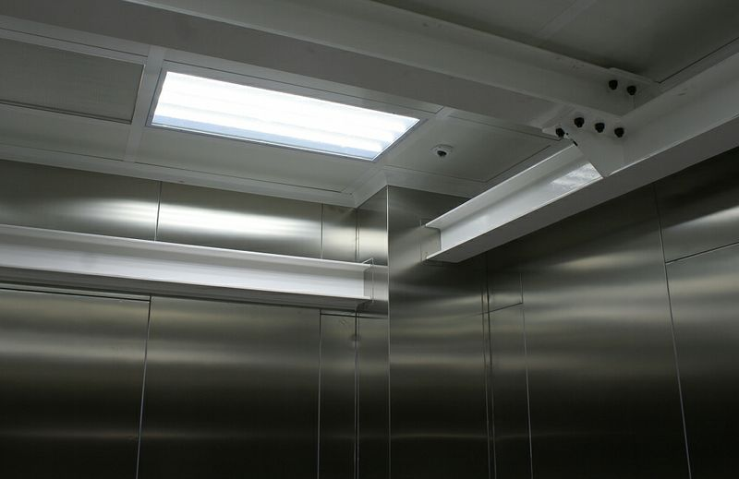
CR on top completed - interior

Slide 17
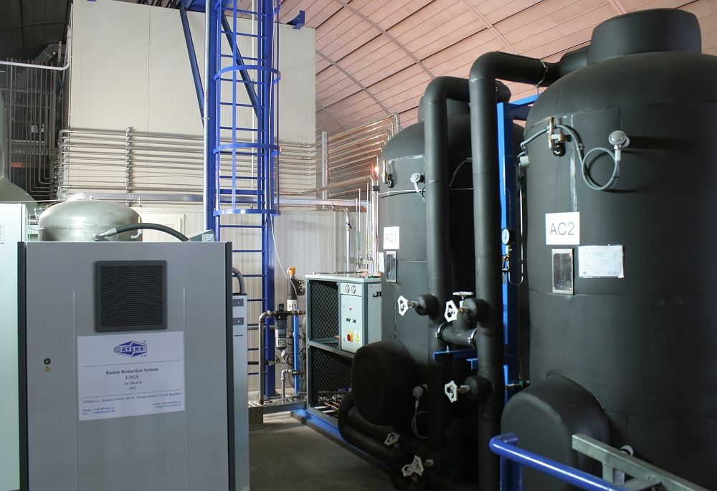
Radon reduction system installed and tested
Obtained ≲30 mBq/m³ in >100 m³ CRH

Slide 18
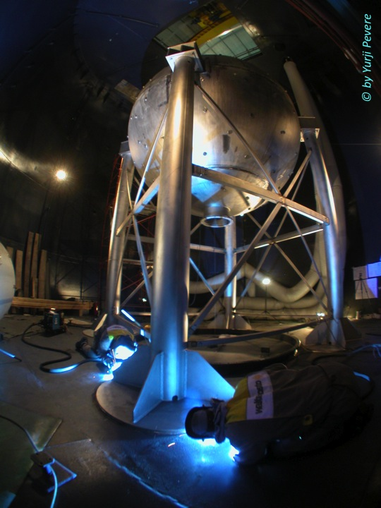
Neutron veto sphere «artistic» view during welding and afterwards (next slide)
Now completed and cleaned

Slide 19
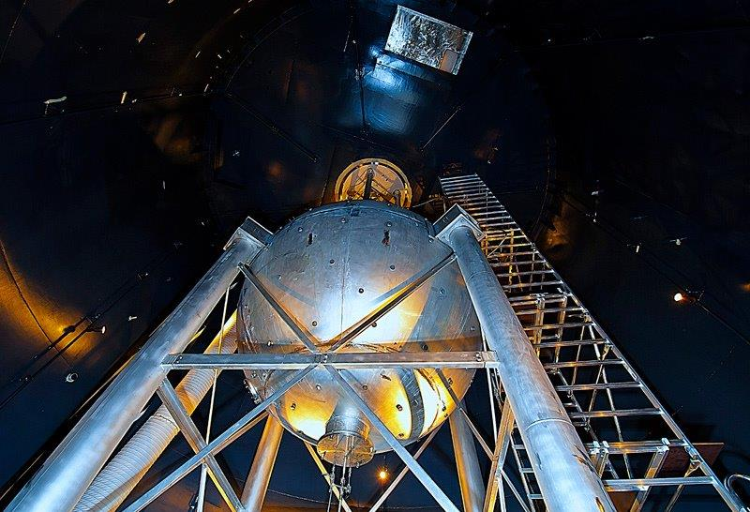

Slide 20
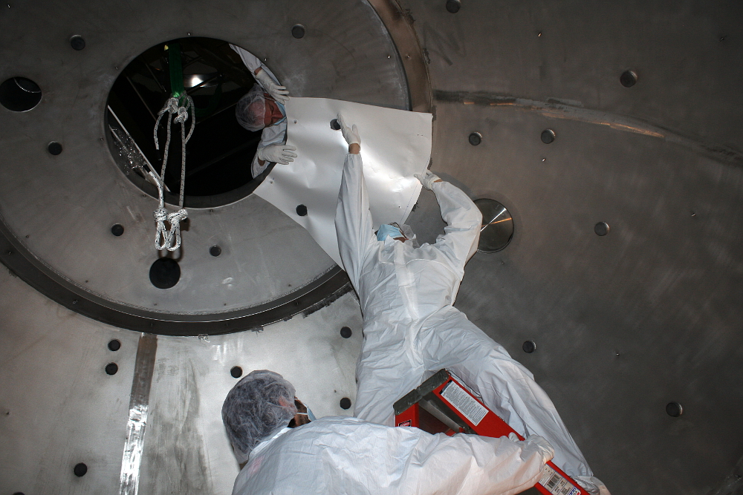
Installation of the Lumirror diffusive panels

Slide 21
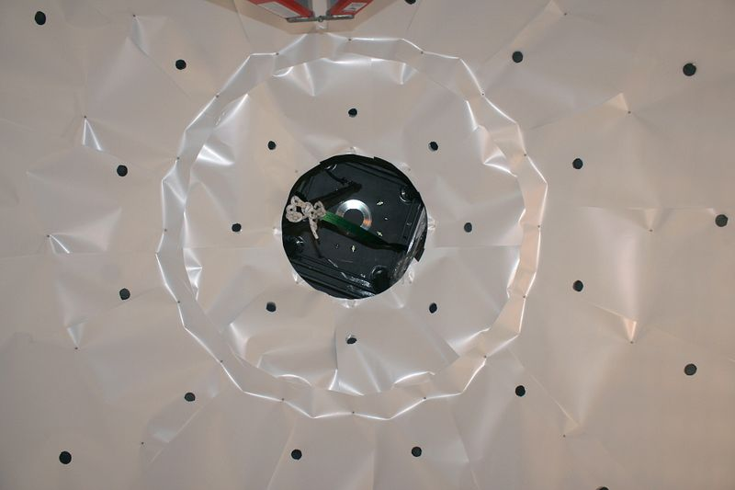
Final configuration Lumirror diffusive panels - detail

Slide 22
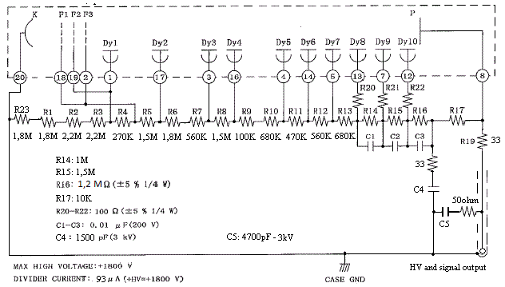
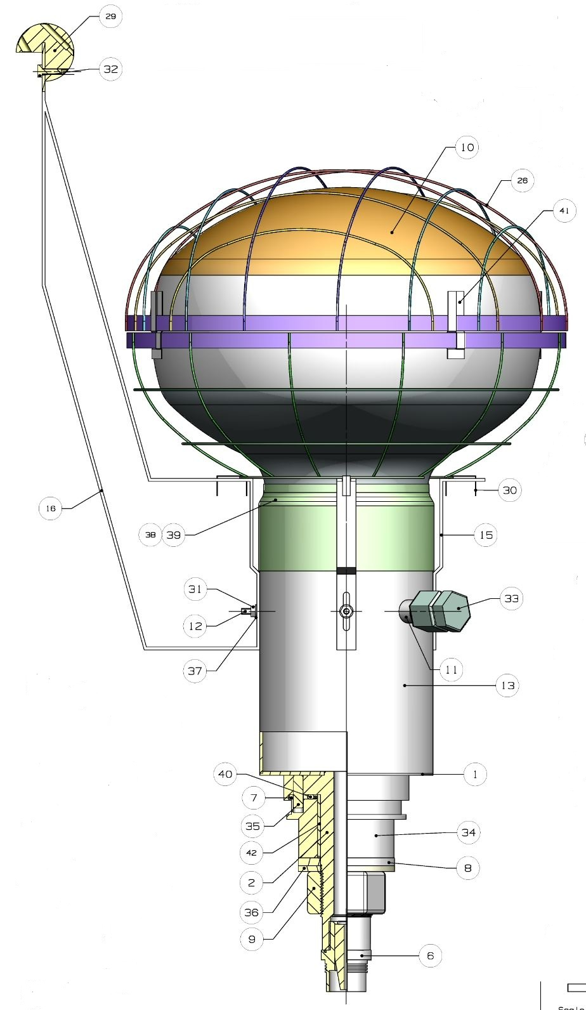
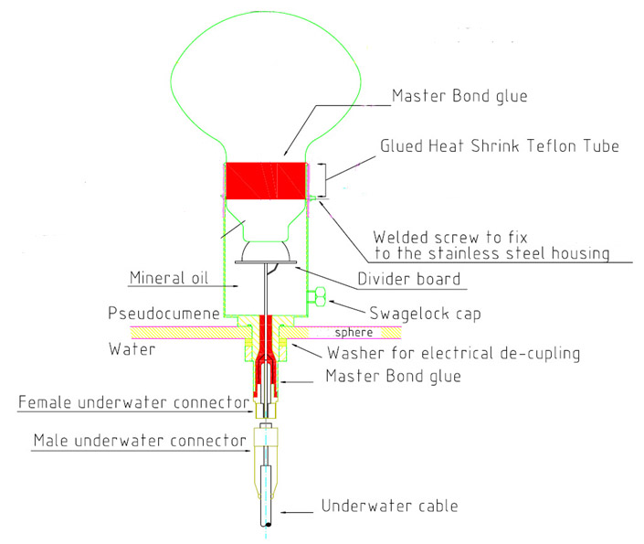
Muon veto PMT electrical sealing and mechanical design

Slide 23
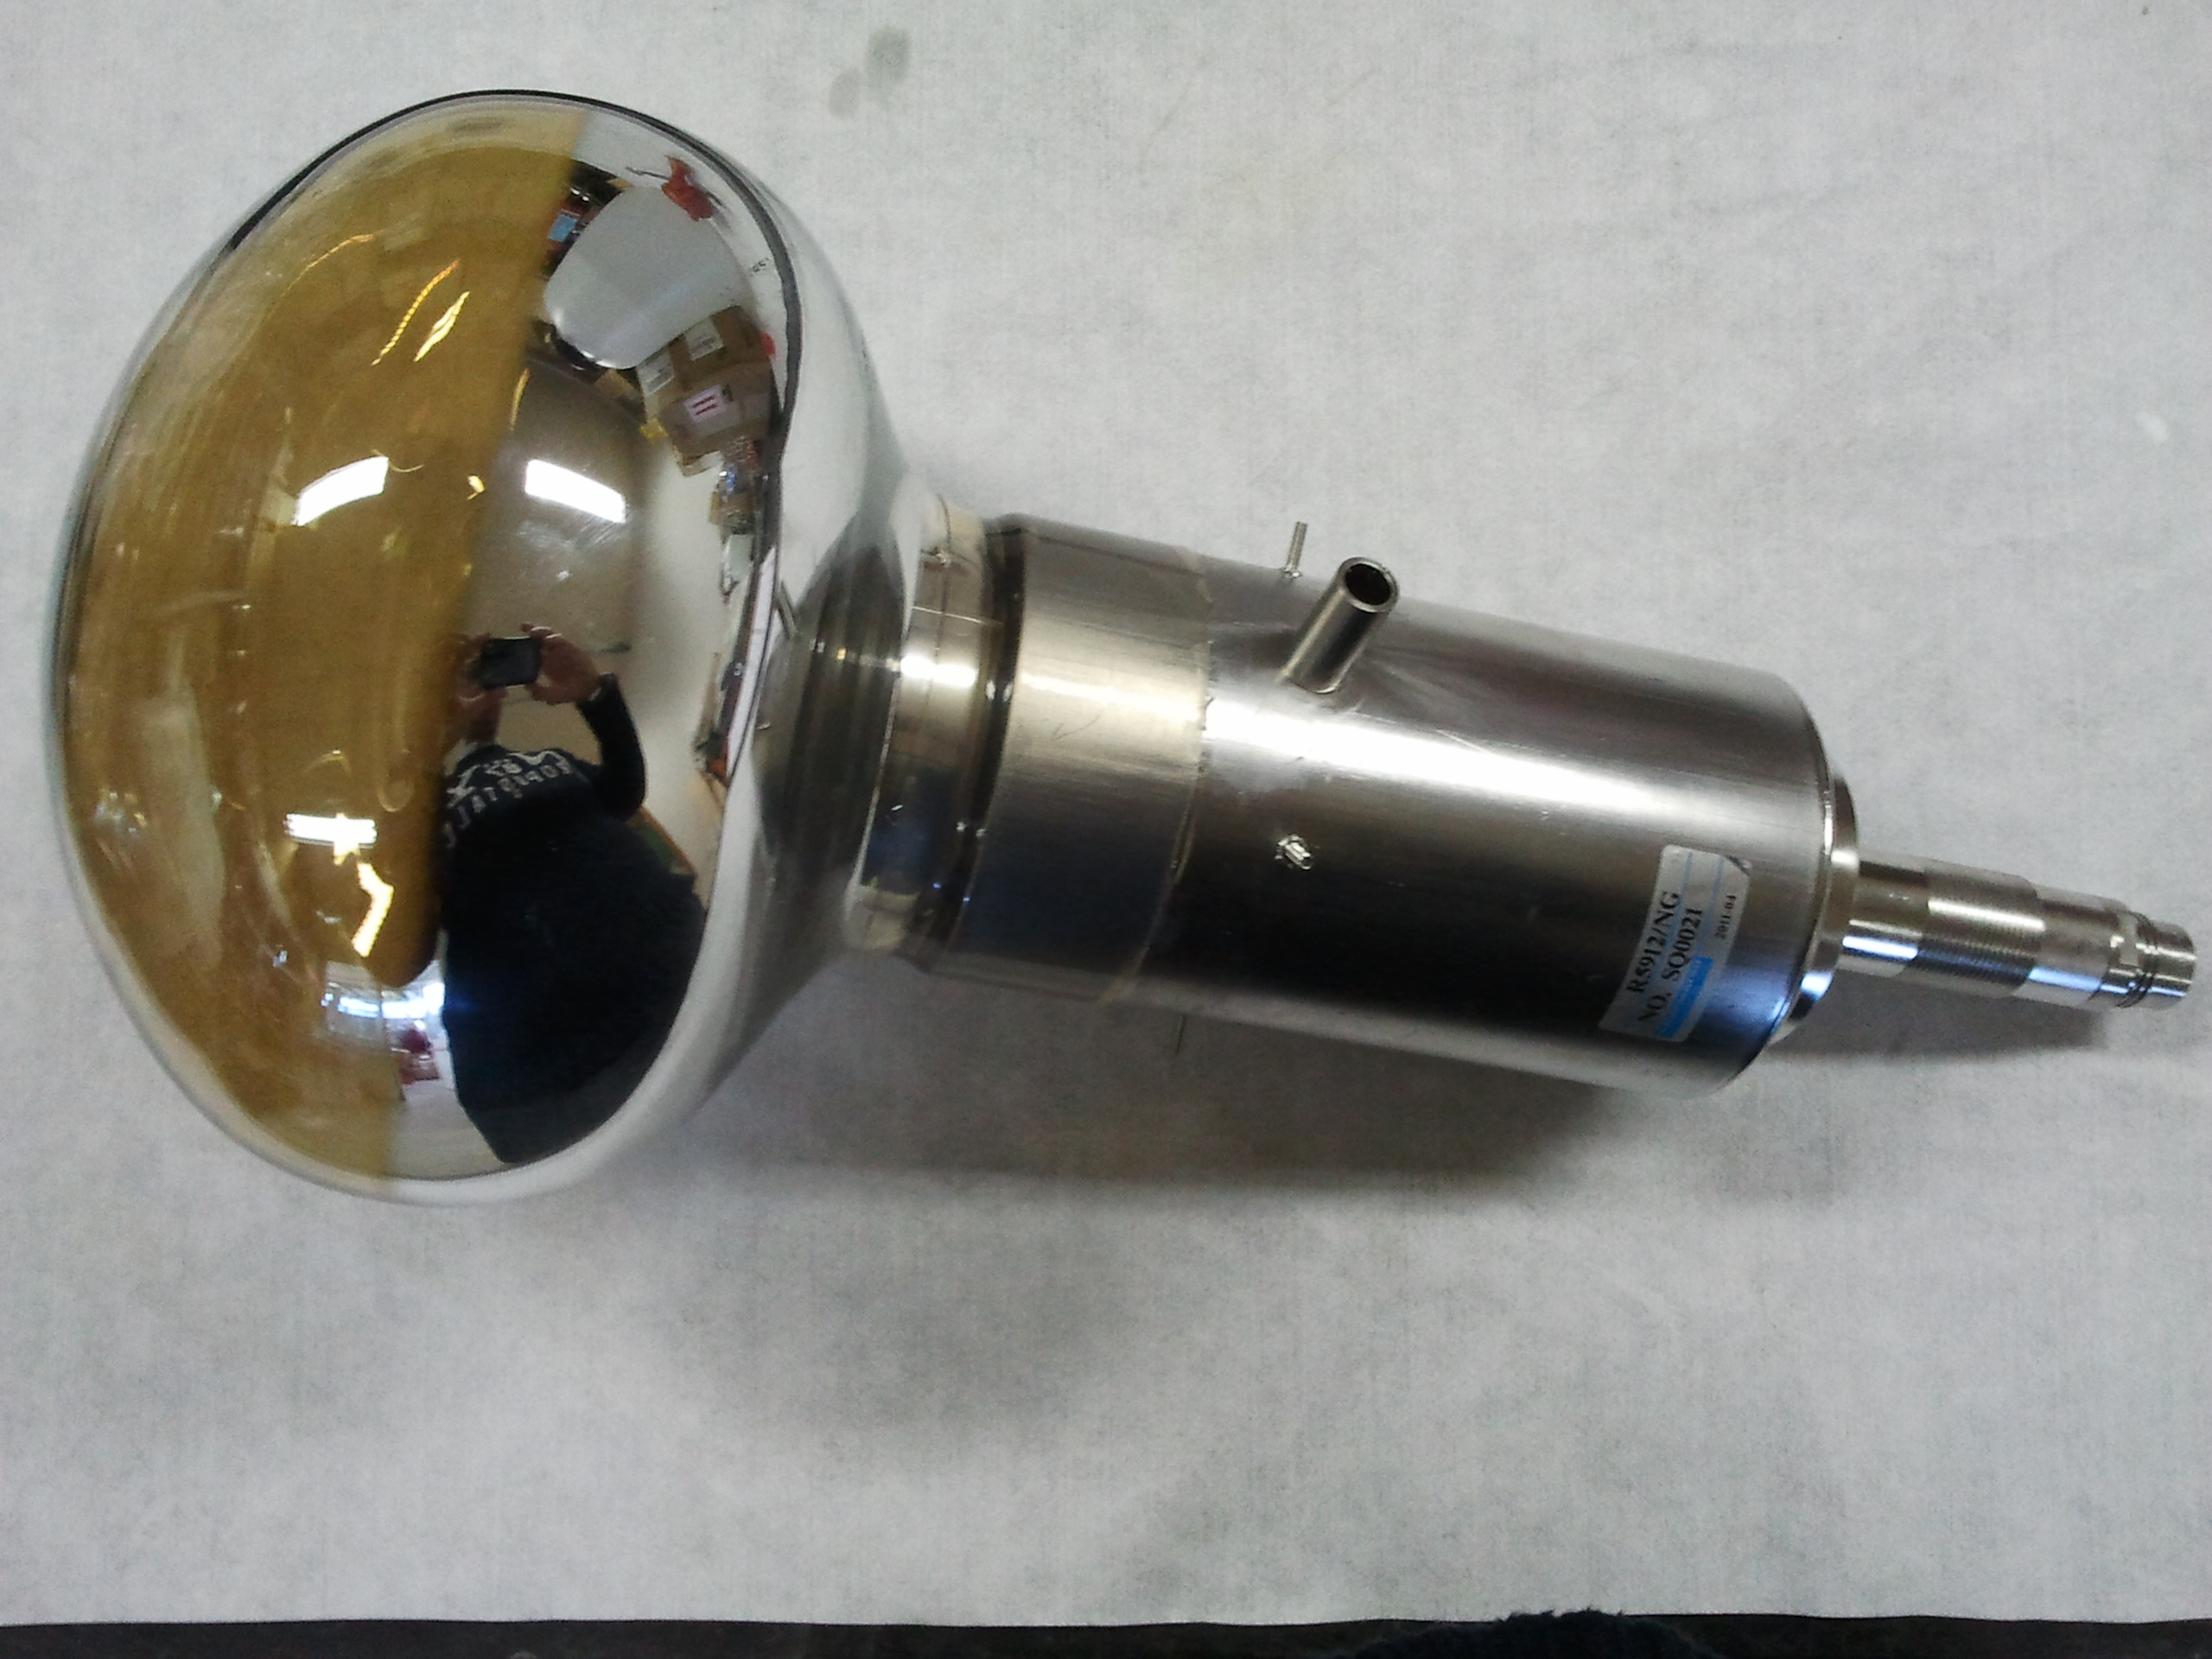
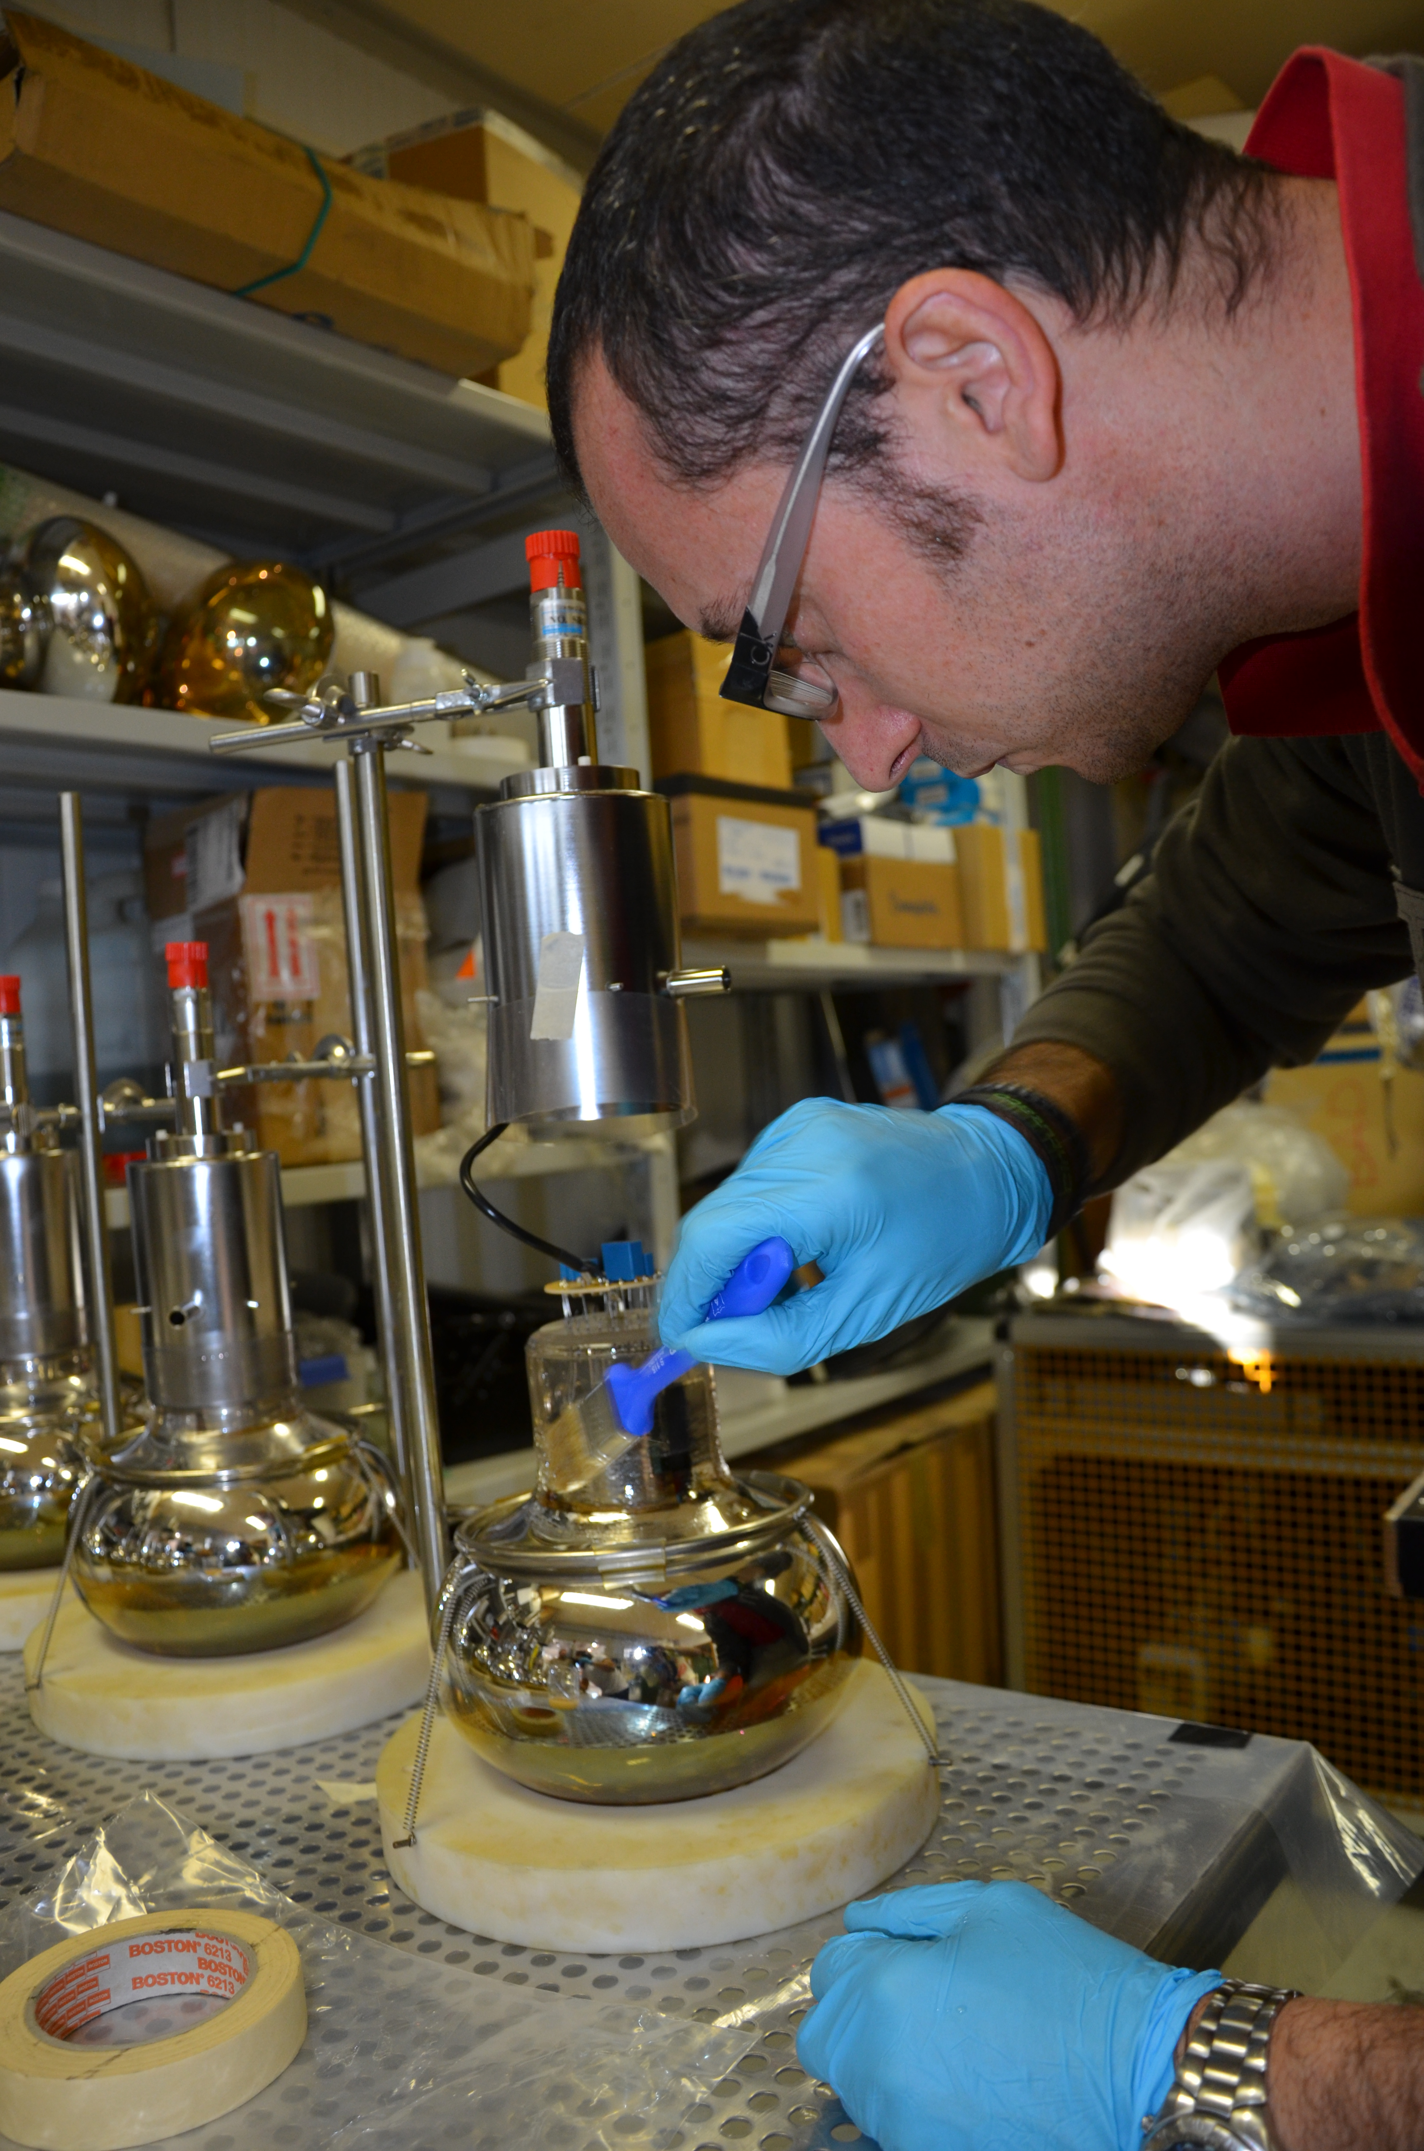
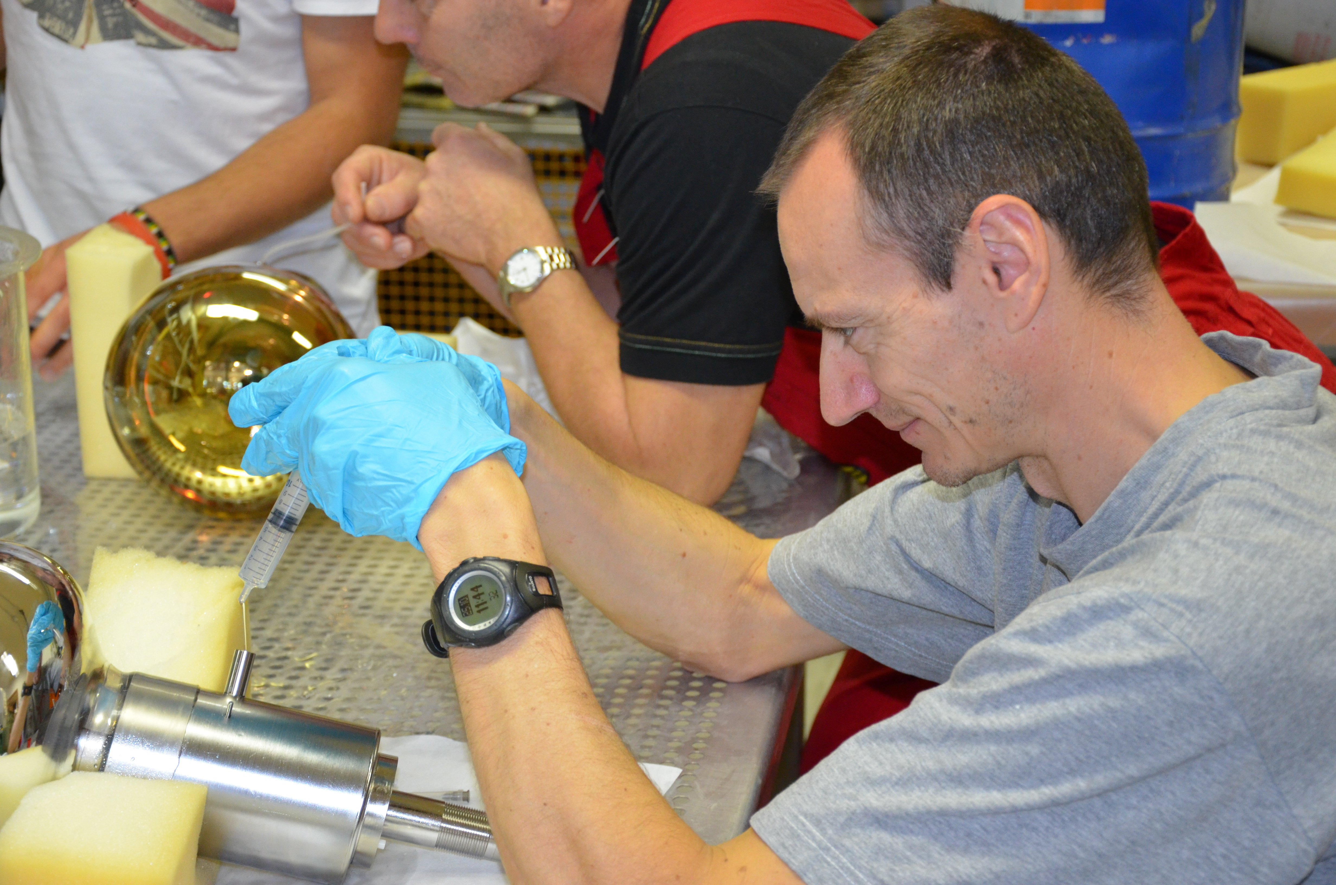

Slide 24
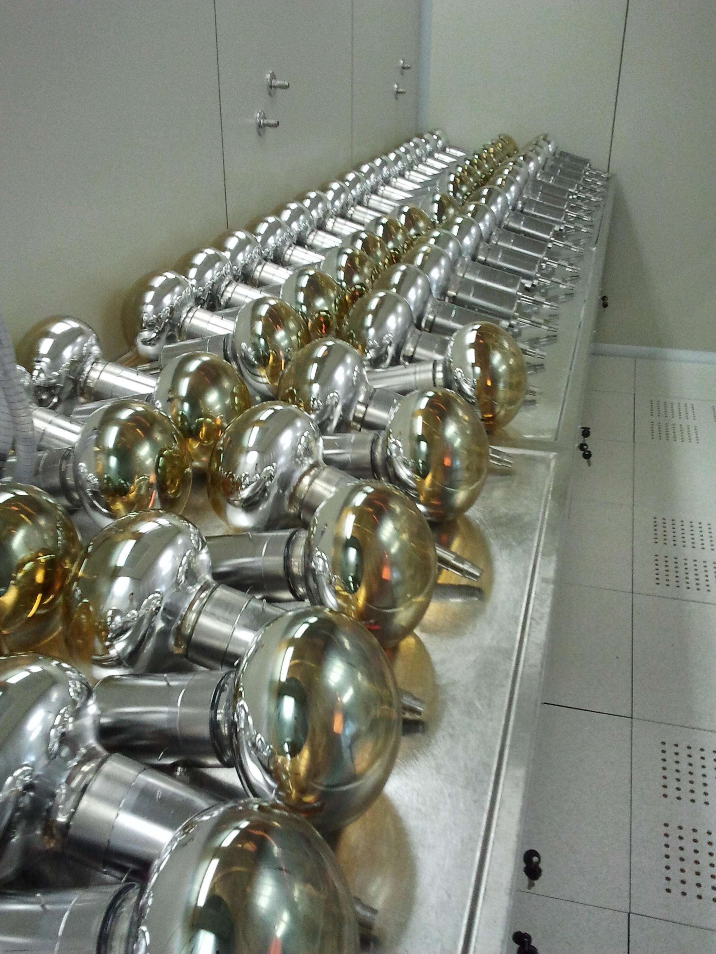
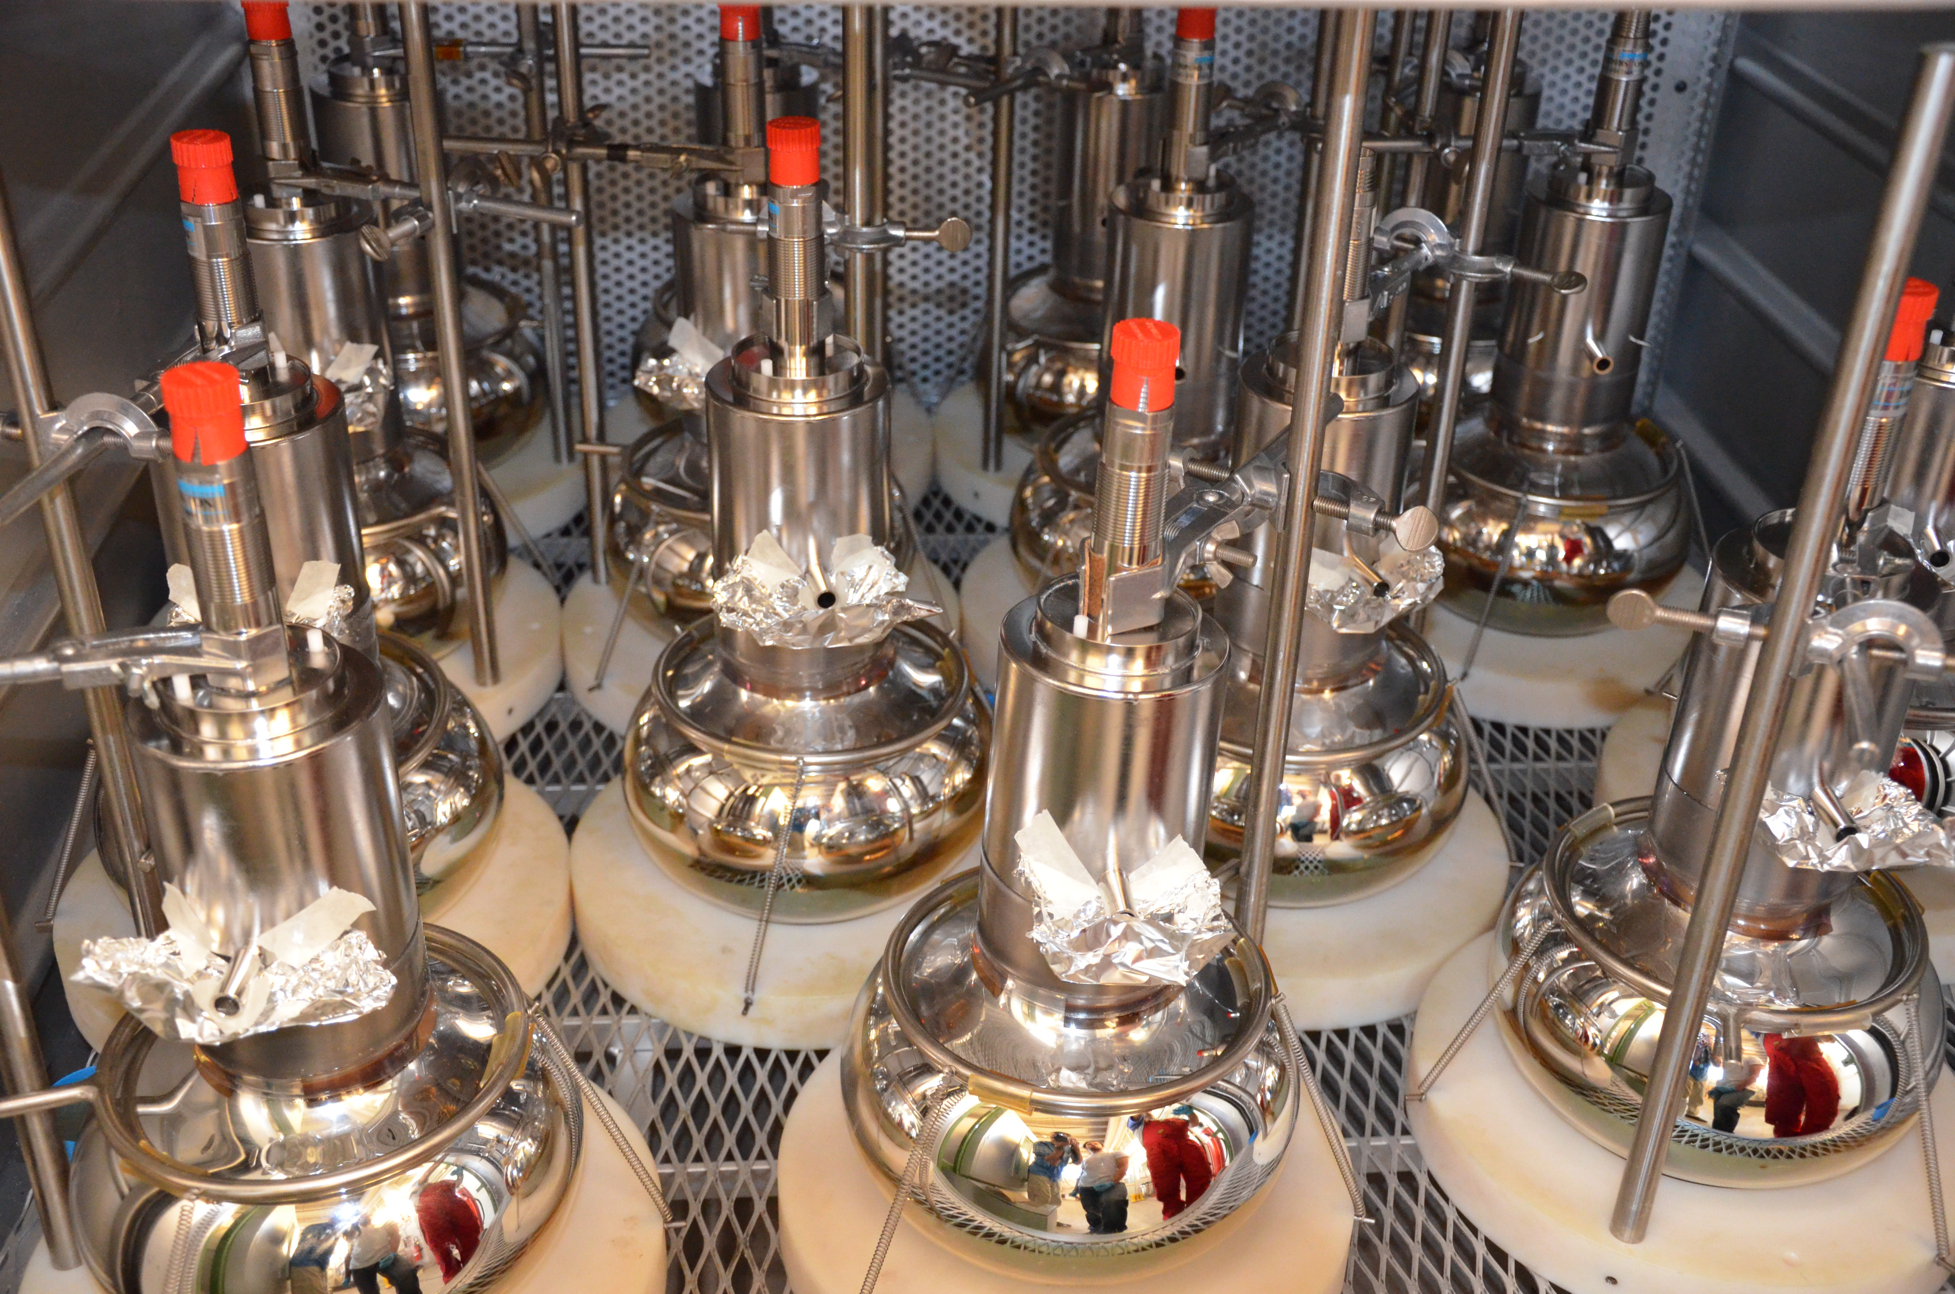
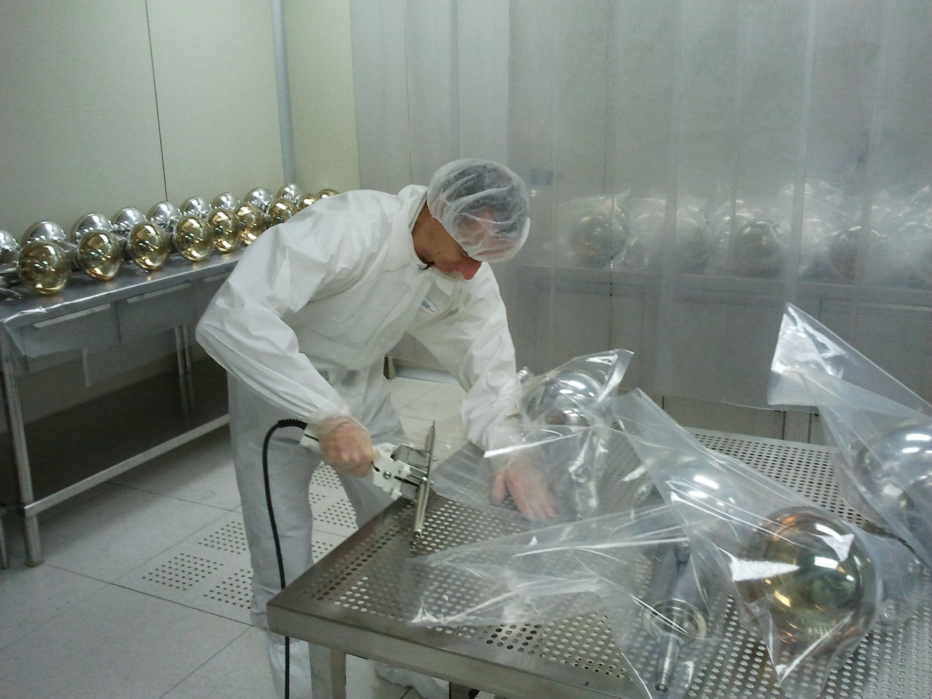

Slide 25
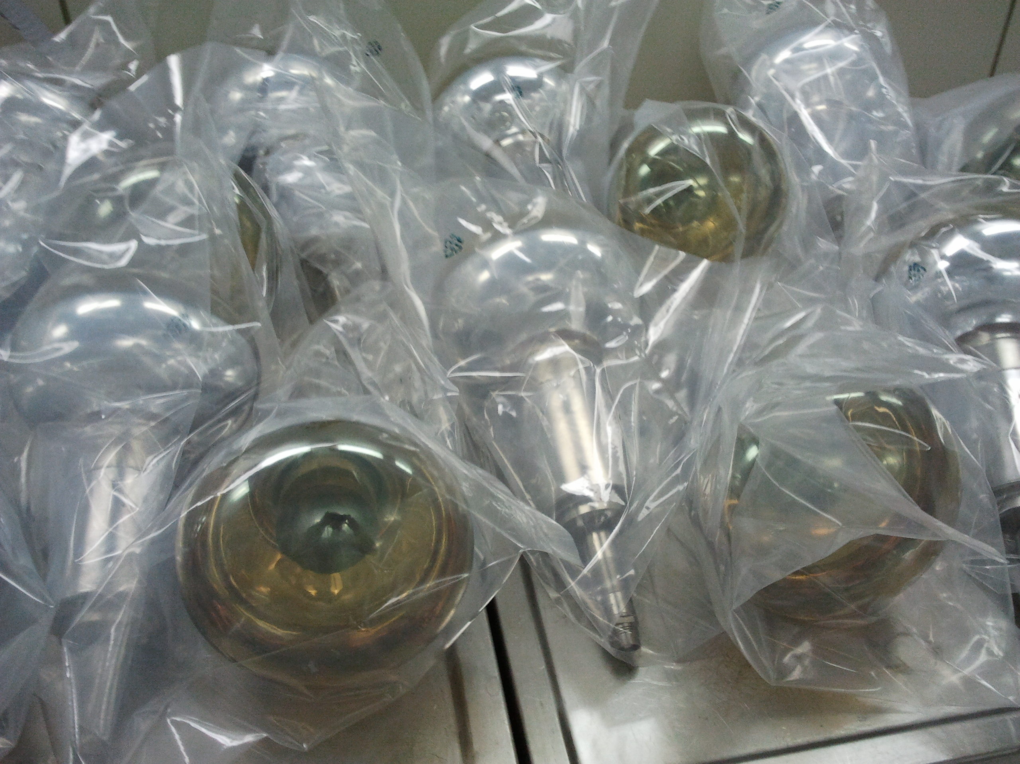
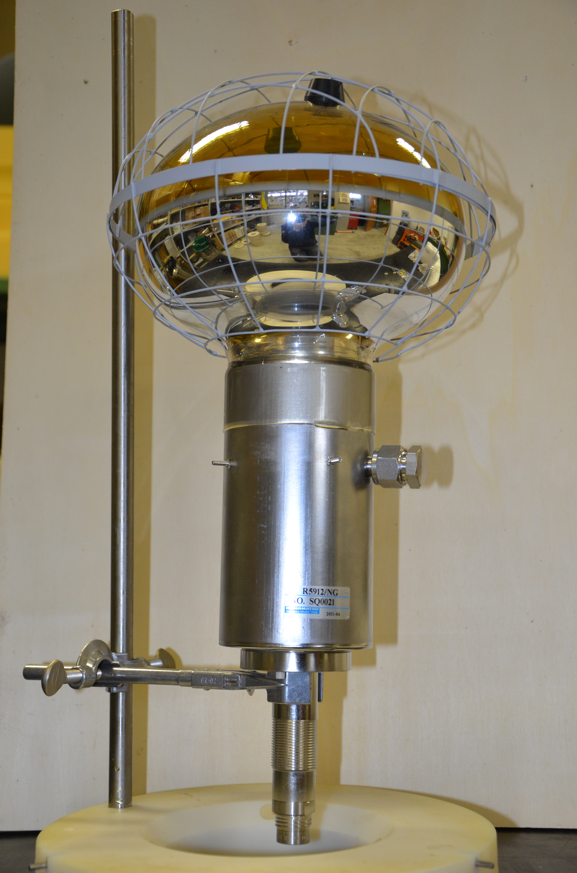
Total inventory of the devices
110 new PMTs for the neutron veto
80 old PMT from CTF for the muon veto plus a few spares

Slide 26
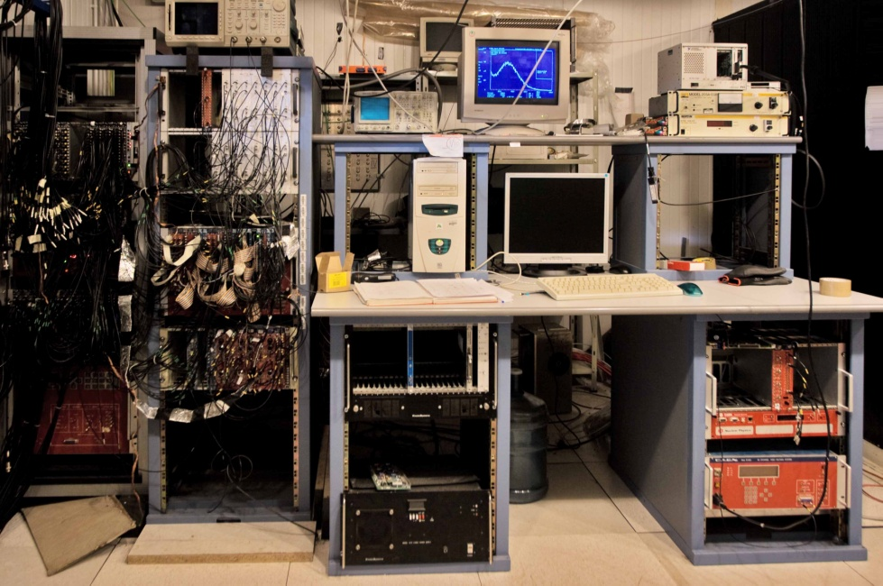
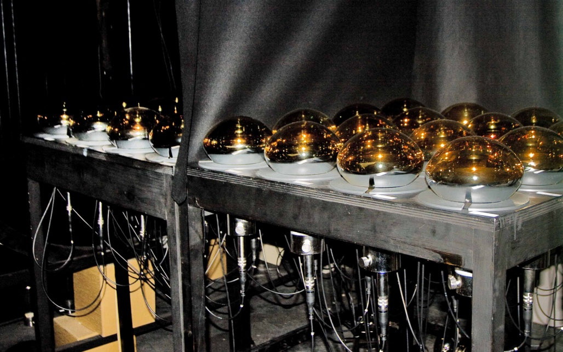
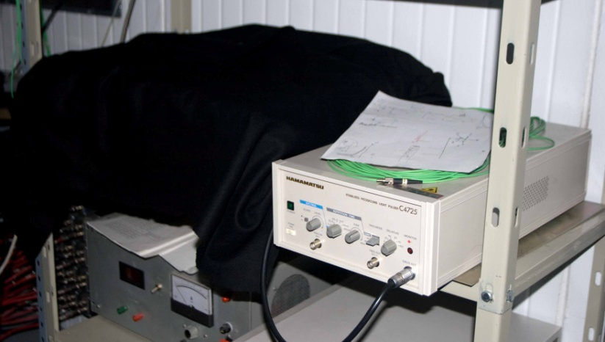
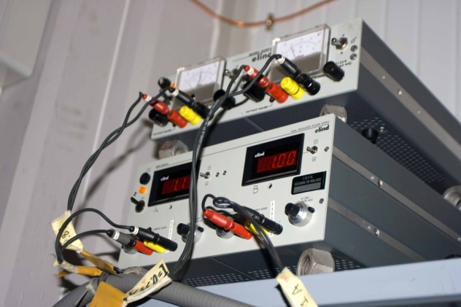
PMT test facility
4x32 channels electronics
4 tables x 16 PMT each
Picosecond laser
Earth Magnetic Field compensation system

Slide 27
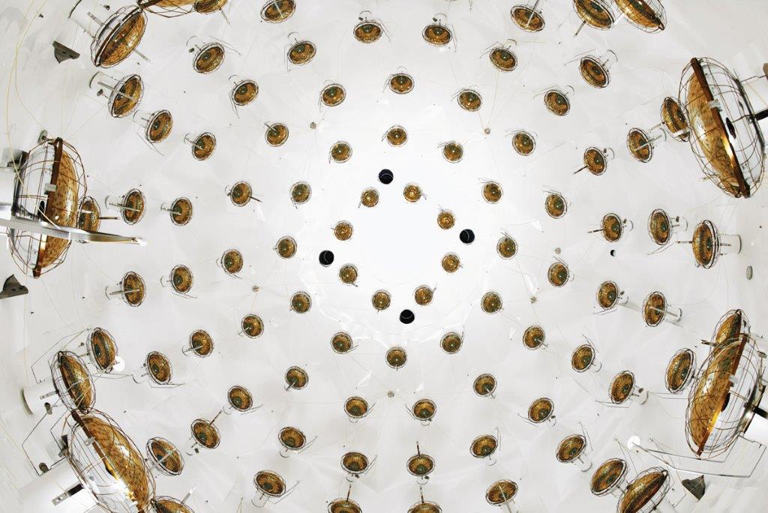
Neutron veto completed

Slide 28
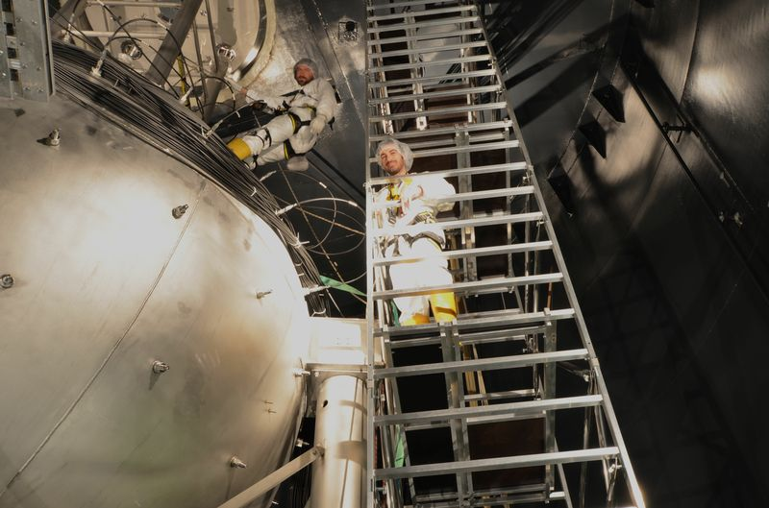
All cables deployed

Slide 29
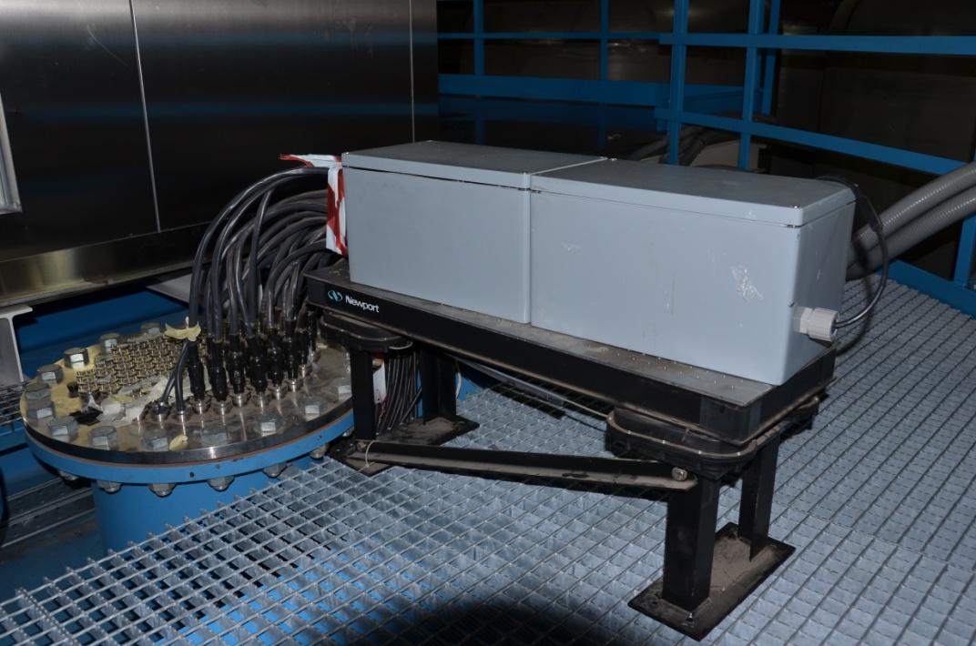
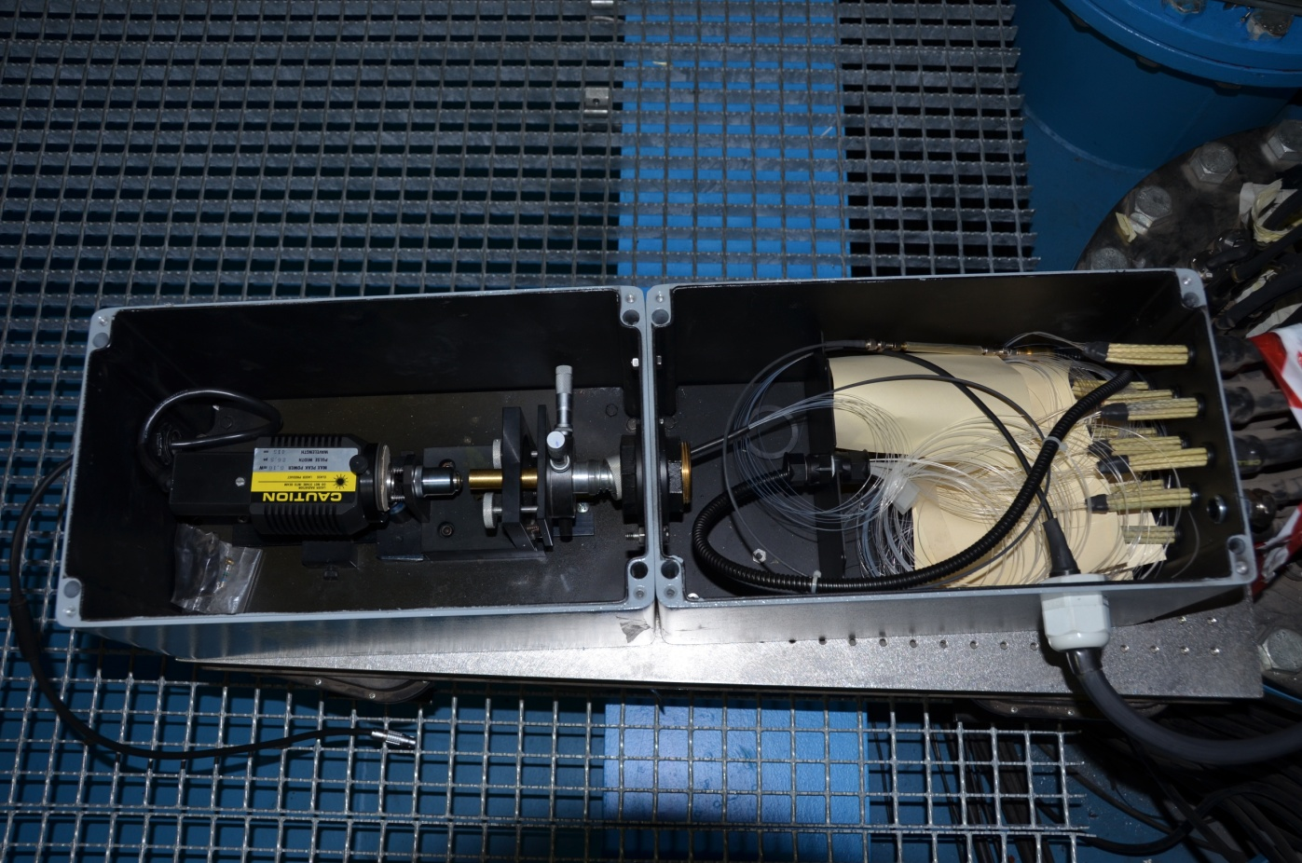
Optical fibers and laser for PMTs monitoring
110 new fibers for neutron veto + 20 spare
80 old fibers for muon veto + 10 spare

Slide 30
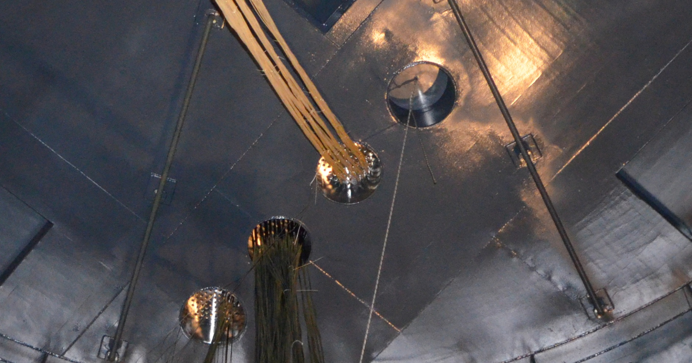
Optical fibers installation

Slide 31
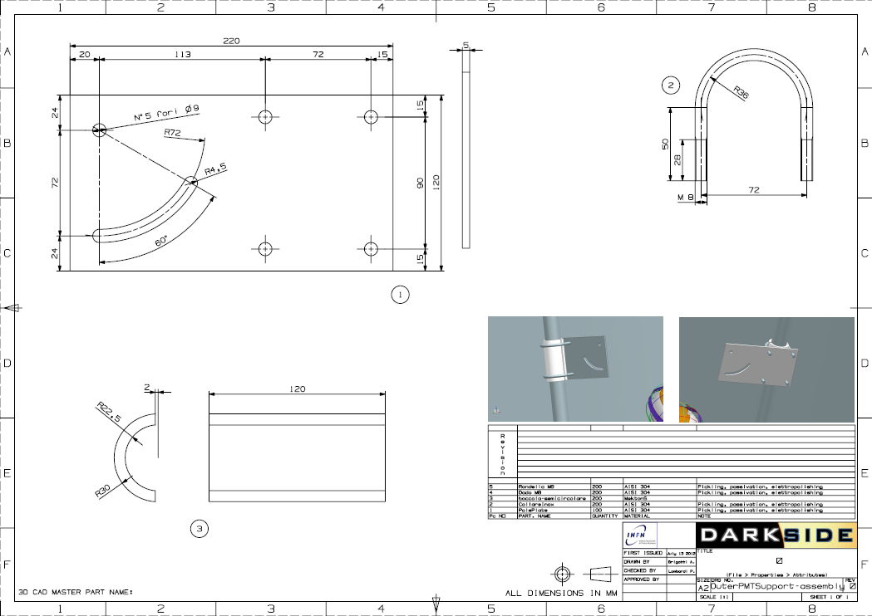
External muon veto
The support structures of the Tyvek and of the external PMT’s have been completely designed and constructed – ready to be mounted
This is the design for the outer PMTs support
Installation in progress

Slide 32
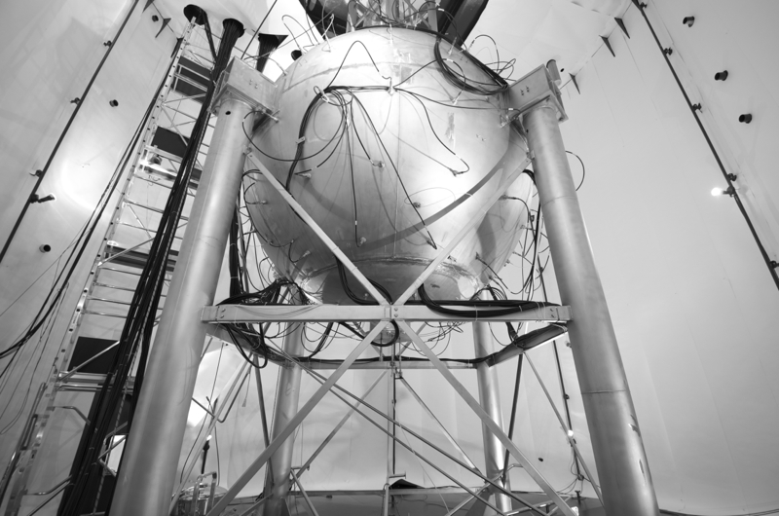
Tyvek on the lateral wall of the Tank

Slide 33
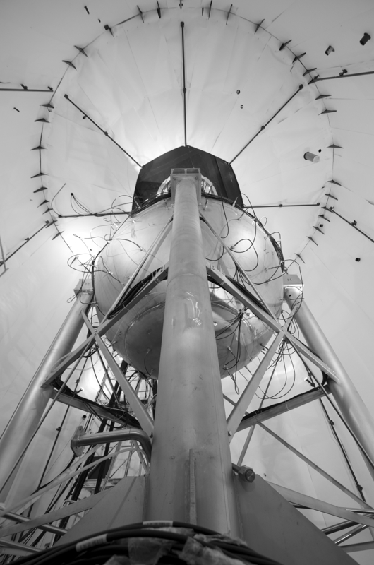
Detail of the roof covered with Tyvek

Slide 34
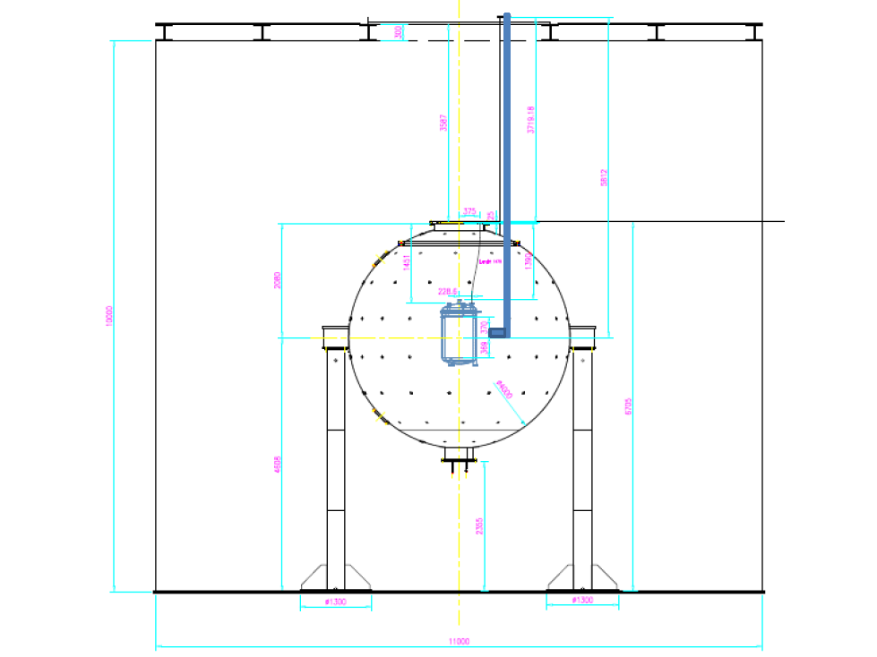
Movable arm to deploy the source in the LSV and close to the TPC
Pre-installation test

Slide 35
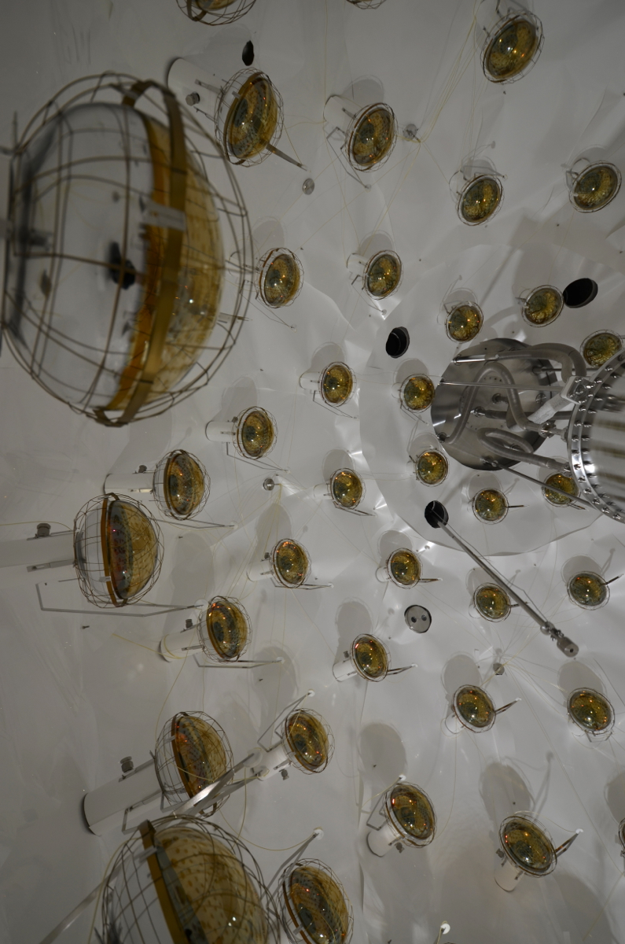

Slide 36
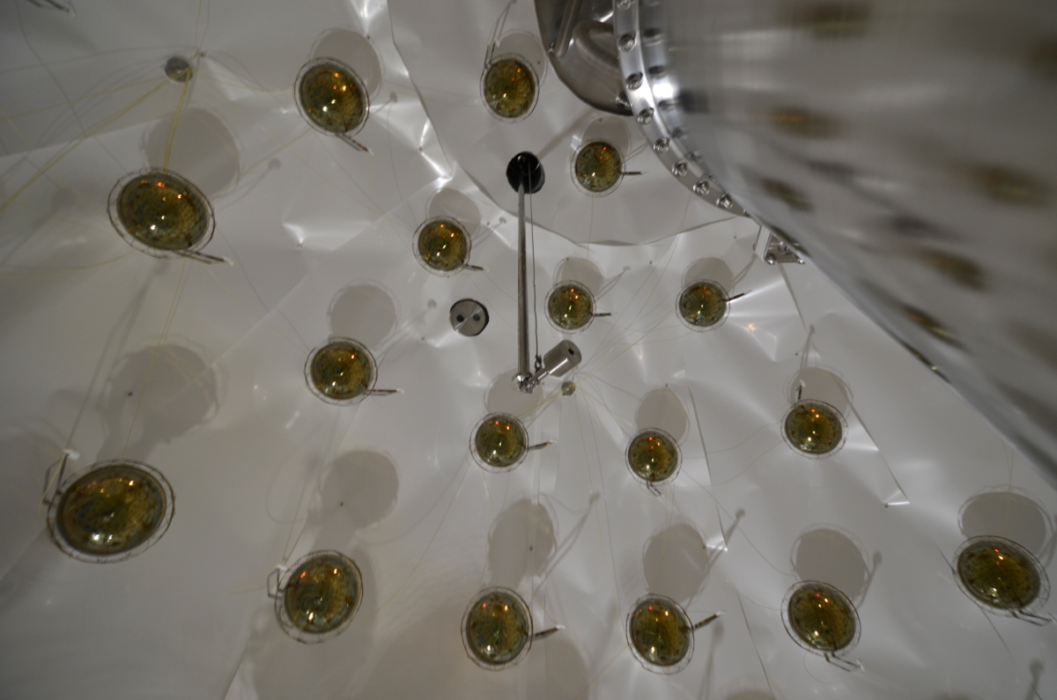

Slide 37
Veto Electronics
Options
FADC commercial boards, 1-2 GHz, 8-10 bit
CAEN (e.g. V1731)
National Instruments (e.g. NI-PXI 5162)
Agilent Technologies
The NI-PXI 5162 will work at 1.25 GHz sampling rate and 10 bits
System under implementation: 190 channels will be assembled for
both vetoes 120 channels already available, assembled and being tested
Purchase of the remaining 70 plus spares channels almost completed!
Suited for the full upgrade of the Borexino electronics
Front end electronics: design completed and construction started
High Voltage modules procured
Selected after
the bid

Slide 38
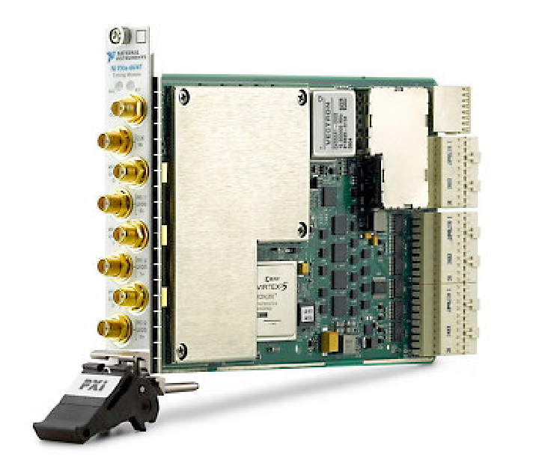
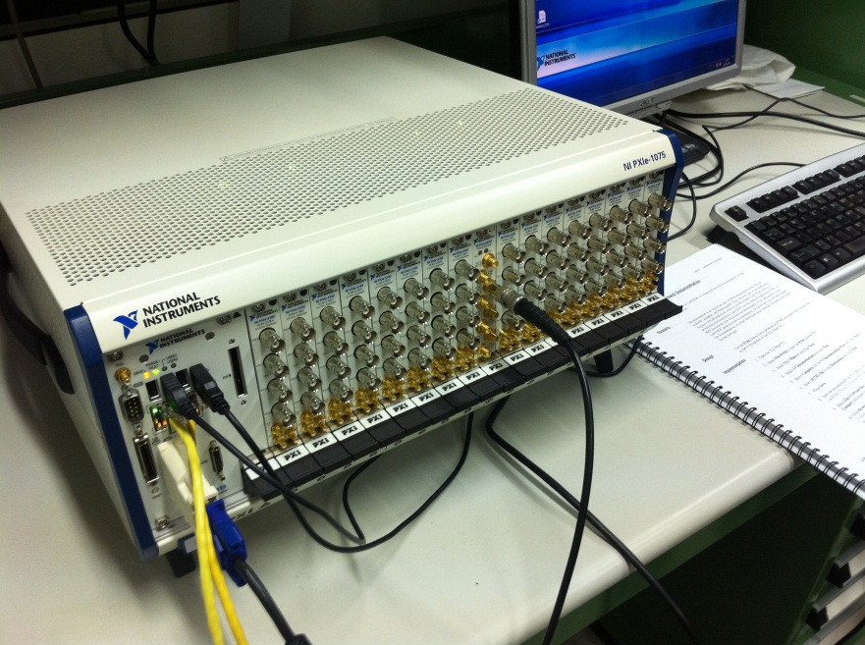
Outer Detector: review of DAQ
NI PXIe-6674T
Trigger and Synchronization Module
Multi-chassis synchronization
Trigger Routing in the chassis

Slide 39
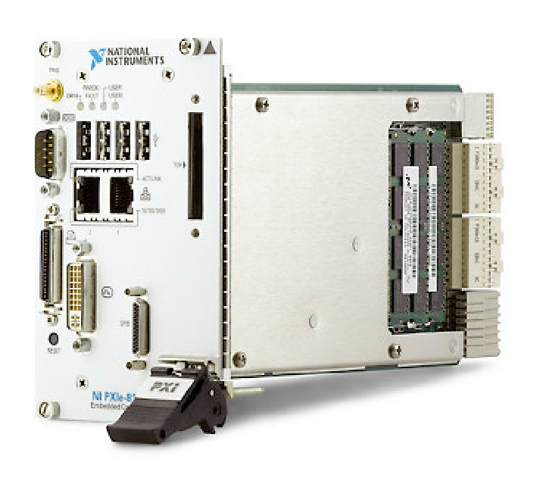
Outer Detector: review of DAQ
NI PXIe-8133 controller
High-performances embed controller
1.73 GHz Quad-Core
Windows/RealTime OS
Gigabit Ethernet (2 ports)
Readout code installed and runs
in the controller of each chassis

Slide 40
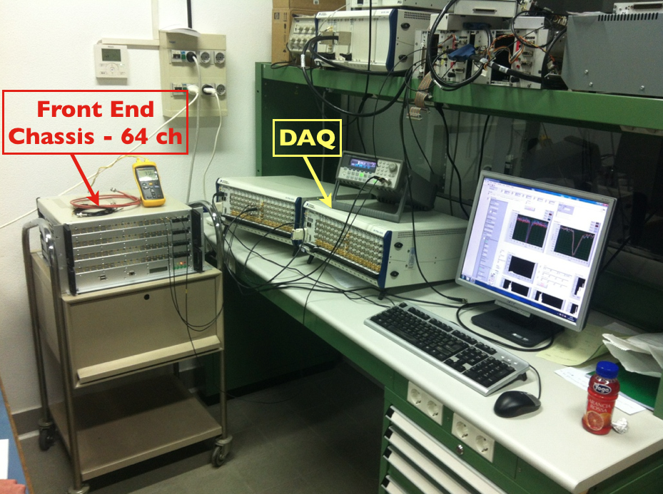
Transferred underground few weeks ago

Slide 41
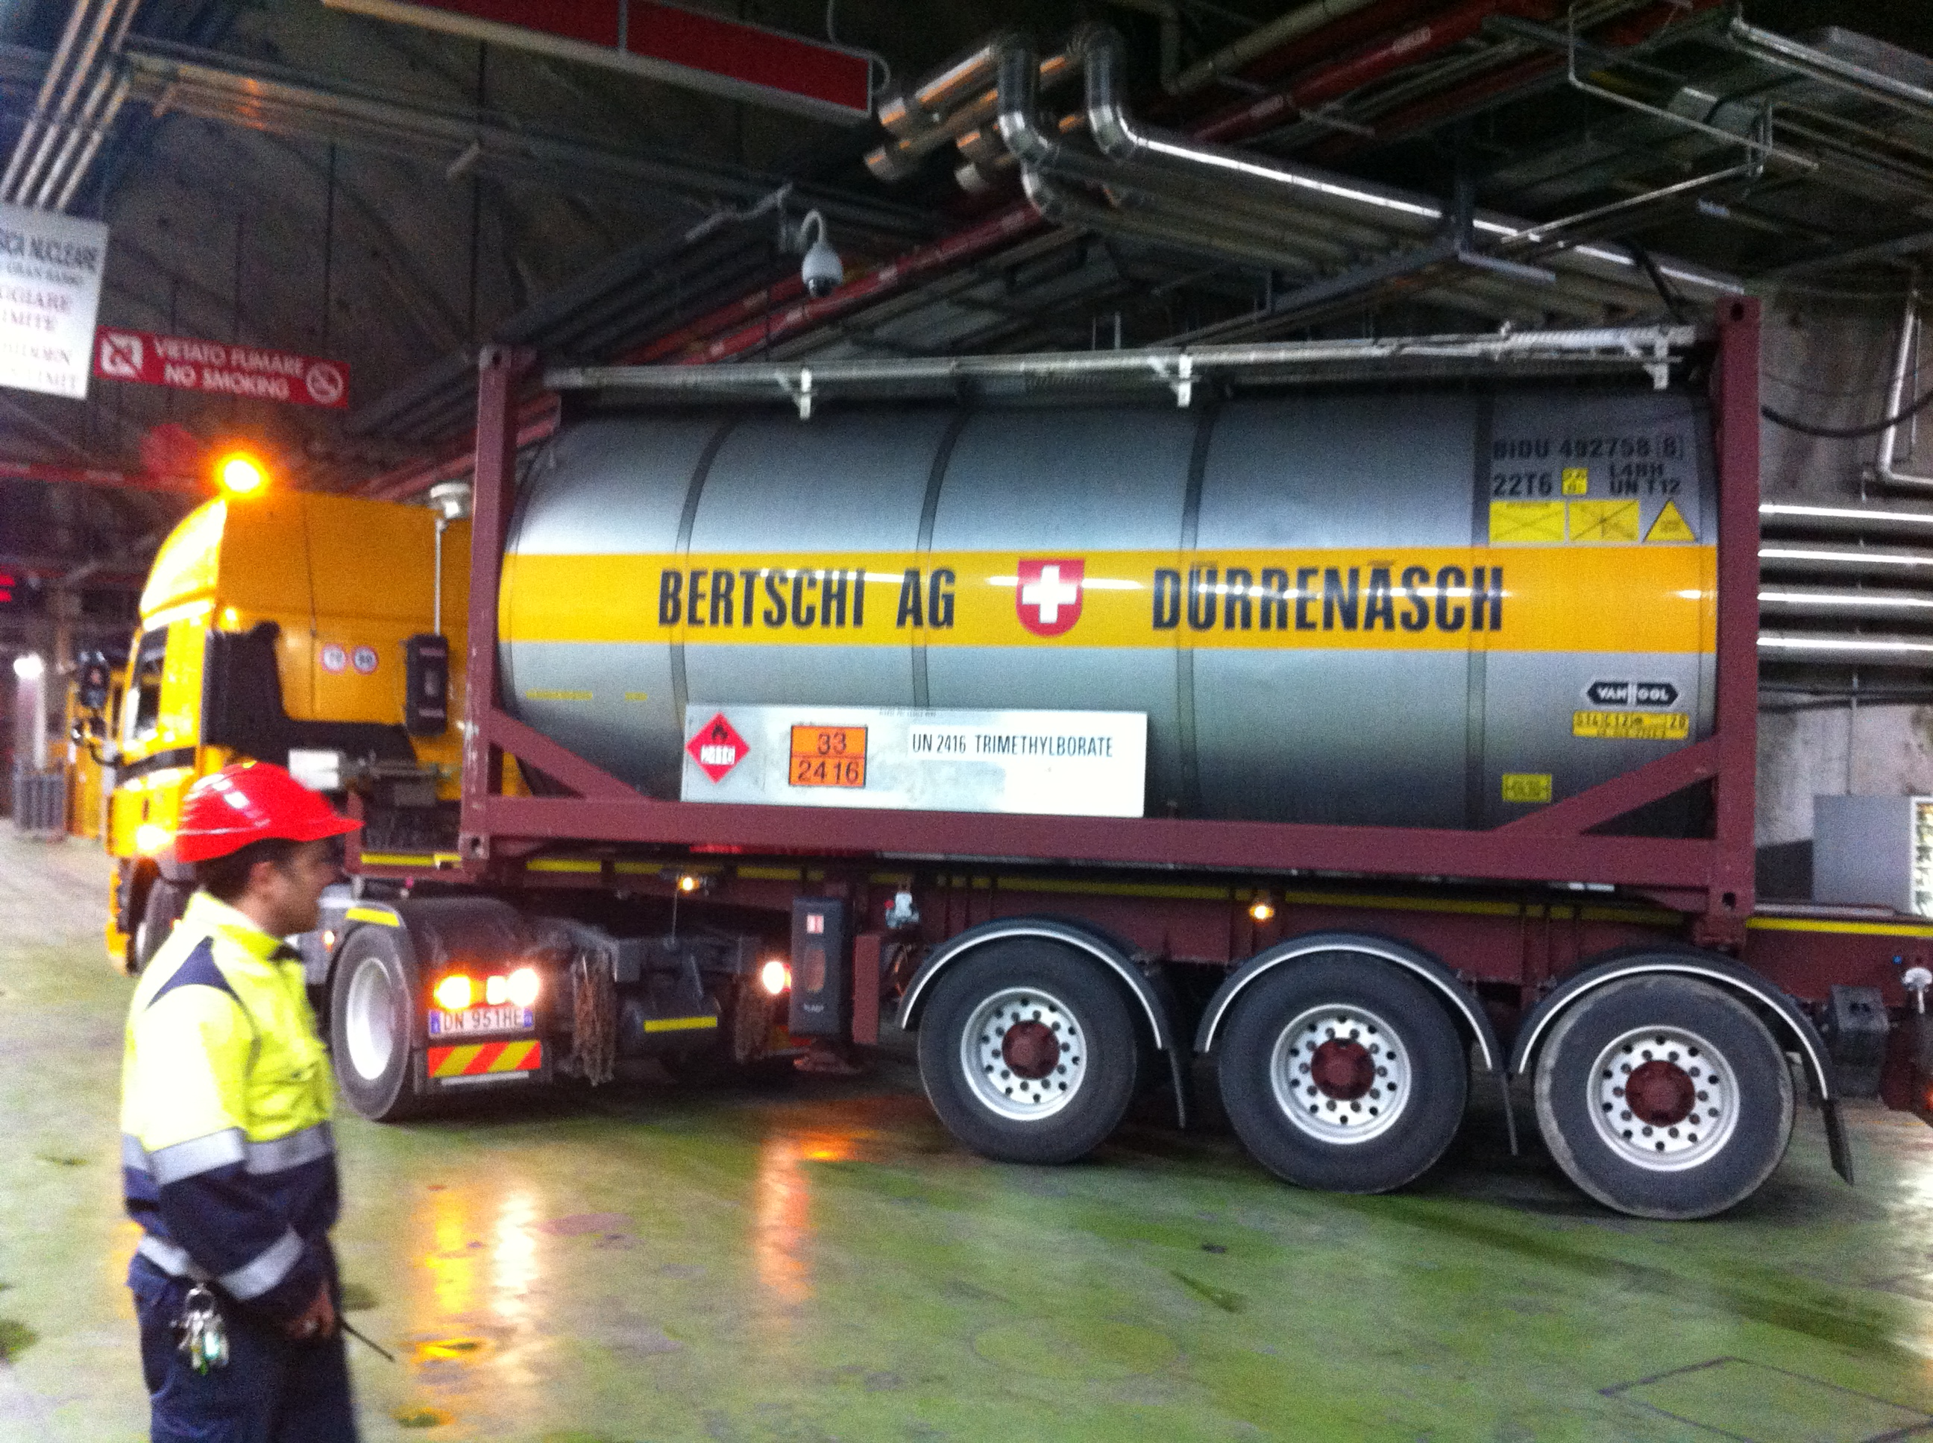
Liquid scintillator – delivery of the TMB

Slide 42
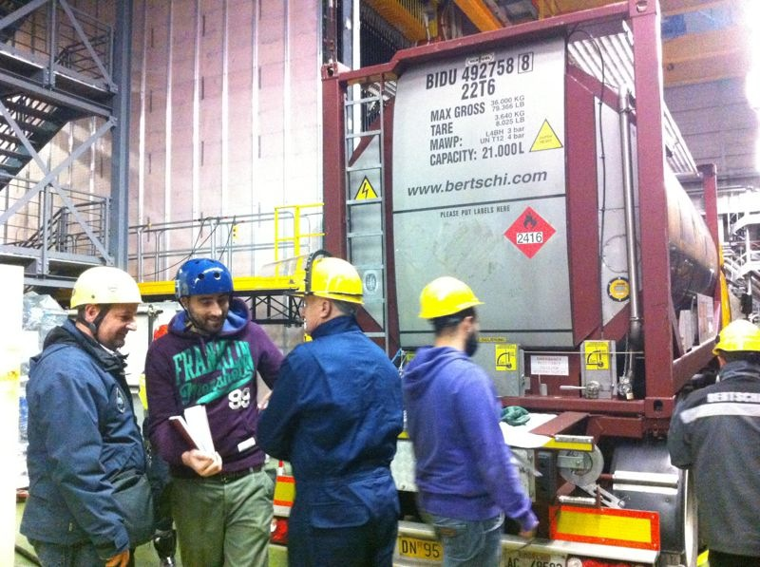

Slide 43
Dedicated purification system

Slide 44
Argon handling system was built at Fermilab and shipped to Gran Sasso in November

Slide 46
Functionality test with a “dummy” dewar

Slide 47
DS-50
Low rad Stainless Steel cryostat (138 kg);
Active Volume diameter 35.6 cm;
Active Volume height 35.6 cm;
Gas Pocket 1.0 cm;
Active LAr mass 49.4 kg;
Total LAr mass ~145 kg;

Slide 49
Dewar suspension and alignment system
Test at the Company site

Slide 50
Dewar in clean room CRH

Slide 51
DS-50 TPC
38 PMT R11065;
Drift field (typical) 1.0 kV/cm;
Extraction field (typical) 3.8 kV/cm;
Multiplication field (typical) 5.7 kV/cm;
HHV voltage -43.2 kV

Slide 52
Procurement of parts completed
Cleaning and TPB evaporation in CR1 done
Final assembly in CRH completed - Deployed in the SSS
Quartz windows + ITO
High reflectivity Teflon
Deposition of the wavelength shifter (Tpb) in CR1
Low radioactivity copper rings for field cage
Diving bell
Metal cryogenic PMTs
R11065, R11065-10, R11065-20
low rad dividers

Slide 60
TPC ReadOut
Discriminated
X 8 amplification
Trigger signal & ID(8 bit)
X 0.2 amplification

Slide 61
Activities well in progress
Cabling
Front-end developed and realized
Digitizers procured
DAQ software
Developed
Acquisition cluster
Procured and under installation
Trigger unit
Developed
Entire system ready to be transferred underground

Slide 62
Front-end circuit

Slide 63
Already transferred underground

Slide 64
150
20-25

Slide 65
DarkSide-50kg MonteCarlo
Geant4:
studies for the definition of the dimensions of the detector
Evaluation of the background due to material contaminations
Fluka + Geant4:
study of the background in Hall C from cosmic rays and from neutrons
Geant4 + custom photon tracing + effect of the electronics:
Investigation of the background rejection through pulse shape discr.
tuning and efficiency evaluation of the reconstruction algorithms

Slide 66
DarkSide-50kg MC event
Argon scintillation light (128 nm) shifted by TPB and collected on Top and Bottom PMT arrays

Slide 67
Imminent DS-50 next steps
First cooldown and calibration campaign with normal argon starting now
Completion of underground installation of both electronics systems
Completion of muon veto
Replacement of the models R11065 with the R11065-20 PMT’s
Fill of the Sphere with boron-loaded scintillator (end of May) finalization of the authorization being worked out together with LNGS Directorship
Fill of the muon veto with ultra-pure water by middle of June
July: fill of the TPC with depleted argon and start-up of data taking

Slide 68
Outlook DS-5000

Slide 69
Conclusions
The installation of the DarkSide-50 set-up is progressing at “full steam” with an impressive record of achievements over the past few months
The detector is ready to enter the full operative mode and data taking with the Depleted Argon will commence in the Summer

