Slide 1
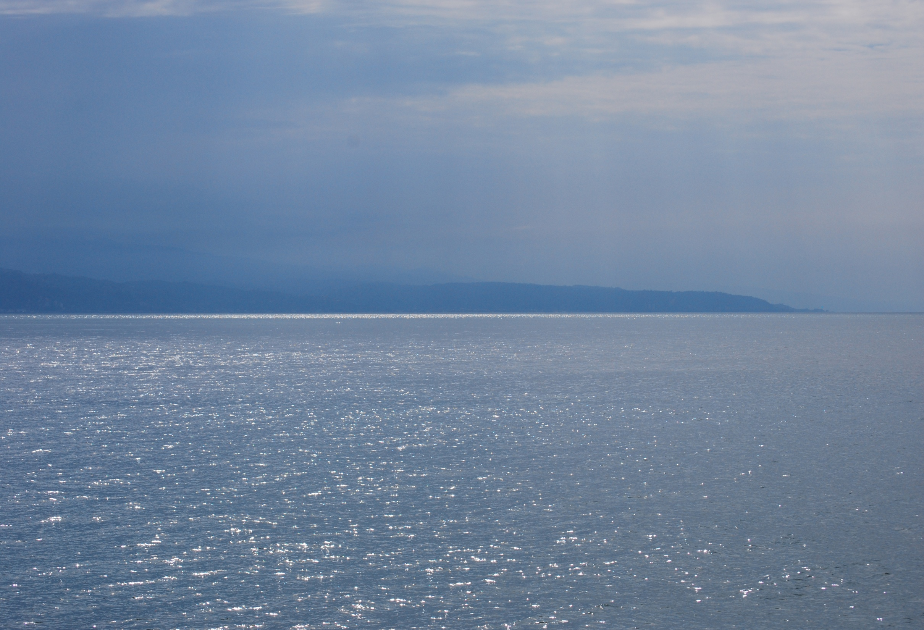


Trento-Padova group in AEgIS Experiment
L. Di Noto, S. Mariazzi, G. Nebbia,
R.S. Brusa
L. Penasa, M.Bettonte

Slide 2
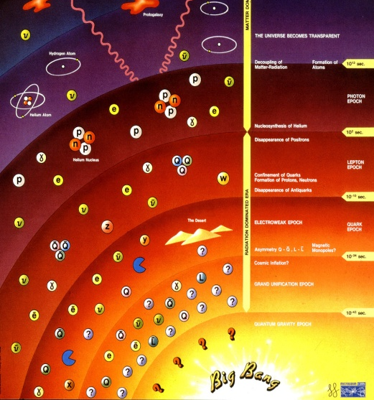
AEgIS
Antimatter Experiment: gravity, Interferometry Spectroscopy
Goals:
Measurement of g on anti-hydrogen
Anti-hydrogen spectroscopy
Methods:
  Produce an Hbar beam
  Moirè deflectometer
Motivations:
verify the Weak equivalence principle (WEP)
Verify the CPT
antimatter disappearance

Slide 3
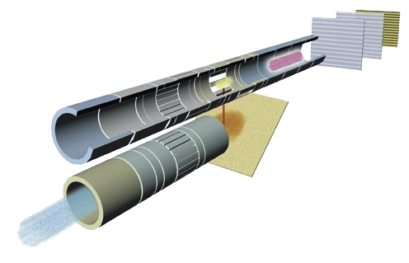
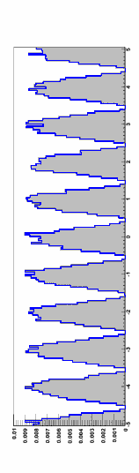
AEgIS experiment
1.Positron-cooled positronium converter
positrons bunch
5 ns e 10⁸
(1 mm in diameter)
2.Lasers for Ps excitation in Rydberg states
Antiprotons 100 mK
3. Anti hydrogen production
4. Moirè
deflectometer
4.Hbar beam formation by
Stark acceleration

Slide 4
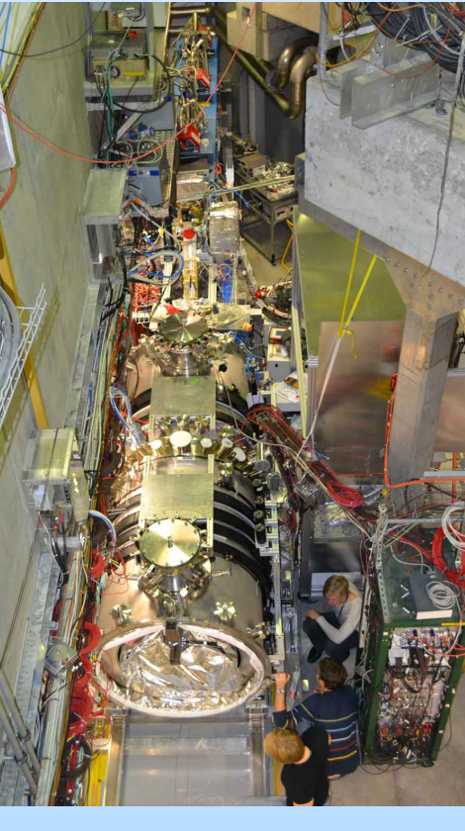
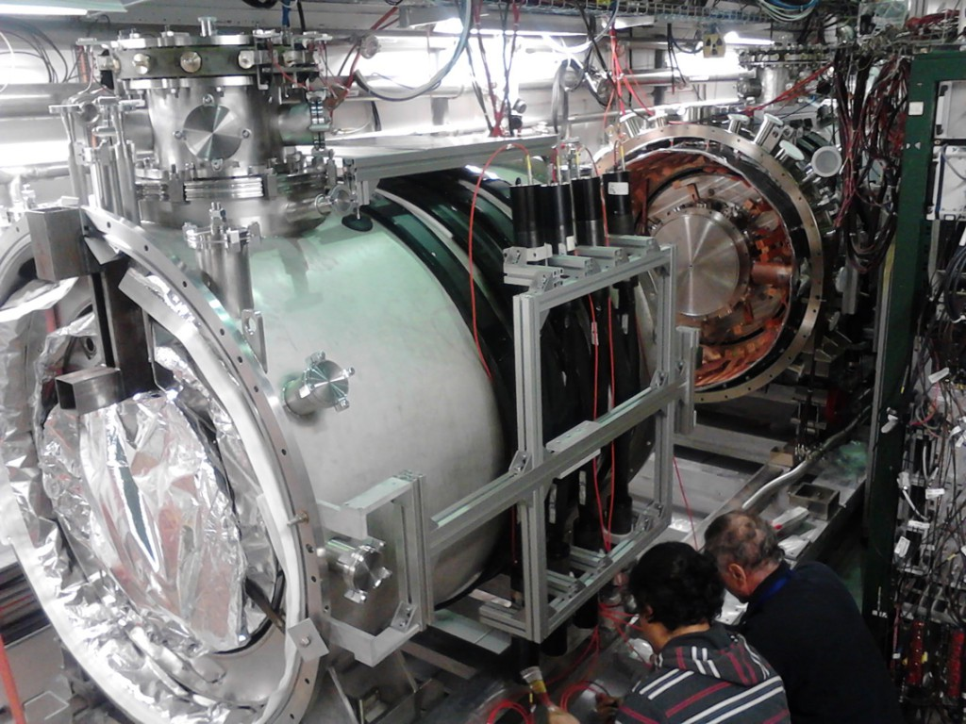
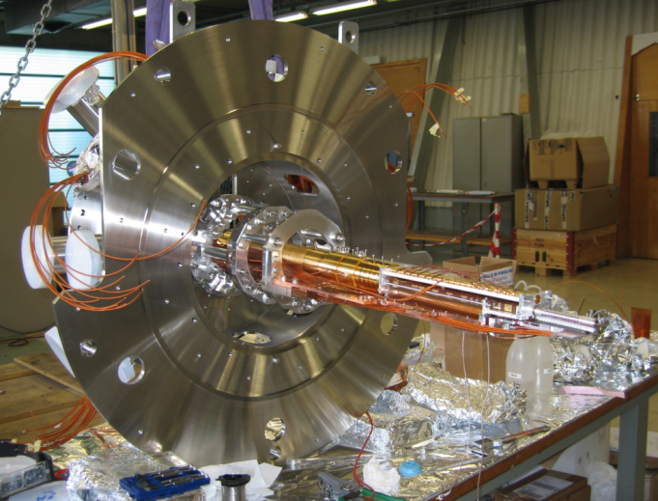
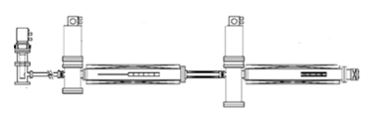
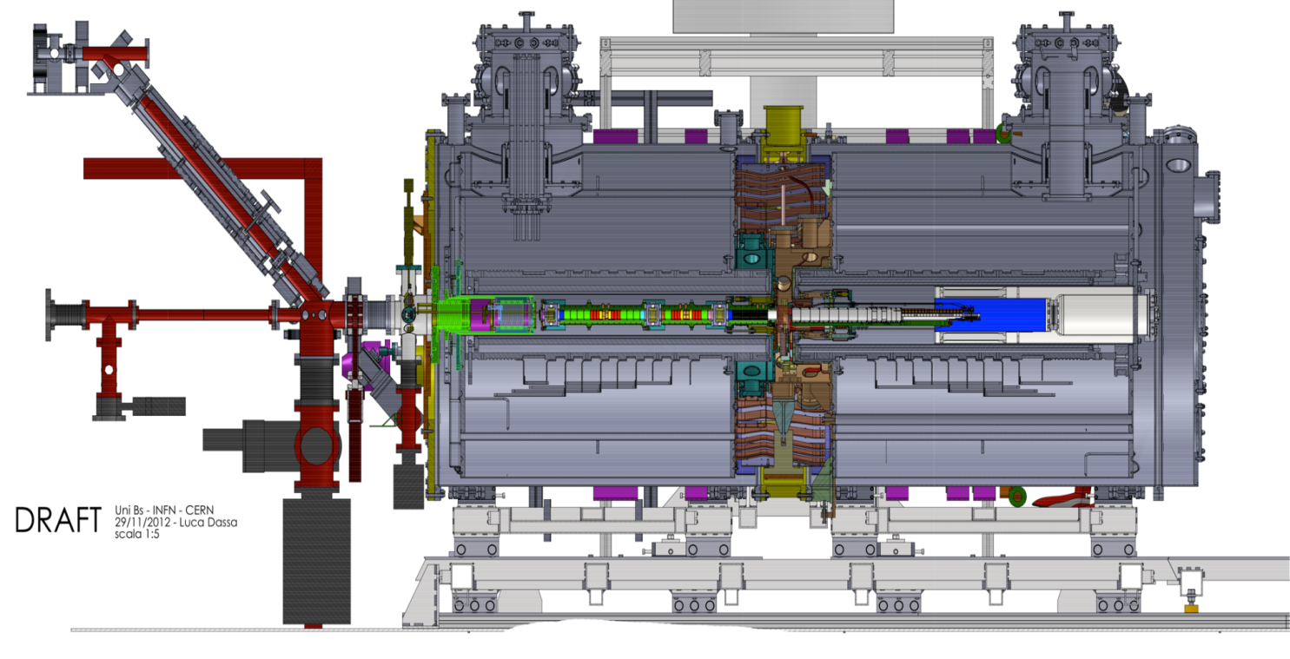
AEgIS apparatus
Antiproton beam from AD

Slide 5
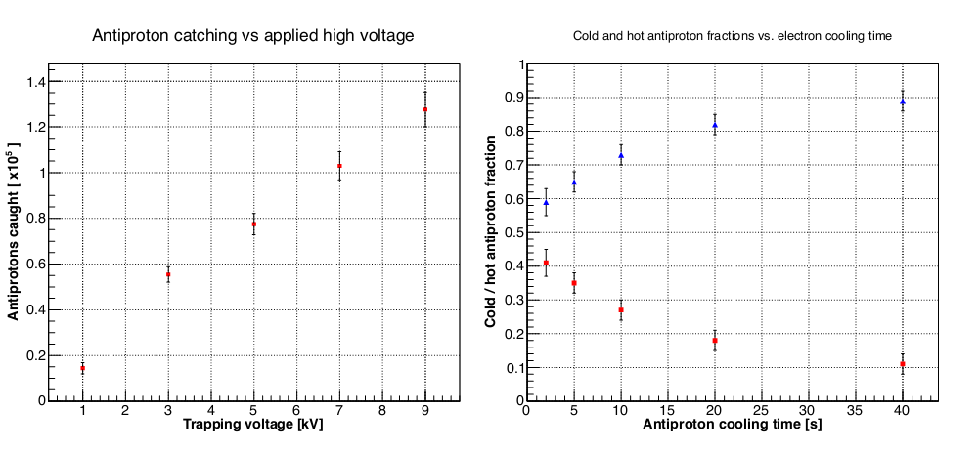
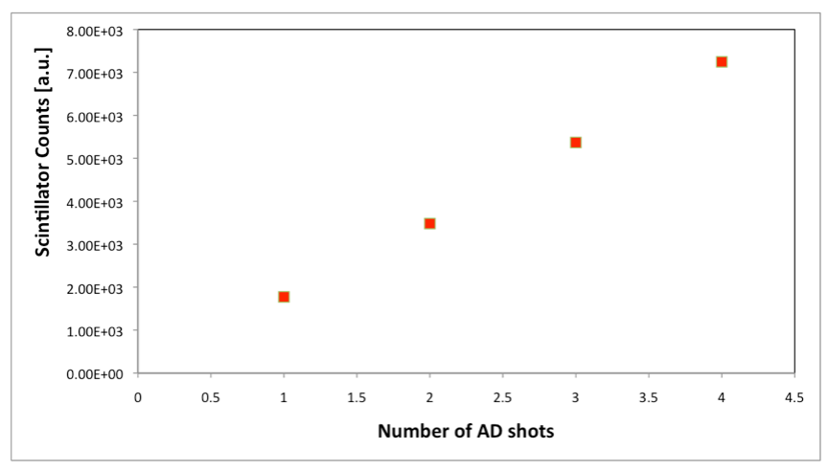
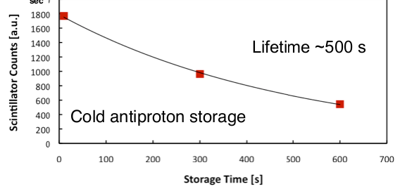
First antiproton run taken in 2012!!
Catching
Cooling
Stacking
Storage

Slide 6
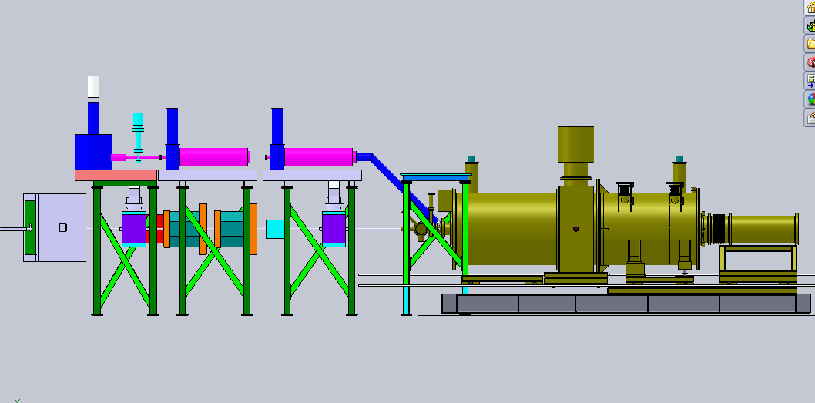
The activities of Trento group
e+ beam
Ps spectroscopy
Ps cooling & converter
1
2
3
Positron source
Positron accumulator
1 T - 100 mK
Anti-hydrogen production
Transfer line
AD SIDE
5 T - 4K
trap
Moirè
Deflectometer
/31
p

Slide 7
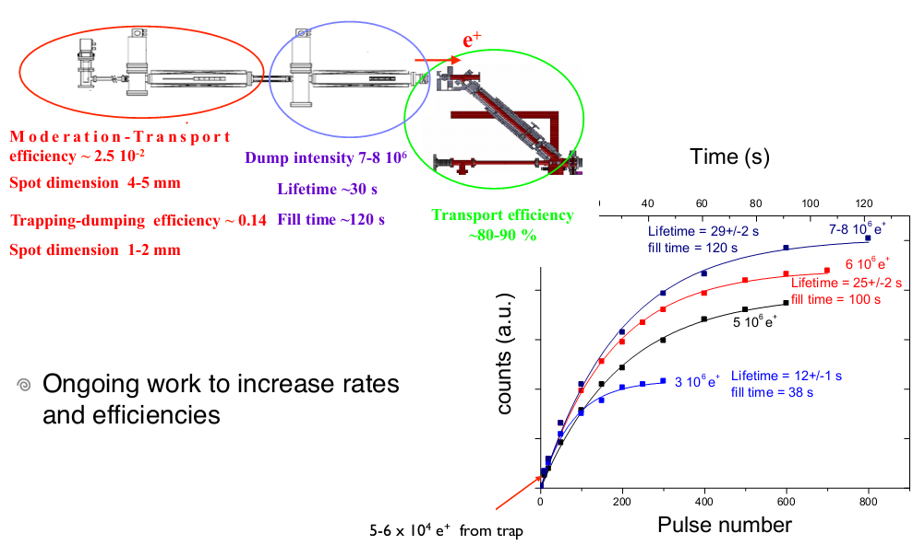
1. Positron system

Slide 8
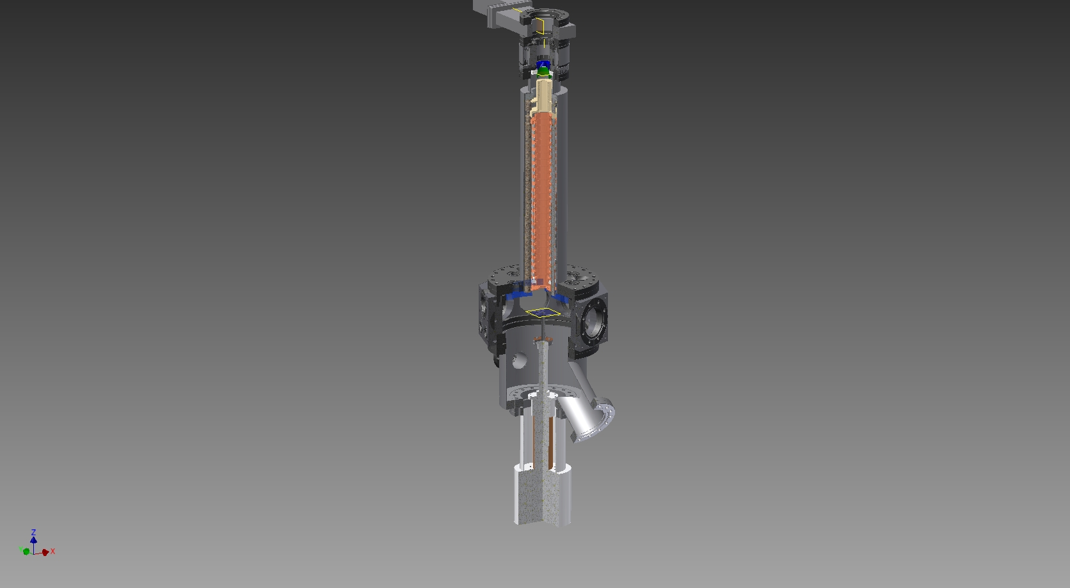
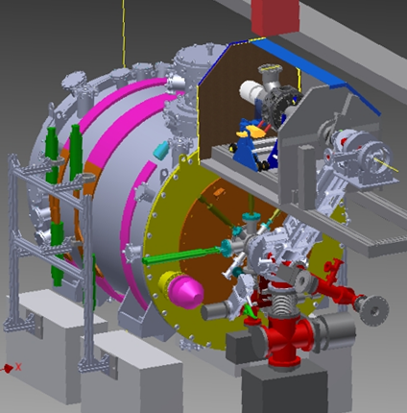
2. Ps spectroscopy
Buncher
Mu metal
electrode
sample
pump
valve
Cryostat
Ion gauge
Total lenght=120cm
AD SIDE
Positron source
Positron accumulator
1 T - 100 mK
Anti-hydrogen production
/31
Transfer line
5 T - 4K
trap
Moirè
Deflectometer
p

Slide 9
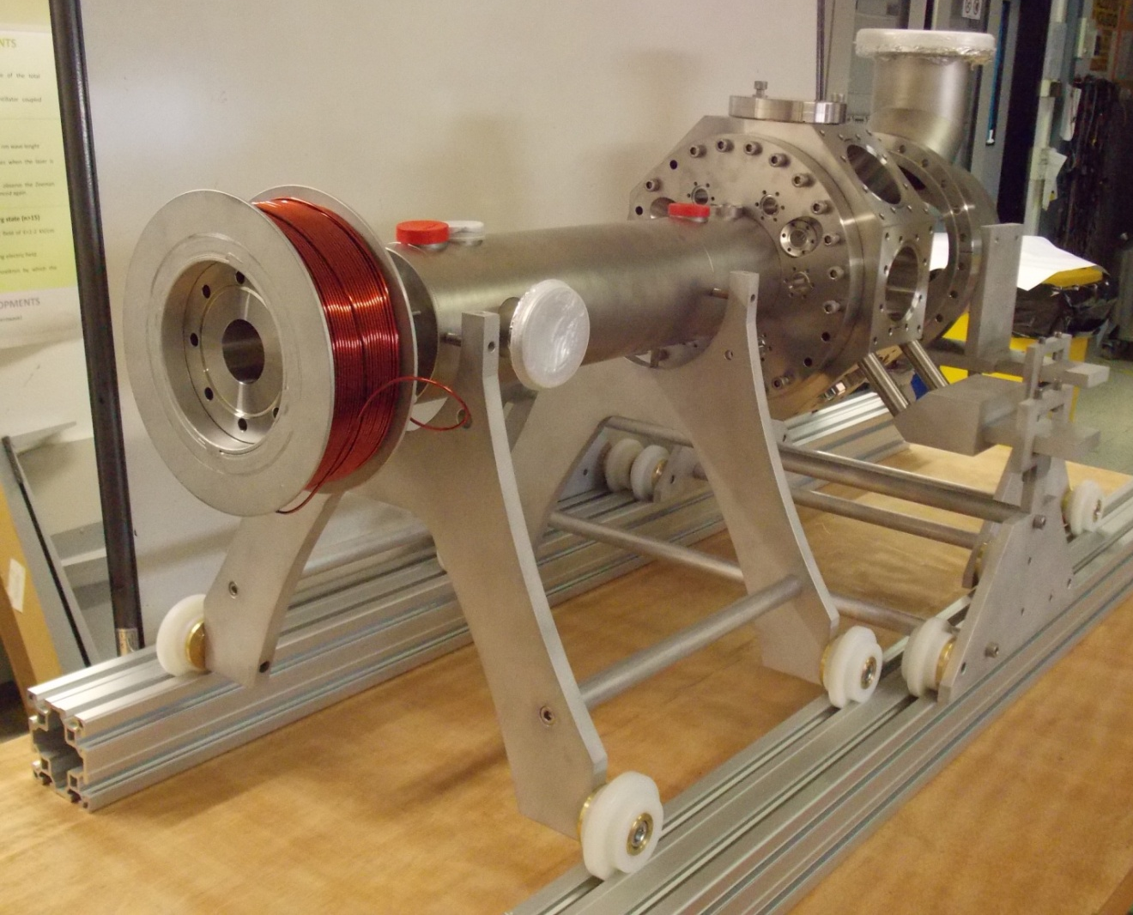
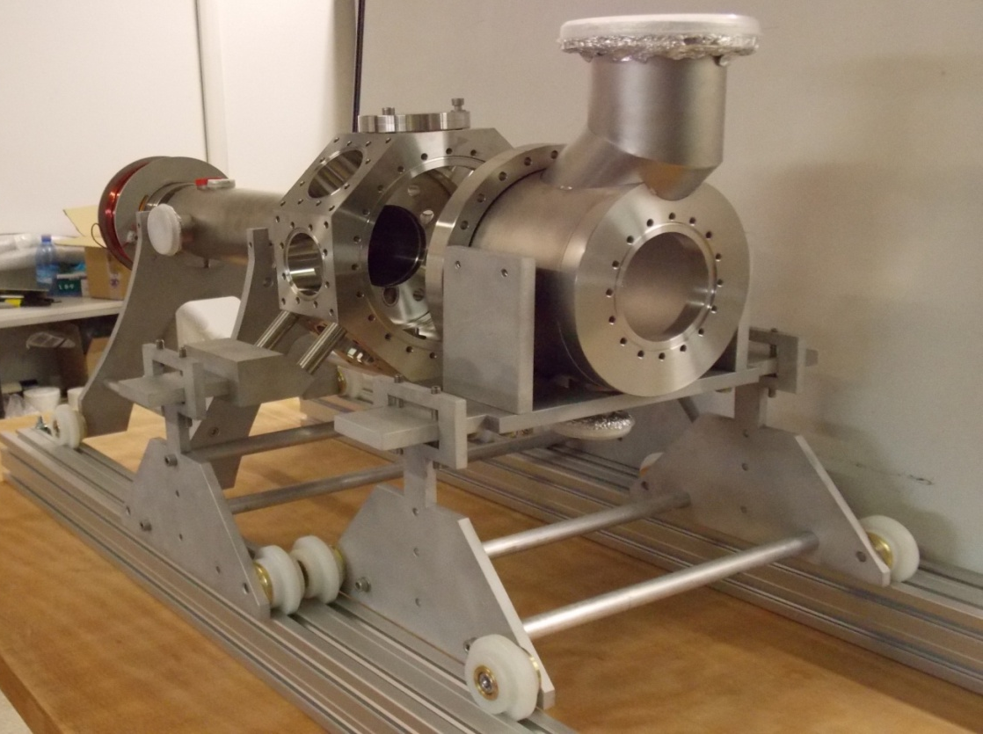
Mechanics: completed!

Slide 10
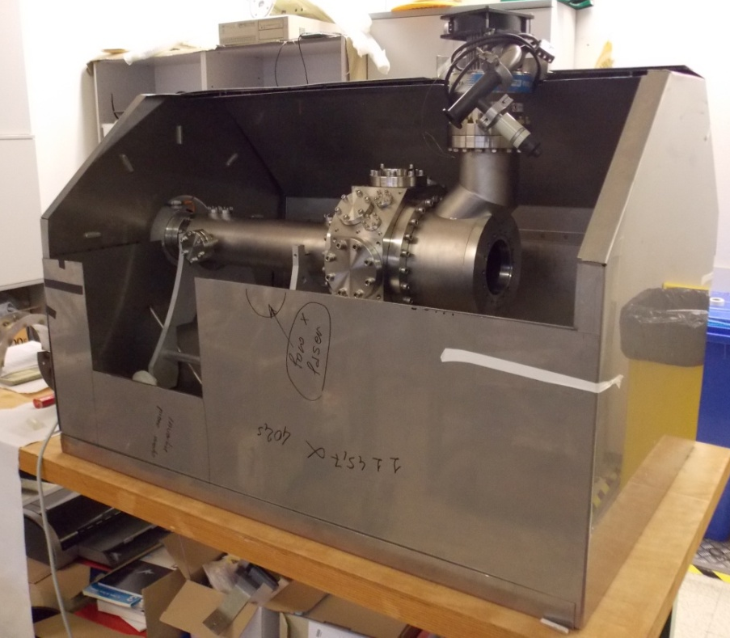
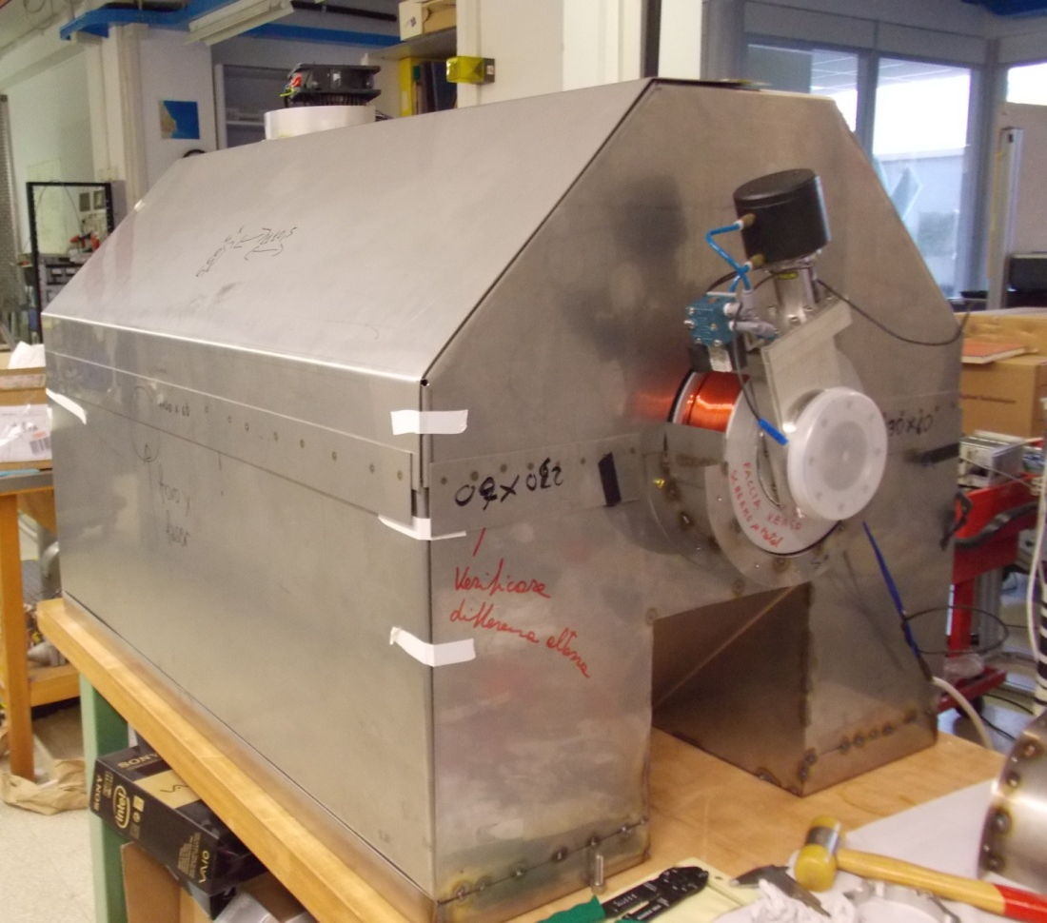
Mu-metal shield
A first dummy in steel was realized
The final shield is under construction in Trento workshop

Slide 11
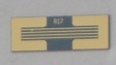
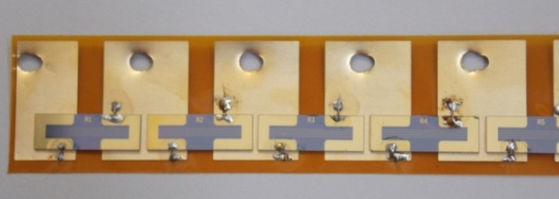
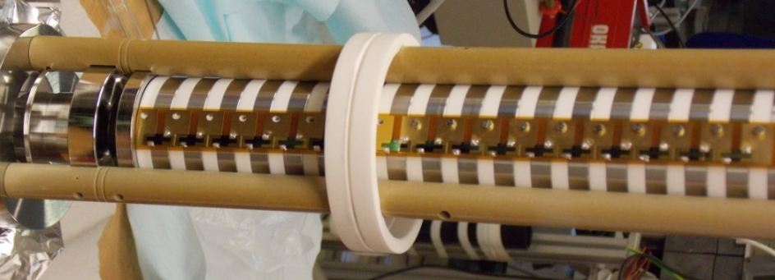

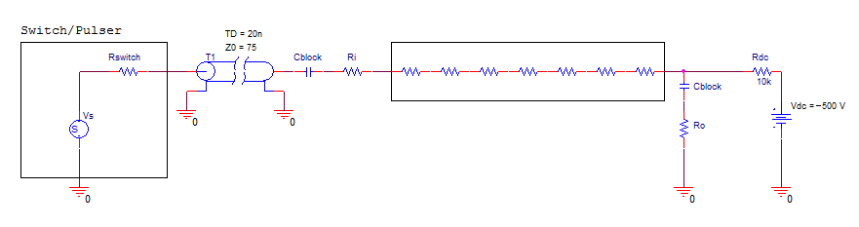
Electronics: under testing
1. Buncher circuit: from -500V to 5-7kV in 5 ns
Gold deposited resistors
ΔV=1800V
This value depends on the desired e+ kinetic energy at the target
ΔV=5-7 kV
Ri
buncher
-500V power supply
Switch of 10 kV
Rf
2. Final lens circuit: from -1kV to 0 V in 10 ns
3. Grids circuit: from 0 V to -700 V in 15
Notes:
Passivo!!

Slide 12
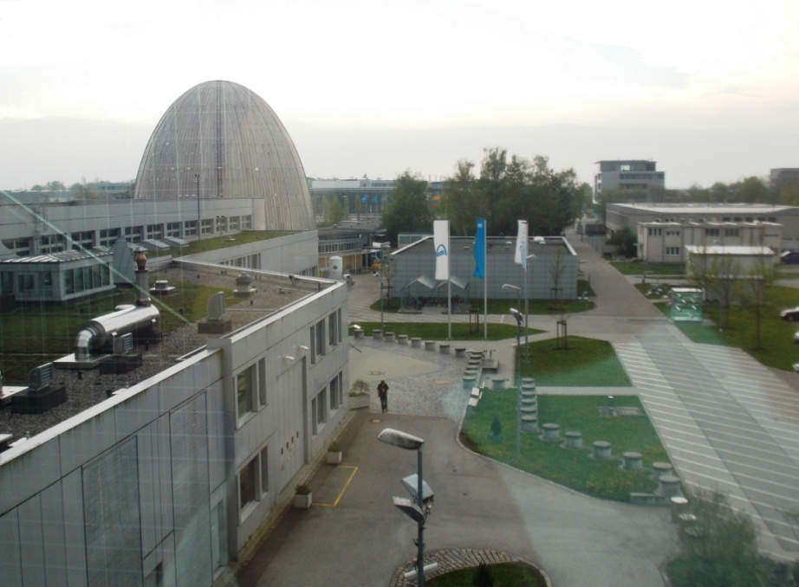
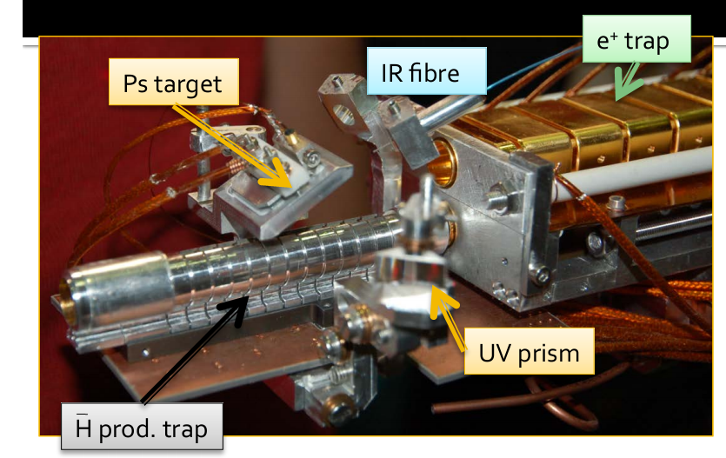
3. Time of Flight measurements
at NEPOMUC facility in Munich 28-April- 8 May 2013
for AEgIS Ps production
Goal: high yield at low temperature v ≈ 10⁴ m/s

Slide 13
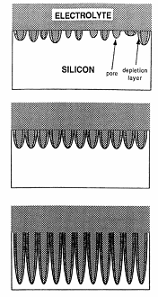

Nanochanneled Si sample
Electrochemical etching of Si p-type
resistivity 0.15-0.21 Ohm/cm
etching current 4-18 mA/cm² ,
etching time 10’-17’
subsequent nanochannel surface oxidation
SiO₂
Positron beam
Si
Ps
Ps
Advantages:
→ high Ps formation and emission into the vacuum
→ possibility to tune the nanochannel dimension (important for Ps cooling at low temperature)
Ps
Ps
Ps

Slide 14
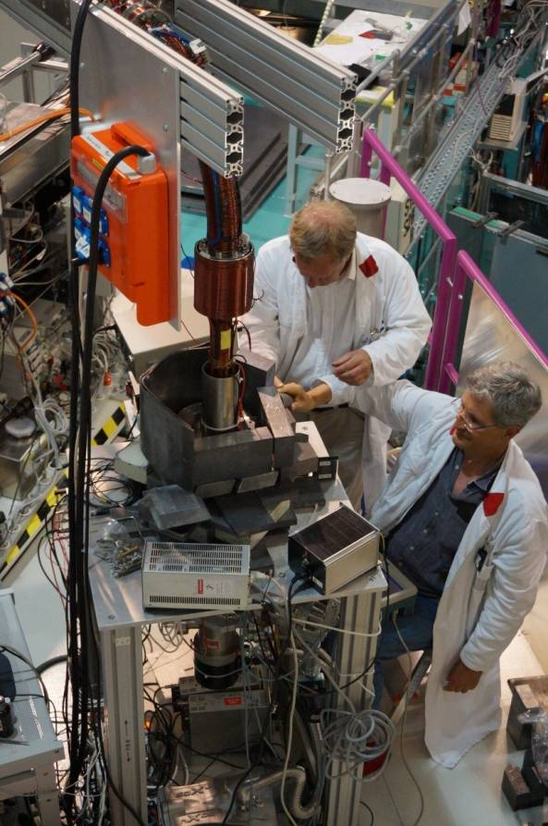
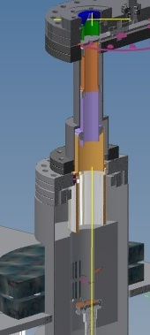
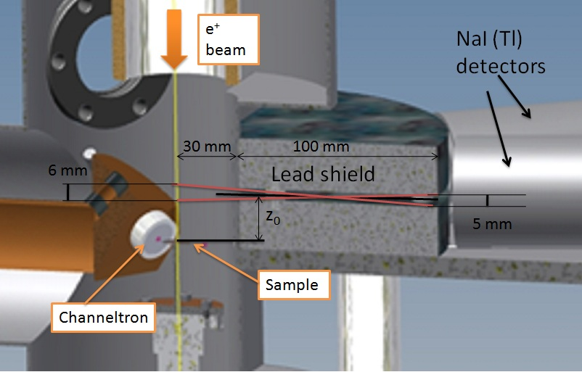
Time of Flight apparatus
Magnetic field terminator
Electrodes for beam transport and focusing
TOF chamber and acquisition system
Di Noto L, Mariazzi S, Bettonte M, Nebbia G and Brusa R S, 2012, EPJ [10.1140/epjd/e2012-20674-7]

Slide 15
From AEgIS point of view
We measured o-Ps time of flight with target of 10-16 nm at 300K and 50 K
→ 32% of o-Ps emitted with v<5•10⁴ m/s
→ 9% of implanted e+
v=5•10⁴ m/s
Nanochannels of 4-7 nm and sample at T=150 K
2% of implanted e+ emitted as o-Ps with v<5•10⁴ m/s
[S. Mariazzi, et al., Phys. Rev. Lett. 104, (2010)]
Notes:
Sottratto fondo e moltiplicato per e…

Slide 16
Attività 2014
CERN : Test apparato eccitazione Ps – Test rivelazione Ps – misure
Spettroscopiche Ps.
2. CERN: settaggio fascio e+ nel magnete 5T e 1 T-
rivelazione Ps nel magnete 1 T
3. FRMII a Monaco. misure TOF Ps

Slide 17
Costituzione gruppo 2014
Roberto S. Brusa (PA) (100%)
G. Nebbia (INFN) (100%)
L. Di Noto (assegnista) (100%)
M. Eccher (assegnista) (100%)
Ing. L. Penasa (tecnico) (100%)
M. Bettonte (tecnico) (100%)
Richieste 2014 (in k€)
 | Missioni | Consumo | Apparati | Tot
 | 29 | 7 | 17 | 50 k€
Per i lavori previsti si utilizzeranno le officine
meccaniche ed elettroniche di Trento e del CERN

Slide 18
Giustificazione richieste 2011
Missioni
25 k€: 6 mesi uomo CERN per test - misure eccitazione Ps – settaggio fascio e+ nel magnete 5T e 1 T- rivelazione Ps nel magnete 1 T
4 k€: 1 mesi uomo FRMII per misure cooling Ps
TOT 29 k€
Apparati:
1 digitizer CAEN per analisi segnali rapidi da 1 Gsample/s a 10 bit circa;
2 quad timing filter amplifier Ortec 863 per channeltron e NaI circa;
1 CF800 Ortec discriminatore 8 canali circa; dual ADC 7072T.
17 k€
Consumabili : rivelatori-componentistica elettronica – materiale da vuoto - 7 k€

