Slide 1
EXOTIC 2013 → 2014 (8 ricercatori, 6 FTE)
PD (4.5 FTE)
M. Mazzocco, C. Parascandolo, C. Signorini, F. Soramel, E. Strano, D. Torresi
NA (1.5 FTE)
M. La Commara, D. Pierroutsakou
MI (0.4 FTE)
A. Guglielmetti
National and International Collaborations: LNS, INFN-Sez. Catania, LNL, Univ. of Ioannina and HINP (Greece), IASA and Univ. of Athens (Greece), Univ. of Thessaloniki (Greece), Horia Hulubei-NIPNE (Romania), IFJ-PAN(Krakow, Poland), Univ. Of Warsow (Poland), Univ. Of Huelva (Spain), CEA-Saclay (France), CNS (Tokyo, Japan), coll. KEK/JAEA, Univ. Osaka (Japan), Univ. Birmingham

Slide 2
The EXOTIC project at LNL
Research Interest: Dynamics induced by light weakly-bound Radioactive Ion Beams at Coulomb barrier energies.
Facility: development of the facility EXOTIC at LNL for the RIB production via the in-flight technique.
Commissioning of the EXOTIC facility in 2004
F. Farinon et al., NIM B 266, (2008) 4097, M. Mazzocco et al., NIM B 266, 4665 (2008)
First “beam for experiment” (¹⁷F) in 2006:
D. P. et al., EPJ ST 150, (2007) 47, C. Signorini et al., EPJ A 44, 63 (2010)

Slide 3
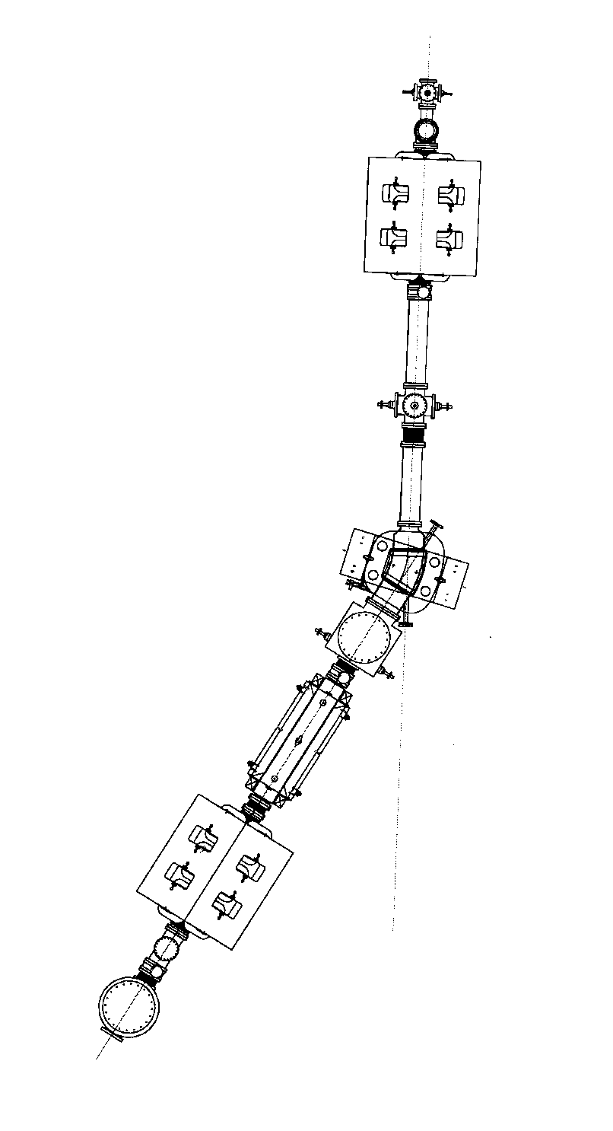
The EXOTIC beamline @ LNL
primary beam
Cryogenic production gas target: 5-cm long double-walled cylindric cell: H₂,D₂,³He,⁴He
Entrance (exit) windows: 14 (16) mm
2 havar windows: 2.2 μm
Pressure: up to 1.4 bar.
1 – 1st slit system
2 – production gas target
3 – 1st quadrupole triplet
4 – 2nd slit system
5 – 30° analysing magnet
6 – 3rd slit system
7 – Wien filter and 4th slit system
8 – 2nd quadrupole triplet
9 - 4th slit system
9 – scattering chamber
1
2
3
4
5
6
7
Solide angle Δω ̴ 10 msr
Energy acceptance ΔE/E ±10%
Momentum acceptance Δp/p ± 5%
Horizontal acceptance Δθ ± 50 mrad
Vertical acceptance Δφ ± 65 mrad
Magnetic rigidity Bρ 0.98 Tm
8
9
1 m
10
RIB

Slide 4
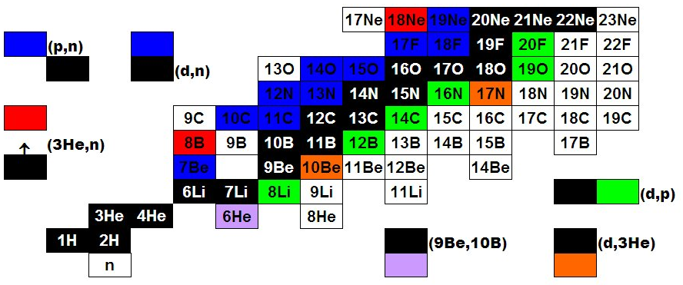
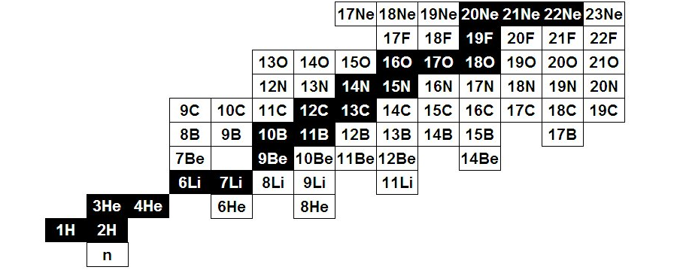
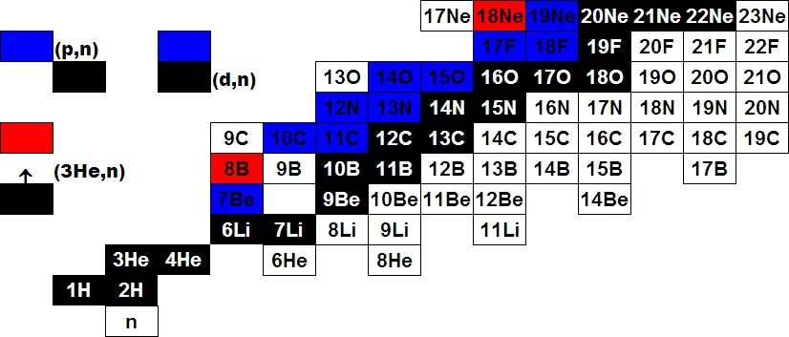
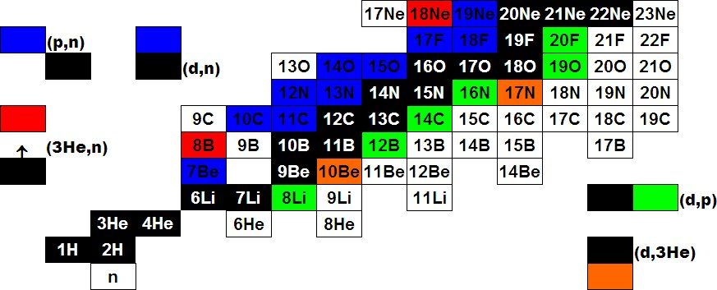
Light RIBs @ EXOTIC
¹⁷F E = 3–5 MeV/u Purity: 93-96% Intensity: 10⁵ pps (ANL)
⁸B E = 3 MeV/u Purity: 40-50% Intensity: 10³ pps (ND, CRIB)
⁷Be E = 3 MeV/u Purity: 99% Intensity: 2-3*10⁵ pps (ND, CRIB)

Slide 5
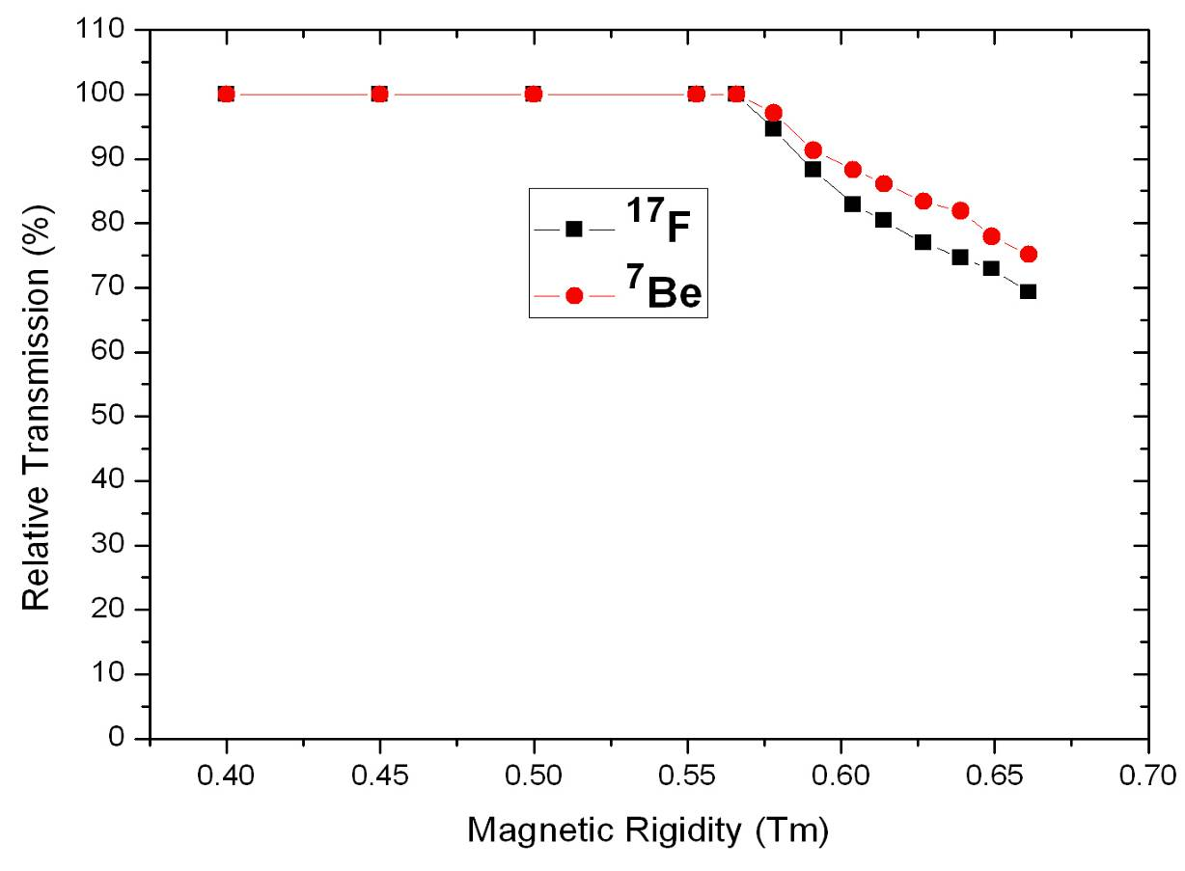
The EXOTIC Upgrade (FIRB project)
V_{b} ¹⁷F + ⁵⁸Ni
V_{b} ⁷Be + ²⁰⁸Pb
V_{b} ⁷Be + ⁵⁸Ni
V_{b} ¹⁷F + ²⁰⁸Pb
The facility has been recently upgraded (financed within the project FIRB cod. RBFR08P1W2_001) of their power supplies will increase the RIB maximum magnetic rigidity by + 15 %, thus providing:
1) 35% increase of the RIB’s maximum energy
2) Higher Transmission (and secondary beam intensity)
3) B-scaling of all ion-optical elements

Slide 6
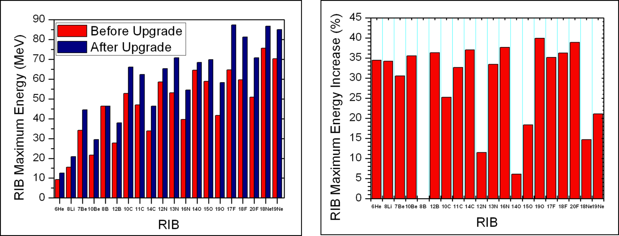
The EXOTIC Upgrade (FIRB project)
Inrease of the maximum RIB’s energy after the upgrade
M. Mazzocco et al., NIM B, Proceeding of the EMIS2012 (to be published)

Slide 7
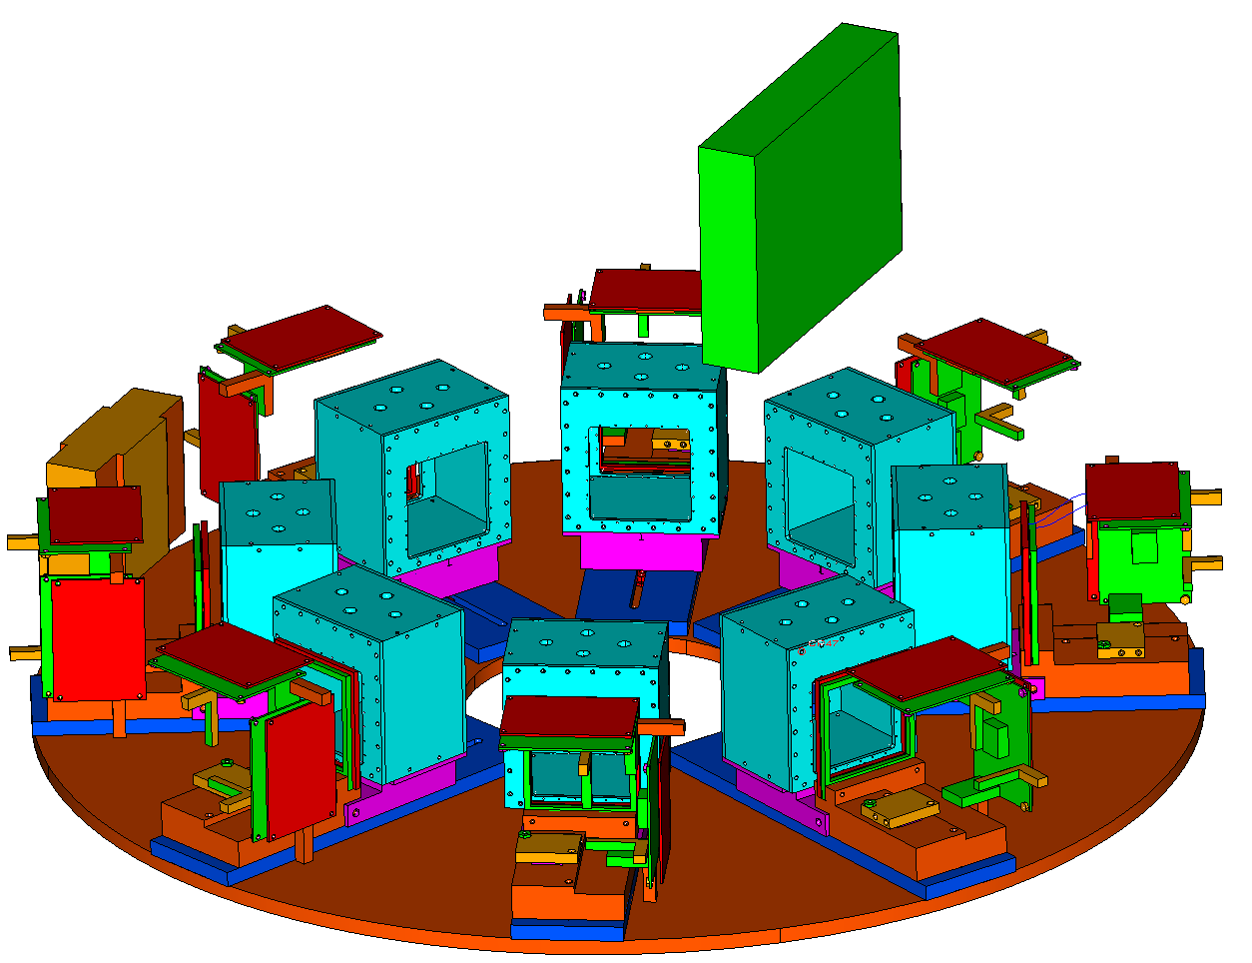
EXOTIC new apparatus for measurements with RIBs
Motherboard
ΔE - E
PPAC_B
BEAM
Ionization Chamber (ΔE)
8 Telescopes each one consisting of:
ΔE – Ionization Chamber
ΔE(40 μm) + E (300 μm)
Double Sided Silicon Strip Detectors
62.5 x 62.5 mm² active area
32 x 32 strips (2 mm) Δθ=1 ° at d=10 cm
last stage: 50 x 50 mm² 500 μm Silicon (single pad) from the EXODET set up
Z identification through ΔE-E
TOF information
Good energy, time and angular resolution
High granularity: coincidence measurements
Coverage: 24% of 4π sr

Slide 8
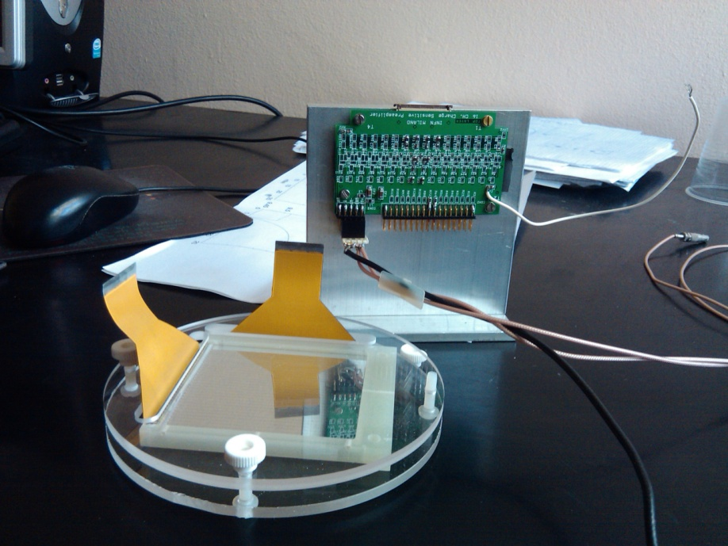
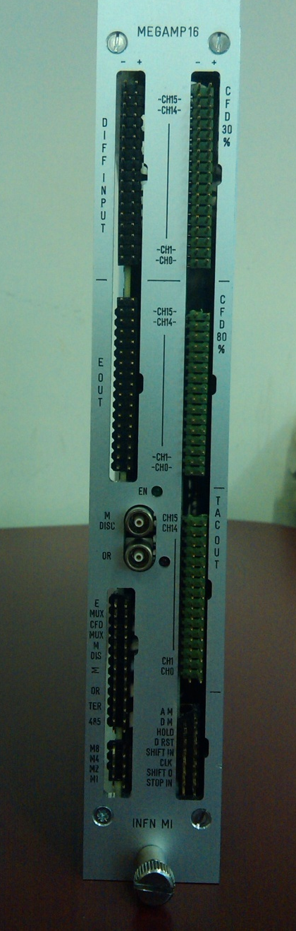
ΔE stage: DSSD 40 μm
Readout: home made highly integrated low-noise electronics (INFN, Milan)
16 channel low-noise pre–amplifier boards
16 channel MEGAMP: (SA+CFD+TAC) modules that allow a sequentially read out of both energy and timing information by means of a fast multiplexer circuit
C. Boiano et al, 2012 IEEE NSS 2012
ΔE (FWHM): 34 keV
Δt (FWHM): 0.5 ns

Slide 9
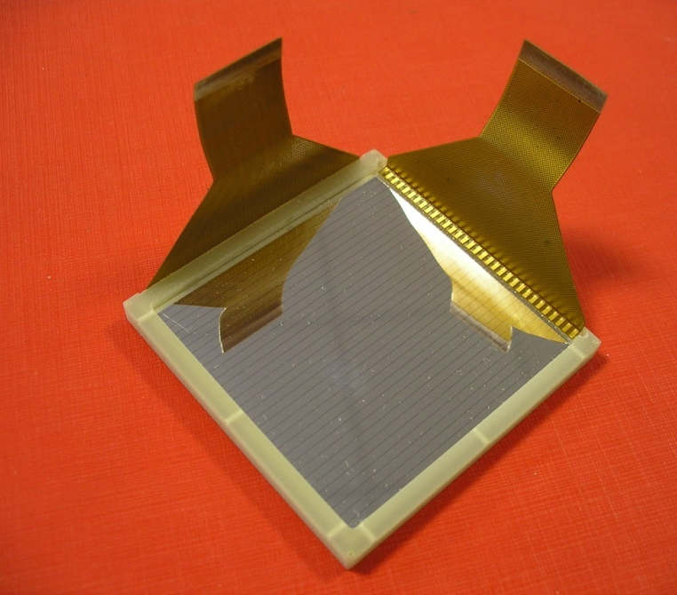
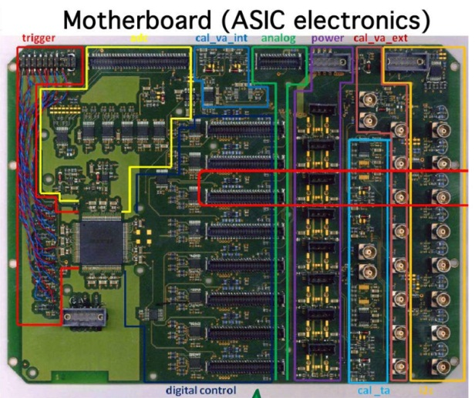
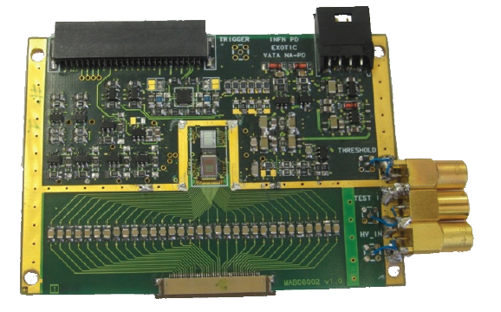
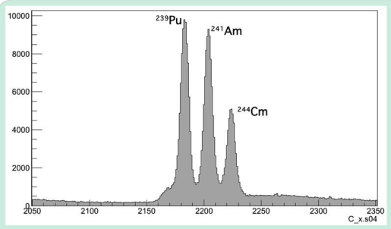
Ε stage: DSSD 300 μm
ASIC electronic board VATA
Innovative readout electronics by means of an 32-channel ASIC chip manufactured by IDEAS-GM (Norway) dedicated to the treatment of the linear and the logical part of the electronic signals coming from the detector strips.
Energy Resolution achieved: 80 keV
M. Romoli et al., NIM B 266, 4637 (2008)
E. Strano et al., NIM B, Proceeding of the EMIS 2012 (to be published)

Slide 10
⁷Be+⁵⁸Ni @ EXOTIC (05/2010)
⁷Be: S_{a} = 1.587 MeV, T_{1/2} = 53.22 d
Primary Beam: ⁷Li³⁺
E_{lab}= 34.2 MeV
i ~ 100-150 pnA on target
Target: H₂ Gas
p₁ = 1 bar, T₁ = 90 K
(t₁ ~ 1.35 mg/cm²)
Secondary Beam: ⁷Be⁴⁺
E₁ = (23.2 ± 0.4) MeV
Purity₁ ~ 100 %
Degrader: 10 μm Al
E₂ = (19.0 ± 0.5) MeV
Purity₂ ~ 100 %
Intensity: 2-3*10⁵ pps
Δx ̴ Δy (FWHM) ̴ 8 mm

Slide 11
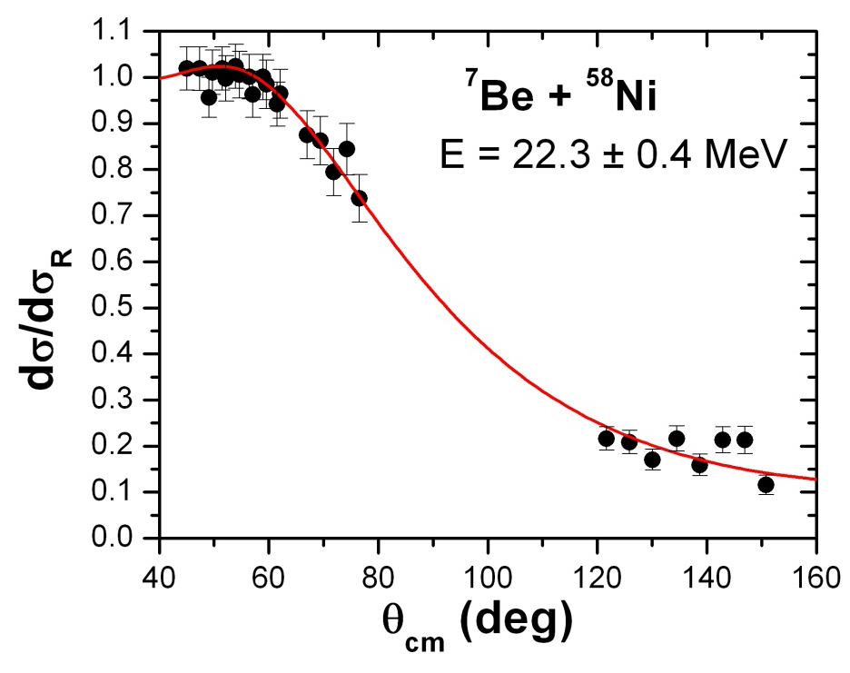
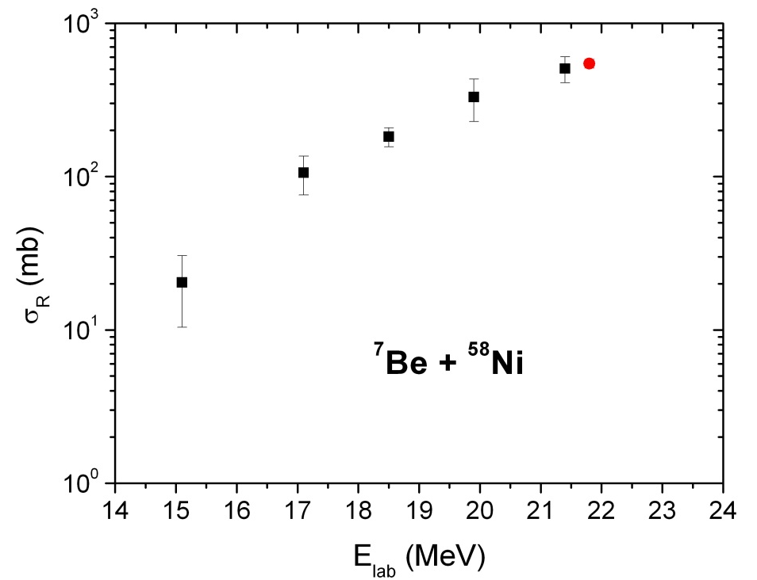
⁷Be+⁵⁸Ni @ EXOTIC: Reaction cross sections
The elastic scattering angular distribution was fitted within the optical model framework with the code FRESCO.
The reaction cross section (546 ± 36 mb) is in fairly good agreement with the trend individuated by the data at lower energies.

Slide 12
⁷Be+⁵⁸Ni @ EXOTIC: ³He and ⁴He production
³He,⁴He
p,d,t
A fairly large charged particles production, mainly ¹H and ³He, ⁴He, was observed both at forward and backward angles.

Slide 13
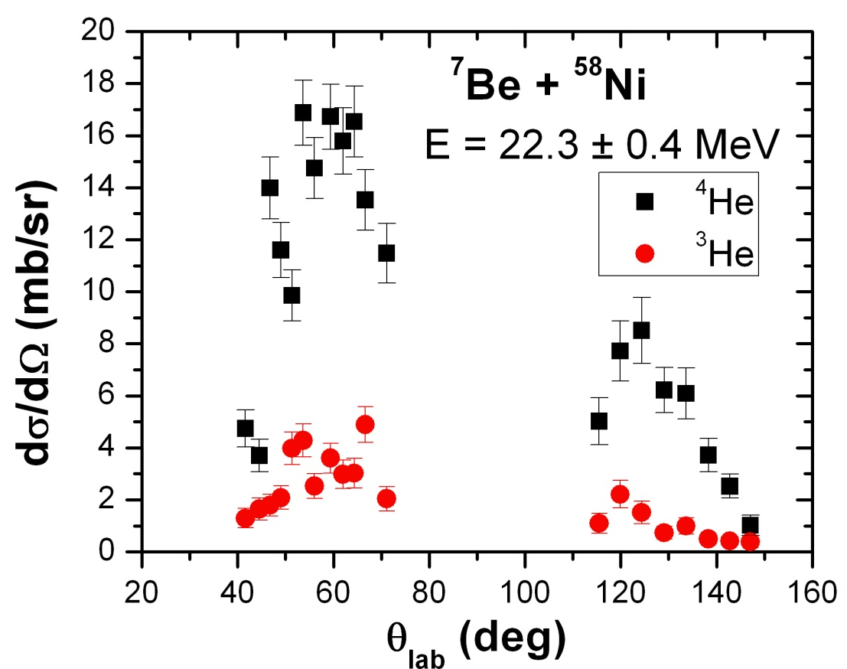
⁷Be+⁵⁸Ni @ EXOTIC: ³He and ⁴He angular distributions
⁴He ions are about 4-5 times more abundant than ³He.
Their angle-integrated cross sections sum up to ~ 20 mb and ~ 100 mb for ³He and ⁴He, respectively.
The breakup channel ⁷Be → ³He + ⁴He is not the only reaction mechanism responsible for the ³He and ⁴He production.
What else? Transfer? Fusion?

Slide 14
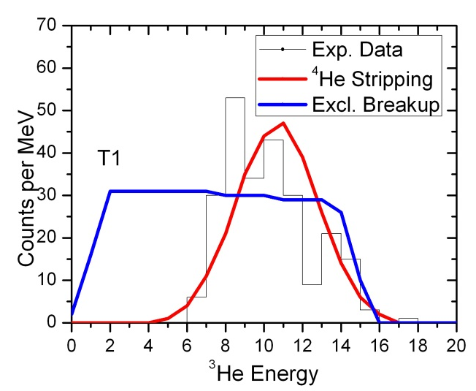
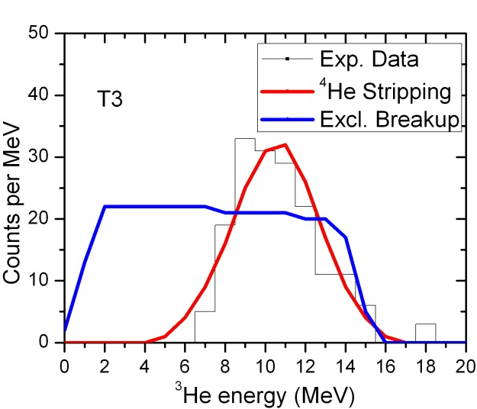
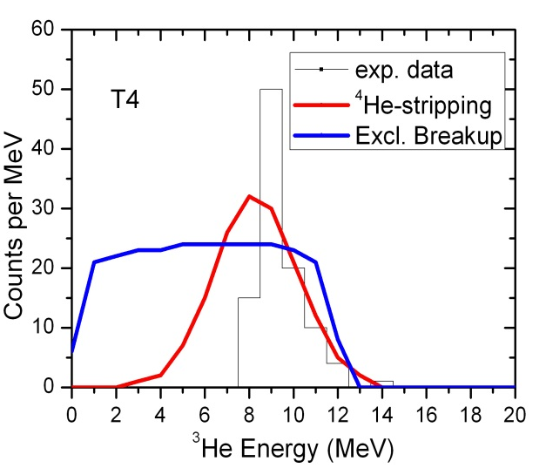
⁷Be+⁵⁸Ni @ EXOTIC: ³He energy spectra
  ³He can be originated by two main processes:
  Exclusive Breakup: ⁷Be → ³He + ⁴He;
  ⁴He-Stripping: ⁷Be + ⁵⁸Ni → ³He + ⁶²Zn (Q_{val} = +1.78 MeV, E_{x} = 10.81 MeV).
³He energy spectra compatible with a ⁴He-Stripping process

Slide 15
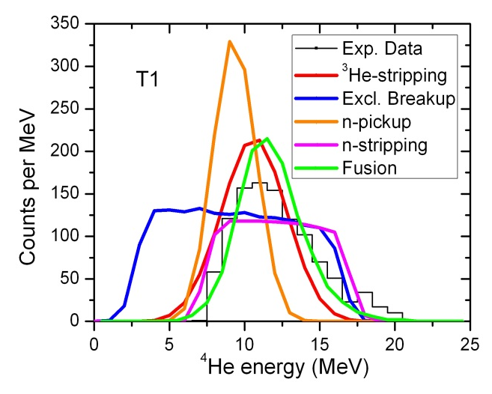
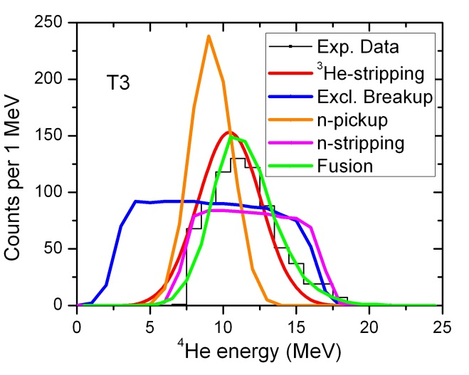
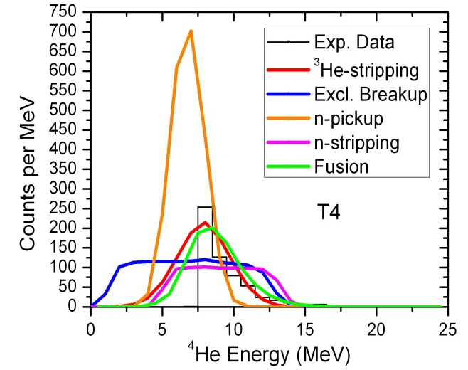
⁷Be+⁵⁸Ni @ EXOTIC: ⁴He energy spectra
  ⁴He can be originated by several processes:
  Exclusive Breakup ⁷Be → ³He + ⁴He;
  ³He-Stripping: → ⁴He + ⁶¹Zn (Q_{val} = +9.46 MeV, E_{x} = 18.49 MeV).
  n-Stripping: → ⁶Be (= ⁴He+2p) + ⁵⁹Ni (Q_{val} = –1.68 MeV, E_{x} = 0 MeV);
  n-Pickup: → ⁸Be (= 2⁴He) + ⁵⁷Ni (Q_{val} = +6.68 MeV, E_{x} = 6.68 MeV);
  ⁴He evaporation after compound nucleus formation (Fusion).
Energy spectra are mainly compatible with ³He-Stripping and Fusion

Slide 16
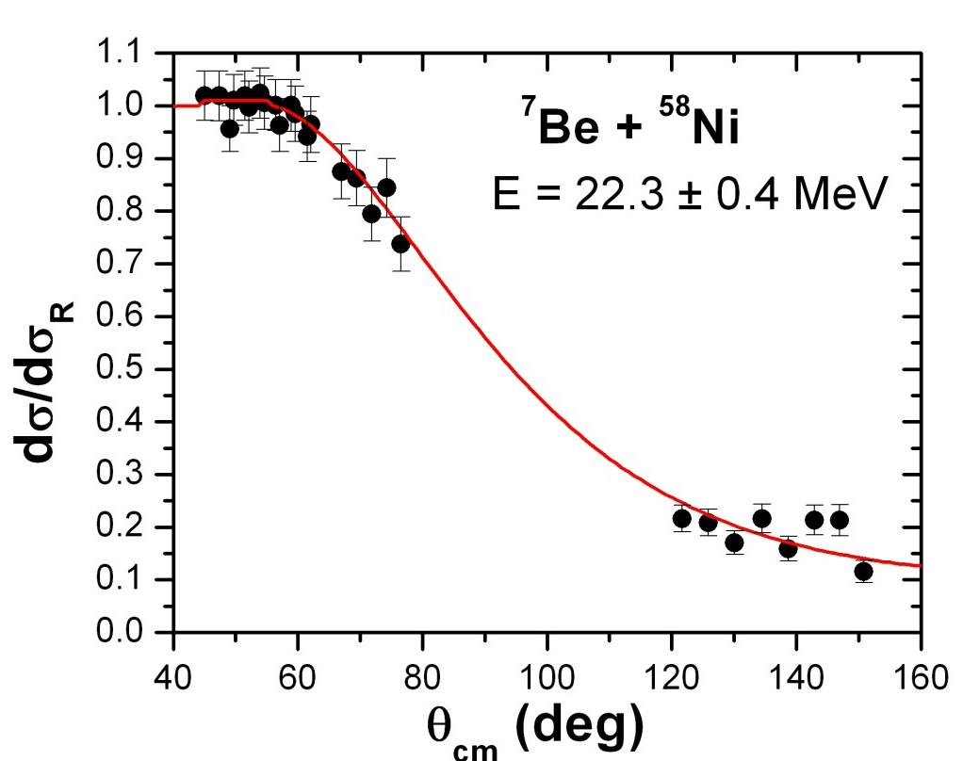
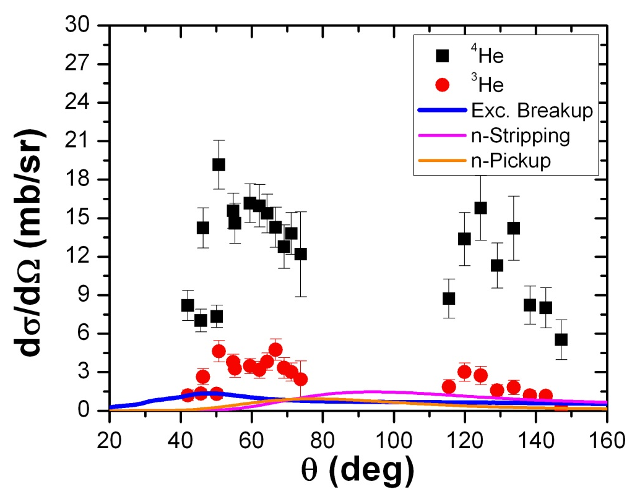
⁷Be+⁵⁸Ni @ EXOTIC: ⁴He coincidences
Within the geometrical efficiency of the set-up, no detection of:
⁴He+³He (Exclusive Breakup) coincidences (σ < 3 mb);
⁴He+⁴He (n-Pickup) coincidences (σ < 6 mb);
⁴He+¹H (n-Stripping) coincidences (σ < 7 mb).
Theoretical (CDCC and DWBA) calculations (by N. Keeley):
Exclusive Breakup: 9.3 mb
n-Pickup: 5.8 mb
n-Stripping: 10.3 mb
Theoretical and experimental confirmation that ³He and ⁴He are mainly produced by other reaction mechanisms, ⁴He- and ³He-stripping (plus fusion?)
Theoretical calculations of the ³He and ⁴He transfer angular distributions will help to disentagle the question
(INPC2013, paper in preparation)

Slide 17
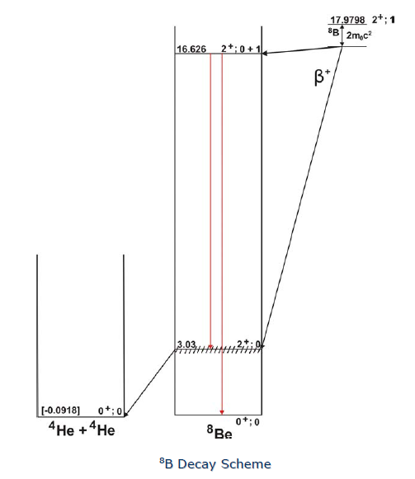
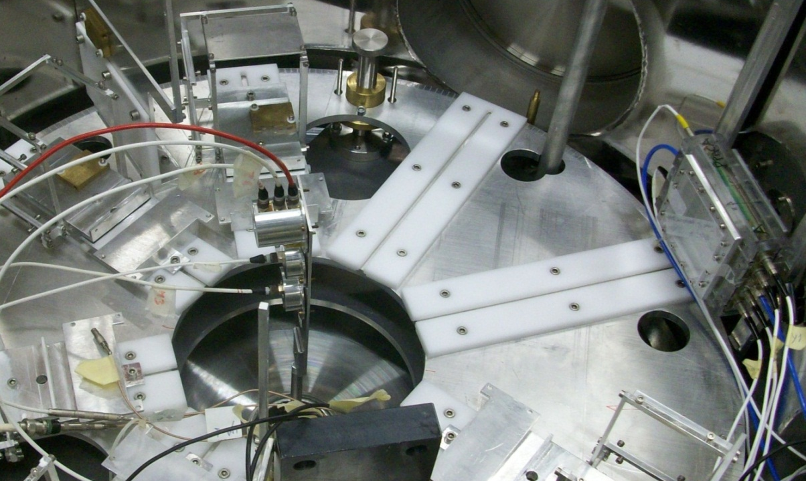
⁸B+²⁸Si @ EXOTIC
  Experimental setup: ΔE 45 μm + ΔE 45 μm + E 2000 μm set at 0° degrees used both as an active target and as a calorimeter.
  Reaction events are separated from non reaction events from their energy.
  Fusion cross section obtained from the α particle cross section.
  ΔE-E technique allows for particle identification and for frame scattering rejection
  Pile up rejection challenging

Slide 18
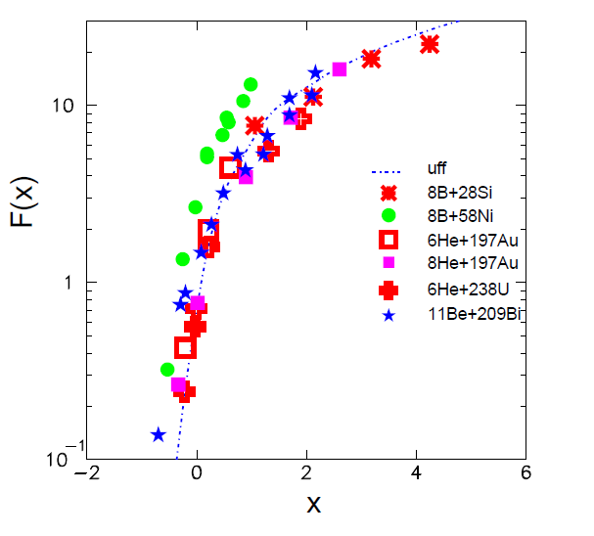
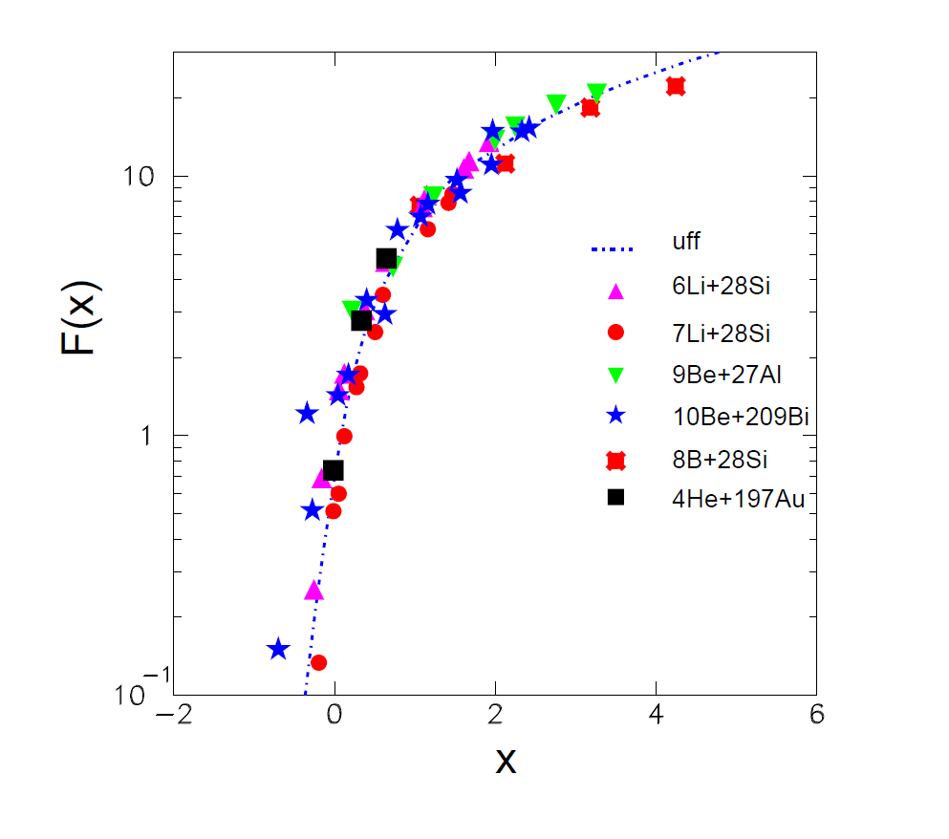
⁸B+²⁸Si @ EXOTIC: Reduced Fusion cross section
Despite the ⁸B proton halo nature, the fusion of ⁸B+²⁸Si at near barrier energies is compatible with the results of weakly bound but stable projectiles and with the 2n-halo ⁶He exotic projectile on the same or similar target and also with the UFF curve.
A. Pakou et al., PRC 87, 014619 (2013)

Slide 19
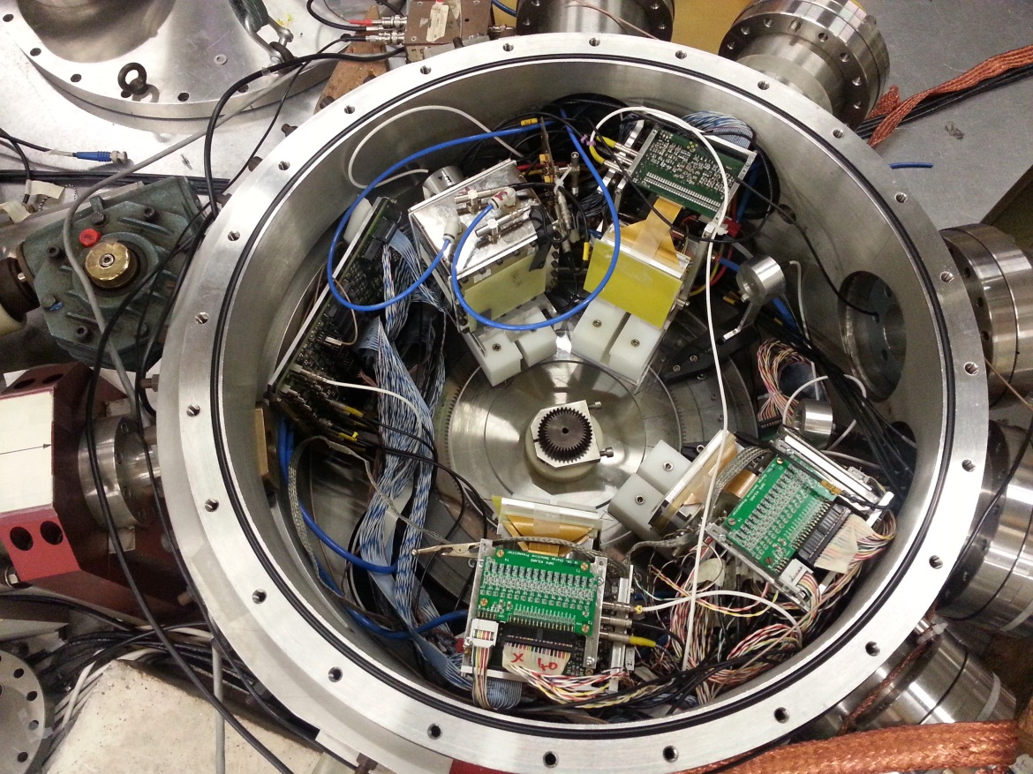
¹⁷O+⁵⁸Ni,²⁰⁸Pb @ LNL (15-17 november 2012)
1)Commissioning of the whole telescope of the new experimental apparatus and the relative electronics
2)Study of the elastic scattering and reaction cross section for the ¹⁷O+⁵⁸Ni,²⁰⁸Pb systems at different energies around the Coulomb barrier

Slide 20
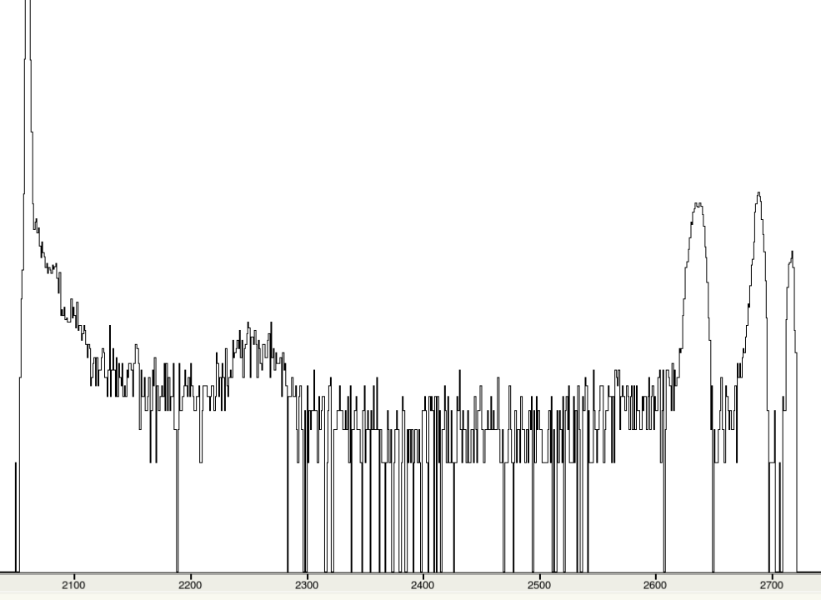
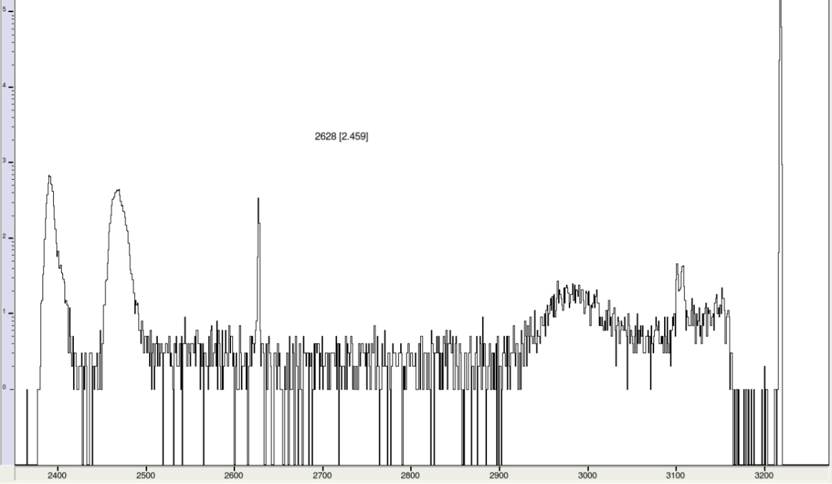
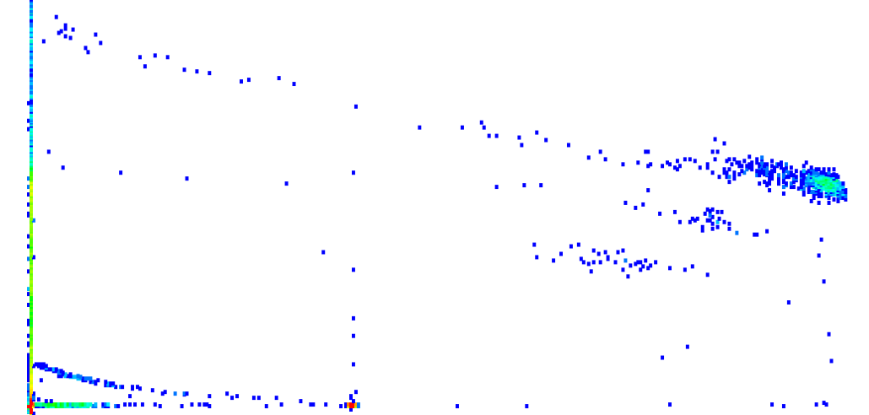
¹⁷O+⁵⁸Ni,²⁰⁸Pb @ LNL: raw data
¹⁷O+⁵⁸Ni,²⁰⁸Pb @ 42.5 MeV
300 μm x strips
ASIC
300 μm x strips
²⁰⁸Pb
²⁰⁸Pb
⁵⁸Ni
pulser
⁵⁸Ni
α
pulser
IC+Si detector
¹⁷O+²⁰⁸Pb @ 84 MeV
O
N
C
He

Slide 21
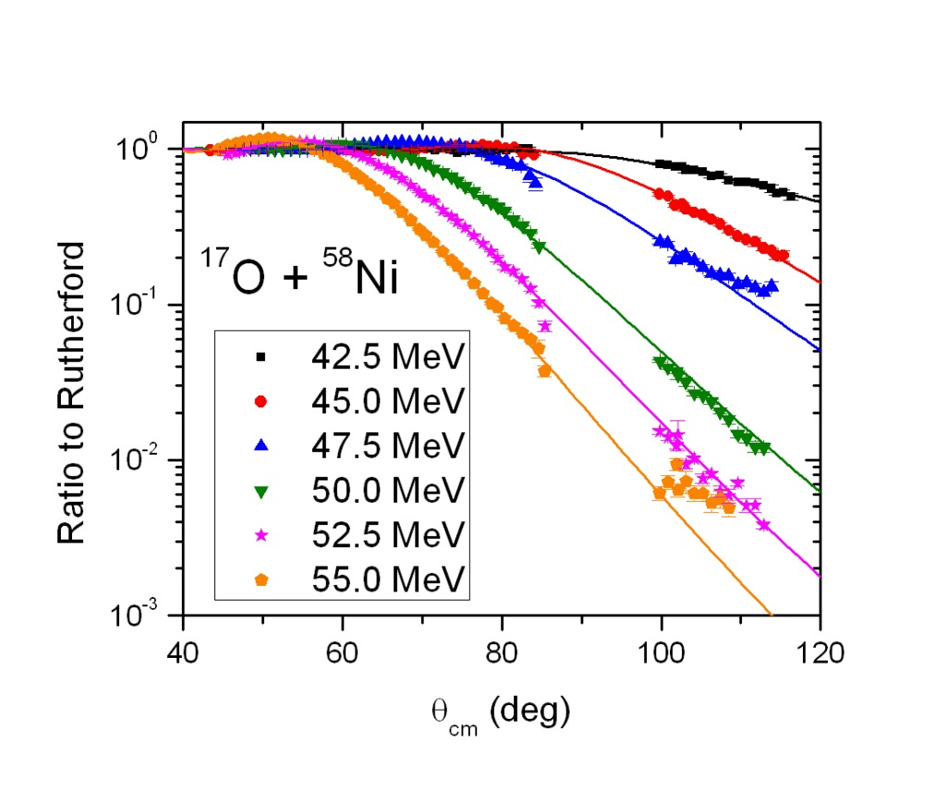
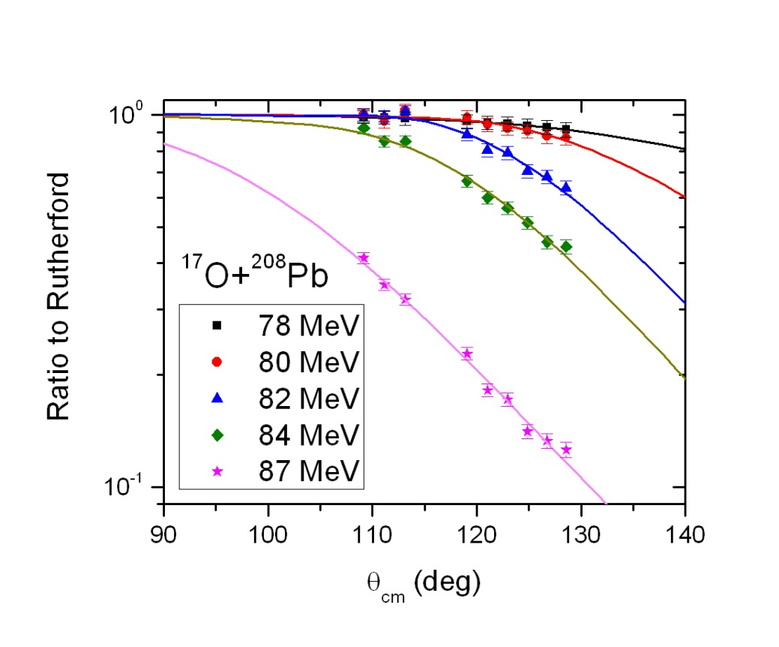
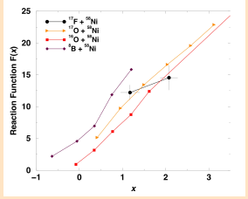
¹⁷O+⁵⁸Ni,²⁰⁸Pb @ LNL: preliminary results
Similar reduced cross section of the ¹⁷F+⁵⁸Ni system studied @ EXOTIC (Mazzocco et al., PRC 82 (2010) 054604) with those of the “reference” stable systems ^{16,17}O+⁵⁸Ni: small influence of the low binding energy in the reaction dynamics
In agreement with our previous findings on ¹⁷F+²⁰⁸Pb system at sub barrier energy (Signorini et al., EPJA 44 (2010) 63)
Paper in preparation

Slide 22
EXOTIC beamline: velocity filter
Aim: to use the EXOTIC beamline as a velocity filter for fusion-evaporation experiments with stable beams to study:
- α and p radioactivity
- Fusion at sub-barrier energies (in coll. with PRISMA-FIDES) to study the fusion “hindrance” phenomenon: in the deep sub-barrier region experimental fusion cross sections have been observed to systematically fall below the predictions of standard coupled-channels calculations
Configuration: dipole magnet and Wien filter used to select evaporation residues + suppression of the primary beam (taking advantage of the smaller velocity of compound nucleus with respect to that of the projectile)
Detection: implanted residues in EXPADES at 0° and study the respective decay.

Slide 23
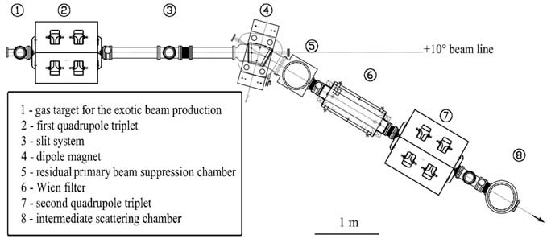
Target
Layout of the EXOTIC beam line
Monitors
MCP
Si
90 cm

Slide 24
PISOLO vs EXOTIC
Set-up Param. | Pisolo | Exotic
Geometrical solid angle | 0.04 msr | 10 msr
Rejection Factor | 10⁷-10⁸ | ~10¹⁰
Total detection efficiency | ~0.5% | ~5 %
Notes:
Detection eff.=trasmissione x accettanza

Slide 25
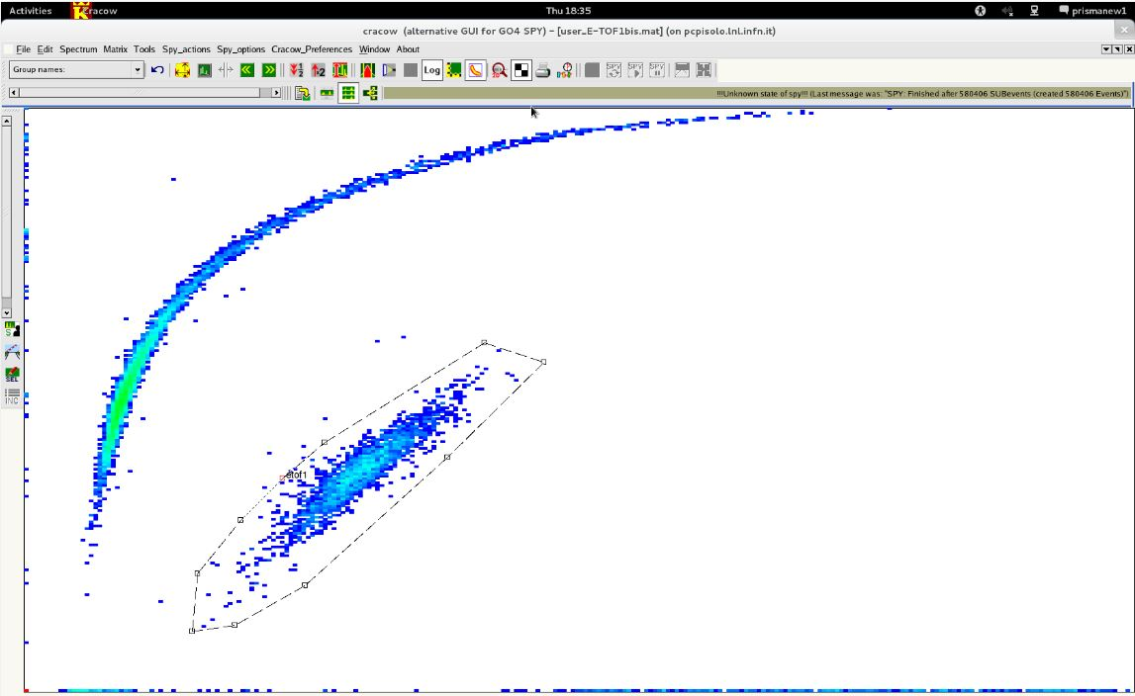
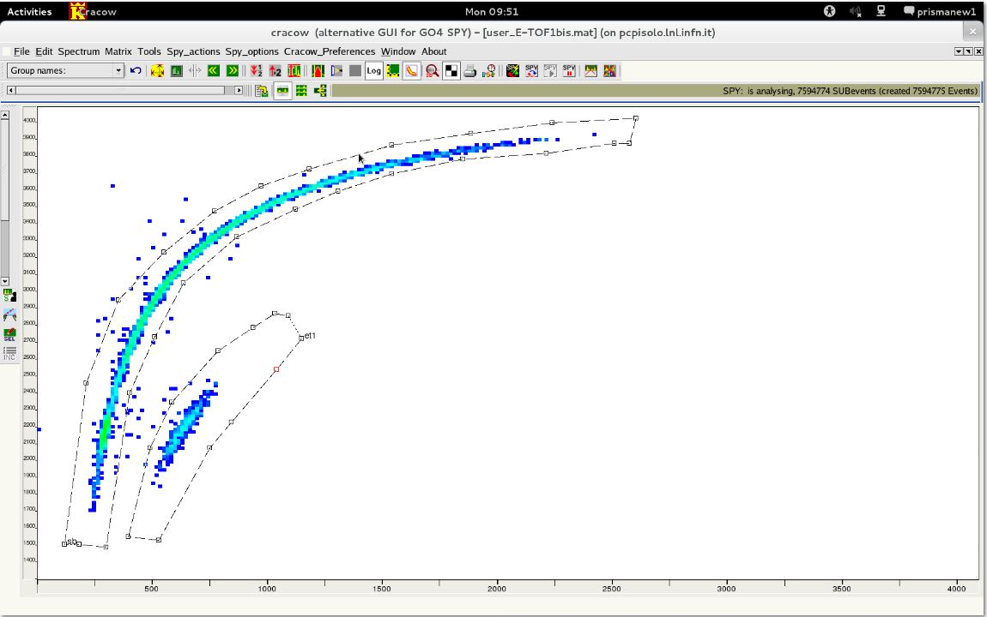
Test of 05/2013 @ EXOTIC: first results
Rejection factor: 10¹¹, highly reduced experimental background.
³²S + ⁴⁸Ca @ E_{lab}= 84 MeV
³²S + ⁶⁴Ni @ E_{lab}= 84 MeV
³²S
³²S
TOF
ER
ER
E
E
For technical problems (vacuum problems of the tandem) the test was not completed: we will ask for two more days in autumn to study the transmission of the EXOTIC beam line which was lower than that expected (probably because of primary beam alignment problems)

Slide 26
Approved proposals to be done @ EXOTIC by the end of 2013
  Fall/2013: ⁷Be + ²⁰⁸Pb: study of the elastic scattering and exclusive and inclusive breakup of the ⁷Be RIB in ³He and ⁴He fragments at Coulomb energies
  Experimental set up: 6 EXPADES telescopes (DSSD 40 +300 μm)
  Fall/2013: ⁷Be + ²⁸Si reaction at EXOTIC at five near-barrier energies. At the highest energy a full study of both elastic scattering and relevant reaction mechanisms (transfer, breakup and fusion) will be performed, while the focus at the lower energies will be on the elastic scattering for probing the energy dependence of the optical potential and therefore the potential threshold anomaly
  Experimental set up: 6 EXPADES telescopes (DSSD 40 +300 μm)
Fall/2013: ¹⁵O radioactive beam production at EXOTIC. The ¹⁵O can be used in order to search for possible cluster configurations ¹⁵O + α in the p-rich nucleus ¹⁹Ne by using the Thick Target Inverse Kinematics scattering. The measurements of the α decay width of low energy resonances in the elastic scattering excitation function ¹⁵O(α, α) has also an astrophysical interest since ¹⁵O is a nucleus involved in the hot CNO cycle. The ¹⁵O(α, γ)¹⁹Ne radiative capture represents a breakout of the Hot CNO cycle.

Slide 27
Approved proposals (RIKEN)
⁸B+²⁰⁸Pb @ CRIB (Japan): elastic and inelastic scattering in a first moment and in the future inclusive, exclusive breakup and fusion cross section
experimental setup: 40 μm DSSD + 300 μm DSSD EXPADES (8 telescopes)
To be done in 2014

Slide 28
Next (07/2013 LNL PAC) proposals @ EXOTIC
⁶He and ⁸Li production
⁶He (0.6 s) production via the inverse kinematics reaction
⁷Li(²H, ³He) ⁶He at E(⁷Li) = 20 - 55 MeV (150 pnA) Q_{value}= -4.48 MeV
FIRB cod. RBFR08P1W2_001: Produzione di un fascio radioattivo di ⁶He e suo utilizzo per studi di dinamica di reazione su bersagli medio-leggeri (2010, Coordinatore: Marco Mazzocco)
⁸Li (830 ms) production via the inverse kinematics reaction
⁷Li(²H, ³He) ⁶He at E(⁷Li) = 20 - 55 MeV (150 pnA) Q_{value}= -0.19 MeV
In case of a successful beam production test, the facility EXOTIC will be able to deliver secondary beams of ⁸Li and ⁶He up to about 20 and 12 MeV beam energy, respectively, and with intensities 10⁴ - 10⁵ pps. These value are sufficient for performing reaction dynamics studies induced at Coulomb barrier energies on targets up to Ni(Z=28)-Zn(Z=30) region and, in the case of ⁸Li, even up to the Sn(Z=50)-Ba(Z=56) region.

Slide 29
Next (07/2013 LNL PAC) proposals @ EXOTIC
⁸B+²⁰⁸Pb @ 43 MeV
⁸B +²⁰⁸Pb @ E_{lab}= 43 MeV: study of the coupling mechanisms at sub-barrier energies by investigating elastic scattering and ⁸B breakup. In CDCC investigations strong couplings of elastic scattering to direct channels do not seem to be directly connected to the observation of large breakup or transfer reaction cross sections.
Coulomb rainbow suppression or a deviation from Rutherford scattering at energies below barrier was observed in previous elastic scattering experiments like ⁶He + ²⁰⁸Pb, ¹¹Be + ⁶⁴Zn and ¹¹Li + ²⁰⁸Pb attributed to Coulomb dipole couplings and/or nuclear couplings (A.M. Sánchez-Benítez et al., Nucl. Phys. A803, 30 (2008), M. Cubero et al., Phys. Rev. Lett. 109, 262701 (2012), A. Di Pietro et al., Phys. Rev. Lett. 105, 022701(2010))
According to existing calculations [N. Keeley et al., Nucl. Phys. A834, 729c (2010)], almost no deviation from Rutherford is predicted for the ⁸B+²⁰⁸Pb system and this has to be verified experimentally, while a large ⁷Be production yield is expected with a cross section for ⁸B breakup of 360 mb exhausting almost all the total reaction cross section.
Experimental set up: 4-6 EXPADES telescopes (DSSD 40+300 μm)

Slide 30
Richieste finanziarie 2014: Missioni
Richieste totali Missioni: 21.5 k€ Interno - 26 k€ Estero
NA
Interno:
1.5 k€ (2 riunioni di collaborazione per 2 persone * 0.35 k€)
12 k€ (turni di misura e preparazione: 10 gg*0.12 k€ +0.3 k€)*4 pers (2 ric+2 tec) *2 viaggi)
Estero
9 k€ (1 turno di misura a RIKEN+ preparazione per 4 persone per 10 giorni: (0.12*10+1)*4 pers)
2 k€: contatti scientifici
PD (8 k€ Int + 15 k€ Est)
Interno:
5.5 k€ (Missioni a LNL per preparazione turni di misura e mnutenzione della linea di fascio(6 persone per un totale complessivo di 18 mesi/uomo. Costo stimato 300 Euro per mese/uomo)
2.5 k€ (Riunioni di collaborazione per 6 persone)
Estero
13.5 k€ (Turno di misura a RIKEN: 3 persone per 15 giorni e 3 persone per 7 giorni. Circa 100 Euro pro die e 1000 Euro viaggio pro capita)
1.5 k€: Contatti scientifici (1 viaggio (1 k€) di 5 giorni per una persona (0.1 k€ pro die))

Slide 31
Richieste finanziarie 2014: CA, Cons, T, M
Costruzione Apparati (50 k€)
11 k€ : Teslametri e una pompa turbo di riserva per la linea di fascio
34 k€: acquisto di 2 MCP e relativa elettronica per esperimenti in cui la perdita di energia nei PPAC è critica
5 k€: Flash ADC (pile up rejection)
Consumo (21 k€)
15 k€ : 2 DSSD di 1 mm (necessari per esperimenti di scattering elastico risonante)
6 k€ (elettronica e materiale di laboratorio)
Manutenzione (2 k€)
2 k€
Trasporti (5 k€)
5 k€ (trasporto di materiale fragile)
Simile richiesta finanziaria nel 2015

Slide 32
EXOTIC: Richieste di supporto Servizi Tecnici
Officina Meccanica: (ca. 6 mesi/uomo)
Realizzazione del secondo target criogenico
Produzione e test di tenuta delle finestre di Havar del Gas Target
Laboratorio di Elettronica: (ca. 3 mesi/uomo)
Completamento dell’assemblaggio degli 8 rivelatori di EXPADES.
Completamento dell’elettronica e degli spare parts.
Assistenza e supporto per turni di misura a LNL
Assistenza e supporto per l’esperimento a CRIB (Giappone)
Progettazione: (Nessuna richiesta)
Servizio di Calcolo: (Nessuna richiesta)

