Slide 1
ICARUS-LBNE project
A. Guglielmi
LBNE-ICARUS Padova meeting
SPS-C C. Rubbia presentation

Slide 2
Seminar of R. Wilson
1300 km

Slide 3
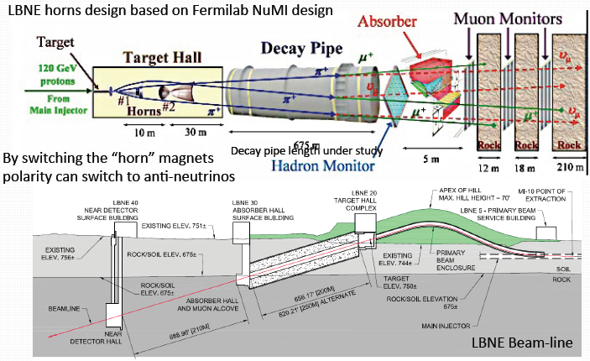
700 kW proto beam --‐>6x10²⁰ pot/year (up to>2 MW)

Slide 4
SURF Underground Lab

Slide 5
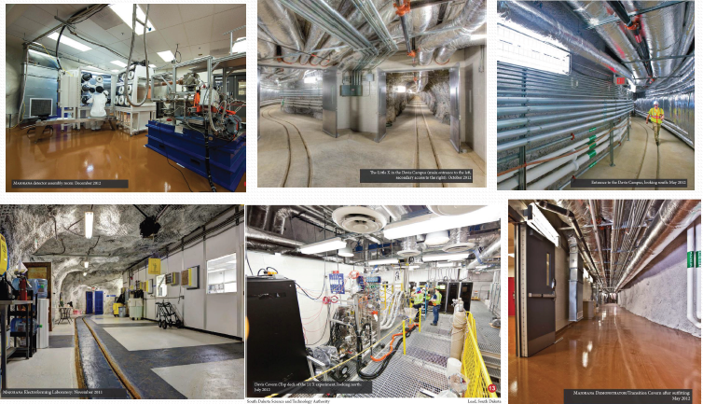
SURF today

Slide 6
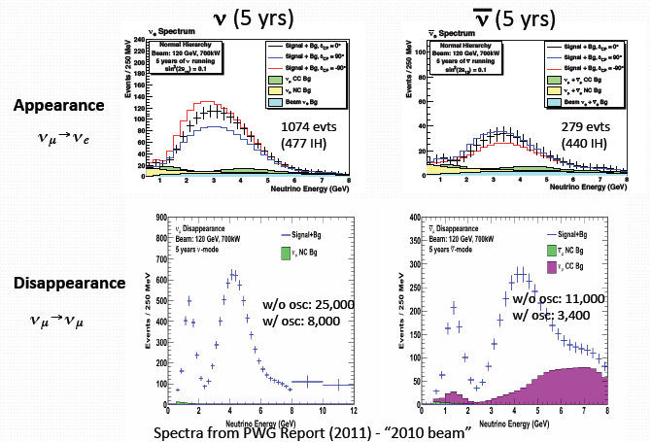
LBNE 34 kt Spectra

Slide 7
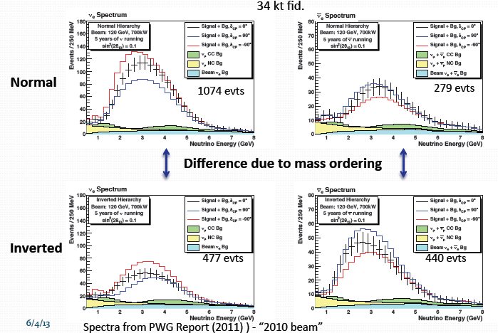
LBNE Spectra-Mass Hierarchy

Slide 8
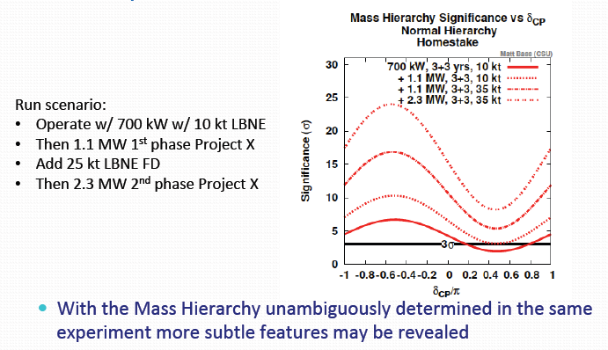
LBNE + Project X (1.1 – 2.3 MW)

Slide 9
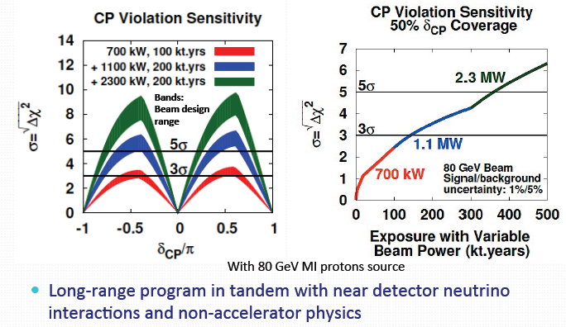
CP violation sensitivity

Slide 10
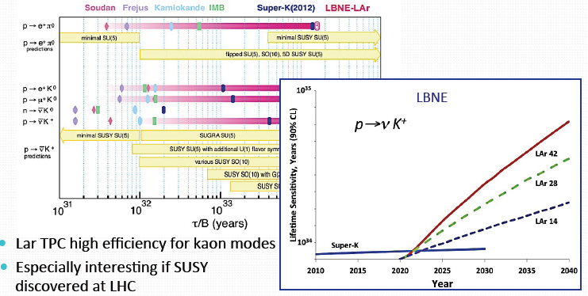
Proton decay search

Slide 11
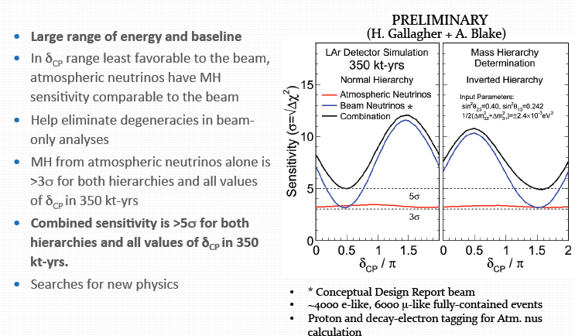
Atmospheric neutrinos

Slide 12
Strategy of LBNE experiment

Slide 13
SPS-C presentation of C. Rubbia (CERN-15 June 2013)
Deliberation Document on the update of the European Strategy for Particle Physics (CERN-16 March 2013)
The European Strategy Group ESG (Prepared by the Scientific Secretariat for the European Strategy Session of the Council)
at point f)
Rapid progress in neutrino oscillation physics, with significant European involvement, has established a strong scientific case for a long-baseline neutrino programme exploring CP violation and the mass hierarchy in the neutrino sector.
CERN should develop a neutrino programme to pave the way for a substantial European role in future long—baseline experiments.
Europe should explore the possibility of major participation in leading long—baseline neutrino projects in the US and Japan.
“CENF and Sterile neutrino not mentioned in the Document”

Slide 14
Our new collaboration ICARUS/LBNE :
The Italian ICARUS Collaboration has now joined LBNE, the long baseline Collaboration from FNAL to the Homestake mine.
In the last ICARUS – LBNE Meeting we have co-signed that:
We agree to collaborate on the Long-Baseline Neutrino Experiment.
We agree to collaborate and coordinate R&D in the development of large LAr detectors for neutrino physics.
We agree to collaborate and coordinate on development of software for LAr detectors for neutrino physics.
We are interested to investigate the potential use of ICARUS T600 as a near detector for LBNE.
Our intention is to proceed towards the joint realization of a larger underground LAr detector in the LBNE neutrino beamline
Mechanisms of exchange of personnel will be investigated.

Slide 15
A neutrino beam activity prior to the LBNE experiment
In order to comprehensively prepare for the LBNE related programme and in view of the relative novelty of the LAr-TPC technology, a vast “LAr programme” must be continued, in which real neutrino and antineutrino events are studied at lower Eν ’s.
The T600 will then be operated (either at CERN, if a beam will be made available on a reasonable time schedule, or else at FNAL) collecting a large number (≥10⁶) of events on a short baseline and also appropriate for the future LBNE experiment.
In addition to a definitive clarification of sterile neutrino, the programme may pave the way to the realization of the LNBE detector for instance with
An accurate determination of cross sections in Argon
The experimental study of all individual CC and NC channels
The realization of sophisticated algorithms capable of the most effective identification of the events.

Slide 16
The need for a continuing neutrino programme
The ultimate goal of the LBNE experiment is the realization of a vast International programme in the Homestake mine with an adequate detector’s mass in order to detect both neutrino events from FNAL and possibly other underground non–accelerator phenomena
We strongly believe that the exclusive utilization of a charged particle beam as proposed by the LAGUNA collaboration, will be vastly insufficient and unrealistic for a substantial European role — at least at the level of development and complexity of our LAr — TPC programme, and in order to prepare adequately for the long term realization of the LBNE.
The direct and continued access to a neutrino beam is necessary if we were to maintain the appropriate levels in the R&D and the participation in the physics developments with a “learning” process based on real events and cross sections.
“LAr ion space charges will strongly distort charged particle beams”

Slide 17
Conclusions
After years of discussions and in spite of the promise to “pave the way for a substantial European role”, the CERN plan for neutrino physics expressed in the CERN-MTP 2014-18 is not yet clearly defined and it is now without any appreciable funding.
ICARUS has now successfully completed the LNGS experiment
The T600 will be overhauled by the end 2014.(but where ??)
Our vigorously INFN driven programme will be continued, but in a closer collaboration and as members of the LBNE team.
T600 is today the only operational, physical scale LAr detector and it shall be so for several years to come. We intend to:
contribute to the clarification of the “sterile neutrino” story
collaborate with LBNE during the preparation phase and with a large amount of neutrino events at the appropriate energy
our detector as a convenient “near detector” for LBNE
The useful lifetime of the ICARUS detector could then be extended to the two next decades to come !

