Slide 1
INFN-LNL
Istituto Nazionale di Fisica Nucleare
Laboratori Nazionali di Legnaro
APOTEMA
Accelerator-driven Production Of TEchnetium/Molybdenum for medical Applications
Juan Esposito
on behalf of APOTEMA collaboration
Presentazione e pianificazione esperimenti CSN5 INFN 2014
LNL , July 2, 2013

Slide 2
APOTEMA
Accelerator-driven Production Of TEchnetium/Molybdenum
for medical Applications
Responsabile Nazionale: Juan Esposito, LNL
3 years project (2012-2014)
MAIN project GOAL:
Assessment of accelerator-driven alternative production of ^{99m}Tc (⁹⁹Mo) exploting the future, high current output, SPES proton cycloton at LNL in the framework of LARAMED project. ^{99m}Tc is currently the largest radionuclide used for diagnostic investigations in nuclear medicine deparments.
Tc-99m production
¹⁰⁰Mo(p,2n)^{99m}Tc (direct route)
¹⁰⁰Mo(p,x)⁹⁹Mo → ⁹⁹Mo/^{99m}Tc generator
INFN branches participating (person in charge)
LNL (Juan Esposito)
FE (Mauro Gambaccini)
PD (Paolo Sartori)
PV (Andrea Salvini), since 2013

Slide 3
APOTEMA project main items: June 2013 update
Short term (2012):
Radiochemical purity (RCP), and Quality Control (QC) standard test, on a set of currently used pharmaceuticals kits labeled with ^{99m}Tc eluted from standard Mo/Tc generators at 24hrs and longer time intervals. Mimic the influence of ^{99g}Tc/ ^{99g}Tc isomeric ratio expected from accelerator-produced 99mTc during the radiolabeling procedures
^{99m}T-labelled radiopharmaceuticals preliminary imaging tests on standard phantoms and impact on images quality vs. ^{99g}Tc/ ^{99g}Tc isomeric ratio using the YAP-(S)PET-CT imaging system for small animals
First theoretical investigation, using nuclear models, about ^{xx}Mo, ^{xx}Tc and ^{yy}XX contaminant nuclides expected at EOB inside ¹⁰⁰Mo samples
Medium term (2013):
¹⁰⁰Mo(p,xn)XX excitation functions experimental measurements related to accelerator-based ^{99m}Tc production, using ¹⁰⁰Mo-enriched samples. GOAL: produce and/or extend nuclear data better than available in EXFOR database reducing current uncertainties (mainly for ^{99m+g}Tc , see former (2011-2012) APOTEMA project presentations)
First ¹⁰⁰Mo-enriched ( 99.05%) moly foils irradiation → ^{99m+g}Tc/⁹⁹Mo production in small quantities for chemical separation/purification processes. Assessment of contaminants (including other Tc isotopes yielded). RCP and QC required tests
High power target holder: start design activities aimed at prototype construction
Long term (2014):
Extension of excitation functions experimental measurements: First ^{99g}Tc excitation functions experimental measurements above 18 MeV to benchmark theoretical data (TENDL2012).
Accelerator- produced ^{99m}Tc for first radiopharmaceutical labeling tests (Possible in vivo imaging analyses?);
Preliminary thermo-mechanical tests (few kW but 500W/cm²) at Pavia and/or JRC-Ispra cyclotrons
Work done
(see also 2012 presentation)
Scheduled Experimental activities
Work in progress..
Scheduled (subject to modifications..)

Slide 4
APOTEMA research activities included inside the international
IAEA-CRP launched in 2011 (code F22062):
“Accelerator-based Alternatives to Non-HEU production of Mo-99 /Tc-99m”
Activity | 2012 | 2013 | 2014 | 2015
1st RCM to review the current status and coordinate work plans for the first phase of the CRP (18 months) | TRIUMF April 16-20
2nd RCM to review and update work plans |  | (INFN-LNL) October 7-11
3rd RCM to review the data, asses the CRP accomplishment, adopt an action plan for the final report |  |  |  | X
Preparation of Manuscript and Publication, Distribution of results and knowledge gained |  |  |  | X

Slide 5
APOTEMA project
LNL
Theoretical research activities
First theoretical investigation related to different reaction routes expected for ¹⁰⁰Mo(p,xn). Research activity performed as MS theses in nuclear physics:
student: Giulia Vecchi
Theses title: Feasibility Study for the production of Tc99m with the Legnaro cyclotron
Tutors: Prof. Fiorentini Giovanni
Dr. Juan Esposito
October 2012, Ferrara University
Further step: Completion of theoretical study and extension to the real ¹⁰⁰Mo-enriched target case
Investigations of optimal proton energy range for accelerator Tc99m production.
Determination of Tc isotopes as well as of contaminant isotopes/radioisotopes map expected to be yielded at End of Bombardment (EOB) inside target.
Work completed in May 2013
Results submitted to the international peer-reviewed journal Science and Technology of Nuclear Installations (Hindawi publishing Corp.) as invited contributing paper to the Special Issues on “Molybdenum-99:past Present and future” Publication date: October 18, 2013
Evaluation of 99Mo and 99mTc productions based on a high-performance cyclotron
J. Esposito, G. Vecchi, G. Pupillo, A. Taibi, L. Uccelli, A. Boschi, and M. Gambaccini
Under review process

Slide 6
^{99m}Tc production with protons
¹⁰⁰Mo(p,2n)^{99m}Tc
10<Ep<20 MeV
Uncertainty band (~250 mb)
All excitation functions (e.f.) experimental measurements performed in last 20 years…
…broad distribution of data for 10<E_{p}<20 MeV

Slide 7
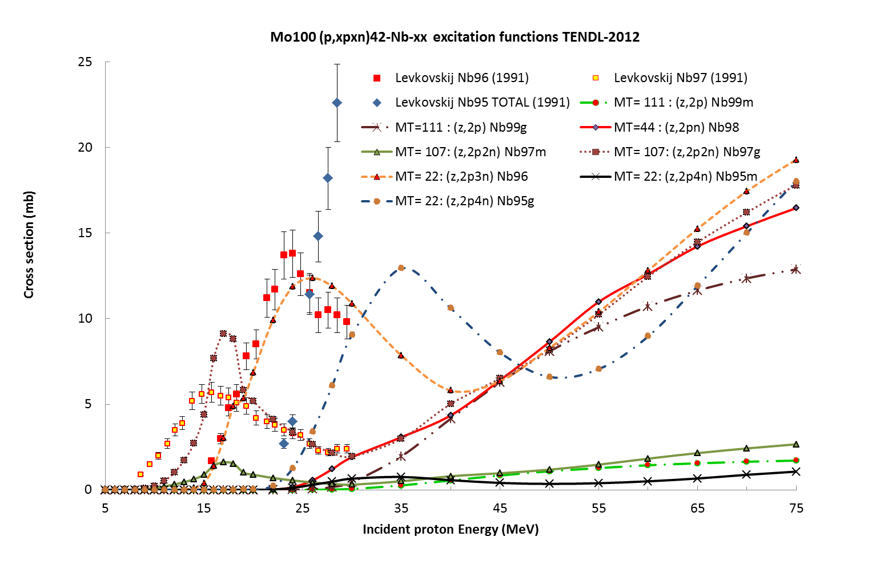
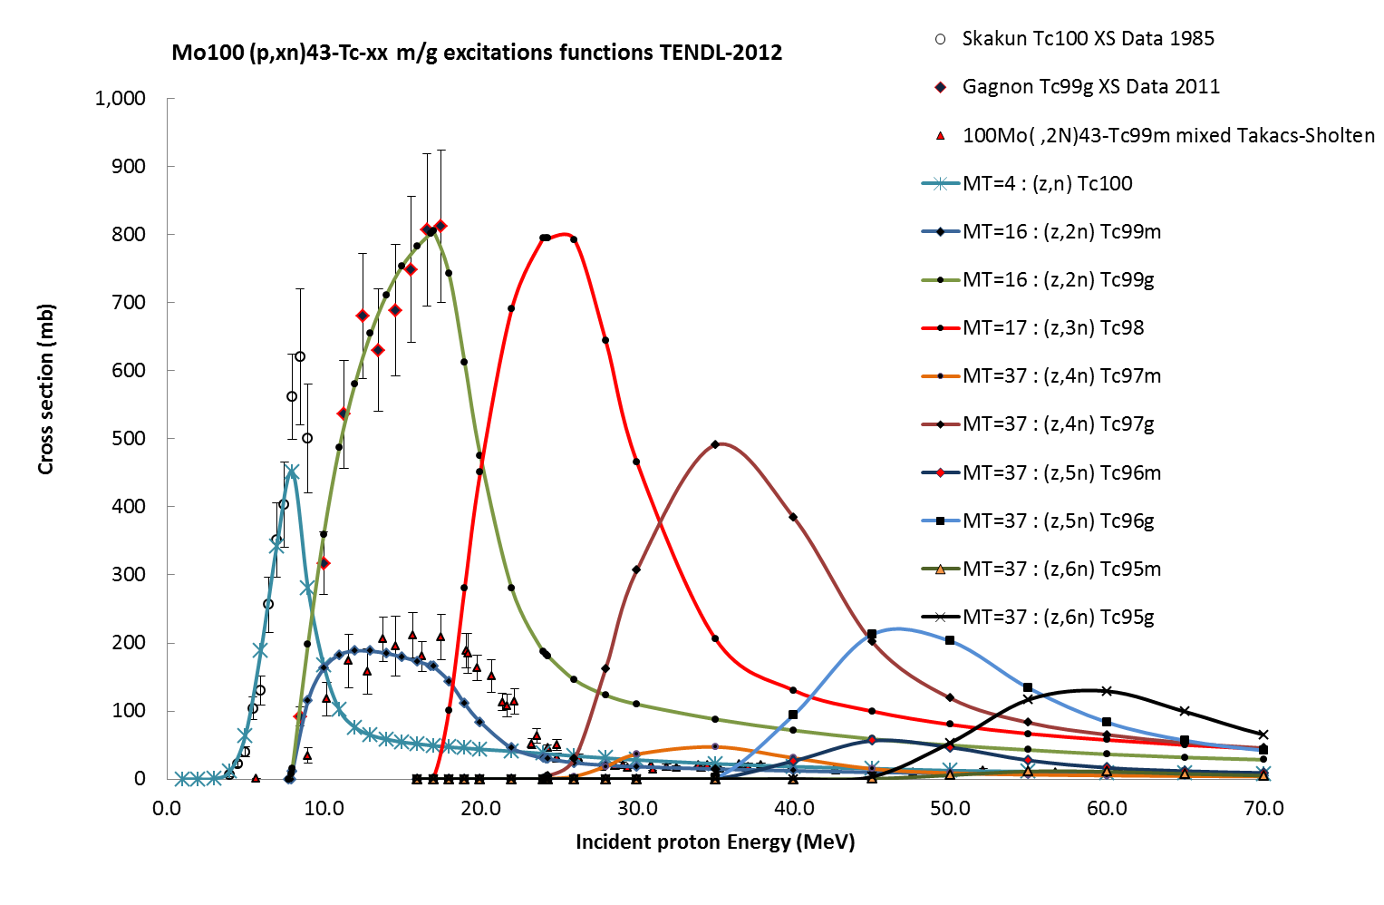
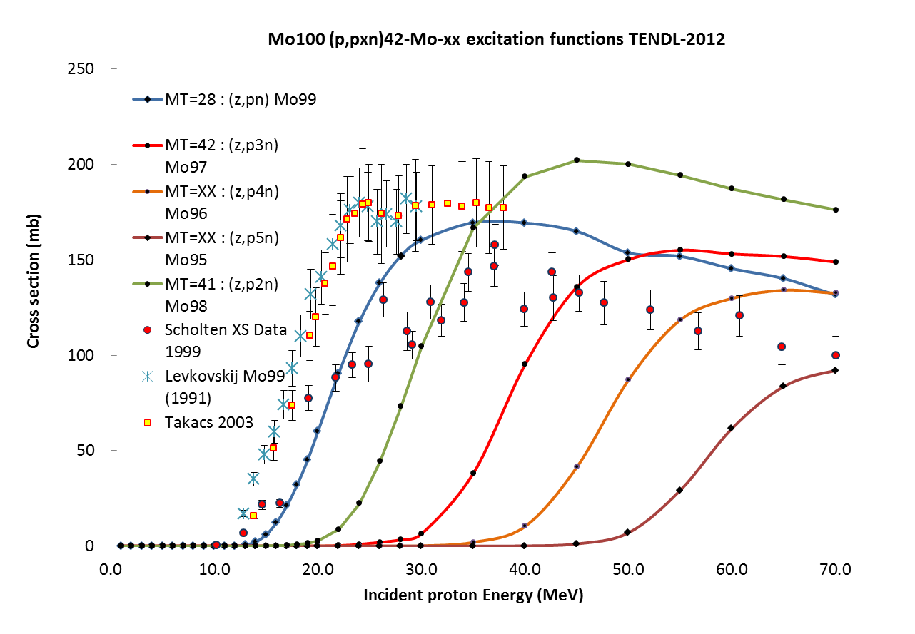
Theoretical determination ^{100-9x}Mo(p,xn) excitation functions
In the framework of APOTEMA activities at LNL results achieved in nuclide maps determination produced inside target taking in to account the real ¹⁰⁰Mo-enriched moly target isotopes compositions
^{9x}Nb series
^{100+9x}Tc series
^{9x}Mo series
TENDL-2012+EXFOR
database

Slide 8
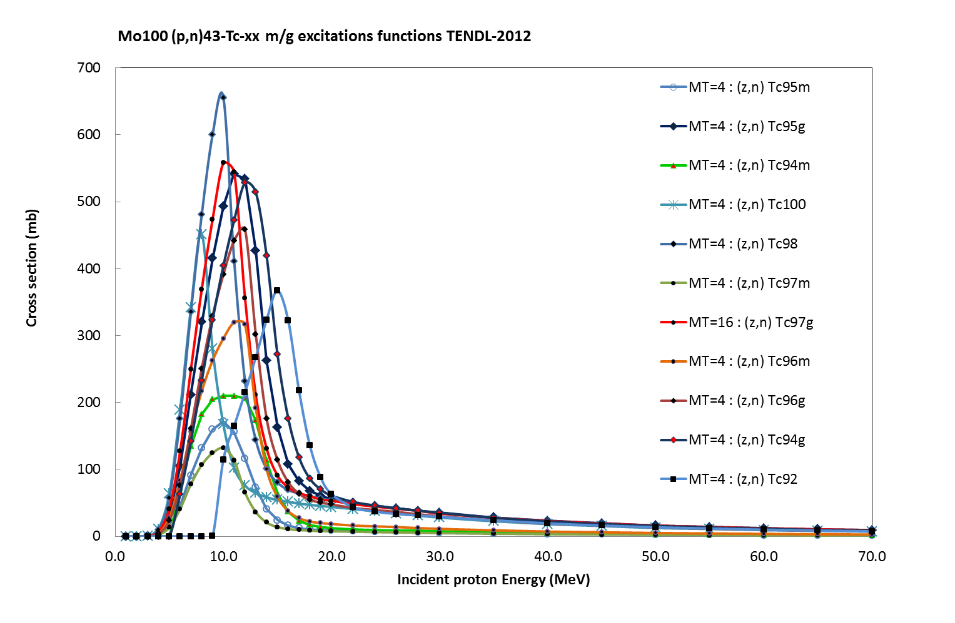
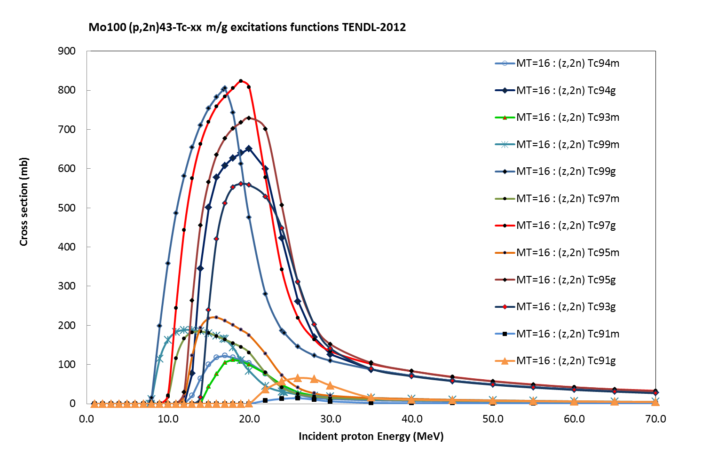
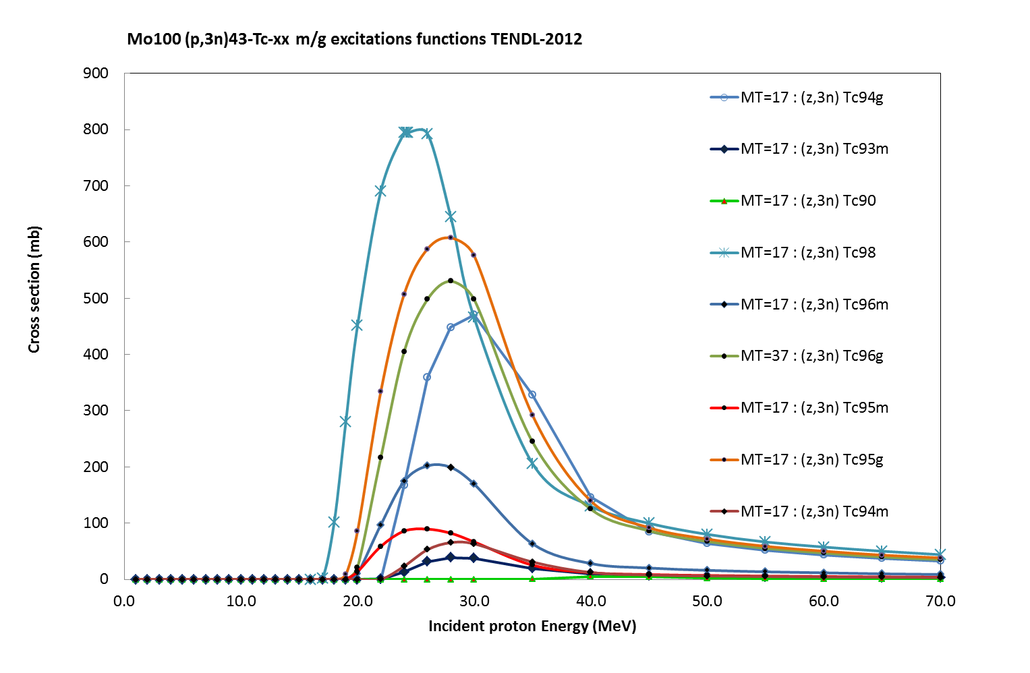
An example: theoretical determination of
^{100-9x}Mo(p,xn) excitation functions up to (x,3n) level
In the framework of APOTEMA activities at LNL results achieved in nuclide maps determination produced inside target taking in to account the real ¹⁰⁰Mo-enriched moly target isotopes compositions
^{100,9x}Mo(p,n)^{9x}Tc series
^{100,9x}Mo(p,2n)^{9x}Tc series
^{100,9x}Mo(p,3n)^{9x}Tc series
TENDL-2012
database

Slide 9
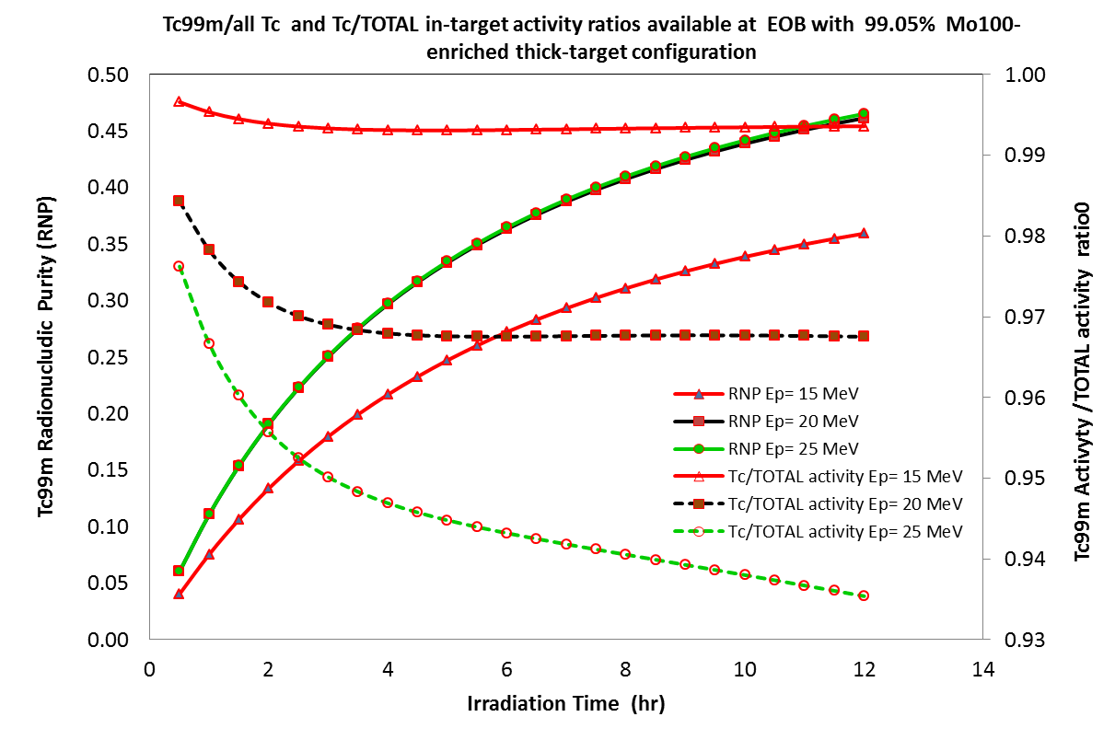
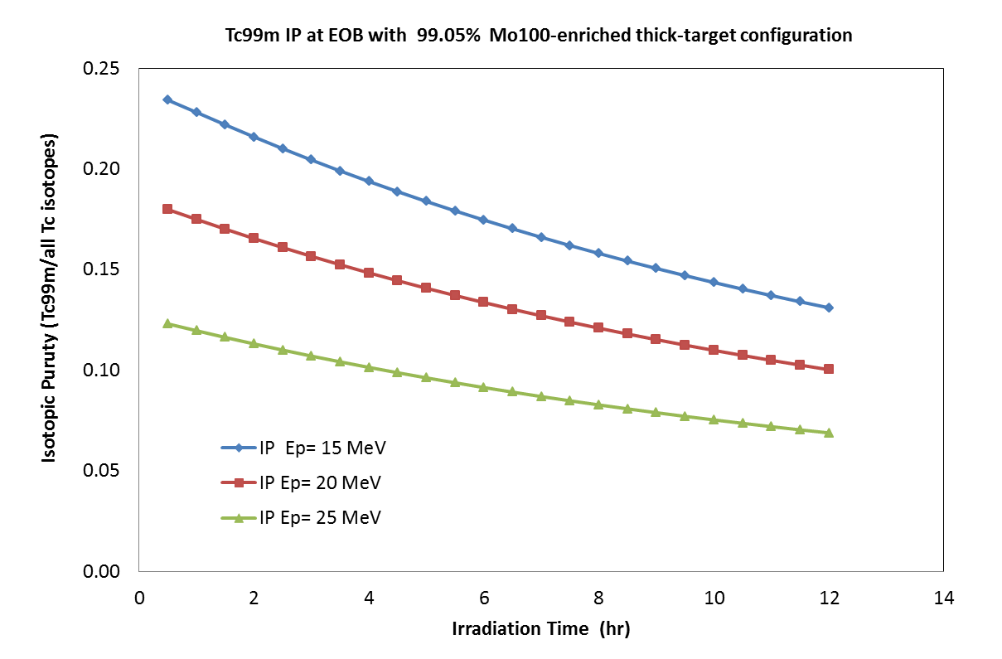
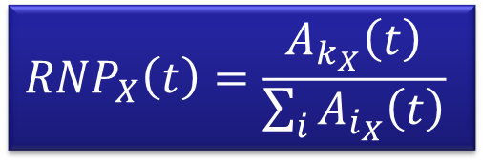
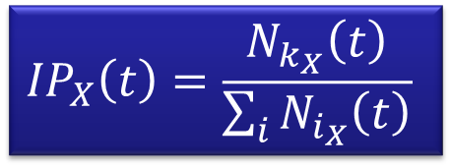
Isotopic Purity (IP) and RadioNuclidicPurity (RNP) expected for accelerator-produced ^{99m}Tc in thick-target configurations
$${RNP}_{X}\left(t\right)=\frac{A_{k_{X}}\left(t\right)}{\sum_{i}{A_{i_{X}}\left(t\right)}}$$
Acceptable IP zone
$${IP}_{X}\left(t\right)=\frac{N_{k_{X}}\left(t\right)}{\sum_{i}{N_{i_{X}}\left(t\right)}}$$
IP values > ~17% for Ep ≤ 20 MeV
RNP values to much low for T_{irr}≤ 3h
Thick-target production has to be avoided!!!!

Slide 10
Theoretical determination of ^{99m}Tc quality expected by (p,xn) reactions on 99.05% ¹⁰⁰Mo-enriched thin-target
Activity, Isototpic purity (I.P.) and radionuclidic Purity (RNP) expected for Tc99m production at 500 μA beam current: optimized (thin) target configuration
t_{irr}(h) | E_{in}(MeV) | Activity EOB (Ci) | I.P. Isotopic Purity |  |  |  | R.N.P. Radio Nuclidic Purity
 |  |  | EOB | EOB+1h | EOB+3h | EOB+6h | EOB | EOB+1h | EOB+3h | EOB+6h
1 | 15 | 2.66 | 0.22 | 0.20 | 0.16 | 0.11 | 0.18 | 0.989 | 0.994 | 0.996
 | 20 | 5.17 | 0.17 | 0.15 | 0.12 | 0.09 | 0.21 | 0.986 | 0.991 | 0.993
 | 25 | 6.16 | 0.12 | 0.10 | 0.08 | 0.06 | 0.18 | 0.976 | 0.986 | 0.989
3 | 15 | 7.14 | 0.20 | 0.17 | 0.14 | 0.10 | 0.38 | 0.992 | 0.995 | 0.996
 | 20 | 13.9 | 0.15 | 0.13 | 0.11 | 0.08 | 0.41 | 0.989 | 0.992 | 0.993
 | 25 | 16.6 | 0.10 | 0.09 | 0.08 | 0.06 | 0.38 | 0.980 | 0.987 | 0.989
6 | 15 | 12.2 | 0.17 | 0.15 | 0.12 | 0.08 | 0.51 | 0.994 | 0.995 | 0.996
 | 20 | 23.8 | 0.13 | 0.12 | 0.09 | 0.07 | 0.55 | 0.990 | 0.993 | 0.993
 | 25 | 28.5 | 0.09 | 0.08 | 0.06 | 0.05 | 0.51 | 0.984 | 0.988 | 0.989
In-target activity production is enough to fulfill the needs of a large metropolitan area (needs of Veneto region: ~7 Ci/day, Padua (2.1 Ci/day)
Product quality expected: IP and RNP some hours after EOB are closer to the generator-produced ^{99m}Tc if short irradiations (i.e. T_{irr} ≤ 3hrs) are chosen
Optimal Energy window: Ep=15-20 MeV

Slide 11
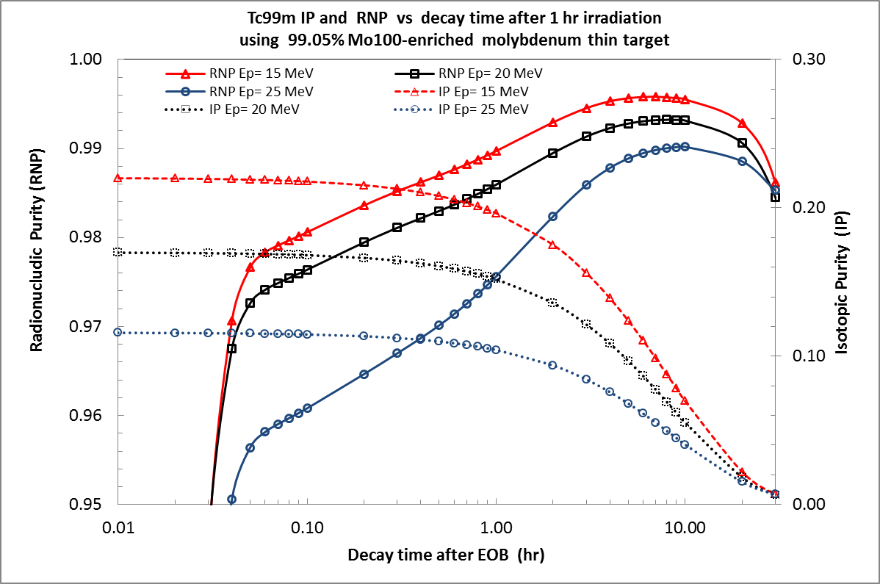
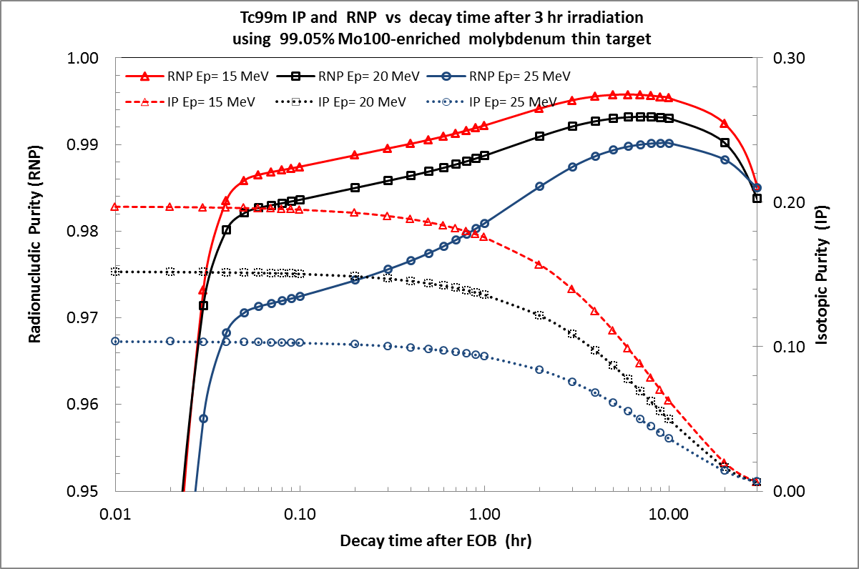
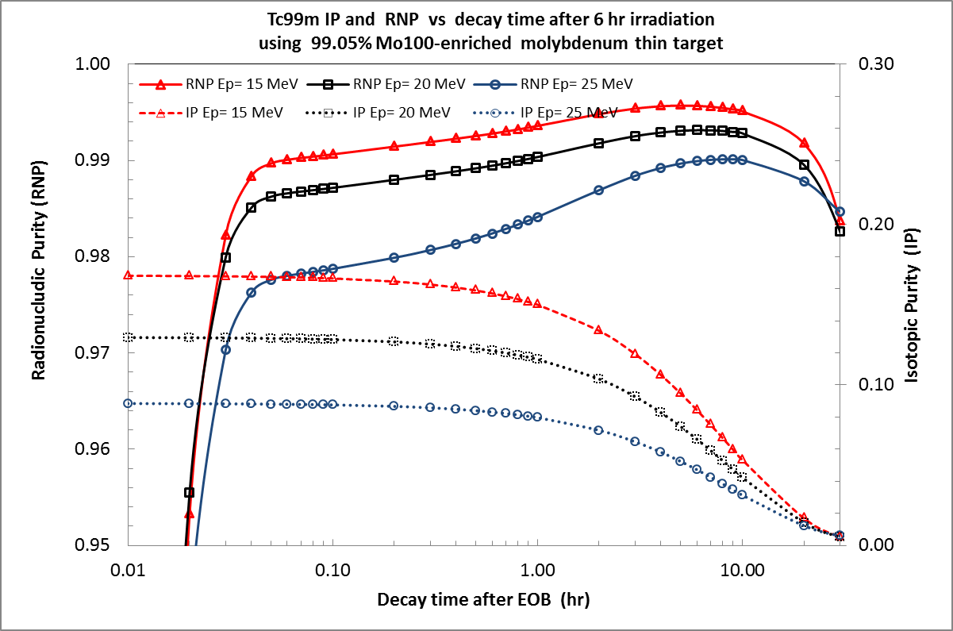
1 hr irradiation
3 hr irradiation
Main theoretical investigations conclusions:
1. irradiation at proton energies above 25 MeV have to be avoided at all, even using higly ¹⁰⁰Mo-enriched material (IP values never >10 %)
Time window 1-8 h post EOB:
RNP > 99%
IP > 10%
If 15 MeV < Ep < 20 MeV (optimal energy window)
2. Short irradiations are better: (i.e. T_{irr} ≤ 3hrs)
6 hr irradiation

Slide 12
¹⁰⁰Mo(p,xn) excitation function experimental measurements
Activity started in Sept 2012 in collaboration with Milan University and INFN LASA group (Bonardi, Groppi, Manenti) for experimental setup preparations at JRC-ISPRA lab, in the framework of CRP IAEA activities. See next slides about INFN Mi activity contribution for further info.
Experimental activities: determination of excitations functions of different ^{xx}Mo and ^{xx}Tc ^{xx}Nb nuclides (some of them still unknown) in the energy range 10-30 MeV
3 basic e.f. measurements have to be performed first, to determine the better proton energy range for an optimized ^{99m}Tc production, minimizing contaminants:
  ¹⁰⁰Mo(p,xn)⁹⁹Mo
  ¹⁰⁰Mo(p,2n)^{99m}Tc
  ¹⁰⁰Mo(p,2n)^{99g}Tc
  limited data known: Only part (≤ 18 MeV) of supposed useful proton energy range (10-25 MeV) to be covered

Slide 13
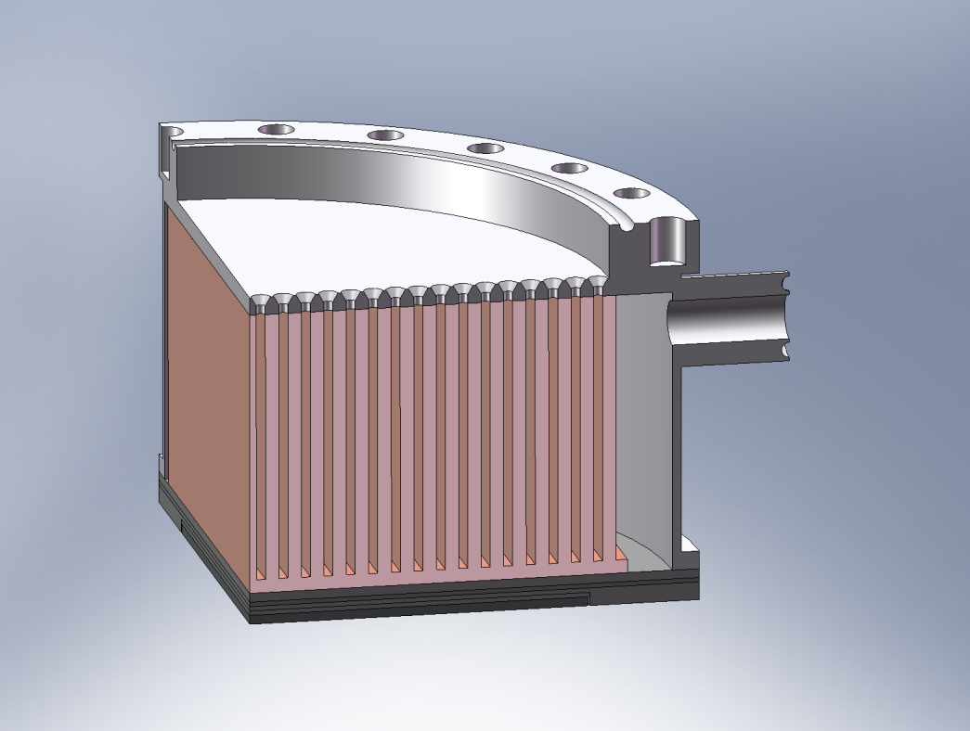
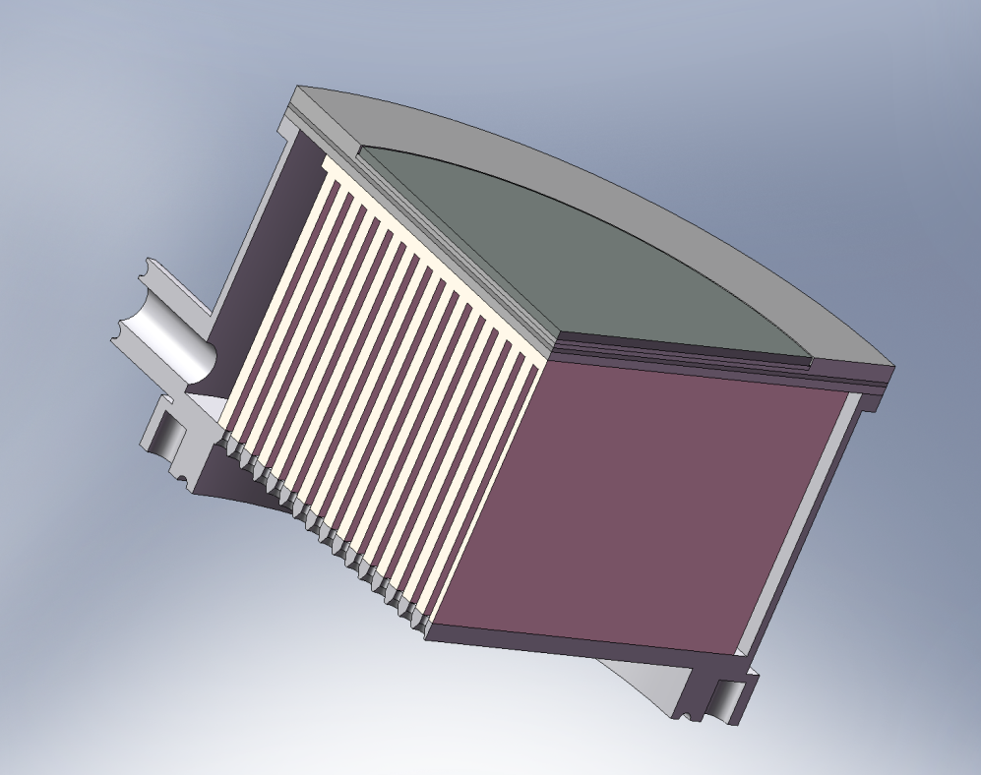
A first design approach for the ¹⁰⁰Mo target holder
High pressure He cooling nozzle
Al target holder
Thermal contact layer
Tantalum backing
He out
¹⁰⁰Mo disk
cooling fin-type thermal radiator (copper)
Due to the priority of excitation functions experimental measurements in 2012, target design activities is shifted in the second-half 2013, beginning 2014

Slide 14
APOTEMA project
INFN-LNL
PLANNED ACTIVITIES for 2014 and budget quotation
Item | What is needed | Estimated Cost
1. Target prototype design construction | High quality nuclear-grade materials purchase for target holder construction. Mechanical workshop: possible outsourcing activities | 20 k€
2. Preliminary test of metallic molybdenum deposition on materials substrate at the STS lab in LNL | Metallic moly powder and related chemical products | 1 k€
3. Completion of ¹⁰⁰Mo(p,xn) excitation functions measurement plan extension at JRC ISPRA MC40 Cyclotron with physics group of Milan University & INFN Milan Section | Travels to ISPRA e/o Milan: | 1.5 k€
4. Radioactive transport service | Irradiations to JRC Ispra to LENA Pavia and /or ferrara | 2.5 k€
4. Prelimary low power test at IBA cyclone 18/9 cyclotron at Pavia (LENA) | Travels to PAVIA e/o ISPRA | 2.0 k€

Slide 15
APOTEMA project
INFN-Ferrara
PERFORMED ACTIVITIES (first semester 2012)
Quality control of Tc-99m radiopharmaceuticals: use of Mo/Tc standard generator. Influence of the isomeric ratio R= N^{99gTc}/N^{99mTc} on the final radiochemical purity.
Imaging studies with a NEMA phantom filled with TcO⁻₄ eluted from a standard Mo/Tc generator: analysis of the images vs. R
Work completed in 2012
Results submitted to the international peer-reviewed journal Science and Technology of Nuclear Installations (Hindawi publishing Corp.) as invited contributing paper to the Special Issues on “Molybdenum-99:past Present and future” Publication date: October 18, 2013
Influence of the generator in-growth time on the final radiochemical purity and stability of 99mTc radiopharmaceuticals
L. Uccelli, A. Boschi, M. Pasquali, A. Duatti, G. Di Domenico, G. Pupillo, J. Esposito, M. Giganti, A. Taibi and M. Gambaccini
Under review process

Slide 16
APOTEMA project
INFN-Ferrara
PERFORMED ACTIVITIES
(2nd semester 2012- 1st semester 2013)
Completion of a high sensitive Beta counter prototype system for ^{99g}Tc xs measurements through beta decay spectrum: full test and characterization of low-noise PMT devices purchased.
Design and test of a dedicated (automated) system aimed at accelerator-^{99m}Tc chemical separation/purification from ¹⁰⁰Mo-enriched targets irradiated at ISPRA labs. Needed for the scheduled ^{99m}Tc production(s) at activity levels enough for labelling procedures with standard pharmaceutical kits.
Radiochemical (RCP) and (QC) procedures on radiopharmaceuticals labelled with accelerator-^{99m}Tc

Slide 17
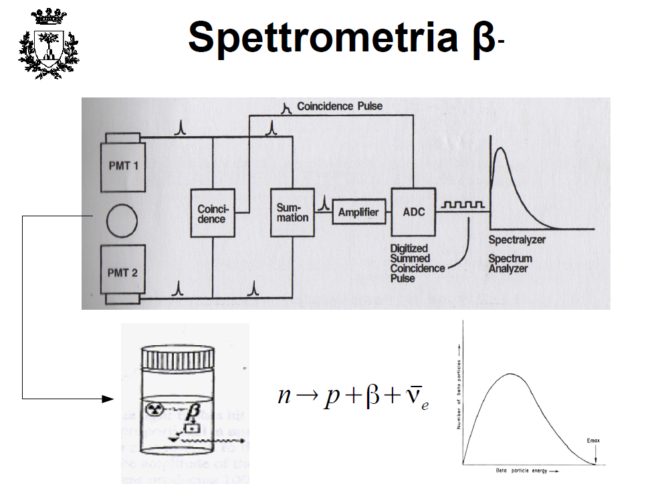
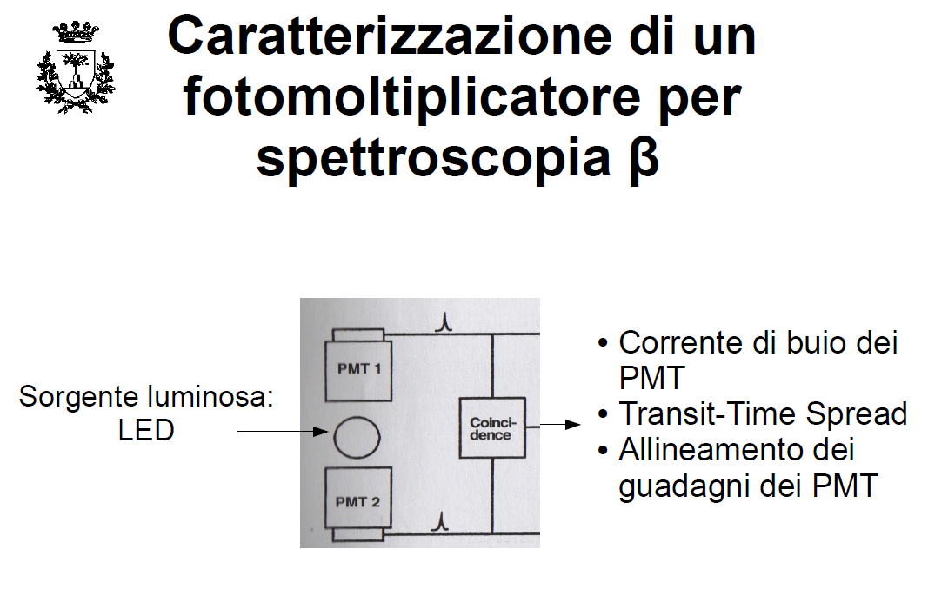
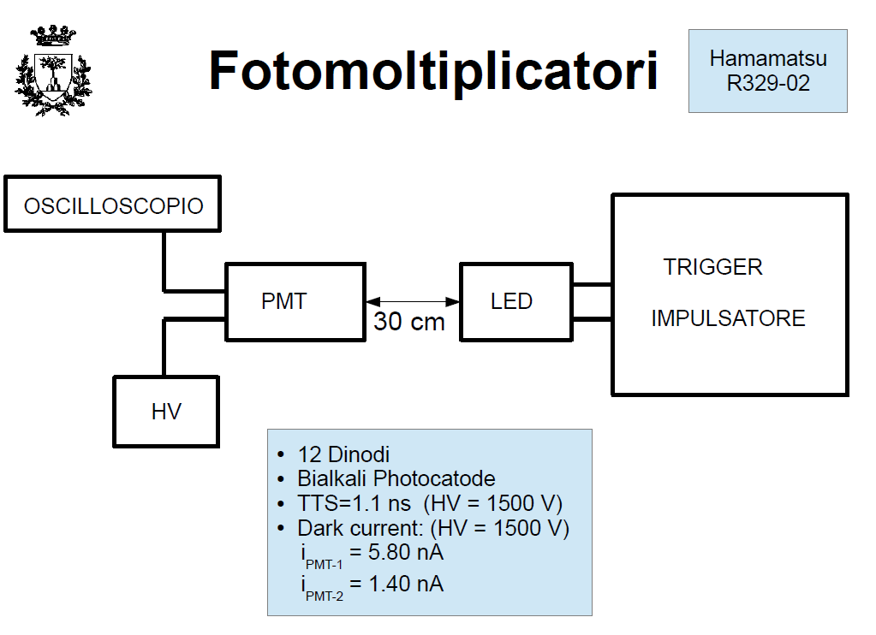
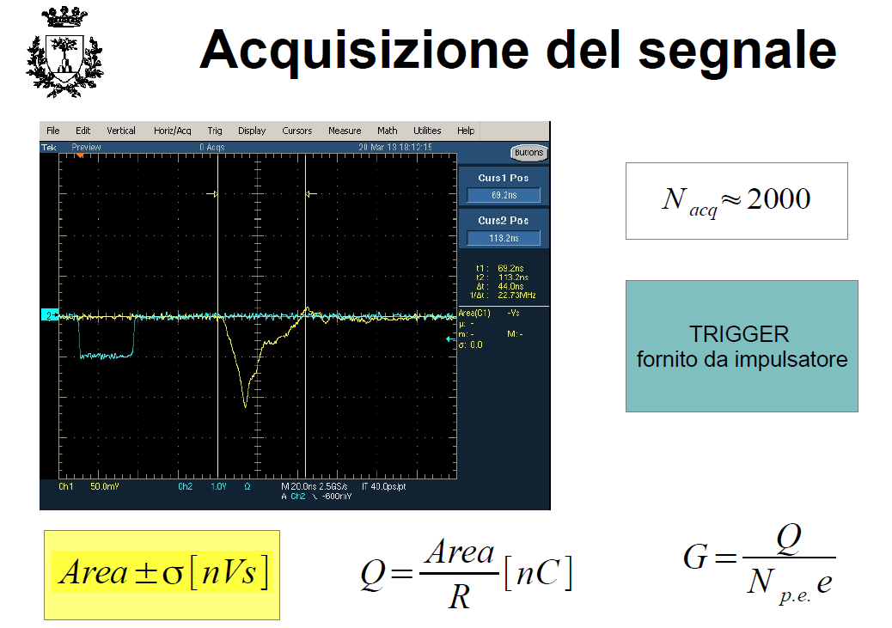

Slide 18
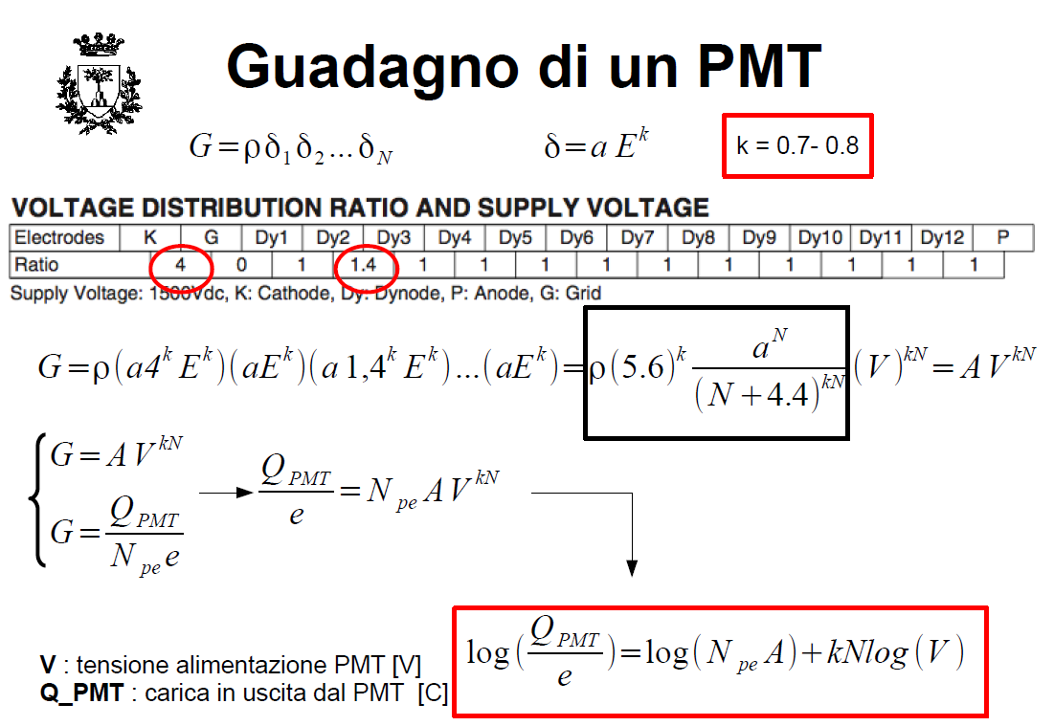
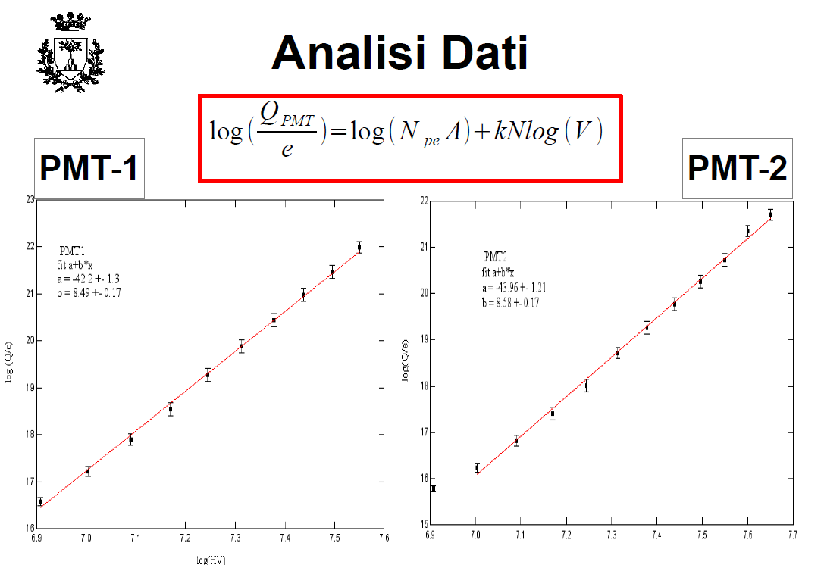
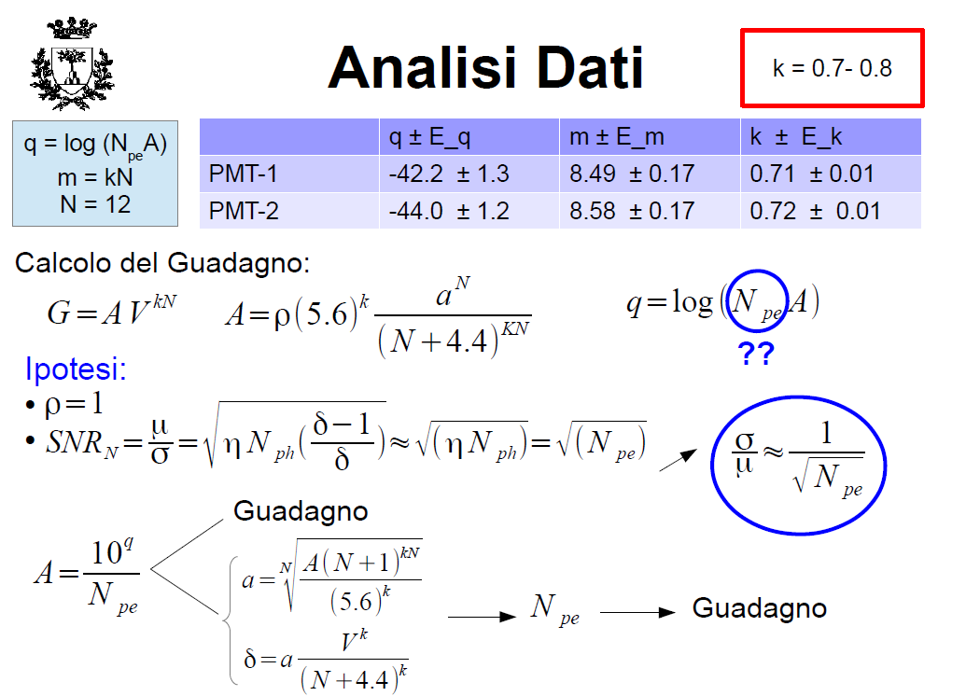

Slide 19
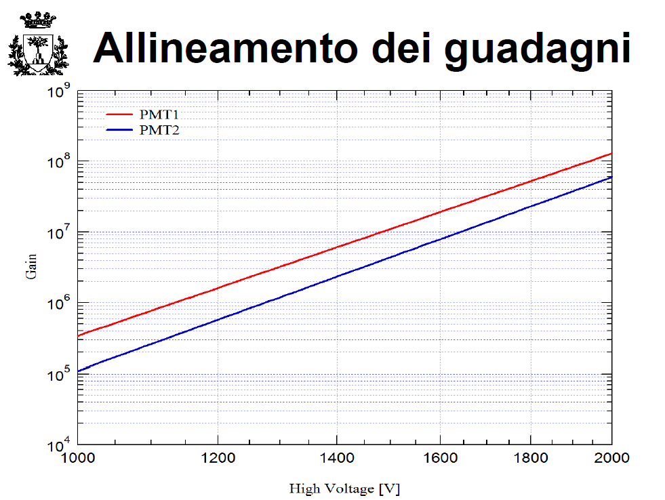
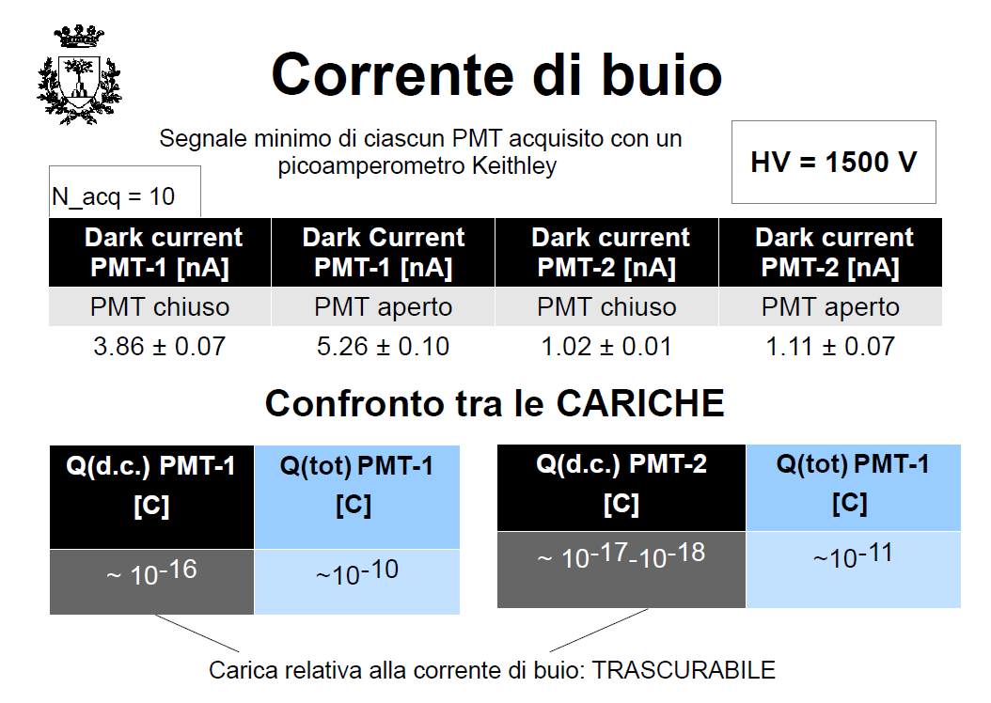
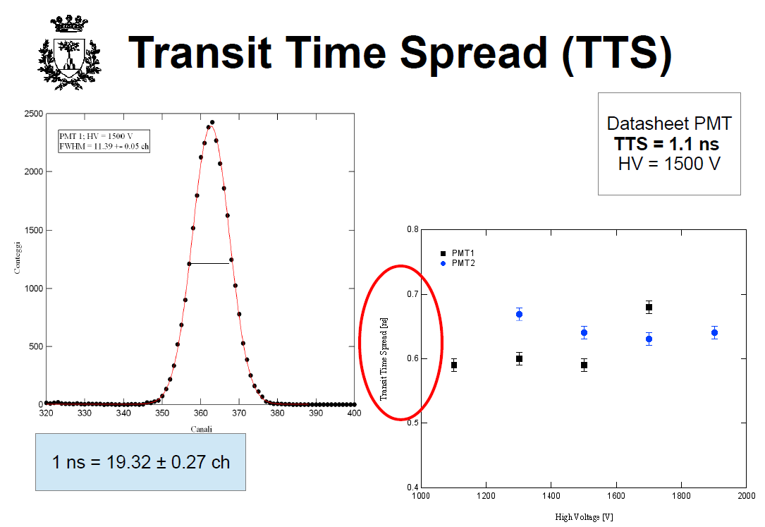

Slide 20
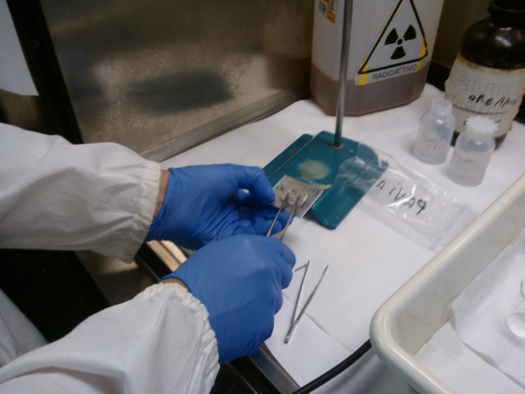
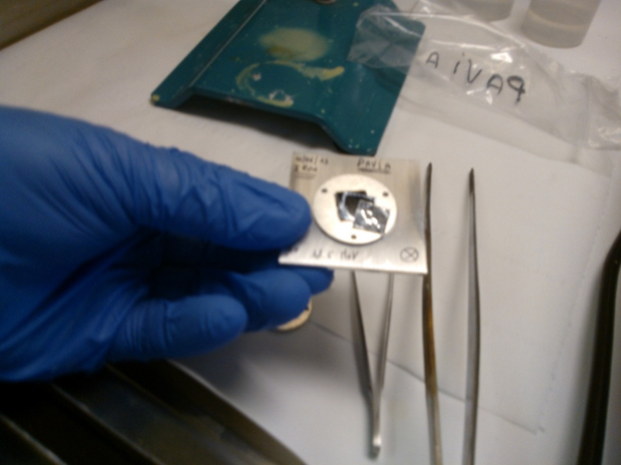
First experimental test on accelerator-^{99m}Tc chemical separation
Three ¹⁰⁰Mo-enriched foils have been irradiated (June, 12, 2013) at JRC Ispra cyclotron at 18.5 MeV (1hr, 100nA beam current). Total activity produced 2.3MBq
Different chemical methods were tested:
sample A (HCL extraction / separation with alumina and H₂O₂ + QMA)
sample B (dissolution in HNO₃ and separation with DOWEX 1x8 resin)
sample C (dissolution in HNO₃/HCl and separation by extraction with MEK)
Preliminary conclusions and deviations with literature data:
- Use of both HNO₃/HCl acid + H₂O₂has shown to get a full ¹⁰⁰Mo-enriched samples dissolution (as needed) to achieve the full extraction ^{99m}Tc
- Separations methods tested with samples B and C will be repeated in order to find out the best way to be used when high activity production test will be performed.

Slide 21
APOTEMA project
INFN-Ferrara
PLANNED ACTIVITIES (second semester 2013)
Completion of the high-sensitive β-spectrometer for ^{99g}Tc xs
measurements
  construction of the electronic system for the acquisition of PMTs' coincidence signals
  β-spectrometer characterization with calibrated source (data analyses and application of correction algorithms)
  Construction of the mechanical system for the vials positioning inside the light-shielded box
Semi-automated (portable?) metallic molybdenum chemical dissolution/separation system construction aimed at high activity ^{99m}Tc production for both RCP and QC procedures.
Design and construction of a portable detector system for planar imaging to be used with standard phantoms and located on the ^{99m}Tc production site (Pavia and/or JRC Ispra) .

Slide 22
APOTEMA project
INFN-Ferrara
PLANNED ACTIVITIES (2014)
Construction of the mechanical system and final prototype assembling for the high-sensitive β-spectrometer
Transfer of the YAP-(S)PET imaging detector system (still available) at the animal facility of UNiFe for possible in-vivo test and making use of the accelerator-^{99m}Tc labeled pharmaceuticals
Further tests of the semi-automated (portable?) system for moly chemical dissolution and separation using the accelerator produced ^{99m}Tc
Test stage of portable detector system for planar imaging with standard phantoms using accelerator-^{99m}Tc on site (Pavia and/or JRC Ispra).

Slide 23
APOTEMA project
INFN-Ferrara
PLANNED ACTIVITIES for 2014 and budget quotation
Item | What is needed | Estimated Cost
1. Completion of Beta counter construction . | Mechanical system construction for vials support inside chamber | 1 k€
2. Characterization of the Beta counter system with calibrated sources, data analysis and correction procedures. | Set of calibration sources | 2 k€
4. Design and test of a chemical separation system for accelerator-produced Tc by the Pavia e/o Ispra cyclotrons. Evaluation test of the radiochemical purity on commercial kits using cyclotron produced Tc-99m. | Solvents, Sep-Pak cartridge, control quality materials, kits | 4.0 k€
 | Travels to PAVIA e/o ISPRA | 4.5 k€

Slide 24
APOTEMA project
INFN-Pd
PERFORMED ACTIVITIES (2nd semester 2012- 1st semester 2013)
All the planned 2012-2013 research activities at the Radiopharmaceuticals and Molecular Imaging (LRIM) laboratory, located at LNL and based on widely used pharmaceutical compounds labeled with ^{99m}Tc are still to be performed.
The reason about that is the necessary completion of the authorization process driven by governmental bodies (Padua prefecture). That is necessary to allow for operations with unsealed radioactive sources. Such authorizations, formerly addressed to Padua University, have been charged to INFN Legnaro.
Since January 2013, all the necessary paper work has been finally completed. LRIM is newly allowed (now as INFN laboratory) for operations with radioactive sources.
However the necessary approval from the LNL radiation protection service was still pending because of the poor efficiency of both the radioprotection and the ventilation system installed. Such a situation has been coming to a positive end only on June 2013.

Slide 25
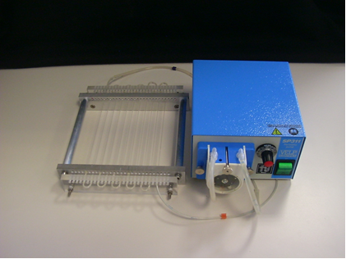
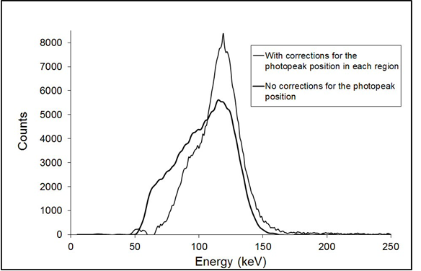
APOTEMA project
INFN-Pd
PERFORMED ACTIVITIES (first semester 2013)
Following the method applied by our group to measure the spatial resolution, the digital resolution and linearity, a phantom was constructed consisting of a system of microcirculation formed by capillary tubes arranged in parallel and fed by a peristaltic pump
To measure the quality of the images of liquid solutions with various Tc99g/Tc99m isomeric ratios, we have characterized a gamma camera for small animals. Energy response for different areas of the field of view of the gamma camera was measured .
For each area calculated a correction factor has been applied for the photo-peak position, obtaining a uniform energy response over the entire field of view.
Following such a correction method, the energy resolution is improved by a factor equal to 2. In these conditions was measured efficiency for the energy of 60 keV (of Am241) and 122 keV (of Co57). After this characterization prior the gamma camera is ready for future measures envisaged with Tc-99m.
References
1. N. Uzunov, M. Bello, P. Boccaccio, G. Moschini, G. Baldazzi, D. Bollini, F. de Notaristefani, U. Mazzi, M. Riondato, Performance measurements of a high-spatial-resolution YAP camera, Physics in Medicine and Biology, 50 (2005) N11
2. N. Uzunov, M. Bello, P. Boccaccio, G. Moschini, D. Bollini, G. Baldazzi, F. de Notaristefani, Accurate determination of the imaging properties of a high-spatial-resolution YAP camera, LNL-INFN (REP) 2004, Legnaro, Italy
3. N. M. Uzunov, M. Bello, K. Atroshchenko, L. Melendez-Alafort, G. Moschini, G. Di Domenico, M. Gambaccini, A. Taibi, G. Pupillo, J. Esposito, Characterization of Scintillation Imaging Camera for Evaluation the Imaging Properties of Isotopes Produced in APOTEMA Experiments, LNL-INFN (REP) 2012 (in press), Legnaro, Italy

Slide 26
APOTEMA project
INFN-Pd
PLANNED ACTIVITIES (second semester 2012 and 2013)
Physics measurements
Imaging measurements with phantoms using a gamma camera having a wide field of view (about 10 cm) and spatial resolution of about 2 mm. (Hamamatsu R3292 pmt, collimator 1.7 mm hexagonal holes, Cesium Iodide scintillator).
Permit to determine of physical parameters starting from images at different isomeric ratio R= Tc99g/Tc99m
Inluence on how these parameters are deteriorated with respect to R. (i.e. spatial resolution, linearity (with a type of puppet) contrast and uniformity (with other phantoms).
Measurements will be carried out following Nema standard protocol(gamma cameras) NU 1-2001.
When (if) will the micro PET, SPECT and CT will be available, topographic (3D) physical measurements on phantoms and in-vivo may be also performed .
II. Radiopharmaceutical
Measurements of radiochemical purity (RCP), carried out by HPLC (liquid chromatography), at different Tc99g/Tc99m ratios. Measurements will be performed on MDP (bones) and Mibi (Heart) and the ratio Tc99g/Tc99m will be increased up to the maximum that may be granted by the sensitivity of HPLC.
Drugs on the market do not have specific receptors. Therefore a study marking peptides or monoclonal antibodies of a given cell kinds is considered and then evaluate the union to specific cellular receptors.

Slide 27
APOTEMA project
INFN-Pd
PLANNED ACTIVITIES for 2013 and budget quotation
Item | What is needed | Estimated Cost
1. Intrumentation calibrations with radioactive sources and experimental activities with ^{99m}Tc | Series of 99Mo/99mTc generators | 6 k€
 | Laboratory instrumentation consumables | 2.5 k€
 | Maintenance costs for suction hood | 1.5 k€
 | peristaltic pump for phantoms | 2.5 k€
2. Travels | Legnaro-Padova-Legnaro and Ferrara | 1.5 k€

Slide 28
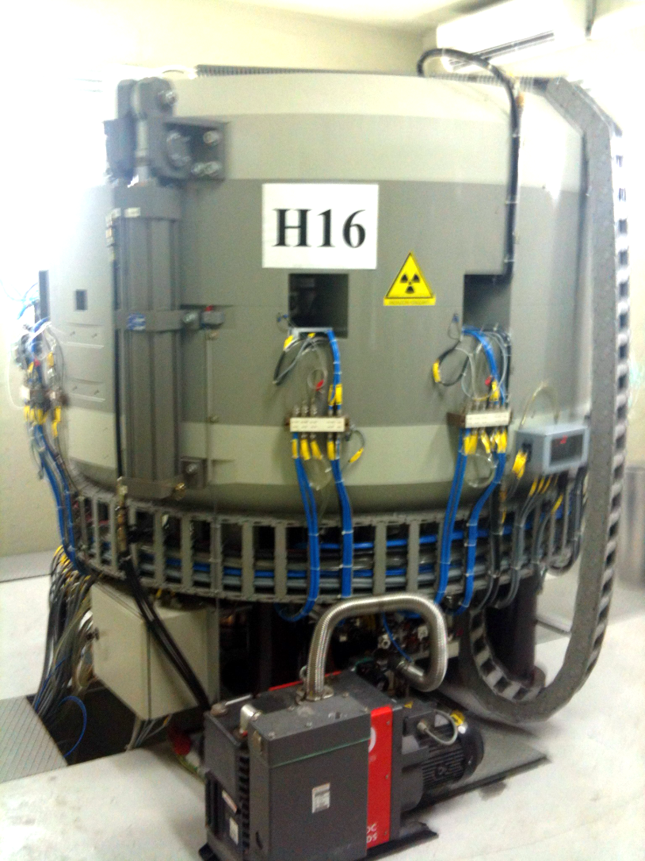
APOTEMA project
INFN-PV
Expertise gained in 2010 in ⁹⁹Mo(^{99m}Tc) production tests at LENA reactor through the ⁹⁸Mo(n,γ) reaction may be transferred to the direct proton-driven ^{99m}Tc accelerator production.
The IBA Cyclone 18/9 in Pavia, has energy beam in the optimal range for ¹⁰⁰Mo (p,2n)^{99m}Tc the reaction (18-10) MeV
Irradiation of a ¹⁰⁰Mo-enriched metallic molybdenum sample is foreseen within activities of the Health Physics surveillance. ^{99m}Tc produced in enough quantities (KBq) for further chemical tests.
Chemical Separation method used: liquid phase extraction with Methyl Ethyl Ketone (MEK) already used in the past in Pavia
The extracted and recovered Tc isotope under pertechnetate (TcO⁻₄) form will be characterized determining the Isotopic/Radionuclid purity. The experimental production yield will be obtained
The ^{99m}Tc prepared will be ​​available to the APOTEMA group in order to determine important pharmaceutical parameters using PET kits allowing an assessment of the finished product.
IBA Cyclone 18/9 will be also available for first low-power thermal-mechanical tests, once the LNL high power production target prototype (70 MeV and high intensity beams) will be constructed

Slide 29
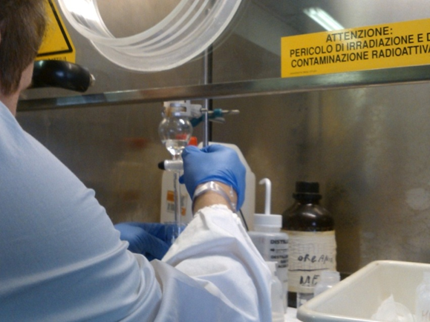
APOTEMA 2013
INFN Pavia Research program
The University of Pavia transferred the expertise gained in the production of ^{99m}Tc/⁹⁹Mo by neutron activation to the production performed by proton irradiation. See experiment performed in collaboration with Ferrara group on June ‘13
The Laboratory has tested different approaches for the recovery of Mo oxide enriched after separation of ^{99m}Tc.
The one that show best results is the precipitation of ammonium isopolymolibdate at pH 2-4.
After filtration with no ashes filter is possible to choose the final oxidation state either as Mo oxide or as metallic deposition. In order to obtain Mo oxide the ammonium salt was calcinated at about 700°C.
The Methyl ethyl ketone (MEK) separation was tested on cyclotron target productions and results are positive.

Slide 30
APOTEMA project
INFN-PV
PLANNED ACTIVITIES for 2014 and budget quotation financial request
Item | What is needed | Estimated Cost
1. Products for chemical separation-purification processes of accelerator-produced ^{99m}Tc | chemical reagents, glassware standards, standards, exchange resin, columns, etc. .. | 7 k€
2. Radioactive transport service | Irradiations to JRC Ispra to LENA Pavia | 2 k€
2. Travels to perform experiments | Domestic between Pavia and Milan, Legnaro, Ferrara, Rome | 3.0 k€
 | International travels (Arronax) | 5.0 k€

Slide 31
APOTEMA project
INFN-Mi new joining 2013

Slide 32
APOTEMA project
INFN-Mi
2012-2013: external support to APOTEMA experiment
6 irradiation runs of thin, highly ¹⁰⁰Mo-enriched molybdenum targets with protons beams at the of JRC Ispra cyclotron. Measurements performed using high-resolution gamma spectrometry (HPGe) at the LASA - INFN sez. Milan and UNIMI of Segrate (MI).
Excitation functions and yield measurements on thin-target and assessment of thick-target yield at total/partial absorption energy up to 18 MeV for reactions:
¹⁰⁰Mo(p,X)⁹⁹Mo
¹⁰⁰Mo(p,2n)^{99m}Tc
¹⁰⁰Mo(p,2n)^{99g}Tc
Excitation functions measurements:
¹⁰⁰Mo(p,αn)⁹⁶Nb
¹⁰⁰Mo(p,α)^{97,cum}Nb

Slide 33
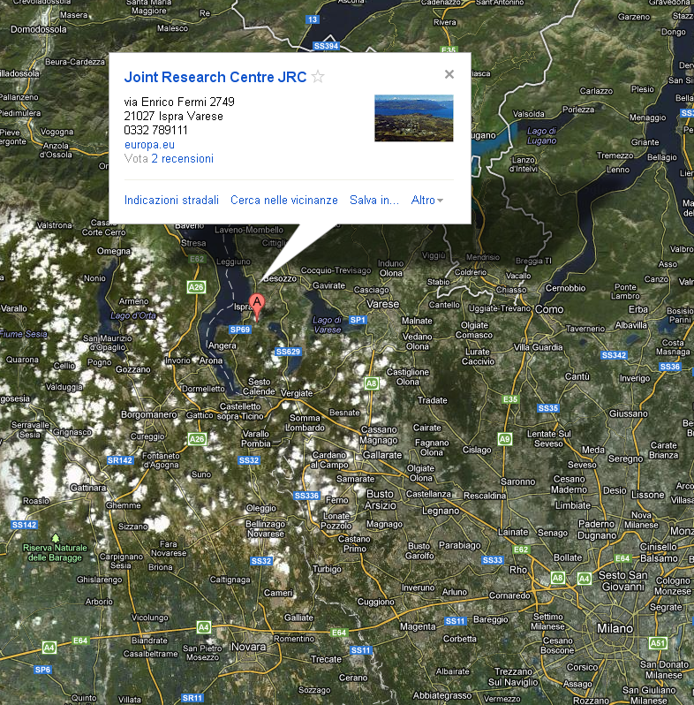
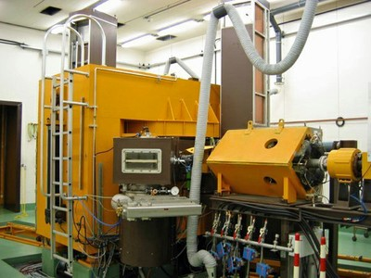
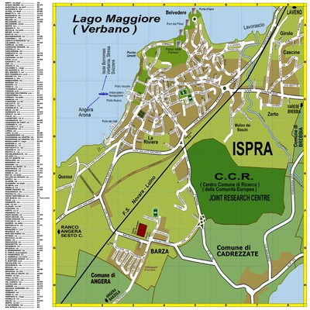
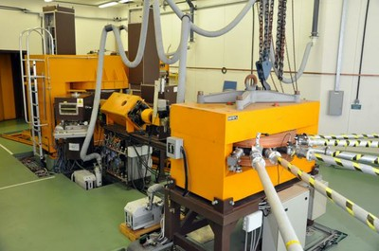
The irradiation facility at Joint Research Center
(EU-JRC) lab in Ispra: The Scanditronix MC40 cyclotron
Milano

Slide 34
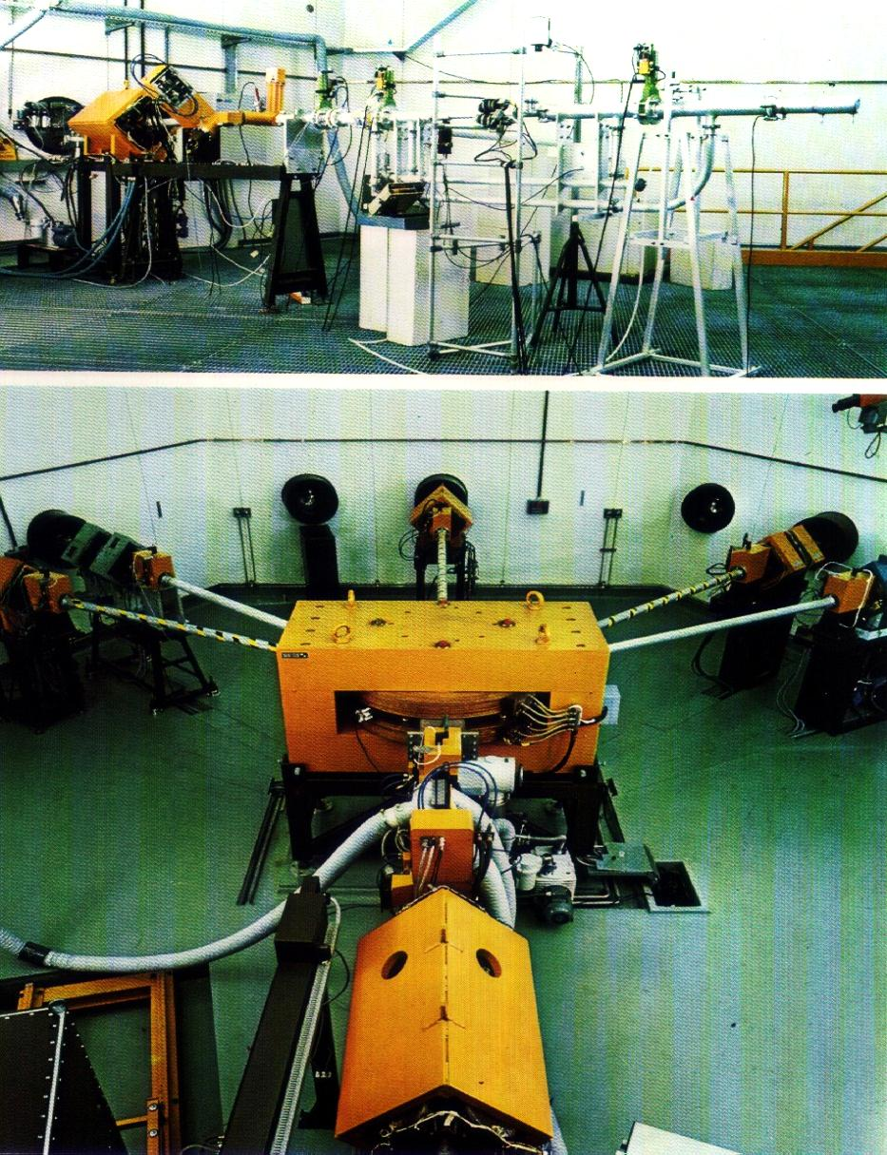
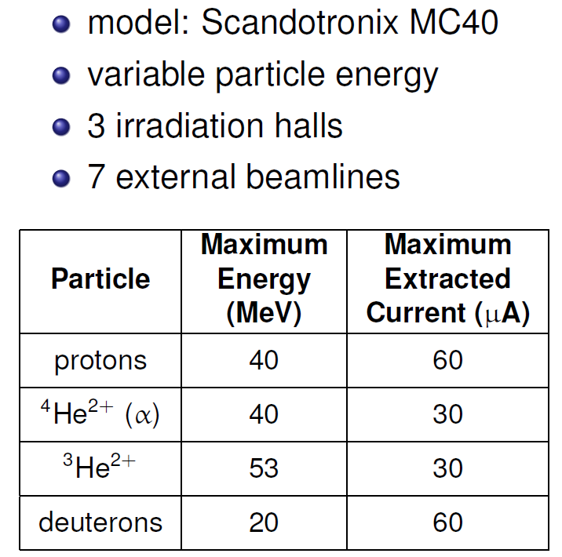
The irradiation facility at Joint Research Center
(EU-JRC) lab in Ispra: The Scanditronix MC40 cyclotron
Irradiations will be performed on a dedicated and well controlled beam line having proper setup for excitation functions measurement.

Slide 35
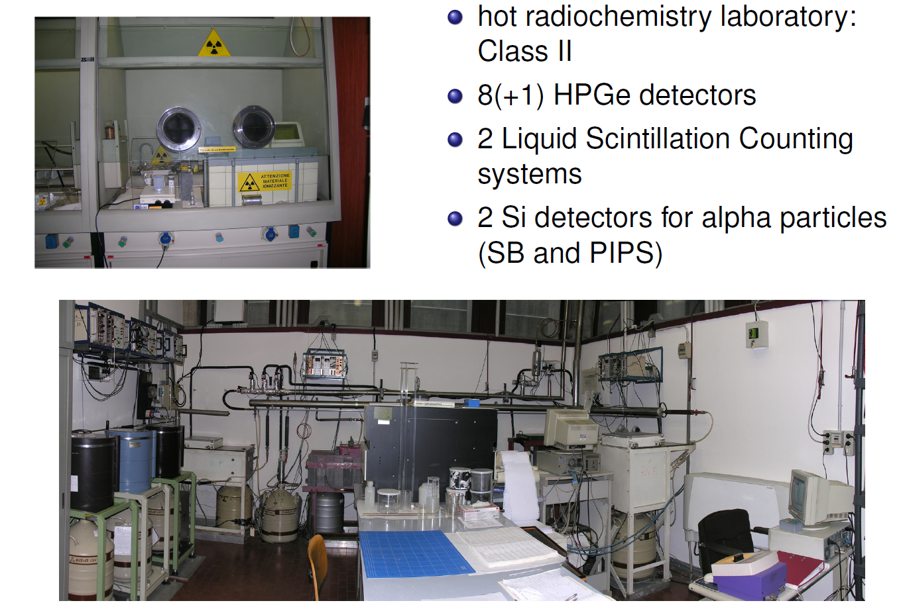
The INFN-LASA Segrate lab

Slide 36
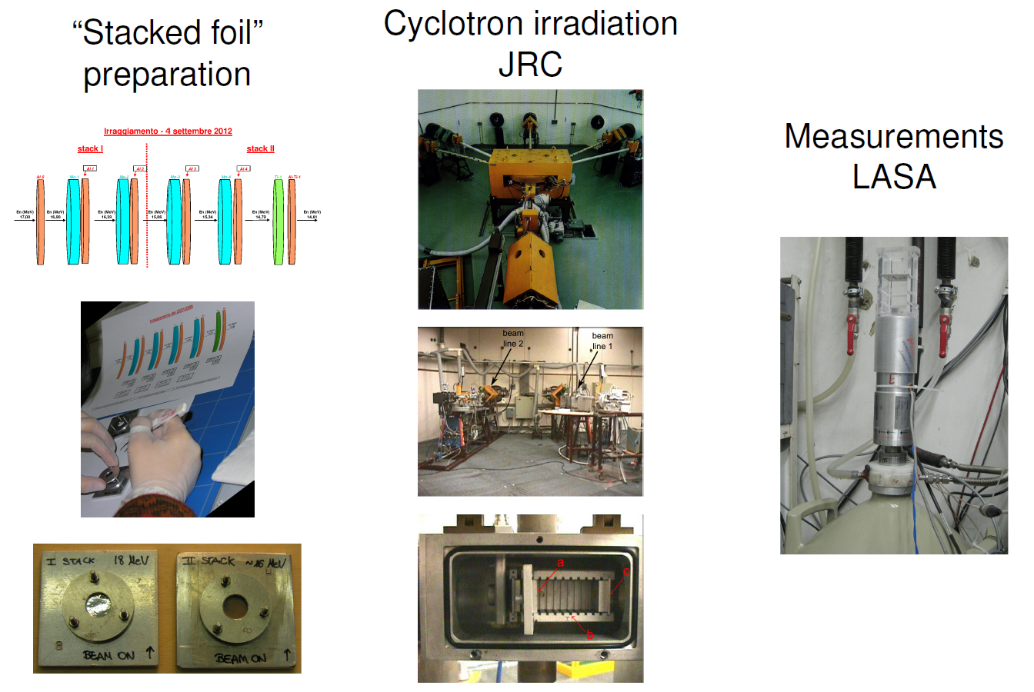
General Experimental setup

Slide 37
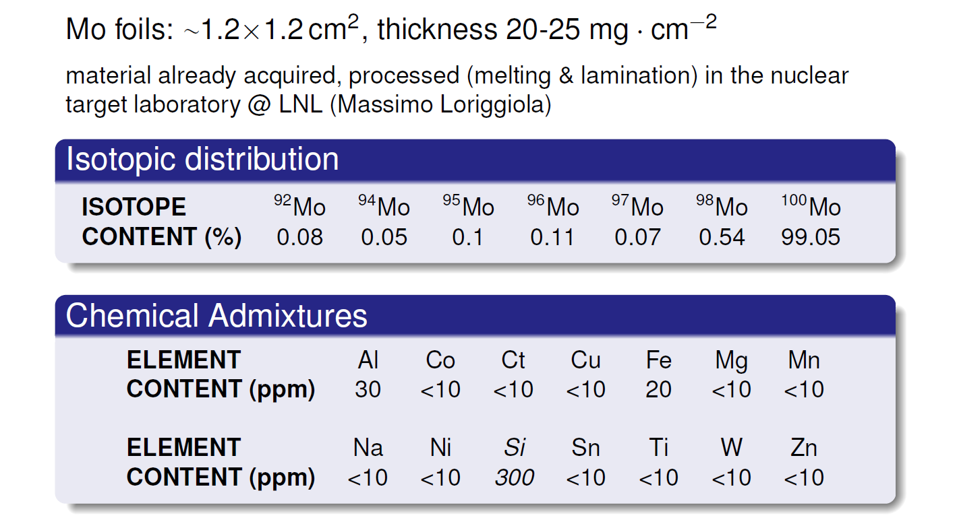
Target material:
¹⁰⁰Mo-enriched metal powder, Isoflex company

Slide 38
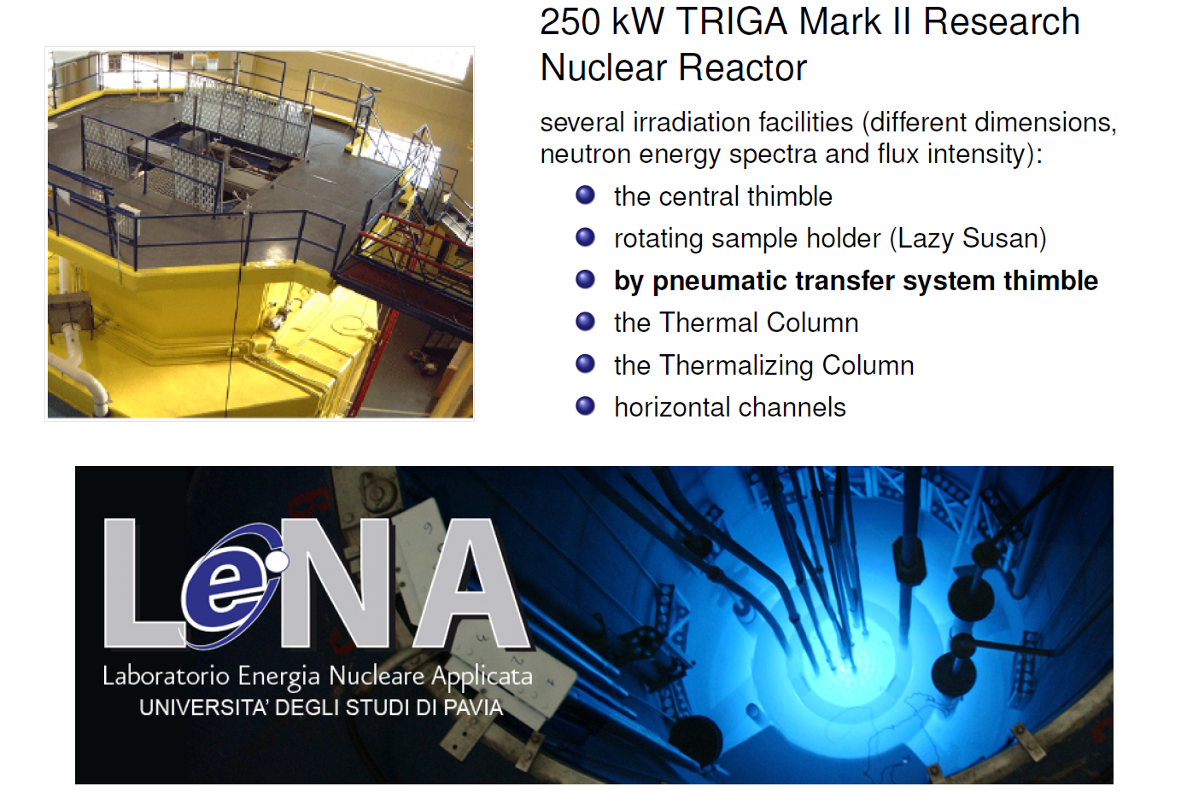
The LENA UniPV, Pavia

Slide 39
APOTEMA project
INFN-Mi
2014: joining inside APOTEMA experiment: proposed activities
extension of experimental measurements for the aforementioned ¹⁰⁰Mo(p,xn) excitation functions for the reaction up to ~30 MeV;
extension of the experimental measurements for the ¹⁰³Rh (d,2n)¹⁰³Pd excitation functions (the only DEUTERONS project activity agreed and included in APOTEMA). Irradiations to be performed partly at JRC Ispra cylotron (up to 19 MeV) and partly at Arronax (Nantes) for energies up to 35 MeV.
Excitation functions and yield measurements on thin-target and assessment of thick-target yield at total/partial absorption energy
Assessment of optimal irradiaton beam parameters and of the waiting time to perform the radiochemical separations as a function of the interfering radionuclides in order to obtain high-purity enough radionuclides.

Slide 40
APOTEMA project
INFN-Mi
PLANNED ACTIVITIES for 2014 and budget quotation
Item | What is needed | Estimated Cost
1. Consumables for laboratory activities | chemical reagents, Liquid nitrogen for HpGe cooling, Laboratory glasses, Small repairs | 5 k€
2. Isotope-enriched Rh material |  | 5 k€
3. Travels to perform experiments | Domestic between Milan, Ispra, Legnaro, Ferrara | 2.0 k€
 | International travels (Arronax) | 4.0 k€
4. Radioactive transport service | Irradiations to JRC Ispra and Arronax | 5 k€
Completion of installation for the suction and tilting pipes for radioactive nanoparticles elimination in one of the Radiochemistry Lab |  | 7 k€

Slide 41
Summary overall budget request FY2014
Sezioni Lab | Missioni interne | Missioni estere | Inventariabile/trasporti | Consumo | Tot. per sez/lab | FTE previsto
LNL | 1.5 | 2.0 | 2.5 | 21.5 | 27.5 | 1.8
Fe | 1.5 | 3.0 | 2.0 | 5.0 | 11.5 | 5.4
Pd | 1.0 | 2.0 | 2.5 | 8.5 | 14 | 2.7
Pv | 3.0 | 5.0 | 2.0 | 7.0 | 17 | 3.0
Mi | 2.0 | 4.0 | 5.0 | 17.0 | 28 | 5.0
TOTALE | 9.0 | 16.0 | 14.0 | 59 | 98 | 17.9

Slide 42
PROGETTO APOTEMA
Distribuzione FTE partecipanti al progetto
LNL | FTE | INFN-Pd | FTE | INFN-Mi | FTE
Esposito J. | 0.6 | Sartori P. | 0.3 | Groppi F. | 1.0
Comunian M. | 0.2 | Gisella G. | 1.0 | Bonardi M. | 1.0
Bello M. | 0.3 | Melendez L. | 0.2 | Manenti S. | 1.0
Uzunov N. | 0.3 | Mammano F. | 1.0 | Gini L. | 0.5
Rossi A. | 0.2 | De Nardo L. | 0.2 | Bazzocchi A. | 1.0
Molakova A. | 0.2 |  | 2.7 | Sabbioni E. | 0.3
 | 1.8 |  |  | Bellomo R. | 0.2
INFN-Fe |  | INFN-Pv | FTE |  | 5.0
Gambaccini .M | 0.25 | Salvini A. | 0.5
Taibi A. | 0.6 | Oddone M. | 0.5
Di Domenico G. | 0.2 | Alloni D. | 0.6
Duatti A. | 1.0 | Prata M. | 0.6
Pupillo G. | 1.0 | Srada L. | 0.8
Uccelli L. | 0.5 |  | 3.0
Pasquali M. | 1.0
Boschi A. | 1.0
 | 5.4 |  |  | TOTALE FTE | 17.9

