Slide 1
OPERA
S.Dusini
Outline
End of CNGS data taking
New tau candidate in muonic channel
numu->nue analysis published
Scanning Lab in LNL

Slide 2
Status of data analysis
December 2012:
end of CNGS operation
Overall 20% less then proposal
value (22.5)
Recorded neutrino interactions in the target | ~ 16700
Located neutrino interactions | 6067
Fully analyzed events | 4969
ν_{τ} candidate events | 3
’08-’09 data: multiple brick per event
without preselection
’10-’12 data: anticipate analysis of most probable brick for all events before moving to second/third
Pmu < 15GeV (-4% signal, -33% numuCC)

Slide 3
τ→μ candidate
Muon momentum
by range: 2.8 ± 0.2 GeV
Multiple Coulomb Scattering in the brick: 3.1 [2.6,4.0] GeV

Slide 4

τ→μ candidate

Slide 5
Charge determination of the muon
Charge measurement based on TT and RPC hits when no hits in the Drift Tubes.
Fitting function:
TT hits
RPC
responsabilità di Padova
p₂ < 0 → negative charge
5.6 σ significance
R ~ 85 cm
P-value = 0.063% (probability to reconstruct a μ⁺ stopping in the 7th iron layer with p₂ < -0.00389 cm⁻¹)
RPC hits

Slide 6
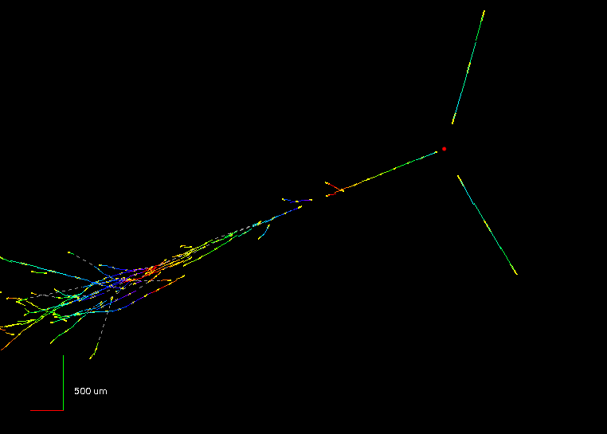
ν_{μ} → ν_{e} analysis
Published on JHEP [arXiv: 1303.3953] (U.Kose editor)
OPERA 2008-2009 data
E_{ν} = 15.6 GeV
Increase sensitivity
caveat: experiments with different L/E
3 flavour analysis:
4 observed events,
4.6 expected ➔ sin²(2θ₁₃) < 0.44 at 90% C.L.
Non standard physics

Slide 7
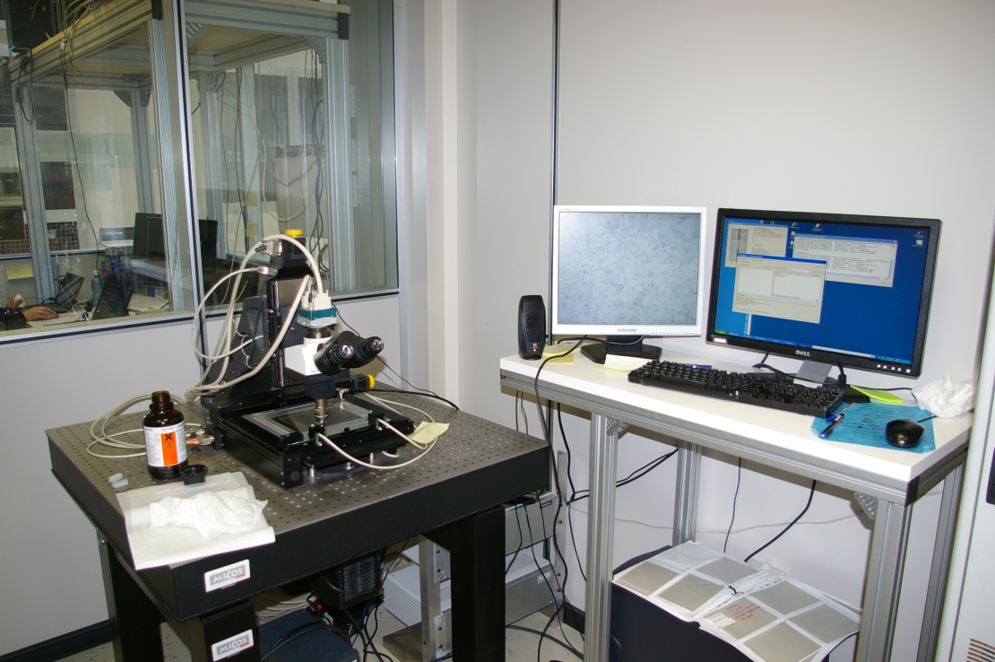
Scanning activity
Two microscope in LNL
Persons involved:
Chiara Sirignano (ric. uni.)
Eduardo Medinaceli (ass. junior till 4/2014)
Umut Kose (art. 23 till 5/2013)
To increase the analyzed event rate optimizing the duty
cycle of the microscope we decided to work in synergy with
the scanning lab in Bologna (Bologna-Padova “consortium”)
Padova: 2 microscopes (1 with plate changer)
Bologna: 5 microscopes with automatic plate changer.
The activity in the two scanning labs is organized in a dynamic way depending of the type of events allocated to BO-PD lab. Typically: location of the vertex in Bologna, full reconstruction of the events in Padova & Bologna.

Slide 8
Statistica complessiva del consorzio
BOLOGNA - PADOVA
Run 2010 completato (72 eventi localizzati su 106 assegnati 68 % ) ,
4 topologie interessanti ( 2 candidati charm e 2 candidati ν_{e} )
Run 2011 | BOLOGNA-PADOVA
EVTYPE | CC | NC | All
TOTAL | 74 | 35 | 109 | 100 %
STARTED | 73 | 35 | 108 | 99 %
CONNECTED | 54 | 27 | 81 | 74 %
LOCATED | 32 | 22 | 54 | 50 %
Scanning cominciato per tutti gli eventi e
analisi vicina alla conclusione
1 candidato ν_{e} , 1 candidato charm,
1 evento molto interessante con doppio
decadimento
Run 2012 | BOLOGNA-PADOVA
EVTYPE | CC | NC | All
TOTAL | 41 | 18 | 59 | 100 %
STARTED | 35 | 14 | 49 | 83 %
CONNECTED | 27 | 8 | 35 | 59 %
LOCATED | 2 | 3 | 6
Scanning e analisi in corso

Slide 9
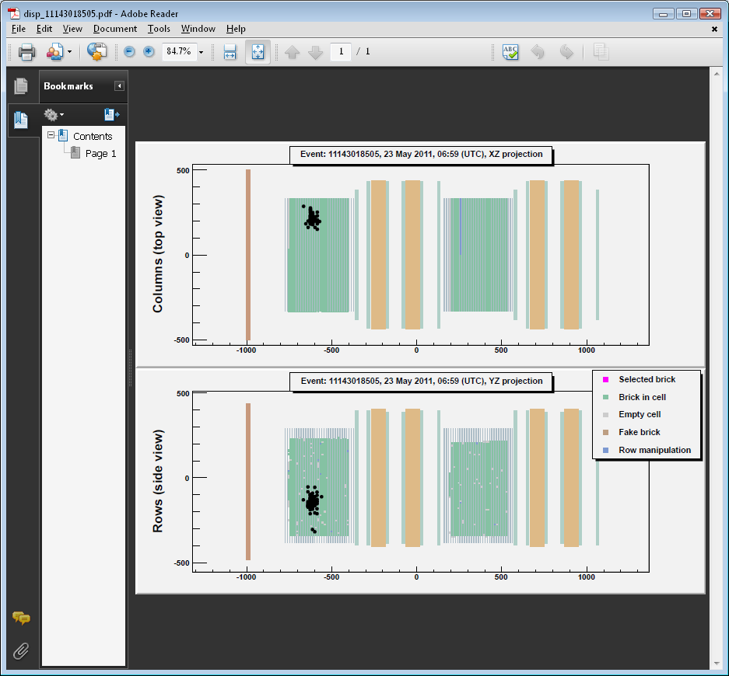
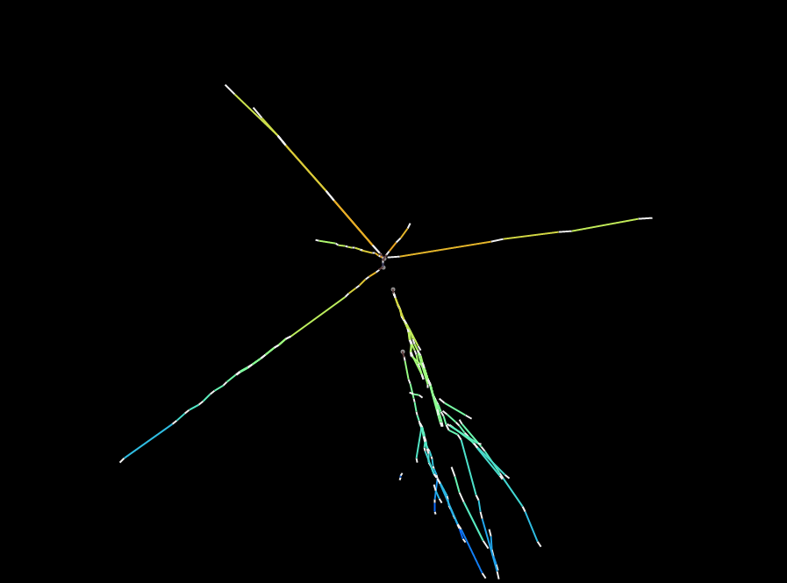
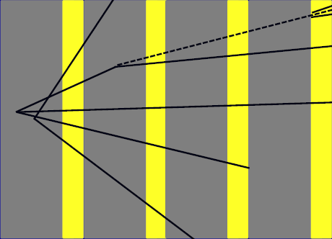
Evento con due decadimenti
Plots preliminari: lo studio accurato dell’evento è ancora in corso.
XY projection
vee
1
kink
6
4
5
2
3
32
33
34
35

Slide 10
Publications 2012/13
U.Kose one of the two editors
Important contribution to the analysis by A.Bertolin and M.Roda
S.Dusini one of the 3 editors
S.Dusini in the editorial board of the paper
S.Dusini contribution to the re-analysis of the data
“New results on ν_{μ} → ν_{τ} appearance with the OPERA experiment at the CNGS neutrino beam” in preparations (editors: A.Longhin, U.Kose)

Slide 11
OPERA
Padova
Responsabilità
Stefano Dusini: Coordinamento fisica, software & computing
Chiara Sirignano: Coordinamento laboratorio sviluppo emulsioni LNGS
Alessandro Bertolin: Project Leader RPC-XPC
Alberto Garfagnini: Slow Control supervisor
Missioni interne
  2 riunioni collab. + 4 analysis/scanning 18.0
  Shift dei Fisici al GS (3 week per 8 firme) 40.0
  Tecnici supporto per CS e sviluppo (10 week) 12.5
  Coordinamento fisica 8.0
  Scanning and development Supervision 12.0
Missioni estere
  Riunioni Collab.: 1 Europa, 1 Giappone 17.0
  Coordinamento fisica 5.0
  Presentazioni conferenze 5.0
Consumo
  Metabolismo sede 10.0
  Manutenzione cambio automatico 2.0
  Manutenzione Condizionamento 4.0
  Manutenzione Microscopi 18.0
Staff:
A. Bertolin 80%
R. Brugnera 30%
S. Dusini 80%
A. Garfagnini 40%
C. Sirignano 80%
L. Stanco 40%
Tempo determinato
E. Medinaceli (assegno) 80%
M. Roda (dottorando) 80%
Totale 5.1 FTE
Contributi dall’OE e OM per turni specializzati al Gran Sasso di
- Sviluppo fotografico delle emulsioni in camera oscura
- Analisi automatica di Scanning dei CS

Slide 12
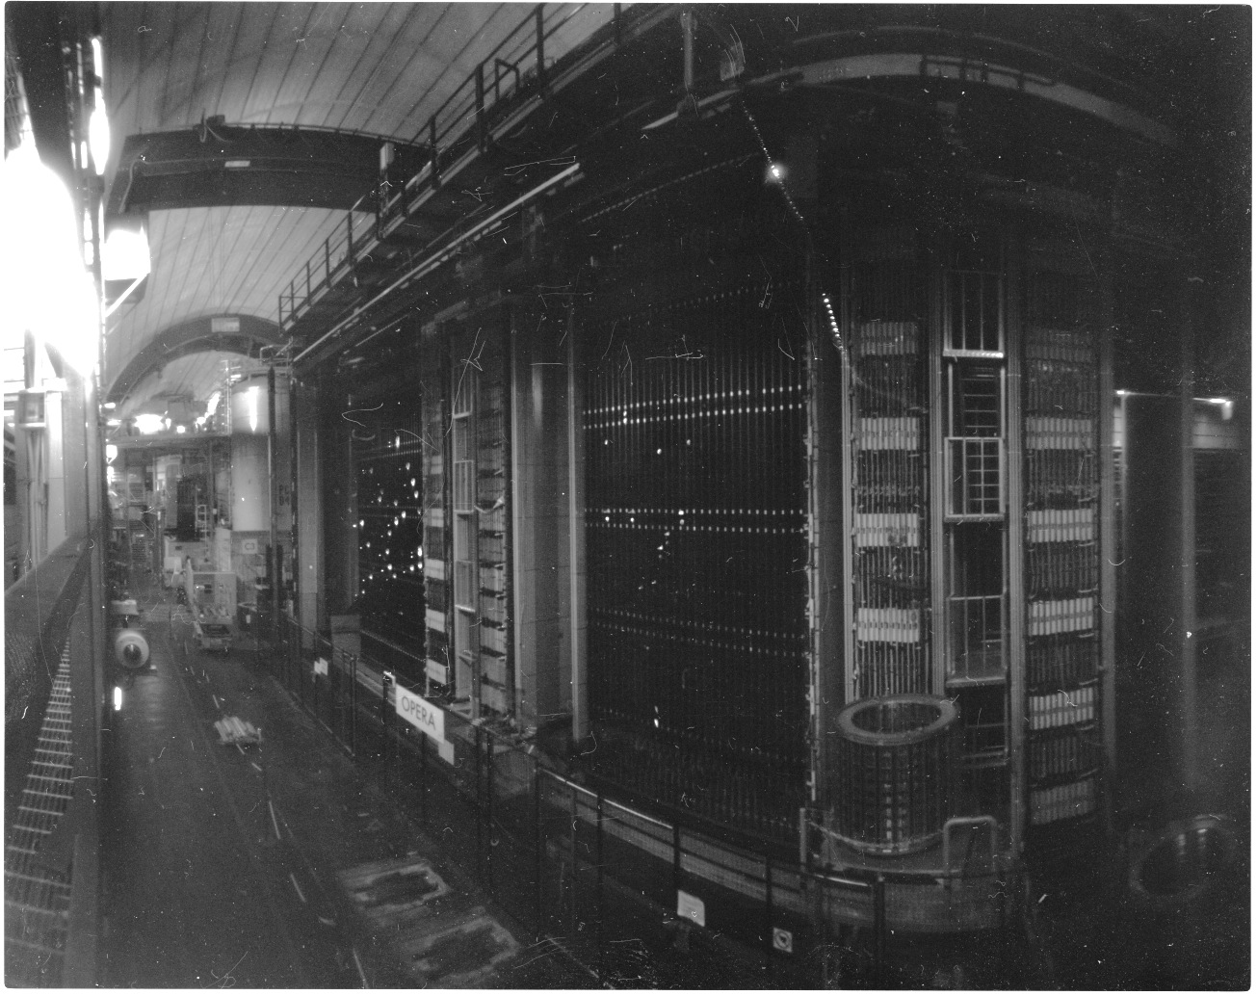
Thank you for your attention
Image taken using OPERA emulsion film with pinhole hand made camera by D. Diferdinando (INFN –Bologna)

