Slide 1



Planck Constraints on the Physics of the Early Universe
Laboratori Nazionali di Frascati, 29th May 2013
arXiv:1303.5082v1 & arXiv:1303.5084v1
Sabino Matarrese
Physics & Astronomy Dept. “G. Galilei”, Padova University
INFN Sezione di Padova
Padova – Italy
on behalf of the Planck collaboration

Slide 2
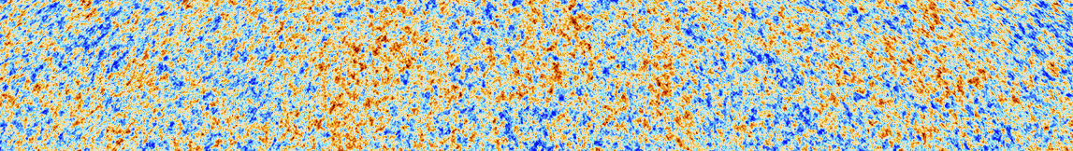
The scientific results that we present today are a product of the Planck Collaboration, including individuals from more than 100 scientific institutes in Europe, the USA and Canada
Planck is a project of the European Space Agency, with instruments provided by two scientific Consortia funded by ESA member states (in particular the lead countries: France and Italy) with contributions from NASA (USA), and telescope reflectors provided in a collaboration between ESA and a scientific Consortium led and funded by Denmark.

Slide 3
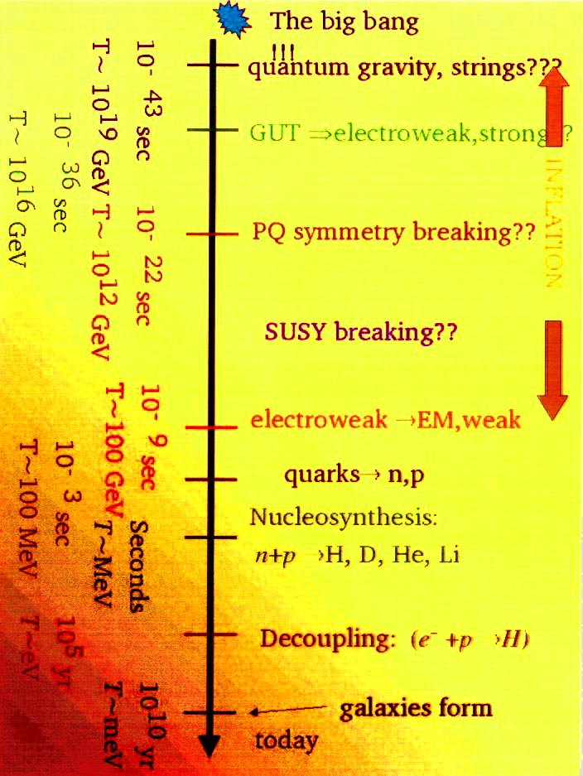
The Universe thermal history & Inflation
Inflation is an era of accelerated expansion in the early Universe, driven by the dynamics of a scalar field, the “inflaton”. Small fluctuations in the energy density originated during inflation from quantum vacuum oscillations. These primordial fluctuations originated the CMB temperature anisotripies (and polarization) and provided the seeds of cosmic structure formation.
The inflationary era had to occur before baryogenesis took place
INFLATION

Slide 4
Friedmann vs. Newton
Robertson-Walker metric
scale factor
F = ma
E = const.
M = const.

Slide 5
The Big Bang “crisis”
Horizon problem: does our Universe belong to … a set of measure zero?
Flatness problem: do we need to fine-tune the initial conditions of our Universe?
Cosmic fluctuation problem: how did perturbations come from?

Slide 6
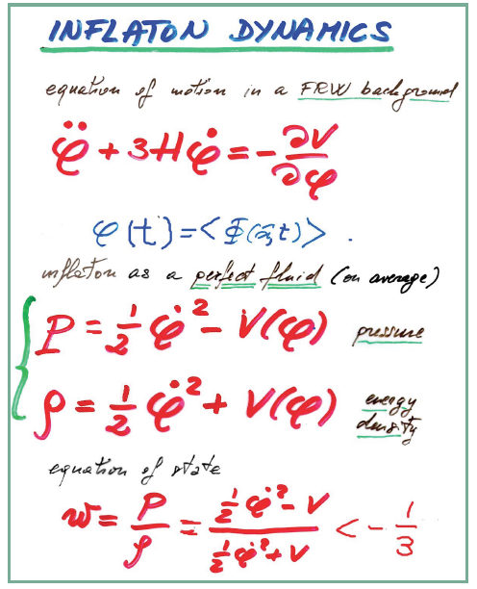
Inflation dynamics I
The vacuum expectation value of the inflaton scalar field behaves like a perfect fluid, but, unlike standard fluids, it can have negative pressure, thus driving a suitable period of accelerated expansion in the early Universe, dubbed “inflation”. If a long enough period of inflation (more than 60 e-folds) occurred it solves the horizon and flatness problem of the Big Bang model and generates the seeds of cosmic structure formation and CMB anisotropies by quantum oscillations of the vacuum state

Slide 7
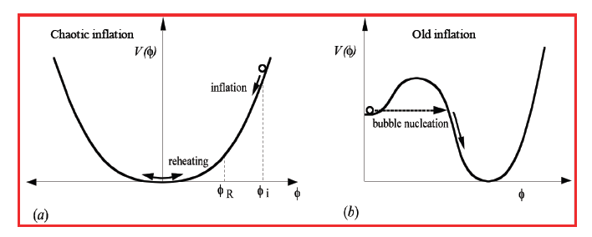
Inflation dynamics II
Different models of inflation derive from different potential and different initial conditions. Old inflation (Guth 1981) assumes thermal initial conditions (which are very difficult to achieve). Chaotic inflation (Linde 1983) is based on the application of the uncertainty principle at Planck energies.

Slide 8




Inflation and the Inflaton
Inflation is attained if the energy density of the universe is dominated by the
potential energy of a scalar field (the inflaton)
The inflaton is slowly rolling along its potential:
Slow-roll conditions: the potential V(ϕ)
must be flat
and

Slide 9

Curvature power-spectrum from inflation
The Planck baseline model assumes purely adiabatic scalar perturbations at very early times, with a (dimensionless) curvature power-spectrum parameterized by
with n_{s} and dns/dlnk = const. The baseline model assumes no “running”, i.e. dn_{s}/d ln k = 0. The pivot scale k₀ = 0.05 Mpc⁻¹. With this choice, n_{s} is not strongly degenerate with the amplitude parameter A_{s}.

Slide 10

Tensor-mode power-spectrum
The Planck analysis also considers extended models with a significant amplitude of primordial gravitational waves (tensor modes) with (dimensionless) tensor mode spectrum parameterized as a power-law with
We define r_{0.05} = A_{t}/A_{s}, the primordial tensor-to-scalar ratio at k = k₀. Our constraints are only weakly sensitive to the tensor spectral index, n_{t} (assumed to be close to zero), and we adopt the theoretically motivated single-field inflation consistency relation n_{t} = - r_{0.05}/8, rather than varying n_{t} independently.

Slide 11
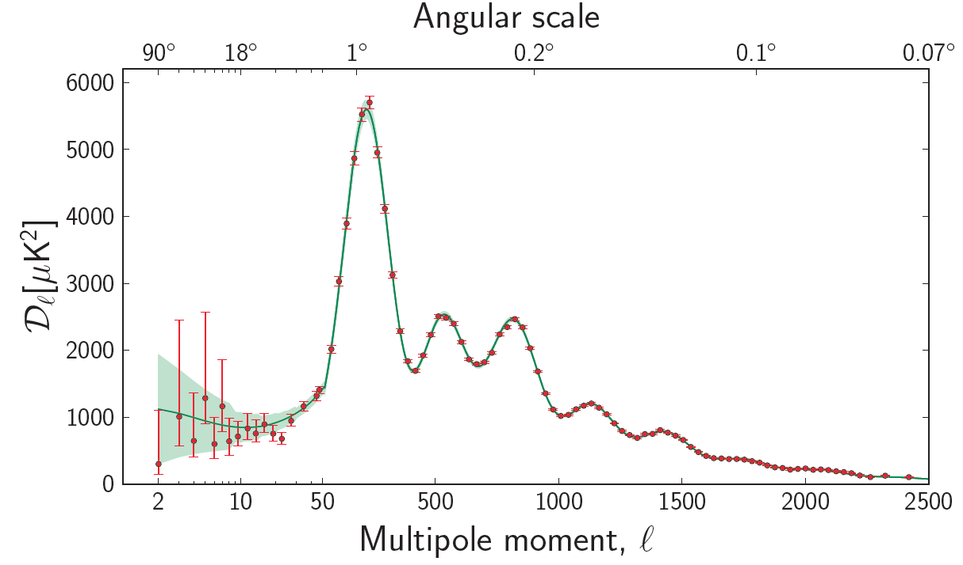
The Planck angular power-spectrum
The temperature angular power spectrum (l(l + 1)C_{l}/2π) of the primary CMB from Planck, showing a precise measurement of 7 acoustic peaks, well fit by a simple 6-parameter ΛCDM model [Planck+WP+highL]. The shaded area around the best-fit curve represents cosmic variance, including sky cut. The error bars on individual points also include cosmic variance. The horizontal axis is logarithmic up to l = 50, and linear beyond. The measured spectrum here is the same as the previous figure, rebinned to show better the low-l region.

Slide 12
Initial (inflationary) conditions
The Planck nominal mission temperature anisotropy measurements, combined with the WMAP large-angle polarization, constrain the scalar spectral index to
n_{s} = 0.9603 ± 0.0073,
ruling out exact scale invariance at over 5σ. Planck establishes an upper bound on the tensor-to-scalar ratio at
r < 0.11 (95% CL).
The Planck data shrink the space of allowed standard infla- tionary models, preferring potentials with V” < 0. Exponential potential models, the simplest hybrid inflationary models, and monomial potential models of degree n ≥ 2 do not provide a good fit to the data. Planck does not find statistically significant running of the scalar spectral index, obtaining
dn_{s} /d ln k = −0.0134 ± 0.0090.

Slide 13

Energy scale of inflation
The Planck constraint on the tensor to scalar ratio r corresponds to an upper bound on the energy scale of inflation
at 95 % CL. This in turn is equivalent to an upper bound on the Hubble parameter during inflation

Slide 14
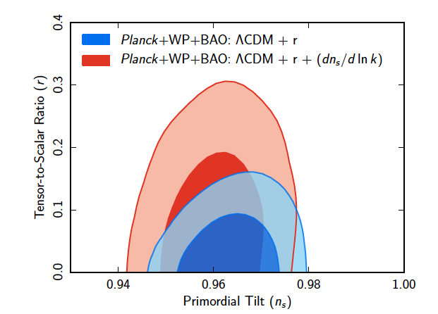
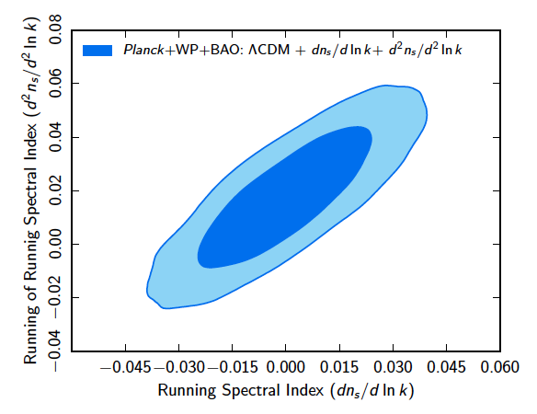
Initial (inflationary) conditions
Marginalized joint 68% and 95% CL regions
for (r, n_{s}), using Planck+WP+BAO with and without a running spectral index
Marginalized joint 68% and 95% CL regions
for (d²n_{s}=d ln k²; d n_{s}=d ln k) using
Planck+WP+BAO.

Slide 15
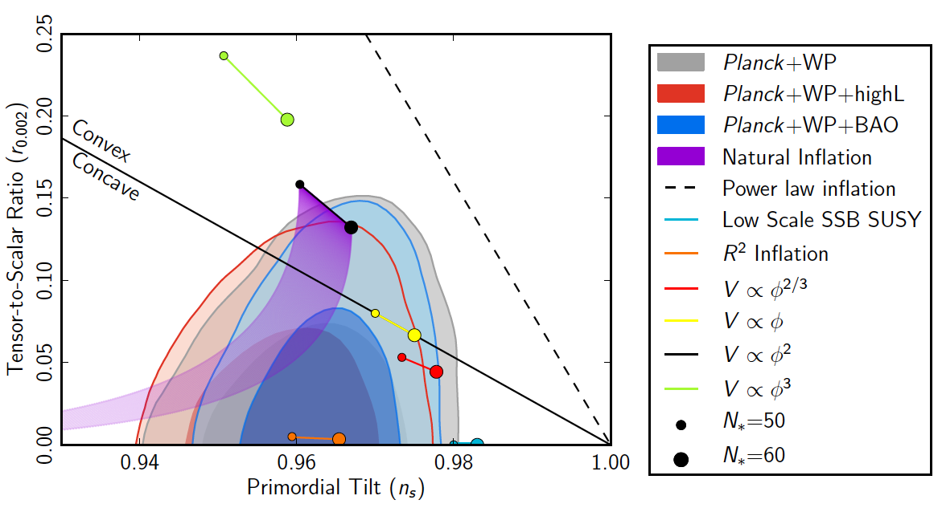
Planck constraints in inflation model space
Marginalized joint 68% and 95% CL regions for ns and r0:002 from Planck in combination with other data sets compared to
the theoretical predictions of selected inflationary models
Marginalized joint 68% and 95% CL regions for ns and r_{0.002} from Planck in combination with other data sets compared to the theoretical predictions of selected inflationary models.

Slide 16
Consequences for Inflation models
exponential, simplest hybrid inflation and monomial (V(φ)=φ^{n}, n=2,4) do not fit well observations, e.g. n=4 outside the 99.7% CL, n=2 outside 95% CL
Axion monodromy inspired models, as above, with n=1,2/3, lie within 95% CL, and on the boundary of 95% CL respectively.
Hilltop (1-φ^{p}/μ^{p}) con p=2 in agreement, within 95% CL
natural inflation (1+cos[φ/f]) consistent, for f ≥ 5 M_{Pl}
R² Model (Starobinsky ‘80) consistent with data

Slide 17
Testable predictions of inflation
Cosmological aspects
  Critical density Universe
  Almost scale-invariant and nearly Gaussian, adiabatic density fluctuations
  Almost scale-invariant stochastic background of relic gravitational waves
Particle physics aspects
  Nature of the inflaton
  Inflation energy scale

Slide 18
Primordial non-Gaussianity: a new route to falsify Inflation ...
Strongly non-Gaussian initial conditions studied in the eighties.
New era with f_{NL} models from inflation (Salopek & Bond 1991; Gangui, Lucchin, Matarrese & Mollerach 1994: f_{NL}~ 10⁻²; Verde, Wang, Heavens Kamionkowski 2000; Komatsu & Spergel 2001; Acquaviva, Bartolo, Matarrese & Riotto 2002; Maldacena 2002; + many models with (much) higher f_{NL}).
Primordial NG emerged as a new “smoking gun” of (non-standard) inflation models, which complements the search for primordial GW.

Slide 19
... and to test the physics of the Early Universe
The NG amplitude and shape measures deviations from standard inflation, perturbation generating processes after inflation, initial state before inflation, ...
Inflation models which would yield the same predictions for scalar spectral index and tensor-to-scalar ratio might be distuinguishable in terms of NG features.
We should aim at “reconstructing” the inflationary action, starting from measurements of a few observables (like n_{S}, r, n_{T}, f_{NL}, g_{NL}, etc. …), just like in the nineties we were aiming at a reconstruction of the inflationary potential.

Slide 21
Simple-minded NG model ... has become reality
Many primordial (inflationary) models of non-Gaussianity can be represented in configuration space by the simple formula (Salopek & Bond 1990; Gangui et al. 1994; Verde et al. 1999; Komatsu & Spergel 2001)
Φ = φ_{L} + f_{NL *} ( φ_{L}² - <φ_{L}²>) + g_{NL *} (φ_{L}³ - <φ_{L}²> φ_{L} ) + …
where Φ is the large-scale gravitational potential (more precisely Φ = 3/5 ζ on superhorizon scales, where ζ is the gauge-invariant comovign curvature perturbation), φ_{L} its linear Gaussian contribution and f_{NL} the dimensionless non-linearity parameter (or more generally non-linearity function). The percent of non-Gaussianity in CMB data implied by this model is
NG % ~ 10⁻⁵ |f_{NL}|
~ 10⁻¹⁰ |g_{NL}|
< 10 ^{–4} from CMB & LSS
10⁻⁵ from Planck
“non-Gaussianity = non-dog”
(Ya.B. Zel’dovich)
< 10⁻⁴ from
CMB & LSS

Slide 22
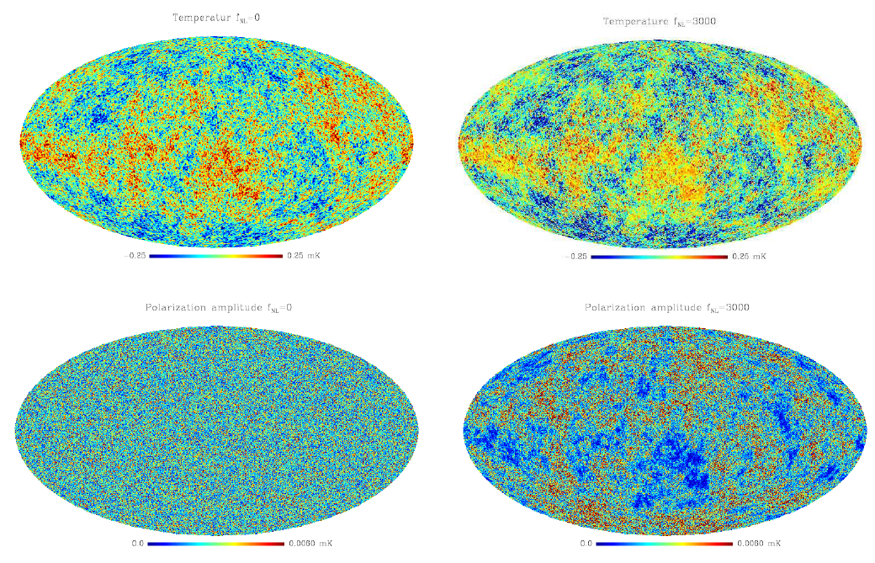
NG CMB simulated maps
temperature
Gaussian
Liguori, Yadav, Hansen, Komatsu, Matarrese & Wandelt 2007
non-Gaussian
polarization

Slide 23
Planck 2013 results XXIV:
Scientific target
Constrain (with high precision) and/or detect primordial non-Gaussianity (NG) as due to (non-standard) inflation
NG amplitude and shape measure deviations from standard inflation, perturbation generating processes after inflation, initial state before inflation, ...
We test: local, equilateral, orthogonal shapes (+ many more) for the bispectrum and constrain the primordial trispectrum (test of multi-field models) parameter τ_{NL}

Slide 24

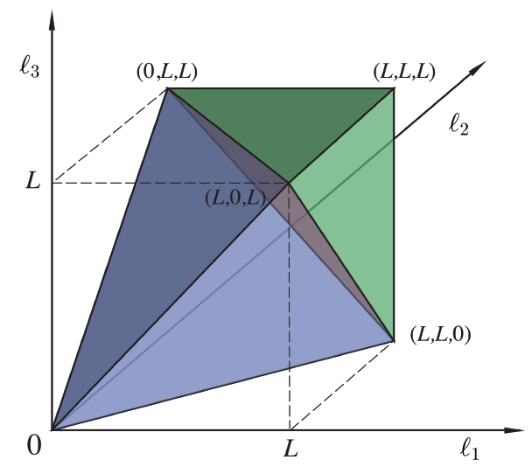

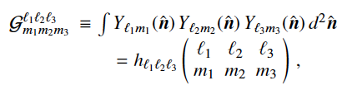
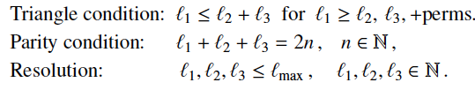
CMB bispectrum
a
Gaunt integrals

Slide 25
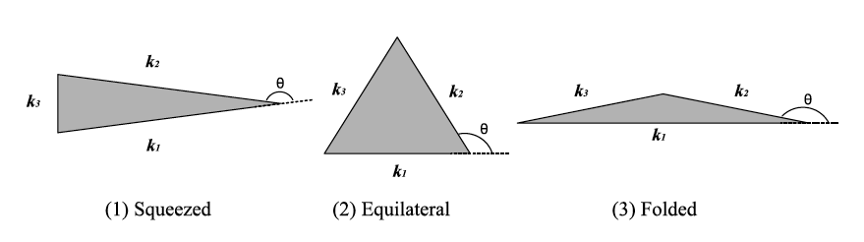
the NG shape information
... there are more shapes of non-Gaussianity
(from inflation) than ... stars in the sky
+ many more

Slide 26
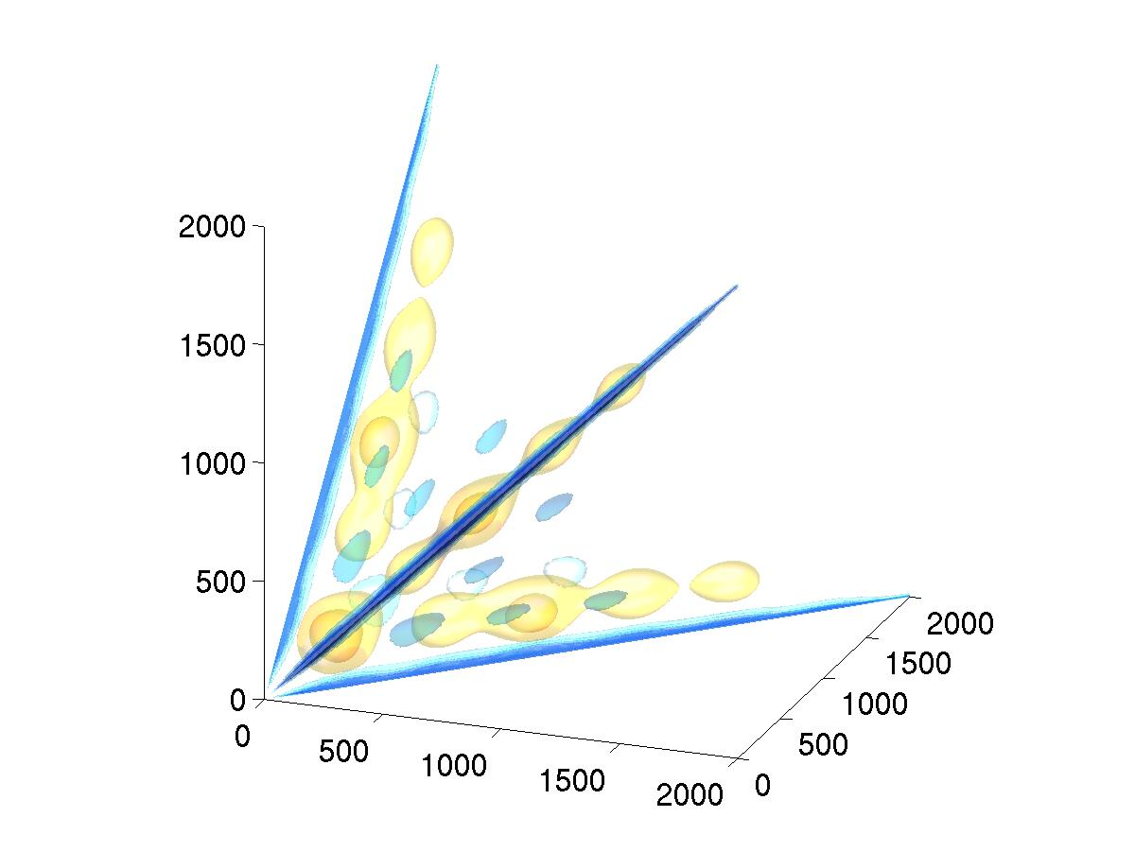
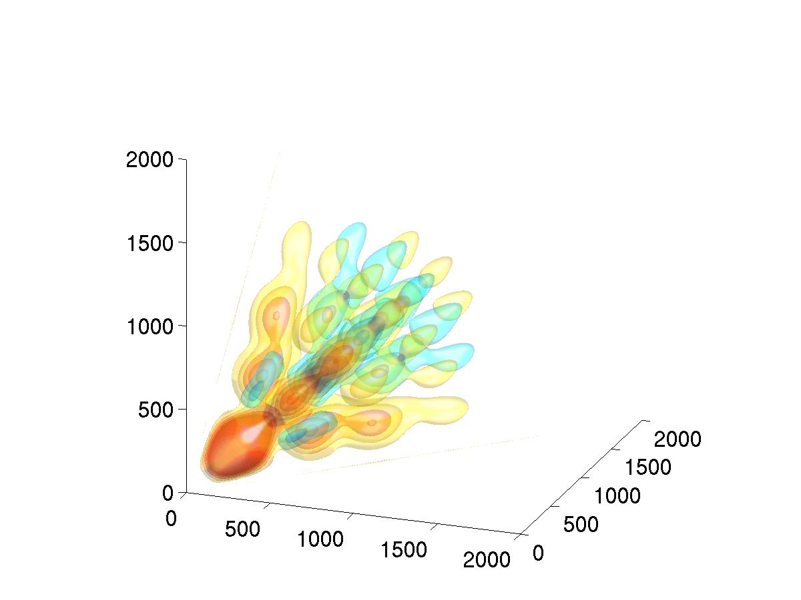
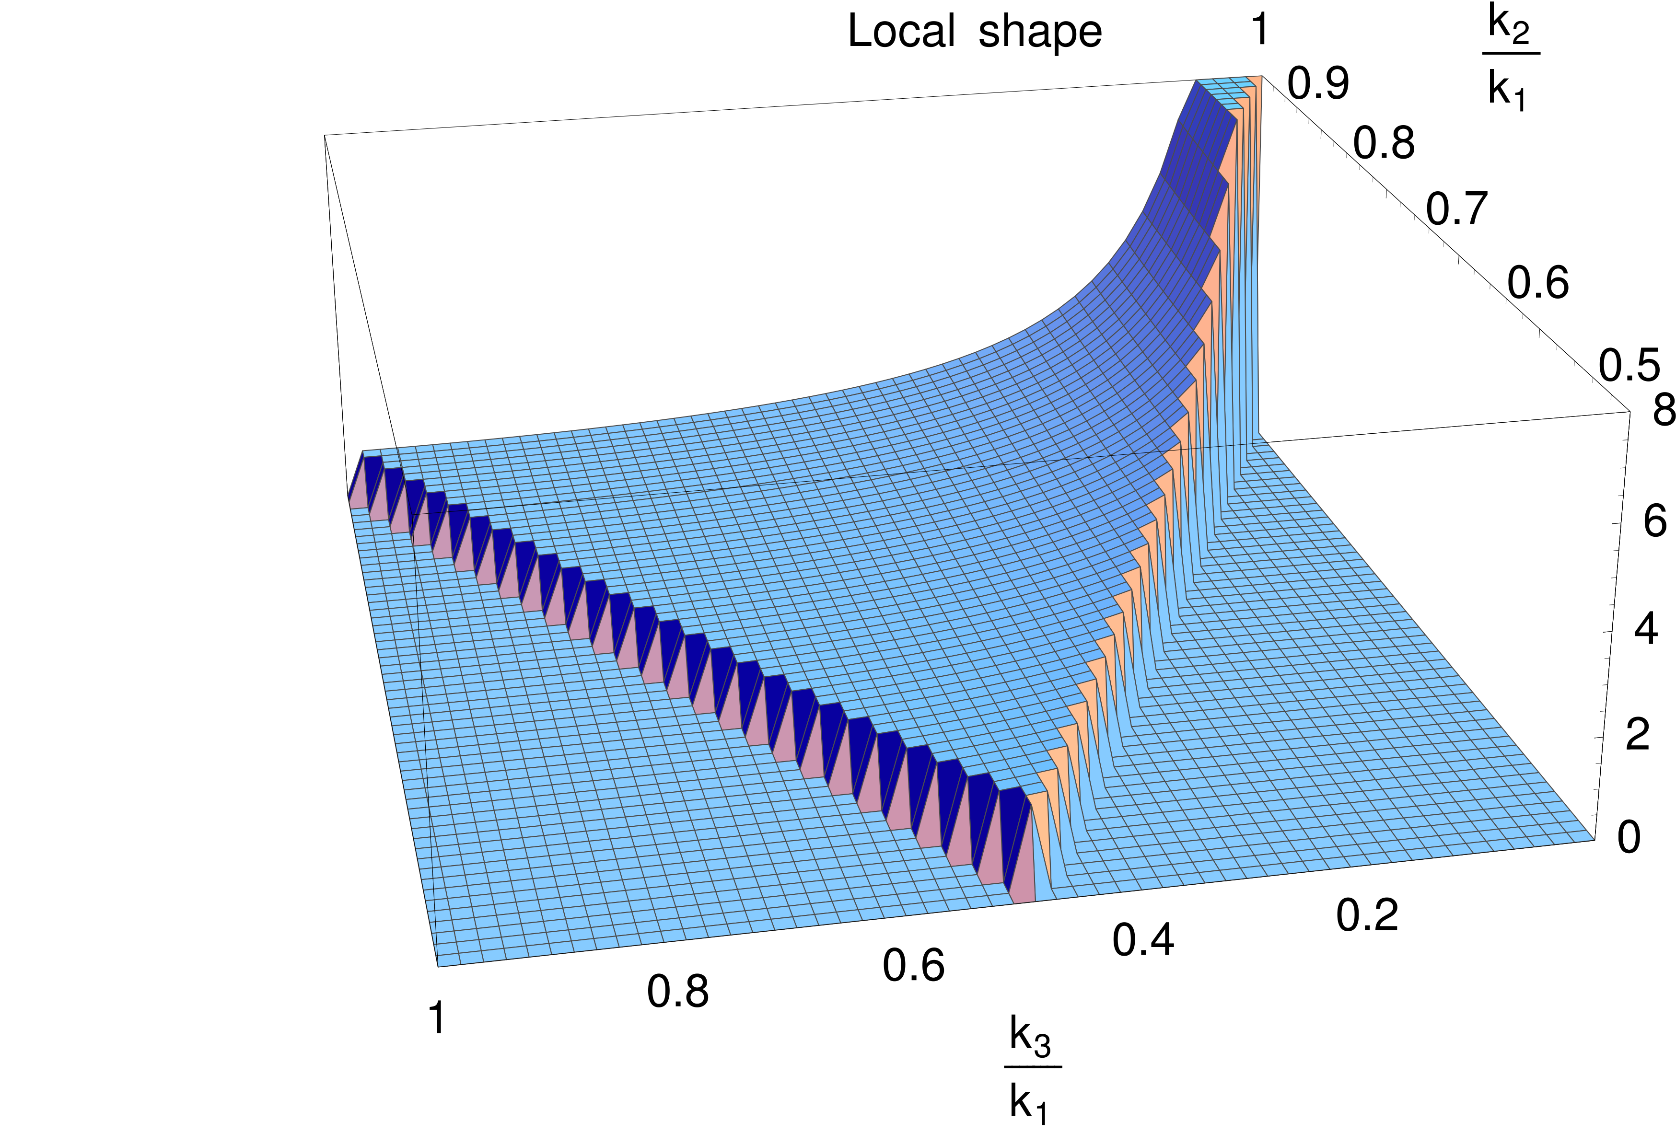
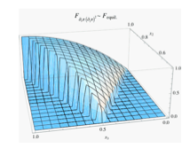
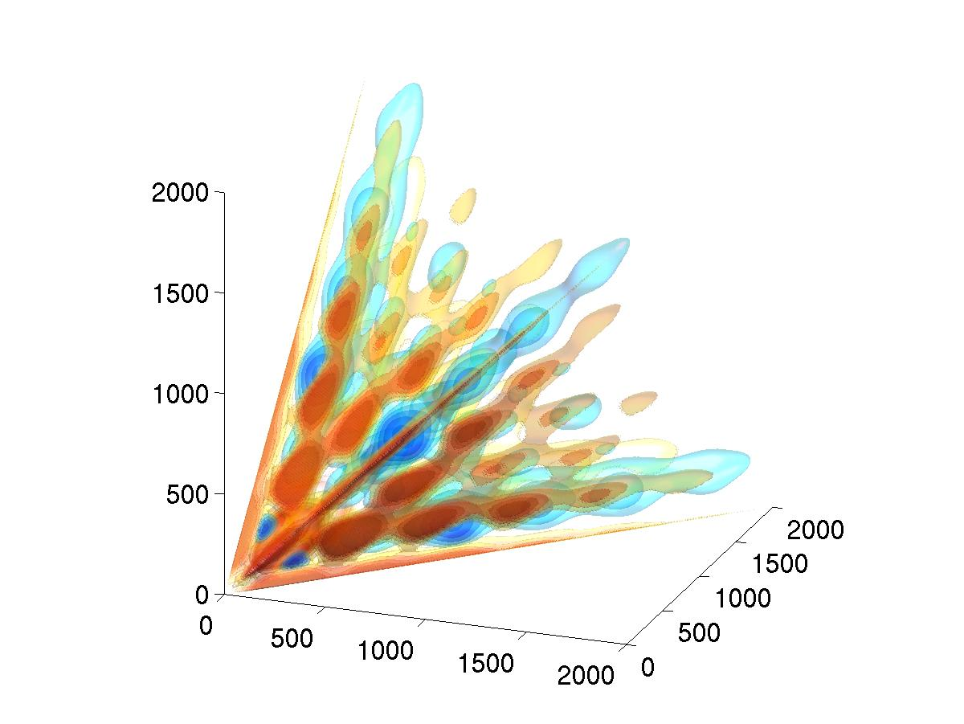
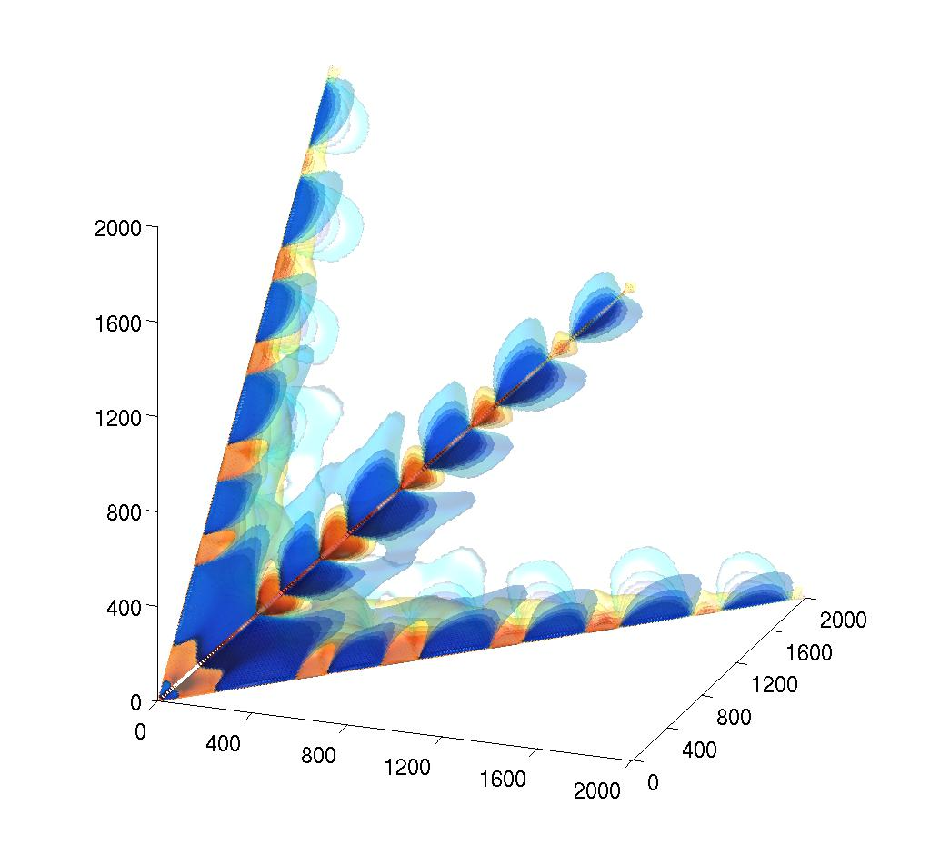
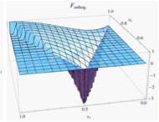
Shapes
Local
Equilateral
Orthog.
ISW-l.

Slide 27
Bispectrum shapes
local shape: Multi-field models, Curvaton, Ekpyrotic/cyclic, etc. ...
equilateral shape: Non-canonical kinetic term, DBI, K-inflation, Higher-derivative terms, Ghost, EFT approach
orthogonal shape: Distinguishes between variants of non-canonical kinetic term, higher-derivative interactions, Galilean inflation
flat shape: non-Bunch-Davies initial state and higher-derivative interactions, models where a Galilean symmetry is imposed. The flat shape can be written in terms of equilateral and orthogonal.

Slide 28
Optimal f_{NL} bispectrum estimator
The theoretical template needs to be written in separable form. This can be done in different ways and alternative implementations differ basically in terms of the separation technique adopted and of the projection domain.
KSW (Komatsu, Spergel & Wandelt 2003) separable template fitting + Skew-C_{l}
extension (Munshi & Heavens 2010)
Binned bispectrum (Bucher, Van Tent & Carvalho 2009)
Modal expansion (Fergusson, Liguori & Shellard 2009)
Sub-optimal estimators also applied:
Wavelet decomposition (Martinez-Gonzalez et al. 2002; Curto et al. 2009) & Minkowski Functionals (Ducout et al. 2013)

Slide 29
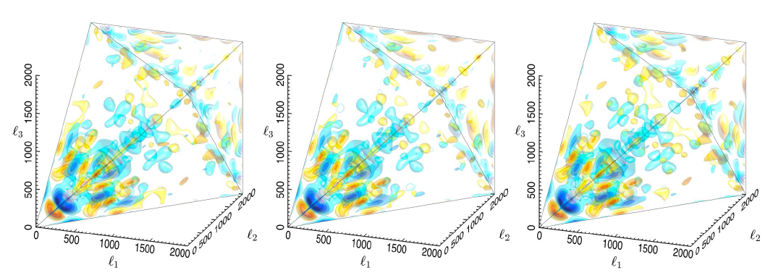
The Planck modal bispectrum
SMICA
NILC
SEVEM
Full 3D CMB bispectrum recovered from the Planck foreground-cleaned maps, including SMICA, NILC and SEVEM, using hybrid Fourier mode coefficients, These are plotted in three-dimensions with multipole coordinates (l₁,l₂,l₃) on the tetrahedral domain out to l_{max} = 2000. Several density contours are plotted with red positive and blue negative. The bispectra extracted from the different foreground-separated maps are almost indistinguishable

Slide 30
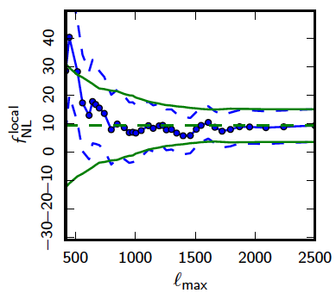
Consistency with WMAP
WMAP
Planck
By limiting the analysis to large scales (low l), we make contact with WMAP9 (f_{NL}^{local} = 37.2 ± 20)
Planck now rules out the WMAP central value by ≈ 6 sigmas.
Note: before subtraction of ISW-lensing bias

Slide 31
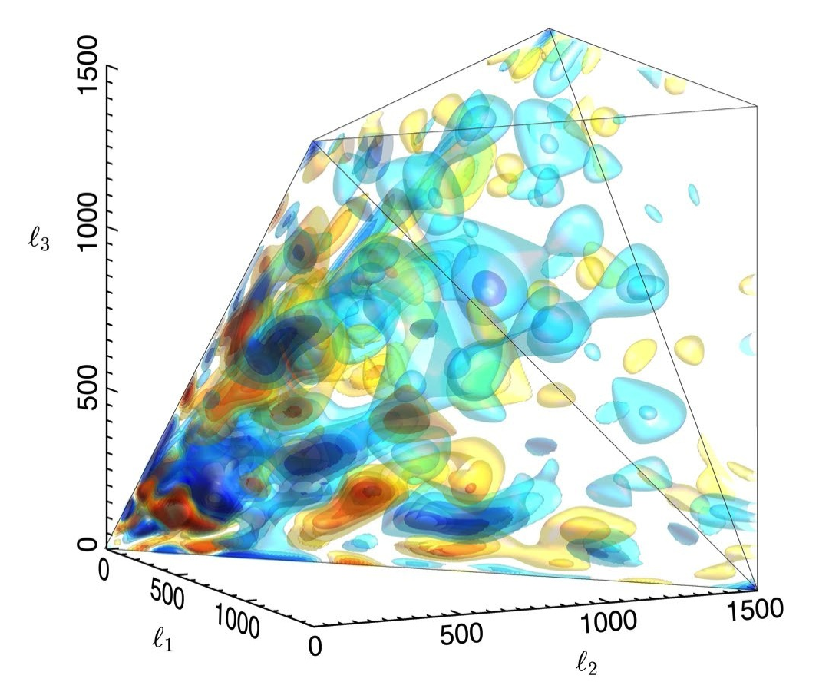
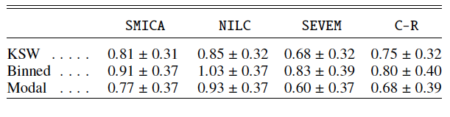
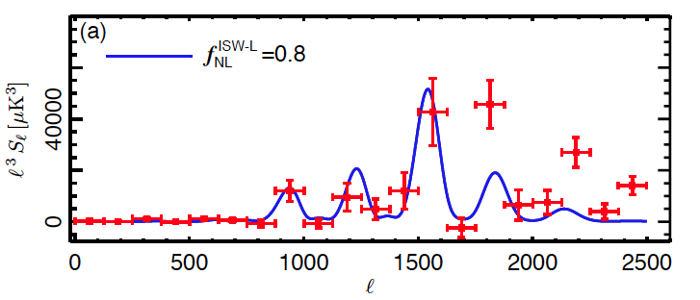
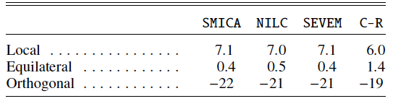
ISW-lensing bispectrum from Planck
The coupling between weak lensing and Integrated Sachs-Wolfe (ISW) effects is the leading contamination to local NG. We have detected the ISW lensing bispectrum with a significance of 2.6 σ
SMICA
Results for the amplitude of the ISW-lensing bispectrum
from the SMICA, NILC, SEVEM, and C-R foreground-cleaned maps, for the KSW, binned, and modal (polynomial) estimators; error bars are 68% CL.
Skew-C_{l} detection of ISW-lensing signal
The bias in the three primordial fNL parameters due to the ISW-lensing signal for the 4 component-separation methods.
SMICA

Slide 32
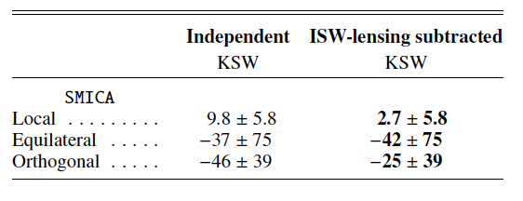
Results for 3 fundamental shapes (KSW)
Results for the f_{NL} parameters of the primordial local, equilateral, and orthogonal shapes, determined by the KSW estimator from the SMICA foreground-cleaned map. Both independent single-shape results and results marginalized over the point-source bispectrum and with the ISW-lensing bias subtracted are reported; error bars are 68% CL.
Union Mask U73 (73% sky coverage) used throughout. Diffusive inpainting pre-filtering procedure applied.

Slide 33
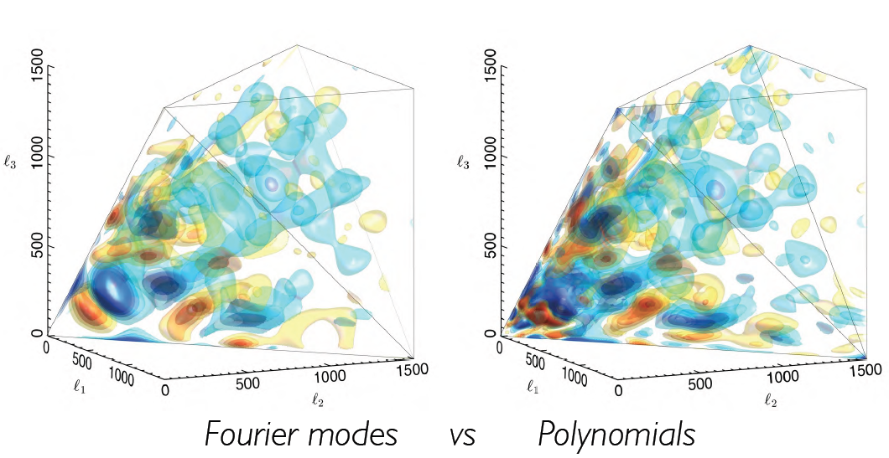
The Planck bispectrum

Slide 34
Standard inflation vs. NG
Standard inflation:
  single scalar field
  canonical kinetic term
  slow-roll dynamics
  Bunch-Davies initiual vacuum state
  standard Einstein gravity
→ no (presently) detectable primordial NG

Slide 35
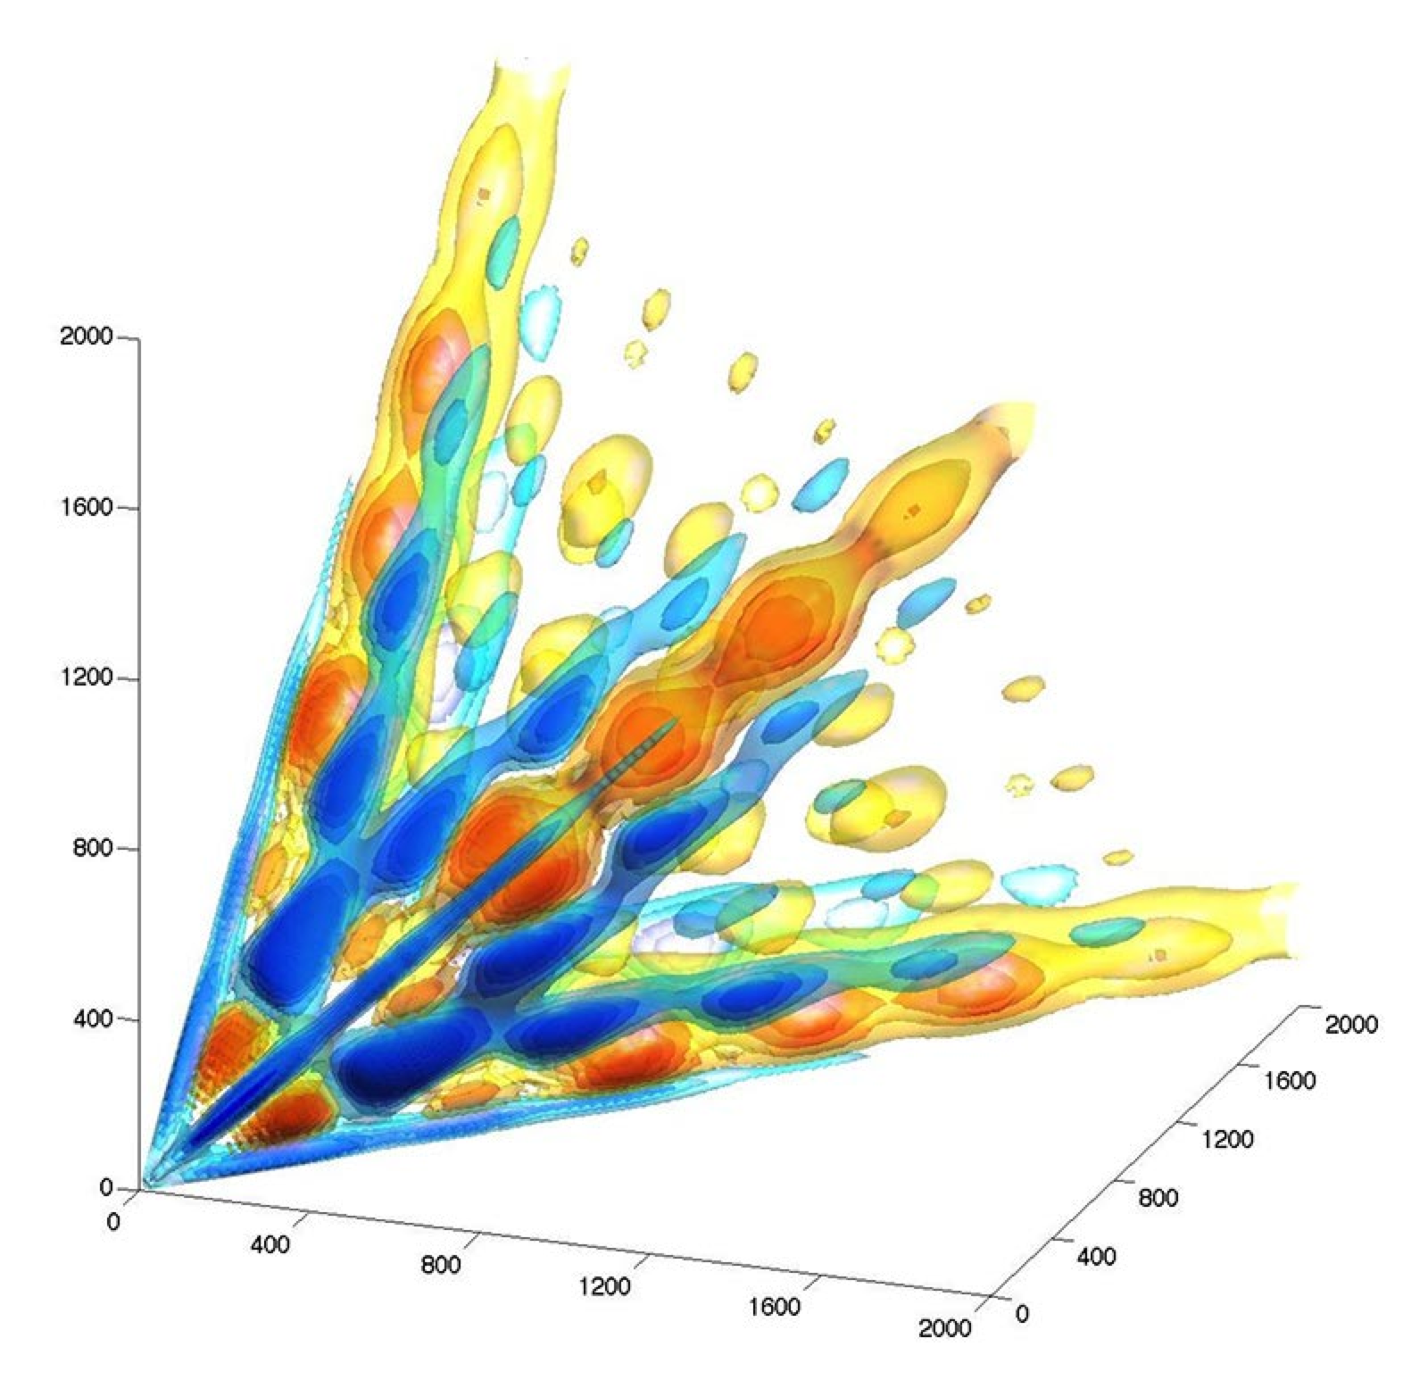
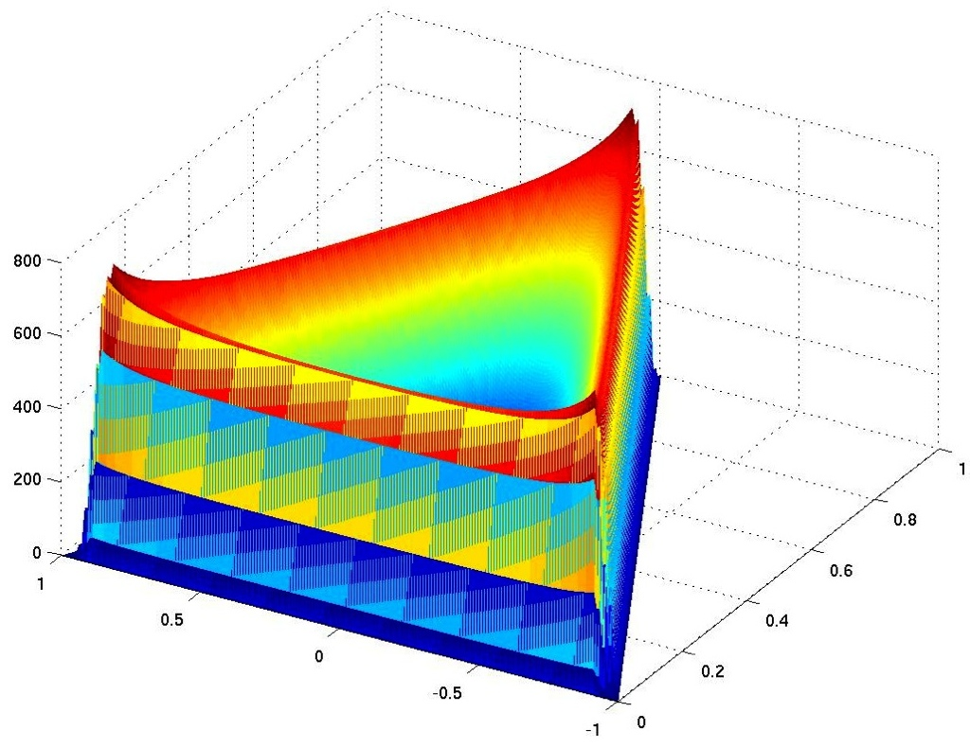
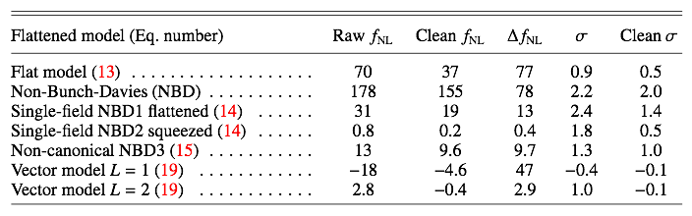
Some non-standard shapes: excited initial states
Non-Bunch-Davies vacua from trans-Planckian effects or features
Five exemplar flattened models constrained
NBD case
Note we also constrained inflation with gauge fields (vector models)

Slide 36
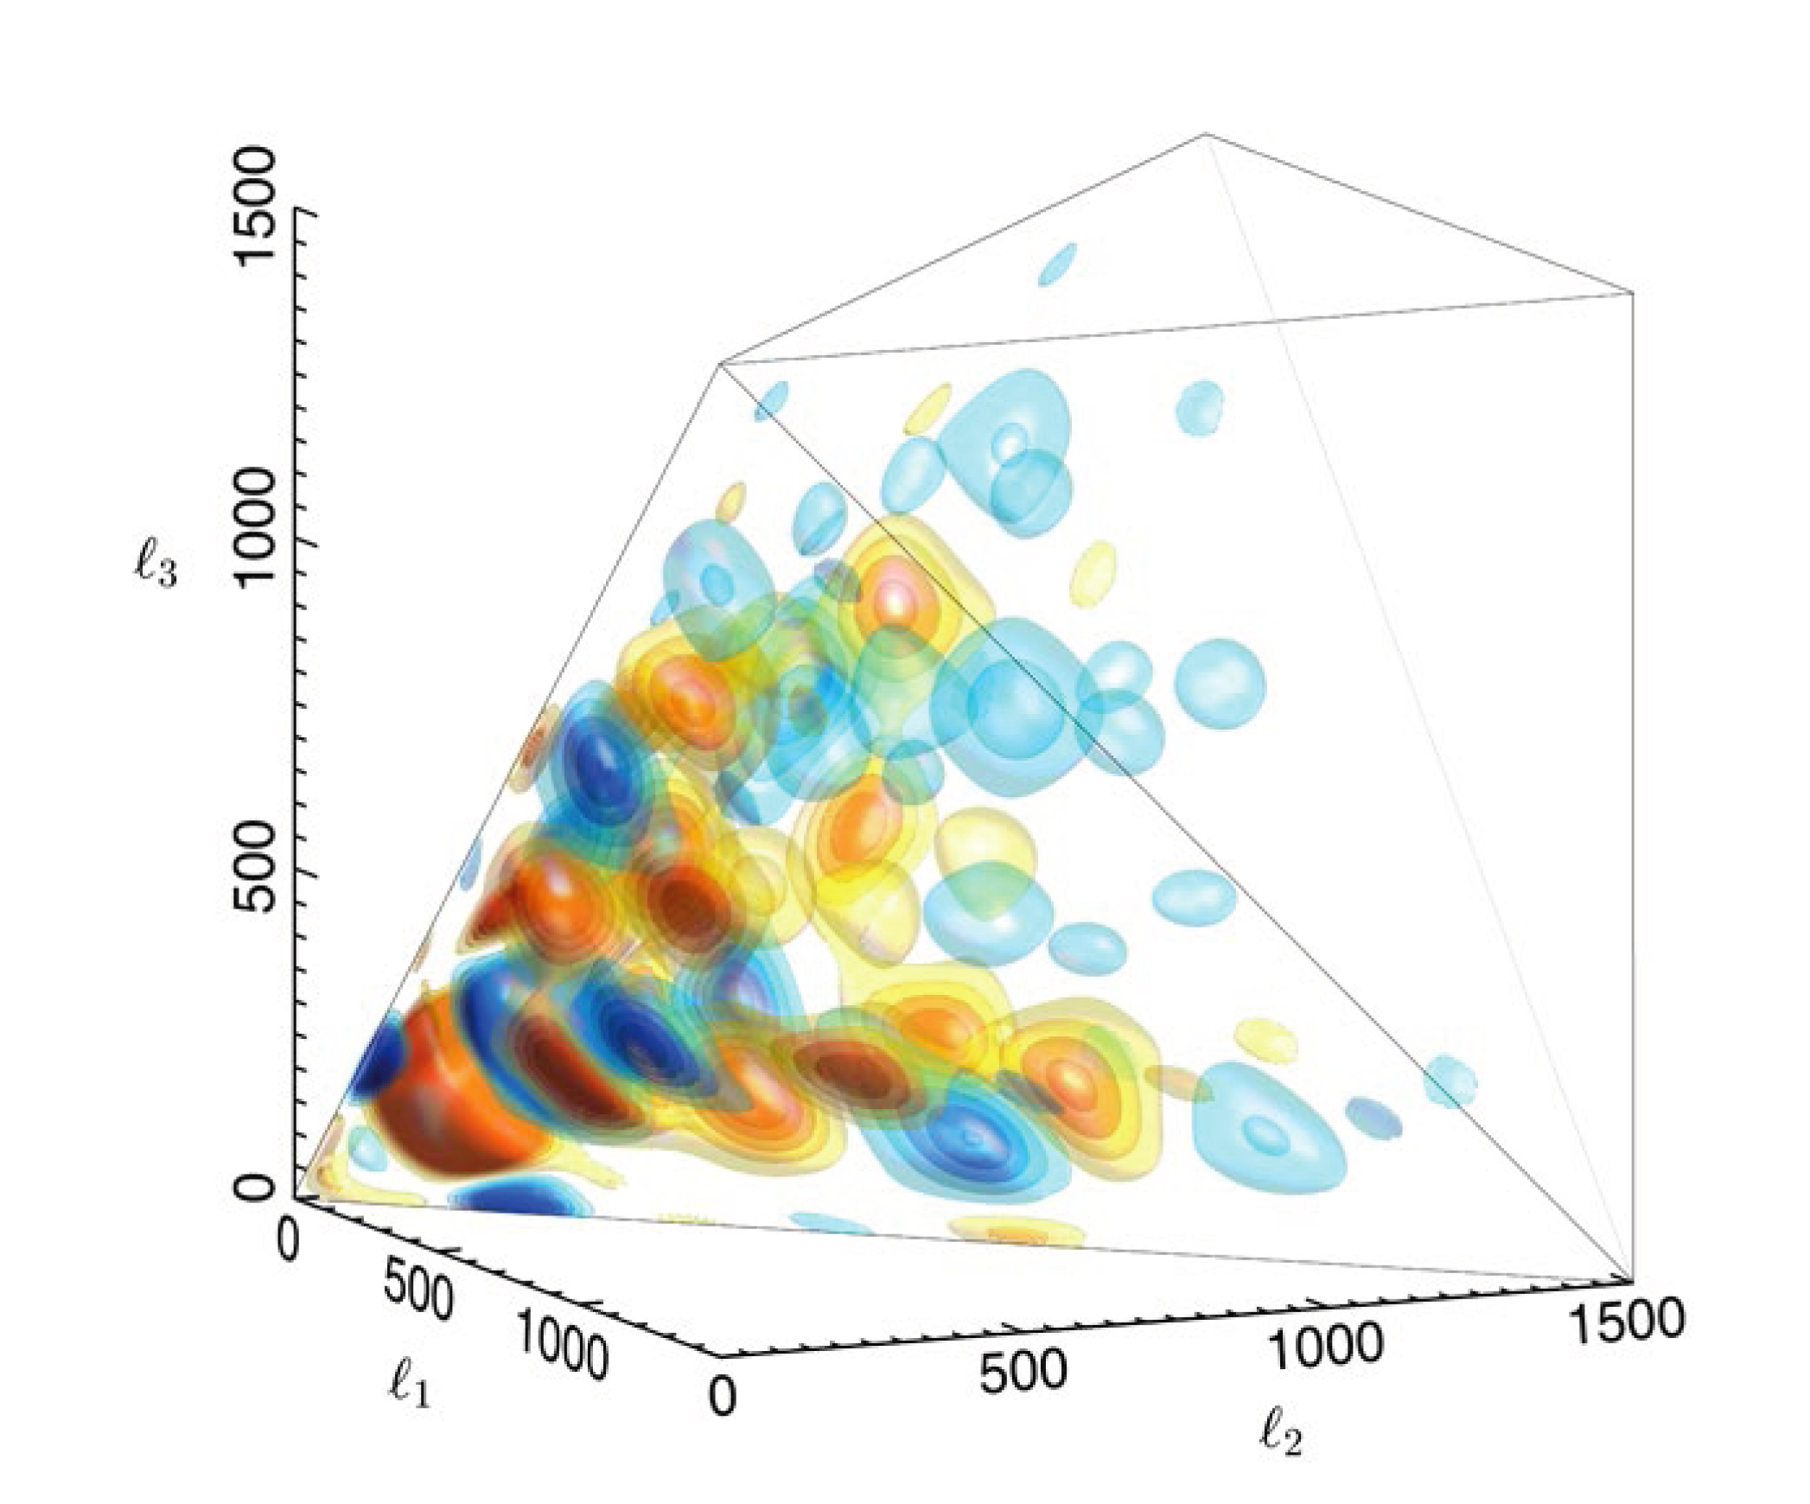
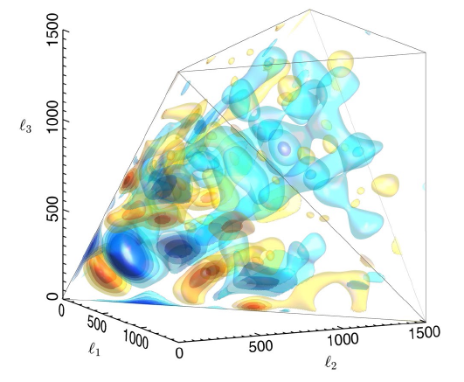
Non-standard NG shapes: Planck vs. feature models
3D CMB bispectrum as seen by Planck
(reconstructed bispectrum)
Bispectrum for the best-fit feature model
Notes:
Mettere l’altra figura per la riconstruzione?

Slide 37
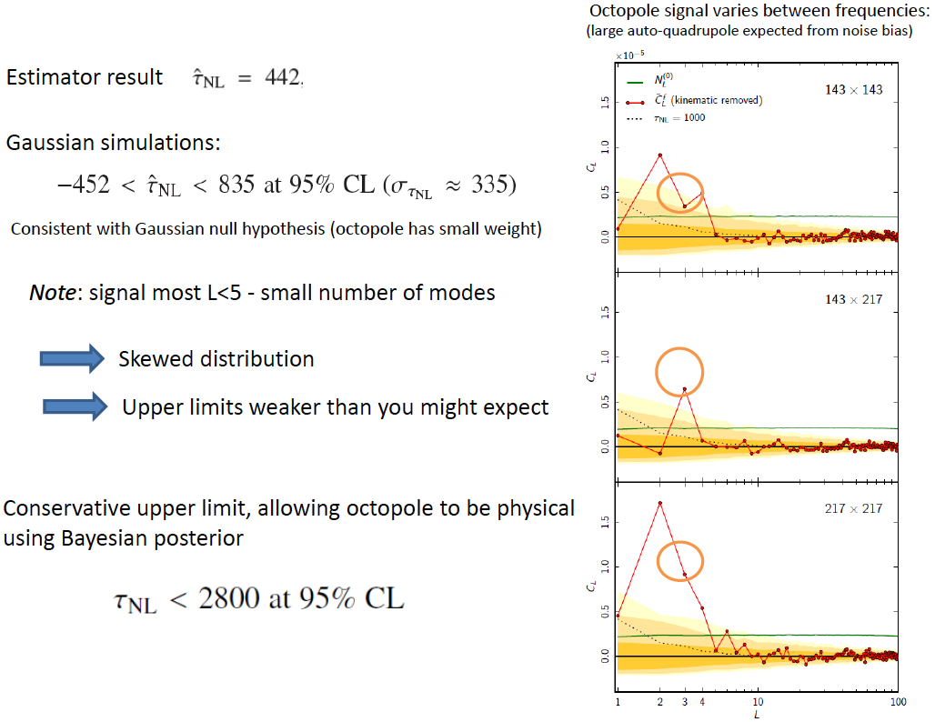
Planck τ_{NL} constraint

Slide 38
Conclusions I
Planck has measured with exquisite precision cosmological parameters, including those characterizing primordial (inflationary) perturbations (scalar spectral index, tensor-to-scalar ratio)
Primordial NG has become a high precision cosmological observable, crucial to unveil the nature of the inflaton field(s), in that it probes the interactions of the inflaton field, i.e. the physics of the Early Universe
Planck measurement of primordial non-Gaussianity represents the most stringent test of inflation obtained so far: deviations from primordial Gaussianity are now constrained to be less than 0.01%
Standard models of slow-roll single-field inflaton have survived; other models ruled out and for many models NG dramatically reduces the parameter space
Planck data bound general single-field and multi-field model parameters, such as the speed of sound, c_{s} ≥ 0.02 (95% CL), in an effective field theory parametrization (cs ≥ 0.07 for DBI inflation), and the curvaton decay fraction r_{D} ≥ 0.15 (95% CL). The amplitude of the four-point function in the local model is τ_{NL} < 2800 (95% CL).

Slide 39
Summary
The simplest inflation models (single-field slow-roll, standard kinetic term, BD initial vacuum state) are favoured by Planck data
Multi-field models are not ruled out but also not detected
Ekpyrotic/cyclic models either ruled out or under severe pressure
Taken together, these constraints represent the highest precision tests to date of physical mechanisms for the origin of cosmic structure

Slide 40
Future prospects
short term goals
  Improve upper bound on stochastic gravitational-wave background
  Improve f_{NL} limits with polarization & full data
  Look for more non-Gaussian shapes, scale-dependence, etc. ...
  constrain g_{NL}
long terms goals
  detect stochastic gravitational-wave background?
  reconstruct inflationary action
  if (quadratic) NG turns out to be small for all shapes go on and search for f_{NL} ~ 1 non-linear GR effects and second-order radiation transfer function contributions
  what about intrinsic (f_{NL} ~ 10⁻²) NG of standard inflation? CMB polarization + LSS + 21cm background + CMB spectral distortions

