Slide 1

Nuclear emulsions in FIRST: a first look
Giovanni De Lellis, Lucia Consiglio, Adele Lauria, Maria Cristina Montesi
University Federico II and INFN, Naples, Italy

Slide 2
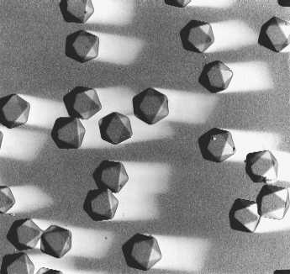
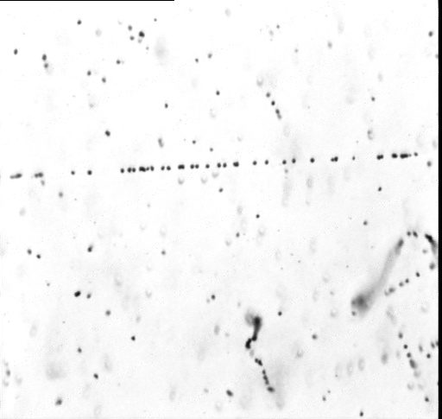
Nuclear emulsion as sensitive media for charged particles
After the passage of charged particles through the emulsion layer, a latent image is produced
After a physical/chemical process known as development, Ag grains become visible with an optical microscope
Recorded as silver grains
along the line particle passed through
AgBr crystal, size 0.2 micron
Is the elementary detection element
30-40 grains/100 microns for MIP
Nuclear emulsions used for
more than 100 years in Particle
Physics
50 micron
Resolution of 0.3 micron
Microscopic Image

Slide 3

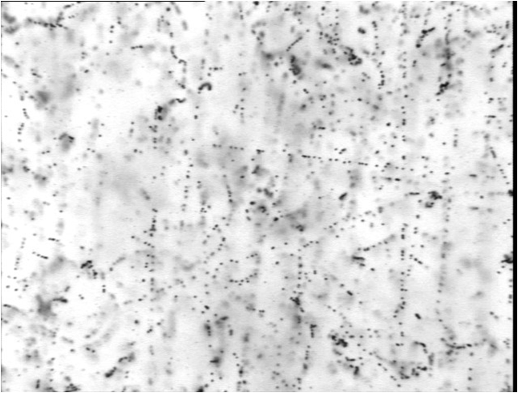
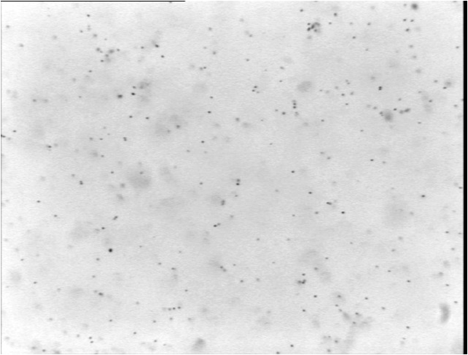
OPERA emulsions
OPERA industrial emulsions from FujiFilm
The AgBr density in the OPERA emulsions is higher in respect to the commercial films
Special R&D for OPERA: the double pouring procedure
Emulsions are continuously sensitive detector
ALL charged particle: cosmic rays,
natural radioactivity etc recorded as a
latent images. They can be partially
erased by a “refreshing” procedure
applied just before the detector assembling
Emulsion Layer (45 microns)
Before refreshing
>30 tracks/mm^2 bg
After refreshing
~1 tracks/mm^2 bg
Plastic Base (205 microns)
Emulsion Layer
150 microns

Slide 4
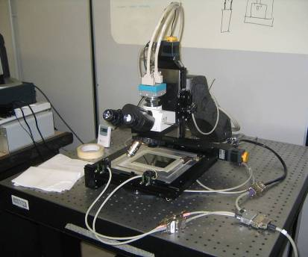
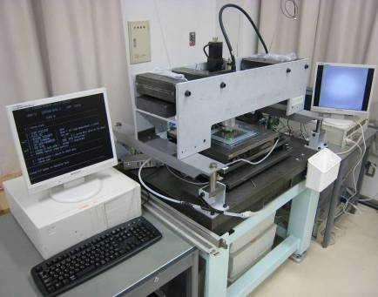
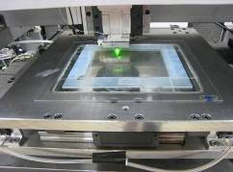
Emulsion Scanning Stations
EU: ESS (European Scanning System)
Japan: SUTS (Super Ultra Track Selector)
• Scanning speed/system: 20cm²/h
• Customized commercial optics
and mechanics
• Asynchronous DAQ software
• Scanning speed/system: 75cm²/h
• High speed CCD camera (3 kHz),
Piezo-controlled objective lens
• FPGA Hard-coded algorithms
Both systems demonstrate:
• ~0.3 μm spatial resolution
• ~2 mrad angular resolution
• ~95% base track detection efficiency

Slide 5
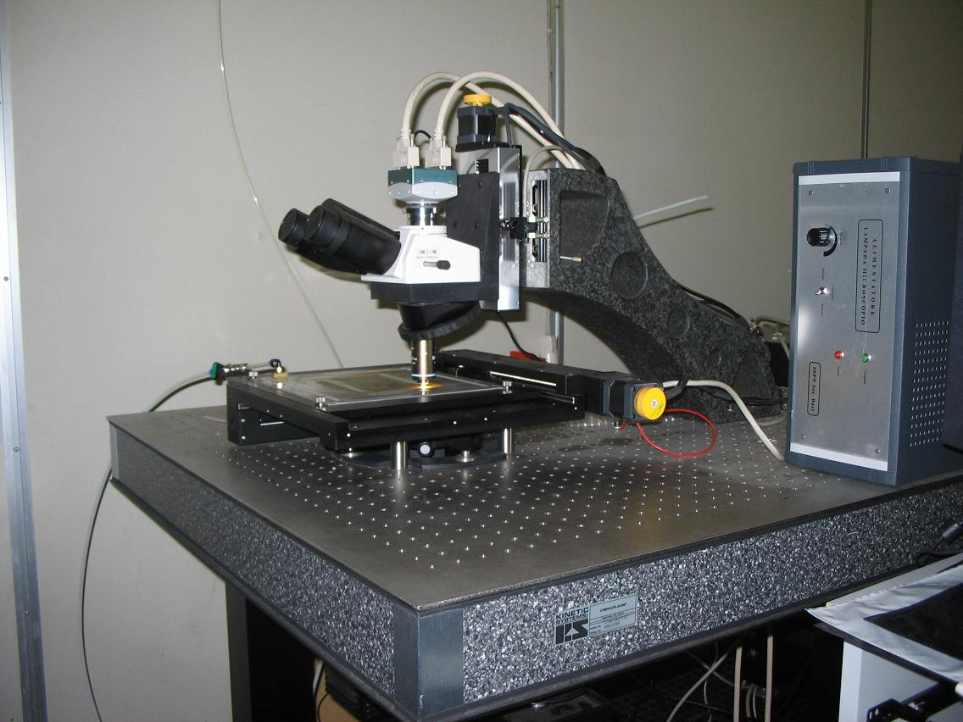
Z stage (Micos)
0.05 μm nominal
precision
CMOS camera
1280×1024 pixel
256 gray levels
376 frames/sec
(Mikrotron MC1310)
Emulsion Plate
XY stage (Micos)
0.1 μm nominal
precision
Illumination system, objective (Oil 50× NA 0.85)
and optical tube (Nikon)

Slide 6
Principle of scanning emulsion
(European)
16 Tomographic Images taken through 44-micron Emulsion Layer
Movable stage

Slide 7
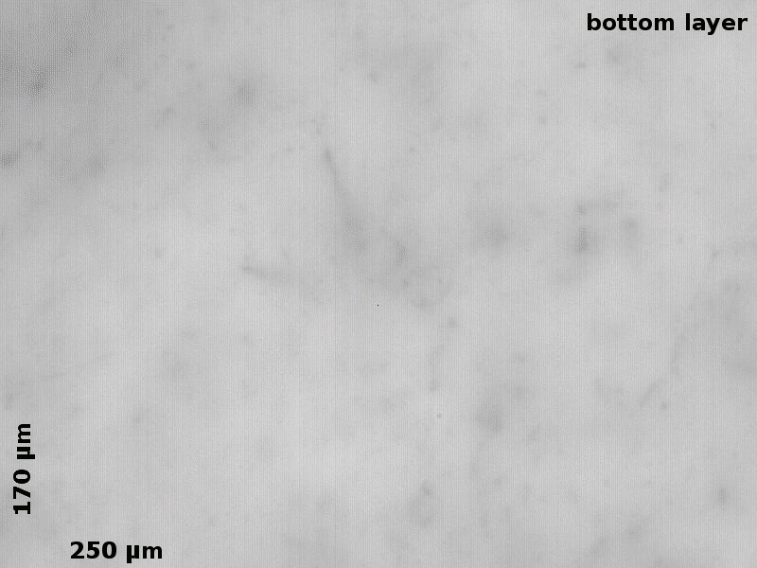
What the microscope CCD sees in one film..

Slide 8

Data (images) processing and motion control flow in the ESS
Tomographic sequences
Z axis moving, 2D images
spanning emulsion thickness
280×365μm²
Next field of view,
Z at top, new cycle
DAQ cycle
(185 ms)
Process/save data
Move XYZ to next view
Camera
Image Processor board
(Matrox Odyssey)
Host PC
(Dual Pentium
Workstation)
Running
WinXP
2D Images
(peak 452 MB/s,
avg. 97 MB/s)
Binarized
2D Images
Motors
(VEXTA
Nanostep)
Motion Controller
(National Instruments
FlexMotion)
3D
microtracks
XYZ Motion
Commands
Power
Functional blocks

Slide 9
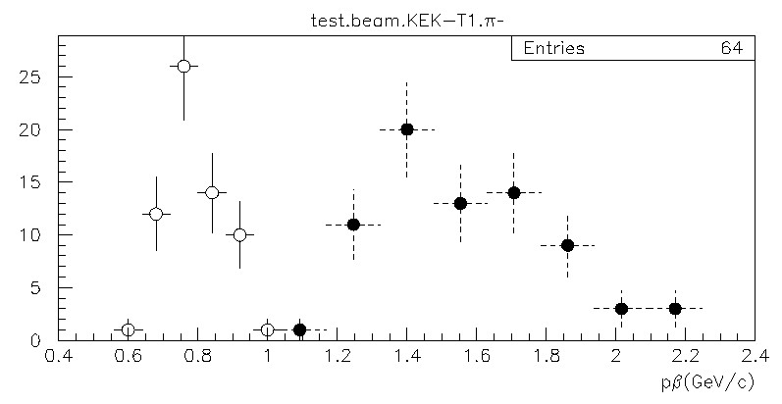
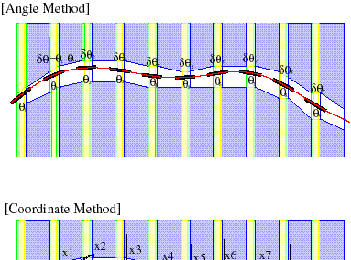
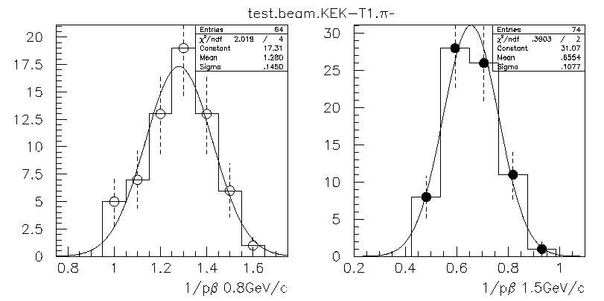
Kinematical measurements
1.Momentum measurement by multiple coulomb scattering
P(GeV/c)
13.6 (MeV/c)
x
Pβ =
δθ
X₀
1/P(GeV/c)⁻¹
0.8GeV/c pion : P =0.79(GeV/c), dP/P =11%
1.5GeV/c pion : P =1.53(GeV/c), dP/P =16%

Slide 10
Exposure of an Emulsion Cloud Chamber (ECC) to 400 MeV/u Carbon ions
ECC structure: 219 emulsion films (300 µm thick) and 219 Lexan plates 1 mm thick (73 consecutive “cells”)
Lexan: ρ = 1.15 g/cm³ and electron density =
3.6 x 10²³/cm3, e.g. Water 3.3 x 10²³/cm3
Cell structure
R0
R1
R2
R0: sensitive to m.i.p.
LEXAN
LEXAN
LEXAN
¹²C
R1: insensitive to m.i.p., sensitive to protons
R2: sensitive to He

Slide 11
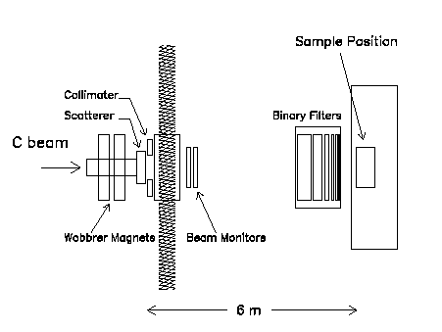
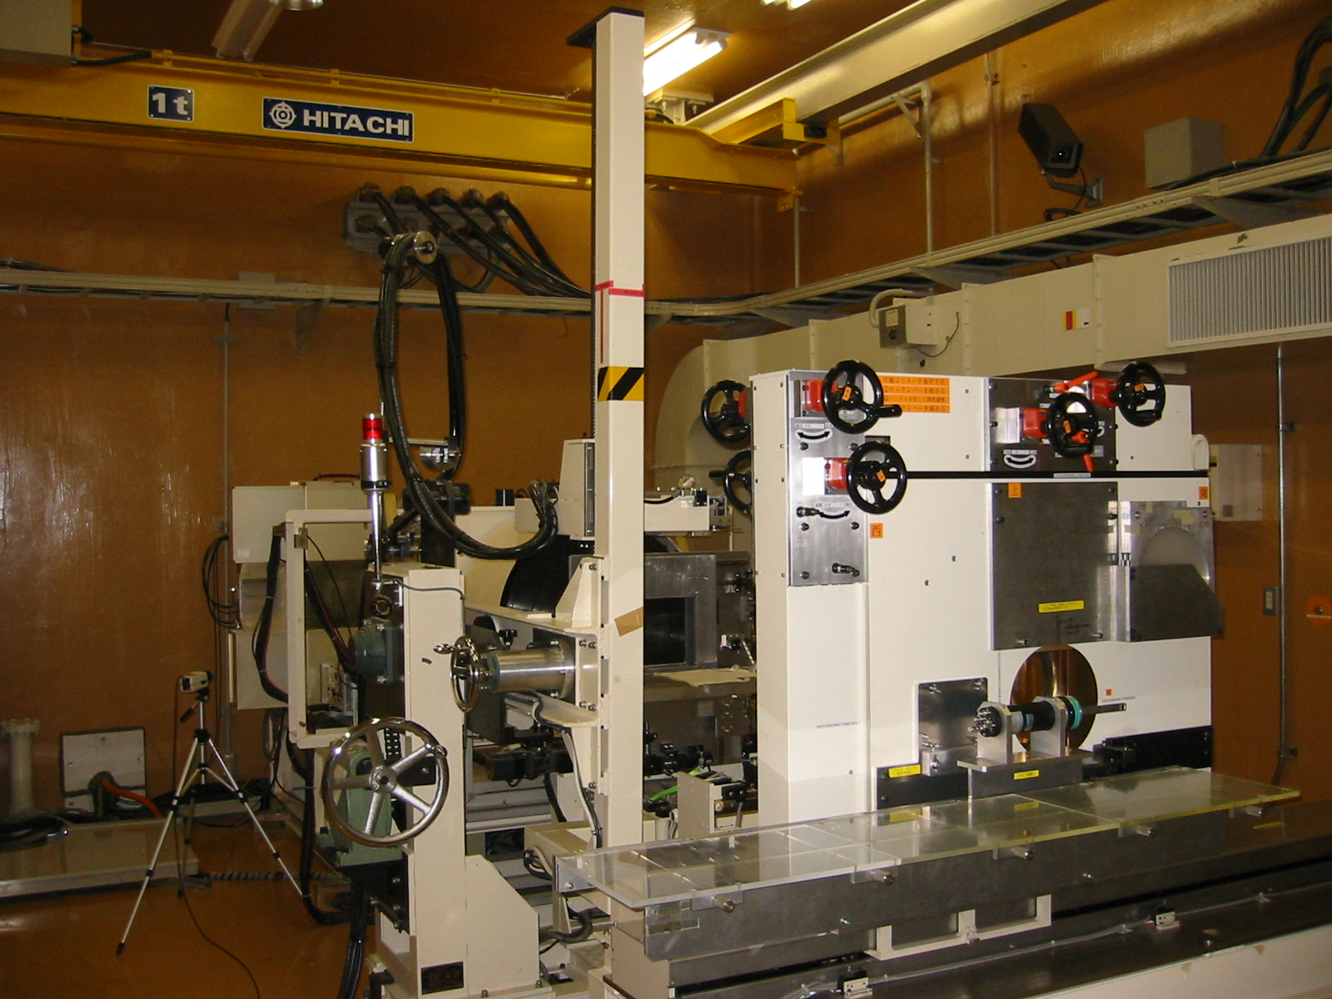
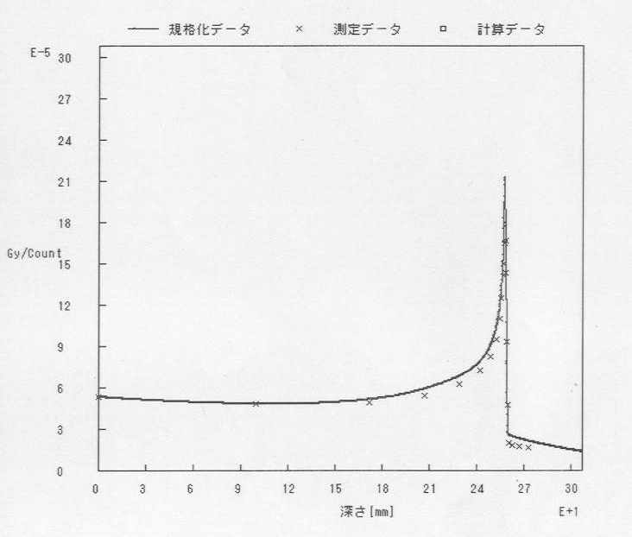
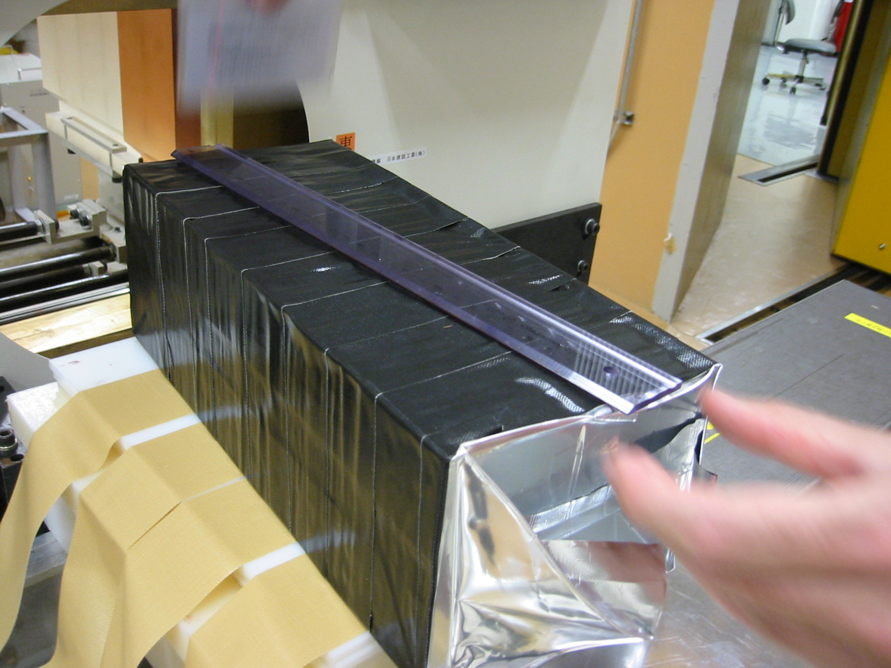
Carbon exposure at HIMAC (NIRS-Chiba)

Slide 12
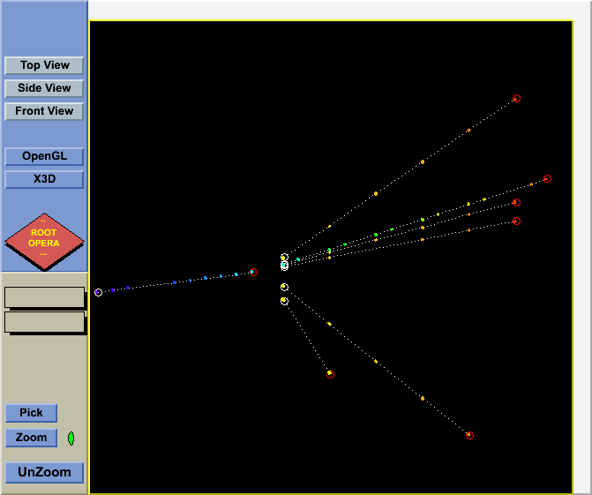
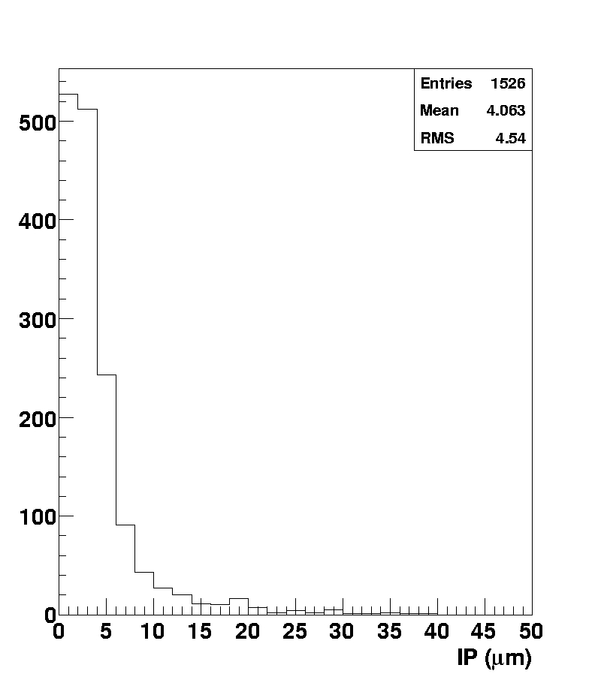
Vertex reconstruction
More than 2000 vertices detected and analyzed
i.p. of He tracks
C
3 cm

Slide 13
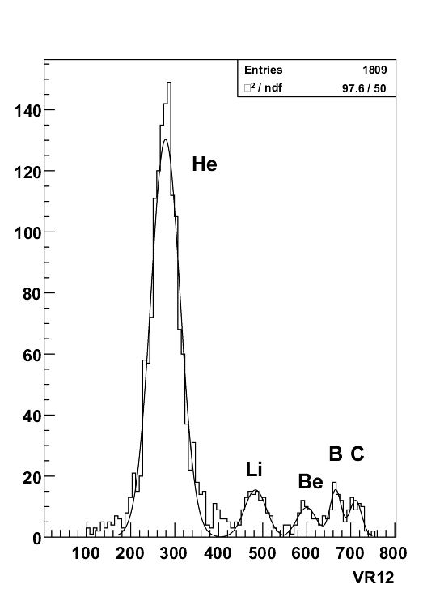
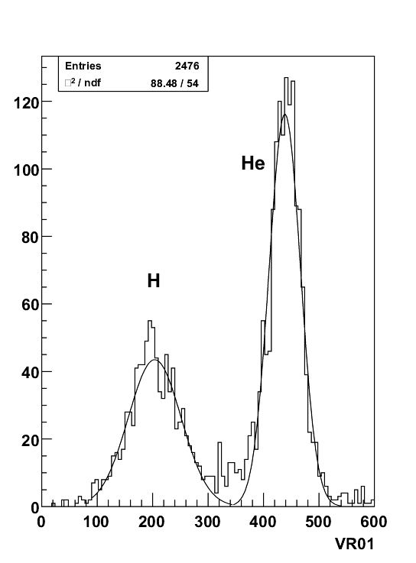
Charge separation
G. De Lellis et al., Journal of Instrumentation 2 (2007) P06004

Slide 14
Charge changing cross-section

Slide 15
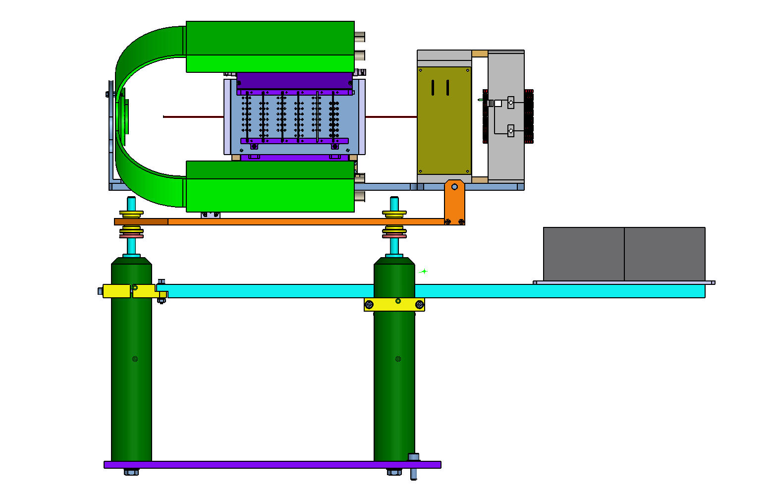
Emulsions in FIRST:
Schematic view
Bricks

Slide 16
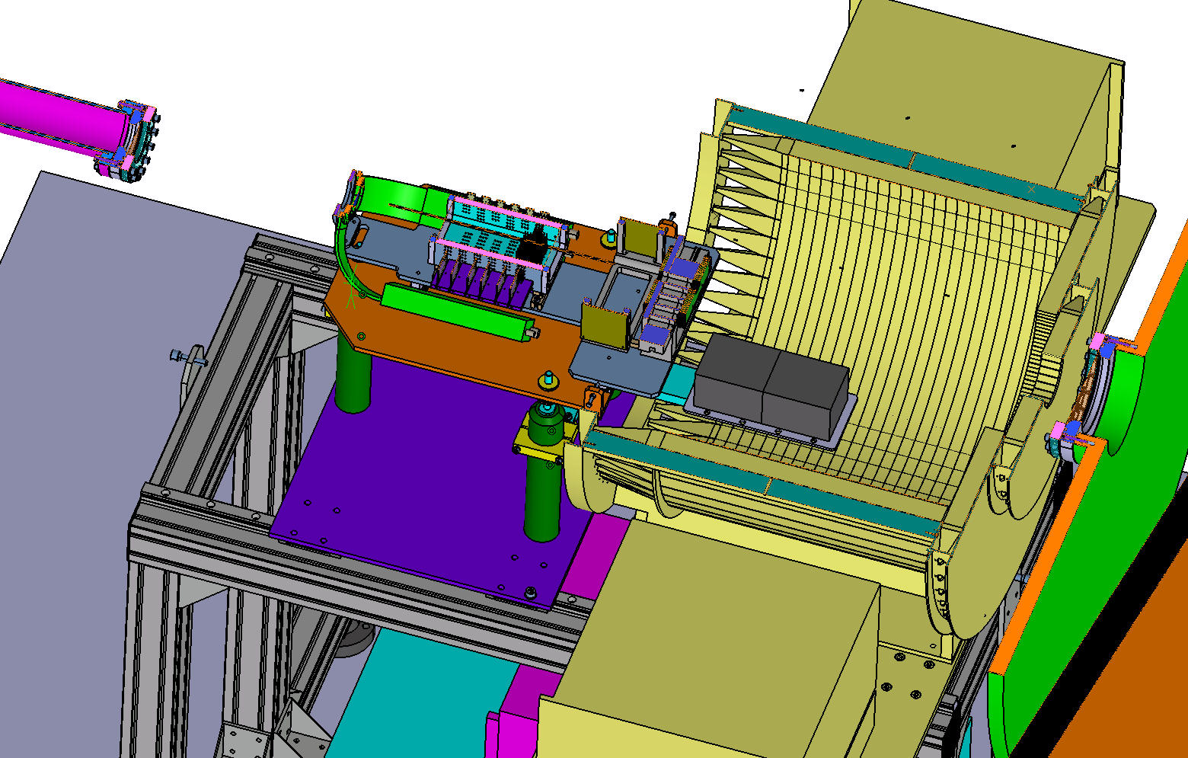
Bricks

Slide 17
Brick structure: 61 films and 55 lead plates
Particles
61
6 consecutive films
56
55
54
55 1mm thick lead plates
interleaving emulsion films
53
52
2
1

Slide 18
Track slopes expected in emulsion
beamline
Z
a ≈ 16.5 cm
Y
b
α
X
L = 13 cm
tg(α) = dx/dz
brick 2
b/a ≤ tg(α) ≤ (b+l)/a
brick 1
(b+l)/a ≤ tg(α) ≤ (b+2l)/a
tg(α) > 1 → α > 45 degrees
Typical values in high energy physics: tg(α) < 0.6

Slide 19
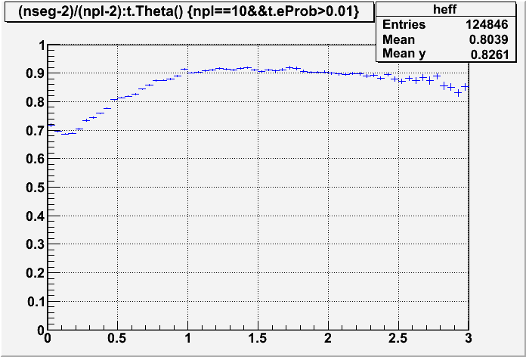
Dedicated study on Large angle track detection
ε
72 degrees!
tg(theta)

Slide 20
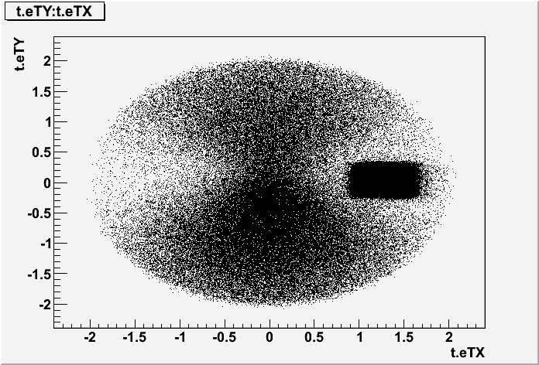
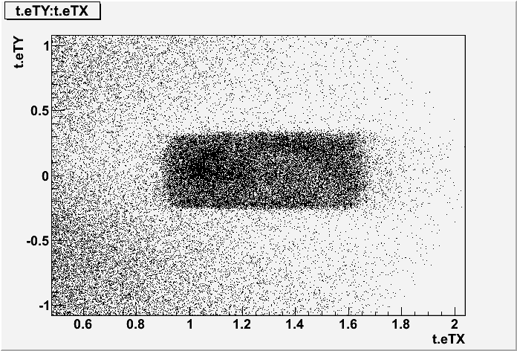
Brick 1: preliminary results
Scanning of 4 emulsion films (slope ≤ 2)
Tracks angular distribution of films 61÷58
Peak signal selection

Slide 21
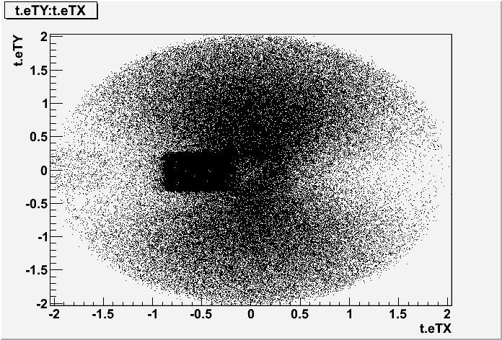
Scanning of brick 2
3 most upstream films
brick rotated by 180 degrees w.r.t. the other one

Slide 22
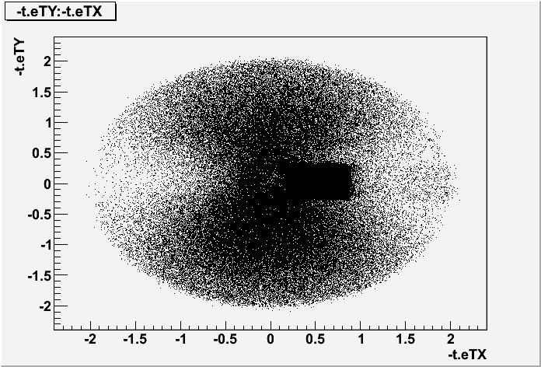
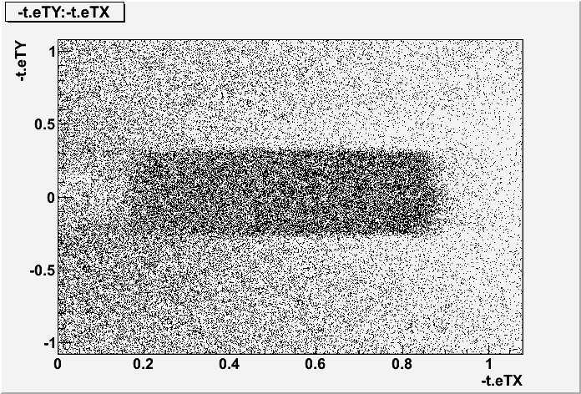
Brick 2: preliminary results
Scanning of 3 emulsion films (slope ≤ 2)
Tracks angular distribution of films 61÷59
274 trks/cm² (nseg>=2)
Contribution from cosmic-rays included

Slide 23
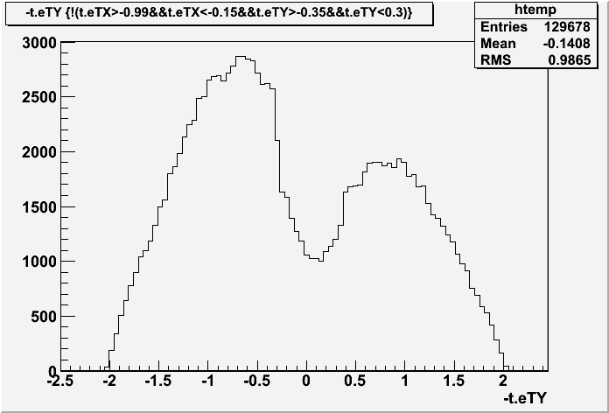
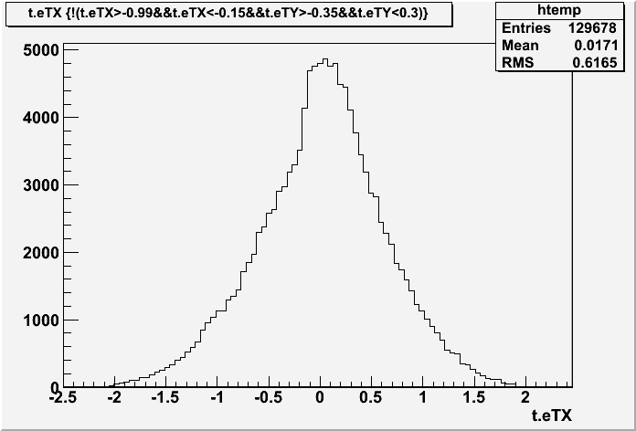
Cosmic-ray angular distribution
Films transported from Gran Sasso to CERN
Brick assembled at CERN
Cosmic-ray integrated during the transportation of the brick from CERN to GSI and from GSI to Gran Sasso
Brick disassembled and film developed at Gran Sasso
Cosmic-rays taken with the films inside the
brick in the same geometrical configuration
as for the beam at GSI, with the brick rotated
by 90 degrees to minimize the flux

Slide 24
Conclusions
Scanning of very large angle tracks is now routinely done
First look at the films exposed at GSI in Summer 2011
To be done:
Define tracks by the first 6 consecutive films
Analysis of the films interleaved with lead to measure the properties of these tracks and try the particle identification (proton/alpha)

