Slide 1
Progress in the installation of the Compton line
C. Vaccarezza

Slide 2
Outline
The Compton source
Nov 2012- May 2013: work done
Commissioning plan
Eli-NP: the sinergy
Summary

Slide 3
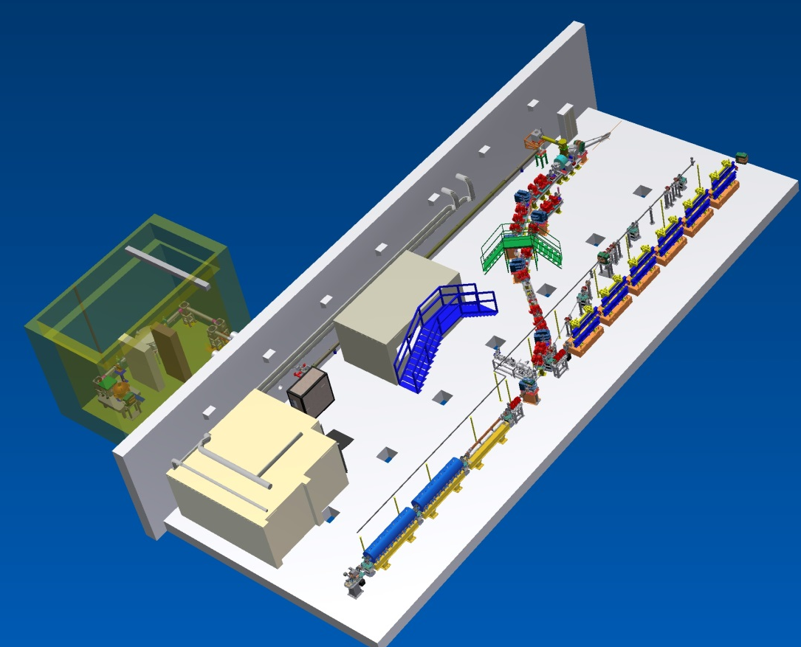
The
La y ou t
A. Zolla

Slide 4
Thomson Source Parameter List
Laser
Electron Beam
Wavelength 800 nm
Compressed pulse energy 5 J
Pulse duration/bandwidth 3 -12 (80) ps/nm
Rep.Rate 10 Hz
Beam quality M2 <1.5
Energy stability 10%
Pointing stability < 2 µm
Synchronization with SPARC photoinjector clock < 1 ps
Bunch charge 0.2-1.0 nC
Energy 28-150 MeV
Length 15-20 ps
ε_{n x,y} 1-5 µ rad
Energy spread 0.1-0.2 %
Spot size at IP 5-20 µm
Rep.Rate 10 Hz

Slide 5
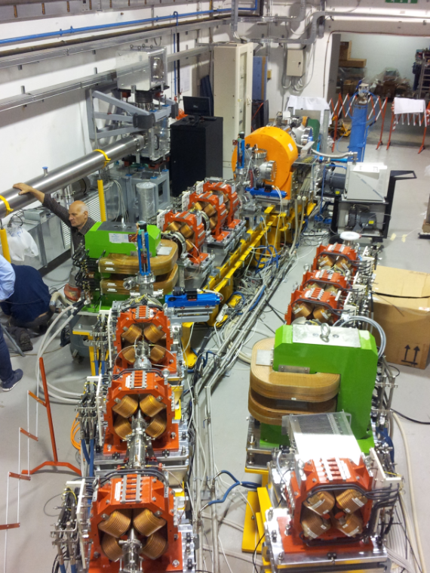
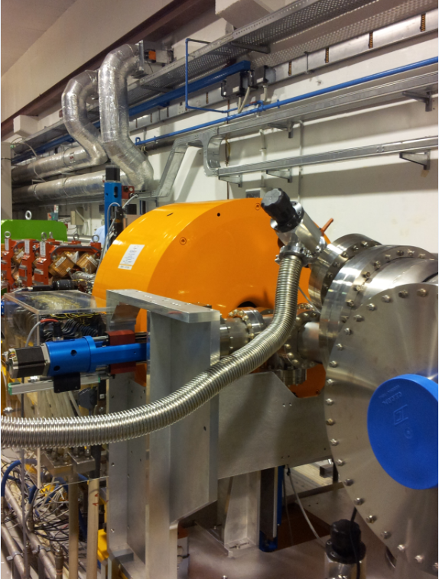
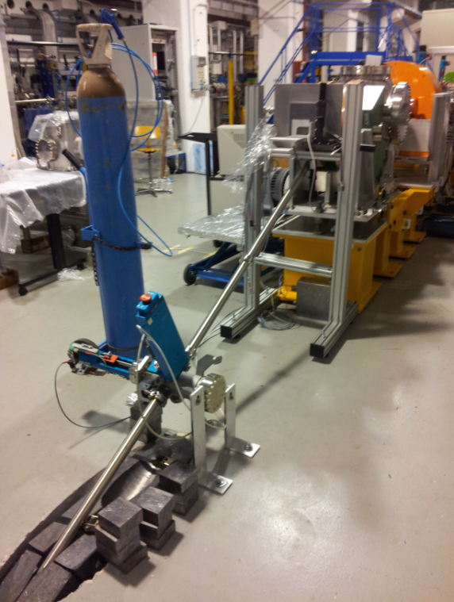
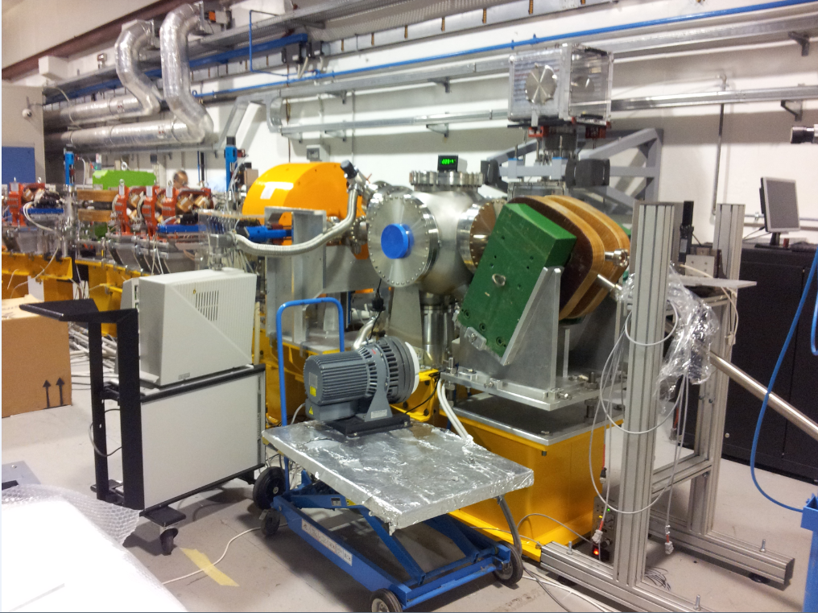
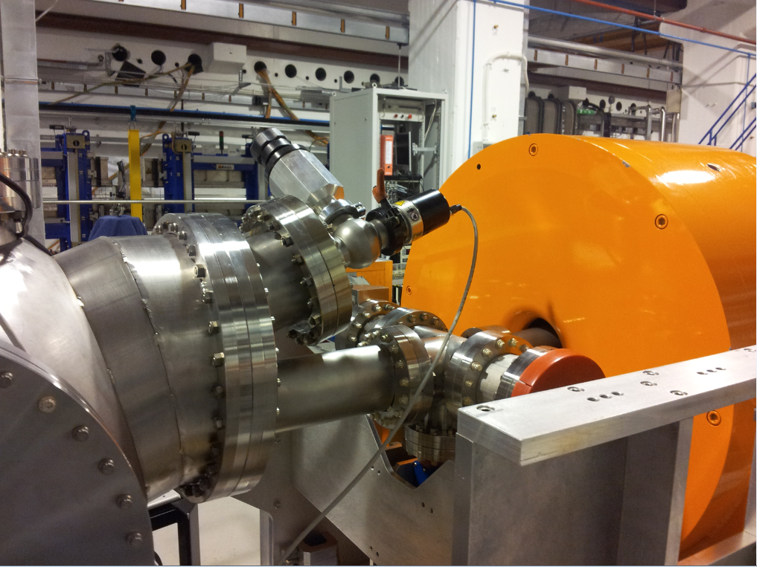
Some pictures

Slide 6
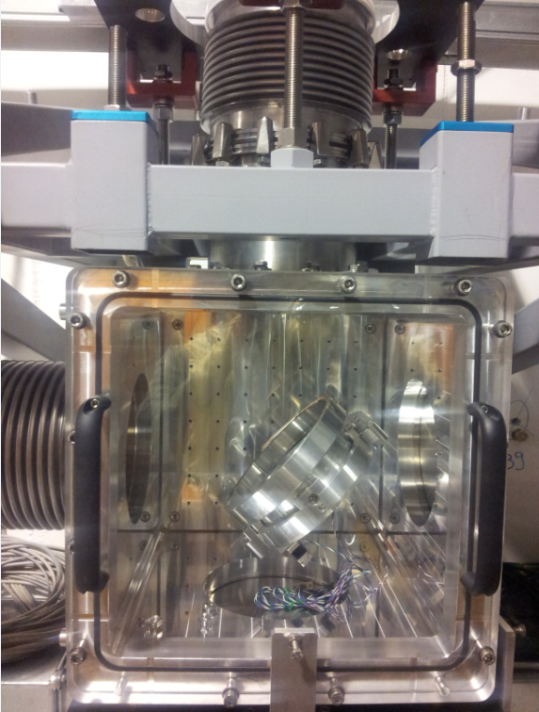
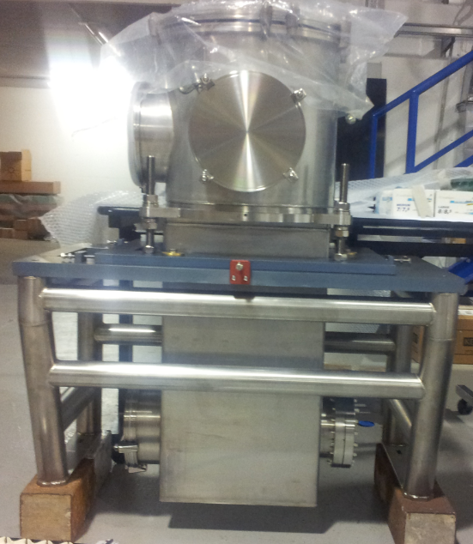
More on the photon beamline
R. Sorchetti

Slide 7
In detail:
Dipole delivery completion by Sep. 2012
The solenoid delivery by the end of Nov. 2012
The Interaction Chamber part. by the end of Dec 2012
Interaction Chamber completion by Mid April 2013
Photon beamline completed by April 2012 w mirror chamber modifications complying the int. chmb.
on going:
  Solenoid magnet & PS water cooling
  Mirror mounting

Slide 8
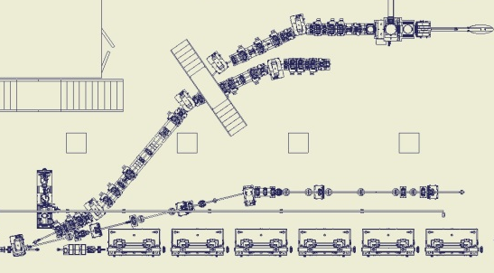
Diagnostic equipment:
6 Flag+pump stations
7 BPMs
1 BCM

Slide 9
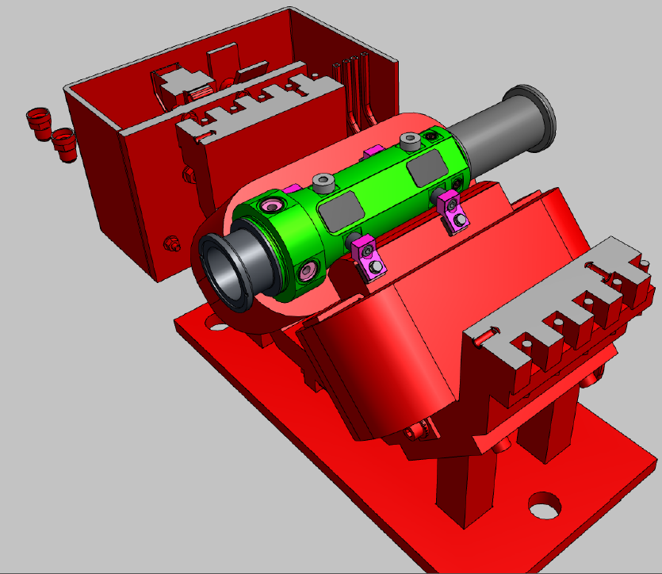
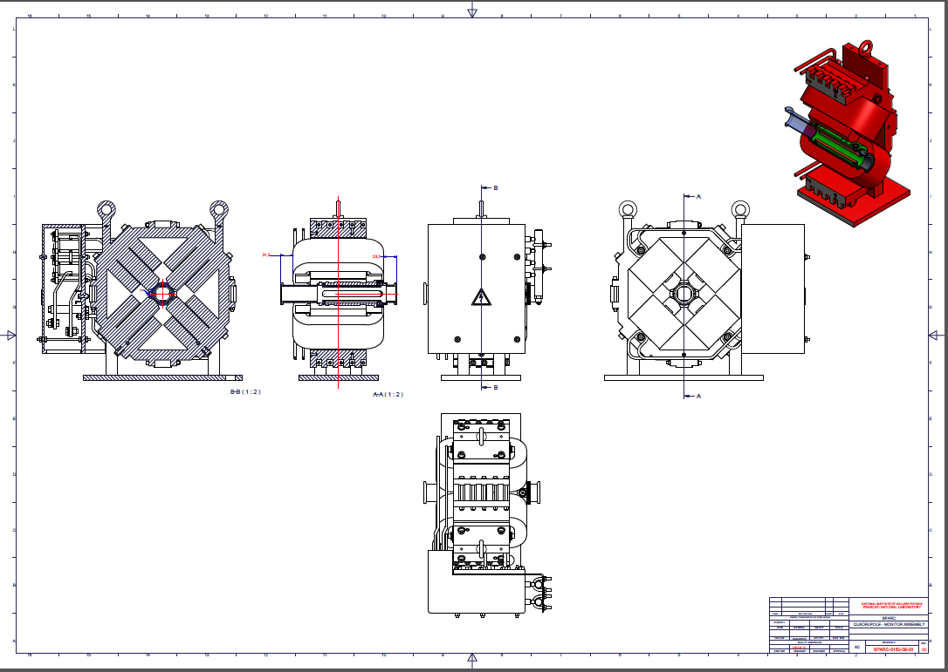
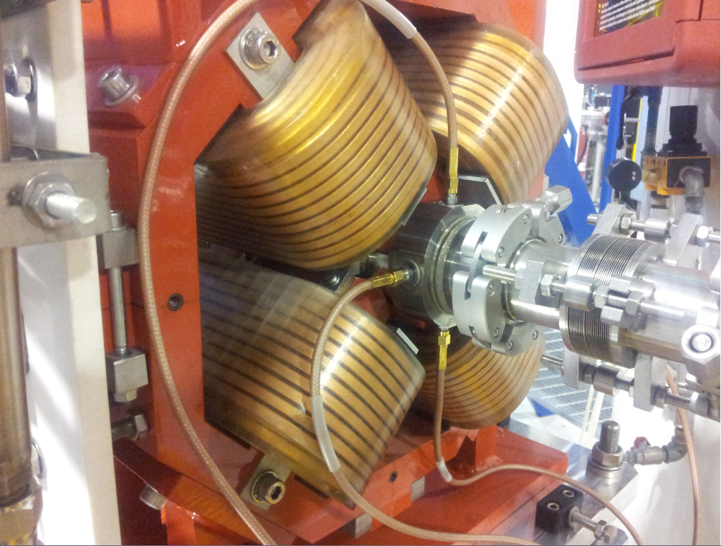
Compact BPM for Thomson beamline
A. Stella, V. Lollo

Slide 10
HFM2 operating mode
For the first experiments the source has been optimized for applications in medical imaging, mammography in particular.
Highest X-ray flux at about 20 keV, with a relative radiation energy spread < 20% and keeping as low as possible the high harmonics contribution.

Slide 11
The Beats2 experiment
M. Gambaccini

Slide 12
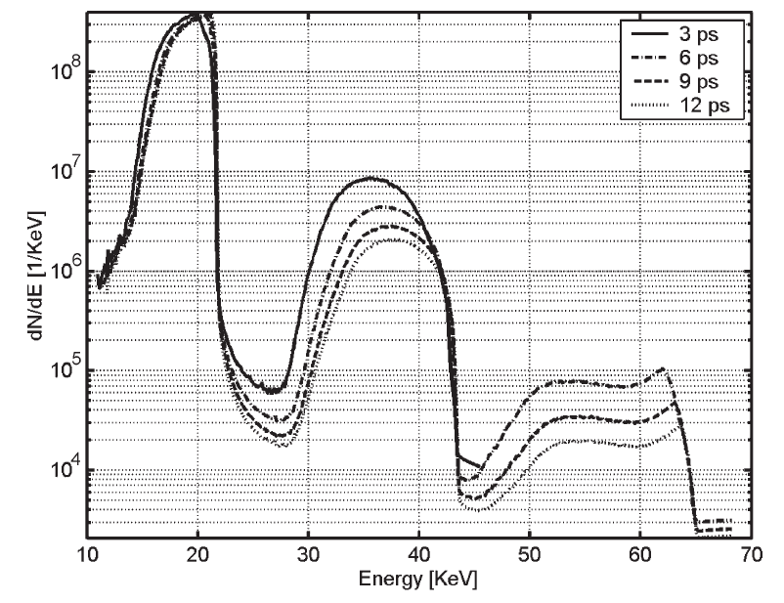
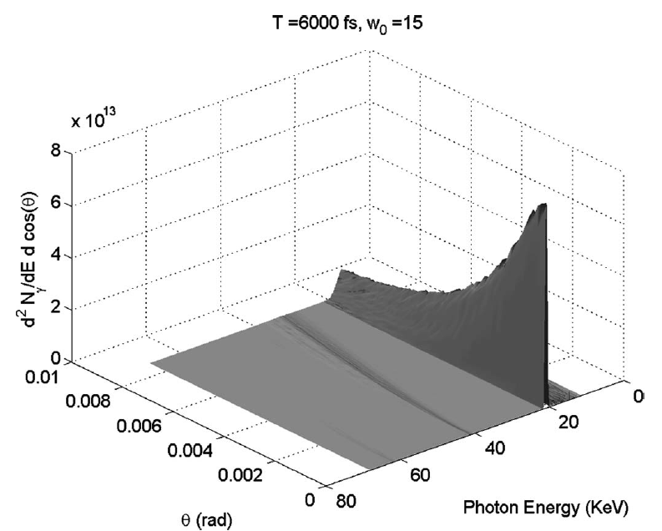



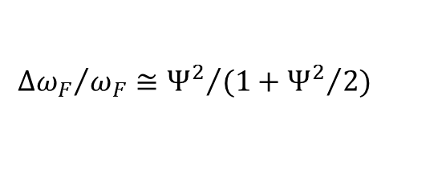
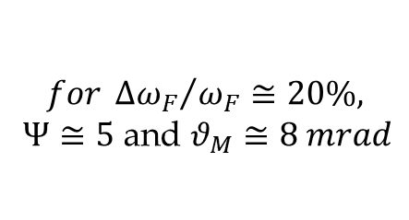
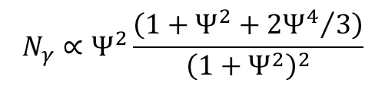
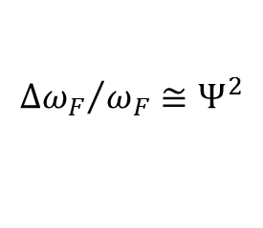
The Thomson Interaction laser
$$N_{γ}∝Ψ^{2}\frac{\left(1+Ψ^{2}+{2Ψ^{4}}/3\right)}{{\left(1+Ψ^{2}\right)}^{2}}$$
$$N_{γ}≈Ψ^{2}$$
$${Δω_{F}}/{ω_{F}}≅Ψ^{2}$$
$${Δω_{F}}/{ω_{F}}≅{Ψ^{2}}/{(1+{Ψ^{2}}/2)}$$
for $Ψ≪1$
$$for {Δω_{F}}/{ω_{F}}≅20\%,$$
$Ψ≅5$ and $θ_{M}≅8 mrad$
$$Ψ^{2}≡γθ_{M}$$
Spectral–angular (integrated in the azimuthal angle φ) distribution of the collected radiation for the optimized parameters w = 15 μm and duration T = 6 ps, where ϑ_{M} = 8 mrad
Spectra of the collected radiation for pulses of duration 3, 6, 9, and 12 ps.

Slide 13
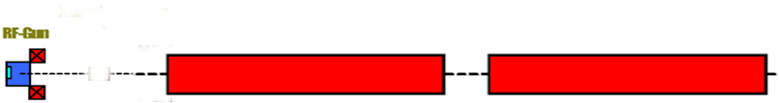
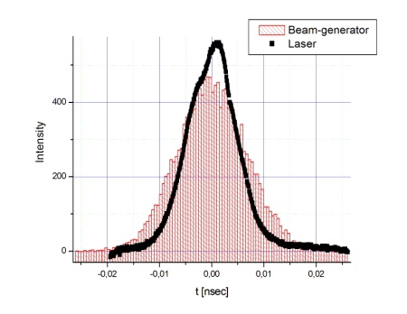
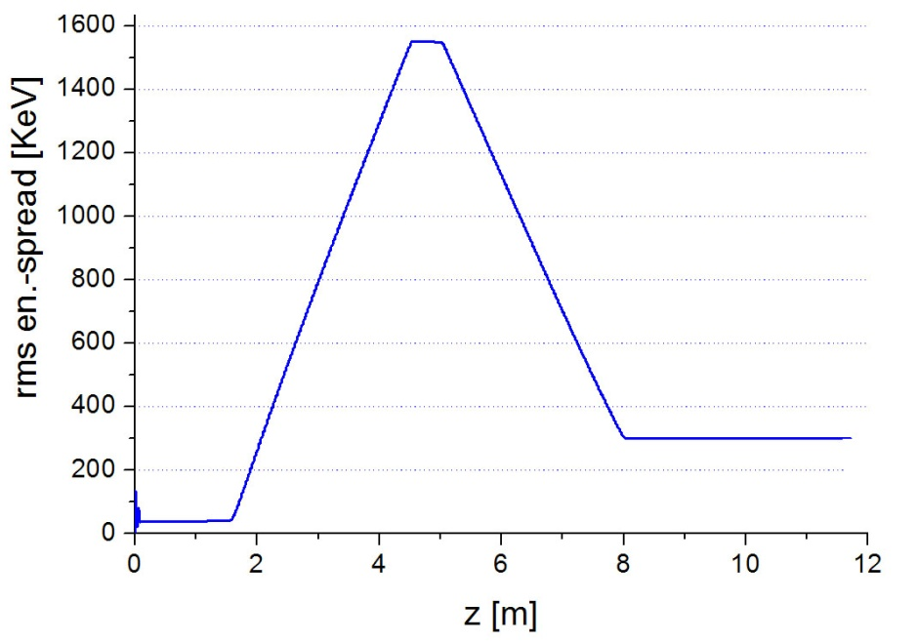
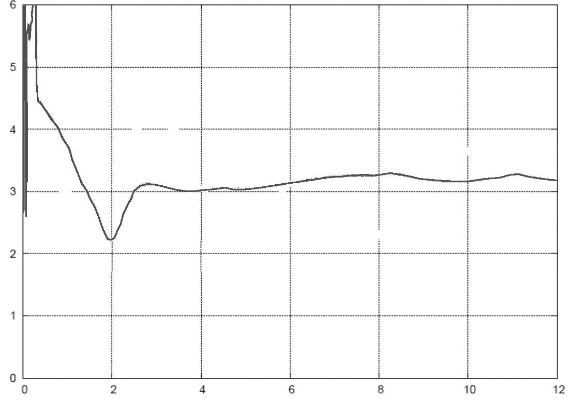
The nominal case injector : 30MeV, 840pC
2007 measured beams
ε_{x,y}= 2.7 mm-mrad (at first TW Cavity entrance)
sol. embedded
sol. embedded
Off
11.0 MV/m
2.0 MV/m
120 MV/m
ϕ(S1)=0°
ϕ(S2)=90°
Measured Laser-profile
A.Bacci
Int.
ε_{th}=1.2 mm-mrad (norm. σ_{x}= 1 mm)
σ_{t} = 6.5 psec
Q_{bunch} = 840 pC
σ_{x,y} = 0.57 mm
Energy Spread Correction
t [ps]
6
emittance
3 mm-rad
ε_{x} [mm-mrad]
0
12
z [m]

Slide 14
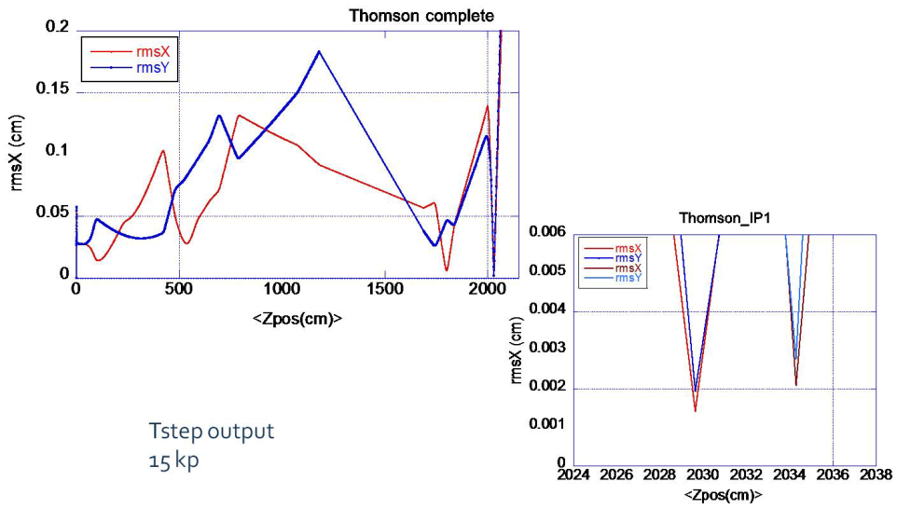
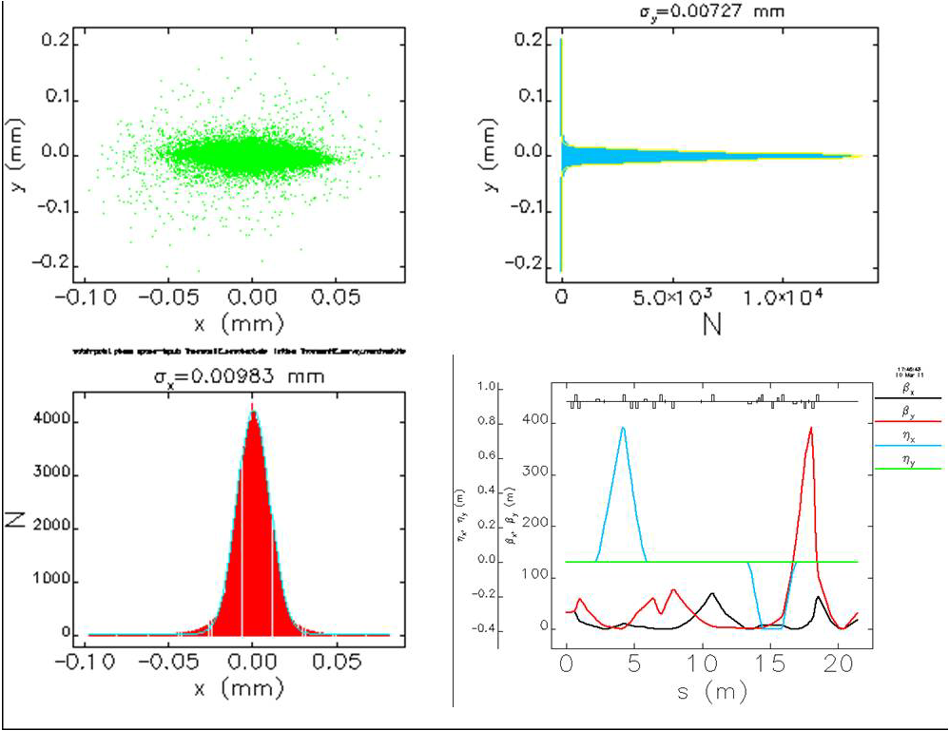
e⁻ beam at IP
E=30MeV
Q=840 pC
E=150 MeV
Q=840 pC
Rms beams sizes evolution along the transfer line & longitudinal tunability" of the beam waist at IP.
Elegant output
120 kp
Rms beam sizes at IP
& Twiss parameters of the 150 MeV beam

Slide 15
Source spectra simulations
Spettro
θ=6 mrad
V.Petrillo
E_{e}=30 MeV
N_{tot}=1,69 10⁹
Δω/ω (FWHM)=10.5 %
Δω/ω rms=5.2 %
div (FWHM)= 22 mrad
div rms= 5.3 mrad
θ=1 mrad

Slide 16
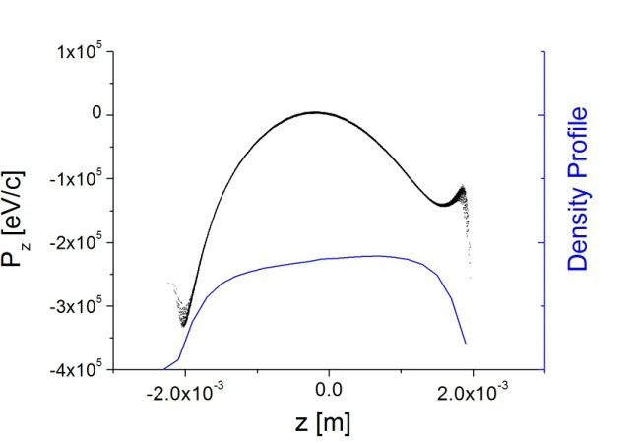
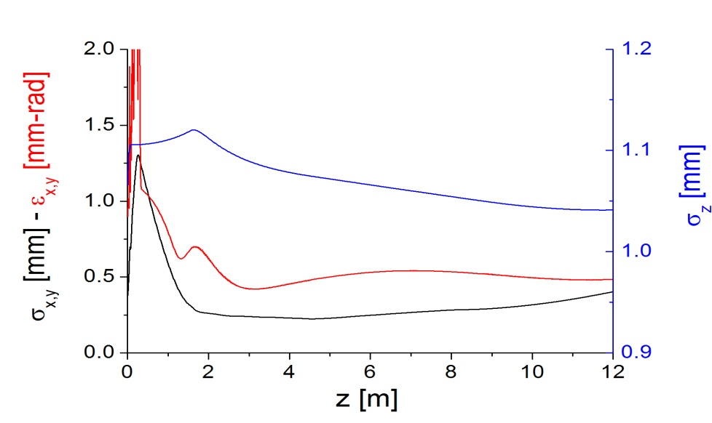
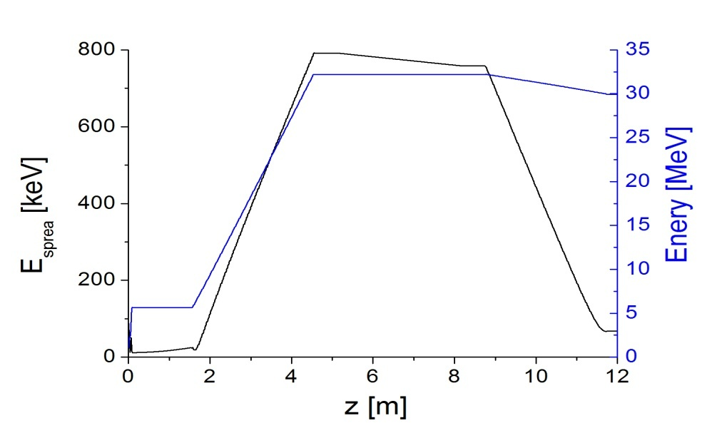
The Low-Charge Case injector: 30MeV, 350pC
Q_{bunch} = 350 pC
σ_{x,y} = 0.300 mm
ε_{th}=1.2 mm-mrad (norm. σ_{x}= 1 mm)
σ_{t} = 16 psec, rise-time= 1psec
sol. embedded
sol. embedded
13.2 MV/m
0.2 MV/m
5.5 MV/m
120 MV/m
ϕ(S1)=-26°
ϕ(S2)=92°
ϕ(S3)=100°
Energy Spread Correction by a proper Acc.Gradient, Phase injection and
phase slippage on the first TW cavity

Slide 17
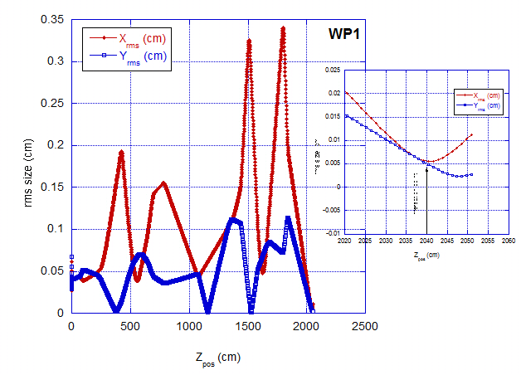
SL-Thomson: e beam for commissioning
Q=350pC
E=30 MeV
Tstep code simulation
With triplet only

Slide 18
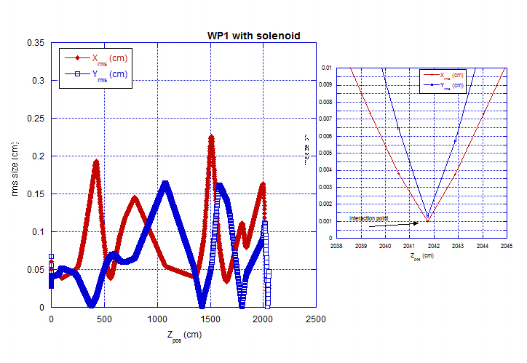
SL-Thomson: e beam for commissioning
Q=350pC
E=30 MeV
Tstep code simulation
With
solenoid

Slide 19
Commissioning:
90 MeV – 160 pC e⁻ beam (Comb or THz exp)
  Down to dumper w flags
  Quads alignement check on this orbit
  BPM first reference orbit
  Response matrix iterations for lattice optimization
30 MeV low charge transport and optimization
= 1÷1.5 month (May)
Photon beam transport & optimization
Synchronization & Collision
= 1 month (June)
  Al-window
    Kapton window
      Carbon fiber window

Slide 20
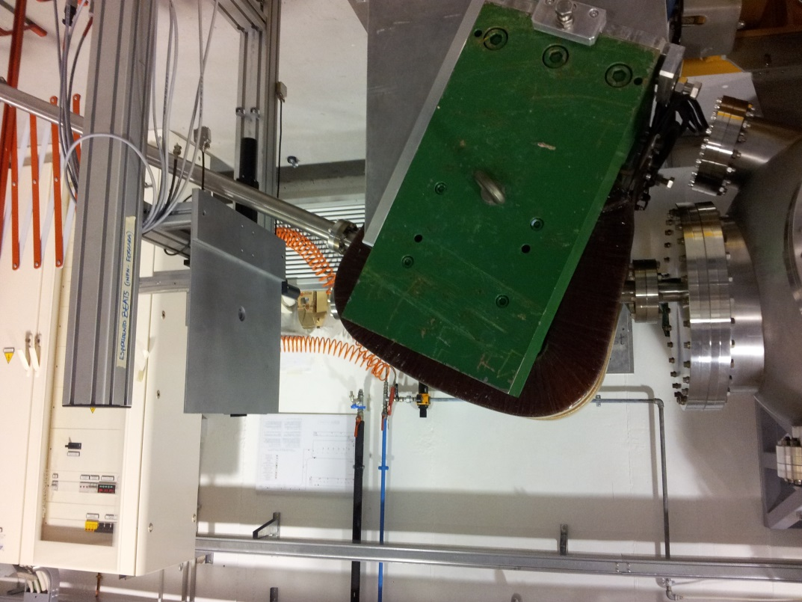
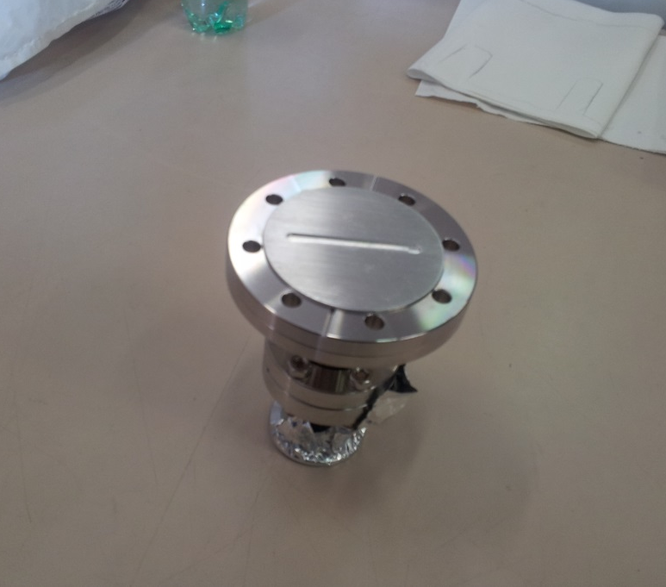
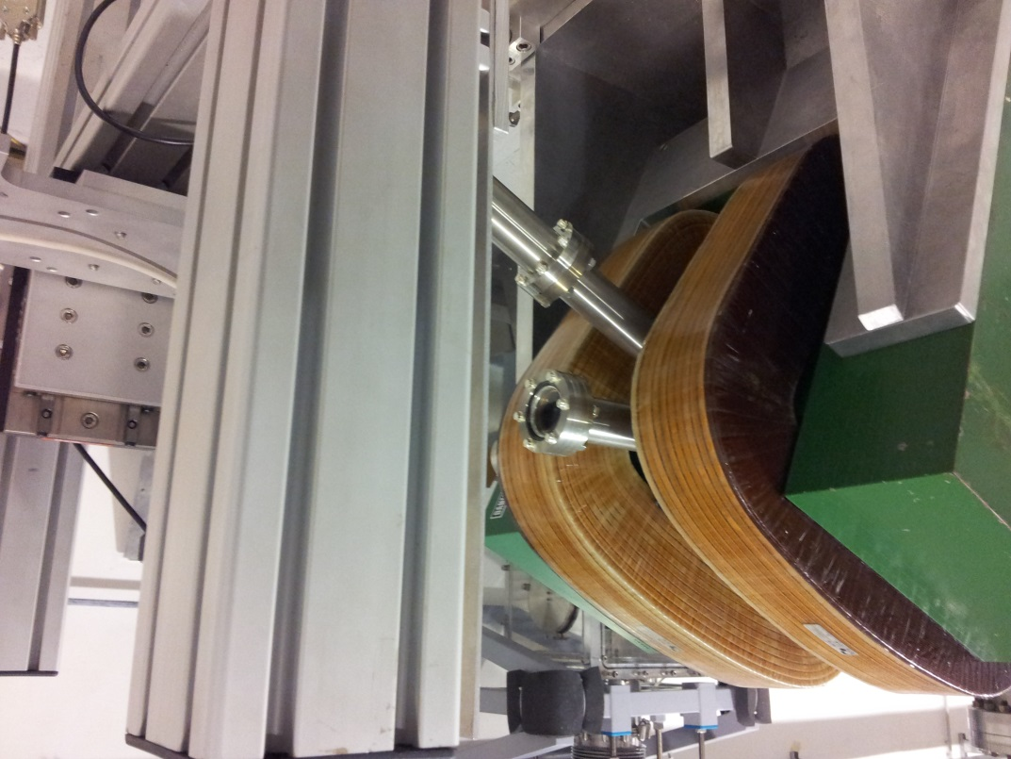
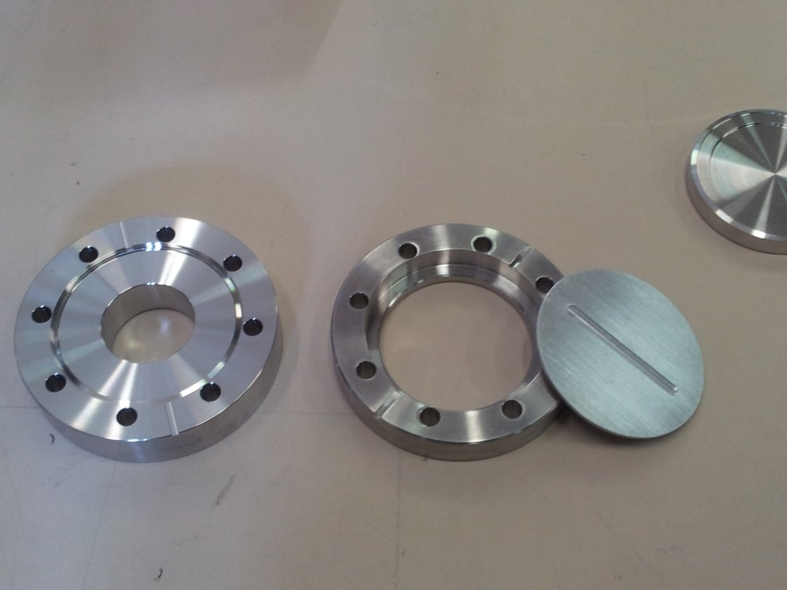
Beats2

Slide 21
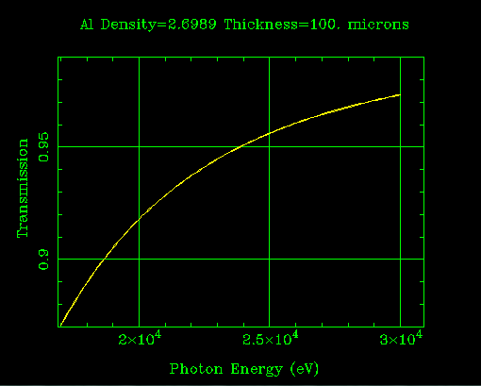
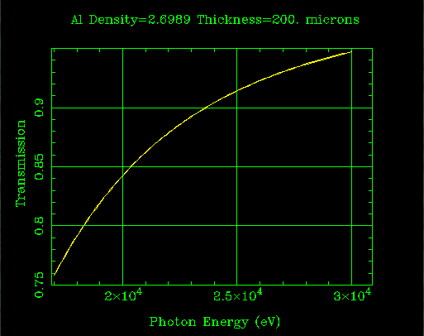
At first:
Al properties: (http://henke.lbl.gov/tmp/xray3931.html
18keV
18keV

Slide 22
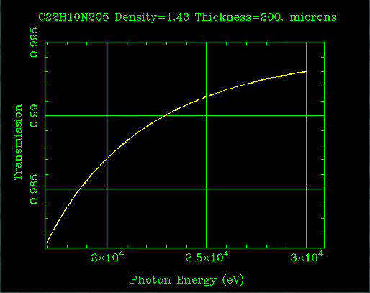
Next:
18keV
18keV
Kapton (limited lifetime)
Cycloparaphenylene: C18H28B2O4
(structure footprint? Check @ Elettra)

Slide 23
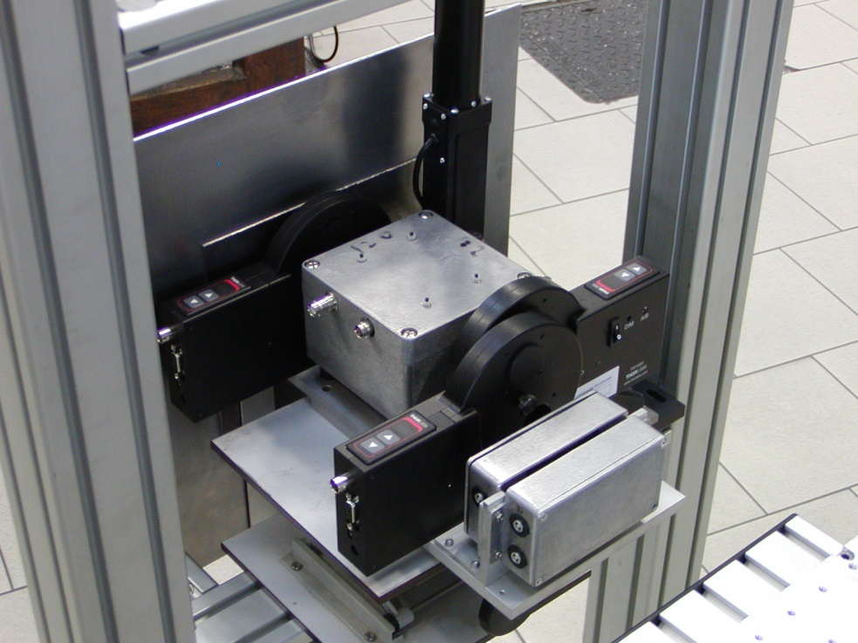
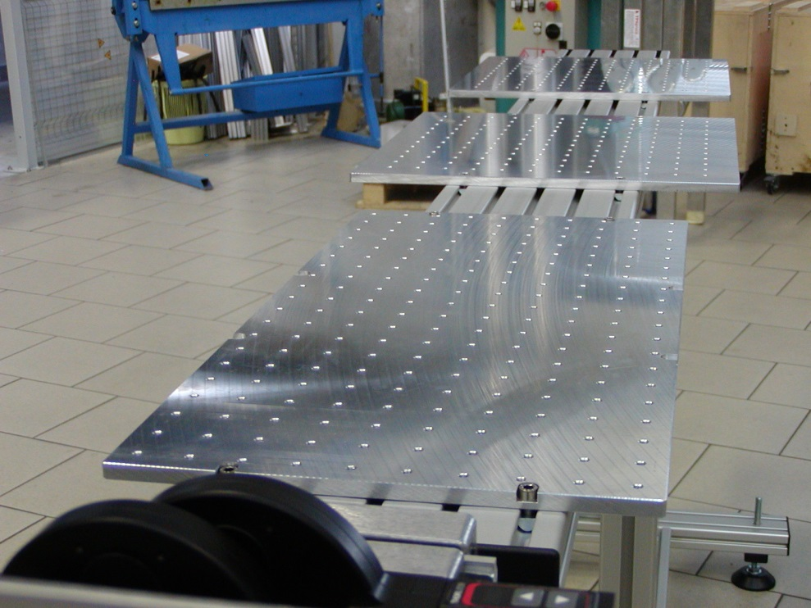
Beats2 apparatus
Filter holders/Collimators
Flux measure
X beam monitor
Banco ottico per allineamento oggetti test
e apparati di imaging X in assorbimento e
In contrasto di fase
M. Gambaccini
Monitor fascio X
e portafiltri

Slide 24

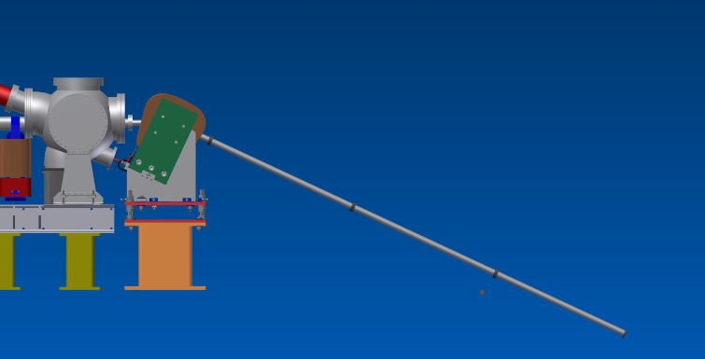
ELI-NP sinergy:
The study of the electron distribution after the scattering is relevant for:
  Informations about the scattering-quantum model validation
  Electron longitudinal phase space
  deterioration
  Eventual transverse cooling
Target position
24

Slide 25
Electron energy distribution at varying laser time duration.
Simulation made with CAIN.
Thomson SPARC-LAB at 150 MeV
Photon distribution vs electron energy for a0 = 0.083 and
Δt=0.083ps
Initial condition,
No collisions
1 collision
2 collisions
courtesy of V. Petrillo

Slide 26
Electron energy distribution at varying laser time duration. Simulation with CAIN
SL-Thomson case ELI-np case
ELI simulated beam
Electron distribution vs electron energy for the a0 = 0.083
a0 = 0.046
Initial
final
Δt=0.083ps
Δt=0.33ps
Δt=3.33ps
Δt=1.66ps
Diffusion in the phase space
Δt=8.33ps
Δt=6.66ps
Γ Funct, typical of random walk
Electron distribution, 2
courtesy of V. Petrillo

Slide 27
Thomson SPARC-LAB data, 150 MeV
Red: CAIN
Blue: master eq.
P is the electron distribution
Chapman-Kolmogorov master-equation for Markov process
Submitted to NJP
courtesy of V. Petrillo

Slide 28
Summary
The e⁻ beamline installation has been completed and the comissioning will start next week jointly w «2 colors FEL» and «THz» exp.
The photon beamline mirror mounting will proceed in parallel to set the high power photon beam transport.
Synchronization optimization and collisions soon after.
The first part of the BEATS2 exp. will provide the source characterization besides
The electron distribution study after the collision will provide information for the ELI-NP scaling.
The second part of the BEATS2 exp. will deal w the source efficiency for the medical imaging.

