Slide 1
Mechanical Upgrade Interaction Region IR1
Luigi Pellegrino
Mechanical Engineering Group
(LNF Scientific Committee, May 9, 2013)

Slide 2
DAFNE, KLOE and the main intervention area

Slide 3
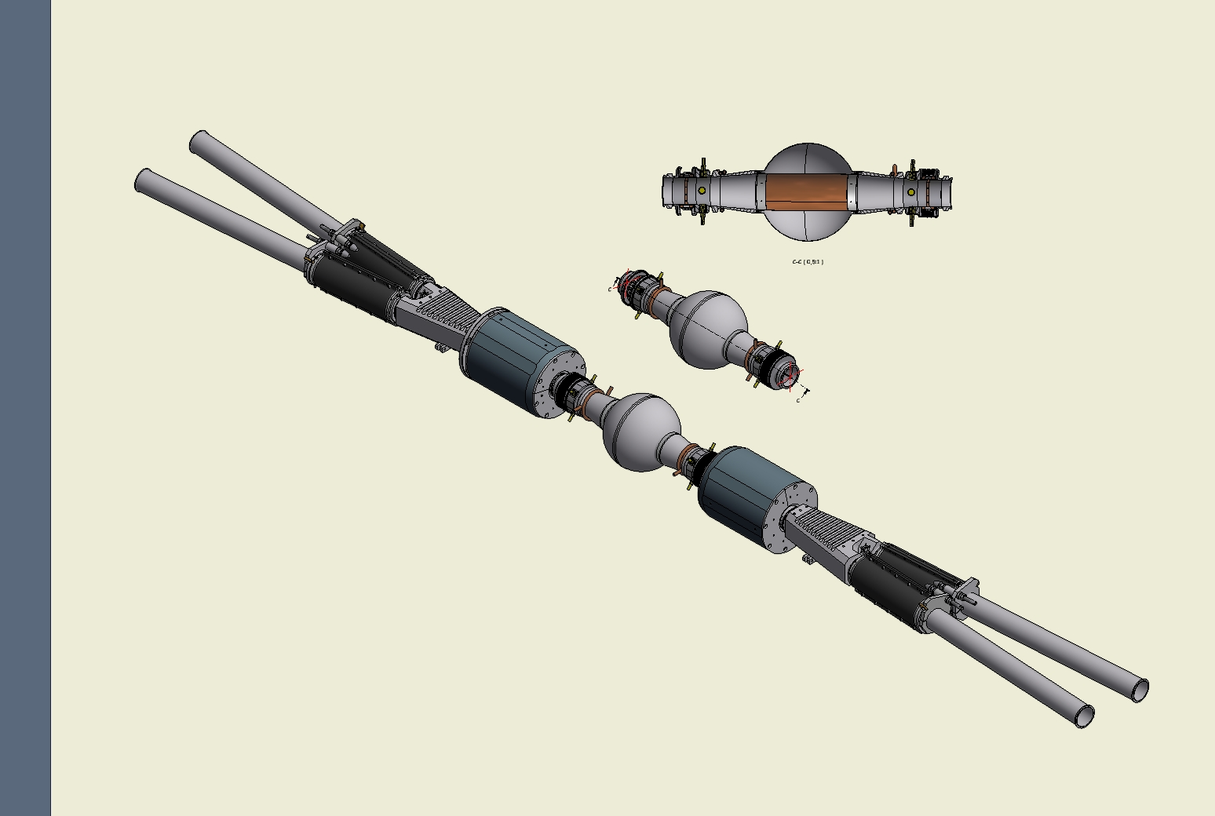
Interaction Region (IR) permanent magnets and vacuum chambers assembly
BPM
Be shield
cooling
bellow
QF magnets
Tapered pipe
Y chamber
IP assembly
QD magnet
Spherical chamber
(Interaction Point IP)

Slide 4
Modification of IR components
New IP Spherical vacuum chamber
New beryllium shields
New BPMs
Moving devices for quadrupoles QF
Cooling of IP vacuum chamber added
Cooling of Y vacuum chambers added
Lead toroidal shields added
New Cylindrical vacuum chamber support
Improvements on alignment tools
H supports reinforced with plates
Modification of tail support of the girder
Temperature probes added
Carbon fiber composite additional supports

Slide 5
Spherical vacuum chamber evolution
Single vacuum chamber tapered
New bellows with improved design
2 BPMS around the IP
water cooling added
New beryllium screens

Slide 6
Old Spherical vacuum chamber with damaged RF contacts

Slide 7
Spherical Vacuum chamber before EB welding (RF contacts between sphere and Be shield)

Slide 8
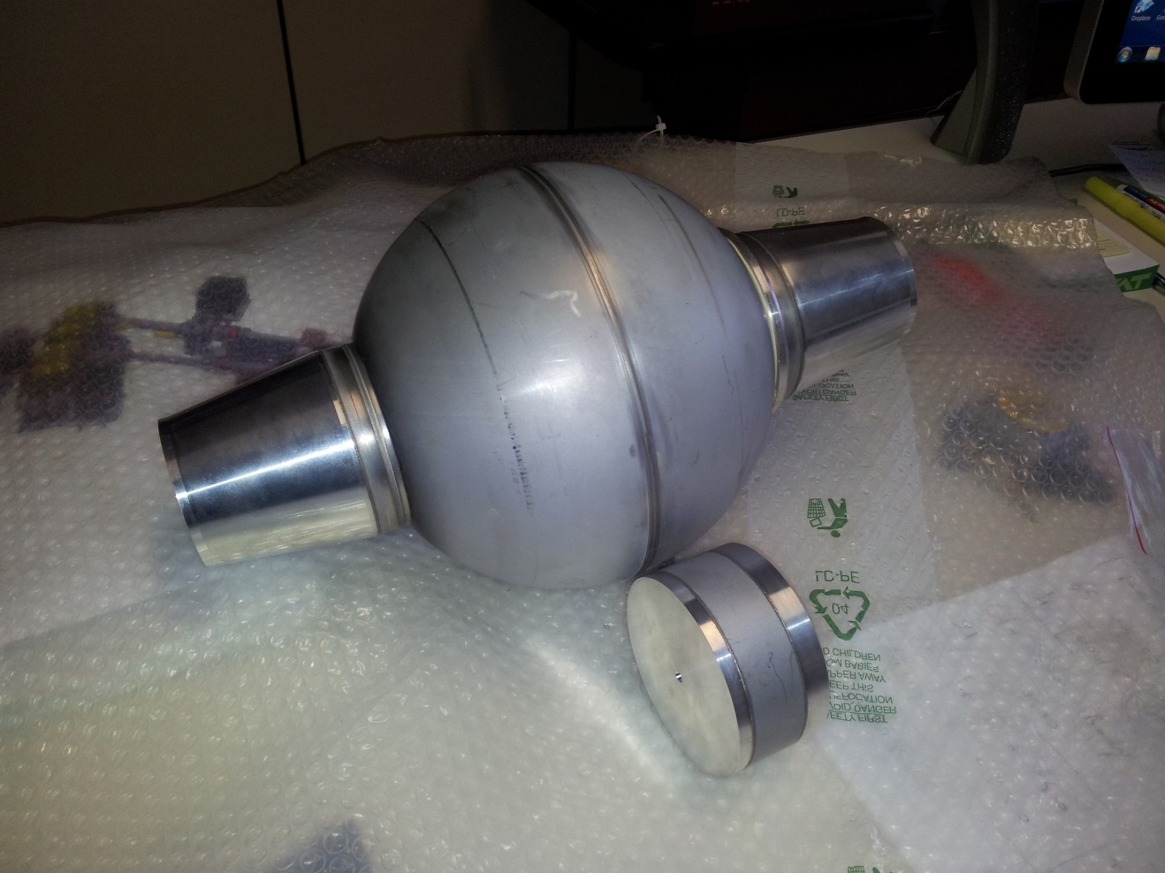
EB Welding tests

Slide 9
IR half 1 A: New Cylindrical vacuum chamber supports B: H shape support reinforced with plates C: New tail support of the girder
A
B
C

Slide 10
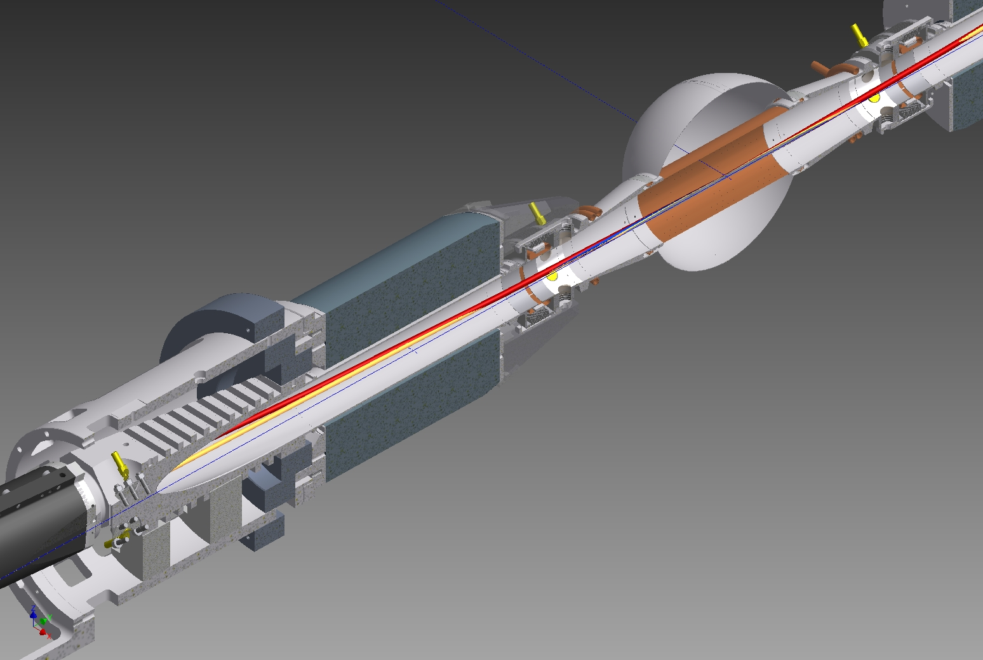
Lead toroidal shields (section)

Slide 11
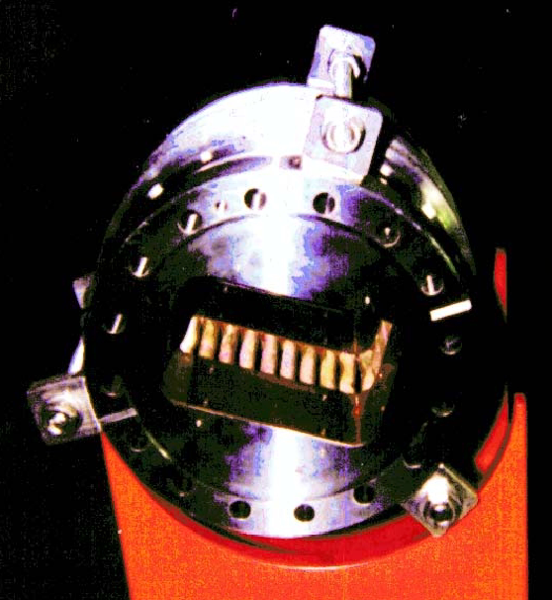
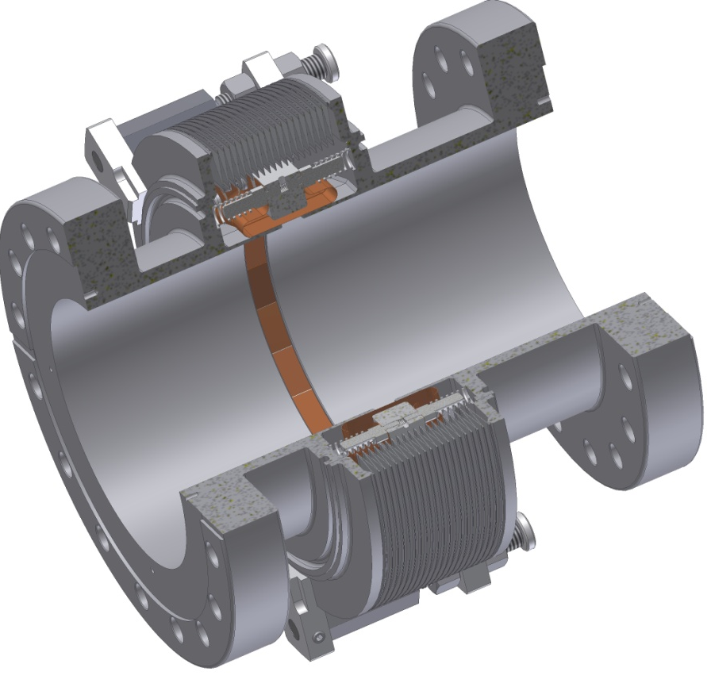
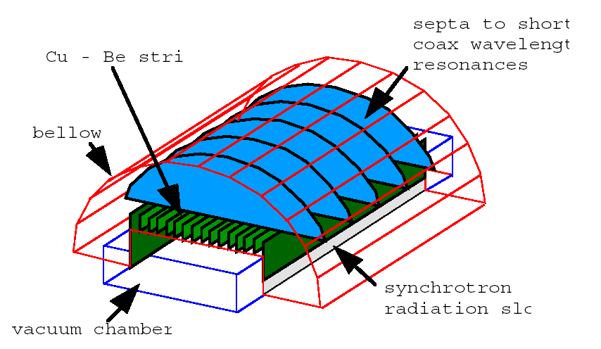
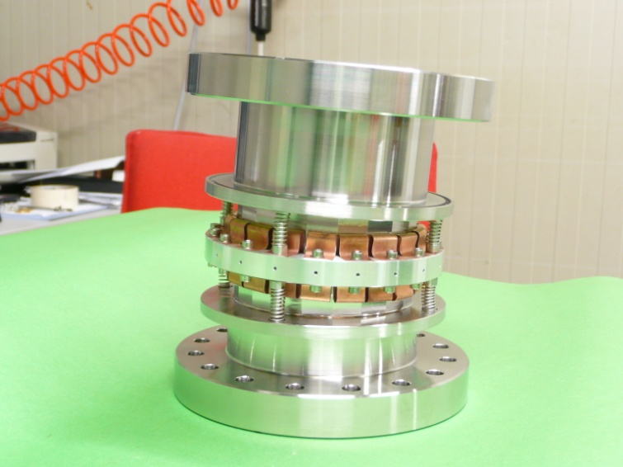
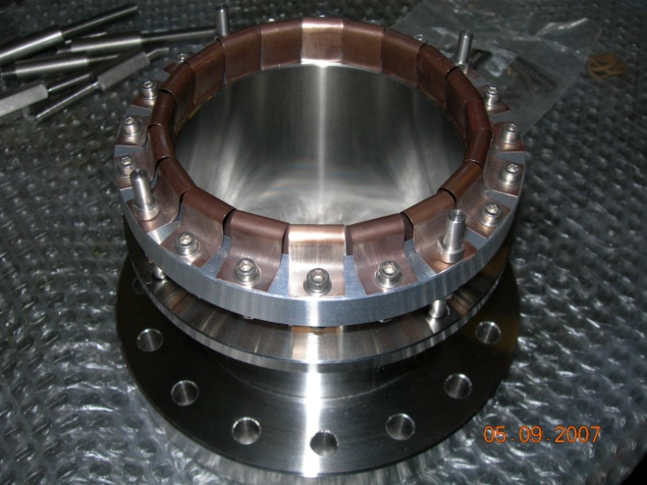
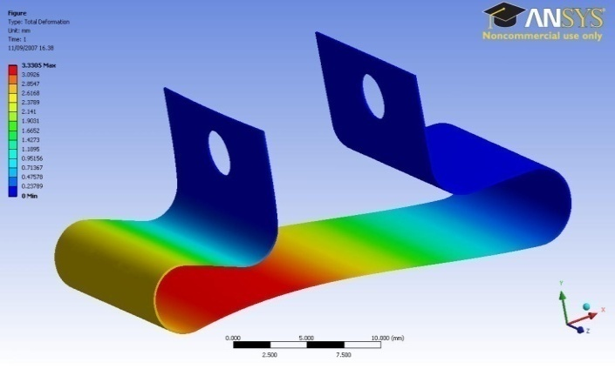
NEW BELLOWS (courtesy of S. Tomassini)
OLD BELLOW
Shielding based on Be-Cu Ω strips 0.2 mm thick
lower impedance and improved mechanical specifications

Slide 12
Operations
Position measurement and disassembling of the four branches of the accelerator at both side of KLOE;
Mounting and aligning of the rails and tools;
Extraction of Interaction Region assembly and placing on the temporary girder;
Measuring and disassembling all the IR components;
Assembling the IR permanent magnets and vacuum pipes with new supports and auxiliaries, for each of the two halves of IR;
EB welding of the Spherical vacuum chamber to the tapered pipes;
Mounting and TIG welding the Spherical vacuum chamber assembly;
Aligning and TIG welding the Spherical vacuum chamber assembly at side 1 of IR;
First step of detectors new components mounting and aligning;
Aligning and TIG welding of the Spherical vacuum chamber assembling at the side 2;
Second step of detectors new components mounting and aligning;
IR assembly Insertion; cabling and piping; final alignment; closing of the KLOE endcaps;
Assembling and alignment of the four branches of the accelerator at both side of KLOE.

Slide 13
Rails (yellow) and half shell support (orange) for IR extraction

Slide 14
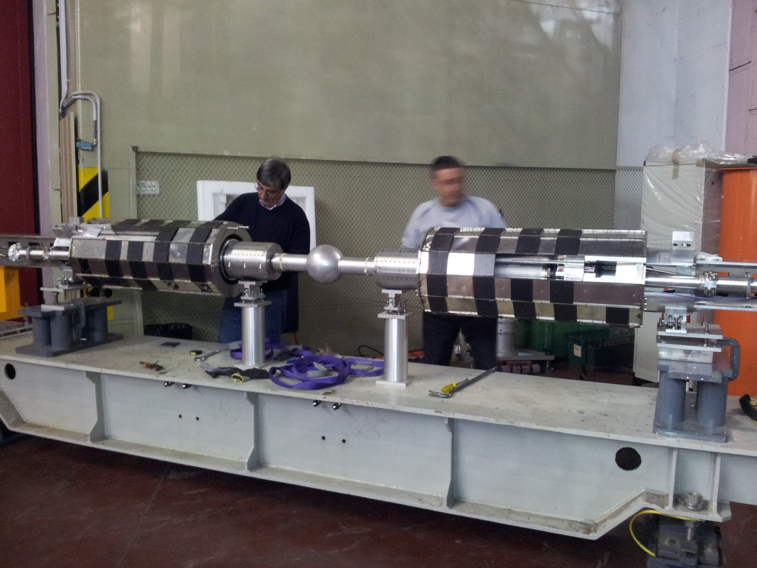
Old IR after extraction, during disassembly

Slide 15
During the assembling of the new supports and components, side 1

Slide 16
Final cams and last joints of the QF moving device

Slide 17
Sphere assembly in final position before TIG welding

Slide 18
Final steps of the IR mounting

Slide 19
Insertion of the IT, before the 2°welding

Slide 20
Summary time schedule
The complete GANTT chart is available at
https://www.smartsheet.com/b/publish?EQBCT=2fe8c5ca318248c18dc57ebfb2d26cb2

Slide 21
People

