Slide 1
LNF NEMO group
oceanografia
Orlando Ciaffoni, Marco Cordelli, Roberto Habel, Agnese Martini, Luciano Trasatti

Slide 2
PORFIDO
Physical Oceanography by
RFID
Outreach

Slide 3
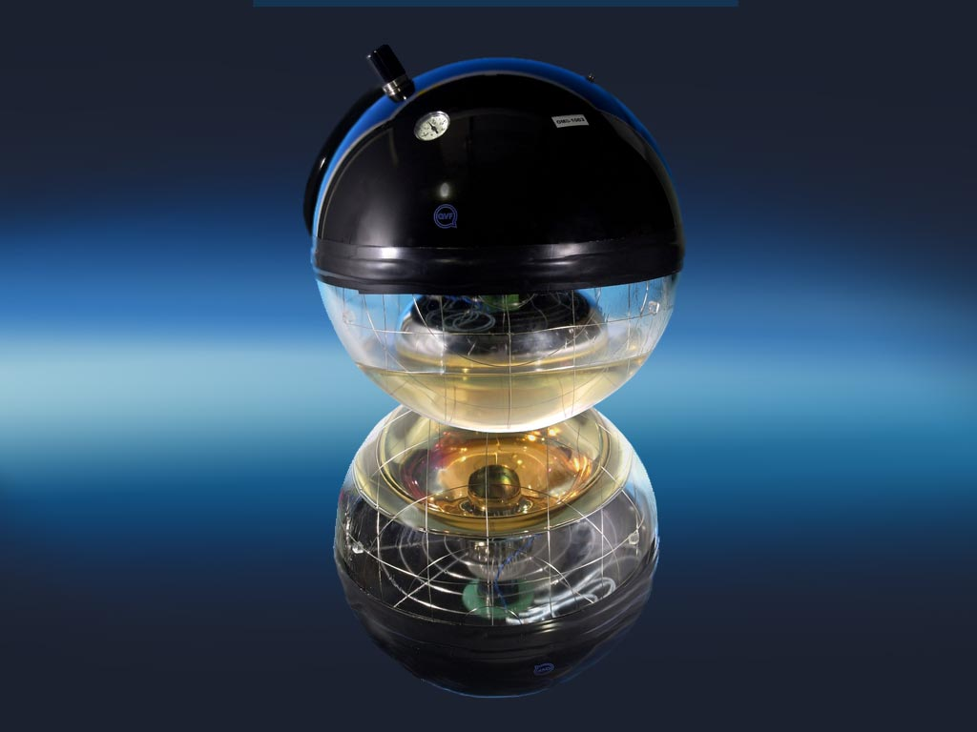
NEMO FASE II Optical module

Slide 4
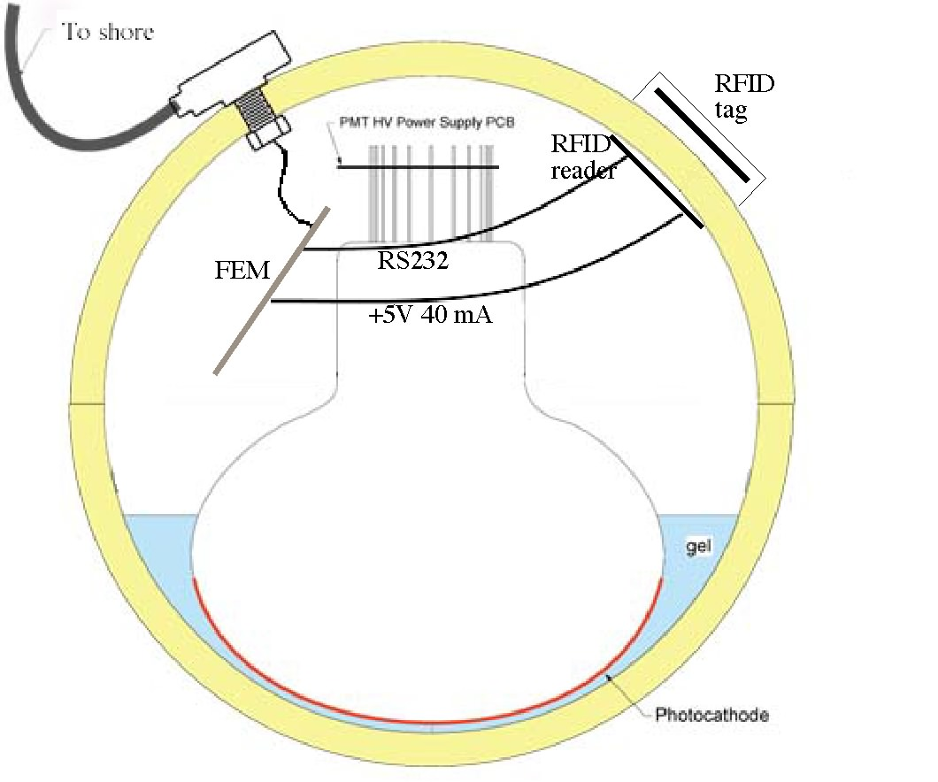
Optical Module with PORFIDO probe schematic
FCM
FCM

Slide 5
PORFIDO
RFID communication through glass
Very little interference with detector
Very little bandwidth to-from shore
Very little power
continuous data taking
data rate controlled from shore

Slide 6
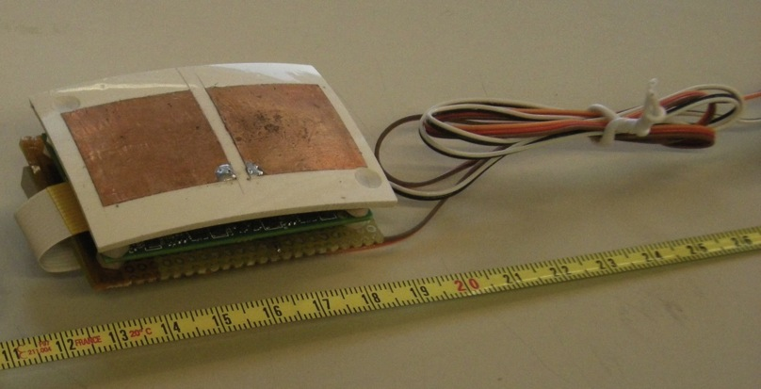
Radio Frequency Identification (RFID
RFID .
Radio Frequency Identification
developed for access control
sensors added
Reader (inside OM)
.
Notes:
Prova

Slide 7
Tag - WISP
RF powered (no batteries)
thermometer and accelerometer on board
open architecture

Slide 8
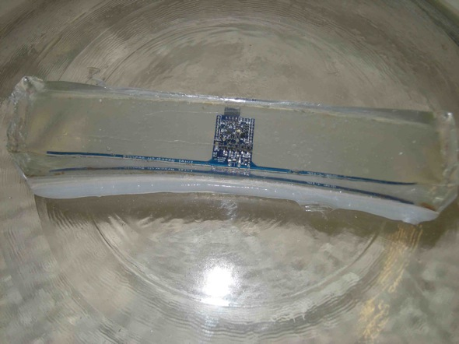
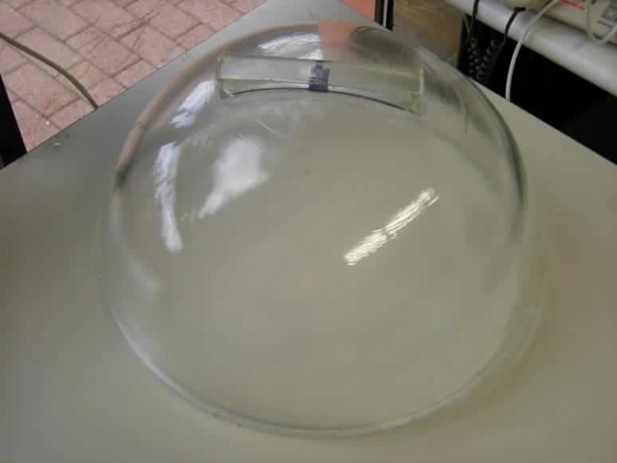
WISP potted in a marine two component epoxy.

Slide 9
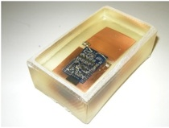
cut the wings
two capacitors, square copper pads, 25x25 mm²

Slide 10
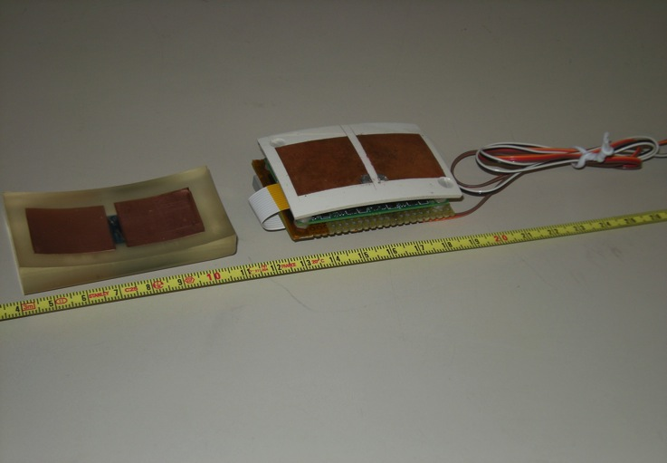
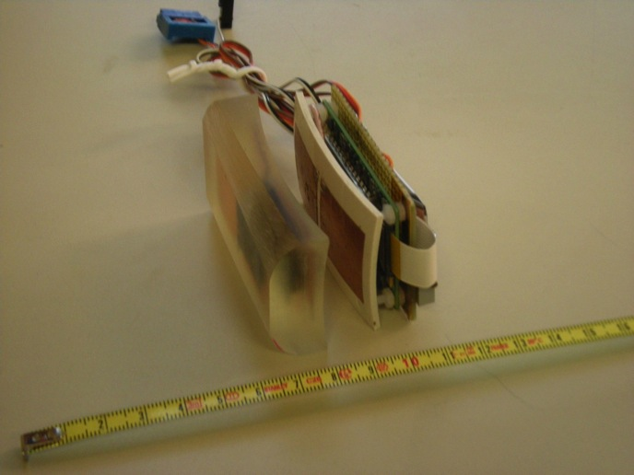
much more stable
immune to the presence of metal
decrease the reader RF power by a factor of 10.
dimensions decreased to the size of the reader (70x40 mm²⁾).

Slide 11
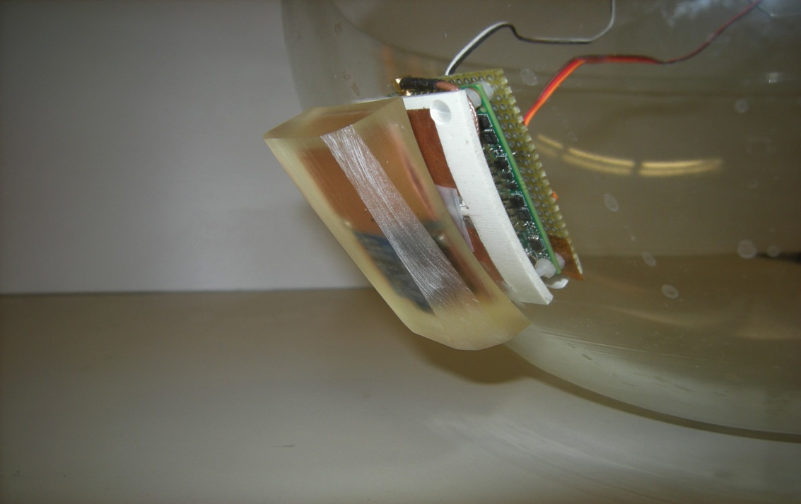
PORFIDO on the OM,

Slide 12
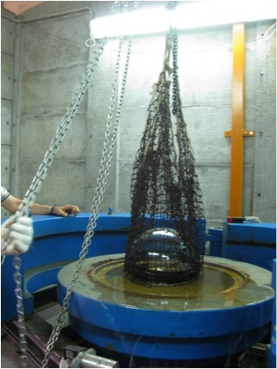
Pressure Test
40 MPa, equivalent to 4000 m depth in sea water
LNS pressure test

Slide 13
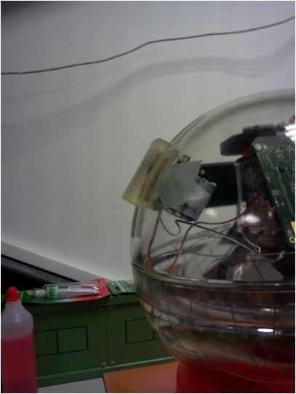
RF Interference test
no interference with the PM tube and with the electronic boards inside the Optical Module.

Slide 14
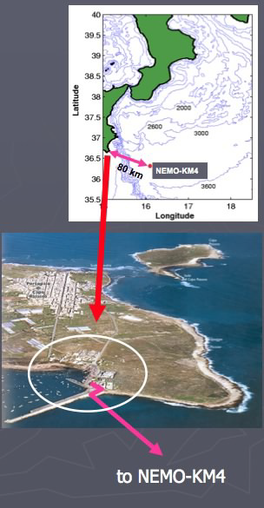
4 PORFIDO probes on the Phase 2 tower - working

Slide 15
PORFIDO for DOM

Slide 16
Developments
- 24 bit AFE (ADC) driven by WISP
Thermometer 0.001 ˚C using PT 100
working
Salinity sensor with 1 ppM sensitivity
2 inductances coupled by seawater
no electrodes in water
testing
Power! → Energy Harvesting
Prototype before summer

Slide 17
Open problems
Where do you put the temperature probe?
OM 1.5 W
Sea current 0.5 cm/s
One thousandth of a degree

Slide 18
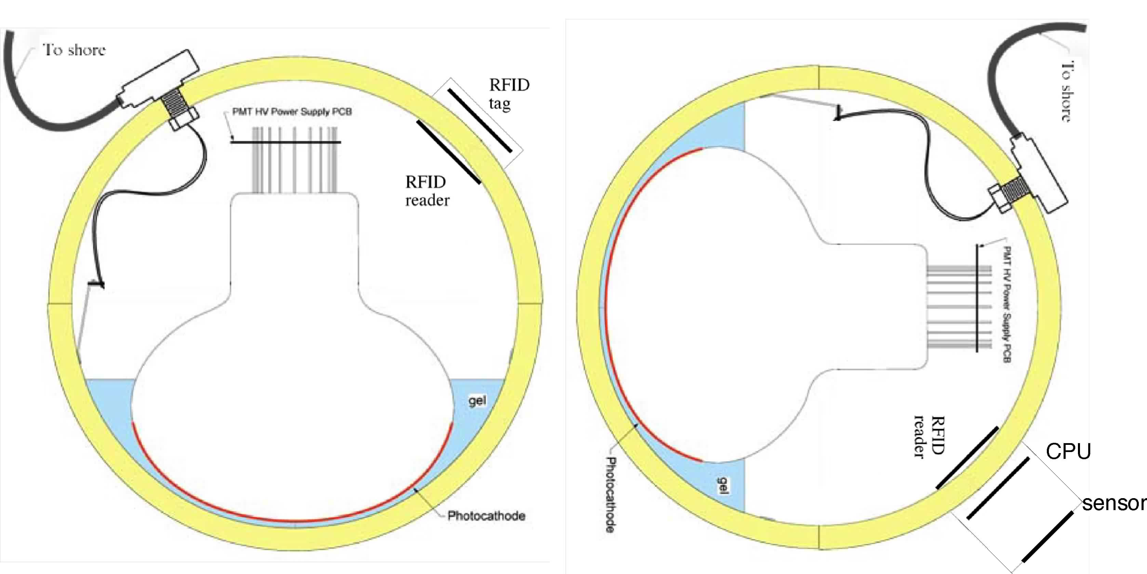
Open problems
Where do you put the temperature probe?

Slide 19
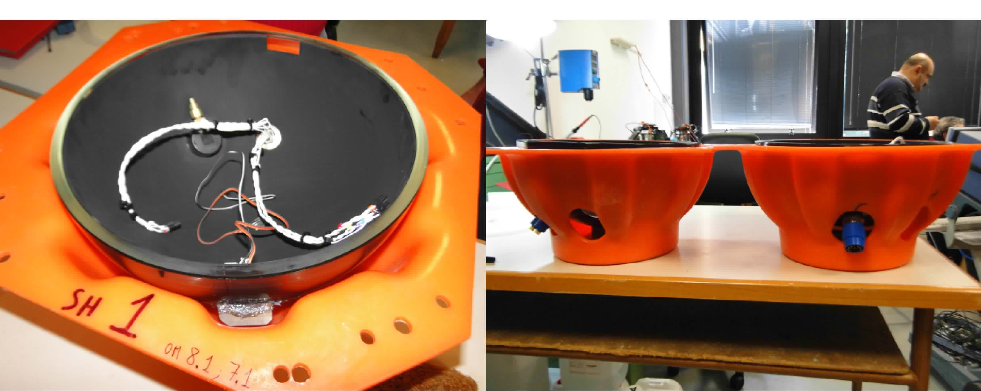
Open problems
Where do you put the temperature probe?
One more hole

Slide 20
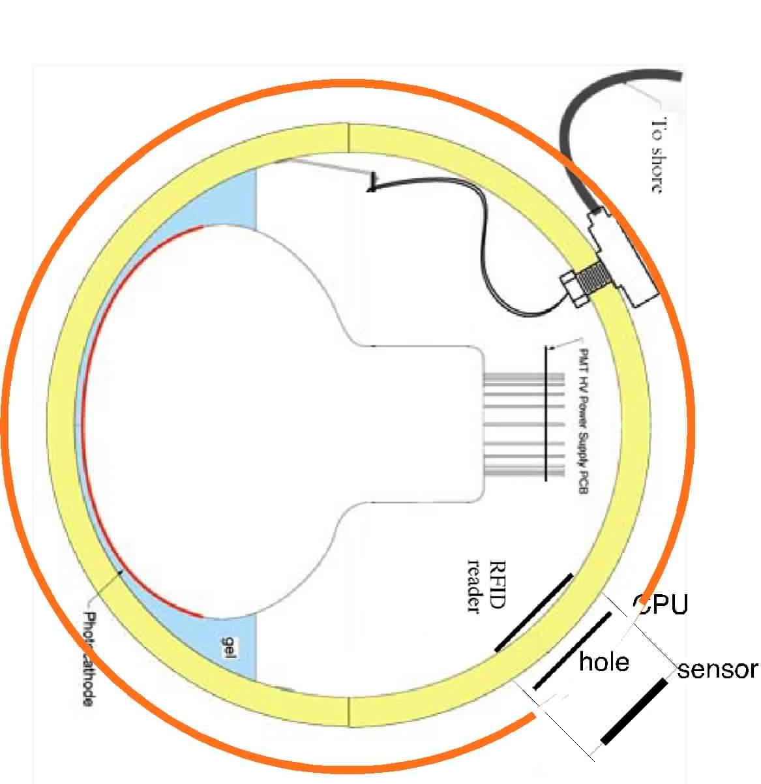
hole

Slide 21
Open problems 2
- Stability absolute or relative? NO Instruments
sold with precision guaranteed > 1 year
Relative calibration – on which time scale?
Pressure
Technological development with good oceanographic data
What else can you do with 24 bits?

Slide 22
Open problems 3
How many PORFIDO probes?
4 towers as far as possible
< every floor (20 m) – 4 /tower
total 32
Distributed in time?

Slide 23
Cost
Reader Thingmagic – 1 k€ ea./ 10 pcs
CAEN Reader – access to software
Temp sensors PT100 IDRONAUT .8 k€ /1 piece
Too much – a few for calib
32 PORFIDO probes
Readers 30 k€
PT100 5 k€
Chips, PCB, resin, etc. 15 k€
Small pressure chamber 5 k€
Total 55 k€

Slide 24
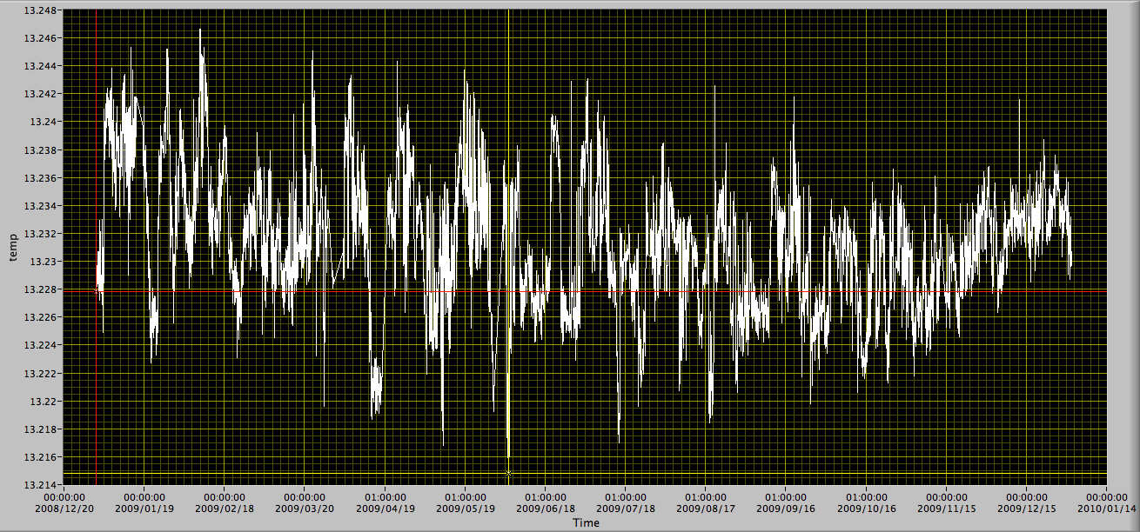
ANTARES temp 1 year

Slide 25
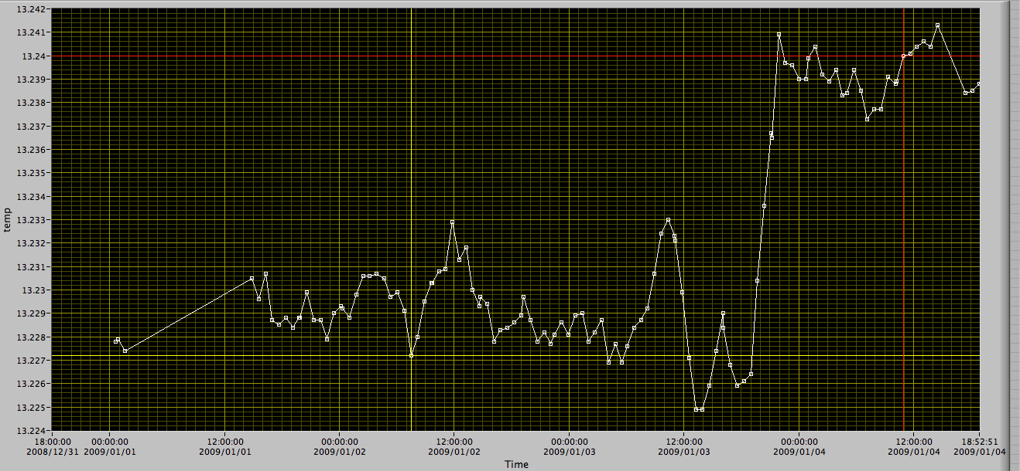
ANTARES temp 3 days

