Slide 1
The ASIM mission on the ISS
to observe TLE phenomena
and gamma ray emission from
TGF electron avalanches
Paul Henry Connell, Victor Reglero, University of Valencia, Spain

Slide 2
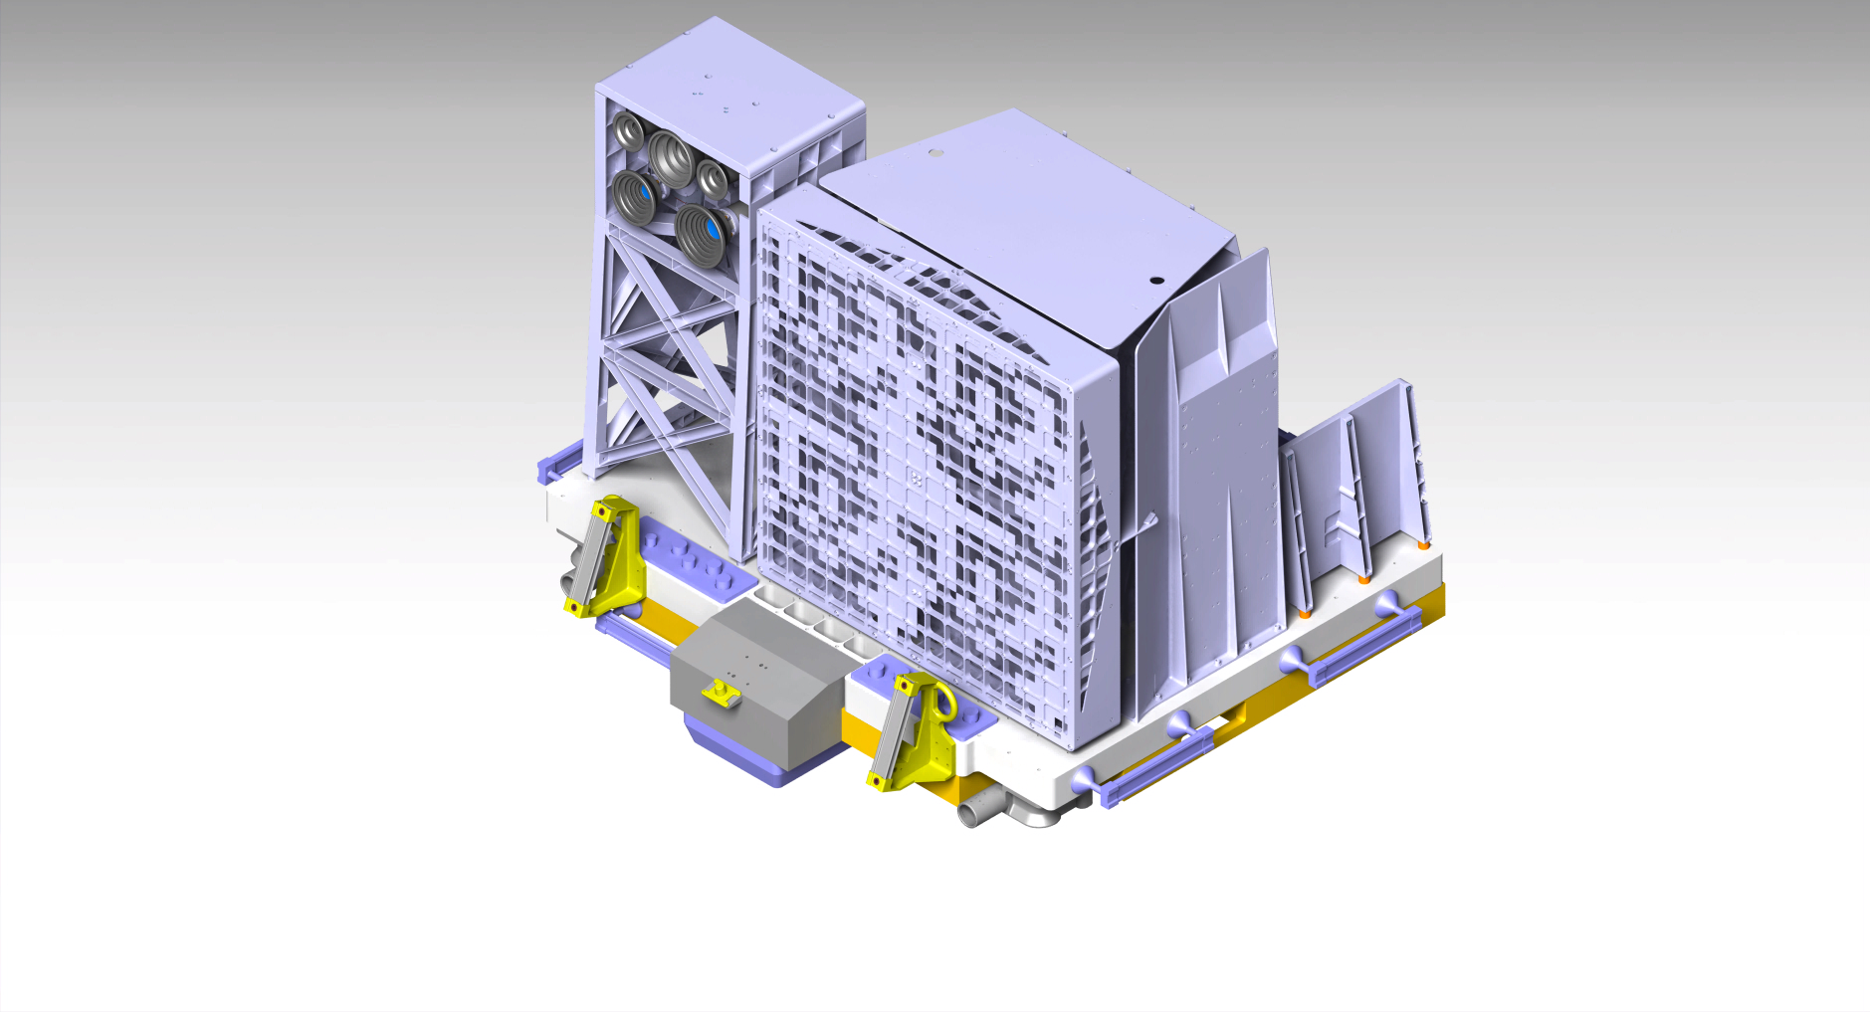
The ASIM mission has two instruments to observe TLEs and TGFs
MMIA - optical cameras (337, 777nm) and photometers (337,777,180-280nm)
MXGS – LE coded mask imager for TGF location and HE BGO spectrometer

Slide 3
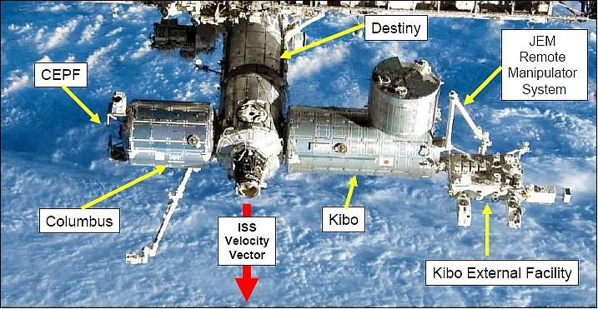
ASIM will observe the earth from the Columbus Module of the ISS

Slide 4
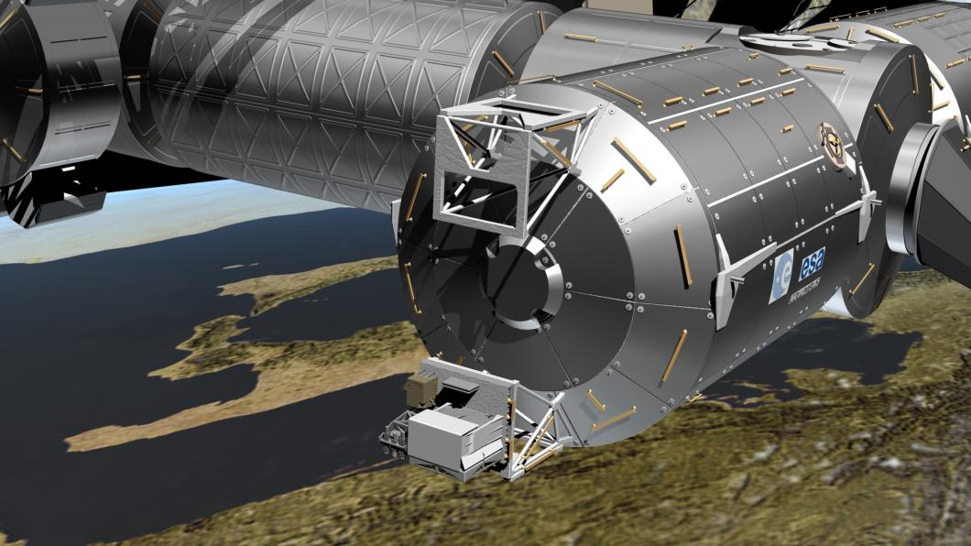
ASIM instrument package mounted on a Columbus CEPF

Slide 5
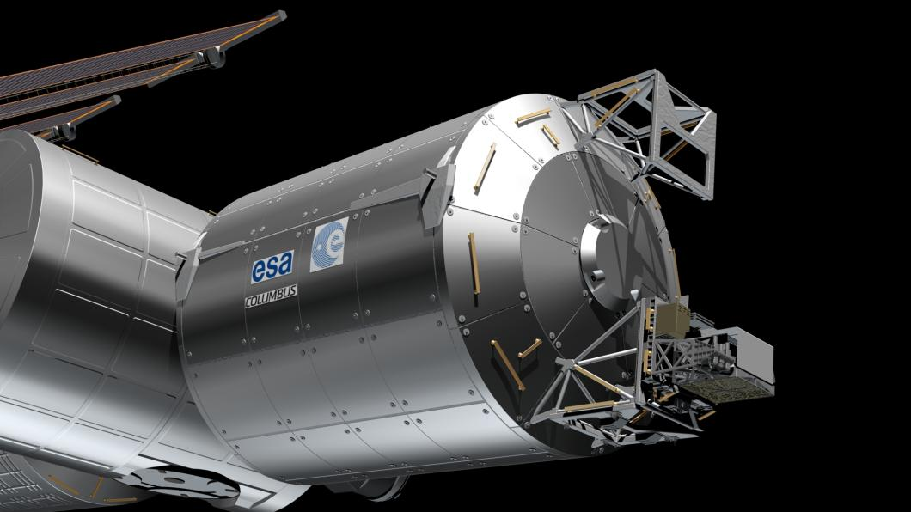
ASIM instruments MXGS and MMIA on the Columbus module

Slide 6
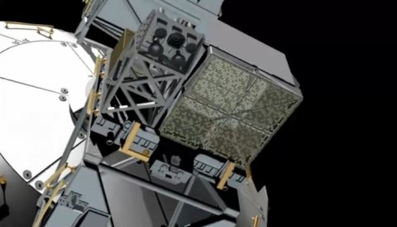
MXGS and MMIA instruments looking down ISS nadir to earth

Slide 7
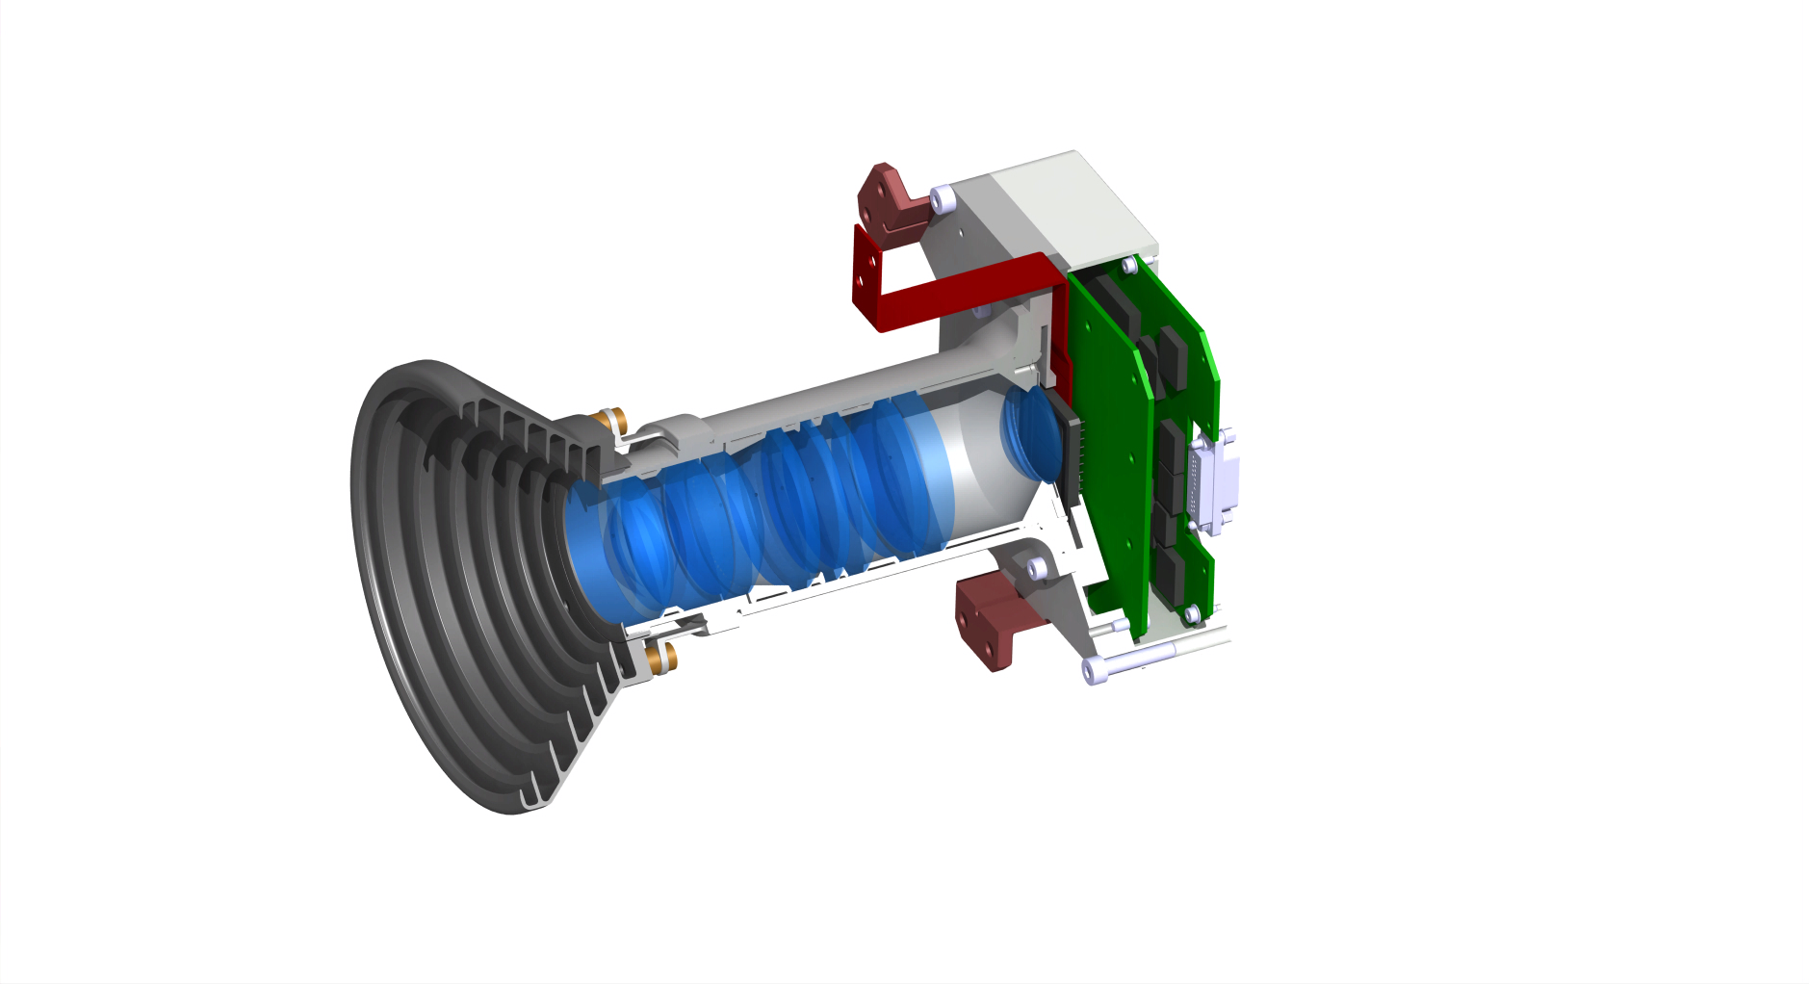
MMIA optical camera
CCD with 5 nm line width for 337 or 777 nm photons
12 frames/sec
400 m resolution

Slide 8
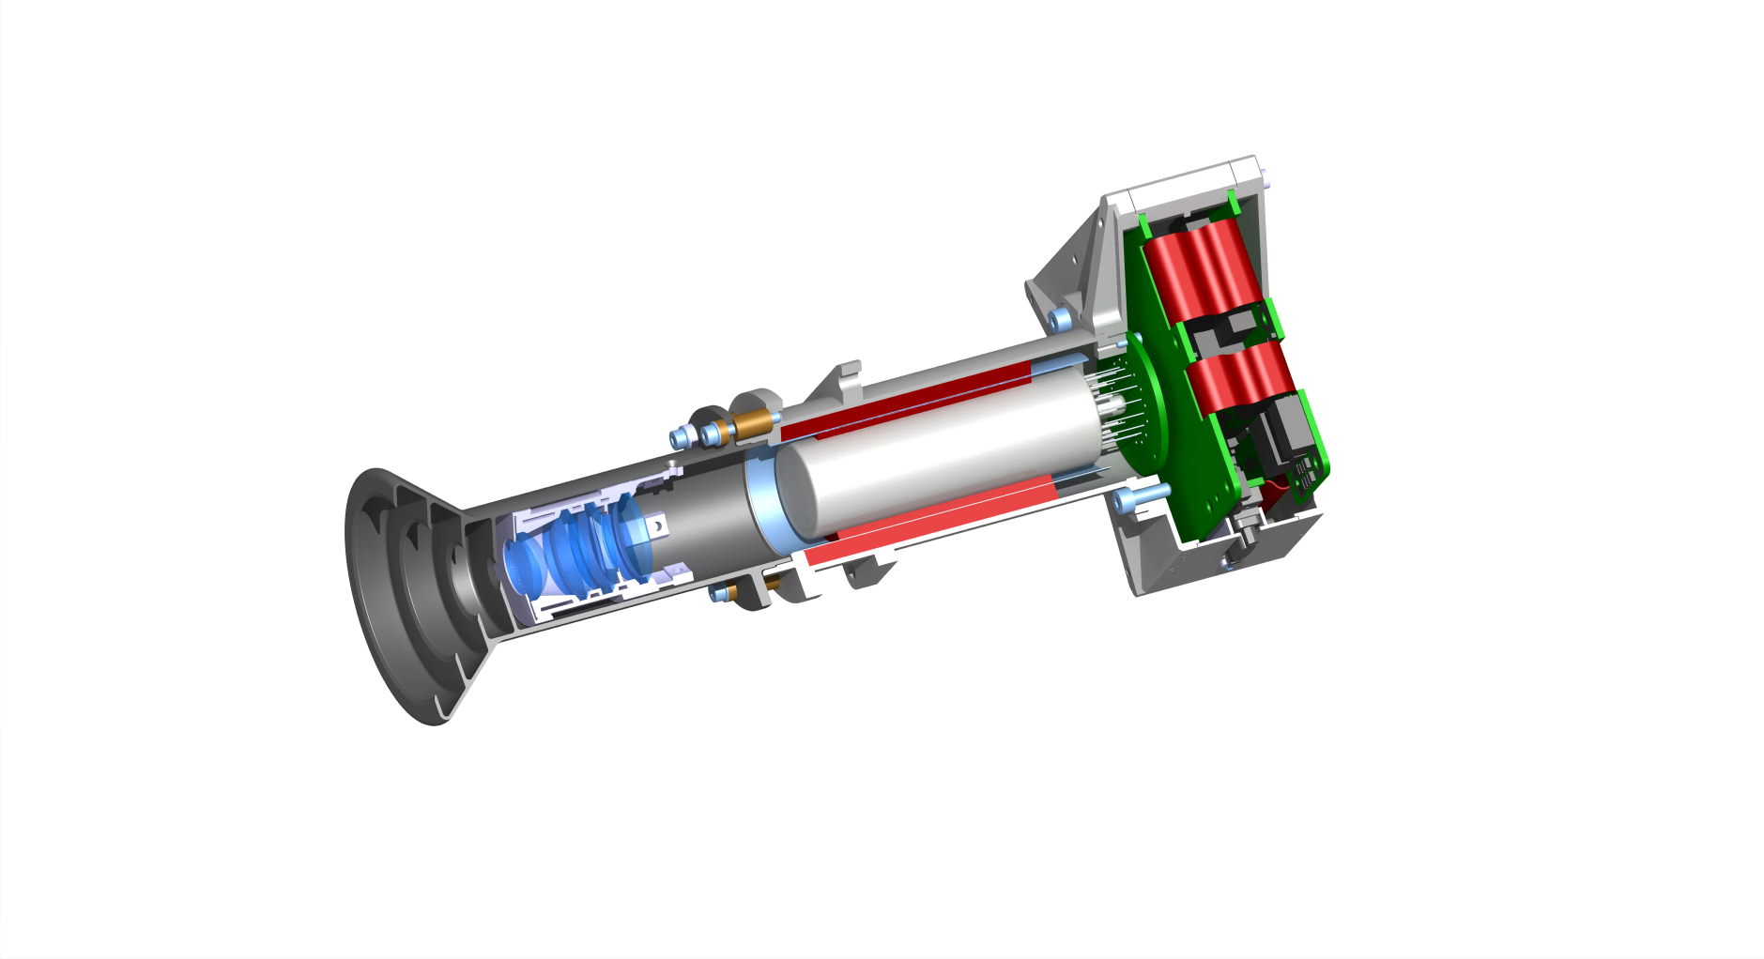
MMIA photometer
Two for 337, 777 nm lines to trigger Sprite associated lightning
One with broadband width of 180-280 nm
Sampling rate of 100 kHz

Slide 9
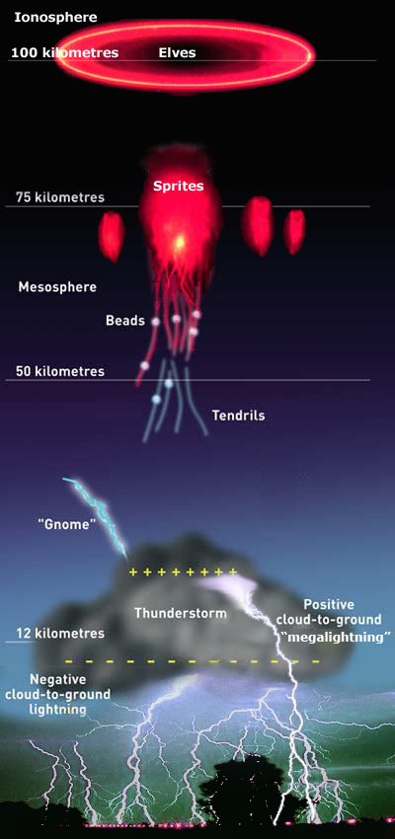
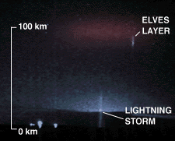
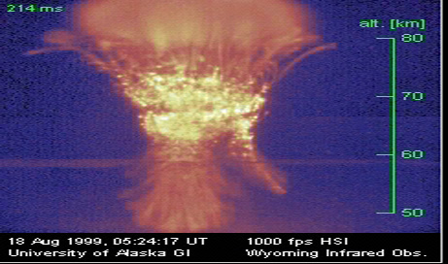
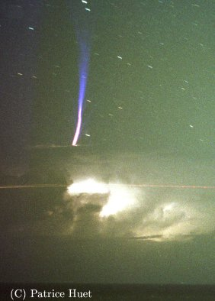
Red Sprites
ELVES
Blue Jets
TLE phenomena observed

Slide 10
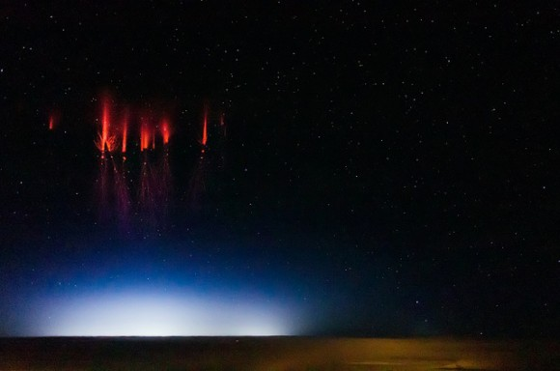
TLE sprite phenomenon observed over Nebraska, August 2013

Slide 11
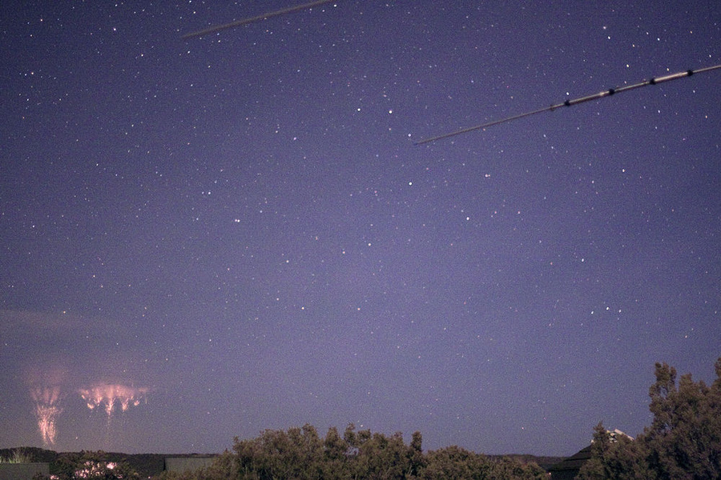
TLE sprites observed looking from your house

Slide 12
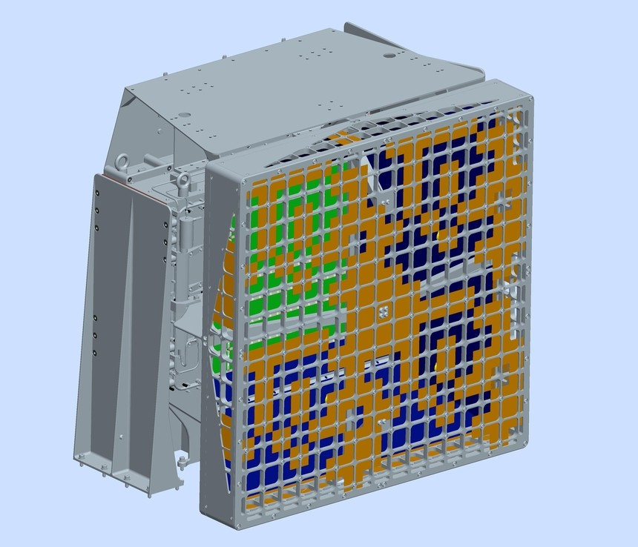
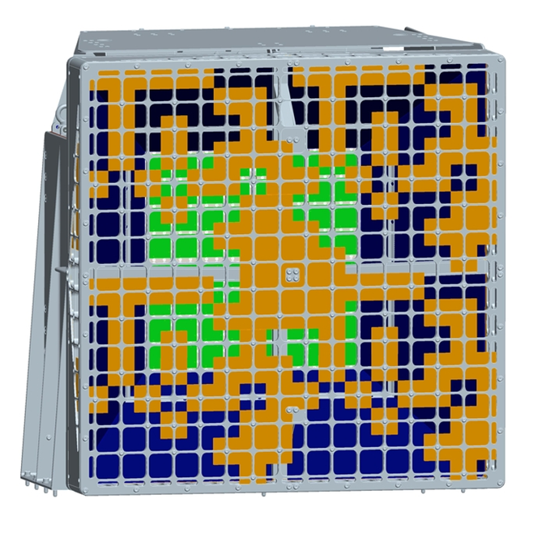
MXGS coded mask imager-spectrometer to locate TGFs from ISS
Mask pattern is a 2x2 cyclic quilt of an 8x8 Perfect Binary Array with 54% open fraction
Mask pattern has 16x16 array of Tungsten elements
Mask elements are 46x46x1mm
Mask open fraction is ~48%
Mask height is 303 mm above the detector plane (green)

Slide 13
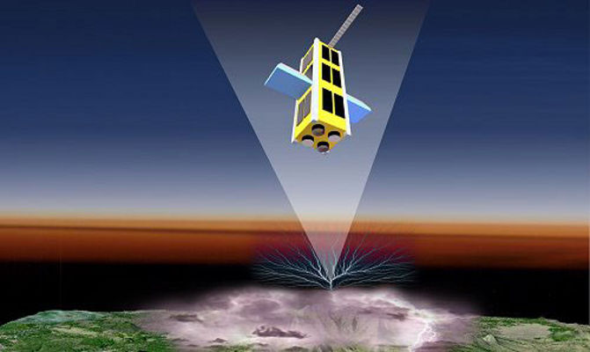
Beam of a Terrestrial Gamma-ray Flash observed from orbit
(Artists Impression)

Slide 14
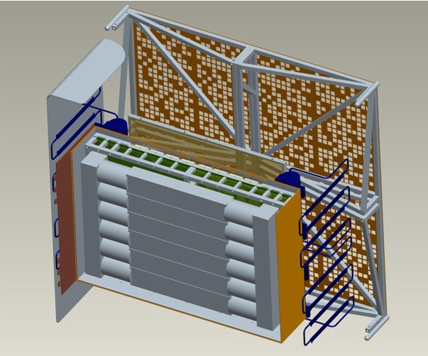
A low energy CZT imaging detector
Detector array 128x128 pixels
Geometrical area ~1000 cm2
Energy range 20 – 300 keV
Energy resolution <10% @ 60 keV
Detection efficiency ~0.94 @ 100 keV
Background ~2.4 cnts/msec
FOV (maximum) +/- 70°
Fully-coded FOV +/- 40°
Half-coded FOV +/- 60°
Angular resolution ~9.5°
Location resolution ~2.0°
Time tag resolution 1 μs
• B
A high energy BGO spectrum detector
Detector array 6 bars of BGO
Geometrical area ~900 cm2
Energy range 200 keV – 20 MeV
Energy resolution <15% @ 662 keV
Detection efficiency >0.60 @ >1 MeV
Background ~ 2.0 cnts/msec
MXGS has two detectors

Slide 15
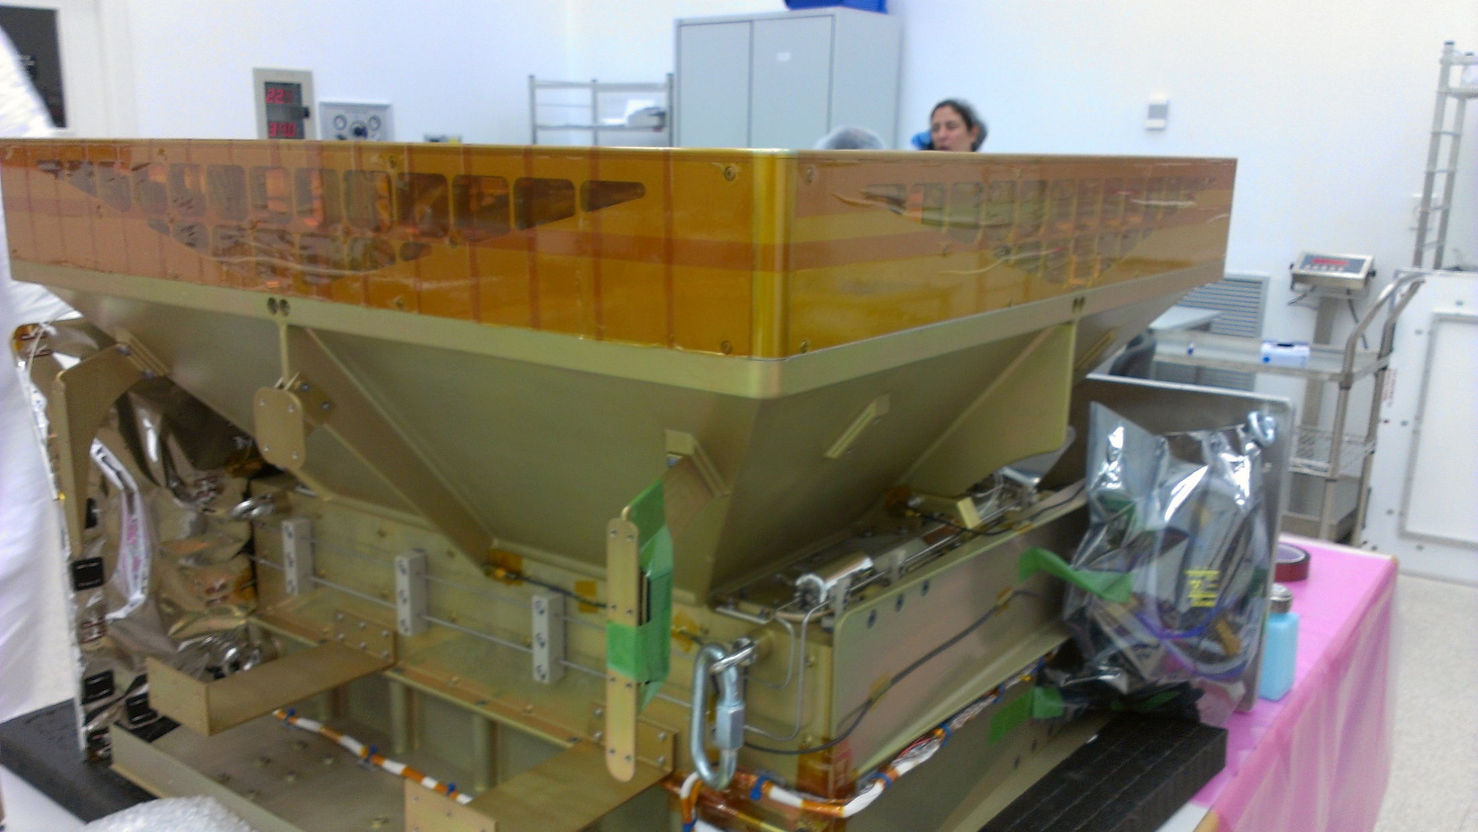
MXGS engineering model – side view at INTA test laboratory

Slide 16
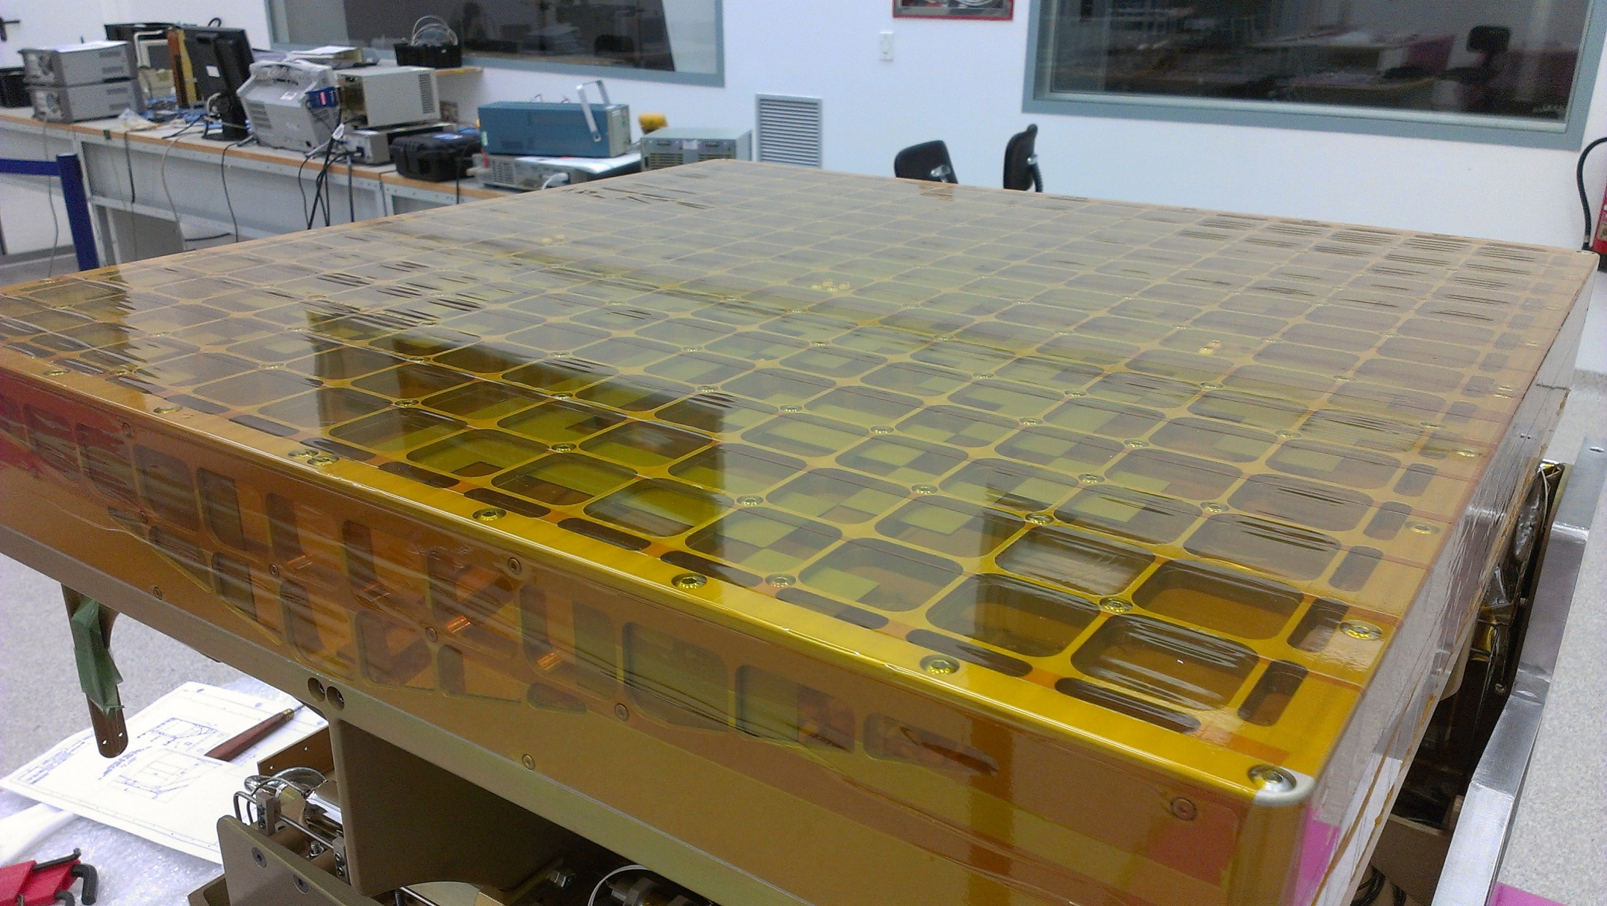
MXGS engineering model – coded mask and its support structure

Slide 17
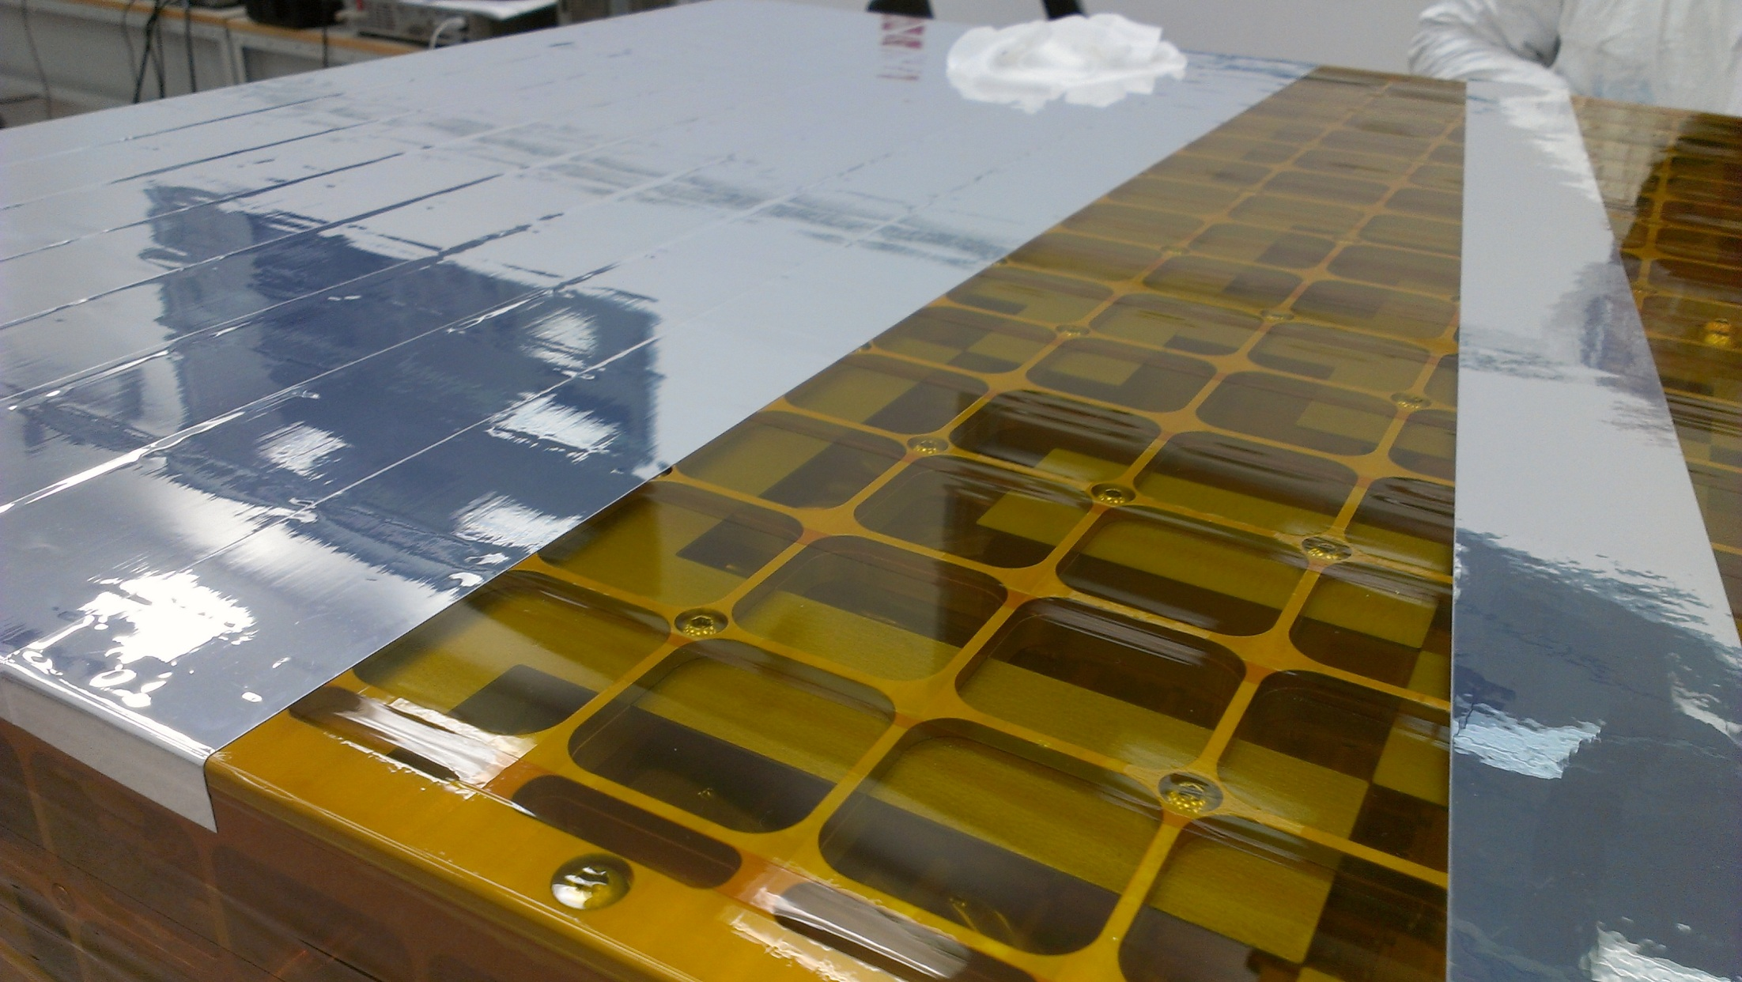
MXGS engineering model – coded mask element attachment

Slide 18
What is the origin of a TGF that the MXGS imager-spectrometer actually observes ?

Slide 19
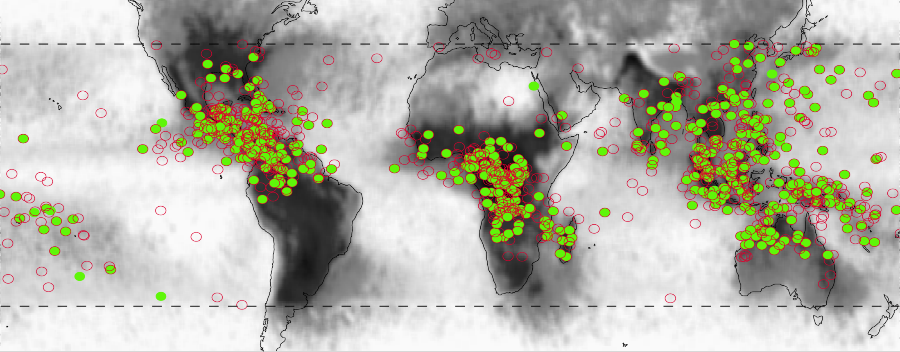
474 TGFs (+554 new) observed by RHESSI (Gjestland et.al, Univ.Bergen)
TGFs were first discovered by BATSE in the 1990s, then many more by RHESSI
Short duration gamma ray pulses < 1 millisec, energies up to 30-40, even 80 MeV
80-90% of TGF pulses found to have a simultaneous lightning flash – from WWLLN
Not clear if the WWLLN detection is due to lightning or from TGF electron movement
TGF flux 0.15 ± 0.1 ph/cm2 at 600 km with ${10}^{16}−{10}^{17} electron/photons$ at origin

Slide 20
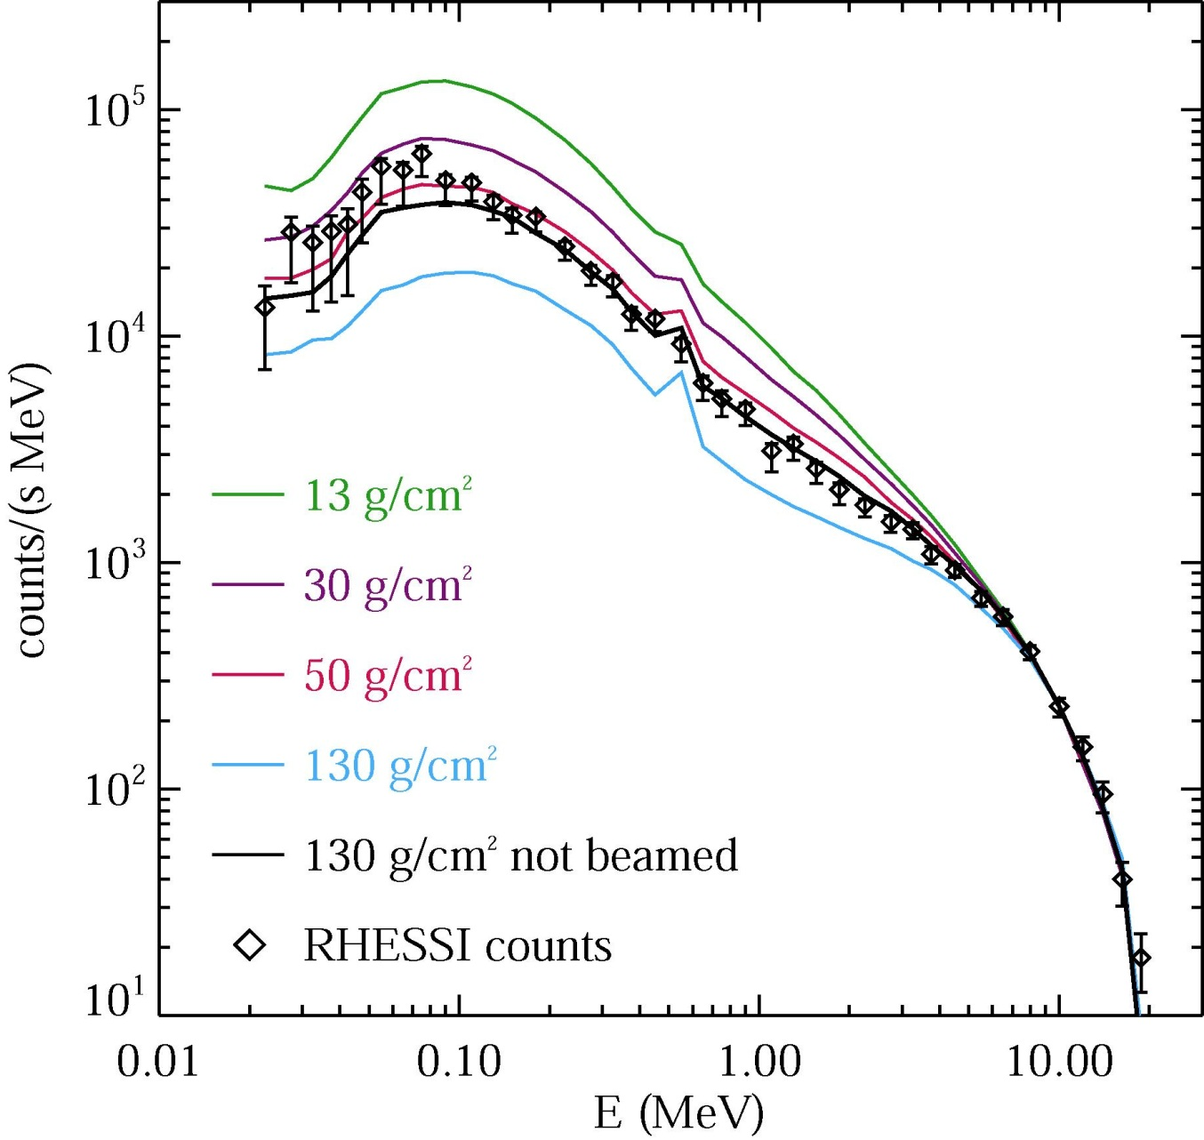
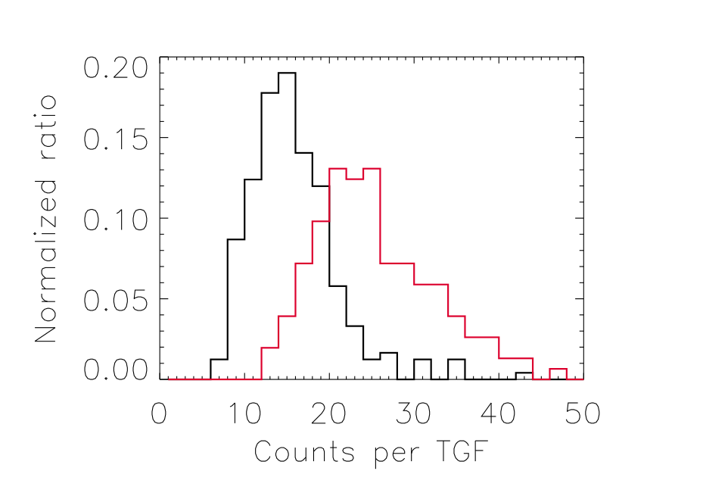
Count spectra in ~250 cm² area of RHESSI detectors
Used with TGF simulation software to estimate altitude of TGF origin at 15-19 km
TGF fluence at 600 km altitude of RHESSI estimated to be
0.15 ± 0.1 ph/cm²
TGFs have single and multiple pulses with T90 of 100-1000 μsec – mean = ~300μsec
TGF multiple pulses are important in validating model predictions

Slide 21
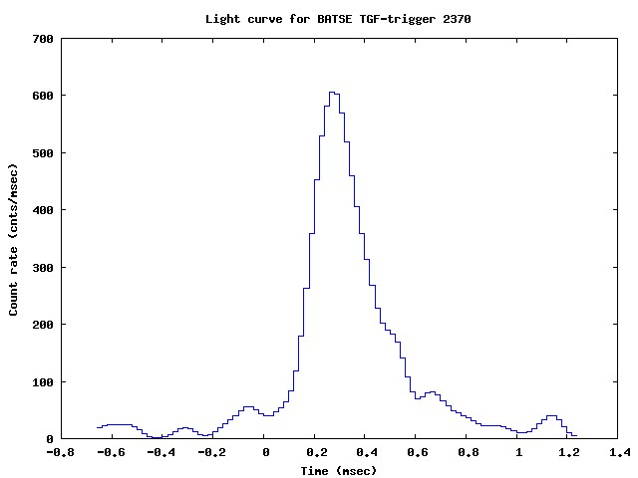
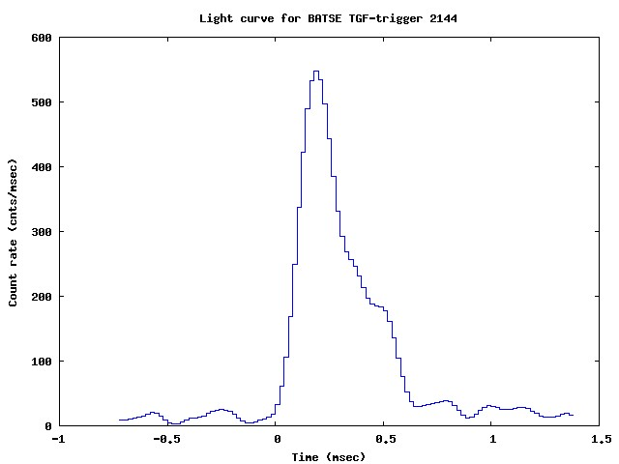
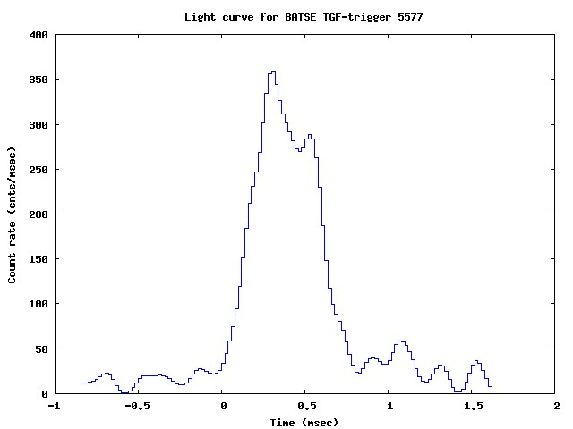
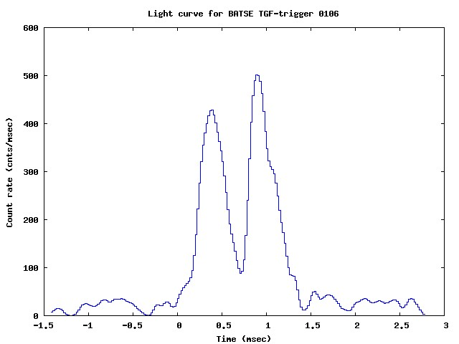

Slide 22
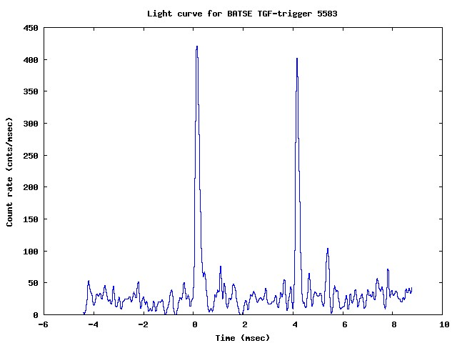
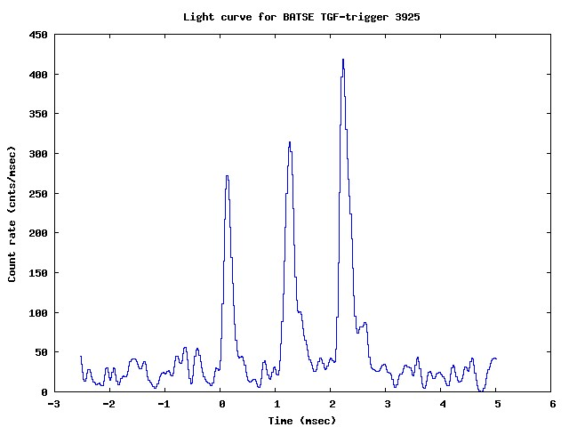
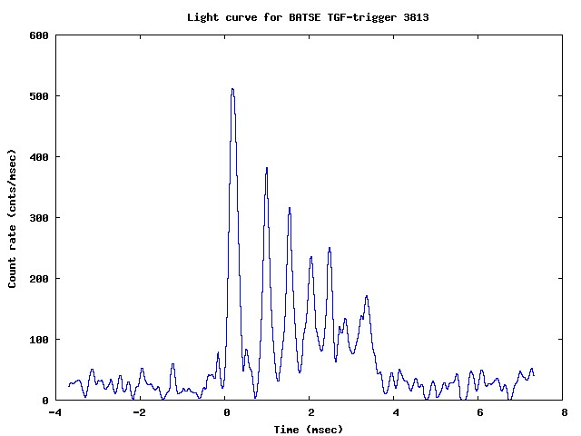
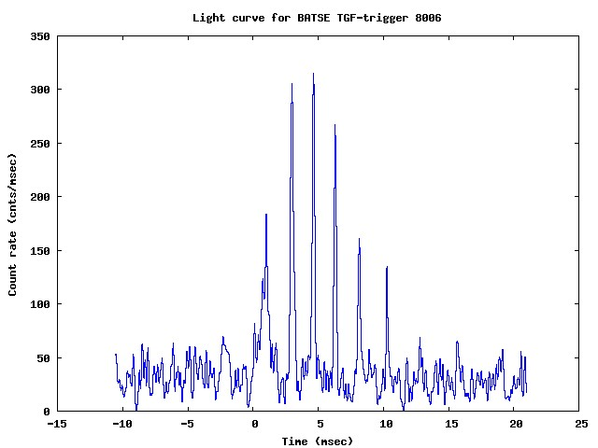

Slide 23
Some thoughts about TGFs observed by BATSE and RHESSI
TGFs have single and multiple pulses with a T90 pulse width of 100-1000 μsec
TGFs at 15 km will have about 60-70 μsec of air until they escape at ~35 km
Pulse width of relativistic escaping electrons and photons will be ~70 μsec
Pulse width of escaping photons is ~100 μsec due to additional LE spatial dispersion
Pulse width of cosmic ray electrons driving a TGF is in μsec – or nanosec ?
So where does the observed TGF pulse width range of 100-1000 μsec come from ?
Is it due to dead-time or other detector time delay problems ?
Does it mean a TGF must have its own (<msec) electron generating mechanism ?
Does it have this by Electron and Compton Scatter feedback – see TGF video below
Where are the driving electrons between multiple pulses – none or non-avalanching?
Does avalanche cutoff-discharge mechanism provide new electrons for next pulse ?

Slide 24
What are the current theories of TGF origin ?
High-energy atmospheric physics: Terrestrial gamma-ray flashes and related phenomena, J.R.Dwyer, D.M.Smith, S.A.Cummer, Space Science Review, doi: 10.1007/s11214-012-9894-0, 2012 – a good synopsis of the current status of TGFs
A lot of ideas, papers and PhDs on Electron Avalanche theories over the last decade
Nothing quite fits – charge moment, E-fields too weak - not enough seed electrons….
Two Runaway Relativistic Electron Avalanche (RREA) theories seem to have survived
Macro model - Thundercloud RREA with gamma/positron feedback – J.Dwyer .et.al
Micro model - Cold RREA around the tips of lightning leader streamers – Pasko .et.al

Slide 25
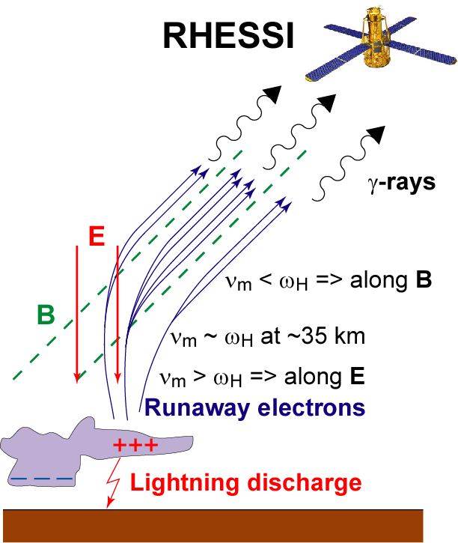
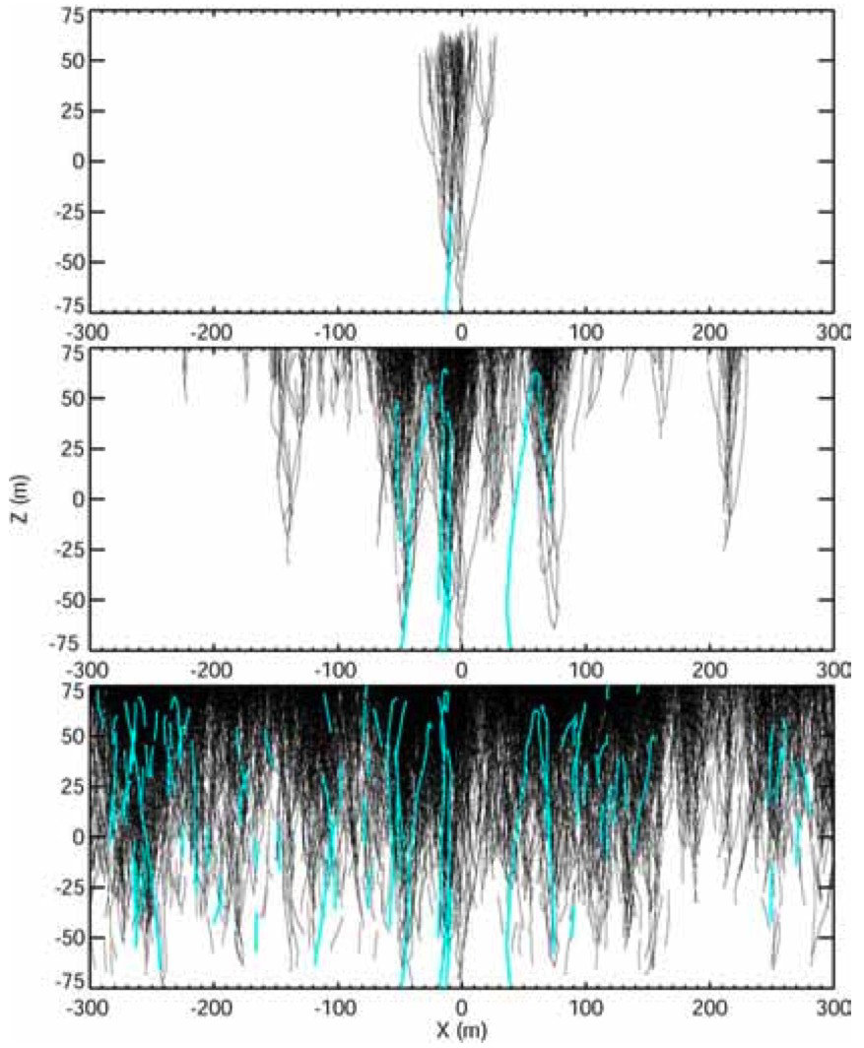
Overview of Runaway Relativistic Electron Avalanche (RREA) feedback model
J.R.Dwyer, et.al. - Florida Institute of Technology, 2007
Explains BATSE data - but how do they stop - and why do they repeat ?

Slide 26
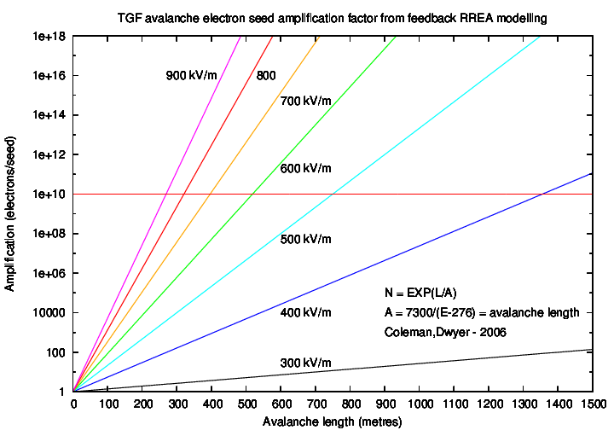
RREA electron seed amplification factor with length of avalanche region

Slide 27
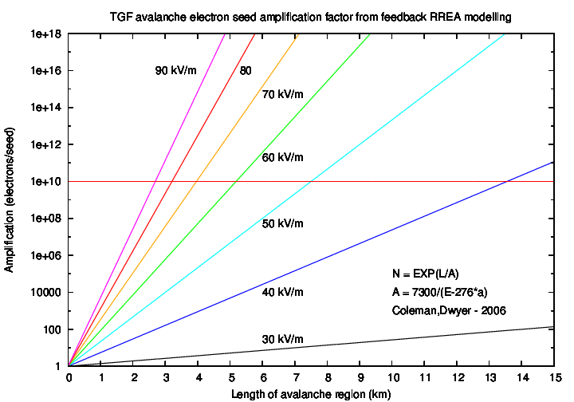
RREA electron seed amplification factor at 17 km – air density 1/10 of STP

Slide 28
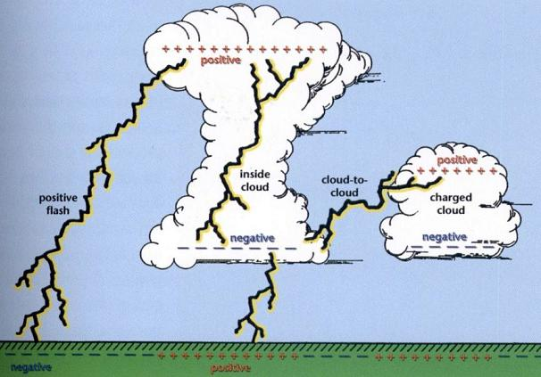
Simplified cloud charge distribution and some lightning discharge geometries
Negative induced shielding charge above cloud top is a plausible TGF driver

Slide 29
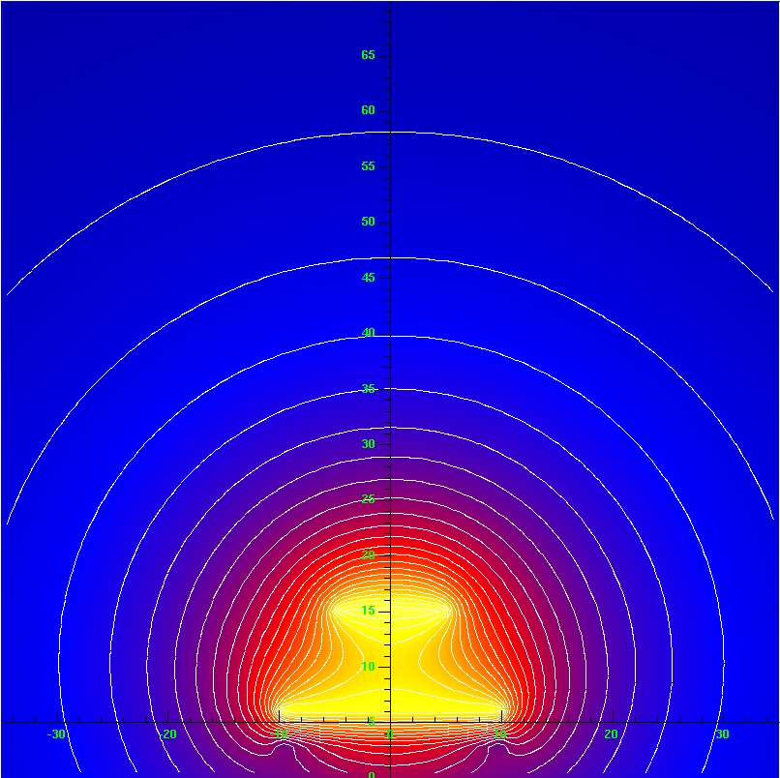
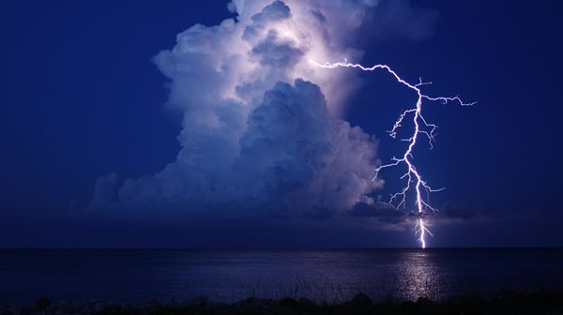
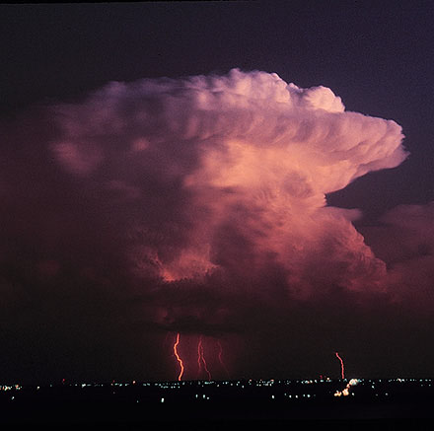
Schematic cloud voltage contours for a negative induced shielding charge above a cloud top where the internal positive charge has been neutralized

Slide 30
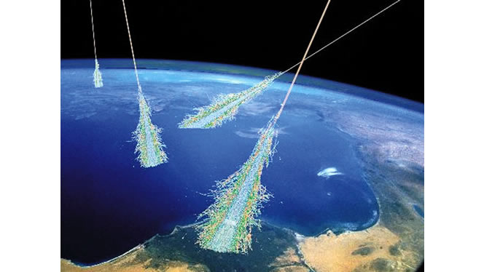
Cosmic ray showers – need electron flux field database for all angles of entry

Slide 31
Cosmic ray shower particles from CORSIKA simulation software - 100 TeV proton
J. Oehlschläger, R. Engel, Institut für Kernphysik, Forschungszentrum Karlsruhe

Slide 32
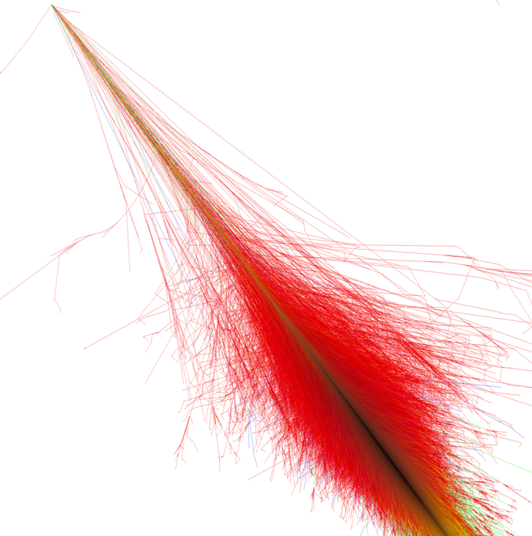
Relationship of cloud charge potential to cosmic ray shower electrons, photons

Slide 33
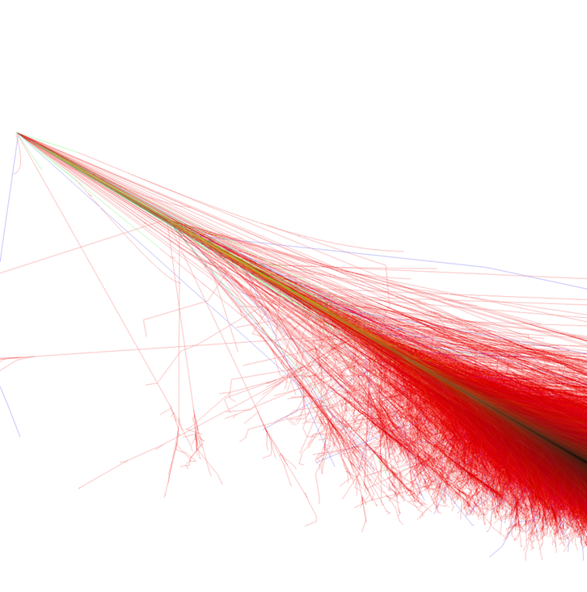
Relationship of cloud charge potential to cosmic ray shower electrons, photons

Slide 34
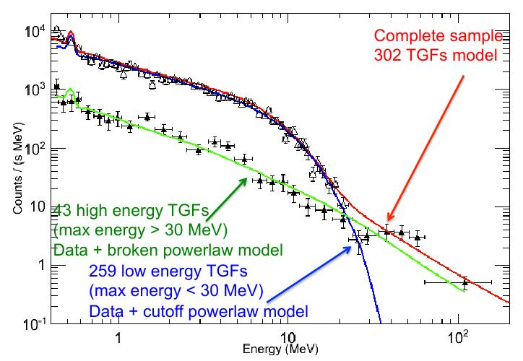
The AGILE problem : No HE absorption => low density => high altitude origin ?
Are electrons seeded at high altitude or do they drift upwards to some E-field ?

Slide 35
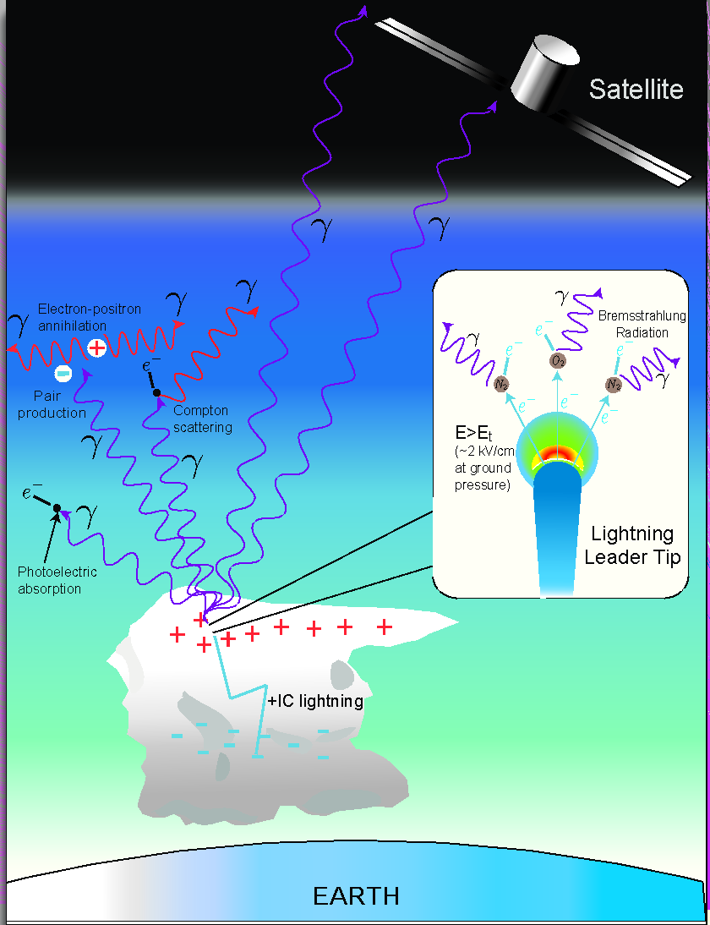
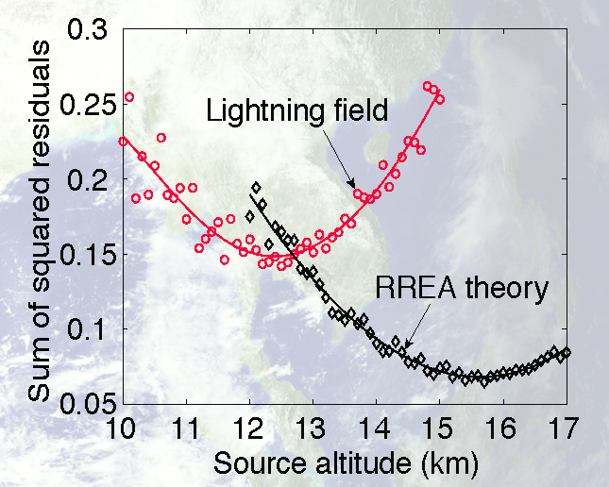
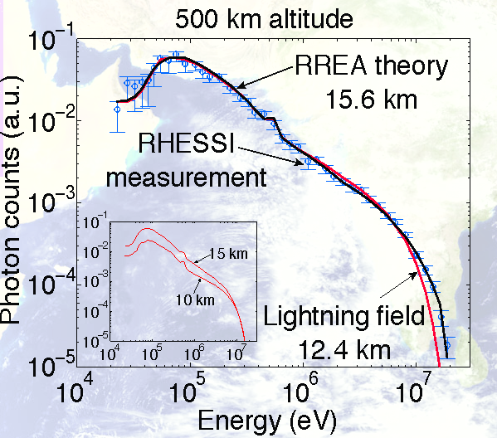
The streamer origin of TGF gamma rays. Does not explain multiple ~msec pulsing.
Wei Xu, S.Celestin, V.P.Pasko, Penn State,2011

Slide 36
What does a TGF actually look like ? First order simulations of TGF photon expansion to orbital altitudes

Slide 37
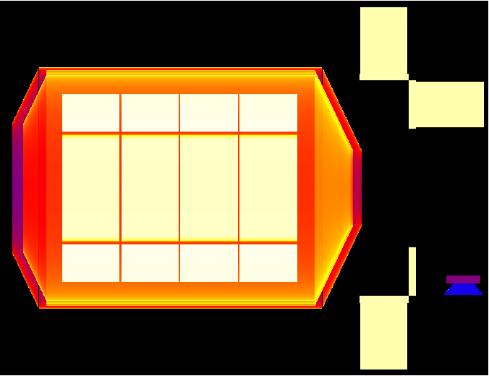
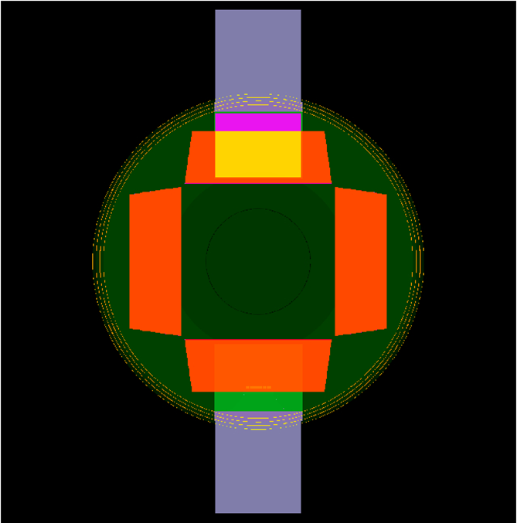
The size and location of MXGS relative to components of Columbus module
Simulate essential structures on Columbus for gamma photon scattering
Necessary to determine the backscatter from incoming MeV TGF photons
Images show photon path lengths through an optimal ~25 volume model

Slide 38
How do we simulate a TGF as seen at orbital altitudes ?
TGF photons must originate in electron bremsstrahlung
Bremsstrahlung photons have a $\frac{α}{E}e^{−E/Ecut}$ type spectrum
Light curve pulse width with $T_{90}$~ 1.0 millisecond - RHESSI
Scattering from deep in the stratosphere – 15-20 km - RHESSI
Radiated vertically within a 20° RMSQ gaussian-like cone
Energy loss by Compton-Photoelectric scattering (Sazanov, et.al)
With these assumptions a vertical cone model was simulated
What results does it produce ? – gigabytes of scatter trees

Slide 39
Photon tracking data for beam angles of 0,15,30,45,60° results in a photon density video showing two components - HE beamed and LE spherical source

Slide 40
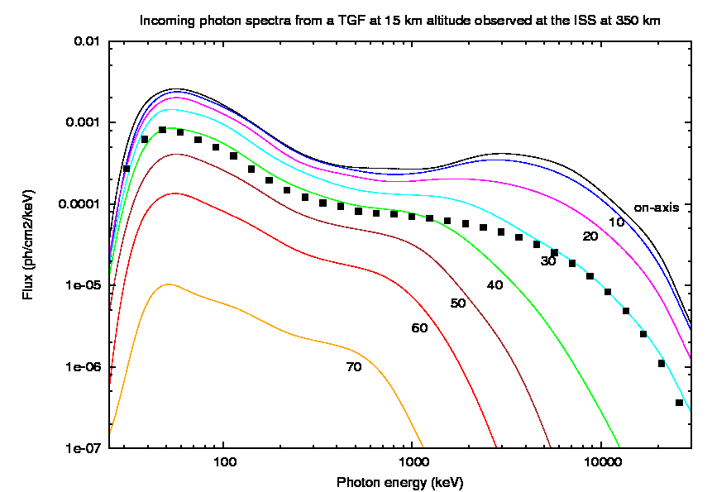
TGF spectral form as a function of zenith observation angle

Slide 41
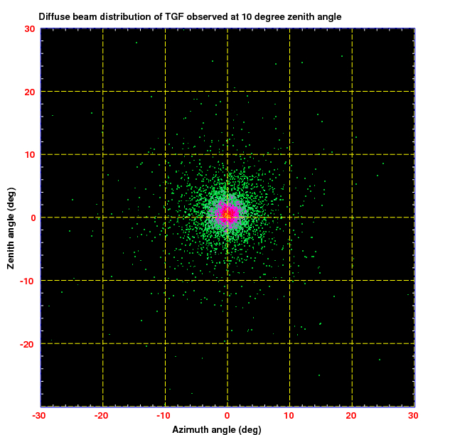
TGF diffuse beam structure for incoming 20-200 keV photons.
MeV diffuse beam structure is almost point-like.

Slide 42
Spectra of PDFs (dF/dθ) for TGF diffuse beam profiles

Slide 43
Angular displacement of TGF centre point from its true location

Slide 44
How does the MXGS imager-spectrometer observe this kind of TGF photon expansion

Slide 45
Detector response for off-axis source
Detector response for on-axis source
Detector imaging array has 128x128 pixels of 2.5x2.5x5.0 mm CZT
Detector imaging array has 8x8 modules of 16x16 pixels – observing 0.4-0.8 ph/cm2
In reality perhaps only 2,3,4 photons per 16x16 detector module - for imaging

Slide 46
MXGS detector count and backscatter spectrum for a TGF at 30°

Slide 47
TGF location by mask-detector pattern correlation imaging

Slide 48
MXGS location plots for parallel beam TGFs – point sources
Zenith angle of incoming TGF beams cover a range of 0-40°

Slide 49
MXGS location plots for diffuse beam TGFs
Zenith angle of incoming TGF beams cover a range of 0-40°

Slide 50
TGFs are weak at orbital altitudes – large detector area required

Slide 51
What is happening at TGF origin ? Electron acceleration Electron orbital excitation and ionization Electron bremsstrahlung scattering New simulation software package required

Slide 52
Video shows a TGF origin at 15 km and its expansion in the stratosphere
What is the spectrum of the optical pulse – compared to lightning ?
Where is the electron-positron beam in the local magnetic field?
What is the ionization density and electron re-attachment rate ?
Note the “Compton Feedback” over a length of 5 km down to 10 km altitude

Slide 53
Components of electron energy loss with distance – the starting point of TGF simulation
This curve determines if an electron will slow down or be accelerated to higher energies

Slide 54
Electron trajectories are formed by the local electric field and earth magnetic field

Slide 55
If the electric field is weak - or short range - the earth magnetic field will dominate

Slide 56
LLL-EEDL physics of RREA - the 4 components of ionization & bremsstrahlung.
For every Bremsstrahlung event there are more than 10000 ionization events !

Slide 57
LLL-EEDL physics of RREA – energy loss from ionization, excitation and bremsstrahung

Slide 58
Compton photon
Compton electron
Bremsstrahlung emitted photons
Bremsstrahlung scattered electron
Hard Moller ionized electron
Moller scattered electron
Free electron in electric field
The trailing “ionization haze” of ~20 eV electrons emitted perpendicular to track.
What are the dynamics of radio, excitation and re-attachment photon emission?

Slide 59
Final thoughts
TGFs are better thought of as a side effect of Terrestrial Ionization Flashes – TIFs or GRIFs
We are developing a new software package for electron acceleration scattering in EM fields
Research should concentrate on Ionization and Gamma production in clouds – not just TGFs
We need to estimate the optical and radio signal of the vast electron ionization trails left behind
Is the TIF optical signal detectable from a balloon or aircraft at 15-20 km altitude?
We need a database of Cosmic Ray shower particle flux vectors for TGF feasibility simulations
Which is the best software to use - CORSIKA, AIRES,….. – or is a database already available ?
Seven orbiting m² CSI scintillators in 100 km hexagonal pattern for TGF location and beaming ?

