Slide 1
Space available for CGEM installation
Mingyi Dong
dongmy@ihep.ac.cn
2013.04.17

Slide 2
Outline
BESIII MDC
The mechanical structure of inner MDC and space available for CGEM
Summary

Slide 3
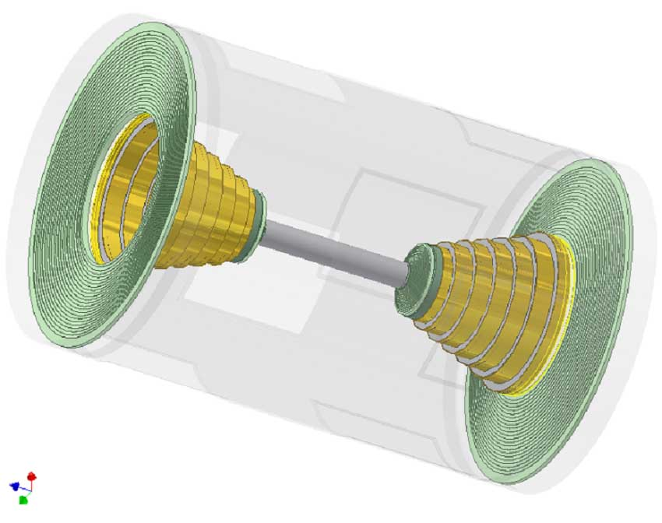
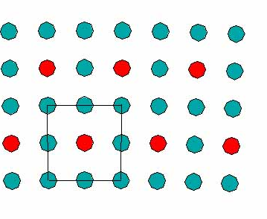
BESIII MDC
Cell size
inner chamber : 12mm²
outer chamber : 16.2mm²
Consist of an inner chamber and an outer chamber
Radial extent : from 59 to 810 mm,
length : inner 774mm, outer 2582 mm,
solid angle coverage : 93%×4π
Inner cylinder : 1.2 mm carbon fiber,
outer cylinder : 11.5 mm CF with 8 windows,
end plate : 18 mm thick Al ( 6 steps & inner chamber: 25 mm thick Al)

Slide 4
MDC Cell arrangement
Layer | Number of cells per layer | type | solid angle(degree)
1 － 4 | 40/44/48/56 | stereo (-) | 2.9 ~ 3.3
5 － 8 | 64/72/80/80 | stereo (+) | 3.4 ~ 3.9
9 － 20 | 76/88/100/112/128/140 | axial | —
21 － 24 | 160 | stereo(-) | 2.4 ~ 2.7
25 － 28 | 176 | stereo(+) | 2.7 ~ 3.1
29 － 32 | 208 | stereo(-) | 3.0 ~ 3.3
33 － 36 | 240 | stereo(+) | 3.3 ~ 3.6
37 － 40 | 256 | axial | —
41 － 43 | 288 | axial | —
6796 cells in 43 circular layers
19 axial layers, 24 stereo layers
8 stereo wire layers in inner drift chamber

Slide 5
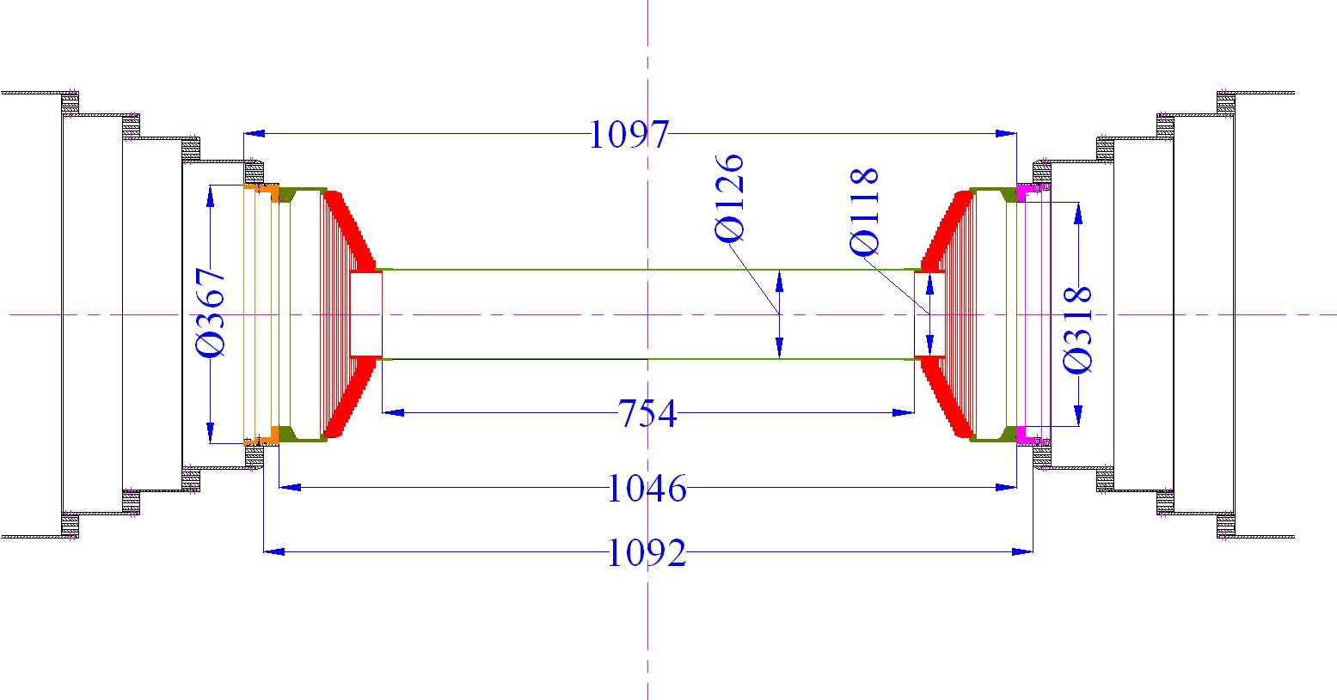
Current BESIII inner drift chamber
with inner MDC
Inner endplate
Dimension of inner MDC:
Rmin: 63mm;
Rmax: 183.5mm;
Lmin: 754mm
Lmax:1046mm
Without inner MDC

Slide 6
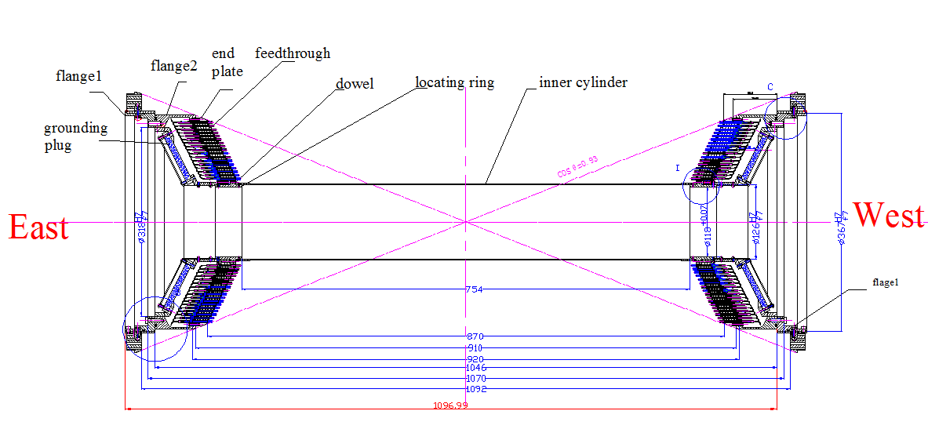
Mechanical structrue of inner MDC
Inner drift chamber is fixed on the first step ring of MDC through two flanges

Slide 7
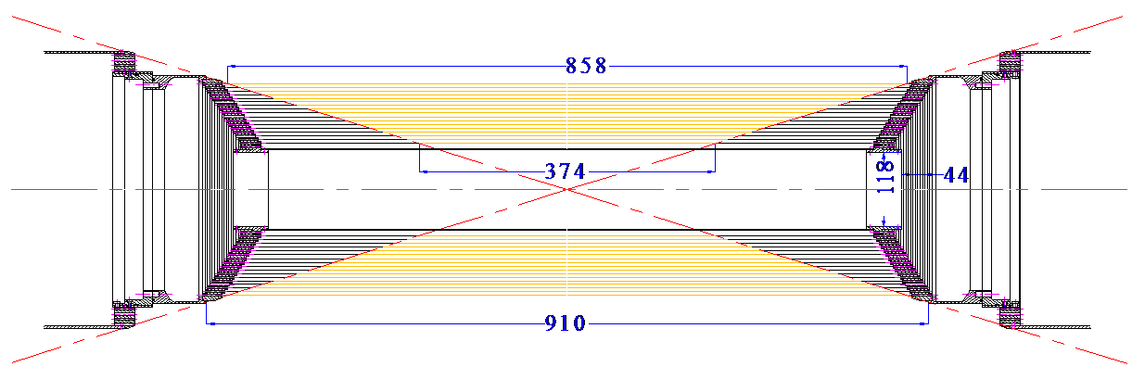
Space available for CGEM
parts of the sense wires in this region are ineffective
Parts of inner sense wires in z direction are out of the effective solid angle (cosθ = 0.93)
Also available space when we consider CGEM installation

Slide 8
Ineffective wire length of inner MDC
Layer No. | Wire length(mm) | Ineffective | Proportion of ineffective (%)
L1 | 780 | 381 | 48.8
L2 | 792 | 333 | 42.0
L3 | 804 | 283 | 35.2
L4 | 816 | 233 | 28.6
L5 | 828 | 184 | 22.2
L6 | 840 | 138 | 16.4
L7 | 852 | 92 | 10.8
L8 | 864 | 46 | 5.3
In CGEM design, If the length of CGEM matches the MDC effective solid angle (cosθ = 0.93), the total count rate will be reduced, and available space for readout electronics will be increased
The length of each layer of CGEM is different

Slide 9
Suppose 3 layers CGEM
Component | L1(Rin/Rout) | L2(Rin/Rout) | L3(Rin/Rout) | Material
Cathode | 78.0/81.0 | 120.5/123.5 | 163.0/166.0 | 3 mm Honeycomb
Conversion + drift | 81.0/84.0 | 123.5/126.5 | 166.0/169.0 | 3 mm gas
Transfer 1 | 84.0/86.0 | 126.5/128.5 | 169.0/171.0 | 2 mm gas
Transfer 2 | 86.0/88.0 | 128.5/130.5 | 171.0/173.0 | 2 mm gas
Induction | 88.0/90.0 | 130.5/132.5 | 173.0/175.0 | 2 mm gas
Readout | 90.0 | 132.5 | 175.0
Outer shield | 90.0/93.0 | 132.5/135.5 | 175.0/178.0 | 3 mm Honeycomb
L1 length: 532mm , L2 length: 690mm
L3 length: 847mm

Slide 10
Space available in z direction
3 layers CGEM
The gap is about 80mm~100mm between the end plate of MDC inner chamber and the mechanical support of beam pipe
105mm~235mm in z direction is available for the support structure, readout electronics, cables of CGEM on each side

Slide 11
Summary
Space available for CGEM in r direction is about 63mm~183.5mm
If the length of CGEM matches the MDC effective solid angle (cosθ = 0.93), space available for CGEM in z direction is about 105mm~235mm on each side
Thank you !

