Slide 1
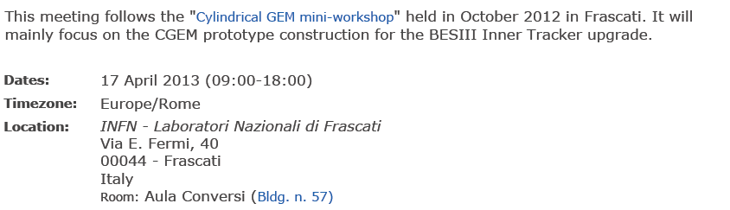
CYLINDRICAL GEM I.T. FOR BESIII meeting

Slide 2
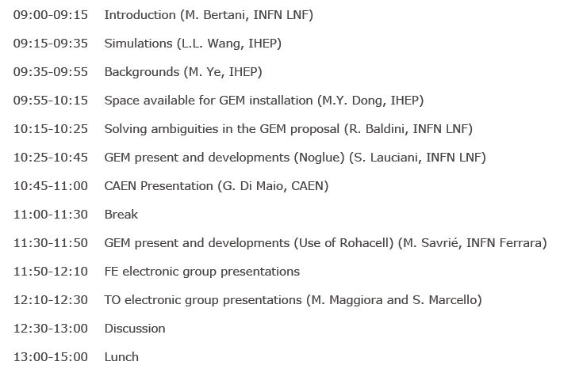
Meeting Agenda (morning)

Slide 3
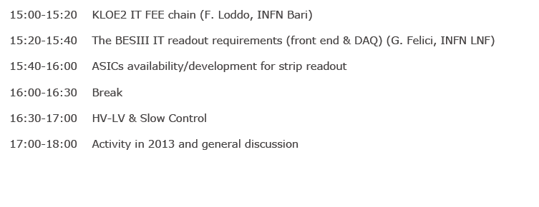
Meeting Agenda (afternoon)
Start writing the Letter of Intent after the Bari meeting
Planning of the Letter of Intent for the June Collab. meeting

Slide 4
Italian groups
We are pleased to welcome new collaborators for INFN sites, who are going to apply for BESIII membership at next June collaboration meeting:
a new INFN group of six physicists from Ferrara University/INFN
two more physicists from LNF
two more physicists from Turin University/INFN

Slide 5
The project of an IT for BESIII needs formal approval from both IHEP and INFN The road is still quite long, and a complete Letter of Intent is an essential component In July 2013 we will present to INFN the original project of a 1-layer prototype, as agreed upon in September 2012 with BESIII, and approved by both INFN and MAE We hope that the next 12 months will put us into a stronger position to proceed to the final objective of a complete proposal to BESIII
IHEP-INFN involvement

Slide 6
Thank you !

