Slide 1
GEM Digital (KLOE) and Analog (COMPASS) readout
&
BesIII readout requirements (DAQ & FEE)

Slide 2
Outline
GEMs - main parameters
  Gain
  Discharges
  Cluster multiplicity
GEM Digital Readout (KLOE IT)
  readout electrodes
  layer instrumentation
  HV sectors
  HV distribution network
  readout plane details
  FEE integration
  HV & FEE chain
  readout chain
GEM Analog Readout (COMPASS)
  readout electrodes
  chambers
  position accuracy
  efficiency vs track multiplicity
  time measurements accuracy
  APV 25 front-end
GEM operation in magnetic fields
  charge broadening (simulation)
  Test beam setup
  resolution
  efficiency
  cluster size
BES IT DAQ & FEE requirements
  DAQ requirements
  2D readout
  C_{STRIPS} effect on SNR
Conclusions

Slide 3
GEMs

Slide 4
GEM: Triple GEM

Slide 5
GEM: gain and discharge probability
Leszek Ropelewski CERN PH-DT2-ST & TOTEM
TOTEM GEM detectors for tracking and triggering

Slide 6
GEM: strips signal
TOTEM GEM detectors for tracking and triggering
Leszek Ropelewski CERN PH-DT2-ST & TOTEM

Slide 7
GEM: strips induced signal
TOTEM GEM detectors for tracking and triggering
Leszek Ropelewski CERN PH-DT2-ST & TOTEM

Slide 8
Digital Readout - KLOE IT

Slide 9
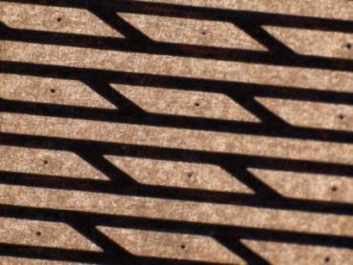
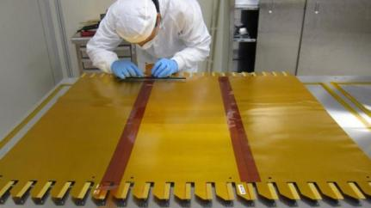
KLOE2 IT - readout electrodes
4 independent tracking layer
XV readout strips
  25-30° stereo angle (depending on the layer)
  X strips (r-φ coordinate): 650 μm pitch - 250 μm width - 694 mm length → C ≈ 100 pF
  V strips (z coordinate): 650 μm pitch (V-pads connected through vias) - length range: 1÷773 mm → C ≈ 1-200 pF
  Overall resolution: σ_{rφ}= 200 μm - σ_{z}= 500 μm
≈ 30k readout channels
Strip signals readout through a 120-pin connectors (each connector collects 40 X strips and 80 V strips)
XV strips on the same plane
X pitch 650µm
→ ResX 190µm
1k strips
1M pads
~1mm
dead zones
V pitch 650µm
→ ResY 350µm
3 foils spliced without overlap: kapton strips are glued on the back of head-to-head joints

Slide 10
KLOE2 IT - layer instrumentation

Slide 11
KLOE2 IT - X strips and HV sectors

Slide 12
KLOE2 IT - V strips and HV sectors

Slide 13
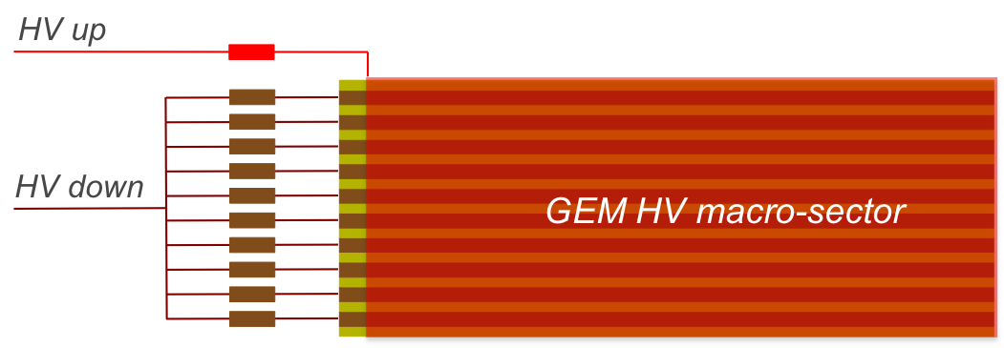
KLOE2 IT - HV Distribution Network

Slide 14
KLOE2 IT – Readout Plane (Detail)

Slide 15
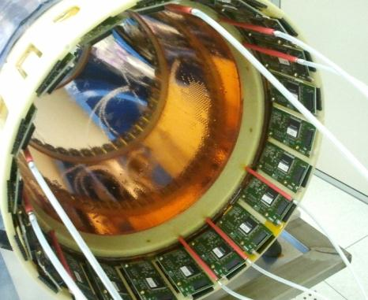
KLOE2 IT - FEE Integration
Readout (XV) plane connectors
HV macro-sector connector
Readout boards
HV distribution must be carefully designed
GND
HV max ≈ 5 kV !!

Slide 16
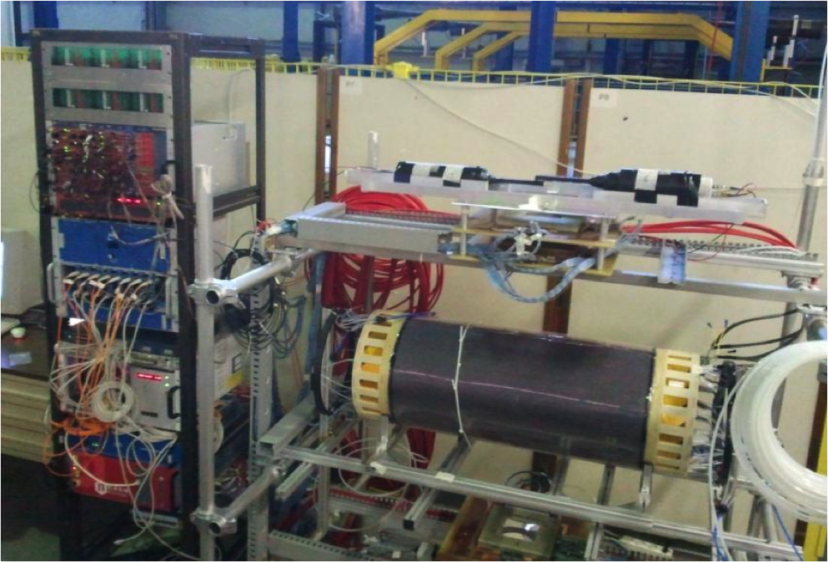
KLOE2 IT - HV & FEE chain (I)
Custom HV distributors
HV & signals cables
Signals cables collected by means of special boards on the back side of a custom crate
Concentrator (hidden by fibers)
HV & FEE boards
A. Aloisio et al., “An FPGA Based General Purpose DAQ Module for the KLOE-2 Experiment” Journal of Physics: Conference Series 331 (2011) 022033

Slide 17
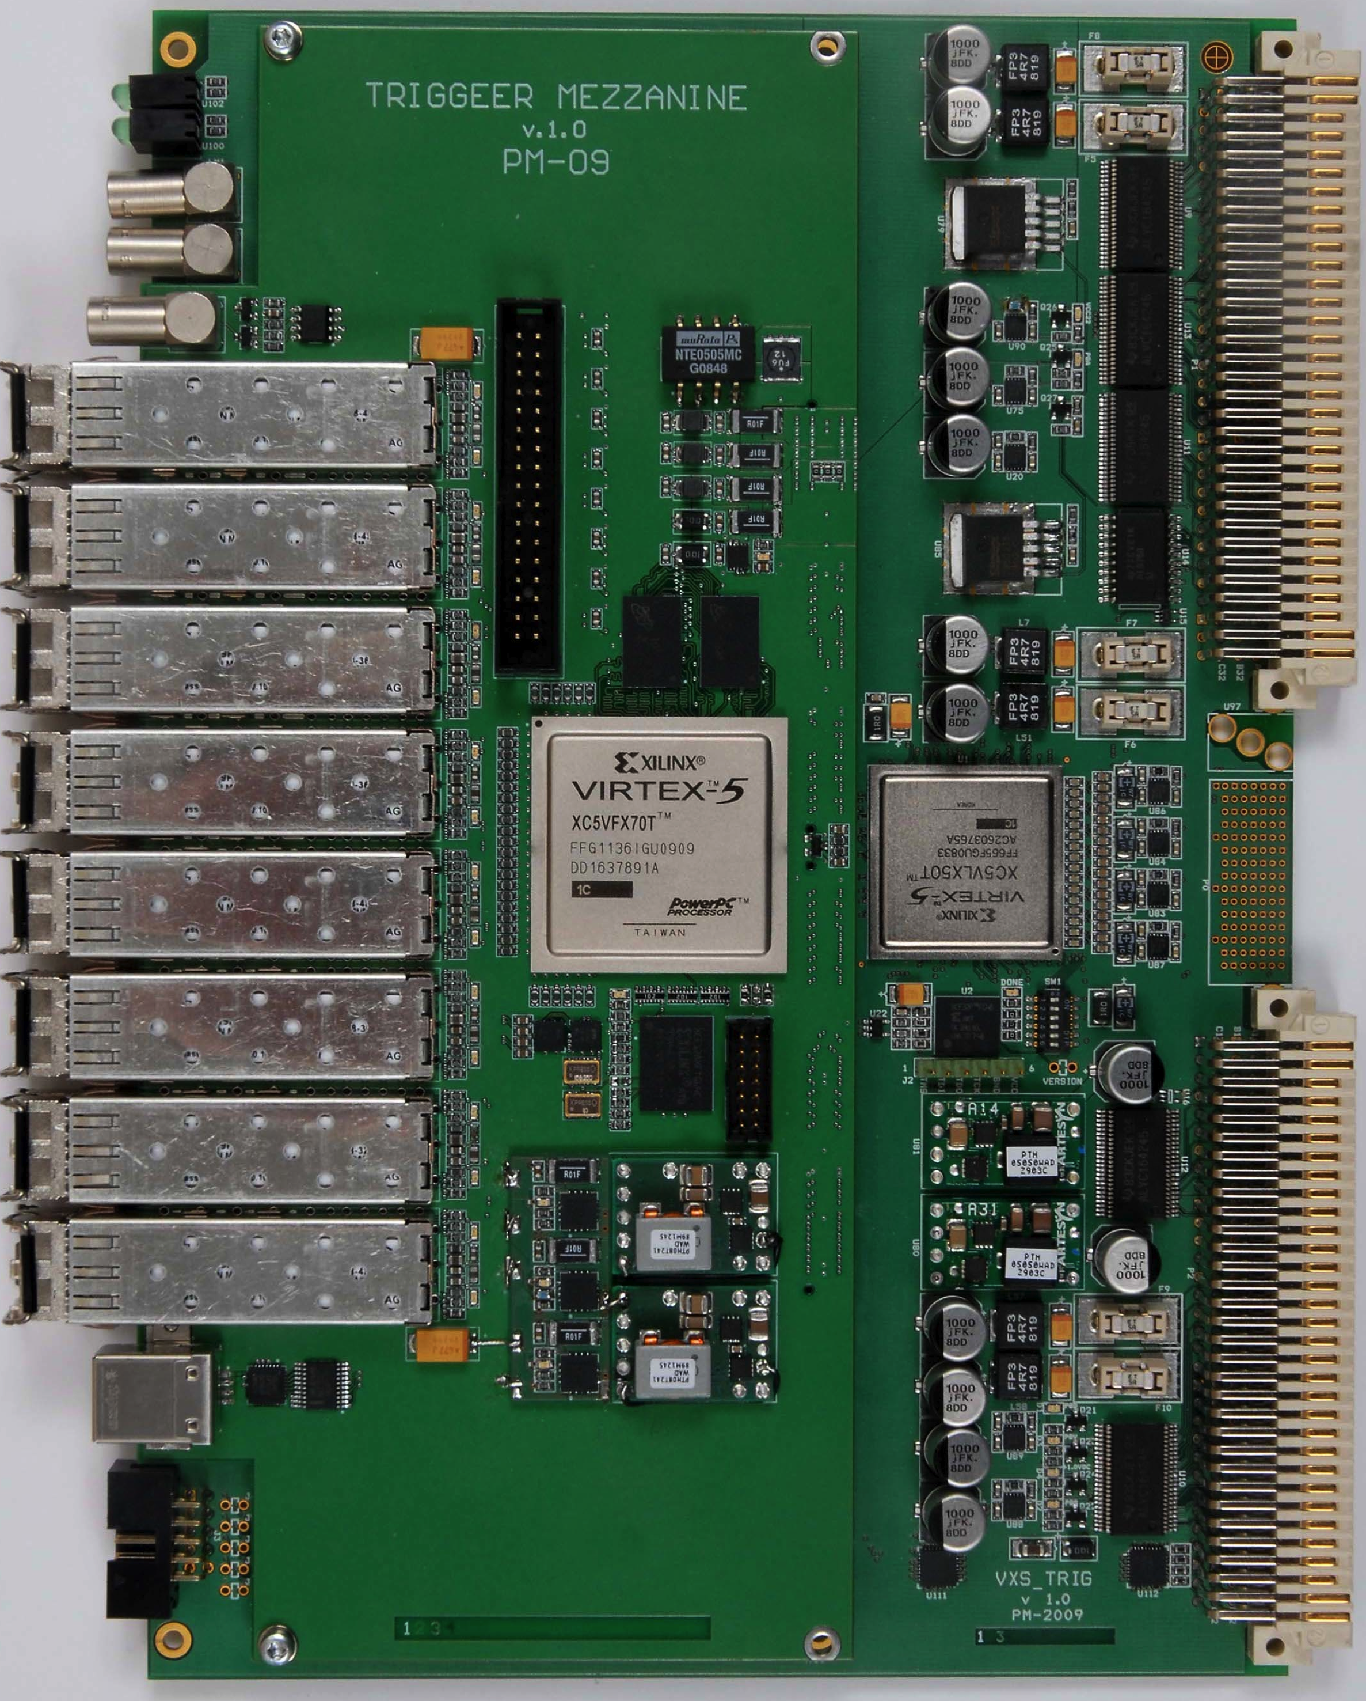
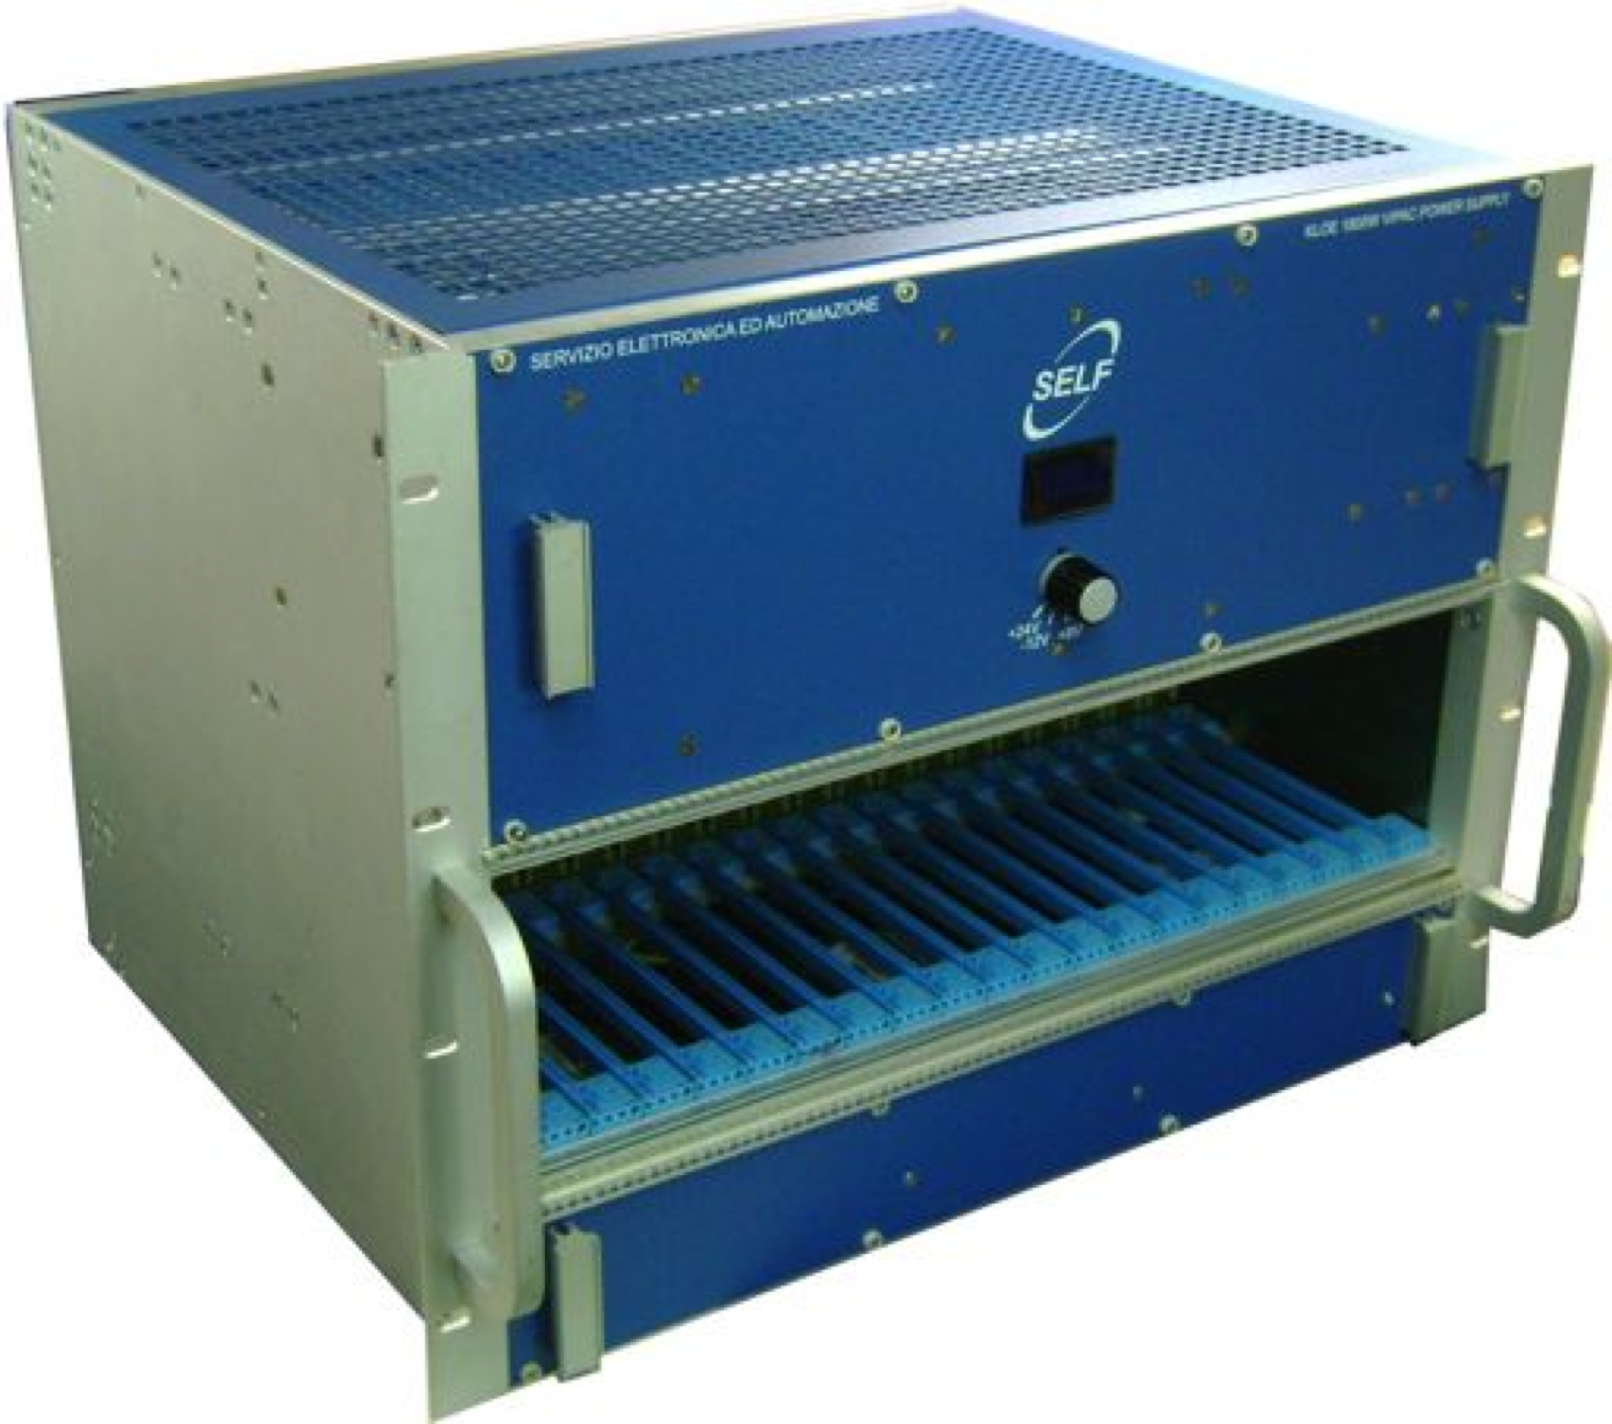
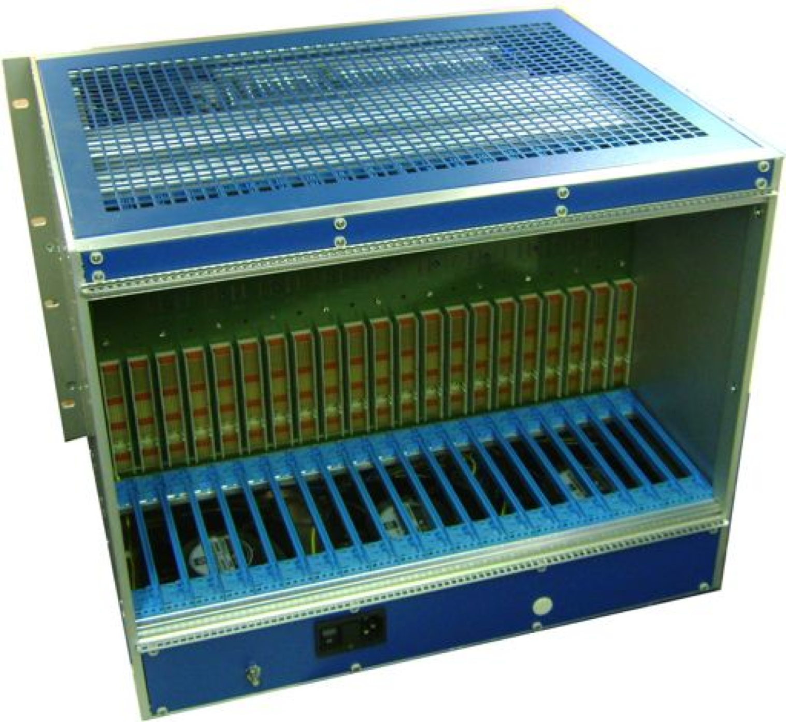
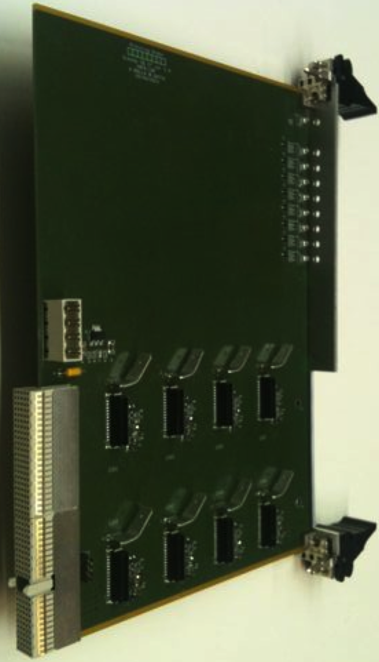
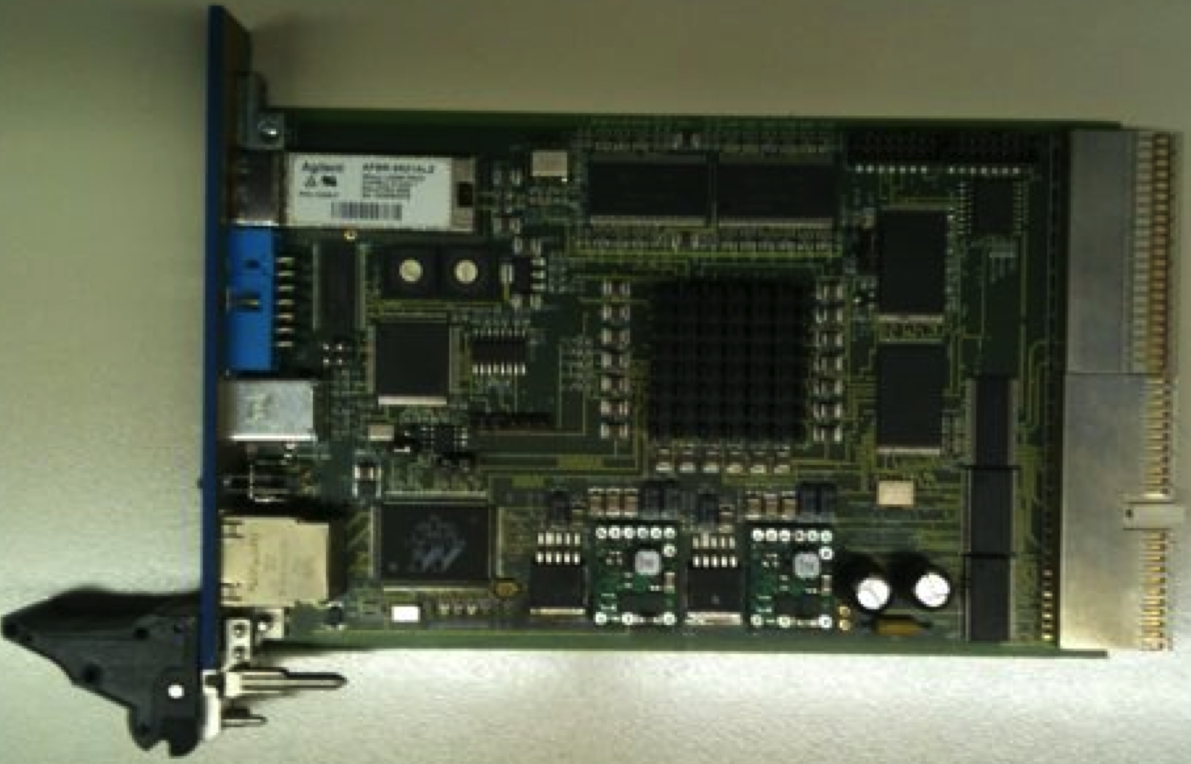
KLOE2 IT - FEE chain
Concentrator Board
manages 16 GIB boards
Event building
128
channels
Uppsala Institute
(Pawel Marciniewski)
5 mt Twisted pairs
Optical Links
D
A
Q
BARI
A. Balla et al., “GASTONE: A new ASIC for the cylindrical GEM inner tracker of KLOE experiment at DAFNE”, ,Nucl. Inst. & Meth. A, vol. 604, no. 23, 2009
GIB Board
(manages up to 8 Gastone Boards)
Data download
Lev1 distriution
Gastone boards parameters setting
1024 channels
TB – GIB interface
GIB crate
(back view)
LNF
GIB crate
(front view)
Transition Board
(collects cables from 8 Gastone boards)

Slide 18
Analog Readout - COMPASS

Slide 19
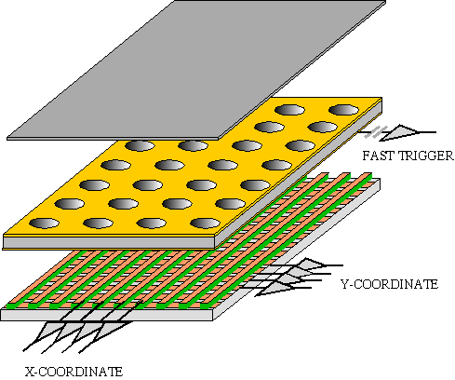
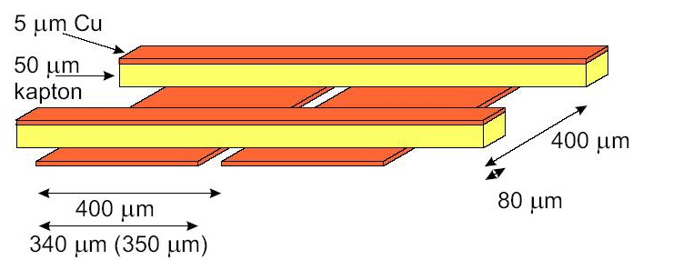

COMPASS: readout electrodes
50 µm kapton
Due to diffusion the charge cloud collected on the readout board is bigger than the strip width (≈ 3.5 x pitch) and a weighting method is used for calculate the exact track position in two dimensions
Every single strip versus the other readout coordinate acts as a plate capacitor. With the permittivity ε=3.9 of Kapton and an area of 2.27⋅10⁻¹cm², this capacitance is 15.7 pF

Slide 20
COMPASS: chambers

Slide 21
COMPASS: position accuracy

Slide 22
COMPASS: time measurement accuracy

Slide 23
COMPASS: efficiency

Slide 24
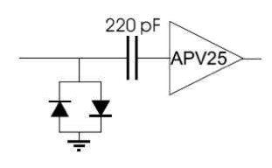
COMPASS: front end (I)
Running Experience with the COMPASS Triple GEM Detectors – Bernard Ketzer
Anode and cathode connected to GND
NO DC into preamplifier
Charging up of strips avoided by diode leakage currents

Slide 25
COMPASS: front end (II)

Slide 26
GEM operation in magnetic field

Slide 27
Magnetic field: charge broadening (sim.)
Design and Construction of a cylindrical GEM detector as the Inner Tracker device of the KLOE-2 experiment - Gianfranco Morello on behalf of Frascati, Bari and Cosenza groups

Slide 28
Magnetic field: test beam setup
Design and Construction of a cylindrical GEM detector as the Inner Tracker device of the KLOE-2 experiment - Gianfranco Morello on behalf of Frascati, Bari and Cosenza groups

Slide 29
Magnetic field (X-V angle = 40°): resolution
Design and Construction of a cylindrical GEM detector as the Inner Tracker device of the KLOE-2 experiment - Gianfranco Morello on behalf of Frascati, Bari and Cosenza groups
1T

Slide 30
Magnetic field (X-V angle = 40°): efficiency
Design and Construction of a cylindrical GEM detector as the Inner Tracker device of the KLOE-2 experiment - Gianfranco Morello on behalf of Frascati, Bari and Cosenza groups
Gain = 6x10⁴

Slide 31
Magnetic field (X-V angle = 40°): cluster size
Design and Construction of a cylindrical GEM detector as the Inner Tracker device of the KLOE-2 experiment - Gianfranco Morello on behalf of Frascati, Bari and Cosenza groups
threshold = 3.5 fC

Slide 32
BES IT
DAQ & FEE requirements

Slide 33
BES IT: DAQ requirements
1) Level-1 trigger rate (average): 1 a 2 kHz
2) Dead time: 4 μs
3) Latency: 8 μs +/- 0.5 μs
4) Event size: 12 kB (including ZDD)
5) System (distributed clock) ≈ 42 MHz (3 bunch crossings - 3x8ns)
  Counters to check events alignment ? Timestamp ?
6) Offline t₀ reconstruction

Slide 34
BESIII IT: 2D readout
Main requirements:
  Minimize electrode capacitance to reduce series noise contribution
    Small width strips
    Special strips design to reduce X-V C_{COUPLING}
    GND plane far from the anode
  Minimize XV views crosstalk
    Special strip design to reduce X-V coupling
    GND plane near to the anode
STRIPS | COMPASS |  | KLOE IT |  | BES IT (I) |  | BES IT (X view)
Width | 350μ | 80μ | 250μ |  | 350μ | 80μ | 350μ | 80μ
Pitch | 400μ |  | 650μ |  | 650μ |  | 650μ
Capacitance | ≈ 17 pF |  | X ≈ 100 pF | V ≈ 1 ÷ 200 pF | ≈ 41 pF |  | X_{SS} ≈ 41 pF | X_{SG}≈ 41 pF
Ground distance | ≈ 3 mm (?) |  | ≈ 200μ |  | ≈ 3 mm |  | ≈ 200μ

Slide 35
BESIII IT: C_{STRIPS} effect on SNR (I)
Q_{STRIP} ≈ 6 fC (average, NO gas gain fluctuations)
  Ar/CO2 (70/30)
  G = 8000
  Factor 1/2 because the two view
  Factor 1/3 because the strip multiplicity
Example 1: COMPASS + APV25
  C_{STRIP} COMPASS ≈ 17 pF
  Z_{IN} APV25 ≈ 900 Ω (?!)
  APV25 shaping time ≈ 50 ns
  APV25 input noise ≈ 396 e + 59.4 e/pF (deconvolution mode) → Noise ≈ 0.26 fC
rise time ≈ 33 ns
OK
SNR ≈ 23

Slide 36
BES IT: C_{STRIPS} effect on SNR (III)
Q_{STRIP} ≈ 6 fC (average, NO gas gain fluctuations)
  Ar/CO2 (70/30)
  G = 8000
  Factor 1/2 because the two view
  Factor 1/3 because the strip multiplicity
Example 2: BES IT + APV25
  C_{STRIP} BESIII ≈ 41 pF
  Z_{IN} APV25 ≈ 900 Ω (?!)
  APV25 shaping time ≈ 50 ns
  APV25 input noise ≈ 396 e + 59.4 e/pF (deconvolution mode) → Noise ≈ 0.45 fC
rise time ≈ 81 ns
NO
SNR < 13 (ballistic deficit not considered !!)
Example 3: BES IT + VFAT2
  C_{STRIP} BESIII ≈ 41 pF
  Z_{IN} VFAT2 ≈ 120 Ω
  VFAT2 shaping time ≈ 22 ns
  VFAT2 input noise ≈ 400 e + 40 e/pF → Noise ≈ 0.33 fC
rise time ≈ 21 ns
NO/OK
SNR < 18 (ballistic deficit not considered !!)
Example 3: BES IT + GASTONE
  C_{STRIP} BESIII ≈ 41 pF
  Z_{IN} GASTONE ≈ 120 Ω
  GASTONE shaping time (C_{D} < 40 pF) ≈ 30 ns
  GASTONE input noise ≈ 800 e + 40 e/pF → Noise ≈ 0.4 fC
rise time ≈ 21 ns
OK
SNR ≈ 15

Slide 37
BES IT: readout conclusion (if any …) and open questions
The experience with the KLOE IT has shown that the preamplifier and the shaper must be carefully designed to maximize readout SNR for C_{D} > 20 pF
A custom device is required for analog strips readout (mainly because the ≈ 8 μs DAQ latency and the foreseen value of C_{D} )
  64/128 channels board
    discharge protection network
    charge measurement - resolution ?
    time measurement - resolution ?
    latency buffer up to 8 μs
    Serial data readout (analog or digital)
XV anode strips readout electrode must be designed to minimize parasitic capacitance
XV crosstalk must be minimized as well
  new strip size/geometry?
Radiation background ? Do we need rad-tol devices near to the detector ? Probably NO, but …

Slide 38
BES IT: Example of 2D optimized readout
minimize strip capacitance
decrease efficiency plateau starting point
decrease HV_{GEM} working point
decrease discharge probability
A.Bondar et al., Performance of the triple-GEM detector with optimized 2-D readout in high intensity hadron beam

Slide 39
Spares

Slide 40
Spares: KLOE DAQ timing
Data readout (dead time)
  ≈ 2 μs (initial design)
  ≈ 4 μs (actual dead time)
≈ 200 ns
Discriminated signals are moved to the readout buffer
Data download is started
If Lev2 GIB: data are routed to the concentrator boards

Slide 41
Spares: VFAT chip
CMS GEM Upgrade Workshop III 18-20 April 2012
^{- Stefano Colafranceschi}

Slide 42
Spares: KLOE DAQ timing

Slide 43
Some results from COMPASS
Hit-residuals distribution
Events arrival time distribution (signal amplitudes measured in three successive time bins of 25 ns)
Cluster size distribution for 80 μm and 350 μm wide strips

