Slide 1
Concept of compact electron positron factory with beam energy from 0.5 GeV to 2 GeV (Super phi-tau-charm factory)
Bogomyagkov
Budker Institute of Nuclear Physics
Novosibirsk
26-31 May 2013
Workshop on Tau-Charm at High Luminosity

Slide 2
Requirements
Beam energy from 0.5 to 2.1 GeV
Peak luminosity is 10³⁵ cm⁻²s⁻¹ at 2 GeV and within as wide as possible energy range
Circumference 366 m to fit in the existent tunnel of VEPP4-M
Conform as much as possible to existent infrastructure
Longitudinal polarization at some energy points
Energy calibration by Compton backscattering
  (~(5 ÷ 10)×10⁻⁵)

Slide 3
Details
Two rings with Crab Waist collision scheme and single interaction point
Sub-mm β_{y} at IP and large β_{x}
No X chromaticity correction section in IR
Wigglers to control emittance
Highly effective positron source (50 Hz top-up injection)
Longitudinal polarization at 2 GeV

Slide 4
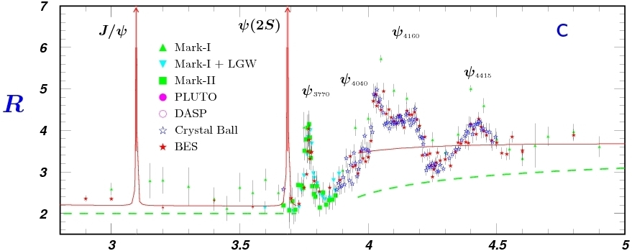
Super-c-tau: scientific case
τ
D
D_{s}
τ⁺τ⁻

Slide 5
Super-phi-tau-c: scientific case
Charmonia
Spectroscopy, BFs
Light hadron spectroscopy
J/ψ rare decays
…
Charm
Spectroscopy
(Semi)leptonic decays
Rare decays
Mixing
CP violation
…
Tau
Spectral functions, BFs
Lorentz structure
CP violation
LFV decays
…
Phi
K meson physics
…

Slide 6
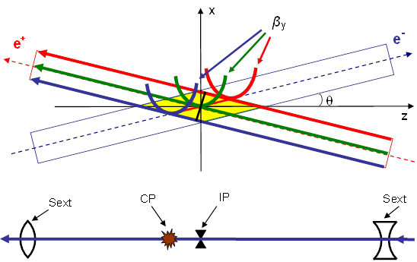
Crab Waist
(P.Raimondi 2006)
Large Piwinski’s angle (σ_{z}/σ_{x}∙θ) – to decrease the overlapping area
Low β_{y} – luminosity increase
Crab waist – to suppress betatron resonances (sextupoles in phase with IP)

Slide 7
Main ring scheme
R≈45 m
Damping wigglers

Slide 8
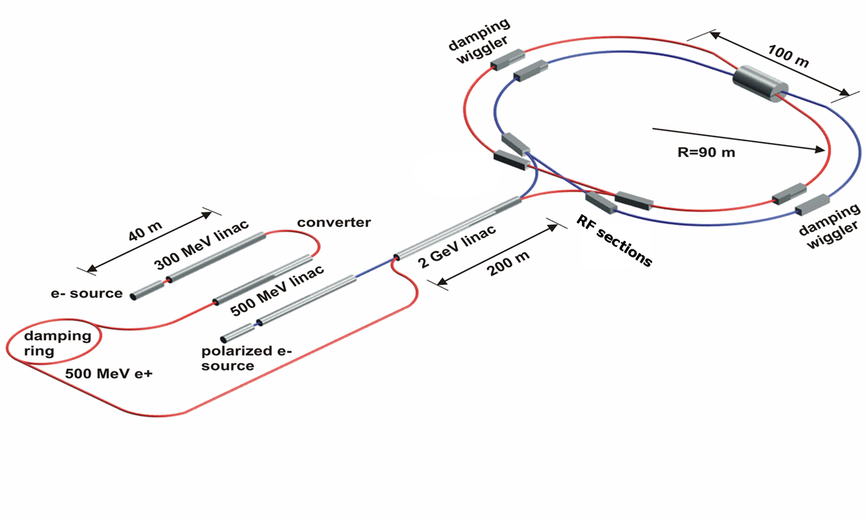
Facility scheme
R=45 m

Slide 9
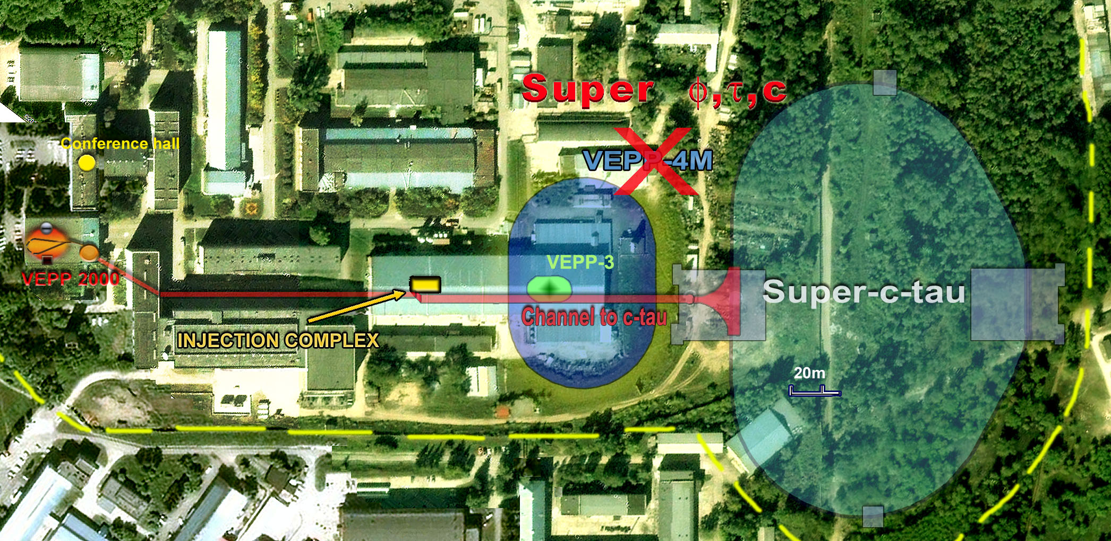
Site

Slide 10
Parameters
C-Tau
Energy | 2.0 GeV | 1.5 GeV | 1.0 GeV | 0.5 GeV
Circumference | 368 m
Beta IP hor/ver | 20 cm / 0.6 mm
Emittance hor/ver with ibs @ 0.5% coupling | 3.1 nm 16 pm | 2.7 nm 14 pm | 5.5 nm 26 pm | 18 nm 89 pm
Crossing angle | 2x30 mrad
Bunch length | 8 mm | 8 mm | 8 mm | 8 mm
Energy spread | 1·10⁻³ | 1.4·10⁻³ | 3.3·10⁻³ | 9.9·10⁻³
RF frequency | 700 MHz
Harmonic number | 864
Particles in bunch | 3.25·10¹⁰ | 3.11·10¹⁰ | 3.78·10¹⁰ | 3.53·10¹⁰
Number of bunches | 418
Total beam current | 1.8 A | 1.7 A | 2.1 A | 1.9 A
Beam-beam parameter | 0.095 | 0.13 | 0.17 | 0.17
Luminosity | 1·10³⁵ | 1·10³⁵ | 0.98·10³⁵ | 0.36·10³⁵
2 cm / 0.76 mm
10 nm
10 mm
7·10¹⁰
1.7 A

Slide 11
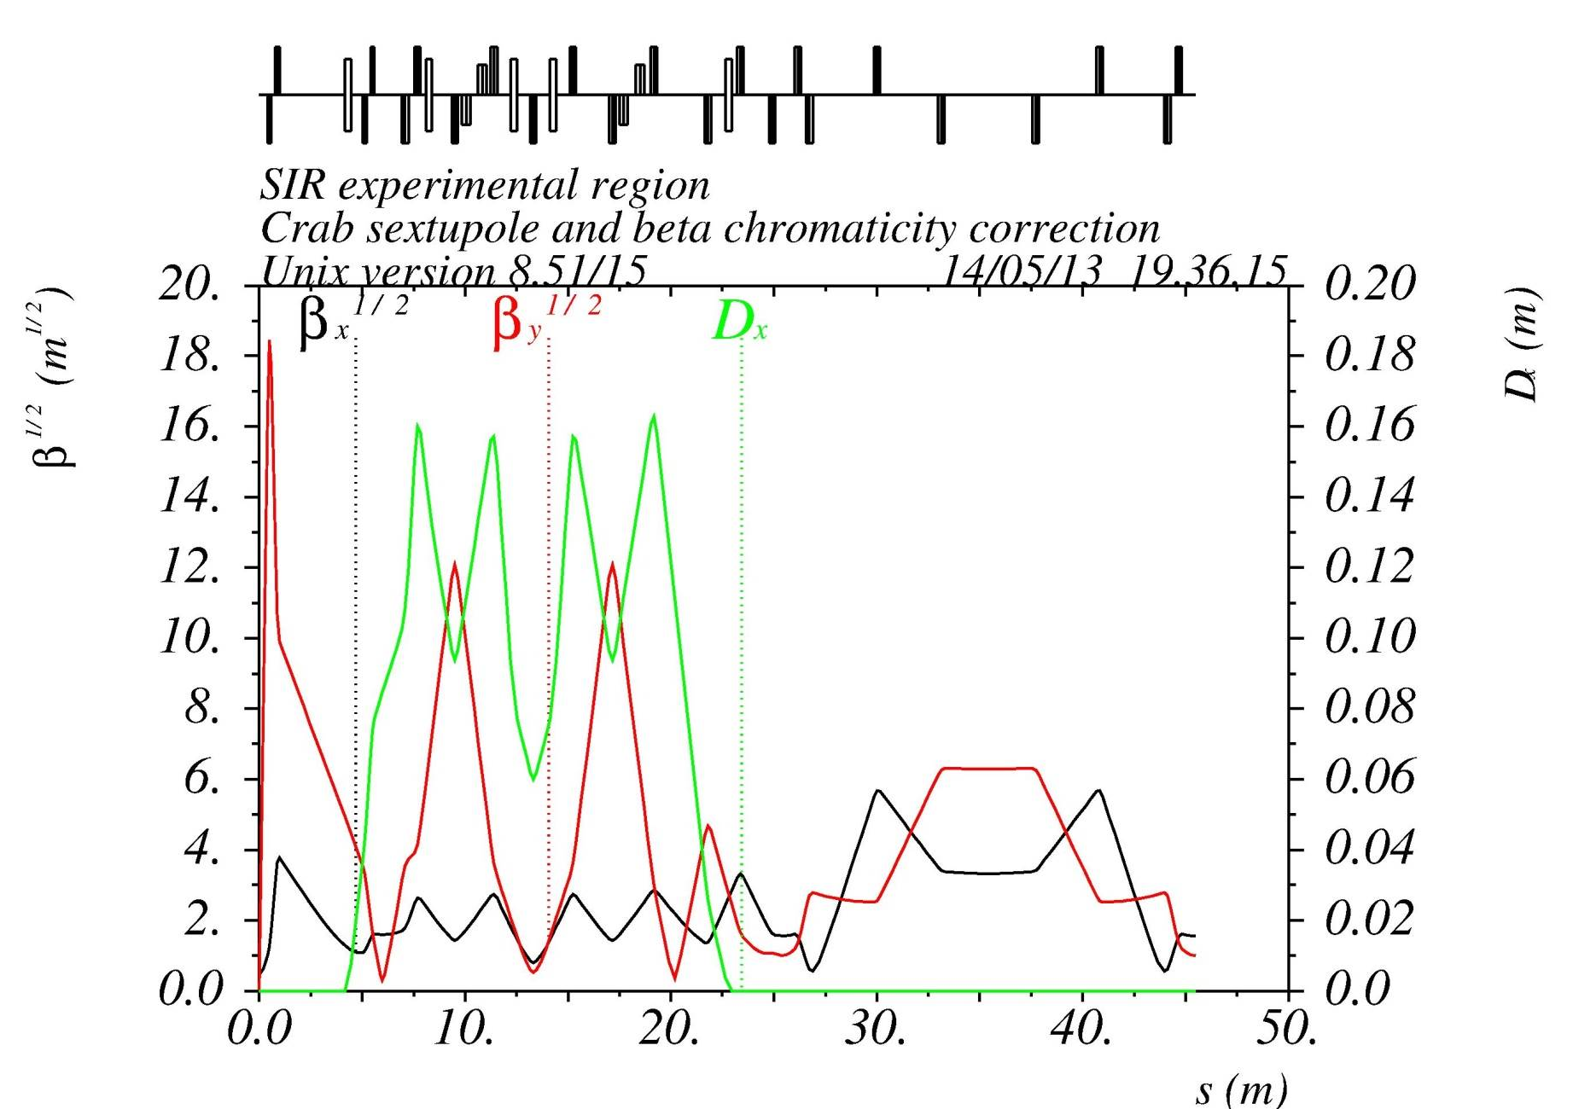
Optical functions: FF
IP: β_{y}=0.6 mm, β_{x}=20 cm

Slide 12
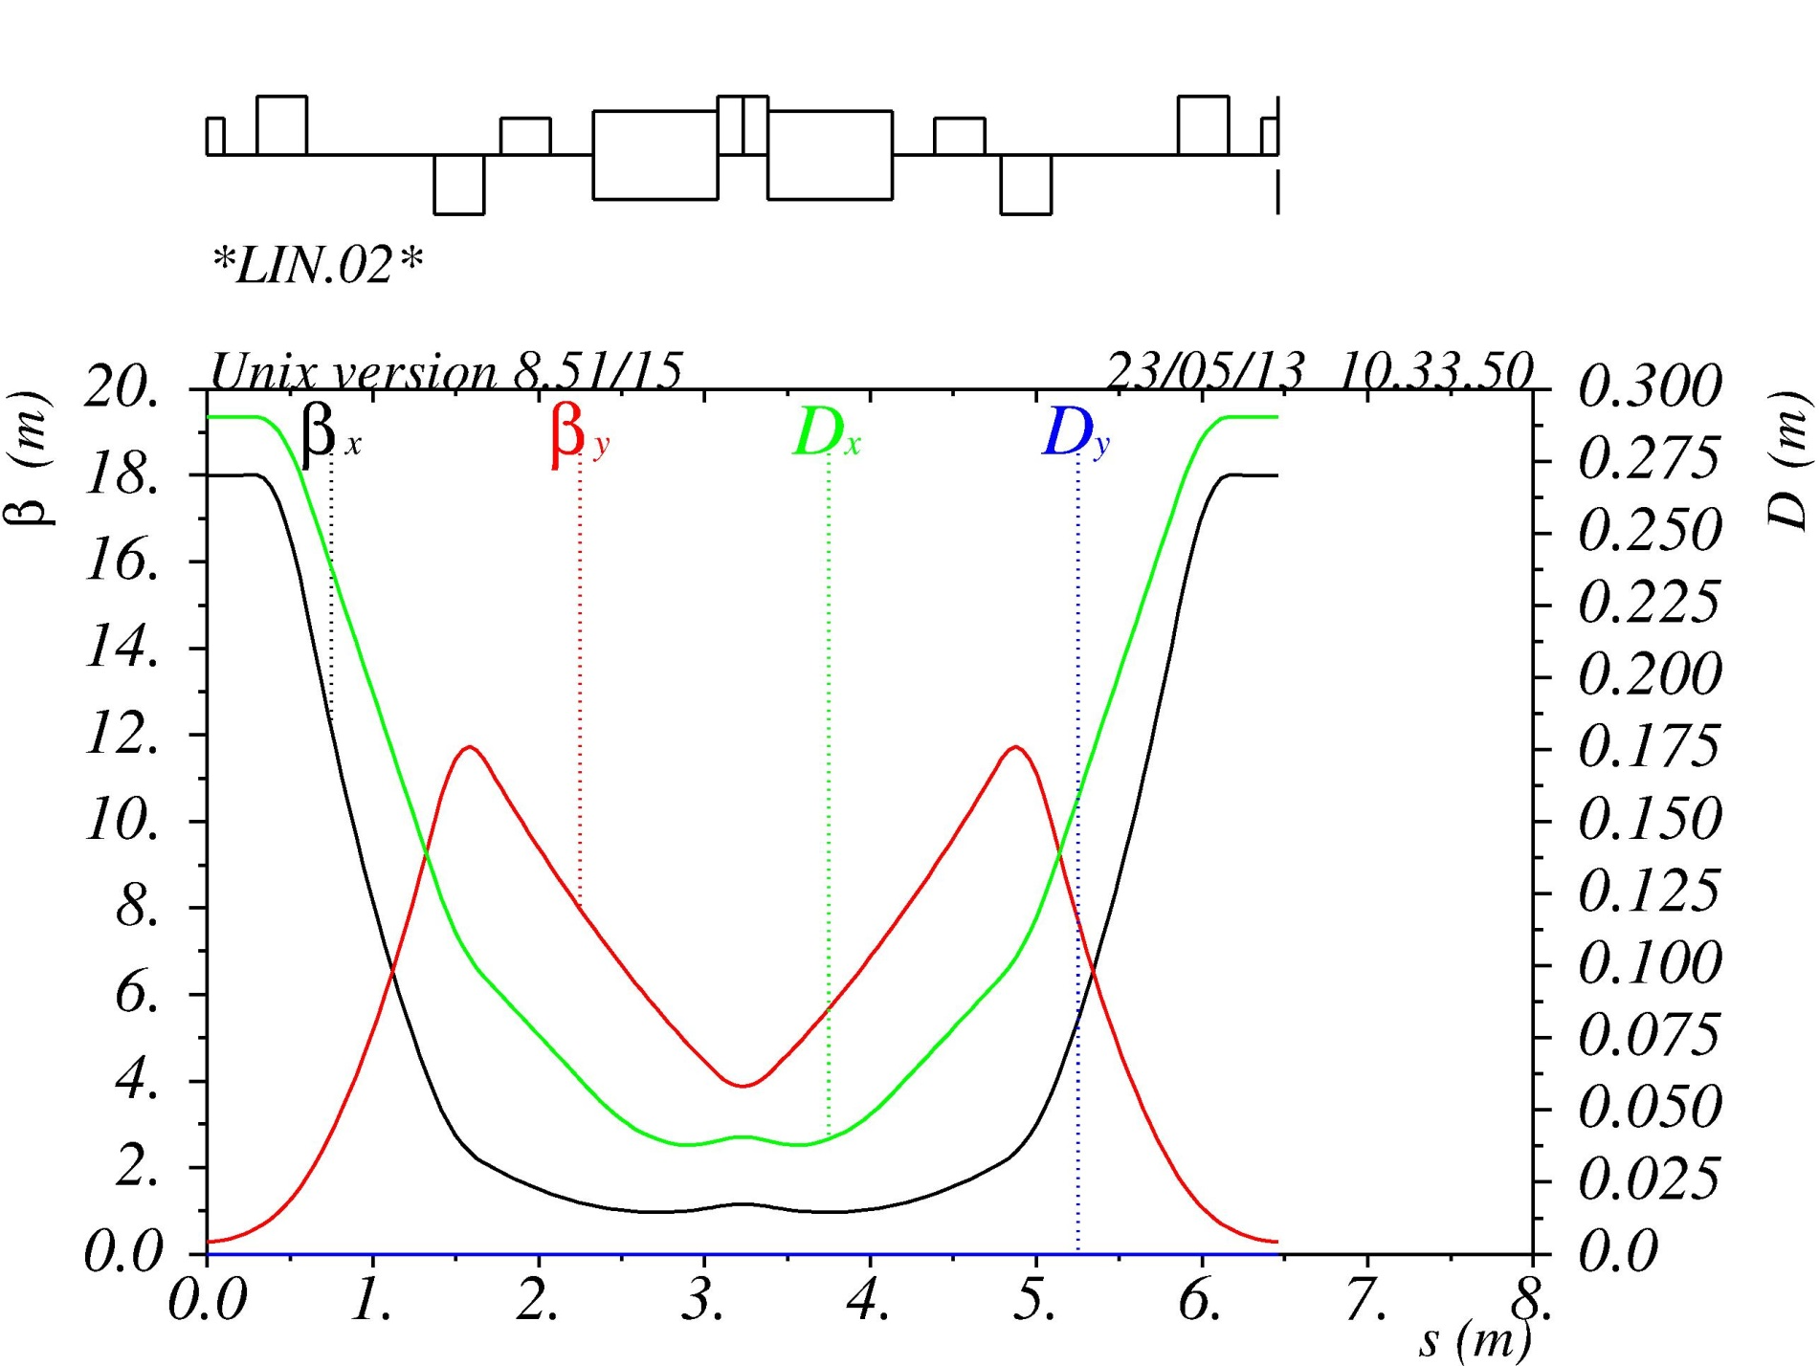
Optical functions: CELL
μ_{x}=μ_{y}=π
Non interleaved sextupoles
ε_{x}=1.5 nm
Compact
Based on diffraction limited ring

Slide 13
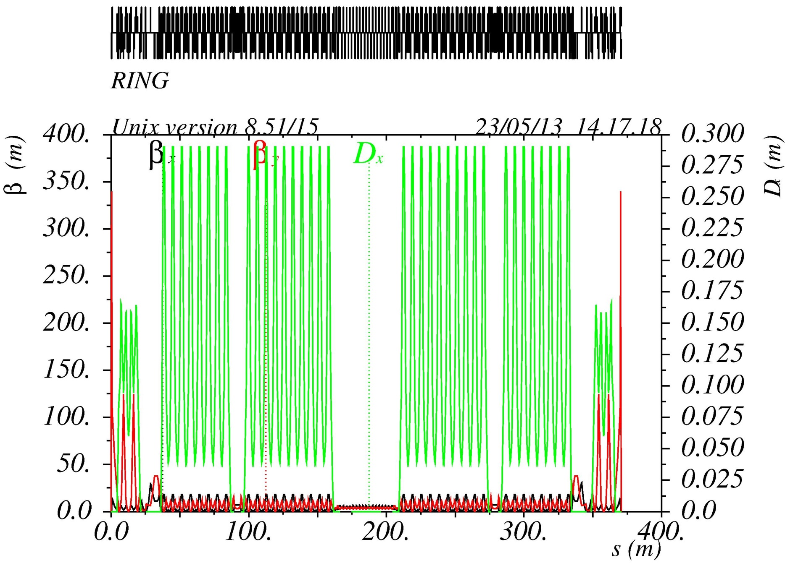
Optical functions: RING

Slide 14
Final focus
Cryostat
Compensation Solenoid
Detector Yoke
Anti Solenoid
e+
e-
QD0
QF1

Slide 15
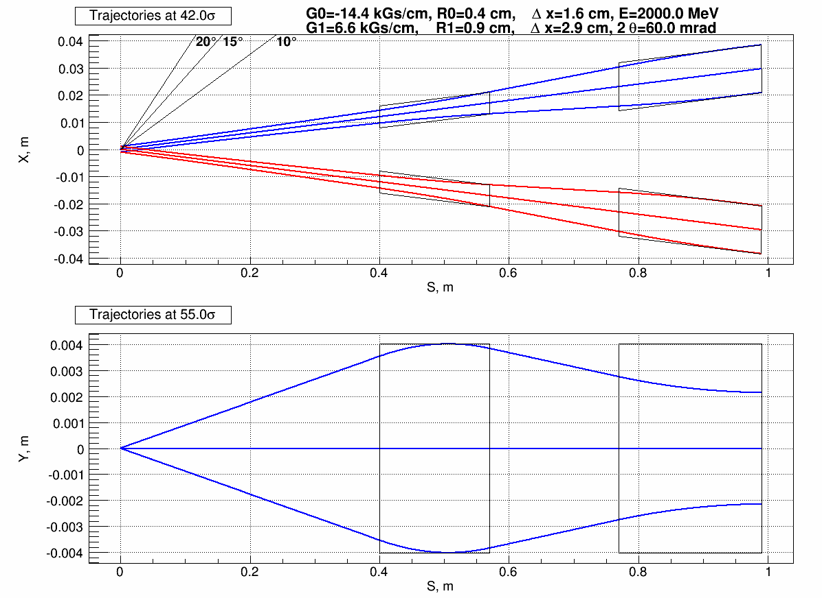
Final focus

Slide 16
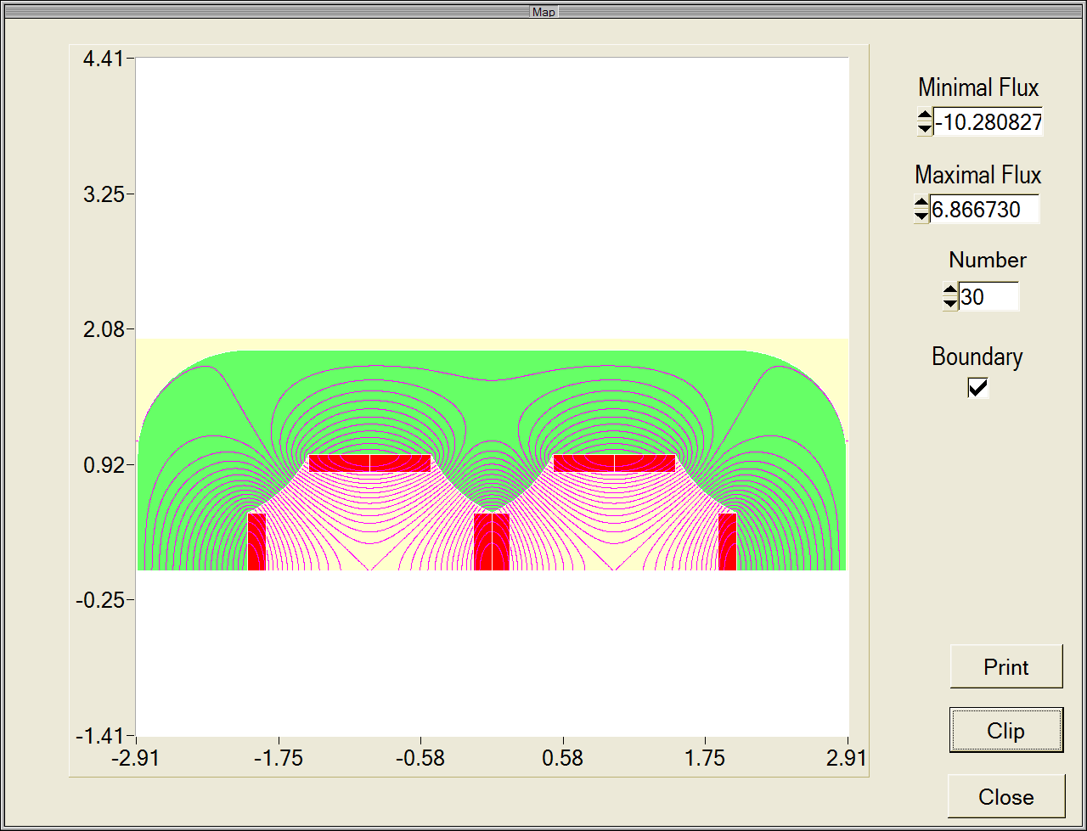
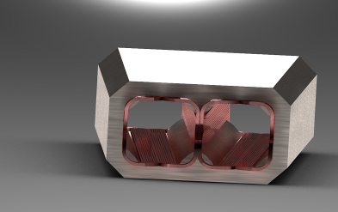
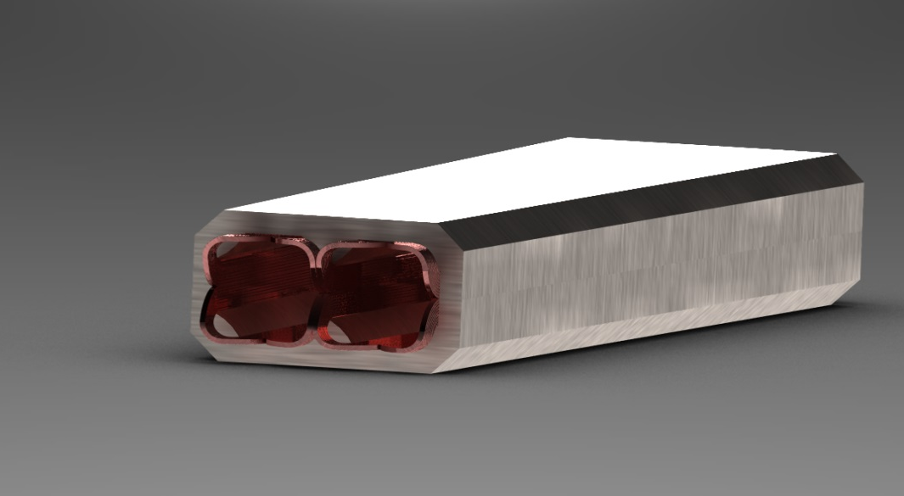
QD0 quadrupole
SC iron yoke twin aperture magnet
Excitation current 8.5 kA·turns
Single aperture 2 cm
Gradient 10.7 kGs/cm
Length 20 cm

Slide 17
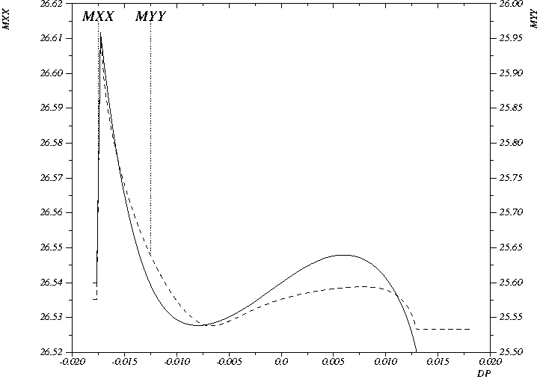
Energy acceptance
Energy acceptance is ±1.2%
Qx=26.54, Qy=25.576

Slide 18
Dynamic aperture

Slide 19
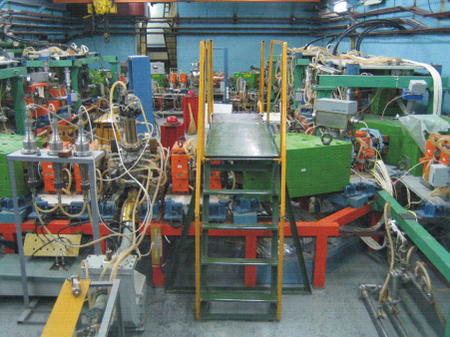
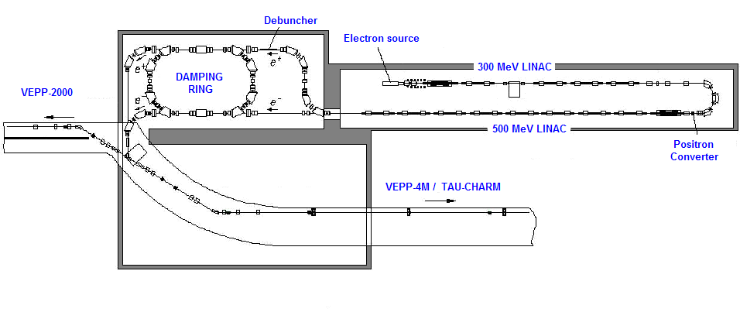
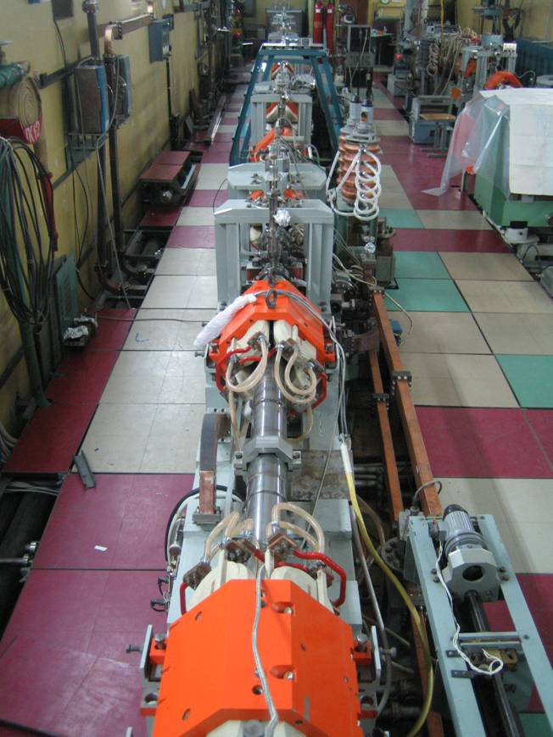
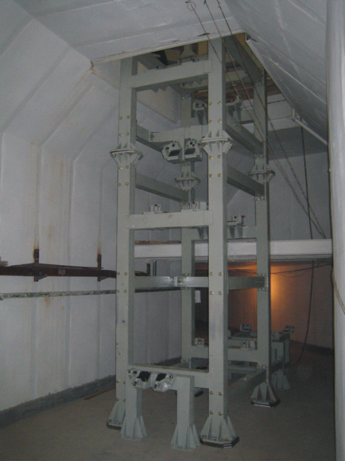
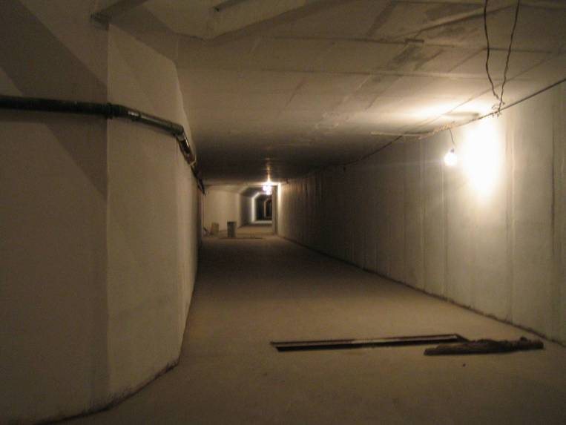
Injection facility

Slide 20
Conclusion
The lattice, meeting all main requirements (600 μm β_{y}, chromatic correction, momentum bandwidth, luminosity optimization for wide energy range, fits in the tunnel of VEPP-4M etc. ) is ready.
FF quadrupoles are reasonable.
Prototype of the damping wiggler is ready.
Detailed machine design and beam dynamics simulation is in progress.
It is possible to increase beam energy up to 2.5 GeV. The limitations are FF quadrupoles and some dipoles.

Slide 21
ESTIMATION OF LONGITUDINAL POLARIZATION AT PhiCT-FACTORY -1
S.A. Nikitin
What energy?
1.8 GeV (τ -lepton production threshold) up to 2.1 GeV (upper limit of PhiCT factory ) is reasonable
LP increases sensitivity of experiments on search of CP violence in τ -lepton decays in several times
Yu.A. Tikhonov. Super c-tau factory (Status Report)/BINP Internal Report (2012)
Maximum of the τ⁺τ⁻ production cross section at E _{b} ≈ 2.2 GeV
LP scheme must be oriented to 2-2.1 GeV
What injector?
Electron-positron linac with energy up to 2.1 GeV
Electrons from a photo-gun source are longitudinally polarized.
Spins are rotated downstream of the gun to match beam polarization in the collider
Continuous mode injection
Radiative polarization time scaling
Sokolov-Ternov polarization build-up time , K – curvature in units of R⁻¹
Current version of PhiCT factory without LP inserts:
τ₀ =0.39 h (23 min) at E=2 GeV
τ₀ =0.70 h (42 min) at E=1.777 GeV
Generally, radiative relaxation time of polarization is given by known formula
- an axis of polarization; - a spin-orbit coupling function; - a velocity vector ( )

Slide 22
ESTIMATION OF LONGITUDINAL POLARIZATION AT PhiCT-FACTORY -2
Siberian Snake estimation
Siberian Snake using solenoid rotates spin around velocity at azimuth of 180⁰ opposite to IP
Betatron coupling is localized over insert with solenoid and matching/compensating quads
Radiative relaxation time , ν=γa, ν_{x} – horizontal betatron tune
Estimation ( betatron factor B(ν, ν_{x}) →1, far from spin resonances ν± ν_{x}=k):
τ_{r} =34 sec at E=2 GeV
τ_{r} =1.2 hours at E=1.0 GeV
Depolarization time is very small as compared with luminosity beam lifetime τ_{l}=3-8 min →
Siberian Snake variant is fully unsatisfying (see next point). At E ≤ 1GeV the situation becomes contrary.
Kinetics of polarization under continuous injection
SuperB CDR, arXive:0709.0451

Slide 23
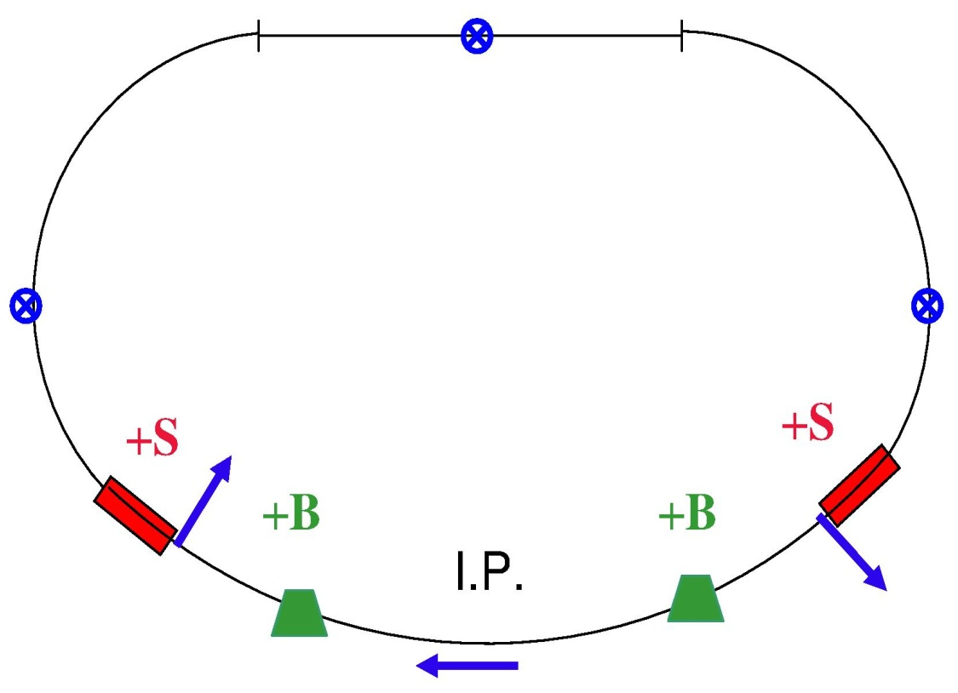
ESTIMATION OF LONGITUDINAL POLARIZATION AT PhiCT-FACTORY -3
LP scheme with restoration of vertical polarization in arcs
spin “back”
spin in plane
Polarized e-beam
from 2.1 GeV linac
χ
π/2 solenoid
π/2 solenoid
Bend magnet
Bend magnet
Due to vertical polarization in arcs the depolarization effect is sufficiently suppressed in comparison with Siberian Snake case. Similar schemes was considered earlier for VEPP-4 and SuperB. The χ-bend is included in the matching optic sections upstream and downstream of Crab Waist FF. Solenoid inserts are at edges of arcs with regular structure. Coupling is localized over these inserts using special quads. Nominal energy can be chosen near 2.1 GeV (γa ≈ 4.77)

Slide 24
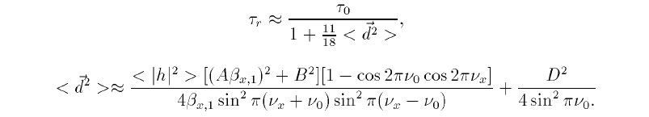
ESTIMATION OF LONGITUDINAL POLARIZATION AT PhiCT-FACTORY -4
Equilibrium polarization extent
Estimate of spin-orbit coupling and relaxation time in LP scheme with “restoration”
S. Nikitin/SB-NOTE-ACC- 2008- 001:
Dispersion of spin
rotation in bend magnets
Betatron term
A and B coefficients found using transport matrix elements for several points at the solenoid inserts;
β_{x,1}, the beta-x value at input of the insert;
<|h|²>, the Courant-Snyder’s invariant averaged over the arcs
D=-π for π/2 spin rotation angle in bend magnets from solenoid rotator to IP
Spin tune ν₀=ν=γa
Term with D is determinative far from ν_{x}±ν₀=k resonances where the first term in d² matters
Working point ν_{x} may be close to half integer values so avoid half integer ν₀ (as well as integer)!
Very preliminary estimate (only D term used):
E=2.05 GeV, χ=19.3°,ν₀=4.65, τ₀=20 min, τ_{r}=7 min, τ_{l}=3 min, P=67%

Slide 25
ESTIMATION OF LONGITUDINAL POLARIZATION AT PhiCT-FACTORY -5
Combined restoration scheme tunable over energy
S. Nikitin/Preprint Budker INP 2009-2
Advantages of combined scheme:
Longitudinal polarization at IP and vertical polarization in arcs are attained not only at a single energy value but over a certain energy range by retuning spin rotation angles in solenoids (ϕ_{1,2})
Polarization axis chromaticity γ∂n/ ∂γ is reduced in every point of working energy region → integer spin resonances ν₀=k become more narrow
No hard requirement to χ_{1,2} taken separately

Slide 26
ESTIMATION OF LONGITUDINAL POLARIZATION AT PhiCT-FACTORY -6
Summary
Longitudinal Polarization at PhiCT factory can be obtained at the beam energy range from 1.8 to 2.1 GeV for studies of CP violence in tau-lepton decays experiments.
Source of polarized particles: continuous injection of polarized electrons from 2.1 GeV linac.
Siberian Snake-based LP scheme is unsatisfactory at the top of PhiCT energy range because of very small depolarization time. But it looks fine at 1 GeV (τ_{r}=1.2 hour). Polarization experiments at the threshold of baryon production?
Quick estimation of the LP scheme with restoration of vertical polarization in arcs gives more 60% polarization at E=2.05 GeV. It needs high luminosity (beam life time is 3 min) . χ-bend of matching section must be increased from 13° (current version) to 19.3 °
Another variant, the combined restoration scheme, has sufficient advantages. It is reasonable to consider.

Slide 27
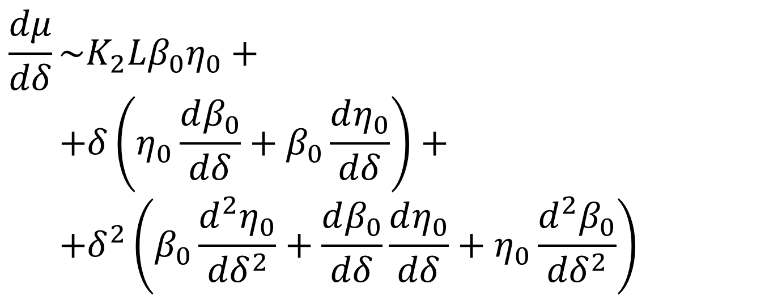
Chromaticity from CRAB sextupole
$$\frac{dμ}{dδ}\sim K_{2}Lβ_{0}η_{0}+$$
$$+δ\left(η_{0}\frac{dβ_{0}}{dδ}+β_{0}\frac{dη_{0}}{dδ}\right)+$$
$$+δ^{2}\left(β_{0}\frac{d^{2}η_{0}}{{dδ}^{2}}+\frac{dβ_{0}}{dδ}\frac{dη_{0}}{dδ}+η_{0}\frac{d^{2}β_{0}}{{dδ}^{2}}\right)$$

